Slide 1
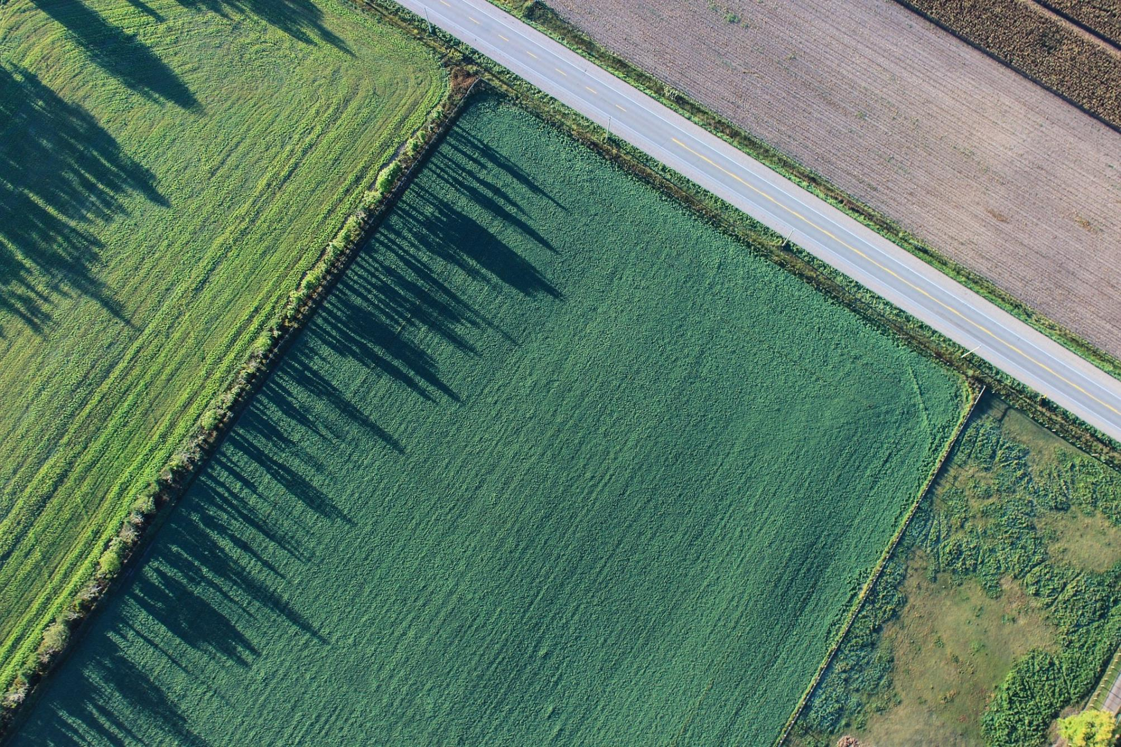
Pixel Twins
Combining earth observation data with ground IoT truth for advanced services
Project and Use Case Overview, Sept. ‘23

Slide 2
Pixel Twins
This project was supported by ESA via a Discovery element contract (contract number 4000137251)
Stakeholder

Slide 3
Use Cases
➔ Smart Farming
➔ Photovoltaics
Technical Implementation
Possible Future Outlook

Slide 4
Use Case
Smart Farming

Slide 5
Pixel Twins
Combining earth observation data with ground IoT truth for advanced services
Project and Use Case Overview, Sept. ‘23

Slide 6
Pixel Twins
This project was supported by ESA via a Discovery element contract (contract number 4000137251)
Stakeholder

Slide 7
Use Cases
➔ Smart Farming
➔ Photovoltaics
Technical Implementation
Possible Future Outlook

Slide 8
Use Case
Smart Farming

Slide 9
Problem
?
soil humidity
⬅

Slide 10
Problem
Satellite data
⬅
?
soil humidity

Slide 11
Challenge
+
ground IoT truth for advanced services
Combining earth observation data with

Slide 12
Data sources
EO data
Area-wide information
Possible data (Sentinel-2 L1C)
Short wave infrared composite (SWIR)
Normalized Difference Moisture Index (NDMI)
Normalized Difference Vegetation Index (NDVI)
IoT data source
Local data
Position/Pixel of sensor
Select important data
E.g. soil moisture data

Slide 13
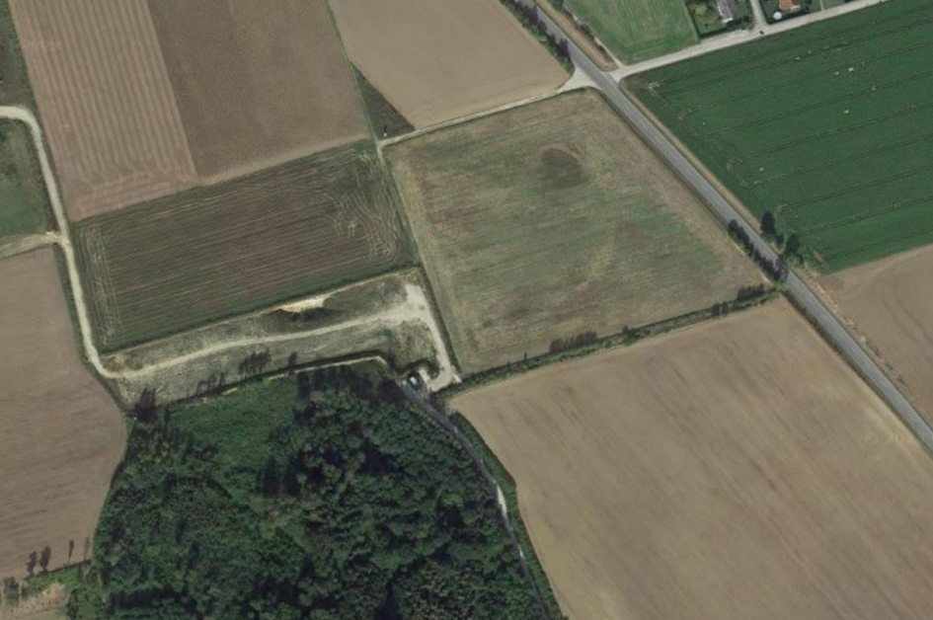
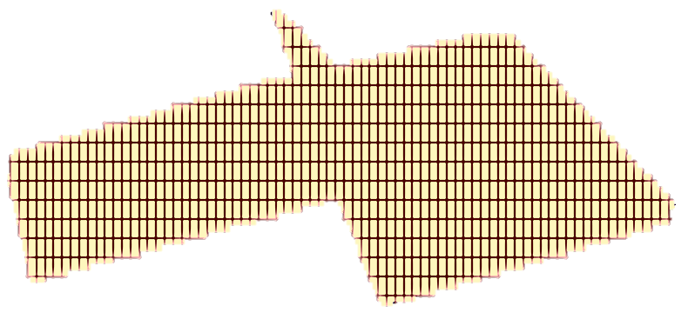
How it works
1. Find region of interest
2. Draw polygon
3. Create pixels
4. Apply EO data
5. Merge with IOT data
➔ Most accurate data source

Slide 15
Use Case
Photovoltaics

Slide 16
Problem
What photovoltaics energy ouput can be expected?
irradiation?
time?
date?
location?

Slide 17
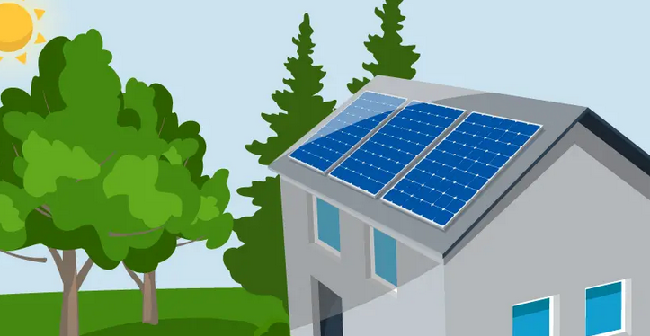
Problem
How to utilize existing photovoltaic data?
data access?
efficiency factor?
size?
inclination?

Slide 18
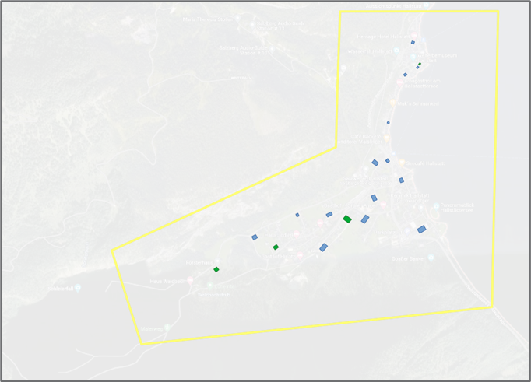
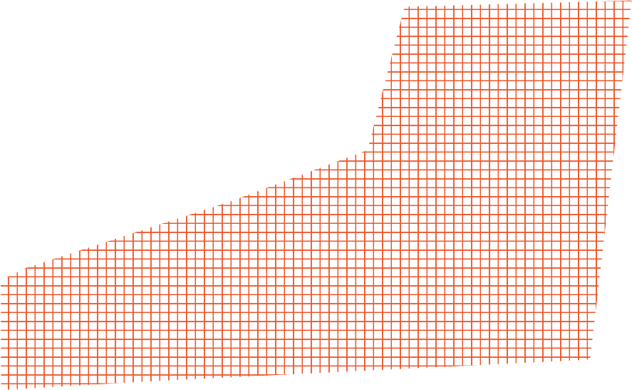
How it works
1. Find region of interest
2. Draw polygon
3. Create pixels
4. Apply EO data
5. Merge with IOT data
➔ Most accurate pv power prediction

Slide 19
Demonstration Video

Slide 20
Technical Implementation

Slide 21
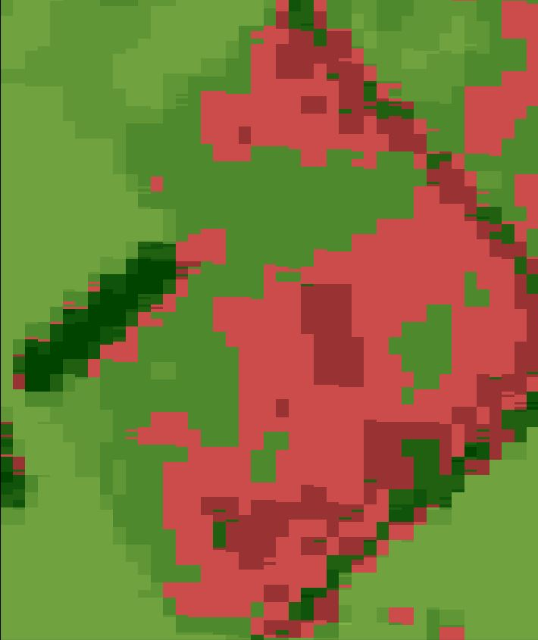
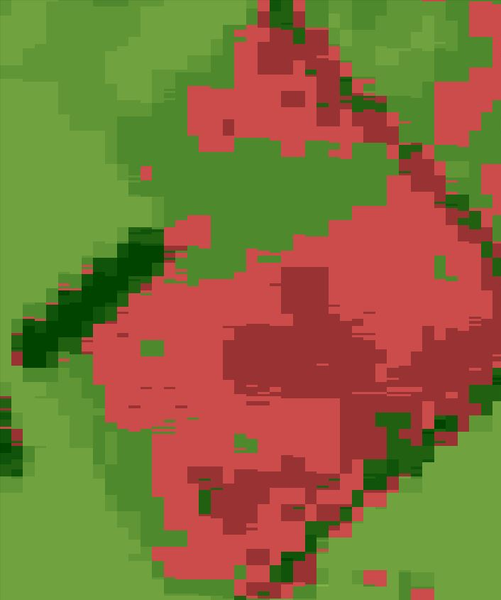
Data Interpolation
Interpolation Scheme
Example
Linear Interpolation with fixed max distance
Satellite data
Satellite data + IoT data

Slide 22
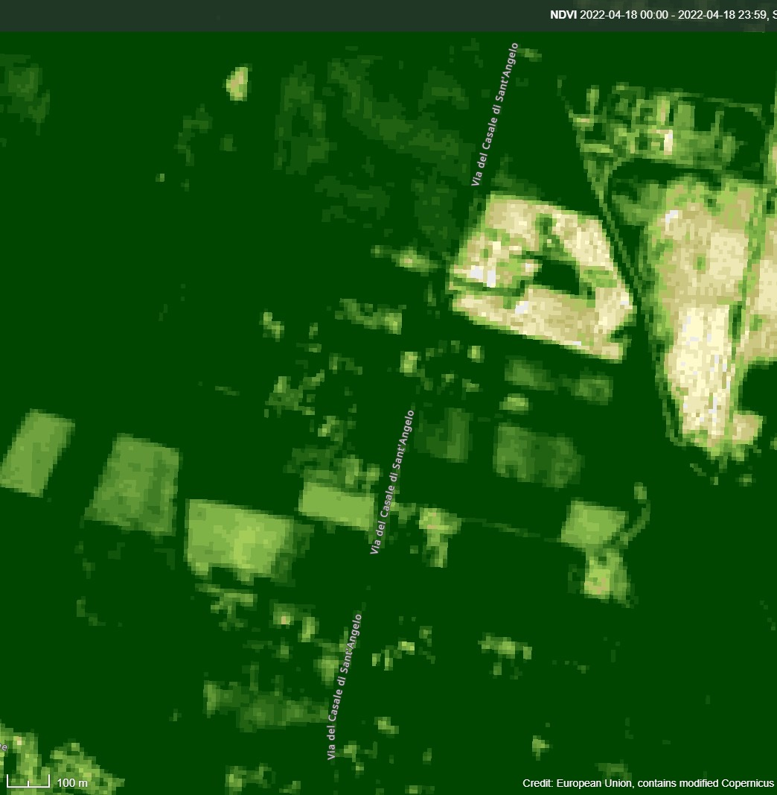
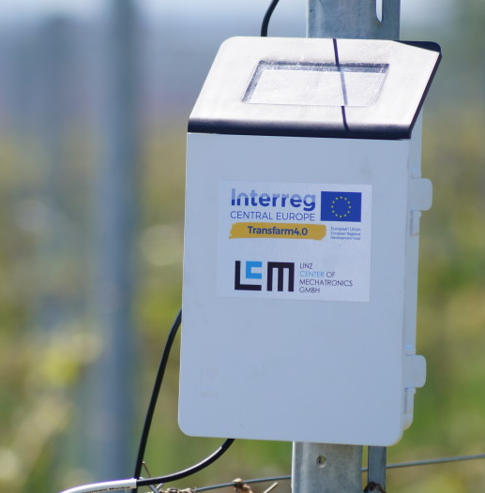
Technical Implementation
Sentinel Hub
Satellite
raw data
Sentinel Hub Data Provider
FIWARE Context Broker
Data subscription handling
Estimation Service
Improved map
PixelTwins Core
Node RED
Zentra Cloud
Advanced services
IoT
raw data
Zentra Cloud Data Provider
cron job
Mongo
DB
FIWARE quantumleap
Siegi PV IoT
GUI / front-end / improved data
IoT
Crate
DB
raw data
FIWARE IoT Agent MQTT broker
DJI Agras T30 | www.dji.com
eg. autonomous
agriculture
Server (local/cloud) with Kubernetes

Slide 23
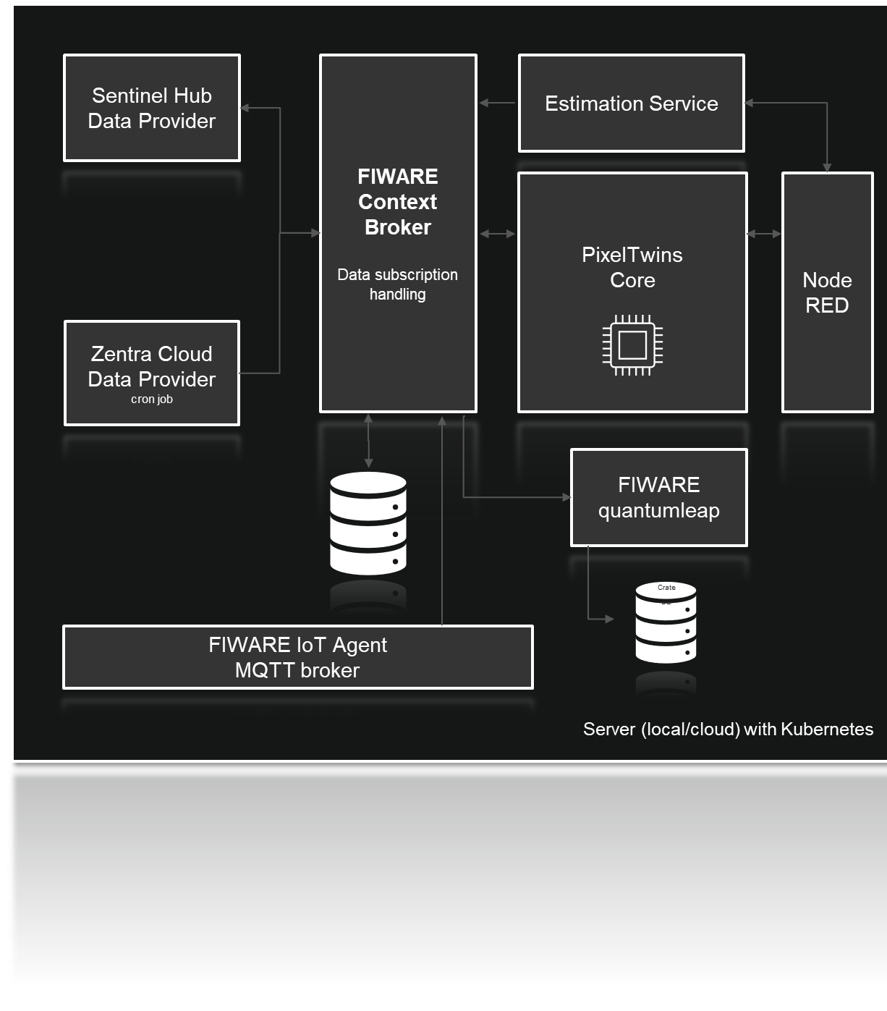
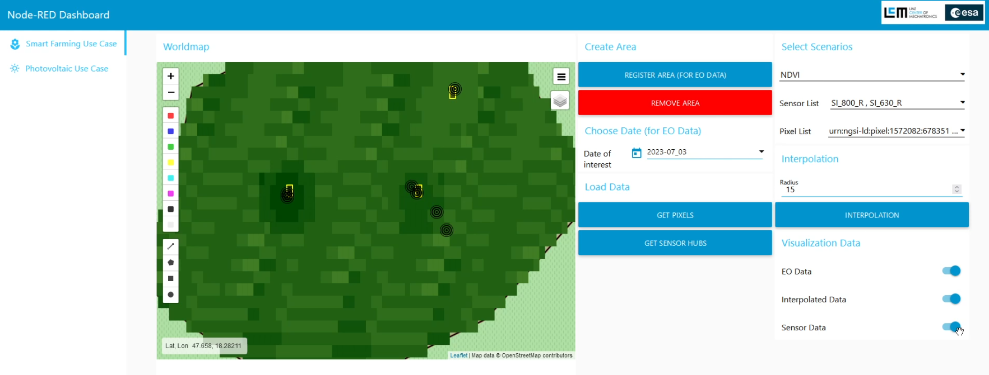
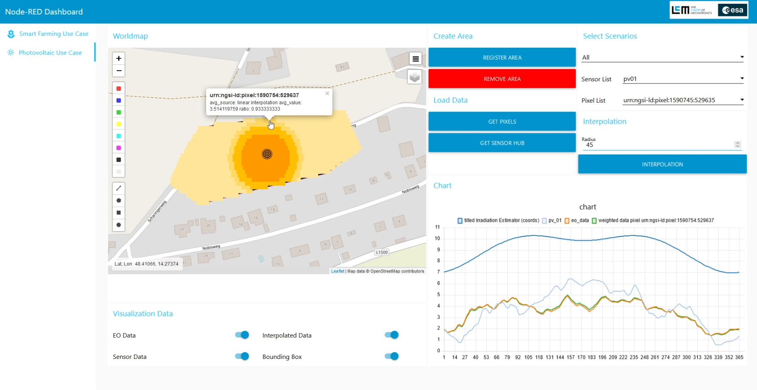
Pixel Twins
Results
Backend-side
Data interface to SentinelHub
MQTT Interface for IoT devices
IoT-Data linked with pixels
Integration of interpolation algorithm
Frontend-side
Use case specific implementations
Visualization of IoT sensor data
Visualization of OE data
Web-based GUI

Slide 24
Pixel Twins
Results
Dissemination
Presentation at FIWARE Global Summit Vienna
Exploitation
Integration into research project proposal (Interreg second call)
Usage in GTIF environment suggested
Usage in EnergyFamily business case possible

Slide 25
Outlook
Possible future steps and exploitation

Slide 26
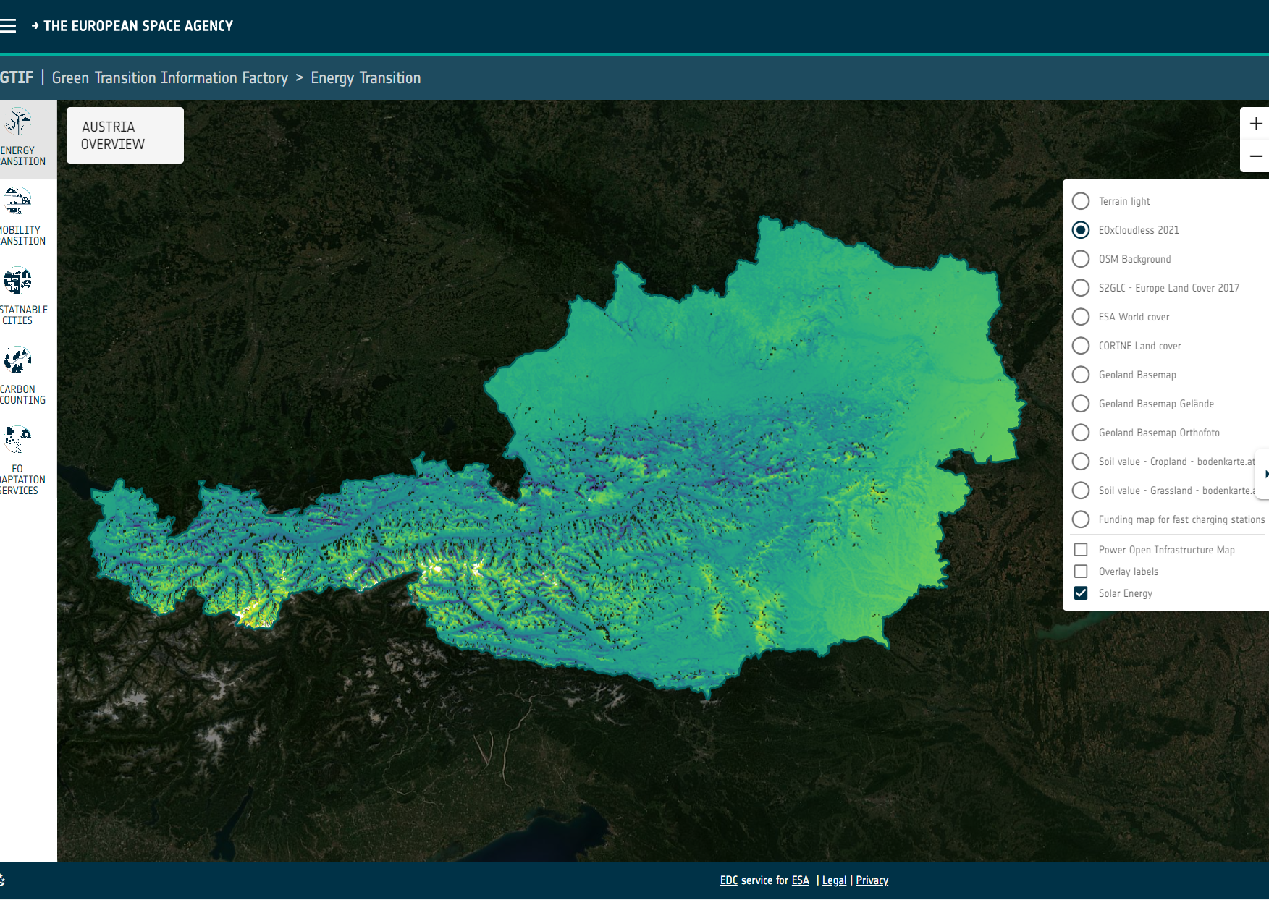
Possible future outlook for advanced services
GTIF environment ➔ expected energy output based production and installment data
ENERGYFAMILY ➔ improved planning for energy production and grid utilization
Agricultural usage in precise farming ➔ irrigation, fertilization, energy efficiency
More … ➔ New ideas?
?
DJI Agras T30 | www.dji.com

Slide 27
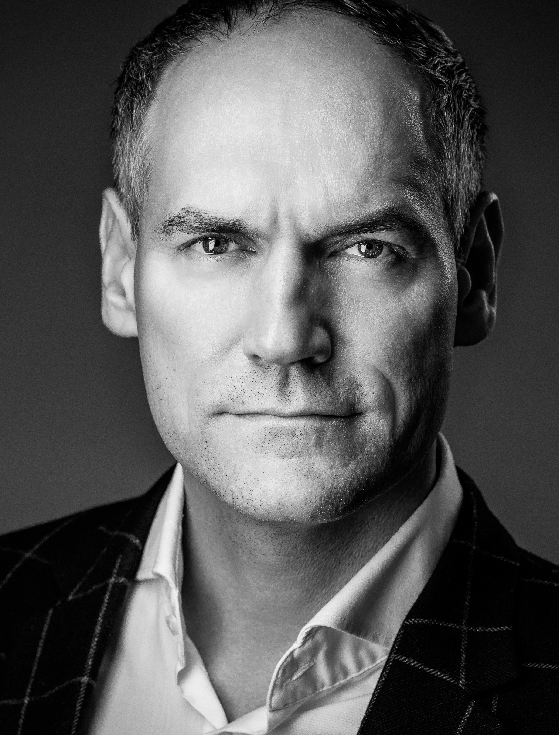
Contacts
Photo credits: Werner Harrer
Dr. Johann Hoffelner Chief Scientific Officer
Linz Center of Mechatronics GmbH
Altenbergerstraße 69 | 4040 Linz | Austria Phone: 0043 (0)732 / 2468 - 6004 Mobil: 0043 (0)664 / 8481307
johann.hoffelner@lcm.at
Dr. Leander Hörmann Team Lead Industrial IoT
Linz Center of Mechatronics GmbH
Altenbergerstraße 69 | 4040 Linz | Austria Phone: 0043 (0)732 / 2468 - 6157 Mobil: 0043 (0)680 / 2316732
leander.hoermann@lcm.at

