Slide 1
Suitability Coverage Engine (SUCE)

Slide 2
SUCE project objectives
Define a concept, an architecture and develop a prototype / demonstrator permitting to effectively select EO products from catalogues and obtain Optimized Coverage for given user AOI
Calculation/Computation based only on image metadata i.e. cloud mask (and derived valid pixel layer)
Proposed solution reduces both manual work and transfer of unsuitable EO products

Slide 3
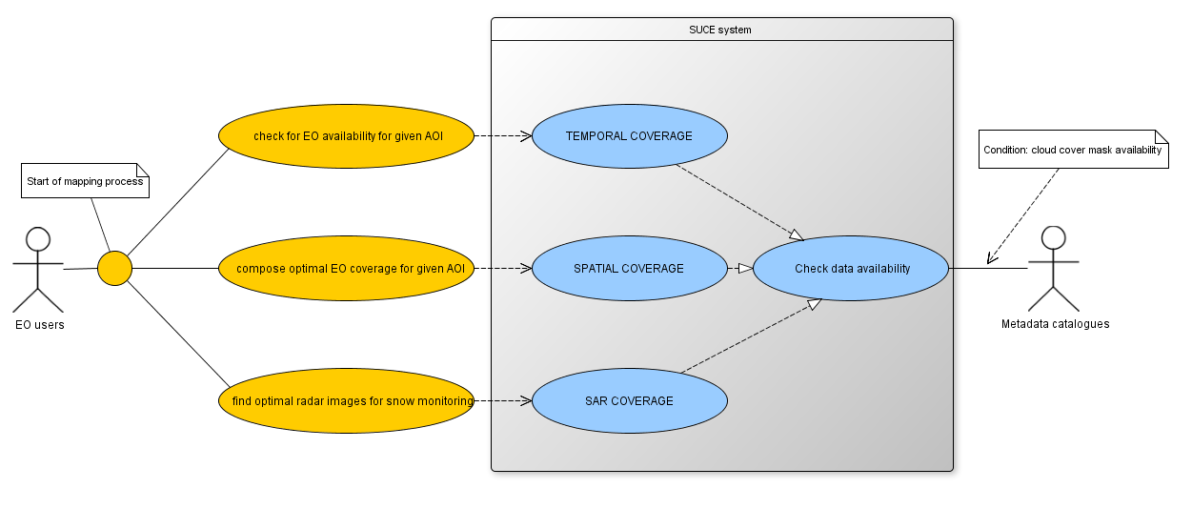
SUCE Use Cases
check EO availability for specified criteria
(area of interest, mission, time window, maximum cloud cover)
calculate optimized EO image coverage for specified criteria
find suitable SAR images for snow mapping

Slide 4
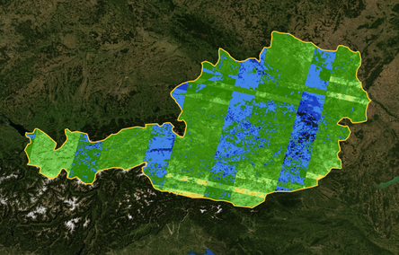
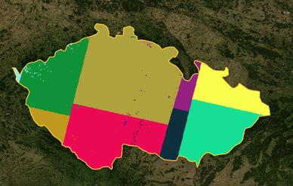
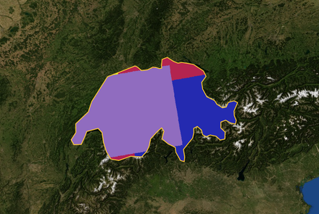
SUCE Use Cases
Temporal coverage
Spatial coverage
SAR coverage
Searches for optimal SAR image pairs suitable for Snow Mapping for chosen time period and area
of interest.
Provides coverage/density information as number of clear-sky observations per pixel for chosen time period and AOI
Composes optimal EO image single coverage for chosen time period and area of interest

Slide 5
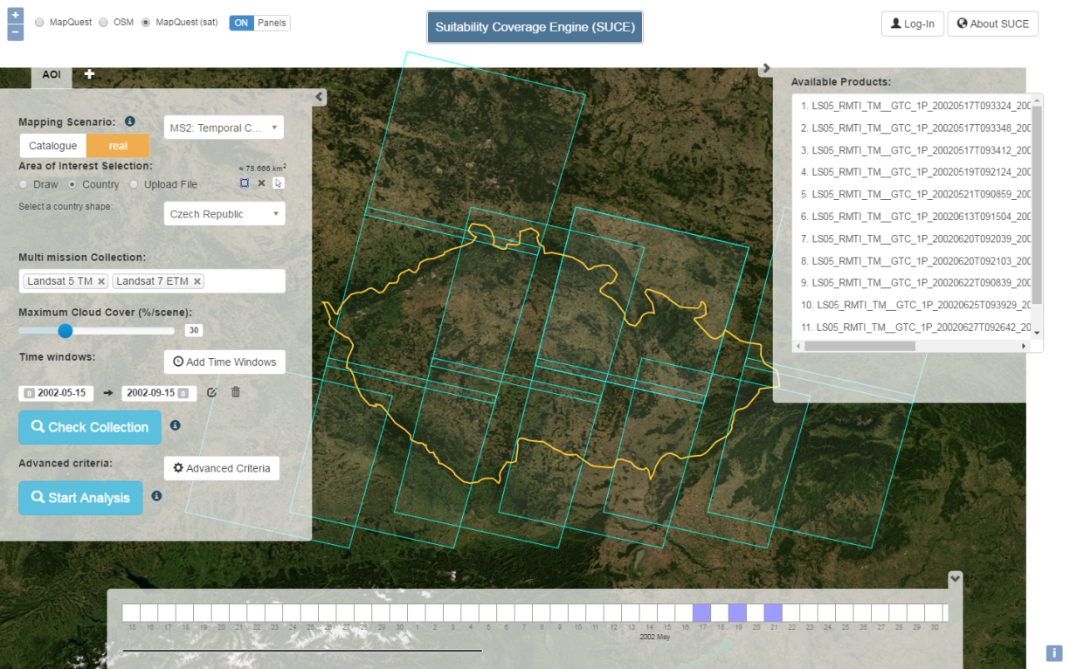
SUCE Temporal coverage usage
Task definition | HOW MANY valid clear-sky observations over chosen AOI / TOI (i.e. Coverage / Density)
Area of interest | Czech Republic
Time of interest | May - September 2001
Missions | Landsat 5 and Landsat 7
- screenshots will be added
- short video (~ 60 sec.)

Slide 6
SUCE Spatial coverage usage
Task definition | Compose OPTIMAL COVERAGE for chosen AOI / TOI and missions
Area of interest | Czech Republic
Time of interest | May - September 2001
Missions | Landsat 5 and Landsat 7
- screenshots will be added
- short video (~ 60 sec.)

Slide 7
SUCE SAR coverage
Task definition | Find optimal SAR IMAGES PAIRS, suitable for SNOW MAPPING over chosen AOI / TOI
Area of interest | part of Czech Republic
Time of interest | TBC
Missions | TBC
- screenshots will be added
- short video (~ 60 sec.)

Slide 8
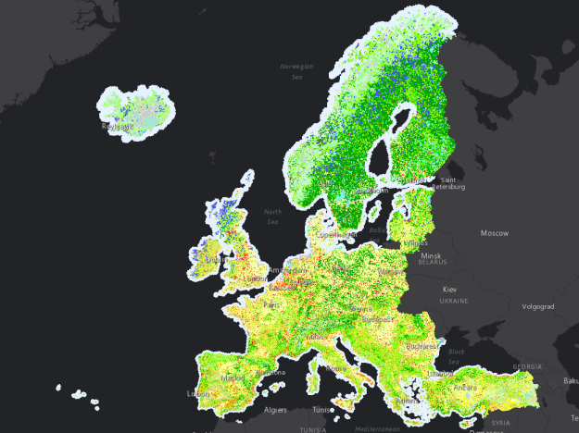
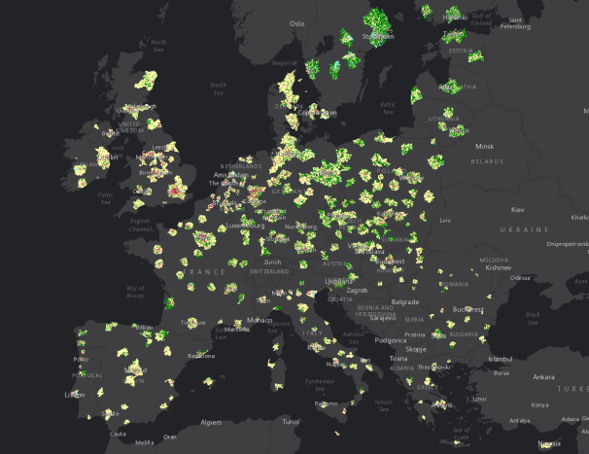
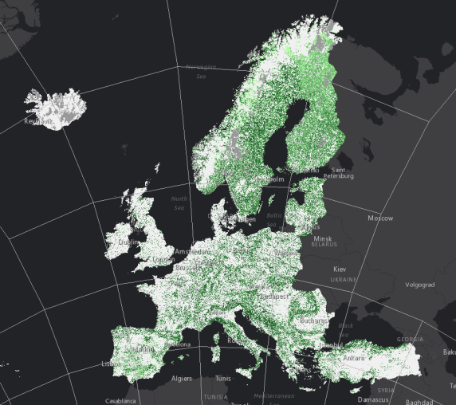
SUCE tools possible Operational Usage
Spatial Coverage
Copernicus Land
Urban Atlas
Copernicus CLC
EC CAP CwRS
Copernicus HRL
SAR Coverage
Temporal Coverage
Copernicus (planned) Snow Monitoring Service
- possibly add screenshots or short video for EEA39 use case

Slide 9
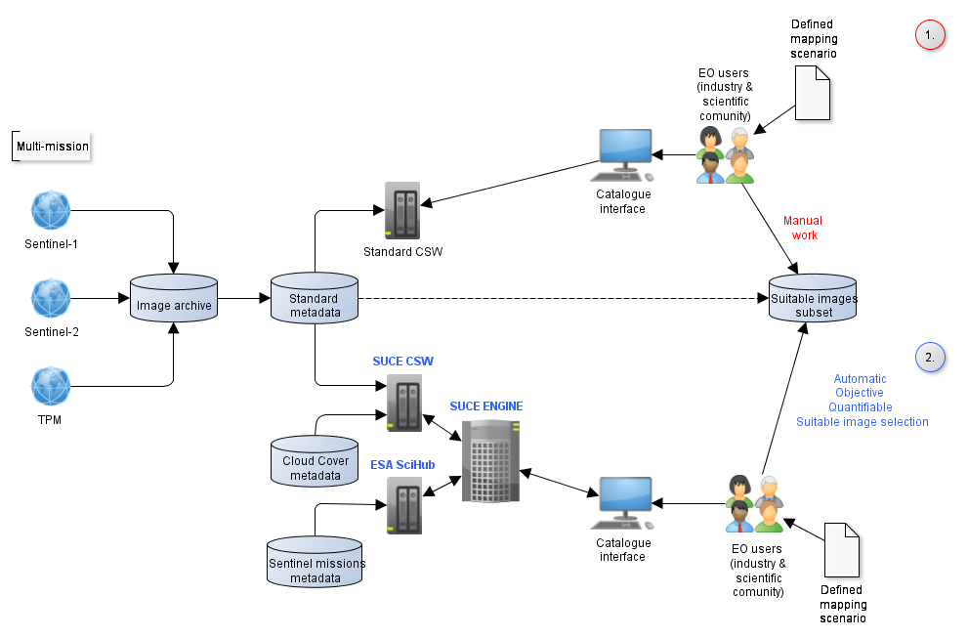
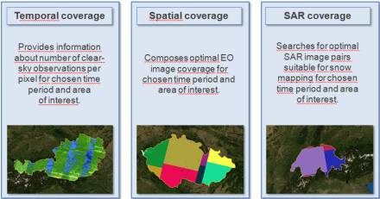
SUCE approach Vs
Traditional catalogue search

Slide 10
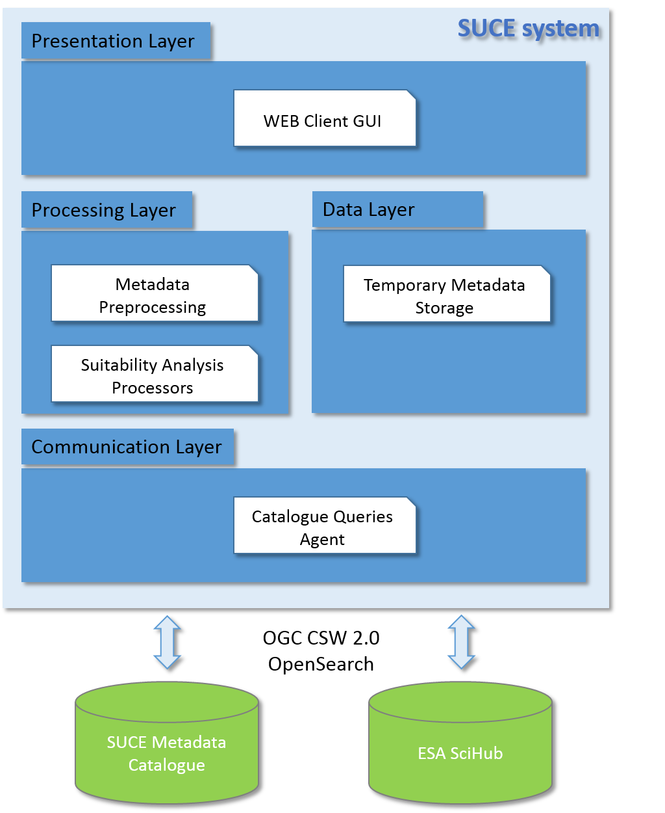
SUCE High Level architecture
Presentation layer: Web based GUI (client side). Retrieves user search and processing criteria and presents coverge results. Also provides system status notifications.
-------------------------------------------------------------
Processing layer: core of the SUCE system. It contains suitability analysis processors with advanced algorithms computing optimal coverage for the defined AOIs. Analysis is based on Cloud Cover metadata harvested from external metadata catalogues.
Data layer: responsible for metadata storage together with system state information in the database and file system.
--------------------------------------------------------------
Communication layer: enables data exchange between SUCE and external EO metadata catalogues using standardized protocols (OGC CSW 2.0 with OpenSearch support).

Slide 11
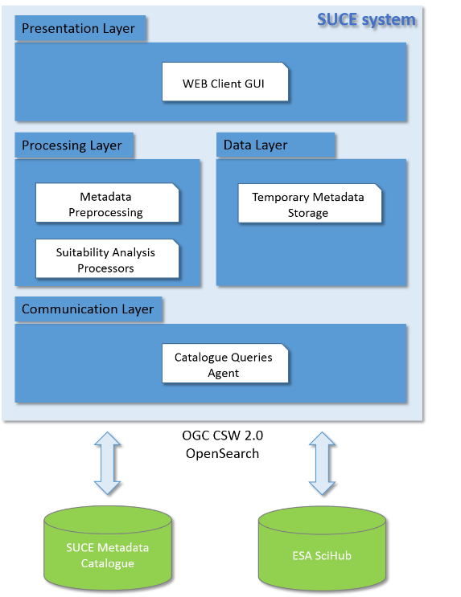
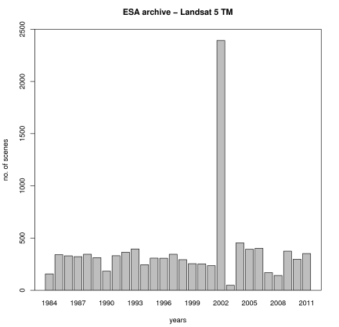
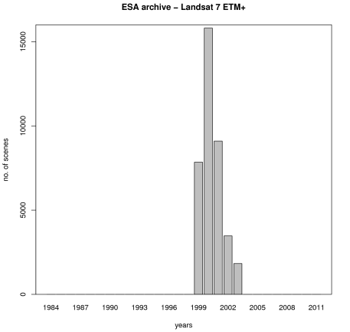
SUCE metadata catalogues
SUCE Metadata Catalogue
contains Landsat 5/7 metadata for EEA39
cloudmasks calculated in ESA G-POD
calculation still in progress
preparation of S2 metadata in progress
ESA SciHub
SUCE connection to operational ESA catalogue
using standardized FedEO compliant OpenSearch 2.0

Slide 12
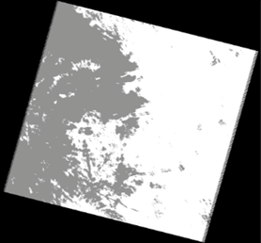
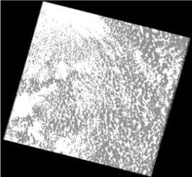
Common cloud cover information / Drawbacks
Common metadata catalogues contain cloud cover information
only as a figure:
1920252007231: CC = 40.1% 1920252011178: CC = 45.1%
No Spatial distribution of the clouds !!!!!!!
1920252007231: CC = 40.1%
1920252011178: CC = 45.1%

Slide 13
Cloud cover information used in SUCE
SUCE uses derived Valid Pixel Mask harvested from metadata.
Largest subsets of valid pixels masks are used by SUCE also for optimal coverage composition (spatial coverage )
Scene with clouds
Cloud cover mask
Valid pixel mask
(white pixels = valid clear sky observations)

Slide 14
Comparison of EO estimated product volumes with CC metadata
Using only derived Valid pixel mask as a part of metadata for analysis dramatically reduces volume of data transferred.
Full data volume / year | Sentinel-2A | Sentinel-2AB | Landsat-7,8 | Sentinel-Landsat
Europe (EEA39) | # 36 180 18 TB (CC: 3.6 GB) | # 72 360 36 TB (CC: 7.2 GB) | # 26 972 40 TB (CC: 2.7 GB) | # 99 332 76 TB (CC: 10 GB)
France | # 3528 1.7 TB | # 7056 3.5 TB | # 2508 3.7 TB | # 9564 7.3 TB
Germany | # 2484 1.2 TB | # 4968 2.5 TB | # 1892 2.8 TB | # 6860 5.3 TB
Czech Republic | # 792 0.4 TB | #1584 0.8 TB | # 616 0.9 TB | # 2200 1.7 TB
0.012%

Slide 15
Evaluation of SUCE results / Procedure
Evaluation performed as a comparison between:
manual EO coverage composition task in GIS
and
the same task done in SUCE
(Initial parameters same for both tasks)
Task definition | compose optimal coverage of images for chosen AOI and TOI
AOI | Czech Republic (78 800 km2)
TOI | 01/05/2001 – 15/09/2001
Missions | Landsat 5 / Landsat 7
Max CC | 30 %
Steps of manual coverage composition task:
Search catalogue for available image products
Download selected subset / footprints
Manually select the first suitable subset
Delete not suitable images
Search additional images to fill the gaps
Repeat 1-5 until satisfactory image coverage is achieved or all possibilities tested

Slide 16
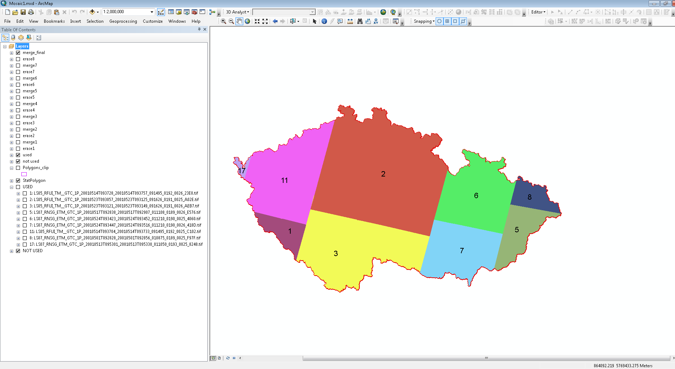
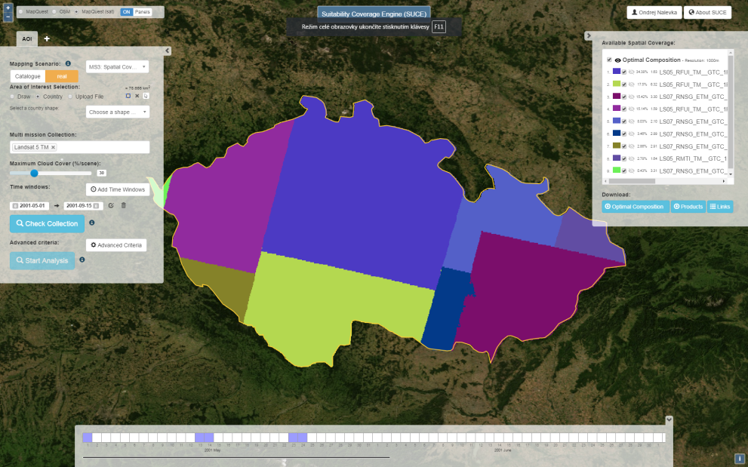
Evaluation of SUCE - result
 | Task performed manually in GIS | Task performed in SUCE
Scenes found | 110 | 110
Scenes used | 11 | 9
Data volume transferred | TBC | TBC
Overall time needed | 470 minutes | 17 seconds
Comparison task between manual and SUCE coverage composition
AOI: Czech (78 800 km2)
TOI: 01/05/2001 – 15/09/2001
Missions: L5 and L7
Cloud cover max: 30 %

Slide 17
Conclusions / User prespective
SUCE provides new analytical tool for EO community that significantly reduces subjective manual work;
SUCE suitability analysis tool can significantly reduce data transfer from EO archives ;
SUCE can enhance current EO catalogues functionality by enabling advanced coverage analysis and efficient access to EO products;

Slide 18
Conclusions / PDGS perspective
Suitable spatial (non-cloudy) coverage can be computed by algorithm as part of catalogue search engine/server;
Analysis possible only when catalogues metadata include link to Cloud Coverge layer (SUCE uses raster layer);
Cloud Coverge layers needs to be pre-computed link and available as EO catalogue metadata to ehance CSW metadata search;
SUCE can connect to ESA operational catalogue (SciHub) using FedEO compliant standards (OpenSearch);

Slide 19
SUCE project information
Suitability Coverage Engine (SUCE)
General Support Technology programme (GSTP 6 El.1)
ESRIN/Contract No. 400112833/14/CS SUCE
Budget: 250K Euro
Duration: 18 months
ESA Technical Officer:
Philippe Mougnaud, Philippe.Mougnaud@esa.int
Andrea Della Vecchia, Andrea.Della.Vecchia@esa.int
SUCE Team:
Prime Project Manager: Ondrej Nalevka, ondrej.nalevka@gisat.cz
Subcontract Manager: Adrian Stoica, adrian.stoica@terrasigna.com

Slide 20
Thank you for your attention!

