Slide 1




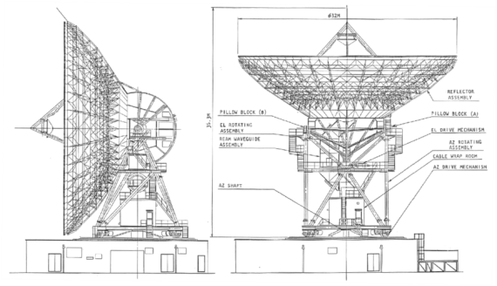


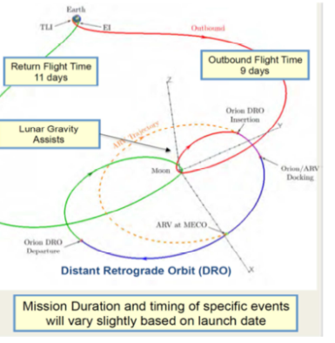
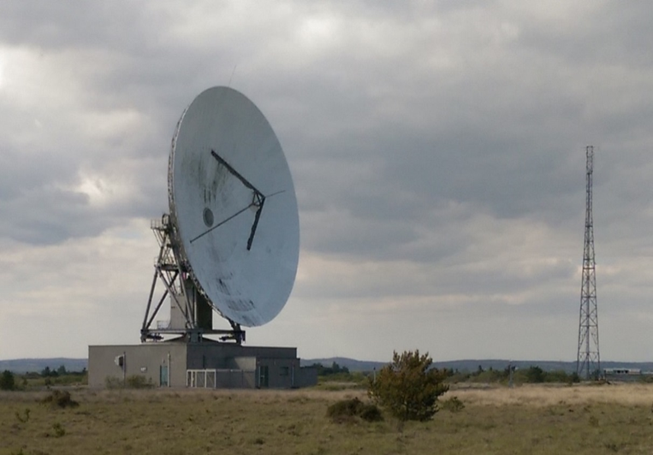
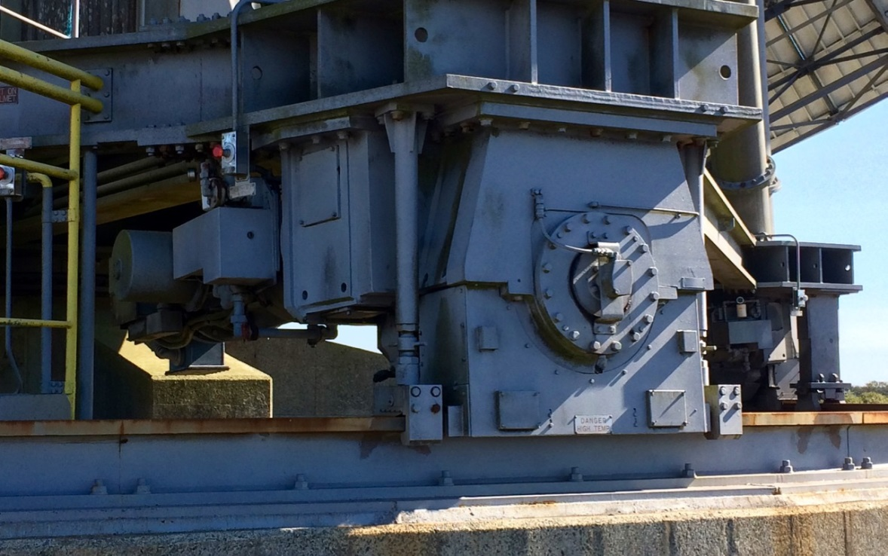
Goonhilly-6 Antenna Support to Orion Exploration Mission 1
Covering QinetiQ / GES / BAES Proprietary
Final Presentation
Matthew Cosby
12th April 2016
Ref. GNY-AS-PRS-QIQ-00042 v1.1

Slide 2
Agenda
Study overview
Assessment of Requirements
  Overall Mission Requirements
  Orion Ground Station Requirements
  Existing GHY-06 Performance
Assessment of Present System Status
Upgrade Requirements
System Performance Specification for the GHY-06 Upgrade
Preliminary Design Feasibility
Availability, Redundancy and Risk Assessment
Upgrade Schedule and ROM Cost Proposal
Conclusions and Recommendations

Slide 3
Study Overview

Slide 4
Background and objectives
Study conducted for ESA/ESOC under contract number 4000114131/15/D/EF
Overall objective
  To assess the feasibility of using the Goonhilly-06 (GHY-06) antenna to support the US Orion Exploration Mission 1 lunar flight
Background
  Orion Exploration Mission 1 (EM-1) is the first planned flight of the Space Launch System (SLS) and the second unmanned test flight of the Orion Multi-Purpose Crew Vehicle (MPCV), scheduled to launch in December 2018
  Orion EM-1 will also be a precursor to a NASA robotic mission called the Asteroid Redirect Mission (ARM), with an expected launch date in the early 2020’s, and will demonstrate the crew element of the ARM
  NASA expected to require 24 hour communications coverage of the Orion EM-1 flight for all phases of the mission
  For the trans-lunar phase, need three ground stations positioned at approximately equal intervals around the Earth
  Baselined ground stations are those at Goldstone (US), Canberra (Australia) and Madrid (Spain)
  This study to address the feasibility of using GHY-06 as either a replacement or back-up European ground station for the Orion EM-1 mission
  UK initiative
Study consortium
  Study led and co-ordinated by QinetiQ Ltd (Space UK business)
  Goonhilly Earth Station Ltd (GES) - owner and operator of Goonhilly Earth Station
  BAE Systems Applied Intelligence Ltd (BAES) - responsible for the baseband element of the upgrade, based on the TTCP system

Slide 5
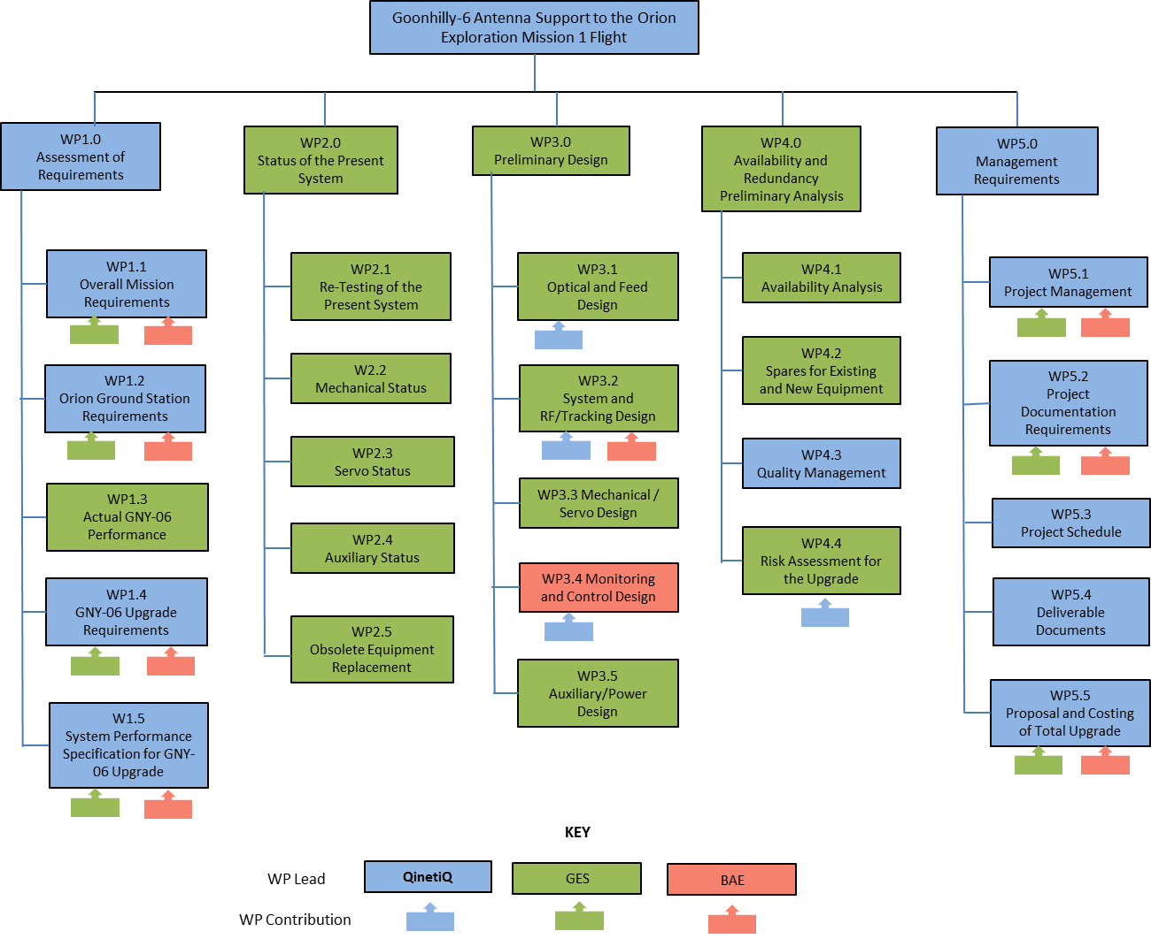
Work Breakdown Structure

Slide 6
Study schedule and major reviews
Event | Contract Baseline Schedule | Achieved
Kick Off Meeting | 01/06/15 | 20/05/15
Progress Meeting 1 | 24/07/15 | 16/07/15
Consolidation Requirements Review / Progress Meeting 2 | 21/09/15 | 09/10/15
Progress Meeting 3 | 13/11/15 | 27/11/15
Preliminary Design Review* / Progress Meeting 4 | 20/01/16 | 27/01/16
Project completion / acceptance of final deliverables | 29/02/16 | 12/04/16
* Pre-PDR as appropriate for feasibility study stage

Slide 7
Programme mapping to ESA project phases

Slide 8
Deliverables
Most deliverables issued initially in draft form and developed as the study progressed
Final approved versions as listed below:
No. | Title of document | Reference | Issue | Rev | Marking
1 | Project Management Plan | GNY-AS-PLN-QIQ-00001 | 2 | 0 | n/a
2 | Quality Assurance Plan | GNY-AS-PLN-QIQ-00003 | 2 | 0 | n/a
3 | Compliance and Verification Matrix | GNY-AS-MTX-QIQ-00002 | 4 | 1 | n/a
4 | Overall Mission Requirements | GNY-AS-RQM-QIQ-00012 | 2 | 2 | n/a
5 | Orion Ground Station Requirements* | GNY-AS-RQM-QIQ-00013 | 1 | 1 | n/a
6 | Existing GNY-06 performance | GNY-AS-REP-GES-00001 | 1 | 0 | n/a
7 | Re-test report of the present system | GNY-AS-REP-GES-00002 | 1 | 1 | n/a
8 | GNY-06 Upgrade Requirements | GNY-AS-RQM-QIQ-00014 | 1 | 2 | n/a
9 | Status of the present system | GNY-AS-REP-GES-00003 | 1 | 0 | n/a
10 | System specification for the GNY-06 upgrade | GNY-AS-SYS-QIQ-00015 | 1 | 2 | Proprietary
11 | Preliminary Design report | GNY-AS-REP-GES-00004 | 1 | 2 | Proprietary
12 | Availability and risk assessment | GNY-AS-REP-GES-00005 | 1 | 0 | Proprietary
13 | Overall Upgrade Schedule and Cost Report | GNY-AS-PRO-QIQ-00016 | 1 | 3 | Proprietary
14 | Final Report | GNY-AS-REP-QIQ-00017 | 1 | 0 | n/a
15 | Proprietary Annex to Final Report | GNY-AS-REP-QIQ-00018 | 1 | 1 | Proprietary
16 | Executive Summary | GNY-AS-REP-QIQ-00019 | 1 | 0 | n/a
* Considered obsolete, content now superseded by System Specification for the GHY-06 Upgrade

Slide 9

Assessment of Requirements
Overall Mission Requirements
Orion Timeline for Asteroid Redirect Mission

Slide 10
Frequency band requirements for Orion MPCV missions
 | Orion MPCV / EM1 (c. Dec 2017 / 2018) | Orion MPCV / ARM (post 2020) | Enabled missions
S-band uplink | Required | Required | LEO
S-band downlink | Required | Required | LEO
X-band uplink | Desirable | Required | Commercial Moon missions / Deep Space
X-band downlink | Desirable | Required | Ditto
K-band downlink | Desirable | Desirable
Down link data rate summary for cases examined (Mbps)
Case | Range | Moon noise | S-band | X-band | K-band
Best | Near | None | 3.1 | 1.9 | 0.6
Nominal | Near | Moon centred | 0.9 | 0.5 | 0.2
 | Far | None | 1.4 | 0.9 | 0.2
Worst | Far | Limb centred | 0.7 | 0.4 | 0.1

Slide 11
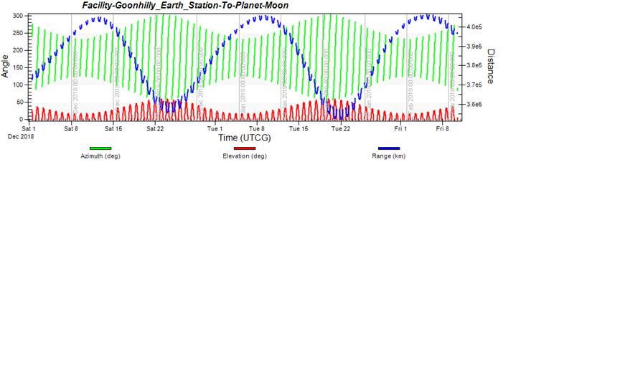
Orbital requirements for Orion EM-1
    Antenna tracking requirements derived from consideration of Orion EM-1 orbit and spacecraft visibility
    “The GHY-06 antenna system shall be capable of supporting communications to and from the Orion MPCV whenever the spacecraft is within line of sight visibility of Goonhilly Earth Station and at an elevation of >10° above the horizon”
        Ideally >20°
    “In order to track the Orion MPCV during the circumlunar phase of its mission, the GHY-06 shall be capable of operating over an azimuth angle range of 0-360º”
        Full range specified to cover Earth Orbiting missions although Orion EM-1 only requires range of ~50 º to 310 º
Variation of Moon azimuth, elevation and slant range
(period 1st December 2018 to 11 February 2019)

Slide 12

Assessment of Requirements
Orion Ground Station Requirements

Slide 13
Scope of Orion Ground Station requirements capture
Functional requirements
  Frequency bands
  Telemetry
  Tele-command and ranging
  Radiometric
  Reference frequency and time distribution
  Monitoring and control
  Test and calibration
  Ranging calibration and telemetry test-loop
  Mechanical
  Angular pointing
  Angular pointing calibration
  Power distribution
  Voice and data communications
  Additional requirements
Technical performance requirements
  General station performance
  Antenna tracking (auto-track not required) and pointing
  Receive
    Receive RF
    Telemetry / baseband
    Timing
  Transmit
    Transmit RF
    Tele-command
    Ranging
  Mechanical
  Servo
  Monitoring and Control
  Auxiliary equipment
    Contents of Orion Ground Station Requirements document largely overlap with the System Performance Specification (SPS) for the upgrade.
    This document last updated after CRR, now frozen/archived, with any future changes to be captured in the SPS.

Slide 14

Assessment of Requirements
Existing Goonhilly-6 Performance

Slide 15
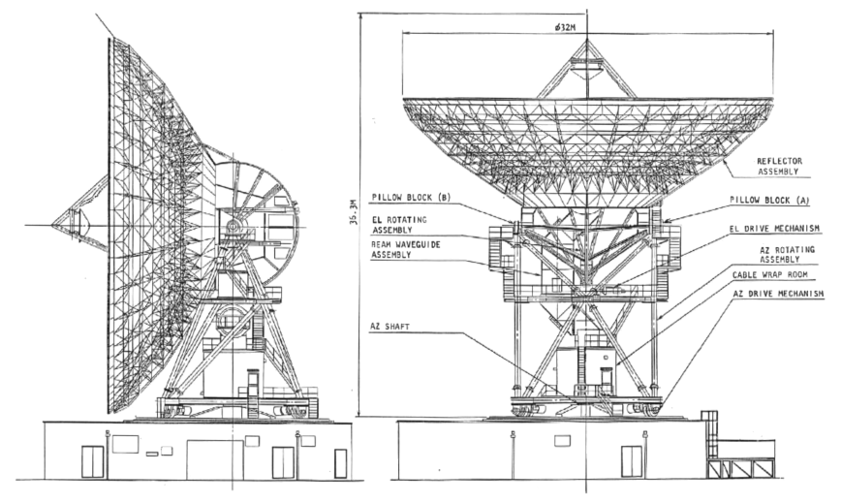
Outline Drawing of Goonhilly-06 Structure
The current GHY-06 antenna system comprises the following subsystems:
  Antenna Structure
  Antenna Feed Sub-system
  Antenna Drive Sub-system
  Servo and Control Sub-system
  Antenna Tracking Receiver Sub-system

Slide 16
Conclusions from review of existing GHY-06 performance
In view of the age and obsolescence of equipment, the following areas need to be addressed:
Replacement of:
  Antenna feed for the required frequency bands
  Antenna tracking (auto track not required) and steering system
  HPAs for the required frequency bands and to achieve required EIRP (including redundancy and switching)
  LNAs for the required frequency bands and to achieve required G/T (including redundancy and switching)
Provision of L-band to SHF frequency converters (including redundancy and switching)
Provision of Monitoring and Control facilities (local and remote)
Provision of cross-site communications equipment for redundant:
  L-band cross-site links
  Ethernet connectivity
  A (non-redundant) 24-fibre cable is expected to be in place; these fibres may be used for RF or Ethernet over fibre

Slide 17
Assessment of
Present System Status

Slide 18
Overview of azimuth and elevation drive re-test results
(present system)
 | Velocity (deg/sec) | Acceleration (deg/sec²)
Clockwise (CW) | 0.179 / 0.168 | 0.179 / 0.161
Counter-Clockwise (CCW) | 0.179 / 0.153 | 0.179 / 0.149
  AZ-1
 | Velocity (deg/sec) | Acceleration (deg/sec²)
CW | 0.180 | 0.180 / 0.194
CCW | 0.179 | 0.179 / 0.170
  AZ-2
 | Velocity (deg/sec) | Acceleration (deg/sec²)
Up | 0.135 / 0.145 | 0.150 / 0.161
Down | 0.135 / 0.148 | 0.142 / 0.164
  EL-1
 | Velocity (deg/sec) | Acceleration (deg/sec²)
Up | 0.135 | 0.144 / 0.134
Down | 0.136 | 0.145 / 0.136
  EL-2
The first figure in each case is the original specification and the second figure is the re-test result

Slide 19
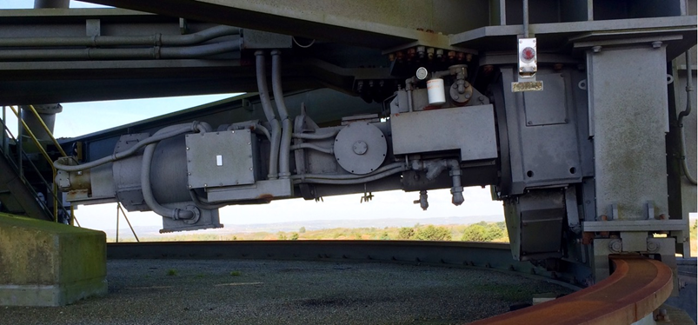
Key findings
The majority of the equipment will need to be replaced
May be more cost-effective to replace motors and the gearboxes than attempting to refurbish
Unable to undertake photogrammetry exercise to establish antenna profile during the course of this study, due to adverse weather conditions; anticipate need for re-adjustment of antenna panels once profile data is available

Slide 20
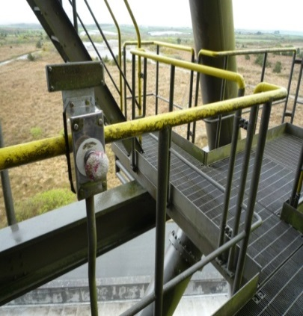

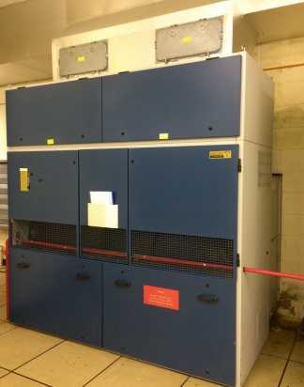
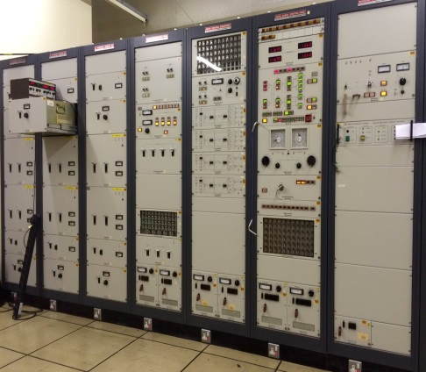
Upgrade Requirements

Slide 21
Summary of main modifications / upgrade work required
Item | Brief description of work | Reason / comment
System schematics and equipment layout | Redesign of system schematics and equipment layout | Redefinition of antenna purpose and capabilities
Feed | New feed for S / X/ K-bands | Existing feed limited to C/Ku-band
Reflector assembly | Surface profile analysis to be carried out and panels to be re-aligned if necessary, modelling of RF performance using GRASP, etc. | Surface accuracy / reflector condition not currently known
Structure | Remedial / refurbishment work urgently needed on structure, plus modelling of structure using finite element analysis | To address structural defects
Mechanical | Assess whether az/el drive system suitable for upgrade, replace parts if necessary, carry out any maintenance required | Operational but 30 years old and in need of maintenance. Designed for GEO not LEO tracking rates.
Servo system | Replacement recommended / required | Operational but the technology and equipment is 30 years old. Designed for GEO not LEO tracking rates.
Auxiliary equipment | Recommission, rearrange or replace as necessary (work needed on all aspects – eg. A/C, power, pressurisation, communications, accommodation, etc.) | To modernise, ensure fit for purpose and/or meet current legislation, for example.

Slide 22
TTCP upgrade requirements to support Orion
Upgrade programme will be first commercial use outside ESA
First use outside ESA ground stations
Signal processing
  Add DSSS ranging
  Modify uplink TC handling to support symmetrical AOS CADUs
Data processing
  Add AOS and security support
  Add NASA compatible M&C front-end
  Add NASA compatible radiometric data format

Slide 23
System Performance Specification for the
GHY-06 Upgrade
QinetiQ Proprietary
Block diagram of GHY-06 Orion ground station

Slide 24
Overview of upgraded system performance specification
QinetiQ Proprietary
Document provides both a functional and performance specification for the upgraded system
System functions and performance specified using the same breakdown as for Orion Ground Station requirements capture
Antenna performance requirements developed from Overall Mission Requirements taking into account what is considered feasible
Baseband, telemetry, tele-command and ranging performance based on the Tracking Telemetry and Command Processor (TTCP)
Environmental specification based on current performance
System will enable Orion support but does not preclude other mission opportunities, including GEO

Slide 25
Block diagram of GHY-06 Orion ground station
QinetiQ Proprietary

Slide 26
Preliminary Design Feasibility
GES Proprietary
Present Goonhilly-06 reflector system and feed assembly

Slide 27
Overview of supplier responses to RFP
GES Proprietary
Request For Proposals (RFP) issued to 12 potential suppliers.
Seven recipients declined to make any proposals as the RFP was considered either too complex or a proposal required more resource than the bidder was able to commit.
Five responses covering some or all of the RFP Work Packages were received from the following bidders:
  Envistacom (US)
  MT Mechatronics GmbH (MTM) (Germany)
  Peak Communications (UK)
  Vertex Antennentechnik GmbH (VA) (Germany)
  Ward Williams Associates (WWA) (local, UK)
MTM, VA and Envistacom all provided responses covering all or most of the requirement.
Peak Communications responded only on provision of frequency converters.
Ward Williams Associates (WWA) responded on the antenna refurbishment and auxiliary aspects and offered to carry out overall project management and planning – so would need to be part of a bigger team.
All potential suppliers that visited the GES site expressed “relief” in seeing the antenna’s state - each stated that they had converted systems in a worse state than GHY-06.

Slide 28
Proposals for antenna optics and feed design
GES Proprietary
All responders suggested that the focal point of the antenna be extended towards basement and optically matched with the indexing mirror
  This would allow the possibility of swapping out the different feed horns for different missions.
  This would require the existing C/Ku feed to be replaced.
  All responders accepted that it would be possible to implement the requested frequency plan in the upgrade.
The first part of the upgrade phase will require a Finite Element (FE) model of the antenna to be produced
  This needs be completed before the main implementation phase.
  The FE model will be used to create a simulation model of the antenna.
  The simulation model will provide information on the servo and drive and control parameters to meet the specified velocities, accelerations, pointing and tracking performance data.

Slide 29
RF tracking, mechanical and servo subsystem design
GES Proprietary
A new servo and tracking system is proposed including redundant ACU and drive systems.
It is concluded and recommended that the gearboxes, motors, servos and drive computer all need to be replaced; new brakes and encoders are also expected.
Two of the bidders (Envistacom and VA) indicated that their drive systems are designed to operate in a single motor configuration while another (MTM) indicated that a trade-off would be required for their standard design. None of the bidders indicated that they could not meet the antenna pointing and tracking requirements, however it is currently unclear how their designs will achieve the required performance and cater for backlash.

Slide 30
Auxiliary subsystem and power design
GES Proprietary
All responders covered this section in similar fashion, with the exception of the time distribution.
For ORION, “accurate” time is not required
  Only if the station is to be used to support Deep Space missions would installation of a hydrogen maser be required.
  In the interests of cost reduction, this has been excluded from the ROM cost estimate developed for the next phase of the study.
  GPS synchronisation should be acceptable for ORION and this has been assumed as the basis for cost estimates.

Slide 31
Proposals for Monitoring and Control design
GES Proprietary
The M&C design proposals address both local and remote elements.
Two options have been identified for local M&C at Goonhilly, to ensure the various subsystems are appropriately configured:
  Implement a bespoke station control system, specific to the Goonhilly station
    This option would allow all Goonhilly-specific functions to be incorporated, although the station would not necessarily then be compatible with the ESTRACK network.
  or
  Implement a station M&C system based on the ESA STC2 (station computer) but with the Front-End Controller (FEC) and Monitoring and Control Module (MCM) components replaced with Goonhilly-specific functions.
    This option would allow the station to be compatible with ESTRACK.
In both cases an interface to the NASA Orion Mission Operations Center (MOC) would need to be added to allow remote station operation, which would include high-level configuration of the station and upload and download of data files.
  It is assumed that GHY-06 would form part of the NASA IONet network (Near Earth Network of NASA ground stations – equivalent to ESA OPSNET operations network)

Slide 32
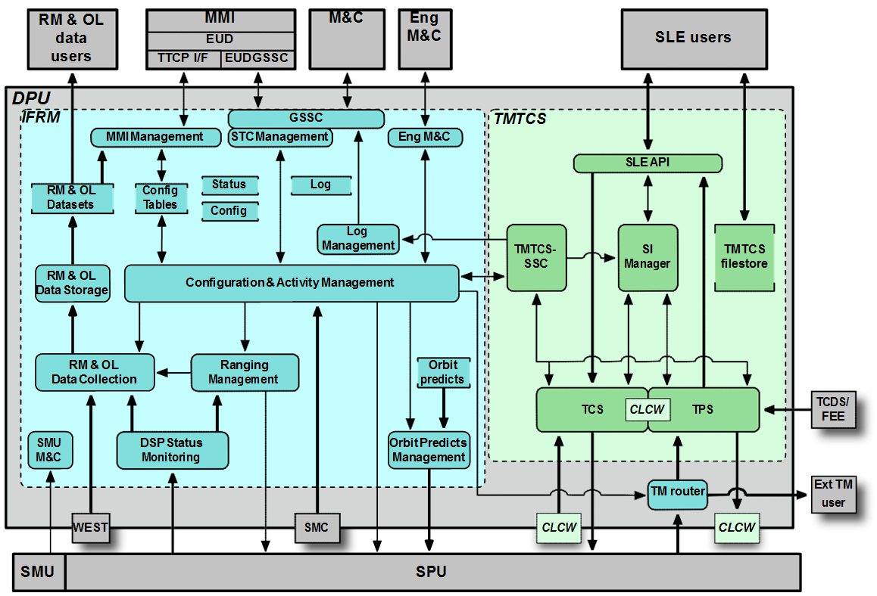
Monitoring and Control
TTCP M&C and SLE interfaces

Slide 33
Summary of preliminary design feasibility conclusions
GES Proprietary
All the suppliers indicated that conversion to a ground station capable of supporting the ORION spacecraft is feasible.
All the bidders required FE modelling as the first part or input to the next phase.
All the suppliers that visited the GES site were complimentary on the current state of the system, based on their experience of refurbishing other systems that are in worse condition than GHY-06.
All the frequencies requested can be supported through the extension of the focal plane into the room under the antenna and having either a selectable (manual) feed configuration or RF paths to multiple feeds.
The design will assume that the antenna will meet pointing and tracking requirements if one drive motor fails in each axis.

Slide 34
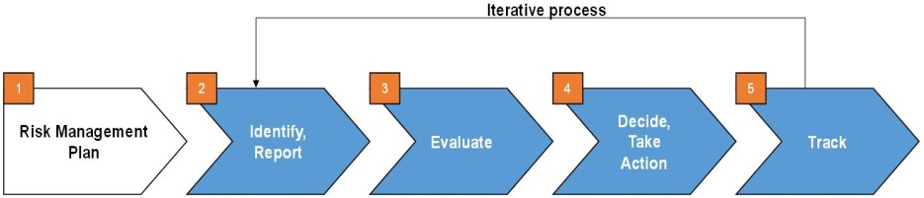
Availability, Redundancy and
Risk Assessment
GES Proprietary

Slide 35
Conclusions on availability and reliability
GES Proprietary
It is considered premature to consider availability, reliability and redundancy aspects in detail until a thorough analysis of the existing RF performance and antenna structure had been carried out and decisions made on the equipment types to be used.
Work under this study has focussed on outline planning of the approach to availability and reliability analysis in a follow-on phase:
  Proposed approach is to create an availability model taking account of the MTBF and MTTR of each item of equipment in the system, the configuration of the system and supporting sub-systems such as power, air-conditioning, etc.
  This model will take account of redundancy, redundancy switching and failure rates, etc. and will be developed in line with a recognised system reliability prediction model.
  As part of the design stage, the reliability model will identify areas where the design or reliability of proposed equipment and/or its redundancy configuration is likely to have a significantly adverse impact on the system availability so that necessary improvements may be implemented.
  Downtime due to scheduled maintenance and other planned engineering works will not be taken into account during the availability analysis.
At this stage, it is envisaged that all the systems will need to be redundant in order to meet the reliability figure
  The assumption at this point is that all the systems will need to be hot redundant.

Slide 36
Risk Assessment for the Upgrade (1)
GES Proprietary
Risk No. | Risk Title | Risk Description | Risk Prob-abiity | Risk Impact |  |  |  | Possible Risk Mitigation Action | Residual Risks after Mitigation | Possible Fallback Options
 |  |  |  | Tech-nical | Cost | Sche- dule | Safety
1 | System suitability | Capability of existing antenna system to be modified for extended frequency bands | L | L | M | M | L | Measurement of antenna system (reflector profile accuracies, BWG parameters). Build RF model. Predict performance. | Implementation fails to meet performance | Limited operation
2 | Access to reflector | Hole through base building roof too small | L | M | M | M | L | May need to enlarge (depends on design) | Possibility of weakened roof or water leaks | Redesigned BWG or feed
3 | FE models | Finite element modelling may indicate structural stiffness unable to support higher frequency operation | L | M | M | H | M | Backing structure to be reviewed and stiffened in accordance with FE model | Regular inspection during lifetime will pick up residual risks for early attention | Limited operation
4 | Major structural issues | Unforeseen major areas of corrosion or structural deformation | L | L | M | L | L | Replace corroded or deformed items using stronger/better protected items | Regular inspection during lifetime will pick up residual risks for early attention | Avoid through proper inspection and maintenance and repair
5 | Lifetime | Future lifetime of structure; failure of major mechanical components such as motors and gearboxes | L | L | M | L | L | Use of proper paint, protection and lubricants. Strict adherence to maintenance regime. | Regular inspection during lifetime will pick up residual risks for early attention | Avoid through proper inspection and maintenance and repair
6 | Structure | Issues found with structure that affect its integrity | L | M | M | M | M | Early full survey and analysis (Finite Element) | FE model indicates that the system is not suitable for the application | Replace defective parts of structure. Trade-off against cost of new antenna.
7 | Main bearings | Main bearings (azimuth / elevation) found to need replacing | L | M | H | M | M | Early inspection | The bearings need to be replaced | Replace bearing(s)

Slide 37
Risk Assessment for the Upgrade (2)
GES Proprietary
Risk No. | Risk Title | Risk Description | Risk Prob-abiity | Risk Impact |  |  |  | Possible Risk Mitigation Action | Residual Risks after Mitigation | Possible Fallback Options
 |  |  |  | Tech-nical | Cost | Sche- dule | Safety
8 | Beam Wave Guide | Antenna performance cannot be met with existing BWG system | L | M | H | H | L | Early full survey and analysis | Mitigation will only cover the schedule risk, with the cost of risk tolerated | Replace more of BWG than anticipated or lower performance requirement
9 | Antenna profile | Difficulty (re)aligning antenna to necessary shape – performance impact, especially at higher frequencies | L | H | M | L | L | Early full survey and analysis, trial alignment using one panel to see what movement possible | Mitigation will only cover the schedule risk, with the cost of risk tolerated | Accept reduced performance, modify or replace
10 | Schedule overrun | Upgrade not ready in time for Orion mission, due to late key supplier deliveries, issues found during upgrade work, etc. | M | L | M | H | L | Conduct regular progress monitoring, carefully vet prime contractor, ensure schedule realistic and feasible, requires thorough initial survey beforehand | There is still a residual risk that the schedule will be extended | Tolerate risk after mitigation
11 | Prime / key contractor availability | Problems / issues with finding/ appointing prime contractor etc., plus other supply chain issues (e.g. problems obtaining key items) | M | M | H | H | L | Early engagement with potential suppliers | There is still a residual risk that the schedule will be extended | Tolerate risk after mitigation
12 | Frequency licensing issues | Difficulty obtaining licence to operate on required frequency bands | L | H | M | H | L | Early engagement with licencing body (Ofcom), early submission of licence extension/ application | None | None
13 | Interface with TTCP | Difficulties found in interfacing TTCP with rest of the bespoke Goonhilly system (especially M&C) | M | M | L | M | L | Define ICD to cover interface between TTCP and antenna system and early interface testing | Issues may still exist after the mitigation | None

Slide 38
Upgrade Schedule and ROM Cost Proposal
This section covering QinetiQ Proprietary

Slide 39
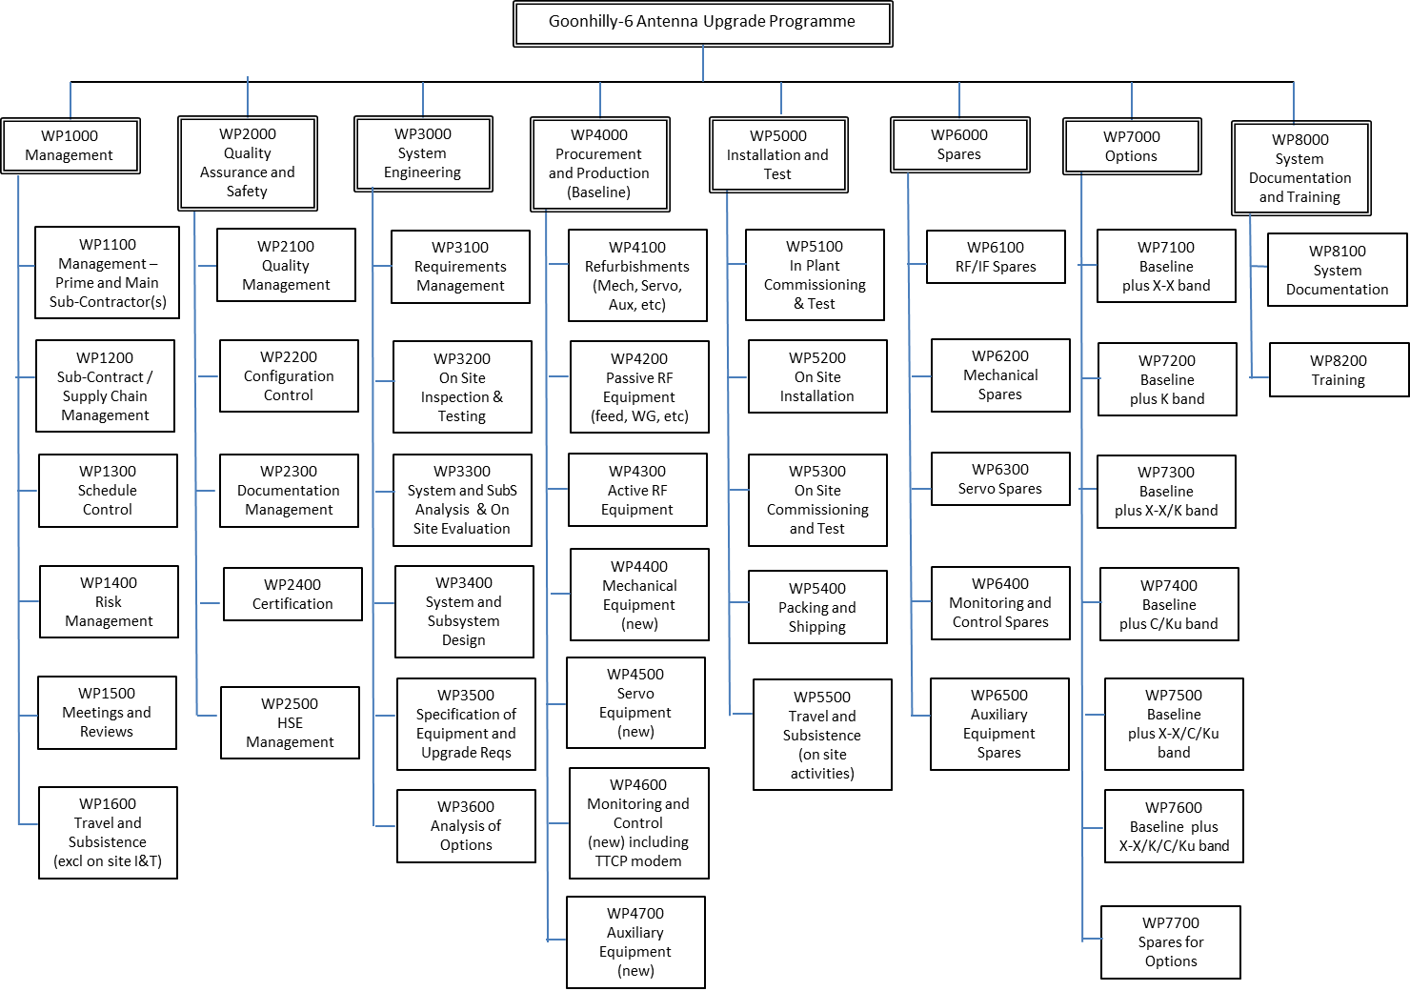
Work Breakdown Structure for the Upgrade

Slide 40
Product Tree
Goonhilly-6 Antenna Upgrade
GHY-06 Antenna System
Ground Station Infrastructure and Auxiliary Equipment
Reflector Assembly (Primary & Secondary)
Monitoring and Control Sub-System
Test and Calibration Equipment
Buildings
Antenna Support Structure
RF Receive and Test Sub-Systems
Air Conditioning
TTCP
X-band
Power Supplies
Feed
Other Baseband Equipment
S-band
Pressure Control
Antenna Tracking and Steering System
Communication Links
Antenna Control System
Intra-Site
Servos (and Power Supplies)
External
DC Motors
Azimuth and Elevation Drive Sub-Systems
Fire Alarms
Gearboxes
Frequency Converters (Up/Down)
Safety Systems
High Power Amplifiers (HPAs)
Security Equipment
Low Noise Amplifiers (LNAs)
Frequency & Timing (F&T)

Slide 41
Schedule overview
Phase | Baseline (months) | Target (months)
Phase B | 4 | 3
Phase C | 6 | 4
Phase D | 14 | 12
Total | 24 | 19
  The objective of achieving operational readiness in time to support Orion Exploration Mission 1 in December 2018 is considered achievable, subject to:
  An early start on Phase B preliminary definition work by the beginning of September 2016, and
  The assumption that NASA certification can be pursued in parallel with Phase B/C/D engineering work.
Plan assumes gap between Phases B and C to allow for approval following ESA Ministerial circa February 2017.

Slide 42
ROM cost/price for baseline and options
QinetiQ Proprietary
S-band baseline
  The total Rough Order of Magnitude (ROM) cost/price estimate for the S-band baseline is £8,447.1k (€11,000.6k)
Costed Options
  S-band baseline plus C/Ku band £9,589.3k (€12,506.9k)
  S-band baseline plus X-X band £10,066.7k (€13,138.1k)
  S-band baseline plus X-X and C/Ku band £11,181.2k (€14,608.1k)
K-band
  Not estimated at this stage (insufficient design detail)
  (Figures applicable for February 2016 Economic Conditions, exchange rate 1.3096 Euros per GBP)

Slide 43
ROM cost/price breakdown by Level 1 Work Package (S-band baseline)
QinetiQ Proprietary
 |  | £k | €k | %
WP1000 | Management | 1431.1 | 1878.1 | 17%
WP2000 | Quality Assurance and Safety | 678.9 | 889.4 | 8%
WP3000 | System Engineering | 1041.6 | 1369.8 | 12%
WP4000 | Procurement and Production (Baseline) | 3624.4 | 4657.1 | 43%
WP5000 | Installation and Test | 1402.2 | 1851.2 | 17%
WP6000 | Spares | 173.4 | 228.9 | 2%
WP8000 | System Documentation and Training | 95.5 | 126.1 | 1%
 | TOTAL for S-band baseline | 8447.1 | 11000.6 | 100%
  (Figures applicable for February 2016 Economic Conditions, exchange rate 1.3096 Euros per GBP)

Slide 44
ROM cost/price breakdown by Phase (S-band baseline)
QinetiQ Proprietary
Phase | £k | €k
Phase B | 586.6 | 770.5
Phase C | 2781.8 | 3602.0
Phase D | 5078.7 | 6628.1
Total | 8447.1 | 11000.6
Key assumptions
  Phase B and C includes cost allowance for the overall programme risk
  Phase C cost/price allows for purchase of long lead items for Phase D
Funding
  Possibility of local funding to enable early start on Phase B and to reduce schedule risk and overall cost
Post-upgrade operations
  GES Ltd estimate of the Rough Order of Magnitude (ROM) cost/price for post-upgrade operational use is an hourly rate of £488/hr (€639/hr), subject to a commitment to a minimum of 2192 hours per year, where the minimum number of hours equates to 25% of a year.
  Scope for increased utilisation.
  (Figures applicable for February 2016 Economic Conditions, exchange rate 1.3096 Euros per GBP)
Notes:
Number of Days = 365
Number of Hours (in a year) = 8766
Number of Hours allocated for NASA 2192
Yearly Cost (£) 1068750
Per hour cost (£) 488
Per hour cost (€) 639

Slide 45
Conclusions and Recommendations

Slide 46
Conclusions
The feasibility of the proposed GHY-06 antenna upgrade implementation programme is considered proven and demonstrated.
  All the suppliers who responded to GES Ltd’s request for proposals indicated that conversion to a ground station capable of supporting the Orion spacecraft would be feasible.
Once upgraded, GHY-06 will provide a useful level of performance for Orion at S-band and potentially at the other frequencies of interest for subsequent missions (X-band and optionally K-band).
  A modular approach has been proposed to allow these new frequencies to be accommodated as and when funding becomes available.
  Of those suppliers that presented proposals covering all or most of the requirement, all provided realistic proposals for upgrading the antenna optics and structure, which constitutes the most critical part of the project.
Whichever supplier is selected, it will be necessary to carry out a detailed antenna survey at an early stage of the project in order to obtain input data for RF performance simulation and structural modelling, as these analyses will be an essential part of the initial design work
  Activity to be performed in Phase B.
A baseline schedule plan of 2 years is considered realistic, with a stretch target of 19 months potentially achievable subject to detailed planning.
The objective of achieving operational readiness in time to support Orion Exploration Mission 1 in December 2018 is considered achievable, subject to an early start in 2016 (assumed locally funded) and the assumption that NASA certification can be pursued in parallel with Phase B/C/D engineering work.

Slide 47
Recommendations
The principal recommendation is to progress and implement the GHY-06 upgrade programme as outlined in this study
This should cover provision of a minimum baseline S-band, as needed for Orion, with consideration given to operation in other frequency bands
  In particular it is recommended that the upgrade retain the capability to operate in the standard TT&C bands, as this will provide a regular revenue stream and help ensure GHY-06 remains viable in the longer term (the GES business model is based on this approach)
An early start on Phase B preliminary definition tasks by the beginning of September 2016 is needed in order to achieve operational readiness in time to support Orion EM-1
  It is recommended that work start as soon as possible to develop a Statement of Work for the critical early start activities
A prime contractor should be appointed to manage the day-to day details of the upgrade
  This prime contractor could potentially be one of the suppliers who responded to GES Ltd’s request for proposals, or another party

Slide 48
Key messages
Benefits
Meets objectives of UK Space Growth Strategy by creating new markets
Highlights UK capability
Provides return on investment
  Investment in TTCP – first commercial use of TTCP
Immediate action plan
Urgent need to coordinate with local government to secure Phase B funding
Coordination for support to next Council of Ministers meeting

