Slide 1
Mission Families: From Common Software to Common Operations
Final Presentation

Slide 2
SUMMARY
01
|
Introduction
02
|
Overview of the activity
03
|
Main results
04
|
Demonstration
05
|
Conclusions and future steps
06
|
Q & A

Slide 3
01
Introduction

Slide 4
Introduction
01
Introduction
Context
A significant degree of commonality across missions achieved by ESA so far
Multiple levels of commonality
Generic spacecraft platforms
Standard communication interfaces
Generic mission control system infrastructure
Challenge/opportunity
Repetitive tasks while preparing mission operations
Similarities across missions, yet not fully exploited
Objective
Produce reusable operational artefacts that could be shared by all missions
Enabler
EGS-CC service-oriented architecture
Layered structure of the EGS-CC Tailoring Data Model (TDM)

Slide 5
02
Overview of the activity

Slide 6
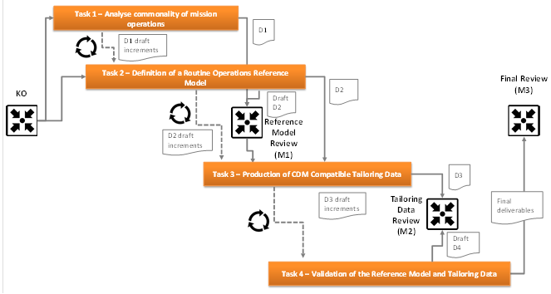
Programme of work
02
Overview of the activity
Work breakdown
TASK 1: Analyse of commonality in mission operations
TASK 2: Definition of a Routine Operations Reference Model
TASK 3: Production of TDM Compatible Tailoring Data covering the Reference Model
TASK 4: Validation of the Reference Model and associated Tailoring Data
Agile approach
1-month sprints
Start a task as soon as there was enough inputs from the previous tasks.

Slide 7
Team consortium
02
Overview of the activity
Organisation
IMMEDIA
Prime contractor, technical responsibility
Core activities
GMV
MCS, EGS-CC, EGOS-CC expert
LSE
Mission operations expert

Slide 8
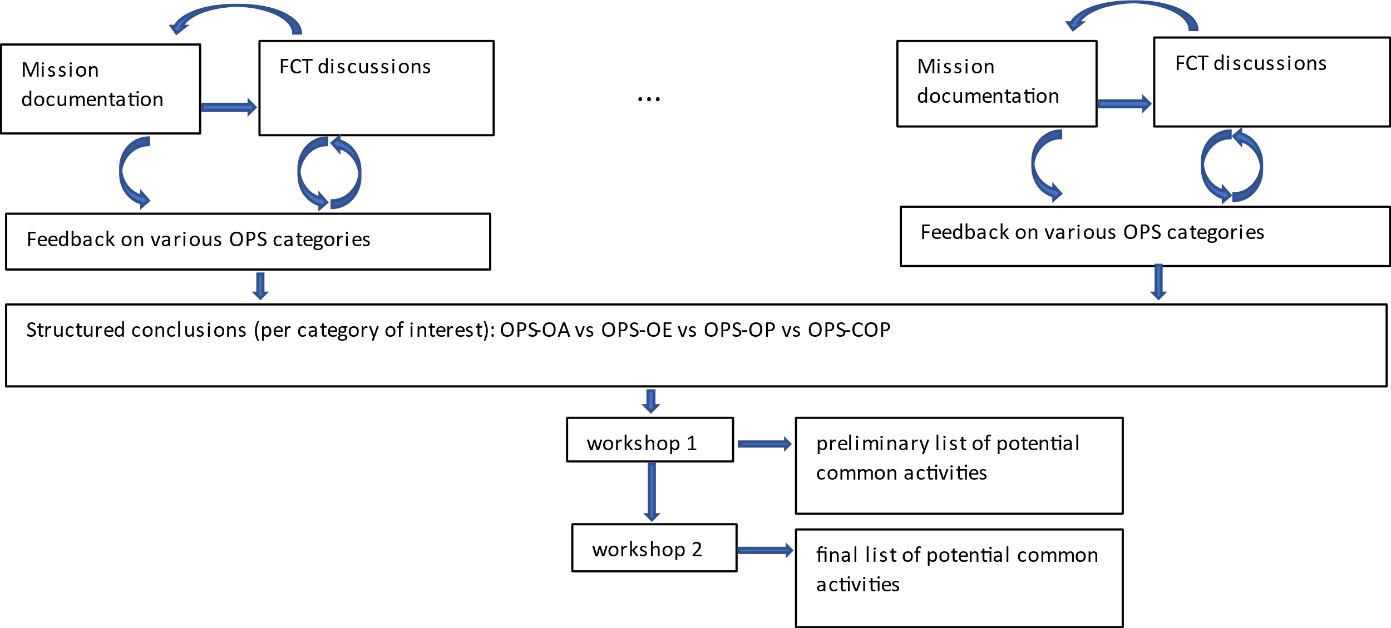
Analysis of commonality in mission operations
02
Overview of the activity
Approach for the analysis
10 ESA missions grouped in 4 mission families
Astronomy
Planetary
Earth observation
Copernicus
Analysis of operations organised in areas
FBO vs PUS usage
degree of automation
manoeuvre strategy and interaction with FD
mission planning strategy
OBSW maintenance
routine vs contingency strategy
TM consolidation/archiving
on board queue activities
data presentation/visualization
analysis and statistics tools

Slide 9
Analysis of commonality in mission operations
02
Overview of the activity
Selection criteria
Operational perspective
Degree of commonality across missions
Operational interest
Implementation perspective
Representative of different solution patterns
Reasonable complexity
Results
Building blocks for common operations
Operations areas for which some operational artefacts could be produced
Generic pass execution macro-activity
Comprehensive operational artefacts for routine pass potentially sharable by all missions
Identification of operations |  | Priorisation
Category | Operational activity
File-based operations | FBO file transaction and management | HIGH
 | FBO TC and TM files processing | HIGH
On-board schedule management | Uplink of on-board schedule contents | HIGH
 | Management of the on-board schedule | HIGH
 | Management of ground model | MEDIUM
Routine | Generic pass execution macro-activity | HIGH
 | Ground station links management | HIGH
 | Time correlation management | HIGH
 | Commanding loop/directives | HIGH
 | Basic pass activities | HIGH
 | Mass memory operations and maintenance | MEDIUM

Slide 10
03
Main results

Slide 11
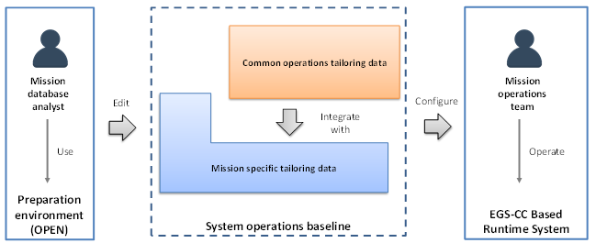
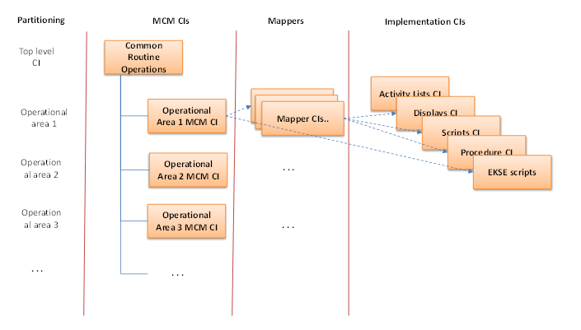
Routine operations reference model
03
Main results
Design principles
Drivers for the structure
Allow the integration of all the definitions within a tree in the mission model in which it is applied.
Allow the operator to logically browse the definitions from an operational point of view.
Allow to partition the definitions and use in the context of a mission only a subset of them as needed.
Key concepts of the TDM
Separation between monitoring and control entities and implementation entities
Mappers linking definitions and implementations
Configuration items, the central elements for configuration control tracking

Slide 12
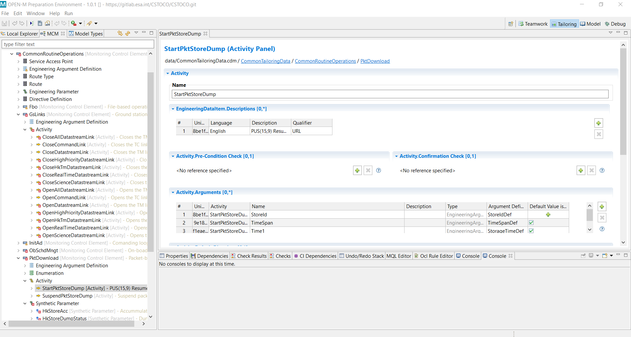
Common tailoring data
03
Main results
Operations areas
G/S links management
Time correlation
Commanding loop/directives
Packet-based data download
On-board schedule management
Stack file upload
File-based operations
OPEN-M

Slide 13
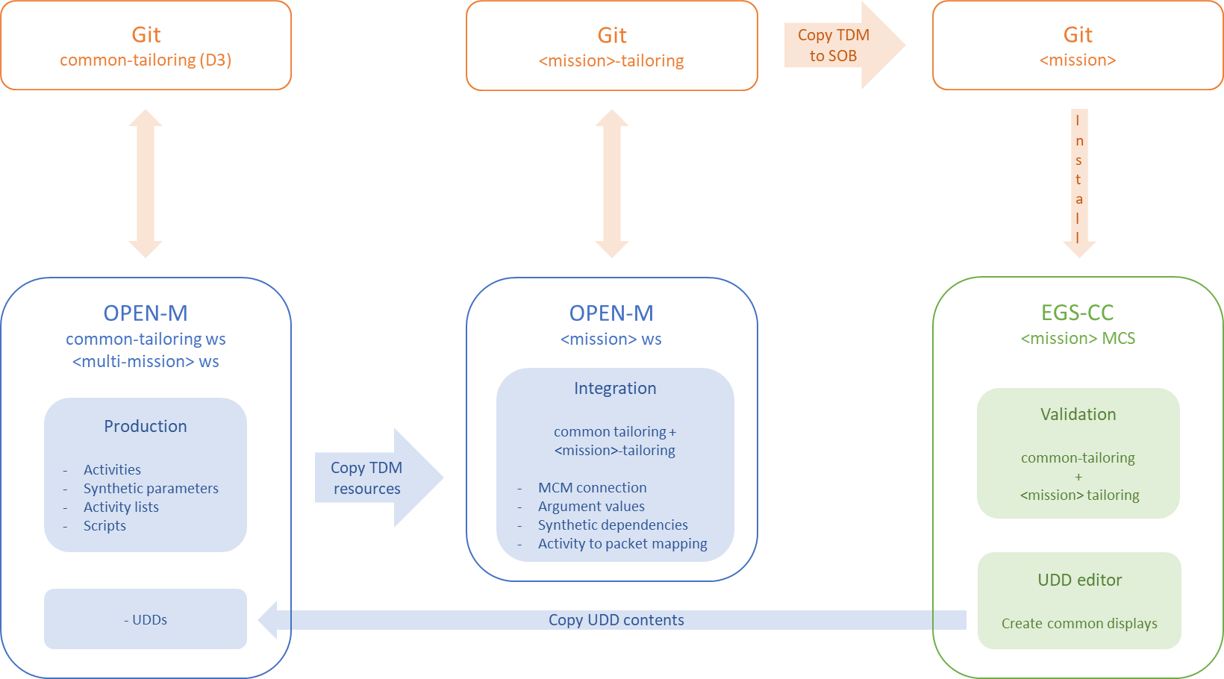
Integration procedure
03
Main results

Slide 14
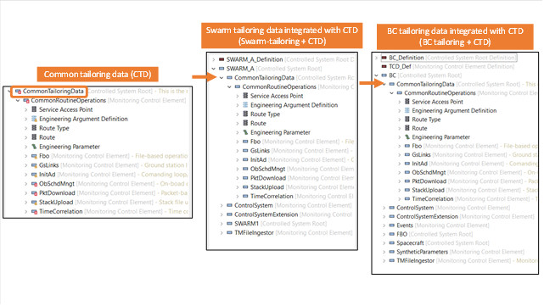
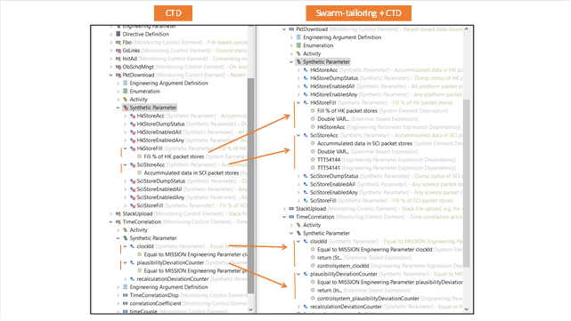
Mission tailoring + common tailoring
03
Main results
Common tailoring data connected to mission tailoring data: common root element becomes a sub-element of the mission root element
Dependencies and expressions of synthetic parameters updated

Slide 15
04
Demonstration

Slide 16
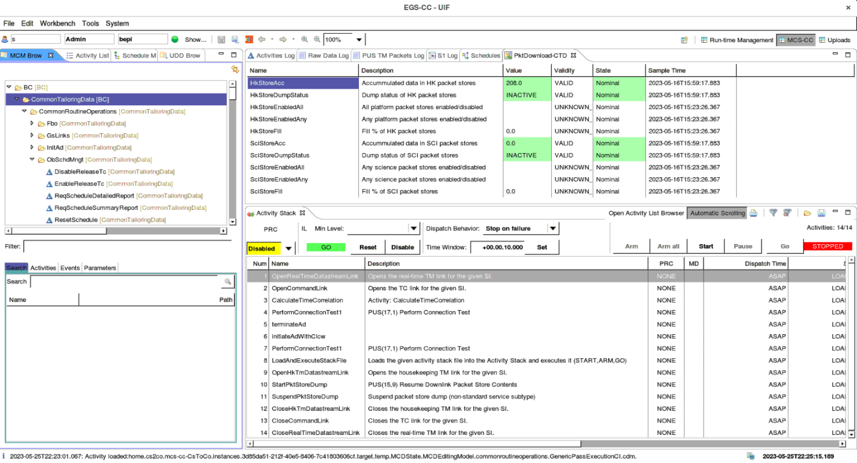
Using the CTD on the MCS-CC
04
Demonstration
Preparation
CTD integrated with Swarm and BC tailoring
MCS-CC software deployed (incl. tailoring data)
Operation
CTD used in the demonstration:
Activity list
Activities
Synthetic parameters
Displays
Operational areas covered in the demonstration:
G/S links management
Time correlation
Commanding loop/directives
Packet-based data downlink
Upload stack file to the on-board schedule
Generic pass execution
MCS-CC

Slide 17
05
Conclusions and future steps

Slide 18
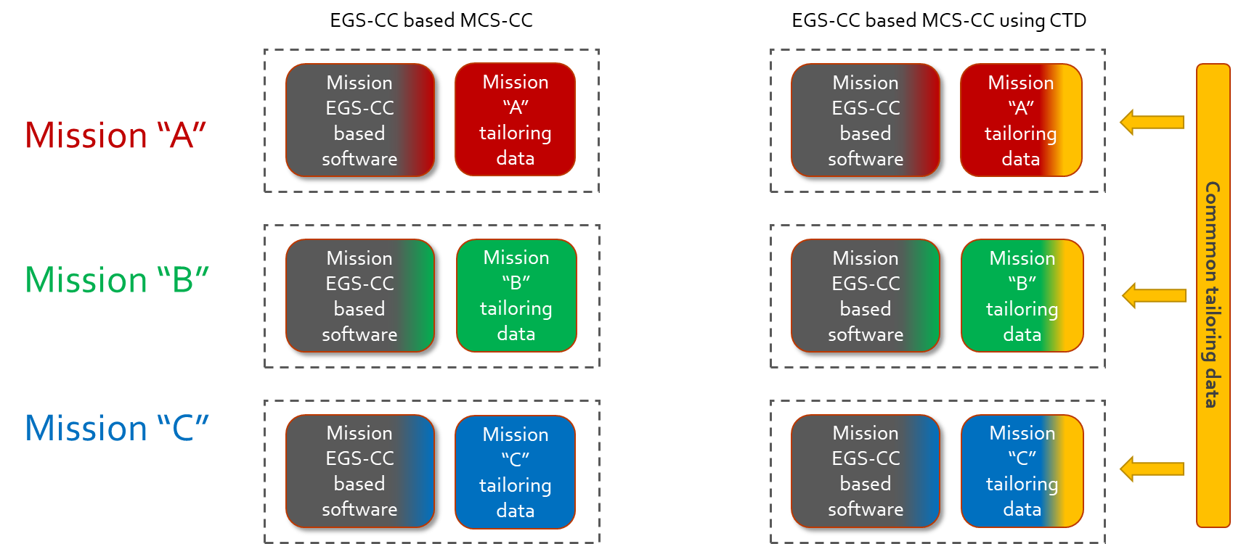
Achievements
05
Conclusions and future steps
Starting point: a well-defined objective, yet open to multiple approaches
Definition of a reference model for the production of reusable common tailoring data (CTD)

Slide 19
Achievements
05
Conclusions and future steps
Operational areas with commonality potential across missions in routine operations
Ground station links management
Time correlation
Commanding loop/directives
Packet-based data download
Stack file-based schedule upload
File-based operations
Several strategies defined for the production of CTD
Reuse elements available in the control systems extensions of missions’ tailoring data
Reuse parts of available generic elements
Define new activities setting only widely applicable argument default values
Define specialised activities for specific purposes as variations of a base activity
Define new synthetic parameters to be identical to mission parameters
Create EKSE scripts that connect common activities to mission service commands

Slide 20
Achievements
05
Conclusions and future steps
Definition of an automated integration process
Common integration script executable under OPEN-M implementing the integration mechanisms
Mission-specific scripts containing the mission-specific data
Several strategies for the integration of CTD
Common activities mapped to mission command packets
Common activities triggering EKSE scripts
Argument mission-specific values
Mission-specific grammar-based expressions for common synthetic parameters
Common user-defined displays copied to missions’ tailoring data
Structure of the CTD enabling full or partial integration into a mission
Logical view based on separate TDM M&C elements for the different operations areas, with no cross dependencies
Physical view based on separate TDM configuration items
Operational validation based on realistic scenarios
OPEN-M as reference tool for the edition and integration of CTD

Slide 21
Achievements
05
Conclusions and future steps
MCS-CC developers and future missions can benefit from
A reference model for the definition of additional CTD using OPEN-M
An integration procedure executable under OPEN-M
An initial CTD to be integrated into the tailoring data of a mission
Definition of a manual generic pass execution “macro-activity”
Manual procedure
Simple logic for routine operations
Activity lists for predefined argument values
Initial proof of concept for an automated generic pass execution “macro-activity”
OPEN-M Procedure Editor
ATOP language
Automatic generation of activity list

Slide 22
Challenges / difficulties
05
Conclusions and future steps
From common concept to common details
Not straightforward implementation of common concept, when getting into the details
Validation of the CTD
Only limited validation of the CTD itself can be done, based on checks run under OPEN-M
Meaningful validation requires the integration of the CTD into a mission, which adds some complexity and problems inherent to the integration
EGS-CC restart time is very long (> 10 minutes), thus making it classical trial-and-error techniques applied to debugging of the CTD impractical
Mission PUS tailorings deviate from the standard
Difficulties in the definition of common activities
Packet-to-activity mappings based on assumptions
Consolidation of the CTD
Two missions have been used for validation in the scope of the study
Including more missions would help identify additional difficulties differences across missions and consolidate the various strategies

Slide 23
Possible follow ons
05
Conclusions and future steps
Validation of the CTD
Additional scenarios
Integration into other missions
Practical case study by the FCT of a mission
Additional features
Additional activities and parameters in the selected operation areas
Automated procedures
Integration of the CTD into the OPEN-M MM repository structure
Additional activities and parameters in the selected operation areas
Automated procedures
Generic pass execution macro-activity
Run the ATOP procedure on the EGS-CC automation component
Evolution of the procedure to exploit more procedure capabilities
Additional levels of abstraction (e.g. nested lists)

Slide 24
06
Q & A

