Slide 1
Definition of a Process Assessment and Improvement Model for Cybersecurity in the European Space Industry
Francisco Aguilera Leal / Patricia Rodríguez Dapena
NTT_22-016_S4S+CYBER_PRE-v1.0
19/01/2023

Slide 2
Project objectives
The main goal of the project is to define a process assessment and improvement model specifically for cybersecurity in the European space industry. This model can either be an extension of the existing process assessment and improvement model (ISO/IEC 33020, ISO/IEC 33061) or a new self-standing model. In either case, the cybersecurity model shall aim to benefit as much as possible from the existing one, allowing for combined assessment and improvement cycles (capability and security) whenever possible.
1. Development of a model for process assessment and improvement for cybersecurity in the European space industry that:
focuses on the security of software development processes (as opposed to the security of work products) [Criterion 1].
is appropriate for suppliers of space segment components as well as to suppliers of ground segment components and its infrastructure [Criterion 2].
takes into account – where applicable – the specific nature of space industry projects. This includes, but is not limited to, aspects like:
  the international context in which space systems are developed and operated, and – as a consequence – the variety of regulatory requirements that may apply;
  the importance of safety and dependability assurance and the potential conflicts that may arise between safety and security requirements;
  safety- and mission-criticality (including manned missions);
  the specific setup of industry consortia;
  the ECSS standards and their tailoring mechanisms
  the use of independent software verification and validation (ISVV)
  the long lifetimes of many of the projects;
  the specific development phases and lifecycles of space projects;
  the fact that space systems can often not be updated, modified or maintained in-flight; and
  the fact that communication with space systems is not always possible in (near-)real-time.
2. Documentation of the cybersecurity model in a handbook, including the Process Assessment Model, the Process Reference Model and a guide for Assessors. The documentation follows the style of ECSS handbooks.
3. Development of training material for the cybersecurity model, consisting of two sets of slides: one for assessors and one for organisations planning an assessment.

Slide 3
Work Break Down structure

Slide 4
Project logic

Slide 5
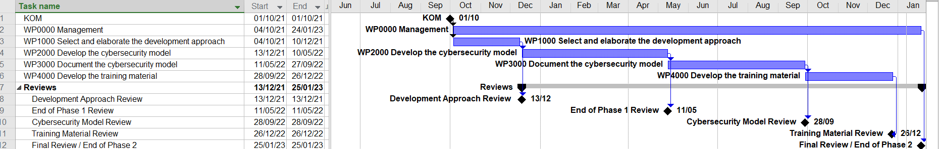
Schedule

Slide 6
Technical deliveries
WP1000 | TN1. Cybersecurity Development approach. Ref: EVE_21-002_CYBER+S4S_TN-v1.1 | Analysis of different existing approaches for cybersecurity processes when engineering and operating security-critical systems
WP2000 | TN2. Cybersecurity Model Description. Ref: NTT_22-009_S4S+CYBER_TN-v1.1 | Aims to extend the coverage of the process assessments in the space industry with cyber-security aspects. It enhances ECSS-Q-HB-80-02A, which is separated in two documents: the description and guidance of assessment framework (Part 1) and the instruments used for the assessment (Part 2).
 | PP1. Cybersecurity model presentation. Ref: NTT_22-007_S4S+CYBER_PRE-v2 | Aims to present the Cybersecurity Model, and how the coverage of the process assessments in the space industry with cyber-security aspects enhances ECSS-Q-HB-80-02A.
WP3000 | D1. Cybersecurity model description. Part 1 v1.1 Ref: NTT_22-004_S4S+CYBER_TN-v1.1 | This handbook (Part 1) provides the instruments and information to determine the level of process performance and capability, to improve the software processes identifying the changes or additions that should be done, and to ensure that all ECSS requirements are met for a given project.
 | D1. Cybersecurity model description. Part 2 v1.1 Ref: NTT_22-005_S4S+CYBER_TN-v1.1 | This handbook (Part 2) provides assessors with a number of instruments needed to perform software process capability assessments using the assessment method described in Part 1. It also provides instruments that help assessors to carry out their activities when performing assessments and supporting the implementation of software process improvement initiatives using the method for process improvement described in Part 1. The instruments provided are: • The Process Assessment Model (PAM) required to perform ECSS-Q-HB-80-02 assessments including process descriptions and process attribute indicators • Conformance statement to the requirements in ISO/IEC 33004 • A definition of the Process Reference Model (PRM) on which the ECSS-Q-HB-80-02 PAM is based upon • Detailed traces from base practices in the ECSS-Q-HB-80-02 PAM to ECSS standards clauses and from ECSS-Q-HB-80-02 process outputs to ECSS expected outputs
WP4000 | PP2. Training slides for assessors Ref: NTT_22-011_S4S+CYBER_PRE-v2 | PP2. Training slides for assessors
 | PP3. Training slides for organisations. Ref: NTT_22-012_S4S+CYBER_PRE-v1.0 | PP3. Training slides for organisations
 | Brochure + Video Ref: NTT_22-013_S4S+CYBER_PRE-v1.0 | 3 pages brochure + Video presenting the process models

Slide 7
TN1: Cybersecurity Development approach
Comparative criteria for the analysis of literature, standards and different approaches
Criterion |  | Values | Weight
1 | The model shall focus on the security of software development processes (as opposed to the security of work products). | 1 (low) 2 (medium) 3 (high) | 16%
 | The processes to be defined will focus of the overall management and software development processes not on more technical focusing on the product.
2 | The model shall be appropriate for suppliers of space segment components as well as to suppliers of ground segment components and its infrastructure. | 1/2/3 | 2%
 | The Cybersecurity processes to be defined shall be applicable and useable to the development of any space SW asset: flight software, ground control SW and user segments. In principle, irrespective to any possible safety/dependability criticality level of the space SW asset under development.
3 | the international context in which space systems are developed and operated, and – as a consequence – the variety of regulatory requirements that may apply; | 1/2/3 | 10%
 | Generic and international enough to be able to co-exist and be complemented by other regulatory requirements national-wise or sector-wise
4 | the importance of safety and dependability assurance and the potential conflicts that may arise between safety and security requirements; | 1/2/3 | 10%
 | The Cybersecurity processes shall allow to coordinate for any potentially explicitly defined stages where potential conflicts that may arise between safety and security requirements may need to be managed. The combination of the development and safeguard of both aspects are not an easy task The study of potential hazards and threats, and the assessment of safety and cybersecurity risks is usually complicated. This is because there exist strong dependencies between the two domains, even though cases where they are independent do also exist. Three types of such dependencies have been identified and studied in literature and can be summarised as follows: 1. Conditional dependencies: Safe operations may be conditioned by cybersecurity, for example, malicious modifications of sensor data or control programs may prevent safety systems from protecting an installation in accidental conditions. Conversely, safety may be a condition for cybersecurity, for example, when unmanaged catastrophic conditions weaken the security posture of a system or an organization, and lead to opportunistic malicious acts. 2. Reinforcement: Safety and cybersecurity measures can be complementary, for example, event and activity logging may be used both for attack detection and accident anticipation, as well as post-event analysis. 3. Conflict: If safety and cybersecurity are considered separately for the same system, it is possible that conflicting requirements or measures may be identified, for example, a safety requirement for an automatic door shutting system, would be to leave the door open, whereas a security requirement would be to leave the door locked in case of failure. Therefore, there is a need to analyse both the safety and the cybersecurity of CPSs by employing a single approach. Such an approach can be employed to identify system faults/vulnerabilities, hazards/threats, safety/security requirements, and to assess safety/security risks.
5 | safety- and mission-criticality (including manned missions); | 1/2/3 | 2%
 | As mentioned in above criteria 2, the processes to be defined and assessed will need to cover any safety and mission criticality mission as the cybersecurity threads are not only affecting the safety of the space systems, but also financial, availability, business, etc.
6 | the specific setup of industry consortia; | 1/2/3 | 2%
 | The Cybersecurity processes shall include and consider all possible aspects related to the customer/supplier project structure in the space projects along the whole sometimes complex industrial chain.
7 | the ECSS standards and their tailoring mechanisms; | 1/2/3 | 2%
 | ECSS standards are applicable project-wise and shall be tailored to each specific project requirements and needs. The S4S processes (ECSS-Q-HB-80-02) instead are not that tailorable as in general one cannot assess part of a process or, for example, when maturity models are in place, no process can be tailored out from the basic set per maturity level. Nevertheless, there are some cases when it is possible to tailor processes out, for example: when there are no subcontractors in a project, no S4S ACQ processes need to apply.
8 | the use of independent software verification and validation (ISVV); | 1/2/3 | 2%
 | S4S (ECSS-Q-HB-80-02) already contains a supporting process for ISVV. This process is general enough so that in case the ISVV processes performed in ESA projects (currently following the ISVV Guide v2 may eventually cover security issues (not only being safety/dependability related as it mainly is now), no major changes will need to be done to this general process. Any other approach covering ISVV will be considered and compared to tis already existing S4S SUP.12 process. There is an on-going update process of the ISVV Guide [ESA ISVV EVOLUTION - CONTRACT REFERENCE: 4000127073/19/NL/AF] and will be followed to check about how the security and cybersecurity aspects are covered.

Slide 8
TN1: Cybersecurity Development approach
Comparative criteria for the analysis of literature, standards and different approaches
Criterion |  | Values | Weight
9 | the long lifetimes of many of the projects; | 1/2/3 | 2%
 | This is a project specific characteristic of big space projects, but what this criterion implies is at least that the cybersecurity processes to be defined will need to cover the operational and maintenance (SW changes) stages of any project till the end of its life time.
10 | the specific development phases and lifecycles of space projects; | 1/2/3 | 2%
 | The cybersecurity processes shall not limit neither restrict the space main development phases in ECSS-E-ST-10C, in ECSS-E-ST-40C and also ECSS-E-HB-40-01A for the agile-like life cycle model by, for example, imposing any specific life cycle model, etc.
11 | the fact that space systems can often not be updated, modified or maintained in-flight; and | 1/2/3 | 2%
 | The cybersecurity processes to be defined will need to be able to ensure that the requirements of having the possibility of modifying or not the software in flight or when in operation these requirements will need to be respected and the SW protected in any case. As criteria 1 requires, the processes to be defined will not be product specific, but development processes and so the processes that will directly affect the system/software would need to consider these specific space requirements. .
12 | the fact that communication with space systems is not always possible in (near-)real-time | 1/2/3 | 2%
 | One of the specific characteristics of space systems is that communications are not always possible in (near-)real-time, and this is a technical product characteristic that will need to be considered as other product characteristics within the technical/engineering cyber-security processes. As criteria 1 requires, the processes to be defined will not be product specific, but development processes and so the processes that will directly affect the system/software would need to consider these specific space requirements.
13 | Approach already containing Cybersecurity processes and assessment models or new models | 1/2/3 | 10%
 | The approach already contains the cybersecurity processes and/or process assessment model and process maturity model that could be reused as the basis of the ones to be defined for the space domain. Defining a completely new model will take longer to be useable in the space projects or as part of the supply chain management schema.
14 | The level of integrability of the cybersecurity processes approach with current ECSS and S4S. | 1/2/3 | 16%
 | The processes to be defined will need to co-exist and be used in combination with current ECSS and S4S. Using very different schemas, for example non ISO/IEC 330xx conformant may imply a less easy supply chain management and evaluation, for example.
15 | The maintainability schema of the cybersecurity processes approach | 1/2/3 | 10%
 | The Cybersecurity processes approach to be used may be based on international standards or not. If defined by international standards organizations the benefit is that it use to be defined by experts in the field, be used in often different domains, are the ones to make the schema evolve that may eventually define the updating periods for the space schema. But with not much direct control over the changes to the schema.
16 | The process Assessors capability and accreditation requirements versus current S4S; | 1/2/3 | 10%
 | Depending on the Cybersecurity processes approach to be used may imply different assessors accreditation requirements, that will need to be complementary to the ones already defined for the S4S assessments.
17 | The process assessments should be repeatable processes. | 1/2/3 | 1%
 | If the approach presents or implies an ‘standardized’ or pre-defined assessment process with all detailed indicators and process assessment model such that the results are repeatable is an aspect to consider when defining the cybersecurity development processes.
18 | Is the approach covering improvement opportunities, guidance or approaches? | 1/2/3 | 1%
 | If the approach presents improvement guidance it will facilitate process improvements by organizations in line with the philosophy of the specific approach, facilitating its integrability with the S4S ones.
 | Totals: | =∑_{i=1..18} (value_{i}* weight_{i}) | 100%

Slide 9
TN1: Cybersecurity Development approach
Summary of analysis of literature, standards and different approaches
The following approaches are analysed:
Approach A: Creation of a new process quality assessment and maturity models for the ‘cybersecurity’ characteristic.
Approach B Cybersecurity Maturity Model Certification
Approach C Automotive SPICE
Approach D Critical Industries
  Nuclear power plants
  European Railway sector
  NIST framework
  ITU-T X Series 1200-1229 (Cyberspace Security)
  Industrial automation and control systems
Approach E: Other ISO Activities outside of ISO-SAE 21434 automotive cybersecurity could also be considered
  ISO 27000 standards
  Common Criteria
Approach F: CMMI cybersecurity models

Slide 10
TN1: Cybersecurity Development approach
Summary of analysis of literature, standards and different approaches

Slide 11
TN1: Summary
Objectives: the analysis of different existing approaches for cybersecurity processes when engineering and operating security-critical systems. It concludes with a brief analysis about how the envisioned cybersecurity model will be appropriate for the specific context of the European space industry.
Content:
1 Criterion to be used to analyse existing approaches
1.1 Criterion objectives and use
2 S4S framework
3 Analysis of different approaches and standards
3.1 Approach A New Process quality characteristic - cybersecurity
3.1.1 Introduction of the approach
3.1.2 Analysis of the approach
3.2 Approach B Cybersecurity Maturity Model Certification (CMMC)
3.2.1 Introduction of the approach
3.2.2 Analysis of the approach
3.3 Approach C Automotive SPICE
3.3.1 Introduction of the approach
3.3.2 Analysis of the approach
3.4 Approach D Critical Industries
3.4.1 Introduction of the approach
3.4.2 Nuclear power plants
3.4.3 European Railway sector
3.4.4 NIST framework [RD.35]
3.4.5 ITU-T X Series 1200-1229 (Cyberspace Security)
3.4.6 Industrial Automation and Control Systems [AD.15]
3.5 Approach E: Other ISO Activities on Automotive Cybersecurity Outside of ISO-SAE 21434 automotive cybersecurity could also be considered [RD.27]
3.5.1 ExVe services
3.5.2 ISO 27000 standards
3.5.3 Common Criteria [AD.12] [AD.12]
3.6 Approach F: CMMI cybersecurity models
3.6.1 Introduction to the approach
3.6.2 Analysis of the approach
4 Summary of the trade-off analysis of the approaches
5 Development of a model for process assessment and improvement for cybersecurity in the European space industry
5.1 The process reference model (PRM).
5.2 The Measurement framework
5.3 The process assessment model
5.4 The process maturity model or the certification model
5.5 Guidelines and documented assessment process document
Approach | Value | Comment
Approach A: New Process quality characteristic - cybersecurity | 2.50 | Very well adapted to the needs of the project, but the investment of time required would be enormous.
Approach B: Cybersecurity Maturity Model Certification (CMMC) | 1.08 | Maturity Model approach very specific for the US DoD systems.
Approach C: Automotive SPICE | 2.66 | Very well defined, highly integrable with S4S.
Approach D
US Nuclear Power Plants | 1.43 | Very specific US land system.
EU Nuclear power plants | 1.13 | Very specific EU land system.
European Railway sector | 1.03 | Very specific EU land system with “really old” documentation.
NIST framework | 1.00 | US model hardly integrable with S4S.
ITU-T X Series 1200-1229 (Cyberspace Security) | 1.23 | Focused on work product, too generic.
Industrial automation and control systems | 1.06 | Very specific industrial systems, hardly integrable with S4S.
ExVe | 1.90 | Very specific vehicle system, but well defined and integrable with S4S.
Approach E
ISO 27000 standards | 1,79 | Well defined and highly integrable with S4S but not for the pure development of cybersecurity systems.
Common Criteria | 1.33 | Poor from a safety point of view, not that easily integrable with S4S.
Approach F: CMMI cybersecurity models (C2M2) | 1.32 | Poor from a safety point of view, integrable with S4S.

Slide 12
TN2: Cybersecurity Model Description
TN2 intends to extend the coverage of the process assessments in the space industry with cyber-security aspects. It enhances ECSS-Q-HB-80-02, which is separated in two documents: the description and guidance of assessment framework (Part 1) and the instruments used for the assessment (Part 2).
The process assessment and improvement scheme presented in this technical note is an elaboration of the approach identified in TN1 of this contract. It based on the ASPICE Cybersecurity process reference model and assessment model and it is conformant to the ISO/IEC 330XX International Standard family. In designing this process assessment and improvement extension to address cybersecurity requirements, a guideline for the performance of the assessment itself, the assessors’ requirements as well as how the improvements are to be planned for, is also presented herein.
This document has the following contents:
  Chapter 1 with the introduction of this document.
  Chapter 2 presents the process reference model, resulting for incorporating cybersecurity to the existing S4S process reference model, which is based on the software life cycle processes of ISO/IEC 12207 .
  Chapter 3 presents the measurement framework. A process assessment model shall incorporate a process measurement framework conformant with the requirements of ISO/IEC 33003 and is expressed as a process quality characteristic with a defined set of process attributes, in this case with capability as the quality characteristic.
  Chapter 4 presents the process assessment model, containing the performance indicators of the new cybersecurity processes.
  Chapter 5 covers the use of a maturity model for cybersecurity in the space sector. A maturity model for capability determination has not been specified by any standard yet.
  Chapter 6 contains guidance for process assessment. This includes:
  • the assessment purpose(s), the definition of the scope, the interaction of cybersecurity assessment with process capability assessment and the tailoring of the process assessment.
  • The documented process assessment processes, with input and outputs and the definition of assessment roles, actors and participants.
  Chapter 7 contains guidance on process improvement, describing roles and responsibilities and the improvement cycle.
  Chapter 8 contains the requirements for assessors and a proposed certification scheme.

Slide 13
TN2: Cybersecurity Model Description
List of Cybersecurity process outputs
Process output | Process output description | Category
Asset library | Register of assets with description, security properties (confidentiality, integrity, availability) and related stakeholders. [Automotive SPICE® for Cybersecurity] | registry | MAN.11
Commitment/agreement | Documented agreement between the service provider and customer that identifies services and service targets. [Adapted from ISO/IEC/IEEE 15289] | contract | AGR.3
Communication record | All forms of interpersonal communication, [Automotive SPICE® for Cybersecurity] | record | SEC.1, SEC.2, SEC.3, SEC.4
…
Disposal report | An account prepared for interested parties in order to communicate the status, results, and outcomes of the disposal activities. [INCOSE SE Handbook 2015] | report | TEC.14 SEC.5
Installation procedures |  |  | SEC.5
Installation report |  |  | SEC.5
Installed system/software | System/software that has been installed in its operational environment. | product | TEC.10 SEC.5
Integrated system or system element (e.g., software) / Software product | Integrated system element (e.g., software) or system ready for verification. The resulting aggregation of assembled system elements. [Adapted from INCOSE SE Handbook 2015] | product | TEC.8 SEC.5
…
Components of the process definitions and PAM elements taken from ISO/IEC 33061 are shown in normal text, and ECSS‐Q‐HB‐80‐02 specific are shown in italics. The formatting of the PRM and all the model elements follow the same protocol: Cybersecurity-related additions original from Automotive SPICE are shown in colour green and further additions specific for space are shown in blue with italics.

Slide 14
TN3: Cybersecurity Model Description Part 1
This handbook defines methods for process assessment and improvement that may be used to meet the requirements on process assessment and improvement of the ECSS-Q-ST-80C subclause 5.7. These methods constitute a clear and proven way of implementing those requirements. Alternative methods can be used provided that they meet the detailed instructions provided in this handbook for recognition of software process assessment schemes and results and process improvement.
This handbook provides a detailed method for the implementation of the requirements of the ECSS-Q-ST-80C for software process assessment and improvement. It also establishes detailed instructions for alternative methods intended to meet the same ECSS-Q-ST-80C requirements.
The process assessment and improvement scheme presented in this handbook is based on and conformant to the ISO/IEC 330XX International Standard family. In designing this process assessment and improvement scheme the ISO/IEC 33061 exemplar process assessment model was adopted and extended to address ECSS specific requirements (detailed in Part 2).
The methods provided in this handbook can support organizations in meeting their business goals and in this context, they can be tailored to suit their specific needs and requirements. However, when used to claim compliance with relevant requirements in ECSS-Q-ST-80C only the steps and activities explicitly marked as recommended in this handbook may be omitted or modified.
The content of this Part 1 is:
1 Scope
2 References
3 Terms, definitions and abbreviated terms
4 Organisation and purpose
5 S4S process assessment model
6 Process assessment method – documented process assessment process
7 Process improvement
8 Recognition of assessment schemes and results
Annex A Examples of target profiles (informative)
Annex B Recommendations for the content of SW process assessment outputs

Slide 15
TN3 Part 1 – Process assessment process definition
Templates also proposed for:
Assessment plan
Assessment report

Slide 16
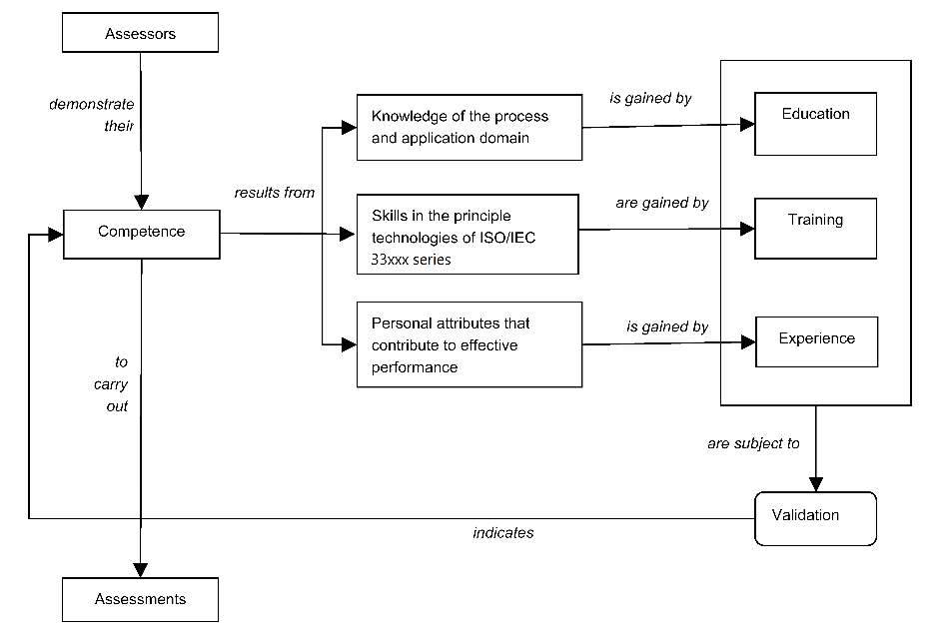
TN3 Part 1 – Assessment actors and roles
      The responsibilities of the actors in an S4S assessment are described:
        Assessment sponsor (AS)
        Local assessment coordinator (LAC)
        Lead assessor
        Assessment team leader (ATL)
        Other assessors in the Assessment Team (AT).
        Technical specialists (AT)
        Observers
        Assessment participants (AP)
        Organizational unit (OU)
Figure 7 Demonstration and validation of assessor’s competency [ISO/IEC 330xx series]

Slide 17
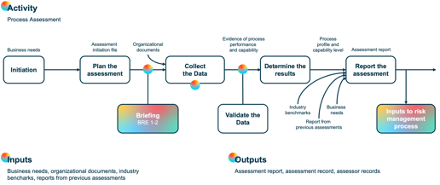


TN3 Part 1 – Process improvement process activities
Inputs
Organization’s needs
Main Outputs
Improvement plans
Process performance reports
Perform an assessment
Management of the project improvement programme
Objectives for
process improvement
Improvement programme plan
List of risks
(IPM), IPL
Organization’s needs
Examine organization´s needs and business goals
Initiate process improvement
Prepare for and conduct a process assessment
Analyse assessment output and derive action plan(s)
(TM), IPM
Improvement project plans
Assessment report with weaknesses and strength as input to define the improvement plan
Assessment report
Sustain
performance
Sustain improvements
Confirm improvements
Implement improvements
(IPM), OU
(TM), OU
(IPM), IPL, SPIG, OU, AT
(SIPG)

Slide 18
TN3 Part 1 – Proposed target profiles
Process ID | Process Title | Capability Level
 |  | A | B | C | D
MAN.1 | Project planning | 3 | 3 | 2 | 2
MAN.2 | Project assessment and control | 3 | 3 | 2 | 2
MAN.5 | Configuration Management | 3 | 3 | 2 | 2
MAN.8 | Quality assurance | 3 | 3 | 2 | 2
MAN.9* | Safety and dependability assurance | 3 | 3 | 0 | 0
MAN.10* | Independent software verification and validation | 3 | 3 | 0 | 0
TEC.3 | System/Software requirements definition | 3 | 3 | 2 | 2
TEC.4 | Architecture definition | 3 | 3 | 2 | 2
TEC.5 | Design definition | 3 | 3 | 2 | 2
TEC.7 | Implementation | 3 | 3 | 2 | 2
TEC.8 | Integration | 3 | 3 | 2 | 2
TEC.11 | Validation | 3 | 3 | 2 | 2
SEC.1 | Cybersecurity requirements elicitation | 3 | 3 | 2 | 2
SEC.2 | Cybersecurity implementation | 3 | 3 | 2 | 2
SEC.3 | Risk treatment verification | 3 | 3 | 2 | 2
SEC.4 | Risk treatment validation | 3 | 3 | 2 | 2
(*)To be in scope as applicable

Slide 19
TN3 Part 2 – Introduction
This part 2 of the handbook incorporates cybersecurity-related processes into the scope of the ECSS-Q-HB-80-02A assessments. It defines additional indicators specific for these cybersecurity processes. As a result:
The Process Reference Model (PRM) in chapter 4 contains new cybersecurity related processes.
The Process Assessment Model (PAM) in chapter 5 includes process descriptions and process attribute indicators for the new cyber security processes.
This task has been carried out having as reference the cybersecurity adaptations of the Automotive SPICE processes being a common framework for the assessment of suppliers in the Automotive Industry. It defines a PAM used to perform conformant assessments of the software process capability of automotive suppliers in accordance with the requirements of ISO/IEC 33002. It has its own PRM, which was developed based on ISO/IEC 12207 and now adding cybersecurity processes based on different regulations and standards such as: ISO UN ECE 155, ISO 21343).
These resulting additional processes have been evaluated and adapted to the space industry context, forming the new PRM and PAM presented in this document. It also incorporates some processes related to aspects or phases of the life cycle of space projects, which are missing or not so much emphatised in the automotive industry.

Slide 20
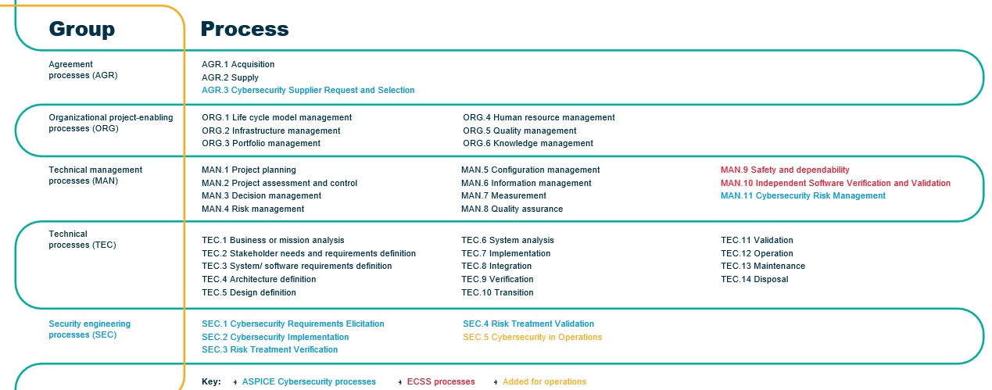
TN3 Part 2 – PRM

Slide 21
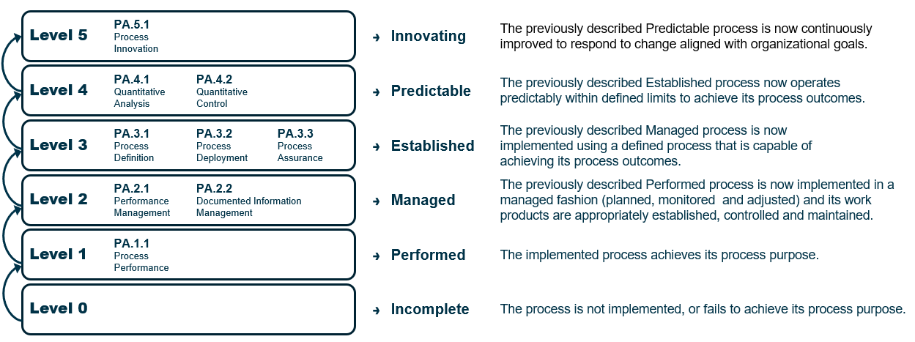
TN3 Part 2 – Measurement framework (as in the latest ISO/IEC 33020:2019)

Slide 22
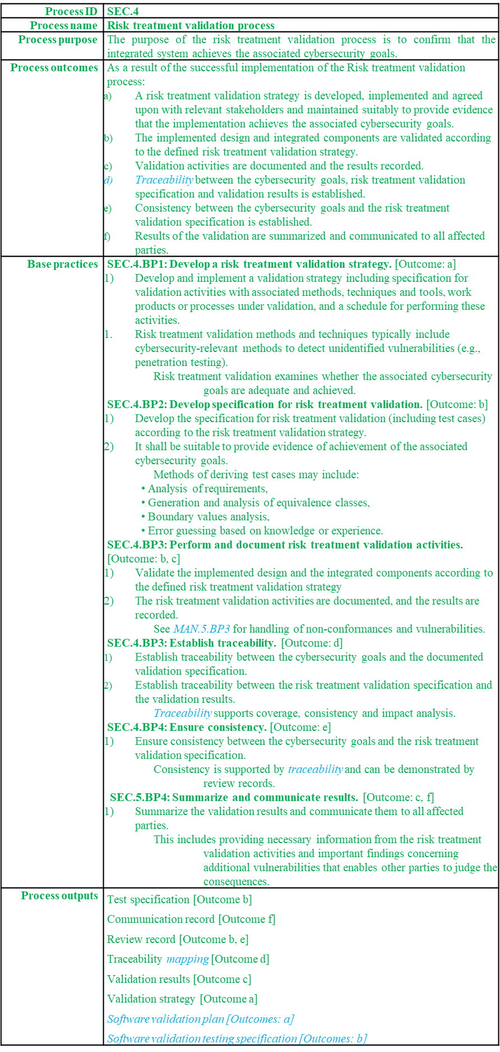
TN3 Part 2 – PAM – sample added process – SEC.4 - and its indicators for capability level 1
Components of the process definitions and PAM elements taken from ISO/IEC 33061 are shown in normal text, and ECSS‐Q‐HB‐80‐02 specific are shown in italics. The formatting of the PRM and all the model elements follow the same protocol: Cybersecurity-related additions original from Automotive SPICE are shown in colour green and further additions specific for space are shown in blue with italics.

Slide 23
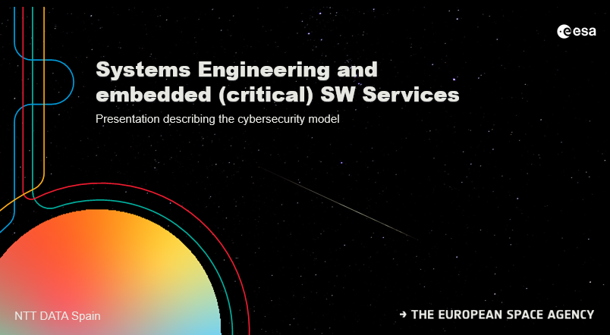
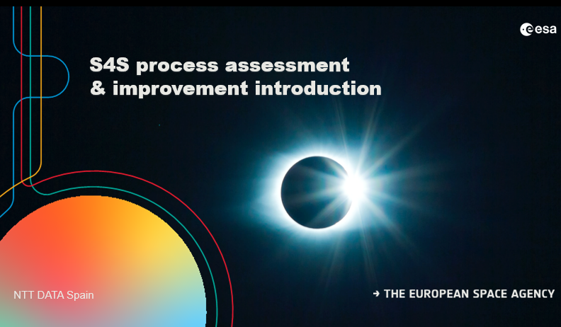
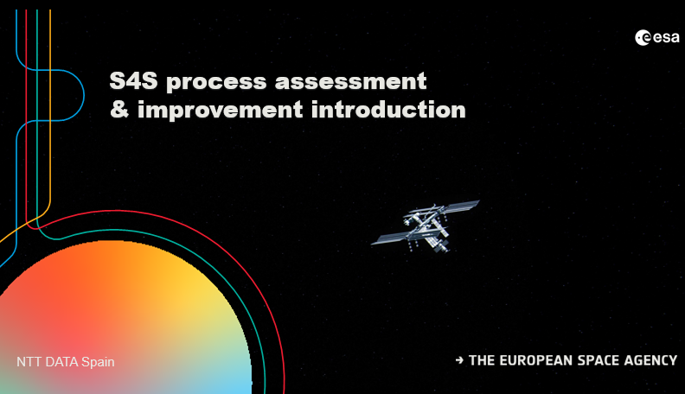
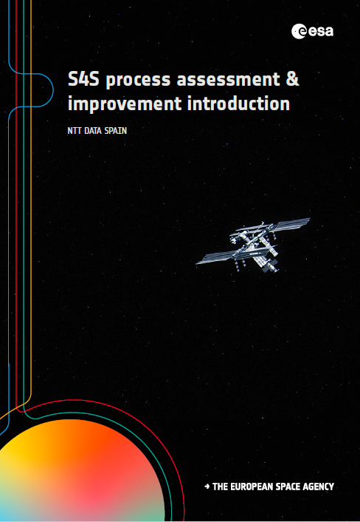
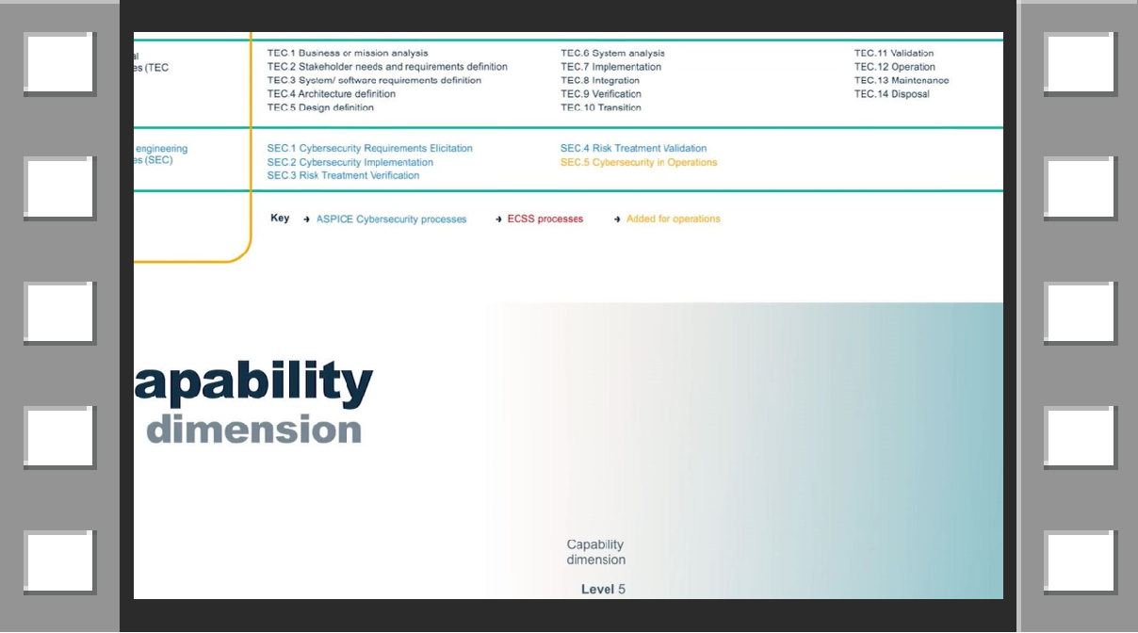
TN4 – Training materials
This task consisted in the development of the following training materials for the models produced: Three sets of PowerPoint slides One brochure One video
PPT 1: Introduction of the models
PPT 2: Training slides for assessors
PPT 3: Training slides for organizations
Brochure
Video

Slide 24
Thank you!

