Slide 1
Traleo – final presentation
TRALEO team
17-Dec-2020

Slide 2


Agenda
Project background, scope, objectives
Work performed
Main results
…..

Slide 3
background
In recent years there has been a proliferation of ideas about using larger satellites constellations based on smaller and cheaper satellites in Low Earth Orbit (LEO) to provide innovative services for communication, e.g. IoT, Earth Observation, AIS and ADS-B data collection respectively from Maritime users and Airplanes
The demand for providing high throughput broadband secure communication and 5G space enabling services through cost-efficient and robust constellation of LEO satellites has significantly increased due to the fact that a LEO satellite approach to broadband communication will reduce the network latency due to signal time of travel in space with ~85% resulting in a much better user response to demand e.g. for browsing

Slide 4
Vision and objectives
Vision: increase cyber security and resilience of LEO constellations defining a “security-by-design” approach
Objectives:
    Perform a vulnerability analysis on the GOMX-4 emulation on one of the possible communication links:
      User link, i.e. the link between satellite and user terminals
      Feeder link, i.e. the link between data transmission gateway and satellite
      TT&C link, i.e. the link between telemetry transmission ground segment and satellite
      ISL communication, i.e. the inter connection link between satellites
    Execute jamming and spoofing attacks on one of selected link;
    Identify the necessary environment, algorithms and tests to be carried out in the RF environment at a later stage in order to execute spoofing and jamming attacks at RF level, including “hardware-in-the-loop”

Slide 5
Work Scope
Use case: GOMX4 will be used as a tangible use case for the study
Analyse the current emulation of GOMX-4 implemented in the RHEA Cyber range
Perform risk assessment, vulnerability analysis and cyber-attacks implementation
Prepare for the follow-up analysis with “hardware-in-the-loop”

Slide 6
Work Scope
Emulation and test environment
Test environment: RHEA Cyber range that will host emulated GOMX-4 constellation using the emulated Virtual Satellites (VS) and Virtual Ground Stations (VGS)

Slide 7
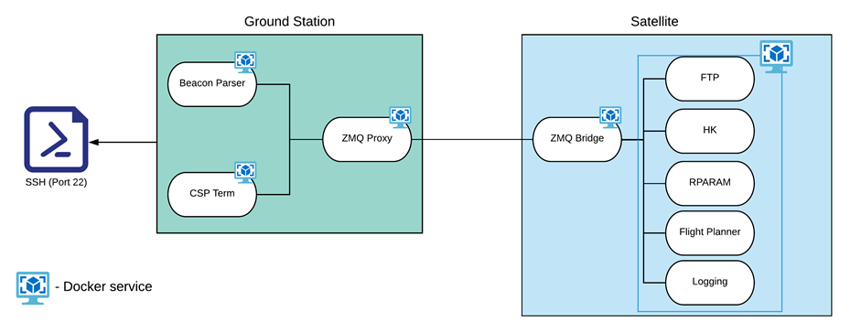
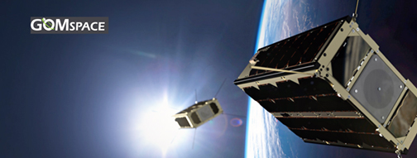
GOMX4 emulation

Slide 8
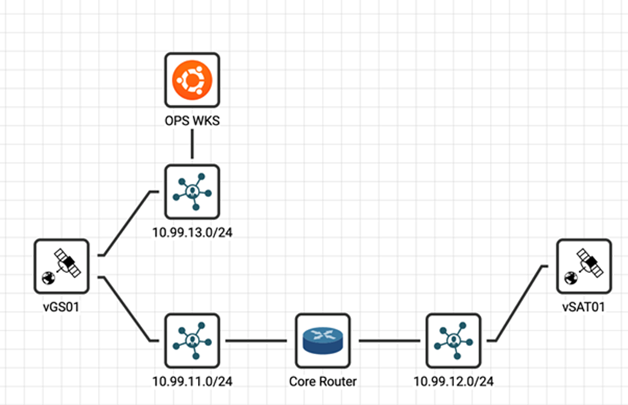
Cyber range implementation of GOMX-4B
CITEF representation of the instantiated virtual systems
vGS01 IPADDRESS = 10.99.11.10 and 10.99.13.11
vSAT01 IPADDRESS = 10.99.12.10
OPS WKS IPADDRESS = 10.99.13.10

Slide 9
Tools and Techniques
Test environment
RHEA CITEF (Cyber-security Integration, Test and Evaluation Framework):
  Virtual environment, supporting secure system and software experimentation, research, development, test and training
  Developed in the frame of Artes C&G, ESA contract number: 4000121180/17/UK/ND.

Slide 10
Tools and Techniques
Test environment

Slide 11
Work Packages: General Structure

Slide 12
Deliverables
Deliverable | Output from Work Package(s)
TN2.1: Requirements definition for platform architecture and cyber range emulation implementation. TN2.2: Nominal operations of emulated GOMX-4 system - Test plan and report | WP2.0
TN3.1: TRALEO Security test plan | WP3.0
TN3.1: TRALEO Security test plan and report. TN4.1 TRALEO Threat Risk Assessment report TN4.2 TRALEO Risk mitigation plan TN4.3 TRALEO Final report and presentation | WP4.0

Slide 13
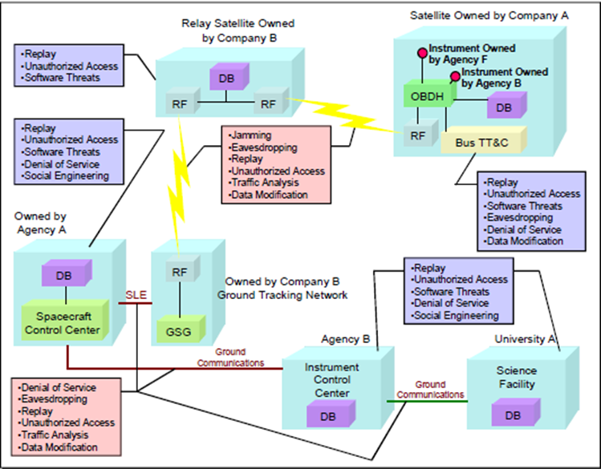
Cyber attacks test results
Attacks summary
ID | Description of test cases | Threat | Risk | Resource Cost | Time Cost
 | Planned
1 | Denial of Service due to traffic flood | High | High | Medium | Low
2 | Denial of Service due to session hangup / exhaust | High | High | Medium | Medium
3 | Session sniffing / eavesdropping | Low-Medium | Low-Medium | Low | Low
4 | Replay attack | Medium | Medium | Medium | Low
Threat = Capability x Intent | Risk = Probability x Harm
Based on selected threats from CCSDS 350-G.2

Slide 14

Security test cases
Test Description
STC#1: Denial of Service due to traffic flood
  Goal: to block any legitimate incoming connections to the satellite
  The attacker initiates a large number of connections with the vSAT01, and keeps generating more, until the vSAT01 starts rejecting them
  STC#2: Denial of Service due to session hangup/exhaust
  Goal: to block any legitimate incoming connections to the satellite
  The attacker initiates a large number of connections with the vSAT01, and keeps generating more, until the vSAT01 starts rejecting them
  The established ones are kept open as long as possible, by sending large blocks of random data with a very small frame window, near the limit of the packet timeout limit

Slide 15
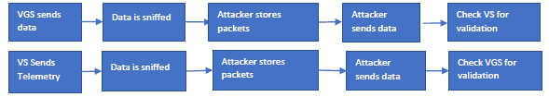
Security test cases
Test Description
STC#3: Session sniffing / eavesdropping
  Goal: to obtain valuable information regarding the satellite and the ground station
  The attacker will monitor, intercept and analyse the traffic between the vSAT01 and vGS01
  STC#4: Replay attack
  Goal: successfully send previously sent data to the satellite and/or the ground station (commands or telemetry data)
  The attacker retransmits intercepted frames to the VS and VGS

Slide 16
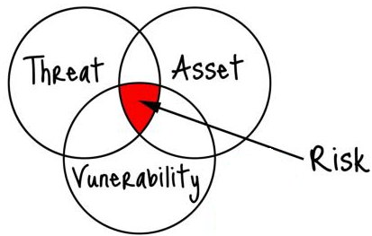
Vulnerability, Threats and Risk Assessment
Methodology
Organizational/procedural
By Design
Technological/implementation
“As-designed” risk assessment
                Based on MEHARI/SEST
“As-built” risk assessment
Based on literature review

Slide 17
Vulnerability, Threats and Risk Assessment
Methodology – As designed
MEHARI – based on ISO27005
Implemented in SEST (ESA tool)
Business process analysis
Business malfunctions
Assets identification and classifications
Threats & Vulnerabilities identification
Risk scenarios identification
Safeguard selection for risk treatment
Security requirements elicitation

Slide 18
Vulnerability, Threats and Risk Assessment
System modelling
Main components
Main information assets:
  Telemetry
  Telecommands
  User data
GOMX-4B

Slide 19
Vulnerability, Threats and Risk Assessment
“As-designed” threats analysis
Assets Threats | ADCS | EPS unit | HSL antenna | ISL Antenna | OBDH | On-board SDR | Propulsion system | Telecommands | Telemetry | TTC antenna | User data exchanged over HSL | Grand Total
CRITICAL | 11 | 13 | 2 | 2 | 10 | 12 | 14 | 33 | 10 | 2 | 24 | 133
Blocking bug due to a design or programming error (internal development) | 1 | 1 | 1 | 1 | 1 |  | 1 |  |  | 1 |  | 7
Breakdown of computing or telecommunication equipment |  |  |  |  |  |  |  | 2 | 1 |  | 1 | 4
Electromagnetic harnessing (Electromagnetic Eavesdropping/sniffing) |  |  |  |  |  |  |  | 1 |  |  | 1 | 2
Error of operation or execution of a procedure | 5 | 7 |  |  | 4 | 7 | 8 | 5 | 1 |  | 5 | 42
Harnessing of files or data (illegal remote loading or copy: Spoofing/ eavesdropping/ injection) |  |  |  |  |  |  |  | 12 |  |  | 12 | 24
Logical alteration of data or functions | 4 | 4 |  |  | 4 | 4 | 4 | 13 | 8 |  | 5 | 46
Malicious saturation of computer equipment or networks (DoS, including jamming) | 1 | 1 | 1 | 1 | 1 | 1 | 1 |  |  | 1 |  | 8
HIGH | 9 | 9 | 1 | 1 | 9 | 9 | 9 | 7 | 27 | 1 | 2 | 84
Blocking bug in system or packaged software | 1 | 1 | 1 | 1 | 1 | 1 | 1 |  |  | 1 |  | 8
Breakdown of computing or telecommunication equipment |  |  |  |  |  |  |  |  | 1 |  |  | 1
Complete destruction of data (files and backup copies) | 2 | 2 |  |  | 2 | 2 | 2 |  |  |  |  | 10
Deliberate erasure of physical or logical media | 6 | 6 |  |  | 6 | 6 | 6 | 6 | 6 |  | 2 | 44
Electromagnetic harnessing (Electromagnetic Eavesdropping/sniffing) |  |  |  |  |  |  |  |  | 1 |  |  | 1
Error of operation or execution of a procedure |  |  |  |  |  |  |  |  | 1 |  |  | 1
Harnessing of files or data (illegal remote loading or copy: Spoofing/ eavesdropping/ injection) |  |  |  |  |  |  |  |  | 12 |  |  | 12
Logical alteration of data or functions |  |  |  |  |  |  |  |  | 5 |  |  | 5
Replay of transaction |  |  |  |  |  |  |  | 1 | 1 |  |  | 2
Grand Total | 20 | 22 | 3 | 3 | 19 | 21 | 23 | 40 | 37 | 3 | 26 | 217

Slide 20
Vulnerability, Threats and Risk Assessment
“As-built” risk assessment
3 items analyzed for their importance
  OBDH/AOCS: both leverage the same component Nanomind A3200
      a high performance 32-bit RISC architecture
      Advanced Software Framework (ASF) including FreeRTOS
      FTP library
  SDR: NanoDock SDR + NanoMind Z7000 + NanoCom TR-600
      Based on Linux
      FTP library
  The CSP protocol and library
      Lack of support due to loss of expertise
      Limitation in the CSP header length (5 bits)
      Checksum bypass
Known vulnerabilities for all of them

Slide 21
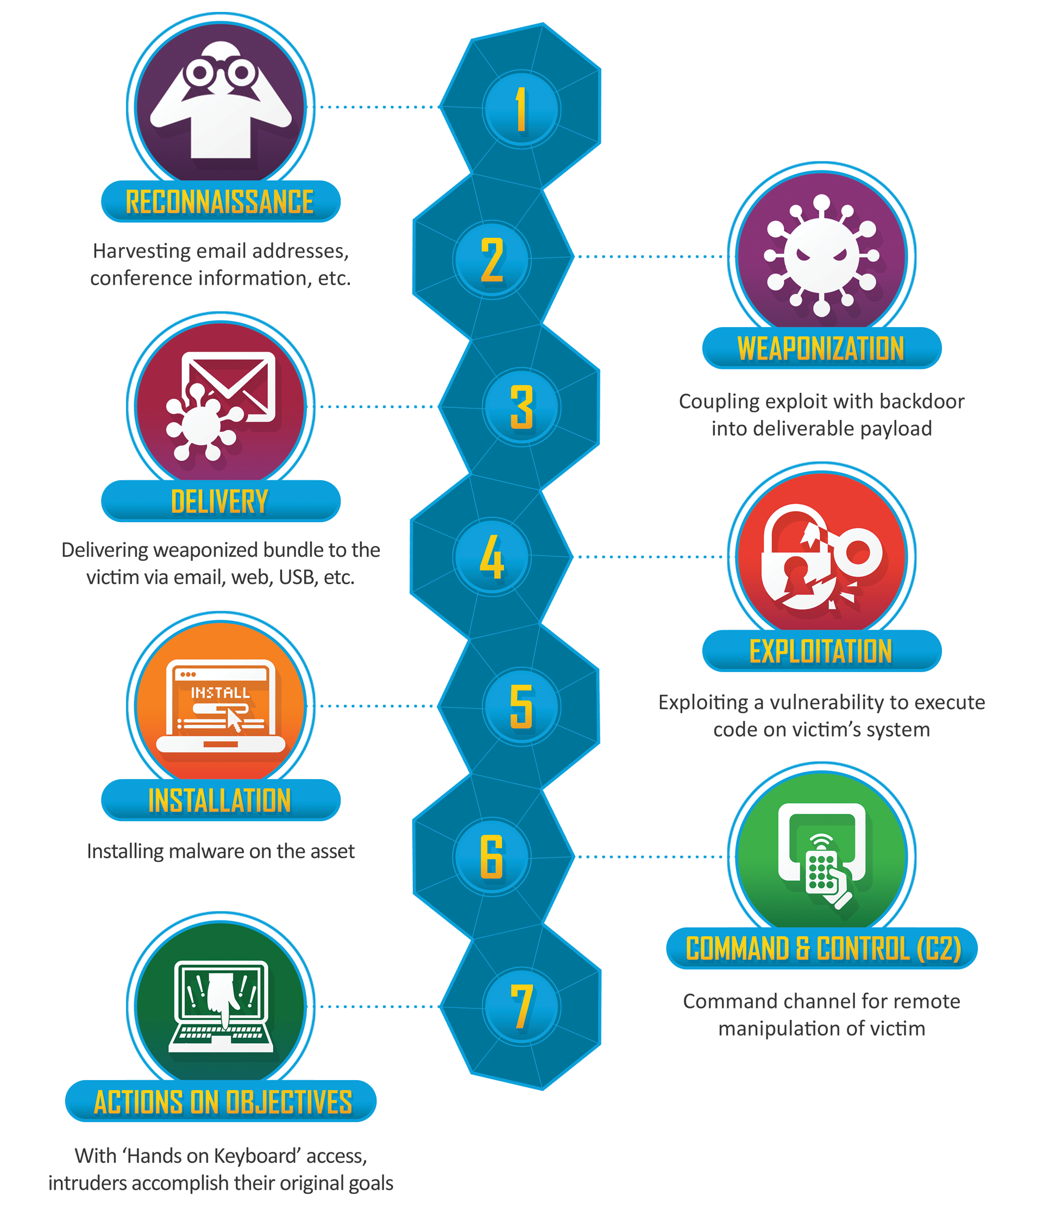
Risk mitigation
Potential measures
Limit and encrypt traffic
Avoid any clear text transmission of information that allows an attacker to gain knowledge about the system.
Avoid delivering information in broadcast without authenticating the receiver
Apply Electronic signature
Perform Emission control (limit interactions)
Control traffic exchange
Improve CSP protocol

Slide 22
Risk mitigation
Potential measures
Perform TTC/user/ISL link authentication and encryption
Protect telecommands with integrity checks (sealing solution)
Control sw/hw upgrade
Allow periodic security patching on-board
Online detection and treatment of IT related abnormal events and incidents
Apply Anti-jamming solutions

Slide 23
Objectives phase 2 activity
Set up the architecture including anechoic chamber using SDR HW/SW elements to emulate the different components of an end to end space communication network between nano sat (GOMX4) and ground; and this in the application Network – up to RF Physical layer for all communication lines.
Deploy the HIL ( Hardware in the loop ) core emulation platform using ESTEC RF lab equipment connected (GUI) with the ESEC RHEA Cyber range and validate with available In Orbit Operation GOMX data
Perform a Threat and Risk Assessment (TRA) using the SDR-driven emulation presuming cyber-attacks in the physical, link and network layers. The analysis will support the enhancement of the protection of future small/nano-satellite missions from a security point of view.
Propose and validate mitigation strategies
Use standard CSP and CCSDC protocols.

Slide 24
Recommendations for next steps
Lab/Network architecture
GS DN + ESTEC LAB
USRP/SDR GOMXA SAT
GS LUX
ESTEC LAB
RHEA- ESA REDU
RF Channel emulator
Cyber Range emulator
In/Out CSP packet generation VM
USRP/SDR GOMX GW
USRP/SDR GOMXB SAT

Slide 25
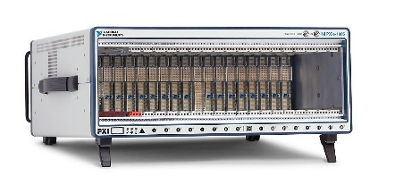
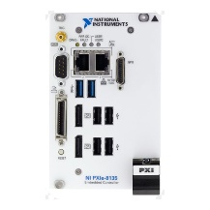
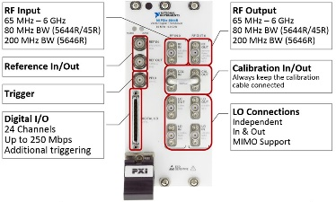
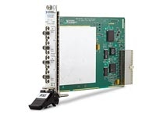
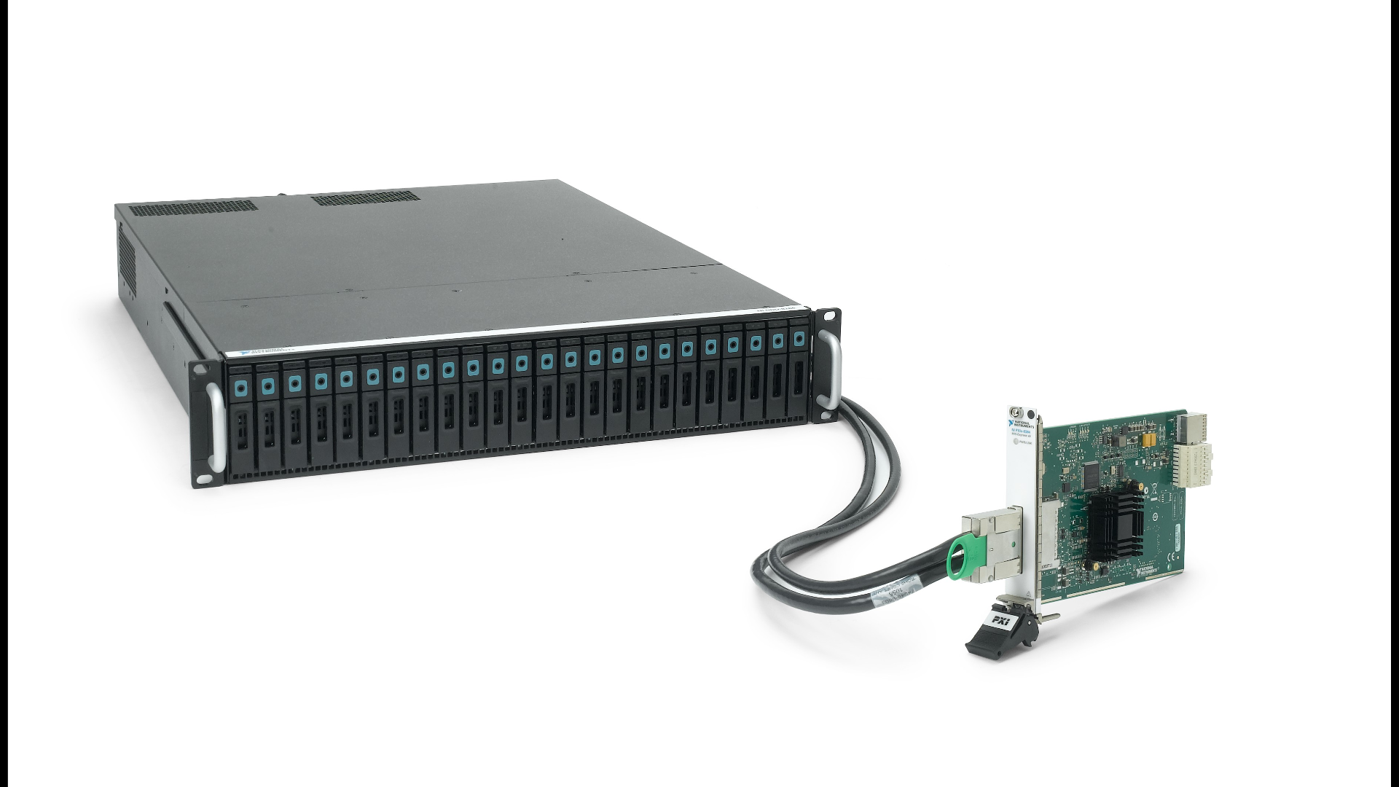
ESTEC facilitates – HW/SW available
1
Item | Device Name | # Id | Qty | Price (k) | Utility
1 | PXIe chassis | PXIe 1085 | 1 | 10.6 | Houses PXI modules and connects them with a high-performance backplane that offers timing and synchronization capabilities.
2 | PC Controller | PXIe 8135 | 1 | 2.2 | Provides a high-performance, compact embedded computer solution for PXI, CompactPCI, and PXI Express systems.
3 | Vector Signal Transceiver | PXIe VST 5645R | 1 | 61 | Combines a vector signal generator and vector signal analyzer with FPGA-based, real-time signal processing and control. (RF vs I/Q path)
4 | RF attenuator | NI PXI-5695 | 2 | N/A | Variable attenuator range 0 to 31.5 dB. Atten resol 0,5 dB.
5 | Data storage | NI HDD 8266 | 1 | N/A | The HDD‑8266 supports sustained reading and writing to disk data rates for PXI streaming systems.
6 | PXIe Remote Control Module | MXI 8384 | 1 | ~2 | This PXI Remote Control Module + x8 cabled PCI express cable are used as interface between the HDD-8266 and the PXI chassis to maximise the streaming bandwidth.
7 | NI Software | - | - | N/A* | LabVIEW / Automated Test SW Suite / TestStand / …
2
3
4
5 & 6

Slide 26
Recommendations for next steps
Conclusion for follow up
The technical objective of this activity is to gain insight in the overall cyber resilience of a Small-/NanoSat space mission in order to mitigate for cyber threats in existing missions and to enhance resilience in upcoming new Small Sat and NanoSat constellation missions. This will be achieved by taking advantage of recent flight heritage by GOMSpace using an innovative Hardware in the loop concept with SDR elements taking advantage of the ESTEC RF lab instrumentation as well as ESEC RHEA Cyber Range SOC tools.
The lessons learned form this new “ archtitecture approach” shall pave the way for further developments such as those needed for Interference detection, forensics and mitigation.

