Slide 1
SESP@ESTEC - 14/04/2023
From System to Simulation Architecture
Towards MBSE EDS and Simulation Convergence
Hien Thong Pham, Juan Perez Rodriguez, Boris Wyszkowski , Délia Cellarier

Slide 2
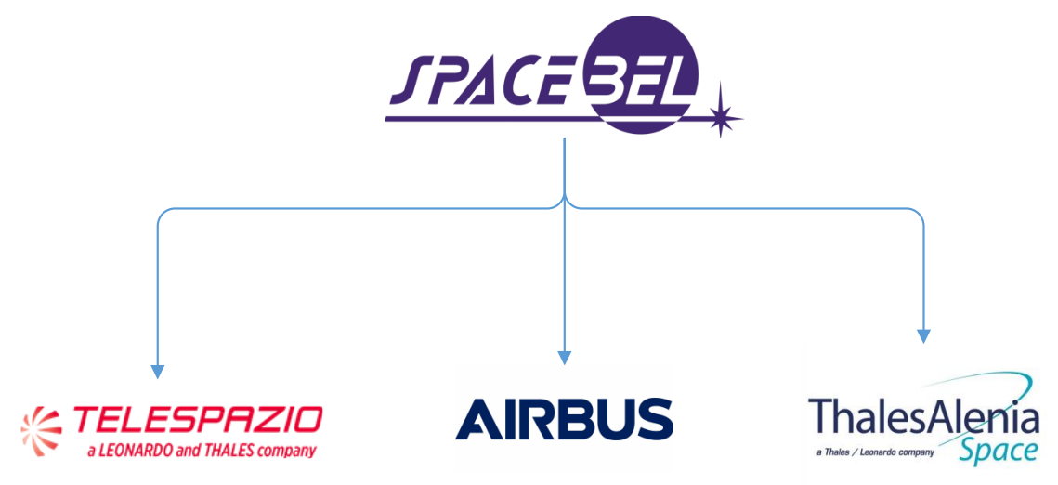
From System to Simulation Architecture (FS2SA)
Study initiated by RATIOSIM WG2
Kicked-off October 2021
Finalizing the PoC and preparing the Final Review…
Understanding FS2SA Objectives And Approach
Identification of Simulation Model and Simulator Needs
Identification of Equipment Unit and System Information
Mapping MBSE and Simulation
Proof-of-Concept
Conclusions
Next Steps

Slide 3
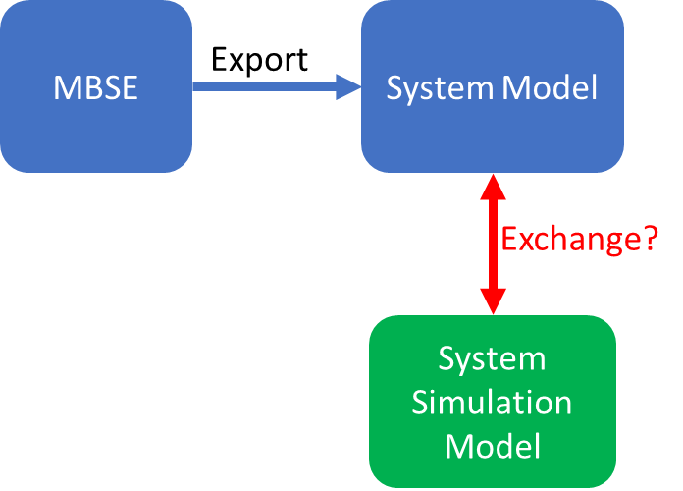
Understanding the FS2SA Objectives
OBJ1 | To improve the automation of the information exchange between the spacecraft subsystems and units and the simulation model development, configuration and validation
OBJ2 | To improve the automation of the information exchange between the spacecraft system and the simulator assembly, scheduling and its mission specific configuration.
OBJ3 | To define how the information identified in the above objectives can be integrated in the simulation architectures typically used in the European space domain.
MBSE
EDS
SSRA
REFA
ISIS
Simulation Model = Spacecraft Equipment Unit Model <-> EDS
Simulator = Spacecraft Simulator <-> MBSE

Slide 4
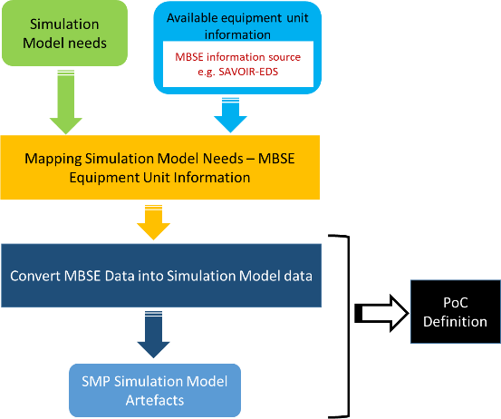
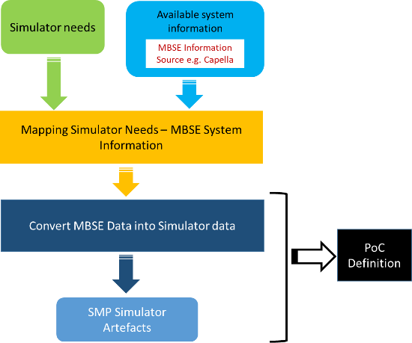
Understanding the FS2SA APPROACH
Data Overlap
(System Interfaces)
Simulation Model
Simulator
Analysis
PoC

Slide 5
SIMULATION NEEDS
Sources:
Virtual System Model from ECSS-E-TM-10-21 for various kinds of simulator
Simulation experience of the study consortium (SPB, TPZG, TAS, ADS)
Spacecraft architecture and design documentation
Equipment unit documentation
Number of equipment unit instances
Equipment unit properties
Equipment unit interfaces (electrical, data), states, modes and behavior
ECSS-E-TM-10-21
Simulator Needs
Simulation Model Needs
Consortium simulation development experience

Slide 6
EQUIPMENT UNIT AND SYSTEM INFORMATION
CAPELLA
System Information
What system and equipment unit information is modelled in CAPELLA?
SAVOIR-EDS
Equipment Unit Information
What equipment unit information is modelled in SAVOIR-EDS?

Slide 7
Mapping MBSE - Simulation
CAPELLA
SSRA
SAVOIR-EDS
Mapping?
SSO MBSE (OSMoSE )
ORM Inside

Slide 8
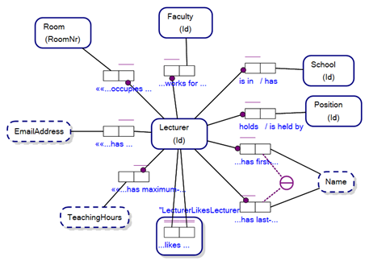
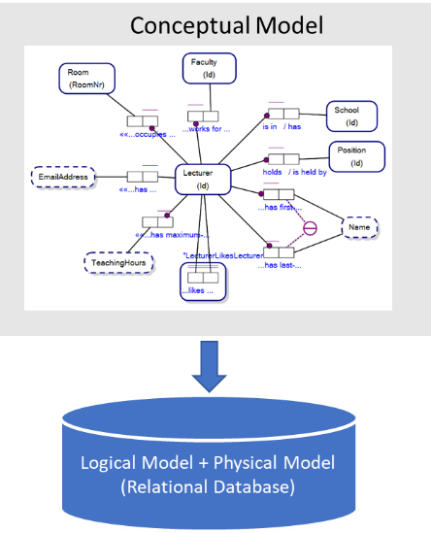
Introduction to Object Role Modelling (ORM)
Entity Types
Value Types
Fact Types: relationships between Entity Types/Value Types
Conceptual Model defines concepts part of the universe of discourse
➔ Logical Model: tables definitions for a relational database
Physical Model: tables are populated with data instantiating the concepts
Source: Wikipedia

Slide 9
Capella | SAVOIR-EDS | SSO MBSE | SSRA
Data Types | EngineeringData | X | ValueType
PhysicalComponent | BehaviouralView/ Equipment | Physical Component | EquipmentModel
ComponentPort PhysicalPort | ElectricalView/ Interface End Bus Signal Type EngineeringData/ NetworkPacket and Component AnalogEngineeringParameter DigitalEngineeringParameter | ComponentPort Physical Port | SystemIFLayerModel
StateMachine | BehaviouralView/ StateMachine Modes and Transitions | StateMachine | OperationalModel
LocalFunction PhysicalFunction | Behavioural View/Functional Behaviour Functional View/External or Internal Signals Functional View/Functional Data Power View/ PowerConsumptionInEquipmentMode Power View/ PowerDissipationInEquipmentMode | Function | CoreFunctionalModel
Actor or LogicalActor | N/A | Actor | PhysicalModel
X | N/A | X | Central Solver
PropertyValue PropertyValueGroup | EngineeringData | X | SimVarDefinition (type VT_PARAMETER)
Mapping results

Slide 10
Capella | SAVOIR-EDS | SSO MBSE | SSRA
ComponentPort ComponentExchange ExchangeItem | See EquipmentModel mapping | ComponentPort ComponentExchange ExchangeItem | SimVarDefinition (types VT_INPUT, VT_OUTPUT)
ComponentPort Interface | See EquipmentModel mapping | ComponentPort ComponentExchange ExchangeItem | Standard Simulation Port TmTcStreamPort
PhysicalPort ComponentPort Extensions ViewPoints | See EquipmentModel mapping | ComponentPort ComponentExchange ExchangeItem | SystemIfPort
FunctionalPort or ComponentPort | See EquipmentModel mapping | ComponentPort ComponentExchange ExchangeItem | PhysicalIfPort DynamicsIfPort PowerIfPort ThermalIfPort MagneticIfPort
FunctionalPort or ComponentPort | See EquipmentModel mapping | ComponentPort ComponentExchange ExchangeItem | ExternalIfPort
X | N/A | X | ODE Port
X | See SystemIFLayerModel mapping | X | Calibration/Conversion
Containment relationship | See EquipmentModel mapping | Containment fact types | Container
X | See Behavioural View | X | Schedulable Function
Error Model | See Functional View | X | LocalFunc FailureCase
REC and RPL feature to instantiate Components | N/A | X | SimulationModelUsage or SimulationModelOccurrence
PhysicalLink | N/A | PhysicalLink | System I/F Network
LogicalSystem PhysicalSystem | N/A | X | BenchDefinition BenchUsage BenchOccurrence
PhysicalLink | N/A | PhysicalLink | System I/F Network
Mapping Results

Slide 11
NON COVERED
Mapping Conclusions
Physical models
Data types
Physical link detailed semantics
Scheduling and dynamics
Instantiation of equipment units and benches
From the Simulation point of view, the SSO MBSE is
Missing the Data Type concept
Missing the Property (configuration parameter of a Simulation Model) concept
Detailed semantics of the Connections between Equipment. (e.g. detailed definition for MilBus 1553, Spacewire… protocols not possible)
Missing the Instantiation concept for Equipment Unit (Simulation Model) as well as for the complete Spacecraft (Bench or Simulator)
From the Simulation point of view, mapping with SSO EDS and CAPELLA is ok
None of the MBSE models supports
Model scheduling aspects
Spacecraft environment & dynamics simulation

Slide 12
Unified Simulation-EDS-MBSE
To define formally the MBSE-Simulation mapping, it is necessary to express all involved models in the same formalism:
Create and integrate the SAVOIR-EDS and SSRA Universes of Discourse in the Space System Ontology
I.e. expressing the resp. metamodel in the ORM formalism
Then, the mapping can be performed within the SSO
SSRA Conceptual Model (UML)
Space System Ontology (ORM)
Simulation
Mapping
MBSE
Model Translation
EDS
Mapping
SAVOIR-EDS Metamodel (UML)
Unsurprisingly, same mapping results

Slide 13
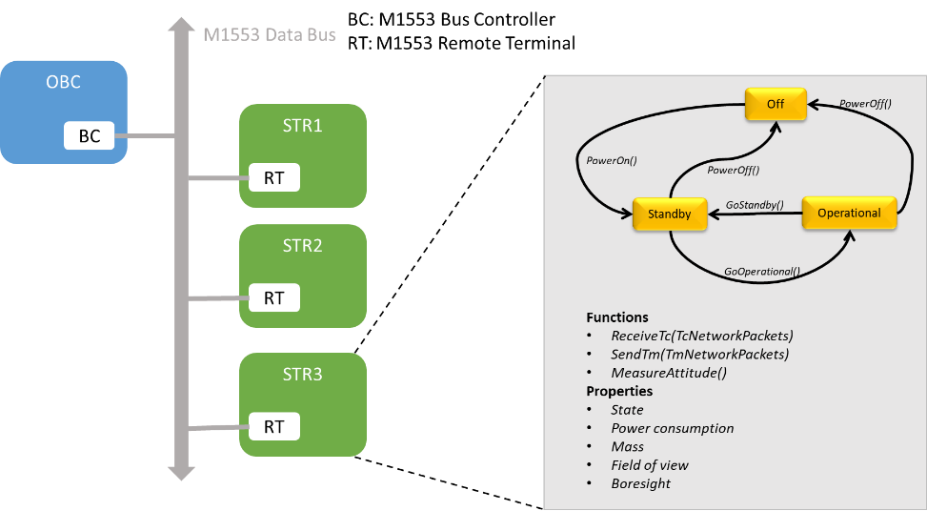
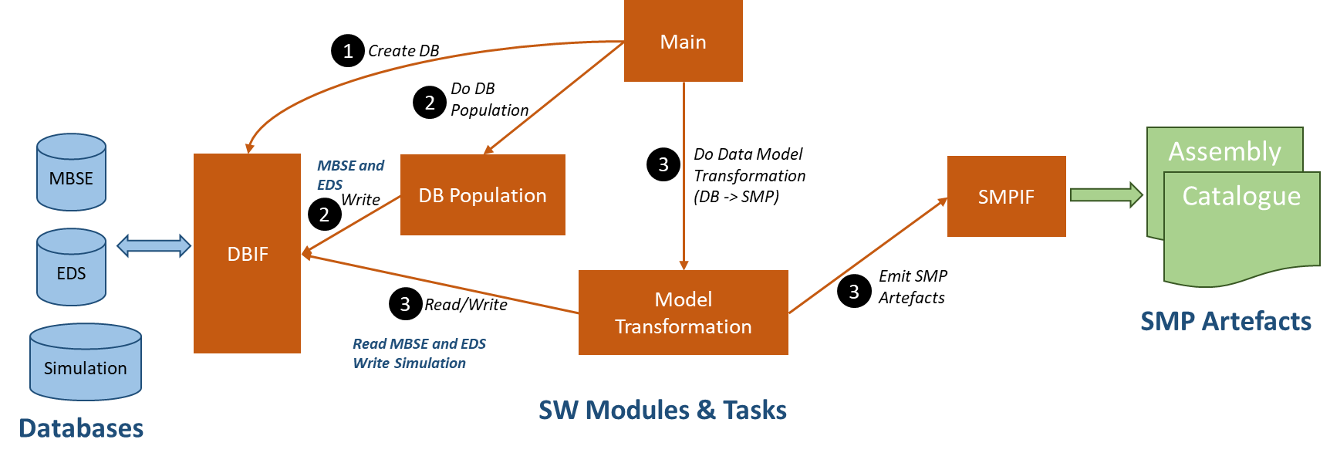
Proof-of-Concept
One small PoC involving the SSO MBSE, SSO Simulation and SSO EDS to illustrate the mapping MBSE-Simulation
NON COVERED?
Non covered data are provided by population of the Simulation tables side only
Software architecture using Python and PostgreSQL DB

Slide 14
Conclusions
Information exchange between Simulation and CAPELLA possible: no major issues or gaps identified
Information exchange between Simulation and the SSO MBE incomplete: gaps identified
Data types
Instantiation
Properties
Physical link semantics
Careful with the terminology/vocabulary used when exchanging information between MBSE and Simulation
SSO MBSE is a conceptual model defining generic concepts independent of MBSE infrastructures/tools
Further analysis or extensions of the SSO MBSE to cover specific discipline aspects (such as Data Handling, Power, Thermal, AOCS…) are necessary to complete the modelling

Slide 15
Next Steps
Issues to address in a follow-up study
Unclear EDS information source in the exchange with Simulation Model
Simulation Model ← (CCSDS EDS + SAVOIR-EDS)?
Simulation Model ← (MBSE model with support for EDS)?
Parallel presence of SSO MBSE and SSO EDS models: strong overlap and duplicated information
Long-term goal should be a seamless and close integration of Simulation in MBSE through a Data Hub
Feedback from this FS2SA study as a first step to develop the MBSE Data Hub

Slide 16
THANK YOU FOR YOUR ATTENTION

