Slide 1


LRNS Final presentation
Esa estec, end of September 2023

Slide 2

tABLE OF CONTENTS
1
CONTEXT & OBJECTIVES
4
OD RESULTS
2
LRNS ODTS System Architecture
5
TS SIMULATOR
3
OD SIMULATOR
6
TS RESULTS
7
SISE ODTS RESULTS & CONCLUSIONS

Slide 3


context and objectives
Context
  ESA Moonlight: dedicated Lunar Radio Navigation System (LRNS).
  Orbit Determination and Time Synchronization (ODTS) concept.
  ODTS tool: clock and ephemeris data required for the NAV MEX.
  Signal-In-Space Error (SISE): evaluation of performances.
Objectives of the paper
  ODTS simulator description.
  SISE assessment:
    Signal-In-Space Error for positioning (SISE_{pos})
    Signal-In-Space Error for velocity (SISE_{vel})
  SISE_{pos} target value of 25 m at 95%.
$${ SISE}_{pos}=\sqrt{{\left(x−\tilde{x}\right)}^{2}+{\left(y−\tilde{y}\right)}^{2}+{\left(z−\tilde{z}\right)}^{2}+{\left(ct−c\tilde{t}\right)}^{2}}$$
$${SISE}_{vel}=\sqrt{{\left(\dot{x}−\tilde{\dot{x}}\right)}^{2}+{\left(\dot{y}−\check{\dot{y}}\right)}^{2}+{\left(\dot{z}−\tilde{\dot{z}}\right)}^{2}+{\left(\dot{c}t−\check{\dot{ct}}\right)}^{2}}$$

Slide 4


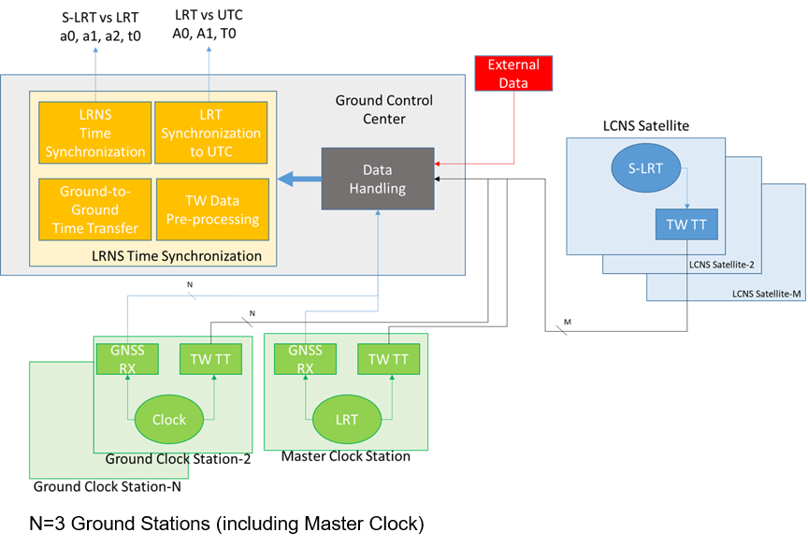
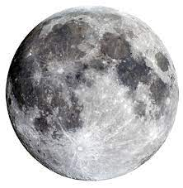
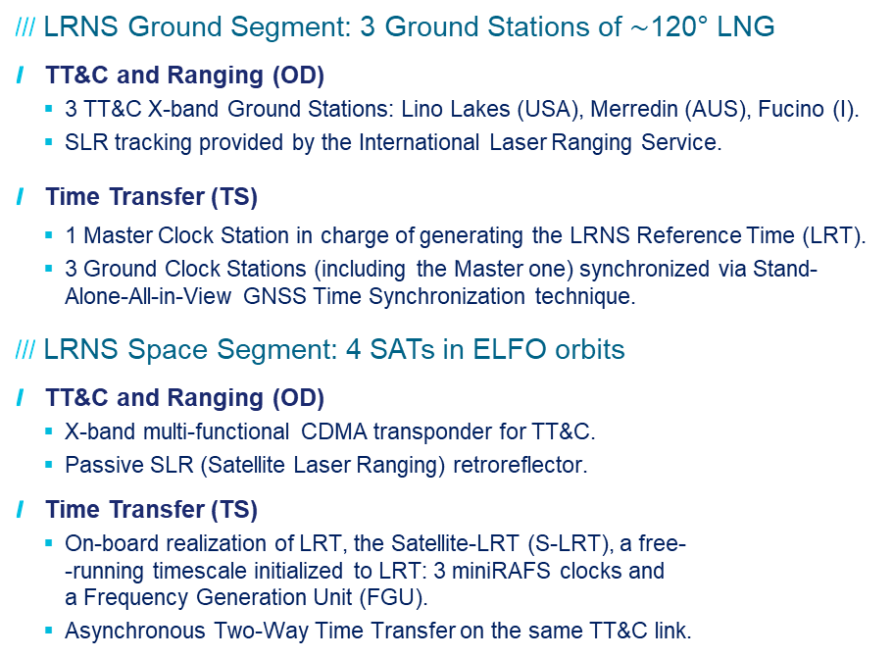
LRNS ODTS SYSTEM ARCHITECTURE
LRNS Ground Segment: 3 Ground Stations of $\sim$120° LNG
  TT&C and Ranging (OD)
    3 TT&C X-band Ground Stations: Lino Lakes (USA), Merredin (AUS), Fucino (I).
    SLR tracking provided by the International Laser Ranging Service.
  Time Transfer (TS)
    1 Master Clock Station in charge of generating the LRNS Reference Time (LRT).
    3 Ground Clock Stations (including the Master one) synchronized via Stand-Alone-All-in-View GNSS Time Synchronization technique.
LRNS Space Segment: 4 SATs in ELFO orbits
  TT&C and Ranging (OD)
    X-band multi-functional CDMA transponder for TT&C.
    Passive SLR (Satellite Laser Ranging) retroreflector.
  Time Transfer (TS)
    On-board realization of LRT, the Satellite-LRT (S-LRT), a free-
    -running timescale initialized to LRT: 3 miniRAFS clocks and
    a Frequency Generation Unit (FGU).
    Asynchronous Two-Way Time Transfer on the same TT&C link.

Slide 5
OD SImulator
OD Error Budget for SISE derivation
  To be noted
    OD SISE influenced by a large number of contributions.
    Numerical integration of the satellites’ equations of motion which suffers from input errors in X₀, V₀ and A(t).
  First approach: SISE derived from assumptions on the outputs of the ODTS process
    Values for the three errors involved in the Newtonian equation of motion (X₀, V₀, A(t)) are provided.
    Monte-Carlo simulations re-assess the assumptions.
  Second approach: SISE derived from Monte-Carlo Analysis
    OD solutions covering the same period by varying input assumptions and simulating truth orbit and tracking data
    Truth orbit and orbit available to the user compared in the three directions (radial, along-track, cross track) separately, and 3D norm for position and velocity.
 | Assumption | Units | Low | Typical | High | MC factor | Accum.
Truth orbits | Solar activity | SFU | - | - | 350 | 1 | 1
 | Arc length | days | - | 4.0 | - | 1 | 1
Data simulation | Lunar reference frame error | masec | 0 | - | 1 | 2 | 2
 | Range noise | m | 0.05 | - | 0.5 | 2 | 4
 | Range-rate noise | mm/s | 0.00 | - | 0.10 | 2 | 8
 | Range bias | m | - | 1.00 | - | 1 | 8
 | Data gaps (nr/max duration) | -/hrs | 0/0 | 5/3 | - | 2 | 16
ODTS configuration | Arc length (overlap) | days | - | 4.0/0.5 | - | 1 | 16
 | Prediction interval |  | - | 0.5 | - | 1 | 16
 | SRP validity (Bernese 9p model) | days | 1 | daily | - | 2 | 32
 | One or both data types | - | - | Range only | both | 2 | 64
 | Observation sample interval | minutes | - | 5 | - | 1 | 64
 | Number of solution arcs | - | - | 10 | - | 10 | 640
Message fit | Typical fit error RMS | m | - | 0.2 | - | 1 | 640

Slide 6
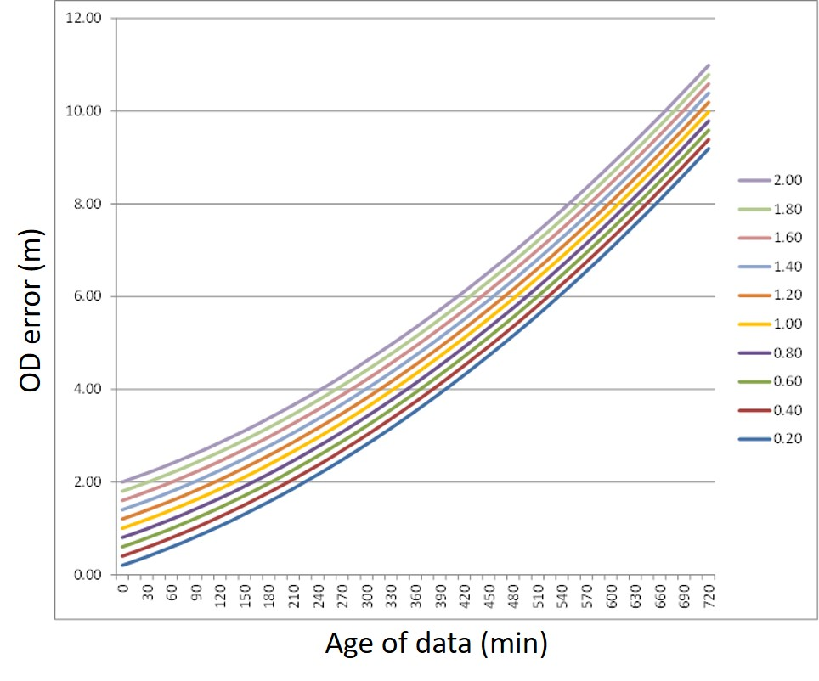
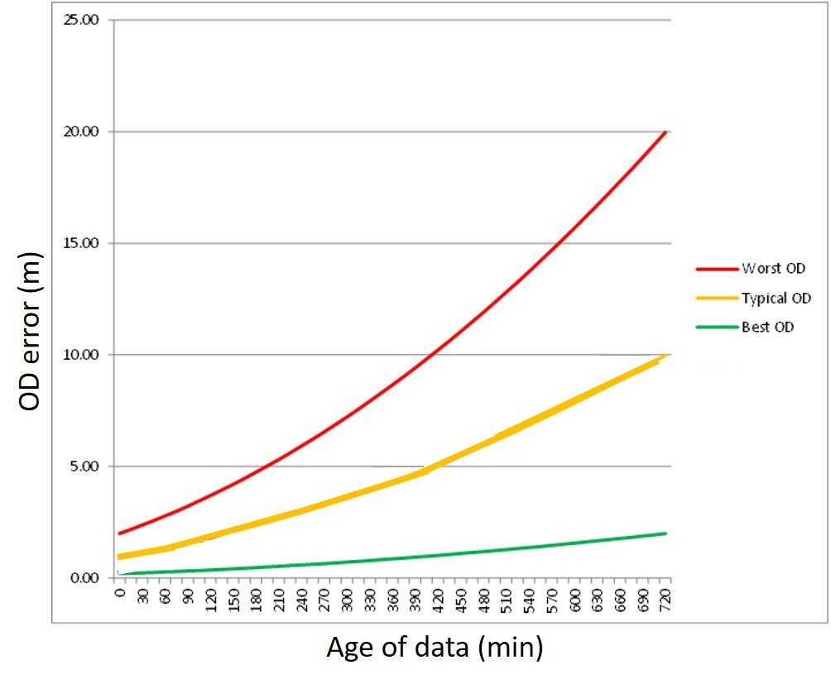
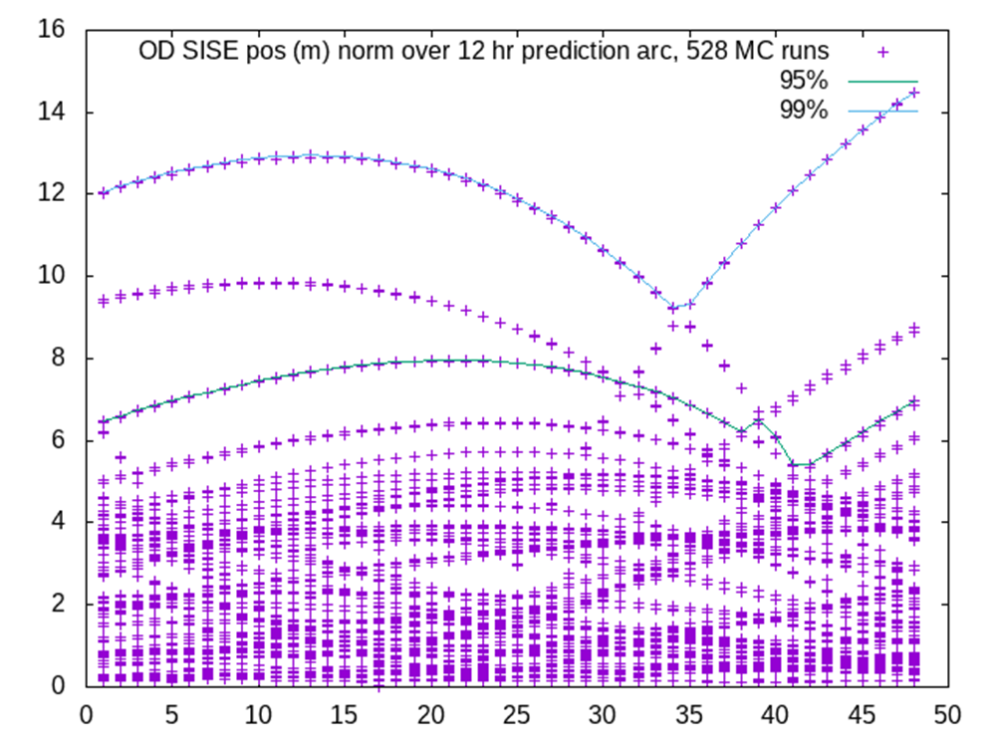
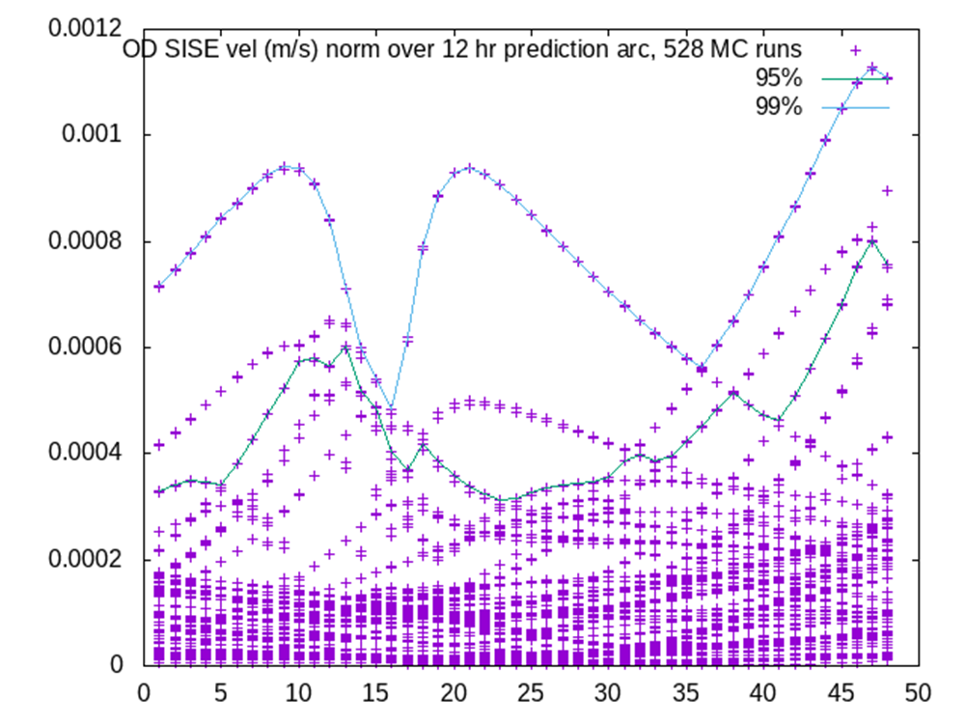
OD results
SISE for the two analysis methods
  First approach
    Figure A: Orbit prediction error shown as function of different position errors X₀.
    Figure B: SISE error as a function of the age of data for the OD process.
    Assuming a normal distribution of errors varying between worst case and best case:
  Second approach
    Figure C: OD SISE for position (m).
    Figure D: OD SISE for velocity (m/s).
    The figures show the point clouds resulting from the Monte-Carlo simulations.
    SISE follows the error envelope imposed by some of the least accurate cases.
Figure A
Figure B
SISE errors (3D position & clock combined)
 | AoD 6 hours | AoD 12 hours
95% error level | 7.6 m | 18.4 m
99% error level | 9.1 m | 22.6 m
Figure C
Figure D

Slide 7
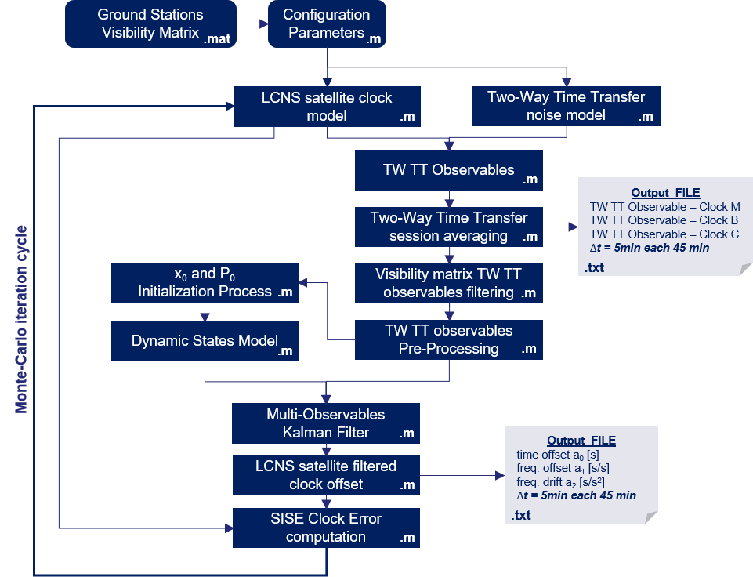
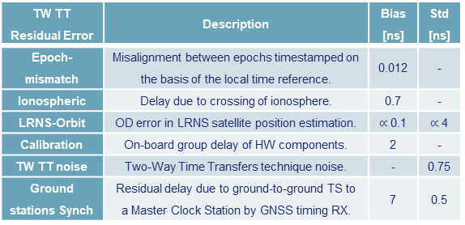
TS SIMULATOR
TS Error Budget for SISE derivation
  Flow logic
    Simulation of LCNS satellite on-board clock offset with respect to LCNS Reference Time (LRT).
    Simulation of the Two-Way Time Transfer noises according to the assessed error budget.
    Simulation of the Two-Way observables.
    Estimation of the LRNS clock offset via Parallel Multi-Kalman Filter.
    SISE clock error computation.
TW TT Residual Error | Description | Bias [ns] | Std [ns]
Epoch-mismatch | Misalignment between epochs timestamped on the basis of the local time reference. | 0.012 | -
Ionospheric | Delay due to crossing of ionosphere. | 0.7 | -
LRNS-Orbit | OD error in LRNS satellite position estimation. | $∝$ 0.1 | $∝$ 4
Calibration | On-board group delay of HW components. | 2 | -
TW TT noise | Two-Way Time Transfers technique noise. | - | 0.75
Ground stations Synch | Residual delay due to ground-to-ground TS to a Master Clock Station by GNSS timing RX. | 7 | 0.5

Slide 8
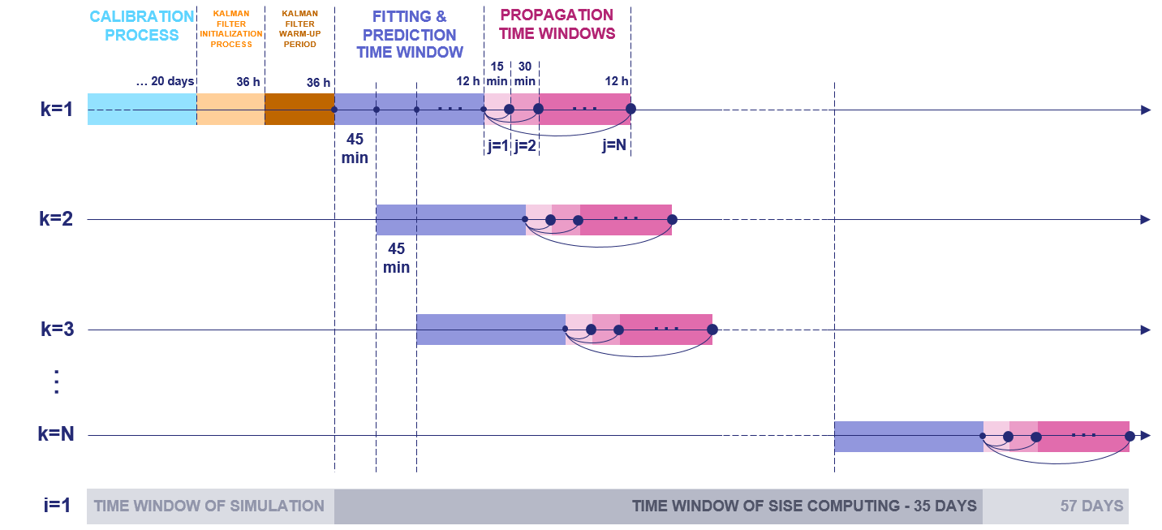
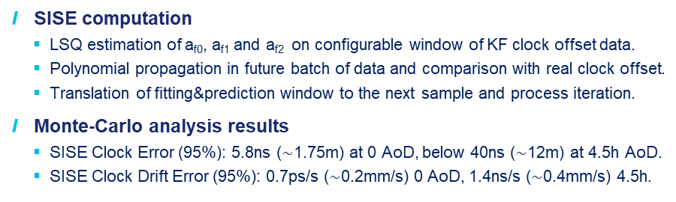
TS RESULTS
  SISE computation
    LSQ estimation of a_{f0}, a_{f1} and a_{f2} on configurable window of KF clock offset data.
    Polynomial propagation in future batch of data and comparison with real clock offset.
    Translation of fitting&prediction window to the next sample and process iteration.
  Monte-Carlo analysis results
    SISE Clock Error (95%): 5.8ns ($\sim$1.75m) at 0 AoD, below 40ns ($\sim$12m) at 4.5h AoD.
    SISE Clock Drift Error (95%): 0.7ps/s ($\sim$0.2mm/s) 0 AoD, 1.4ns/s ($\sim$0.4mm/s) 4.5h.

Slide 9
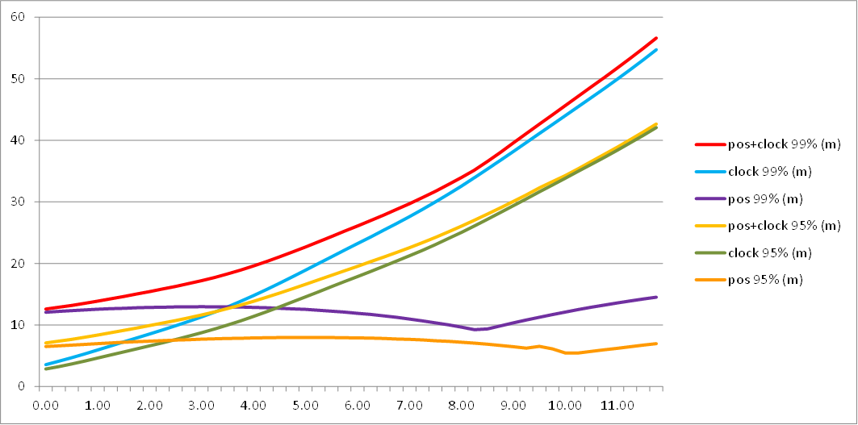
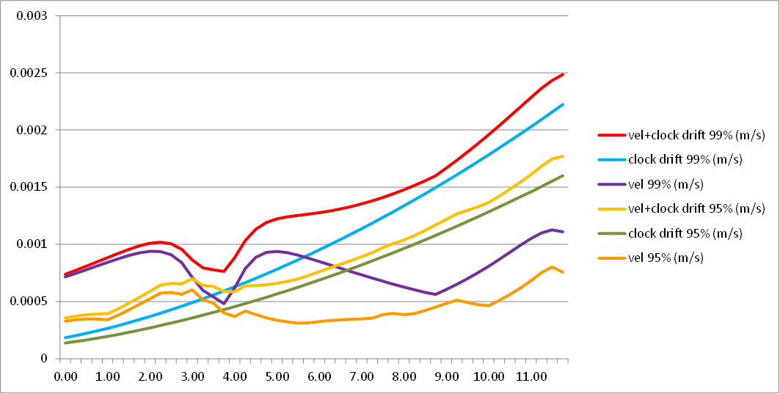
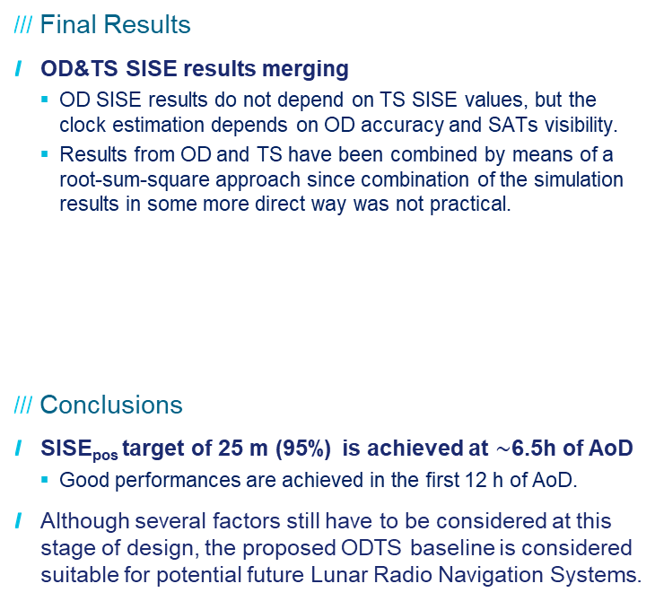
SISE ODTS RESULTS & CONCLUSIONS
Final Results
  OD&TS SISE results merging
    OD SISE results do not depend on TS SISE values, but the clock estimation depends on OD accuracy and SATs visibility.
    Results from OD and TS have been combined by means of a root-sum-square approach since combination of the simulation results in some more direct way was not practical.
Conclusions
  SISE_{pos} target of 25 m (95%) is achieved at $\sim$6.5h of AoD
    Good performances are achieved in the first 12 h of AoD.
  Although several factors still have to be considered at this stage of design, the proposed ODTS baseline is considered suitable for potential future Lunar Radio Navigation Systems.
SISE_{pos} [m]
 |  | OD |  | TS |  | OD & TS combined
AOD | Error level | Position (m) | Vel (mm/s) | Bias (ns) | Drift (s/s) | Pos+Bias (m) | Vel+Drift (mm/s)
6 hrs | 95% | 7.9 | 0.33 | 57 | 2.20E-12 | 18.8 | 0.74
 | 99% | 11.9 | 0.85 | 74 | 3.00E-12 | 25.2 | 1.24
12 hrs | 95% | 7.0 | 0.61 | 140 | 5.30E-12 | 42.6 | 1.70
 | 99% | 14.5 | 1.10 | 182 | 7.40E-12 | 56.5 | 2.48
AoD [h]
SISE_{vel} [m/s]
AoD [h]

Slide 10
To be finalised

Slide 11
THANKS FOR YOUR ATTENTION
Authors:
Cosimo Stallo¹, Carmine Di Lauro¹, Mattia Carosi¹ , Laura De Leo¹, Martina Cappa¹, Daniele Musacchio¹, Daniele Cretoni¹, Henno Boomkamp², Pietro Giordano³, Richard Swinden³, Javier Ventura-Traveset³
¹Thales Alenia Space Italy (TAS-I); Cosimo.Stallo@thalesaleniaspace.com
²Telespazio Germany (TPZ); Henno.Boomkamp@telespazio.de
³European Space Agency (ESA); Pietro.Giordano@esa.int

