Slide 1
Final Review Presentation
Express Procurement Plus - EXPRO+
Microwave heating of ISRU feedstock
MICROwaves heating for sintering of regoLITH - MICROLITH

Slide 2
Table of Content
Topic
Introduction
WP4: additional tests Development of a microwave reflector / shield Boron Nitride Coating Ultrasonic Vibration Tests Test at room pressure: Single Layer Test at room pressure: Multi Layer
WP5: performed activities Roadmap ROM Cost Estimation Time Estimation for Demonstrator Development
Results summary & considerations
Suggested improvements for future developments
Activities conclusion

Slide 3
Introduction
In this meeting, the work carried out by the last Progress Meeting, which concerned additional tests within WP4 and the development of WP5 activities, will be discussed.
Then, the meeting will proceed with a summary of the activities performed during the project, with focus on the relevant outputs, suggesting some possible options for future developments.
Finally, the procedural activities necessary for the conclusion of the contract will be discussed.

Slide 4
WP4: additional tests (1 of 9)
Development of a microwave reflector / shield
ESA design (A)
Reflector made by material extrusion covered in aluminum tape (B)
Network analyzer indicates RL decrease from -8dB to -10dB
Possible impedance stabilization
Uncertainty on the real focus of the MW
No visible improvement in the sintering tests
Figure 1: Microwave reflector: A) ESA’s version, B) Unimore’s version

Slide 5
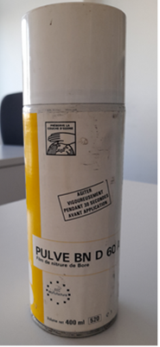
WP4: additional tests (2 of 9)
Boron Nitride Coating
ESA advice of covering the tip with Boron Nitride (BN)
Dip coating from BN-water slurry
Brittle coating detached from the tip
First attempt
Second attempt
Industrial BN spray
No melting until upmost part of the tip lost the coating
Figure 2: BN spray used for the tip coating attempt

Slide 6
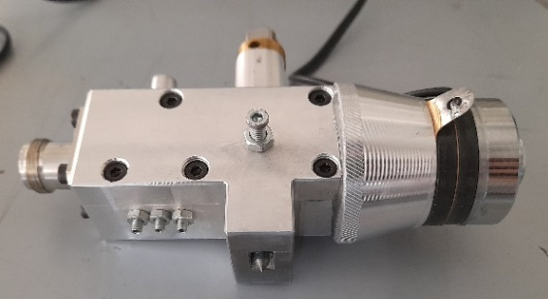
WP4: additional tests (3 of 9)
Ultrasonic Vibration Tests
Characteristics:
Typically used on ultrasonic cleaners
Frequency: 40kHz
Power: 120W
Ultrasonic generator (USG) mounted on the antenna body to promote molten material detach
USG interfered with electronic devices such as CNC system and webcam
Figure 3: Antenna with attached ultrasonic transducer.
Shielding of cables and filtering of the control board
Better behavior but the board got damaged before actual testing
Figure 4: A) mains filter applied to USG board, B) shielding of USG cable

Slide 7
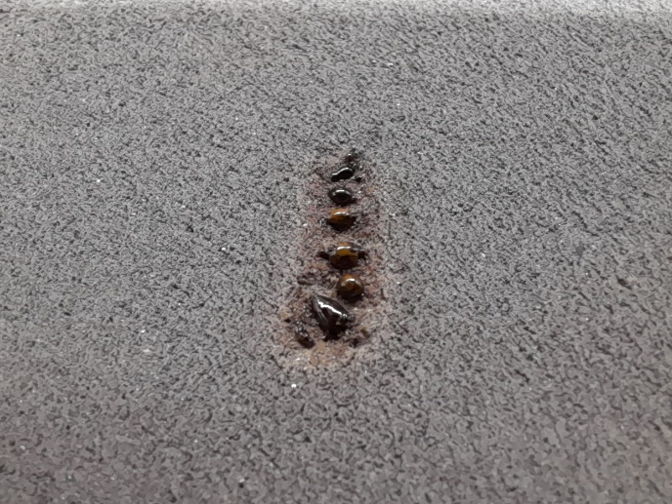
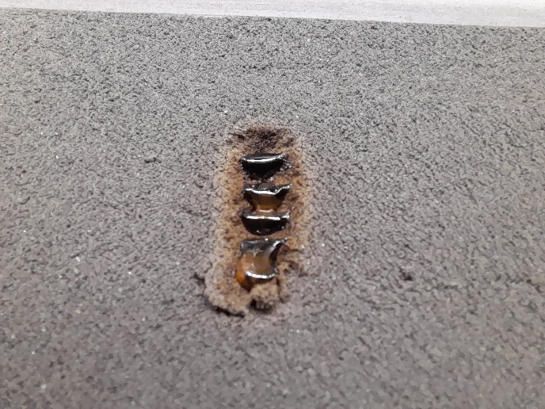
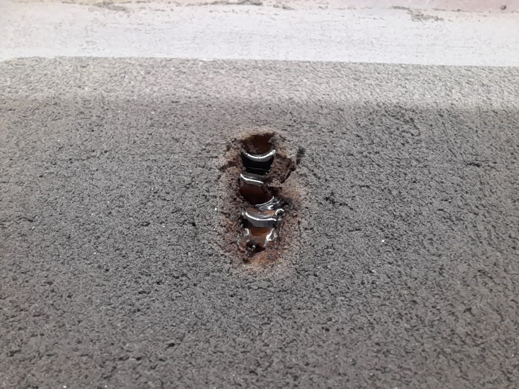
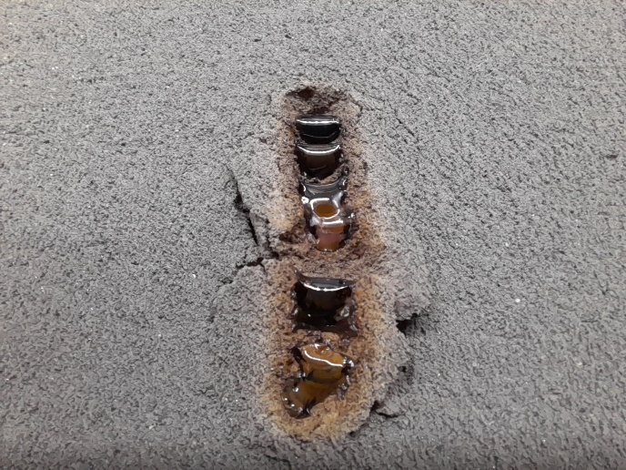
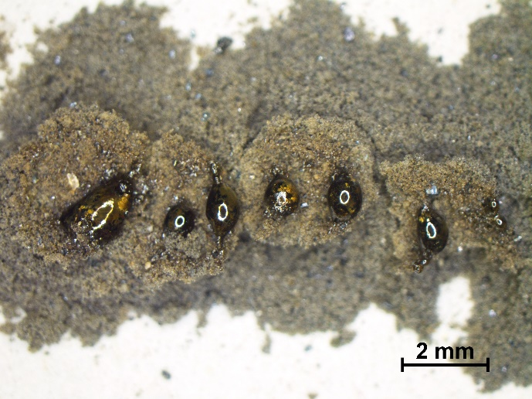
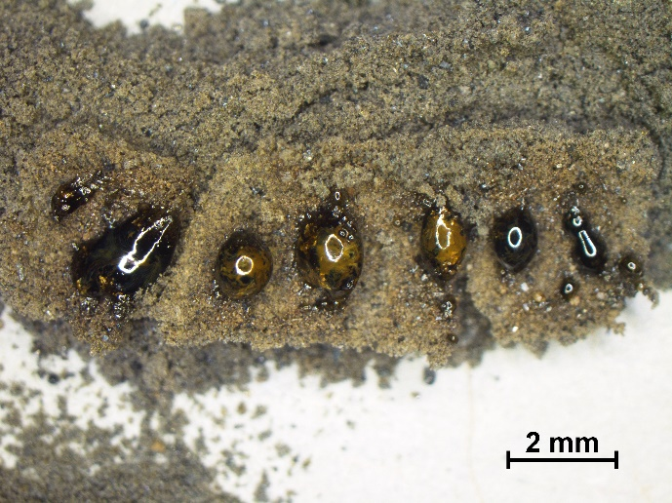
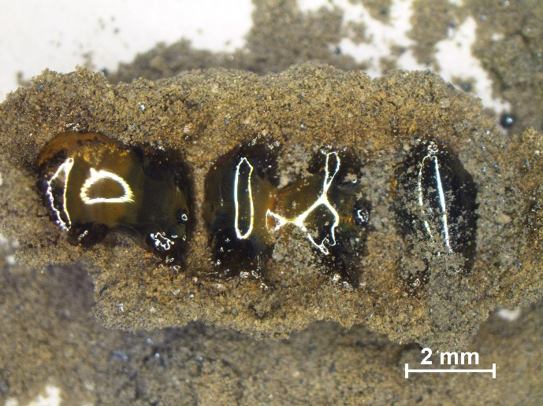
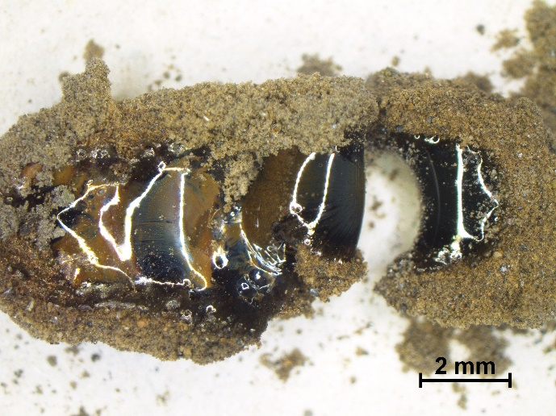
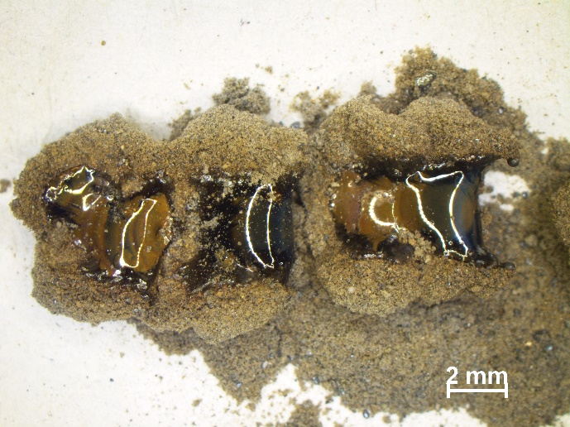
WP4: additional tests (4 of 9)
Test at room pressure: Single stripe
Aim to verify the capability of the process to produce larger samples, once the adhesion problems were resolved.
Tests fixed parameters: MM7 powder, bed-tip distance = 1 mm, forward power = 100W, line length = 10 mm.
A
C
E
G
I
B
D
F
H
J
100 mm/min
50 mm/min
5 mm/min
2.3 mm/min
2.3 mm/min
(20 mm stripe)
Figure 5: Stripes of molten regolith obtained by different scanning speed.

Slide 8
WP4: additional tests (5 of 9)
Test at room pressure: Multiple stripes
Stripe sintering was extended by adopting a more sophisticated tool path.
Tests fixed parameters: MM6 powder, bed-tip distance = 1 mm, forward power = 120W.
First attempt
2 stripes strategy (A) varying scanning speed
Second attempt
Multiple stripes strategy to reach a layer dimension > 10x10mm
Figure 6: Multi-stripes strategies used for the tests, including coordinates.

Slide 9
WP4: additional tests (6 of 9)
Test at room pressure: Multiple stripes
A
B
20 mm/min
10 mm/min
5 mm/min
2.5 mm/min
2.5 mm/min
Figure 7: Results of multi-stripes strategies: A) 2 stripes, B) odd layer strategy.

Slide 10
WP4: additional tests (7 of 9)
Test at room pressure: Multiple layers
After the consolidation of one layer, other layers of powder were deposited and consolidated onto the first one. Two attempts were made:
First attempt
4 layers repeating the 2 stripes strategy
Second attempt
5 layers alternating odd and even strategy to obtain a cube
Tests fixed parameters:
MM6 powder
Bed-tip distance = 1 mm
Forward power = 120W
Scanning speed = 2.5 mm/min
Layer thickness ≈ 0.7 mm.

Slide 11
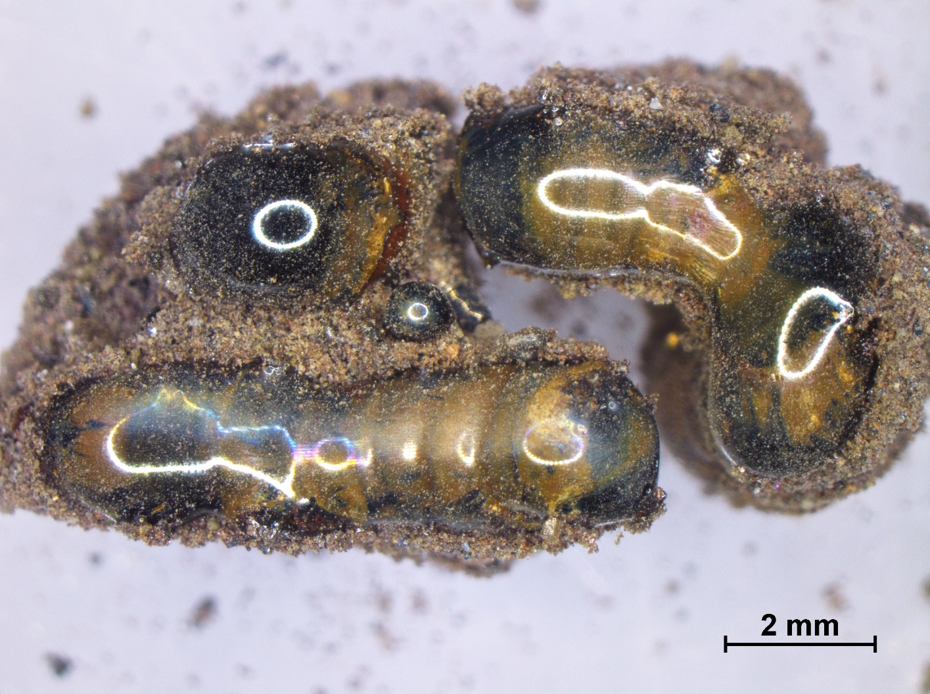
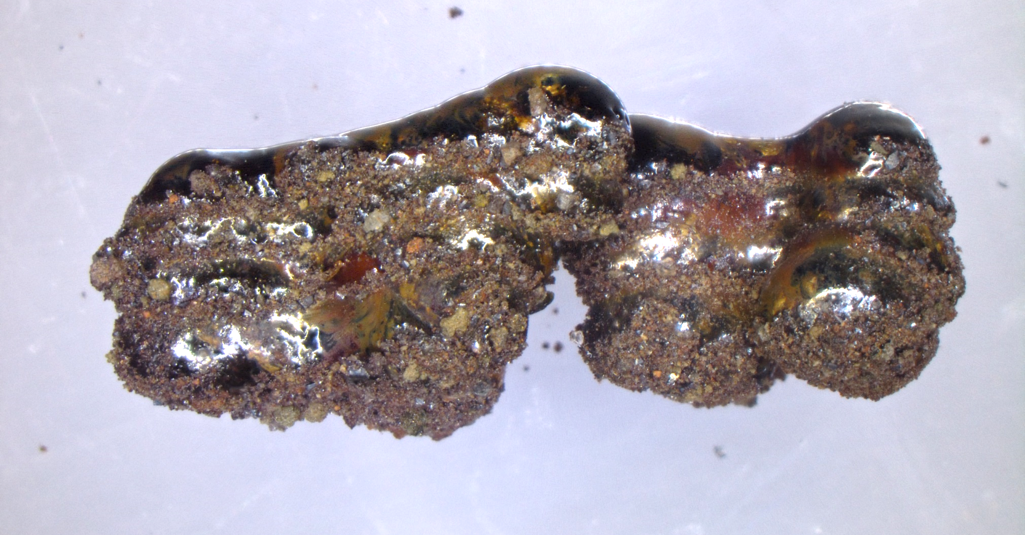
WP4: additional tests (8 of 9)
Test at room pressure: Multiple layers
First attempt
4 layers repeating the 2 stripes strategy
A
B
y
z
x
x
Figure 8: A) Top and B) lateral view of the two-stripe multi-layer sample.

Slide 12
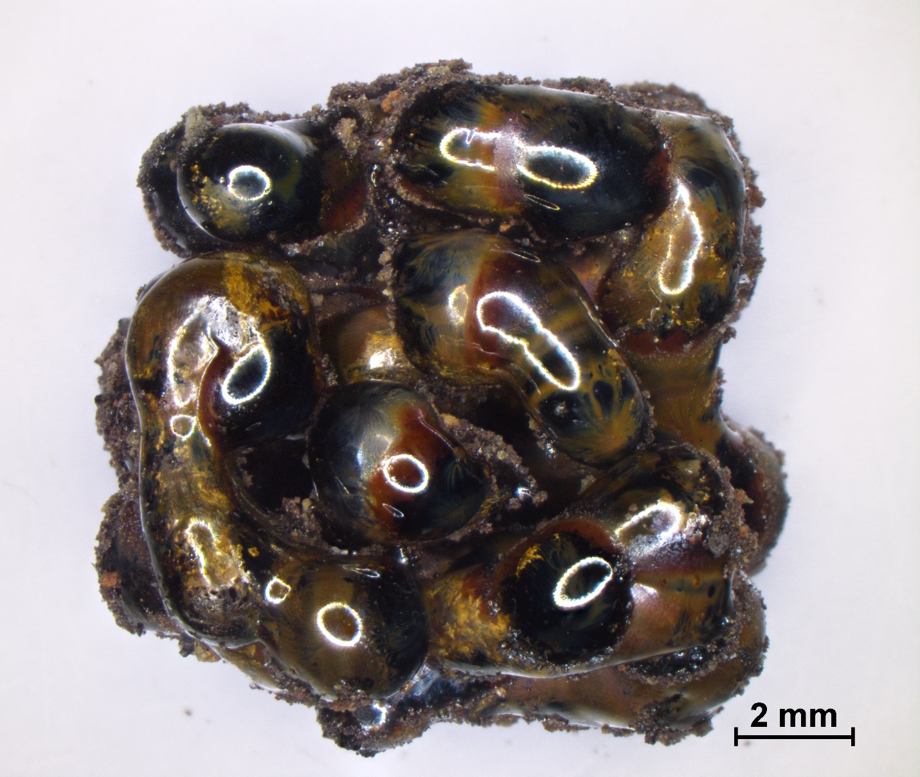
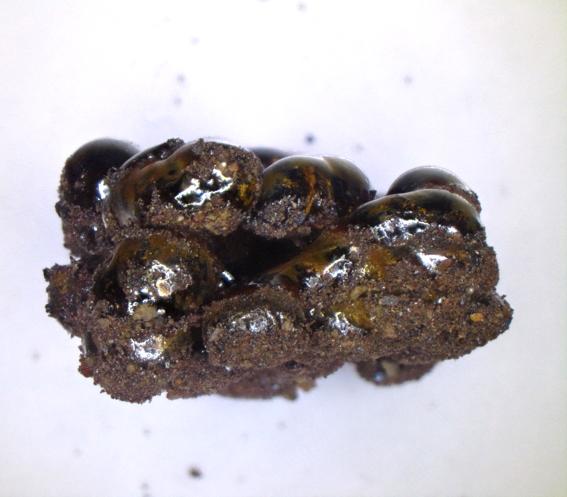
WP4: additional tests (9 of 9)
Test at room pressure: Multiple layers
Second attempt
5 layers alternating odd and even strategy to obtain a cube
A
B
Approximate dimensions:
11 x 11 x 6.5 mm (X, Y, Z)
y
z
x
x
Figure 9: A) Top and B) lateral view of the odd + even strategies multi-layer sample.

Slide 13
WP5: performed activities (1 of 12)
Roadmap
Outline
Considerations related to the lunar regolith simulant
Considerations related to the laboratory demonstrator
Development of the flight model
Lunar missions and future perspectives
Cost and timeline estimation

Slide 14
WP5: performed activities (2 of 12)
Considerations related to the lunar regolith simulant
The microwave sintering process has been effective with all the simulant samples prepared in this project (from MM1 to MM8), using the DNA-1 as reference of lunar regolith simulant.
Samples prepared in the MICROLITH project
Sample | Description | AIM
MM1 | DNA-1 Fraction <250 μm | Represented most of the lunar regolith granulometry. Two different levels of average granulometry
MM2 | DNA-1 Fraction <600 μm
MM3 | MM1 65 wt.% DNA-1V 35 wt.% | Represented most of the lunar regolith granulometry. Two different levels of average granulometry plus an average level of glass/amorphous material
MM4 | MM2 65 wt.% DNA-1 V 35wt.%
MM5 | MM1 88 wt.% Ilmenite 12wt.% | Represented most of the lunar regolith granulometry. Two different levels of average granulometry plus an average level of ilmenite considering the lunar mares
MM6 | MM2 88 wt.% Ilmenite 12wt.%
MM7 | MM1 65 wt.% DNA-1V 35 wt.% Ilmenite 12wt.% | Represented most of the lunar regolith granulometry. Two different levels of average granulometry plus an average level of glass/amorphous material plus an average level of ilmenite considering the lunar mares
MM8 | MM2 65 wt.% DNA-1 V 35wt.% Ilmenite 12wt.%
Relevant characteristics of DNA-1:
Simulant representative of the basaltic Maria regions
Iron oxides content with Fe²⁺ of 2% by weight (microwave susceptor)
Titanium content below 1% by weight
Negligible content of glassy/amorphous phase
Augmented versions of DNA-1:
Addition of the glassy phase and ilmenite (source of Fe²⁺) to DNA-1. They have a beneficial effect on the microwave sintering process.

Slide 15
WP5: performed activities (3 of 12)
Considerations related to the lunar regolith simulant
Several missions have been planned at lunar south pole and in such contest the typical characteristics of the lunar Highlands are an important reference to be considered for ISRU processes.
Relevant characteristics of lunar Highlands simulants:
Iron oxides content with Fe²⁺ of about 5% by weight (microwave susceptor)
Titanium content below 1% by weight
Significant content of glassy/amorphous phase (20% by weight as average)
Chemical characterization of lunar Highlands simulant
Oxide | Apollo 16 Samples Avg. | OB-1 | LHS-1 | MLS-2 | NAO-1 | NU-LHT | OPRH | TUBS-T
SiO2 | 45.00 | 48.40 | 51.20 | 48.3 | 43.83 | 46.6 | 48.00 | 48.71
TiO2 | 0.54 | 0.08 | 0.60 | 0.03 | 0.77 | 0.12 | 0.63 | 0.12
Al2O3 | 27.30 | 31.60 | 26.60 | 32.4 | 25.79 | 21.55 | 25.00 | 30.33
FeO | 5.10 | - | 2.70 | 0.45 | 3.52 | 5.08 | - | 1.05
Fe2O3 | ND | 1.33 | - | - | 2.62 | - | 5.30 | -
MgO | 5.70 | 0.35 | 1.60 | 0.15 | 4.93 | 9.50 | 2.70 | 0.57
MnO | 0.30 | <0.01 | 0.10 | - | 0.09 | 0.09 | 0.08 | 0.02
CaO | 15.70 | 15.40 | 12.80 | 16.00 | 15.12 | 12.6 | 15.00 | 14.57
Na2O | 0.46 | 2.47 | 2.90 | 2.42 | 1.41 | 0.97 | 2.70 | 3.05
K2O | 0.14 | 0.08 | 0.50 | 0.06 | 0.47 | 0.12 | 0.32 | 0.22
P2O5 | 0.11 | <0.01 | 0.10 | - | 0.08 | 0.07 | 0.26 | -
Cr2O3 | 0.33 | - | - | - | - | 0.12 | - | 0.00
LOI | ND | 0.06 | 0.40 | - | 1.10 | 2.74 | 1.00 | 0.99
Total | 100.08 | 99.79 | 99.50 | 100.43 | 99.71 | 99.56 | 100.99 | 99.61
The microwave sintering process is expected to be effective also in the case of lunar Highlands. Some tests using lunar Highland simulants are recommended in the future activities.

Slide 16
WP5: performed activities (4 of 12)
Considerations related to the laboratory demonstrator
The laboratory demonstrator has validated the feasibility of the sintering process to produce solid materials from the use of the DNA-1 lunar regolith simulant.
A functional sintering strategy has been reached in air, showed that a stratification is possible, obtaining samples with a considerable surface and thickness.
The tests performed in vacuum (at 0.01 mbar) have posed some challenges due to the Corona discharge phenomenon (relevant at the operational pressure), ultimately causing sticking problems to the antenna tip.
In the future activities further developments and optimizations of the laboratory demonstator is needed to avoid the powder sticking to the antenna tip. Further tests in higher vacuum chamber are recommended to solve the problems encountered by performing the sintering process and improve the process efficiency in vacuum.

Slide 17
WP5: performed activities (5 of 12)
Development of the flight model
The laboratory demonstrator is un-eligible as a moon demonstrator and some components shall be adapted or replaced
Solid-state microwave generator (LEANGEN-2450M-500-M)
CRITICAL POINT:
POSSIBLE SOLUTION:
Genmitsu 3018 PRO DIY Mini, 3-axes CNC
CRITICAL POINT:
Lack of a system to print 3D parts
Computing system (controller; laptop)
S&A CW-5200, liquid-cooled system
CRITICAL POINT:
CRITICAL POINT:
Need of a different thermal control less bulky and suitable for the lunar environment
Design an ad-hoc generator suitable for vacuum (feasibility study )
Design a pressurized element to accommodate the microwave generator
POSSIBLE SOLUTION:
Design a 3D printer system considering a feeding system, powder reservoir platform/hopper, mechanical roller, movable platforms
Need of a miniaturized computing system
POSSIBLE SOLUTION:
Design of a thermal control, including both active and passive elements (e.g., heaters, thermoelectric devices, MLI, heat sink, etc.)
POSSIBLE SOLUTION:
Use of a Single Board Computer (e.g., Raspberry Pi)
Not suitable for working in vacuum

Slide 18
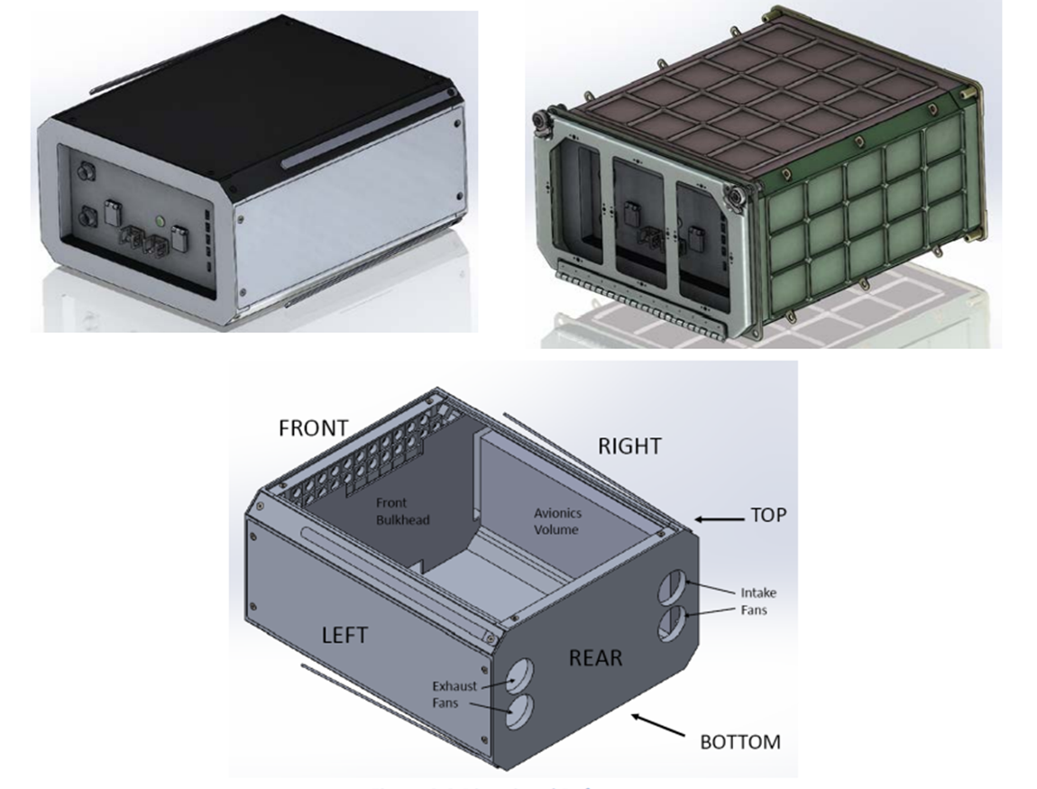
WP5: performed activities (6 of 12)
Development of the flight model: Nanoracks BlackBox to accommodate the Moon demonstrator
Nanoracks BlackBox
BlackBox features for the Moon payload
Case materials more suitable for the Moon environment (e.g., AA 7075)
Design of a proper thermal control considering the Moon environment
Reconsideration of electrical and mechanical interfaces (e.g., 24-28 VDC power ports)
Implementation of a computing system and data storage (e.g., Single Board Computer)
Reconsideration of volume and mass of the BlackBox
BlackBox current features
USB 3.0 ports
5VDC 5A and 12 VDC 3A power ports
Cooling air interface
Volume of ca. 34 liters

Slide 19
WP5: performed activities (7 of 12)
Lunar missions and future perspectives
Both institutional and commercial lunar missions have been planned and some of them are relevant for the development of the flight model. They can allow to:
know more about lunar regolith features (e.g., chemical and physical composition, regolith sticking issue, etc.)
know more about technologies for the collection of lunar regolith
find a potential opportunity to accommodate the flight model

Slide 20
Table 7 - No-exhaustive list of the future commercial lunar missions
WP5: performed activities (8 of 12)
Lunar missions and future perspectives
Commercial lunar missions of interest for the MICROLITH project
Institutional lunar missions of interest for the MICROLITH project
Mission | Sponsoring agency | Industrial provider | Launch date | Description
IM – 1 | NASA | Intuitive Machine | 2022 | lunar lander mission
IM-2 | NASA | Intuitive Machine | 2023 | lunar lander mission
IM-3 | NASA | Intuitive Machine | 2024 | lunar lander mission
PM1 | NASA | Astrobotic | 2022 | lunar lander mission
Mission 1 | NASA | Masten | 2023 | lunar lander mission
M1 |  | ispace | 2022 | lunar robotic mission
M2 |  | ispace | 2024 | lunar robotic mission
Mission | Agency | Launch date | Description
Artemis I | NASA ESA | 2022 | uncrewed flight
Chang’e-6 | CNSA | 2024 | lunar robotic mission
Artemis II | NASA ESA | 2024 | first crewed mission of NASA's Orion spacecraft
Chang’e-7 | CNSA | 2024 | lunar robotic mission
Artemis III | NASA ESA CSA JAXA | 2025 | first crewed Moon landing mission
LUPEX | JAXA ISRO | 2025 | joint robotic lunar mission of ISRO and JAXA, lander and rover mission.
EL3 | ESA | 2028 | lunar lander mission

Slide 21
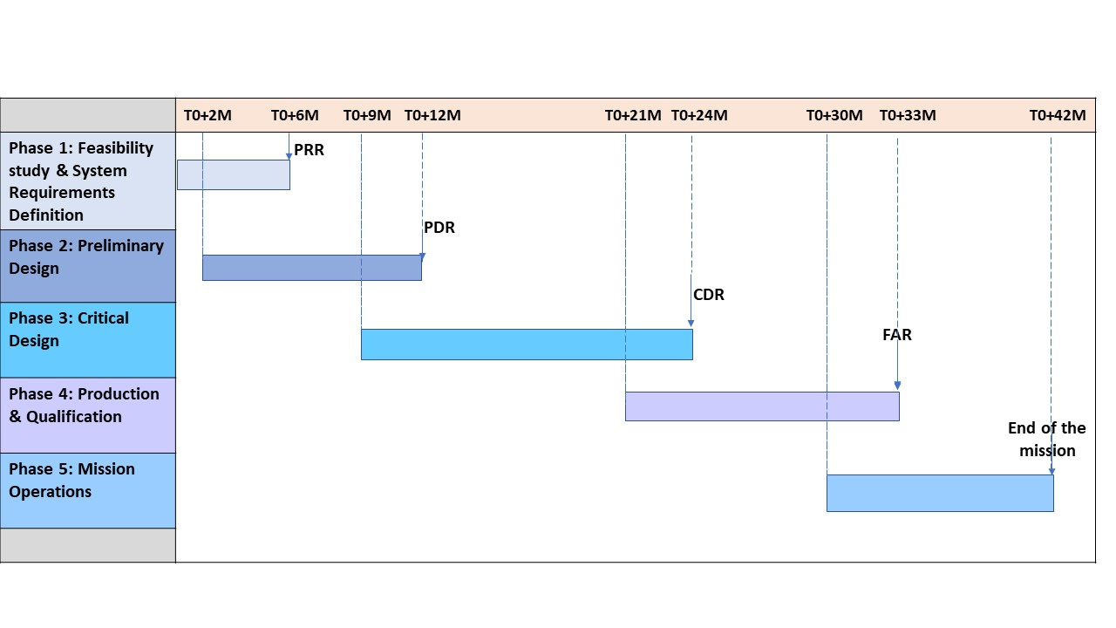
WP5: performed activities (9 of 12)
Timeline Estimation
Work logic
Envisioned timeline
Feasibility study & Requirement definition
Preliminary Design
Critcal Design
Production & Qualification
Mission Operations

Slide 22
WP5: performed activities (10 of 12)
ROM Estimation for roadmap implementation: Reviewed BlackBox solution
Key-Components | Costs [€]
Microwave generator | 10.000
RF Cable | 500.00
Antenna | 15.000
CNC system | 100.000
Sub-Total (A) | 125.000
The cost figures of the microwave generator and RF cable come from a market survey
The cost figures of the antenna are derived by the evidence of the solutions adopted under this project
The cost figures for the development of the CNC system to print 3D parts are internally assessed and validated by external expert opinions, including guesses from the consortium team members
The estimation of the enabling itmes has included all the material needed to manufacture the BlackBox and all test items, the mechanical and thermal analysis as well as tests needed to qualify the flight hardware (e.g., power quality, EMI/EMC, vibration, shock, and thermal vacuum tests)
Enabling items | Cost [€]
Materials | 650.000
Analysis activities | 60.0000
Testing campaigns | 75.0000
Sub-total (B) | 785.000
Express Procurement Plus – Microwaves heating of ISRU feedstock - MICROLITH

Slide 23
WP5: performed activities (11 of 12)
Cost Estimation for roadmap implementation: Reviewed BlackBox solution
Personnel | Hourly Rate (2022) [€] | Hours | Cost [€]
Mission Management | 95,00 | 4.500 | 427.500
Technical Support | 60,00 | 2.500 | 150.000
Mechanical Engineering | 75,00 | 4.000 | 300.000
Safety Engineering | 75,00 | 4.000 | 300.000
Science Expertise | 75,00 | 1.000 | 75.000
Avionics Engineering | 75,00 | 4.000 | 300.000
Systems Engineering | 75,00 | 4.500 | 337.500
Quality Assurance | 75,00 | 500 | 37.500
Sub-Total (C) |  |  | 1.927.500
The hourly rate cost items are referred to the prices of SMEs to the Agency
The cost figures for the general & administration activities are charged with 15% applied to personnel cost items
The contingency percentage is charged at 35% in order to cover risks from socio-economic conditions over the 42-month period (e. g. inflation rate, economic shocks and crisis, geo-political matters, resilience of the supply chain, etc.); market risks and science and technology matters
Additional cost elements | Overload percentage | Cost [€]
General & Administration | 15% | 289.125
Contingency | 35% | 1.050.569
Sub-total (D) |  | 1.339.694
Express Procurement Plus – Microwaves heating of ISRU feedstock - MICROLITH

Slide 24
WP5: performed activities (12 of 12)
Conclusion
The laboratory demonstrator has been effective in sintering the lunar regolith samples, also in case of matrices poor of Fe²⁺, inducing to state that the microwave sintering process is applicable in case of regolith from lunar Maria but also from lunar Highlands.
A roadmap for future developments of the microwave regolith-sintering payload for the Moon has been proposed, analyzing the work performed during the activity and identifying the critical elements to adapt the technology to lunar enviroment operations, and the possible solutions for a platform suitable to work on the Moon.
A reviewed version of the Nanoracks BlackBox has been proposed as facility to host the payload, describing all the modifications needed for this scope.
Timeline estimation and a Rough Order of Magnitude cost estimation have been performed, listing the cost items related to the development of the payload components and the BlackBox, giving a high-level view of the cost foreseen for building the flight model.
Express Procurement Plus – Microwaves heating of ISRU feedstock - MICROLITH

Slide 25
Results summary & considerations (1 of 5)
The Microlith project represented a relevant activity to study, analyze and identify a series of important aspects related to both prototyping and the development of technologies for microwave sintering.
From the point of view of prototyping, the possibility of using terrestrial simulants with efficiency has been demonstrated, artificially modifying their characteristics to make them more similar to the lunar regolith and to the differences in different regions of the Moon.
The results of the experiments have demonstrated the feasibility to obtain sintered samples with characteristics suitable to develop simple items, exploiting technologies based on microwave heating through the use of solid-state devices, characterized by good efficiency, compactness and cost, characteristics that make them particularly attractive for their use on the Moon.
It has been possible to enhance the knowledge of the physical phenomena that must be managed to make the process more efficient.

Slide 26
Results summary & considerations (2 of 5)
The sintered specimens obtained operating in vacuum conditions allowed to verify significant aspects related with the aims of the project. In this regard:
1) The modification of the ratio Fe2+/Fe3+ has been obtained by mixing proper granulometric fractions of the DNA-1 simulant (and of mixtures of DNA-1 with its vitrified version) with adequate granulometric fractions of ilmenite, this last at very high purity level (>95%)
2) The 8 Master Materials represented a wide range of possible variability that can have an impact on the efficiency of microwave process for heating and sintering of the dust. The relevant aspects to emphasize in that the set of materials includes matrices with very low Fe2+ with or without glasses, versions without glasses with Fe2+ in the range of High-Ti Maria, and combinations including both ilmenite and glasses.
3) The microwave system resulted to be effective in heating all the 8 Master Materials up to adequate temperatures for obtaining the sintering of the mixture or even their melting. This is an aspect that is worth emphasizing as the unmodified versions of DNA-1 have a content of Fe2+ around 1÷1.5% so, in principle, not favorable for microwave process.

Slide 27
Results summary & considerations (3 of 5)
4) In case of wider and coarser granulometric distribution of the powder mixture (<600 µm vs. <250 µm) better results in terms of material densification are obtained.
5) The presence in the original mixture of vitrified phases as well as the presence of ilmenite is beneficial for achieving better densification of the obtained specimens.
6) The density obtained with most of the Master Materials is in a range that can be considered for electrolysis purposes. In one case, namely with the material augmented through the simultaneous addition of both ilmenite and glassy phases, a higher densification is obtained moving towards the range expected for construction material.

Slide 28
Results summary & considerations (4 of 5)
7) The materials containing vitreous phases demonstrated that the presence of these do not hinder the sintering process, on the contrary these facilitate it favoring a better densification of the material. These results let suppose that the process should work in case of Highlands regolith, too. In these regions, indeed, the regolith has low Fe2+ contents (1% or less) and different mineralogical distribution (in terms of mainly Anorthosite). From a point of view of the response to microwaves susceptivity, this situation can be considered to behave similarly to the case of DNA-1 as received with or without vitrified fractions. On the other hand, the mineralogical differences do not imply a dramatic increase of the sintering temperature (about 100°C higher than that of Maria regolith); according to the results of the experimental activities done in the project, this difference is not expected to hinder the reaching of the sintering temperature by the microwave heating.
8) In addition of a proper setup of microwave system to be used, an adequate scanning strategy for producing solid artifacts with due characteristics (e.g. 11x11x6.5 mm) has been optimized.
9) The experiments demonstrated with a reasonable level of confidence the applicability in situ of the developed technology.

Slide 29
Results summary & considerations (5 of 5)
10) A roadmap has been defined for future developments of the technology. In particular, the possibility to develop a flight model has been discussed highlighting the further studies needed for a future application such as the identification of a microwave generator suitable to work in vacuum, CNC system and a full 3D printing system for the lunar regolith. Moreover, a review of the facility (Nanoracks BlackBox) to host the payload has been proposed considering the use of different materials to build the enclosure, the implementation of a proper thermal control and computing system, and different electrical and mechanical interfaces.
11) A rough estimation of the cost for developing the flight model has been performed and a timeline estimation for its development has been analysed and provided.

Slide 30
Suggested improvements for future developments
The analysis of the results obtained allows to identify what are the current issues and the technological improvements to be implemented.
A deeper investigation about the remarked effect on sintering process yield operating in low pressure range (down to 10-2 mbar), with a terrestrial demonstrator, which should be useful to validate the hypothesis that the sintering at very low pressures, such as in lunar environment, can be performed with the proper efficiency. According to theoretical considerations and to the data achieved from the activities performed, operating with the terrestrial demonstrator at pressure range below 10-5 mbar should demonstrate the hypothesis.
The improvement of the microwave systems, with focus on the optimization of microwave actuator, with the goal to enhance the convey of the energy on the sintering processes.
The feasibility study of a proper system for collecting and feeding regolith powder in the microwave sintered apparatus with the aim to highlight the operating issues occurring under harsh lunar environmental conditions (e.g. very low pressure, very high thermal gradients etc.), providing possible options.

Slide 31
Activities Conclusion
The document TN4 – Test Report (Rev.2), reporting the activities of WP4 has been delivered to ESA.
The document TN5 - Future Work related to a Microwave Regolith-Sintering Payload, reporting the activities of WP5 has been delivered to ESA.
Samples delivered during the Activity have been delivered to ESA.
The draft version of the Contract Closure Documentation (CCD) has been proposed to ESA with some comments.
The Final Documentation has been delivered to ESA for Review.

Slide 32
Final Review Presentation
Express Procurement Plus - EXPRO+
Microwave heating of ISRU feedstock
MICROwaves heating for sintering of regoLITH - MICROLITH

