Slide 1
Model-BASED SOFTWARE DEVELOPMENT LIFECYCLE
TEC-ED & TEC-SW Final Presentation Days - December 9th 2015
Joan Clua, Patricia López Martínez, Dominique Torette, Jorge Garrido

Slide 2
Project Overview
MBSDL
Model-Based Methodology Review
Define a methodology covering the entire SW lifecycle
Work on ECSS to accommodate MSDL-based projects (deliverables, phases, reviews…)
TASTE Extension
Take the TASTE toolset as a baseline for tool selection to implement defined methodology.
Explore areas where lifecycle is not deeply covered by the toolset (requirements, V&V…)
Add tools and integrate them in the toolset
Proof of Concept in a Mission
Define specific mission (Flight Formation based).
Implement the mission using the toolset produced in the project.
Exercise point of view of SW developers, system engineers and reviewers

Slide 3
Consortium
MBSDL
Project Coordination
Indra
Model-Based Methodology Review
Universidad de Cantabria (UC)
Universidad Politécnica de Madrid (UPM)
Spacebel
TASTE Extension
Indra
UC
UPM
Proof of Concept in a Mission
TU Delf (Mission Definition)
Spacebel (Mission Implementation)
Delft
Liège
Santander
Barcelona
Madrid

Slide 4
TOC
MBSDL
01 Model Based Methodology (P. López, UC)
02 Timing Analysis in TASTE (J. Garrido, UPM)
03 Mission Proof of concept (D. Torette, Spacebel)
04 Conclusions

Slide 5
01 Model Based Methodology (P. López, UC)
02 Timing Analysis in TASTE (J. Garrido, UPM)
03 Mission Proof of concept (D. Torette, Spacebel)
04 Conclusions

Slide 6
MBSDL – Starting point
01 Model Based Methodology
Notes:
The software development lifecycle that was considered the most suitable for the proposal is based on a typical V-model.
In fact, The ASSERT/TASTE approach that represented the starting point of the project have already addressed the lifecycle phases related with design and implementation. They were already supported by the TASTE environment and the purpose of the project was to improve and complemente them with the rest of phases of the lifecycle.
Finally, we have focused mainly on the specification phase.

Slide 7
MBSDL – Early model-based analysis
01 Model Based Methodology
Notes:
process leads to a lifecycle that does not follow strictly a V-model. When applying a traditional V-model approach, the V&V activities do not start until the code is available.
early V&V can be applied on the models generated as result of each phase of the development

Slide 8
MBSDL DEfinition
01 Model Based Methodology
An architecture-centric and specification-centric lifecycle
Requirements Engineering
Specification Model
System
Testing
(RDAL)
Driven by specification of the problem
Traceability
Architectural Design
Integration Testing
Driven by architecture
of the solution
Detailed Design
Unit Testing
Test the
System
Build the
System
Design Model
(AADL)
Implementation
Notes:
TASTE adopts an architecture-centric model approach for the design and implementation phases, based on AADL. As shown in the figure below, there is a unique design model, formulated on AADL, which supports directly the purely architectural aspects, such as modularization, interfaces, etc.
Other aspects, such as functional behaviour, real-time behaviour, etc. are supported by specific models that are referenced from the design model or generated from annotations on it.
A similar approach is going to be followed for supporting the requirements specification and V&V phases of the lifecycle. Thus, our proposal is that they will also rely on a single model, the Specification model, which will support directly or by reference all the information generated or managed on these phases.
For formulating such a model, a requirements modelling language such as RDAL or GRL, is the most suitable option. These languages provide direct support for modelling requirements, but also provide with capacity to associate requirements with other kind of models, such as use cases, functional specifications, tests descriptions, scenarios, etc. used to analyse, document, and understand the requirements. So, the figure below shows how the proposed lifecycle is supported by these two backbone models (design and specification models) and how they must provide backward and forward traceability in order to validate the design against the specification.
Considering that the entire development process is supported by a single model, or more exactly by two complementary models, the purpose of each phase in the lifecycle is the generation of different perspectives or views of the model, which contain (or add to the model) the information that is characteristic (or is the result) of the specific phase or task. In the next section each phase of the development is explained in detail, showing the tasks that are carried out on each phase and the views of the models that they generate.
Este concepto de la verificación temprana se ha tratado de aplicar en el proyecto MBSDL.
En él se partía de un modelo de ciclo de vida centrado en al arquitectura. Esta es una estrategia propuesta por el SEI que se basa en utilizar el modelo de arquitectura como el modelo central del proceso de desarrollo, en el que además de la arquitectura sirva para dar soporte a todo el conjunto de propiedades extrafuncionales a las que se les puede ir aplicando los análisis tempranos
Los aspectos propiamente arquitecturales como flujo de control, modularización e interfaces son soportados por el propio modelo AADL, mientras que otros aspectos (funcionalidad, comportamiento temporal, gestión de memoria, etc.) utilizan modelos específicos (diagramas de estados, modelos de comportamiento temporal, etc.) que por extensión o por referencia están incorporados al modelo AADL. Este proceso de diseño es lo que en la figura 10.6 se engloba dentro del “Design Model”.
El proyecto MBSDL, en el que participa el grupo ISTR, tenía como punto de partida el proceso de diseño definido en el proyecto ASSERT, y su objetivo era mejorar la aplicación del resto de pilares de la estrategia del SEI, esto es, mejorar la trazabilidad entre las fases de diseño y de especificación y verificación. Para ello, se consideró conveniente organizar también los modelo de especificación y de verificación en base a un modelo genérico que sirva de columna vertebral común a toda la información gestionada desde ellos.
l resultado es por tanto, un modelo de ciclo de vida del software sustentado por dos modelos principales, cómo se observa en la :
El modelo de requisitos, que da soporte (de manera directa o por referencia) a toda la información asociada a las fases de requisitos y de verificación y validación.
El modelo de diseño, que sustenta las fases de diseño e implementación.
Cómo es lógico, estos dos modelos deben presentar trazabilidad bidireccional entre sí, pues un aspecto vital del proceso de desarrollo consiste en validar la
implementación respecto a su especificación.
Considerando que el proceso completo de desarrollo es soportado por estos dos modelos complementarios, el objetivo de cada una de las fases de desarrollo es la de generar las diferentes vistas del modelo, que contienen (o añaden al modelo central) la información resultado de dicha fase de desarrollo.

Slide 9
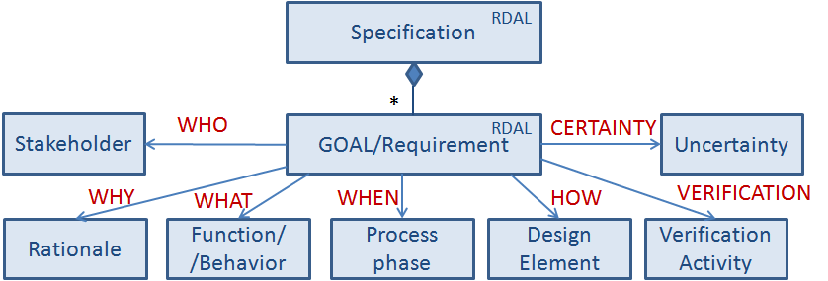
RDAL Language
01 Model Based Methodology
RDAL: Requirements Definition and Analysis Annex
AADL Annex but independent from it
In process of standarization
Traceability to design elements, functional models, reactive models, V&V Actitivites, etc.
Notes:
RDAL provides capacity to model requirements, with their typical attributes as priority, interested stakeholders, rationale, id, etc. It also allows to define requirements hierarchy and traceability.
But also provide with capacity to associate requirements with other kind of models, such as Use case maps or SDL diagrams to define the functional behaviour specfiication, tests descriptions, scenarios, etc. used to analyse, document, and understand the requirements.
It also provides capacity to trace the requirements to elements of the preliminary design, which will be later refined in the design phase, and to veriification activities, which can be defined also according to standard specifications as TTCN-3.
Desde un punto de vista más concreto, los lenguajes que se utilizaron en el proyecto MBSDL para impelmentar los modelos arquitecturales y de requisitos fueron AADL Y RDAL.
RDAL define un metamodelo que por un lado da soporte a la especificación de los requisitos propiamente dichos, con todas sus características típicas como identificador, descripción, prioridad, versión, stakeholders interesados, etc.; pero además como representa la figura 1.5, proporciona mecanismos que permiten incorporar a la especificación de requisitos:
• trazabilidad entre requisitos,
• trazabilidad entre requisitos y elementos del diseño,
• trazabilidad entre requisitos y sus correspondientes actividades de verificación y validación,
• trazabilidad entre requisitos y otros elementos de modelado, como casos de uso, especificaciones funcionales, etc. que faciliten la propia tarea de definición de requisitos.

Slide 10
SOFTWARE REQUIREMENTS SPECIFICATION IN MBSDL
01 Model Based Methodology
Data View
Context View
Data Modelling
(ASN.1 and AADL)
Context Modelling (AADL)
High-level Goals/Req Definition
(RDAL)
Requirements View
Goals/Req Refinement
(RDAL)
Functional Modelling
(UCM)
Functional View
Behavioural View
Behavioural Modelling
(SDL)
Interface View
Logical Architectural Modelling
(AADL)
Validation Tests Identification and Formulation
(RDAL)
V&V View

Slide 11
TOOL Selection
01 Model Based Methodology
MBSDL Phase | Tools
Requirements Specification | RDALTE (RDAL Tool) jUCM (Use Case Maps Tool) + OpenGeode (SDL Tool) AADL + ASN.1
Software Architectural Design | AADL + ASN.1 OpenGeode (SDL) MAST/Cheedar (Schedulability Analysis)
Software Components Design | AADL + ASN.1 OpenGeode + Simulink/SCADE/RTDS MAST/Cheedar
Implementation | TASTE Code Generators
Software Testing | Rapita AADL + MAST/Cheedar MSC Test Tracer (TASTE)
Notes:
Several tools can be used to model or analysis the different aspects involved in the development of a space application. We address a survey of tools, analizing their main advantages and drawbacks and the final selection was the one presented here.
We use RDAL as the backbone of the requirement specification phase, improved with the usage of UCM maps and SDL diagrams for the logibal model of hte applicaton
We use AADL and ASN.1 for the design phase, and thanks to AADL extensions we can include information that allow us to apply schedulability analysis based on tools such as MAST and Cheedar.
Simulink can be used at the desing level to define the specific behaviour of some AADL modules, whose code can be automatically generated from the model.
We have integrated also

Slide 12
01 Model Based Methodology (P. López, UC)
02 Timing Analysis in TASTE (J. Garrido, UPM)
03 Mission Proof of concept (D. Torette, Spacebel)
04 Conclusions

Slide 13
WORK OVERVIEW
02 Timing analysis in TASTE
Objective: provide a working integration of Rapitime
Structural analysis
Execution time analysis
UPM and Rapitime Systems collaboration
Rapita Systems:
Provision of tools
Initial integration version
UPM:
Providing previous integration as starting point
Support on TASTE internals
Versions iteration with Rapita
Validation of final integration

Slide 14
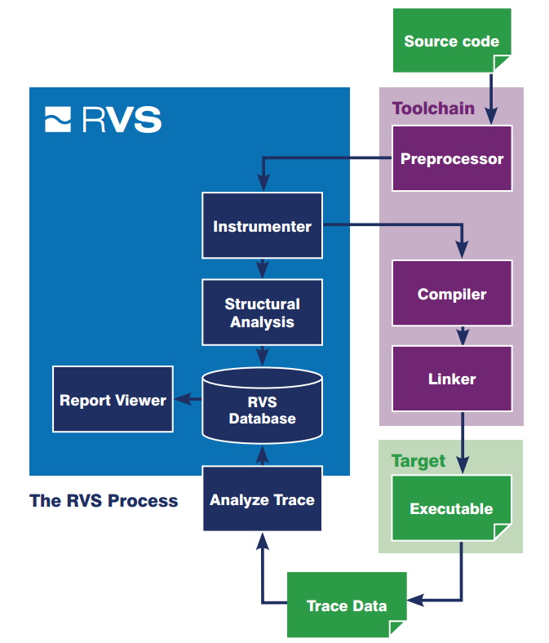
Rapitime overview
02 Timing analysis in TASTE
On-target timing analysis tool
Rapitime process
Based on:
Structural analysis of the code (compiler and user aided)
Automated instrumentation points
Execution traces
Provides:
Automated timing analysis framework
Execution paths analysis
Timing behavior of the system (including WCET estimation)
Graphical and textual results
Other analysis offered in Rapita Verification Suite (RVS)

Slide 15
Integration overview
02 Timing analysis in TASTE
Integration based on previous version by UPM
Aimed to follow TASTE methodology:
Command-line based process
Python and bash scripts
Text-files results
Automated system analysis based on AADL and Ocarina generated files
Integration within assert-builder-ocarina.py with new parameter –instrument
Two-steps integration:
First build generates system as usual
Second build generates instrumented system at an auxiliary directory

Slide 16
Integration results
02 Timing analysis in TASTE
Automated timing analysis for TASTE projects
Textual and graphical results
Stored in a SQL database
Textual output customizable
== project.vt_ground_result_wrappers.artificial_result.rvd
vt_ground_result_wrappers.artificial_result: 4077 cycles
== project.vt_myfunction_pulse_wrappers.artificial_pulse.rvd
vt_myfunction_pulse_wrappers.artificial_pulse: 73745 cycles
== project.vt_myfunction_start_processing_wrappers.artificial_start_processing
vt_myfunction_start_processing_wrappers.artificial_start_processing: 2328 cycles

Slide 17
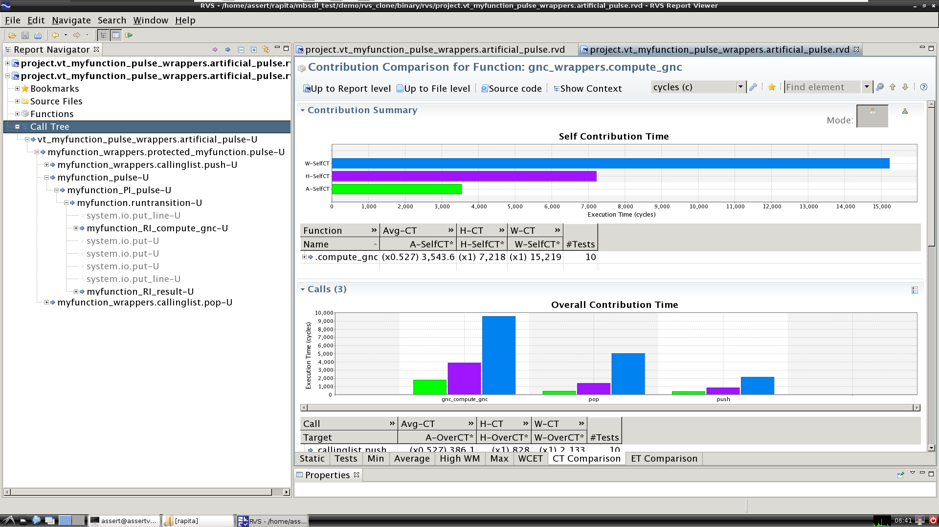
Integration results
02 Timing analysis in TASTE

Slide 18
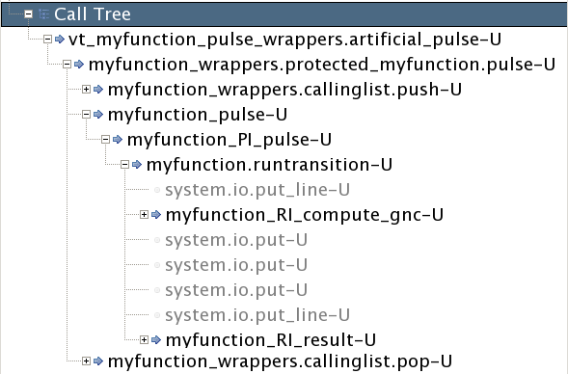
Integration results
02 Timing analysis in TASTE
TASTE overhead
User code
Subcalls
TASTE overhead

Slide 19
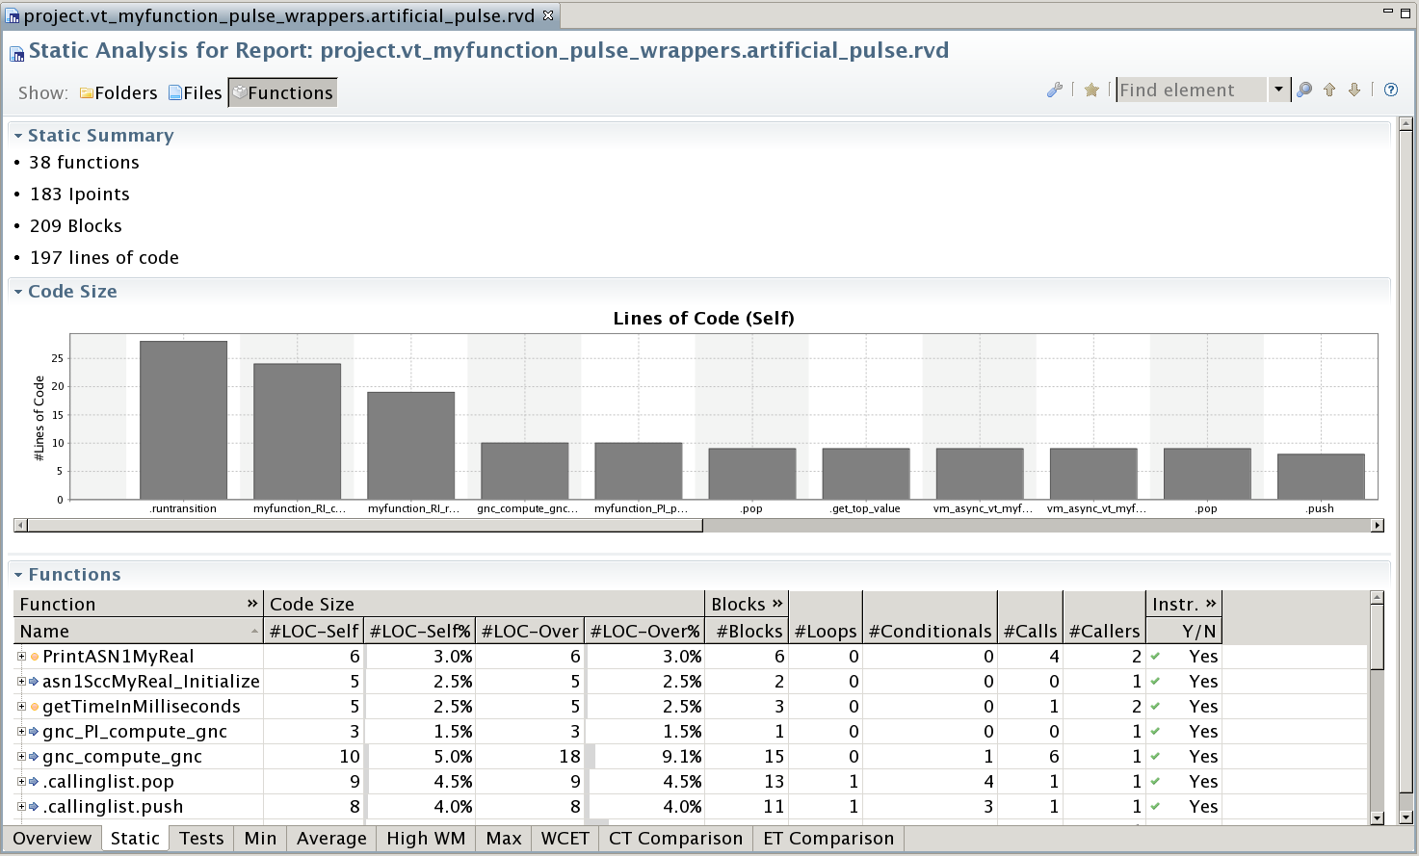
Integration results
02 Timing analysis in TASTE

Slide 20
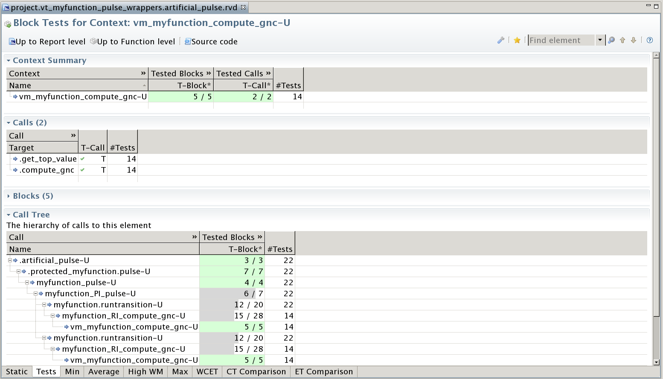
Integration results
02 Timing analysis in TASTE

Slide 21
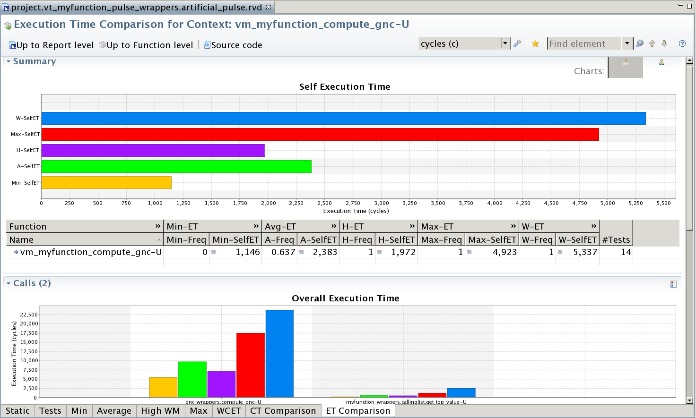
Integration results
02 Timing analysis in TASTE

Slide 22
01 Model Based Methodology (P. López, UC)
02 Timing Analysis in TASTE (J. Garrido, UPM)
03 Mission Proof of concept (D. Torette, Spacebel)
04 Conclusions

Slide 23
Use case
03 Mission Proof of concept
Software Requirement Specification for a Formation Flying Mission
GNC FF Algorithms
FF Operational modes
Distribution of the responsibilities across the formation
Routing of PUS TM/TC
Ground and Inter Satellites Link communication interfaces
Top inputs : High Level Specifications from TUDelft
Introduction to AOCS/GNC functionalities of FF Satellites
Mission Requirement Document
System Requirement Document
Operational Requirement Document
Additional inputs : In-house ongoing PROBA-3 FF project feedbacks

Slide 24
Outputs
Models
Specification and Documentation Generation
Use Case Maps : URN/UCM
RDAL : RDAL
Design and Code Generation
TASTE (Interface, Deployment) : AADL
TASTE (Data model) : ASN.1
TASTE/OpenGeode (Behavior, modes) : SDL
Traceability links
ECSS-like documentation (Fully generated from models - template based)
SSS
SRS

Slide 25
User Requirements Notation (URN)
03 Mission Proof of concept
User Requirements Notation (URN) is intended for
Elicitation and specification of requirements.
Discover and specify requirements for a proposed system
Analysis and validation of requirements.
Analyze such requirements for correctness and completeness
Execution of Scenarios and branches coverage
Simple formal language for Behaviors and Scenario expected results definition
Impact analysis of Implementation Trade-Off.
Explore impacts of alternative responsibilities assignments.
Graphical Representation
Visually communicate design choices

Slide 26
Use Case Maps (UCM)
03 Mission Proof of concept
Use Case Maps (UCM)
graphically describes the functional requirements of a software system,
precisely describe processes (alt. view to Message Sequence Chart),
represents control flows and distributes responsibilities to actors, by superimposition of scenario paths on a structure of components.
Use Case Ma p fairly addresses
operational requirements,
functional requirements,
architectural trade-offs.
At later stages, UCM may be further refined into:
MSCs or UML sequence diagrams,
SDL state machines or UML state chart diagrams.
No new concepts, but same concepts introduced earlier in the development cycle.

Slide 27
jUCMNav
03 Mission Proof of concept
UCM Tool
Free Eclipse-based plug-in/editor
Now in version 6.0, August 2014
Since May 2006
Dedicated Perspective, Graphical editor with palette
Eclipse Navigator, Outline view and Preferences
EMF metamodel
Allows model to model and model to text transformations
Export to graphical representations (.jpg, .dot, .png)
Export to Message Sequence Charts (.jucmscenarios)
Included Message Sequence Charts viewer
Allows the early definition, execution and verification of Scenarios
Allows graphical animation of Scenarios
Cross platform (Linux, Windows 7, Mac OS X)

Slide 28
JUCMNaV: Perspective
03 Mission Proof of concept

Slide 29
JUCMNaV: Palette
03 Mission Proof of concept
Structure of components
Team, Object, Process, Agent, Actor.
Scenario paths
Start Point : Scenarios initial conditions
End Point : Scenarios completion conditions
This is the place to allocate/verify requirements
Textual description, but also formal expression to be verified on scenario completion. Boolean expression based on variables updated by Responsibilities.
Or Fork : Execution path Or Fork (logical conditions)
And Fork : Execution path And Fork (logical conditions)
Or Join : Execution path Or Join
And Join : Execution path And Join
Responsibility: Pseudo-code fragment
Stubs : Hierarchical decomposition, refer another UCM

Slide 30
JUCMNAV: CODE/CONDITION EDITOR
03 Mission Proof of concept
Editor for
Responsibility code
Requirement condition
Variables list
Variables creation
Syntax Verification

Slide 31
JUCMNAV: SCENARIO EXECUTION
03 Mission Proof of concept
Scenario:
Start points
Initializations
End points
Inclusions
Scenario Group:
Run all
Coverage
Unsatisfied Conditions reported as errors in problems panel

Slide 32
JUCMNAV: Message sequence chart Export
03 Mission Proof of concept
Once Executed scenarios can be exported and viewed as MSC

Slide 33
GENDOC: MODEL BASED SSS Generation
03 Mission Proof of concept
Template based Model2Txt transformation
EMF
Embedded Acceleo in .odt or .docx templates
Support for tables and figures
Test coverage and requirements traceability's

Slide 34
RDAL METAMODEL: System OVERVIEW
03 Mission Proof of concept
Identification of
the System and
its Environment.
Identification of Data Interface.
Concept of
Monitored Variables
Controlled Variables
but only at top level.
Similar to Simulink Block inputs/outputs.

Slide 35
RDAL METAMODEL: Requirement
03 Mission Proof of concept
Organized in Packages
Complex structure, oversized for mid-size project
Reference to external models (traceability) through EObject
Natural language
Formal languages: BLESS, Lute, OCL but no provers support

Slide 36
RDAL TOOLING: RDALTE
03 Mission Proof of concept
EMF meta-model
EMF Sample Reflective Model Editor
Live validation
Export to textual representation
RDAL Graphical Representation V2 not yet implemented by RDALTE

Slide 37
GENDOC: MODEL BASED SRS Generation
03 Mission Proof of concept
Same M2T tooling as for jUCMnav
No graphical representation

Slide 38
TASTE: AADL and ASN.1 OPEN-SOURCE EDITOR
03 Mission Proof of concept
Model2Code
C, Ada, GUI, VHDL
Chaser System modes SDL
Chaser GNC Simulink

Slide 39
OpenGEODE: SDL OPEN-SOURCE EDITOR
03 Mission Proof of concept
Model2Code
Ada and LLVM
SDL variables
Equivalent
FSM
SDL Events:
TC, FDIR,…
ASN.1
Data Model
SDL Actions:
On/Off, counters
SDL States: System modes
Static Analysis

Slide 40
01 Model Based Methodology (P. López, UC)
02 Timing Analysis in TASTE (J. Garrido, UPM)
03 Mission Proof of concept (D. Torette, Spacebel)
04 Conclusions

Slide 41
Conclusions
04 Conclusions
Software Requirements Specification has been integrated into a Model Based Software Development Lifecycle
Use Case Maps and rdal language tools have been integrated in TASTE
The methodology and the tools have been evaluated on a realistic mission
Rapitime has been integrated in TASTE
Software Requirements can be adequately modelled using rdal and UCM, providing a bridge with system architects
TASTE is an excellent platform to add new functionality

Slide 42
Model-BASED SOFTWARE DEVELOPMENT LIFECYCLE
Joan Clua jclua@indra.es
Joan Ametller
Marc García
Laura Perea
Marcos Venteo
Dominique Torette Dominique.Torette@spacebel.be
Paul Parisis
Philippe Créten
TEC-ED & TEC-SW Final Presentation Days
December 9th 2015
Patricia López Martínez lopezpa@unican.es
Michael González Harbour
Jorge Garrido jgarrido@dit.upm.es
Juan Antonio de la Puente
Jian Guo J.Guo@tudelft.nl
Thank you very much for your attention

