Slide 1
Menhir Photonics
Final presentation-1
30/08/2023

Slide 2




Project details
MICOR: Microwave Optical Oscillator
Start date: 1 October 2022
Duration: 9 months
Our partners: CSEM
Gran type: ESA
Total budget: 200’000 EUR
Menhir Photonics budget: 120’000 EUR
CSEM: 80’000 EUR

Slide 3
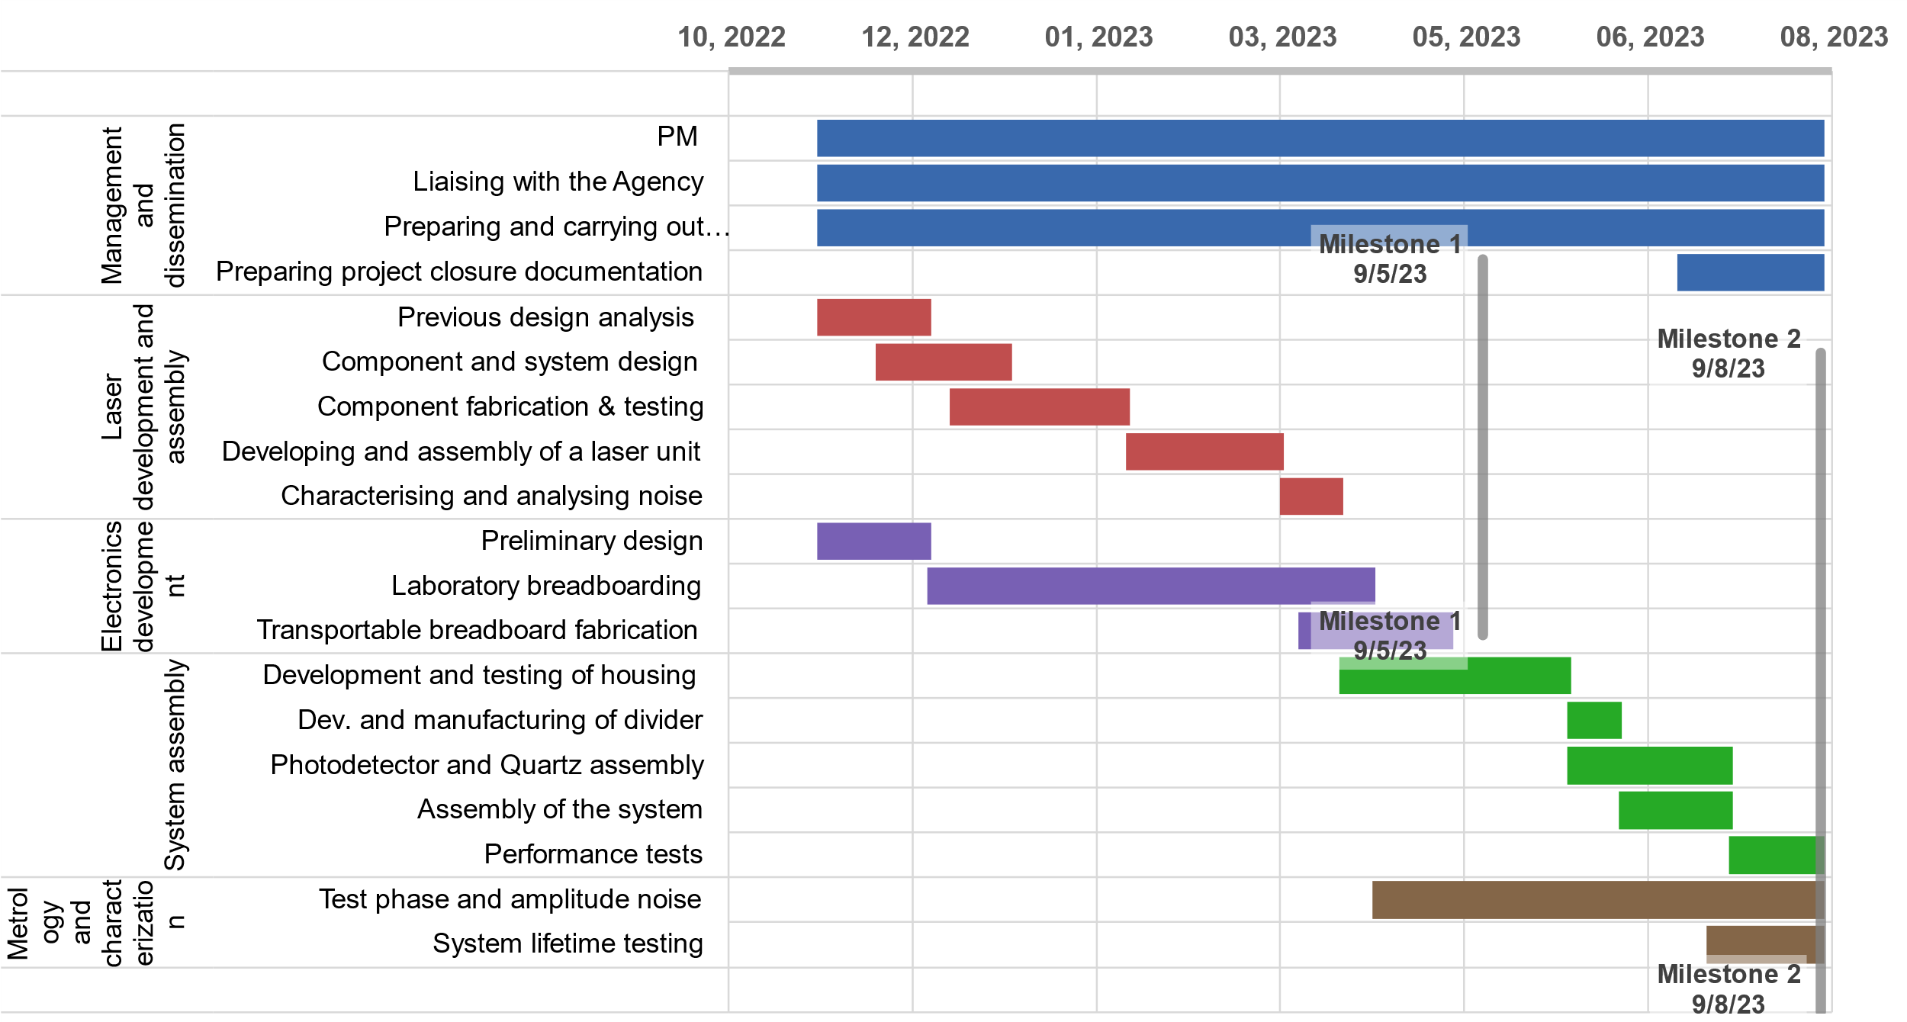
Gannt Chart

Slide 4
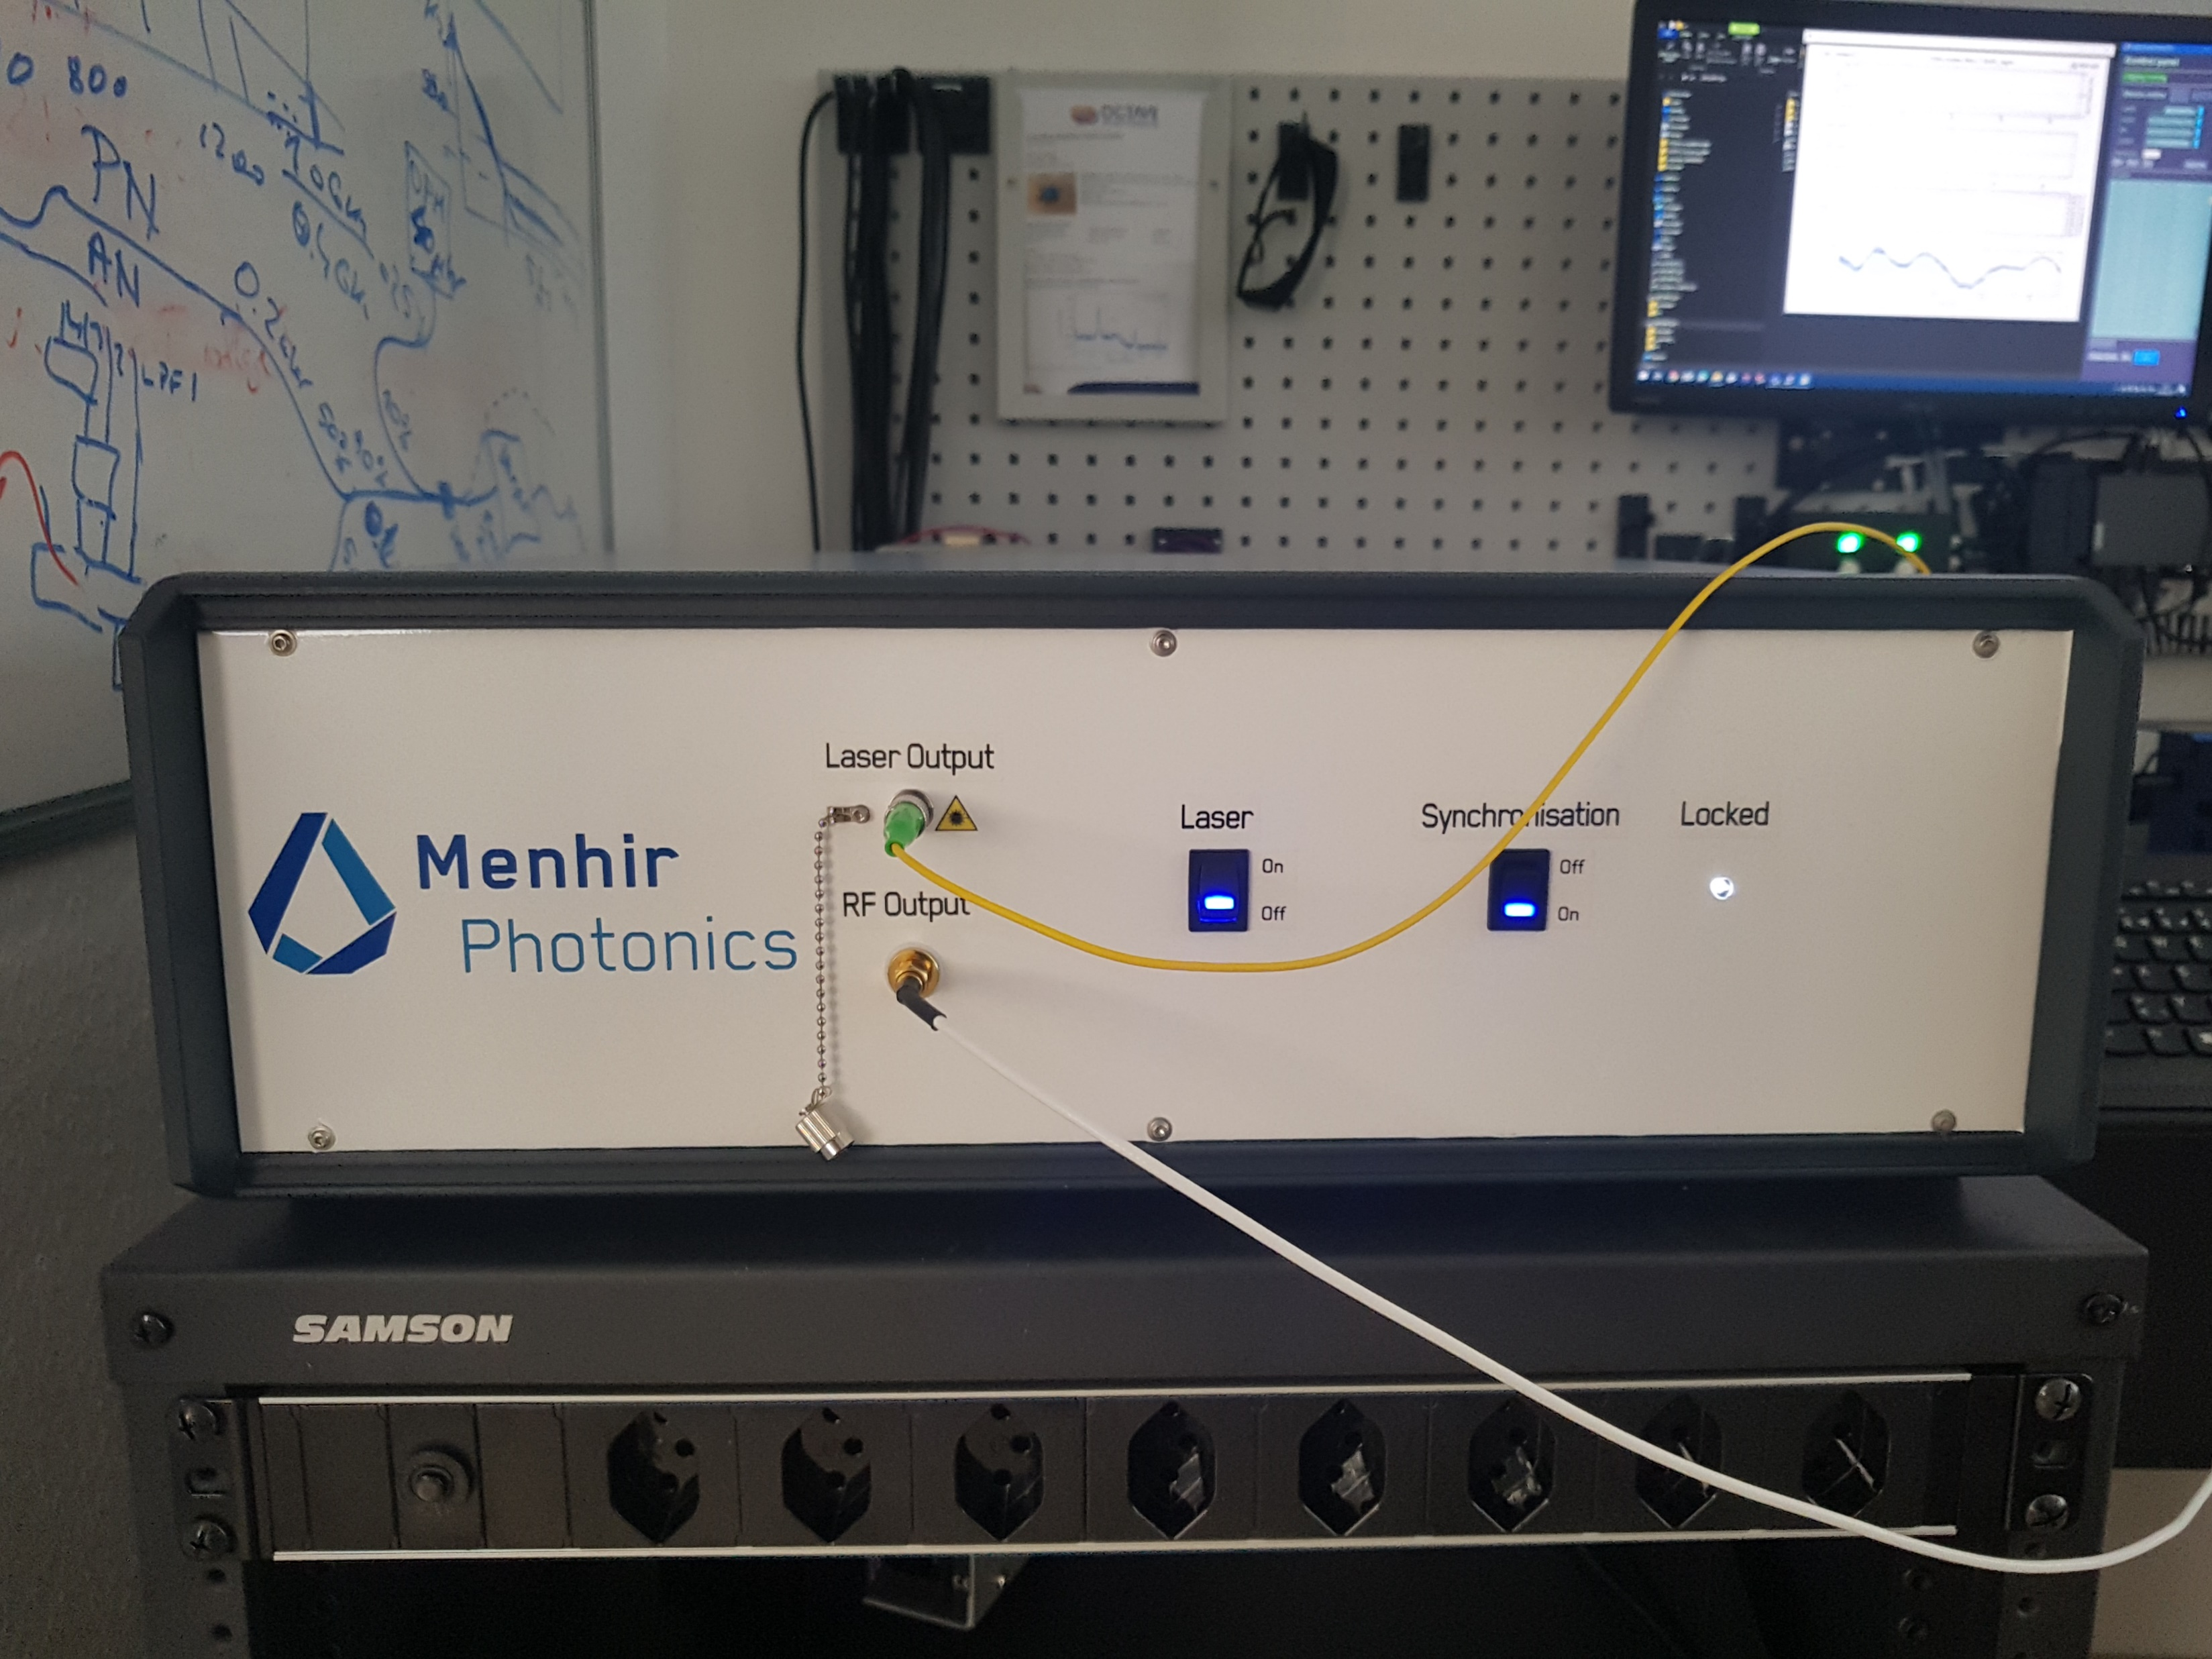
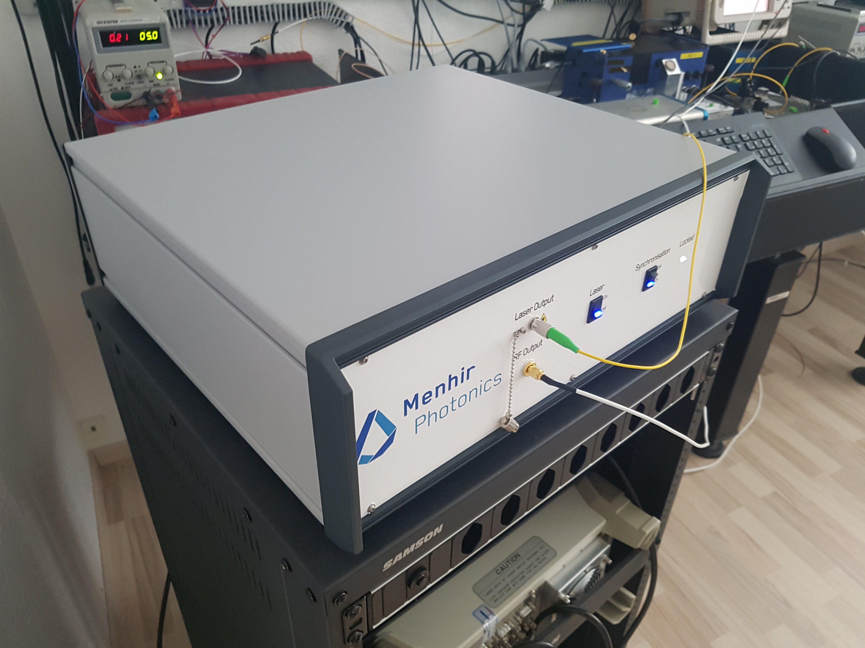
Photonic microwave MEN-MICOR-1

Slide 5
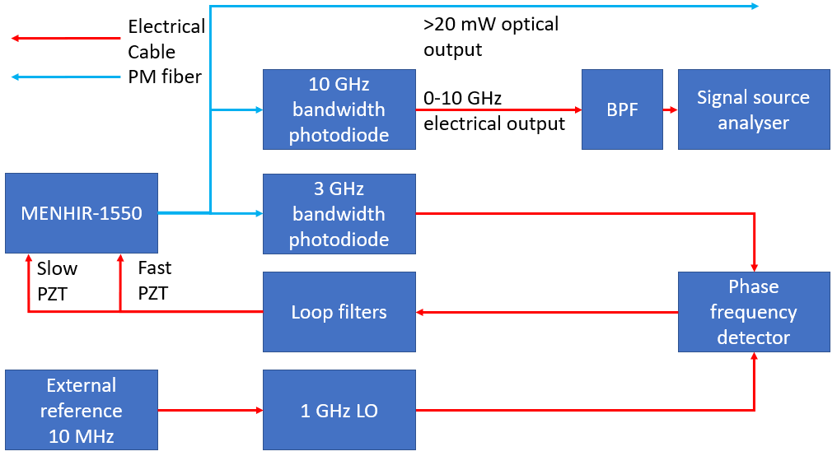
Photonic microwave generation architecture

Slide 6
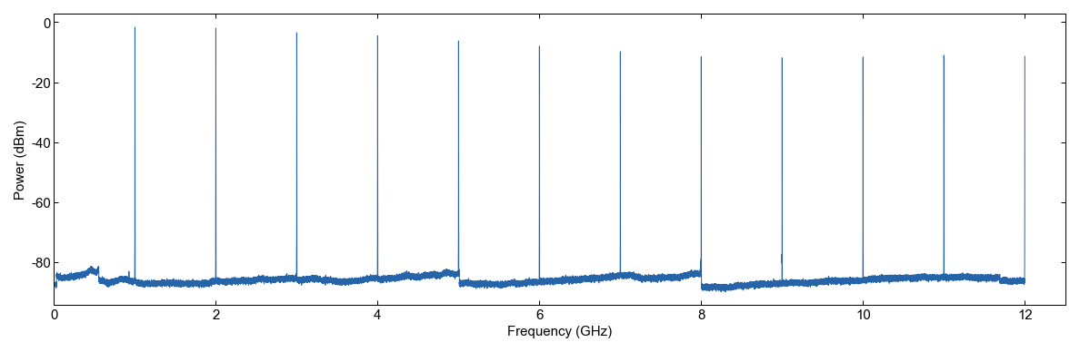
Photonic microwave RF trace

Slide 7
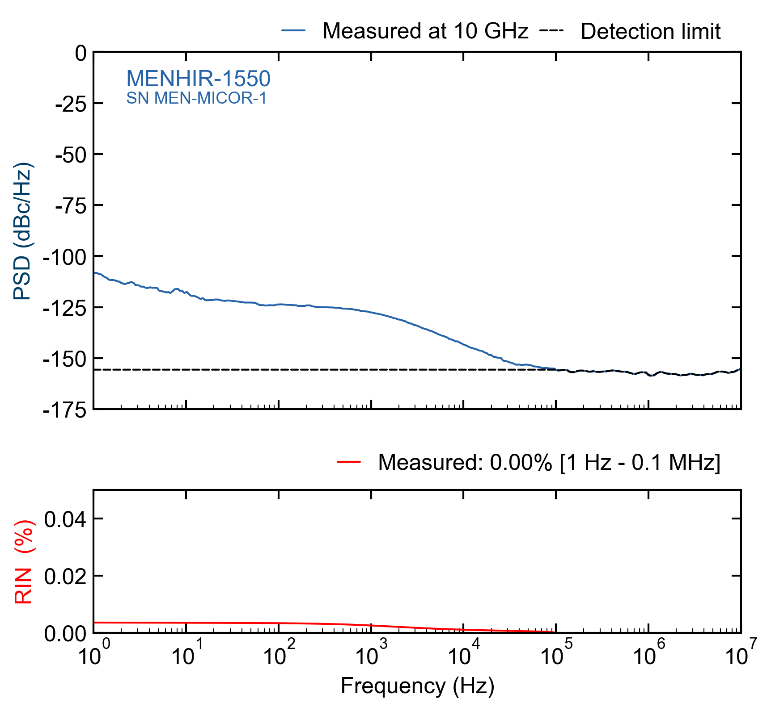
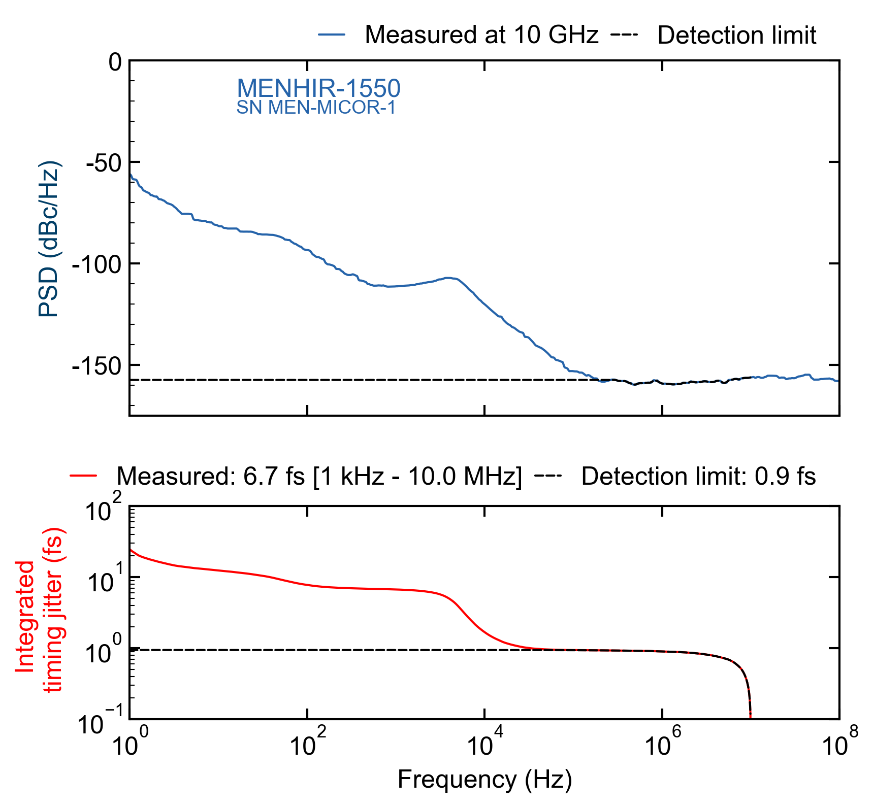
Photonic microwave amplitude and phase noise

Slide 8
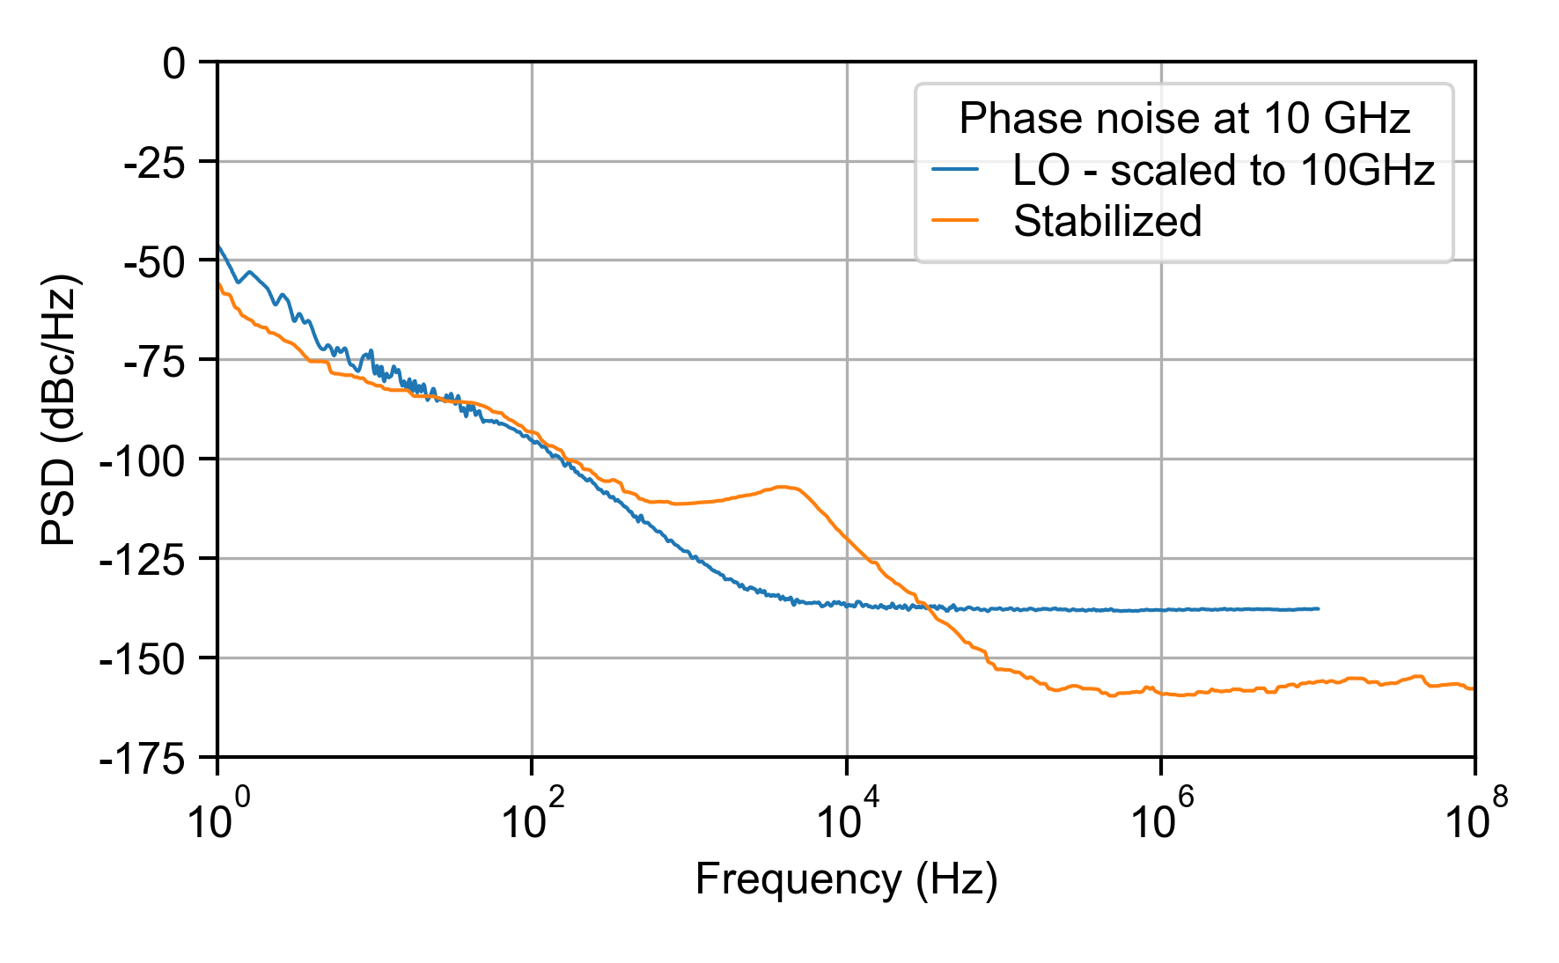
Photonic microwave stabilized laser vs LO

Slide 9
Photonic microwave Allan variance
Allan deviation of MICOR system at 10 GHz carrier measured with FSWP (blue curve) and Symmetricom 5125 (orange curve). Grey curve depicts Allan deviation of the Micor reference output at 10 MHz. The carrier frequencies are given for completeness but does not impact the ADEVs.

Slide 10
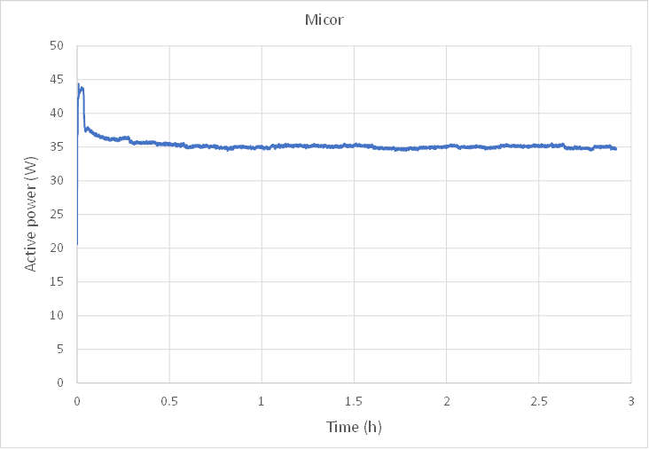
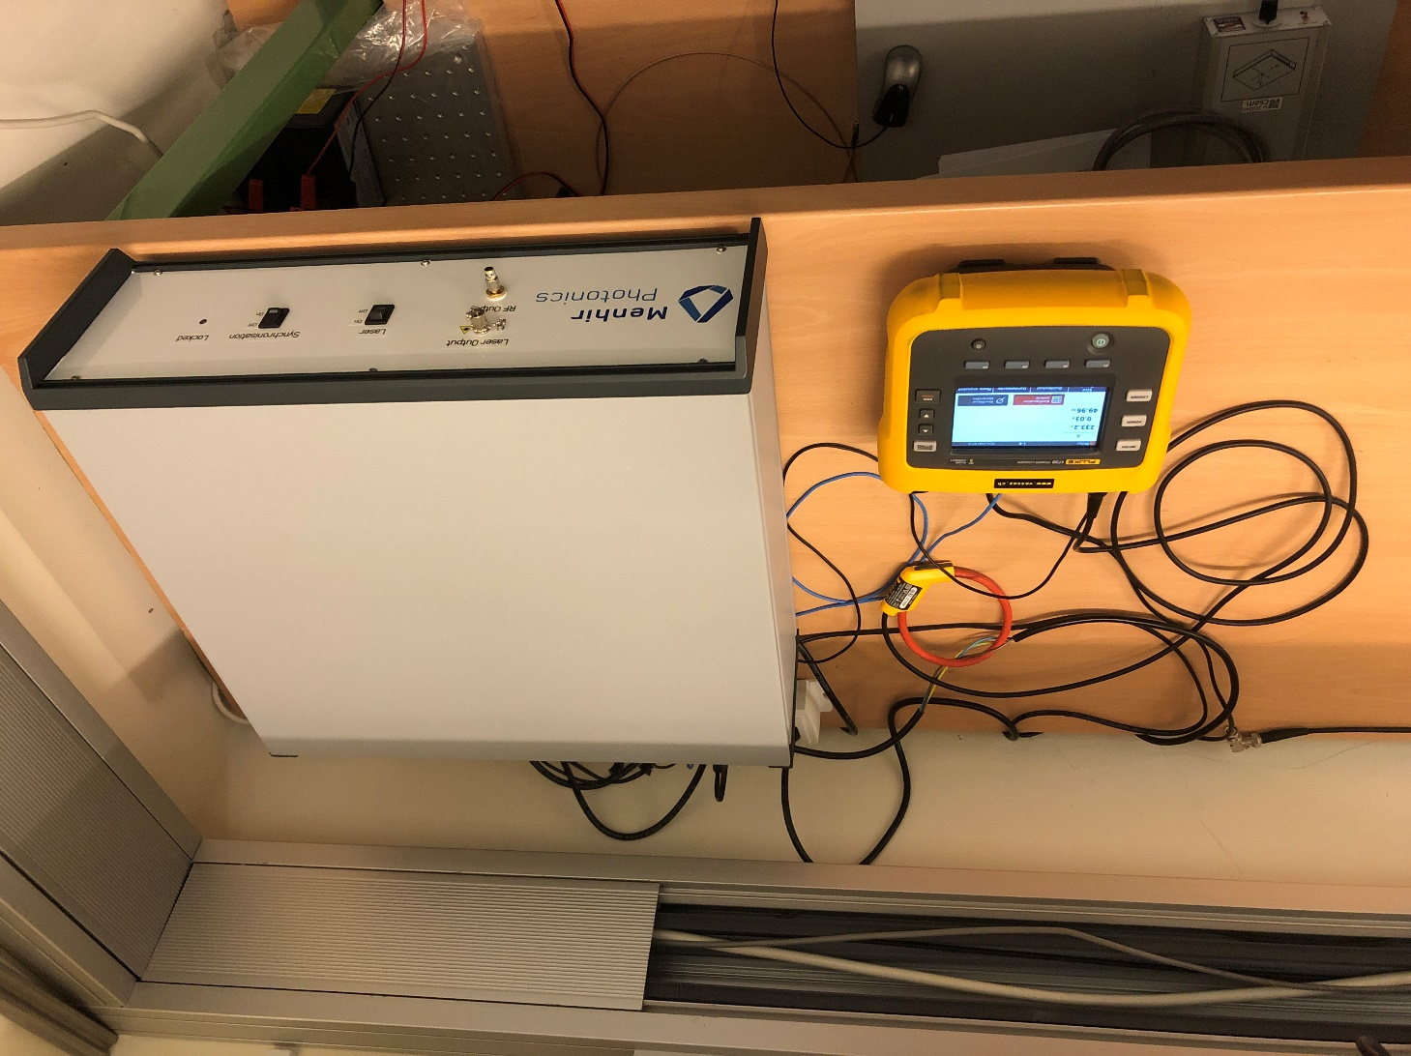
Photonic microwave power consumption

Slide 11
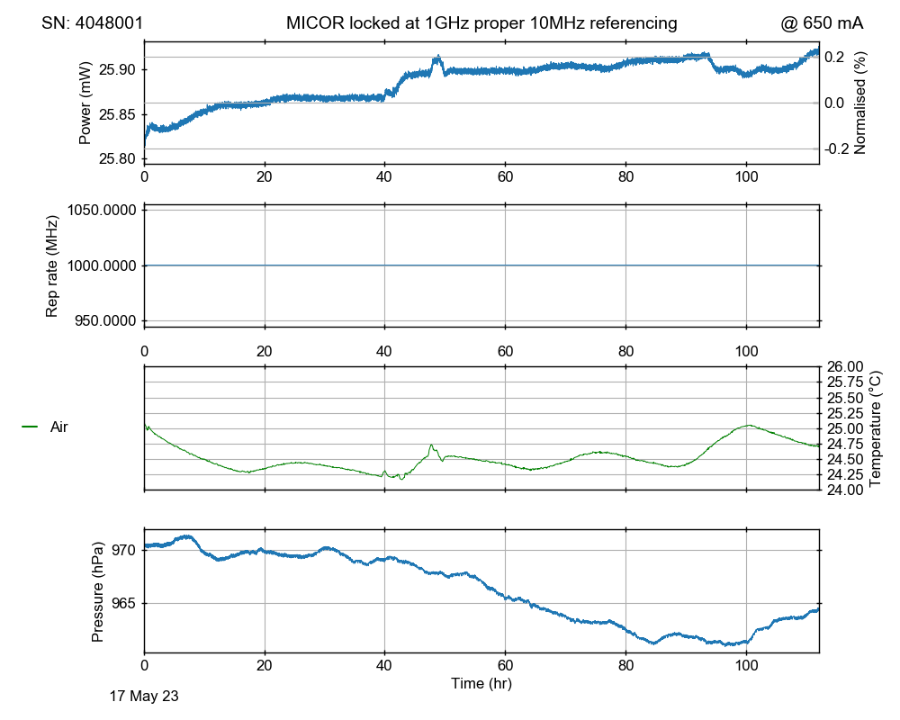
Photonic microwave long-term frequency stability

