Slide 1
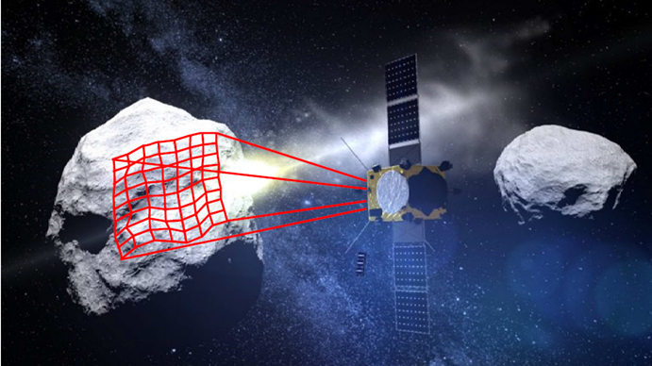
Deep-Space Optical Communications Compatible Multi-function Lidar
Final presentation
D A Orchard
21st November 2018

Slide 2
Contents
Background
Requirements
Numerical model
Technology trade-off
Design
Manufacture and assembly
Testing
Conclusions

Slide 3
Background

Slide 4

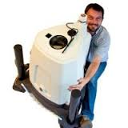
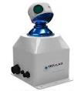
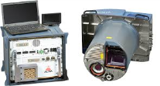
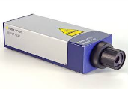
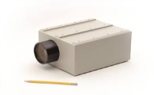
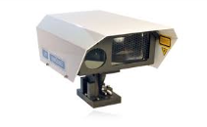
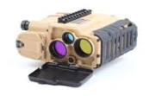
SDML - Introduction
What is LIDAR?
  Like radar but using light in place of radio waves.
  Used for ‘optical remote sensing’.
  Many different LIDAR instruments and associated sensing modalities:
    Rangefinding, 3D mapping/imaging;
    Velocimetry, vibrometry, anemometry;
    Target marking/designation;
    High bandwidth, covert optical comms;
    Retro comms.

Slide 5
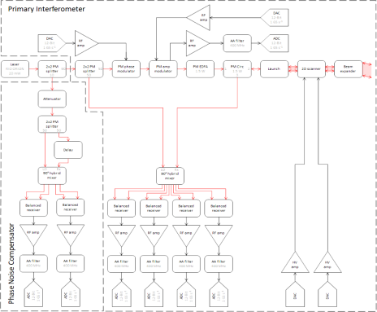
SDML - Introduction
Our idea – Software Defined Multifunction LIDAR (SDML):
  Combine all these sensing modalities in a single,
  physical instrument and swap between them
  under software control.
  Offers unprecedented sensing agility and flexibility.
Technical approach:
  Digitally synthesized amplitude and phase
  modulation in the Tx chain (and digitizers in the Rx chain).
  Software-configured modulation-demodulation format.
  Allows us to defer definition of sensing mode to run time.
  Potential to be as disruptive in the optical remote sensing domain
  as Software Defined Radio has been in the RF.
Recently started programme to develop SDML for HAPS platform
  https://www.qinetiq.com/News/2018/11/QinetiQ-team-wins-contract-to-develop-Software-Defined-Multifunction-LIDAR-SDML-after-success-in-UK-DSC-innovation-competition

Slide 6
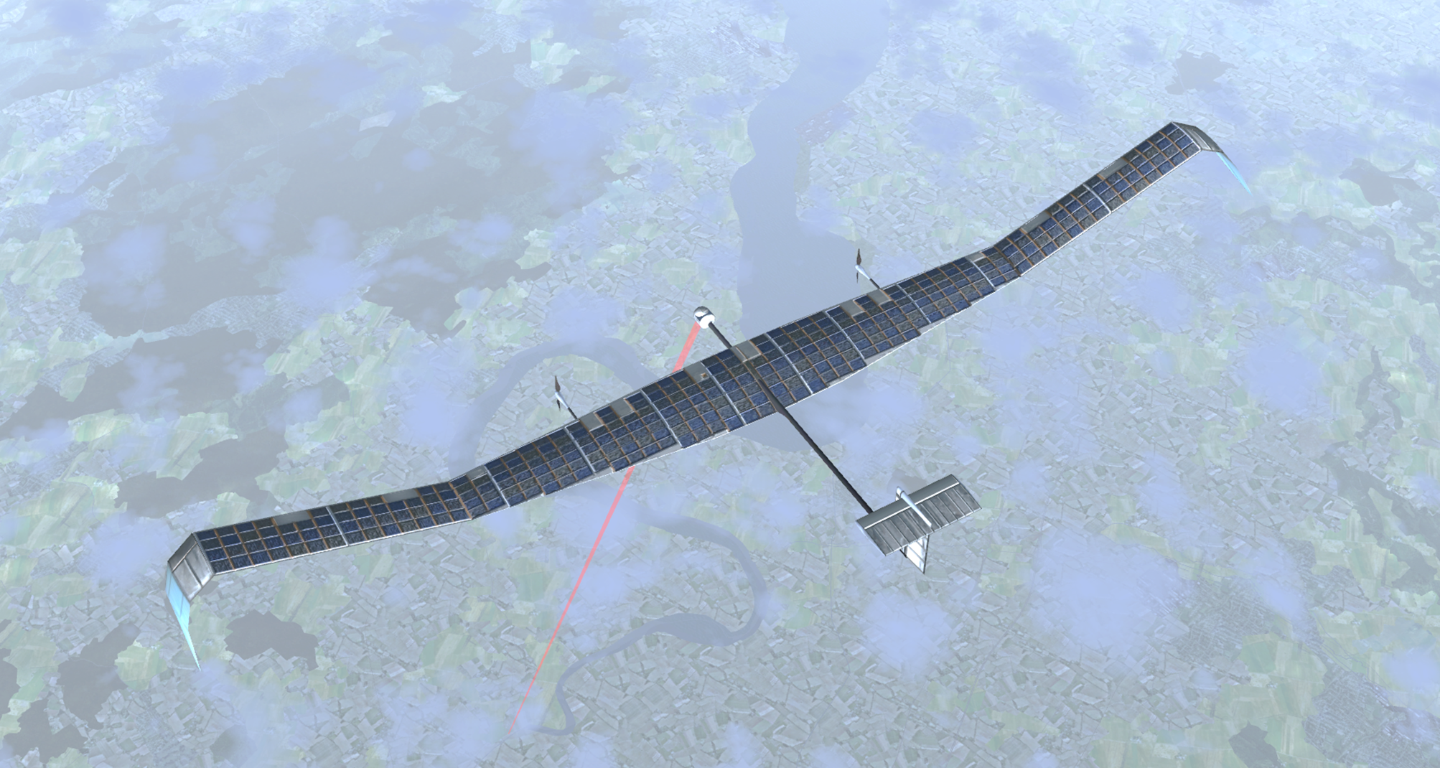
HAPS SDML concept

Slide 7
Free Space Optical Communications
Transmission of light over a free-space optical link to convey information
Typical elements of a free space optical communications system include:
  Optical source
  Modulation
  Beam director
  Transmitter
  Receiver
  Processor
The main difference between a Lidar and a comms system is the location of transmitter and receiver
  Lidar: Tx and Rx on the same end of the optical path
  Comms: Tx and Rx on opposite ends of the optical path
Can we adapt an existing Optical communications system to function as a range-finding lidar?

Slide 8
This programme
AIM
  Asteroid Impact Mission due for launch 2020
  Rendezvous with Didymos binary asteroid in 2022
  Study and characterise system before and after impact by NASA DART
OPTEL-D
  Deep-space optical communications terminal
  Incorporated into design of AIM mission
Aims of this programme
  Investigate options to add lidar functionality to OPTEL-D
  Produce breadboard to verify chosen option
  Identify route to upgrade OPTEL-D on timescales compatible with AIM

Slide 9
Requirements

Slide 10
Requirements summary
Develop Lidar Add-on concept
  Compatible with OPTEL-D
  Maximise re-use of OPTEL-D hardware
  Minimise modifications to OPTEL-D hardware
  Fibre optic solution preferred
Develop numerical simulation of lidar
  High-level language (Python)
  Model performance of chosen design
Construct and test breadboard
  Functionally representative of Lidar Add-on
  COTS components
  Test over representative ranges
    Static and moving targets
Parameter | Mode
 | Ranging | Surface Characterisation
Minimum range (m) | 100 | 100
Maximum range (km) | 35 | >13
Range precision (m 3σ) | 0.3 | 0.2
Range trueness (m) | 0.5 | 0.5
Surface resolution (m) | 1 | 0.3
Relative motion (ms⁻¹) | 0.5 | 0.5
Measurement rate (Hz) | >1 | -

Slide 11


Horizontal resolution
Horizontal surface resolution 1m @ 35km, 0.3m @13km
  Assume Tx aperture, d = 135mm
  Assume diffraction limited Gaussian beam
  Assume beam waist
  Far field divergence
  Beam size at 35km ~70cm, meets resolution requirement
  Beam size at 13km ~31cm, just outside requirement, but probably OK
$$ω_{0}=\frac{d}{π}≈43 mm$$
$$2θ=\frac{2λ}{πω_{0}}≈\frac{2λ}{π}\frac{π}{d}=\frac{2λ}{d}={2.3×10}^{−5} radians$$

Slide 12
Range precision
Range precision, 3σ, 0.3m @ 35km, 0.2m @ 13km
  Implies timing resolution ~0.44ns, 1σ
  Assume pulse lengths in the range 10 – 20 ns
    Sub-pulsewidth interpolation will be required
Several algorithms were investigated to determine most robust approach for estimation of pulse position
  Centroid: Centroid of data in the neighbourhood of the estimated peak location
  CFD: Digital implement of constant fraction discriminator with linear interpolation around zero-crossing point
  Correlation: Correlation of data with Gaussian pulse followed by quadratic interpolation of points near the correlation peak
Correlation algorithm was found to be the most accurate and robust method over a wide range of SNR values
  SNR > 15 will be needed to achieve target resolution

Slide 13
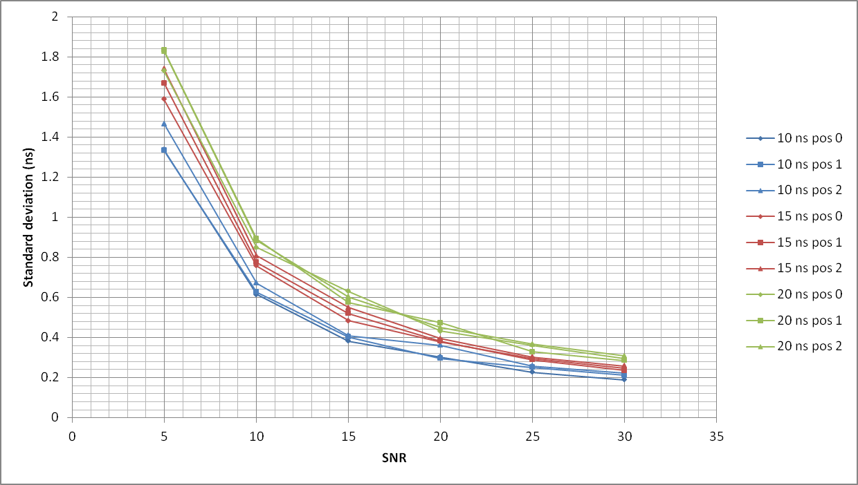
Correlation algorithm: Pulse position as a function of SNR
Assumptions:
  Digitisation of optical return @ 200MHz sample rate, plus added noise
  Gaussian temporal pulse profiles, radius to 1/e²
  Various timings of pulse with respect to sample positions

Slide 14
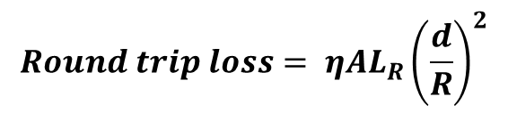
Link estimate
$$Round trip loss= η{AL_{R}\left(\frac{d}{R}\right)}^{2}$$
where
  Receiver losses L_{R} = 0.5 (assumed value)
  Target albedo A = 0.1 (assumed value)
  Single-mode Gaussian beam optimised for Tx aperture d = 135mm (assumed value)
  Single mode coupling efficiency η = 0.81 (for plane wave to single mode fibre)
  R = range
Round-trip loss = 128 dB @ 35km range
  Peak return power = 150pW from transmitted pulse with 1kW peak power
  Noise equivalent power (NEP) ~1.76nW
    commercial InGaAs avalanche photodiode (APD) into 64MHz bandwidth
Estimated SNR (single pulse) : ~0.086

Slide 15
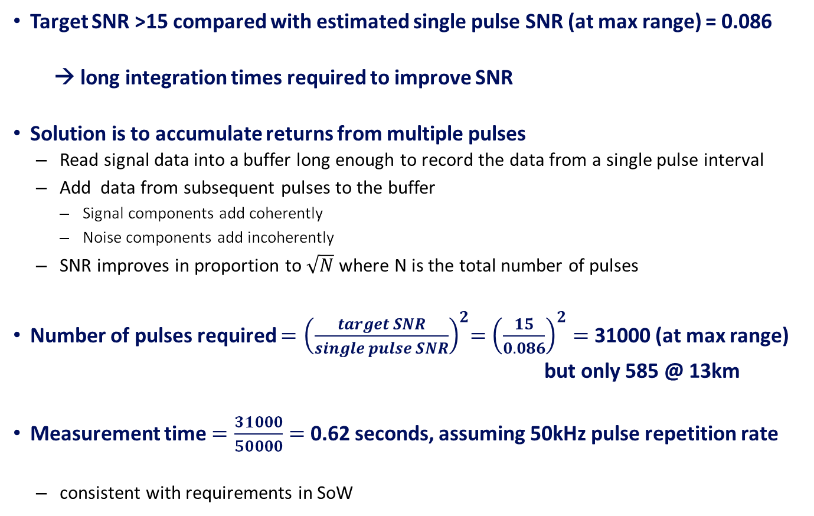
Accumulation of multiple pulses
Target SNR >15 compared with estimated single pulse SNR (at max range) = 0.086
→ long integration times required to improve SNR
Solution is to accumulate returns from multiple pulses
  Read signal data into a buffer long enough to record the data from a single pulse interval
  Add data from subsequent pulses to the buffer
    Signal components add coherently
    Noise components add incoherently
  SNR improves in proportion to $\sqrt{N}$ where N is the total number of pulses
Number of pulses required ${=\left(\frac{target SNR}{single pulse SNR}\right)}^{2}={\left(\frac{15}{0.086}\right)}^{2}=$ 31000 (at max range)
but only 585 @ 13km
Measurement time $=\frac{31000}{50000}=$ 0.62 seconds, assuming 50kHz pulse repetition rate
  consistent with requirements in SoW

Slide 16
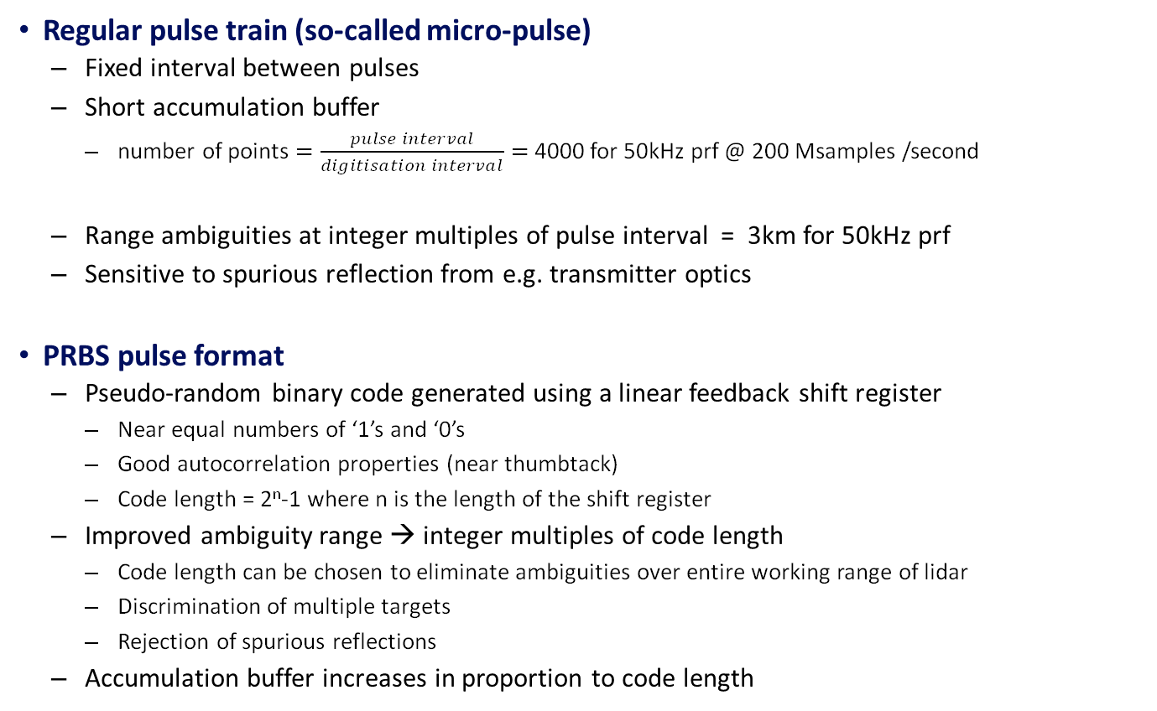
Modulation patterns
Regular pulse train (so-called micro-pulse)
  Fixed interval between pulses
  Short accumulation buffer
    number of points $=\frac{pulse interval}{digitisation interval}=$ 4000 for 50kHz prf @ 200 Msamples /second
  Range ambiguities at integer multiples of pulse interval = 3km for 50kHz prf
  Sensitive to spurious reflection from e.g. transmitter optics
PRBS pulse format
  Pseudo-random binary code generated using a linear feedback shift register
    Near equal numbers of ‘1’s and ‘0’s
    Good autocorrelation properties (near thumbtack)
    Code length = 2^{n}-1 where n is the length of the shift register
  Improved ambiguity range → integer multiples of code length
    Code length can be chosen to eliminate ambiguities over entire working range of lidar
    Discrimination of multiple targets
    Rejection of spurious reflections
  Accumulation buffer increases in proportion to code length

Slide 17
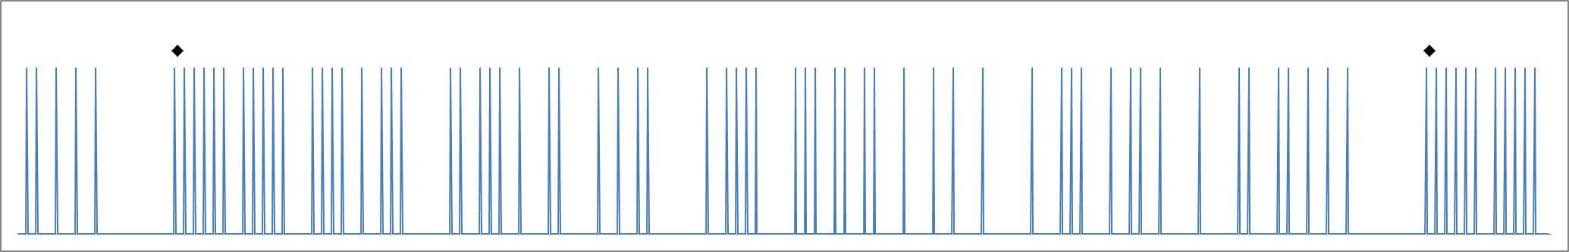
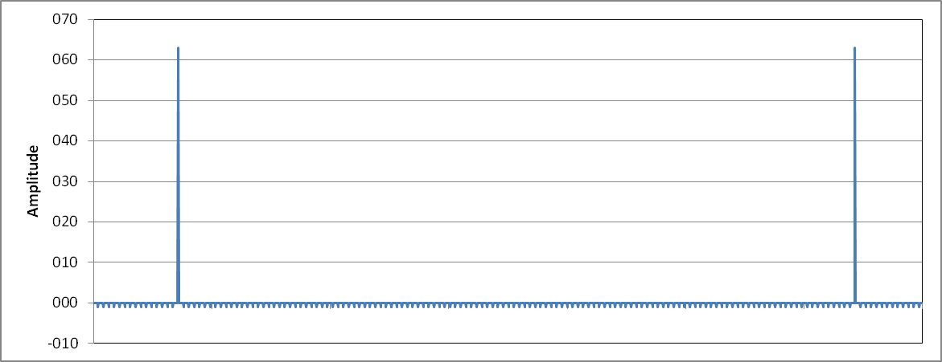

PRBS: simple modulation scheme
Transmit a pulse for each ‘1’ in the sequence
  Near-thumbtack correlation function
  Average pulse repetition frequency (prf) is half the un-modulated prf
  Interval between pulses highly variable
    Sequence contains runs of ‘0’s of various lengths
    EDFA stores energy while the pulses are absent → energy of next pulse depends on delay time
    First pulse after a long run of ‘0’s could be especially energetic → risk of optical damage
Pulse pattern
Correlation output

Slide 18
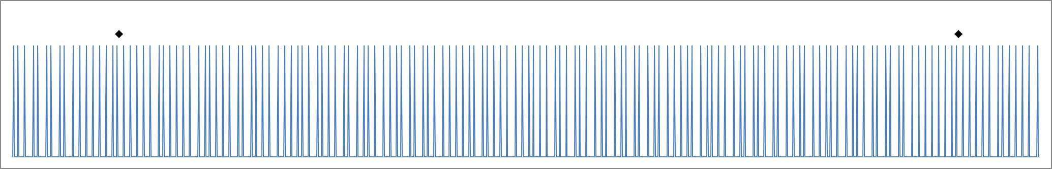
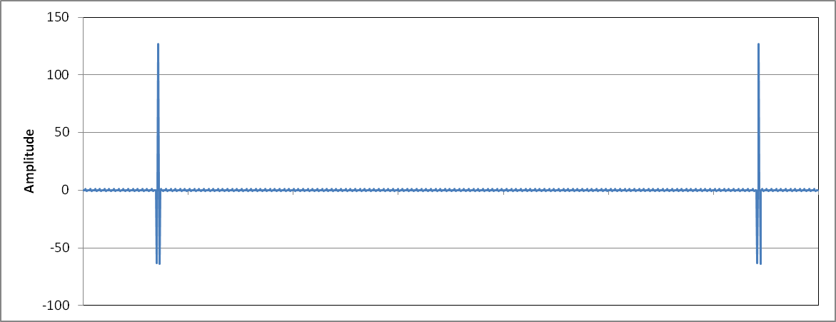
PRBS: ppm modulation scheme
Transmit a pulse for both ‘0’s and ‘1’s but in different time slots
  Strong correlation peak with adjacent negative ‘peaks’
    better rejection of small sidelobes
    limited discrimination of targets if strong correlation features from different targets overlap
    average prf determines measurement window between positive and negative features
  Average prf same as un-modulated prf → faster measurement rate
  Less variation of inter-pulse interval → less pulse-to-pulse variation
Pulse pattern
Correlation output

Slide 19
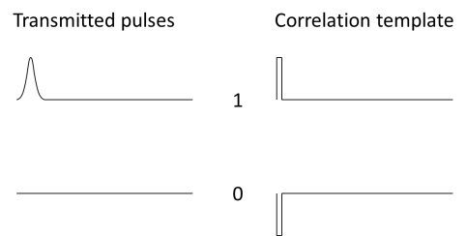
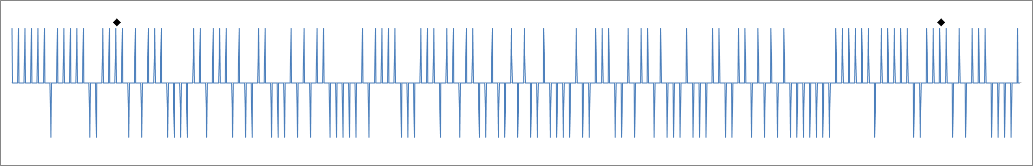
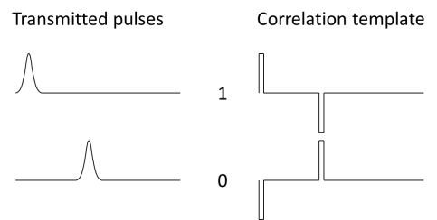
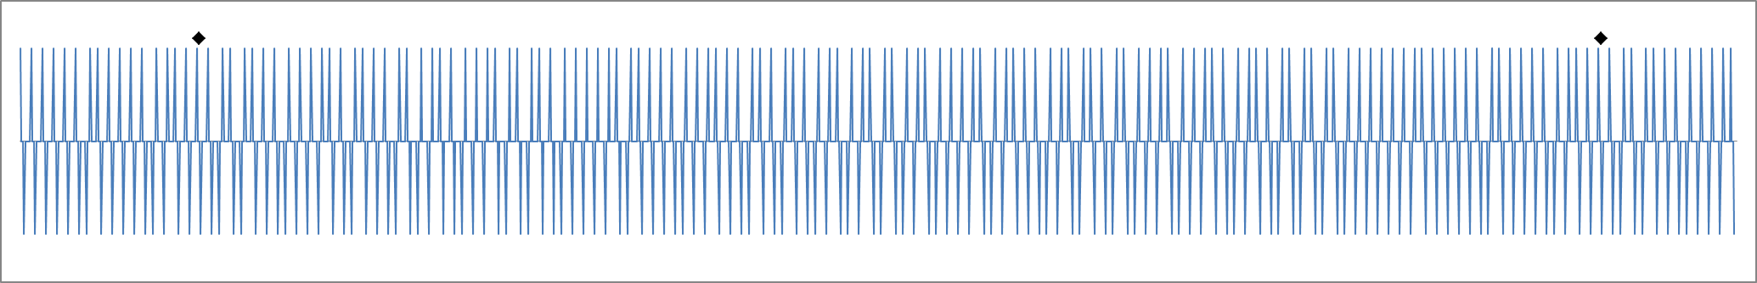
PRBS signal processing
1. Correlate buffer with template
2. Locate peak(s) of interest
3. Quadratic interpolation around peak to estimate peak position to fraction of data interval
Correlation template for simple modulation scheme, n=7
1
0
-1
Correlation template for ppm modulation scheme, n=7
1
0
-1

Slide 20
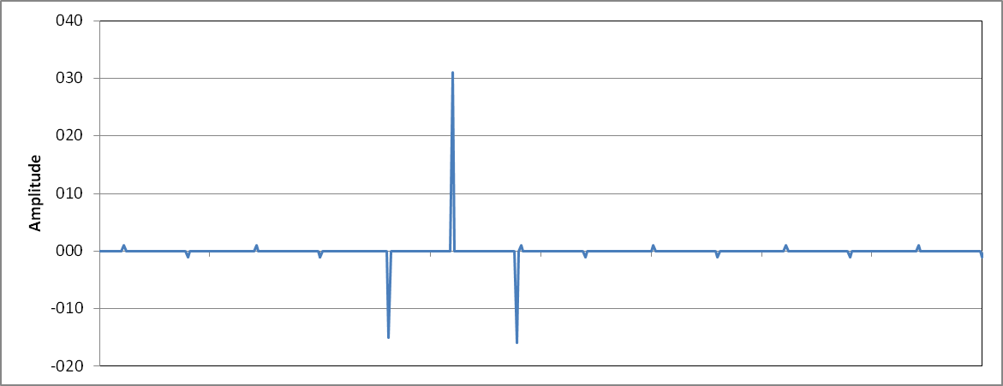
Resolution of multiple targets
  Main correlation feature consists of one sharp peak equidistant from two negative spikes
    No weak sidebands present between negative features
  Negative spikes are separated by mean pulse interval, equivalent to 3km @ 50kHz prf
    Negative and positive features will not overlap for targets less than 1.5km apart
    De-convolution of pulse shape will be required to resolve targets closer than the pulse width (~3.3m for a 20ns pulse)
  Widely separated targets can be resolved provided that weak sidebands of the stronger return are smaller than the main peak of the weaker return
    e.g. discrimination between target and reflections from Tx optics
Close-up of main features (n=5)

Slide 21
Numerical model

Slide 22
Simulation flow diagram
Configuration
Propagation
Detection and digitisation
Analysis
Define model parameters
Update target positions
Calculate detector signal
Apply processing gain
Signals above threshold?
Define target(s)
Calculate target returns
Calculate digitiser output
Locate strongest signal
YES
NO
Define modulation sequence
Advance modulation sequence
Update output buffer
Calculate range and strength
Eliminate signal from buffer
NO
Sequence complete?
YES
Store outputs
Display results

Slide 23
Model parameters
Digitiser
  Bit depth
  Sensitivity
  Sample rate
  Bandwidth
  Noise
Other
  Model sample rate
    typically a few times digitiser rate
  Integration grid size
  Temporal waveform
    time series of (complex) amplitudes
Source and transmitter
  Rx aperture
  Beam properties
  Laser power
  Laser noise characteristics
    amplitude noise
    phase noise
Detector
  NEP
  Sensitivity
  Bandwidth
  Trans-impedance gain
  Filters
    Low pass (typically 60MHz)
    High pass

Slide 24
Propagation model
Transmitted field
S₀
S₁-S_{n}
Receiver field
S₁-S_{n}

Slide 25
Model elements
Scatterers
  Point-like scattering elements make up target
  Normal vector defines direction of element
  Cross-section determines scattering strength
    Defined as area of target element multiplied by albedo
    Corrected for angle between normal and line of sight to lidar
  S₀ typically a single scatterer close to transmitter to represent stray reflections in the optics
  S₁– S_{n} typically one or more elements that make up a target
Targets
  Rigid assemblies of scatterers
  Targets have linear and angular velocity
  The model supports multiple targets
Beams
  Tx beam defines the amplitude and phase of the transmitted beam
  Rx ‘beam’ defines the amplitude and phase of the receiver mode
  Tx and Rx are identical for a monostatic receiver

Slide 26
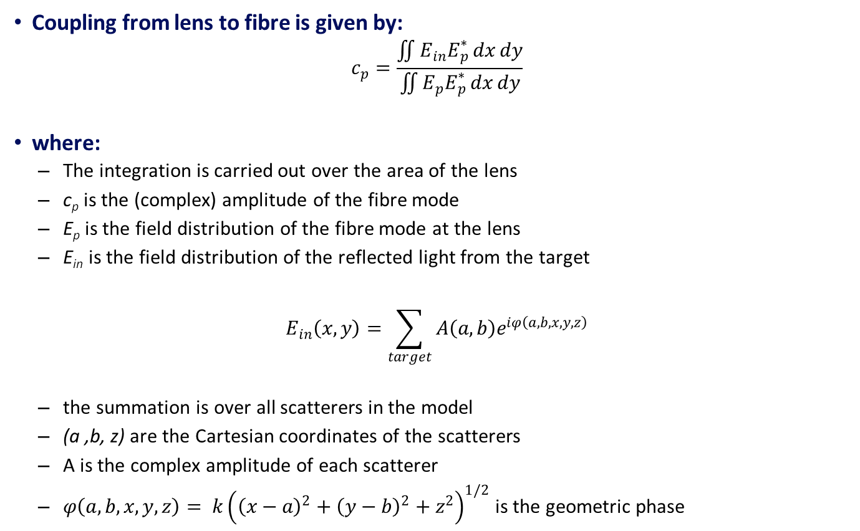
Overlap integral
Coupling from lens to fibre is given by:
$$c_{p}=\frac{\iint{E_{in}E_{p}^{∗}dxdy}}{\iint{E_{p}E_{p}^{∗}dxdy}}$$
where:
  The integration is carried out over the area of the lens
  c_{p} is the (complex) amplitude of the fibre mode
  E_{p} is the field distribution of the fibre mode at the lens
  E_{in} is the field distribution of the reflected light from the target
$$E_{in}\left(x,y\right)=\sum_{target}{A\left(a,b\right)e^{iφ\left(a,b,x,y,z\right)}}$$
  the summation is over all scatterers in the model
  (a ,b, z) are the Cartesian coordinates of the scatterers
  A is the complex amplitude of each scatterer
  $φ\left(a,b,x,y,z\right)= k{\left({\left(x−a\right)}^{2}+{\left(y−b\right)}^{2}+z^{2}\right)}^{1/2}$ is the geometric phase

Slide 27
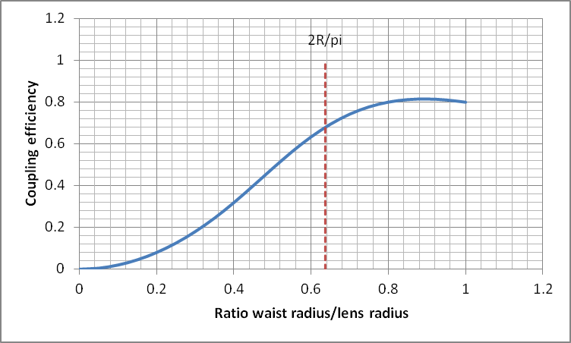
Plane wave coupling to single mode fibre

Slide 28
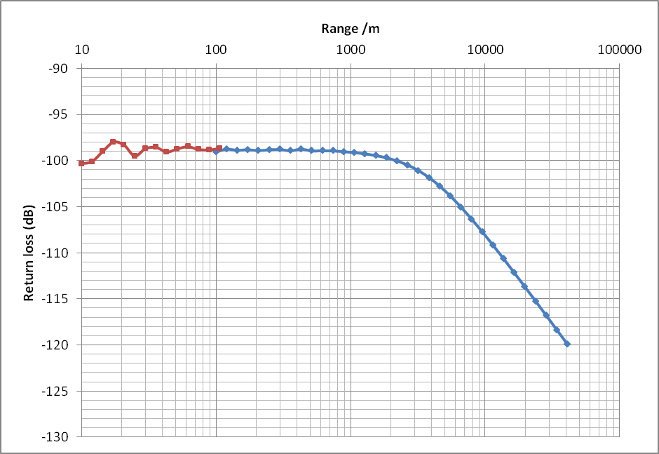
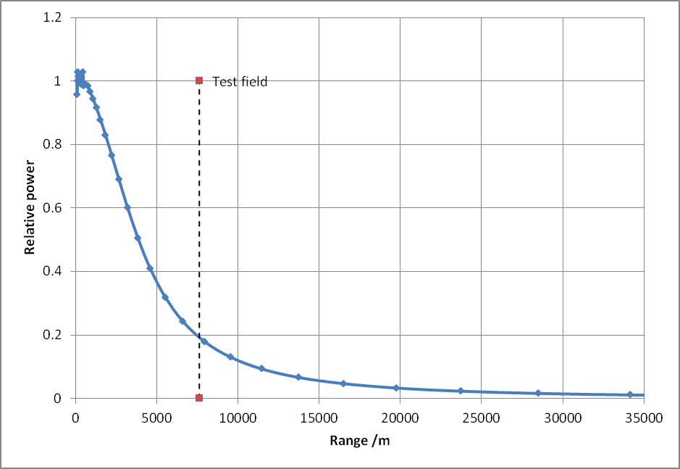
Return loss as function of range (planar target)
Far field: return is inversely proportional to square of range
Near field: return is nearly constant
  NB Oscillations at very short range (red curve) are artefacts of numerical model (under-sampled grid)
Predicted dynamic range ~20dB (neglecting variations of albedo)
Model agrees with analytic estimate of return

Slide 29
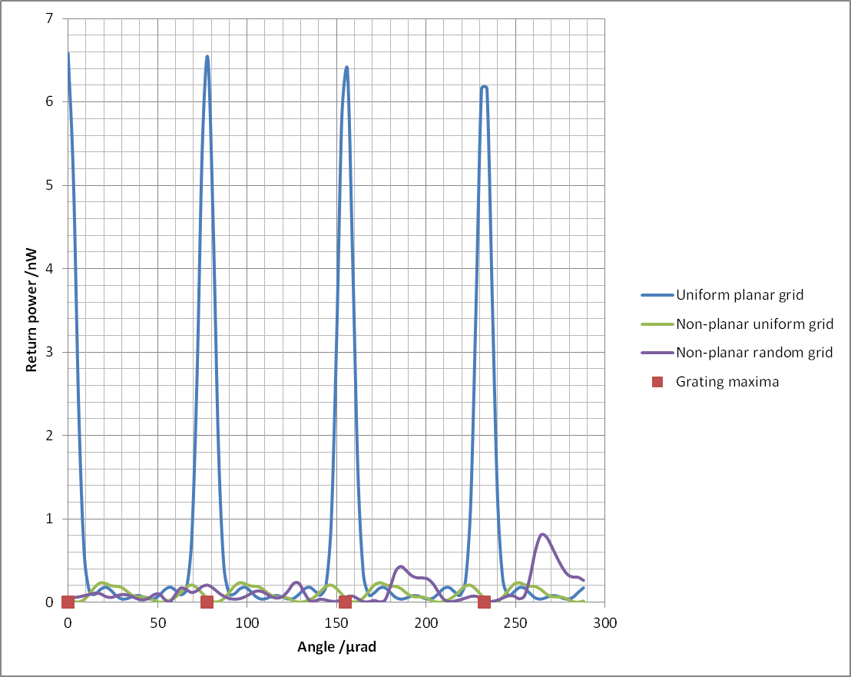
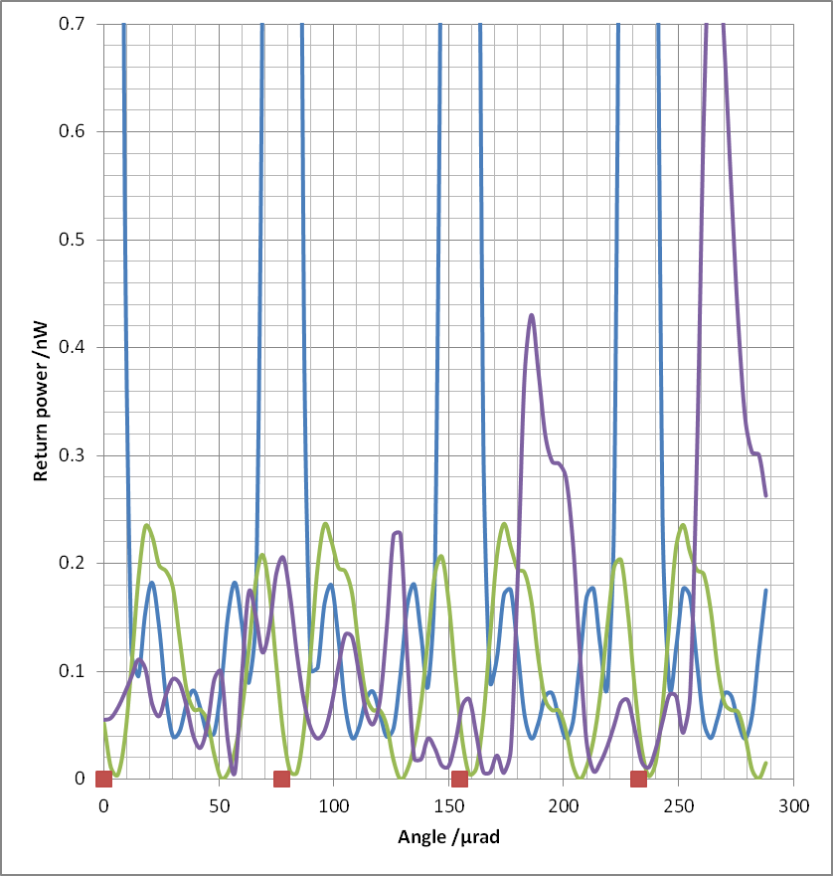
Coherence effects
Regular grid of scatterers acts as a diffraction grating
Random phases assigned to each scatterer reduce effects of constructive interference
Irregular grid simulates laser speckle

Slide 30
Detection and digitisation
Loop over simulation iterations
Seed laser field generation
Transmit field generation
Loop over scatterers
Backscatter field generation and accumulation
Detector signal and noise generation
Amplification
Filtering
Digitisation

Slide 31
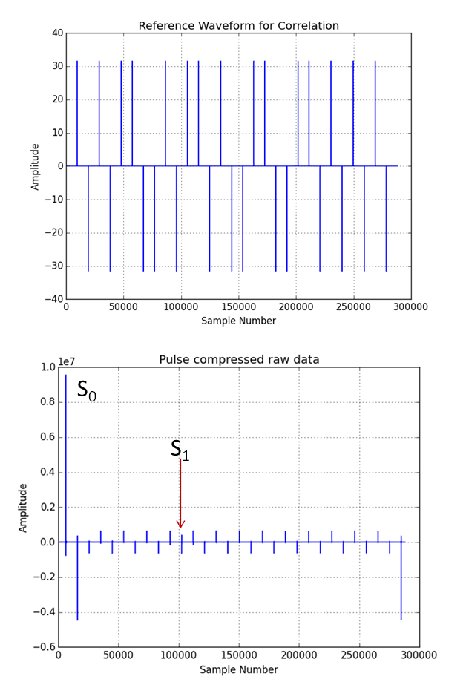
Processing gain
Construct correlation template according to transmitted waveform
Calculate periodic correlation function between template and periodic detector buffer
Correlation output shows clear features from both S₀ and S₁
Main peak due to S₁ is smaller than, and partially overlapping, secondary peak from S₀

Slide 32
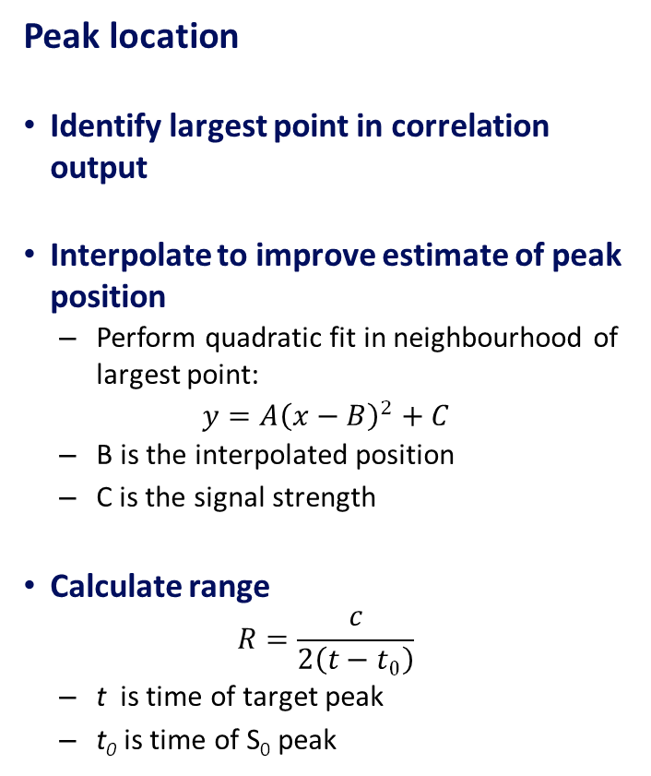
Find peaks
Calculate threshold for peak detection
Locate largest point in correlation output
Select a portion of the detector output away from the largest point
Calculate the standard deviation, σ, of the selected portion
Ignore peaks smaller than 5σ when locating peaks
Peak location
Identify largest point in correlation output
Interpolate to improve estimate of peak position
  Perform quadratic fit in neighbourhood of largest point:
$$y=A{\left(x−B\right)}^{2}+C$$
  B is the interpolated position
  C is the signal strength
Calculate range
$$R=\frac{c}{2\left(t−t_{0}\right)}$$
  t is time of target peak
  t₀ is time of S₀ peak

Slide 33
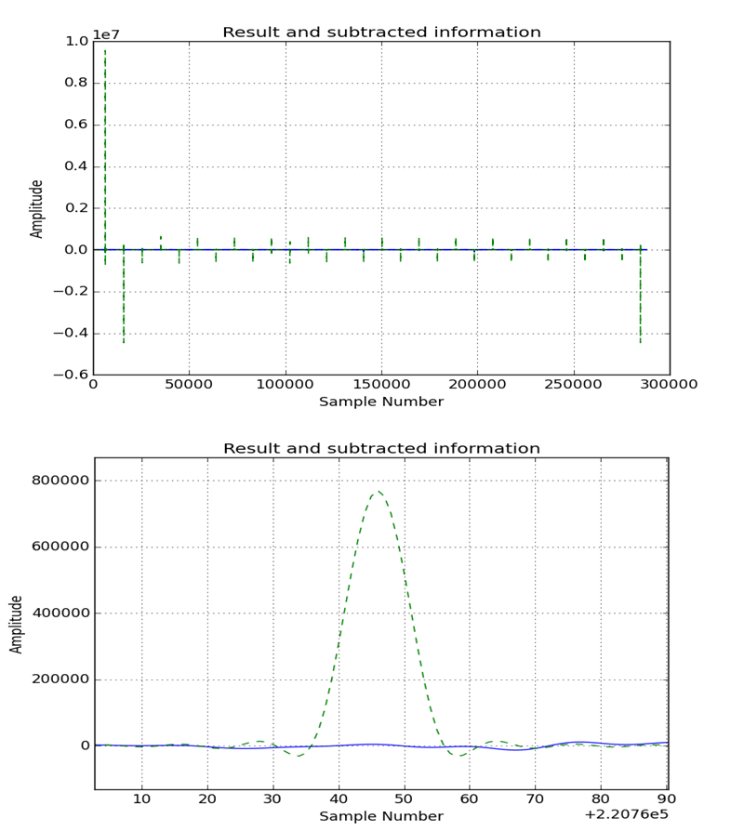
Peak removal
Calculate periodic convolution between main peak and idealised correlation output (i.e. from noise-free delta-function pulse)
Subtract convolution output from buffer
  Signals and noise in vicinity of secondary peaks are largely preserved
Re-calculate noise threshold
Search for further peaks

Slide 34
Simulation parameters
System Parameter | Value
ADC Sample Rate | 160 MHz
Waveform Gen Sample Rate | 960 MHz
Pulse Width | 20 ns
Pulse Peak Power | 1 kW
PRF | 50 kHz
Aperture Radius | 0.0675 m
NEP | 0.45 pW/Hz^{1/2}
Digitiser Bit Depth | 8
Low Pass Filter | Disabled
High Pass Filter | Disabled

Slide 35
Simulation of range measurements to single scatterers
Range | Cross Section | Calculated Range (m) | Code Length | Dwell Time (s)
100m | 0.1 | 99.92 | 15 | 1
1km | 0.1 | 999.14 | 15 | 1
2.5km | 0.1 | 2499.05 | 15 | 1
5km | 0.1 | 499.039 | 15 | 1
10km | 0.025* | 9998.92 | 15 | 1
20km | 0.1 | 19998.94 | 31 | 1
35km | 0.5 | 34999.18 | 255 | 1
Note: S₀ at 1 metre distance

Slide 36
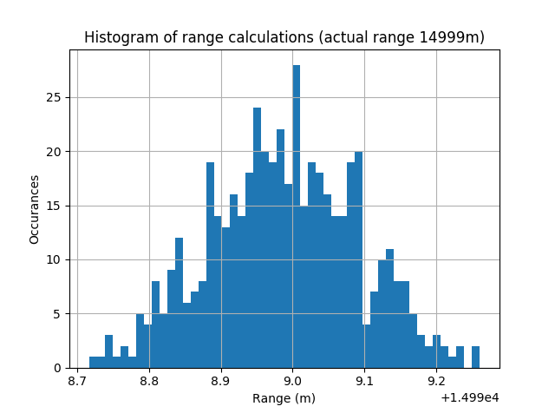
Variation of range estimates
500 independent simulations
0.01s integration time
Target @ 14999m
Mean estimate is consistent with nominal target position
Standard deviation is consistent with target specification for lidar add-on

Slide 37
Algorithm profiling
Code Length | Total | Integration | Pulse Compression | Peak Removal | Range Calculation
15 | 0.349 | 0.1 | 0.019 | 0.309 | ~0
31 | 0.600 | 0.1 | 0.140 | 0.460 | ~0
63 | 1.34 | 0.1 | 0.250 | 1.180 | ~0
127 | 5.62 | 0.1 | 1.190 | 4.430 | ~0
255 | 6.760 | 0.1 | 1.160 | 5.600 | ~0
511 | 24.45 | 0.1 | 5.240 | 12.210 | ~0
1023 | 45.58 | 0.1 | 9.350 | 36.230 | ~0
2047 | 121.240 | 0.1 | 26.860 | 94.380 | ~0
4095 | 232.850 | 0.1 | 63.050 | 169.810 | ~0

Slide 38
Model Summary
The numerical model covers optical propagation, detection and digitisation and includes various effects such as laser coherence, speckle, detection and digitisation noise
The output of the model matches theoretical calculations under known conditions
The processing and analysis algorithm can locate and measure weak returns in the presence of much stronger returns at other ranges
The processing time is less than one second for short codes, but rises as the code length increases; further optimisation may be required to allow real-time measurements of weak returns at 1Hz
The model has been used to verify the detailed design using nominal device parameters. Future simulations will be run with actual device parameters where available.

Slide 39
Design

Slide 40
Lidar detection schemes
Direct detection
Detector voltage is proportional to return power
Signal falls as the square of the range
Noise limited by detector and electronics
SNR depends on peak laser power
Simplest detection scheme
  minimal hardware changes to OPTEL-D
  addition of detector and associated electronics
Compatible with existing components of OPTEL-D
  No need for narrow linewidth laser
  Laser polarisation is unimportant
Coherent detection
Detector voltage is proportional to the square root of the return power
  Return signal at detector is mixed with local oscillator
Signal varies inversely with the range
Shot noise limited
SNR depends on average laser power
Complex detection scheme
Requires significant changes to OPTEL-D
  Change of laser to narrow linewidth type
  Addition of interferometer
  Addition of phase noise compensation scheme

Slide 41
Trade off
Factor | Weighting | Micro pulse | Coded pulse | Coherent detection
Size | 3 | 4 | 4 | 3
Weight | 3 | 4 | 4 | 3
Power | 3 | 4 | 4 | 3
Compatibility with OPTEL-D | 5 | 4 | 4 | 2
Hardware complexity | 3 | 5 | 5 | 2
Software complexity | 2 | 5 | 3 | 2
Cost | 5 | 3 | 3 | 1
Maturity | 5 | 4 | 3 | 2
Target discrimination | 4 | 1 | 5 | 5
Sensitivity | 4 | 3 | 2 | 5
Accuracy | 5 | 5 | 5 | 5
Versatility | 1 | 1 | 3 | 5
Weighted score |  | 158 | 163 | 132

Slide 42
Functional diagram
Source
Detection
Director
To target
Laser
Modulator
EDFA
Isolator
Circulator
Tx / Rx
Pulse generator
Filter
Motor driver
Detector
optical
Laser control
Pulse generator control
EDFA control
electrical
Amplifier
Motor control
Source and Director sections represent existing elements of OPTEL-D.
RF Filter
Digitiser
Control, acquisition, processing and visualisation

Slide 43
EDFA performance
EDFA output connected to short test fibre
CW
  Power rises linearly with diode current
  No issues with power handling
Pulsed
  50 kHz, 10 ns pulses
  Power initially rises linearly with diode current
    Average power lower than CW power for the same diode current
  Rate of increase falls for diode currents above ~5200mA
    Appearance of new spectral features consistent with SBS
    Increase in broadband background level
    Output signal fluctuates
  Peak output power estimated to be ~450W
    No significant rise observed with increase in diode current
    Higher currents have been avoided to minimise risk of damage

Slide 44
Output spectra (in pulsed mode)

Slide 45
Circulator
Requirements
  3W average power handling
  >1kW peak power handling
  Low return loss ( > 50dB)
Two high power circulators were procured and tested
  Both companies have experience in manufacture for space
  AFR have stated that their circulator “would be designed and made to be compatible with space use, although it would not be tested or qualified as such”
Manufacturer | Part number | Peak power [kW] | Average power [W] | Crosstalk [dB]
Advanced Fiber Resources (CHN) | FCIR-55-N-B-1-P | 2 | 3 | 60
Agiltron (USA) | MX-LN-10-PD-P-P-FA-FA | >1 | 5 | 50

Slide 46
Circulator testing
Two circulators tested prior to breadboard assembly
The circulators both functioned nominally after more than twenty minutes of continuous operation at the maximum power achieved, and have withstood occasional pulses with a peak power of more than 1.2kW.
Both circulators have low coupling from port 1 to port 3.
The AFR unit has the best performance in this regard (better than -60dB) and is the preferred circulator for the breadboard.
The AFR unit has now been permanently spliced to the output of the EDFA

Slide 47
Fibre caps
Diamond PSf technology
  Glass rod fused to end of fibre
  Increases beam area at glass/air interface
  Minimise risk of laser-induced damage
  Estimated beam diameter 70µm at output facet
  Power density at output facet below estimated damage threshold for 3W average power
Capped fibres to be fusion spliced to port 2 of circulator
mode expands through capped section
large mode area at fibre exit
single mode fibre
cap

Slide 48
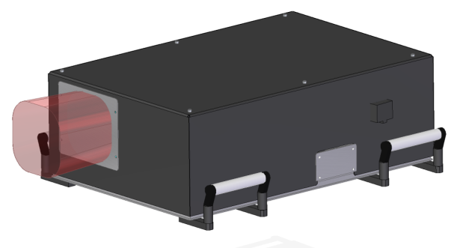
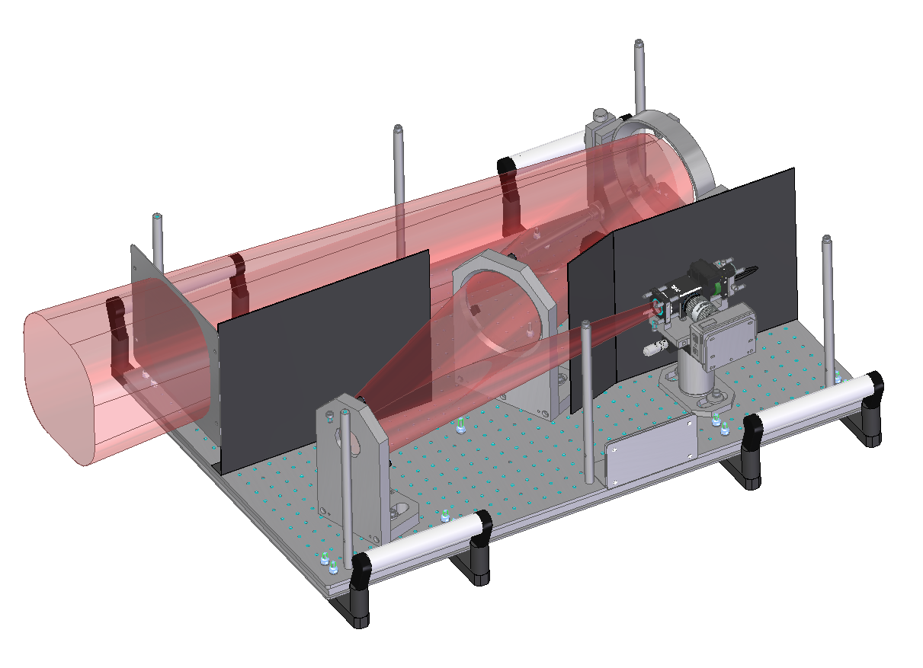
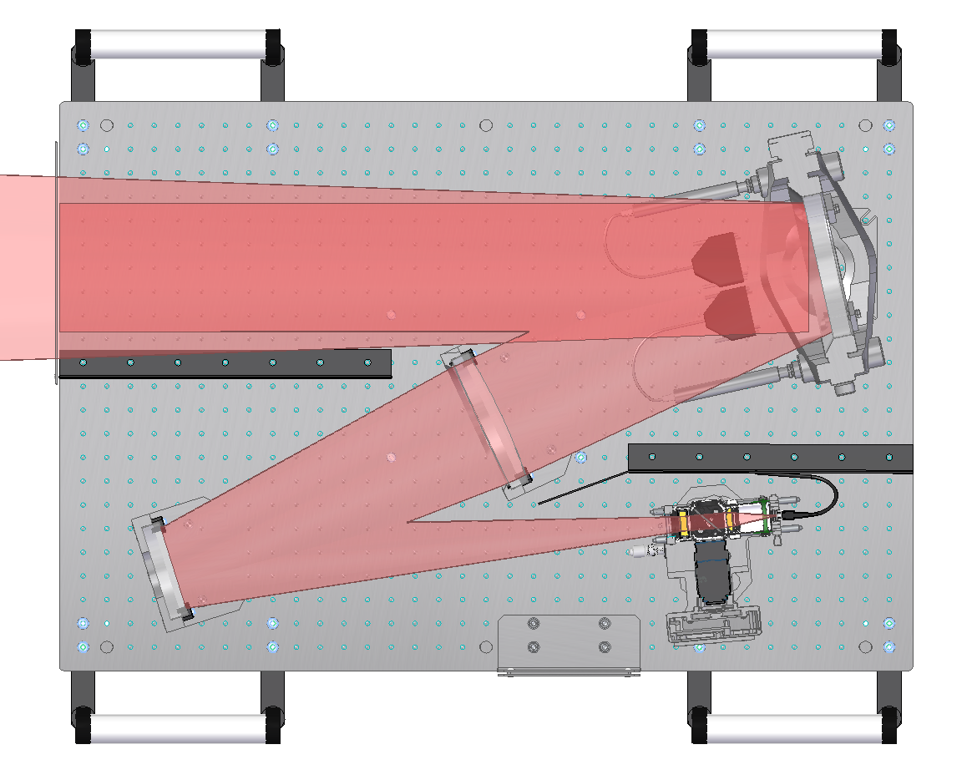
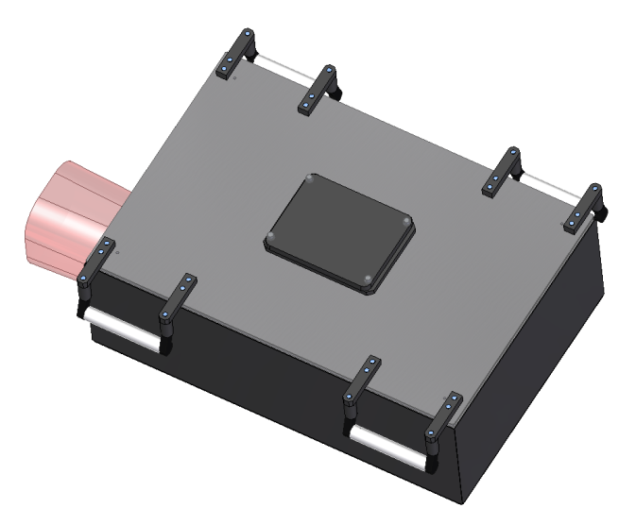
Optical Head Layout
Handles
Honeycomb breadboard
Gimbal with Mirror
Beam
Baffle
Baffle
Lens
Fold Mirror
Interface panel
Fibre Launch
Sub Assembly
Camera

Slide 49
Detector
Requirements
  Low NEP
  Tolerant to over-exposure
    Narcissus signal could be 10⁻⁵ of peak laser power i.e. up to 10mW peak
    Rapid recovery required
  Bandwidth ~100MHz
Selected item Princeton Lightwave PAR-150M-1550TOC
  Lowest NEP of devices identified
  Overload protection circuitry
  Direct access to bias control and TEC
  Manufacturer has confirmed that there are no fundamental reasons why a device like this could not be qualified for the space environment
Manufacturer | Model | Ø [µm] | BW [MHz] | NEP [nW_{rms}] | V_{noise} [mV_{rms}] | P_{sat} [dBm] | TEC | Type
Princeton Lightwave | PAR-150M-1550TOC | 80 | 150 | 0.6 | 0.23 | 0 | Yes | Integ’d device

Slide 50
Digitiser / Pulse generator
Digitiser requirements
  100 – 200 MHz sampling rate
  ~100 MHz bandwidth
  Dynamic range >10bits
  Voltage range matched to amplifier output
  Synchronised with pulse generator
Pulse generator requirements
  Capable of generating 10 – 30 ns pulses
  Fast rise times
  Synchronised to digitiser
Combined DAC / ADC
  Innovative Integration XA-160M
  TI ADC16DV160 ADC
  Analog Devices AD9122 DAC
  160 MSamples/second
  160 MHz bandwidth
  16 bit depth, 12bit ENOB
  50 ppm clock
Possible space grade ADC
  Texas Instruments TI ADS-5474-SP
  Up to 400 MSamples/second
  14 bit depth, 10.9 bit ENOB
Space grade DAC
  Existing source modulation system in OPTEL-D can be used

Slide 51
Manufacturing and Assembly

Slide 52
Breadboard layout
The layout of optical components is dictated by the optical system
Other components have been positioned to minimise impact on the lidar beam
  Minimise beam distortion
  Components liable to get warm have been mounted outside beam path
    Power board
    EDFA (external heat sink)
    Amplifier
    Motor controllers
Cables coiled up underneath beam path
  Motor drive cables
  Serial cables
  Power cables
External connections
  1 x power
  2 x USB
  2 x SMA
Cover
  Interlocked to EDFA
  Removable dust cover on lidar aperture
Tripod interface
  4 x M8 tapped holes
  4 x M6 tapped holes
  Mounted below estimated CoG
Handles fitted at four corners
  Ease of lifting heavy load
  Convenient power supply cradle

Slide 53
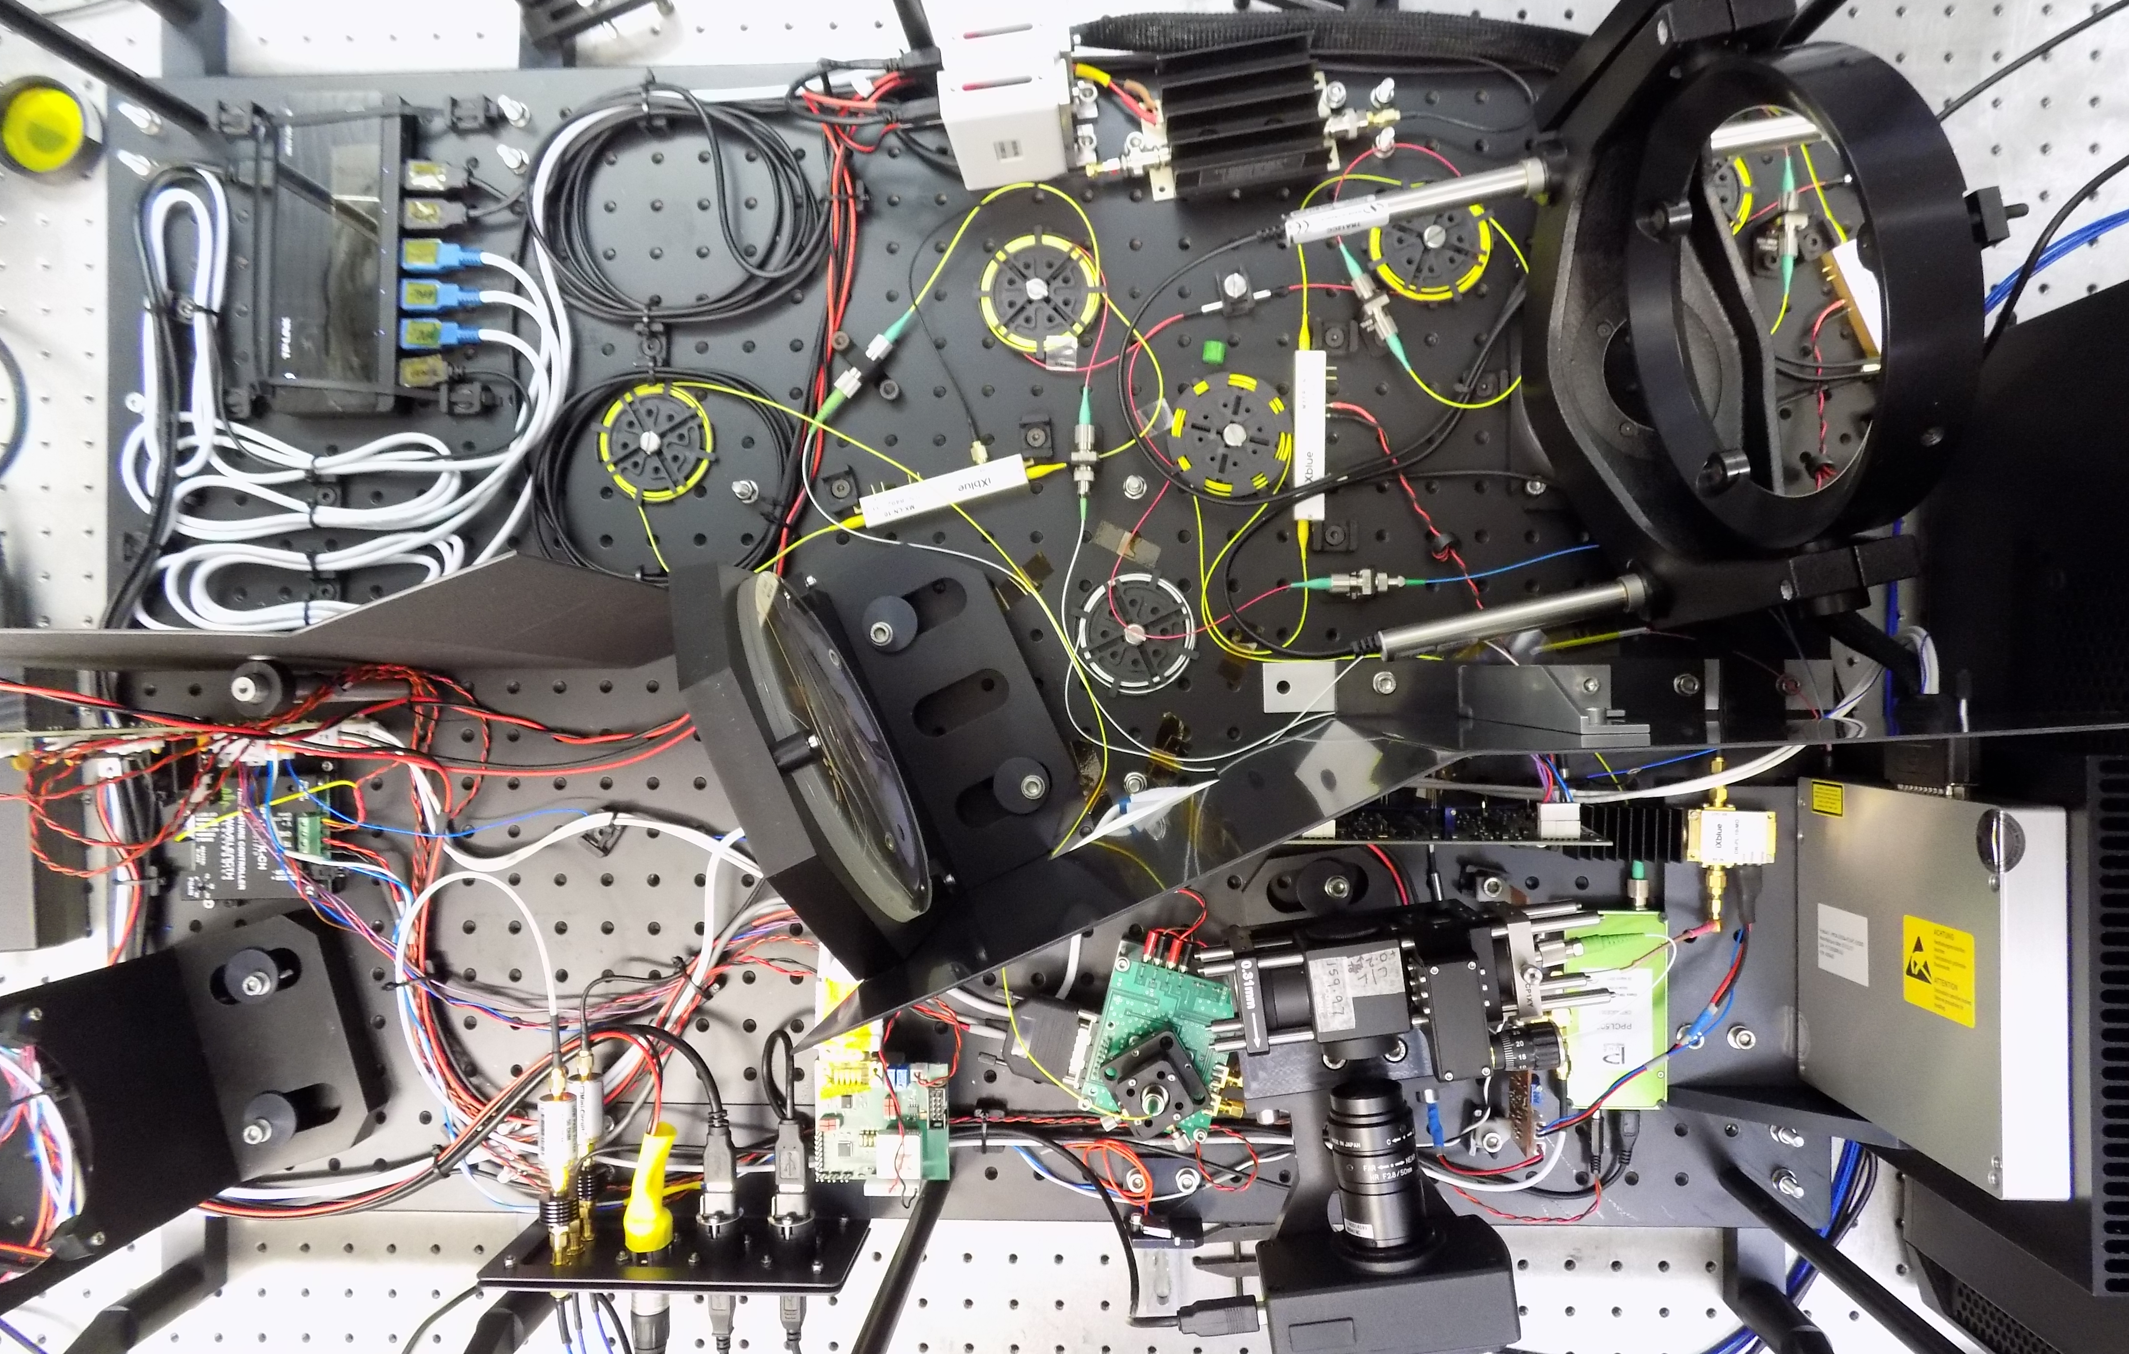
Breadboard layout
Beam director
Modulator
Detector
EDFA
Camera

Slide 54
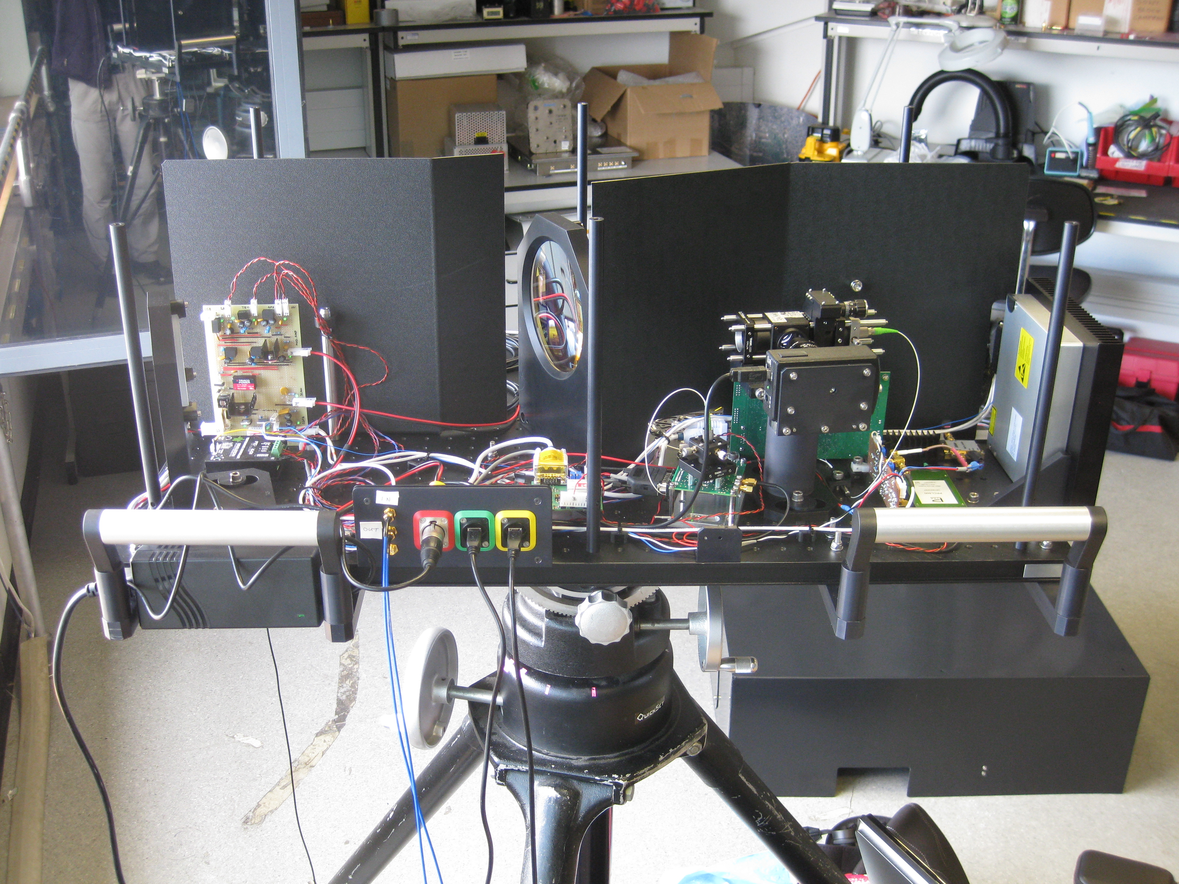
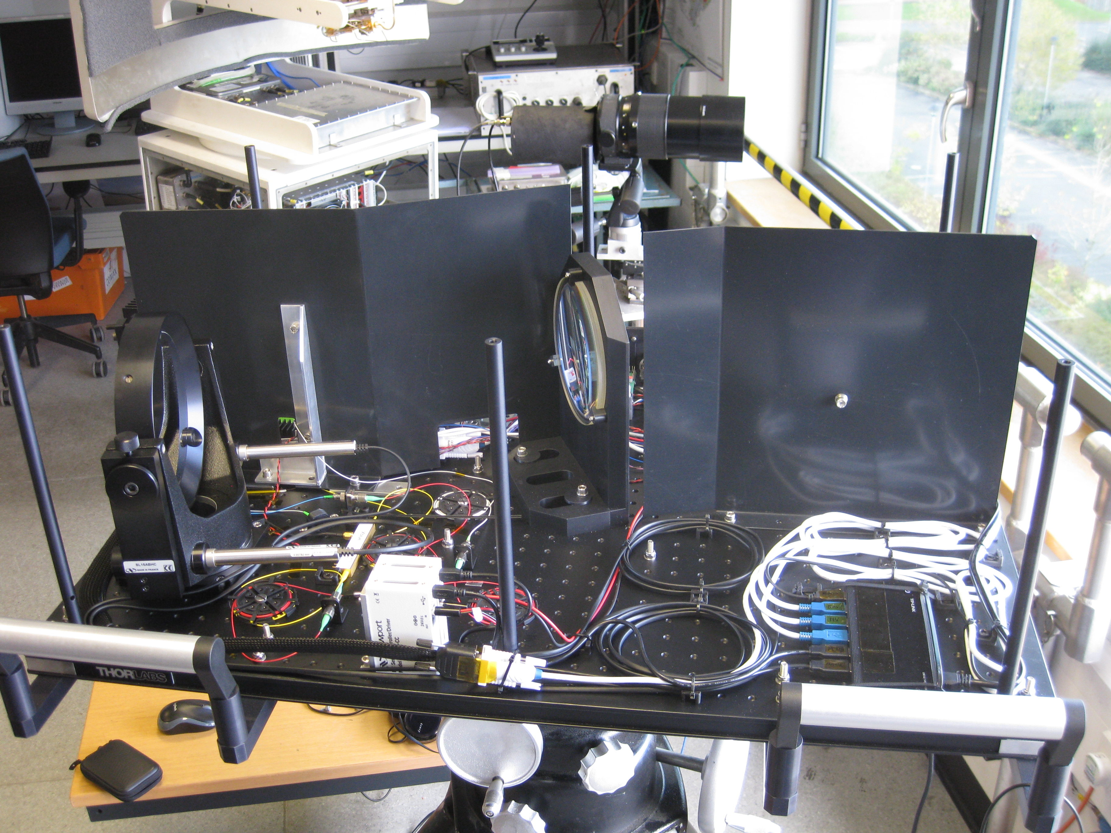
Breadboard layout

Slide 55
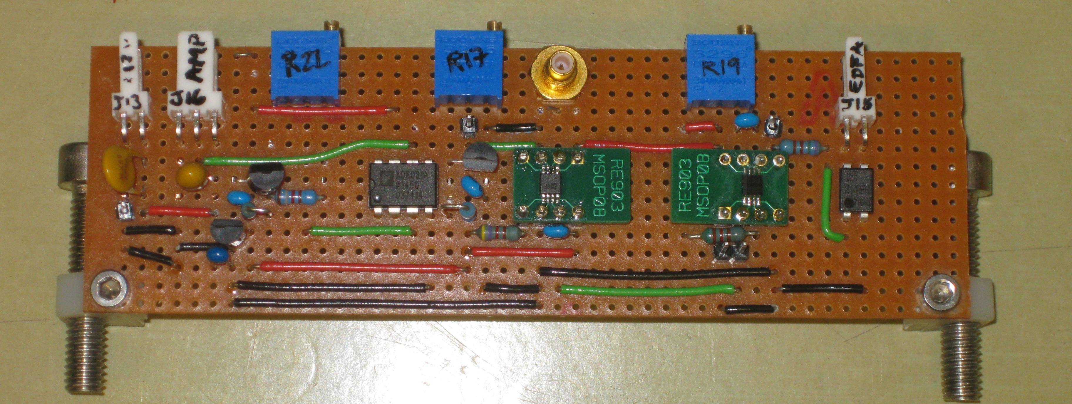
Amplifier bias circuit and pulse monitor
Amplifier bias circuit
Regulated voltage source to control amplifier gain
Adjusted to maximise pulse amplitude out of first stage of EDFA
Pulse monitor
Part of interlock circuit
Monitors continuity of input pulses to amplifier
Disables EDFA if pulse is absent for more than 50 µs
  Slow recovery allows time for software to respond
Prevents dangerous build-up of EDFA gain in the event of a problem with the DAC

Slide 56
Narcissus suppression
An electro-optic modulator has been introduced between receiver output and detector
  50ns blanking pulse suppresses receiver signal during pulse transmission
  >17dB improvement in signal to clutter by suppression of narcissus signal
  ~3dB loss of sensitivity to targets at ranges corresponding to integer multiple of prf (2% of ranges theoretical)
  ~4dB degradation of SNR due to insertion loss of modulator
narcissus
narcissus
signal
signal
from receiver
E-O modulator
detector
blanking signal

Slide 57
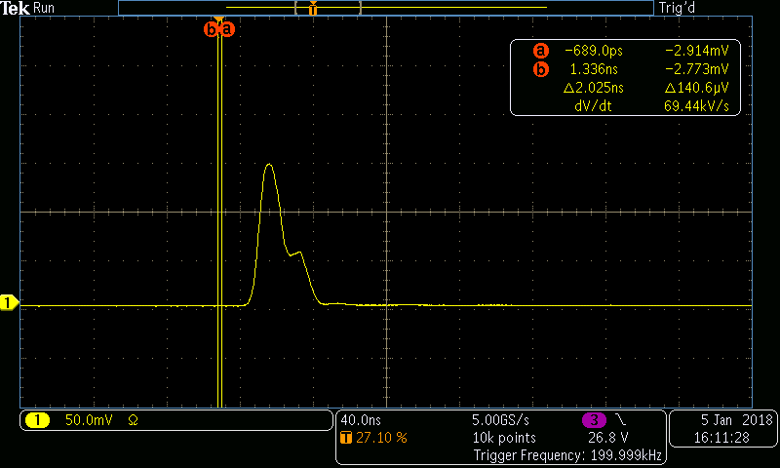
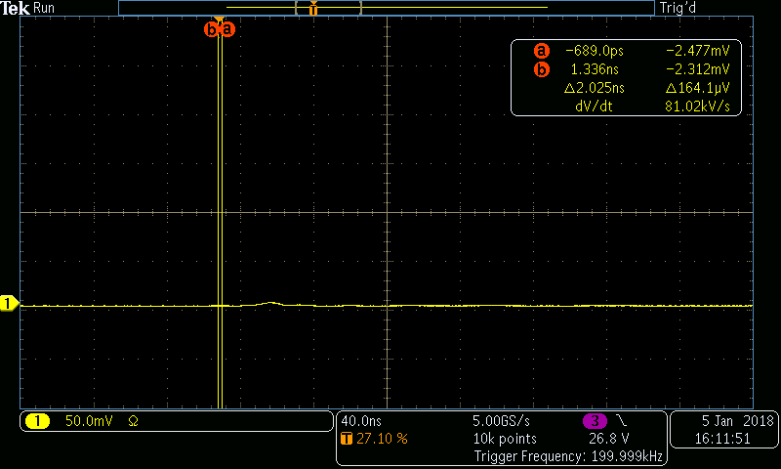
Narcissus suppression
No blanking signal
With blanking signal

Slide 58
Controller
Computer
  Custom build for this programme
  Software
    Windows OS
    Python
    Anti-virus
    Version control software
  Samsung EVO 960 nVME storage drive
    Supports high speed data transfer for ADC and DAC
    1.7 GBps write speed, 3.2 GBps read speed
ADC and DAC
  Innovative Integration XA-160M
GPS clock
  Leo Bodnar clock installed inside computer case
  External connections to aerial and ADC/DAC card
  Verified against GPS reference clock

Slide 59
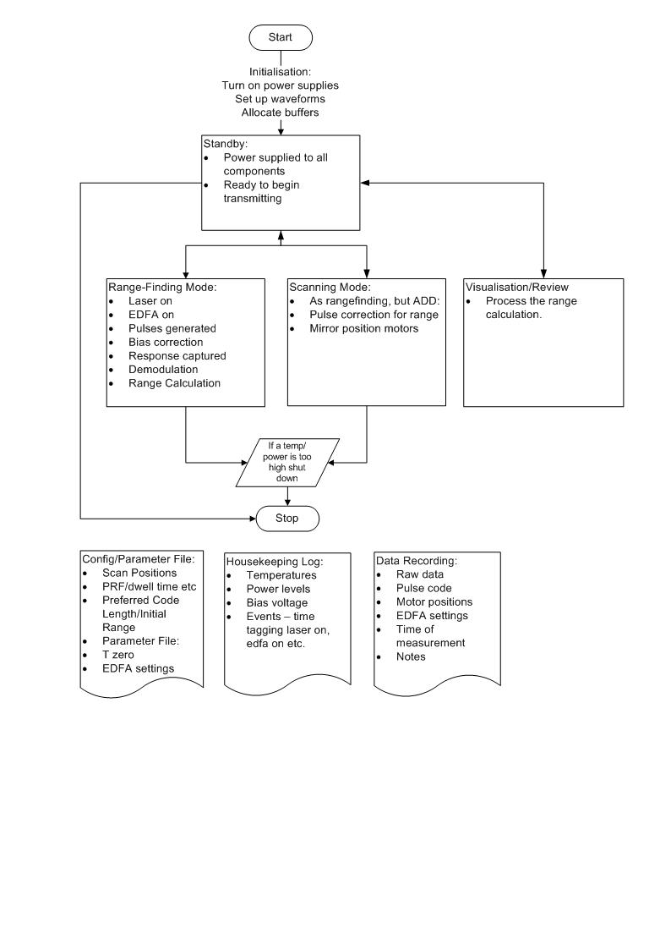
Lidar control flow diagram

Slide 60
Laser safety

Slide 61
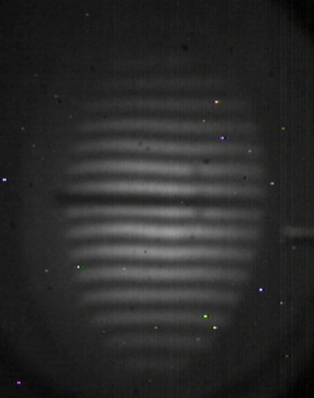
Collimation
Final collimation adjusted with the aid of a shear plate
  Focus adjuster micrometer on fibre launch assembly
Focus position was repeatable to ±20µm
Fringes appear substantially straight and parallel
  No significant beam distortion
reference line
NB The glass plate was not originally intended as a shear plate and may have imperfections which account for the deviation from ideal fringes. In the worst case that the deviation is entirely due to the beam, the beam quality is still very good.

Slide 62
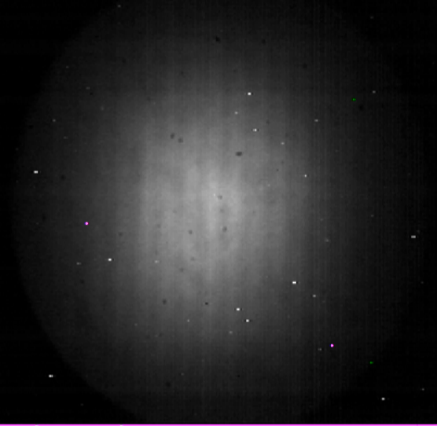
Beam profile
Beam profile was measured using an InGaAs camera to record an image of the beam
Good Gaussian fit to the beam profile in both axes
Beam dimensions were calibrated by taking an image of a target with known dimensions using the same imaging geometry
  Slight difference in x and y axes since the camera is slightly off the normal to the screen
Beam radii (to 1/e² ) after correction:
  x: 52 ± 2 mm
  y: 54 ± 2 mm
  consistent with circular beam radius 53 mm
Origin of fringes is unclear

Slide 63
Laser safety
Laser safety calculations suggest that the 3W output of the optical head will be at the threshold for laser safety class 1M, i.e. safe for viewing with the unaided eye but not safe for viewing with optical aids (e.g. binoculars)
Internal to the optical head, the beams will exceed the 1M limit. The head will be provided with an opaque ABS cover to restrict internal access. The cover will be fitted with micro-switches to disable the EDFA in the event of its removal.
The collimation of the beam will be maintained at normal laboratory temperatures (21 ± 5°C). Operation outside this limited temperature range may change the collimation condition, possibly causing the beam to focus and therefore exceed the 1M limit. Modelling suggests that higher temperatures may cause focussing.
The breadboard should be re-focussed if used at temperatures outside the nominal range

Slide 64
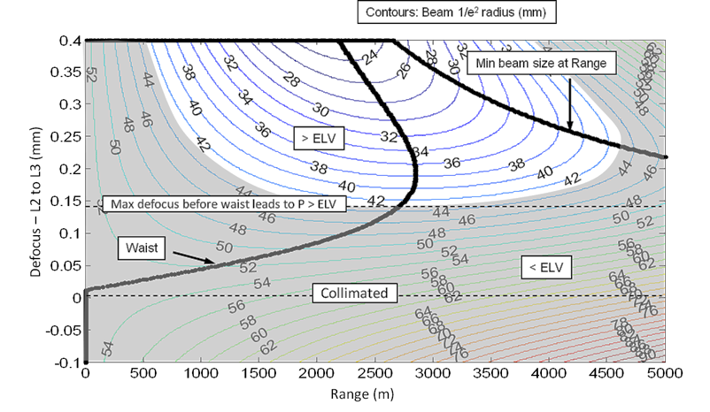
Laser Safety
Output Characteristics
  Laser class: 1M (embedded class 4 source)
  Wavelength: 1530 – 1570 nm
  Average power: < 3 W
  Peak power: < 1 kW
  Pulsed repetition frequency: > 50 kHz
  Pulse width: 10 ns
  Beam profile Gaussian
  Beam radius (1/e²) 53 mm
ENOHD ~37 km

Slide 65
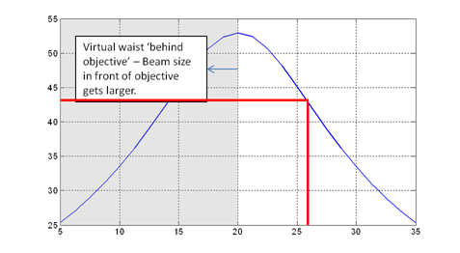
Operating Temperature
Optical system is temperature sensitive due to thermal expansion of baseplate
Beam is collimated at alignment temperature (21°C)
  Increased temperature → beam waist in front of aperture
  Decreased temperature → beam waist behind aperture
Beam may exceed class 1M threshold in warm conditions
  Maximum excursion 6°C above alignment temperature
Beam remains class 1M beyond 4.6 km

Slide 66
Test range

Slide 67
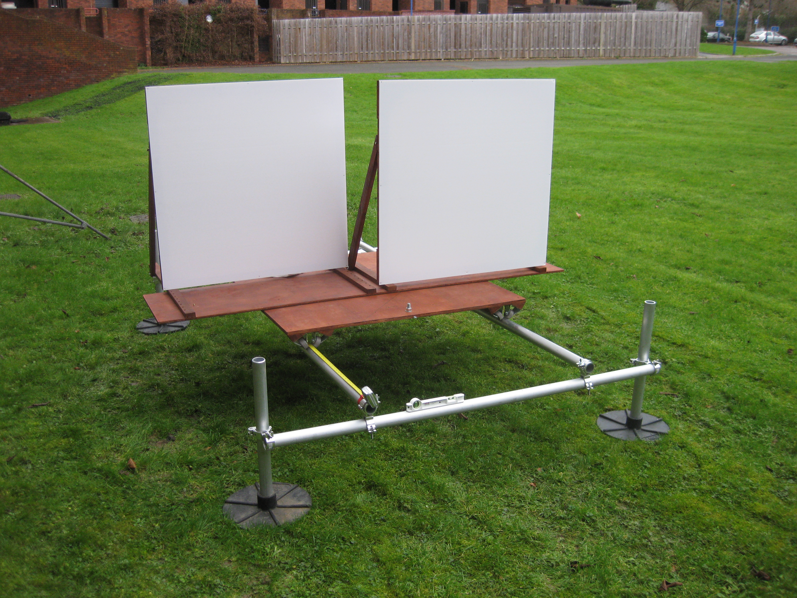
Test target
2 off 1 x 1 metre diffuse screens
  0.85 albedo @ 1.5µm
Adjustable gap
Rail mounted for ease of movement
Tape for accurate measurement of relative positions
GPS unit can be fastened to base

Slide 68
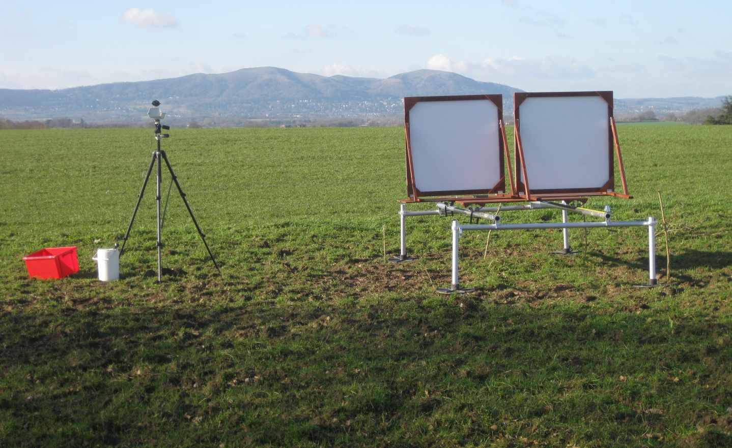

Test range
Laboratory. Left to right:
ATLAS atmospheric measurement system
SWIR camera
LIDAR Optical Head
Test field @ 7.6km from LIDAR, showing beacon for turbulence measurements and test target

Slide 69


Test Field
Open area for location of test targets and other equipment
Clearly visible from 3rd floor laboratory at QinetiQ Malvern
Test path well above ground level over most of its length
  Minimise turbulence
~7.7 km test range

Slide 70
Test results

Slide 71

Lidar configuration
Standard lidar configuration
  Sequence length: n = 10, N = 1023-bit sequence
  Measurement time: 1 second (195 sequences)
  Pulse repetition frequency: 200 kHz
  Pulse power: ~150 W peak
Output buffer
  Narcissus signal typically 10¹⁰ counts at peak
  Target board signal peaks
    typically 2.5 x 10⁷ – 9.5 x 10⁷ @ 96 m range
    typically 0.8 x 10⁶ – 3.6 x 10⁶ @ 7.6 km range
  Corner cube reflector
    well-defined point-like target
    12.7 mm diameter metallised solid glass reflector
    strong returns at all ranges (up to 17.7 km tested)

Slide 72

Repeated range measurements to diffuse target @ 96 m
Lidar measurements to single diffuse panel
Standard deviation 0.061m
  low beam wander on target
  possible some target movement due to windy conditions
Variations of signal strength
  2.5 x 10⁷ – 9.5 x 10⁷ counts at peak
  possible speckle effects due to target movement

Slide 73

Repeated range measurements to diffuse target @ 7.6 km
Lidar measurements to diffuse panels
Panels separated by 0.4m
Mean measured range difference 0.27m
  Consistent with rotation of target structure by ~6.5° relative to line of sight
Standard deviation 0.087m
Measurements degraded by turbulence
  Beam wander → aim point changes from measurement to measurement, increasing spread of results
  Beam spreading → fluctuation of signal return strength causing loss of some measurements

Slide 74

Repeated range measurements to corner cube
Signal strength fluctuations
  Scintillation due to atmospheric turbulence
  4 orders of magnitude variation in signal strength
  Range measurement is largely invariant with signal strength
Standard deviation 0.032 m

Slide 75

Variation of measured range with corner cube position
100 successive measurements at each position
Standard deviation < 0.04m in each position
Good overall fit to line with gradient = 1
Largest displacement from fitted line <80mm
  Displacements exceed standard deviation of measurements,
  Possible position errors due to windy conditions
  Possible systematic error (<0.1 sample step)
Good measurement repeatability
  Two sets of measurements at position 1 (lower left on graph) taken 94 minutes apart differ by only 11 mm

Slide 76

Range calibration – GPS survey
Location | Latitude | Longitude | Range (m)
QinetiQ | 52.101655 | -2.314901 | 0
St Andrew’s Church | 52.098762 | -2.308134 | 562.60
Ox Hill | 52.097830 | -2.288331 | 1867.25
Drips Hill | 52.109894 | -2.257515 | 4034.64
Layby | 52.096481 | -2.238325 | 5276.38
Test Field | 52.085266 | -2.207032 | 7611.94
Parson’s Folly | 52.060073 | -2.064640 | 17769.14

Slide 77

Range calibration
GPS positions corrected using fixed datum
Lidar position measured by triangulation
  GPS survey of 7 points in car park
  Theodolite used to measure each from lidar position
Ambient conditions recorded for each measurement
  Temperature
  Pressure
  Humidity
Lidar ranges have been adjusted for atmospheric refractive index

Slide 78

Horizontal scans
Horizontal scan across target boards separated by 0.4m
~0.2 m interval between points
Scatter in range measurements is too great to pick out target structure in individual scans
Target structure can be seen when scans are averaged

Slide 79

Moving target – along line of sight
Diffuse target moved by hand along line of sight
  Range to target ~7633 m
Video measurements
  Movement was recorded by filming the moving stage passing over a tape measure
  Video was analysed to determine the time at which the target passed over markers on the tape at 10 cm intervals
Lidar measurements
  Continuous data recording for 12.5 seconds
  Measurements calculated from 1 second portions of contiguous data at 0.1 second intervals
Good agreement between the video and lidar measurements

Slide 80

Moving target – across line of sight
Diffuse target moved by hand across line of sight
  Step change in range 0.4 m as beam transits from one board to the next
Video measurements
  Movement was recorded by filming the moving stage passing over a tape measure
  Video was analysed to determine the time at which the target passed over markers on the tape at 10 cm intervals
Lidar measurements
  Continuous data recording for 12.5 seconds
  Measurements calculated from 1 second portions of contiguous data at 0.1 second intervals
Good agreement between lidar and video results
  Step height ~0.4 m
  Transition time consistent with target speed

Slide 81




Field scan
Top view: 60m range span
Front view
Blue: target
Yellow: van
Red: tree
Top view: 2m range span
7660 m
7600 m
~4 m
Expanded horizontal scale

Slide 82




Test site
20m
Lidar
To Lidar
Van
27m
37m
Tree trunk
Lidar

Slide 83

Scan of Severn Bank House
Back wall seen through window

Slide 84

Turbulence measurements
Measurements were limited by atmospheric turbulence
  Fried parameter typically 4 – 40 mm
  Lidar aperture: 135 mm
  Transverse resolution defined by turbulence under all but the calmest conditions
Signal strength varies with turbulence
  measurements are weighted towards strong returns
  measured range is almost independent of signal strength

Slide 85
Validation of numerical model

Slide 86
Optical losses
Component | Loss / dB | No. of Interfaces | Total Loss / dB
Lens Surfaces | 0.02 | 6 | 0.12
Beam Splitter | 0.22 | 1 | 0.22
Mirror Surfaces | 0.13 | 2 | 0.26
Total Free Space (1 Way) |  |  | 0.60
Total Free Space (2 Way) |  |  | 1.20
Free Space to Fibre | 0.18 | 2 | 0.36
Circulator | 0.8 | 1 | 0.8
Detector Relay Optics Interfaces | 0.02 | 4 | 0.08
Blanking Modulator (100% Transmission Loss) | 4.0 | 1 | 4.0
Fibre Connections | 0.2 | 1 | 0.2
Total Internal |  |  | 5.44
Total Loss |  |  | 6.64
Losses are modelled by adjusting the fraction of the signal power that reaches the detector.
An additional loss of 7dB was added to account for atmospheric transmission losses

Slide 87
Model parameters
Standard lidar configuration
  Sequence length: n = 10, N = 1023-bit sequence
  Measurement time: 1 second (195 sequences)
  Pulse repetition frequency: 200 kHz
  Pulse power: 150 W peak
  Pulse width 10 ns
Detector sensitivity
  74.1 kV / W (measured value from the breadboard)
Target structure
  Single scatter to minimise processing time.
  Cross-section of scatterer defined as (beam area at the target x albedo of target)
    Beam area = πw² , where w is the waist radius at the target
    Albedo = 0.85

Slide 88
Simulations at 96 m range
100 independent simulations (randomised seeds) and 100 consecutive measurements
Good agreement between simulated and experimental signal strength
Experimental noise levels exceed simulated levels by factor ~4
Large spread in experimental data despite high SNR
  possible movement of target from run to run
  possible effect of narcissus clutter at short range
Range = 96 m | Simulated | Experimental
Signal counts | 7.6 x 10⁷ | 2.5 x 10⁷ – 9.5 x 10⁷
Threshold counts (5σ) | 2.2 x 10⁵ | ~8.8 x 10⁵
SNR | ~1730 | 142 – 540
Range standard deviation (m) | 0.0005 | 0.061

Slide 89
Simulations at 7.6 km range
100 independent simulations (randomised seeds) and 100 consecutive measurements (91 valid)
Good agreement between simulated and experimental signal strength
Experimental noise levels exceed simulated levels by factor ~4
Spread in experimental data consistent with reduced SNR
  possible movement of target from run to run
  possible range variation due to beam wander
Range = 7.6 km | Simulated | Experimental
Signal counts | 2.8 x 10⁶ | 0.8 x 10⁶ – 3.6 x 10⁶
Threshold counts (5σ) | 2.1 x 10⁵ | ~8 x 10⁵
SNR | ~65 | 5 – 22
Range standard deviation (m) | 0.016 | 0.089

Slide 90
Conclusions

Slide 91
Performance against measurement goals
Parameter | Goal | Verified | Achievable | Comments
Minimum range | 100 m | Yes | Yes | Narcissus clutter is the limiting factor for identification of signal at short range
Maximum range | 35 km | Partly | Partly | Max available test range ~17.7 km Extrapolation to 35 km suggests measurements may be limited to targets with high albedo
Range precision (3σ) | 0.2 m | Yes | Yes | Precision to diffuse targets @ 7.6 km during testing was limited to 0.26 m by turbulence. Precision to corner cube targets was better than 0.1 m
Range trueness | 0.5 m | Yes | Yes | Trueness verified to within limitations of GPS survey equipment over 17.7 km range
Surface resolution | 0.3 m | Partly | Yes | Resolution limited to 0.4 m at long range during testing due to atmospheric turbulence
Relative motion | 0.5 ms⁻¹ | Yes | Yes | Lidar returns average range during measurement period
Measurement rate | 1 Hz | No | Yes | Breadboard is not optimised for speed. Sub-second processing times have been demonstrated for short sequences. A future system could use an FPGA for fast processing

Slide 92
Compatibility with OPTEL-D
Existing components
Clock
  accurate to better than 10ppm
Optical source
  >150 W peak
  10 – 30 ns FWHM
  200 kHz prf
  2-PPM coding
Transmitter
  135 mm clear aperture
  Low optical backscatter
Processor
  Range calculations >1 Hz
x
New components
Circulator
  Tolerant to high peak power >1.2kW
  Tolerant to high average power >3W
  Space compatible
Receiver
  High sensitivity
  Low noise
  Space compatible
Digitiser
  >150 MHz
  Space compatible
?
?
?
?

Slide 93
Development roadmap
Suggested timeline from Thales (formerly RUAG) to combine SDML with OPTEL-D
Months
0
1
7
14
22
36
Phase 1
Phase 2
RR*
Product engineering and verification
EM MAIT
Detailed space terminal design
PFM manufacture and testing
* Requirements Review

Slide 94
Summary
An SDML breadboard compatible with an optical communications system has been developed and tested
  Precision range-finding (better than 0.2m) to targets at km ranges
    Diffuse targets to 7.7 km
    Corner cube target to 18 km
  Surface scans of remote targets at 7.7km
    Diffuse targets
    Vegetation
    Buildings
  Maximum range was limited by atmospheric turbulence
A numerical model of the system performance has been developed
  Good estimate of signal levels
  Underestimate of the levels of noise (due to excess noise in the detector)
Extrapolation of the lidar breadboard test results suggests that the majority of goals for the LIDAR Add-on are achievable
  Performance at maximum range will benefit from the higher peak powers expected from the OPTEL-D laser source

Slide 95


