Slide 1
New ground segment test automation tools, processes and techniques
Final Presentation
Eduardo Gomez – ESOC
Stefan Korner – Atos
Michael Oswald – Atos
Herwig Rabeder – Atos
Kurt Siegl – Atos
Catalin Dumitru - Atos
Bogdan Danes – Atos
Mihai Domocos – Atos
01/10/2020

Slide 2
Agenda
Slide Presentation
1. Management 2. Test Concept and Test Environment 3. Modification of Test Tools
4. EGS-CC / EGOS-CC / Miconys-CC Tests
5. Conclusion and Lessons Learned
Demo
Questions and Answers

Slide 3
1. Management
laNGoSTA

Slide 4
laNGoSTA – Project Description
GSTP study
Objective:
Analysis and review of existing EGS-CC validation scenarios for potential reuse (agreed after Kick-Off). The scenarios have been deployed and executed and the results have been analysed.
Refinement of validation scenarios for EGOS-CC. The scenarios were originally described at high level and have been refined, executed and documented. The scenarios cover some EGOS-CC prototype software such as the ASA component (adapter to REALS) and the PFI component (packet file injector).
Test automation technology for EGOS-CC/EGS-CC: Existing software previously used to validate Miconys products has been enhanced with new functionality to speed up and simplify the development lifecycle for automated testing and to integrate it better with EGS-CC. Several proofs of concept have been created including monitoring and commanding test cases.

Slide 5
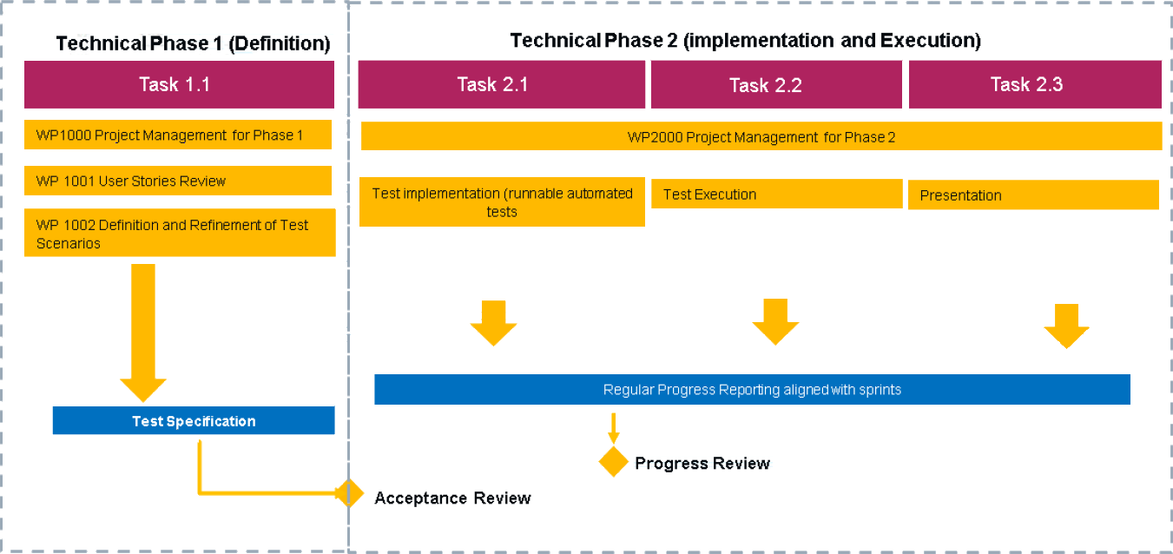
laNGoSTA – Project Schedule

Slide 6
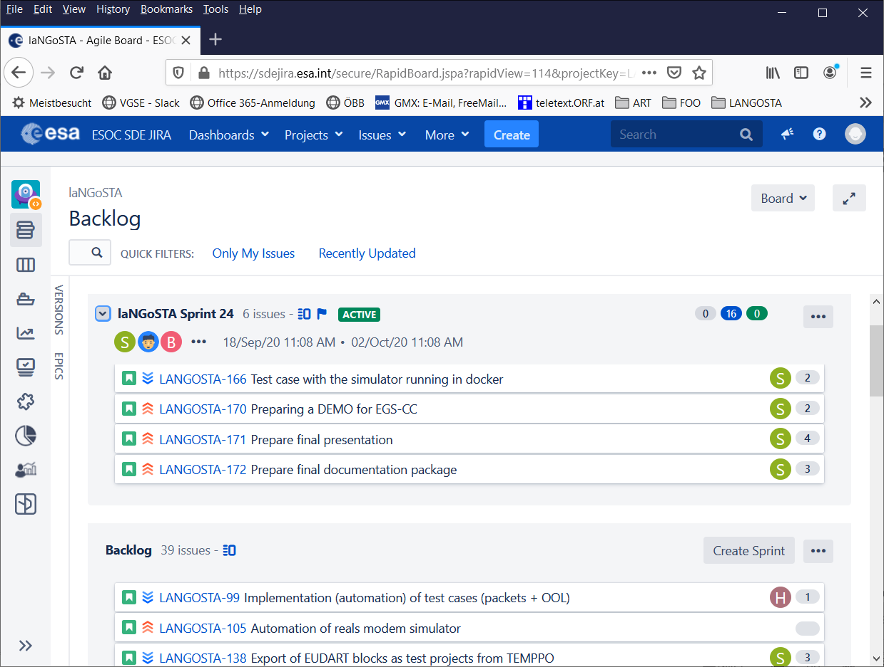
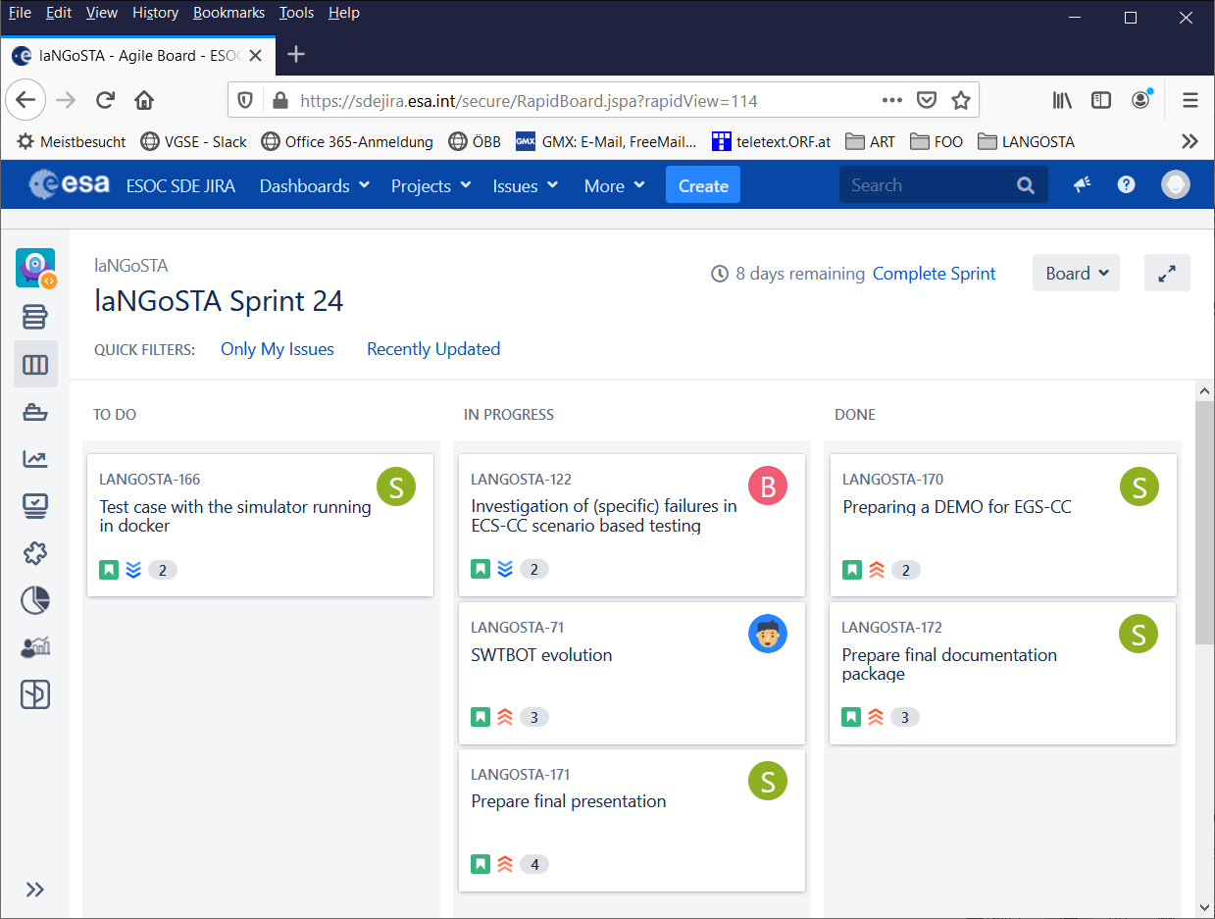
laNGoSTA – SCRUM Sprints with Jira
24 sprints performed in the study
Sprint duration: 2-4 weeks
SCRUM product owner: ESA Technical Officer Eduardo Gomez

Slide 7
laNGoSTA – Team
Atos Project Management: AT
Stefan Korner
Technical Officer
Eduardo Gomez
Atos Team AT:
Stefan Korner (PM)
Michael Oswald
Herwig Rabeder
Kurt Siegl
Atos Team RO:
Catalin Dumitru (PM)
Bogdan Danes
Mihai Domocos

Slide 8
2. Test Concept and Test Environment
laNGoSTA

Slide 9
laNGoSTA – Test Concept
Test Preparation
Test Execution

Slide 10
laNGoSTA – Test Concept
Test Preparation
Test Execution
Actions for the Tester
High-Level
Design of Test Cases
Refinement of Test Cases
Automated
Widget Actions
Test Case Execution
Widget Capturing
Test Script Implement.
Test Script Execution

Slide 11
laNGoSTA – Test Tools
Test Preparation
Test Execution
High-Level Design
Test Cases Refinement
Widget Actions
TMS
TEMPPO
Designer
SWTBot
Test Case Execution
EUDART
Widget Capturing
Test Script Implement.
Test Script Execution
SMURF
Python
Groovy
Python
Groovy [EKSE]

Slide 12
laNGoSTA – old Round Trip
indeterministic
order of items
on Windows
High-Level Design
Test Cases Refinement
Widget Actions
TMS
TEMPPO
Designer
SWTBot
Test Case Execution
EUDART
re-start of GUI
Widget Capturing
Test Script Implement.
Test Script Execution
SMURF
Python
Groovy
Python
Groovy [EKSE]

Slide 13
laNGoSTA - Test Tools modified
High-Level Design
Test Cases Refinement
modified
Widget Actions
TMS
TEMPPO
Designer
SWTBot
Test Case Execution
EUDART
Widget Capturing
Test Script Implement.
Test Script Execution
SMURF
Python
Groovy
modified
Python
Groovy [EKSE]

Slide 14
laNGoSTA – new Round Trip
modified
Widget Actions
SWTBot
Test Case Execution
EUDART
Test Script Execution
modified
Python
Groovy [EKSE]

Slide 15
laNGoSTA – Test Configuration
Test Environment
System Under Test
Widget Actions
SWTBot
Miconys-CC
EGOS-CC
Test Case Execution
EUDART
EGS-CC
Test Script Execution
Python
Groovy [EKSE]

Slide 16
3. Modification of Test Tools
laNGoSTA

Slide 17
laNGoSTA - Test Tools modified
modified
Widget Actions
SWTBot
Test Case Execution
EUDART
Test Script Execution
modified
Python
Groovy [EKSE]

Slide 18
laNGoSTA – EUDART
General:
EUDART is a test case scheduling application.
It is implemented as plugin for the EGOS User Desktop (EUD).
It is a replacement of the Test Commander (TECO) from the ART environment.
It is supported by GIMUS
Details:
EUDART has already been used for testing Miconys / SCOS.
In laNGoSTA version 2 of EUDART has been used.

Slide 19
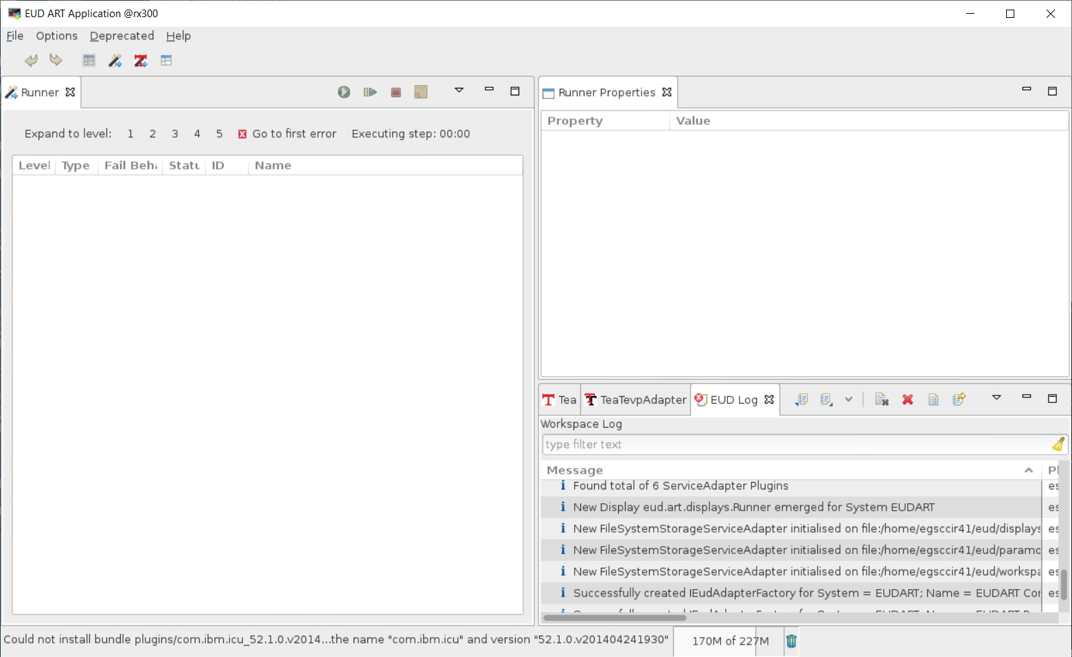
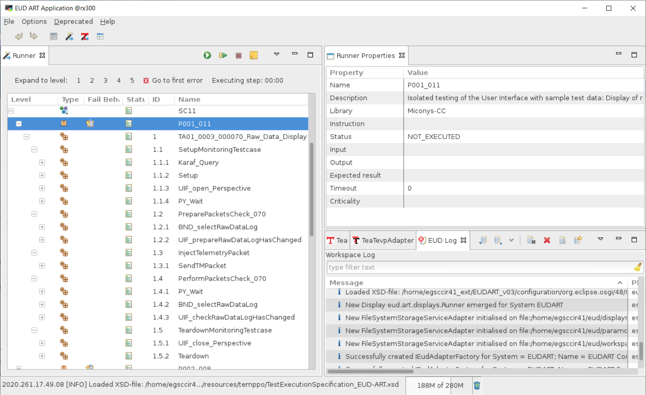
laNGoSTA – EUDART screenshot

Slide 20
laNGoSTA – Test Cases exported
High-Level Design
Test Cases Refinement
Widget Actions
TMS
TEMPPO
Designer
SWTBot
Test Case Execution
EUDART
Widget Capturing
Test Script Implement.
Test Script Execution
SMURF
Python
Groovy
Python
Groovy [EKSE]

Slide 21
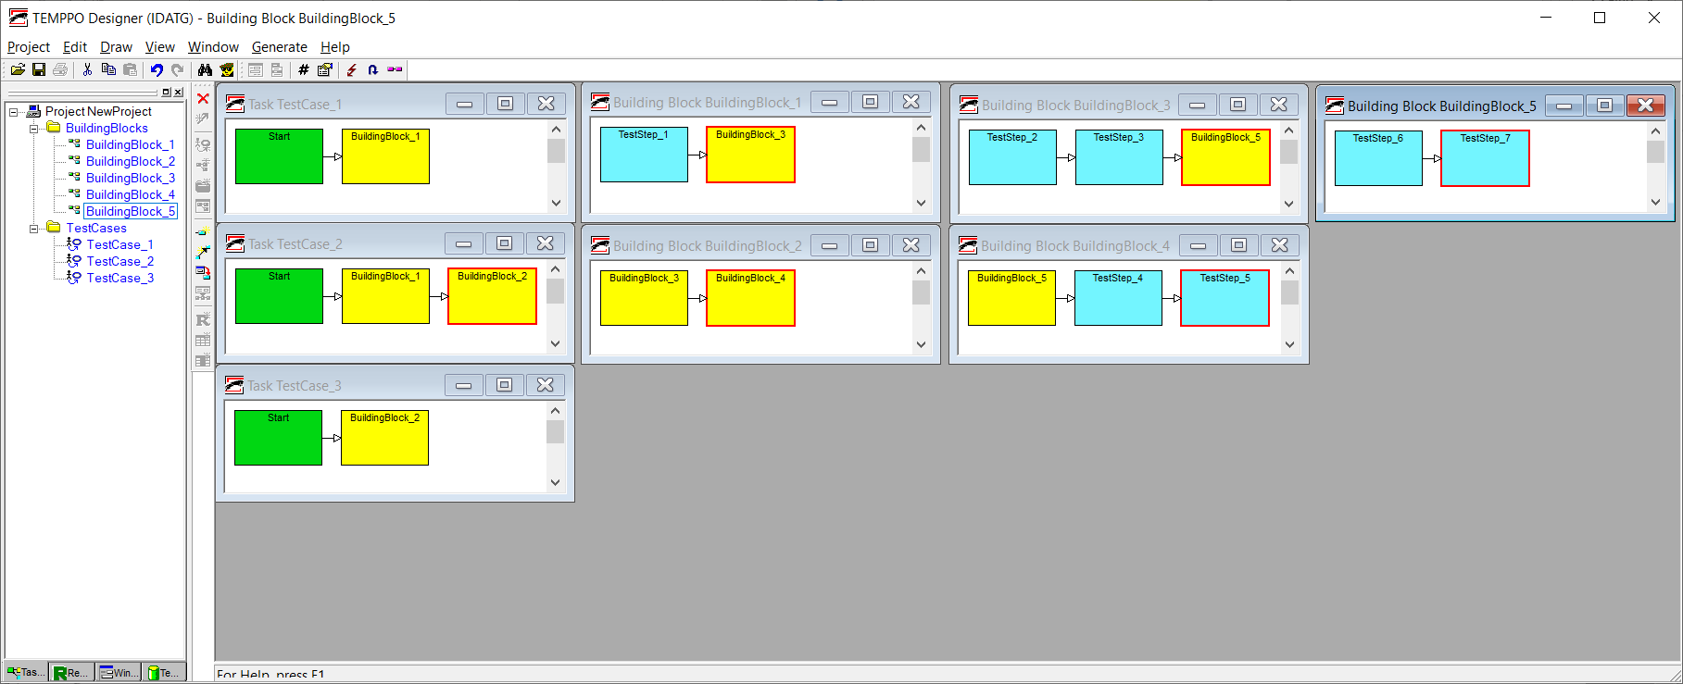
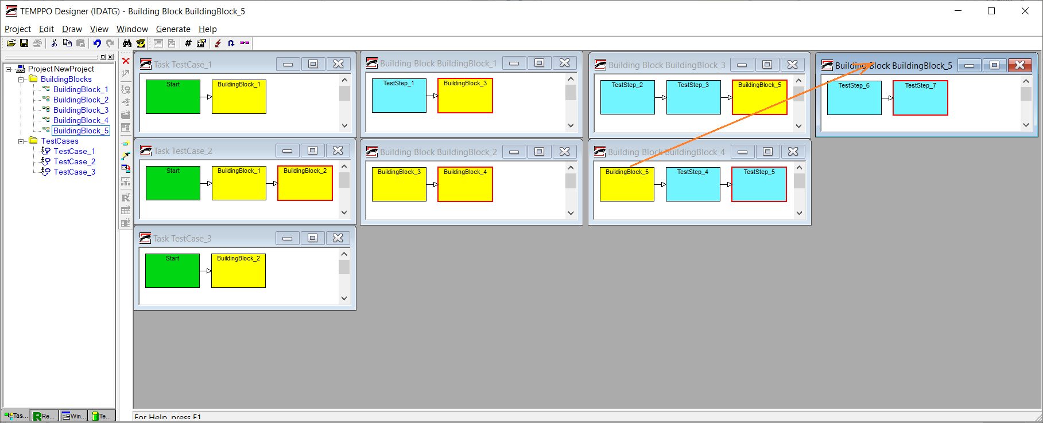
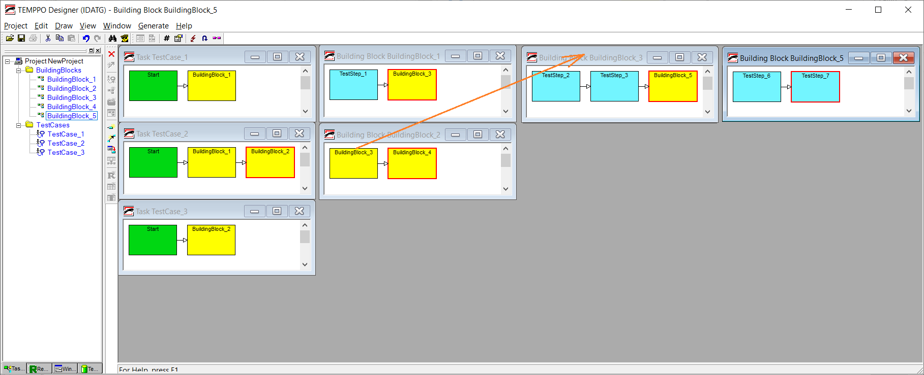
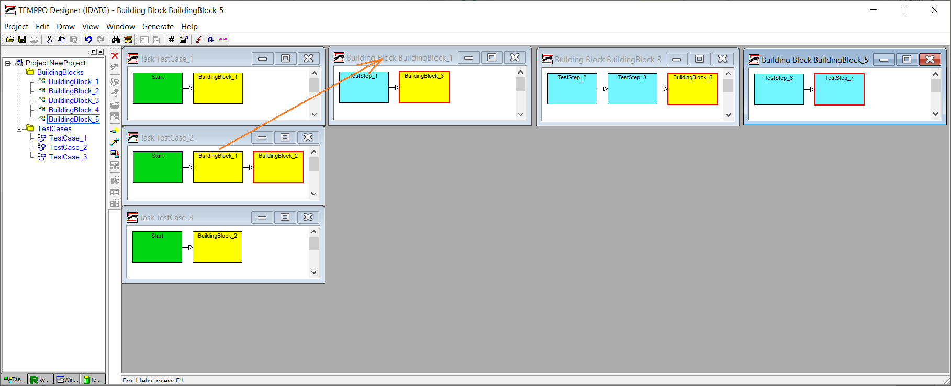
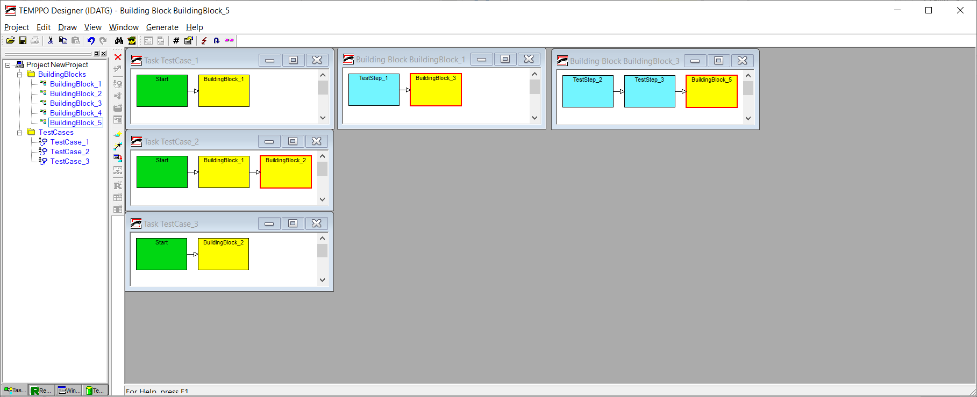
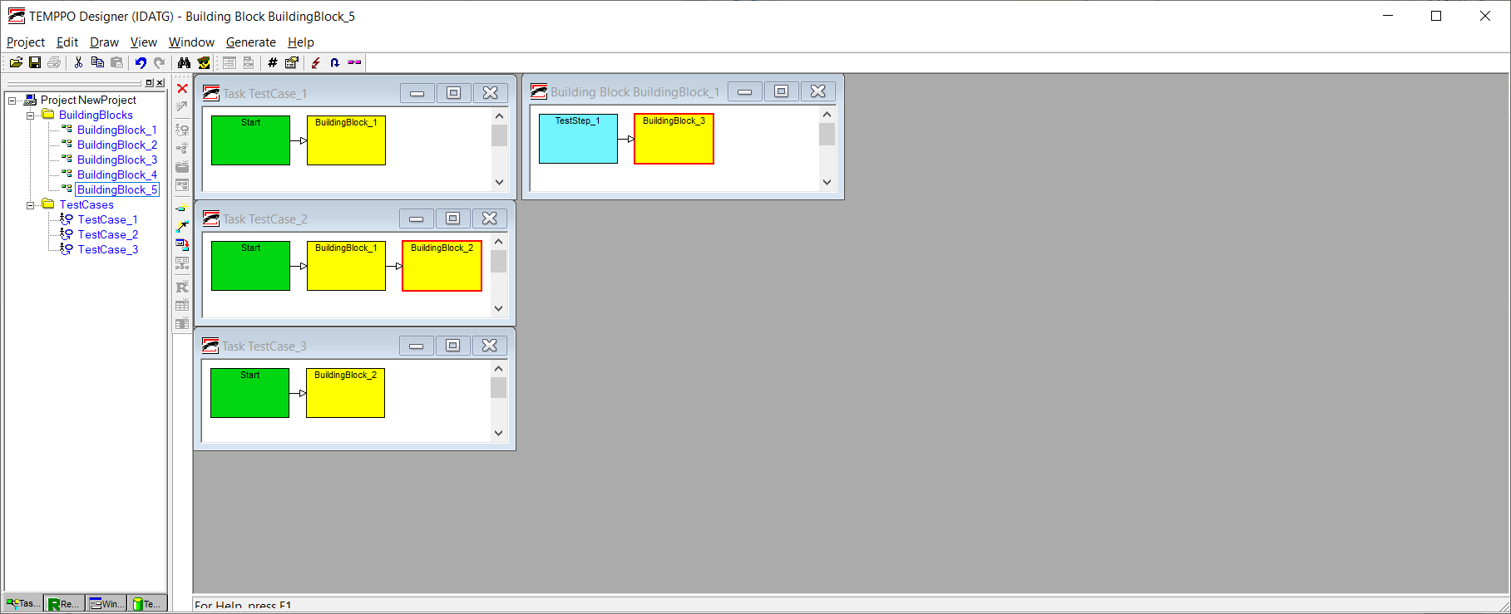
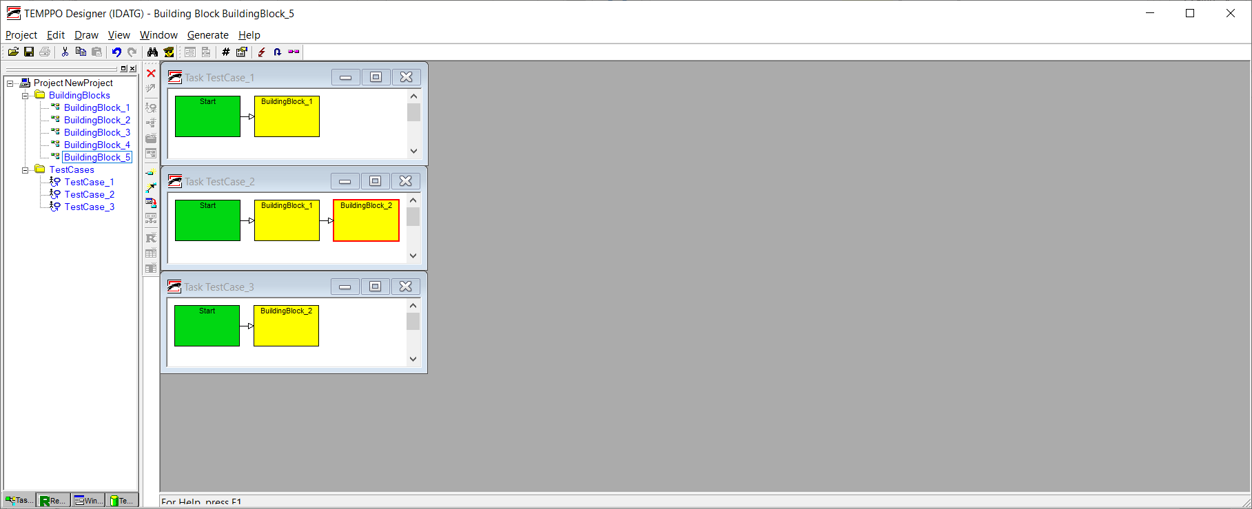
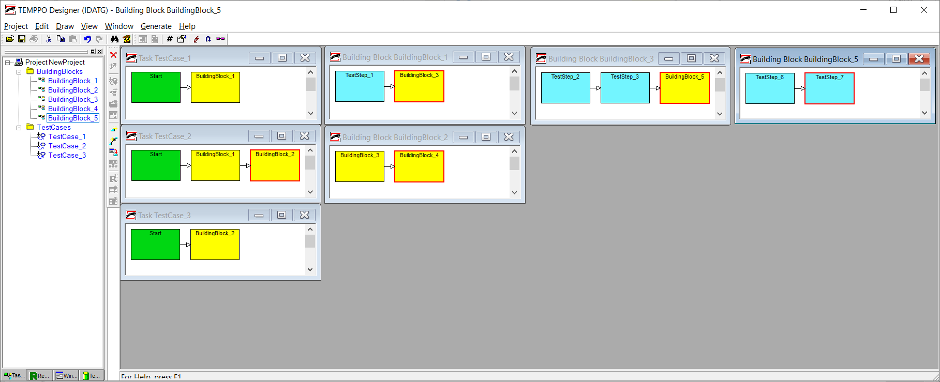
laNGoSTA – Test Cases in TEMPPO Designer

Slide 22
laNGoSTA – Test Case Graph in TEMPPO Designer
For re-use of Building Blocks
and Test Steps

Slide 23
laNGoSTA – Test Case Tree exported for EUDART
Simplified structure
in compare to Graph,
Parameters are propagated

Slide 24
laNGoSTA – Define and Re-use of Building Blocks
copy
paste

Slide 25
laNGoSTA – EUDART v3
General:
Tree structure for test cases kept (as in EUDART v2).
Import format from TEMPPO Designer kept (Test Schedule XML files).
New functionality:
Creation of new test cases.
Copy/paste of test cases, building blocks and steps supported.
Dynamic propagation of building block parameters.
Modified support of the --remote switch to support SSH calls.

Slide 26
laNGoSTA – SWTBot
General:
SWTBot is an Eclipse plugin that can be added to any Eclipse based GUI.
It supports access to the widgets of the Eclipse GUI.
SWTBot is remote controlled from EUDART.
Details:
Most widgets from the SWT library are supported, some Swing widgets, too.
SWTBot has been significantly enhanced in ESA’s MMIT activity.

Slide 27
laNGoSTA – Widget Location and Widget Actions
During test execution the GUI widgets of the system under test (SUT) must be located.
Actions are then executed on these widget, e.g. read text, write text, open context menu, copy or paste text to/from clipboard
The EGS-CC JAVA GUIs are based on the SWT library. For this environment the library SWTBot is used. It support the widget location. Enhancements have been implemented in a previous study MMIT to allow execution of actions from an external application.
This mechanism relies on a hierarchical structure of the GUI. The widgets are then located based on this structure → static widget location

Slide 28
laNGoSTA – Static Widget Location – Example
TestObjects.xml
UUID
UUID
UUID
UUID
UUID
UUID
UUID
UUID
UUID
UUID
UUID
UUID
UUID
UUID
UUID
UUID

Slide 29
laNGoSTA – Static vs. Dynamic Widget Location
Problems of static widget location:
It must be considered during the GUI development
Handling of the TestObjects.xml file is not user friendly
Capturing not completely supported (manual patching of TestObjects.xml)
Solution → dynamic widget location
SWTBot has been enhanced with this mechanism
Dynamic widget location is based on search patterns
Building blocks have been defined to encapsulate the functionality
Speed up of the development cycle without the need to always capture widgets into the TestObjects.xml file
Now implemented: Incremental work completely in EUDART

Slide 30
laNGoSTA – Karaf TTI
Test Environment
System Under Test
System Under Test
Widget Actions
SWTBot
Miconys-CC
Miconys-CC
EGOS-CC
EGOS-CC
Test Case Execution
Widget Actions
EUDART
TEA
EGS-CC
GTD
SWTBot
TTI
SWTBot Plugin
EGS-CC
Test Script Execution
Python
Groovy
Karaf commands
EKSE commands
Groovy scripts
Karaf
TTI
Test Script Execution
Shell scripts
Python scripts

Slide 31
4. EGS-CC / EGOS-CC / Miconys-CC Tests
laNGoSTA

Slide 32
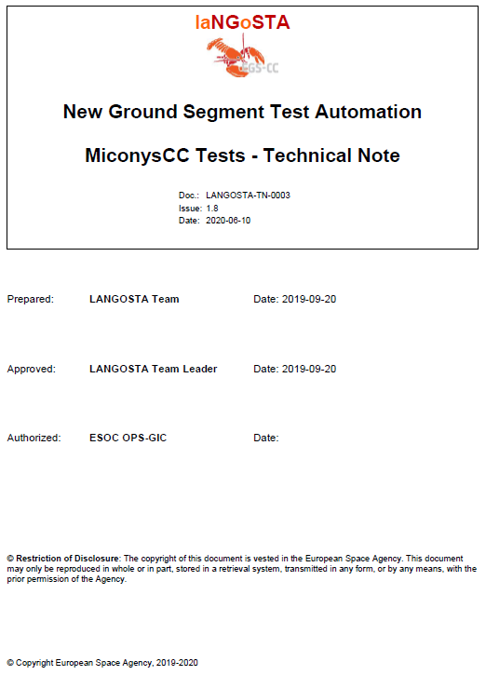
laNGoSTA – EGS-CC / EGOS-CC / Miconys-CC Tests
Tests are described in Technical Note: LANGOSTA-TN-0003-MiconysCC-Tests
Automated tests are stored in GIT repository: https://sdereps.esa.int/gerrit/TestItemsMiconysCC.git

Slide 33
laNGoSTA – Test Case Layering
The tests are layered according to a layering concept that has been defined in the MMIT activity.
The layers are implemented in library GIT repositories:
Tier 05 – Test-Case specific functional Test Actions
Tier 04 – Re-Usable, Functional Test Actions
Tier 03 – Complex Test Actions
Tier 02 – Bound Test Actions
Tier 01 – Unbound Test Actions
Tier 00 – Atomic Test Actions
TestItemsMiconysCC.git
LibItemsMiconysCC.git
LibEgsccUIF.git, (LIbEgsccRTFSIM.git)
LibItemsGEN.git, LibItemsPythonSIM.git

Slide 34
laNGoSTA – Telemetry Tests
TA01_0003_000070_Raw_Data_Display
TA01_0003_000080_Alphanumeric_Parameter_Display
TA01_0003_000090_Plot_Parameter_Display
TA01_0003_000096_Scrolling_Display
TA01_0003_000097_Plot_XY_Display
TA01_0003_000040_Parameter_Monitoring_Checks
TA01_0003_000050_Synthetic_Parameters
TA01_0003_000110_Parameter_Calibration
System Under Test
Miconys-CC
EGOS-CC
EGS-CC
Test Case Execution
EUDART
Python
Simulator
TM
CnC SCOE
Packet Interface
MCM
Parameter
Karaf
Shell
Test Environment

Slide 35
laNGoSTA – Telecommand / Complex Tests
TA01_0004_000060_MCM_Browser_Activity_Invocation
TA01_0004_000081_Activity_Invocation_from_Activity_History
TA01_0004_000090_Invocation_of_Activity_on_Event_Reception
TA01_0004_000100_Activity_Invocation_from_Activity_Stack
TA01_0004_000110_Activity_Stack_Interlocks
TA01_0004_000120_Activity_Stack_Execution_Time
TA01_0004_000130_Activity_Stack_Save_Load
System Under Test
Miconys-CC
EGOS-CC
EGS-CC
Test Case Execution
EUDART
Python
Simulator
TC
CnC SCOE
Packet Interface
MCM
Activities
TM
Test Environment

Slide 36
laNGoSTA – Other Tests
TA01_0003_000200_M4C_PFI_Packet_Injection
TA01_0003_000210_File_Based_Injection_Packet_Based
TA01_0003_000211_PFI_Install
TA01_0006_000030_Alarm_Acknowledgement
TA02_0010_000010_Alert_Files
TA02_0010_000040_Install_ASA
System Under Test
System Under Test
Miconys-CC
Miconys-CC
EGOS-CC
EGOS-CC
EGS-CC
EGS-CC
Test Case Execution
TM
EUDART
Packet File
PFI
Raw Packets
Alarms
Karaf
Shell
ASA
Alert File
Test Environment

Slide 37
5. Conclusion & Lessons Learned
laNGoSTA

Slide 38
laNGoSTA – Experience: Test Approach
Test cases implemented on the GUI level take high effort for implementation.
Test cases based on APIs (e.g. Karaf) are much simpler to implement.
Groovy scripts are recommended when EGS-CC internals shall be access, Python is recommended as scripting language for system tests where the system under test is as black box with external interfaces.
The tests should be properly layered, otherwise they must be fully re-implemented when the system under test changes (e.g. change of the GUI).
The test environment needs to be maintained during the life-cycle of a system under test with sufficient resources.
The test environment and the system under test must be managed under consistent version control. This is required to validate and analyse regressions in the tests.

Slide 39
laNGoSTA – Experience: EGS-CC
EGS-CC version changed in the study: IR3 → IR4D0 → IR4D1.
EGS-CC installation is still a big challenge and different issues appear in the different versions.
There should be one agreed installation approach between ESTEC, ESOC and the EGS-CC development consortium that is well maintained and that shall not be changed too often (installation from GIT, installation from Nexus, provision of a Docker-Image, provision of a VM).
There should be a good documented configuration and tailoring guide that is designed for end-users and not for experienced EGS-CC developers.
Tailoring tools for maintaining the system configuration and the CDM are needed → see next slide.
Branches and tags shall be defined for ALL deliveries (including EGS-CC related repositories) so that they can be built at any time.
The laNGoSTA test approach has enough maturity for system level testing of EGS-CC, EGOS-CC, Miconys-CC.

Slide 40
laNGoSTA – Experience: OPEN-M
OPEN-M is intended to be standard the tailoring tool for end-users.
The version analysed in the study, has provided the functional requirements needed for manipulating the CDM.
It is based on a flexible, generic architecture.
Some improvements are proposed:
Standard use cases should be supported by wizards and hiding of the XML low-level schema. E.g. definition of TM packets and their related MCM parameters.
The exported CDM files (→XML) should be formatted to be read-able with a text editor.
MIB import should be supported in a convenient way, with a consistent (but maybe flat) CDM structure that can be used out-of-the-box without a need to manually change it.
MIB export should be supported in a convenient way (e.g. with additional wizards) in order to get complete working MIB.

Slide 41
laNGoSTA – Conclusion
laNGoSTA provides a good starting point for a powerful test approach for EGS-CC / EGOS-CC / Miconys-CC.
Test cases have been implemented as proof-of-concept, covering many areas including telemetry, telecommands/activities, interface to REALS, PFI,…
The delivered prototypes should be integrated into the products, so that they are available for end-user.
As a future step, the test-chain shall be integrated with E2EVAL to take care of the test orchestration, handling of test results and identification of regressions.
Proof-of-concept has been limited to EGS-CC used as Mission Control System. It is recommended to test it on other areas (EGSE, Ground Station,…).

Slide 42
DEMO EGOS-CC / Miconys-CC Tests
laNGoSTA

Slide 43
Questions & Answers
laNGoSTA

Slide 44
Thanks
For more information please contact:
T+ 49 6151 90 2921
eduardo.gomez@esa.int
T+ 43 664 8855 5519
stefan.korner@atos.net

