Slide 1
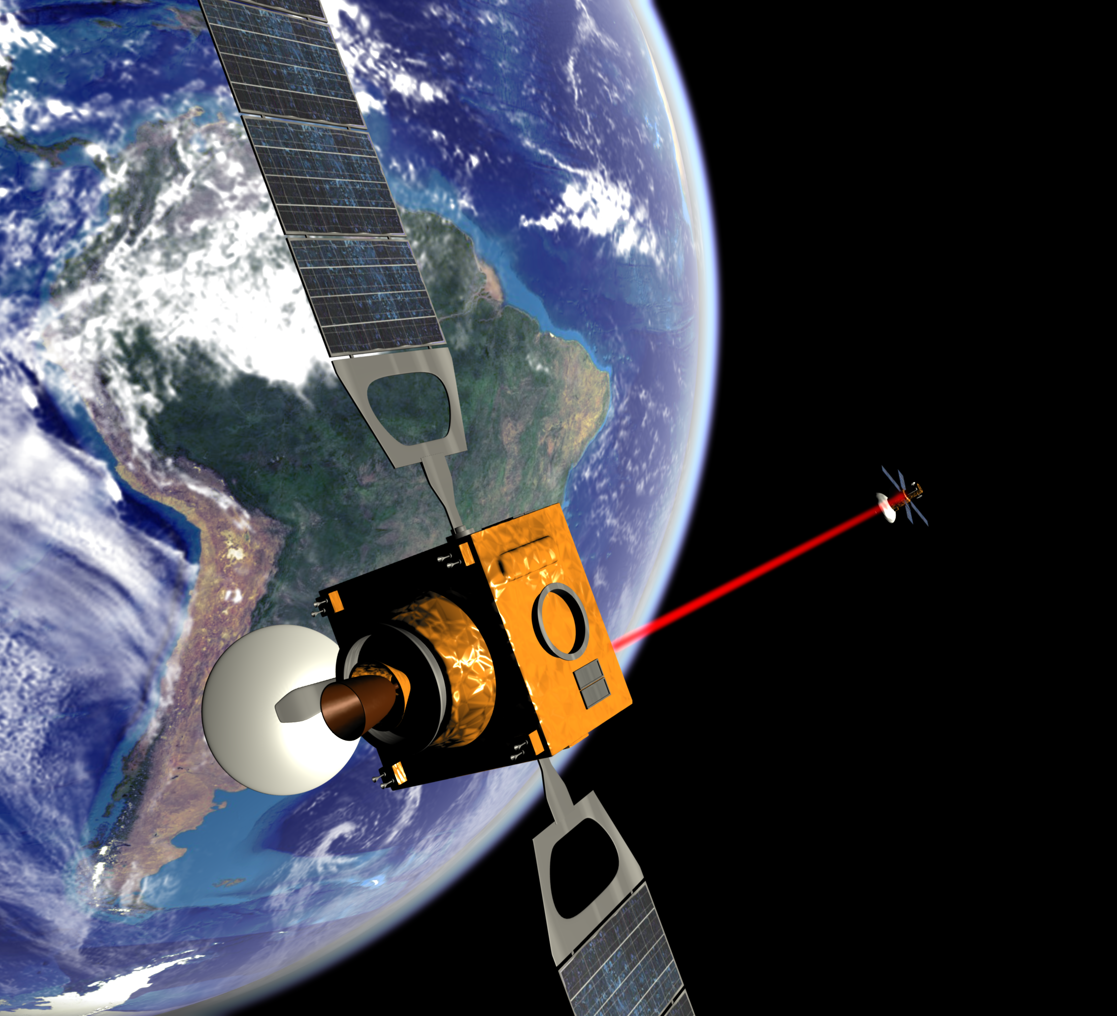


Compact Scanning Lidar
Matias Hernandez
MDA UK Senior Software Engineer
Notes:
Welcome slide:
This is a GSTP De-Risk project taking high TRL LIDAR technology from MDA UK, and low TRL emerging technology developed by the University of Oxford (soft matter photonics, optical communications, and beamforming groups) to ultimately build a compact scanning lidar (COLD). This is a low MVP lidar for space situational awareness applications.

Slide 2

Notes:
This video provides an idea of the usefulness of lidar for space applications, in this case, autonomous landing on a celestial body. LIDAR can also be used for other situational awareness applications in space, such as satellite rendezvous and docking, and rover navigation.

Slide 3
Problem Statement – Space LiDAR MVP Budget
Laser-focused resolution and the ability to work without background illumination favour the use of Light Detection and Ranging (LiDAR) in a vast range of space applications.
Government and commercial mission parameters are converging, requiring a step change from payload providers to minimize size and cost.
Space LiDAR Mass, Volume, and Power restricts the technology for medium to large spacecraft applications.
Notes:
Problem Statement:
Good things about LIDAR: LIDAR is an active technology, meaning it provides its own illumination, does not require the sun or radiation from the target to illuminate it. LIDAR is a 3-D technology, it provides depth (Z) as well as bearing (XY). LIDAR is a high-resolution technology, in the order of 1cm for 100m distance to the target.
Things that can be improved about LIDAR: LIDAR as it exists today has a higher MVP cost to other solutions. MVP is in the order of 10kg, 50cm per axis, and 100W.

Slide 4
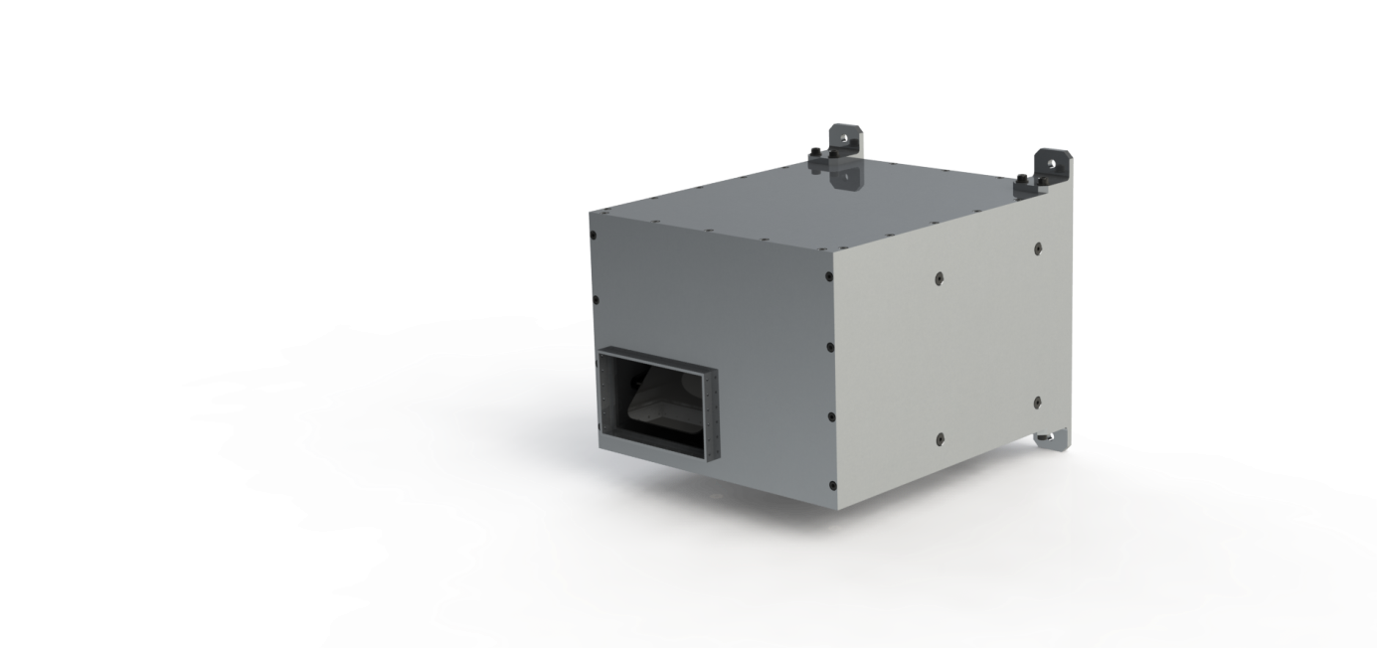
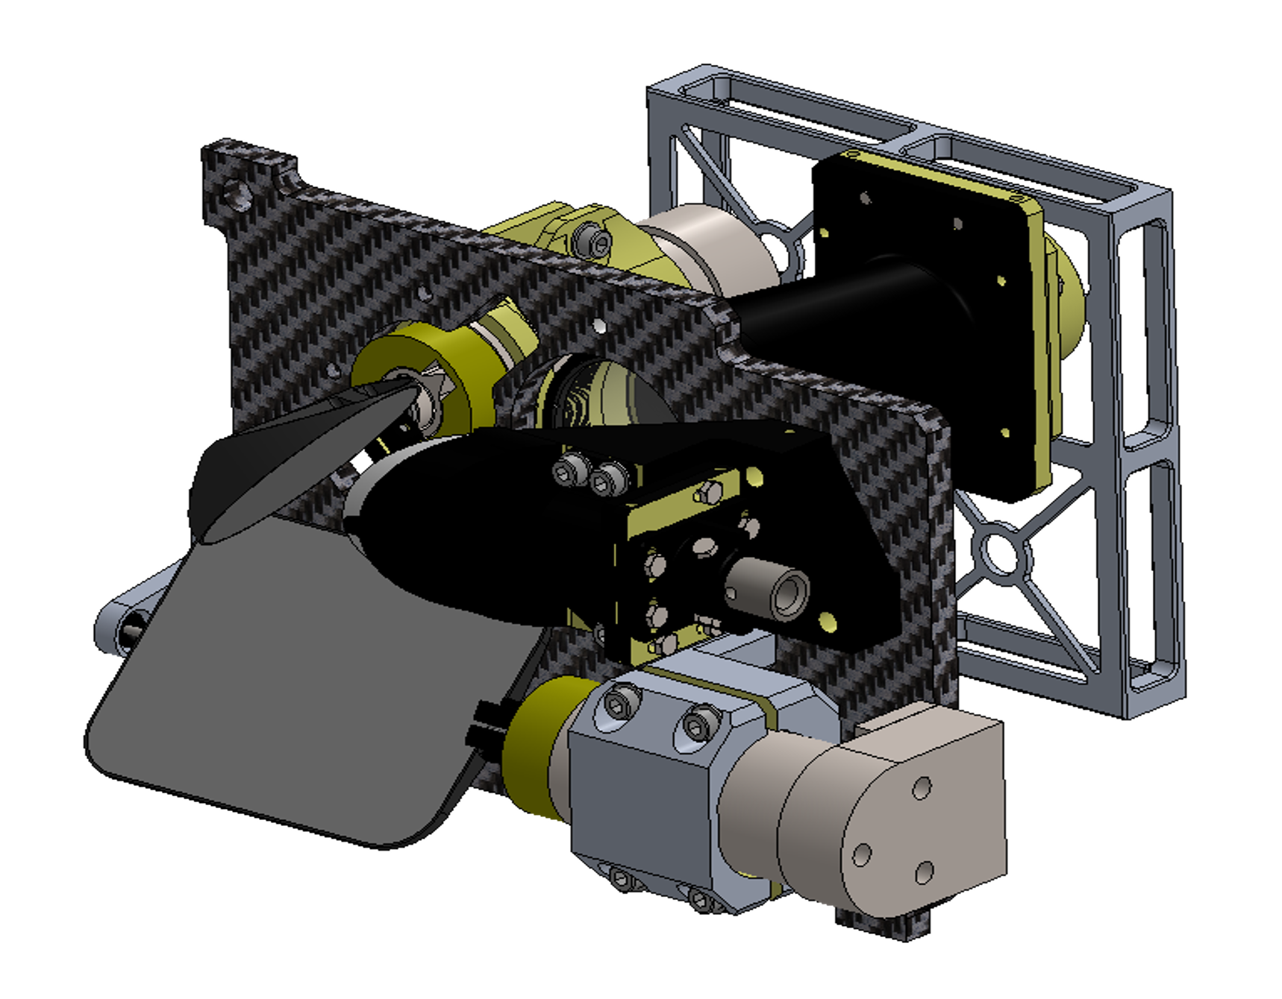
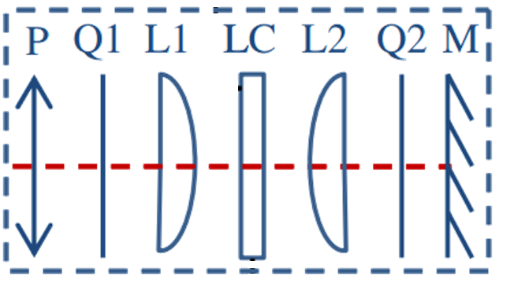
Solution – Spatial Light Modulator Scanning
MDA UK and The University of Oxford are collaborating to de-risk, design, and develop a Compact Scanning Lidar for Space applications using emerging technology.
The technology uses light interference to point, replacing the need for mechanical scanning. This allows a 70% reduction in MVP, enabling LiDAR for CubeSat applications.
Notes:
The solution, COLD:
A LIDAR is a relatively simple system, it is composed of a few main modules:
- A laser source, similar to a laser pointer but uses a pulsed laser. This laser source coupled with a chronometer and detector allows you to time how long a laser pulse takes to go to a target, reflect back, and be detected by a laser detector (avalanche photodiode). This is a laser rangefinder (z direction)
A scanning mechanism (X,Y): if you add a way to direct light to a surface of locations in front of the laser source, we get a LIDAR. You can now create a 3-D map of a surface in front. This is usually done now using two scanning mirrors mounted on high-precision motors (by light reflection), or a rotating prism (by refraction)
This scanning assembly is what the project targets: it is the only moving part of the LIDAR and can account for about 70% of the MVP. The idea is to replace this system using a different property of light, that of superposition/interference. MDA UK build LIDARs for Space, UoO research and build liquid crystal based technology. Together, the idea is to develop LIDAR based on SLM, a component a few micrometers thick, and as wide as the laser beam, that works using the same principles of spaced-array.

Slide 5
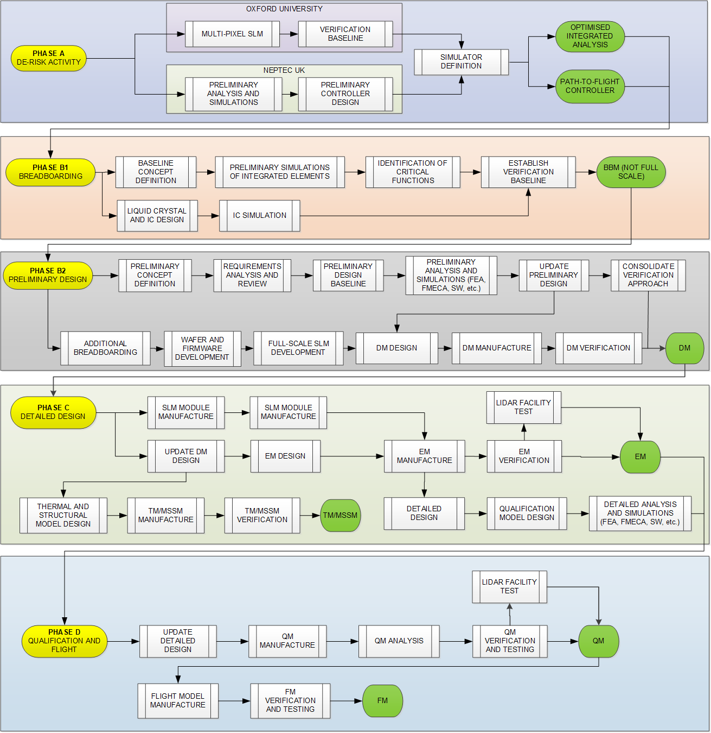
Roadmap – From GSTP De-Risk to Flight
Phase A (TRL1 – TRL3): show that the SLM technology can be controlled to direct a laser beam, prove that the fast control system can be implemented in equipment with path to flight
Phase B1 (TRL4): lab scale UoO SLM and controller/processor card will be electrically and mechanically interfaced in BBM. Custom silicon fabrication run in a commercial foundry for ~800x800 device begins.
Phase B2 (TRL5): DM Lidar with commercial SLM. In this phase the critical technical risks will be addressed by means of analysis and testing to improve the technical maturity. FPGA development and radiation assessment on critical components conducted. The UoO SLM will begin full-scale fabrication activities
Phase C (TRL6): The SLM will be integrated and calibrated into EM. EEE parts derating, EMI and EMC, procurement of LLI for qualification and flight. Environmental testing in long-range Lidar test facility.
Phase D (TRL8): QM and FM hardware development with flight parts. Qualification test campaign including EMI/EMC testing, environmental testing (vibration and shock, thermal-vacuum, Lidar facility1) under flight-representative scenarios. FM acceptance testing. Spacecraft integration and launch.
Notes:
This is the full roadmap of the project:
Phase A is this de-risk phase
Phase B1 is requirements analysis and preliminary design tradeoff phase, a BBM is build with lab-scale SLM and requirements are solidified, ending in SRR.
Phase B2 is preliminary design phase, a DM is built using a commercial SLM and the preliminary design is done, including architecture selection, ending in PDR.
Phase C is the detailed design phase, an EM is built using the UoO SLM, now fully developed. An EM of the LIDAR is built with flight components where possible, and tested to show the design meets requirements and intention
Phase D is the qualification testing phase, a QM is built and environmentally verified and validated, then an FM is built and acceptance tested, ready for flight.

Slide 6
Roadmap – GSTP De-Risk
Phase A (TRL1 – TRL3): show that the SLM technology can be controlled to direct a laser beam, prove that the fast control system can be implemented in equipment with path to flight
Notes:
Gstp de-risk:
The programme is to fund a relatively small activity to target specific risks seen as critical to a fully-fledged flight programme. The overall objective of this activity is to prove 2 things:
That the electro-optic effect of a specific LC technology can be integrated into a multipixel cell and controlled to vary phase. If each pixel can vary phase satisfactorily at lab scale (meaning the SLM is tens of cms wide in XY plane, and has only ~6 pixels), we can extrapolate that a micro-scale device (as wide as a laser beam, with ~800x800 pixels) would be able to beamform.
That a processor with path to flight, such as is currently used in LIDAR to control 1 or 2 scanning motors, is able to control ~800x800 individual pixels at the SLM refresh rate (1kHz, UoO emerging technology is about x10 faster than currently existing SLMs in commercial market)

Slide 7
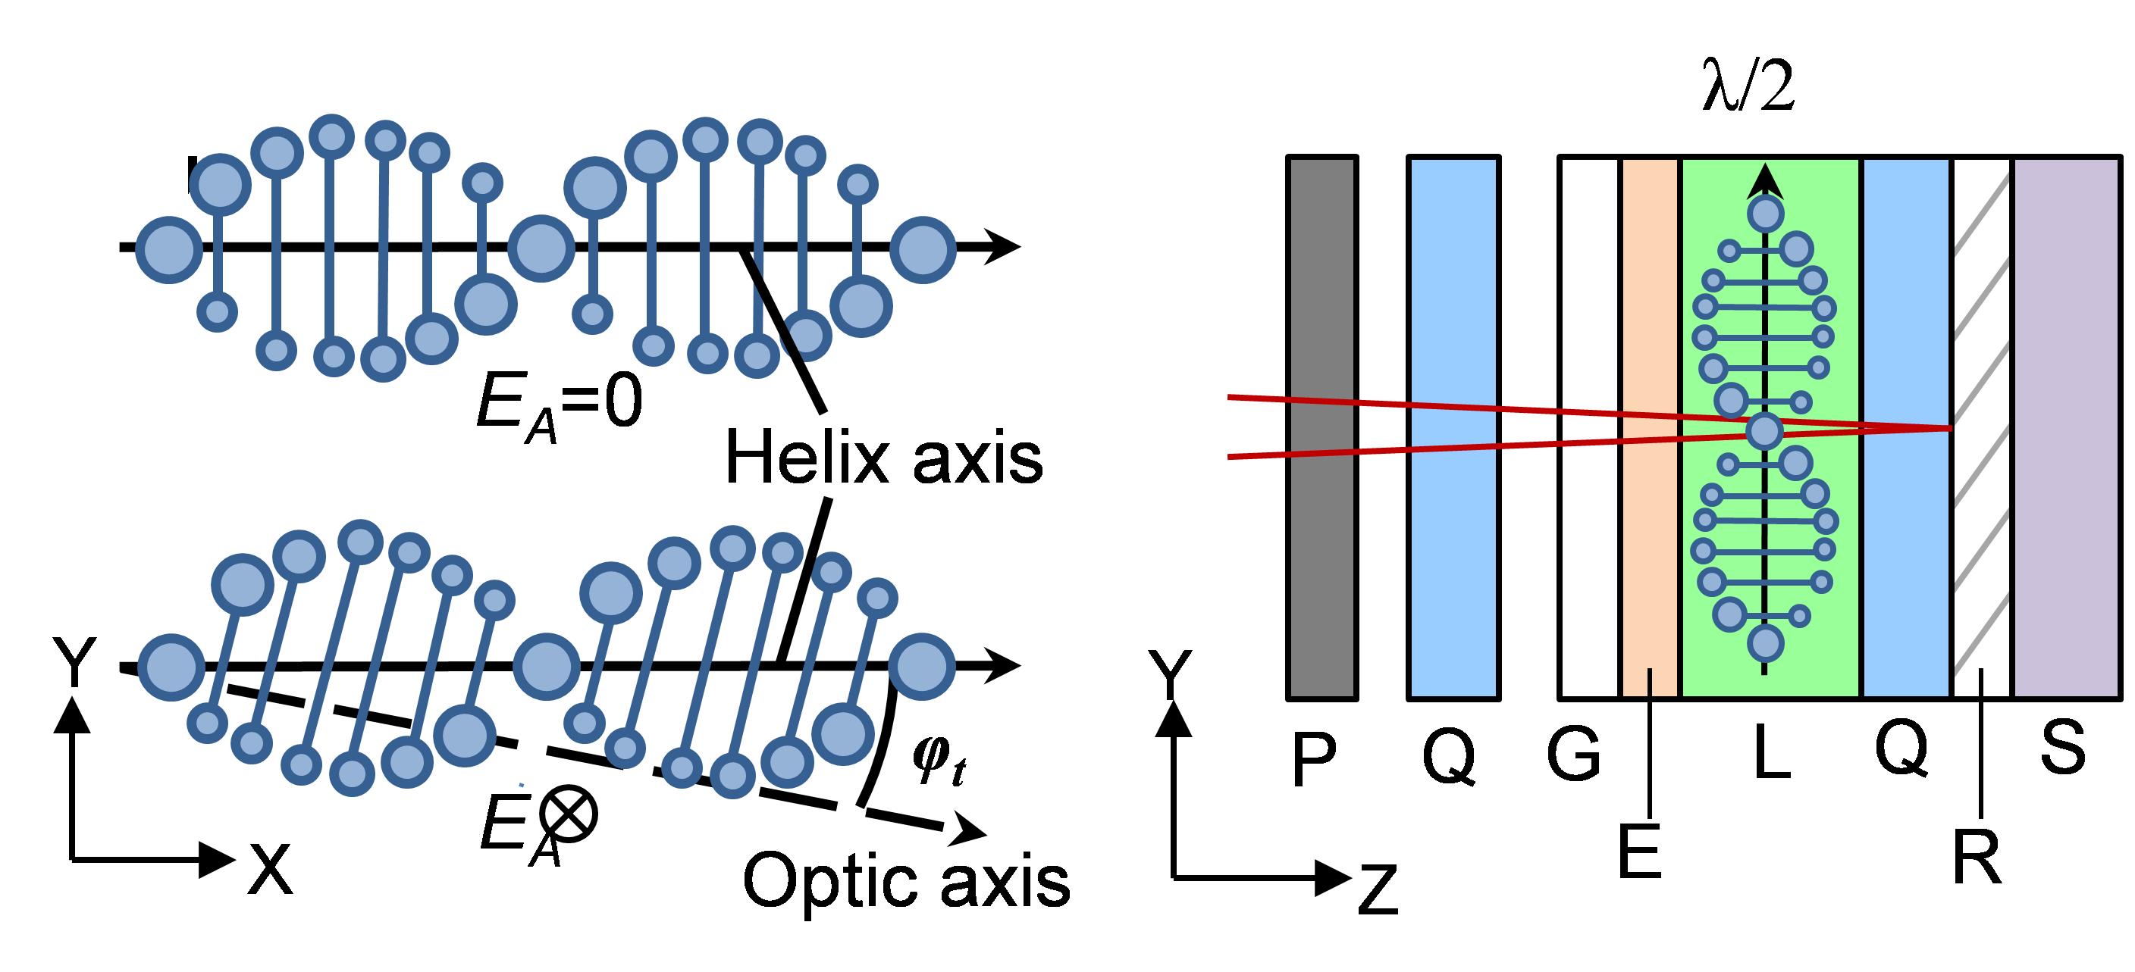
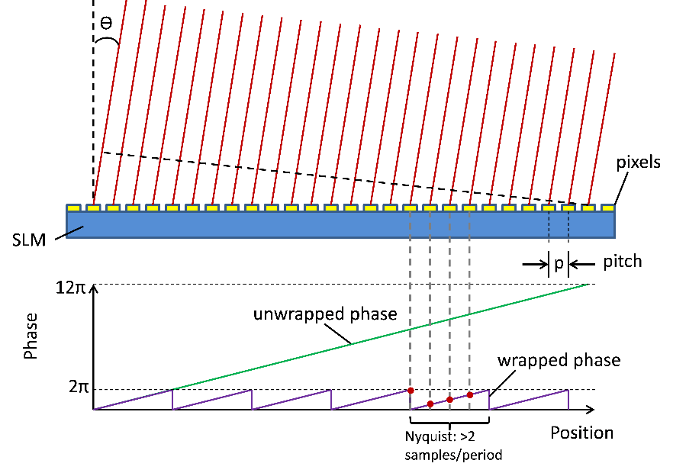
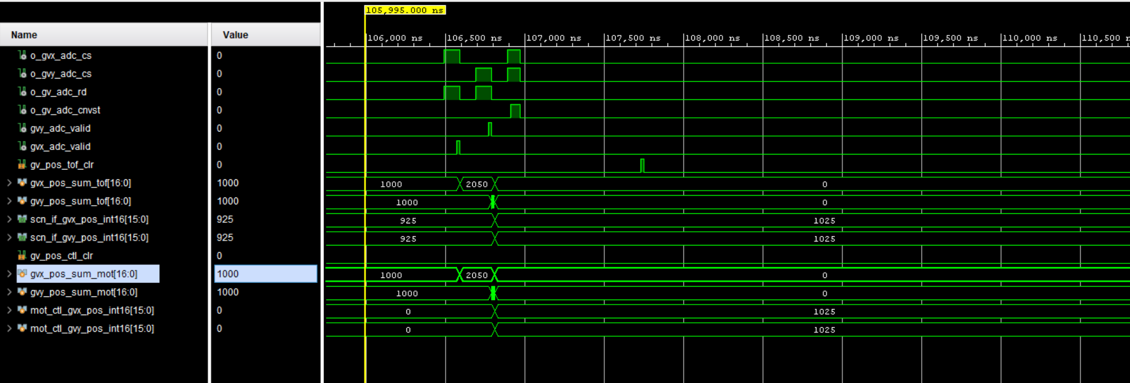
COLD Phase A: De-Risk
Demonstrate that a Lidar with path to flight is physically viable with a 1kHz SLM:
  UoO: upgrade single pixel prototype to 4-pixel, and show they can be controlled simultaneously to steer light.
  MDA UK: use the transfer function of the SLM pixels to develop control system in PC simulator and then benchmark on path to flight processor.
Notes:
Main tasks in more depth:
UoO will upgrade their single pixel distributed prototype into a 4-pixel, integrated device, then show the optical and electrical properties of the resulting device agree with the single prototype. This shows that a micro-scale SLM would work. Their multi-pixel device is to be a few micrometers thick, but several centimeters wide.
MDA UK develops a simulator for the full LIDAR including SLM, then translate that into a path-to-flight processor, and benchmark resource usage and speed to ensure it is viable for flight. This control system needs to determine required phase change for up to 1M elements within 1ms.
To explain further about the SLM, an SLM is just a liquid crystal with some optical components around it. A liquid crystal is just a medium that has an effect on light that travels through it. This effect can be modified using a voltage across the medium. In the case of an LCD screen, the voltage allows more or less light to pass through the medium. A RGB filter is added to 3 pixels to create a single color pixel. In the case of an SLM, the pixel only varies the phase of the light passing through it. The voltage can be changed to select the phase change of the light. If we have many pixels very close together, we can beamform the light using interference, and we have an SLM.
The figure above shown the optical sandwich around the SLM, which includes:
P: polarizer, required unless light already polarized
Q: quarter-wave plates, create the correct light polarisation for the liquid crystal to operate correctly
G: Glass to hold the sandwich together
E and R: electrodes, one transparent at the beginning (ITO) and a reflective one at the end
L: the liquid crystal in lying helix configuration
S: silicon backplane

Slide 8
De-Risk Results: Path to Flight Processing
Optimised SLM LIDAR control system synthesized and laid-out for MicroSemi RTG4 with ample resource margins
Notes:
Two FPGAs were investigated, the MicroSemi RTG4 has the following specs:
151,824 Logic Elements (4-input LUT + register)
462 DSP slices (18x18bit)
3.125 Gbps PCIe outputs
5.2Mbits RAM
The kintex ultrascale has the following specs:
726,000 Logic Cells (6-input LUT + register)
2760 DSP slices (27x18 bit)
12.5 Gbps GTH transceivers
38 Mbits RAM
Ample resource margins for benchmark on RTG4 FPGA, kintex ultrascale available with much larger resources for upgraded version.

Slide 9
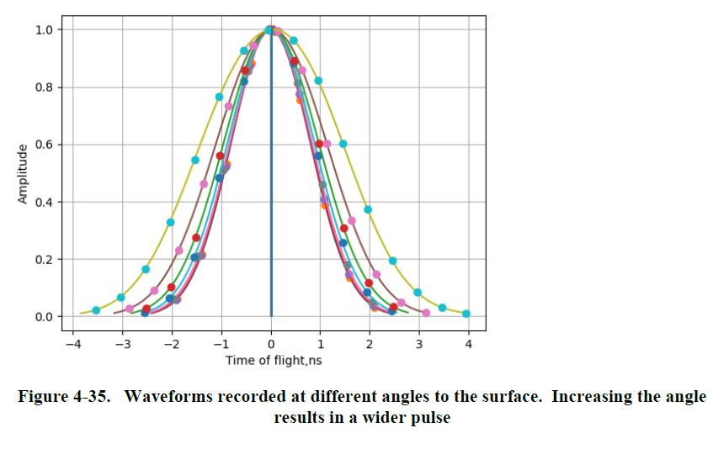
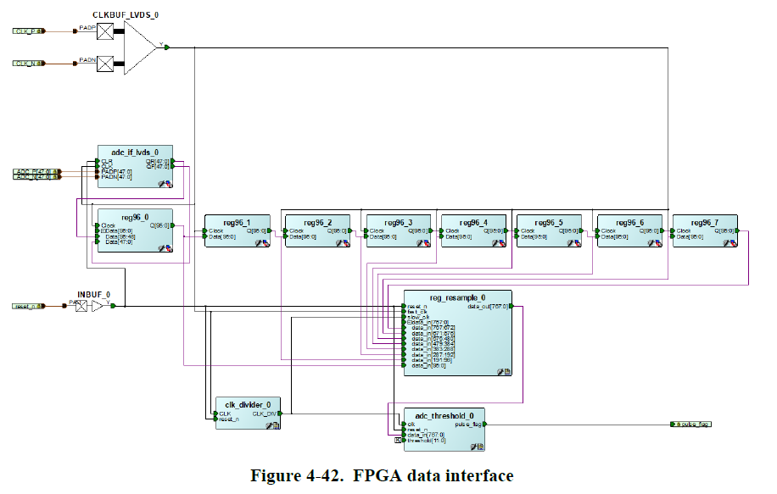
De-Risk Results: Full-wave recording
The current time of flight solution for MDA UK LIDAR detects laser reflections using analogue front end.
The full-wave recording solution takes advantage of advances in ADC speed to use a mostly digital solution. This can significantly further reduce the overall LIDAR footprint (less PCBs).
Solution implemented on FPGA with good results

Slide 10
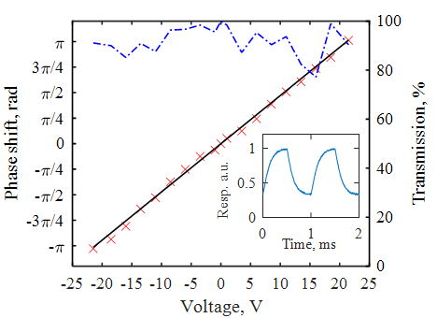
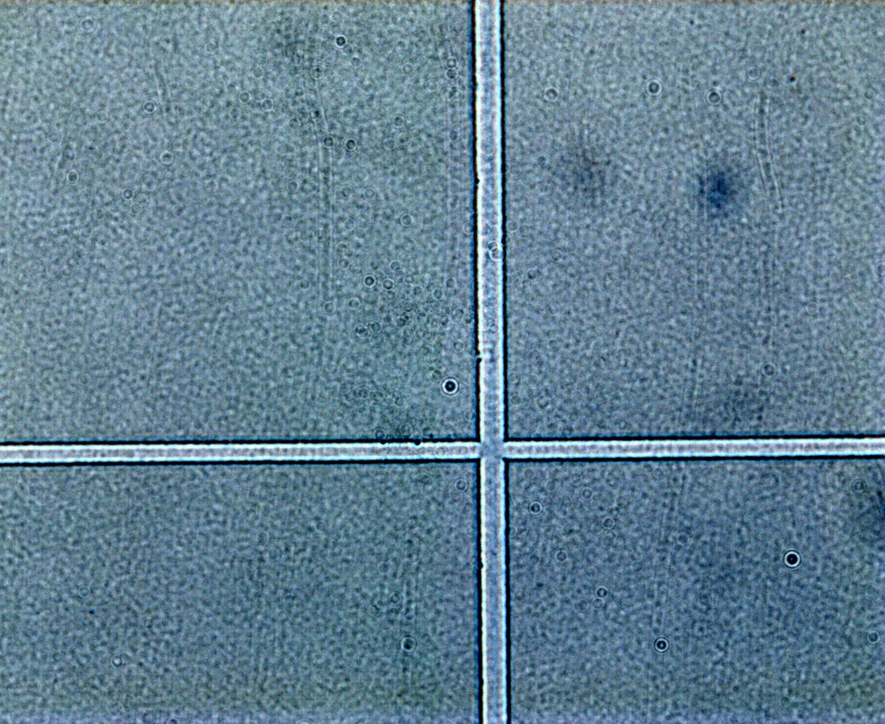
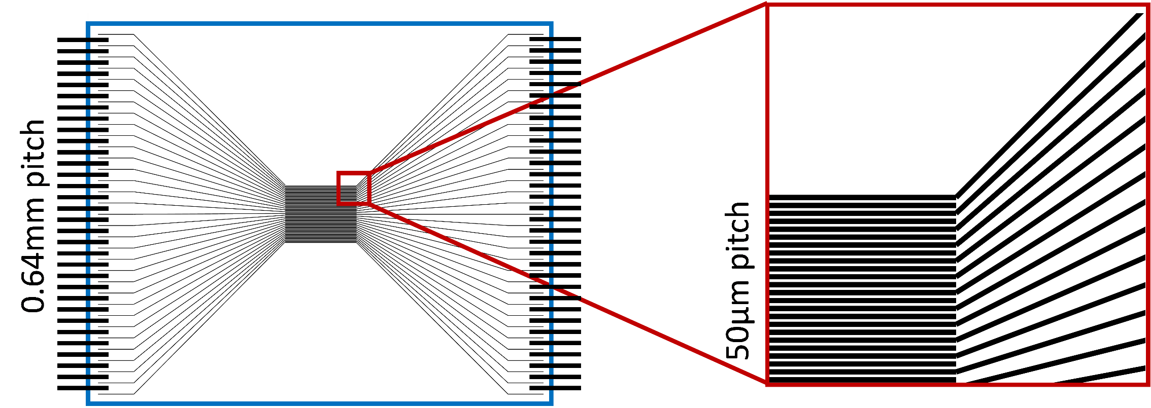
De-Risk: Integrated Spatial Light Modulator
Singe pixel device optical characteristics successfully demonstrated.
Fabrication process determined to simplify the integration of a multi-pixel SLM from a single glass cell filled with liquid crystal.
Notes:
Results form integrated lab-scale SLM (1):
Project started with 1-pixel distributed demonstrator showing electro-optic effect at 1kHz speed capable of varying phase by 2pi (TRL1)
UoO was able to develop a rapid prototyping process for a micrometer cell using a femtosecond laser to burn off ITO from the cell in order to create several pixels. The width of the “burnt off” track is good enough for micro-scale SLM.
UoO has also developed a preliminary design for a 1-D SLM demonstrator of 50um pixel size. This was beyond the scope of the project.

Slide 11
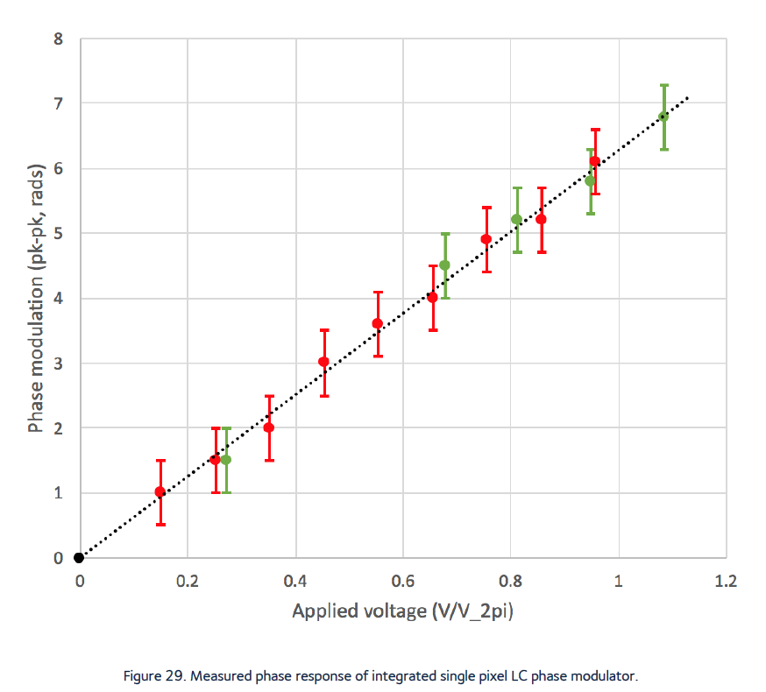
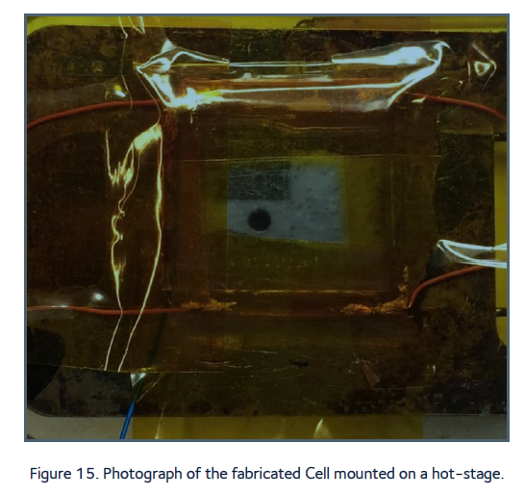
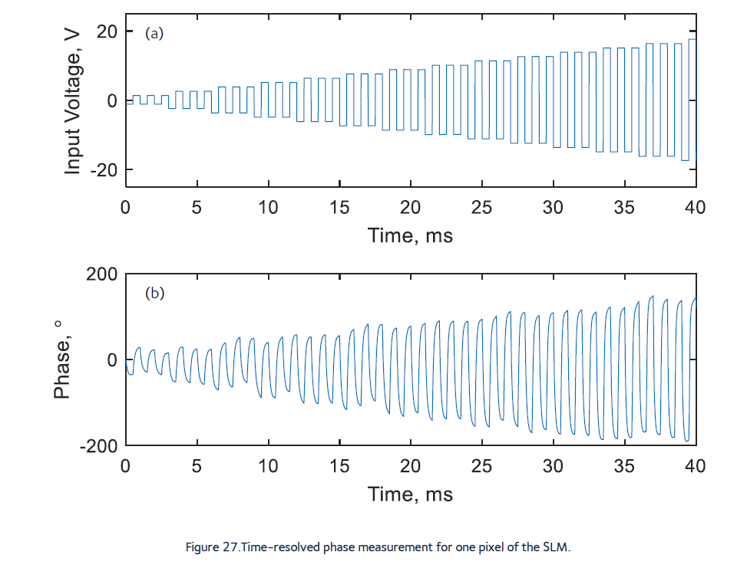
De-Risk: Integrated Spatial Light Modulator
Laboratory-scale multi-pixel device fabricated and characterized. Results show optical and switching characteristics are suitable for beamforming at 1kHz.
Notes:
Results form integrated lab-scale SLM (1):
Lab-scale SLM of micrometer depth developed. This included a novel technique to use the same liquid crystal to create a quarter waveplate (the second Q in the diagram in slide 7), which optimizes the thickness of the overall solution and makes it more manufacturable.
It was then demonstrated that the optical properties and switching properties at 1kHz are of sufficient quality to develop an SLM.

Slide 12
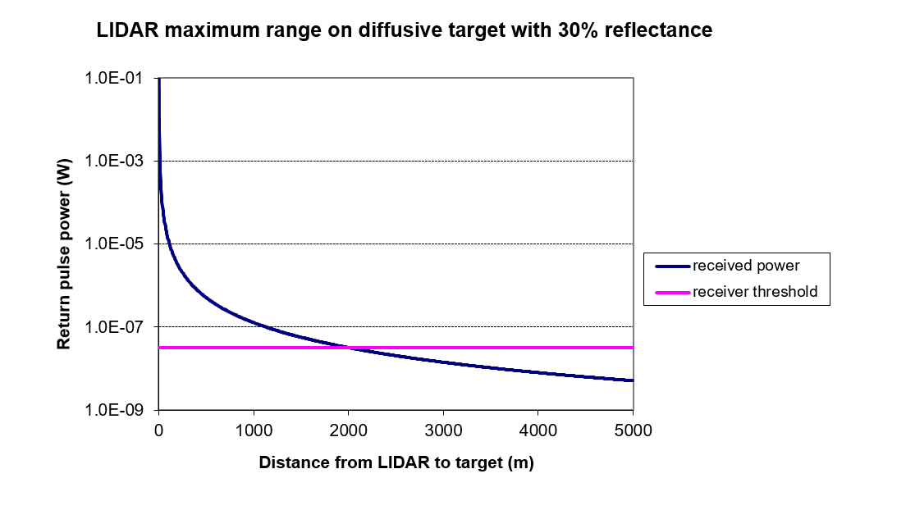

Remaining risks: SLM Field of View and Power Loss
SLM LiDAR is viable provided technical trade-offs are leveraged for mission parameters.
  LiDAR field of view can be enhanced at the expense of target resolution.
  Launch power loss due to SLM scattering (up to 6dB) can be mitigated using high-performance receiving devices. 2km range is possible with 30% reflectance target (lunar average)
$$θ$$
$$P_{APD}=P_{ref}K_{rx}×dP_{Ω}$$
$$P_{pk}$$
$$P_{ref}=P_{pk}K_{tx}K_{moon}$$
Notes:
Main remaining risks for SLM:
Field of view: current commercial SLMs have about +-2 degrees FOV, this is a physical limitation that depends on wavelength and pixel pitch. We would require an optical expansion to solve the problem.
Scattering loss: the scattering loss of the SLM currently can be about 3dB, which means 6dB in reflective configuration. Current simulations show 3dB loss is acceptable for automatic landing mission requirements, but this needs to be optimised.

Slide 13
Remaining Risks: SLM temperature and Data Communications Bottleneck
SLM operates at ~90degC
  Thermal solution required, should be possible due to small SLM footprint (<20mm diameter)
Possible difficulties with FPGA data throughput
  SLM current solution including beam expansion requires 22-bit x 835 x 835 @ 1kHz = 15Gbps
uSemi: up to 4 parallel 3.125 Gbps transmitters
Xilinx: up to 32 parallel 12.5 Gbps transceivers

Slide 14
Roadmap Next Step – Phase B1
Advanced Phase B1 (12 months): Requirements analysis and preliminary design of modules deemed as high risk (optical/thermal). Emphasis on resolving field-of-view and scattering loss problems. DDP has full details of activity, enhancing the current consortium to include UK and German liquid crystal manufacturing and materials experts. LIDAR BBM of control system FPGA interfaced to SLM information sink
Phase B1 (TRL4): requirements analysis to arrive at a preliminary architecture for COLD. Lab scale SLM or similar information sink and controller/processor card will be electrically and mechanically interfaced in BBM. Custom silicon fabrication run in a commercial foundry for ~800x800 device begins.
Phase B1+ (6 months): Finalize requirements analysis and preliminary design of full COLD, flowing down from target mission, SRR.
Notes:
Next phase is B1: the phase is further detailed in DDP, there is an option to split the phase to bring forward the most pressing analysis and preliminary design tasks. The idea is to de-risk FOV, power loss, data throughput, and localized heating to ensure requirements are correctly set, and likely to be met going forward for potential missions.

Slide 15
ESA GSTP Programme
Funded Phase A through de-risk programme and provided technical and programmatic guidance monthly
ESA technical contact was a valuable asset for information dissemination
ESA facilities identified for robot arm LiDAR testing
Facilities / contacts for custom silicon fabrication in Europe would be an asset

Slide 16
Conclusions
All objectives for De-Risk phase completed with high degree of success.
Work progressed beyond de-risk scope (1-D SLM design, full-wave recording, full FPGA layout)
Remaining risks found: SLM FOV, loss, and temperature. FPGA data speed. Proposal to address these as part of Advanced Phase B1. Detailed plan in DDP.

Slide 17
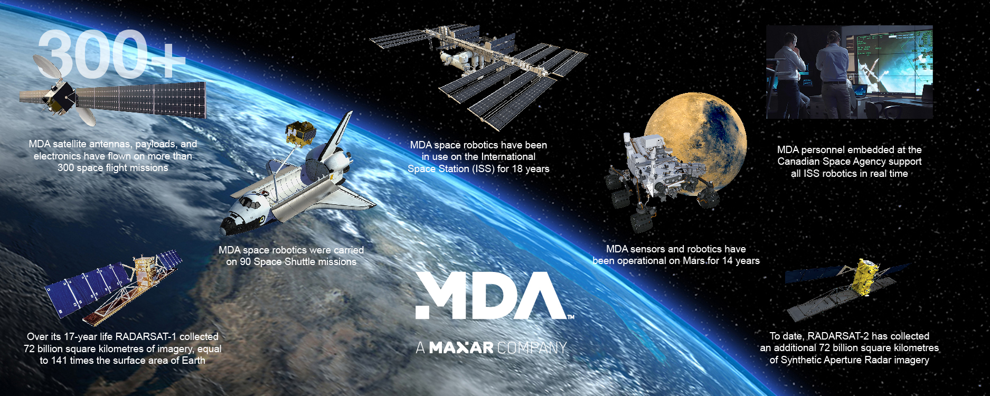
MDA Background and Heritage
MDA has posted some impressive numbers since 1969

Slide 18
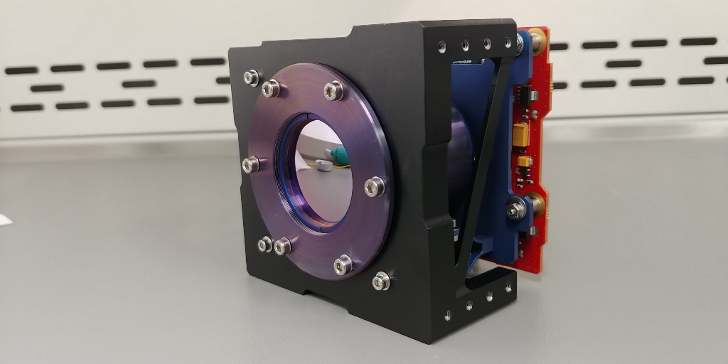
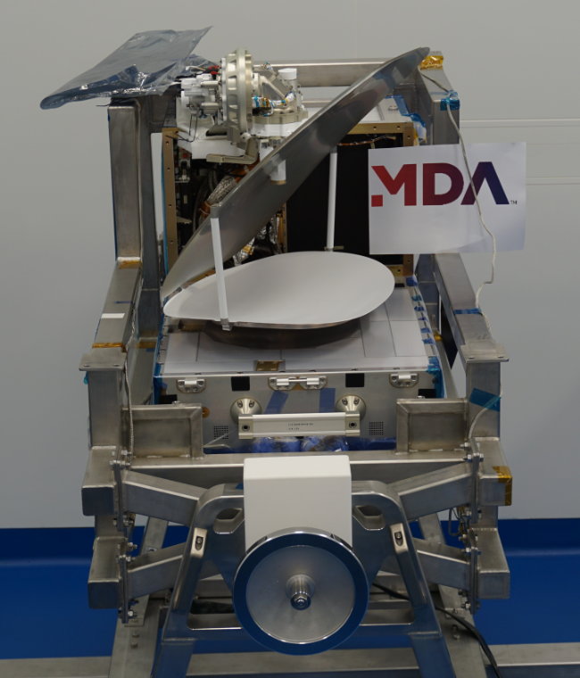
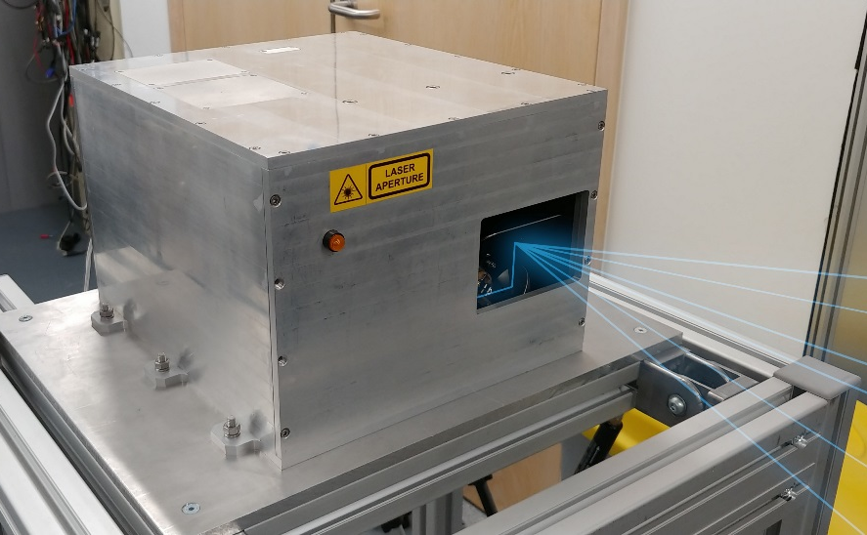
MDA UK Capabilities
Communication Payloads
  Ka Band Data relay
  On Board Computers
  Active and Passive RF systems
Sensor Systems
  Laser target detection, docking and landing system
  Wide band IR Cameras
Robotics and Automation
  Growing participation in existing Mars, Lunar and On Orbit Servicing projects

