Slide 1



GSTP E1 Efficient Information-Preserving Image Compression for Space Applications EIPICSA
Dotphoton, Zug, Switzerland

Slide 2
Overview
Motivation
Implementation
Testing

Slide 3
Motivation
AI will allow for vast volumes of data to be processed. We aim at making the collecting and handling big image data easier.

Slide 4
Raw data for AI?
AI typically uses preprocessed data, however,
Most preprocessing has been developed for the human eye
Preprocessing pipelines are continuously improving
AI needs its input data to be from the same distribution as its training data
The best option is to keep the raw-data and preprocess it with state-of-the-art techniques just before feeding to AI applications.

Slide 5
Different applications need different preprocessing of raw data.

Slide 6
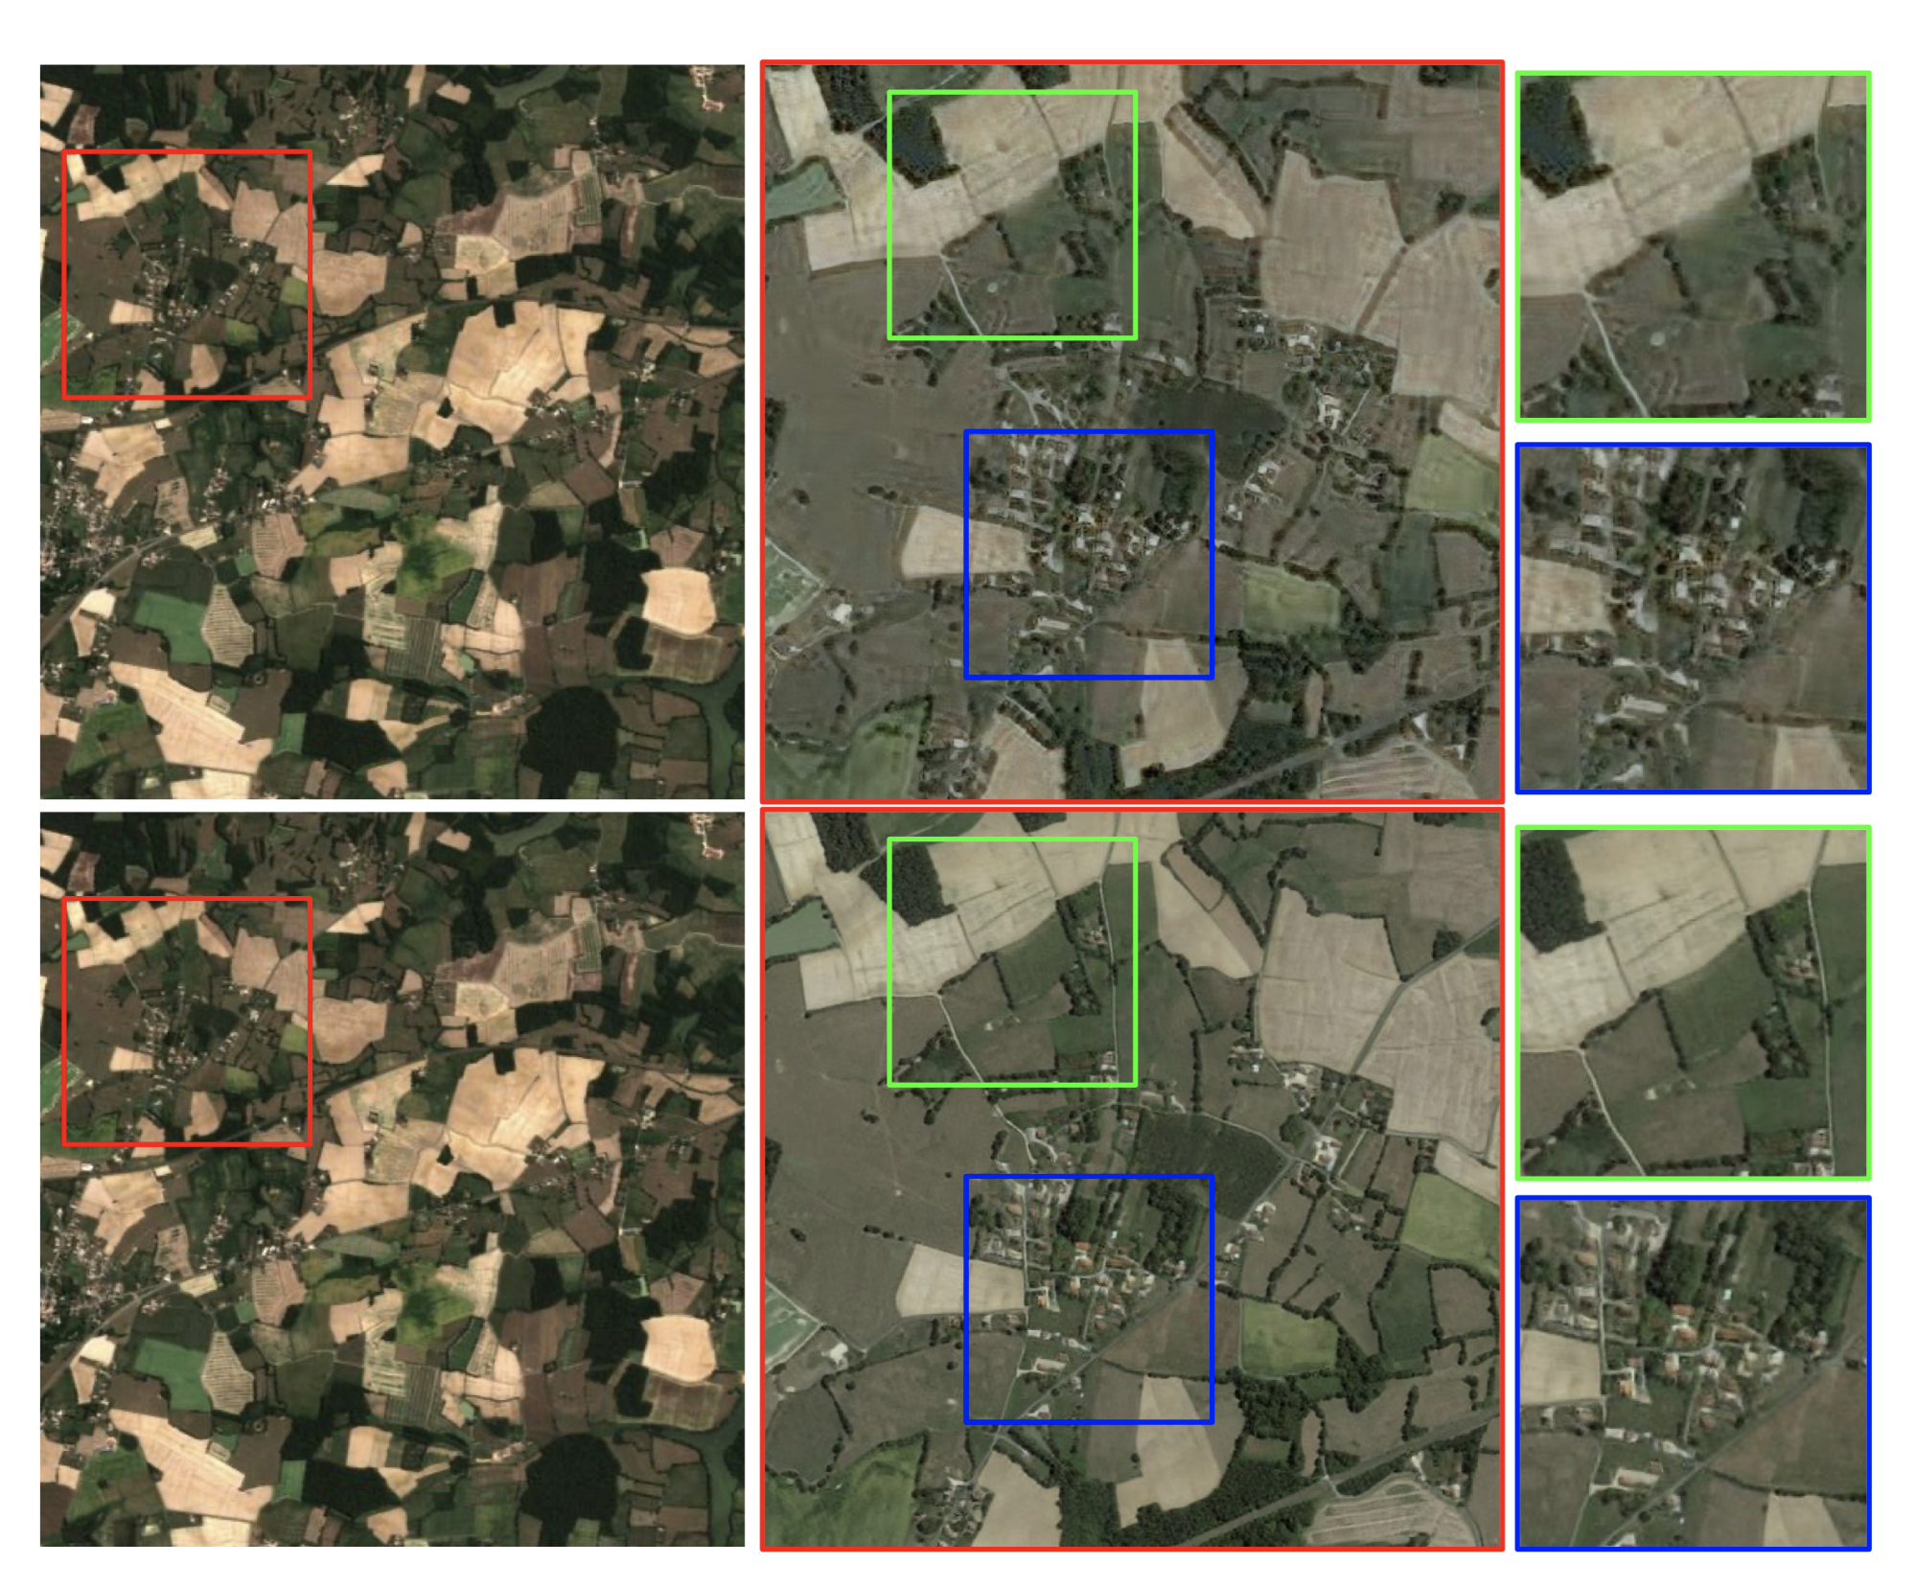

Illustration 1:
4x AI upsampling

Slide 7
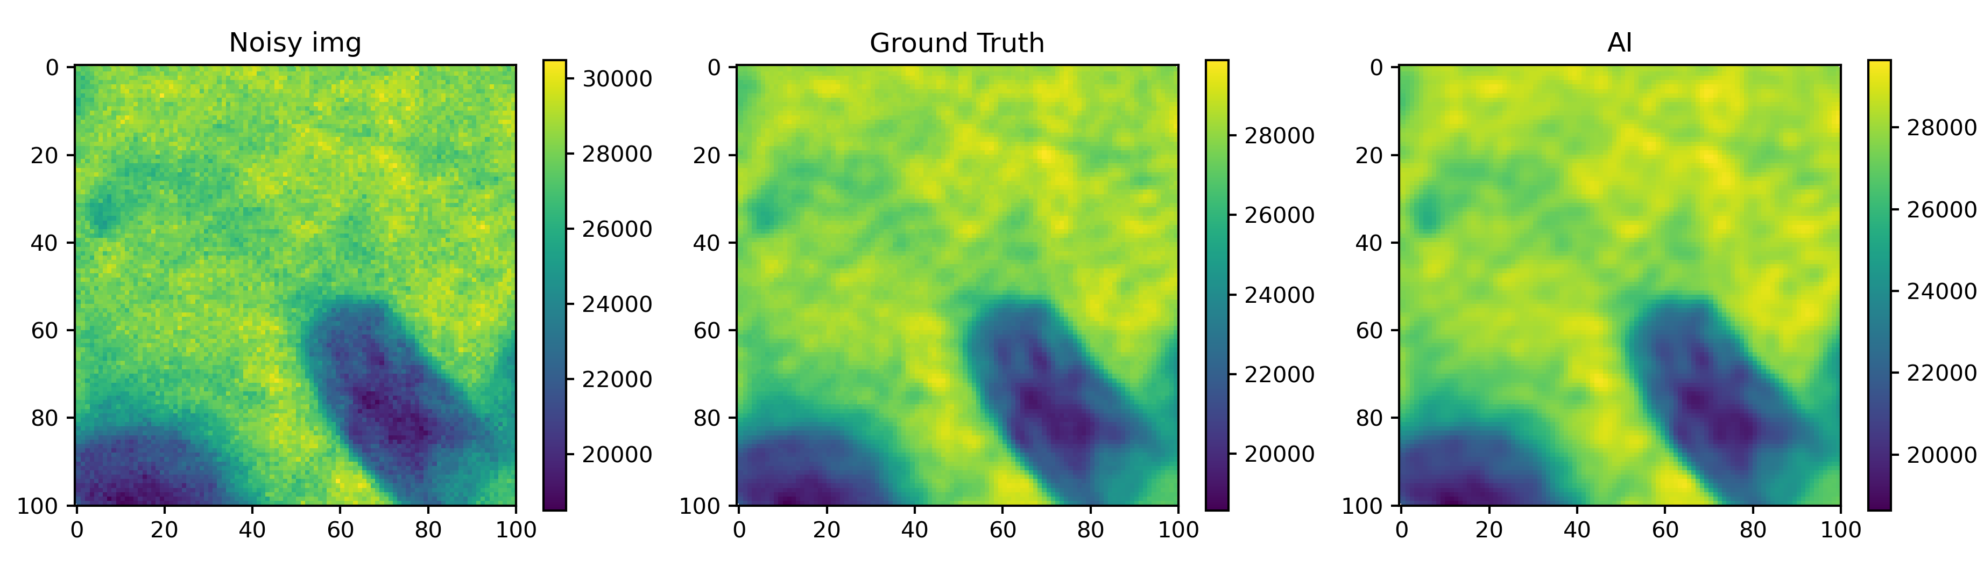
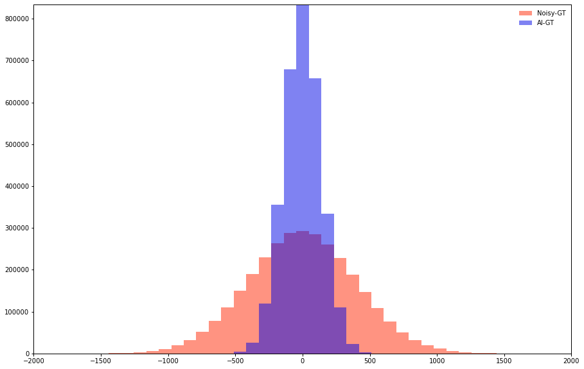
Illustration 2: AI-based denoising
9dB SNR improvement
Notes:
Requires a very accurate noise model for the system, and both training and inference on raw data.

Slide 8
Required features
Handle large volumes of data:
  High compression ratio
  High speed
Interoperability
  Ease of transcoding across different (lossless) file formats (e.g. tiff, hdf5, …)
  No interaction with lossy file formats (e.g. DCT, wavelet, …)
  Transparently traverses existing data pipelines
Maintain quality
  No artefacts, visible or invisible
  Works with raw data
  Metrologically accurate (no bias)

Slide 9
Lossy-lossless scale
 | Lossy | Visually lossless | Limited-error | “steganographic” | lossless
Loss invisible | ✗ | ✓ | ✓ | ✓ | ✓
Bounded pixel error | ✗ | ✗ | ✓ | ✓ | ✓
No artefacts / bias | ✗ | ✗ | ✗ | ✓ | ✓
Image indistinguishable from genuine raw | ✗ | ✗ | ✗ | ✓ | ✓
Bit-accurate | ✗ | ✗ | ✗ | ✗ | ✓
Typical compression ratio | 10:1 | 2:1-10:1 | 2:1-5:1 | 5:1-10:1 | <2:1
Examples | Jpeg (DCT) | Wavelet e.g. JPEG2000 lossy | e.g. JPEG-LS lossy, LERC | JetRaw | JPEG-LS, FLIF, …

Slide 10
Implementation

Slide 11
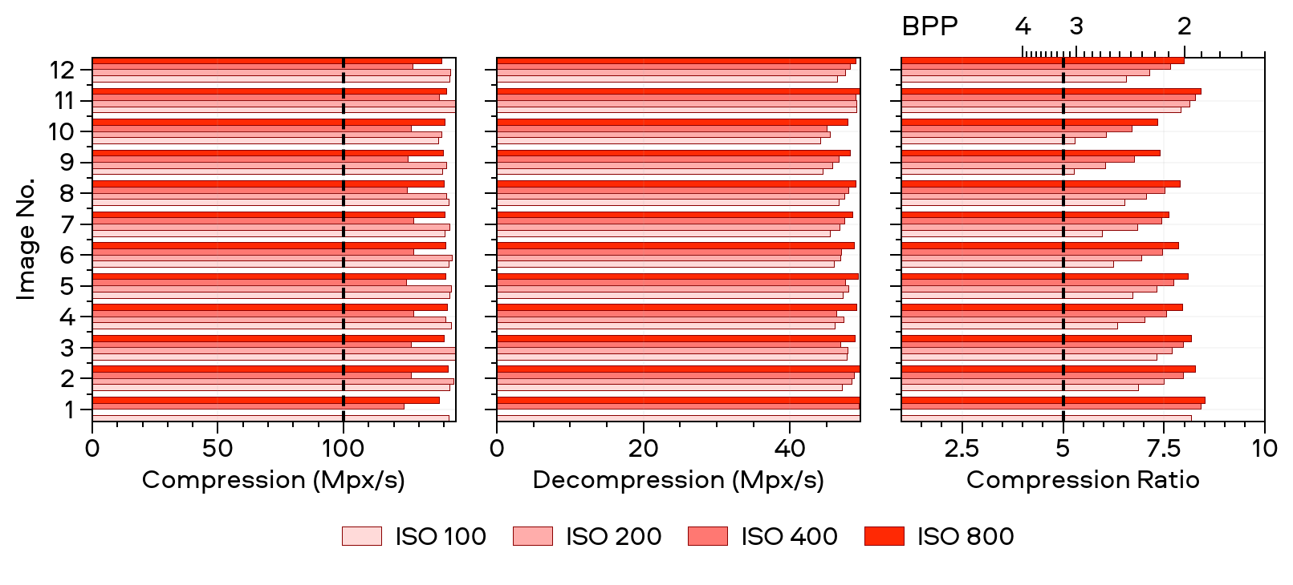
Software performance:
2-3 bpp @ >100 Mpixels/s/core

Slide 12
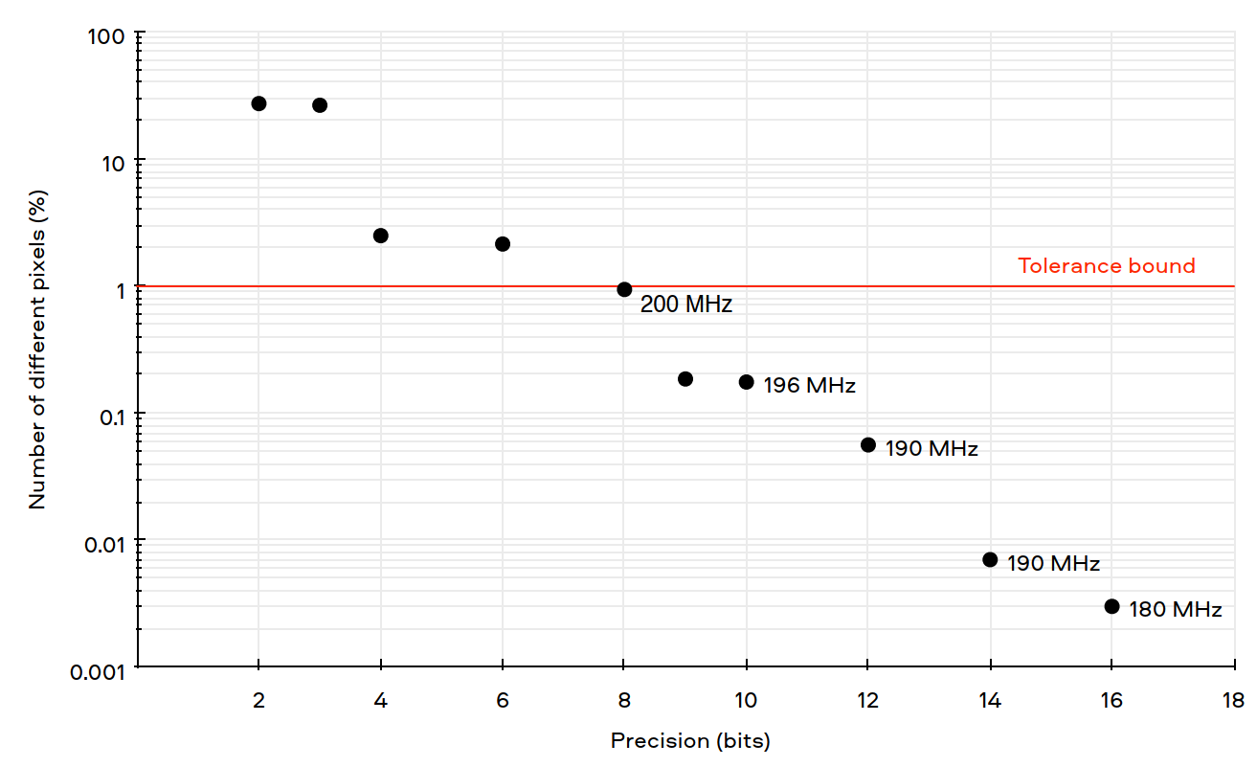
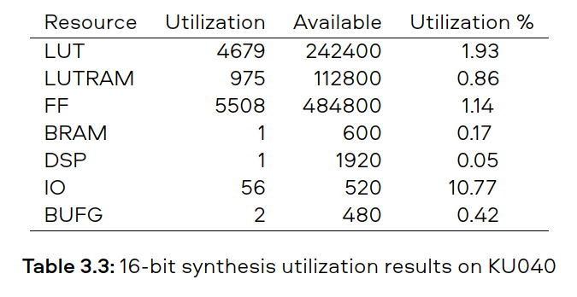
FPGA performance:
200Mpix/s with ~5000 LUTs, ~0.7W

Slide 13
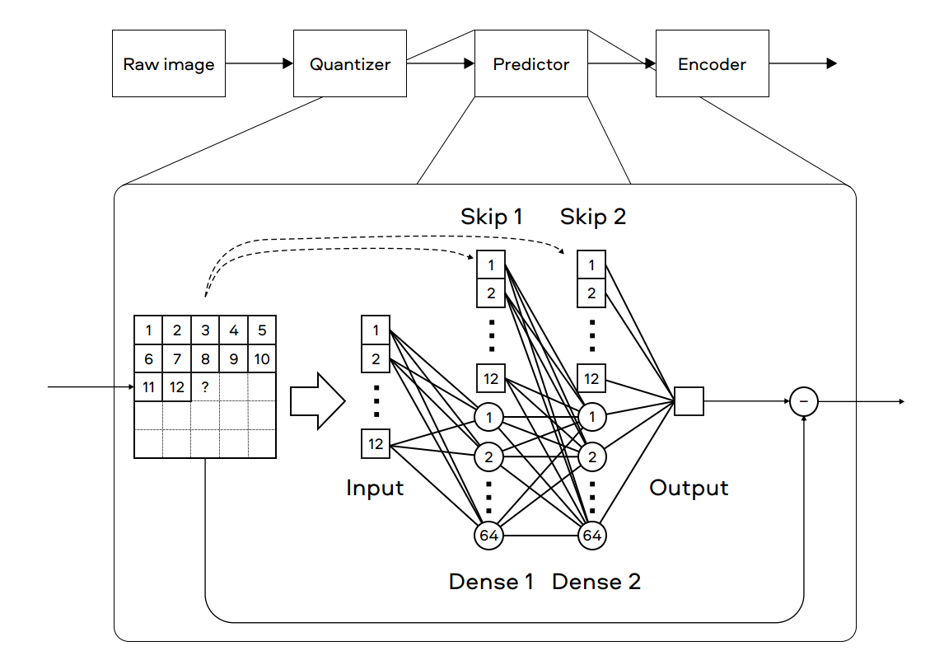
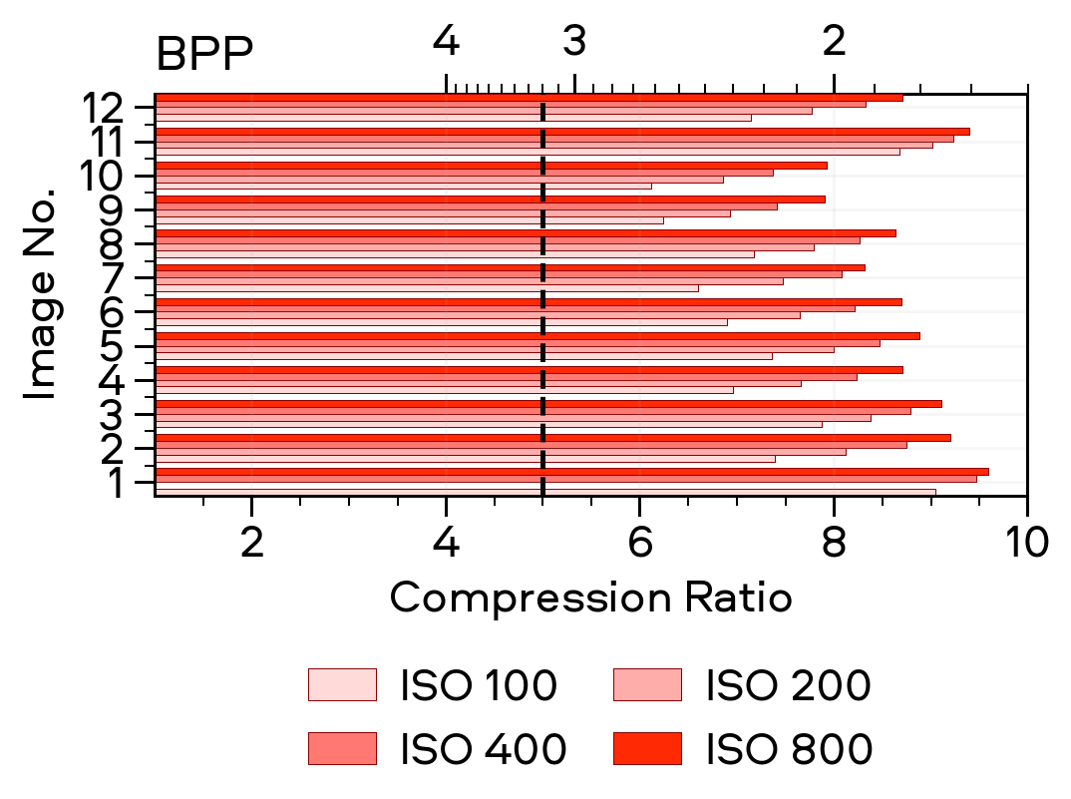
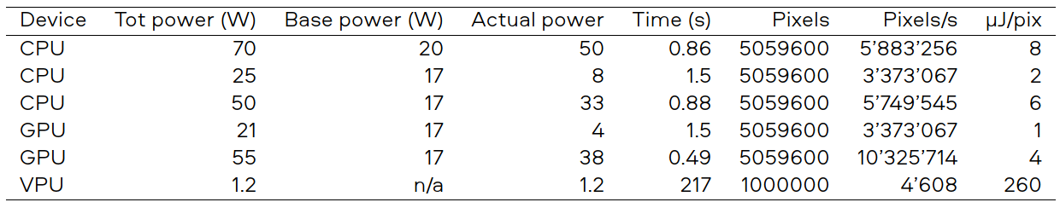
Implementation with tensor hardware:
10% better compression, 10MPixels/s

Slide 14
Four validation methods
Theory (mathematics)
Code (unit/system tests) 96% coverage
Black-box laboratory test (take n images and do statistics)
Application testing (get same results with raw and compressed)

Slide 15
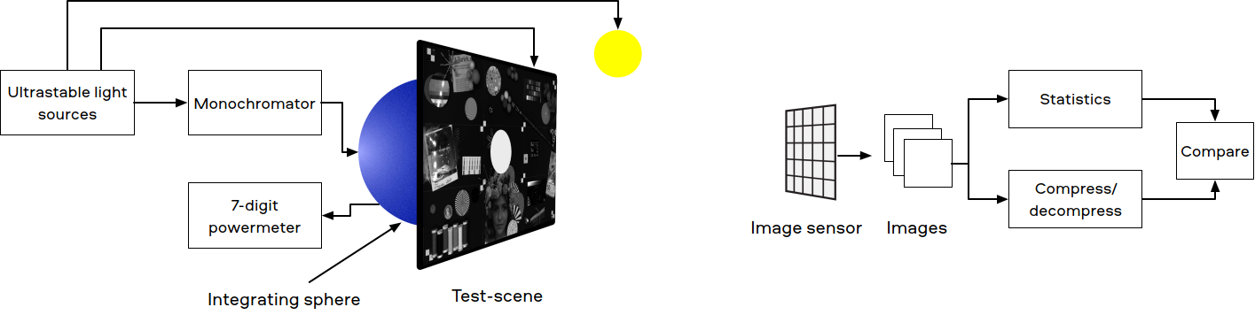
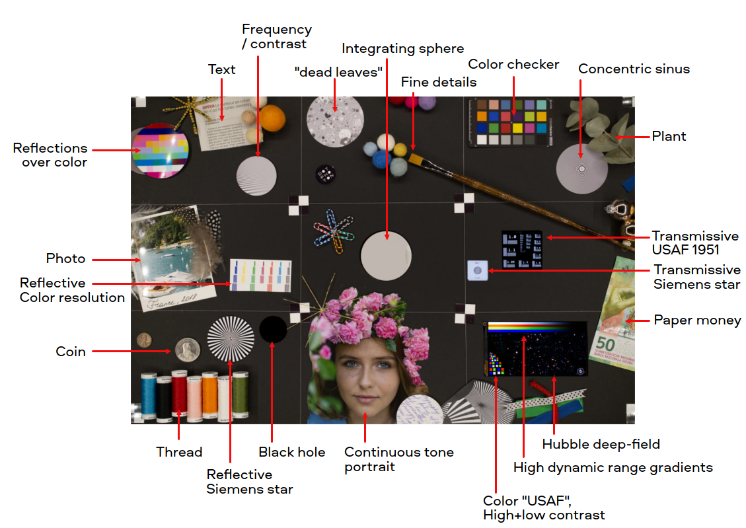
Black box tests

Slide 16
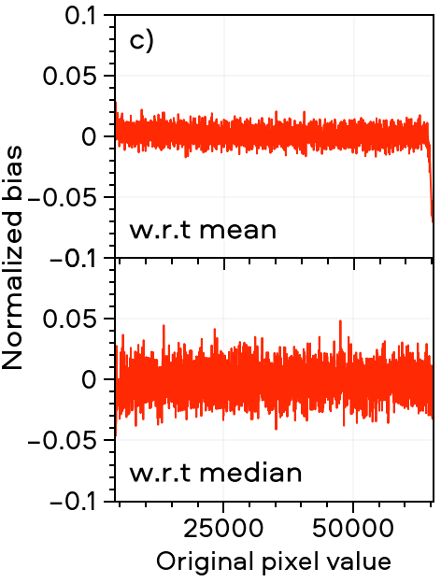
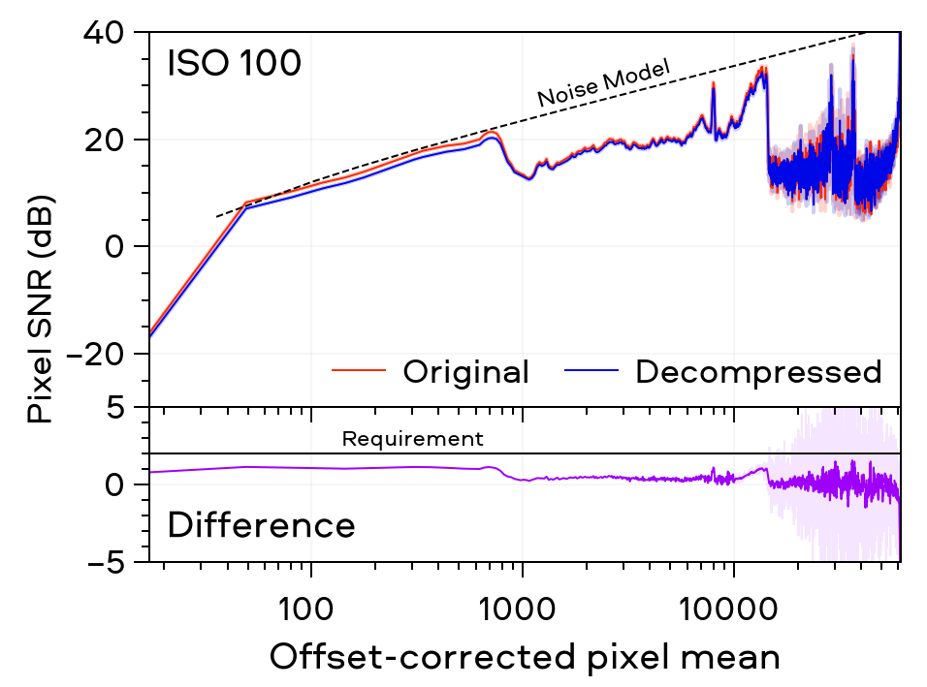
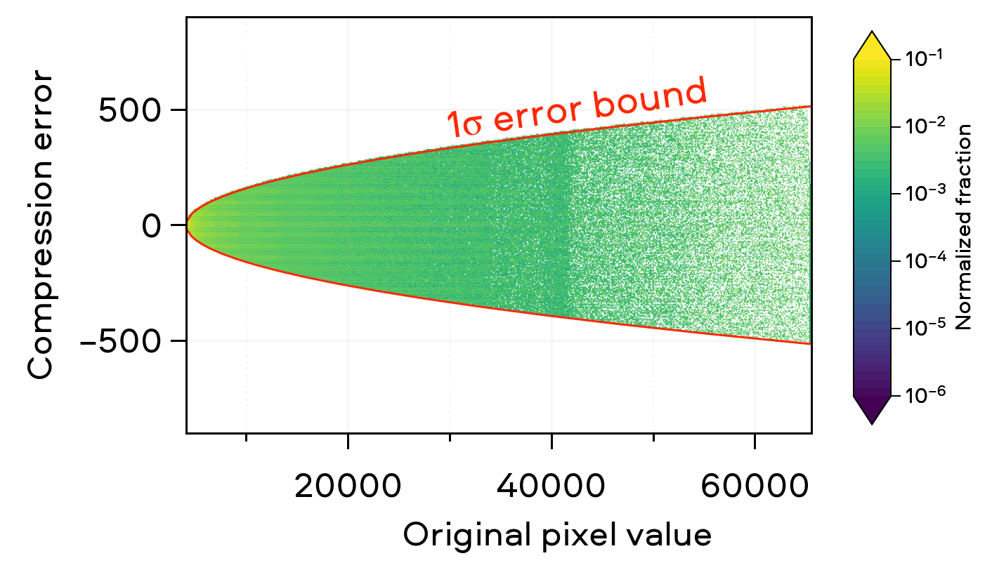
Results:
error bound: 1σ
SNR loss: <1.2dB
Bias: <2%

Slide 17
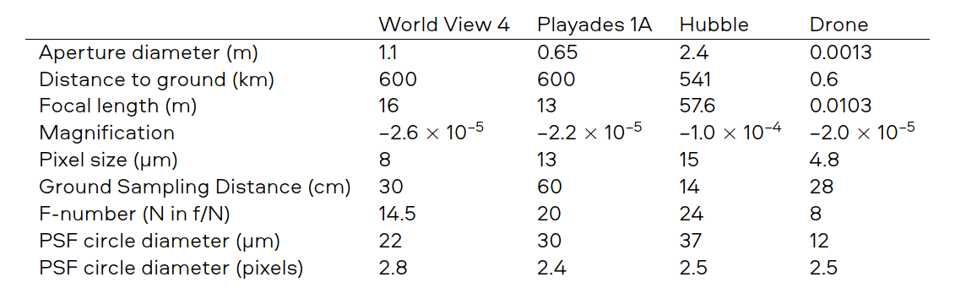
Image dataset emulation target:
30cm GSD and 2.5 Pixel PSF diameter

Slide 18
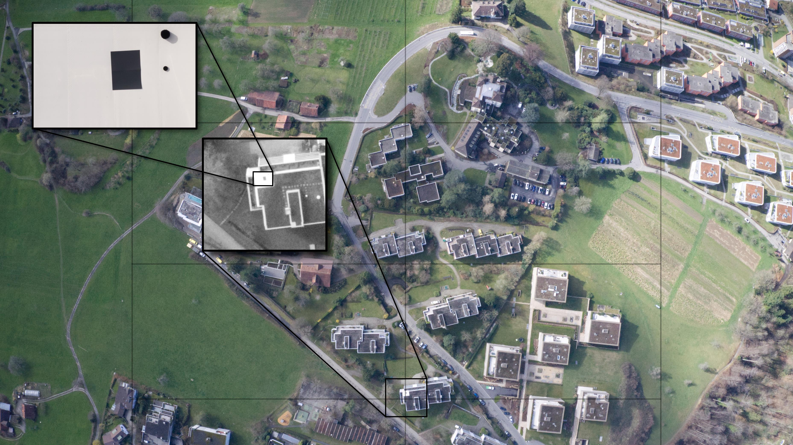
Verify emulation correctness
Measure PSF and ESF

Slide 19
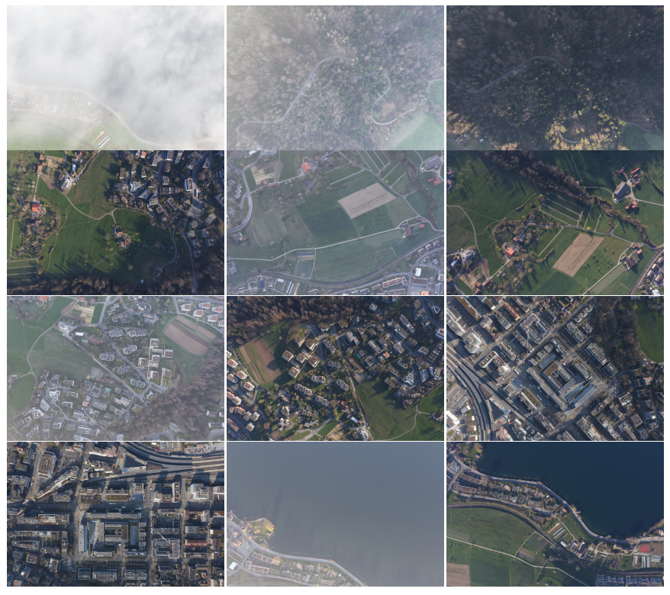
Test imageset
12 scenes
4 “iso” settings (i.e. exposure times/gain combinations)

Slide 20
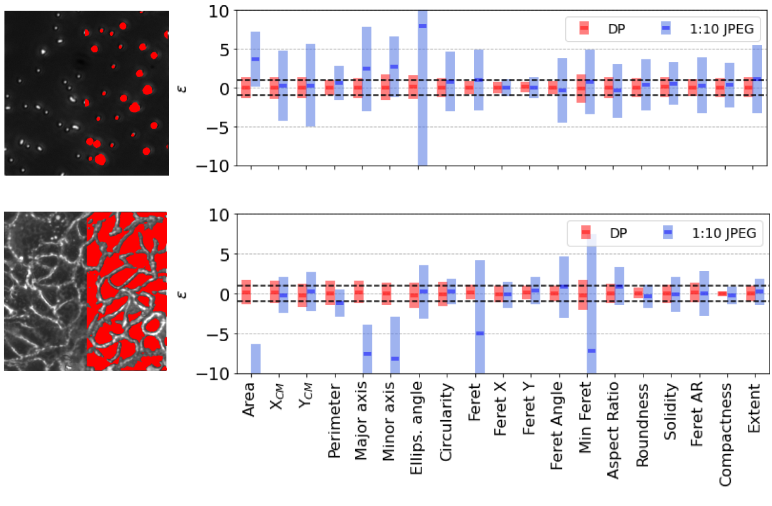
Application testing
Tested to yield statistically equivalent results to those obtained with raw data in a number of existing applications
(HEPIA)

Slide 21
Conclusion
We presented a compression implementation targeted at metrological and AI applications.
Compression ratios of 5:1 to 10:1 can be obtained for a tradeoff of <1.2dB in SNR.
Speed is > 200MBps/core

Slide 22
ESA GSTP
Swiss Space Office
ITU, WHO: standardization of AI data quality metrics
WYSS EPFL Max Planck HEPIA, UniGE
PCO: integrated in their cameras
Attract/CERN: hyperspectral compression
10 Corporate customers, 15 FTEs

