Slide 1

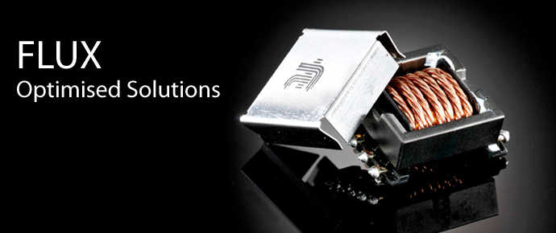

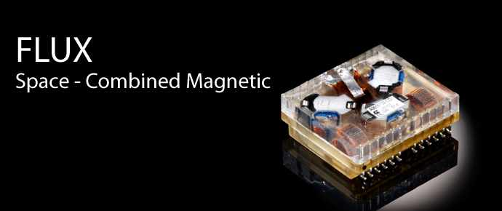
Presentation by Flux A/S
Final Review, contract 40000122089/17/NL/CRS CCN1
ESCC3201/013 Qualification Test
30/10-2020

Slide 2
Purpose of CCN1 – Proof of concept
Qualification of High Power and Encapsulated Components developed under GSTP contract:
Electrical Propulsion Output Stage Transformer (QS1) and Inductor (QS2) max. operating at 5KW/62A
Encapsulated LF Input Filters 139nH-1,24mH (3A-20A ESCC-Q-ST-30-11 de-rated) (QS3) (QS4)
Included in addition to contract: Toroid Inductor wound with Litz wire (QS5)
    Fully encapsulated toroid on carrier (QS6)
    EFD inductor wound with terminated Litz Wire (Q7)

Slide 3
Focus points and targets
Due to increasing electrification of propulsion systems of satellites, Flux experience need for higher power components than already qualified.
As a major focus of the electrification is to reduce launch weight there is a natural need to develop electrical components with the utmost attention to weight.
Customers request parts based on construction using Litz wire, which differs from traditional and ESCC documented products like massive CU wire and Multi Stranded CU wires. Litz wire can consist of hundreds even thousands of cores providing a different design platform in terms of power versus frequency.
There is a need for encapsulated components as some customers regard those as more rigid than open construction components.
To cover the above needs, Flux defined the following target for GSTP development and ESCC qualification:
Achieve power level of 5kW for PPU Transformer and Inductor (design defined max. current 62A)
Achieve the higher power level maintaining a mass increase of maximum 20% weight (18% achieved)
Achieve the above by utilizing design for manufacturing at lowest material cost possible
Develop encapsulation and potting process by applying and approving an industrially accessible Epoxy
Define the process of tinning and solder Litz wire through experiments, trials and ESCC Qualification

Slide 4
Manufacturing of the test vehicles
Full documentation packages were produced for all targeted designs. Part manufactured for verification test and step stress test under the main contract were updated based on experiences. Additional products were documented based on results from experiments and trials.
The Litz based components led to the updating of several internal Workmanship instructions:
FT08710604 Tinning – added instructions for tinning of Litz wire
FT08710403 Cleaning post impregnation and encapsulation – added cleaning of Litz wire
FT08710602 Thermal Stripping – added removal of outer isolation layer, separation of cores and Tin dipping parameters
FT08710802 Mounting and solder to terminals – added process relevant for Litz wire
Manufacturing of all units was successful and without incident.

Slide 5
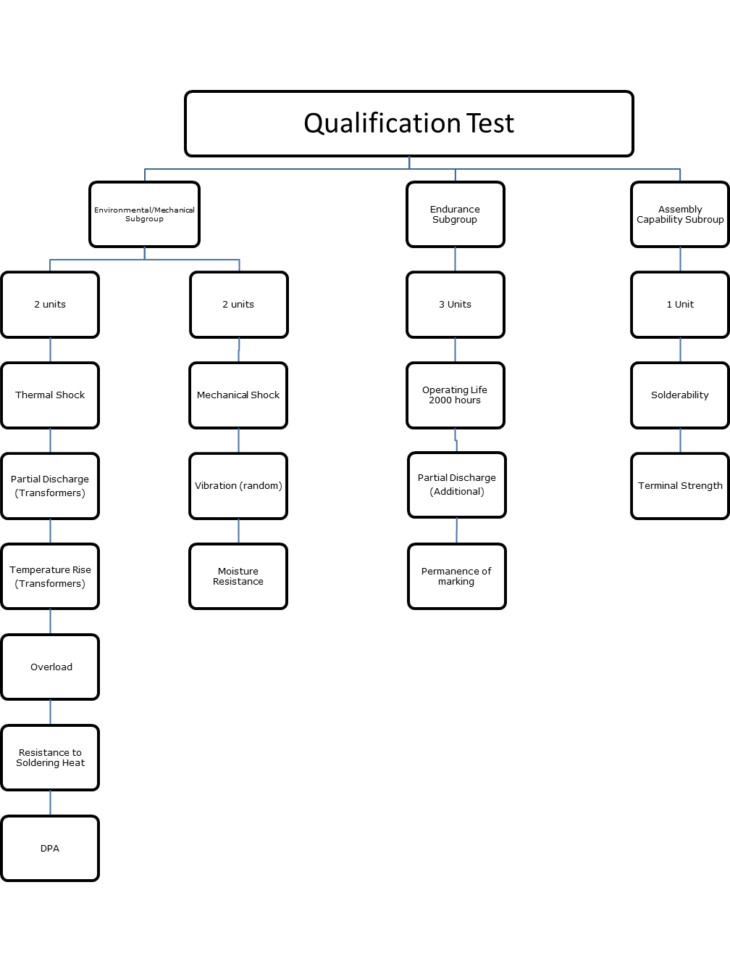


ESCC3201/013 Qualification Flow

Slide 6
Qualification test results QS1 and QS2
Group and Test |  |  |  |  |  |  | 12413001-1 |  |  |  |  |  |  |  | 14413001-1
 |  |  |  |  |  |  | 001 | 002 | 004 |  |  | 005 |  | 006 | 015 |  | 017 |  | 018 | 019 | 020
 | Life Test |  |  |  |  |  |  |  | P |  |  | P |  | P |  |  |  |  | P | P | P
 | Partial Discharge (High Power Transformers only) |  |  |  |  |  |  |  |  |  |  |  |  |  |  |  |  |  | P | P | P
 | Permanence of marking |  |  |  |  |  |  |  | P |  |  | P |  | P |  |  |  |  | P | P | P
 | Solderability |  |  |  |  |  |  |  | No Terminals |  |  |  |  |  |  |  |  |  | No Terminals
 | Terminal Strength |  |  |  |  |  |  |  | No Terminals |  |  |  |  |  |  |  |  |  | No Terminals
 | Mechanical Shock |  |  |  |  |  | P | P |  |  |  |  |  |  | P |  | P
 | Random Vibration |  |  |  |  |  | P | P |  |  |  |  |  |  | P |  | P
 | Moisture Resistance |  |  |  |  |  | P | P |  |  |  |  |  |  | P |  | P
 | Thermal Shock |  |  |  |  |  | P | P |  |  |  |  |  |  | P |  | P
 | Partial Discharge (High Power Transformers only) |  |  |  |  |  | Inductor |  |  |  |  |  |  |  | P |  | P
 | Temperature Rise (Transformers only) |  |  |  |  |  |  |  |  |  |  |  |  |  | P
 | Overload |  |  |  |  |  | P | P |  |  |  |  |  |  | P
 | Resistance to Soldering Heat |  |  |  |  |  | No Terminals | No Terminals |  |  |  |  |  |  | No Terminals
 | DPA |  |  |  |  |  | P |  |  |  |  |  |  |  | P
Sample Size = 5
 |  | Key:
 |  | Pass |  | Passed with comments See section |  | Fail See section 7. |  |  |  |  |  |  | This test is required, however it is Not Applicable for this part type |  |  |  |  | In accordance with Test procedure this test is not required for this S/N

Slide 7
Qualification test results QS3 and QS4
Group and Test |  |  |  |  |  |  | 12781001-1 |  |  |  |  |  |  |  | 12781007-1
 |  |  |  |  |  |  | 009 | 010 | 001 |  |  | 002 |  | 003 | 006 |  | 009 |  | 001 | 002 | 003
 | Life Test |  |  |  |  |  |  |  | P |  |  | P |  | P |  |  |  |  | P | P | P
 | Partial Discharge (High Power Transformers only)
 | Permanence of marking |  |  |  |  |  |  |  | P |  |  | P |  | P |  |  |  |  | P | P | P
 | Solderability |  |  |  |  |  |  |  | P |  |  |  |  |  |  |  |  |  | P
 | Terminal Strength |  |  |  |  |  |  |  | Flying Leads |  |  |  |  |  |  |  |  |  | Flying Leads
 | Mechanical Shock |  |  |  |  |  | P | P |  |  |  |  |  |  | P |  | P
 | Random Vibration |  |  |  |  |  | P | P |  |  |  |  |  |  | P |  | P
 | Moisture Resistance |  |  |  |  |  | P | P |  |  |  |  |  |  | P |  | P
 | Thermal Shock |  |  |  |  |  | P | P |  |  |  |  |  |  | P |  | P
 | Partial Discharge (High Power Transformers only) |  |  |  |  |  | Inductor |  |  |  |  |  |  |  | Inductor
 | Temperature Rise (Transformers only)
 | Overload |  |  |  |  |  | P | P |  |  |  |  |  |  | P |  | P
 | Resistance to Soldering Heat |  |  |  |  |  | P | P |  |  |  |  |  |  | P |  | P
 | DPA |  |  |  |  |  | P |  |  |  |  |  |  |  | P
Sample Size = 5
 |  | Key:
 |  | Pass |  | Passed with comments See section |  | Fail See section |  |  |  |  |  |  | This test is required, however it is Not Applicable for this part type |  |  |  |  | In accordance with Test procedure this test is not required for this S/N

Slide 8
Qualification test results QS5 and QS6
Group and Test |  |  |  |  |  |  | 12311067-1 |  |  |  |  |  |  |  | 12169002-1
 |  |  |  |  |  |  | 001 | 002 | 003 |  |  | 004 |  | 005 | 001 |  | 002 |  | 003 | 004 | 005
 | Life Test |  |  |  |  |  |  |  | P |  |  | P |  | P |  |  |  |  | P | P | P
 | Partial Discharge (High Power Transformers only) |  |  |  |  |  |  |  | Inductor |  |  |  |  |  |  |  |  |  | Inductor
 | Permanence of marking |  |  |  |  |  |  |  | P |  |  | P |  | P |  |  |  |  | P | P | P
 | Solderability |  |  |  |  |  |  |  | P |  |  |  |  |  |  |  |  |  | P
 | Terminal Strength |  |  |  |  |  |  |  | Flying Leads |  |  |  |  |  |  |  |  |  | Flying Leads
 | Mechanical Shock |  |  |  |  |  | P | P |  |  |  |  |  |  | P |  | P
 | Random Vibration |  |  |  |  |  | P | P |  |  |  |  |  |  | P |  | P
 | Moisture Resistance |  |  |  |  |  | P | P |  |  |  |  |  |  | P |  | P
 | Thermal Shock |  |  |  |  |  | P | P |  |  |  |  |  |  | P |  | P
 | Partial Discharge (High Power Transformers only) |  |  |  |  |  | Inductor |  |  |  |  |  |  |  | Inductor
 | Temperature Rise (Transformers only)
 | Overload |  |  |  |  |  | P | P |  |  |  |  |  |  | P |  | P
 | Resistance to Soldering Heat |  |  |  |  |  | P | P |  |  |  |  |  |  | P |  | P
 | DPA |  |  |  |  |  | P |  |  |  |  |  |  |  | P
Sample Size = 5
 |  | Key:
 |  | Pass |  | Passed with comments See section |  | Fail See section |  |  |  |  |  |  | This test is required, however it is Not Applicable for this part type |  |  |  |  | In accordance with Test procedure this test is not required for this S/N

Slide 9
Qualification test results QS7 (001-005)
Group and Test |  |  |  |  |  |  | 12189001-1
 |  |  |  |  |  |  | 001 | 002 | 003 |  |  | 004 |  | 005
 | Life Test |  |  |  |  |  |  |  | P |  |  | P |  | P
 | Partial Discharge (High Power Transformers only) |  |  |  |  |  |  |  | Inductor
 | Permanence of marking |  |  |  |  |  |  |  | P |  |  | P |  | P
 | Solderability |  |  |  |  |  |  |  | P
 | Terminal Strength |  |  |  |  |  |  |  | P
 | Mechanical Shock |  |  |  |  |  | P | P
 | Random Vibration |  |  |  |  |  | P | P
 | Moisture Resistance |  |  |  |  |  | P | P
 | Thermal Shock |  |  |  |  |  | P | P
 | Partial Discharge (High Power Transformers only) |  |  |  |  |  | Inductor
 | Temperature Rise (Transformers only)
 | Overload |  |  |  |  |  | P | P
 | Resistance to Soldering Heat |  |  |  |  |  | P | P
 | DPA |  |  |  |  |  | P
Sample Size = 5
 |  | Key:
 |  | Pass |  | Passed with comments |  | Fail See section 6.6 |  |  |  |  |  |  | This test is required, however it is Not Applicable for this part type |  |  |  | In accordance with Test procedure this test is not required for this S/N

Slide 10
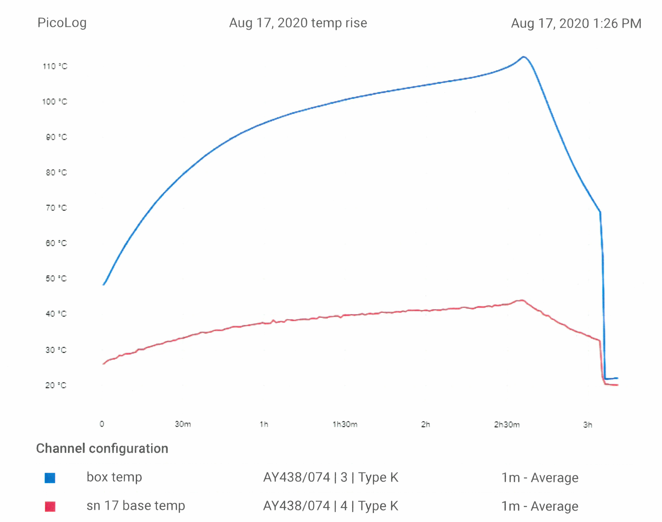
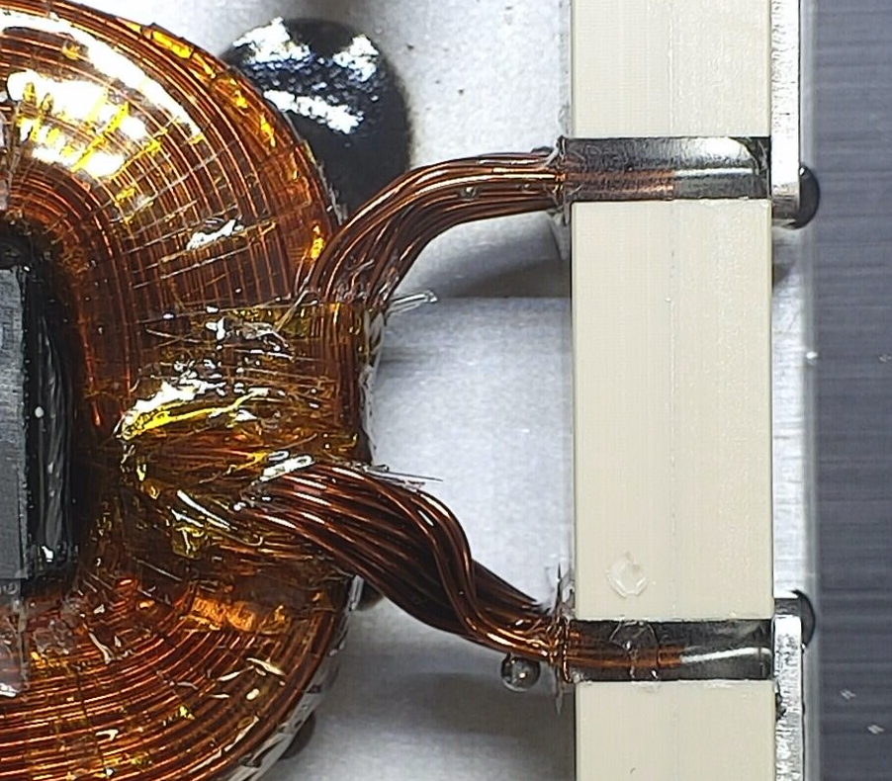
Observations and lesons learned
Temperature Rise QS2 Serial Number 017:
The temperature rise test on S/N 017 caused the unit to overheat and enter thermal runaway. The baseplate temperature was in excess of 110ºC, with the internal temperature considerably higher. The Temperature lead to the melting of the solder, this indicates a temperature >183ºC.
The unit is design to be used with active cooling to avoid overheating. Without some manner of dispersing the heat the unit will overheat.
The test cannot be performed on the manner prescribed by Flux’s Engineering. A new method should be devised which allows for a simulation of actual operating conditions including a cooled baseplate to dissipate heat.

Slide 11
Conclusion – ESCC Qualification
Observations on Temperature Rise QS2 Serial Number 017 has shown that a test setup designed strictly to international standard needs to be modified to reflect the actual design besides being compliant to standard.
Conclusion:
The qualification has proved concept of design in all tested categories and applied materials and is deemed successful.

