Slide 1

SAVOIR EDS Final Presentation
Richard.Melvin@cgi.com
Technical Lead
22/10/2020

Slide 2
Agenda
Study Context
Study Overview
Achievements and Results
Process Model
Datasheets Tooling
Conclusions
Proof of Concept Prototypes

Slide 3
Study Context
SAVOIR EDS

Slide 4

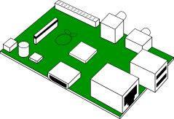

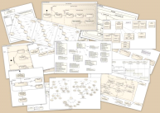
What is an Electronic Data Sheet?
Data, Electrical,
Thermal and Mechanical
A computer-readable replacement (or supplement) to the current printable documents used to manage the interfaces to and from onboard electronic devices.
This should be capable of both generating a comparable human-readable document, and being automatically imported into, or generated from, relevant system databases.
ICD
EDS
SRDB

Slide 5
What does an EDS cover?
Meta
Communications
Thermal
Mechanical
Electrical
  Communications
  Data, TM/TC, packets, parameters, units, calibrations
  Thermal
  Heat-related properties and models
  Mechanical
  Physical properties and models
  Electrical
  Electrical properties and modles, connectors, power
  Meta
  Datasheet-related information, e.g. version and maturity.

Slide 6
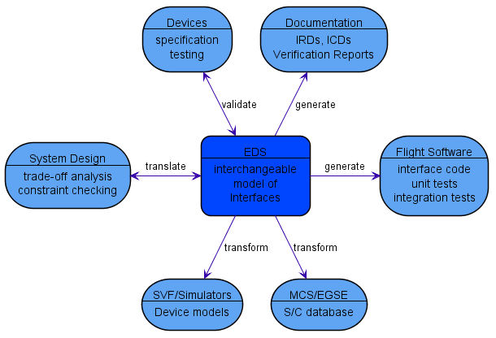
What can you do with an EDS?
Test that a device conforms to it
Generate human-readable documentation
Generate parts of the FSW handling that device
Generate parts of the databases used by MCS and EGSE to control the device
Generate parts of the SVF and simulator models for that device
Import information provided into other system design tools
And more…
CTME
C

Slide 7
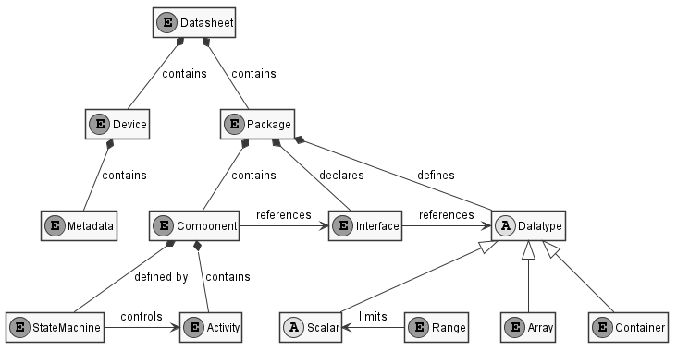
What is the structure of an EDS?
A Data Sheet contains device Metadata plus multiple Packages, which
  define a variety of Data Types;
  declare Interfaces referencing those types; and
  contain Components that specify a behavioural mapping between those interfaces.
In turn, components
  are defined by a set of State Machines;
  which control the execution of a set of Activities.
The data types supported are
  single-valued Scalar Data Types, which can be limited by Ranges;
  Arrays, which contain repeated similar elements; and
  Containers, which contain a sequence of named fields.

Slide 8

What documentation is available from CCSDS?
876x0r0
XML Specification for Electronic Data Sheets
876x1r0
Specification for Dictionary of Terms for Electronic Data Sheets
870x0g1
EDS and DoT for Onboard Devices
r1 pink sheet update planned for agency review this year.

Slide 9



What has been done with EDS?
…
SOIS Proof Of Concept (2012)
Adoption of Electronic Data Sheets (2014)
Deploying Plug and Play Avionics (2015)
SAVOIR EDS (2018)
FAST II (2019)
FUSIMO
(2020)
Vericocos (2018)
SOIS PoC
  Originated the idea of a datasheet
Adoption of EDS
  Standardized datasheet as XML schema
Deploying PnP Avionics
  EDS production by device suppliers
Vericocos
  TASTE integration
  SMP2 simulator interface generation
SAVOIR EDS
  This study.
FAST II
  Static analysis of FSW code
FUSIMO
  Simulator model generation

Slide 10
Study Overview
SAVOIR EDS

Slide 11






Who was involved?

Slide 12
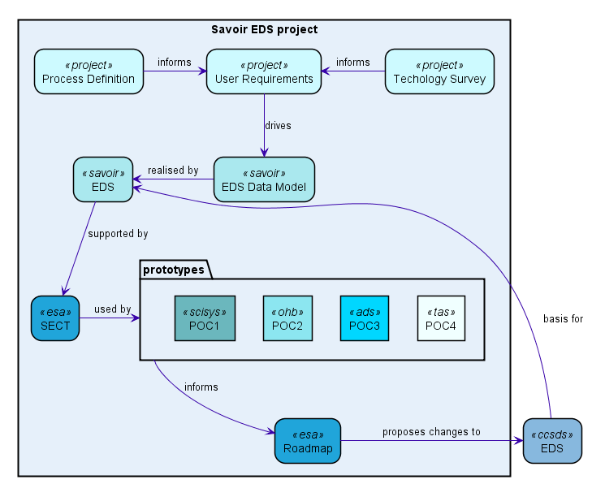
What was the overall approach?
Technology Survey and Process Definition inform User Requirements
Data Model driven by those requirements
SAVOIR EDS (SEDS):
    is a concrete realisation of that model
    is based on the existing CCSDS EDS
SECT software supports the SEDS format
Four Proof of Concept prototypes:
    one for each consortium member
    each using SECT for as a validation tool or library
  Prototyping results and conclusions:
    inform a roadmap for how to standardise EDS
    likely imply proposed changes to CCSDS EDS

Slide 13
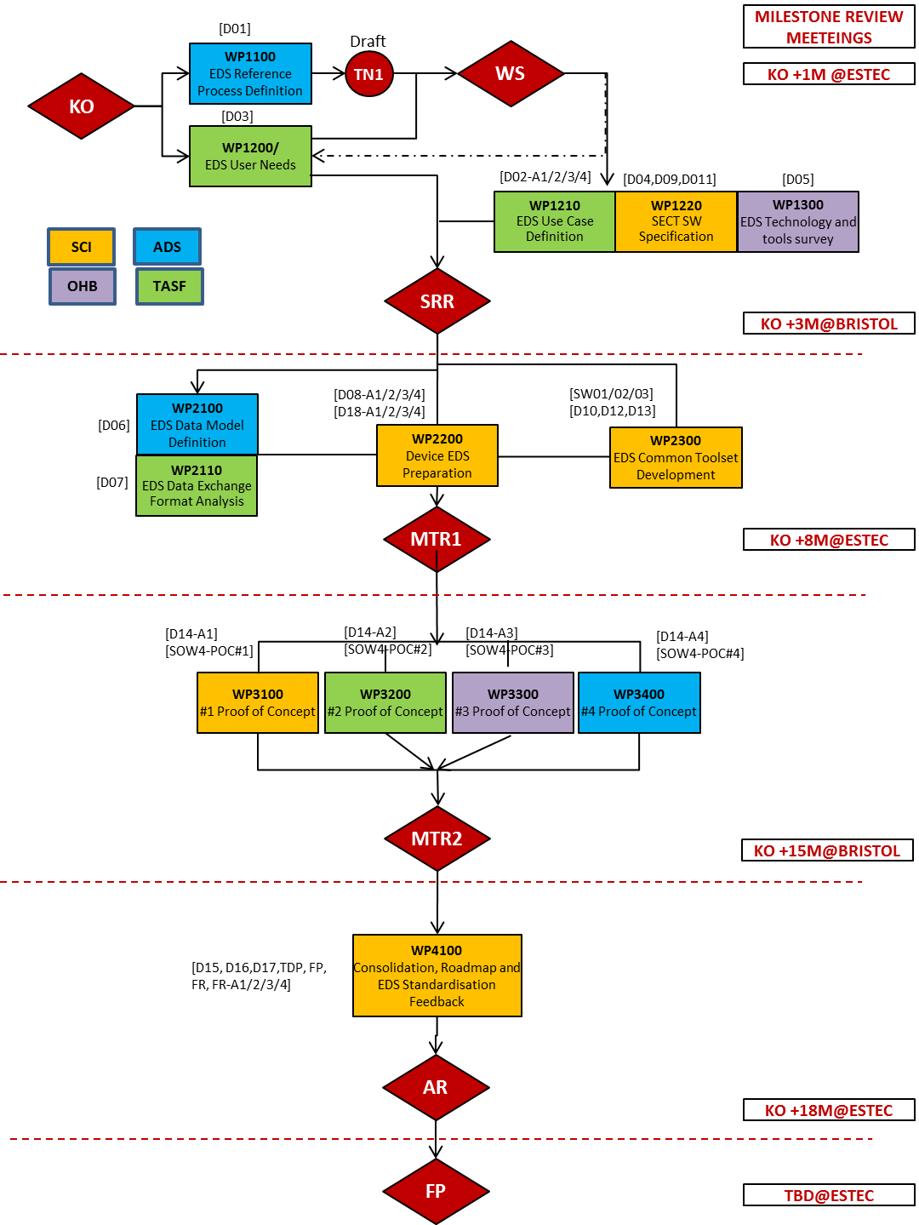
What was the work plan?
Logical tasks split into workpackages
Each workpackage assigned to a single company
Four phases, with review meetings in between:
    Phase 1, culminating in SRR
    Phase 2, to MTR1
    Phase 3, to MTR2
    Phase 4, to AR
  Final Presentation after all work complete

Slide 14
Prototyping
Proof of Concepts

Slide 15
Prototyping Summary
 | UC1 Unit Documentation | UC2 SRDB Generation | UC3 FSW Generation | UC4 Test Generation | UC5 Device I/O Simulation
ASTRO APS Jena Optronik | CGI | ADS
IMU Astrix 200 | CGI |  | OHB |  | OHB
iADCS BerlinSpace | CGI |  | CGI, TAS | CGI
PCDU TAS-B | CGI |  | TAS
RIU RUAG | CGI |  | TAS
JUICE MMS | CGI

Slide 16
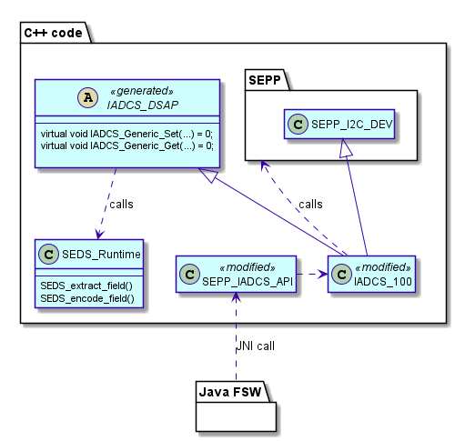
CGI PoC

Slide 17
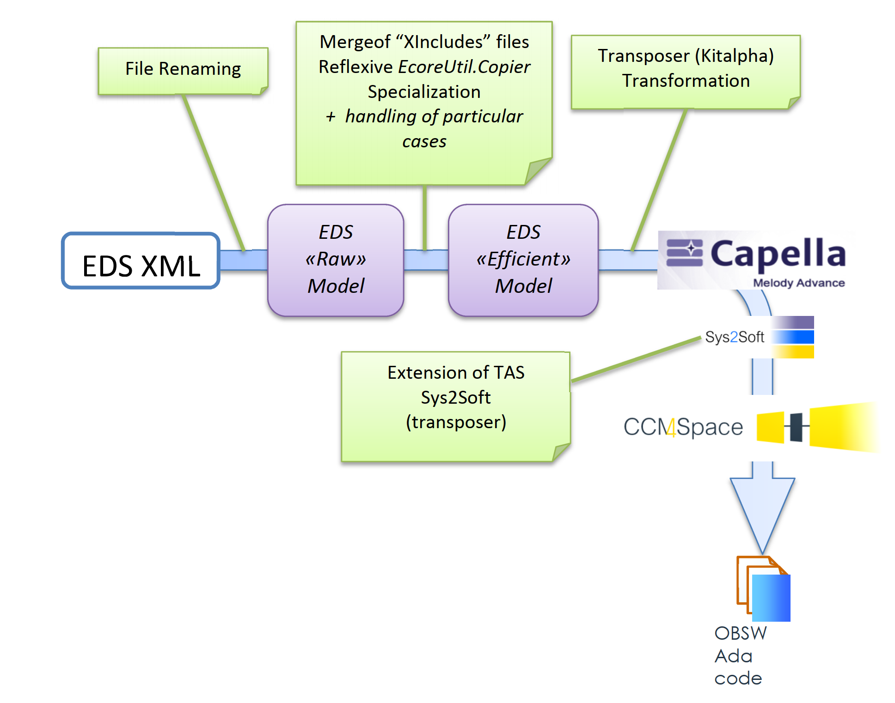

TAS Prototyping

Slide 18

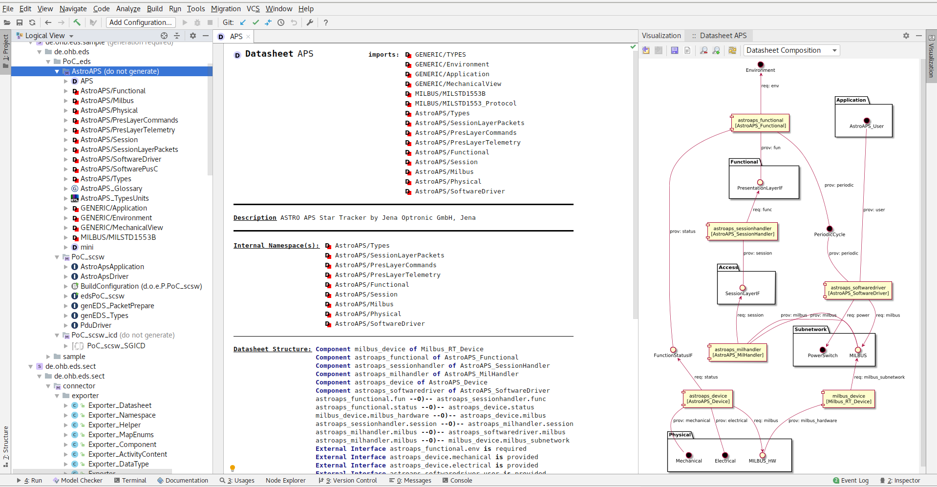
OHB Protoyping

Slide 19
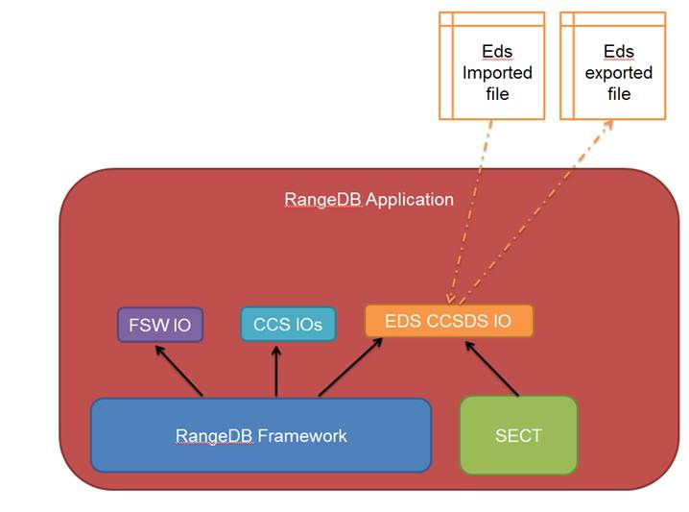
AIRBUS prototyping

Slide 20
Achievements and Results
Process

Slide 21
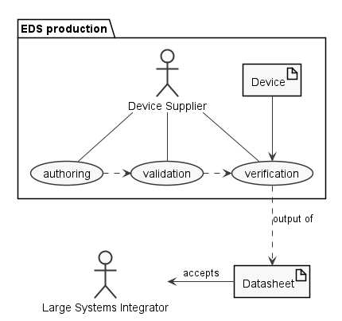
Initial Process Model
A Device Supplier produces a Datasheet by:
  Authoring: creation or import
  Validation: internal consistency checking
  Verification: checking the correctness of the datasheet against the device
The resulting validated datasheet is delivered to the Large System Integrator (i.e. prime) who accepts it.
Successful completion of the validation and verification process removes most or all errors and ambiguities from the delivered datasheet, speeding acceptance and reducing the risk of downstream problems and rework.

Slide 22
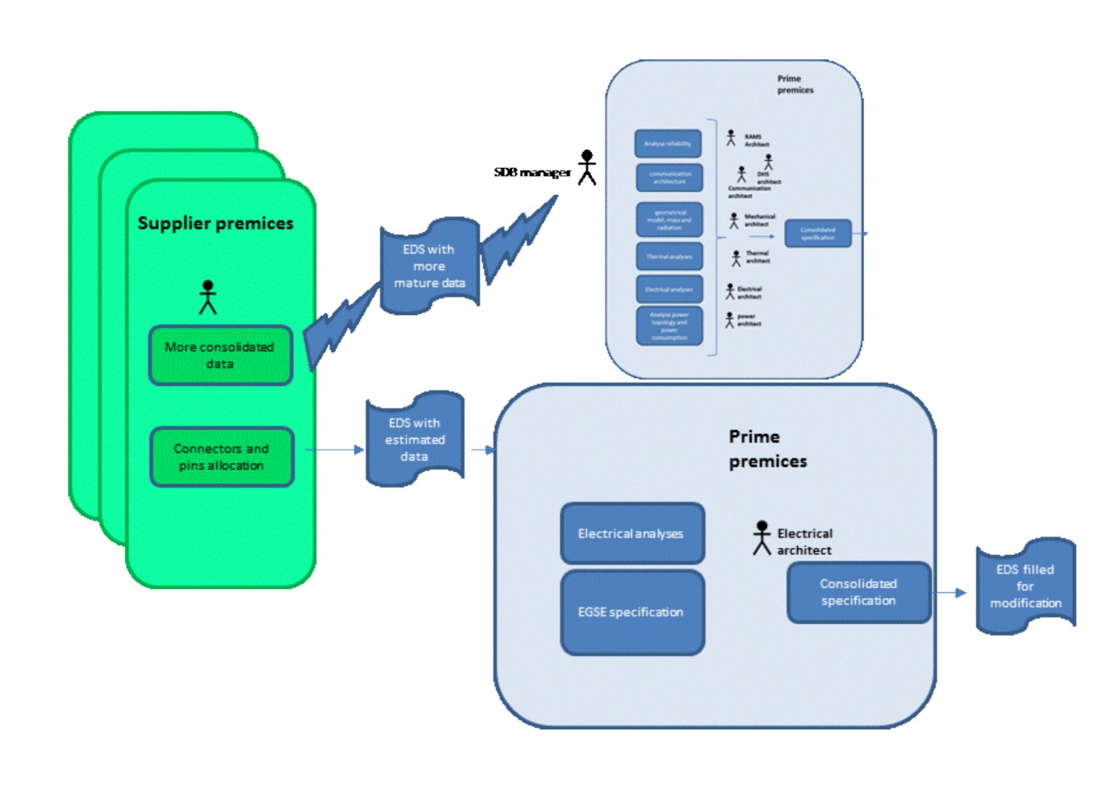
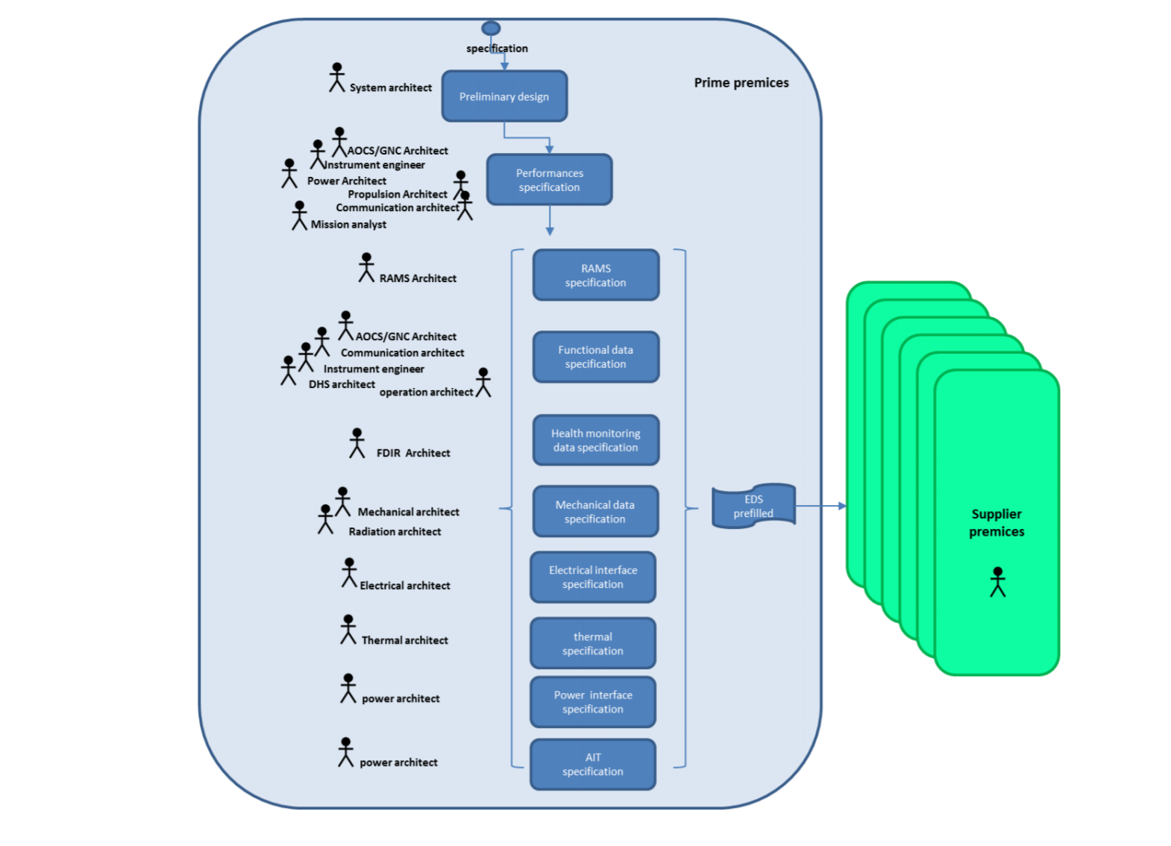
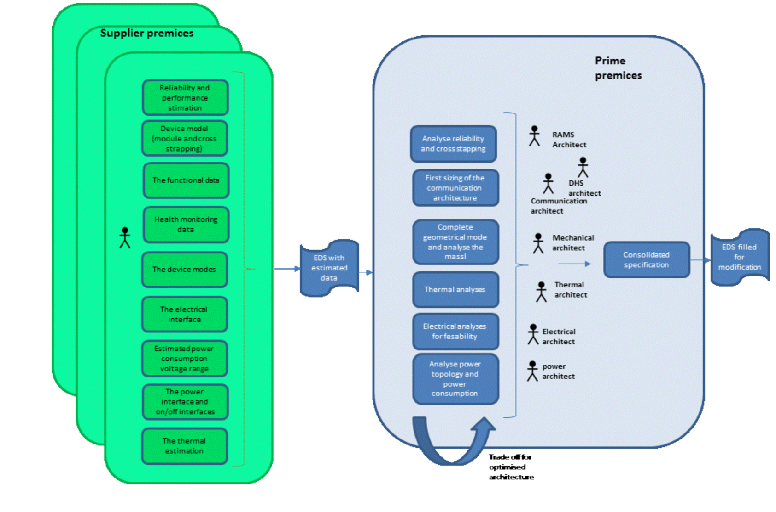
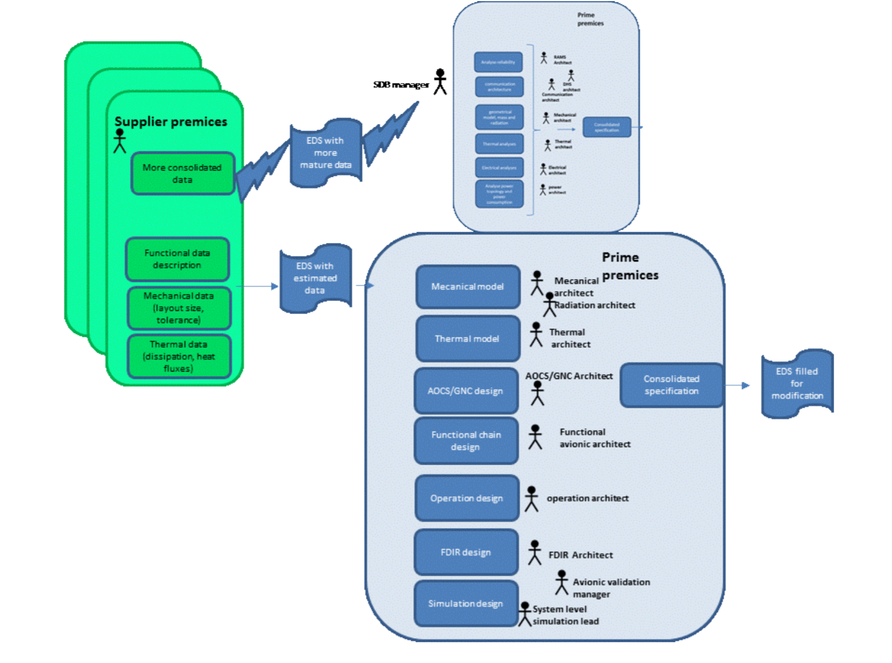
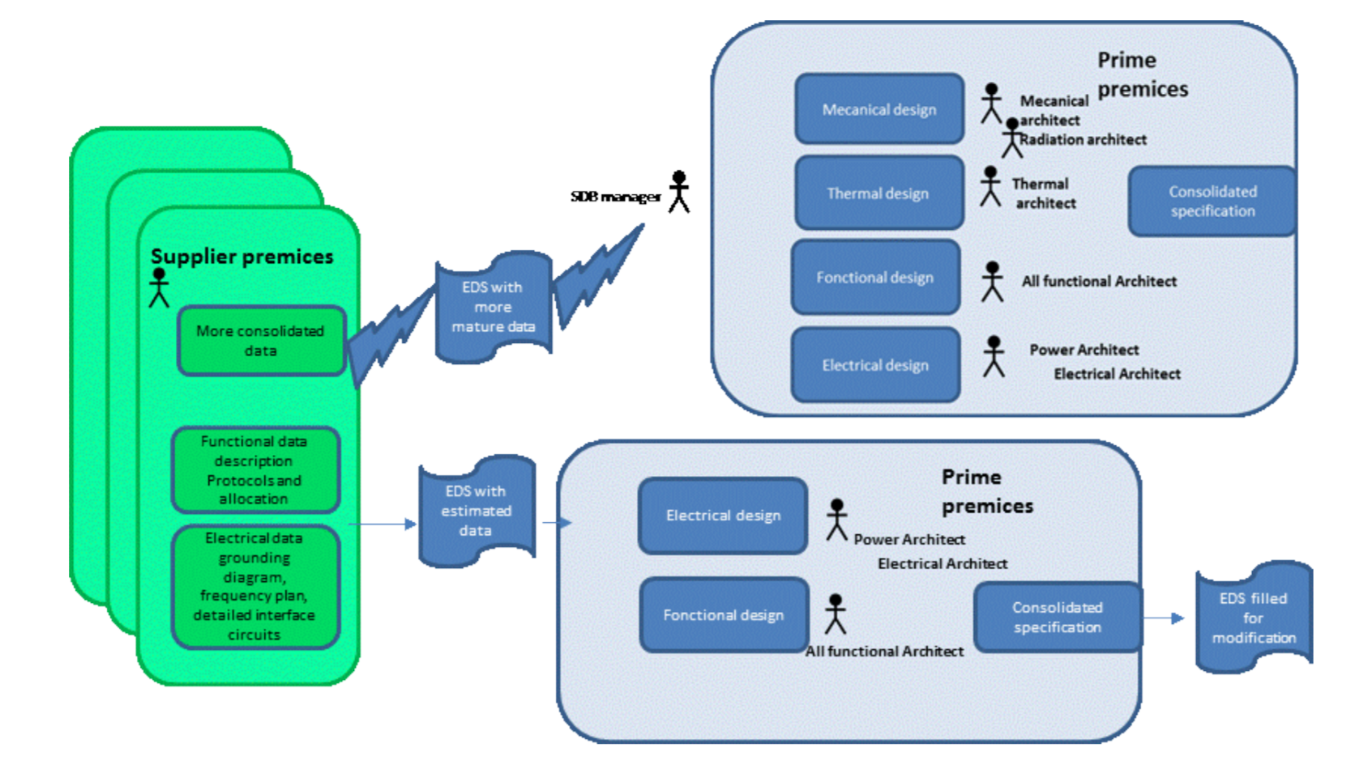
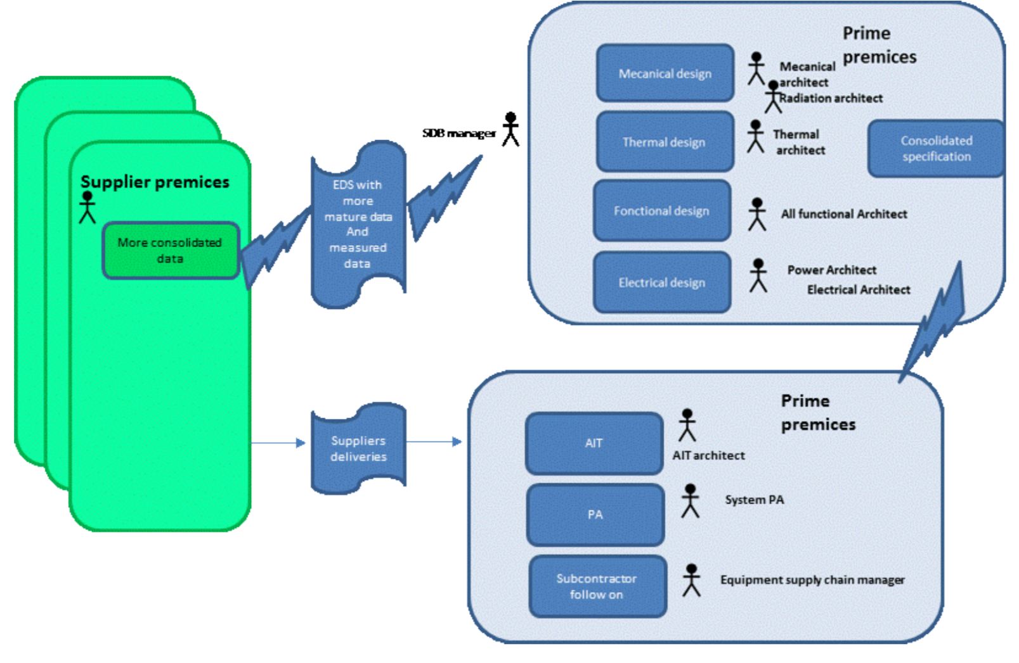
D01: Detailed Systems Engineering Process Model

Slide 23
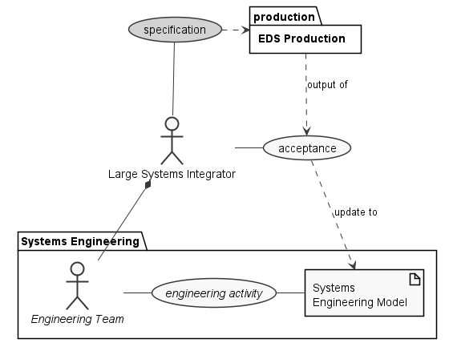
Extended Process Model
The acceptance process, as performed by LSI involves import into a Systems Engineering Model.
This system model is used by a large number of different engineering teams to perform a range of diverse engineering activities.
Acceptance will only succeed if the datasheet conforms to the expectations of the system model:
  contains everything it needs to
  in a form that can be understood
This means there is an additional specification process that is an optional input to EDS production.

Slide 24
Achievements and Results
Model

Slide 25
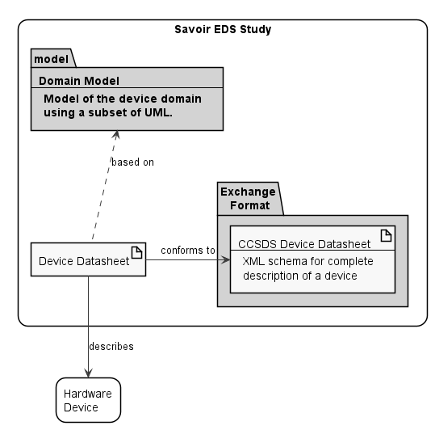
Initial Domain Model Context
A Device Datasheet describes a particular hardware device or class of devices.
It has a concrete, checkable format; the Exchange Format.
The domain concepts in that format are taken from the Domain Model. This consists of the subset of the overall Systems Engineering Model relevant to hardware devices in general.

Slide 26
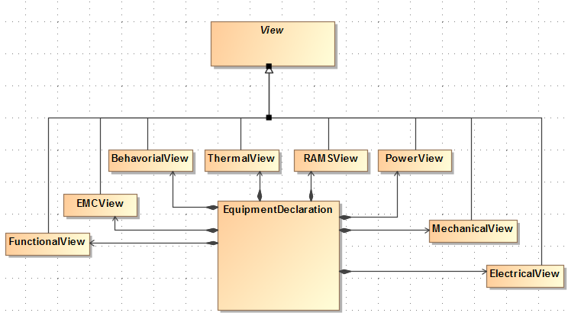
DM01: Domain Model Top Level

Slide 27
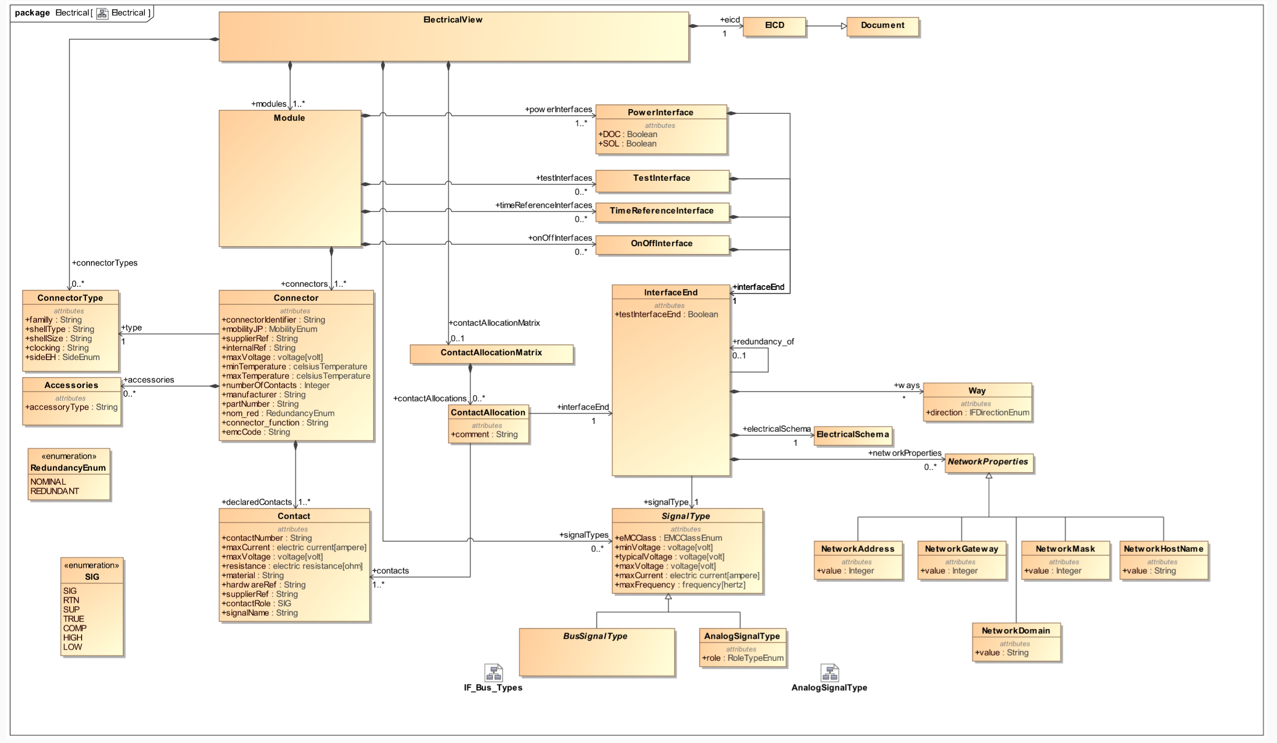
M01: Domain Model Electrical View Detail

Slide 28
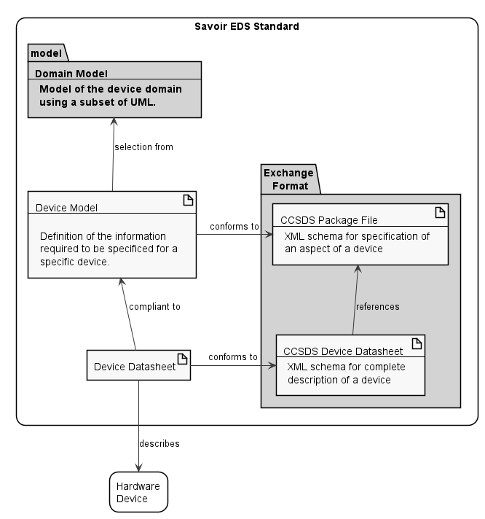
Extended Domain Model Context
A Device Model:
Corresponds to the subset of the overall domain model that applies to a particular device
Specifies what is required of a datasheet in order for it to be accepted into the domain model.
Can be represented as a CCSDS Package File, a subunit of the CCSDS Device Datasheet.
Such a datasheet is said to be compliant to that device model.
The compliance relation can be formally defined and checked by tooling.

Slide 29
Achievements and Results
Datasheets

Slide 30
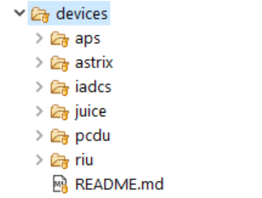
Datasheets
The device datasheets produced for this project are:
  aps: Astro APS, as covered by OHB as D18-A3
  astrix: Astrix 200 fibre optic inertial measurement unit, as covered by AIRBUS as D18-A4
  iadcs: BerlinSpace iADCS, as covered by CGI in D18-A1
  juice: Juice MMS, as produced by AIRBUS as D18-A4
  pcdu: TAS-B PCDU, covered by TASF as D18-A2
  riu: RUAG RIU, as covered by CGI in D18-A1
These are available as test data in the SECT project repository, and licensed according to the same terms as SECT.
The next 5 slides show the automatically-generated overview diagrams for each datasheet.

Slide 31
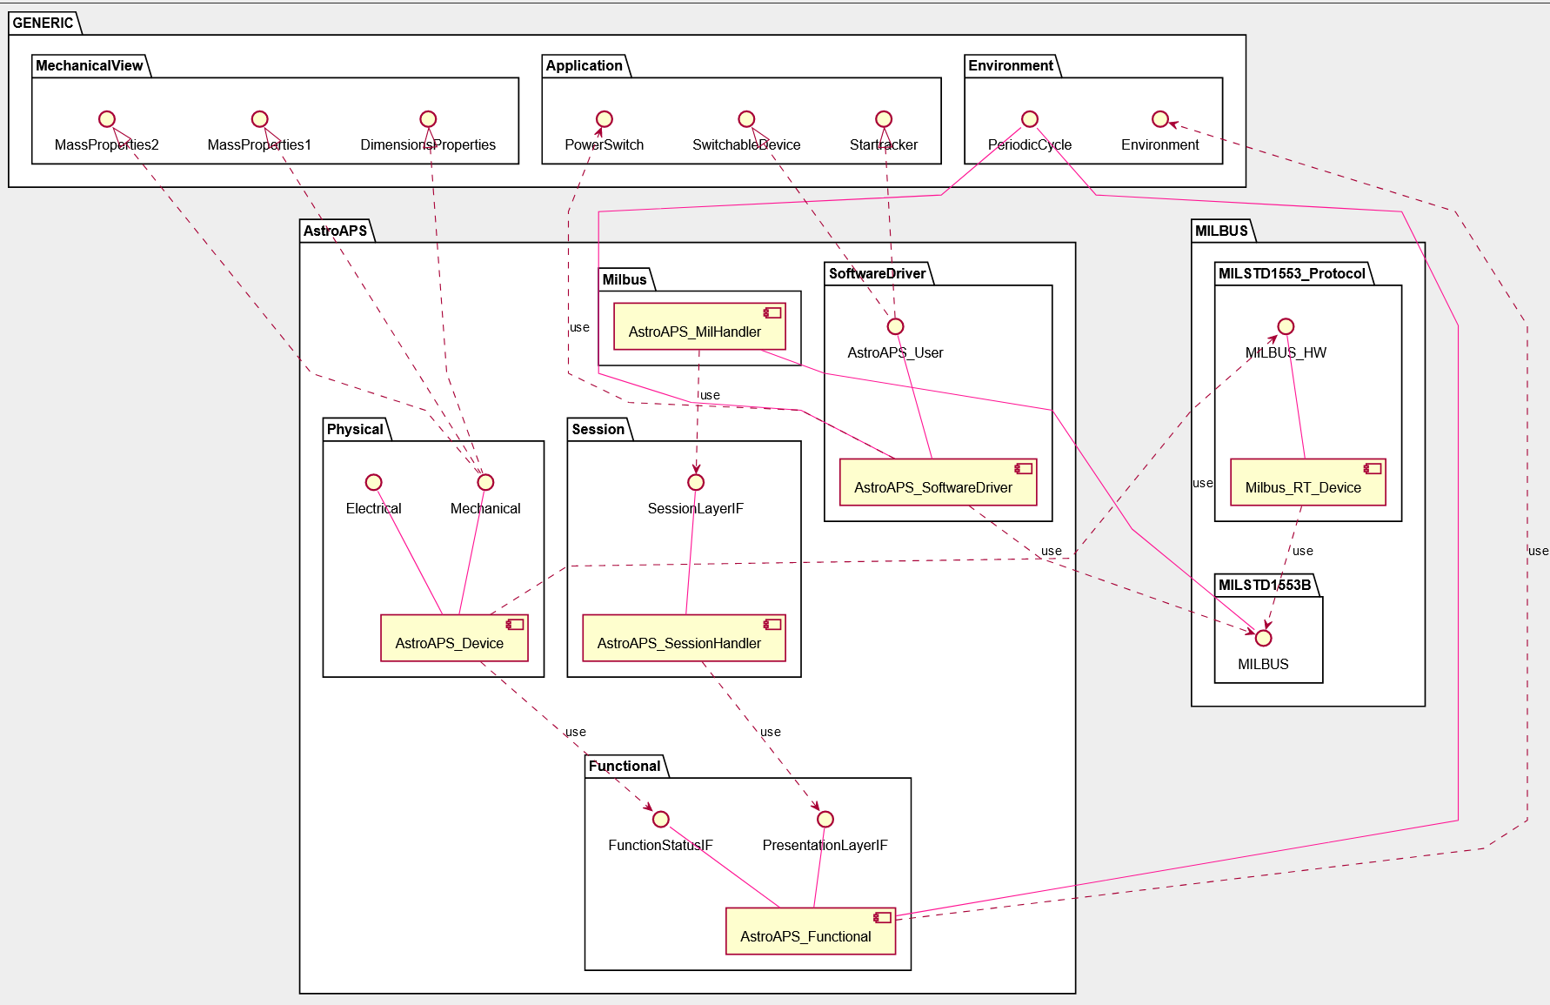

Slide 32
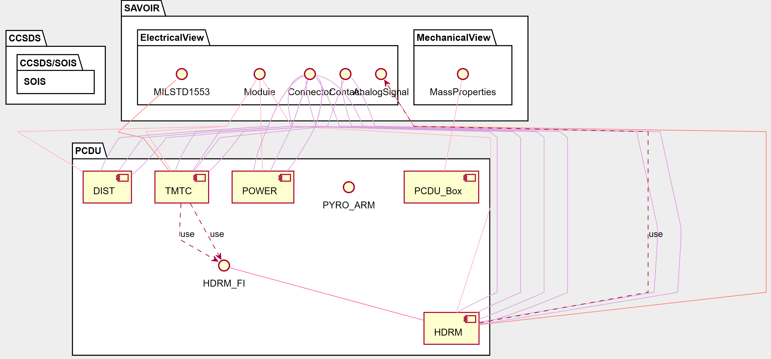

Slide 33
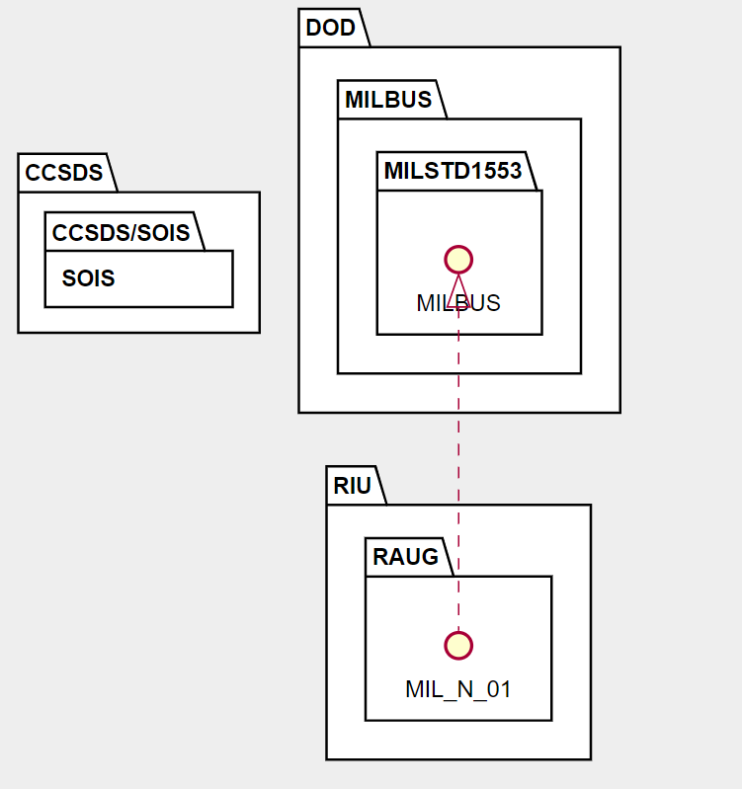

Slide 34
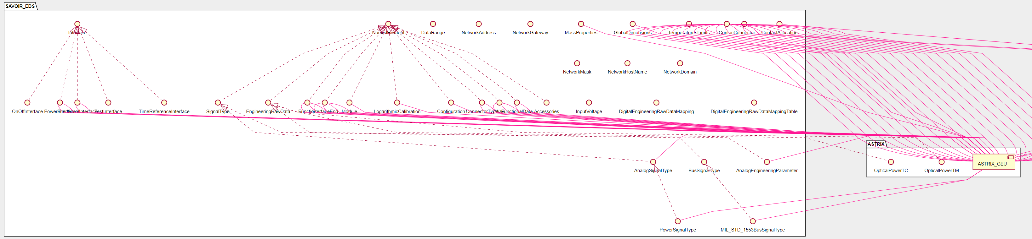
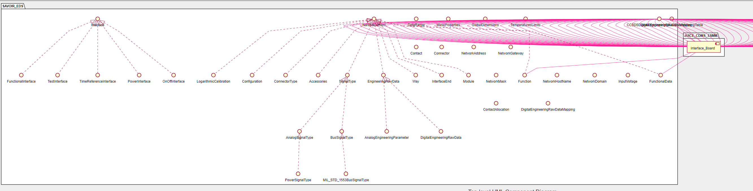

Slide 35
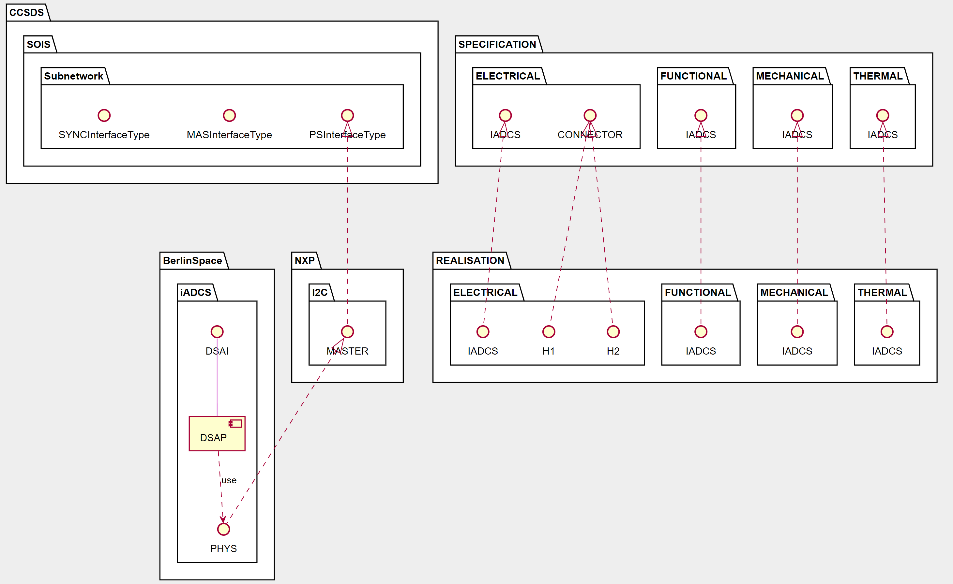

Slide 36
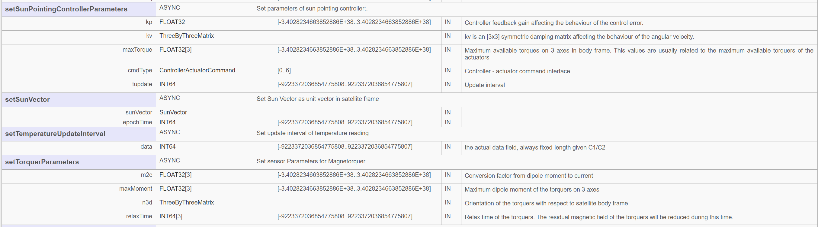
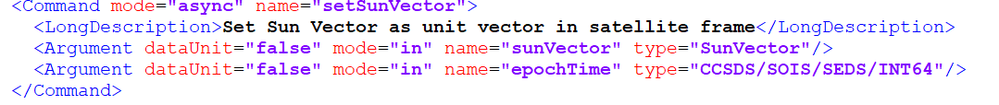
iADCS Communications View
Access Interface Extract

Slide 37
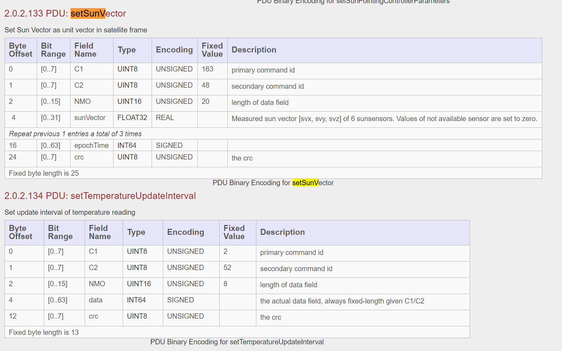
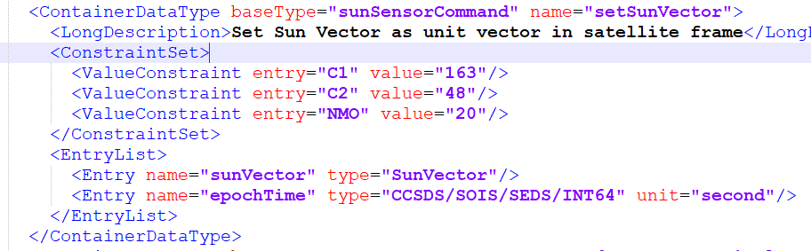
iADCS Communications View
Physical Interface Extract

Slide 38
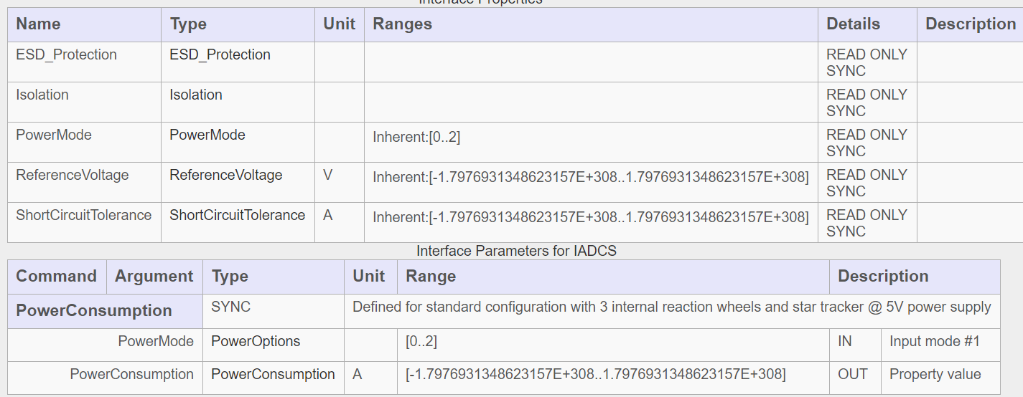
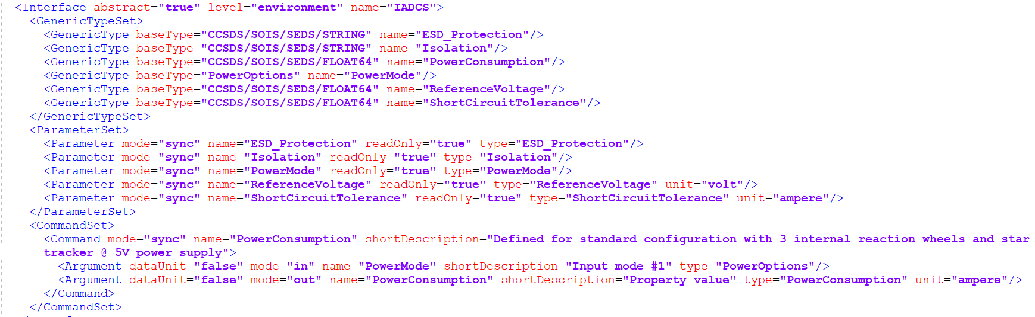
iADCS Electrical Model
Device Model Specification
Translating between the terms in the iADCS ICD (e.g. ReferenceVoltage, ShortCircuitTolerance) and the domain model (TypicalVoltage, MaxCurrent) is a non-trivial process involving expert knowledge. So we simply reproduced what the device model that produced the data documented in the ICD would have been.

Slide 39
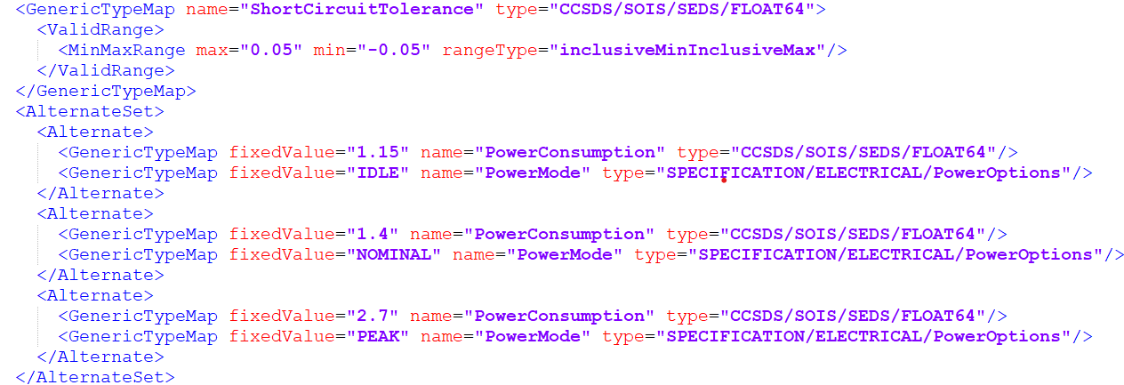
iADCS Electrical Model
Device Datasheet Extract
This shows how the datasheet represents:
  A simple property, ShortCircuitTolerance. with a range of values.
  A modal property, PowerConsumption whose value depends on system mode.
Conformance checking to a device model is then simply based on the CCSDS SEDS type system. Note that while this mechanism works, it is a strong candidate for replacement with something functionally equivalent, but simpler.

Slide 40
Achievements and Results
Tooling

Slide 41
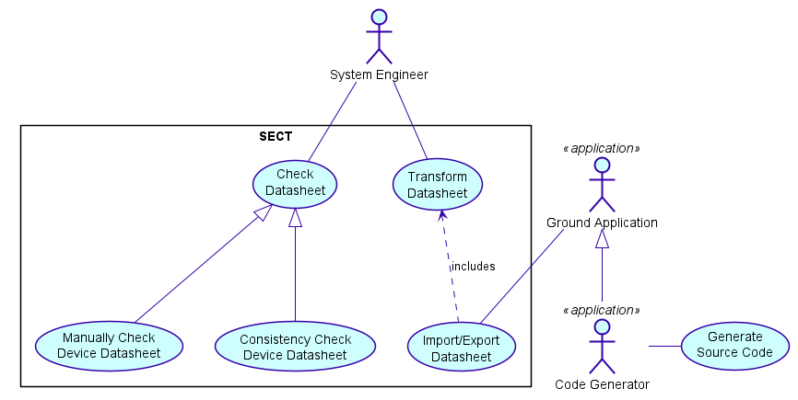
SAVOIR EDS Common Tooling
Requirements

Slide 42
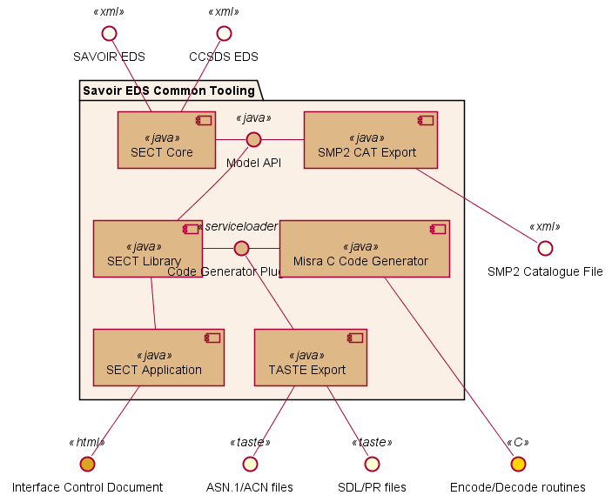
SAVOIR EDS Common Tooling
Design
Converts these inputs
Extension or integration
points
To these outputs

Slide 43
Conformance Checking
As performed by SECT
Both a communications interface and a set of properties can be modelled by a CCSDS EDS interface.
That interface will reference a set of types, one for each property.
Two interfaces SPEC and DEV are in conformance if:
DEV defines a type, range or value for every property defined in SPEC
All DEV specific values are legal according to the type of the corresponding SPEC property.
All DEV ranges and types are subtypes of the corresponding SPEC property type.
The modality of any property is the same in both interfaces.

Slide 44
Availability
https://gitrepos.estec.esa.int/SAVOIR-EDS/SECT
  Main project development repository.
  V2.2.2 represents closeout of development activity for MTR2.
  For access, contact marek.prochazka@estec.org
SectTooling is Copyright (c) 2013-2020 European Space Agency
Publicly released binaries are licensed under ESA Community License – ESCL Type 3.
These are available at ESSR:
  https://essr.esa.int/project/ccsds-eds-reference-tooling

Slide 45
Conclusions
SAVOIR EDS

Slide 46
Positive conclusions
Storing and exchanging information in a tool-readable electronic datasheet has the potential to be a major source of time and cost savings and risk reduction
    The ability for the device supplier to do validation, verification and conformance checking is the key to unlocking that potential; bad data efficiently imported is still bad data.
  XML is an acceptable underlying exchange format to all study participants
    Some would ideally have preferred something different, but no consensus on what.
CCSDS XML is an acceptable starting point for representing the communications domain of an EDS
    Everyone has specific issues with it, some minor, some major, but none blocking
    13 detailed technical and editorial points have been raised with the relevant CCSDS committee, for inclusion in the 876c0r1 pink sheet update.
Representing the device model as a set of CCSDS XML Package files works
    Most of the work of conformance checking is then a straightforward use of the CCSDS EDS type system
Common tooling, in the form of SECT Tooling, is very helpful in ensuring compatibility
    Even when not used as an implementation library, a universally-accessible reference implementation that provides an unambiguous answer as to what is and isn’t allowed is key to successful exchange.

Slide 47
Open Areas
A device datasheet based on one device model will be difficult to use by a prime that uses a different domain model.
  Is it effectively possible to solve this by universally standardising a core domain model?
  If not, will a SAVOIR-level standard help?
  Alternatively, can a space ontology be used to automatically map datasheets to alternate domain models?
In some areas, the terminology used by a datasheet is excessively abstracted from something a user would normally work with.
    This leads to unclear error messages, not always at the location the error was made.
  Can the CCSDS EDS be usefully simplified without losing functionality?
    Perhaps drop local interfaces, types, activity mappings and higher-order spline calibrations?

Slide 48
Potential Future Work
General
Standardise Domain Model
    The domain model developed in the scope of this project has the potential to be further developed, and proposed for publication as an European industry standard.
    This would involve the creation and publication of EDS package files that optimally represented the model.
  Update SEDS Common Tooling
    fully support the r1 pink sheet update to CCSDS XML Specification.
    add transforms to rewrite datasheet constructs deprecated for removal
    import and export to spreadsheets for user-friendly data entry and import
    other minor issues from the project backlog
  Full Authoring Tool
    Implement a full ESA-owned EDS authoring tool, targeted at advanced use cases that cannot be managed by simple spreadsheets.

Slide 49
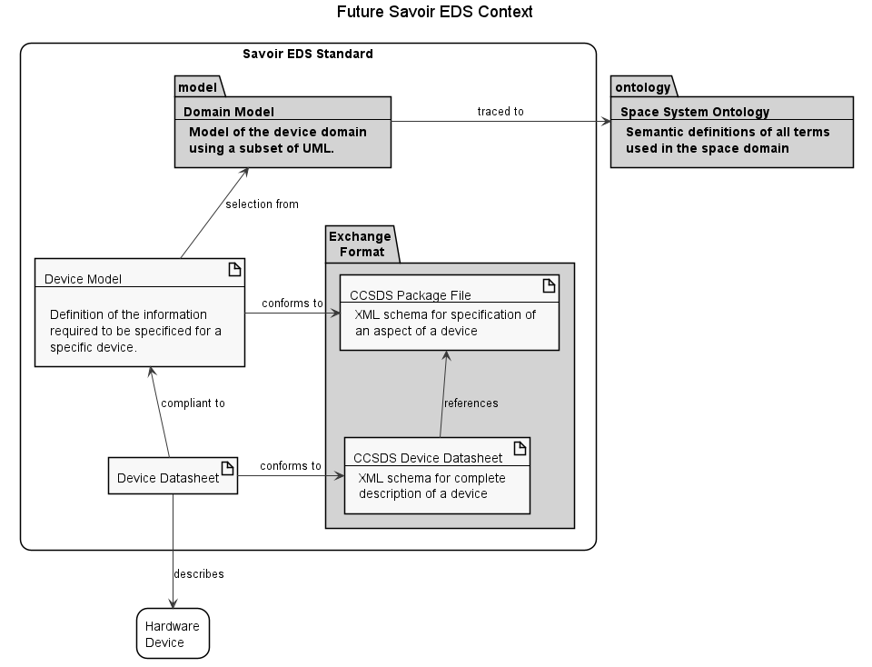
Potential Future Work
Space Ontology Reference
  Given two different domain models both traced to a common space ontology, it should be possible in principle to take a datasheet compliant to a device model extracted from one and transform it into one compliant to the other.
  This would be a challenging test of the capabilities of such semantic transformation. While a promising technology to investigate, any plans to adopt EDS in the medium term should probably not depend on it.

Slide 50
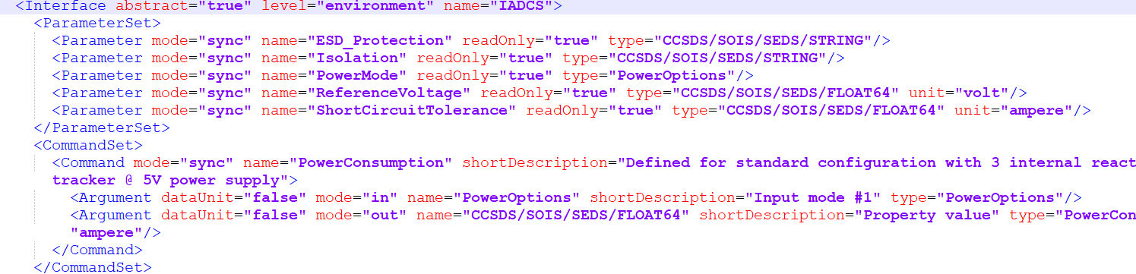
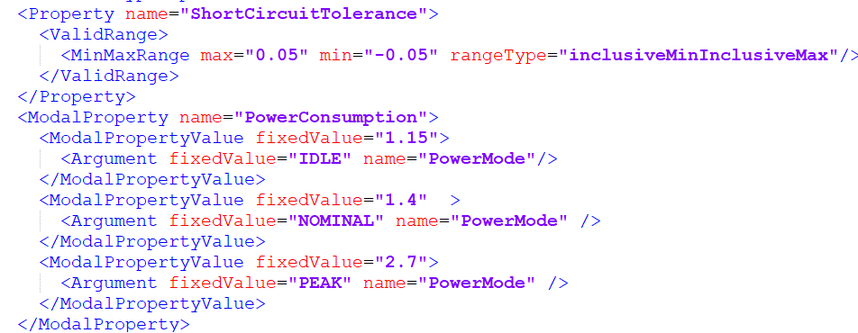
Potential Future Work
Drop Use of GenericTypeMap for Properties
Interfaces representing device model elements would no longer need to be generic, with a redundantly-named type for each parameter and command argument.
Instead the new syntax Property and ModalProperty will directly reference parameters by name.
Semantically and functionally this is equivalent, but dropping the redundant elements improves readability and eliminates error cases.

