Slide 1

ST CREAM
Implementation
15 December 2022

Slide 2
Agenda
01 | CGI Team | 04 | Data Sharing
02 | Architecture | 05 | High-Interest Events
03 | TRACE User Interface

Slide 3

Located near you and all over the world.
Estonia
Morocco
Poland
Europe
39,500 coworkers
Portugal
Slovakia
Spain
Czechia
Hungary
Canada
USA
Americas
28,500
coworkers
India
Malaysia
Philippines
Asia Pacific
16,000
coworkers
4,500+
27
Onshore,
nearshore, offshore
84,000+
31
staff
cities
flexible mix of blended delivery locations
staff globally
global
delivery centers

Slide 4
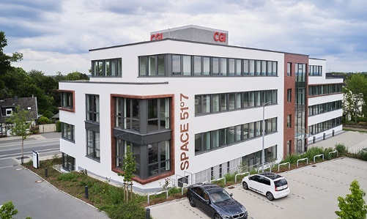
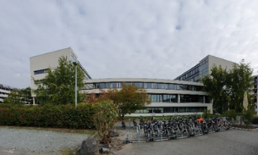
CGI Space in Europe and Germany
300+ Space Domain Professionals in Germany
Sweden
Finland
Estonia
United Kingdom (non-EU)
The Netherlands
Germany
Two main locations in Germany: Darmstadt & Bochum
Belgium
Czech Republic
Austria
France
Bochum
Italy
Support to 50+ Space Missions since >40 years
Spain
Darmstadt

Slide 5
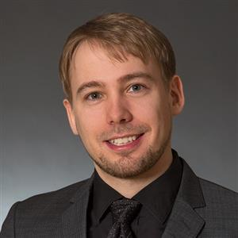
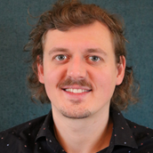
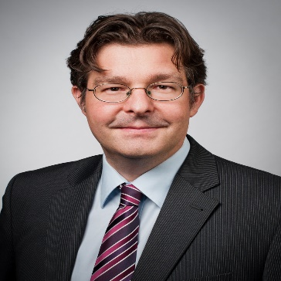
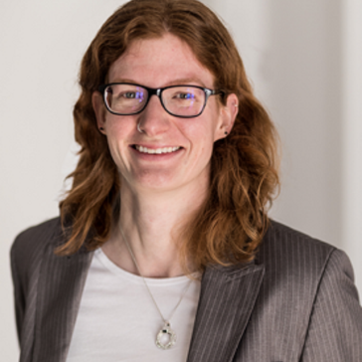
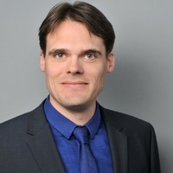
The CGI Team
Ingo Burmeister
Markus Daugs
Florian Jung
Anne Eggemann
Pepijn Witte
Project Manager
Technical Project Officer
Lead Developer
Test Manager
PA/QA
Notes:
This slide is intended to help people know a bit more about who is who on the project (and in the office); therefore pictures of the team are mandatory!
You can use the official pictures from the share, but pictures from any team activities are of course even better!

Slide 6
Architecture
High-Level Overview

Slide 7
High-Level Architecture

Slide 8
TRACE User Interface
User Registration
Web UI Overview
Dashboard
Space Objects

Slide 9
User Registration (Video)
New User
Registers as new user
Fills out profile, in particular name, affiliation, region and role(s)
Admin
Reviews and approves the new user
New User
Sees that profile has been approved
Navigates to dashboard

Slide 10

Notes:
Video: User Registration

Slide 11
Dashboard and Navigation (Live Demo)
Dashboard information and open tasks
Navigate through the different screens

Slide 12
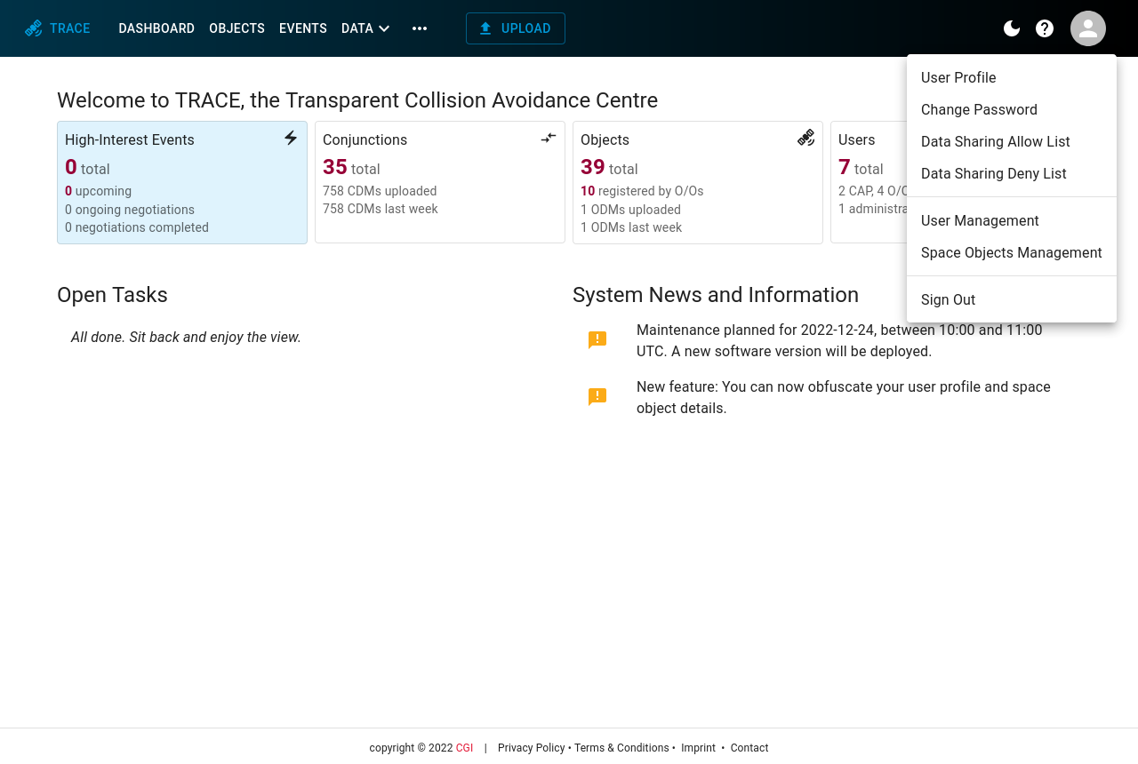

Slide 13
Object Registration (Video)
User
Registers new object
Inspects the registration request
Admin
Reviews and approves the object registration
User
From dashboard navigates to objects browser
Inspects object details

Slide 14
Notes:
Video: Object Registration

Slide 15
CCSDS Data Sharing
Data Upload
Data Sharing Rules

Slide 16
CDM Upload (Video)
User
Uploads CDM
Inspects the uploaded data

Slide 17
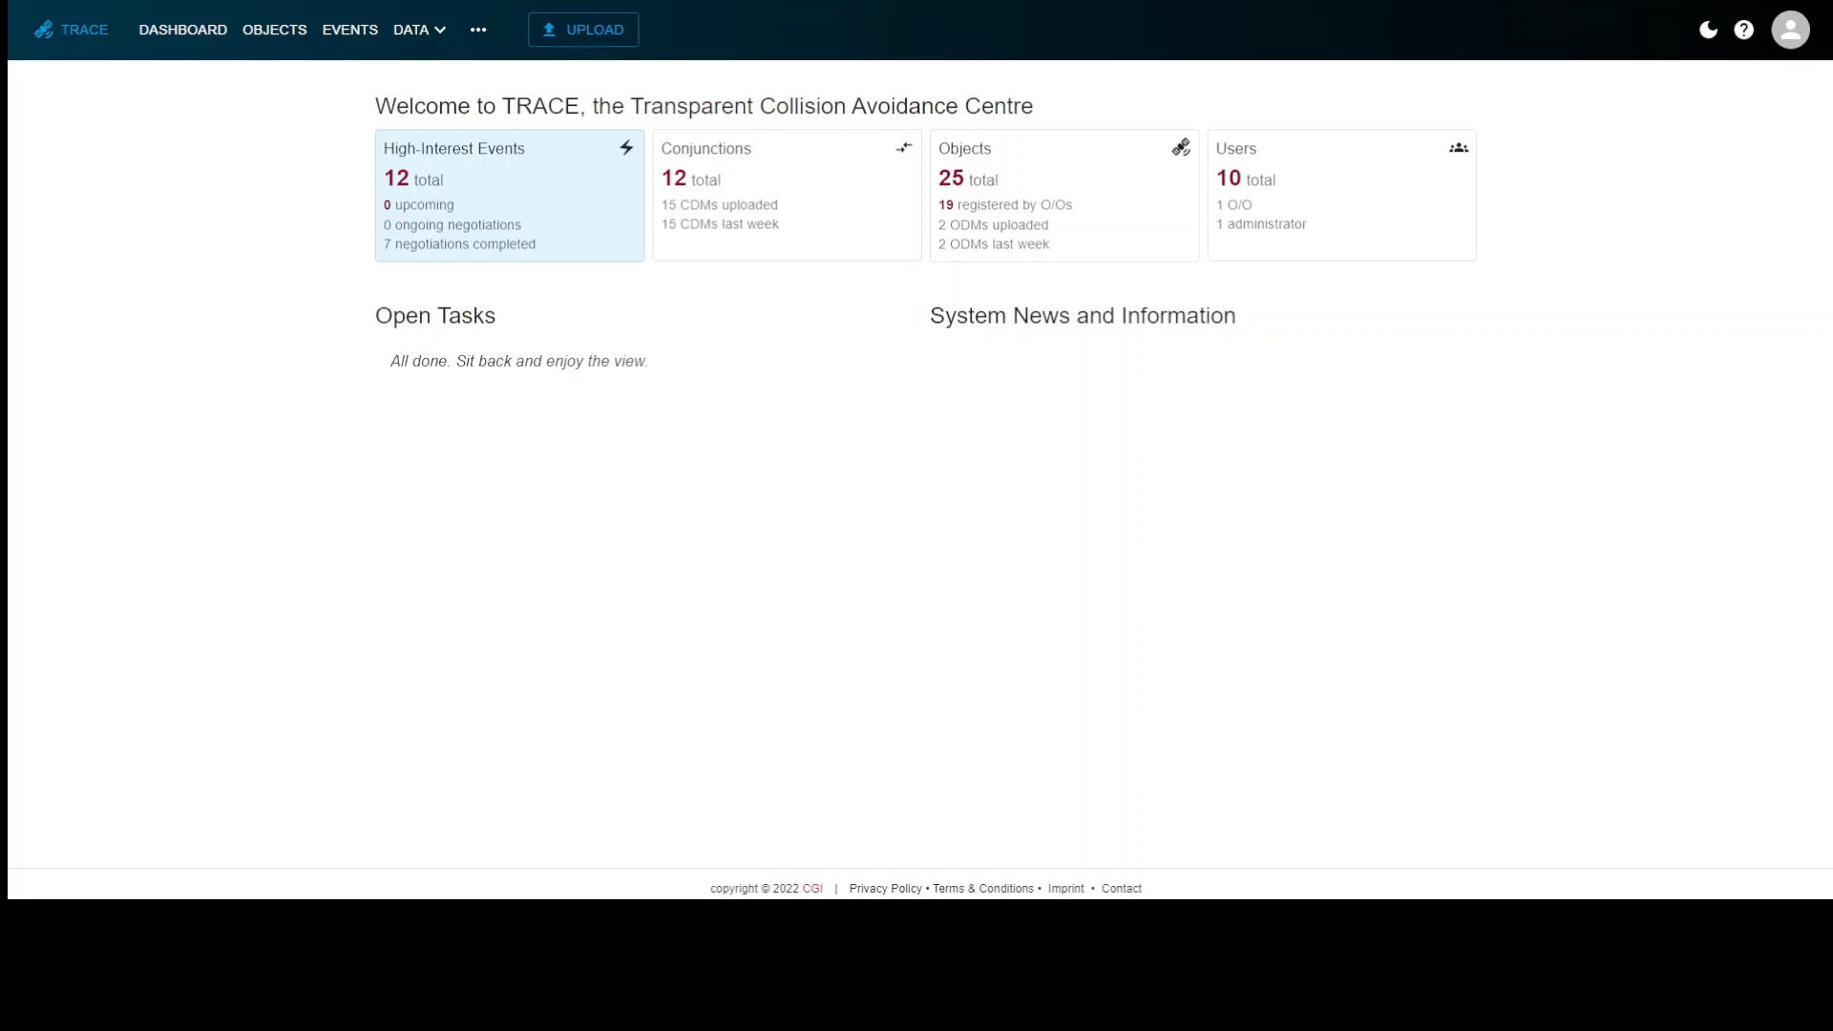

Slide 18
Data Sharing Policies (Video)
Scenario
Three users:
Commercial user
University user
Governmental user
The users set sharing policies and define data sharing rules.
The effects are shown for each individual user.

Slide 19
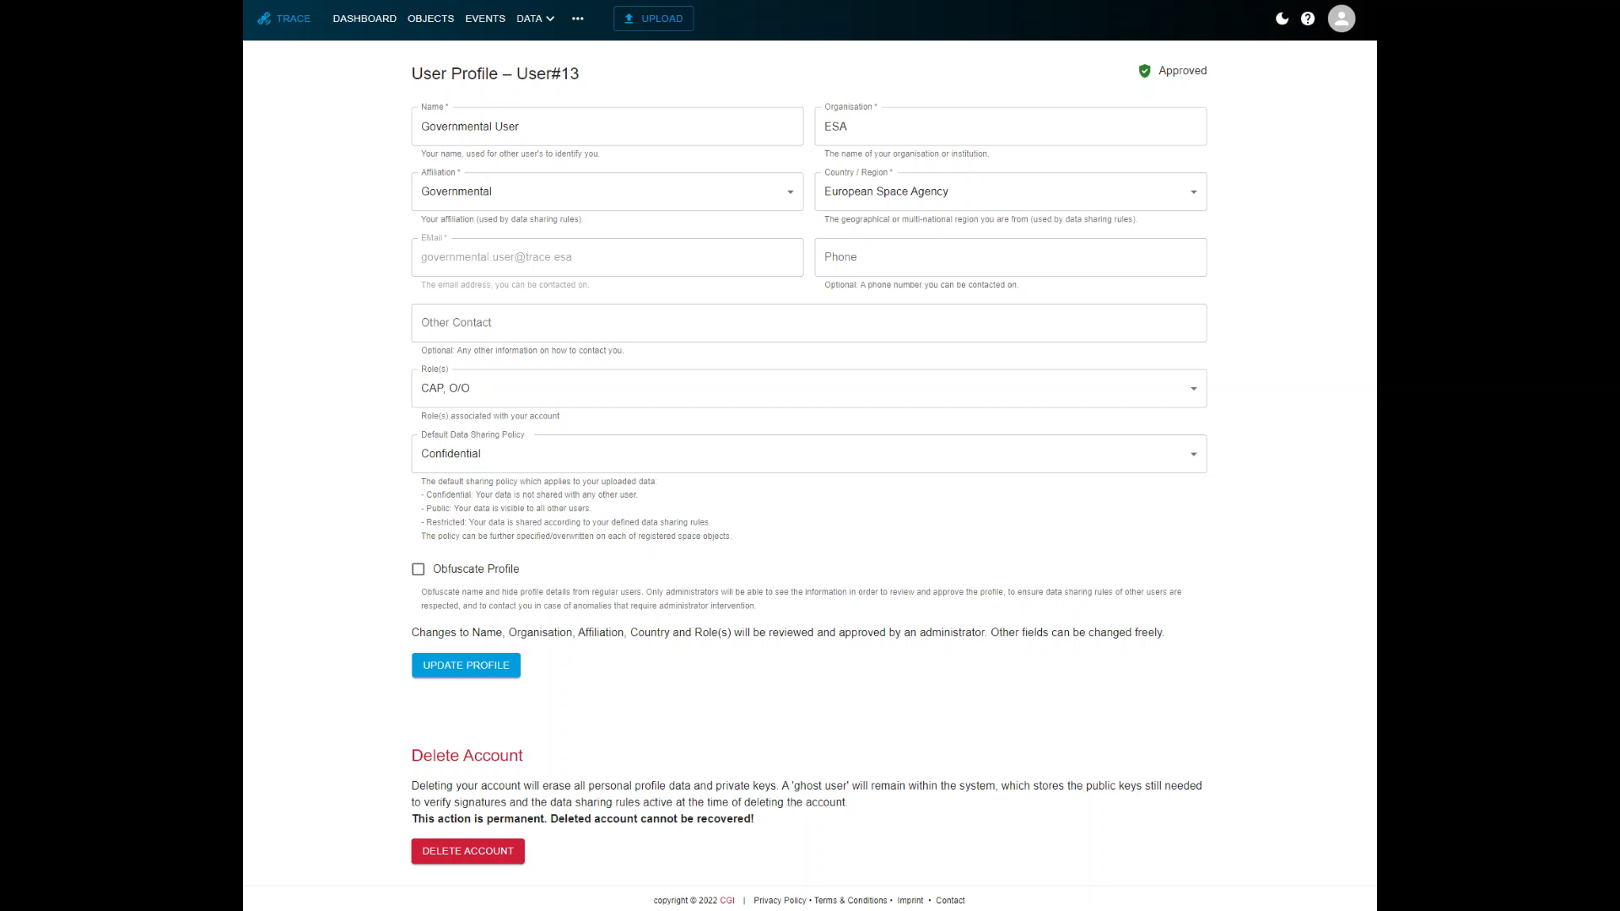

Slide 20
High-Interest Events
Negotiations
Manoeuvre Execution

Slide 21
Detect High-Interest Event (Live Demo)
Upload CDM with small miss distance
View object and user details
Navigate to event details

Slide 22
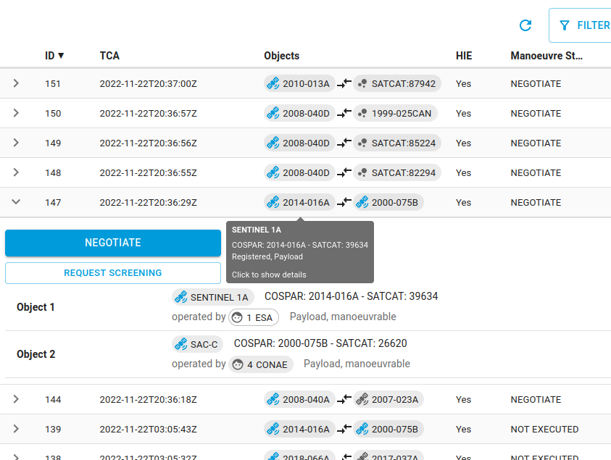
HIE Negotiations and Manoeuvres

Slide 23
Negotiation (Live Demo)
User 1 (ESA, Aeolus)
Start on event details screen
Send end-to-end encrypted message
Submit negotiation input (8, 2)
User 2 (USAFA, FalconSat-7)
Start on Dashboard and navigate to event details screen
View audit trail (message + hidden negotiation input)
Submit negotiation input (5, 1)

Slide 24
Double-Offer Evaluation
Offers state a clear preference to manoeuvre or
not to manoeuvre.
If offers are fully equal,
random choice decides.

Slide 25
Manoeuvre Planning and Execution (Live Demo)
User 1 (ESA, Aeolus)
From Dashboard navigate to event browser, from there to event details
Inspect audit trail
Upload OEM with manoeuvre plans (as virtual data)
Open screening request
Transition to PLANNED
Transition to SCREENED
Transition to APPROVED
Transition to UPLINKED

Slide 26
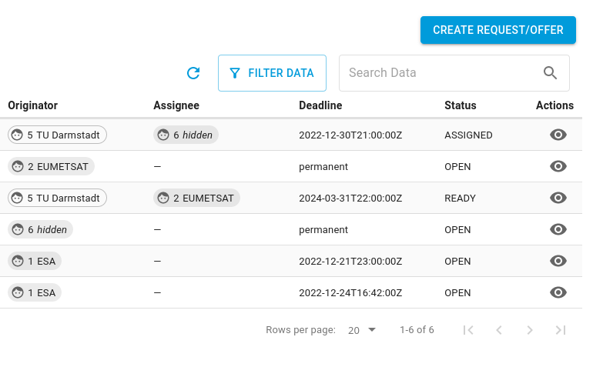
Service Requests

Slide 27
Screening Request (Live Demo)
(Screening request has been created during HIE manoeuvre planning)
Assignee (Other User)
From dashboard navigate to service requests
Self-assign screening request
Provide response
Originator (ESA)
From dashboard navigate to request using open tasks
Accept and view answer

Slide 28
Backup Slides

Slide 29
Blockchain – Merkle Trees for Tamper Detection
Data is stored within a Merkle tree.
Cryptographic hashes are used to prove that values are included in the tree and have not been tampered with.
The root hash verifies the entire tree.
Notes:
Ralph Merkle

Slide 30
External API (Live Demo)
Generate Master Key
Server protocol reflection (used to create structured forms)
Sign in and create a session key
Query CCSDS CDM data
Open-source gRPC UI API client: https://github.com/fullstorydev/grpcui

Slide 31
Profile and Object Obfuscation (Live Demo)
Mark profile as obfuscated.
View user details as administrator / as regular user.
Mark space object as obfuscated.
View object as administrator / as regular user.

Slide 32
AITF Conceptual Model

Slide 33
AITF Deployment

Slide 34
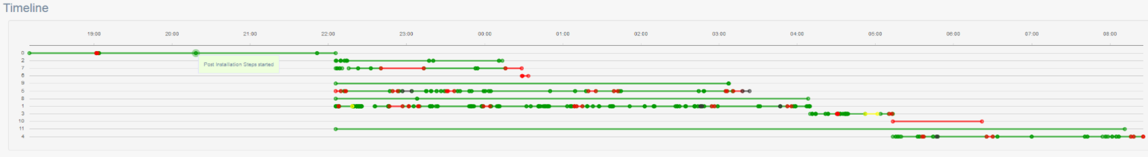
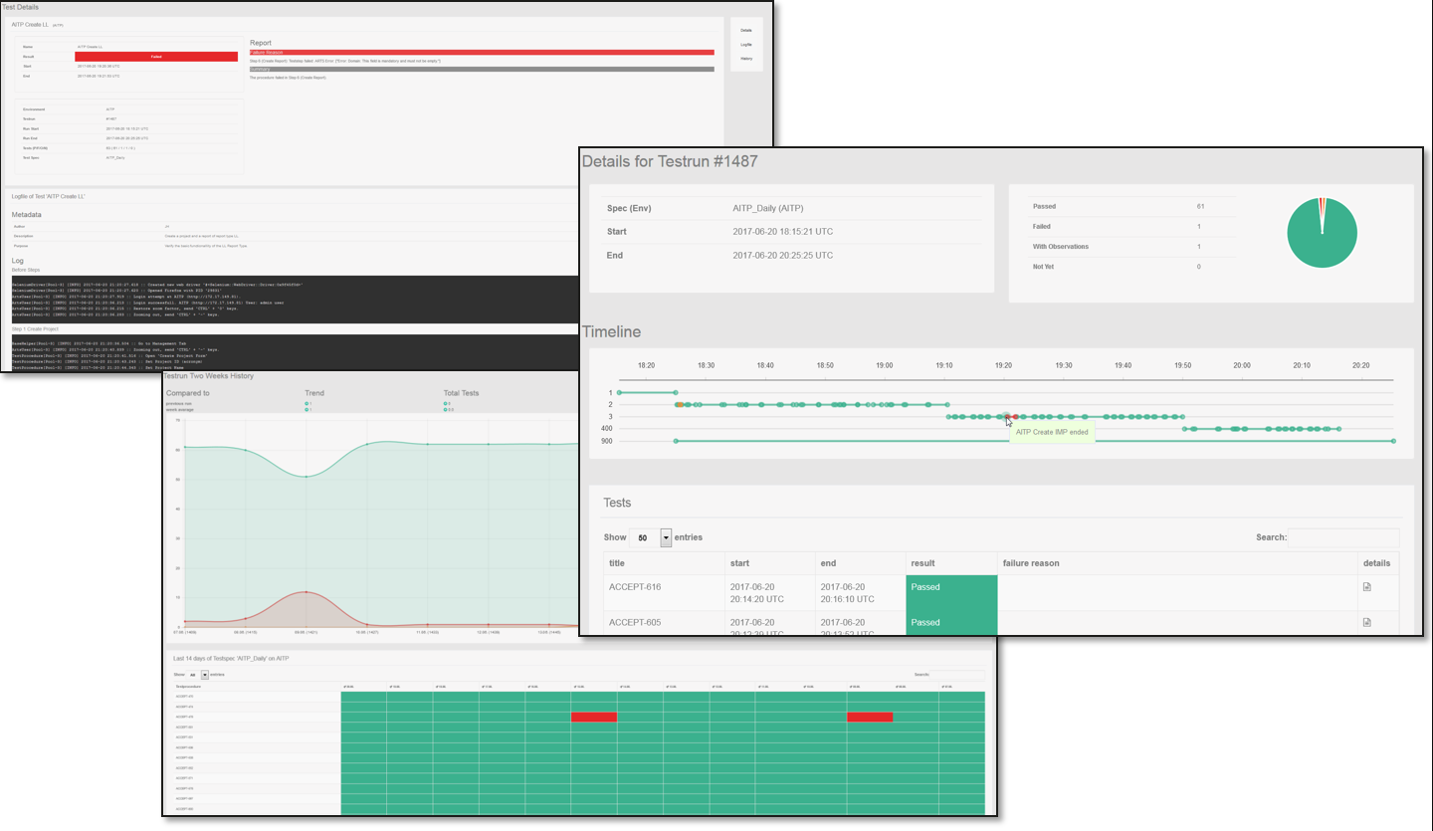
AITF Test Execution

Slide 35
Insights you can
act on
Founded in 1976, CGI is among the largest IT and business consulting services firms in the world.
We are insights-driven and outcomes-based to help accelerate returns on your investments. Across hundreds of locations worldwide, we provide comprehensive, scalable and sustainable IT and business consulting services that are informed globally and delivered locally.

