Slide 1
Operational Migration to Multi-Mission Control System
Study overview
19th October 2023

Slide 2
Agenda
General information and context
Schedule
Performed activities
Kafka solution
Performance metrics
Remaining work
Demo
Questions

Slide 3
General information and context
The objective of the study is to create, prototype and demonstrate a concept for a shared multi-mission data operational storage solution supporting a fleet of missions.
Three main tasks have been identified
Support for migration of data for existing flying missions, based on S2K, to EGOS-CC and EGOS-MG.
Identify an optimal data storage solution for EGOS-CC and future generations of Ground Segment systems.
Analyse and propose an evolution of the current adopted solution. What comes after Hadoop/HBase?.
The scope of the project has changed from a PoC demonstration to a mission ready production product. Objective 3 of the project has been therefore shrunk.

Slide 4
Schedule
Kick-Off - 30th May 2022
Planned for 1st March 2022
MS1 – 21st November 2022
9th October 2022
MS2 – 15th May 2023
16th February 2023
MS3 – 19th October 2023
28th September 2023
15 total Sprints
3 weeks deviation from the original plan

Slide 5
Performed activities
Data migration between SCOS based and EGOS-CC based MCS
Extraction of Data from S2Ks MariaDB instances
Conversion of legacy data into EGS-CC data types
Injection of data
Data types
Telemetry Frames
Telemetry Packets
Telemetry Parameters
Telecommands
Out of Limits information
Time Correlation information
Files
Reference missions
BEPI
Swarm

Slide 6
Performed activities
Storage solution improvements
EGOS-MG requirements analysis in terms of storage
Multi-mission and multiple schema versions support
Analysis on reprocessing opaque data
Analysis on cloud solutions
Data deletion implementation for Archive Hadoop backend
Introduction of Kafka Consumers for storing data in HBase
Market analysis for HBase alternatives

Slide 7
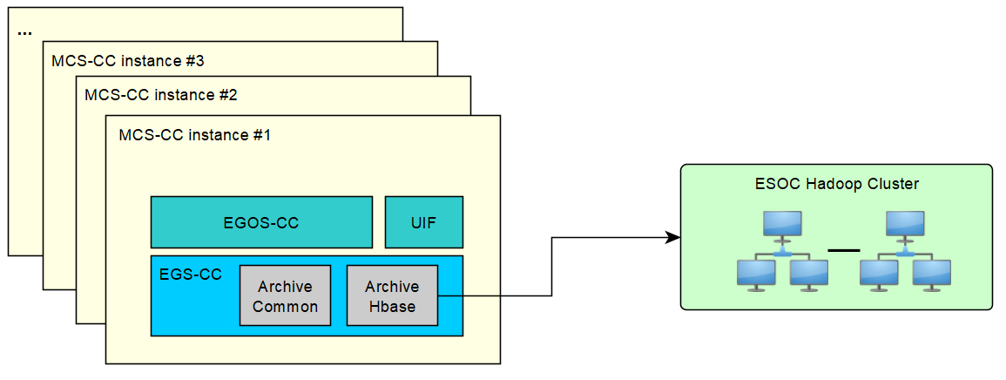
Kafka solution
Current implementation

Slide 8
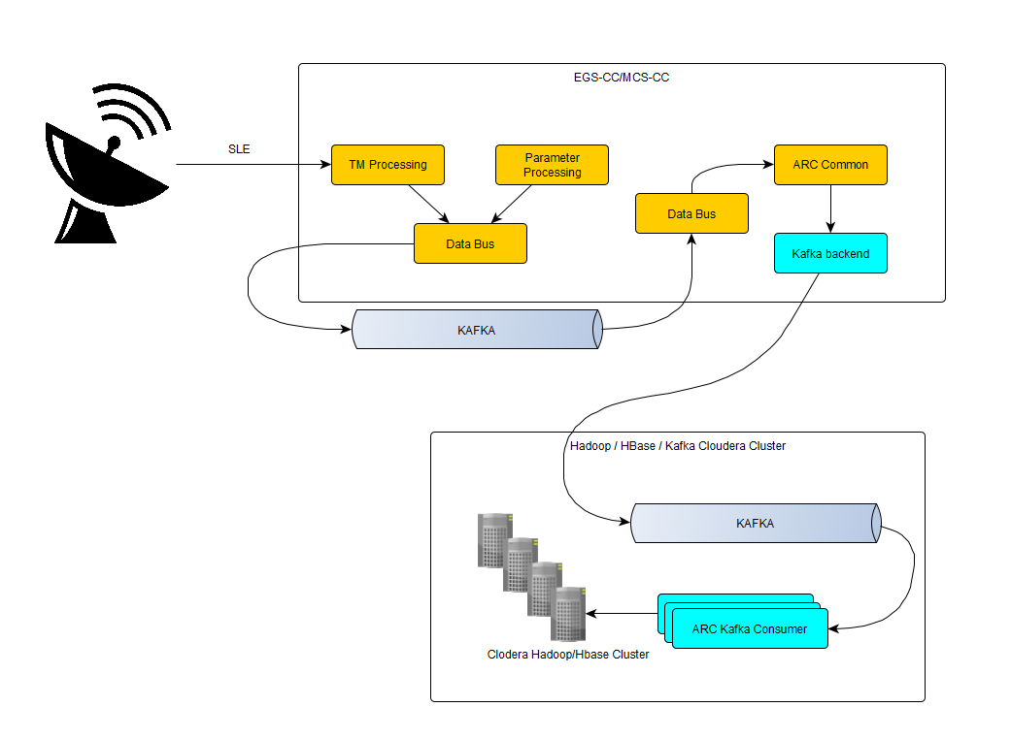
Kafka solution

Slide 9
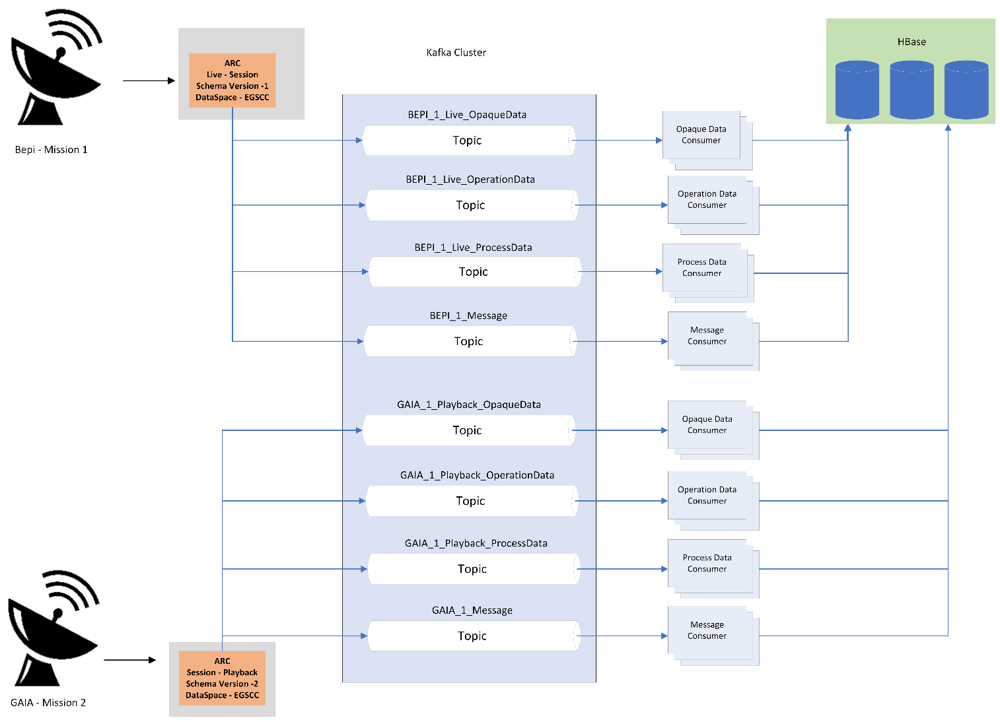
Kafka solution (Topics)

Slide 10
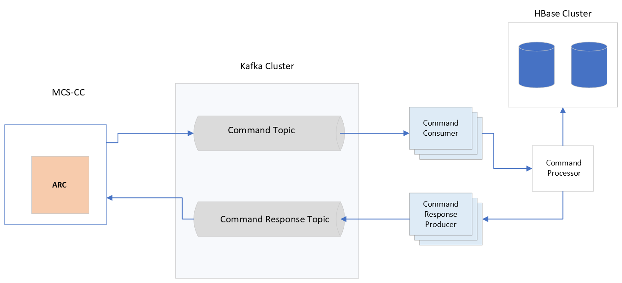
Kafka solution
Actions

Slide 11
Performance metrics
Messages & Operations
One month’s worth of test data generation (293 & 174 MB)*
Opaque data
15 days’ worth of test data generation (14,8 GB)*
Processed data
15 days’ worth of test data generation (1330 GB)*
Data Type | Items stored to HBase w/o Kafka |  | Items saved to Kafka | Items stored to HBase with Microservice
Messages |  | 10.322,38 | 53.413,56 | 27.283,947
Operation data |  | 63.702,17 | 40.276,06 | 7.919,643
Opaque data |  | 6.059,61 | 32.773,96 | 4.324,998
Processed data |  | 8.456,12 | 74.859,78 | 8.103,631
* One node and replication factor of 1

Slide 12
Remaining work
Kafka solution improvements
Add additional services
Increases fault tolerance
Support multiple missions
Increases the consumed data from the Kafka topics
Further optimaise the Kafka and HBase storage
Analyse how to keep Protobuf serialisation for Operation data
Integrate microservice docker in MCS-CC installation script

Slide 13
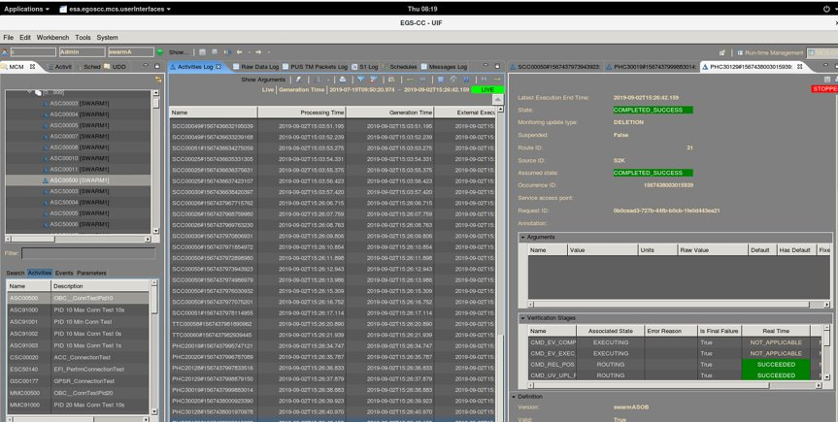
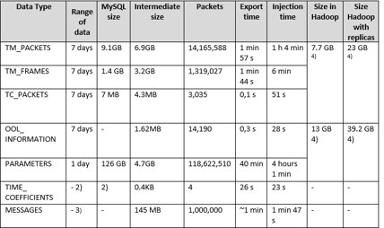
DEMO – Legacy Data export & injection
Export Tool interprets Packet Raw Data and exports necessary fields​
OM2MMCS Injection tool matches these fields to the EGS-CC types and inserts them into Hadoop

Slide 14
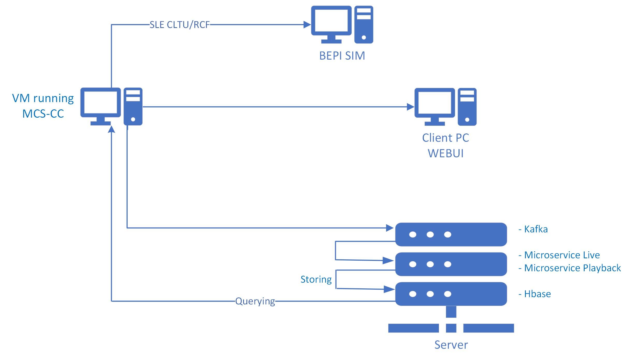
DEMO infrastructure - Kafka

Slide 15
Questions

Slide 17
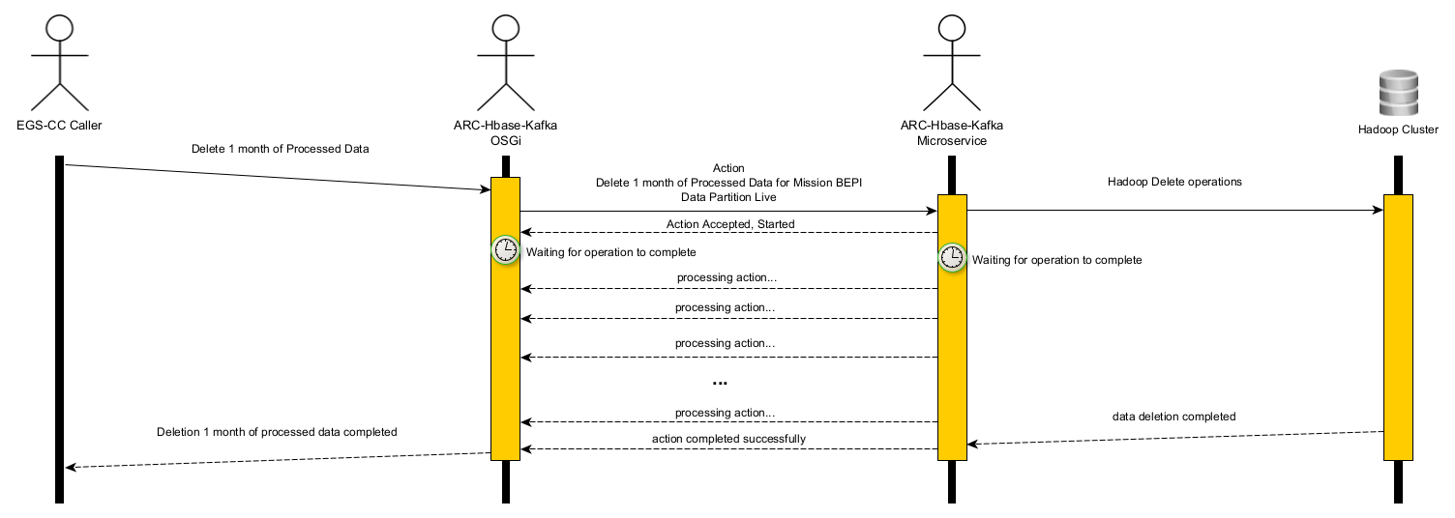
Communication

Slide 18
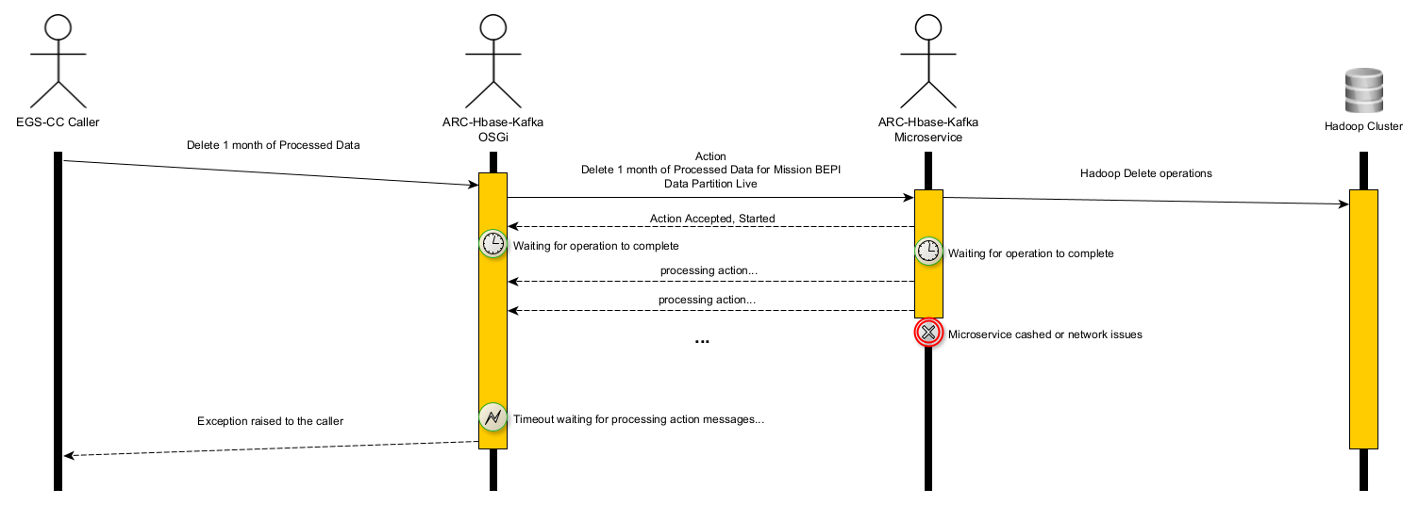
Communication

Slide 19
Actions
The following actions have been identified:
Action ID | Action | Assignee

