Slide 1
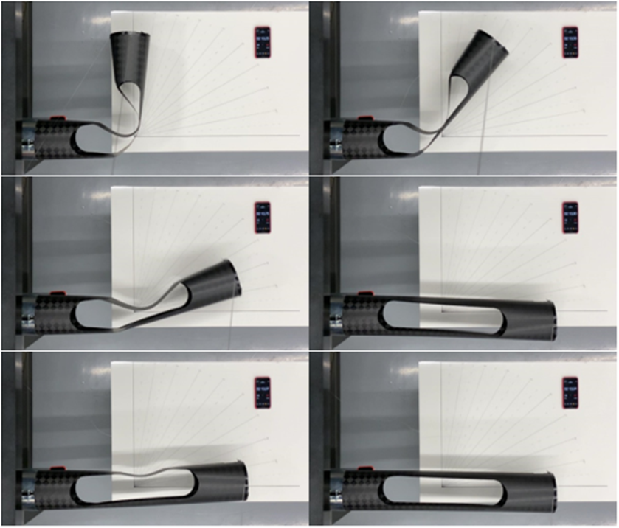
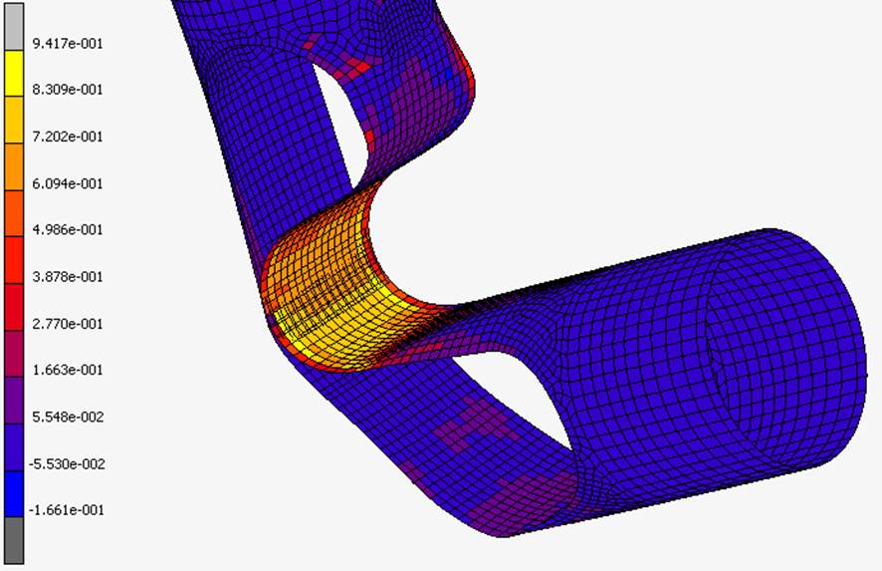
PASSIVE DAMPED DEPLOYMENT OF FULL COMPOSITE STRUCTURES
Contractor(s): PROSIX ENGINEERING S.L.
ESA Budget:
Co-funded Budget:
175,000 k€
0 k€
4000124219/18/NL/CRS
YoC: 2018
TO: Gonçalo Rodrigues
TRL
Initial: 3
Achieved: 5
Target TRL: 5 Date: Q4 2020
Background and justification: Uncontrolled deployment of booms and other devices in space can jeopardize the integrity of the deployed components or the spacecraft itself. Carbon Fibre Reinforced Flexible Epoxy resins (CFRFE) have demonstrated in a previous ITI-A project to be customizable so that the stiffness and damping of the constitutive material of a deployable structure made with thin composite laminates can be compliant with its requirements and deploy smoother than another one made with classic CFRP (made with 100% rigid epoxy resin).
Objective(s): Demonstration of the feasibility, use and functionality of CFRFE materials for self-deployable space structures such as a deployable full composite boom with tape-spring hinges by means of designing, simulating, manufacturing, testing and correlating a classic CFRP deployable tape-spring hinge and a CFRFE deployable tape-spring hinge and compare their dynamic behaviours, showing the goodness of this material for this application.
Fig 1: Deployment sequence
Achievements and status: CFRFE material with different flexible and rigid epoxy properties have been characterized (tensile, bending, damping, creep and thermal cycling), demonstrating its capability of being customized to the product needs. A CFRFE boom has been designed, manufactured and tested successfully and compared with a classical CFRP boom. Deployment tests with a mass on the booms tip have shown that the CFRFE boom reaches a final 30% lesser speed than the classical CFRP one, and it does not buckle, whilst the classical CFRP one does. Stiffness tests have shown that both booms have the same stiffness in its deployed state, which is fundamental to accomplish with the boom requirements.
Benefits: Extremely light and passive deployable structures manufactured with CFRFE can have smoother deployments and accomplish with stiffness requirements, allowing weight, cost and risk reduction with respect to classic CFRP passive deployable structures or other passive deployable structures that include metal springs, dampers and/or fittings.
Next steps: Include this CFRFE deployable boom in the development of a space component such as an antenna, reflector or boom, in order to raise the TRL of this product integrated in a full space component.
Fig 2: Strength analysis of folded configuration

