Slide 1




Brillouin – backscatter – fluorescence LIDAR research for Underwater Exploration of marine litter
ESA contract no. 4000132184/20/NL/GLC
V. Raimondi¹, P. Di Maggio¹, D. Guzzi¹, C. Lastri¹, V. Nardino¹, L. Palombi¹, R. DeVries², M. L. Santarelli³, M. C. Ciacchella³, M. P. Bracciale³
¹ Istituto di Fisica Applicata “Nello Carrara” del Consiglio Nazionale delle Ricerche (CNR-IFAC); ² The Ocean CleanUp (NL)
³ Department of Chemical Engineering, University of Rome «La Sapienza» (IT)

Slide 2
The goal and main objectives
Investigate the potential of diverse LIDAR techniques – fluorescence, elastic backscatter, Raman - to address plastic litter issue at sea, with an emphasis on plastics under the water surface and its identification.
(1) Study the potential of fluorescence LIDAR to detect and characterise plastic items
(2) Evaluate the potential of LIDAR bathymetric data from airplane to detect and characterise (geometrically/spatially) plastic items
(3) Investigate the potential of backscatter LIDAR techniques from space to detect changes in the optical properties of the water column due to microplastics
(4) Investigate the potential of Raman spectroscopy to identify plastics and discriminate its compounds, also in standoff configuration

Slide 3
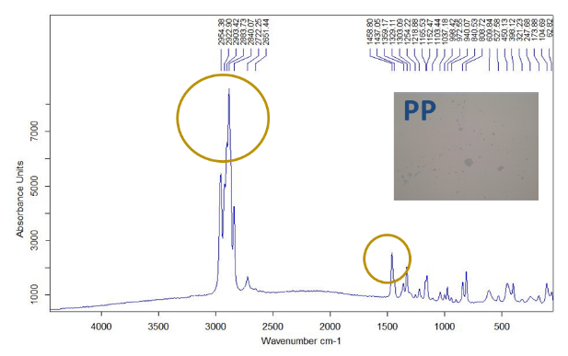
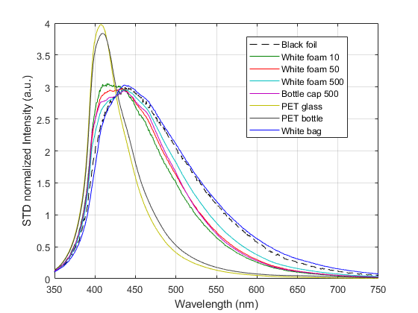
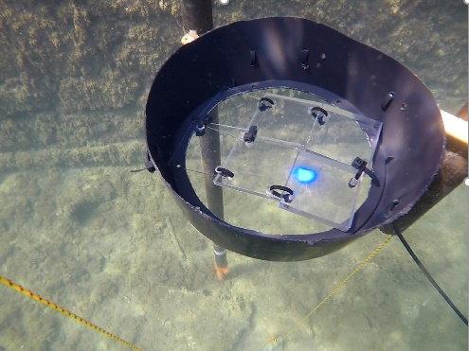
Highlights
Most plastics showed very good fluorescence efficiency and typical spectral distribution useful for its spectral characterisation
Detection of plastic microfibers – suspended in natural water - by fluorescence LIDAR, down to a concentration of 0.4 gr/L
Detection and identification of PET macroplastics by fluorescence LIDAR in a realistic marine scenario, down to a water depth of 2.4 m
Detection and characterisation of heavily fouled PET plastics by fluorescence LIDAR
Fluorescence hyperspectral LIDAR imaging of different types of plastics
Raman measurements useful for plastics composition identification, even on heavily fouled plastics
Good potential - based on simulations - for airborne fluorescence LIDAR detection and characterisation, for at least some types of plastics, and for standoff Raman LIDAR identification of plastics
Hints on apparent water attenuation coefficient as a proxy of suspended plastics
Raman spectra of raw PolyPropilene (PP) plastics acquired in the laboratory.
Fluorescence LIDAR spectra of different types of commercial plastics (λ_{exc}= 355 nm; distance: 11 m; spectra normailised to the standard deviation).
Submerged PET plastics detected by fluorescence LIDAR in marine scenario

Slide 4
Thanks for the attention! Contact: Valentina Raimondi, CNR-IFAC v.raimondi@ifac.cnr.it

