Slide 1

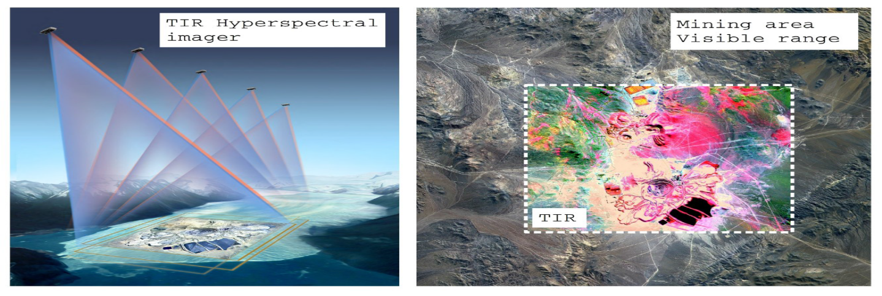


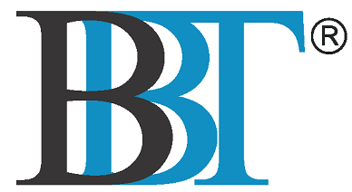
Idea I-2021-03511 - TWINS-HG
An Ultracompact Hyperspectral imager in the Thermal Infrared
ESA CONTRACT NO. 4000137531/22/NL/GLC/OV
Final Presentation
Consiglio Nazionale delle Ricerche
Istituto di Fotonica e Nanotecnologie - Milan, Italy
NIREOS S.R.L. – Official Spin-Off company of Politecnico di Milano
Milan, Italy
BBT Materials Processing, Ltd., Prague, Czech Republic

Slide 2
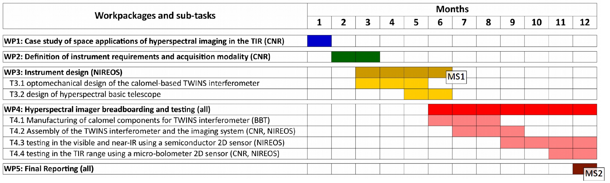
Project outline

Slide 3
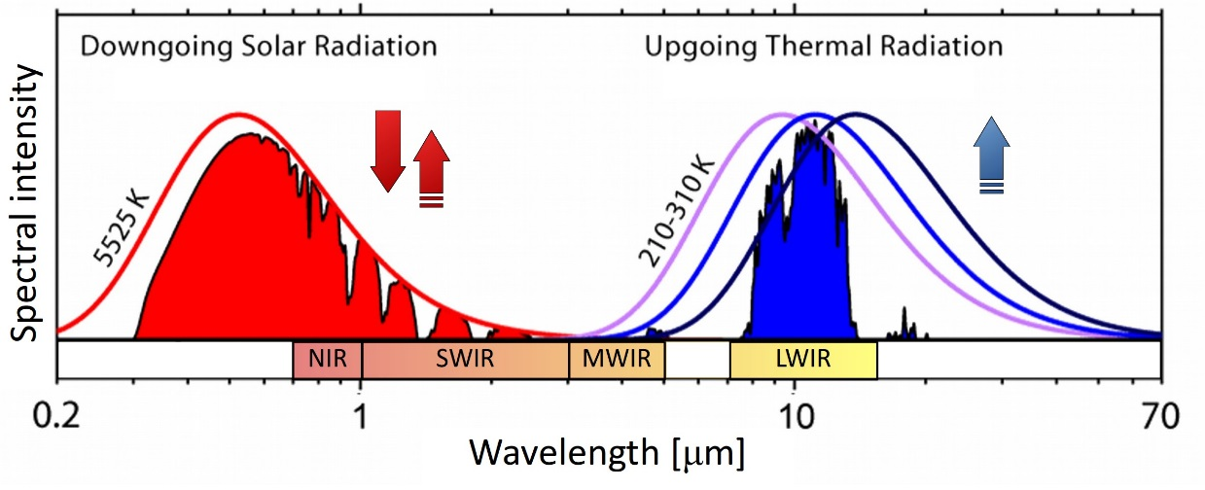
WP1: case study result
3-14 μm: Thermal infrared (TIR)
Visible / NIR
scattered solar radiation
spectral information about absorption, reflection and scattering of molecules and particles
land, water and atmosphere environments;
MWIR / LWIR
thermal radiation from Earth surface and atmosphere
spectrum reveals temperature, albedo, radiance and emissivity, composition of the surface
Bands due to absorption lines from vibrational modes
fingerprinting of chemical compounds on surface and in atmosphere.

Slide 4
WP1: case study result
Spectral imaging of Earth surface and atmosphere:
enables monitoring various ecosystem and natural aspects, such as
Volcanoes and Earthquakes
transient thermal anomalies preceding eruptions
Atmospheric gases (SO₂, ash and water ice in the eruptive plumes)
Wildfires
burning biomass
Water Use and Availability
global freshwater supplies
Water resources
Ice
Earth Surface Composition and Change:
composition and thermal properties of the surface of the Earth

Slide 5
WP2: definition of instrument requirement
Following the results from the case study, the following requirements have been defined:
Requirement | Threshold | Target | Obtained
Spectral range | 7 – 15 um | 2 – 20 um | 3 – 16 um
Spectral resolution | 20cm⁻¹ | 5cm⁻¹ | 4.2 cm⁻¹
Footprint | < 150 x 150 mm (225 cm²) | < 100 x 100 mm (100 cm²) | 120 x 90mm (108 cm²)
Interferogram Contrast | 50% | 70% | > 91.8%

Slide 6
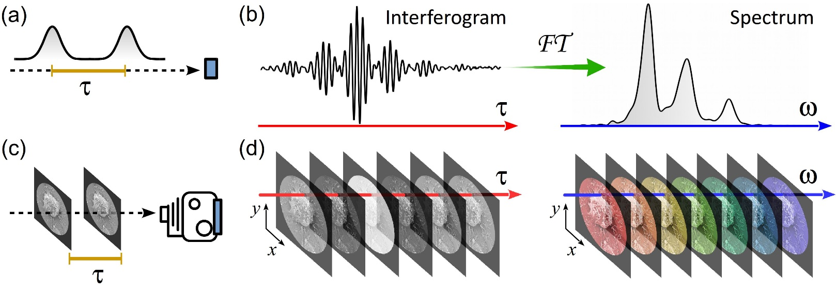


WP3: instrument design
Fourier-transform spectroscopy
Interferometry + Fourier transform
- 1822 -
Wiener-Khinchin-Einstein theorem
- 1930 – 1934 – 1914 -
Ray of light
0D
Image 2D
HYPERspectral Image
Requirements?
Accuracy of delay < 1/100 of the optical cycle (2·10⁻¹⁵ seconds @ 600 nm)

Slide 7
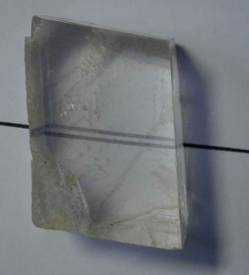

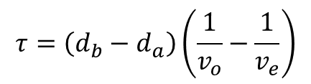
CPI: A Common-Path Interferometer
Generation of phase-locked replicas by birefringence
ordinary and extraordinary polarizations: different propagation speeds
Total delay: proportional only to thickness
Collinear replicas
z
$$τ=\left(d_{b}−d_{a}\right)\left(\frac{1}{v_{o}}−\frac{1}{v_{e}}\right)$$
Crystal Range (micron)
Alpha-BBO 0.2-3.5
Yttrium Vanadate 0.4-5
Lithium Niobate 0.4-5.2
Calomel 0.4-20
_{τ}
y
d_{b}>d_{a}
45°
45°
d_{a}
D. Brida, C. Manzoni, G. Cerullo, Opt. Lett. 37, 3027 (2012)
C. Manzoni, D. Brida, G. Cerullo, US Patent: 9182284 (2015)
x

Slide 8
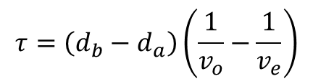
CPI: A Common-Path Interferometer
z
$$τ=\left(d_{b}−d_{a}\right)\left(\frac{1}{v_{o}}−\frac{1}{v_{e}}\right)$$
x
POL. 45°
_{τ}
y
d_{b}(x)
45°
45°
d_{a}
D. Brida, C. Manzoni, G. Cerullo, Opt. Lett. 37, 3027 (2012)
C. Manzoni, D. Brida, G. Cerullo, US Patent: 9182284 (2015)
x

Slide 9

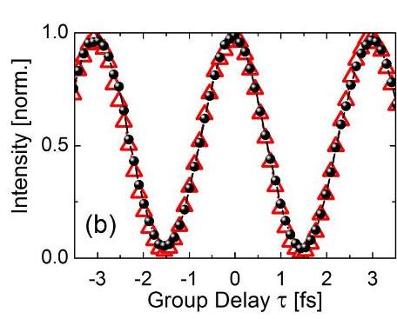
CPI characterization - Dynamic Reproducibility
Broadband incoherent
light source
SUPERCONTINUUM
FIBER LASER
τ
PHOTO-DIODE
BBO
x
Dynamic Reproducibility
Interferograms acquired after 30 minutes
perfect reproducibility
Delay or Motor position
D. Brida, C. Manzoni, G. Cerullo, Opt. Lett. 37, 3027 (2012)

Slide 10
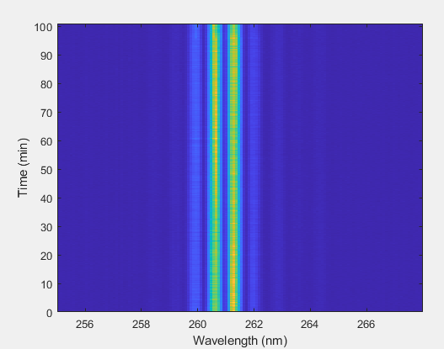
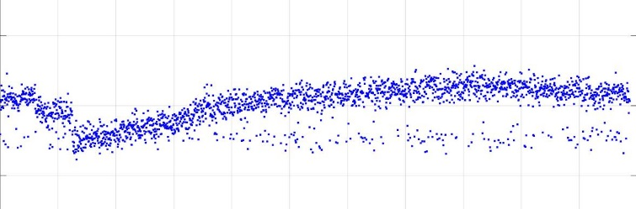
CPI characterization - Static Stability
Broadband incoherent
light source
τ
SUPERCONTINUUM
FIBER LASER
BBO
x
@ Fixed position of the wedge
DETECTION WAVELENGTH
Wavelength [nm]
258 261 274
Static Stability
delay fluctuations:
λ / 360 (∼5 as at 600 nm)
λ / 225 (∼3.87 as at 261 nm)
TWINS characterization for experiment at FERMI
Phase [rad]
-0.1 0 0.1
0 50 100
Time [Minutes]
D. Brida, C. Manzoni, G. Cerullo, Opt. Lett. 37, 3027 (2012)

Slide 11
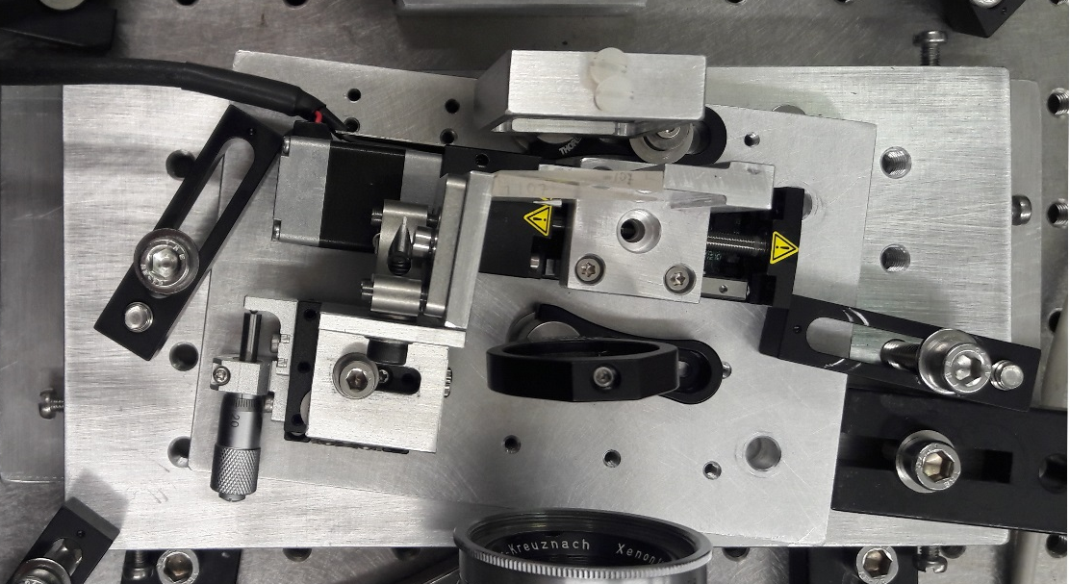
WP4: Hyperspectral Imager: breadboarding and testing
Compact footprint
108 cm²
Power consumption
< 50 W
Optical alignement
Alignment free
4-5 cm
Robust
No stability control is required
Insensitive to any mechanical fluctuations
Keeps alignment even in the presence of considerable mechanical perturbations
Lightweight
Optics+mechanics <1 kg
Ideal device for portable, on field and spaceborne applications
Optics and mechanics: to be qualified for space

Slide 12
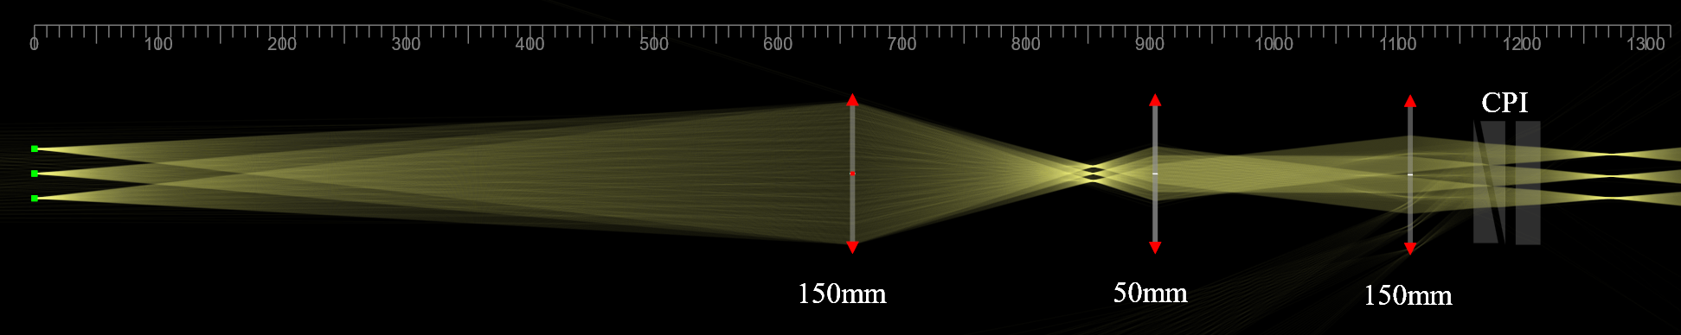
Telescope design including the CPI
Beams are NOT collimated at the CPI plane
The interference contrast is good
The beams are parallel at the image plane (Image tele-centricity)
The beams corresponding to off-axis points are parallel at the CPI plane
The interferogram phase is the same for each point of the object, leading to hyperspectral images without spatial aberrations
Ideal for satellite staring images
More versatile: the camera lens can be changed based on the required AFOV, without affecting the interferential pattern spatial distribution.
Sensor: Sony Pregius IMX174
Pixel size: 5.86 μm
N of pixels: 1280 x 1024
Horizontal AFOV=0.73°
Vertical AFOV=0.52°
Objective lens= 150 mm achromatic doublet
N-BK7 / N-SF5
Eyepiece lens= 50 mm achromatic doublet
N-BK7 / N-SF5
Camera lens= 150 mm achromatic doublet
N-BK7 / N-SF5
Notes:
Hyperspectral Cameras are very complex and expensive devices

Slide 13
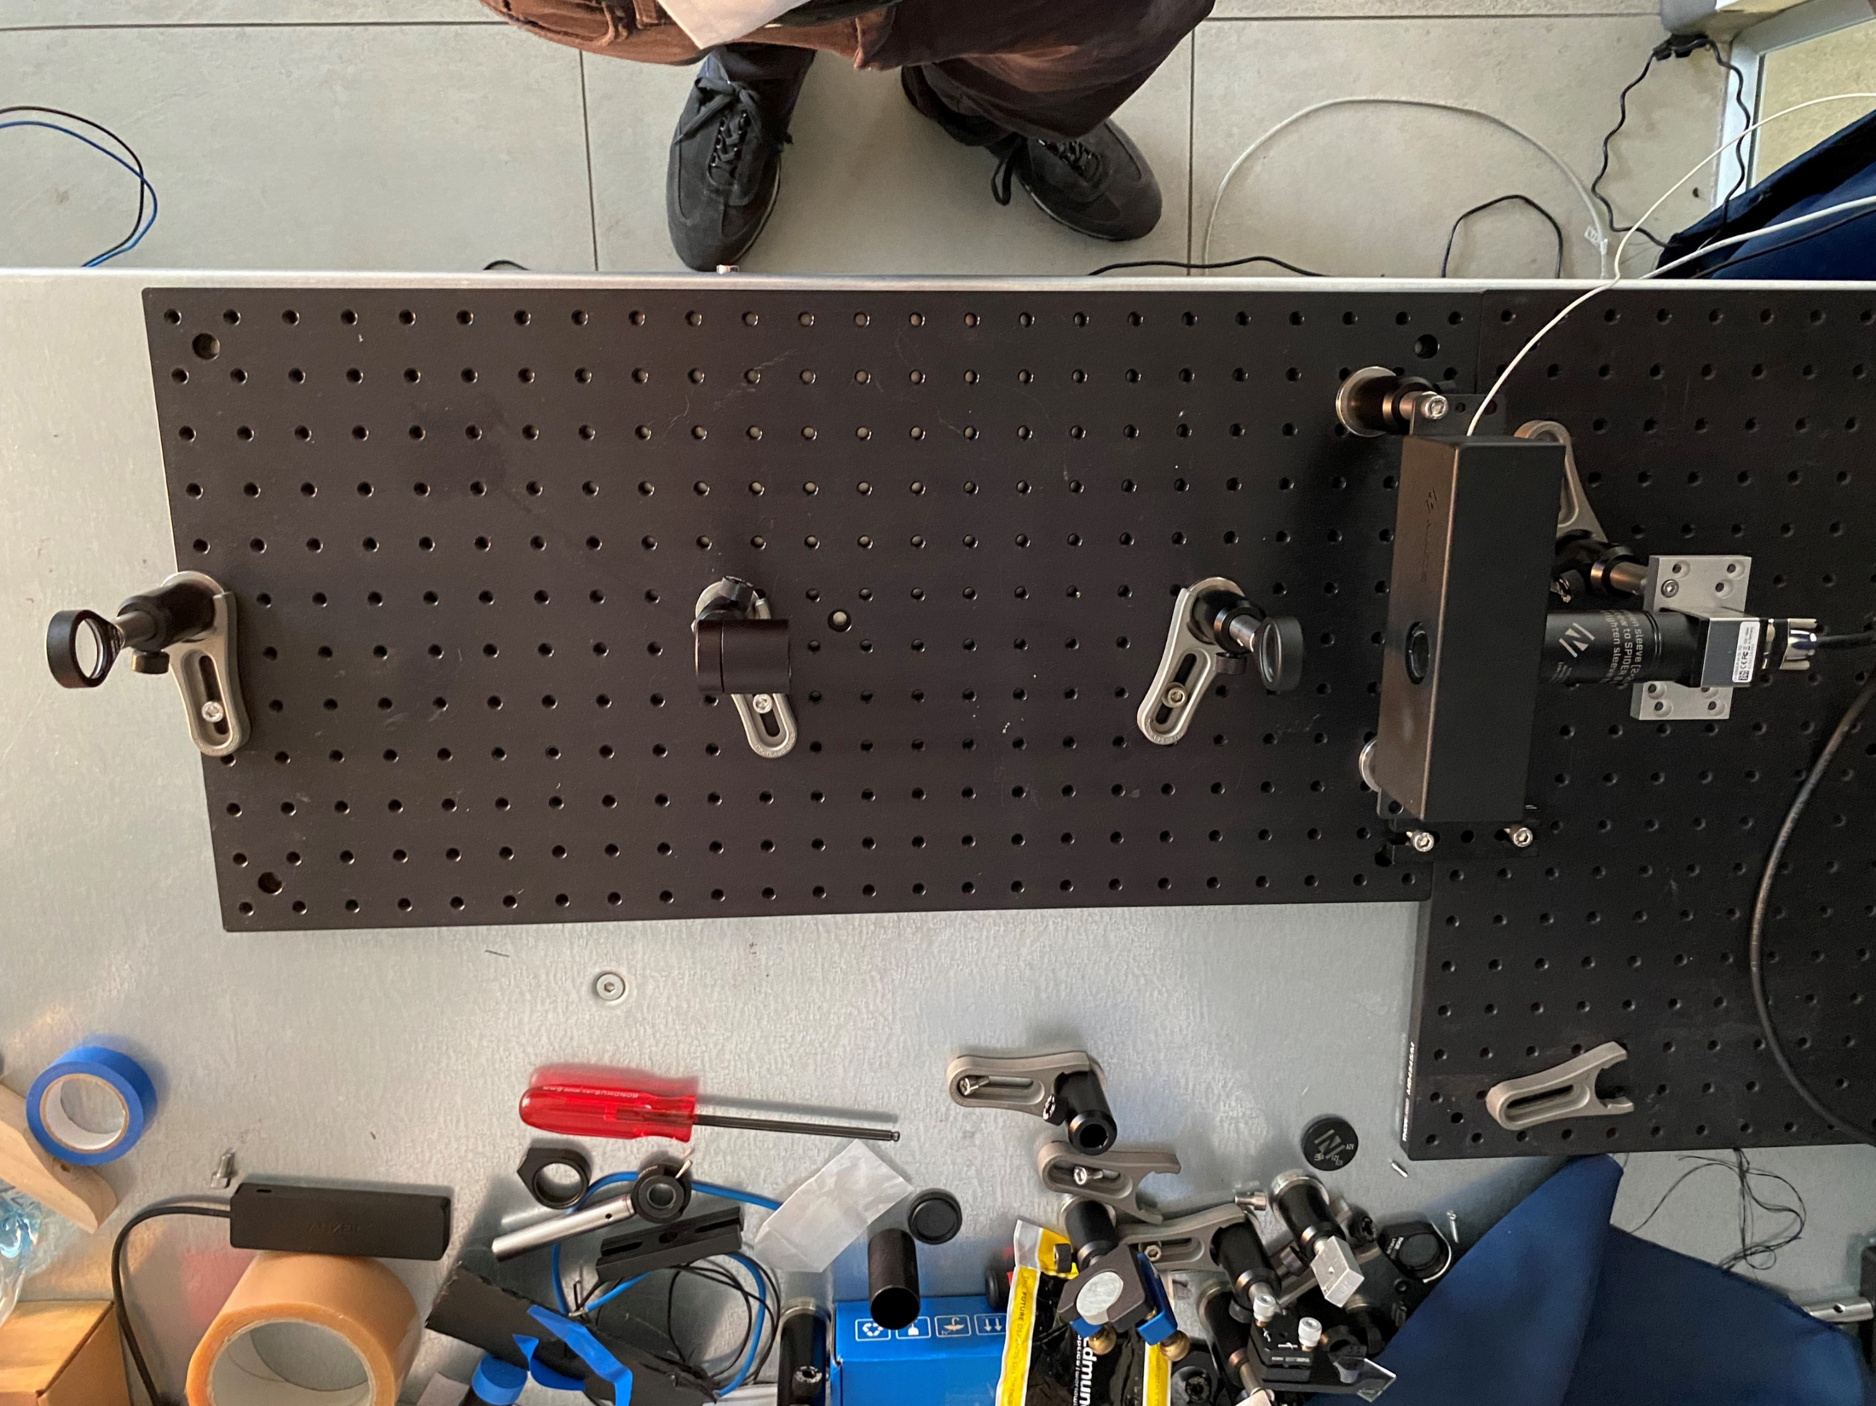
Picture of the Brassboard
Notes:
Hyperspectral Cameras are very complex and expensive devices

Slide 14
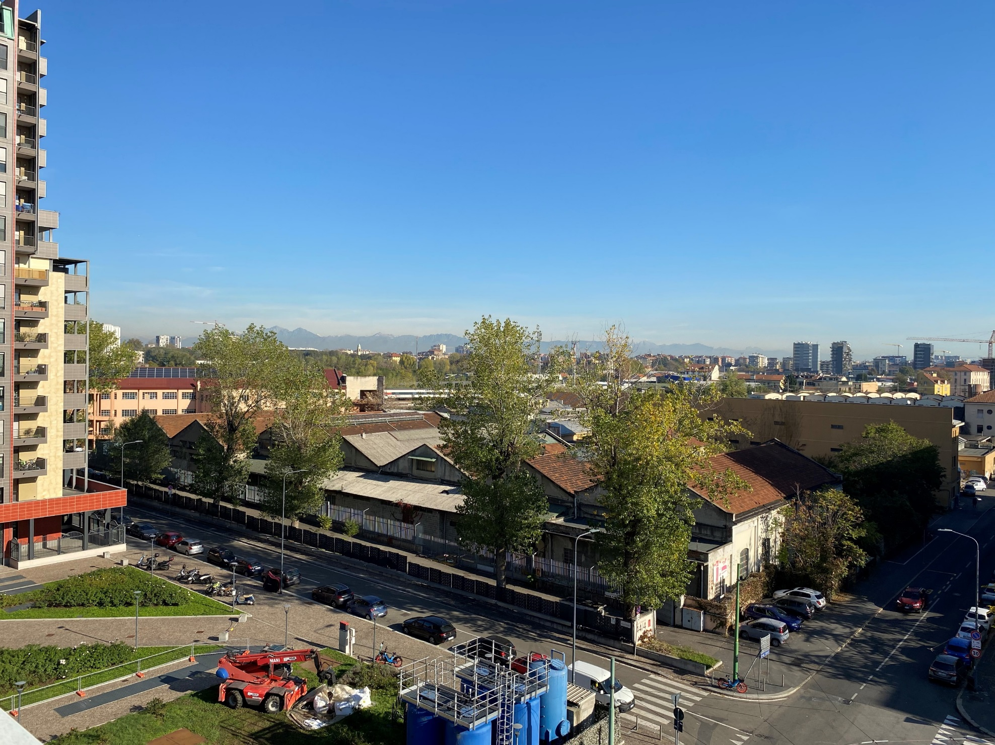

Long Distance Measurement
Shot with mobile phone
Object: “Pizzo dei Tre Signori” (2554 m s.l.m)
Distance: 60 km
Horizontal AFOV=0.73°
Vertical AFOV=0.52°
RGB projection of the hyperspectral data
Notes:
Hyperspectral Cameras are very complex and expensive devices

Slide 15
Test images at selected bands
450 nm
550 nm
650 nm
750 nm
850 nm
950 nm
Notes:
Hyperspectral Cameras are very complex and expensive devices

Slide 16
Interferometer test plan
Test plan | Test procedure | Spectral Range
Transmission of the interferometer | Measure the ratio between input and output powers | CW laser beam in the visible (He:Ne) | CW laser beam in the TIR (Quantum cascade laser @5.1 micrometers)
Interferometric contrast with collimated beam | Measure the interferogram as a function of the delay | CW laser beam in the visible (He:Ne) | CW laser beam in the TIR (Quantum cascade laser @5.1 micrometers)
Notes:
What is the size of the laser beam in the TIR?
The shock test

Slide 17
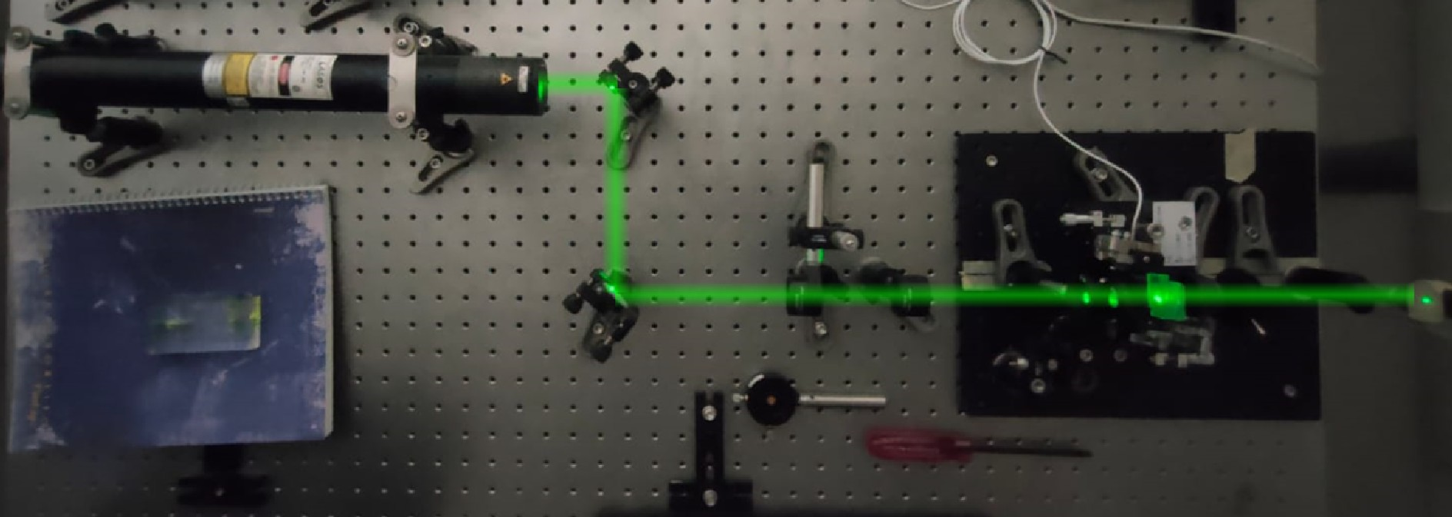
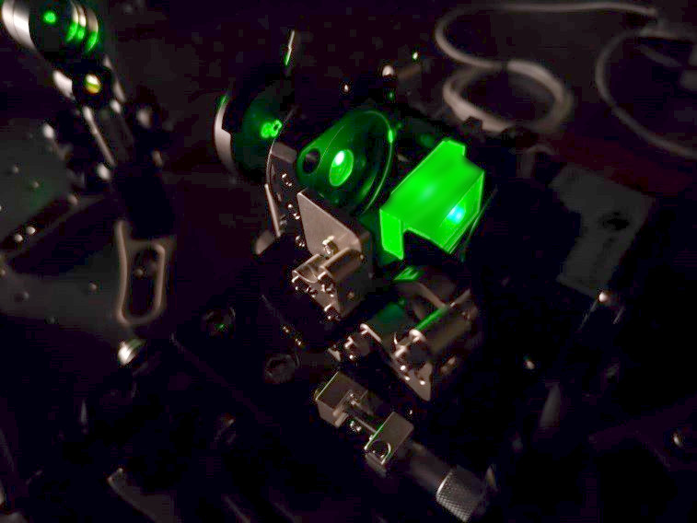
Tests in Visible: coherent light
VISIBLE RANGE
Notes:
Hyperspectral Cameras are very complex and expensive devices

Slide 18
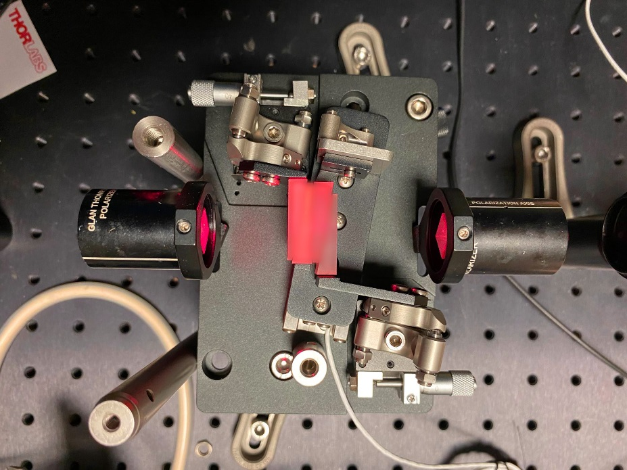
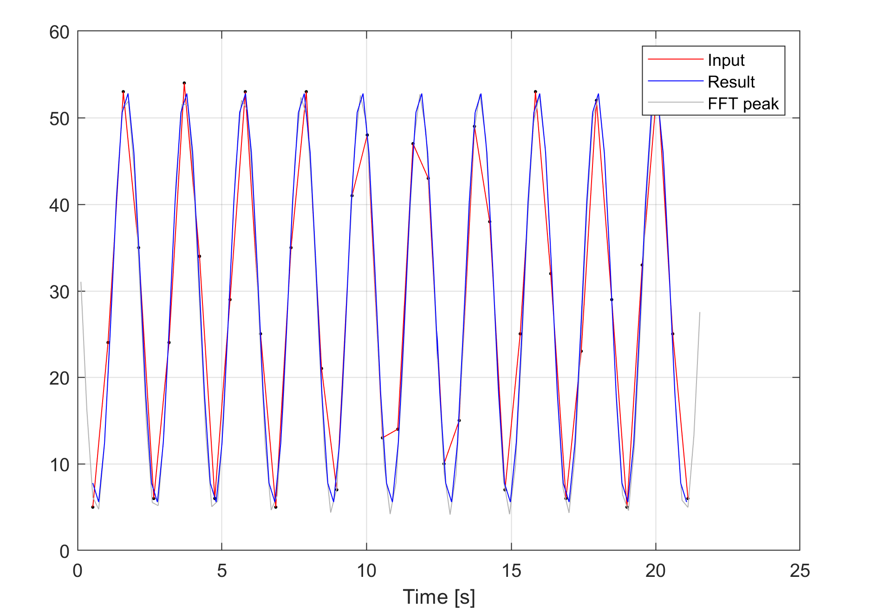





















Transmission and contrast
VISIBLE RANGE
He:Ne laser @ 632 nm
Contrast
$$M_{1}$$
$$M_{2}$$
$$M_{3}$$
$$M_{4}$$
$$M_{5}$$
$$M_{6}$$
$$M_{7}$$
$$M_{8}$$
$$M_{9}$$
$$M_{10}$$
Contrast: 83 %
Reflectivity
4 calomel wedges: each beam experiences 4 reflections as ordinary beam and 4 reflections as extraordinary beam
Expected from theory (Fresnel reflections: Rp=20.08%, Rs=10.58%): 24%
Measured: 14 % Most light is scattered
$$m_{1}$$
$$m_{2}$$
$$m_{3}$$
$$m_{4}$$
$$m_{5}$$
$$m_{6}$$
$$m_{7}$$
$$m_{8}$$
$$m_{9}$$
$$m_{10}$$
Delay [fs]

Slide 19
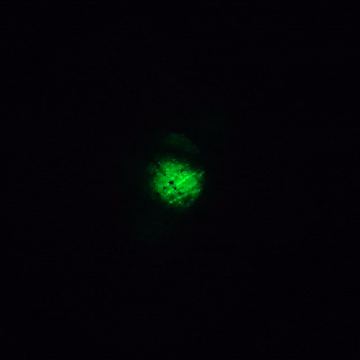
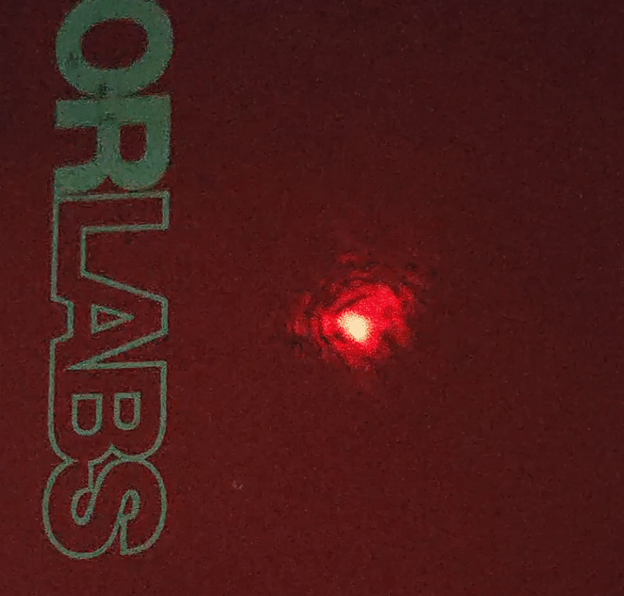
Contrast in the visible
VISIBLE RANGE
Transmitted light, on a screen
Notes:
Hyperspectral Cameras are very complex and expensive devices

Slide 20
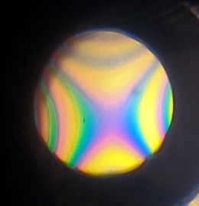
Visual Tests in Visible: incoherent light
VISIBLE RANGE
Test with a Light bulb
Hypebolic spatial intereference pattern
Very high coherence
Very limited spatial walk-off

Slide 21
Characterization of interefrometer performances
Characterization of the following properties:
Transmission
Interferometric contrast
spectral resolution
frequency calibration
Notes:
What is the size of the laser beam in the TIR?
The shock test

Slide 22
Test plan
Test plan | Test procedure | Spectral Range
Transmission of the interferometer | Measure the ratio between input and output powers | CW laser beam in the visible (He:Ne) | CW laser beam in the TIR (Quantum cascade laser @5.1 micrometers)
Interferometric contrast with collimated beam | Measure the interferogram as a function of the delay | CW laser beam in the visible (He:Ne) | CW laser beam in the TIR (Quantum cascade laser @5.1 micrometers)
14%
82%
Notes:
What is the size of the laser beam in the TIR?
The shock test

Slide 23
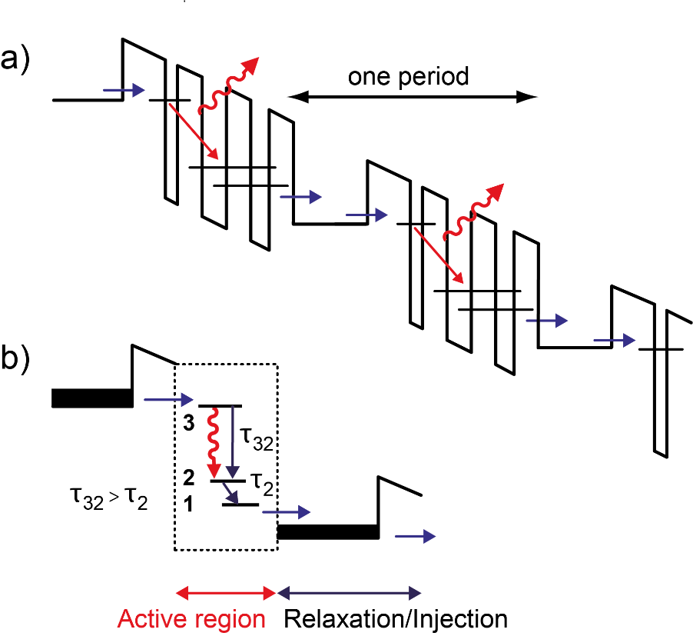
Test Infrared: Goals & Methods
TIR RANGE
Characterize of the Calomel interferometer in terms of:
Transmission
Interferometric contrast
spectral resolution
frequency calibration
The light source
We used two light sources from COSMOS lab at Politecnico Lecco (Prof. Davide Gatti):
Narrowband: Quantum Cascade Lasers (QCL). The available QCL can be tuned from 5 to 9 micron
Broadband: difference frequency generation (DFG)
QCL lasers can access the IR range by exploiting multiple intersubband transitions in the conduction band of a structure made by repeated cells of 3 quantum wells. These are usually made of InGaAs, and separated by AlInAs spacers to create a miniband where electrons are injected or extracted.

Slide 24
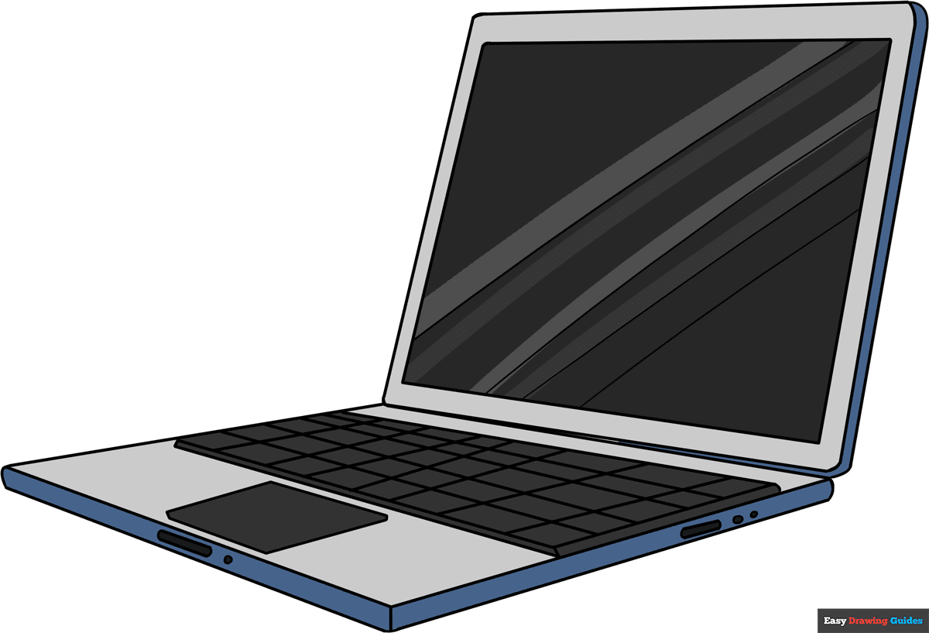
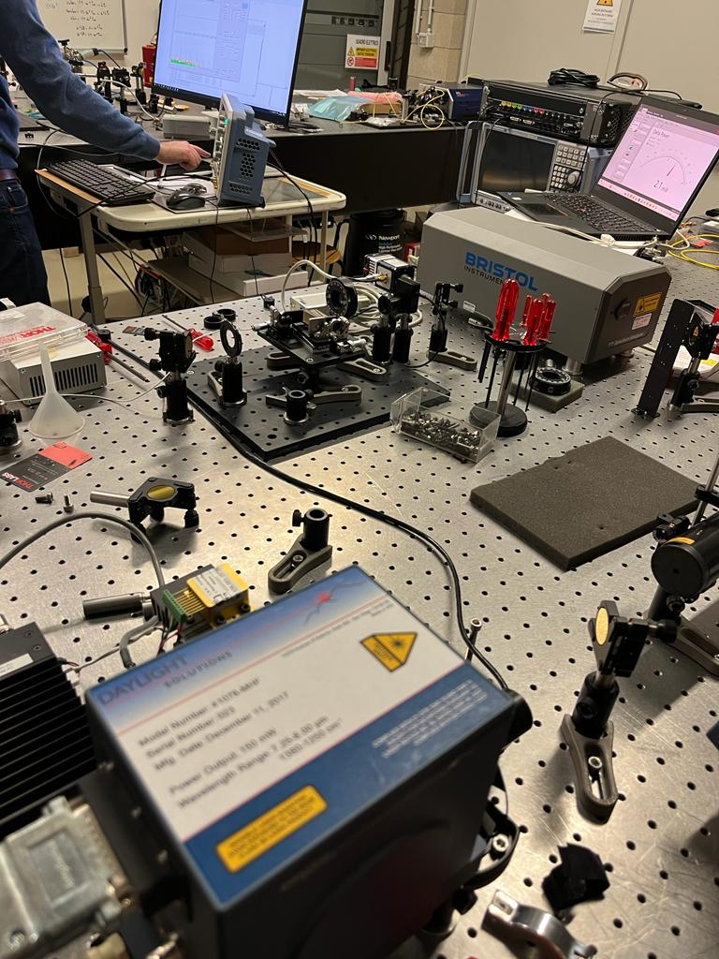


The experimental Setup
TIR RANGE
PC
$$f_{r}=684 Hz$$
Lock-in
amplifier
Reference
Signal
MCT Detector
Chopper driver
Iris or Polarizer 1
Calomel
Gold mirror 3
MCT detector
Calomel
interferometer
Iris or Polarizer 2
Bristol wavemeter
Gold mirror 2
Iris or Polarizer 1
Gold mirror
PM 2
Gold mirror
Iris or Polarizer 2
PM 1
Bristol wave-
meter
Piezoelectric motor
QCL
Gold mirror 1
Gold mirror
Laser
Gold mirror
Chopper
Gold mirror
Motor driver
Chopper

Slide 25
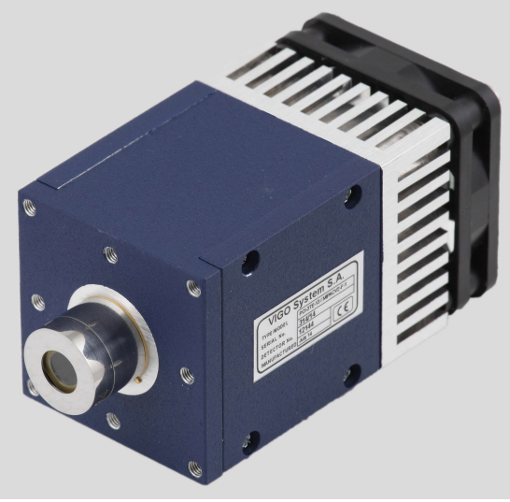
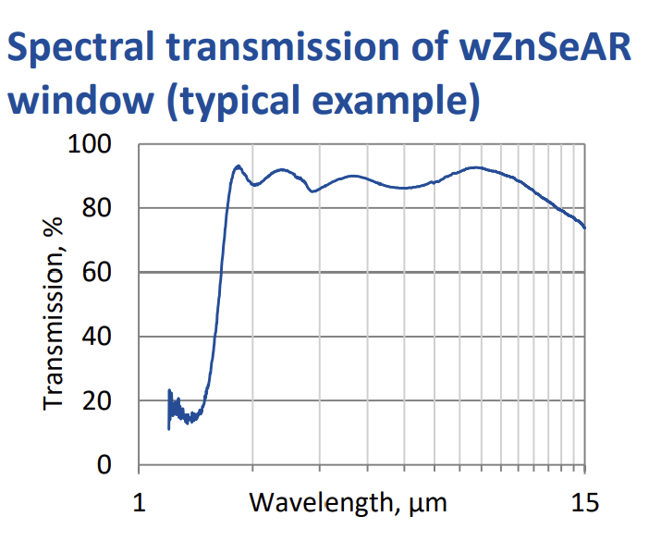
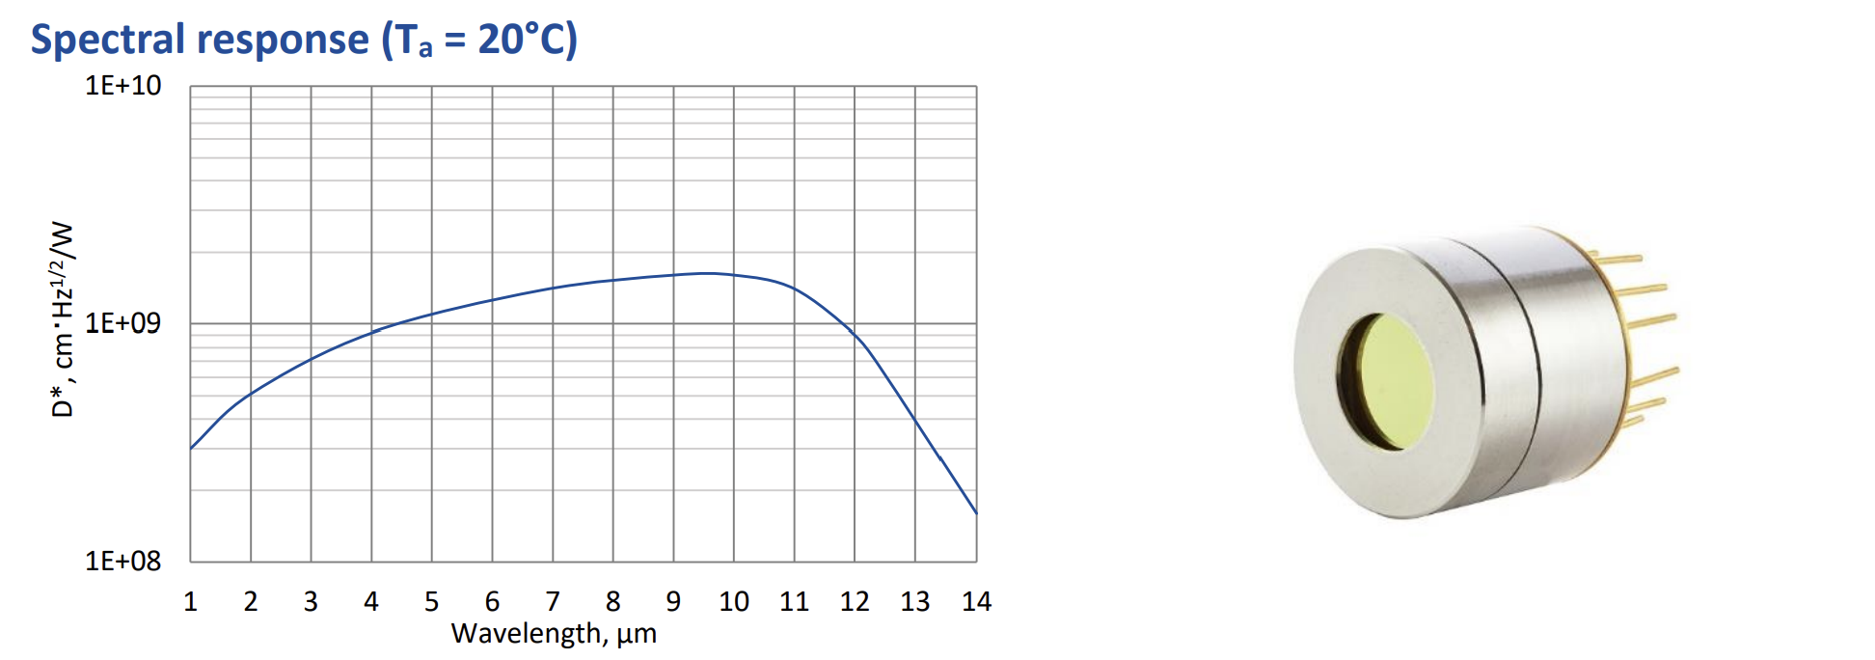
The Detectors - I
TIR RANGE
Placed after the interferometer, it collects the interferogram
Mercury-Cadmium-Telluride (MCT): Code: PCI-3TE-12-1×1-TO8-wZnSeAR-36 (probably) Type: epitaxial HgCdTe heterostructure photoconductive S/N: 443150140
Range: 1-14 μm (optimized for 12 μm) Window: wedged zinc-selenide anti-reflection coated
Mounted on MIP-DC-5M-F-M4 preamplifier

Slide 26
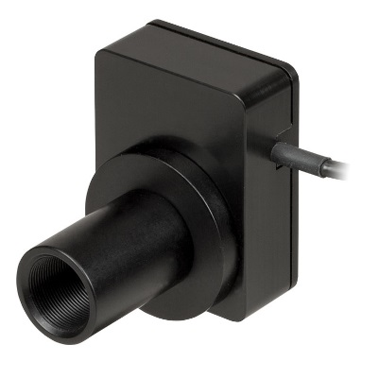
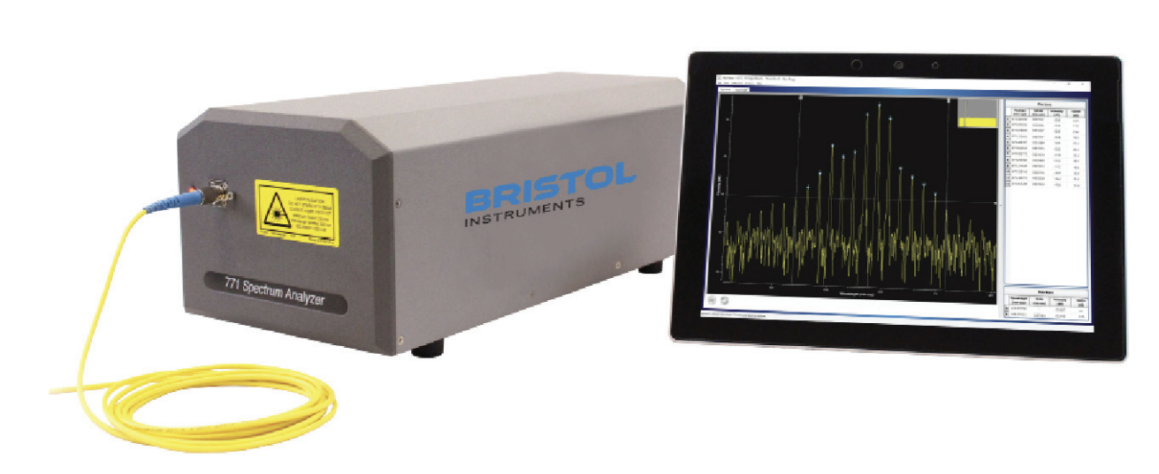
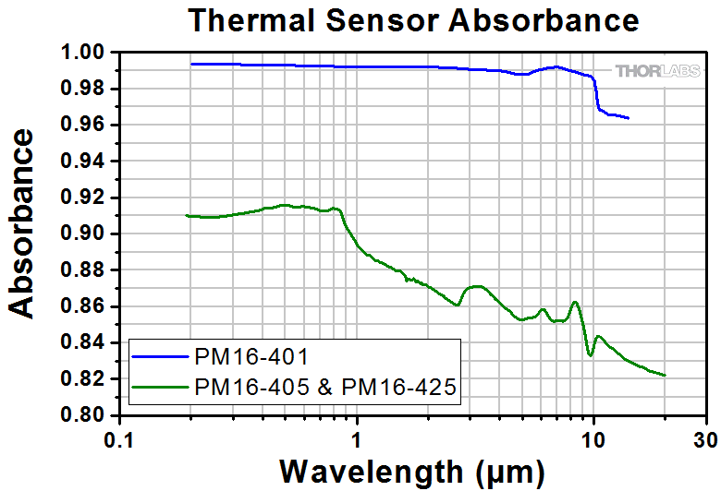
The detectors - I
TIR RANGE
Wavemeter/analyser (Bristol 771): The wavemeter analyser is a calibrated commercial device to measure the emission spectra from the QCL and the laser sources.
Power meter (PM):
It is used to measure the power of the laser light, for the characterization of the transmission
PM16-401 Type: thermopile S/N: 1905780
Range: 0.19-20 μm Maximum power: 1 W
Type: Michelson interferometer, FT
Range: 0.375-12 μm
Resolution: 0.1 pm Accuracy: 0.2 ppm

Slide 27


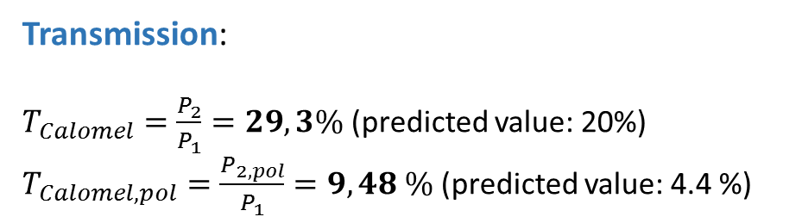
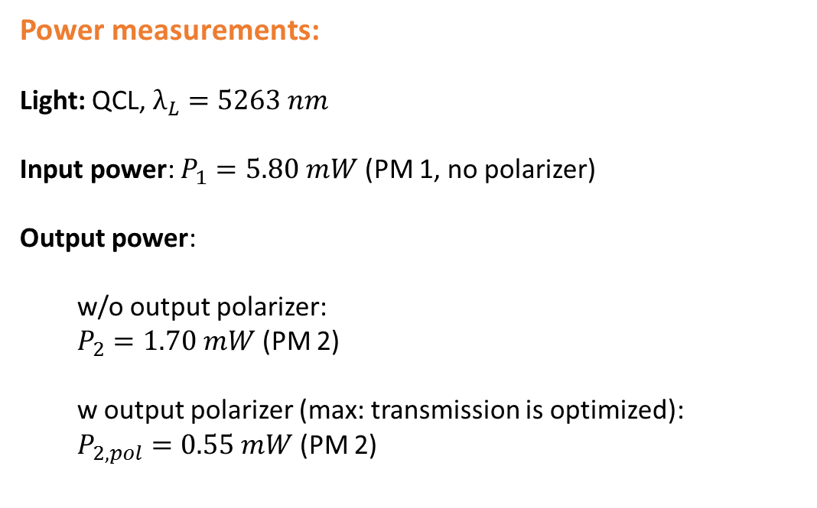
Transmission @5 μm
TIR RANGE
Date: 21/04/2023
Method:
Transmission is calculated by taking two transmission measurements: Input: before interferometer; output: after interferometer
Power measurements:
Light: QCL, $λ_{L}=5263 nm$
Input power: $P_{1}=5.80 mW$ (PM 1, no polarizer)
Output power:
w/o output polarizer:
$P_{2}=1.70 mW$ (PM 2)
w output polarizer (max: transmission is optimized): $P_{2, pol}=0.55 mW$ (PM 2)
Transmission:
$T_{Calomel}=\frac{P_{2}}{P_{1}}=29,3\%$ (predicted value: 20%) $T_{Calomel, pol}=\frac{P_{2, pol}}{P_{1}}=9,48 \%$ (predicted value: 4.4 %)
Transmission is higher than expected because light polarization is p (lower Fresnel losses).

Slide 28
Test plan
Test plan | Test procedure | Spectral Range
Transmission of the interferometer | Measure the ratio between input and output powers | CW laser beam in the visible (He:Ne) | CW laser beam in the TIR (Quantum cascade laser @5.1 micrometers)
Interferometric contrast with collimated beam | Measure the interferogram as a function of the delay | CW laser beam in the visible (He:Ne) | CW laser beam in the TIR (Quantum cascade laser @5.1 micrometers)
14%
9.5 – 29.3%
82%
Notes:
What is the size of the laser beam in the TIR?
The shock test

Slide 29
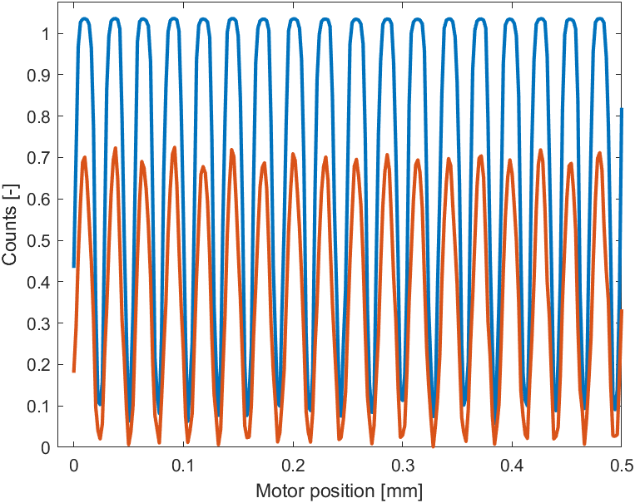
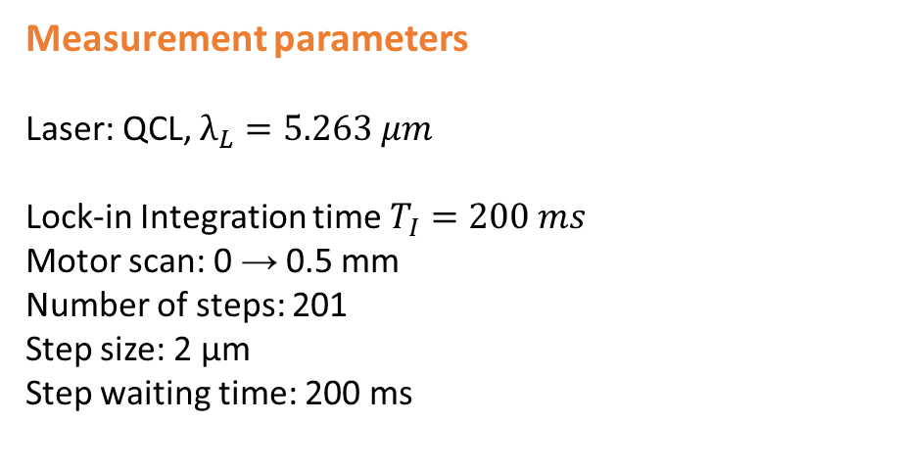

Contrast @5 μm
TIR RANGE
Date: 21/04/2023
Experimental Interferogram
Method:
Contrast is measured by a single, short scan, and comparing maxima and minima
Interferogram 1 is saturated
Measurement parameters
Laser: QCL, $λ_{L}=5.263 μm$ Lock-in Integration time $T_{I}=200 ms$ Motor scan: 0 → 0.5 mm Number of steps: 201 Step size: 2 µm Step waiting time: 200 ms
Contrast
$$\left\langle ν_{2}\right\rangle =96.13 \%$$

Slide 30
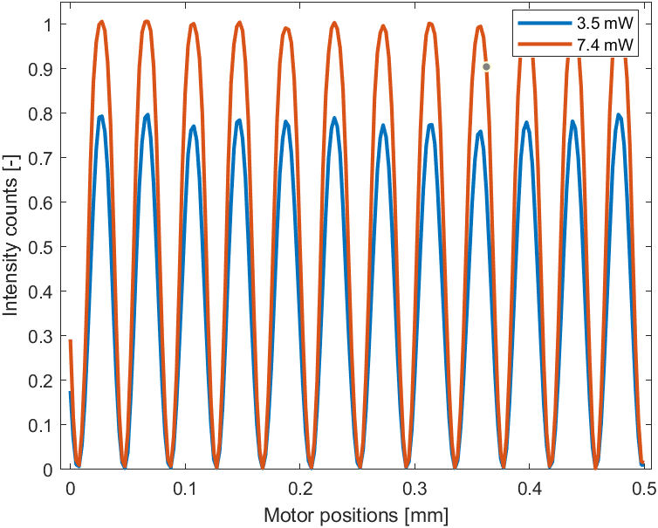
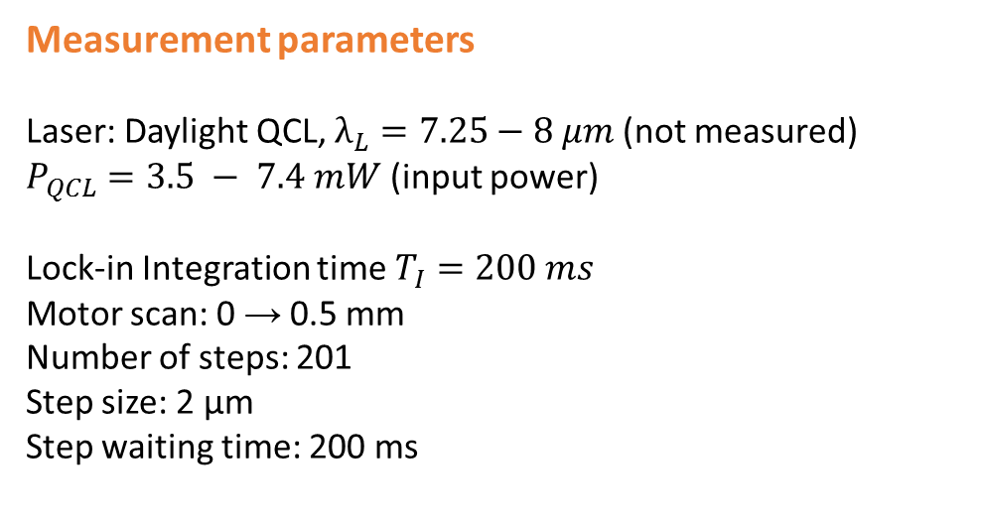
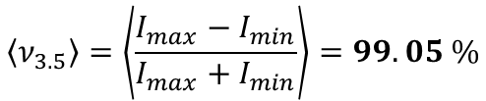
Contrast @7 μm
TIR RANGE
Date: 20/04/2023
Experimental Interferogram
Measurement parameters
Laser: Daylight QCL, $λ_{L}=7.25−8 μm$ (not measured) $P_{QCL}=3.5 − 7.4 mW$ (input power)
Lock-in Integration time $T_{I}=200 ms$ Motor scan: 0 → 0.5 mm Number of steps: 201 Step size: 2 µm Step waiting time: 200 ms
Contrast
$$\left\langle ν_{3.5}\right\rangle =\left\langle \frac{I_{max}−I_{min}}{I_{max}+I_{min}}\right\rangle =99.05 \%$$
$$\left\langle ν_{7.4}\right\rangle =\left\langle \frac{I_{max}−I_{min}}{I_{max}+I_{min}}\right\rangle =98.91 \%$$

Slide 31
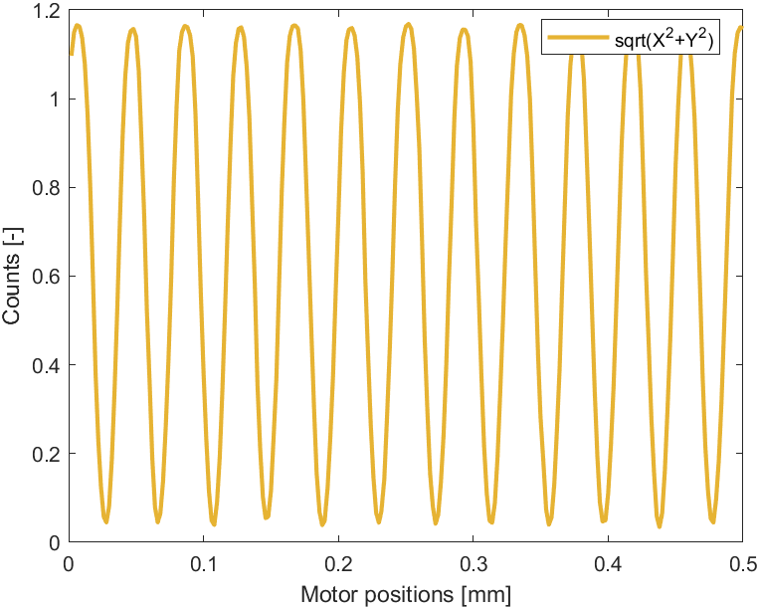
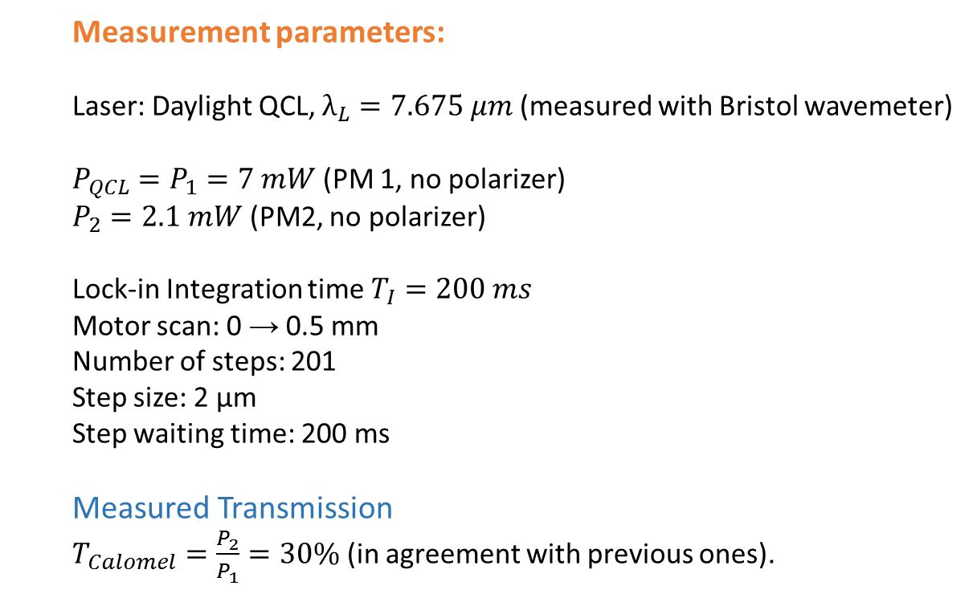

Contrast @7 μm
TIR RANGE
Date: 21/04/2023
Contrast
Measurement parameters: Laser: Daylight QCL, $λ_{L}=7.675 μm$ (measured with Bristol wavemeter) $P_{QCL}=P_{1}=7 mW$ (PM 1, no polarizer) $P_{2}=2.1 mW$ (PM2, no polarizer) Lock-in Integration time $T_{I}=200 ms$ Motor scan: 0 → 0.5 mm Number of steps: 201 Step size: 2 µm Step waiting time: 200 ms
Measured Transmission
$T_{Calomel}=\frac{P_{2}}{P_{1}}=30\%$ (in agreement with previous ones).
$$\left\langle ν\right\rangle =92.85 \%$$

Slide 32
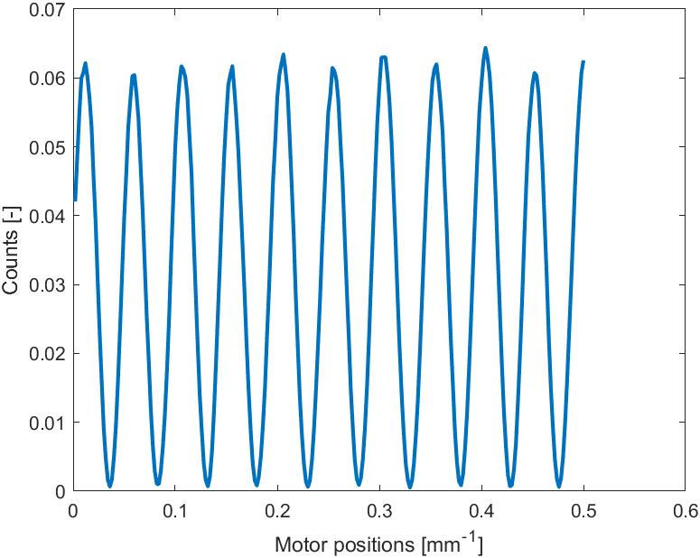
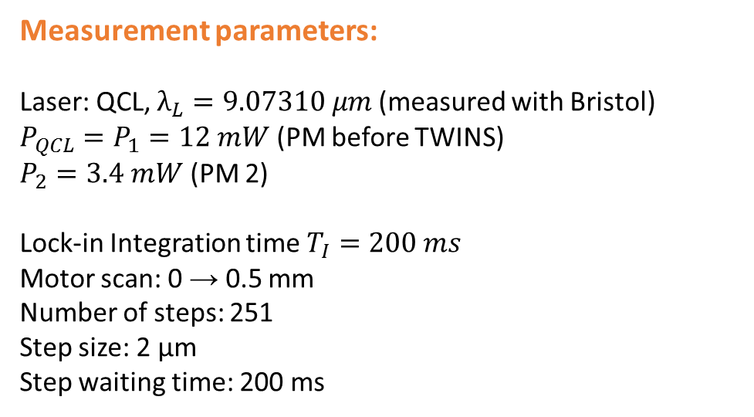

Contrast @9 μm
TIR RANGE
Date: 27/04/2023
Contrast
$$\left\langle ν\right\rangle =97.64 \%$$
Measurement parameters: Laser: QCL, $λ_{L}=9.07310 μm$ (measured with Bristol) $P_{QCL}=P_{1}=12 mW$ (PM before TWINS) $P_{2}=3.4 mW$ (PM 2)
Lock-in Integration time $T_{I}=200 ms$ Motor scan: 0 → 0.5 mm Number of steps: 251 Step size: 2 µm Step waiting time: 200 ms

Slide 33
Test plan
Test plan | Test procedure | Spectral Range
Transmission of the interferometer | Measure the ratio between input and output powers | CW laser beam in the visible (He:Ne) | CW laser beam in the TIR (Quantum cascade laser @5.1 micrometers)
Interferometric contrast with collimated beam | Measure the interferogram as a function of the delay | CW laser beam in the visible (He:Ne) | CW laser beam in the TIR (Quantum cascade laser @5.1 micrometers)
14%
9.5 – 29.3%
82%
>92%
Notes:
What is the size of the laser beam in the TIR?
The shock test

Slide 34
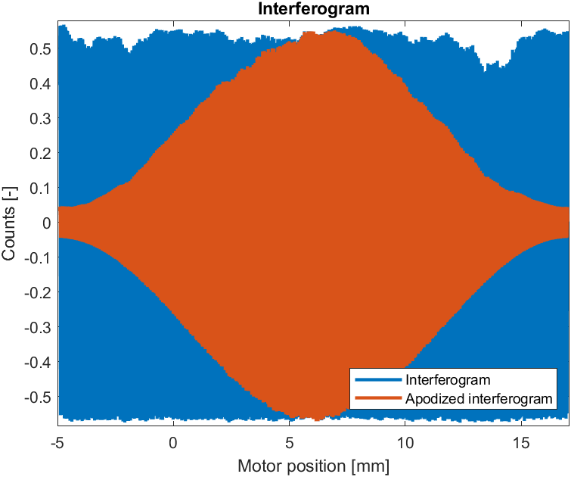
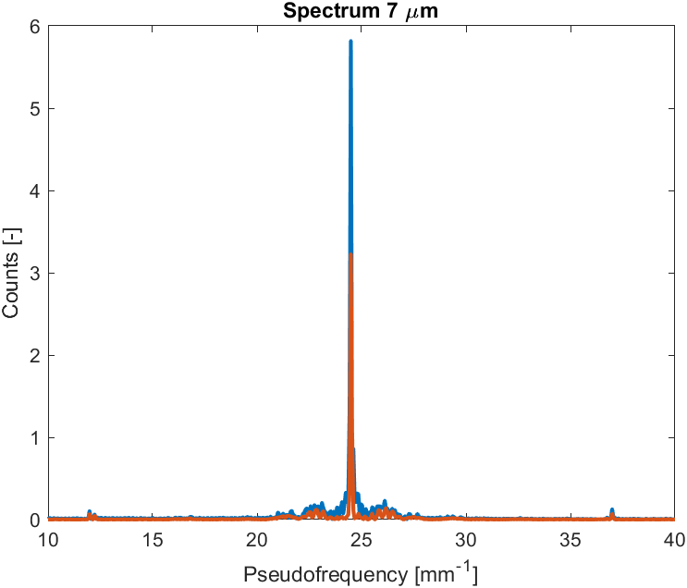

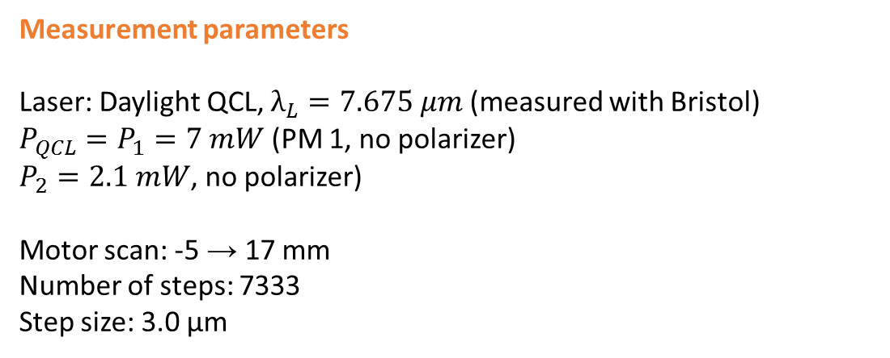
Spectral Resolution @7 μm
Date: 21/04/2023
Measurement parameters Laser: Daylight QCL, $λ_{L}=7.675 μm$ (measured with Bristol) $P_{QCL}=P_{1}=7 mW$ (PM 1, no polarizer) $P_{2}=2.1 mW$, no polarizer)
Motor scan: -5 → 17 mm Number of steps: 7333 Step size: 3.0 µm
Longest available scan,
Higher spectral resolution
Spectrum
after FT
These artefacts arise from errors in motor positioning
Motor position calibration is required

Slide 35
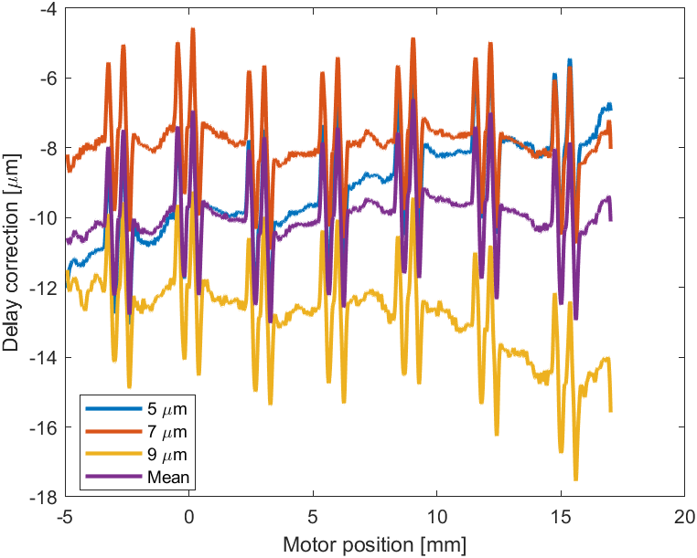
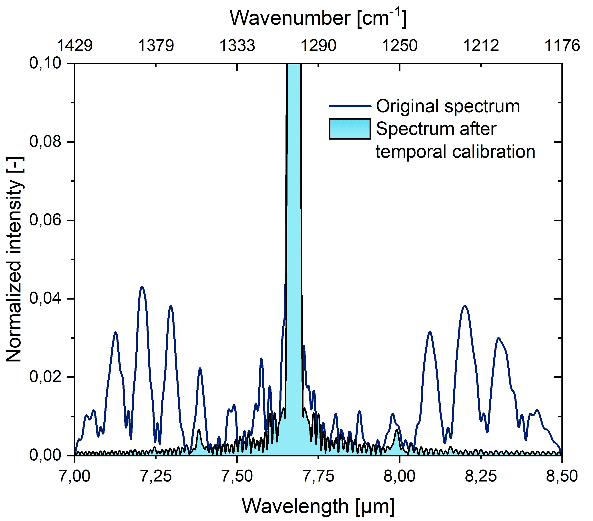

Delay Calibration
Date: 27/04/2023
Motor delay correction: obtained from time traces of the CW lasers at 5, 7 and 9 μm. The correction (stable and reproducible) enables to calculate the correct motor position, before taking the FT. All corrections show a similar behaviour, with only an offset. Correction is of the order of +/-2 um. Origin: unknown.

Slide 36
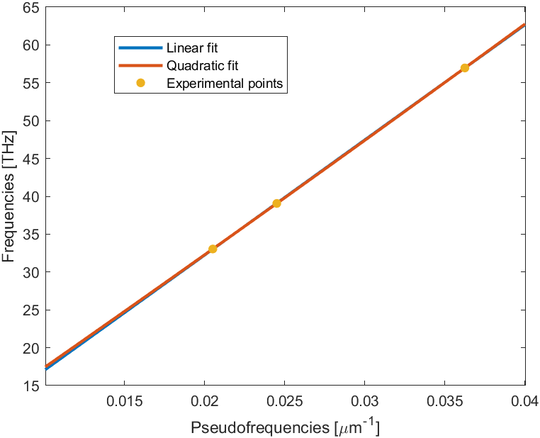
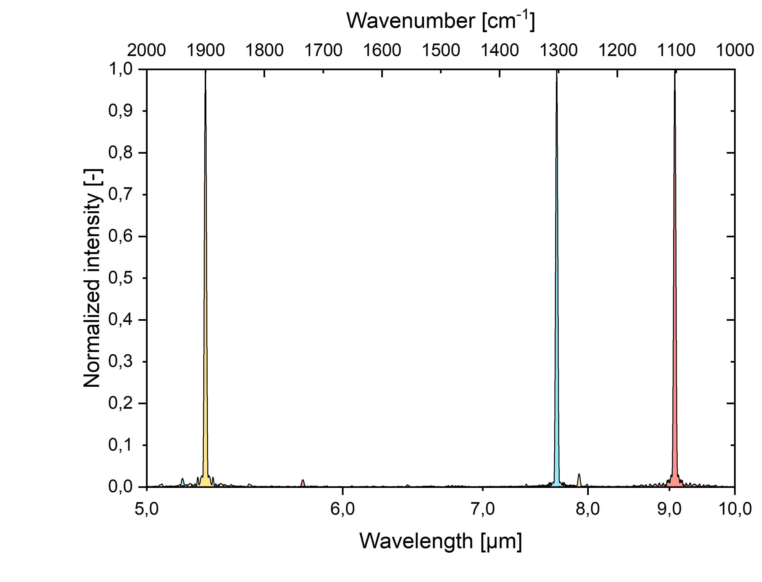

Frequency Calibration
Date: 27/04/2023
From the spectra of the QCL laser we derived the frequency calibration of the interferometer. This relates the pseudofrequency to the optical frequency (measured with Bristol).
FT Spectra after frequency and delay calibration
5.263 μm
1900 cm⁻¹
FWHM:
4.3 cm⁻¹
11.9 nm
7.675 μm
1303 cm⁻¹
FWHM:
4.23 cm⁻¹
24.9 nm
9.073 μm
1102 cm⁻¹
FWHM:
4.2 cm⁻¹
34.6 nm
5,5

Slide 37
Contrast and spectral resolution
From the spectra of the QCL laser we derived the spectral resolution of the interferometer/spectrometer.
Wavelength | Contrast | Spectral width
5.3 μm | 96.1% | 4.30 cm⁻¹
7.7 μm | 92.8% | 4.23 cm⁻¹
9.1 μm | 97.6% | 4.20 cm⁻¹

Slide 38
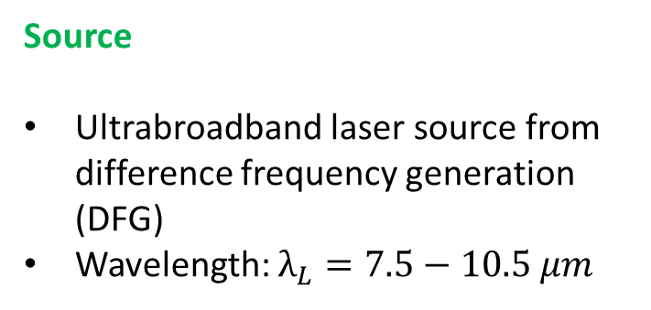

Tests with Broadband Laser Spectrum
Date: 27/04/2023
Source
Ultrabroadband laser source from difference frequency generation (DFG)
Wavelength: $λ_{L}=7.5−10.5 μm$
Measurement parameters
Lock-in Integration time $T_{I}=500 ms$ Motor scan: -3 → 3 mm Number of steps: 1500 Step size: 4 µm Step waiting time: 250 ms
Data treatment:
interferograms are apodized
Delays are corrected
spectra are frequency-calibrated

Slide 39


Broadband Laser Spectrum
Date: 27/04/2023
Comparison between calomel interferometer and Bristol commercial spectrometer
Interferograms
Spectra
after FT
$P$ = $0.23 mW$
before TWINS
Measurement 1
Laser: DFG, $λ_{L}=7.5−10.5 μm$
Laser: DFG, $λ_{L}=7.5−10.5 μm$ + bandpass filter @$9 μm$
Measurement 2

Slide 40




Broadband Incoherent Light
Date: 28/04/2023
The ultimate test for the project: proving that the interferometer works also with incoherent radiation
Parabolic mirror
Chopper
Flat mirror
Source:
Kantal (FeCrAl) filament
Iris
Shield
Polarizer
Calomel
Chopper driver
Polarizer
Iris
MCT
Lock-in amplifier
Flat mirror

Slide 41




Test with Incoherent Light
Date: 28/04/2023
We collected three scans with different scan ranges (influencing spectral resolution)
Interferogram
Spectrum
Spectral range:
3 - 16 μm
Contrast
$$\left\langle ν\right\rangle =89.17 \%$$

Slide 42



Tests with microbolometer + incoherent source
Ceres V640 GigE
Dione 640 OEM thermal imaging core 640x480 pixels, 12 μm pixel pitch
Spectral range: 8 - 13 μm

Slide 43


Thermal emission from heated samples
3 samples: pure monocrystalline quartz, defected mineral quartz, polycrystalline fused silica glass
the temperature: ≈200°C (473.15K), to increase the emittance (Stefan-Boltzmann law)
Interferogram
Spectrum

Slide 44
Verification Matrix
Requirement | Threshold | Target | Obtained
Spectral range | 7 – 15 um | 2 – 20 um | 3 – 16 um | Threshold
Spectral resolution | 20cm⁻¹ | 5cm⁻¹ | 4.2 cm⁻¹ | Target
Footprint | < 150 x 150 mm (225 cm²) | < 100 x 100 mm (100 cm²) | 120 x 90mm (108 cm²) | Target
Interferogram Contrast | 50% | 70% | > 91.8% | Target
The spectral range is only limited by emission of the light sources and the detection range
The spectral resolution has been reached by performing the longest scan, with the new interferometer design
The contrast has been greatly improved by the new interferometer design

Slide 45


Communications to conferences
Small Satellites Systems and Services: 4S Symposium
16-20th May 2022 Vilamoura (Portugal)
F. Preda, D. Polli, G. Cerullo, C. Manzoni, “A compact and rugged Hyperspectral Camera for Remote Sensing based on a birefringent ultrastable common-path interferometer” (Presenter: C. Manzoni)
14 th IAA Symposium on Small Satellites for Earth System Observation
7-12th May 2023, Berlin (Germany)
M. Corti, B. Ardini, F. Preda, A. Perri, D. Polli, G. Cerullo, C. Manzoni, “A compact and rugged hyperspectral camera for Remote Sensing based on FT spectrometry” (Presenter: M. Corti)

Slide 46

Future development plan
The further development will consist on the following activities:
optimization of the interferometer throughput: design of a suitable antireflection coating; optimization of the deposition procedures
engineering of the detection system: selection of a suitable focal plane array (micro-bolometer or MCT)
design and realisation of an imaging telescope
design of the calibration unit
Elegant Breadboard realisation and validation of the overall concept
The results of the first two activities will enable the development of a commercial product for terrestrial applications by NIREOS. A potential market for the TIR has already been identified.

Slide 47
Idea I-2021-03511 - TWINS-HG
An Ultracompact Hyperspectral imager in the Thermal Infrared
ESA CONTRACT NO. 4000137531/22/NL/GLC/OV
Final Presentation
Consiglio Nazionale delle Ricerche
Istituto di Fotonica e Nanotecnologie - Milan, Italy
NIREOS S.R.L. – Official Spin-Off company of Politecnico di Milano
Milan, Italy
BBT Materials Processing, Ltd., Prague, Czech Republic

