Slide 1

Quantum communication
for deep-space applications
Contract No. 4000138194/22/NL/GLC/ov
Konrad Banaszek*, Marcin Jarzyna, Michał Jachura
*konrad.banaszek@qopt.tech
07.09.2023

Slide 2





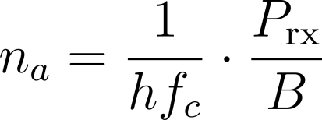
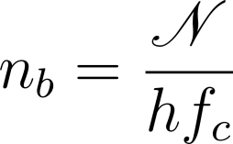
Communication link model
K. Banaszek et al., J. Lightwave Technol. 38, 2741 (2020)
– Planck’s constant
– signal carrier frequency
– slot rate (bandwidth)
– received average
optical signal power
– background noise
power spectral density
Relevant parameters:
received average signal photon number per slot (signal strength):
received average background noise photon number per slot (noise strength):

Slide 3



Communication link performance
Attainable information
rate [bits/s]:
Gordon-Holevo capacity limit per slot (Gaussian noise model):
where

Slide 4
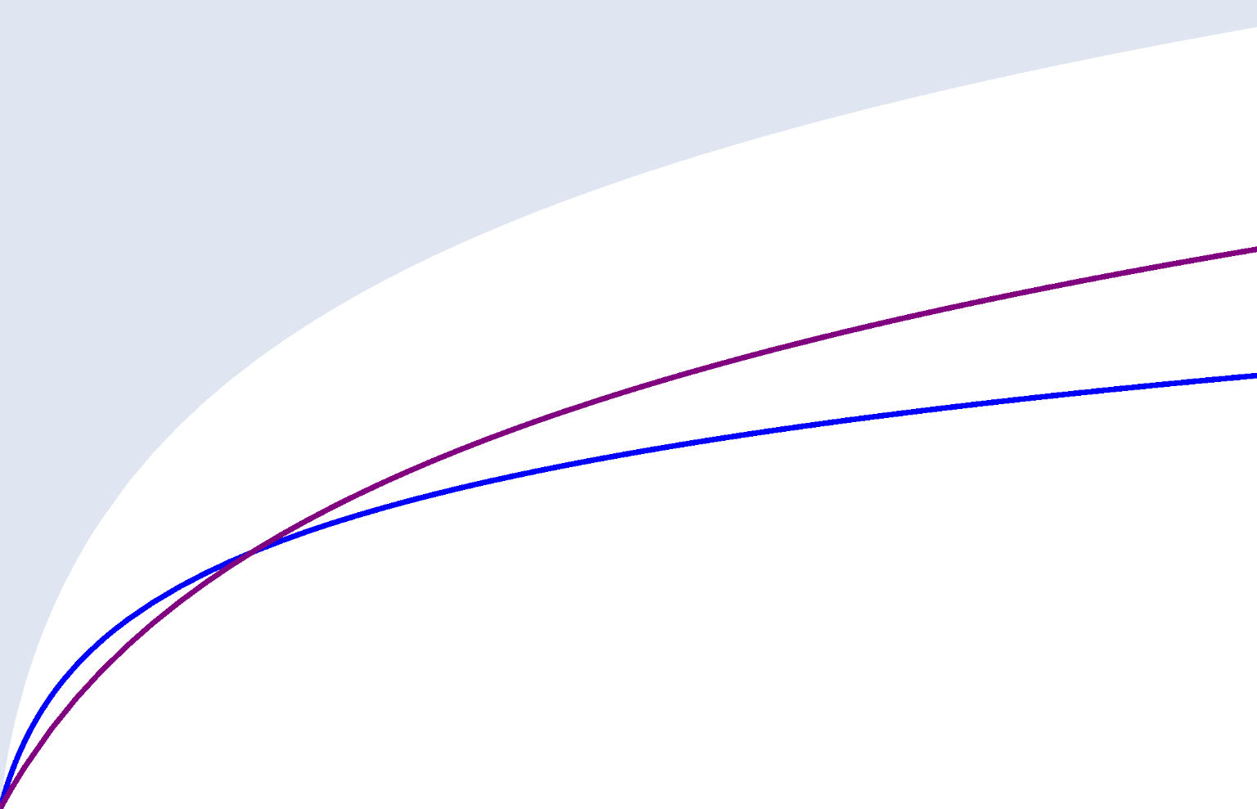




Loss-only channel
5
4
Gordon-Holevo capacity limit
3
Capacity [bits/slot]
shot-noise-limited two-quadrature coherent comm
2
shot-noise-limited one-quadrature coherent comm
1
0
0
2
4
6
8
10
Signal strength

Slide 5
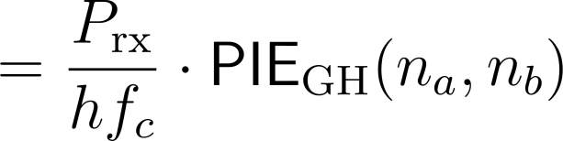
Communication link performance
Attainable information
rate [bits/s]:
Gordon-Holevo capacity limit per slot (Gaussian noise model):
where
Photon information efficiency (PIE):

Slide 6


Photon-starved communication
14
No background noise
12
Gordon-Holevo limit
10
?
8
Photon information efficiency PIE
6
4
2
one-quadrature coherent
two-quadrature coherent
0
-4
10
0.001
0.010
0.100
Signal strength

Slide 7






Pulse position modulation (PPM)
No background noise,
shot-noise limited detection
…
…
pulse photon number
erasure

Slide 8

Photon-starved communication
14
No background noise
PPM order
12
2048
Gordon-Holevo limit
10
1024
512
8
256
Photon information efficiency PIE
128
6
64
32
4
16
2
0
-4
10
0.001
0.010
0.100
Number of photons per PPM slot -

Slide 9
Communication link performance
Attainable information
rate [bits/s]:
Gordon-Holevo capacity limit per slot (Gaussian noise model):
where
Photon information efficiency (PIE):

Slide 10
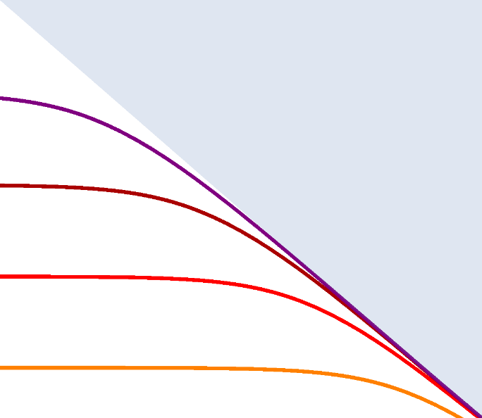







Background noise
20
Gordon-Holevo limit for noise strength
15
Noiseless GH limit
Photon information efficiency PIE
10
5
0
-7
-5
0.001
0.100
10
10
Signal strength

Slide 11
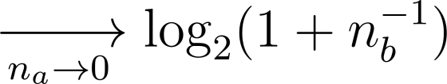
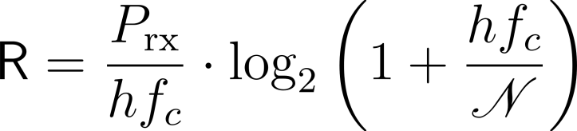
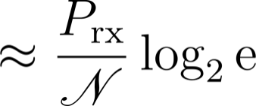

Communication link performance
Attainable information
rate [bits/s]:
Gordon-Holevo capacity limit per slot (Gaussian noise model):
where
Photon information efficiency (PIE):
Ultimate information rate in the power-limited regime:
when

Slide 12
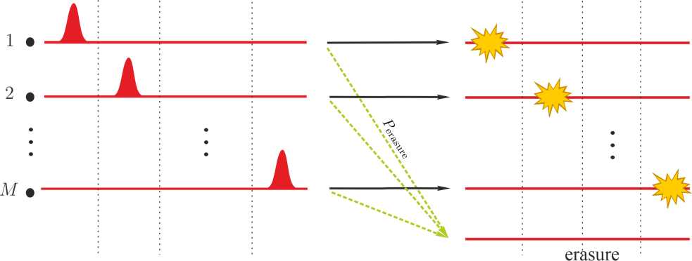
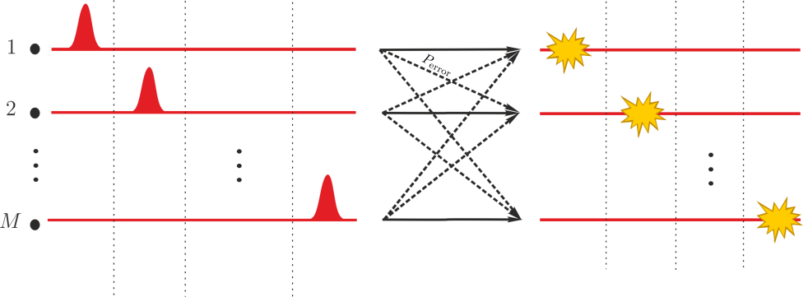

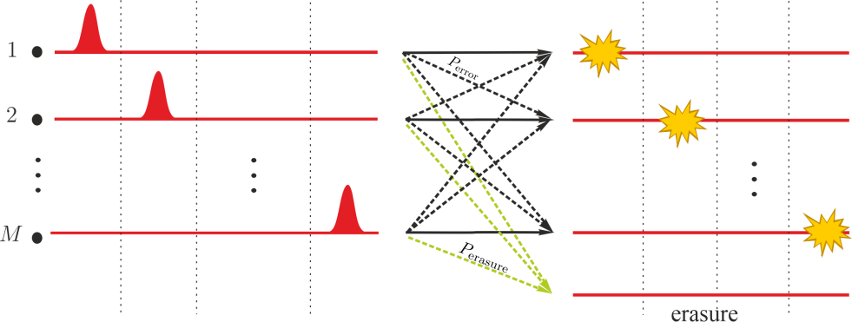


Errors and erasures
Erasure
Errors
Errors and erasures receiver (EER)
For low input symbols cannot be distinguished perfectly (corresponding quantum states are not orthogonal)
Trade-off between and
Needs to be optimized by maximizing mutual information
D. M. Boroson, Toward optimum efficiency in a quantum receiver for coded PPM,
Proc. SPIE 10562, ICSO 2016, 105623M (2017)
Notes:
MARCIN PART

Slide 13
Quantum Receivers
Taxonomy
CPN
DD
CPN+QPG
DD+QPG
MPE
ERROR RECEIVERS
EER
ERASURE RECEIVERS
CPN – Conditional pulse nulling
QPG – Quantum pulse gating
EER – Error and erasure receiver
MPE – Minimum probablity of error
DD – Direct detection

Slide 14
Minimum probabiity of error (MPE)
MPE saturates the Helstrom bound
Only errors
Measurement beyond direct detection
Needs cumbersome optimization
Only formula, no physical realisation.
Known solution for binary coherent states (BPSK constellation) – Dolinar receiver
S. J. Dolinar An optimum receiver for the binary coherent state quantum channel, MIT Res. Lab. Electron. Q. Prog. Rep. 111 (1973), p. 115.

Slide 15
CPN
DD
CPN+QPG
DD+QPG
MPE
ERROR RECEIVERS
EER
ERASURE RECEIVERS
CPN – Conditional pulse nulling
QPG – Quantum pulse gating
EER – Error and erasure receiver
MPE – Minimum probablity of error
DD – Direct detection

Slide 16
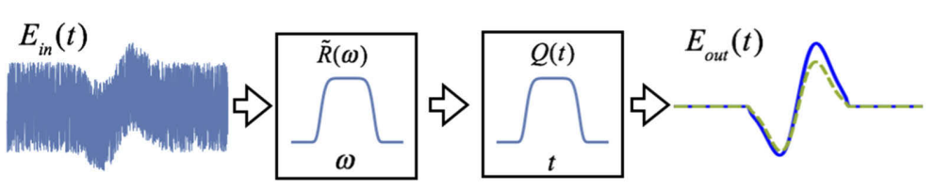
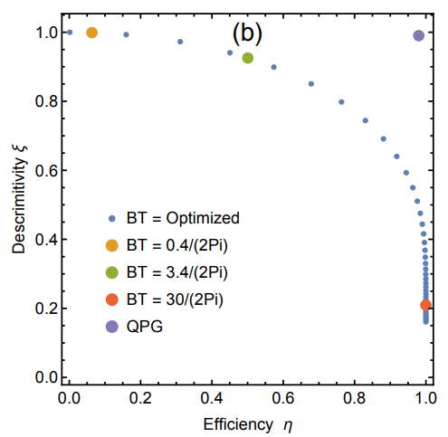
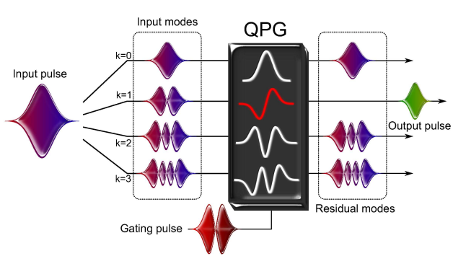
Noise rejection
Sequential incoherent filtering (SIF)
Efficiency: filter signal transmission
Descrimitivity: scales output SNR
BT: Bandwidth [Hz] x Time window [s]
= Effective number of transmitted modes
QUANTUM PULSE GATING (QPG)
M. G. Raymer and K. Banaszek,
Opt. Express 28, 32819 (2020)
A. Eckstein, B. Brecht, C. Silberhorn,
Opt. Express 19, 13770 (2011)
Descrimitivity vs. Efficiency
trade-off (Rectangular SIF)

Slide 17
CPN
DD
CPN+QPG
DD+QPG
MPE
EER
CPN – Conditional pulse nulling
QPG – Quantum pulse gating
EER – Error and erasure receiver
MPE – Minimum probablity of error
DD – Direct detection

Slide 18
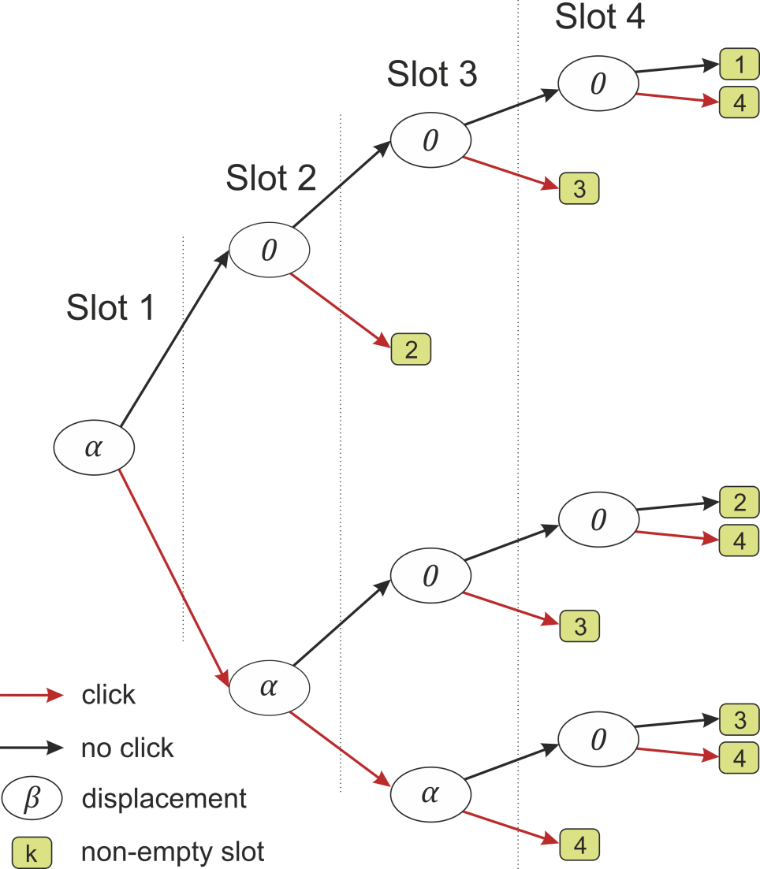
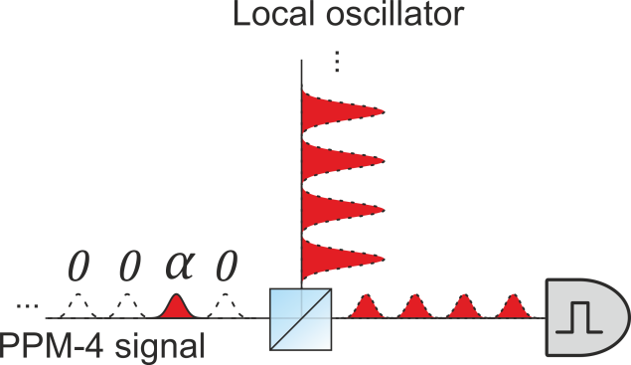
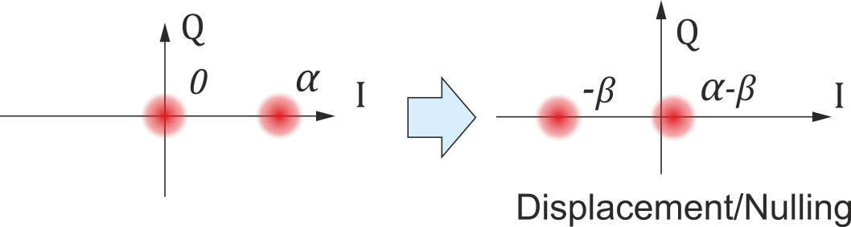
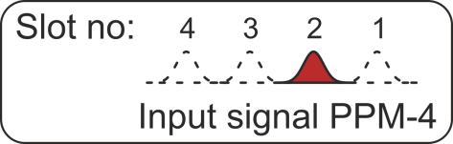
Conditional pulse nulling (CPN)
S. J. Dolinar Jr. A near-optimum receiver structure for the detection of M-ary
optical PPM signals, The Telecommunications and Data Acquisition Progress
Report 42–72, December 1982 (Jet Propulsion Laboratory, 1983).

Slide 19
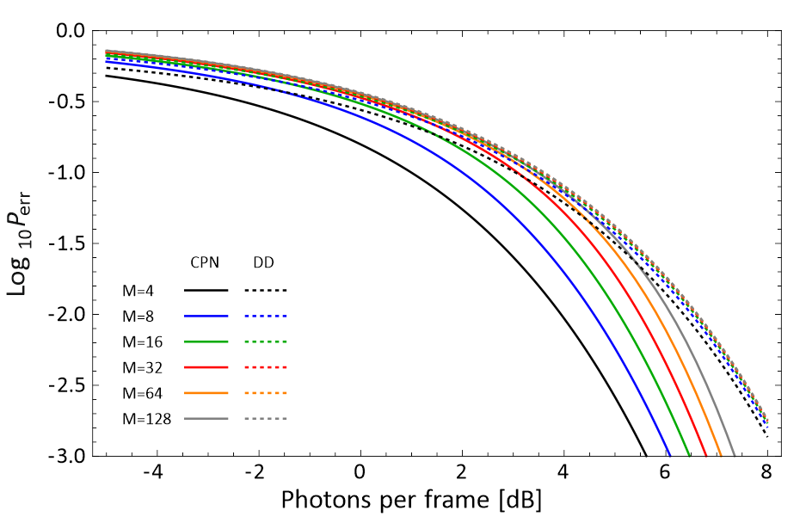
CPN error – noiseless scenario

Slide 20
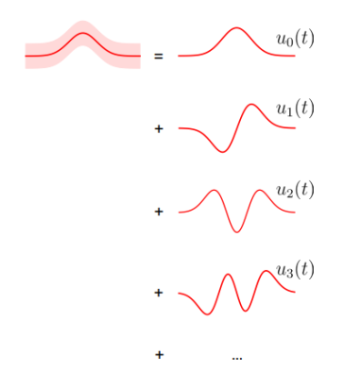
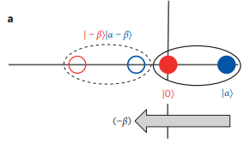


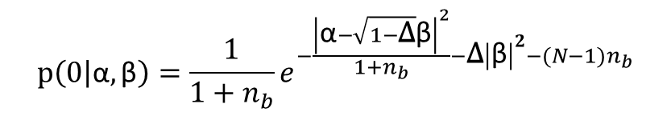
Realistic CPN receiver
$$p\left(0 | \text{α},\text{β}\right)=\frac{1}{1+n_{b}}e^{−\frac{{\left|\text{α}−\sqrt{1−\text{Δ}}\text{β}\right|}^{2}}{1+n_{b}}−\text{Δ}{\left|\text{β}\right|}^{2}−(N−1)n_{b}}$$
$$p\left(1 | \text{α},\text{β}\right)=1−p\left(0 | \text{α},\text{β}\right)$$
|α|² = 0 for empty slot
|α|² = n_{f} for the pulse
Mode mismatch
$$\text{Δ}={1−\left|\int{u_{0}\left(t\right)}u_{\text{β}}\left(t\right)dt\right|}^{2}$$
Number of modes
Δ = 0 perfect mode matching
N
Δ= 1 mode mismatch
Nulling amplitude
Background noise
n_{b} = dark counts/ detection slot/mode
|β|² = n_{f} perfect nulling
|β|² ≠ n_{f} imperfect nulling

Slide 21
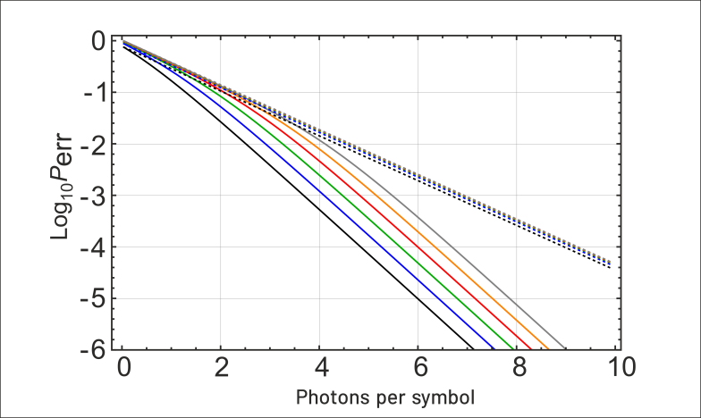
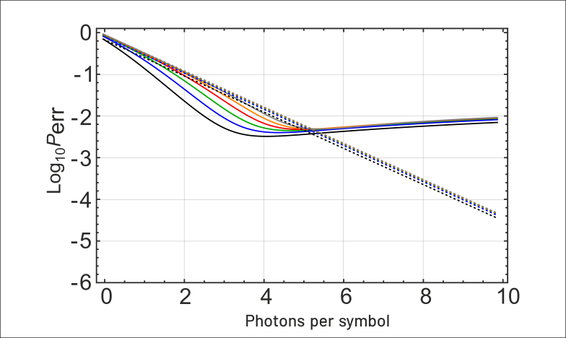
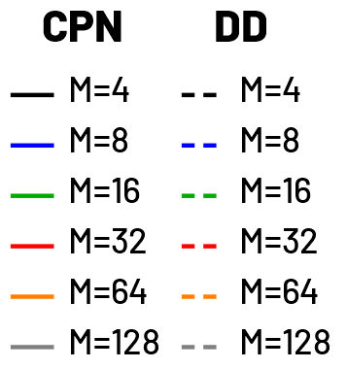
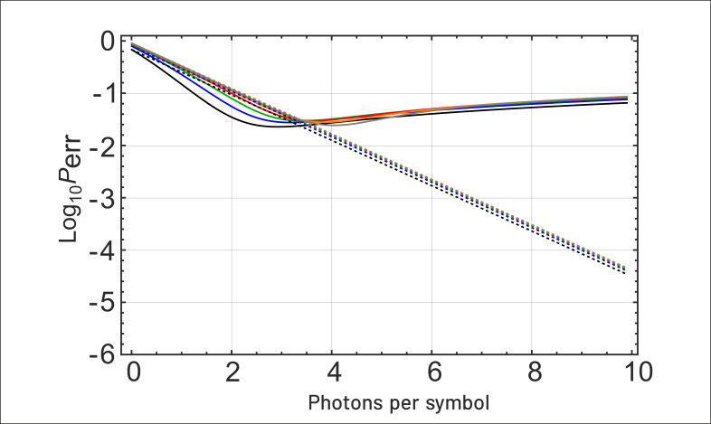



CPN with finite visibility
Mode mismatch $\text{Δ}$ = 0
Mode mismatch $\text{Δ}$= 0.001
Mode mismatch $\text{Δ}$ = 0.01
CPN advantage is lost for higher photon numbers per frame,
due to mode mismatch

Slide 22

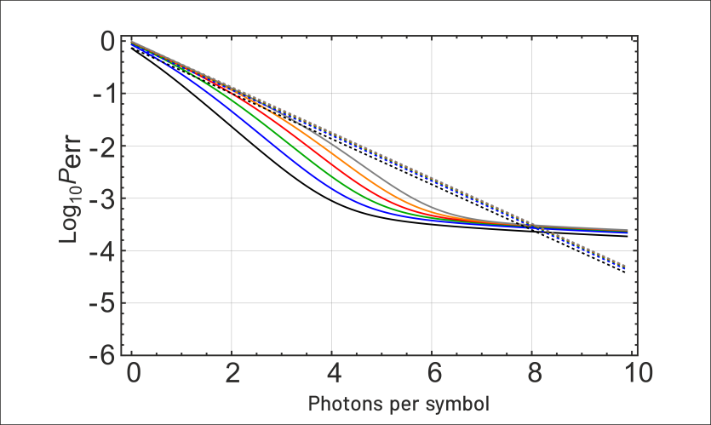
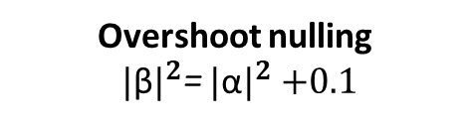
CPN with imperfect nulling
Overshoot nulling
${|\text{β}|}^{2}$= ${|\text{α}|}^{2}$ $+0.1$
Pefect nulling
CPN advantage is also vulnerable to nulling amplitude

Slide 23
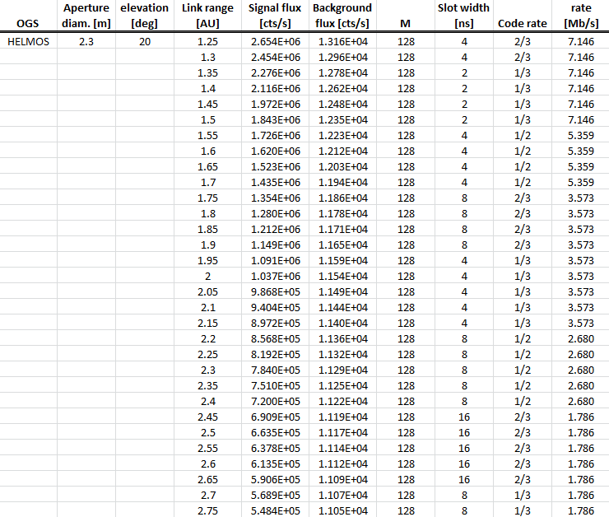
Detection strategies in PSYCHE mission
Conditional pulse nulling
Conditional pulse nulling
+ Quantum pulse gating
Direct detection
Direct detection
  + Quantum pulse gating
Each strategy is evaluated
using probability of error in symbol detection
Optical link simulations provided by ESA
Notes:
JACHUR PART

Slide 24
CPN
DD
CPN+QPG
DD+QPG
MPE
EER
CPN – Conditional pulse nulling
QPG – Quantum pulse gating
EER – Error and erasure receiver
MPE – Minimum probablity of error
DD – Direct detection

Slide 25
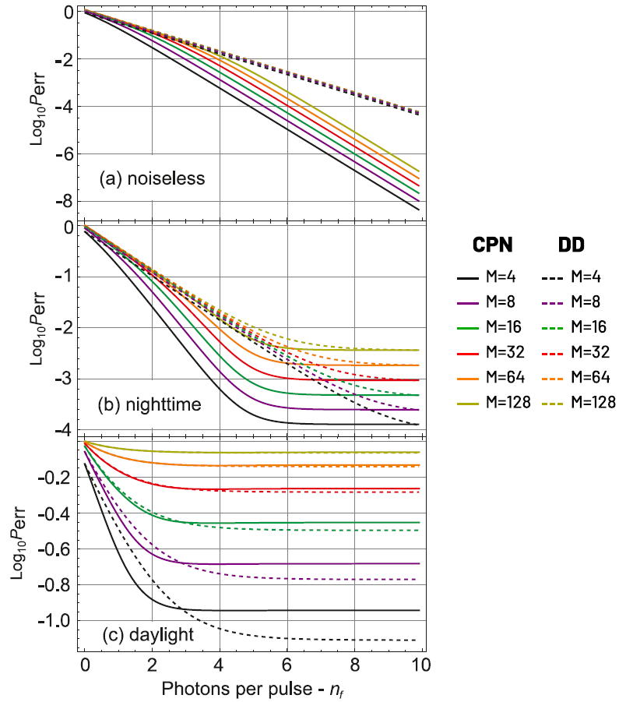
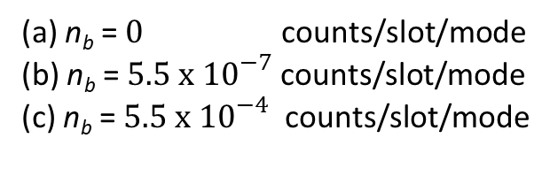
Conditional pulse nulling vs direct detection
Pefect nulling + perfect mode matching
Advantage provided by CPN
is mostly pronounced in a regime of
high n_{f} and low n_{b}
(a) n_{b} = $0$ counts/slot/mode
(b) n_{b} = $5.5 x {10}^{−7}$ counts/slot/mode
(c) n_{b} = $5.5 x{ 10}^{−4}$ counts/slot/mode

Slide 26
CPN
DD
CPN+QPG
DD+QPG
MPE
EER
CPN – Conditional pulse nulling
QPG – Quantum pulse gating
EER – Error and erasure receiver
MPE – Minimum probablity of error
DD – Direct detection

Slide 27
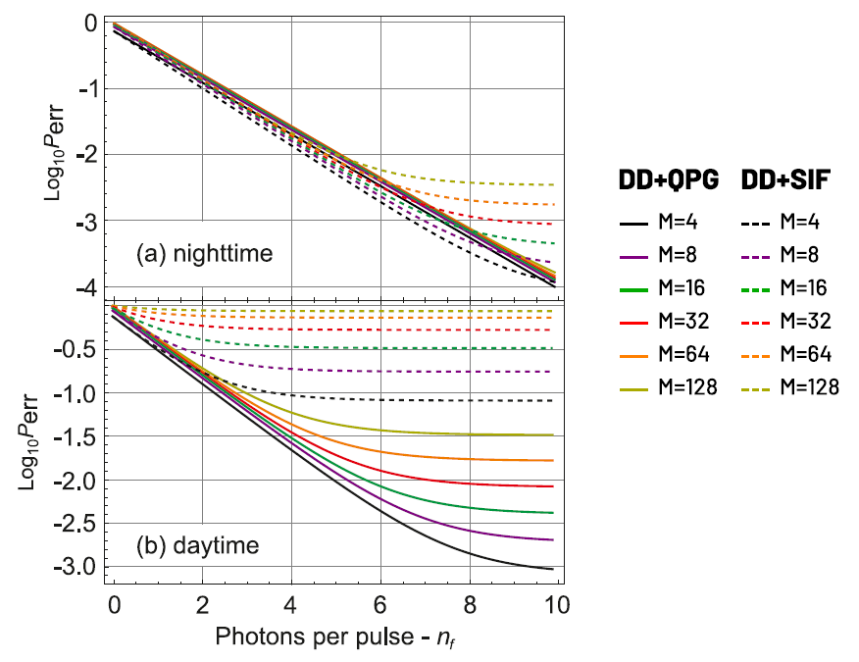
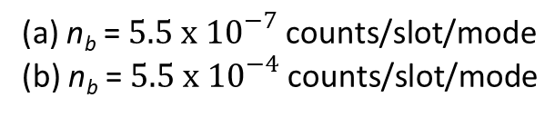
Direct detection + quantum pulse gating/sequential incoherent filtering
QPG efficiency – 90%
Advantage provided by QPG
is mostly pronounced in a regime of
high n_{b}
(a) n_{b} = $5.5 x {10}^{−7}$ $\text{counts}\text{/}\text{slot}\text{/}\text{mode}$
(b) n_{b} = $5.5 x{ 10}^{−4}$ $\text{counts}\text{/}\text{slot}\text{/}\text{mode}$

Slide 28
CPN
DD
CPN+QPG
DD+QPG
MPE
EER
CPN – Conditional pulse nulling
QPG – Quantum pulse gating
EER – Error and erasure receiver
MPE – Minimum probablity of error
DD – Direct detection

Slide 29
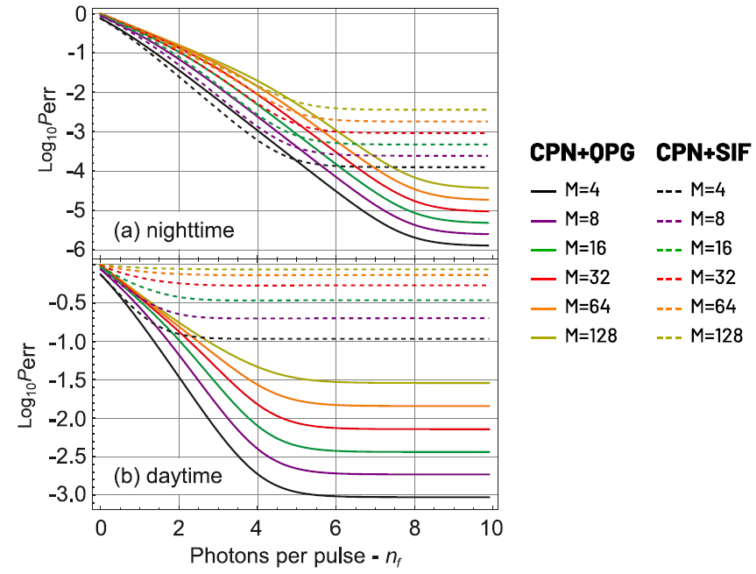
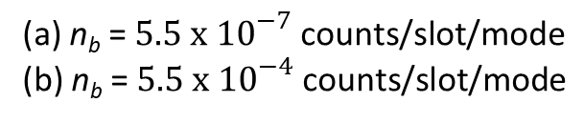
Conditional pulse nulling + quantum pulse gating/sequential incoherent filtering
QPG efficiency – 90%
Advantage provided by QPG
is mostly pronounced in a regime of
high n_{b}
(a) n_{b} = $5.5 x {10}^{−7}$ $\text{counts}\text{/}\text{slot}\text{/}\text{mode}$
(b) n_{b} = $5.5 x{ 10}^{−4}$ $\text{counts}\text{/}\text{slot}\text{/}\text{mode}$

Slide 30
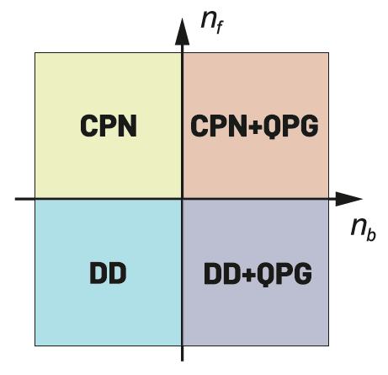
Nolan chart for detection strategy selection
n_{f} ⨠ 1
n_{f} ≈ 1
Nighttime
Daytime

Slide 31
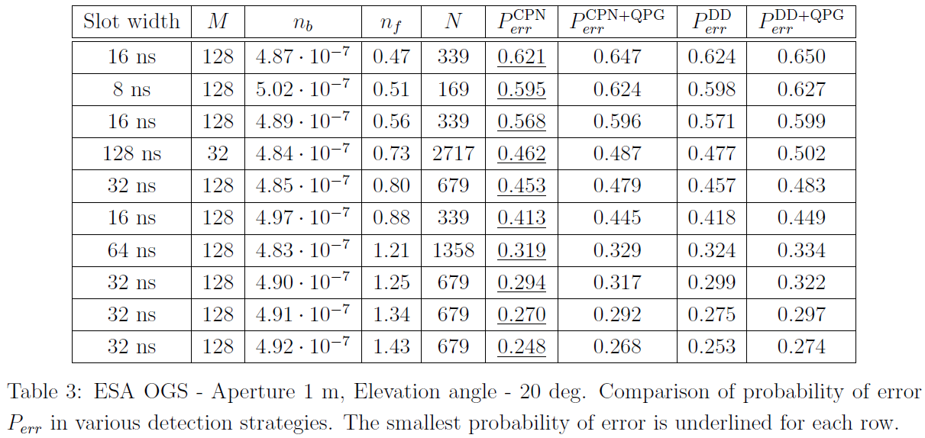
PSYCHE link data (nighttime)
Direct detection is nearly
optimal in nighttime regime

Slide 32
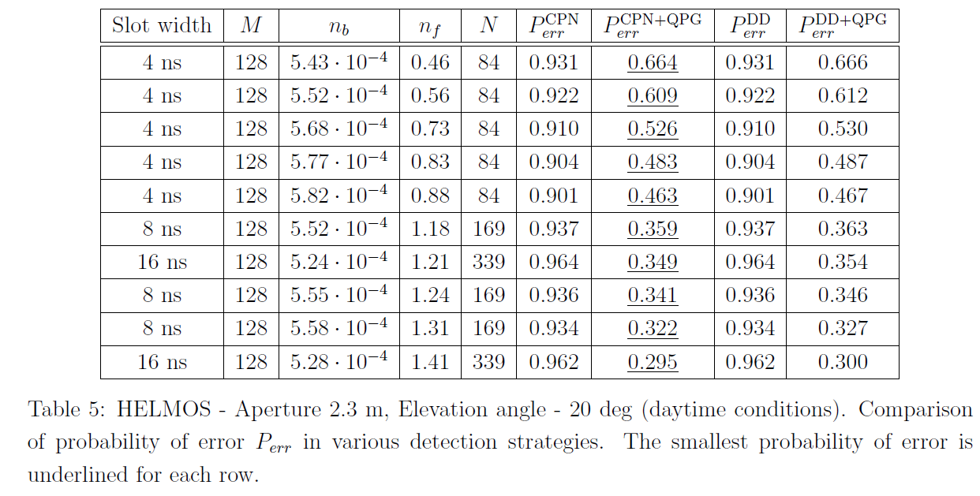
PSYCHE link data (daytime)
Quantum pulse gating gets very beneficial in daytime conditions

Slide 33
List of available scripts I
QRX-DOCS-DD.nb
PerRandDDId[M, nf] - Average probability of error for direct detection receiver assuming noiseless case.
PerRandDDvis[M, nf, nb̸= 0, n] - Average probability of error for direct detection receiver with multimode noise.
QRX-DOCS-CPN.nb
PerRandvis[M, nf, nd, Δ, nb ̸= 0, n] - Average probability of error for the conditional pulse nulling receiver in the noisy case.

Slide 34
List of available scripts II
QRX-DOCS-ACPN.py
mutual information adaptive receiver(nf, nd, Delta, nb, n, M) - mutual information attainable with an adaptive CPN receiver.
QRX-DOCS-EER.nb
IeeraOpt[M,nf]- mutual information per slot for EER in the noiseless case assuming optimal probabilities a, b and e.

Slide 35
Summary
Conventional detection strategies are usually suboptimal, with respect to G-H limit
Quantum receivers can offer enhanced performance…
…but are susceptible to noise and imperfections
Photon starved communication is a challenging regime owing to quantum nature of light
Attainable performance of quantum receivers is related to their complexity
For PSYCHE optical link during nightime conditions conventional receivers are nearly optimal
During daytime conditions, noise supression offered by Quantum Pulse Gating substantially reduces probability of error

Slide 36
Outlook
More complex logical channels, e.g. EER, soft-decoding strategies
Reaching G-H limit in principle requires operation of universal quantum computer
Feasibility of implementations growing with technology developments for e.g. optical quantum computers
Noise supression techniques are even more crucial for quantum communications e.g. key distribution

Slide 37
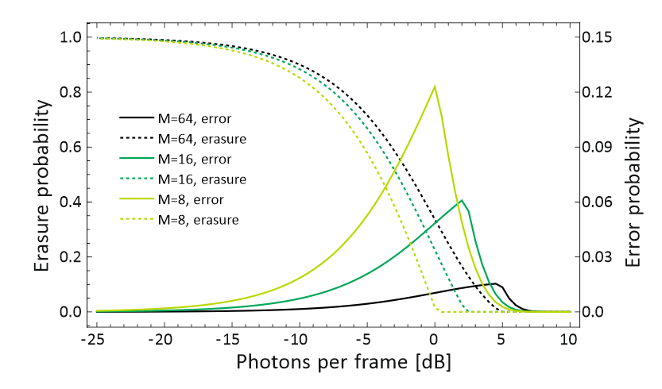
Optimized EER – noiseless scenario

Slide 38
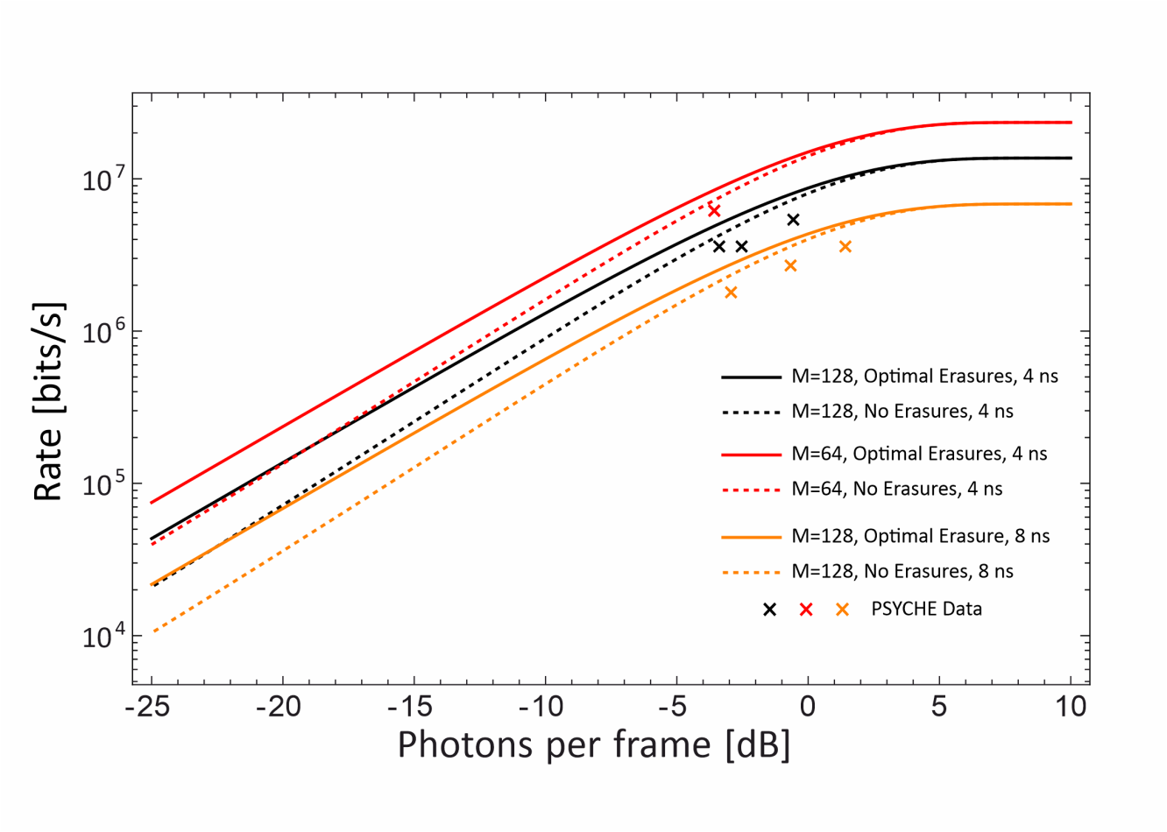
EER vs. PSYCHE

