Slide 1



Responsibility for presentation contents resides in Stellar Advanced Concepts Ltd
ESA OSIP Early Technology Development – Final Presentation (27/06/2023)
Bio-inspired morphing wing for deployment from HAPS and ORBIT (BIOUAS HALO)
Project Reference: 4000134261/21/NL/GLC/ov

Slide 2
ESA OSIP Early Technology Development – Final Presentation (27/06/2023)
Agenda (approximate)
Total meeting time (minutes) | 180
Intro: | 10
Introduction of Attendees (ALL) | 7
Quick summary of OSIP projects (MN) | 3
Background: | 65
Overview of the Project Proposal and Aims (MN) | 5
Stellar company overview and role (MN) | 5
Vorticity company overview subcontractor role (SL) | 5
Background scientific papers (CB) | 20
Q&A on papers | 10
Summary of state of the art - Span Morphing flight demos (MN) | 10
Summary of similar launch systems & previous experience (SL) | 10
Coffee Break and Q&A | 10
R&D phase : | 20
R&D - Folding wing system - Prototyping/ targets and main issues (MN) | 10
R&D - High altitude Launch system, main issues (SL) | 10
Final Designs & Build : | 45
Wing System (MN) | 15
Launch System (SL) | 15
Wing Testing Phase and Technical aspects (CB) | 15
Q&A and showing of physical prototypes (All) | 20
Exploitation routes (MN/All) | 10
Coffee and free discussion / end of meeting

Slide 3
ESA OSIP Early Technology Development – Final Presentation (27/06/2023)
Introductions
Dr. Arrun Saunders
Joseph Lynch
Mike Newsam
Prof. Christoph Bruecker
Dr. Anna Litsiou
Alden Midmer

Slide 4

ESA OSIP Early Technology Development – Final Presentation (27/06/2023)
OSIP Early Technology Development
OSIP - Early Technology Development activities
The emphasis is on novel, potentially game changing low Technology Readiness Level activities for space applications.
These activities are typically involving an early proof of concept with hardware up to prototype level with potential customer interests.

Slide 5
ESA OSIP Early Technology Development – Final Presentation (27/06/2023)
Background
Overview of the project proposal and aims
Full span morphing has not been the focus of most bio-inspired R&D to date
Full span morphing offers significant benefits to planetary probes terrestrial UAVs
Focus was development of a UAV with a high-altitude launch system
Morphology of peregrine to be used for advancing Structures & Mechanisms

Slide 6
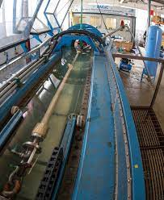

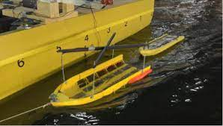





ESA OSIP Early Technology Development – Final Presentation (27/06/2023)
Background
Stellar AC company overview & Project role

Slide 7
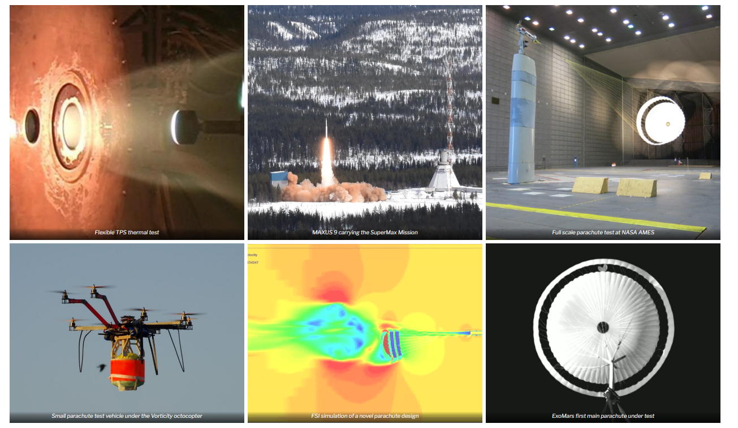
ESA OSIP Early Technology Development – Final Presentation (27/06/2023)
Background
Vorticity company overview & Project subcontractor role

Slide 8
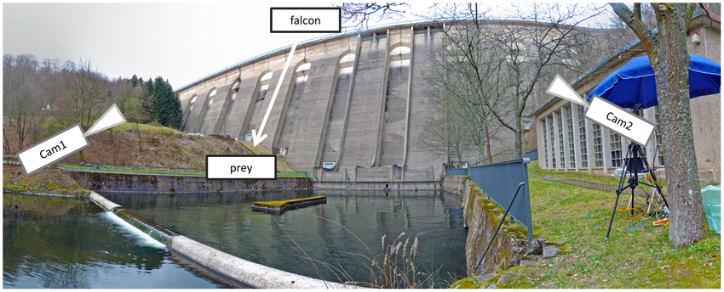
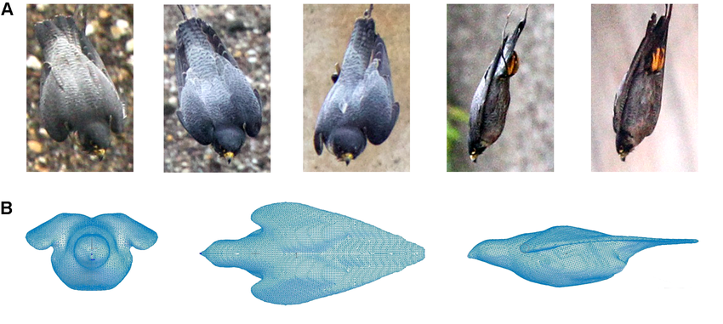
ESA OSIP Early Technology Development – Final Presentation (27/06/2023)
Background (Research papers)
Background scientific papers
Diving-Flight Aerodynamics of a Peregrine Falcon (Falco peregrinus) - 2014

Slide 9
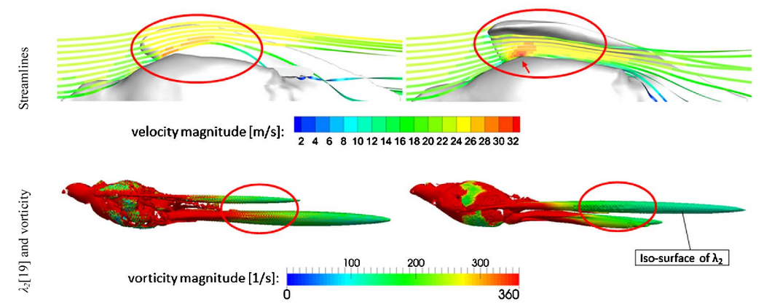
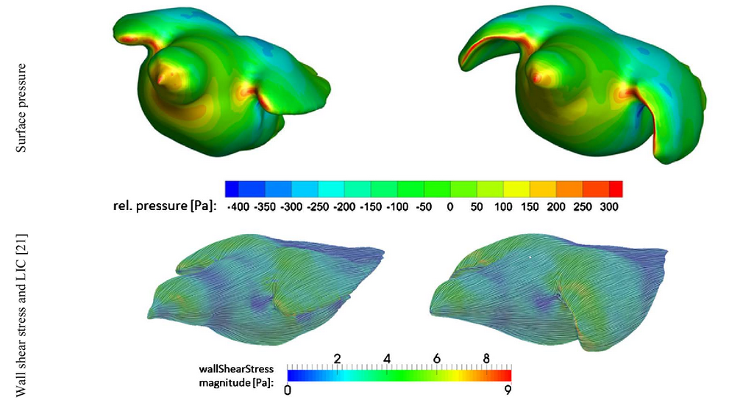
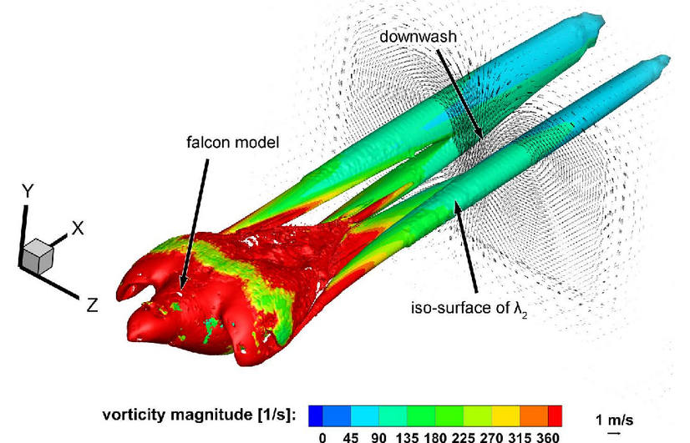
ESA OSIP Early Technology Development – Final Presentation (27/06/2023)
Background (Research papers)
Background scientific papers
Aerodynamics of the Cupped Wings during Peregrine Falcon’s Diving Flight - 2014

Slide 10
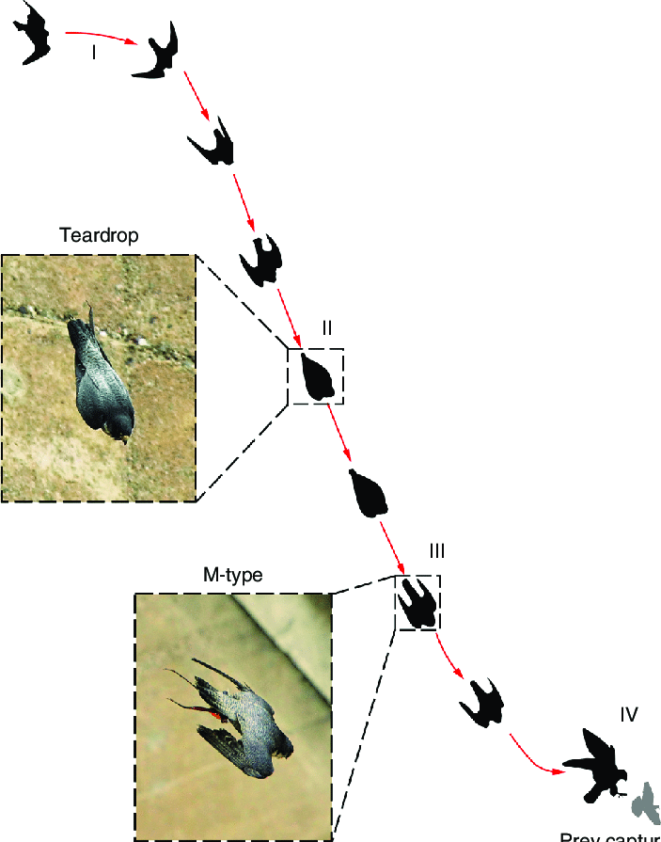
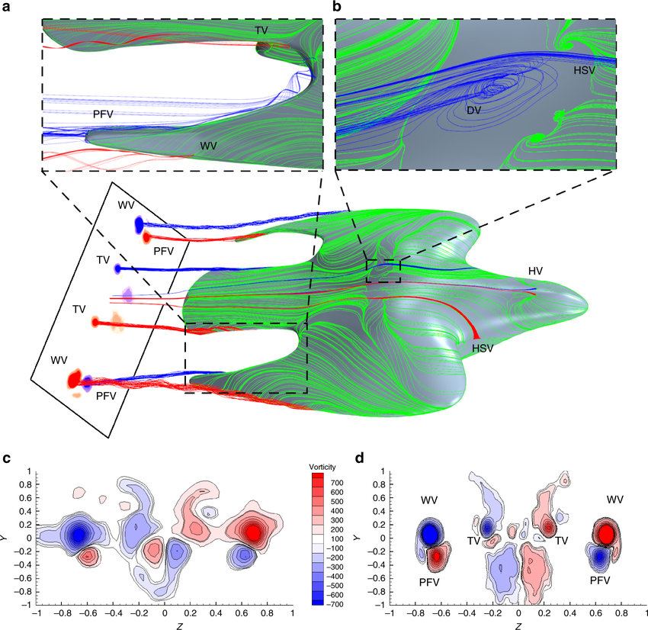
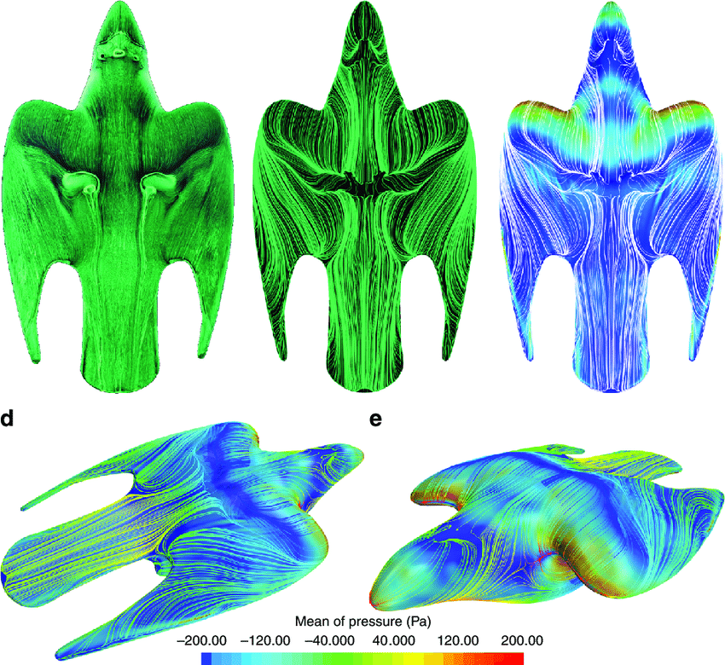
ESA OSIP Early Technology Development – Final Presentation (27/06/2023)
Background (Research papers)
Background scientific papers
Vortices enable the complex aerobatics of peregrine falcons - 2018

Slide 11
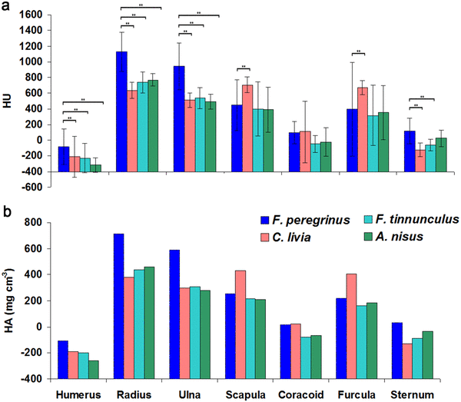
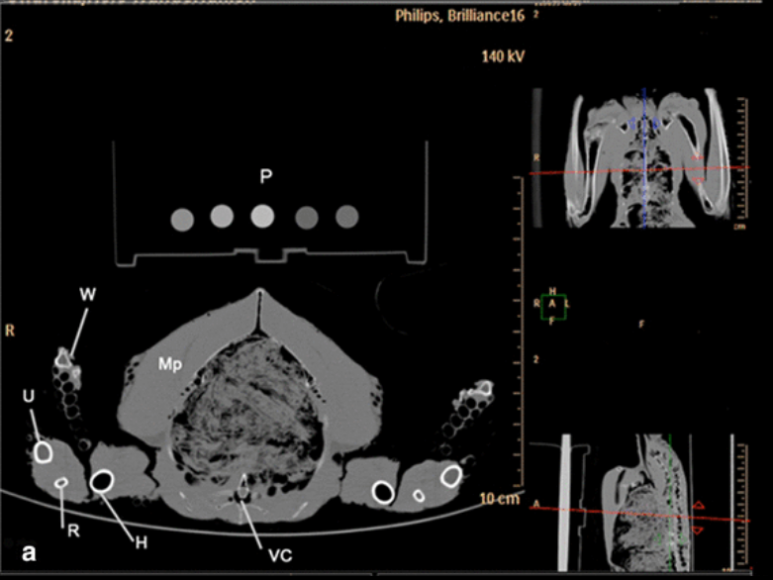
ESA OSIP Early Technology Development – Final Presentation (27/06/2023)
Background (Research papers)
Background scientific papers
The peregrine falcon’s rapid dive: on the adaptedness of the arm skeleton and shoulder girdle - 2018

Slide 12
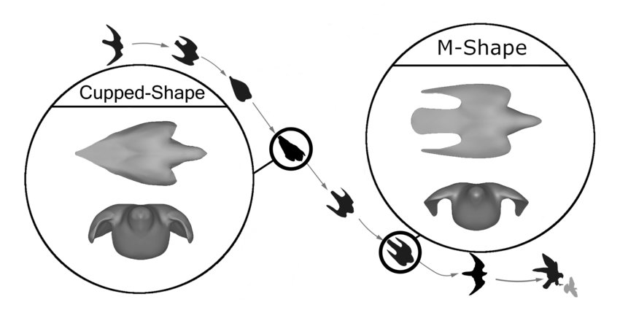
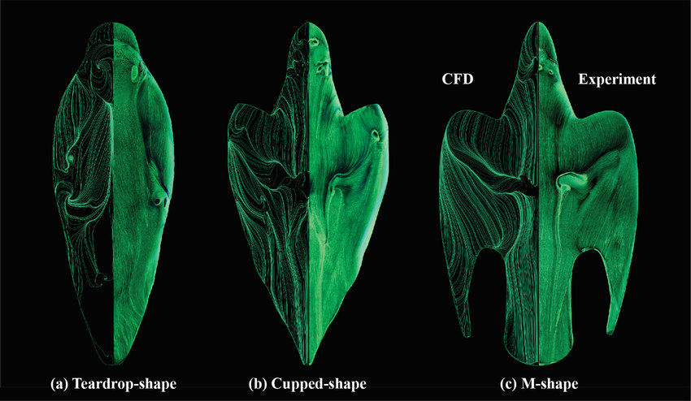
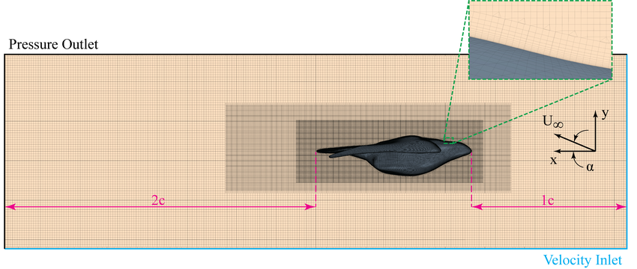
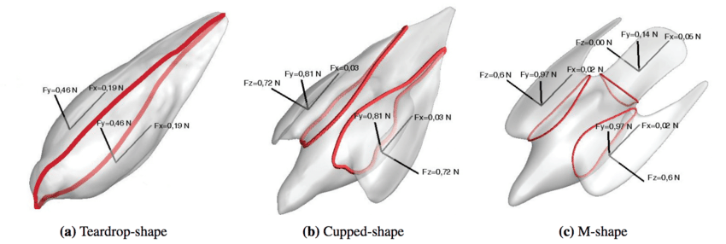
ESA OSIP Early Technology Development – Final Presentation (27/06/2023)
Background (Research papers)
Background scientific papers
The Peregrine Falcon's Dive: On the Pull-Out Maneuver and Flight Control Through Wing-Morphing - 2020

Slide 13
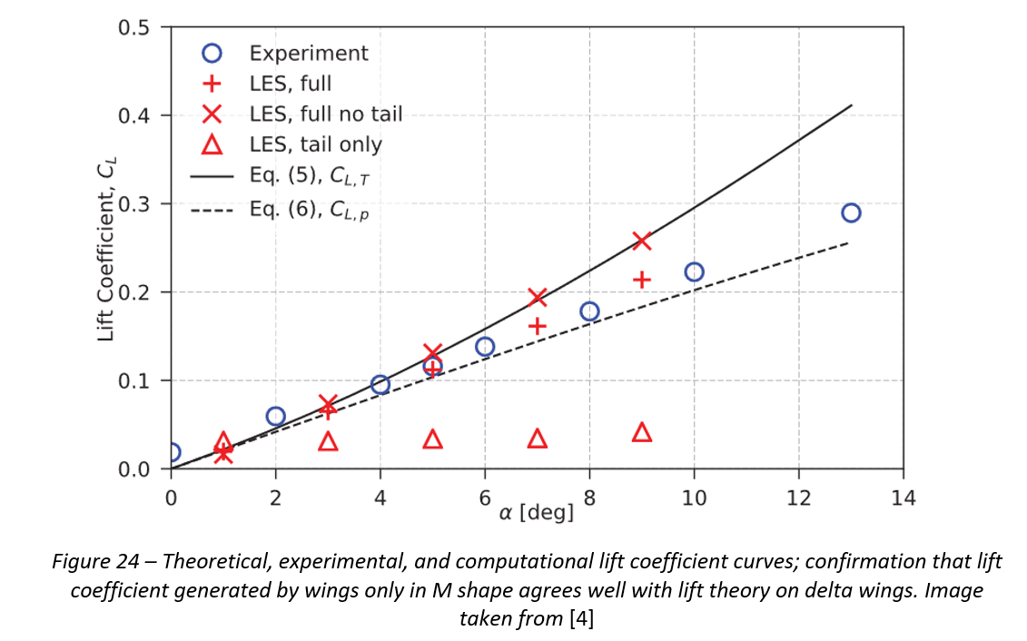
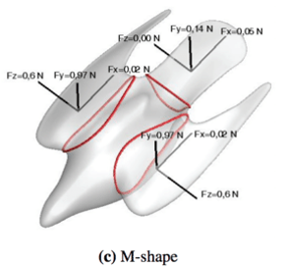
ESA OSIP Early Technology Development – Final Presentation (27/06/2023)
Background (Research papers)
Background scientific papers
The Peregrine Falcon's Dive: On the Pull-Out Maneuver and Flight Control Through Wing-Morphing - 2020

Slide 14
ESA OSIP Early Technology Development – Final Presentation (27/06/2023)
Background (Research papers)
10 min Q&A on scientific papers

Slide 15
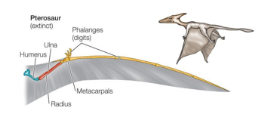
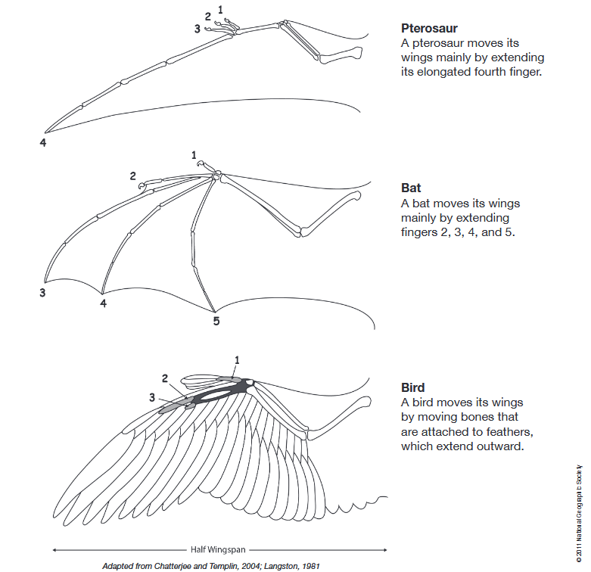
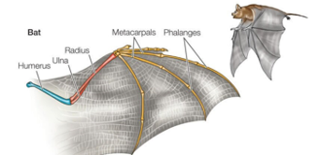
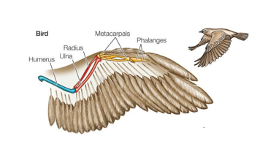
ESA OSIP Early Technology Development – Final Presentation (27/06/2023)
Background (Structures & Mechanisms)
Tetrapod limb flight - Convergence

Slide 16
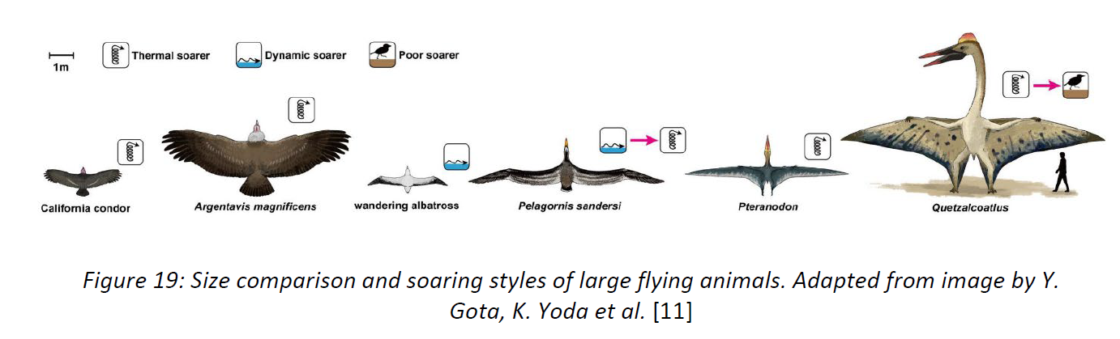
ESA OSIP Early Technology Development – Final Presentation (27/06/2023)
Background (Structures & Mechanisms)
Tetrapod limb flight – Size range

Slide 17
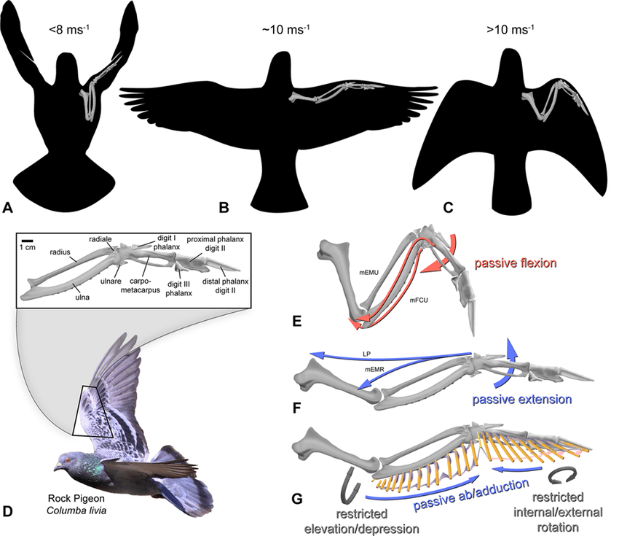
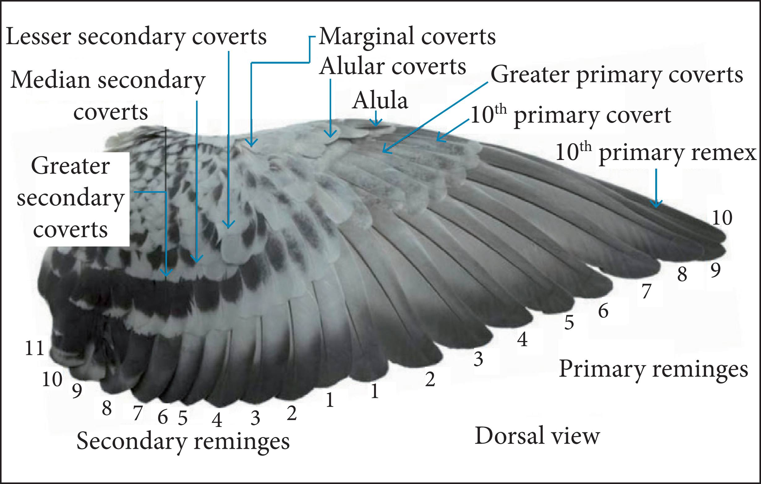
ESA OSIP Early Technology Development – Final Presentation (27/06/2023)
Background (Structures & Mechanisms)
Summary on bird flight limb
Image after Vazquez (1994). Abbreviations as in text and Appendix A. G: Hypotheses of ligamentous limits on flight feather motion, as summarized by Pelissier (1923) and Raikow (1985).
Topography of a Pigeon wing (dorsal view on a separated Pigeon wing; Bachmann, 2010). The numbers represent location of feathers in the wing.

Slide 18
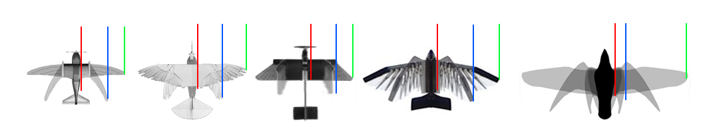
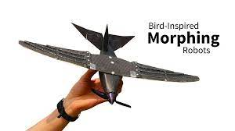
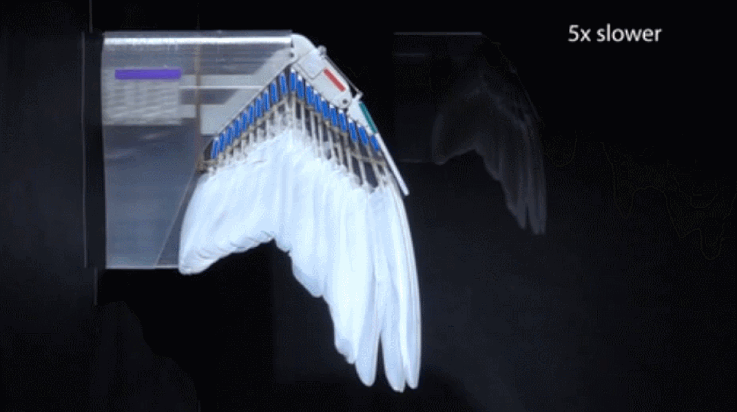
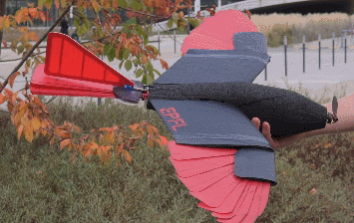
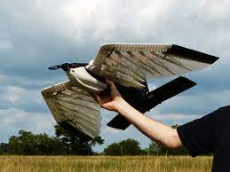






ESA OSIP Early Technology Development – Final Presentation (27/06/2023)
Background (Structures & Mechanisms)
Summary of state of the art - Span Morphing flight demos
~100% span extension
>500% span extension
+ out-of-plane folding
Dutch National Police Services Agency (KLPD)
Laboratory of Intelligent Systems / NCCR Robotics
MAST STC

Slide 19
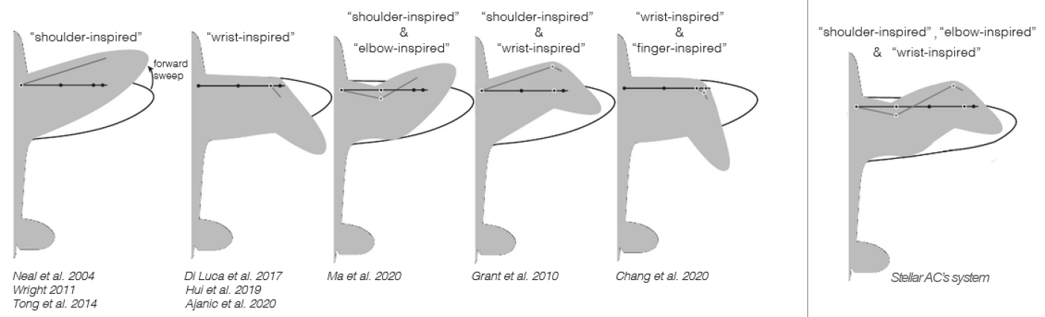



ESA OSIP Early Technology Development – Final Presentation (27/06/2023)
Background (Structures & Mechanisms)
Summary of state of the art - Span Morphing flight demos
Limited articulation
Full articulation
+ out-of-plane folding
A review of avian-inspired morphing for UAV flight control, 2022
+ future proof

Slide 20
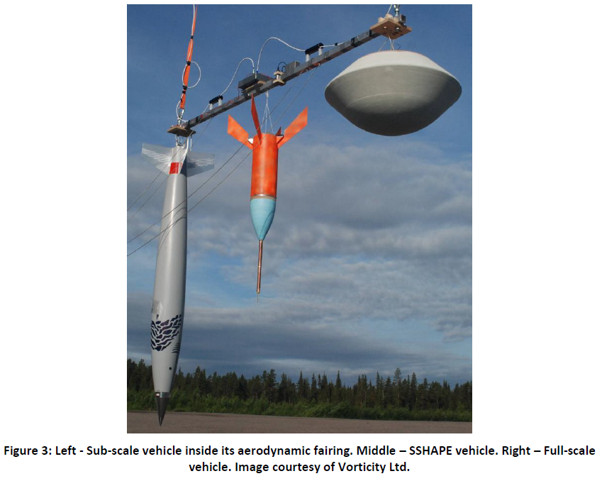
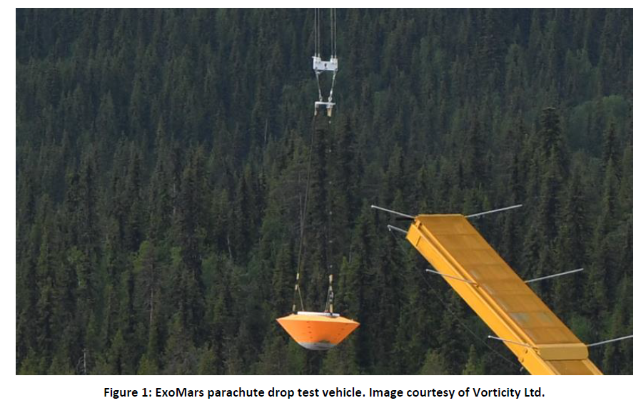
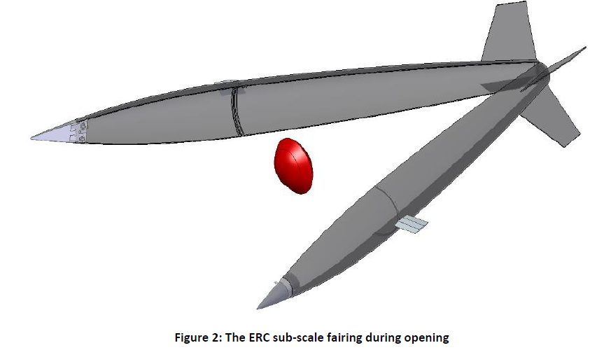
ESA OSIP Early Technology Development – Final Presentation (27/06/2023)
Background
Summary previous experience

Slide 21
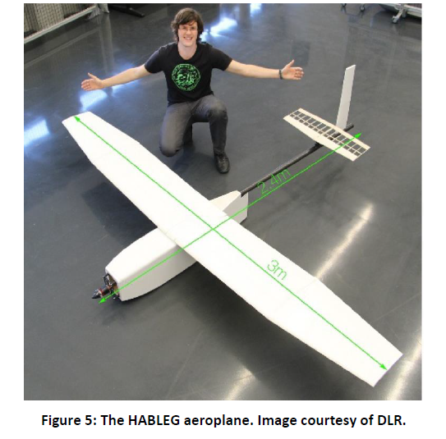
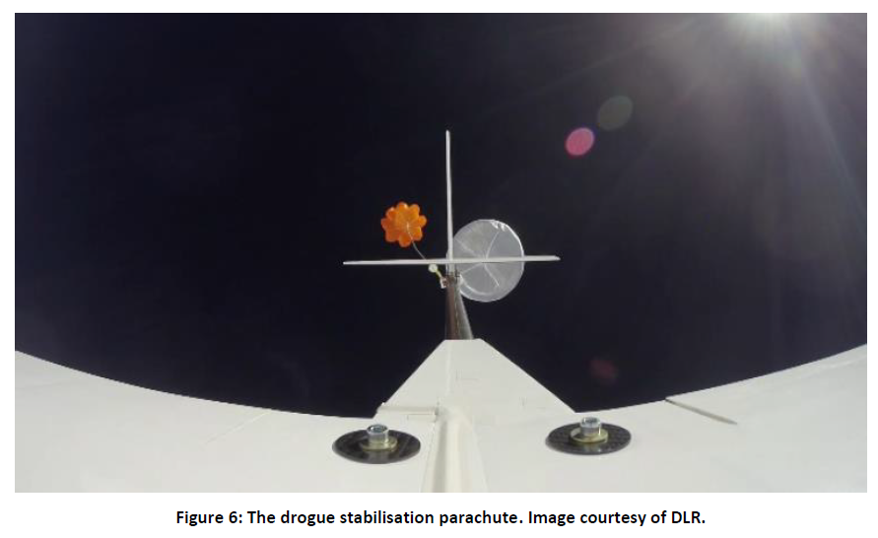
ESA OSIP Early Technology Development – Final Presentation (27/06/2023)
Background
Summary of similar launch systems
DLR high altitude balloon-launch experimental glider (HABLEG) test

Slide 22
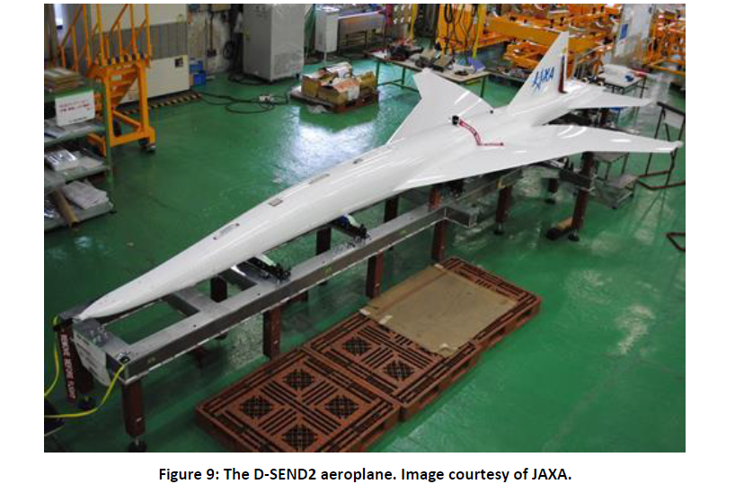
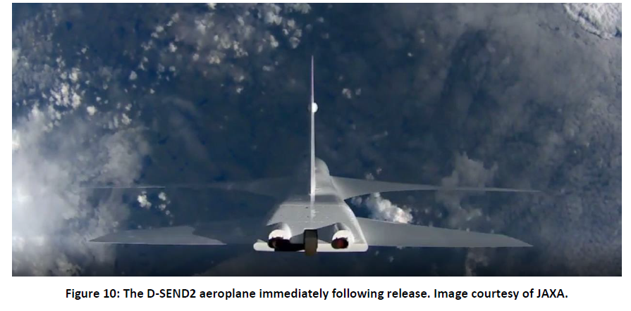
ESA OSIP Early Technology Development – Final Presentation (27/06/2023)
Background
Summary of similar launch systems
JAXA D-Send2

Slide 23
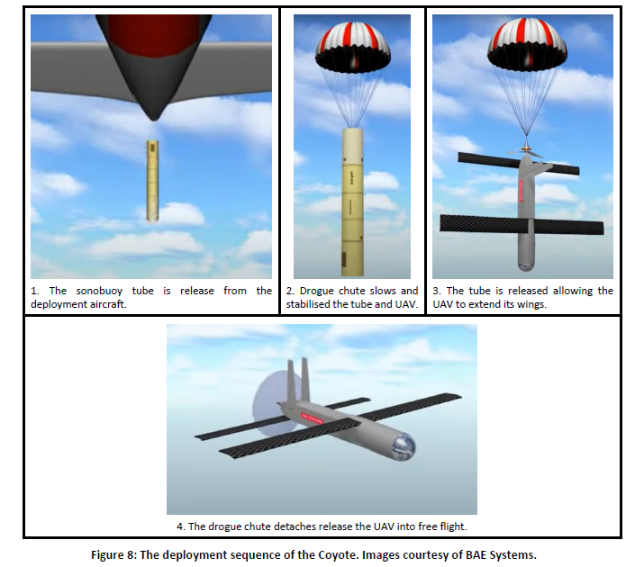
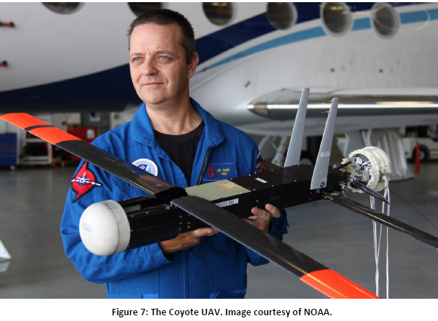
ESA OSIP Early Technology Development – Final Presentation (27/06/2023)
Background
Summary of similar launch systems
Tube launched Coyote UAV

Slide 24

ESA OSIP Early Technology Development – Final Presentation (27/06/2023)
Coffee Break and Q&A (10min)
Next: R&D phase, final prototype manufacture and flow testing

Slide 25
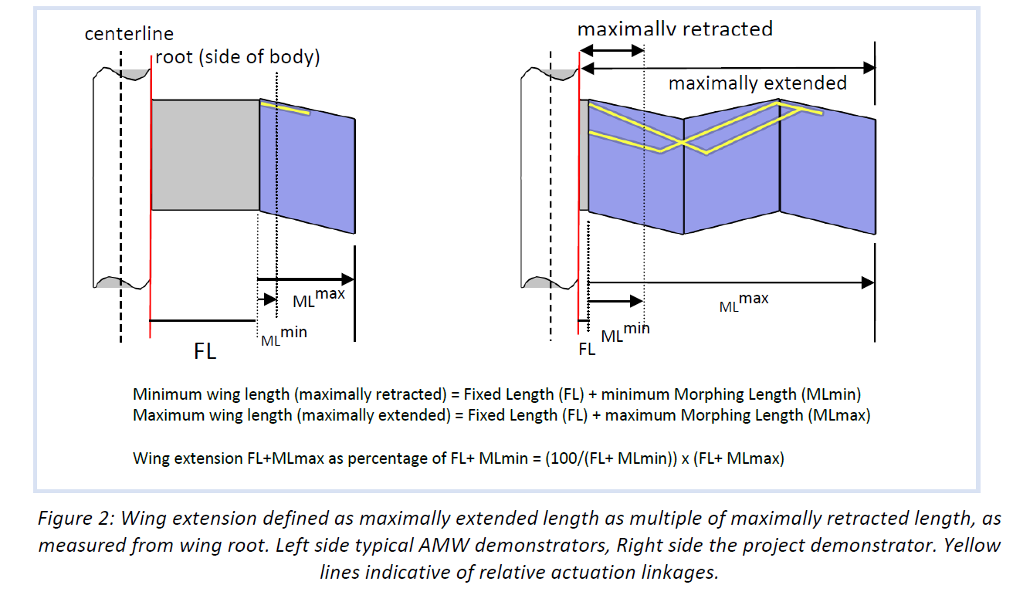
ESA OSIP Early Technology Development – Final Presentation (27/06/2023)
R&D Phase (Wing system)
Folding wing system – Main design target
Stanford’s PigeonBot wing.
Image: E. Chang. et al

Slide 26
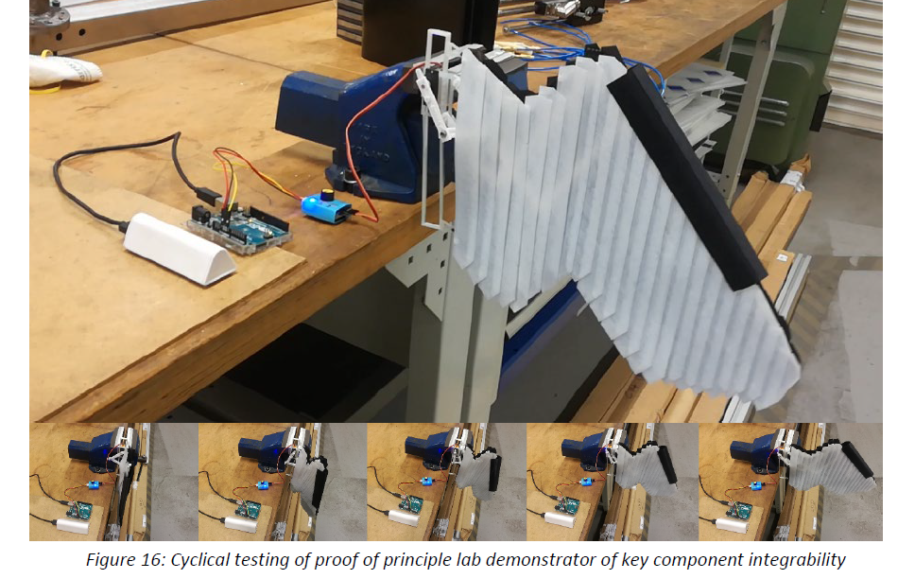
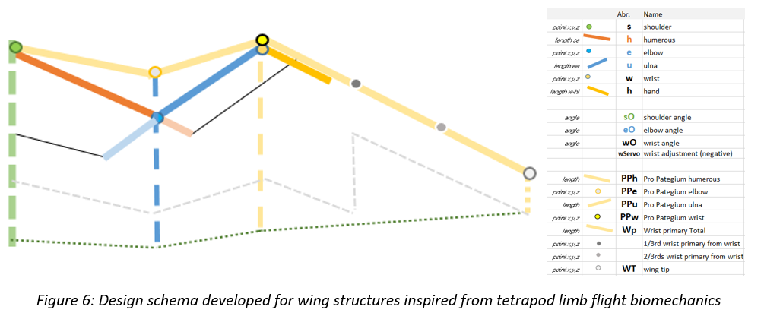
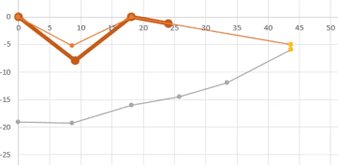
ESA OSIP Early Technology Development – Final Presentation (27/06/2023)
R&D Phase (Wing system)
Folding wing system – Prototyping

Slide 27
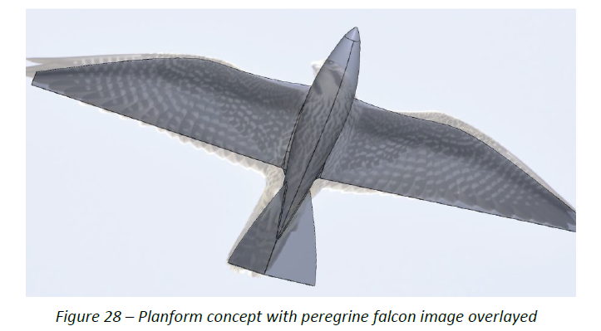
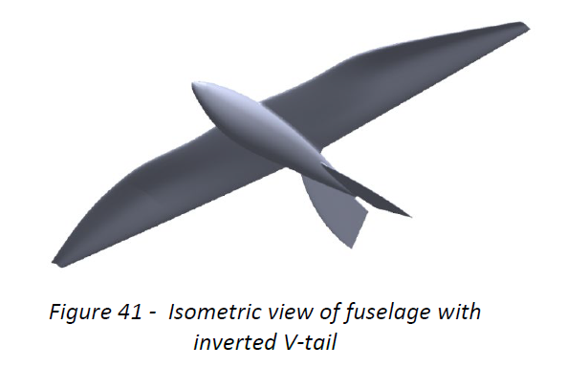
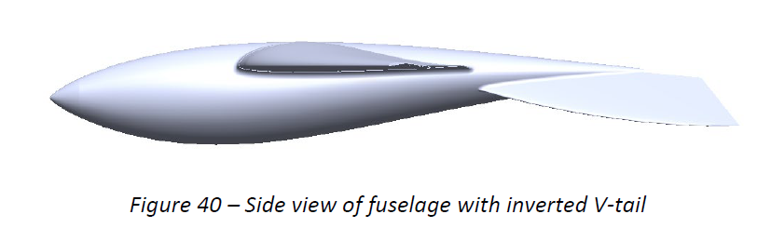
ESA OSIP Early Technology Development – Final Presentation (27/06/2023)
R&D Phase (Wing system)
Folding wing system – Planform & Aerofoil

Slide 28
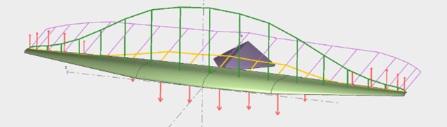
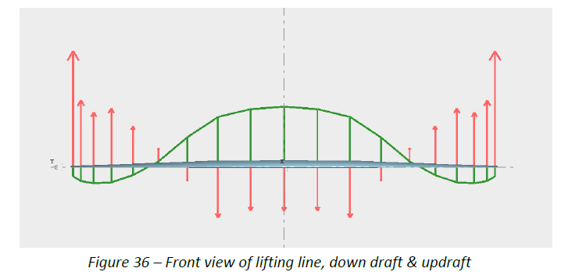

ESA OSIP Early Technology Development – Final Presentation (27/06/2023)
R&D Phase (Wing system)
Folding wing system – Planform & Aerofoil

Slide 29




ESA OSIP Early Technology Development – Final Presentation (27/06/2023)
R&D Phase (Wing system)
Folding wing system – Linkage prototyping
R&D phase CAD implementation

Slide 30


ESA OSIP Early Technology Development – Final Presentation (27/06/2023)
R&D Phase (Wing system)
Folding wing system – Mechanism

Slide 31


ESA OSIP Early Technology Development – Final Presentation (27/06/2023)
R&D Phase (Wing system)
Folding wing system – UAV configuration

Slide 32


ESA OSIP Early Technology Development – Final Presentation (27/06/2023)
R&D Phase (Launch system)
High altitude launch system – Concept of operation
20 m diameter balloon
Flight train
Released test vehicles

Slide 33

ESA OSIP Early Technology Development – Final Presentation (27/06/2023)
R&D Phase (Launch system)
High altitude launch system - Architecture

Slide 34

ESA OSIP Early Technology Development – Final Presentation (27/06/2023)
R&D Phase (Launch system)
High altitude Launch system - Architecture

Slide 35


ESA OSIP Early Technology Development – Final Presentation (27/06/2023)
R&D Phase (Launch system)
High altitude launch system - Architecture

Slide 36



ESA OSIP Early Technology Development – Final Presentation (27/06/2023)
R&D Phase (Launch system)
High altitude launch system - Prototype Design

Slide 37

ESA OSIP Early Technology Development – Final Presentation (27/06/2023)
Final Designs & Build
Wing System – Main loadbearing linkage

Slide 38




ESA OSIP Early Technology Development – Final Presentation (27/06/2023)
Final Designs & Build
Wing System – M Shape & out-of-plane folding

Slide 39


ESA OSIP Early Technology Development – Final Presentation (27/06/2023)
Final Designs & Build
Wing System – Cover and actuation
s9 s1
p1 p2 p3 p4 p5

Slide 40

ESA OSIP Early Technology Development – Final Presentation (27/06/2023)
Final Designs & Build
Wing System – Cover and actuation

Slide 41


ESA OSIP Early Technology Development – Final Presentation (27/06/2023)
Final Designs & Build
Wing System – Cover and actuation

Slide 42


ESA OSIP Early Technology Development – Final Presentation (27/06/2023)
Final Designs & Build
Wing System – Compression for tube and M Shape

Slide 43



ESA OSIP Early Technology Development – Final Presentation (27/06/2023)
Final Designs & Build
Launch System - Overview

Slide 44


ESA OSIP Early Technology Development – Final Presentation (27/06/2023)
Final Designs & Build
Launch System – Aft casing
Copyright © Stellar Advanced Concepts Ltd 2022. All rights reserved. This document may only be reproduced in whole or in part, or stored in a retrieval system, or transmitted in any form, or by any means electronic, mechanical, photocopying or otherwise, either with the prior permission of Stellar Advanced Concepts Ltd or in accordance with the terms of ESA Contract 4000134261/21/NL/GLC/ov.

Slide 45

ESA OSIP Early Technology Development – Final Presentation (27/06/2023)
Final Designs & Build
Launch System – Carrier module

Slide 46

ESA OSIP Early Technology Development – Final Presentation (27/06/2023)
Final Designs & Build
Launch System – Release mechanism

Slide 47



ESA OSIP Early Technology Development – Final Presentation (27/06/2023)
Final Designs & Build
Launch System – Guide rails

Slide 48



ESA OSIP Early Technology Development – Final Presentation (27/06/2023)
Final Designs & Build
Fuselage eyelet interface & test

Slide 49



ESA OSIP Early Technology Development – Final Presentation (27/06/2023)
Flow tank testing
Semi span test article design and manufacture

Slide 50


ESA OSIP Early Technology Development – Final Presentation (27/06/2023)
Flow tank testing
Semi span test article design and manufacture

Slide 51

ESA OSIP Early Technology Development – Final Presentation (27/06/2023)
Flow tank testing
Semi span test article design and manufacture

Slide 52


ESA OSIP Early Technology Development – Final Presentation (27/06/2023)
Flow tank testing
Semi span flow tank testing

Slide 53

ESA OSIP Early Technology Development – Final Presentation (27/06/2023)
Flow tank testing
Semi span flow tank testing

Slide 54

ESA OSIP Early Technology Development – Final Presentation (27/06/2023)
Flow tank testing
Semi span flow tank testing

Slide 55


ESA OSIP Early Technology Development – Final Presentation (27/06/2023)
Flow tank testing
Semi span flow tank testing

Slide 56


ESA OSIP Early Technology Development – Final Presentation (27/06/2023)
Flow tank testing
Semi span flow tank testing

Slide 57

ESA OSIP Early Technology Development – Final Presentation (27/06/2023)
Q&A and showing of physical prototypes
Presented today:
Final wing system linkage, cover & fuselage
Final prototpye launch system

Slide 58


ESA OSIP Early Technology Development – Final Presentation (27/06/2023)
Exploitation routes (SAR)
UKSAR2G - British Coast Guard trial CAMCOPTER VTOL UAV for Unmanned SAR missions
Example UAV air drop test programme: Coyote tube-launched Multi-Mission UAV
Bristow's Sikorsky S-92 SAR helicopter flying alongside a Camcopter VTOL UAV. Bristow picture.
The 13-pound, propeller-driven air vehicle, which has foldout tandem wings and tail fins, deploys from a standard A-size sonobuoy tube with a parachute, or from a pneumatic ground box launcher. Image - Joe Cione of NOAA with Coyote UAV.

Slide 59





ESA OSIP Early Technology Development – Final Presentation (27/06/2023)
Exploitation routes (Venus/Titan)
Venus probe applications and mission ‘piggyback’ opportunities
LEVL Probe Programme for Venus
Work has now started on the dimensions for a working prototype of the LEVL probe in conjunction with the MIT led Morning Star Missions to Venus under Prof. Sara Seager. Credit SpaceAM Limited
Black Swift Technologies has won a NASA contract to develop a drone to study Venus' upper atmosphere. Credit: Black Swift Technologies

Slide 60




ESA OSIP Early Technology Development – Final Presentation (27/06/2023)
Exploitation routes (Mars)
Quantifying the dynamic wing morphing of hovering hummingbird
One of the unique features of the hummingbird wing is that the arm wing is very short and the hand wing is relatively long, and the joint between them (elbow joint) cannot be stretched because of the anatomical restriction [2,3]. https://royalsocietypublishing.org/doi/10.1098/rsos.170307

Slide 61

ESA OSIP Early Technology Development – Final Presentation (27/06/2023)
Next steps
Self funding to flight test and minimum viable Maritime SAR UAV
Engaging with the ESA Innovative Propulsion Workshops (June 2023)
ESA follow-on project with UKSA support
      TRL 7 high altitude drop testing version (TBD Q3 2024)
      Planetary exploration version (potentially TRL 4 by Q4 2024).
Engaging with NATO C-UAS TIE, UK CPNI
      Regarding UAVs for protection of airports

Slide 62
ESA OSIP Early Technology Development – Final Presentation (27/06/2023)
Free discussion / end of meeting

Slide 63


ESA OSIP Early Technology Development – Final Presentation (27/06/2023)
Appendix (additional compatible bio-inspired flow devices)
Recent conference paper
Nature-inspired self-adaptive wingtip for vortex mitigation 2022

