Slide 1



ESA OSIP study
Contract NO 4000136881/21/NL/GLC/ov
Study of mm-wave GaN transistors for space applications

Slide 2
Requirements /Figure of merits for mm-wave GaN technology
High RF performances
High PAE/P_{out}
Reliability
Linearity
High power gain G_{P}
High BV capabilities
Optimized passivation and bulk defects for low trapping effects
Minimize self-heating (e.g. improve thermal dissipation)
Vertical epi-scaling
Short gate length (sub-100 nm)
Reduction of SCE
High aspect ratio L_{G}/a
Buffer engineering: reduction of DIBL under high electric field
Low and stable leakage current
Maintain low junction temperature
High MTTF
Flat g_{m}
High OIP3
High OIP3/P_{DC} ratio
Low IM3
High C/IM3
Simultaneously

Slide 3

Challenges
Epi-structure choice
Device fabrication
MMICs
Cap layer
DC & small signal performances:
Low R_{C}
High F_{t}/F_{max}
High and flat G_{m}
Barrier layer
High RF performances
Reliability
Low consumption
Linearity
Low noise
Compactness
Channel
Buffer
RF performances:
High PAE
High P_{OUT}
High gain
High linearity
Substrate
Good thermal dissipation
Low dislocation / Low leakage current
Ultrathin Barrier thickness with high polarization
High aspect ratio L_{g}/a
Low trapping effects
Currently, reaching high PAE (> 60%) together with high linearity and reliability in the mm-W is the main challenge: not demonstrated so far
Notes:
So, To address these challenges, several aspects can be considered in order to achieve high RF performances and high device reliability.
Indeed, the Epi-structure design could be optimized on SiC, which is the substrate of choice du to its high thermal dissipation.
These optimizations consist in:
The epitaxial growth conditions in order to minimize the dislocation density and to suppress deep level traps.
The buffer and the channel thickness to reach a good trade-off between electron confinement and trapping effects.
Then the barrier layer configuration especially the barrier thickness and the associated polarization and leakage current which is crucial for high frequency and device robustness.
So, Currently, reaching high PAE in the mmW is the main challenge and not demonstrated so far due to the lack of power gain, the enhanced trapping effects and reduced electron confinement when downscaling the device size or the self heating.
So; One of the approach is the use an ultra-thin AlN/GaN heterostructure which is promising for mm-wave range, because of the possibility to highly scale the epitaxial structure, while still benefiting from high polarization.
In this work, we performed a comparison between two AluminiumNITRIDE/GaLLIUM NITRIDE HEMT structures using a 3 nm and 4 nm barrier thickness.

Slide 4
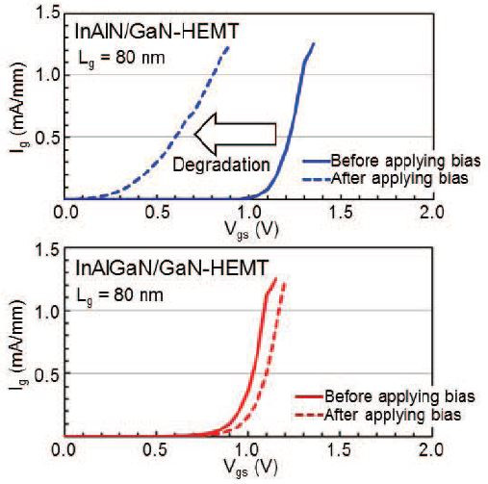
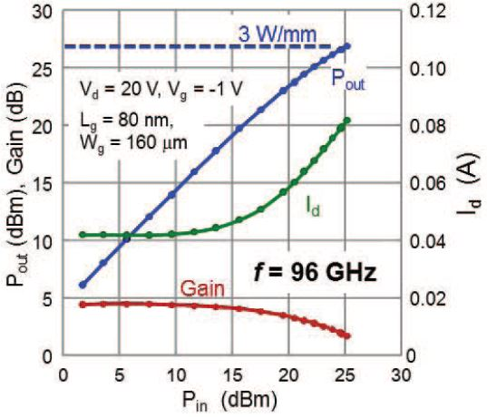
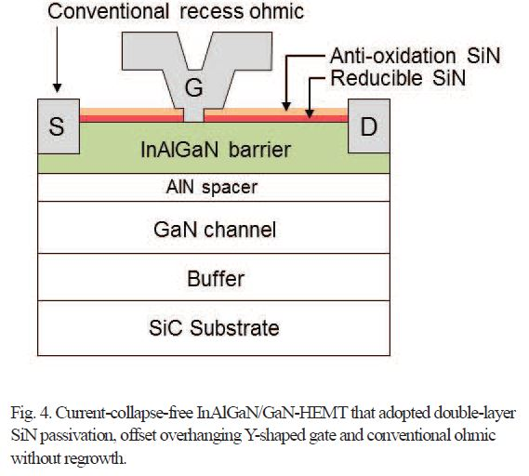
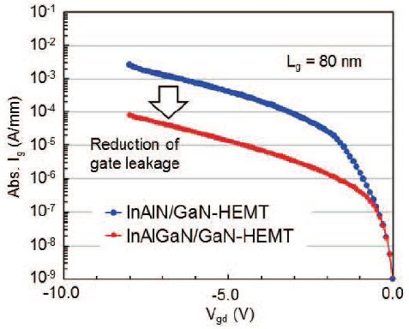
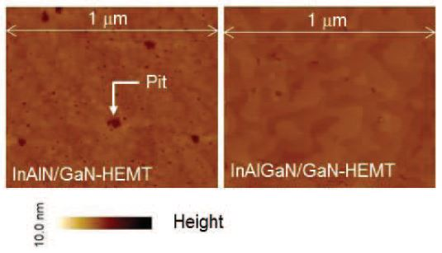
GaN HEMT – Fujitsu
SiC substrate
InAlGaN barrier was used instead of InAlN:
1. Reduced gate leakage.
2. 90% more 2DEG density.
Double layer SiN => prevent oxidation and reduce current collapse.
f_{max}=200GHz
P_{out}=3W/mm @ 96 GHz (W-band), @V_{g}=-1V, V_{ds}=20V
K. Makiyama et al., IEDM 9.1, 2015

Slide 5
GaN HEMT – Fujitsu
Pros | Cons
High power density High power gain High drain bias operation (V_{DS} ≥ 20 V) | PAE Reliability Linearity
☺
☹

Slide 6
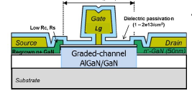
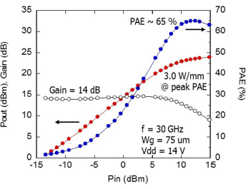
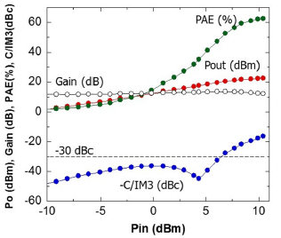
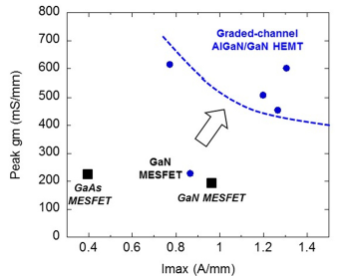
Graded channel HEMT – HRL
Measured g_{m} of GC AlGaN/GaN
Single tone power performances @ 30 GHz
SiC substrate
10% graded-channel AlGaN/GaN → polarization-graded FETs
Improved output power density compared to AlGaN/GaN HEMTs
L_{g} = 50 nm, g_{m} = 500 mS/mm, U_{max} = 14 dB
PAE > 65%, P_{out}= 3 W/mm @ 30 GHz @V_{ds}=14V
J s Moon et al., IEEE IMS, 2019
Two tone linearity of GC AlGaN/GaN
Peak g_{m} of different technology
C/IM3 = 30 dBc which is promising for mm-wave linear and efficient amplifiers without digital pre-distortion

Slide 7
Graded channel HEMT – HRL
Pros | Cons
High power density High power gain High PAE Linearity | Limited drain bias operation (V_{DS} < 15 V) Reliability
☺
☹

Slide 8
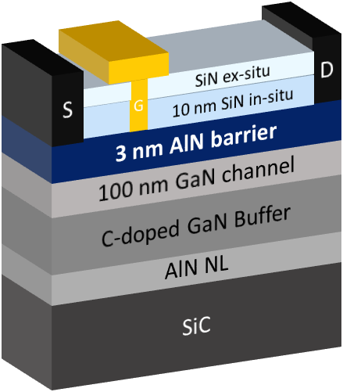
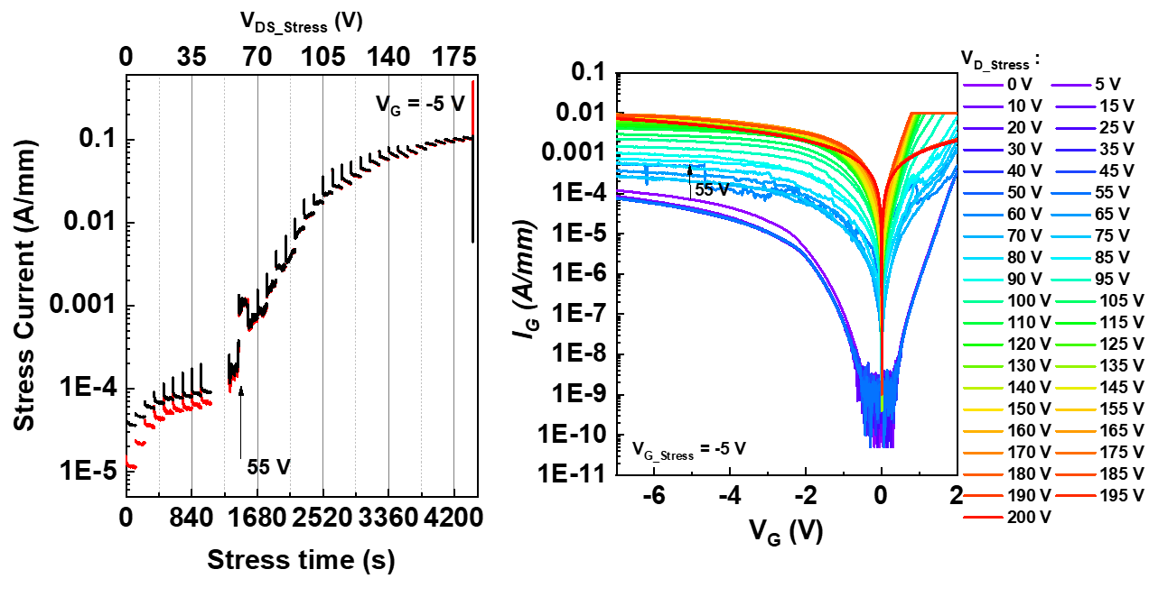
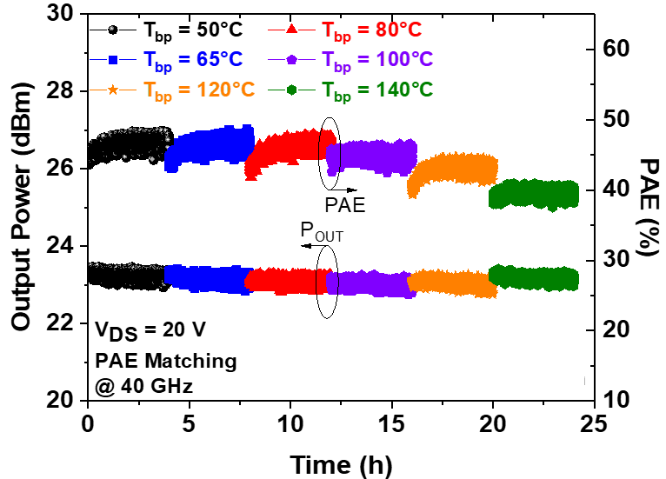
GaN HEMT – IEMN
Large signal characterization @ 40 GHz
Large signal characterization @ 94 GHz
SiC substrate
Ultra-thin AlN barrier was used:
High 2DEG density: N_{s} = 1.8 x 10¹³ cm⁻², µ = 965 cm²/V.s
L_{g} = 100 nm, f_{t}/ f_{max}= 65/300 GHz, U_{max} = 18 dB
PAE > 70%, P_{out}= 5.2 W/mm @ 40 GHz @V_{ds}=30V
PAE = 14%, P_{out} = 4 W/mm @ 94 GHz @ V_{ds} = 20V
K. Harrouche et al., IEEE IMS, 2020
RF short term reliability @ 40 GHz
DC reliability: off-state drain step stress
DC reliability: degradation off-state at V_{DS} = 55V
RF reliability: Outstanding and stable performances up to 20V at room temperature and up to 140°C during 24 hours

Slide 9
GaN HEMT – IEMN
Pros | Cons
High power density High power gain High PAE High drain bias operation Preliminary reliability | Residual trapping effects Linearity Long-term reliability
☺
☹

Slide 10
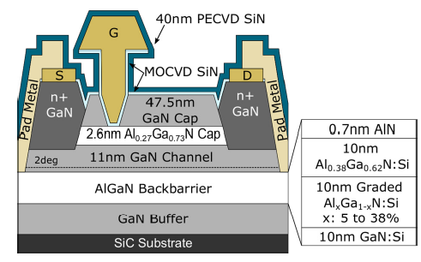
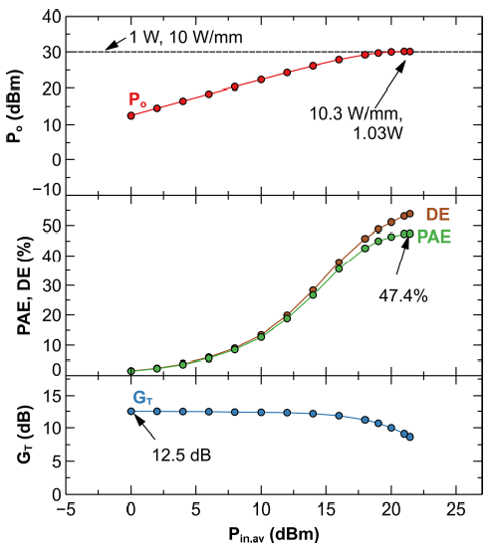
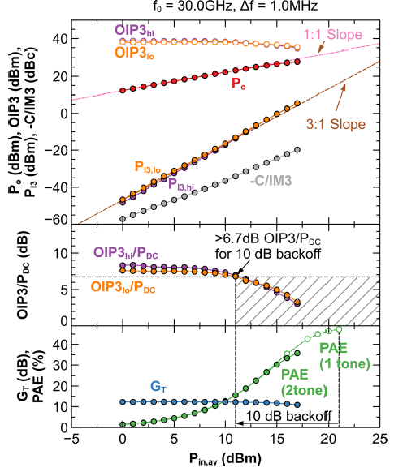
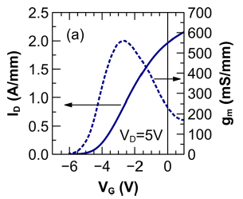
N-polar MIS HEMT – UCSB
Single tone power performances @ 30 GHz
two tone power performances @ 30 GHz
Output characteristics
SiC substrate
Deep recess structure
High channel conductivity
L_{g} = 58 nm, I_{max} > 2 A/mm, g_{m} = 550 mS/mm, f_{t} =113 GHz, f_{max} = 238 GHz,
PAE > 47.3%, P_{out}= 10.3 W/mm @ 30 GHz @V_{ds}=26V
Brian Romanczyk et al., Appl. Phys. Lett, 2021
OIP3 = 38 dBm, OIP3/P_{DC} = 6.7 dB and C/IM3 = 34 dBc under backoff conditions (>10 dB from the peak PAE of the one tone measurements)

Slide 11
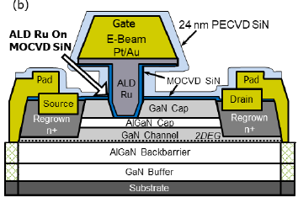
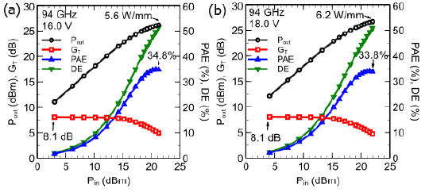
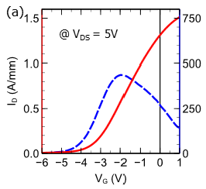
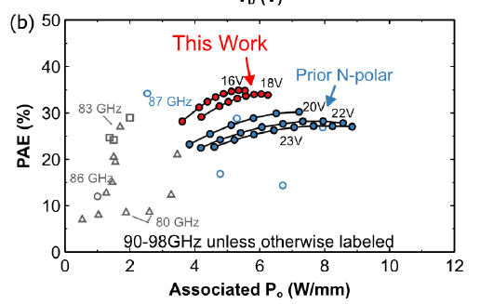
N-polar MIS HEMT – UCSB
Large signal power performances @ 94 GHz
Output characteristics
MIS HEMT structure
Deep recess structure→ control the DC-RF dispersion
ALD Ru gate metallization → shorter gate length with lower gate resistance
L_{g} = 48 nm, I_{max} = 1.34 A/mm, g_{m} = 440 mS/mm, f_{t} =112 GHz, f_{max} = 260 GHz,
PAE > 33.8%, P_{out}= 6.2 W/mm @ 94 GHz @V_{ds}= 18V
W. liu et al., IEEE Microw. Wirel. Components Lett, 2021

Slide 12
N-polar MIS HEMT – UCSB
Pros | Cons
High power density High power gain High PAE Linearity High drain bias operation (V_{DS} ≥ 20 V) | Reliability concern for two reasons: Gate recess is used (damaging the crystal below the gate) MISHEMT using ex-situ gate dielectric
☺
☹

Slide 13
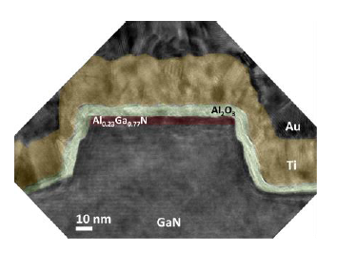
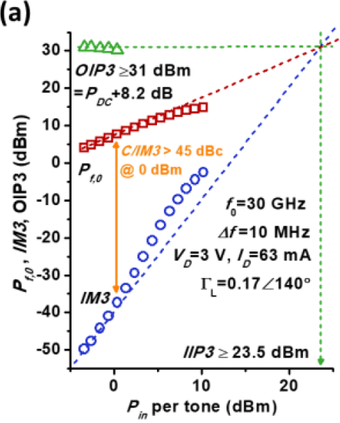
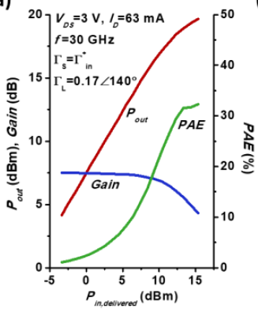
Other alternatives:
Planar/FinFET – UCSD
AlGaN/GaN/Si
MIS FET: 6 Fingers in parallel
L_{g} = 90 nm , W_{fin} = 50-200 nm
LNA: PAE > 32.3%, P_{out}= 19 dBm, G_{p} = 7.52 dB @ 30 GHz @V_{ds}=3V
OIP3 = 31 dBm
OIP3/PDC = 8.2 Db
C/IM3 = 45 dBc
W. Choi, IEEE, 2020
Hybrid planar/FinFET device displayed a highest intrinsic device linearity among the 30 GHz devices determined by high OIP3/PDC and C/IM3.

Slide 14
Other alternatives:
Planar/FinFET – UCSD
Pros | Cons
Linearity | Very limited drain bias operation (V_{DS} < 10 V) and subsequent output power density Reliability ?
☺
☹

Slide 15
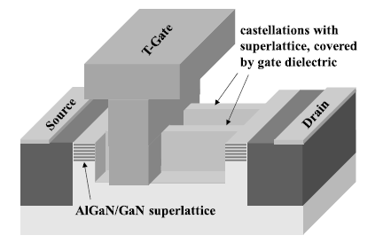
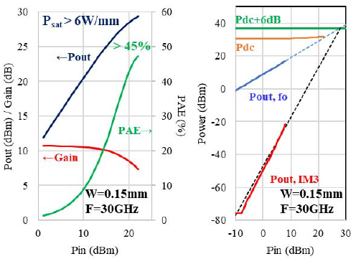
Other alternatives:
Multi-channel SLCFET– Rochester institute
AlGaN/GaN super-lattice
6 stacked heterostructures: Stacked 2DEG layers
L_{g} = 150 nm , R_{sheet} = 300 ohm/sq, I_{max} = 1.8 A/mm, G_{m} = 150 mS/mm , f_{t}/ f_{max}= 47/124 GHz
Amplifier: PAE > 45%, P_{out}= 6 W/mm @ 30 GHz @V_{ds}=15V
OIP3/PDC = 6 dB
J. Chang et al, IEEE, 2019
SLCFET’s novel architecture with a high charge density super-lattice modulated by sidewall gates provides a promising new amplifier device technology

Slide 16
Other alternatives:
Multi-channel SLCFET– Rochester institute
Pros | Cons
High current density High power density Linearity | Low transconductance: charge modulation issue ? Reliability ?
☺
☹

Slide 17
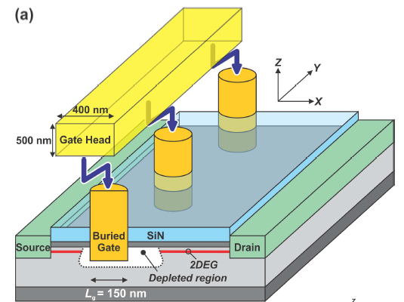
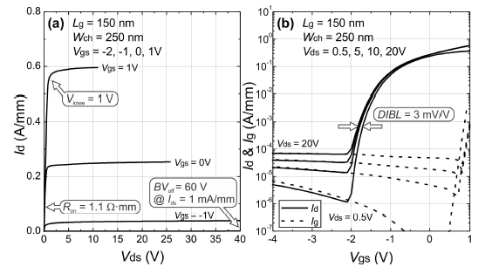
Other alternatives:
BRIDGE HEMT– Teledyne
AlGaN/GaN/SiC BRIDGE FET
L_{g} = 150 nm, R_{sheet} = 306 ohm/sq, N_{s} = 1.2 x 10¹³ cm⁻², µ = 1600 cm²/V.s
f_{t}/ f_{max}= 80/150 GHz, BV = 60 V, DIBL = 3 mV/V, R_{ON} = 1.1 ohm.mm
Buried Schottky contact → no short channel effect and punch through at high V_{DS}
Low gate leakage, reduction of current collapse and knee walkout phenomena
Reduced G_{m} derivatives near threshold → enhanced linearity
Absence of the inverse piezoelectric effect → enhanced reliability
K. Shinohara, IEEE, 2018
Buried dual gates (BRIDGE FET) is suitable for high-efficiency, high-linearity devices
The technology also offers an improved reliability

Slide 18
Other alternatives:
BRIDGE HEMT– Teledyne
Pros | Cons
Very low DIBL Low trapping | No LP measurements Reliability ?
☺
☹

Slide 19
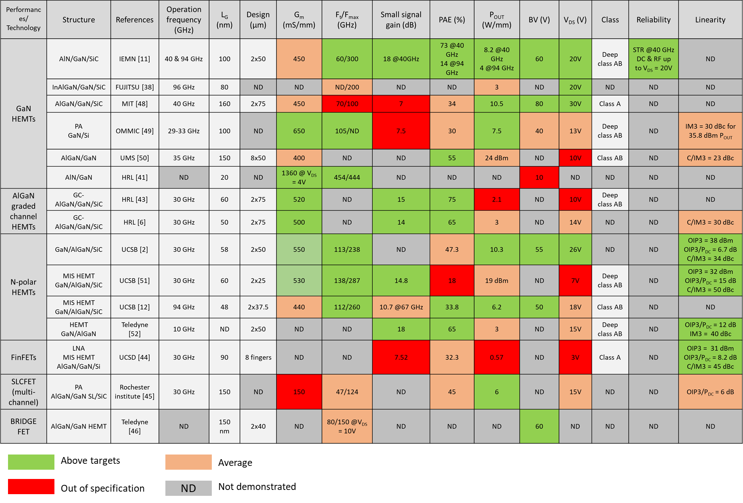
State-of-the art mm-wave GaN devices with L_{G} < 150 nm

Slide 20
Simulation Updates / Possibilities
S
SiN
G
SiN
D
AlN Barrier
GaN channel
GaN Buffer doped C
Simulation can be performed including buffer layers
Different variations (scaling) can be carried out

Slide 21
Simulation possibilities
Small signal |  | Linearity | Large signal
DC | AC | From gm | Not possible directly on Silvaco
IdVd | S parameters | gm₂ / gm₃ | Pout
IdVg / gm | f_{t} / f_{max} | V_{IP2} / V_{IP3} | Power gain
BV / DIBL | Cgd / Cgs vs. frequency | IIP3 / OIP3 / IDM3 | Drain efficiency
Scaling possibilities
Thickness of the layers | Lg Ld Ls | Gate-Drain-Source distances
Rg Rd Rs | Cg Cd Cs | Traps density Thermal effects
Layer doping | 2DEG concentration | % of component (i.e AlxGa1-xN)

Slide 22
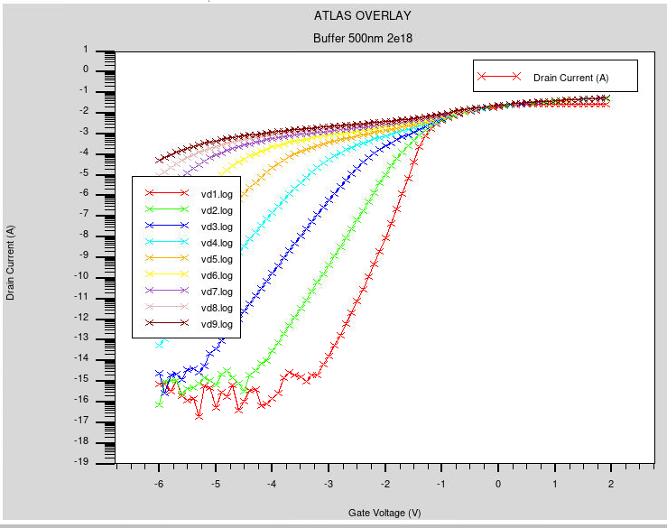
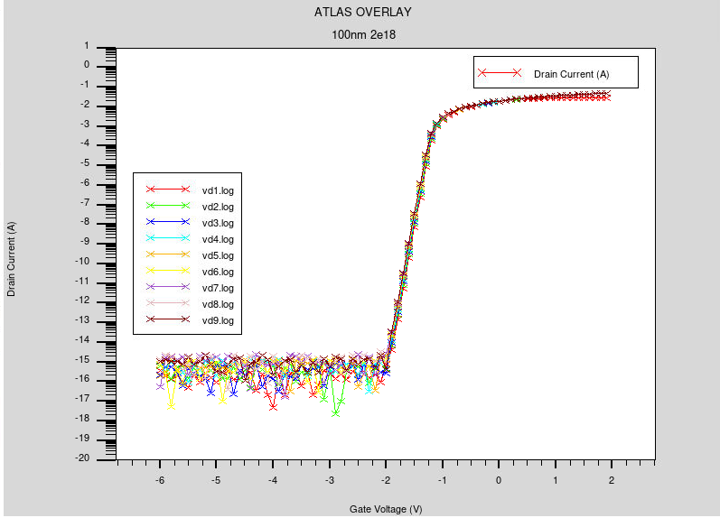
Example of scaling : Impact of channel thickness
AlN barrier = 4nm / Lg = 100 nm / Lgd = 1 micron / Lgs = 600 nm
500 nm C-doped Buffer: high C-doping
100 nm C-doped Buffer: high C-doping
Vds → 2V to 18V

Slide 23
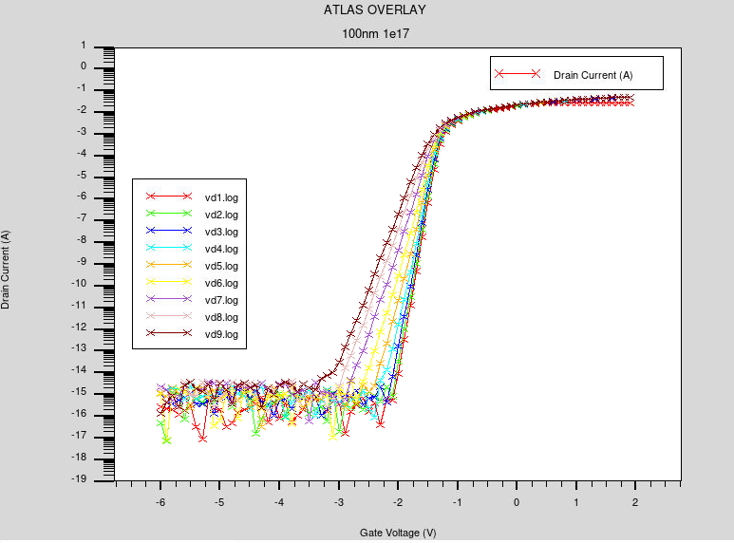
Example of scaling : Impact of C-doping concentration
AlN barrier = 4nm / Lg = 100 nm / Lgd = 1 micron / Lgs = 600 nm
100 nm C-doped Buffer: low C-doping
100 nm C-doped Buffer: high C-doping
Vds → 2V to 18V

Slide 24
TCAD : Graded vs standard channel HEMTs

Slide 25
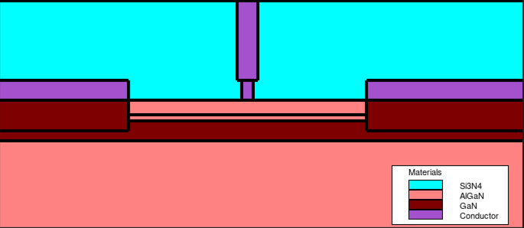
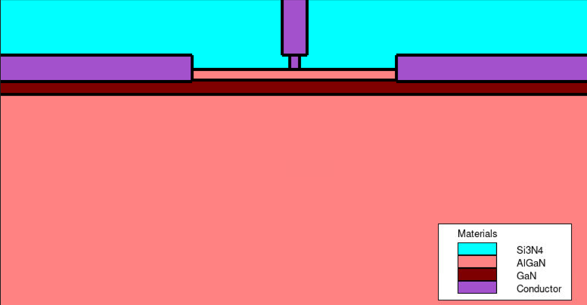
I. TCAD simulations : Graded vs standard
Graded AlGaN channel
15nm AlGaN (25%) barrier
6nm Graded AlGaN channel (0 to 10%)
20nm GaN channel
1µm AlGaN (4%) buffer
Lg = 50nm, Lgd = 0.5µm
Ns = 9.0e12 cm², µ = 1500 cm²/Vs
Standard GaN channel
15nm AlGaN (25%) barrier
20nm GaN channel
1µm AlGaN (4%) buffer
Lg = 50nm, Lgd = 0.5µm
Ns = 1.5e13 cm², µ = 1500 cm²/Vs

Slide 26
I. TCAD simulations : IV Characteristics
Impact of transconductance flatness on Gm2 and Gm3 : more intermodulation distortion (IMD) for standard channel

Slide 27
I. TCAD simulations : IV & small signal characteristics

Slide 28
ICCAP : Angelov fitting
Graded channel

Slide 29
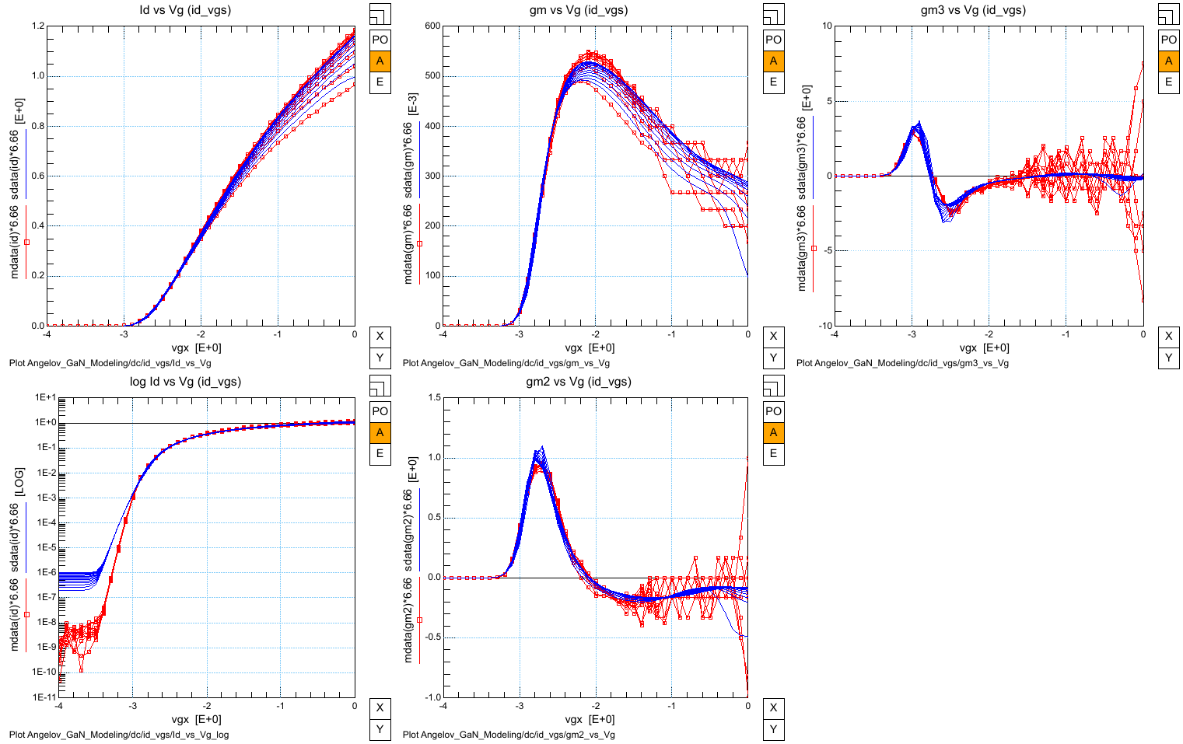
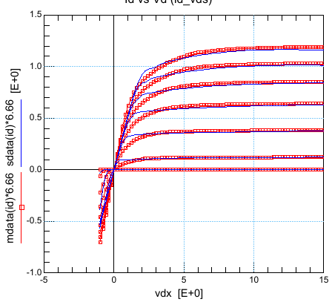
II. ICCAP Fitting : DC characteristics
TCAD
Angelov
TCAD
Angelov
TCAD
Angelov
Vds: 4 V to 15V step = 1V
Vds: 4 V to 15V step = 1V
Vgs: -4 V to 0V; step = 0.5V

Slide 30
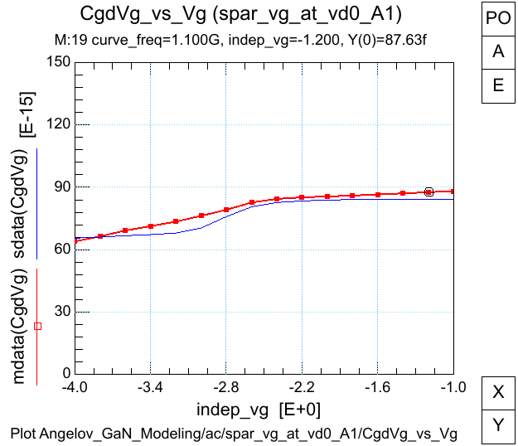
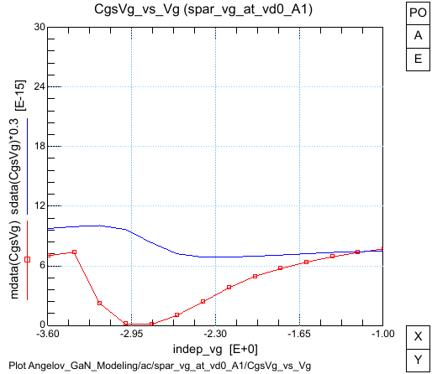
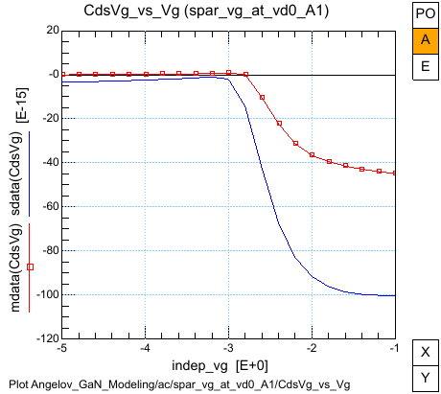
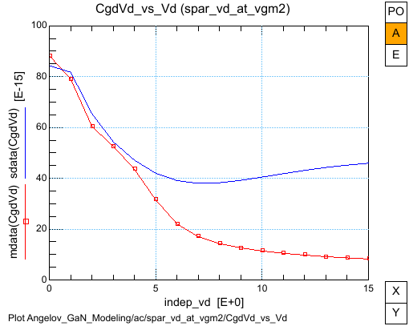
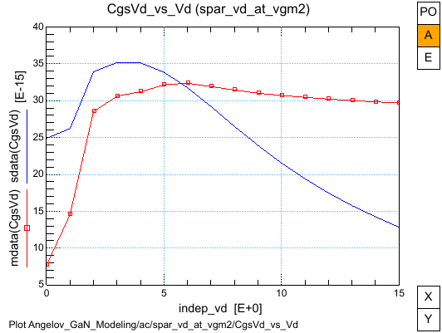
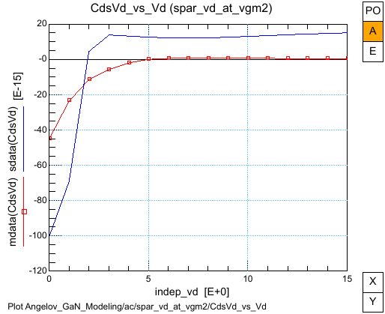
II. ICCAP Fitting : Capacitances
TCAD
Angelov
Vds = 0V
Vds = 0V
Vds = 0V
Vgs sweep
Vgs = -2.1V
Vgs = -2.1V
Vgs = -2.1V
Vds sweep

Slide 31
ICCAP : Angelov fitting
Standard GaN channel

Slide 32
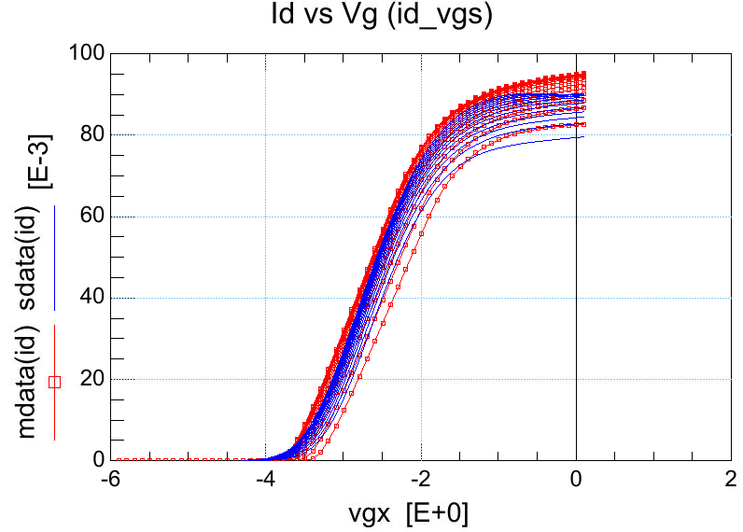
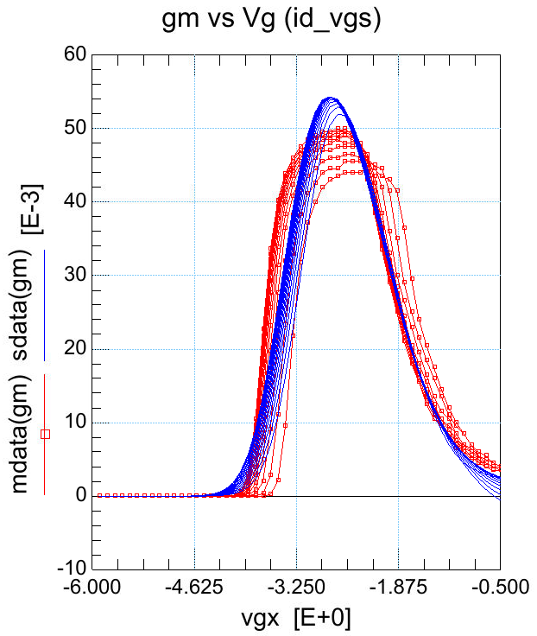
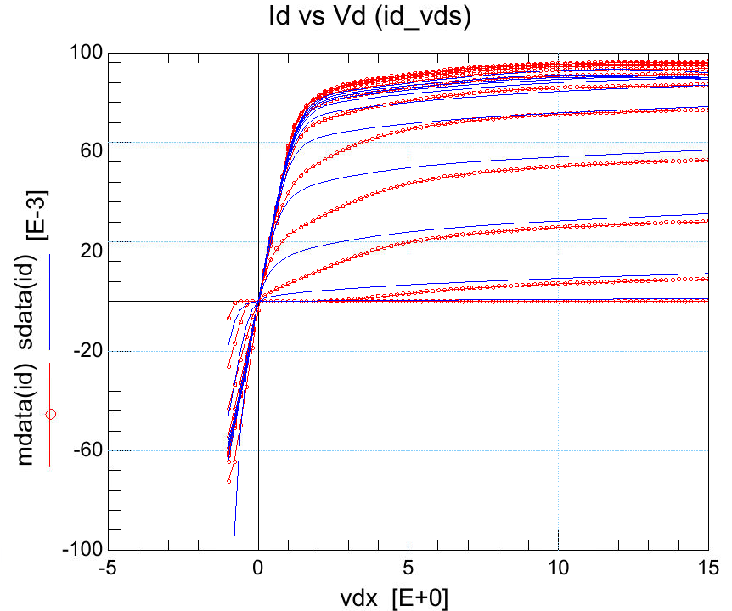
II. ICCAP Fitting : DC characteristics
TCAD
TCAD
TCAD
Angelov
Angelov
Angelov
3 < Vds < 15V
step 1V
-4 < Vgs < 1V ; step 0.5V
3 < Vds < 15V ; step 1V

Slide 33
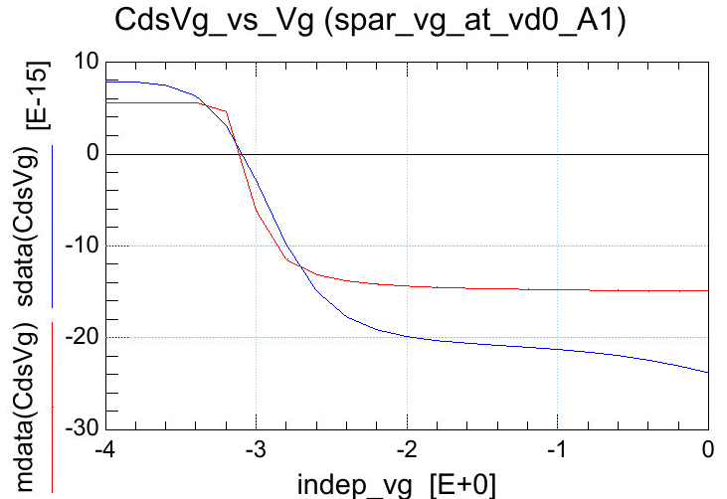
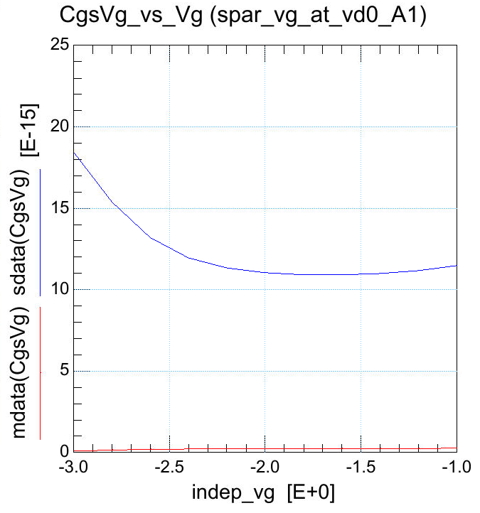
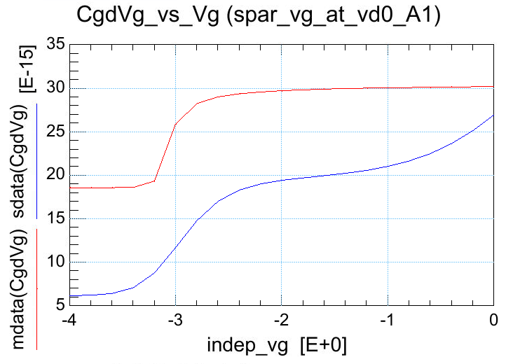
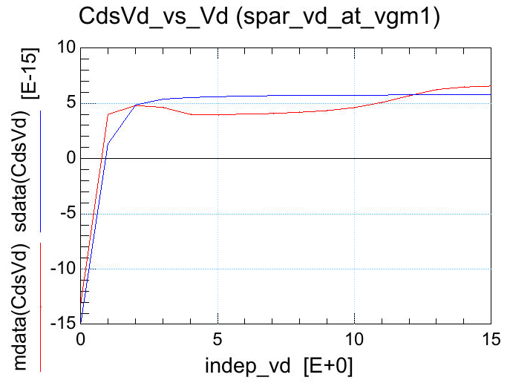
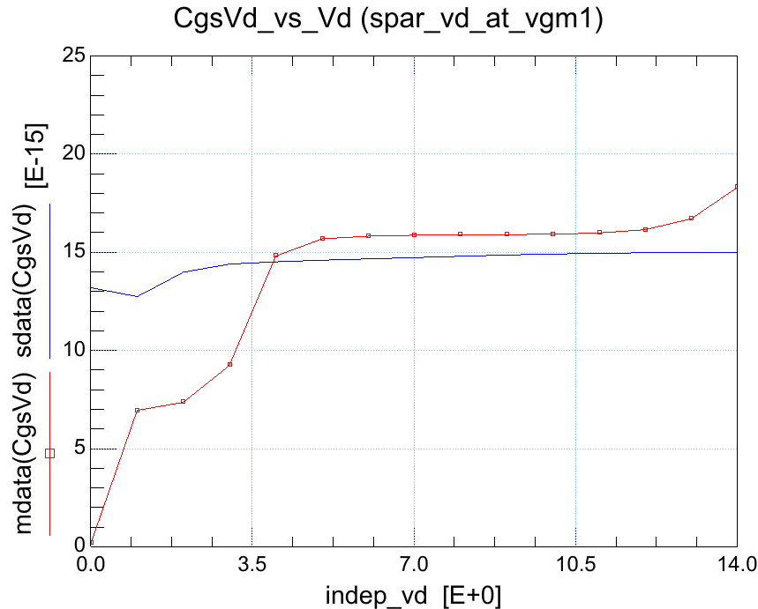
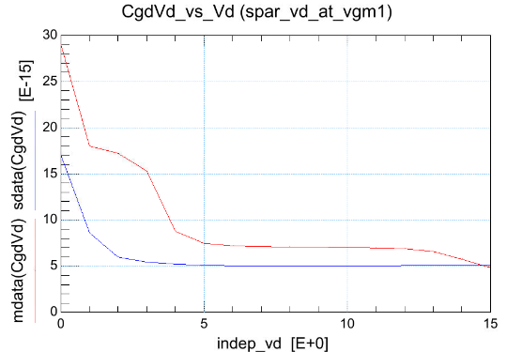
II. ICCAP Fitting : Capacitances
TCAD
Angelov
Vds = 0V
Vds = 0V
Vds = 0V
Vgs sweep
Vgs = -2.6V
Vgs = -2.6V
Vgs = -2.6V
Vds sweep

Slide 34
ADS : Large signal & Linearity
comparison

Slide 35
III. Large signal modelling : Class AB, Vds = 14V
Graded – IEMN simulation
Standard – IEMN simulation
Higher PAE are found for standard channel at the same P_{OUT,} consistent with the higher gain
Simulations are performed with the same impedance matching

Slide 36
III. Linearity modelling : Class AB, Vds = 14V
Graded – IEMN simulation
Standard – IEMN simulation
-30 dBc at 7dB output power backed-off with 40% PAE
-30 dBc at 10dB output power backed-off with 30% PAE
Same value of C/I are achieved in both cases but with higher output power back-off (10dB) for standard channel with lower associated PAE

Slide 37
3D TCAD simulations : FinFET
Literature survey

Slide 38


Reference Paper
Intrinsically Linear Transistor for Millimeter-Wave Low Noise Amplifiers
Woojin Choi, Renjie Chen, Cooper Levy, Atsunori Tanaka, Ren Liu, Venkatesh Balasubramanian, Peter M. Asbeck, and Shadi A. Dayeh, 2020
MIS-FinFET
Ns = 9.9e12/cm²
µ = 1124 cm²/Vs
Breakdown = 54V

Slide 39


Reference Paper
Intrinsically Linear Transistor for Millimeter-Wave Low Noise Amplifiers
Woojin Choi, Renjie Chen, Cooper Levy, Atsunori Tanaka, Ren Liu, Venkatesh Balasubramanian, Peter M. Asbeck, and Shadi A. Dayeh, 2020
Ft planar
Ft FinFET
Strong trade-off with gain and thus high frequency of operation
Question about higher drain bias? robustness
Large signal MIS-FinFET
Ns = 9.9e12/cm²
µ = 1124 cm²/Vs

Slide 40


Reference Paper
GaN-Based Field-Effect Transistors With Laterally Gated Two-Dimensional Electron Gas
Keisuke Shinohara , Senior Member, IEEE, Casey King, Andrew D. Carter, Member, IEEE, Eric J. Regan, Andrea Arias, Member, IEEE, Joshua Bergman, Member, IEEE, Miguel Urteaga, Senior Member, IEEE, and Berinder Brar, Senior Member, IEEE, 2018
BRIDGE FET
BRIDGE FET
HEMT
15nm AlGaN (28% Al)
Ns = 1.2e13/cm²
µ = 1600 cm²/Vs
Lg = 150nm / Wchannel = 250nm
Ft / Fmax = 31/80 GHz @Vds = 30 V
Ft / Fmax = 80/150 GHz
@Vds = 10 V
Breakdown = 60V

Slide 41



Multi-channel Schottky-gate BRIDGE HEMT Technology for Millimeter-Wave Power Amplifier Applications
Keisuke Shinohara , Casey King# , Dean Regan# , Eric Regan# , Andrew Carter# , Andrea Arias# , Joshua Bergman# , Miguel Urteaga# , Berinder Brar# , Yu Cao$ , Andy Xie$ , Edward Beam$ , Cathy Lee$ # Teledyne Scientific and Imaging, USA $ Qorvo Inc., USA, 2022
Multi-channel BRIDGE FET
Breakdown = 30V

Slide 42

3D TCAD : FinFET Structure
Dimensions :
Lg = 100nm
Lgs = 500nm
Lgd = 500nm
W_Fin= 200nm
16 nm AlGaN (%Al = 27%)
100 nm GaN channel + 1 µm Buffer
Ns = 1.2e13/cm²
µ = 1600 cm²/Vs
SiN
DC and small signal RF comparison between Finfet and Planar for the same epi-structure to be performed

Slide 43
TCAD : FinFET vs Planar HEMT
-
DC & Small signal study

Slide 44

TCAD structures : Planar HEMT
Lg = 100nm
Lgd & Lgs = 500nm
16 nm AlGaN barrier (25% Al)
150 nm GaN channel
1 µm GaN buffer
Ns = 1.2e13/cm²
µ = 1300 cm²/Vs
Standard AlGaN/GaN HEMT

Slide 45

TCAD structures : FinFET
3D simulations :
1 Fin is simulated to avoid convergence and time consuming issues
Nevertheless, the simulations still takes twice as long compare to 2D
Lg = 100nm
Lgd & Lgs = 500nm
W_Fin = 120nm
16 nm AlGaN barrier (25% Al)
150 nm GaN channel
1 µm GaN buffer
Ns = 1.2e13/cm²
µ = 1300 cm²/Vs

Slide 46
DC characteristics
Indication of improved linearity with flat Gm
Impact of Gm flatness on Gm2 and Gm3 : IMD reductions
sweet spots
sweet spots

Slide 47

Electric field comparison : Open channel Vgs = 0V & Vds 10V
Peak electric field in the channel = 0.9 MV/cm
Planar
cutline
GaN channel
cutline
Gate edge
Drain edge

Slide 48

Electric field comparison : Open channel Vgs = 0V & Vds 10V
FinFET
GaN channel
Peak electric field in the channel = 0.5 MV/cm
GaN channel

Slide 49

Electric field comparison : Pinch-off channel Vgs = -4V & Vds 10V
Peak electric field in the channel = 1.2 MV/cm
Planar
cutline
GaN channel
cutline
Gate edge
Drain edge

Slide 50

Electric field comparison : Pinch-off channel Vgs = -3V & Vds 10V
FinFET
GaN channel
Peak electric field in the channel = 1.0 MV/cm
GaN channel

Slide 51
DC characteristics & Small signal
Much higher Capacitances for FinFET due to sidewall additional metal
Capacitances (fF/mm) | Planar | FinFET
Cgs | 426 | 645
Cgd | 150 | 202
Cds | 254 | 373
Severe trade-off between linearity improvement and small signal performances with a drop of Ft/Fmax due to higher capacitances
Capacitances are extracted @1GHz, Vds = 5V & peak Gm

