Slide 1
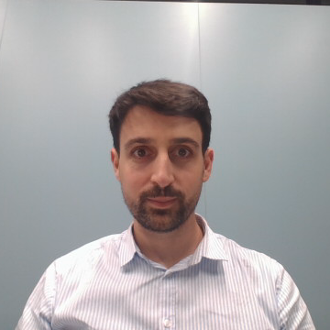
Menhir Photonics
Towards high performance space-grade frequency-combs
ESA 4000138841/22NLGLCov
3/11/2023

Slide 2
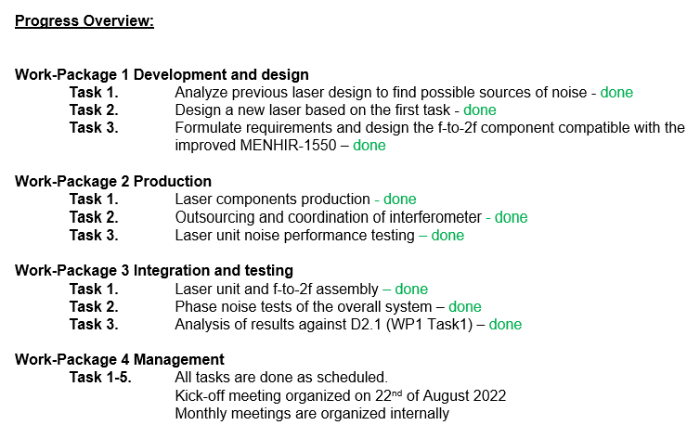
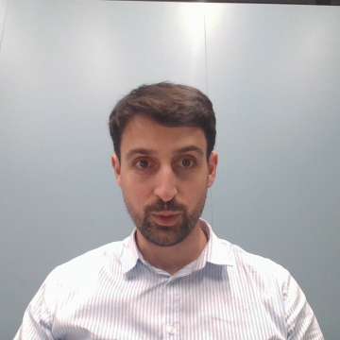
Gannt chart

Slide 3
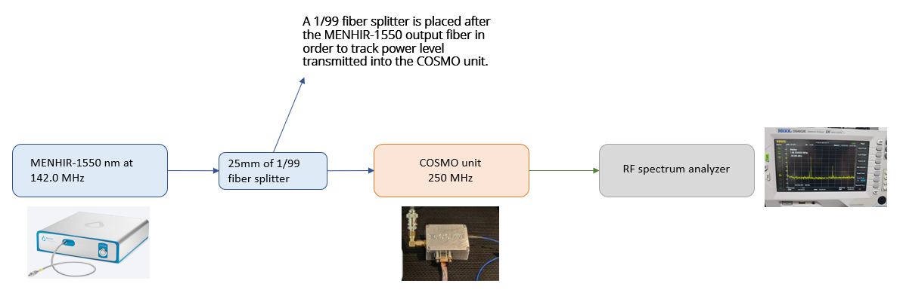
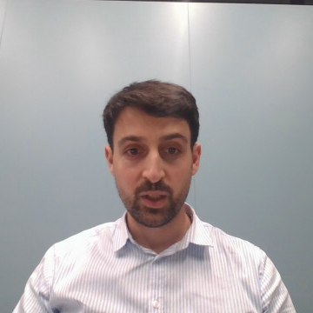
Schematic of the measurement
No | Description | Qnt | Item number | SN | SMF length, m
1 | Femtosecond laser | 2 | MENHIR-1550 | CU1 = SN4411001 CU2 = SN4411002 | 0.80
2 | 1/99 fiber splitter | 1 |  |  | 0.35
3 | Comb Offset Stabilization Module | 1 | COSMO for 250 MHz f_rep | COSMO-2022-12-05-001 | 0.50
4 | Power supply | 1 | GPS-3030DD |  | -
5 | RF spectrum analyser | 1 | DSA832E Spectrum analyser |  | -

Slide 4
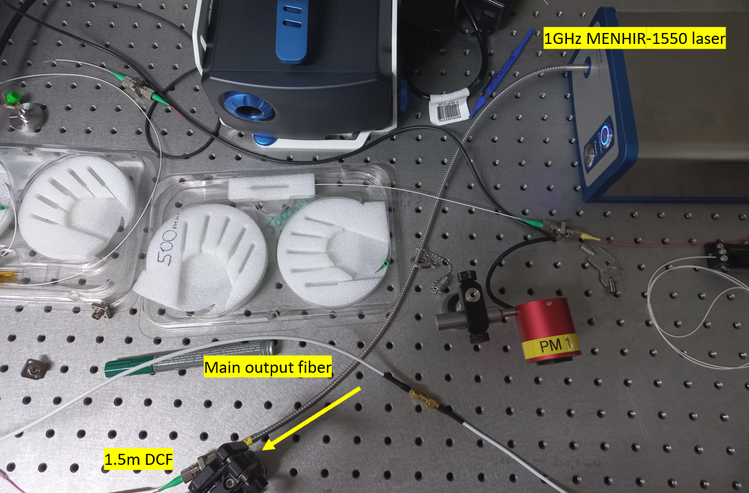
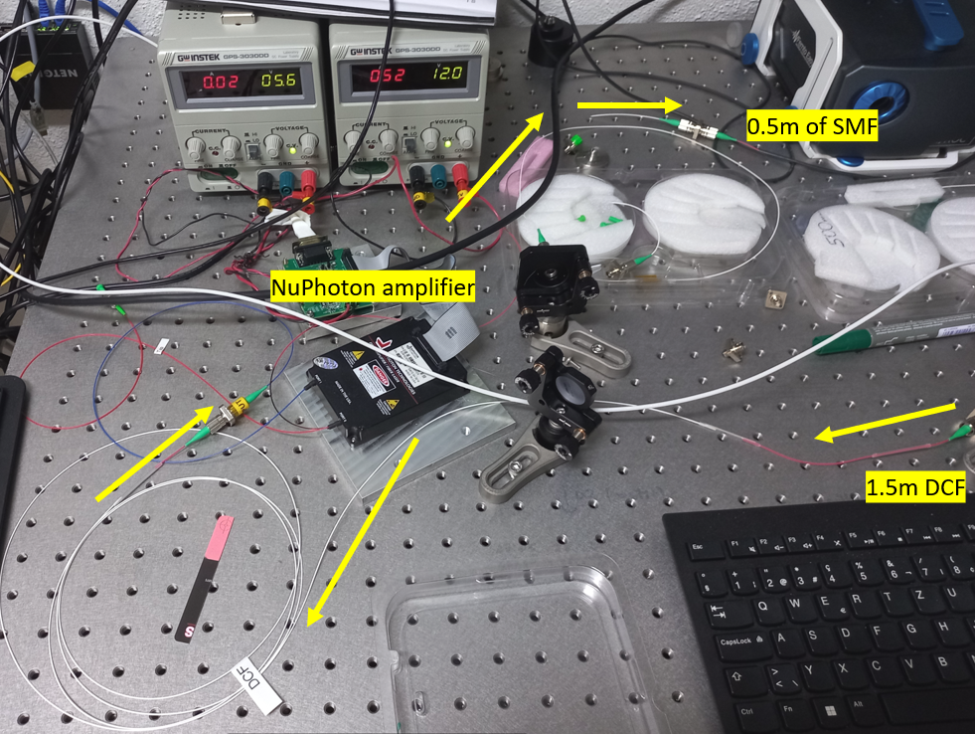
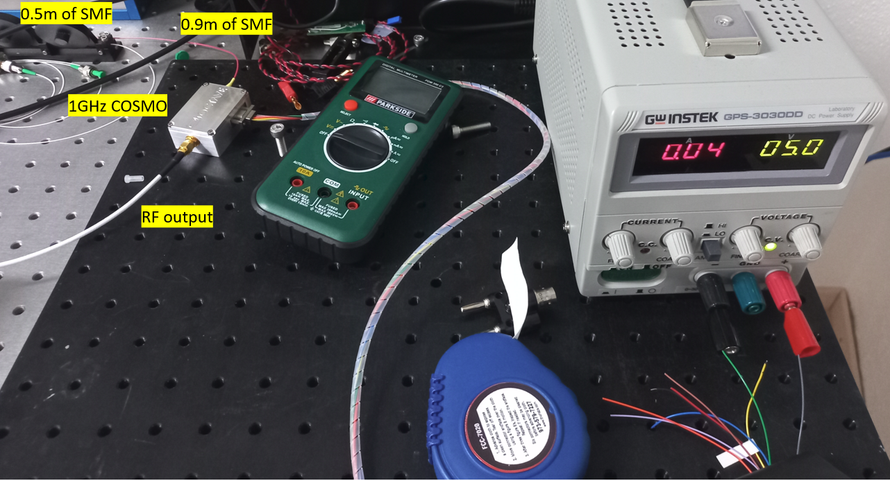

Experimental setup

Slide 5
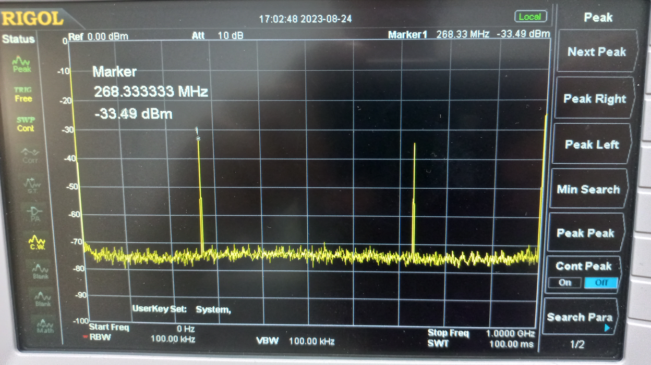
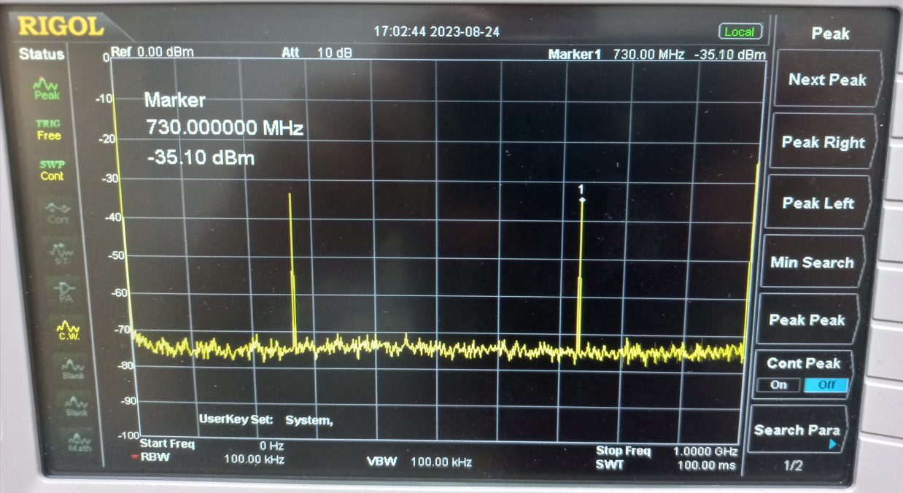

RF beat note and all other mixed tones in RF domain

Slide 6

f_{CEO} measurements

Slide 7
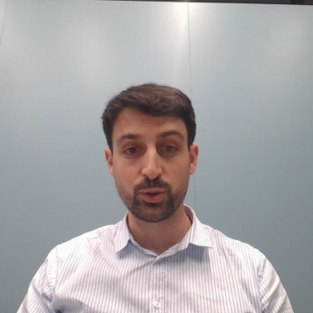
f_{CEO} stability
f_{CEO} drift is due to temperature change:
- beam pointing inside the cavity is changing
- refractive index change as well

Slide 8
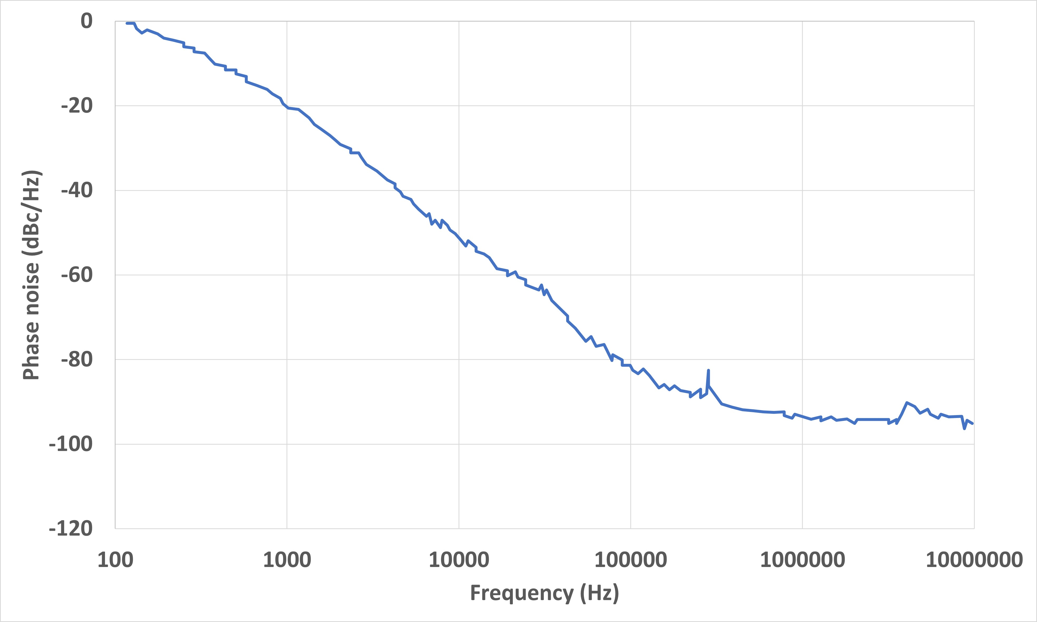
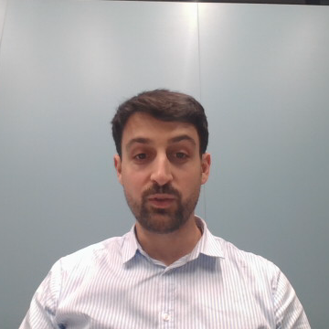
Phase noise measurements
f_{CEO} phase noise is very stable when changing the laser parameters.
- such frequency noise can be easily locked with pump current modulation.

Slide 9

Project conclusions
In this project we have built a f-to2f stabilization setup, based on the low-noise 1 GHz MENHIR-1550 lasers. Main project achievement are:
Understanding and defining the f_{CEO} frequency dependency on voltage and pump current, allowing for precise control and stability.
Long-term monitoring of f_{CEO} frequency changes, with a primary source of variation attributed to temperature-induced refractive index and beam pointing adjustments within the cavity.
The results of the project will be used for improving the passive stability of MEN-1550 lasers throughout production, ensuring consistent f_{CEO} positioning and system performance.

