Slide 1

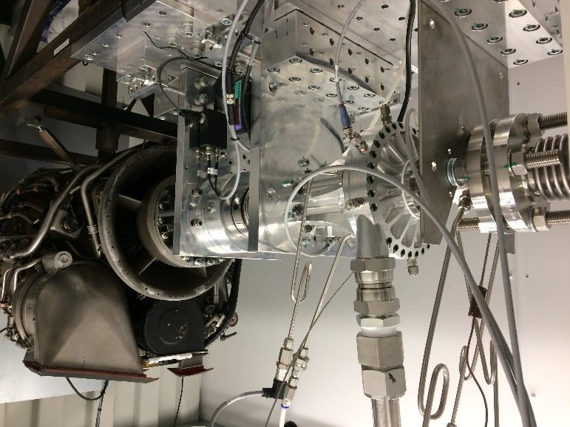
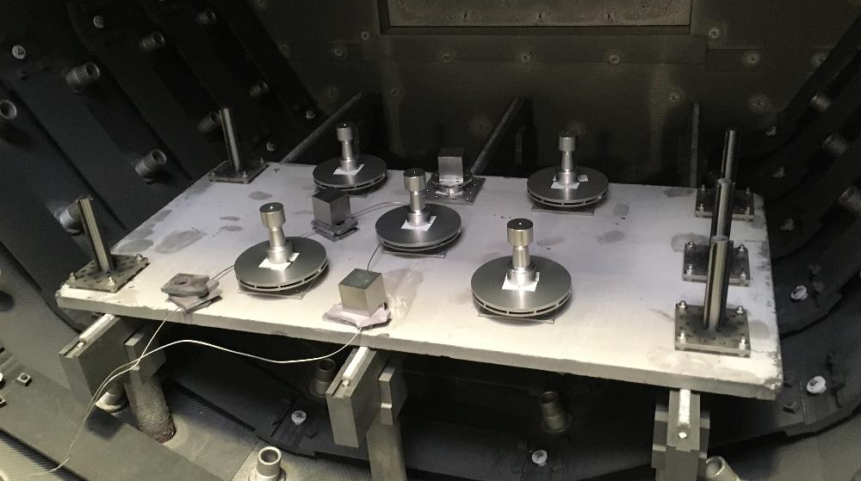
Launcher class kerosene pump de-risk
Contractor(s): LENA SPACE (UK)
ESA Budget:
Co-funded Budget:
200k€
0 k€
GSTP, G617-241TAbm
4000127127/19/NL/BJ/zk
YoC: 2019
TO: Simon Hyde(TEC-MPC)
TRL
Initial: 2
Achieved: 4
Target TRL: 4 Date: Q3 2022
Background and justification:
The majority of large engine activity in Europe is hydrogen based and requires more costly pump technology, with deep cryogenic temperatures and complex sealing requirements. This activity was to demonstrate a low-cost Kerosene pump design, manufacture and test capability with view to enabling a LOX Kerosene 60kN Engine program. These engines are more appropriate for the small launcher market than LOX/LH2.
Objective(s):
Demonstrate 60kN Kerosene pump design, MGSE design, manufacturing and testing.
Achievements and status:
LENA space successfully built and demonstrated a 60kN Kerosene pump, developed internal manufacturing capabilities including specialist impeller manufacturing procedures. LENA have designed a technology development roadmap for the pump technology targeting the next critical steps towards flight qualification.
Benefits:
There are no LOX/Kerosene engines yet operational in Europe, a prerequisite for their development and finalization is the turbopump technology, this 60kN pump activity represents a significant amount of the overall effort required to develop the turbopump, with LENA also working on the 60kN LOX pump in parallel, and a turbine concept from a larger engine program (137kN HTP/Propane).
60kN Kerosene pump in test cell driven by Jet Engine (far right).
Next steps:
Current small launcher engine activities are pivoting towards LOX/LNG (Liquid Natural Gas) the current pump technology can be repurposed for a LOX/LNG system. This activity has confirmed that LENA have the necessary digital design tools, internal manufacturing capability and testing facilities to develop launcher class pumps. We can continue with the Kerosene LOX pump activity to the demonstration model phase (DM) or switch to LOX/LNG depending on commercial opportunities, the decision is under review.
Pump impeller manufacturing

