Slide 1
Welcome
Final Presentation

Slide 2
Agenda
Introductions
Presentation of Build SPOC
Documentation Package Guidelines
Deliverable Documentation
Lessons Learned
Upgrade points for a Flight Model
AOB

Slide 3
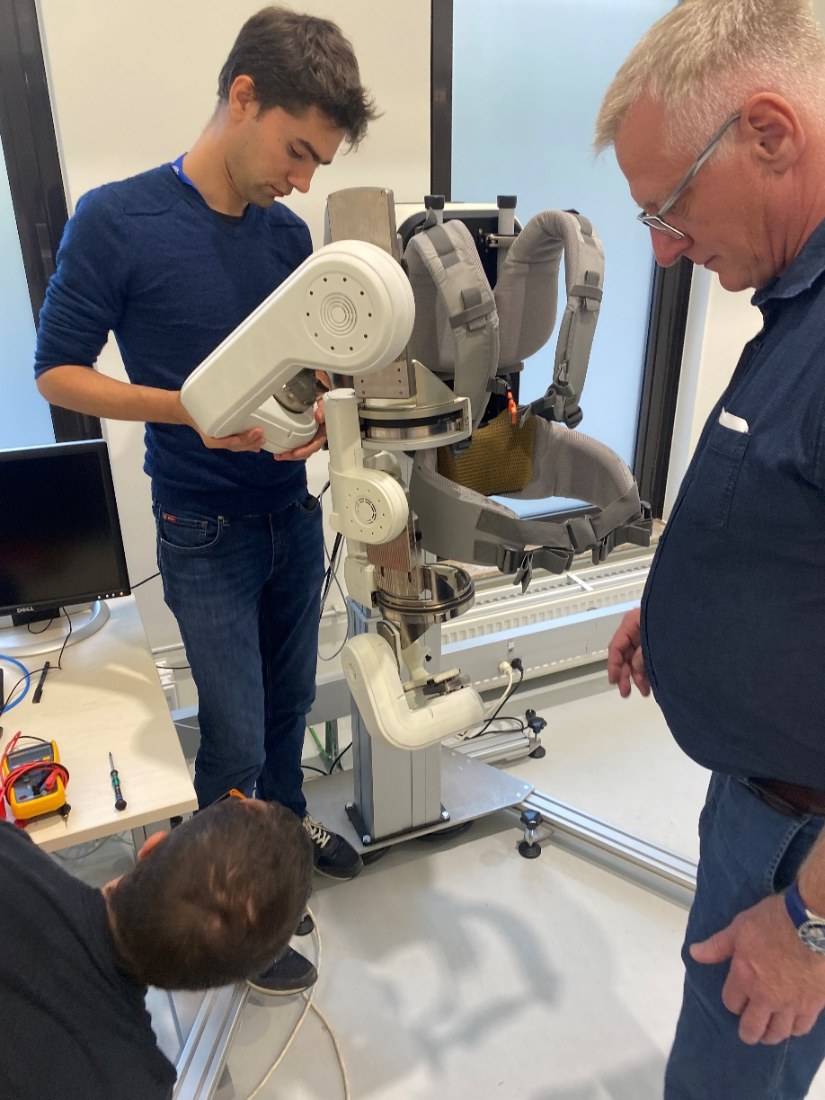
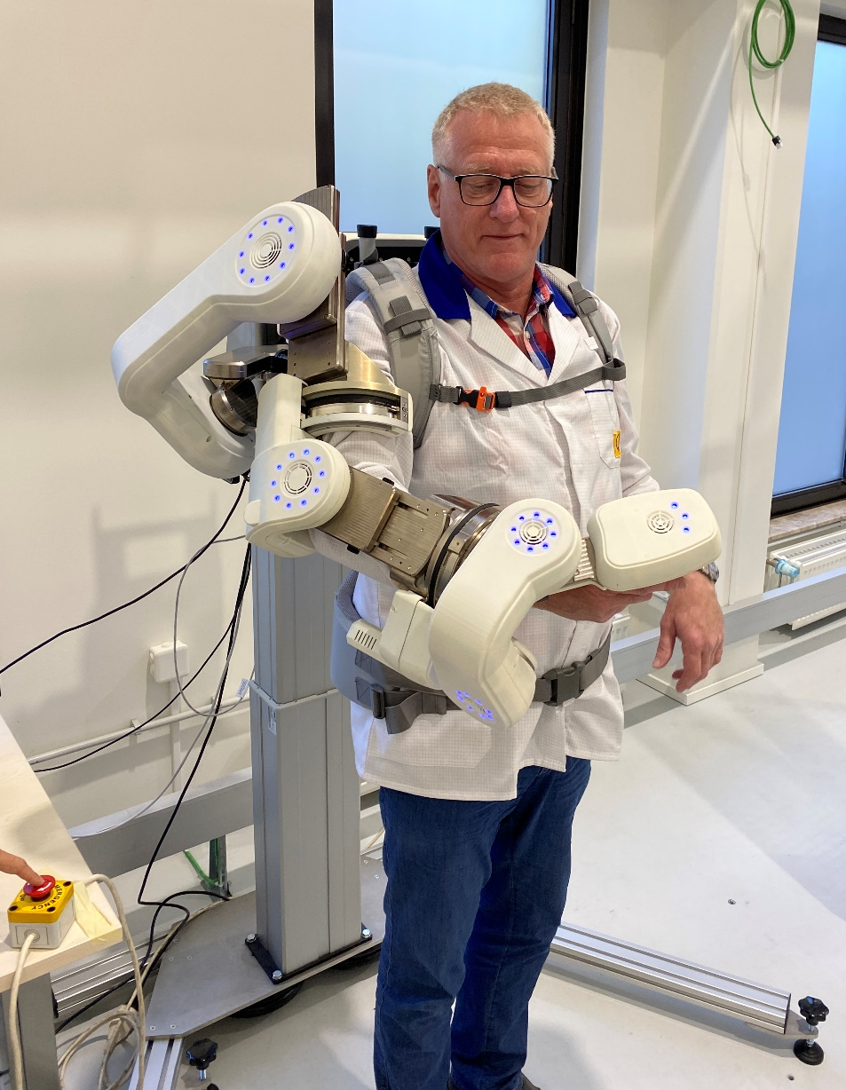
Presentation of Build HW & SW

Slide 4
Deliverable Items List
Line item | Level | Title | Part Number | EM | Comments
1 | 1 | Exoskeleton Arm | EXO-HW1-a | X
2 | 1 | Exoskeleton Backpack | EXO-HW1-b | X
3 | 1 | Exoskeleton Body Vest and braces | EXO-HW1-c | X
4 | 1 | Joint Identification Test Setup Joint 1 | EXO-HW2 | X
5 | 1 | Transport Container | EXO-HW4 | X
6 | 1 | Mechanical Support Stand | EXO-HW5 | X
7 | 1 | Exoskeleton external harness | EXO-HW6 | X
7 | 1 | Slave Board unit software | SW1 | X | *ownCloud
8 | 1 | ELMO joint configuration files | SW2 | X | *ownCloud
9 | 1 | SPOC functional testing software | SW3 | X | *ownCloud
10 | 1 | SPOC GUI software | SW4 | X | *ownCloud

Slide 5
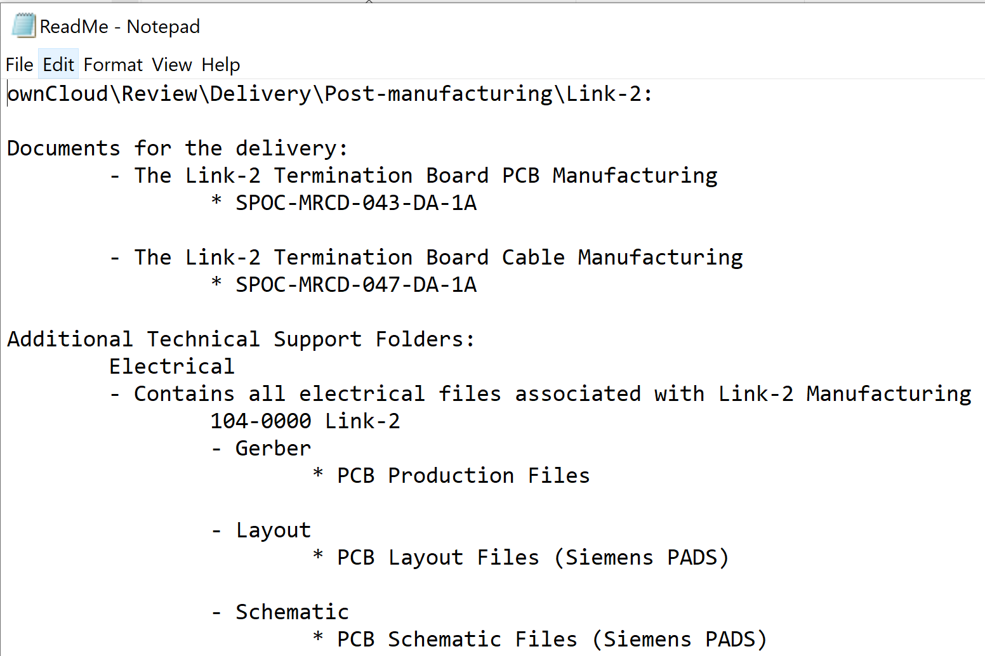
Documentation
Documentation folder:
Each folder with dedicated ReadMe:

Slide 6
Documentation Overview (Cont’d)
Design Documents
Manufacturing Documents
Link Design reports
(SPOC-RP-DA)
Non conformance records
(SPOC-NCR-DA)
Electrical Diagrams
(SPOC-DIA-DA / SPOC-E80/E99-DA)
CAD Link Models
Config. Items Data List
(SPOC-CIDL-DA)
Cable Lists
(SPOC-LST-DA)
->
Cable Manf. Records
(SPOC-MRCD-DA)
Schematic Diagrams (updt.)
(SPOC-E99-DA)
->
Electrical Parts List
(SPOC-LST-DA)
->
PCB Manf. Records
(SPOC-MRCD-DA)
->
Schematics/Layout Chg Log
(SPOC-LOG-DA)
Assembly Procedures
(SPOC-PRC-DA)
->
Mech. Manf. Records
(SPOC-MRCD-DA)
->
Full CAD Model (Updt.)
Pre Manufacturing
Post Manufacturing

Slide 7
Documentation Overview (Cont’d)
Design Documents
Manufacturing Documents
Software Interface Control Doc
(SPOC-SPE-DA)
Joint SW Release Record
(SPOC-SRCD-DA)
->
Joint SW Integration Record
(SPOC-IRCD-DA)
->
Joint SW Config File
(SPOC-SCF-DA)
->
Joint SW Valid. Specifications
(SPOC-TRCD-DA)
SPOC Software User Manual
(SPOC-MAN-DA)
Joint Calibration Method Desc.
(SPOC-RP-DA)
Master Software As Built List
(SPOC-ABL-DA)
Firmwar. SourceCode
Master SourceCode
Pre Manufacturing
Post Manufacturing

Slide 8
Troubleshooting & re-manf. (example #1)
Sourcing Documents
Manufacturing Documents
Config. Items Data List
(SPOC-CIDL-DA)
Cable Manf. Records
(SPOC-MRCD-DA)
Electrical Parts List
(SPOC-LST-DA)
PCB Manf. Records
(SPOC-MRCD-DA)
Full CAD Model (Updt.)
Mech. Manf. Records
(SPOC-MRCD-DA)
PCB Gerber Files
Joint SW Integration Record
(SPOC-IRCD-DA)
Troubleshooting / Re-Manufacturing example #1

Slide 9
Upgrade & manf. of SPOC (example #2)
Sourcing Documents
Manufacturing Documents
Schematic Diagrams (updt.)
(SPOC-E99-DA)
Config. Items Data List
(SPOC-CIDL-DA)
Cable Manf. Records
(SPOC-MRCD-DA)
->
Electrical Parts List
(SPOC-LST-DA)
PCB Layouts (updt.)
(SPOC-E80-DA)
->
PCB Manf. Records (updt.)
(SPOC-MRCD-DA)
Full CAD Model (Updt.)
->
Schematics/Layout Chg Log
(SPOC-LOG-DA)
->
Legend
Blue: Delivered
Purple: To be created
PCB Gerber Files
Upgrade & Manufacturing example #2

Slide 10
Deliverable Documentation
The following documents will be deliverables per CCN#1: |  | Status | Comment
· Payload Specification |  | Available | SPOC-SPE-001
· Test Procedures (Joint test only) |  | Available | SPOC-TRP-005 to 019
· Delivered Items List |  | Available
· Design Report(s) |  | Available | Links, Sensors, STO reports
· Outline Installation Drawings, Schematics and Parts List |  | Available | CAD Model, DIAs (Updated)
 |  | Available | SPOC-DIA-001 to -013-DA
 |  | Available | SPOC-MRCD-006 to -063
 |  | Available | SPOC-PRC-009 to 051
 |  | Available | SPOC-LST-002 to -023-DA
 |  | Available | SPOC-CIDL-001 to -008-DA
 |  | Available | SPOC-RP-013 to -032-DA
· Software Design Document |  | Available | SPOC-SRCD-008, SPOC-ICD-001
· Software Verification Plan |  | Available | SPOC-PLN-003
· Software Validation Test Specification |  | Available | SPOC-SPE-004 to 008
· Software Validation Test Report |  | Available | SPOC-TRCD-006 to 040
· Software Interface Control Document |  | Available | SPOC-IRCD-002 to 019
· Software Configuration File |  | Available | SPOC-SCF-010-DA & previous versions
· EM-FM Model Difference Description |  | Available | (Pending QA)
· Contract Closure Documentation |  | Available | DAC to finalize and sign after Delivery & Accept.
· Technical Data Package |  | Available | See all above
· Summary Report |  | Available | (Pending QA)
· Abstract |  | N/A | No Abstract or publications
Additions:
STO Safety Overview |  | Available | SPOC-RP-020-DA
Updated assembly procedures |  | Available | (Pending QA) -> ownCloud discrepancy between SA/DAC
ABL Software report |  | Available | (Pending QA)
Software User Manual |  | Available | (Pending QA)
To be found in:
\ownCloud\Review\Delivery |  |  | e.g. Post-manufacturing

Slide 11
Overview of DOC numbers per link
Doc/Link |  | Link6 | Link4-5 | Link3 | Link2 | Link1 | Link0 | GM | Backpack
SPOC-MRCD-006 to -063 |  | 13,14,18,19,22,24,25,26,63 | 23,30,31,44,45,48,4953,54,62 | 20,21,32,33,51,52,61 | 43,47 | 55,56,59 | 42,46 | 6,7,8,9,10,11,15,16,28,34,36,64 | 12,50
SPOC-DIA-001 to -013-DA |  | 3,4 | 12,13 | 3,8 | 7 | 3,9 | 3 | 2 | 1,3
SPOC-PRC-009 to 051 |  | 10 | 20 | 18 | 16 | 26 | 8 | 4,5,9 | 7
SPOC-LST-002 to -023-DA |  | 10,11 | 18,19 | 15,16 | 13,14 | 22,23 | 2,6 | 4,5 | 7,8
SPOC-CIDL-001 to -008-DA |  | 4 | 7 | 6 | 5 | 8 | 3 | 1 | 2
SPOC-RP-013 to -032-DA |  | 22,23 | 23,32 | 20,23,29 | 27 | 32,37 | 19 | 13,18 | 16,19,20

Slide 12
Identified Tweaks for Operation
Willtec Encoder
Joint 5, Absolute track issue (upon startup, move to end stop), linear track works fine
End Stop Peculiarity
Joint 1 End Stops tripped by Joint 2 and vice versa
Joint 6 End Stops tripped by Joint 7 and vice versa
Upper Arm Link Adj. (Link 2)
20 mm saturation zone (small japanese woman zone)
Backpack Casing
New casing procured, slightly different color due to new production

Slide 13
Summary of Lessons Learned
Termination Boards provide possible (but difficult disassembly)
Link Adjustment sensors replacements (quality issue)
Netzer absolute encoder version exists now without I/F board
Casing tightness: fine-cutted parts of casing to fit cables
Split version of Link 1 casing could be made, like Link 6
Subcontractor (Steingross) tolerance and quality issues (GM esp.)
Holes for Push button/Hat Stick PCB drilled larger
Various small PCB layout issues lead to manf. changes (MRCD’s)
Faulhaber motor replaced in Joint 5, due to ordered motor defect
Non-conformance records summarizes issues link by link (NCRs)

Slide 14
SPOC Upgrade to Flight Model build (EM->FM)
See SPOC-RP-049-DA-1A for the EM to FM differences and further details
Same type connectors & cables
Manufacture flight cable for ISS Power Interface (120VDC)
Same class mechanical/electrical components to be used
Check for obsolete electronics components
Correct PCB Layouts or re-manufacture with known issues (Based on updated schematics or current PCB Layouts)
Manf. Flight PC boards (IPC Class III/ECSS)
Add input filter for Backpack Power Supply to comply with given ISS Power Interface (120VDC)
Electrical testing of new PC boards (according to test records provided)
Flight PC Boards to be baked, soldered, coated by qualified personnel (ECSS)
Manufacture mechanical items (Updated in CAD model, referenced in manf. records)
Investigate 3D printed casing material (Ultem/other material space approval)
Seek ESA Safety approval for SPOC inflight use
Define proper FMEA analysis for Safety Board and conclude the safety process
EMI testing
Shielding of casing, EMI gaskets
Vibration testing
Off-gass testing

Slide 15
Thank you for your attention!
www.danishaerospace.com

