Slide 1
ESA Contract No. 4000136329/21/NL/MG
EVACPRO
Chemical Modelling of Reactions and Processes in Propellant Systems
Final Presentation 2023 / 11 / 29
Empresarios Agrupados Internacional (EAI)
https://www.ecosimpro.com/products/espss/

Slide 2
Agenda
 | Topic
1 | Introduction | 5’
2 | Project Organization | 10’
3 | Review of modelling approaches | 15’
4 | Review of ESPSS components | 15’
5 | Review of validation | 15’
6 | Q&A | 20’
7 | Closeout/AoB | 10’

Slide 3
Introduction

Slide 4
Introduction
Project goal: The objective is to improve ESPSS capabilities applied to transient simulations of complete chemical propulsion systems using novel propellants. Agreement of 10% during operation sequence.
Branch 1: LOX/ CH4. M10 Upper Stage
Task1: Model identification
Turbo-machinery thermal, mechanical and fluid dynamic transient models.
Reduced-order finite rate chemistry models for LOX/CH4.
Pyrolysis and coking phenomena within cooling jackets.
Heat and mass transfer in novel injectors for LOX/CH4.
Task2: Implementation
Task3: Validation
Branch 2: Monopropellant case. RACS – VEGA C
Task1: Model identification
Instabilities modelling in the catalysts of monopropellant thrusters.
Reduced-order finite rate chemistry models for H2O2 and other green propellants.
Chemistry models for H2O2 and other green propellants.
Injectors modelling for monopropellants.
Task2: Implementation
Task3: Validation

Slide 5
Project organization

Slide 6
Project Team Organisation
ESA TO
Csaba Jeger
Prime Contractor
Empresarios Agrupados Internacional
CO: Miguel Alcázar
TO: María Aranda
Subcontractors
U. Rome La Sapienza
Francesco Nasuti
AVIO
Attilio Cretella
NAMMO
Martina Faenza
ILOT Lukasiewicz
Zbigniew Gut

Slide 7
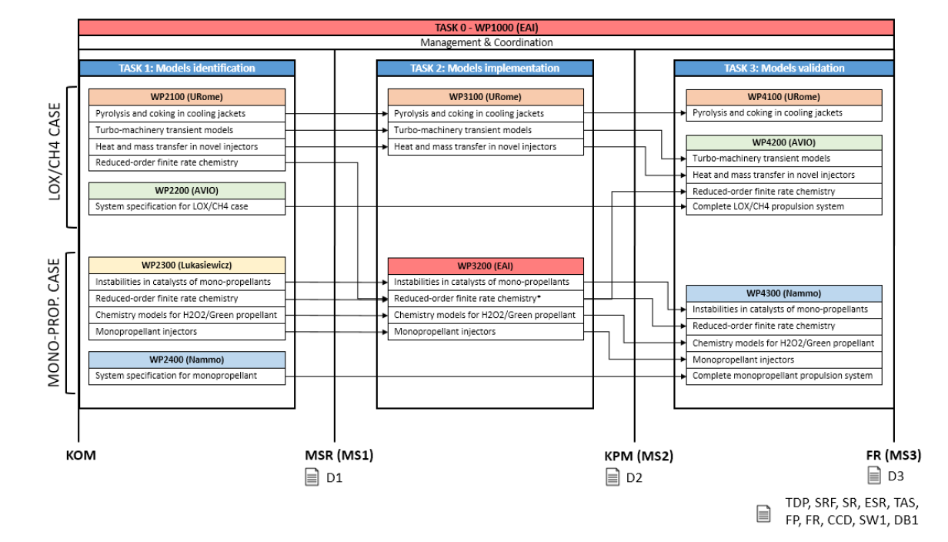
Project Plan

Slide 8
Project Deliverables
 | EAI | Urome | AVIO | Nammo | Status
D1: “Propulsion system Models” |  | X | X | X | Delivered and accepted
D2: “Model design document” | X | X |  |  | Delivered pending on final acceptance
D3: “Model Validation Report” |  | X | X | X | Delivered pending on final acceptance
SW1: “ESPSS library extension” | X |  |  |  | Delivered and accepted
SR, ESR, TAS, FR, CCD, FP, SRF | X |  |  |  | Delivered and accepted
KOM= 2021 / 11 / 19
MS1 = KOM + 4 M = 2022 / 03 / 21
MS2= MS1 + 8 M = 2022 / 11 / 24
MS3 = MS2 + 10 M = 2023 / 10 / 16

Slide 9
Task 1: models identification

Slide 10
Project Plan

Slide 11
TASK 1: Models identification
Models identification:
LA SAPIENZA (UROME) WP2100
COKING IN CJ
HEAT AND MASS TRANSFER IN NOVEL INJECTORS
TURBOMACHINERY TRANSIENT MODELS
REDUCED ORDER FINITE RATE CHEMISTRY
LUKASIEWICZ (ILOT) WP2300
MONOPROPELLANT MODELLING
INJECTORS
CATALYTIC BED
CHEMISTRY MODELS
FINITE RATE FOR GREEN PROPELLANTS

Slide 12
TASK 1: Models identification
Models identification:
LA SAPIENZA (UROME) WP2100
COKING IN CJ
HEAT AND MASS TRANSFER IN NOVEL INJECTORS
TURBOMACHINERY TRANSIENT MODELS
REDUCED ORDER FINITE RATE CHEMISTRY
LUKASIEWICZ (ILOT) WP2300
MONOPROPELLANT MODELLING
INJECTORS
CATALYTIC BED
CHEMISTRY MODELS
FINITE RATE FOR GREEN PROPELLANTS

Slide 13
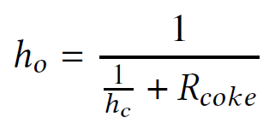
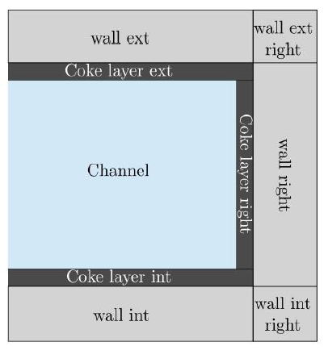
TASK 1: Models identification
Coking in cooling channels
Heat supply from the chamber in rocket engines can contribute to a carbon deposit layer at the walls. This deposit affects the heat exchange and can lead to too-high temperatures and cause engine failures
A thermal resistance is computed with a semi-empirical approach dependent on 4 parameters and the Reynolds number:
Afterwards, the convective heat transfer coefficient is computed taking into account this contribution

Slide 14
TASK 1: Models identification
Implementation phase:
LA SAPIENZA (UROME) WP2100
COKING IN CJ
HEAT AND MASS TRANSFER IN NOVEL INJECTORS
TURBOMACHINERY TRANSIENT MODELS
REDUCED ORDER FINITE RATE CHEMISTRY
LUKASIEWICZ (ILOT) WP2300
MONOPROPELLANT MODELLING
INJECTORS
CATALYTIC BED
CHEMISTRY MODELS
FINITE RATE FOR GREEN PROPELLANTS

Slide 15
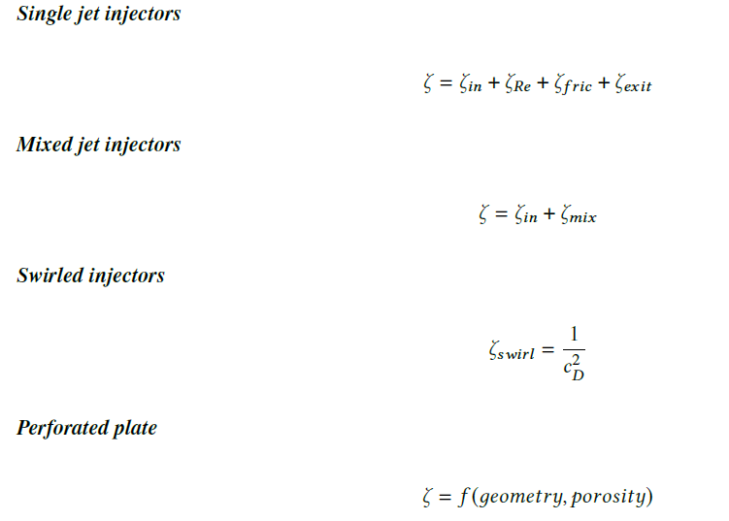
TASK 1: Models identification
Heat and mass transfer in novel injectors
a) Pressure losses computation
The pressure losses at injectors will take into account different geometries and types of injectors:
Different geometries are possible:
- Sharp
- Rounded
- Slanted
- Angled inlet

Slide 16
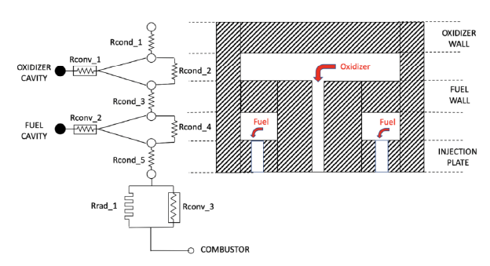
TASK 1: Models identification
Heat and mass transfer in novel injectors
b) Heat transfer
An improved thermal network has been created for the combustor components, which take into account an axial distribution of the injector holes and walls:
Several nodes compute dynamically the evolution of the temperatures at the walls, taking into account the conduction among them and the ambient. It is possible to activate convection between the cavities and the walls.

Slide 17
TASK 1: Models identification
Implementation phase:
LA SAPIENZA (UROME) WP2100
COKING IN CJ
HEAT AND MASS TRANSFER IN NOVEL INJECTORS
TURBOMACHINERY TRANSIENT MODELS
REDUCED ORDER FINITE RATE CHEMISTRY
LUKASIEWICZ (ILOT) WP2300
MONOPROPELLANT MODELLING
INJECTORS
CATALYTIC BED
CHEMISTRY MODELS
FINITE RATE FOR GREEN PROPELLANTS

Slide 18
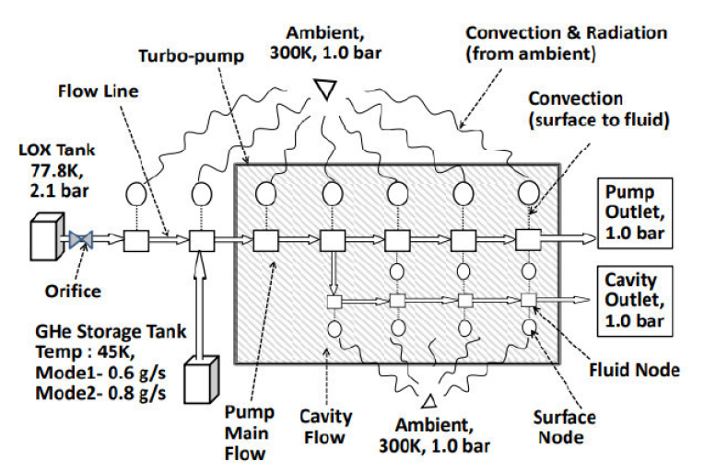
TASK 1: Models identification
Turbomachinery transient models
A model in open literature has been found that is fully compatible with ESPSS due to its topology. It is based on a work by a group of ISRO (Indian Space Research Organization).
Such work has been selected to be the starting point for the development of the enhanced pump component in ESPSS.
Combination of fluid nodes (conservation of mass and momentum) + thermal nodes (energy)

Slide 19
TASK 1: Models identification
Implementation phase:
LA SAPIENZA (UROME) WP2100
COKING IN CJ
HEAT AND MASS TRANSFER IN NOVEL INJECTORS
TURBOMACHINERY TRANSIENT MODELS
REDUCED ORDER FINITE RATE CHEMISTRY
LUKASIEWICZ (ILOT) WP2300
MONOPROPELLANT MODELLING
INJECTORS
CATALYTIC BED
CHEMISTRY MODELS
FINITE RATE FOR GREEN PROPELLANTS

Slide 20
TASK 1: Models identification
Reduced order finite rate chemistry
4 Arrhenius schemes have been proposed after a detailed literature review. They are generated starting from the C1-C4 kinetic mechanism by Zhukov Z-DKM:
TSR-stoic21, general 21 species scheme including initiation chemistry aspects associated to homogeneous ignition
TSR-stoic12, compact 12 species scheme
TSR-lean14, compact 14 species scheme to be operated under fuel-lean conditions
TSR-rich32, a 32 species scheme to be operated under fuel-rich conditions
All the schemes have been tested and validated in terms of equilibrium temperaeture and composition, counter flow diffusion flames and perfecly stirred reactor calculations.
Comparable or superior performance compared to Zhukov scheme.

Slide 21
TASK 1: Models identification
Implementation phase:
LA SAPIENZA (UROME) WP2100
COKING IN CJ
HEAT AND MASS TRANSFER IN NOVEL INJECTORS
TURBOMACHINERY TRANSIENT MODELS
REDUCED ORDER FINITE RATE CHEMISTRY
LUKASIEWICZ (ILOT) WP2300
MONOPROPELLANT MODELLING
INJECTORS
CATALYTIC BED
CHEMISTRY MODELS
FINITE RATE FOR GREEN PROPELLANTS

Slide 22
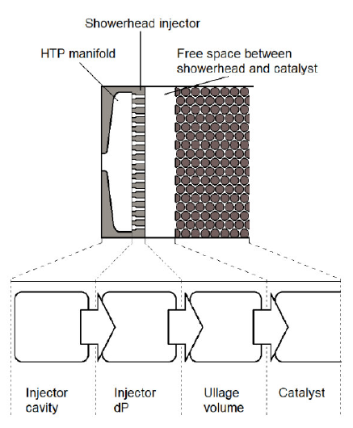
TASK 1: Models identification
Chemical modelling of HTP
HTP modelled as a Perfect Liquid: it keeps simplicity while fulfils all the termal/fluid requirements
Several new properties files have included inside ESPSS, each of them for a different concentration of HTP: 85, 87.5, 90, 92, 95 and 98 %.
Injectors
Showerhead injector is the most prevalent type in monopropellant thrusters. Uniform injection pattern.
Manifold: modelled as a simple, constant 0D volumen
Injector element: 1D momentum equation that computes dP = f (Cd)
Ullage volume: due to ambiguities on physical phenomena in this region is rejected

Slide 23
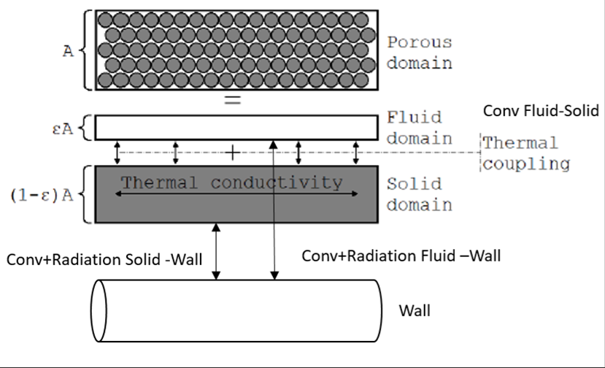
TASK 1: Models identification
Catalyst bed modelling
Liquid and gas phase are mechanically coupled.
Solid and fluid are at different temperatures. Thermal losses due to convection and radiation are included in the energy equation
Mixture is composed by:
H2O Liquid
HTP Liquid
H2O2 Gas
H2O Gas
O2 Gas
Properties of the mixture are defined by the concentrations of the liquids (HTP_L, H2O_L) in the flow. They have their own evolution equations
Finite rate chemistry is done by bulk reaction models which can be easily linked to test data.
Ergun equation is used for the pressure drop. It expresses the friction factor as function of the Reynolds number and porosity.

Slide 24
TASK 1: Models identification
Catalyst bed modelling
HTP Decomposition
HTP_L
H2O_L
H2O2 Decomposition
O2_G
Boiling
H2O_G
H2O2_G

Slide 25
Task 2: models implementation

Slide 26
Project Plan

Slide 27
TASK 2: Models implementation
Implementation phase:
LA SAPIENZA (UROME) WP3100
COKING IN CJ
HEAT AND MASS TRANSFER IN NOVEL INJECTORS
TURBOMACHINERY TRANSIENT MODELS
EMPRESARIOS AGRUPADOS (EAI) WP3200
MONOPROPELLANT MODELLING
INJECTORS
CATALYTIC BED
CHEMISTRY MODELS
FINITE RATE FOR GREEN PROPELLANTS

Slide 28
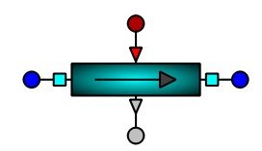
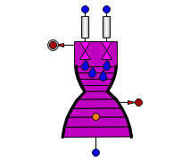
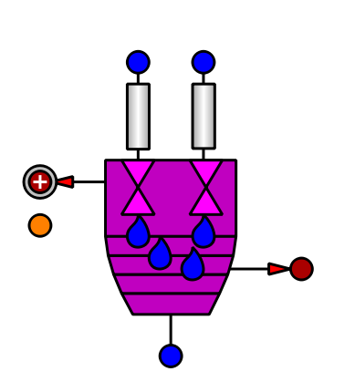
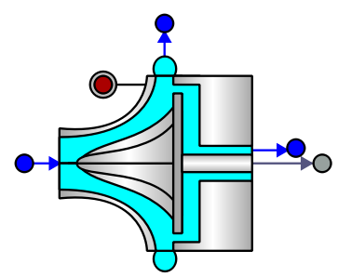
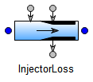
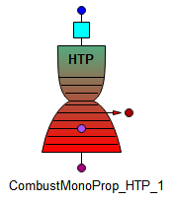
TASK 2: Models implementation
Implementation phase:
LA SAPIENZA (UROME)
COKING IN CJ
HEAT AND MASS TRANSFER IN NOVEL INJECTORS
TURBOMACHINERY TRANSIENT MODELS
EMPRESARIOS AGRUPADOS (EAI)
MONOPROPELLANT MODELLING
INJECTORS
CATALYTIC BED
CHEMISTRY MODELS
FINITE RATE FOR LOX/CH4

Slide 29
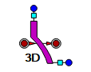
TASK 2: Models implementation
Implementation phase:
LA SAPIENZA (UROME)
COKING IN CJ
HEAT AND MASS TRANSFER IN NOVEL INJECTORS
TURBOMACHINERY TRANSIENT MODELS
Creation of a new component in ESPSS called "Tube_coking" which has a flag for activating coking phenomena.
Existing Cooling Jacket component in ESPSS has been upgraded, adding this new coking flag as a construction parameter.

Slide 30
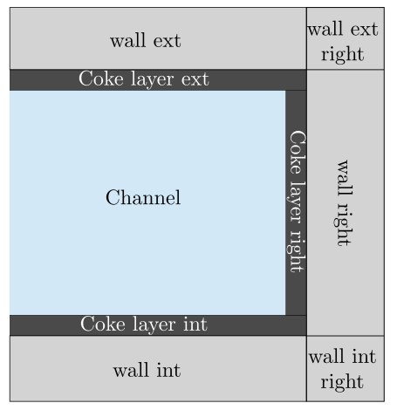
TASK 2: Models implementation
Pyrolysis and Coking formulation
Released carbon might interact with the walls
Acts as an insulation coating which can affect the cooling process
Fluid-dynamics effects not considered
Time dependent thermal resistance is introduced:
4 experimental data
$${\dot{R}}_{coke}=c_{1}Re^{c_{2}}exp(1+\frac{c_{3}}{T_{wall}}+\frac{c_{4}}{T_{wall}^{2}})$$
$$\left.q = A_{wet} h_{o}(T_{fluid} − T_{wall}\right)$$
$$h_{o}=\frac{1}{\frac{1}{h_{c}}+R_{coke}}$$

Slide 31
TASK 2: Models implementation
Implementation phase:
LA SAPIENZA (UROME)
COKING IN CJ
HEAT AND MASS TRANSFER IN NOVEL INJECTORS
TURBOMACHINERY TRANSIENT MODELS
A new injector component has been created: "InjectorLoss", more accurate.
Set of possible pressure-loss modes: single jet, mixed jets, swirled, closed swirl, open swirl, bipropellant swirl, gas-swirl and perforated plate.
Two new topological macro-combustors have been added to ESPSS: "Preburner_Plate" and "ChamberNozzleDynamic_Plate".
Novel injectors, plus a new heat exchange modelling. It has a detailed thermal network for computing the heat exchanged between the injector plate, the combustor walls and the cavities, as well as their temperatures.

Slide 32
TASK 2: Models implementation
Injector Head for oxygen/methane rocket engine
Inlet
Sharp, Rounded, Slanted or Angled Inlet
Single Jet Injector
Mixed Jet Injectors
Swirled Injectors
Closed Swirl Injectors
Open Swirl injectors
Bipropellant swirl injectors
Gas-swirl injector
Perforated plate
Thick plate
Thin plate
$$ζ=ζ_{in}+ζ_{Re}+ζ_{fric}+ζ_{exit}$$
$$ζ=ζ_{in}+ζ_{mix}$$
$$ζ_{swirl}=\frac{1}{c_{D}^{2}}$$
$$ζ=f(geometry,porosity)$$

Slide 33
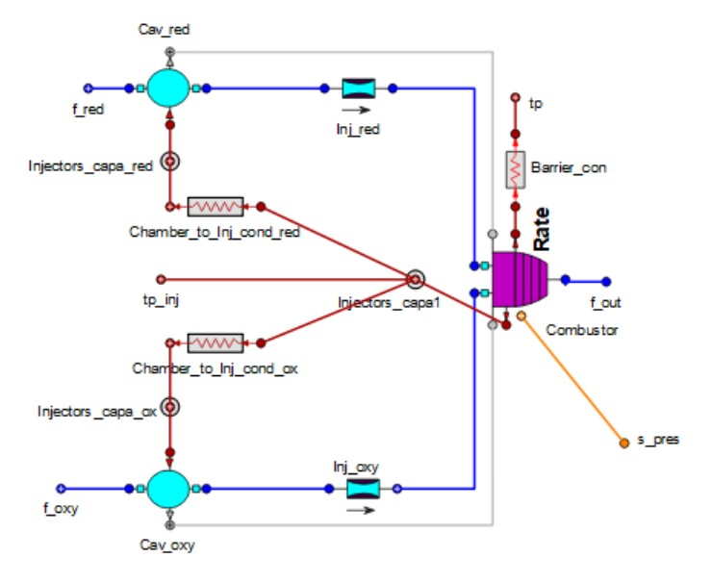
TASK 2: Models implementation
Heat Exchange for injectors
Improved thermal network to simulate CH4/O2 injectors
Thermal Network of Injectors in ESPSS 3.6
New Thermal Network

Slide 34
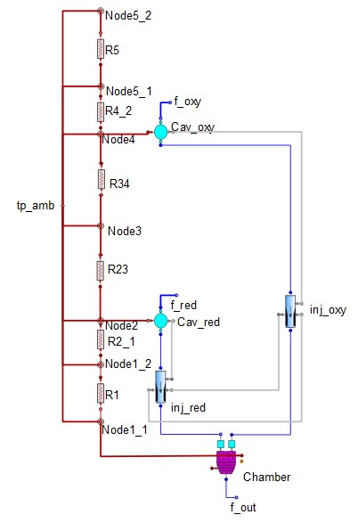
TASK 2: Models implementation
New components
New PreBurners and CN components created with new thermal network and injectors
Option to activate or deactive the convection in the injection elements
FLAG Inj_cov
ChamberNozzleDynamic_Plate
Preburner_Plate

Slide 35
TASK 2: Models implementation
Implementation phase:
LA SAPIENZA (UROME)
COKING IN CJ
HEAT AND MASS TRANSFER IN NOVEL INJECTORS
TURBOMACHINERY TRANSIENT MODELS
New component: "Pump_chilldown". It is a topological component that is formed by the main fluid stream, plus a secondary stream in charge of chill down.
The proper heat exchange with the inclusion of thermal nodes and conduction elements has been taken into account.
A series of discretized volumes have been included to represent the different parts of the pump (impeller, volute, etc.)

Slide 36
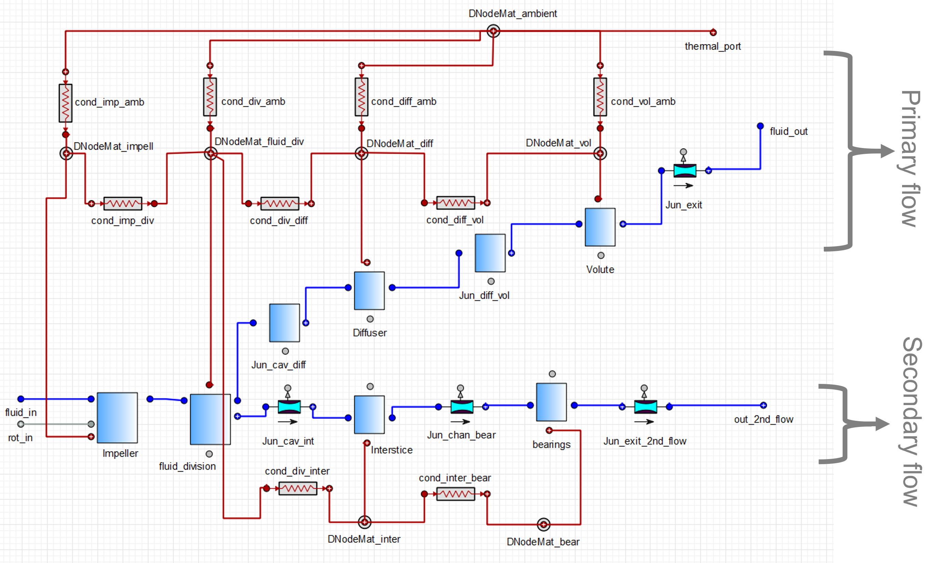
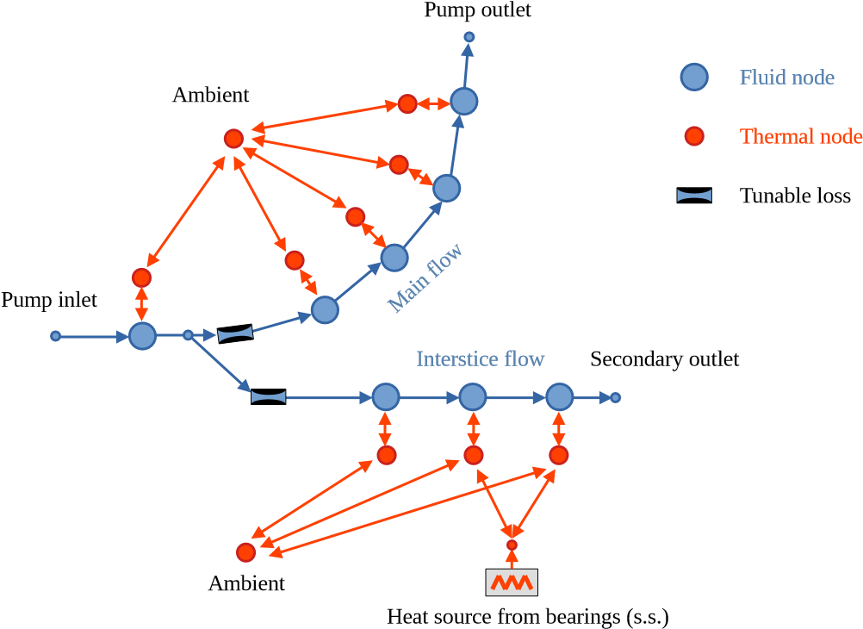
TASK 2: Models implementation
Development of pump component for transient chill down
The NPSH Calculation and Conservation Equations are the same of the Pump and Pump gen component
Cooling of the bearing cavity behind the impeller
Cooling coming from spilled from the main flow

Slide 37
TASK 2: Models implementation
Implementation phase:
LA SAPIENZA (UROME)
COKING IN CJ
HEAT AND MASS TRANSFER IN NOVEL INJECTORS
TURBOMACHINERY TRANSIENT MODELS
EMPRESARIOS AGRUPADOS (EAI)
MONOPROPELLANT MODELLING
Injectors
Catalytic bed
Chemistry models
FINITE RATE FOR LOX/CH4

Slide 38
TASK 2: Models implementation
Finite Rate Chemistry for LOX/CH4 combustions
Modification of the Abstract combustor components to select Arrhenius cases
4 options loaded in Arrh_option
TSR_Stoich-21
TSR_Stoich-12
TSR_Lean-14
Global
New chemicals included to the CEA database of ESPSS
CH3, C2H, C3H3, CH3O
All the schemes have been tested and validated in terms of equilibrium temperature and composition, counter flow diffusion flames and perfectly stirred reactor calculations. The results showed comparable or superior performance compared to the Zhukov scheme.

Slide 39
TASK 2: Models implementation
Monopropellant HTP
Development of specific functions for the calculation of properties of liquid/gas mixture in HTP decomposition
Calculation of P,T of HTP as a function of u and $ρ$ and $w_{H2O2_{HTP}}$
HTP_Mix_state_vs_ru
Transport properties f(P,T,$x_{HTP}$)
HTP_visc_vs_pT or HTP_cond_vs_pT
Thermodynamic properties f(P,T, $x_{HTP}$)
HTP_prop_vs_pT
Density,h,Psat,Tboil,vsound
Integration of property files into ESPSS
Including multiple perfect liquid files with varying HTP mass composition
85, 87.5, 90, 92, 95, 98, 100 (%)

Slide 40
TASK 2: Models implementation
Monopropellant HTP
Injector HTP component
Modified Junction with discharge coefficient calculation
Cd_Constant
Cd_Table f(Re)
Cd_Lichtarowicz empirical correlation f(Re)
Included multiple orificies, calculates actual throat area
Embebbed in the “InjectorLoss” component
Injector developments for LOX/CH4 case (URome WP3100) +
Injector developments for HTP case (EAI WP3200)

Slide 41
TASK 2: Models implementation
Monopropellant HTP
Injector developments for LOX/CH4 case (URome WP3100) +
Injector developments for HTP case (EAI WP3200)

Slide 42
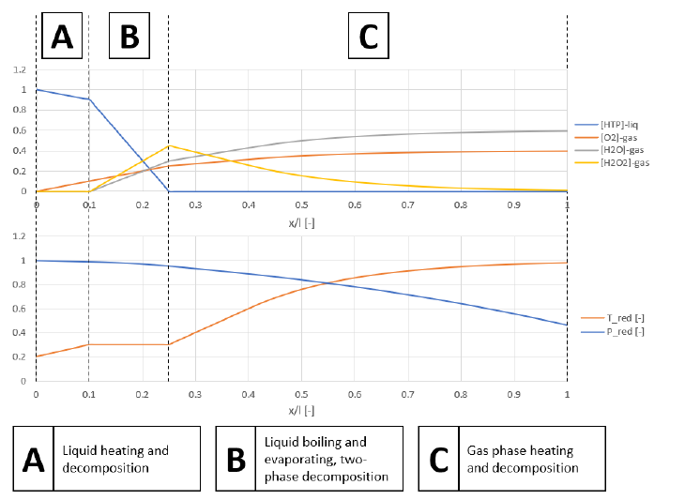
TASK 2: Models implementation
Monopropellant HTP
CombustHTP component
Created component based on abstract formulation
Formulation
Mixture of chemical components
Boiling Options
HTP_Boil1, HTP_Boil2, HTP_Boil2, HTP_BoilKW
AbsCombustorHTP
CombustHTP
AbsCombustorHTP_NP
AbsCombustorMonoProp_HTP
CombustMonoProp_HTP

Slide 43
TASK 2: Models implementation – SUMMARY
Additional components
Modified/improved components
COMB CHAMBERS
TURBO MACHINERY
Coking
Arrhenius schemes of LOX/CH4

Slide 44
Task 3: models validation

Slide 45
TASK 3: Models validation

Slide 46
TASK 3: Models validation
Clasification of validation activities
Pre-validation at component level against open literature/use cases
URome, Lukasiewicz
Validation at component level against test data
AVIO, NAMMO
Validation at engine level against test data
AVIO, NAMMO
New examples available:
“test_ch4_tsr12”
“test_ch4_tsr21”
“test_ch4_tsrlean14”
“test_coking”
“test_comb_htp”
“test_comb_htp_nozzle”
“test_injMonoprop”
“test_injector_loss”
“test_pump_chilldown”
“test_preburner_plate”

Slide 47
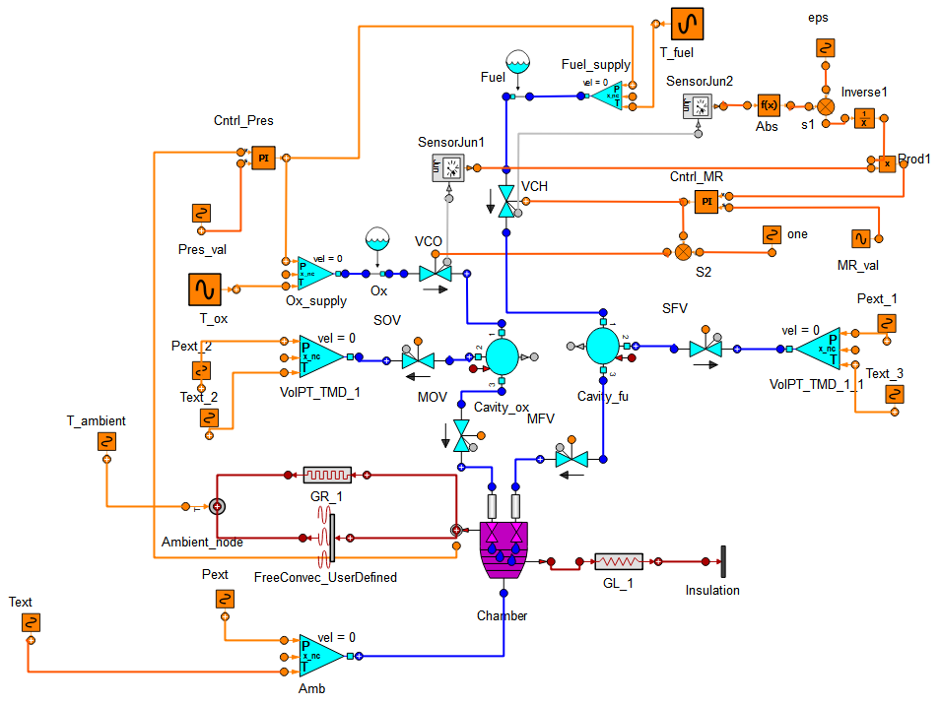
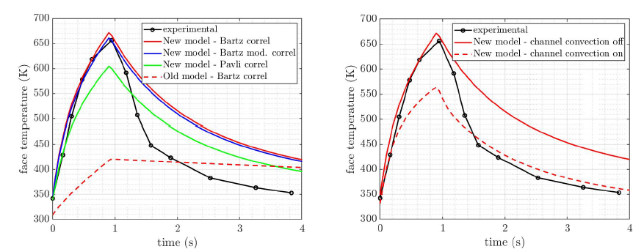
TASK 3: Models validation
Validation of PreburnerPlate component
“test_preburner_plate” in ROCKET_EXAMPLES
Proposed model enables to represent the heating transient
Uncertainties in shutdown leads to discrepancies
Reference: “DeRidder, M. A and Anderson, W.E. Heat flux and pressure profiles in an oxygen/hydrogen multielement rocket combustor, JPP 2010”

Slide 48
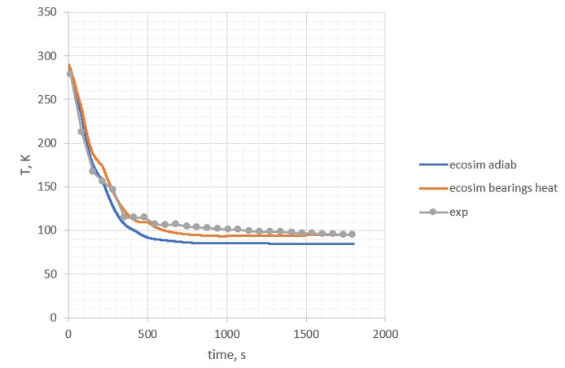
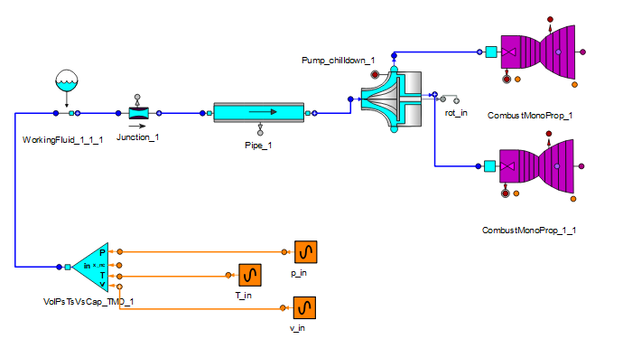
TASK 2: Models implementation
Validation of pump component for transient chill down
“test_pump_chilldown”:
Good reliability in reproducing the experimental behaviour
Reference: J Joseph et al. “Chilldown study of cryogenic turbopump bearing coolant cavity”, ICAME 2015

Slide 49
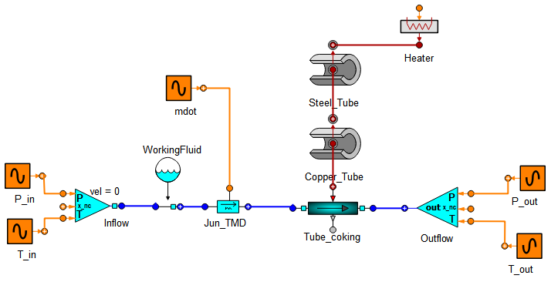
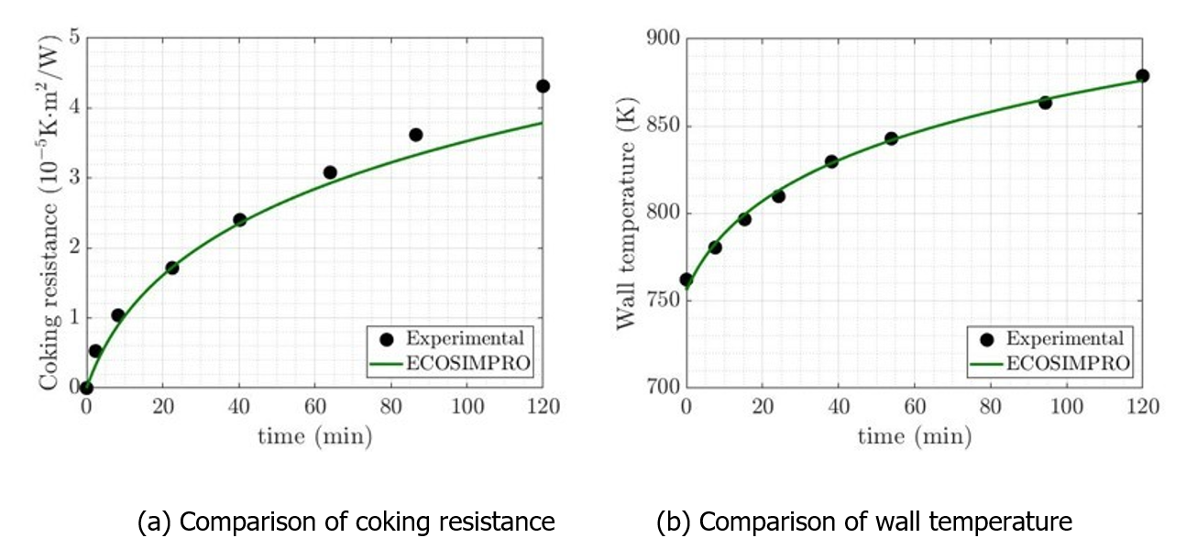
TASK 3: Models validation
Coking Validation
“test_coking” in ROCKETS_EXAMPLES
Kerosene RP1 experimental data, fitted (JP10)
Reference: “K. Liang, B. Yang, and Z. Zhang, “Investigation of heat transfer and coking characteristics of hydrocarbon fuels,” Journal of Propulsion and Power, 1998”

Slide 50
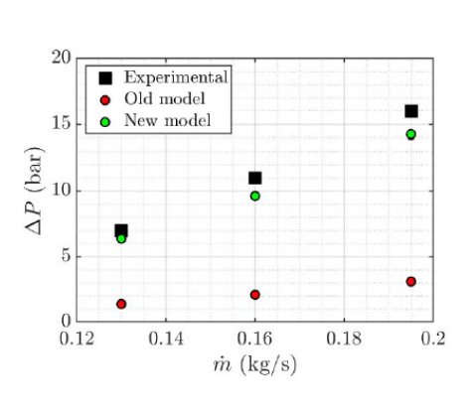
TASK 3: Models validation
LOX/CH4 injectors
Validation
test_injector_loss in ROCKET_EXAMPLES for the Close swirled with sharp inlet validation
Reference: “Ahn et al, Experimental Study on the Discharge Coefficient of Bi-Swirl Coaxial Injectors, Journal of Applied Fluid Mechanics, 2019”

Slide 51
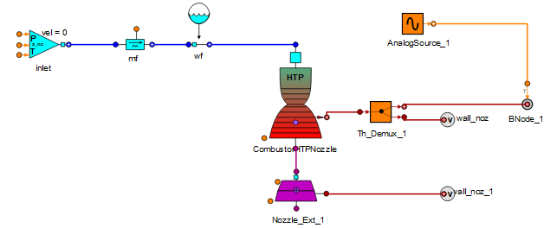
TASK 3: Models validation
Monopropellant Examples
Test of Catalytic Bed test_comb_HTP in ROCKET_EXAMPLES
Test of Monopropellant in test_comb_htp_nozzle in ROCKET_EXAMPLES
Reference: “Paweł Surmacz PhD Thesis. ILOT. “ Experimental studies decomposition process of 98%hydrogen peroxide in composite catalytic beds in rocket engine injection systems”

Slide 52
TASK 3: Models validation
Validation of LOX/CH4 injectors
Validation of pressure losses through injectors with two set of experiments:
Water cold-flow tests: validation of jet injectors (sharp edge, rounded inlet and slanted inlet) and perforated plate with slanted inlet for different mass flows. Perforated plate model shows better performance, with a 20% deviation (uncertainties of measurements)
Hot-firing tests: data coming from DM1 M10 engine test. Numerical results show very good agreement (below 10% error) for the steady state.
Thermal network validation taking into account relevant dimensions of the elements.
Fluidic temperatures are very well reproduced
Solid temperatures are not well reproduced (effective thermal conductivity, actual exposed surfaces for the heat exchange, position of thermocouples…)
Reduced order finite rate chemistry
Two models were validated and compared to the global mechanism in ESPSS: TSR-Stoich-21 and TSR-Stoic-12.
Data coming from DM1 M10 hot firing tests.
Good prediction of chamber pressure at steady state (<10% error) and good prediction of the ignition event.

Slide 53
TASK 3: Models validation
Validation of Pump chilldown
Several simulations:
Chilldown
Transient phases (start-up, shutdown)
DATA: turbopumps assemblies from DM1 experimental test campaings DM1-02, DM1-04-02.
Fluid temperatures and most important wall temperatures follow the experimental behavior
Some differences in other wall temperatures are observed due to uncertainties in the model layout and the 1D approach of ESPSS.
A major difference was observed during shutdown due to a residual rotational speed near 0-rpm conditions. This has been changed and the correction will be included in the next ESPS version.
Validation of coking
Several simulations:
RP-1 (Kerosene)
Propane
Jet-A
Good reproduction of the results by adjusting the semi-empirical parameters to open literature data

Slide 54
TASK 3: Models validation
LOX/CH4: AVIO validation of M10 DM1 test campaign
Variables compared:
Rotational speed, mass flow, outlet pressure of the oxidizer pump
Pressure and MR of the combustion chamber
Results are in line with experimental data both in absolute values at steady state and the transient trends.
Complete engine assembly with new pump and new combustor reproduces with high accuracy the engine real performance (startup, steady, shutdown)
HTP: Nammo validation of PoC1 and PoC4 test campaign
Variables compared: pressure, temperature, decomposition evolution and mass flow.
Simulations done with 87.5% concentration of H2O2
Different operating points tested
PoC1: general performance with error <10%. Pressure rise faster than in testing due to several causes (decomposition rate of H2O2, flash boiling, Leidenfrost effect, 3D effects, small cavity downstream of injector plate not included…)
PoC4: general performance with error <10%. Better results for single firing than pulse firing. Combustion chamber temperature rise happens more rapid than in tests. (Uncertainties in the delay of the pressure signal)

Slide 55
Conclusions and future work

Slide 56
Conclusions
LOX/CH4
New pump component is able to follow the trend of the fluidic nodes, while for the nodal temperature the geometry and layout must be as much as possible similar to the real one to have a representative trend
Simulations at engine level show a high degree of accuracy for reproducing test data results
Injectors pressure losses tests show <10% error for the hot firing tests when predicting the mass flow
The use of finite rate schemes penalizes the runtime performance but is of great advantage for a good prediction of the ignition time.
HTP
Better performance of the “CombustMonoprop_HTP” component than the assembly of “CombustHTP” + “Nozzle”.
Error below 10% in the most important variables
Robust model
No big runtimes

Slide 57
Future work
LOX/CH4
Combustor: compute pressure based on Dt (without relying on the chamber mesh)
Limitation in new chemical schemes: Missing N2 and He in the list of non-condensable fluids
Dedicated component with finite rate chemistry only to assess performance in transient phases of small thrusters
HTP
Improve the way in which the geometry of subsonic and supersonic parts are inputted by the user (avoid inconsistencies)
Improve robustness when the nozzle type is set as “NonIsentropic”
Handle N2 as pressurizer gas in the system
Option to specify different porosities along the length of the catalyst.
Extend HTP component to any other chemical scheme (e.g. Hydrazine…)
Merge HTP properties functions with previously existing ones in FLUID PROPERTIES library

Slide 58
Questions ?

Slide 59
Thank you!

