Slide 1


Test Solution for New Space Market
6th March 2024
by Nikolaos Voutsas

Slide 2

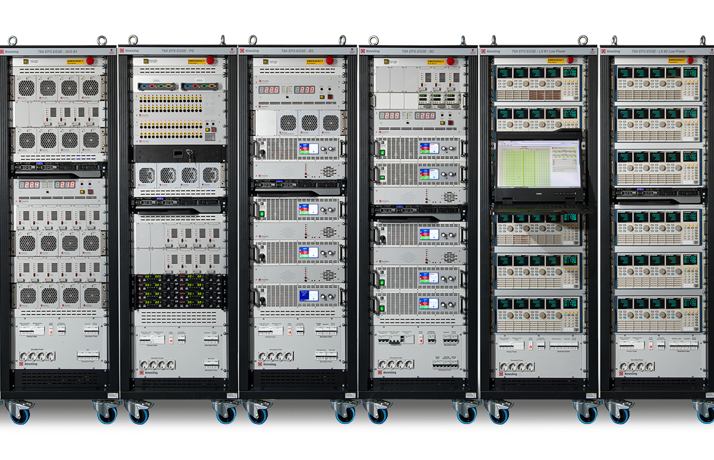

Agenda
Introduction of project
Rack design
Explain why these components
Software
Business Plan
Next Steps

Slide 3

Introduction Project
Based on internal assessments averaged over Science and Earth Observation satellites, the cost composition by the various disciplines involved in a typical satellite is estimated as:
• Management 10%
• Back Office 15%
• Engineering 30%
• MAI* 25%
• Quality 10%
• Testing 10% (Power, Avionics, Software, Radio Links, EMC, Propulsion, Mechanisms, Thermal Control)
Of the estimated Testing cost, the estimated contribution of EGSE is 30%, so approx. 3% of the total satellite cost.

Slide 4
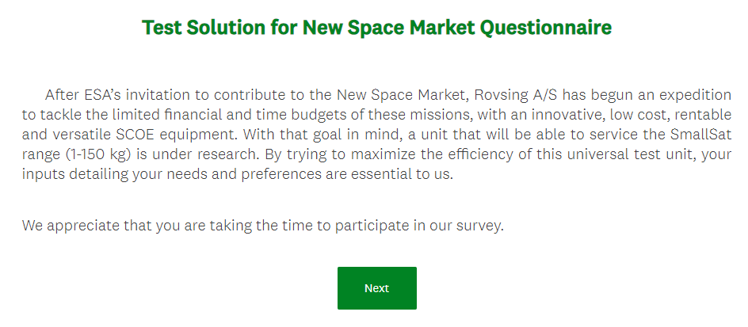
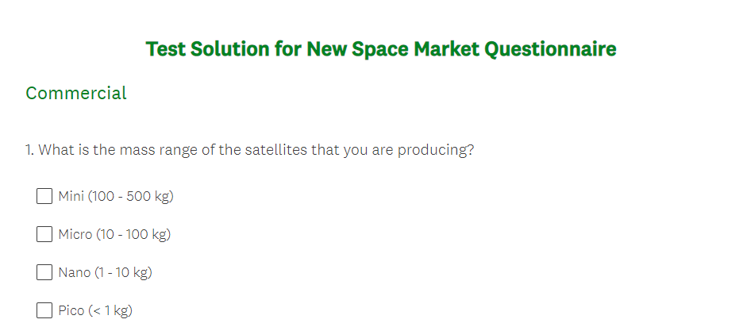
Introduction Project. The Study Approach
The questionnaire
It includes 76 questions separated into the following categories:
Commercial
Battery Simulation
Solar Array Panel Simulation
Actuators Simulation
Thermistor Simulation
Bus Interfaces
Load Simulation
Umbilical Charging
Battery Charging
Monitoring needs
Safety
Software needs
Harness Characteristics
General

Slide 5
Introduction Project. The Study Approach
The customer data base
Name
AAC CLYDE SPACE | ENDUROSAT | Orbex
Aerospace Lab | European Test Services | Orbital Astronautics
Airbus Defence and Space | Exobotics | Plan-S
Alba Orbital | Exotrail | QinetiQ
Alen Space | Experior Laboratories Inc | Re-Orbit
ALTER | FOSSA Systems | Satellite Applications Catapult
Apogeo Space | GMV | SATLANTIS
ARCA Dynamics | GomSpace | SatRev
Argotec | HEMERIA | SITAEL
Artemis Space | IABG | Skylabs
Asteroid Mining Corporation | ICEYE | Spåce Forge
Astroscale | ISISPACE | Space Inventor
Ball | Karten Space | Space Utility drones
Berlin Space Technologies GmbH | Kongsberg NanoAvionics | Spire
BOEING | KUVA SPACE | SSTL
C3S | LEONARDO | Stratosyst
Centre Spatial de Liège | LMO | TEIDESAT
CLEMESSY | Millennium Space | Thales Alenia Space
COMET Ingeneria | New Space Systems | The Exploration Company
CSL | NPC SPACEMIND | Thermal Vacuum Projects, S.L.U.
Deimos Engineering and Systems SLU | OHB Systems | Tyvak International
D-Orbit | Open Cosmos Ltd | U-space
66 Companies were identified for the targeted market

Slide 6
Introduction Project. The Study Approach
Capture Market feedback
Methods:
Company contacts
LinkedIn
Personal contacts
Face to face
Includes 32 companies that ROVSING has already facilitated contact with.
Finding the appropriate employees through their LinkedIn profile
From ROVSING employee's previous collaboration on projects etc.
Participation of ROVSING A/S on the “6th ESA CubeSat Industry days”

Slide 7
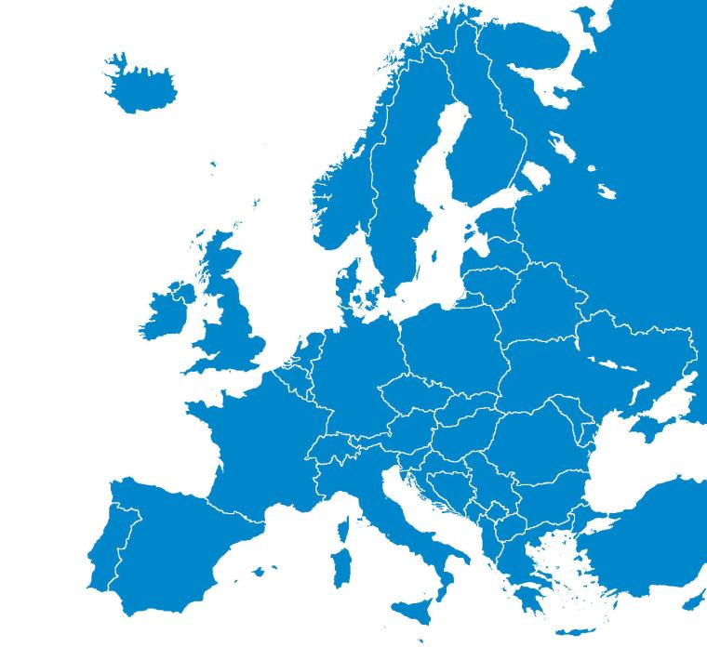

Introduction Project. Data Conclusion
15 Total answers
There is a compelling spread
The data are reliable

Slide 8

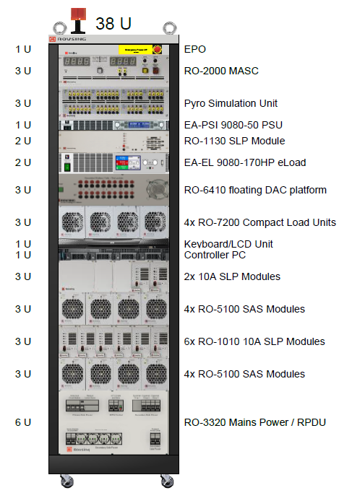
Rack Design
HLC Board
Bi-level Board
A/D Board

Slide 9
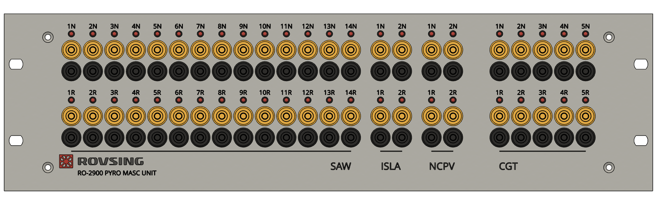
Data conclusion
Pyro Board
LLD Board

Slide 10
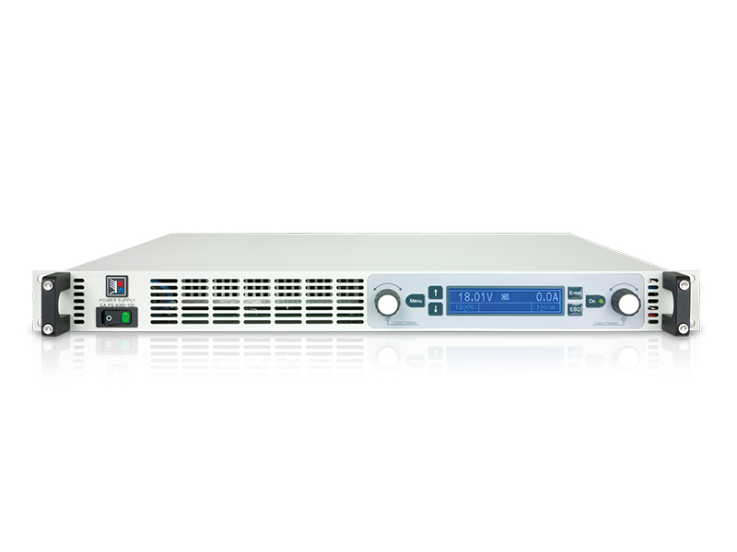
Data conclusion
Charging
Battery Simulation
Notes:
Main features (EA-PS 9080-50):
1U PSU
80V / 50A (max 1500W)
CC / CV operating modes
OVP / OCP / OTP / OPP protection features
Accuracy Voltage (±0.1%) / Current (±0.2%) / Power (±1%)

Slide 11
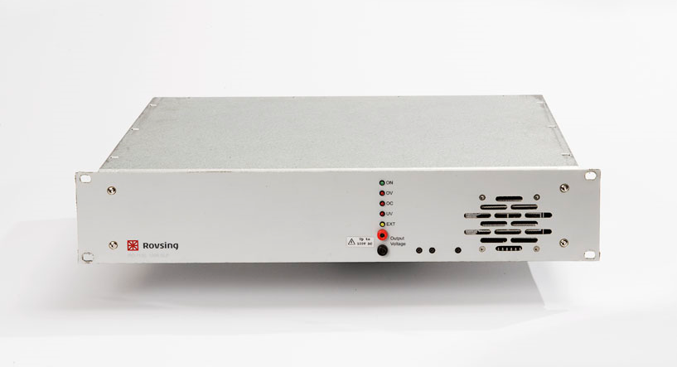
Data conclusion
Second Layer of protection
Notes:
Main features (EA-PS 9080-50):
1U PSU
80V / 50A (max 1500W)
CC / CV operating modes
OVP / OCP / OTP / OPP protection features
Accuracy Voltage (±0.1%) / Current (±0.2%) / Power (±1%)

Slide 12
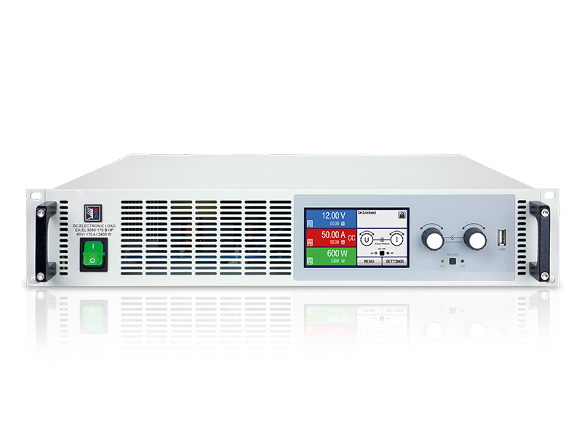
Data conclusion
Discharge
Notes:
Main Features (EA-EL 9080-170 B HP):
2U Electronic Load
80V / 170A (max 2400W)
CC / CV / CP / CR operating modes
OVP / OCP / OTP / UVL protection features
Accuracy Voltage (±0.1%) / Current (±0.2%) / Power (±0.5%)

Slide 13
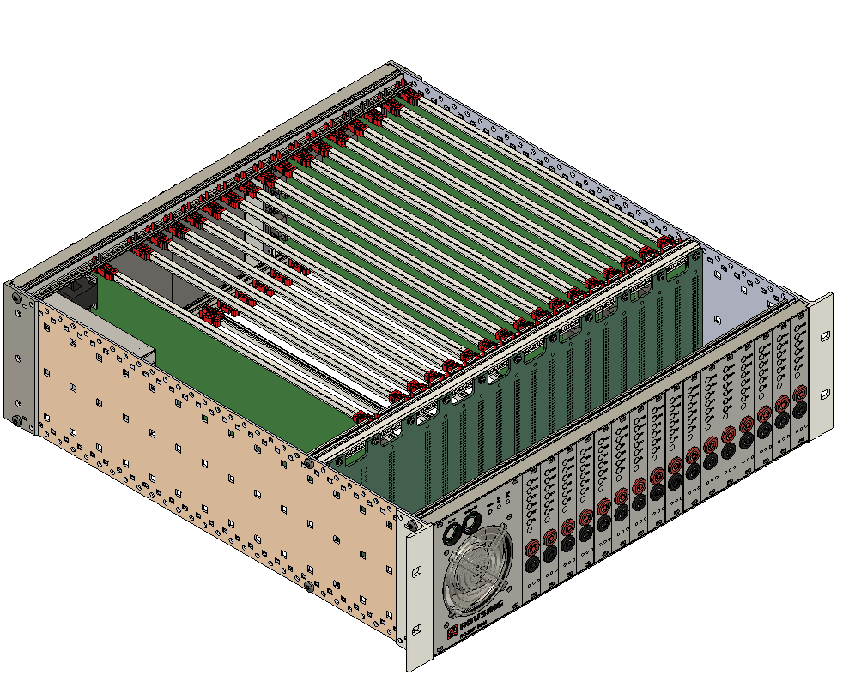
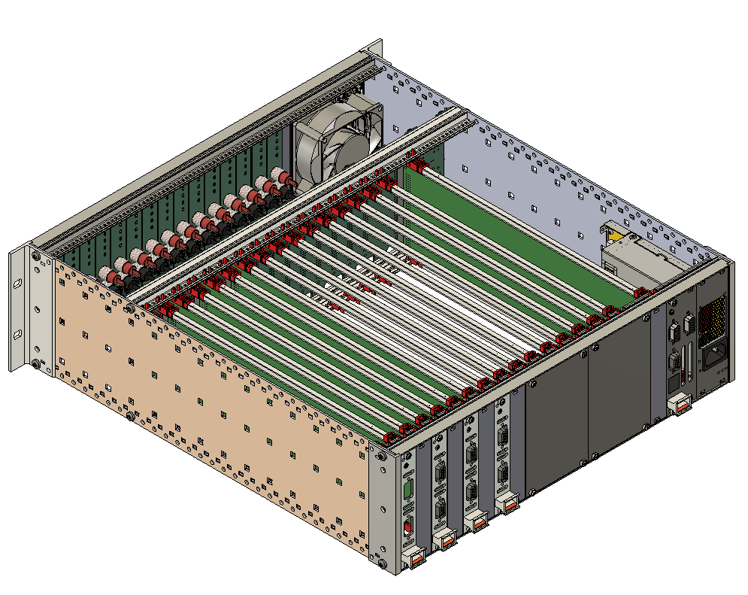
Data conclusion
Battery Cell Emulation

Slide 14
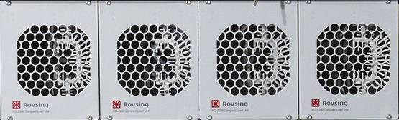
Data conclusion
Up to 18 channels that can be combined

Slide 15
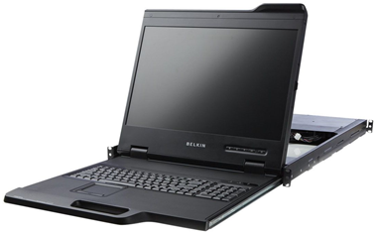
Data conclusion
Local MMI

Slide 16
Data conclusion
Solar Array Simulation

Slide 17
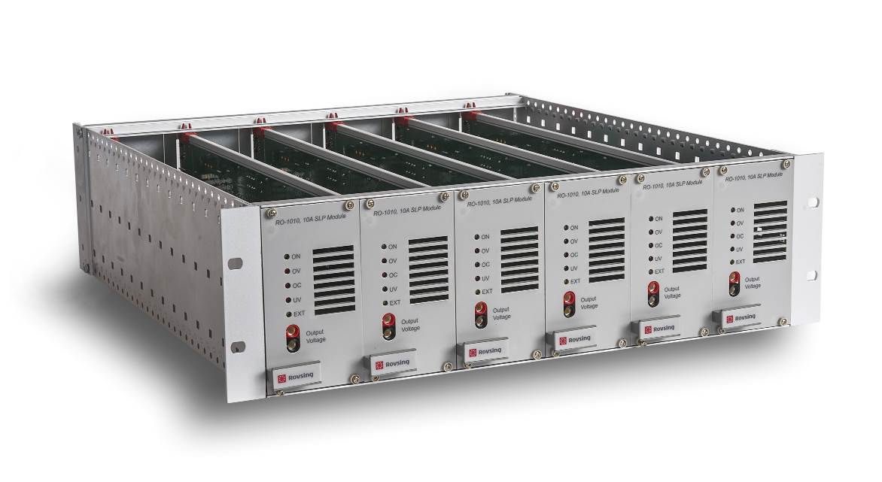
Data conclusion
Second Layer Protection (SAS)

Slide 18
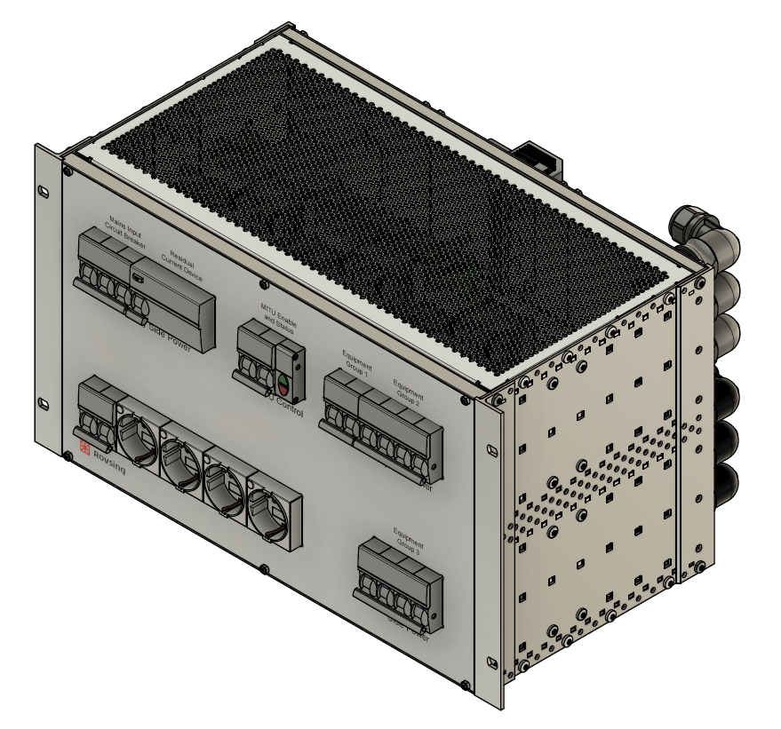
Data conclusion
Power Distribution Unit

Slide 19

Software
Software Features:
Modularity and Configurability : allowing for flexible customization to meet diverse needs, such as Mission-Driven Configurations.
Real-Time Control and Monitoring
Automated Testing Procedures
Data Logging and Analysis
Cross-Platform Compatibility
Scalability and Future Expansion
Application
Configuration
Feature 1
Feature 1
Feature 3
Feature 2
Feature 2
Feature 3
Feature 4
Feature 3
Feature 5

Slide 20

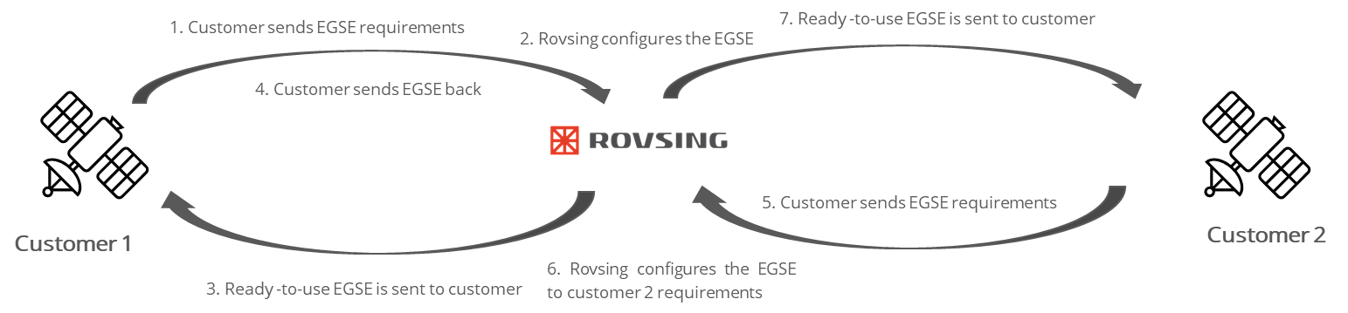
Business Plan

Slide 21
Business Plan
Business case for Rovsing and customer
ROVSING
Customer
To take into account:
The down time between two campaigns that can be short or long depending on the next signed contract
Conclusion
Rovsing would have a ROI of 29% after 4 test campaigns for 9 months each. The overall investment/ payback time is around 2 years.
Conclusion
Up until 18 months, it is financially preferable to lease the equipment.

Slide 22

Next Steps. Development Phase

Slide 23
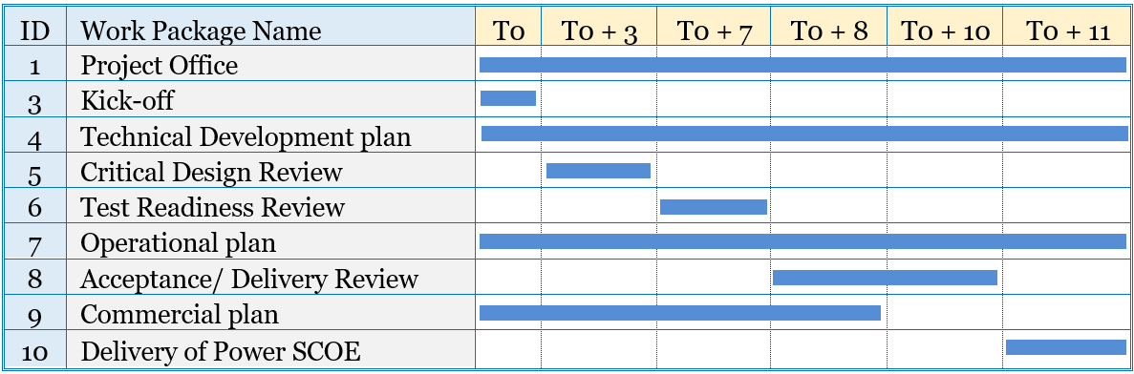
Next Steps. Development Phase
Investigate possible external financial support
Promotion
Software Development
Hardware Development
Hardware/ Software Testing
Delivery

Slide 24


ANY QUESTIONS OR COMMENTS?

