Slide 1


Analysis of GNSS Spaceborne Resilience
Final presentation
C4000133305/20/NL/CRS/hh
- ESTEC - Noordwjik 2023-06-14

Slide 2
Agenda
Project introduction
Establishment of context
RFI Risk Assessment
RFI detection and mitigation
Conclusions & Outlook

Slide 3
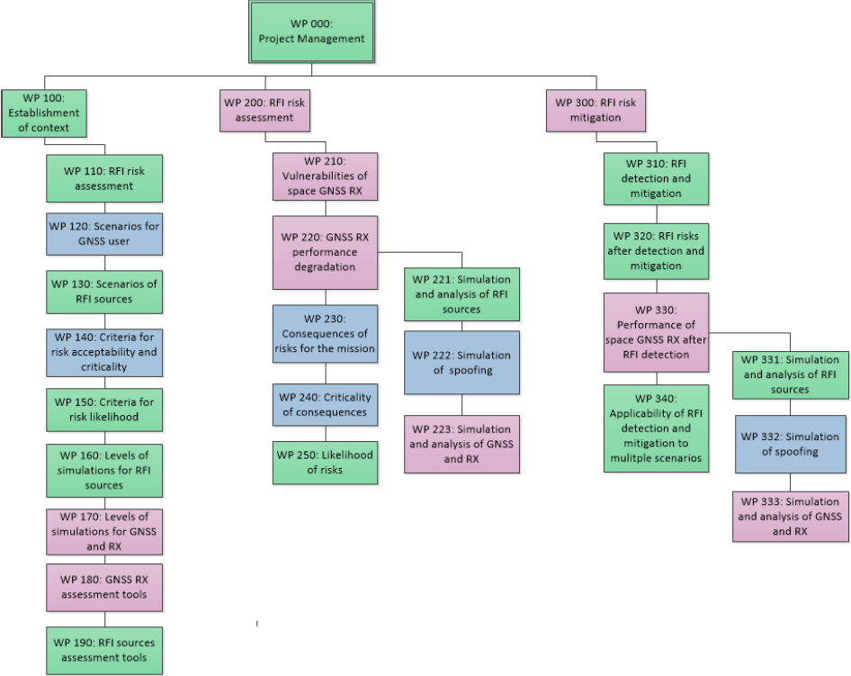



Project introduction
  Comprehensive quantitative RFI risk assessment for spaceborne GNSS receivers and derived products
  RFI mitigation techniques, considering different
  missions and scenarios
Notes:
Workbreakdown structure with assignment of tasks to partners and project’s objectives

Slide 4
Agenda
Project introduction
Establishment of context
RFI Risk Assessment
RFI detection and mitigation
Conclusions & Outlook

Slide 5
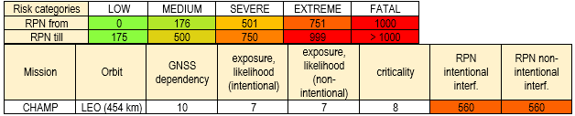
Risk assessment for typical scenarios / missions
Establishment of context 1/3
3 factors for overall risk:
  GNSS dependency of a mission
  RFI exposure of spacecraft in orbit
  RFI criticality
Evaluated scenarios:
  Attitude and orbit control system (AOCS)
  Time referencing/synchronization
  Launch
  Re-entry
  Rendezvous or formation flying
  Precise orbit determination (POD)
  Precise on-board orbit determination (P2OD)
  GNSS reflectometry
  Radio occultation
Notes:
Risk priority number aims to make risks comparable

Slide 6
Evaluated criterions for risk assessment of missions/scenarios
Establishment of context 2/3
Mission objective
Use of GNSS
Requirements on GNSS
Location and orientation of antenna(s)
Observations
Processing
Latency
Orbit (altitude, time of visibility)
Mission phases
Backup/supplementary sensors
RFI exposure and spoofing related risk
Worst-case impact of RFI / spoofing

Slide 7
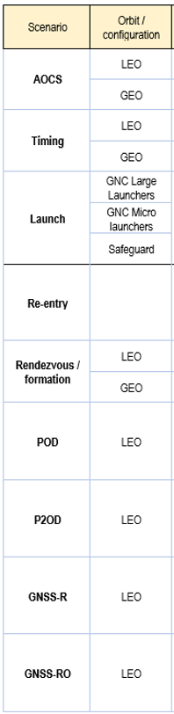
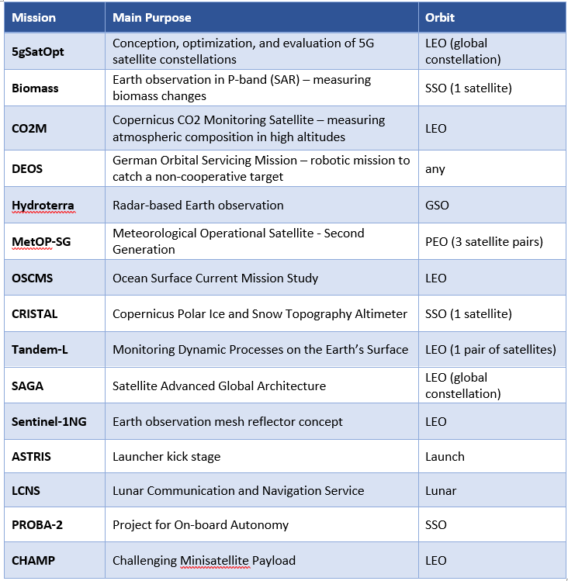
Scenarios / missions considered
Establishment of context 3/3

Slide 8
Scenarios of RFI sources
Establishment of context 4/4
Unintentional:
Aeronautical Radio Navigation Services
DME/TACAN
JDITS/MIDS (NATO)
Flight Surveillance Radars (primary/secondary)
Amateur Radio Services
Pseudolites
Out-of-band emissions
Other interferers:
  Ultra wide band (UWB)
  5G / Ligado
  Spurious RF emissions
  Onboard interferers
Intentional:
Jammers
  Personal privacy devices
  High-power jammers
Spoofing
Notes:
UWB: only with high Tx power or mobile use; SPURIOUS: Harmonic emissions, intermodulation products, parasitic emissions, frequency conversion products; ONBOARD: Synthetic Aperture Radar (SAR) satellites
SPOOFING: Navigation message attacks, data parameters for modification

Slide 9
Agenda
Project introduction
Establishment of context
RFI Risk Assessment
RFI detection and mitigation
Conclusions & Outlook

Slide 10
RFI impact on GNSS signals
RFI risk assessment 1/5
Can be expressed and simulated by Spectral Separation Coefficient (SSC)
SSC used to calculate loss in C/N0 of GNSS signals by specific interference
C/N0 is degraded depending on SSC and received power of interference
Effects:
  Increased correlation and measurements noise
  Increased bit error rate (BER)
  Increased PVT noise
  Loss of PVT availability
  Loss of tracking

Slide 11
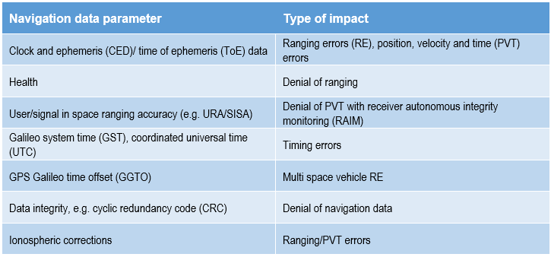
Impact of Spoofing
RFI risk assessment 2/5
Strictly similar to impact of RFI (causes C/N0 degradation of authentic signals)
Impact on GNSS receiver’s correlators:
  Acquisition and tracking modules of the receiver are either tracking authentic or spoofed signals
  Without dedicated spoofing detection algorithms no distinction possible
Navigation message attacks
data parameters for modification:
Notes:
Jam and then spoof

Slide 12
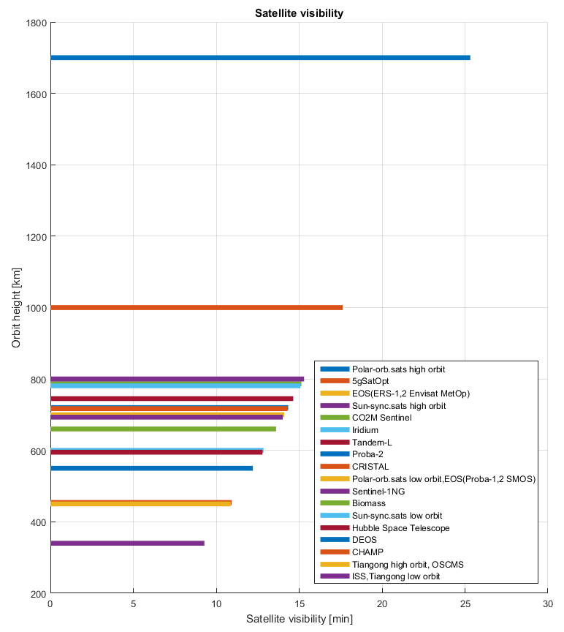
RFI risk assessment 3/5
Notes:
Jam and then spoof

Slide 13
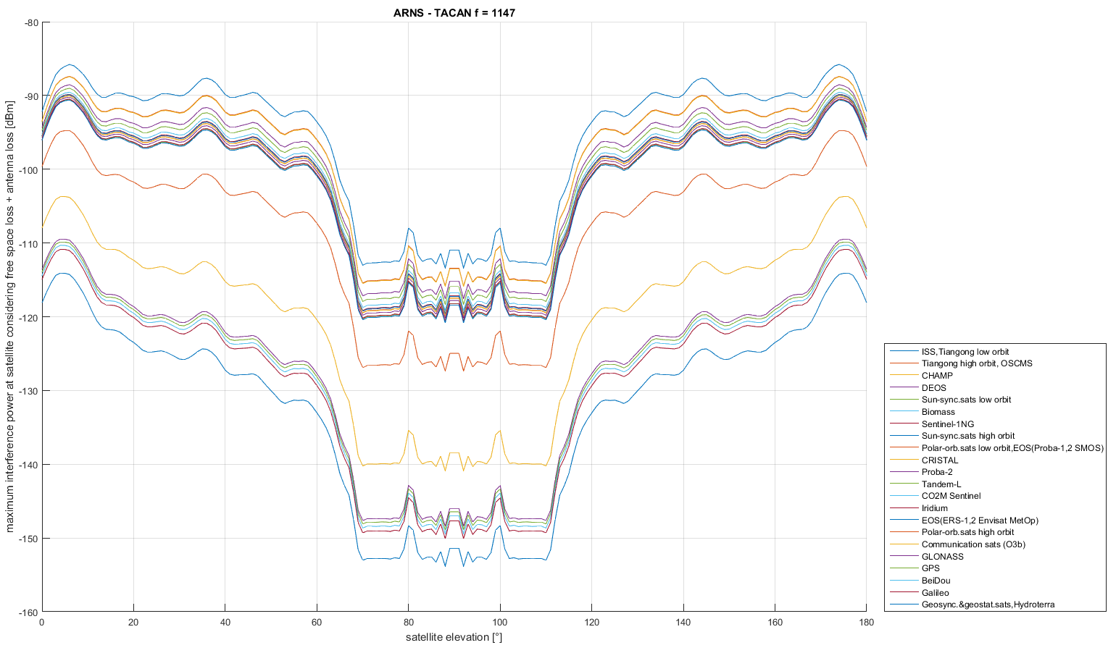
RFI risk assessment 4/5
Notes:
Jam and then spoof

Slide 14
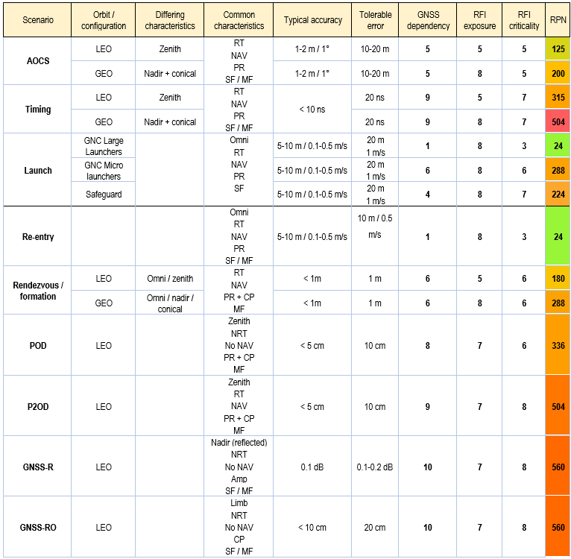

RFI risk assessment 5/5
Risk Priority Number (RPN)
Abbreviations:
Requirements:
RT (real-time), NRT (non-real-time)
Observations:
AMP (amplitude), PR (Pseudorange),
CP (carrier phase)
GNSS configuration:
SF (single-), MF (multi-frequency)
If not stated otherwise nadir-pointing and
conical antennas mostly receive second lobe signals
instead of direct signals,
which reduces the signal amplitude.

Slide 15
Agenda
Project introduction
Establishment of context
RFI Risk Assessment
RFI detection and mitigation
Conclusions & Outlook

Slide 16
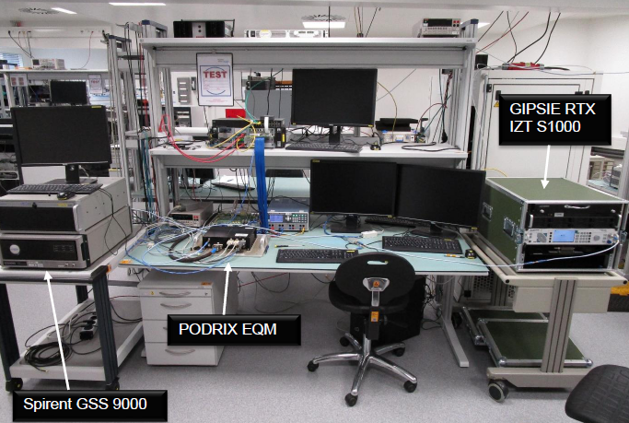
RFI detection and mitigation
RFI detection and mitigation 1/12
Two approaches for assessing the impact of interference and spoofing:
  Tests with BG receivers (PODRIX multi-frequency navigation receiver, PRETTY reflectometer)
  Simulation model MatlabTM.

Slide 17
Simulation of signals and receiver tests
RFI detection and mitigation 2/12
2 receivers from Beyond Gravity:
  PRETTY EM (Passive REflecTomeTry
  and dosimetry) mock-up of LEO cube-
  sat for slant geometry GNSS
  reflectometry from in orbit as well as
  radiation measurements
  PODRIX EQM, a multi constellation,
  GPS and Galileo receiver for Precise
  Orbit Determination (POD)
Test signals:
  Standard GNSS signals simulated by Spirent GSS simulators
  Jamming RFI (chirp and white noise type) computer generated and played out by
  OHB Digital GIPSIE RTX signal generator
  DME/TACAN RFI computer generated simulation of 9 frequency relevant stations at European hotspot around Frankfurt/Main/Germany and played out by OHB Digital GIPSIE RTX
  Spoofing signals by OHB Digital GIPSIE AJ+S with signals played out by GIPSIE RTX;
  Spirent GSS simulator for highly synchronised and long duration spoofing
Notes:
GIPSIE AJ+S: advance jamming and spoofing system

Slide 18
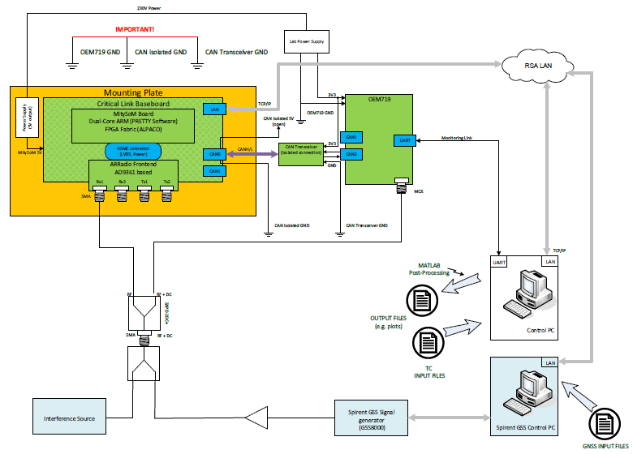
PRETTY Tests
RFI detection and mitigation 3/12
PRETTY
  Passive altimeter exploiting GNSS signals reflected on the surface of earth
  Implements interferometric approach
  Designed for a CubeSat mission => only single antenna for direct and reflected signals
  Single-frequency: L5/E5a

Slide 19
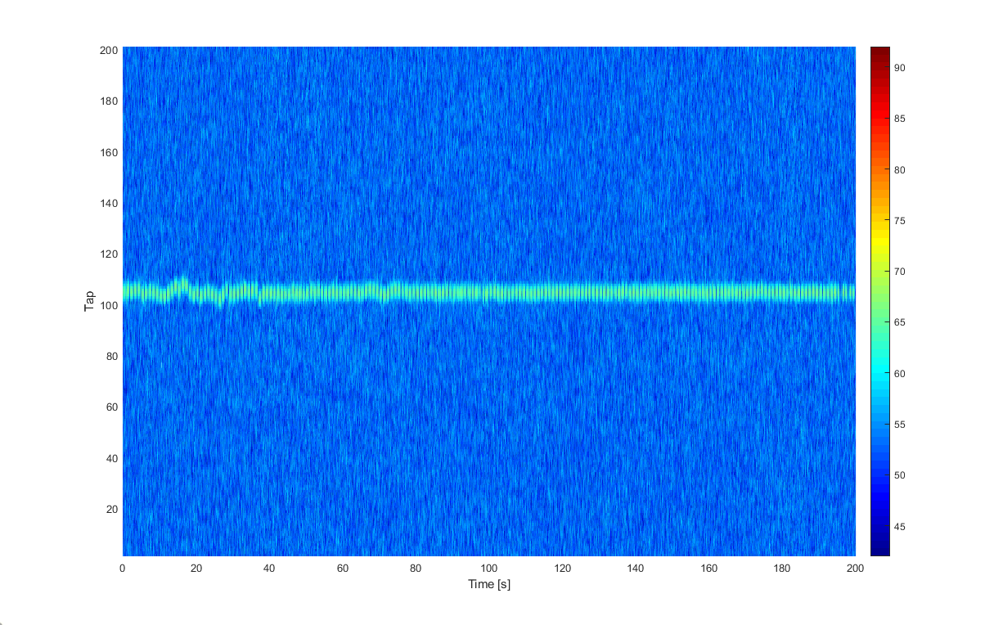
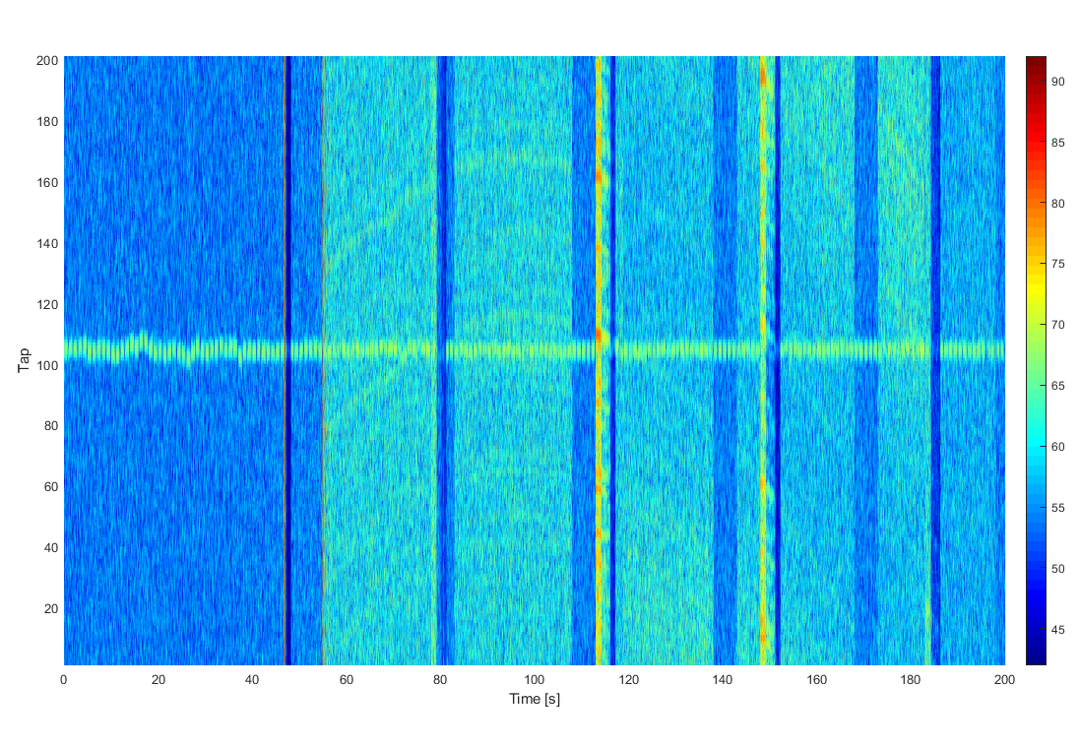
PRETTY Tests, cont.
RFI detection and mitigation 4/12
No interference
Results
  DME/TACAN interference resulted in degradation of correlation results
  Correlation results show cyclical behaviour of DME/TACAN pulses
  Significant degradation for input power levels of about -63dBm
Conclusion:
  At least in areas with high number of DME/TACAN stations this source of interference is a threat for GNSS reflectometers
With interference
Notes:
2 hotspots: Europe = around Frankfurt/Main/Germany, U.S.A. = Harrisburg/PA, Chicago/IL, Fresno/CA

Slide 20
PODRIX Tests
RFI detection and mitigation 5/12
PODRIX
  HighRel multi-frequency GNSS receiver for precise orbit determination (POD) missions
  Processes Galileo and GPS signals (L1/E1, L2, L5/E5a)
  Dynamically filtered navigation solution
  Initial spoofing tests were performed with a prototype of a Precise Point Positioning (PPP) software

Slide 21
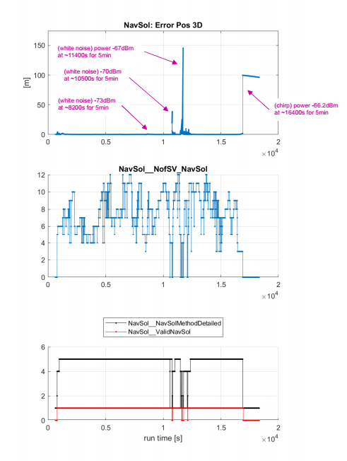
PODRIX Tests, cont.
RFI detection and mitigation 6/12
Jamming
  Impact of interference is observed as C/N0 degradation
  The impact on measurement and navigation performance can be directly derived from the degraded link budget
  A sensitivity level of -70 dBm was determined for broadband noise
  DME/TACAN a significant impact on the GNSS receiver performance was observed for power levels actually not expected in orbit

Slide 22
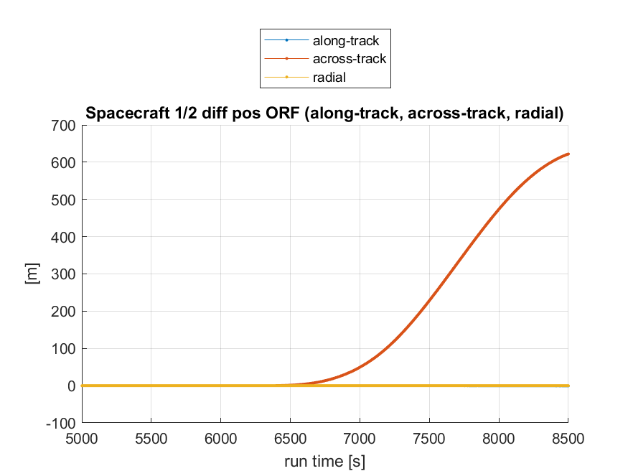
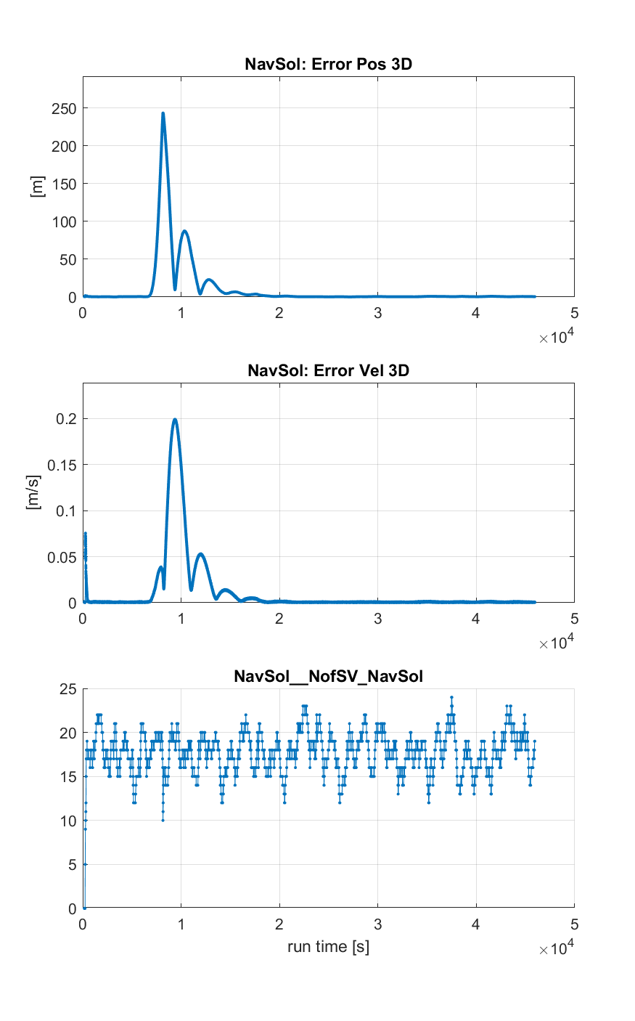
PODRIX Tests, cont.
RFI detection and mitigation 7/12
Spoofing
  Initial spoofing attempts with unsynchronised spoofer failed. Spoofing signals acted as interference => receiver stopped tracking.
  In a second test campaign a synchronised spoofer was simulated slowly deviating from the actual trajectory (thrust manoeuvre of
  2100 seconds).
  Receiver showed position and time errors
  PODRIX not sufficiently protected against such attacks, but detection would be feasible.

Slide 23
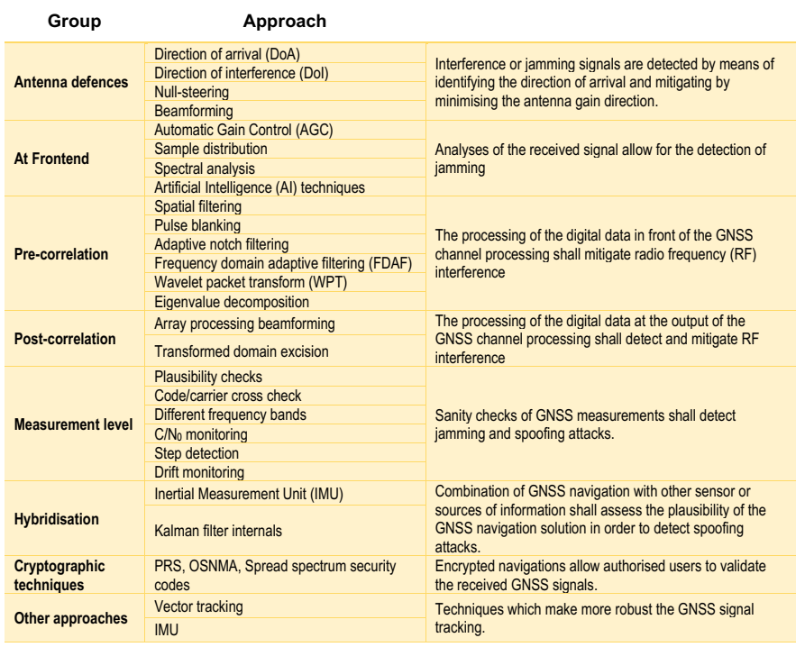
Mitigation Techniques
RFI detection and mitigation 8/12

Slide 24
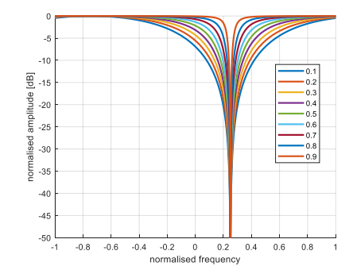
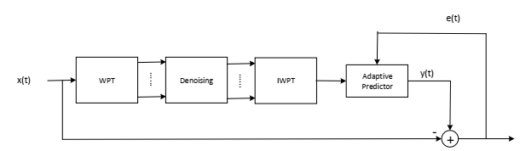
Assessment of Mitigation Techniques
RFI detection and mitigation 9/12
Discussion of various techniques for detection and mitigation of jamming and their suitability for spaceborne GNSS receivers
Simulation of selected pre-correlation techniques
  Adaptive notch filter
  Frequency domain adaptive filter (FDAF)
  Wavelet packet transform (WPT)
Notch filter
WPT
FDAF

Slide 25
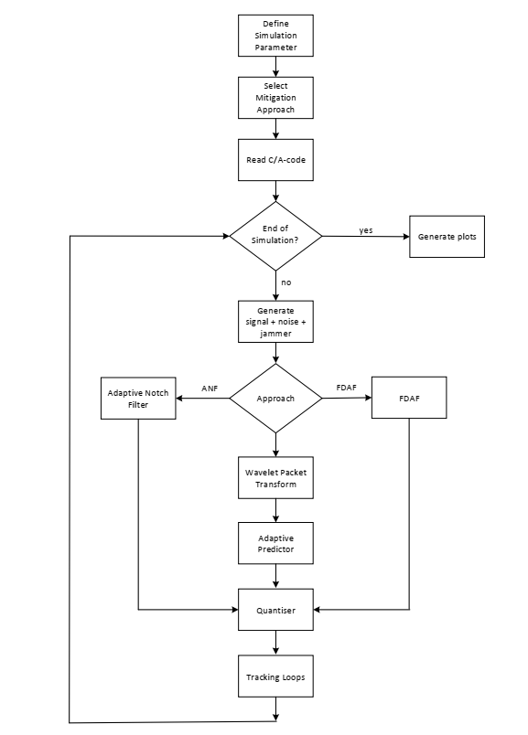
Simulation Model
RFI detection and mitigation 10/12
Simulation model implemented in MatlabTM
Signal model for GPS C/A-code
Simulated interference types
  Chirp
  Continuous wave
Quantiser after interference mitigation
Code and carrier tracking loops
C/N0 estimator

Slide 26
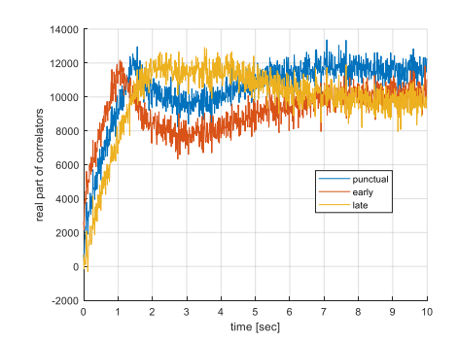
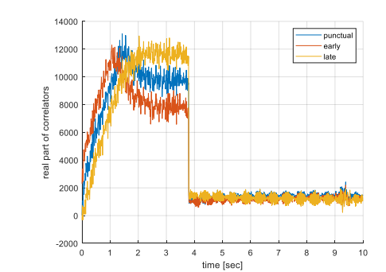
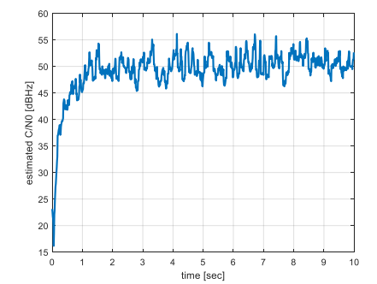
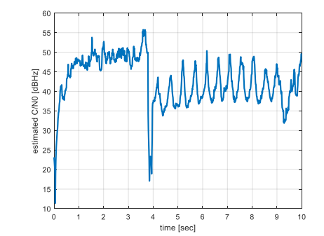
Simulation Results
RFI detection and mitigation 11/12
Interference w/o mitigation
Assessment of the three approaches mainly for chirps
Chirp amplitude and sweep rate varied
  Sweep rates from 5e10Hz/s to 1e13Hz/s
  Equivalent interference power levels up to -56 dBm
All simulated mitigation approaches were sensitive to the characteristics of the jamming signal
No interference

Slide 27
Conclusions on Simulation Results
RFI detection and mitigation 12/12
Unintentional interference can reach levels up to about -74 dBm.
For unfavourable antenna orientation the receivers needs to cope with higher levels.
The simulated mitigation approaches can protect against significantly higher levels.
However, for high sweep rates of chirps, the adaptive processes struggle.
For known interference characteristics, adequate parameters of the mitigation approaches can be found.
FDAF is considered as the most versatile approach, as also pulsed interferences can be suppressed.

Slide 28
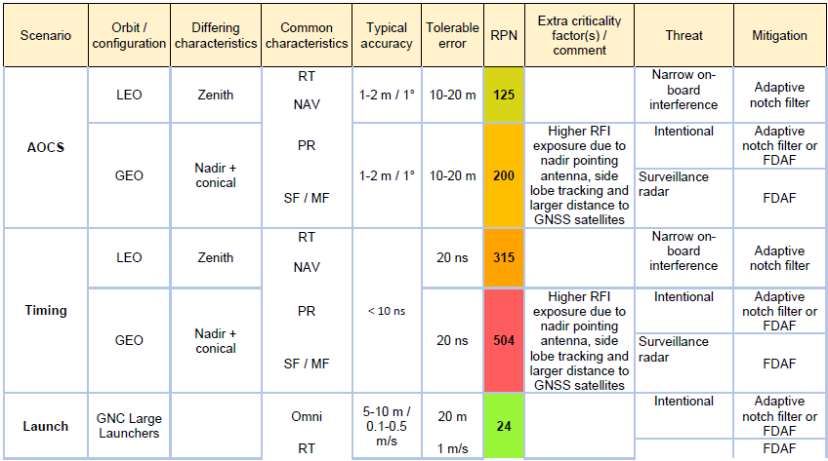
Possible mitigation technology for different scenarios 1/3

Slide 29
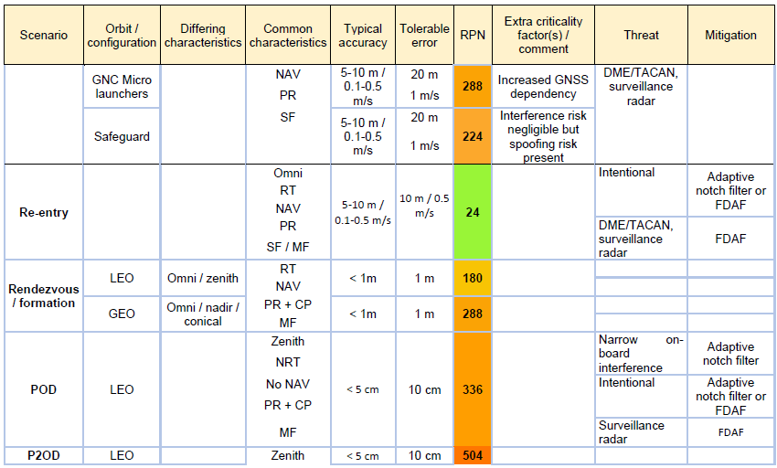
Possible mitigation technology for different scenarios 2/3

Slide 30
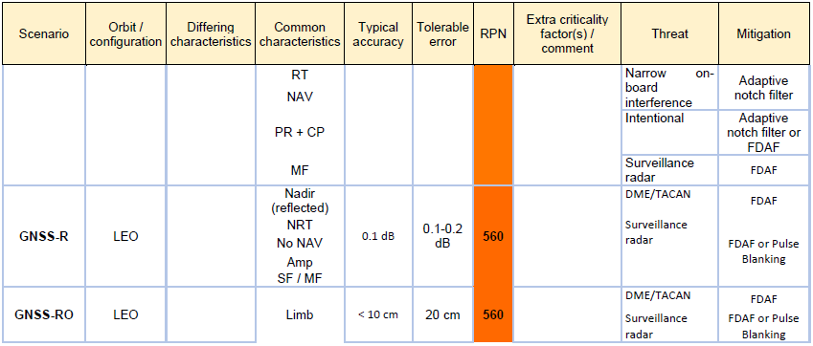
Possible mitigation technology for different scenarios 3/3

Slide 31
Agenda
Project introduction
Establishment of context
RFI Risk Assessment
RFI detection and mitigation
Conclusions & Outlook

Slide 32
Conclusions & Outlook
Unintentional interference is known to be a problem for GNSS earth observation sensor (e.g., radio occultation sensors).
Jamming is recognised as potential threat. Especially, receivers with antennas pointing nadir or having in view the limb of earth can be jammed from the surface of the earth with feasible transmit power levels.
None of the simulated mitigation techniques can protect against all potential jamming signal characteristics.

Slide 33
Conclusions & Outlook, cont.
The short duration of visibility of a LEO satellite for a spoofer complicates spoofing attacks from ground.
The well-predictable trajectory of a satellite enables detection of too fast position changes.
Nevertheless, the capabilities of spaceborne GNSS receivers to detect spoofing should be enhanced.
Multi-frequency receivers and antennas provide major improvement of robustness against RFI.
Array antennas for bigger spacecrafts with nadir pointing antennas open possibility of several additional detection and mitigation techniques.

Slide 34
Thank you for your attention!
Thomas Prechtl
JOANNEUM RESEARCH
Forschungsgesellschaft mbH
DIGITAL
Institute for Information and
Communication Technologies
Steyrergasse 17
8010 Graz
Tel. +43 316 876-2514
thomas.prechtl@joanneum.at
www.joanneum.at/digital

Slide 35
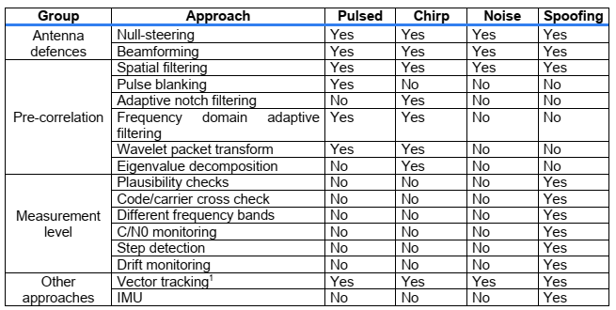
Conclusions on Mitigation Approaches
Appendix: Mitigation Approaches

Slide 36
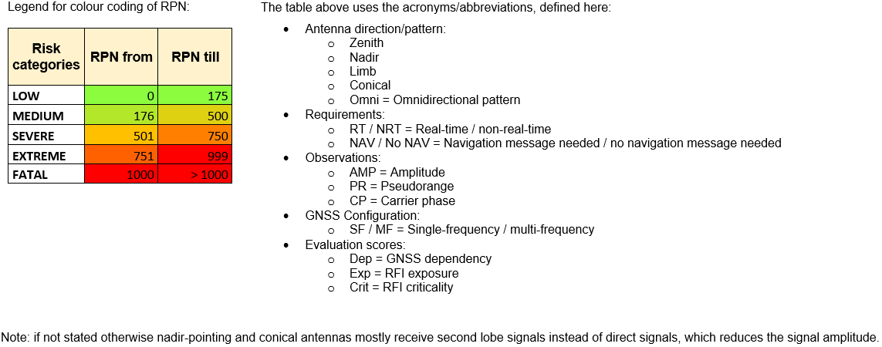
Appendix: Risk assessment table for different missions
Appendix 1: Risk assessment for different missions 1/9

Slide 37
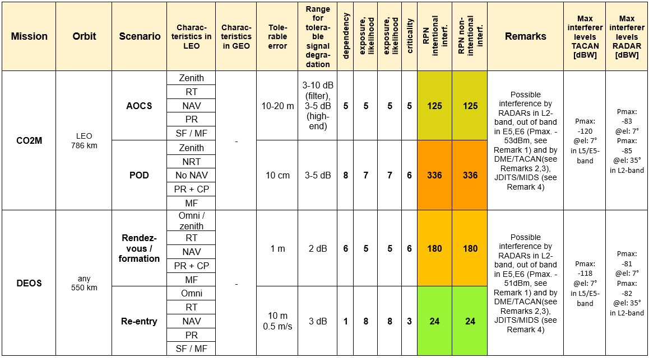
Appendix 1: Risk assessment for different missions 2/9

Slide 38
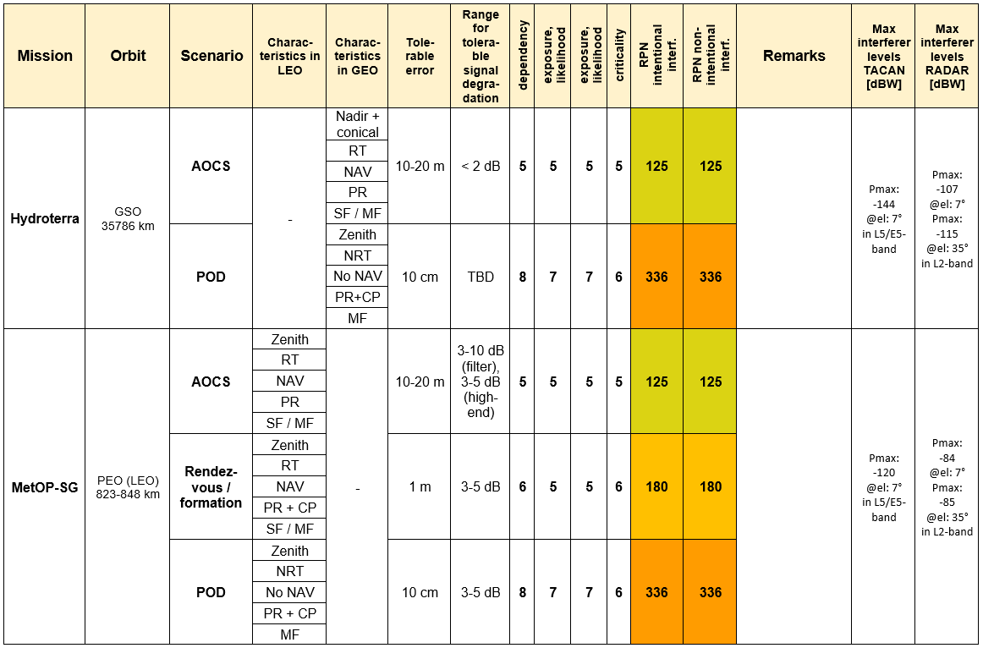
Appendix 1: Risk assessment for different missions 3/9

Slide 39
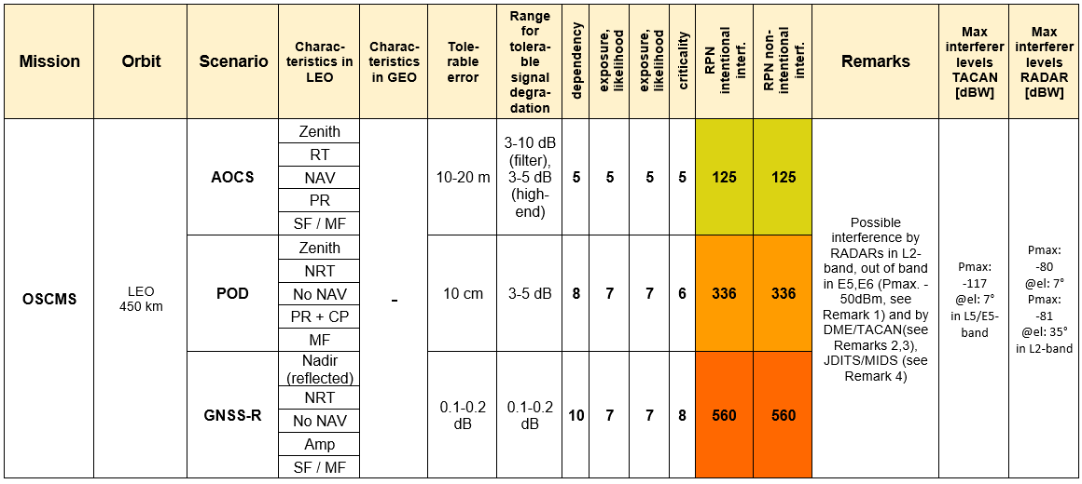
Appendix 1: Risk assessment for different missions 4/9

Slide 40
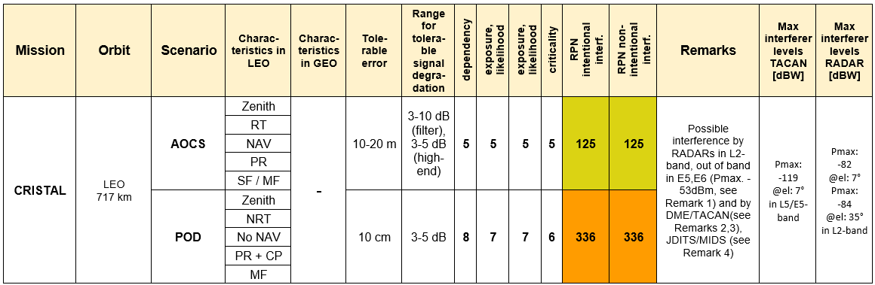
Appendix 1: Risk assessment for different missions 5/9

Slide 41
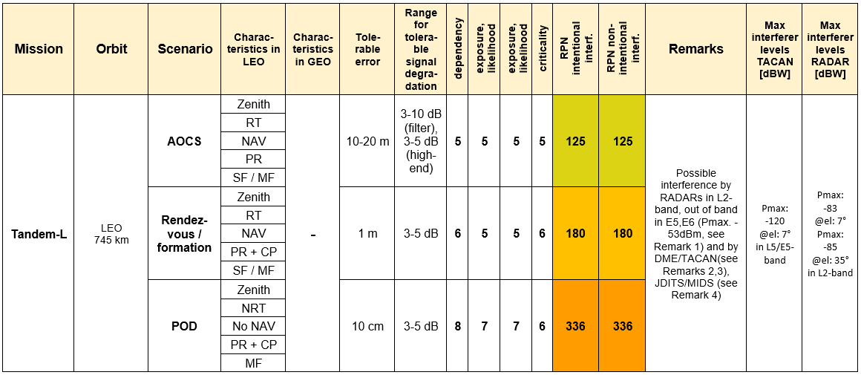
Appendix 1: Risk assessment for different missions 6/9

Slide 42
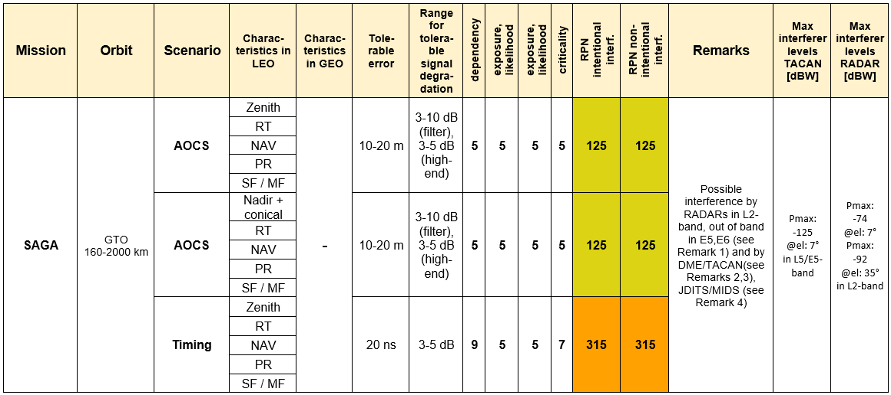
Appendix 1: Risk assessment for different missions 7/9

Slide 43
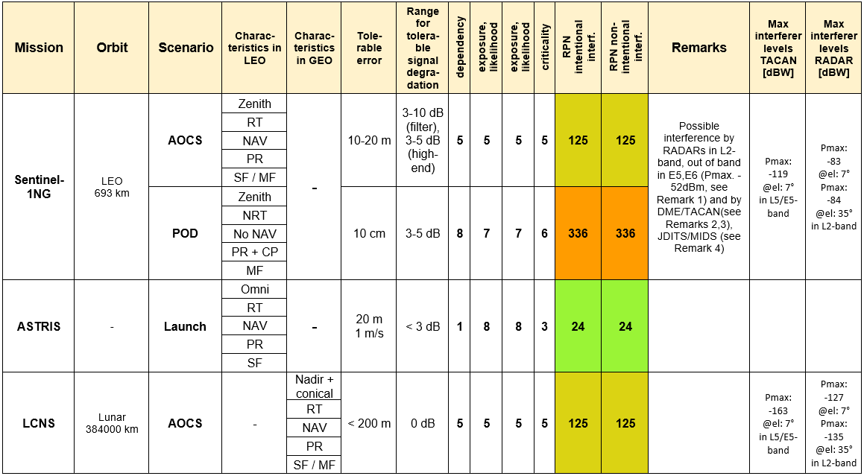
Appendix 1: Risk assessment for different missions 8/9

Slide 44
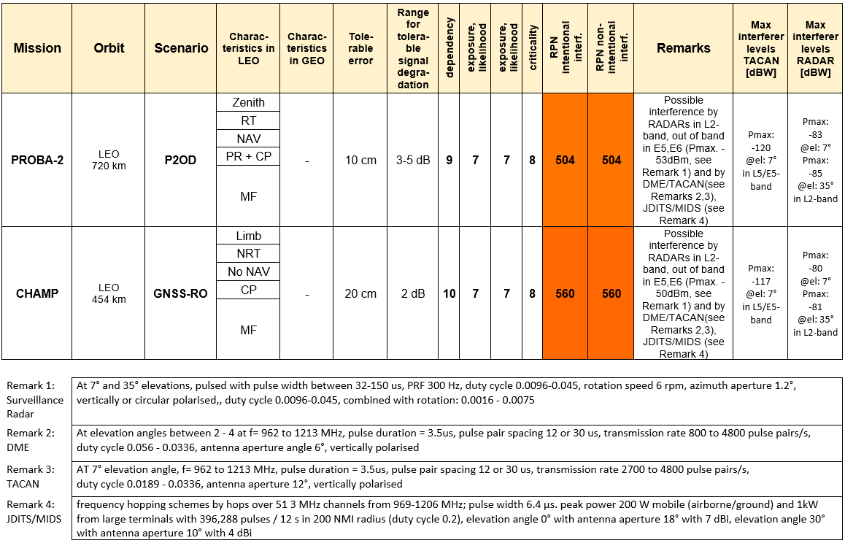
Appendix 1: Risk assessment for different missions 9/9

