Slide 1
FITAI
Artificial Intelligence for GNSS post-fit residual and position joint analysis. A plugin for Jason, Rokubun cloud GNSS processing service
Final Review Meeting ESA / ROK
2024-03-015, Teleconference

Slide 2
Agenda
11:00 Project status
11:05 ML Architecture overview
11:20 Validation results
11:50 Conclusions
12:15 Next steps

Slide 3
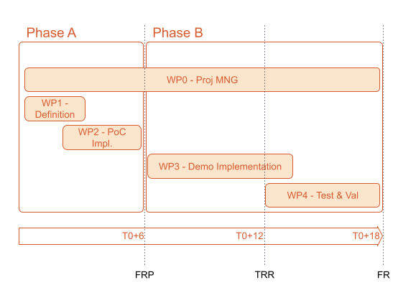
Progress Status
We have finished the Phase B of the project, which include
WP1 - Definition
WP2 - PoC development
WP3 - Demo implementation
WP4 - Test & Validation

Slide 4
Agenda
11:00 Project status
11:05 ML Architecture overview
11:20 Validation results
11:50 Conclusions
12:15 Next steps

Slide 5
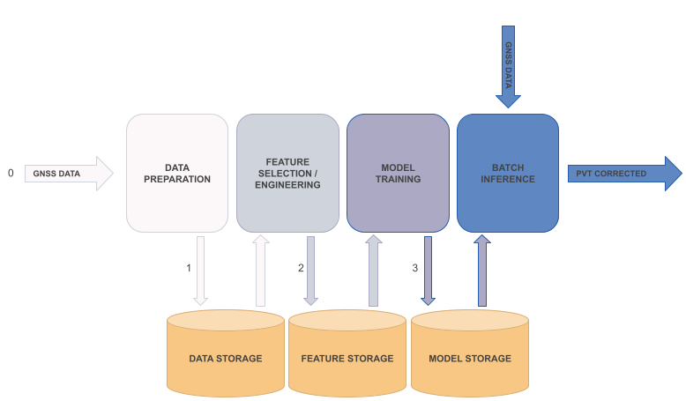
ML Architecture overview
ML Pipeline automated to simplify the process of creating datasets, training models and analysing its performance

Slide 6
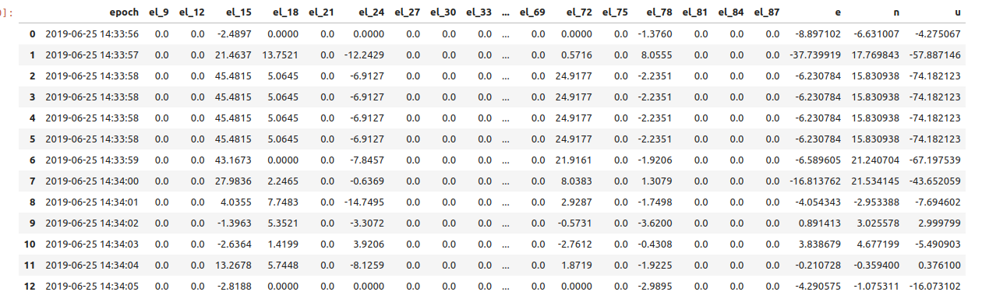
ML Architecture overview
Use of bins of elevations for storing the values of the different properties to use in the NN (residuals, snr, etc)

Slide 7
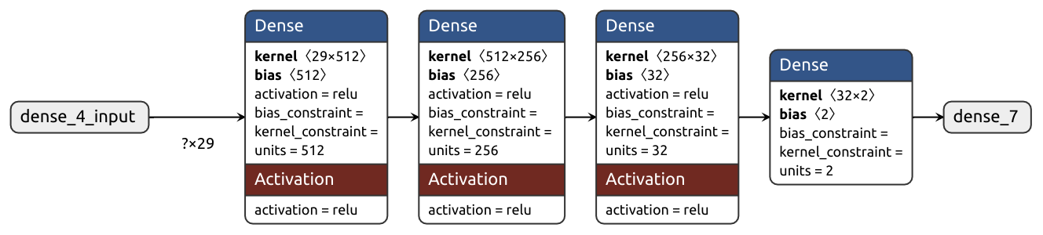
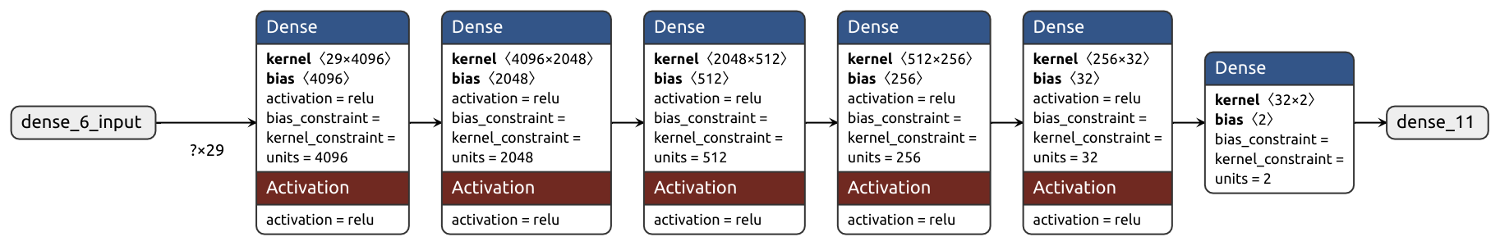
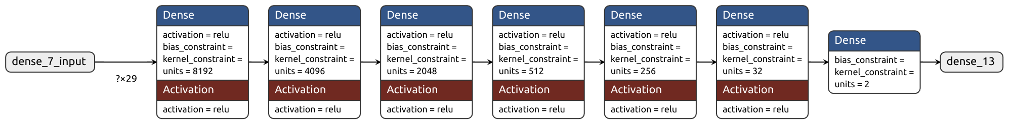
ML Architecture overview
Three different sizes based on the number of hidden layers and neurons per layer with hyper-parameter tuning:
Small
~2MB | 1ms/sample
Medium
~100MB | 4ms/sample
Large
~500MB | 12ms/sample

Slide 8
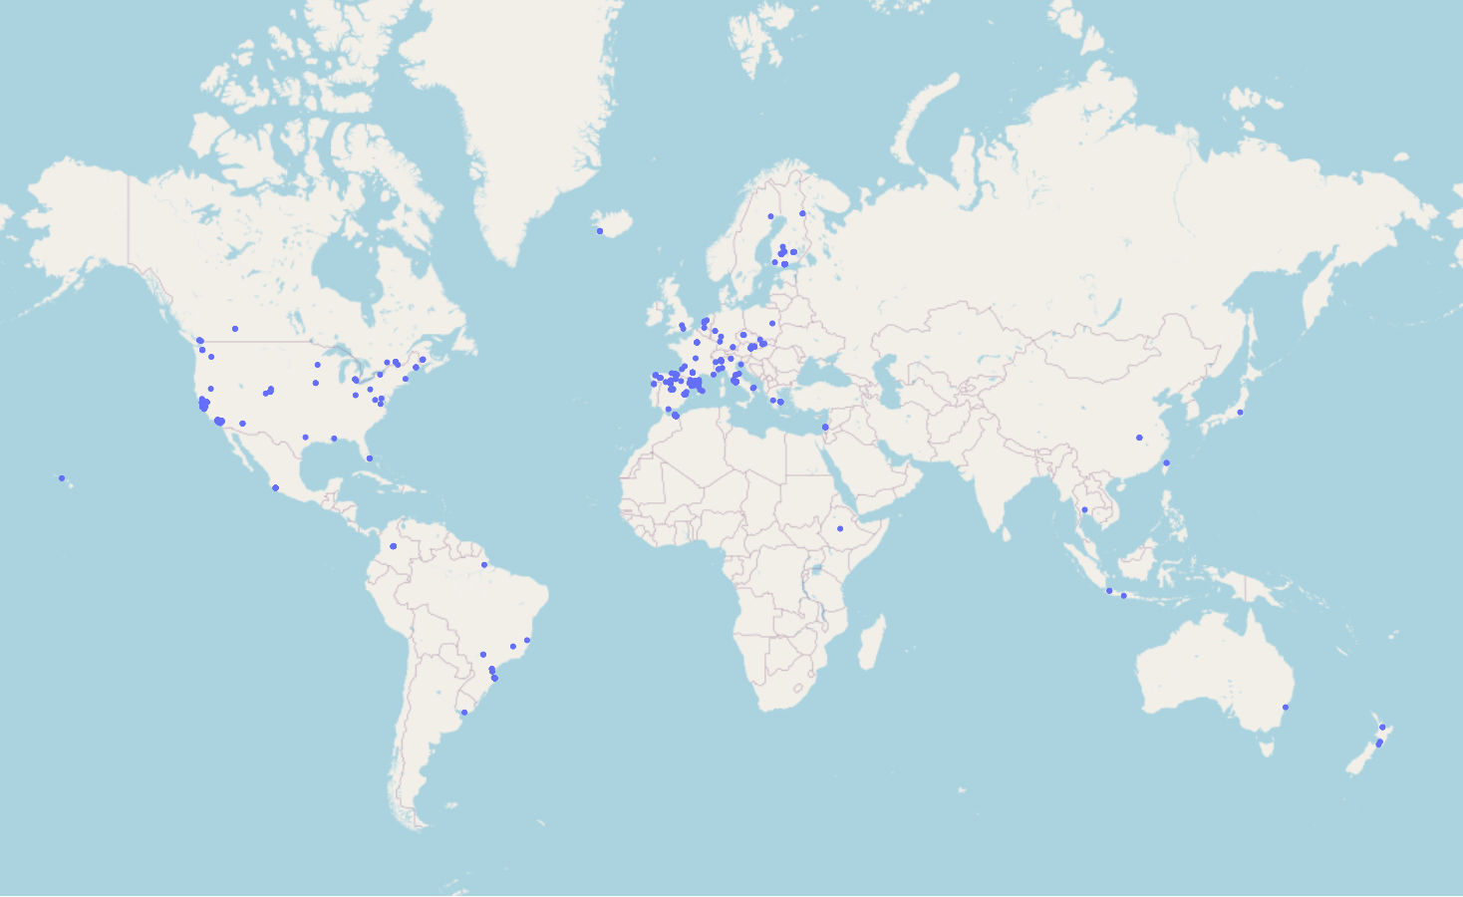
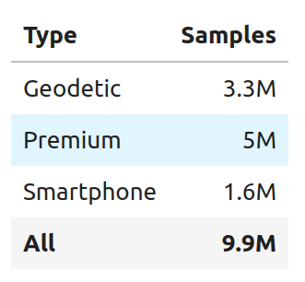
ML Architecture overview
Inventory of data used for training

Slide 9
ML Architecture overview
Other architectures analyzed
FCN with signals
CNN using azimuth and elevation to represent images of the skyplot

Slide 10
Agenda
11:00 Project status
11:05 ML Architecture overview
11:20 Validation results
11:50 Conclusions
12:15 Next steps

Slide 11
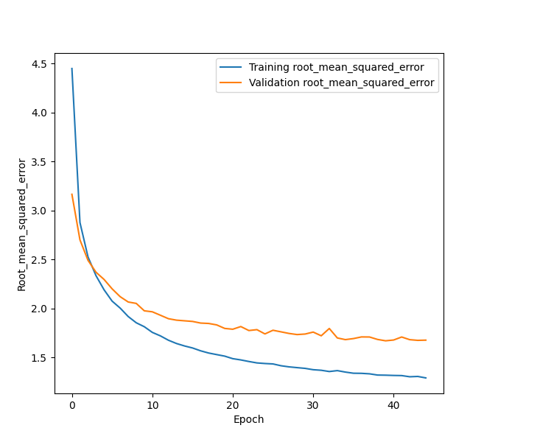
Validation results
Focused on 95 percentile instead of RMSE
Overtifiting parameter not relevant since models used for validation not showing a high value of overfitting to the training dataset

Slide 12
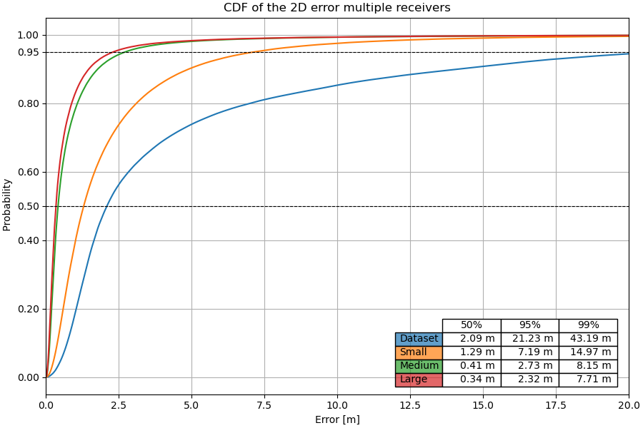
TEST.001 - self-consistency
Performance of the model with split in three datasets: training, validation and test:
Dataset with all receivers and categorical feature

Slide 13
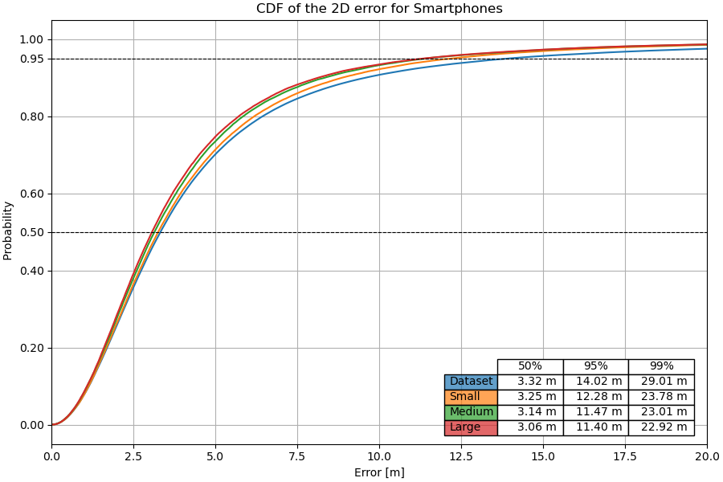
TEST.001 - self-consistency
Performance of the model with split in three datasets: training, validation and test:
Dataset with smartphones

Slide 14
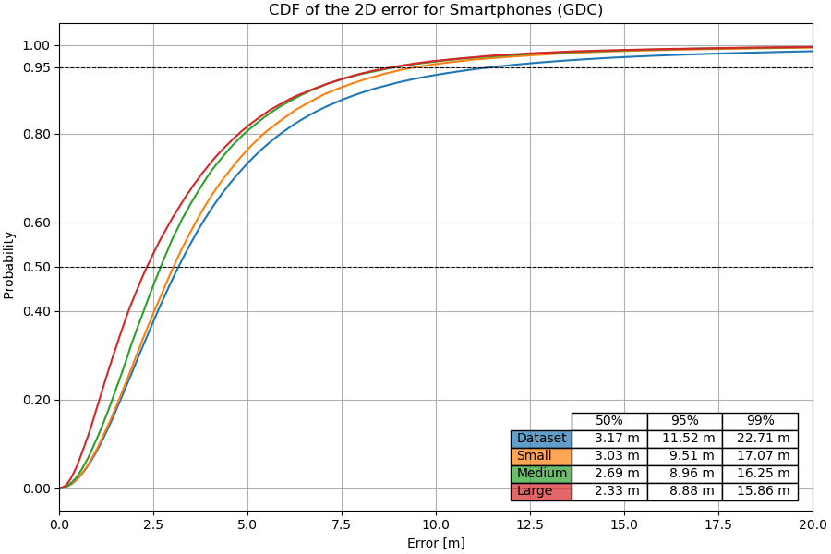
TEST.001 - self-consistency
Performance of the model with split in three datasets: training, validation and test:
Dataset with smartphones from Google Decimeter Challenge data

Slide 15
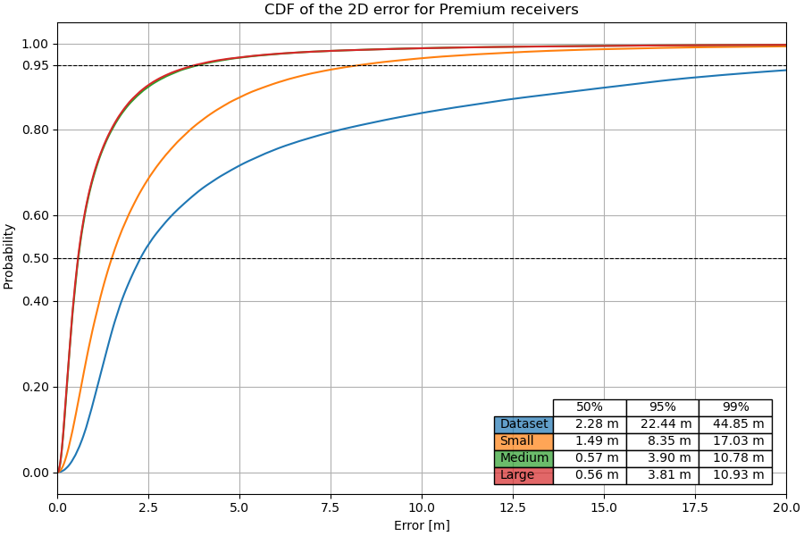
TEST.001 - self-consistency
Performance of the model with split in three datasets: training, validation and test:
Dataset with premium receivers

Slide 16
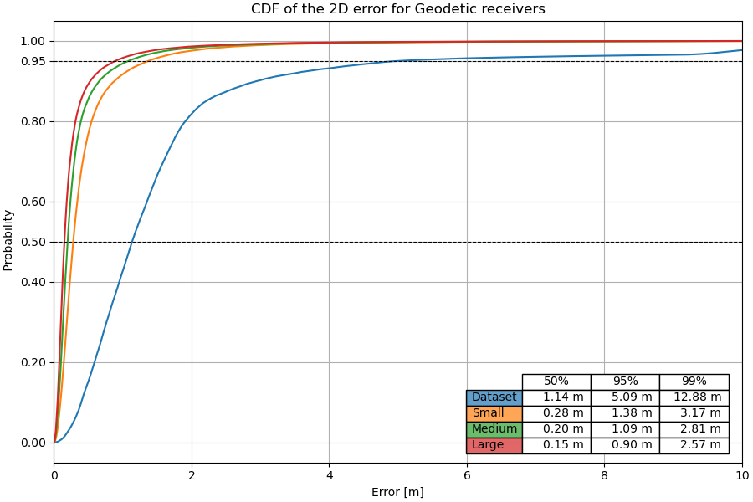
TEST.001 - self-consistency
Performance of the model with split in three datasets: training, validation and test:
Dataset with geodetic receivers

Slide 17
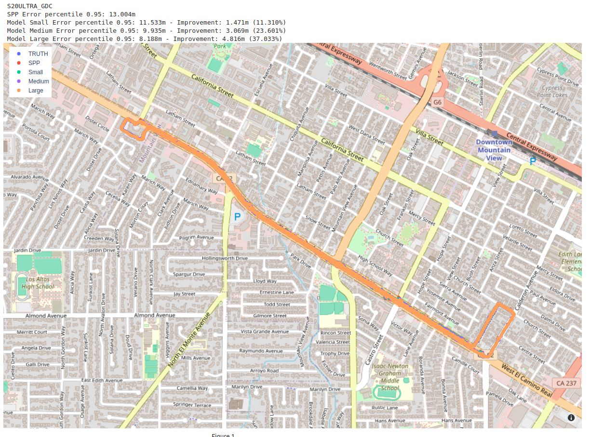
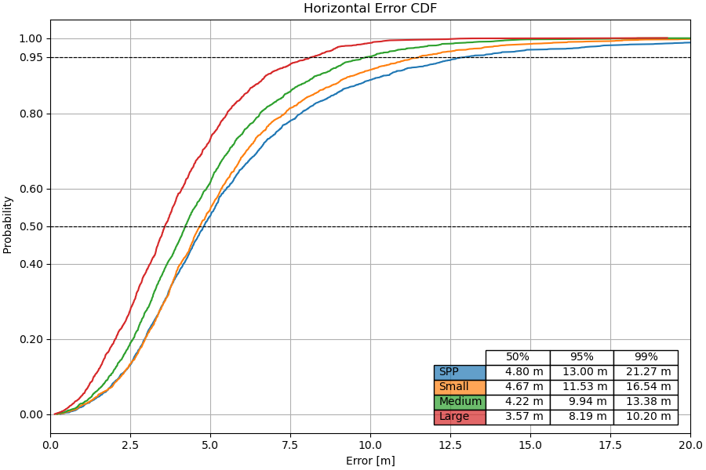
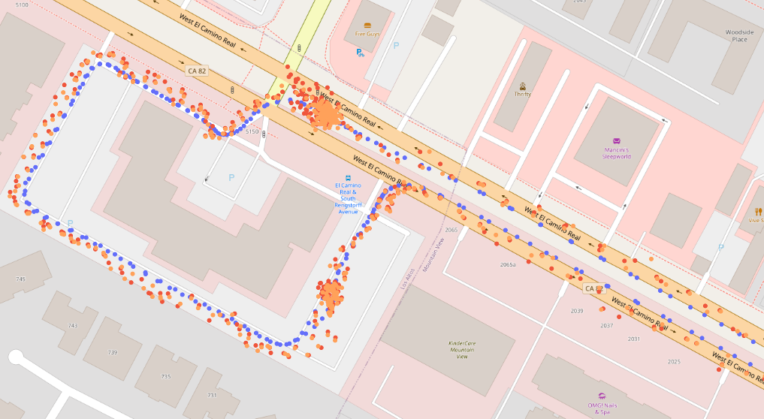
TEST.002 - Batch inference for multiple receivers
Performance of the model with Samsung S20 Ultra from GDC (San Francisco)

Slide 18
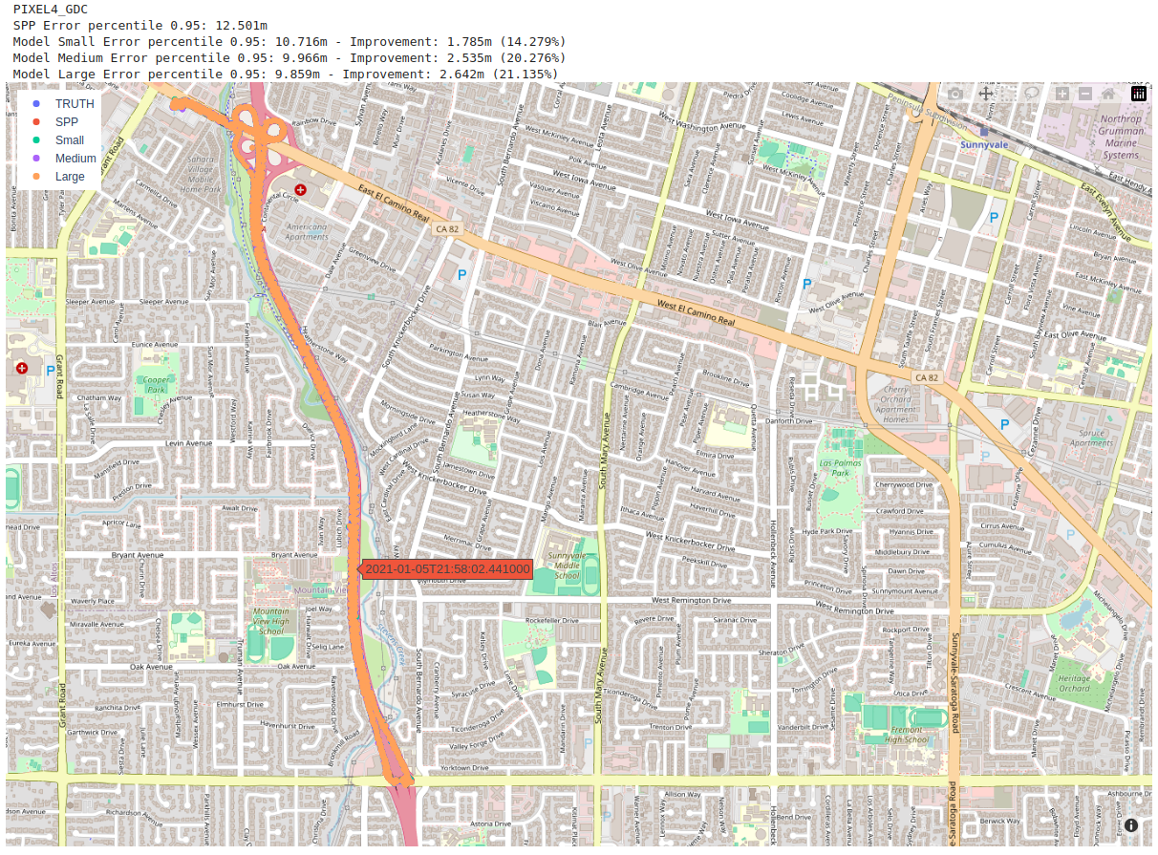
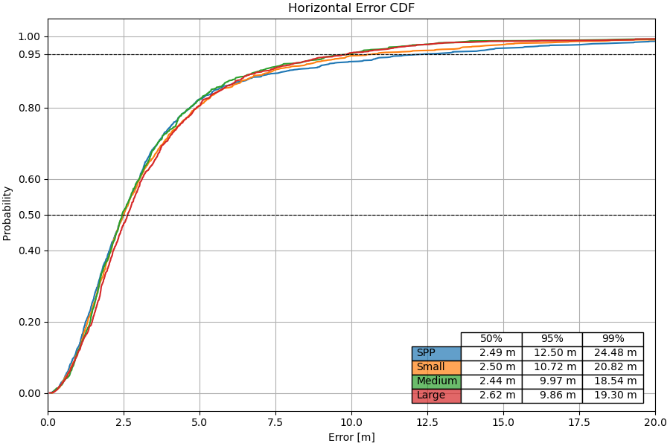
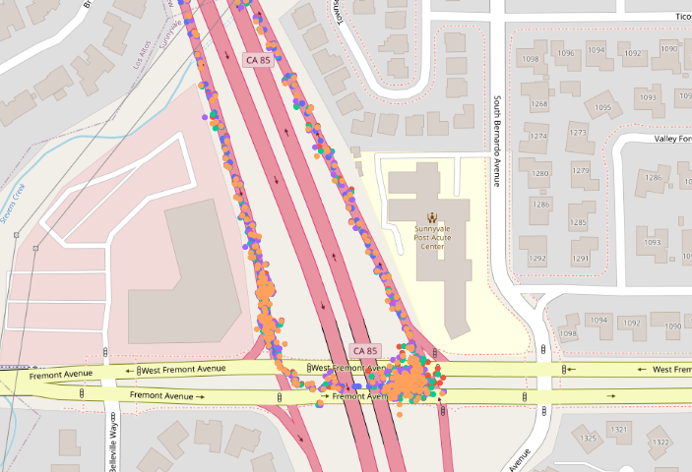
TEST.002 - Batch inference for multiple receivers
Performance of the model with Pixel 4 Ultra from GDC San Francisco

Slide 19
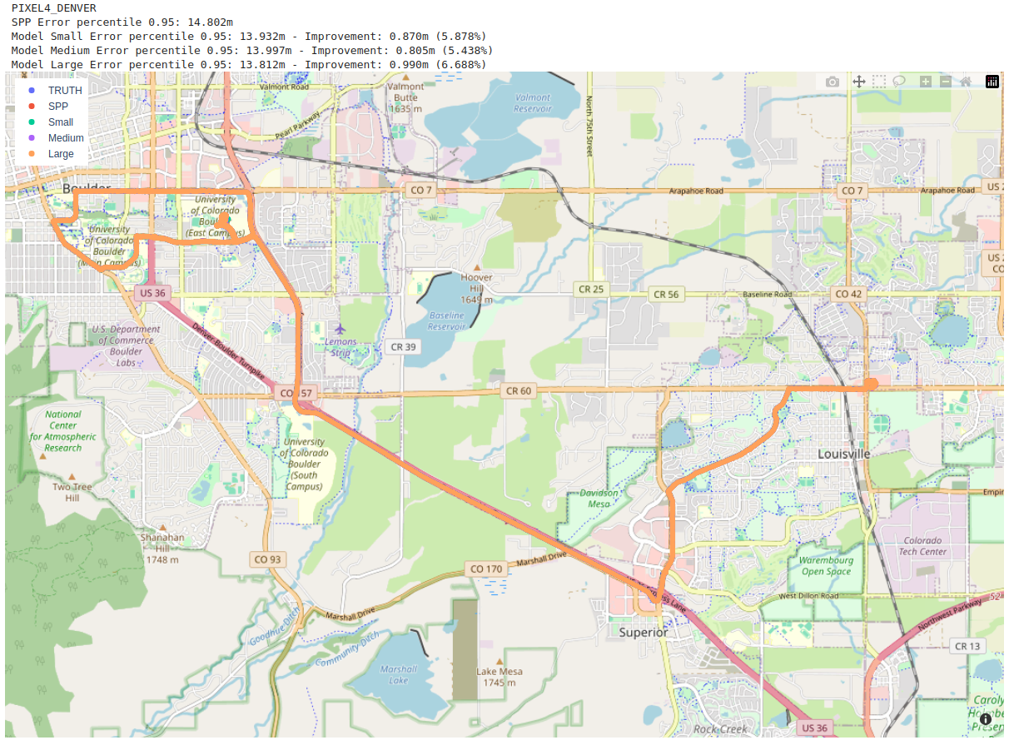
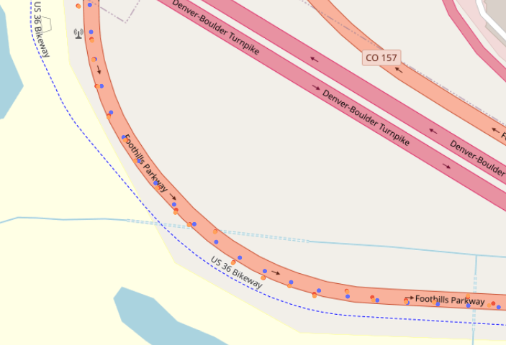
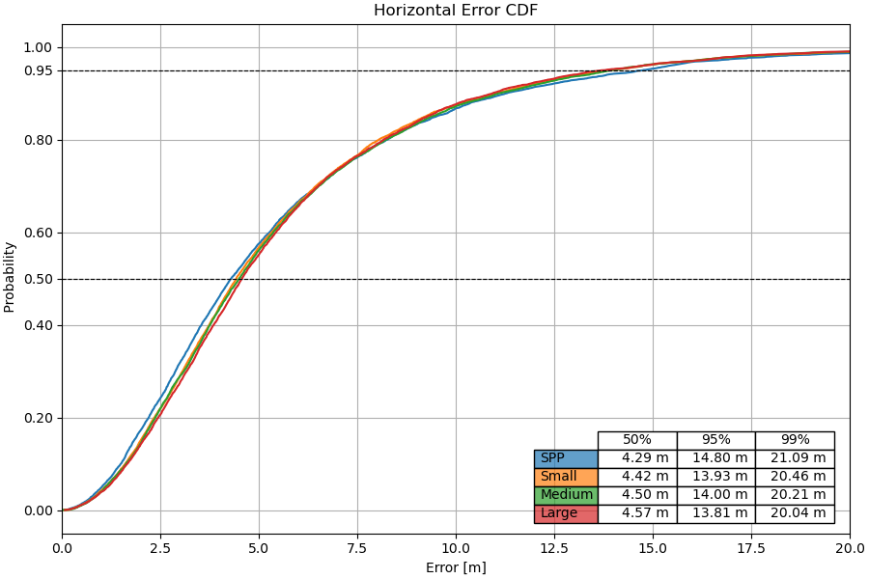
TEST.002 - Batch inference for multiple receivers
Performance of the model with Pixel 4 in Denver

Slide 20
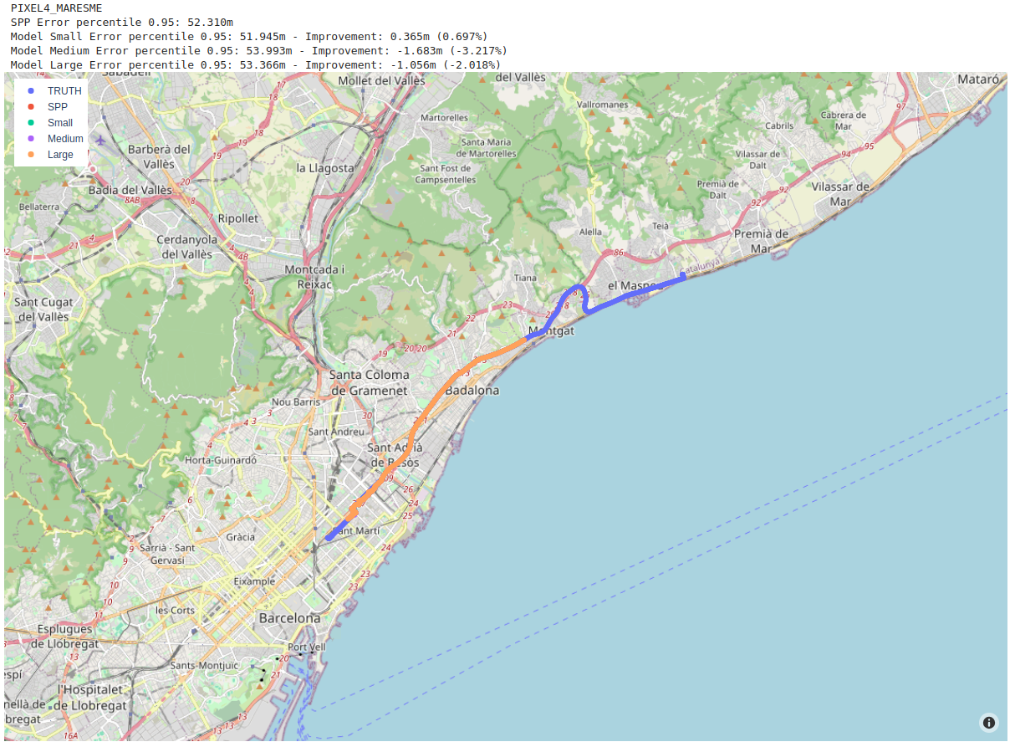
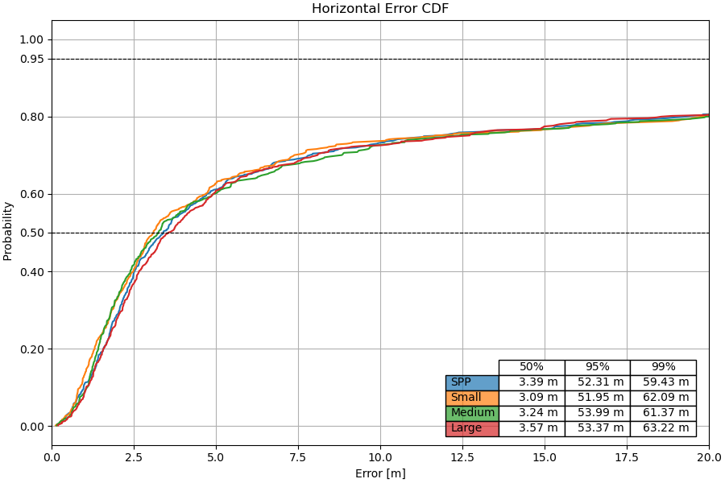
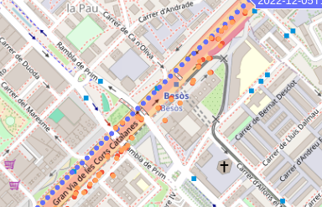
TEST.002 - Batch inference for multiple receivers
Performance of the model with Pixel 4 in Barcelona

Slide 21
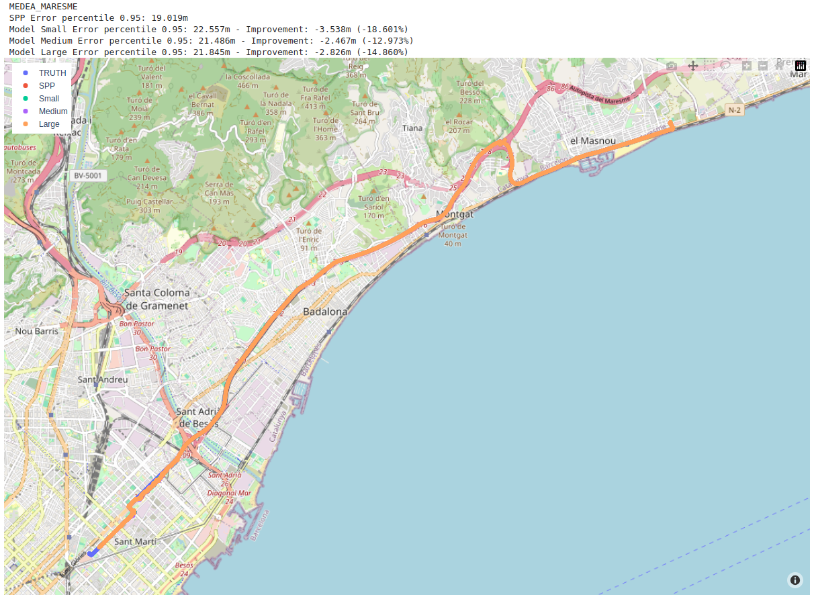
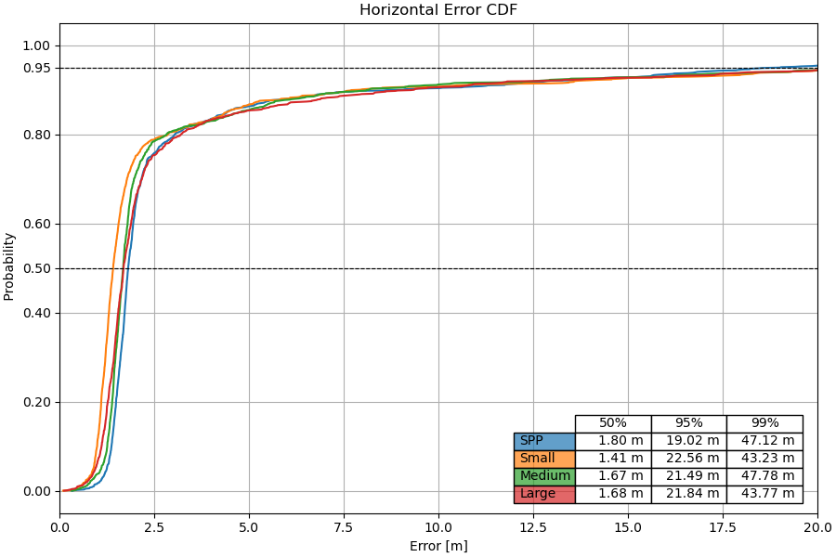
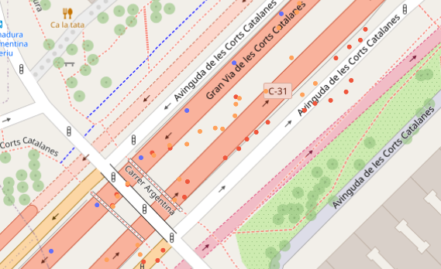
TEST.002 - Batch inference for multiple receivers
Performance of the model with UBlox F9P in Barcelona area

Slide 22
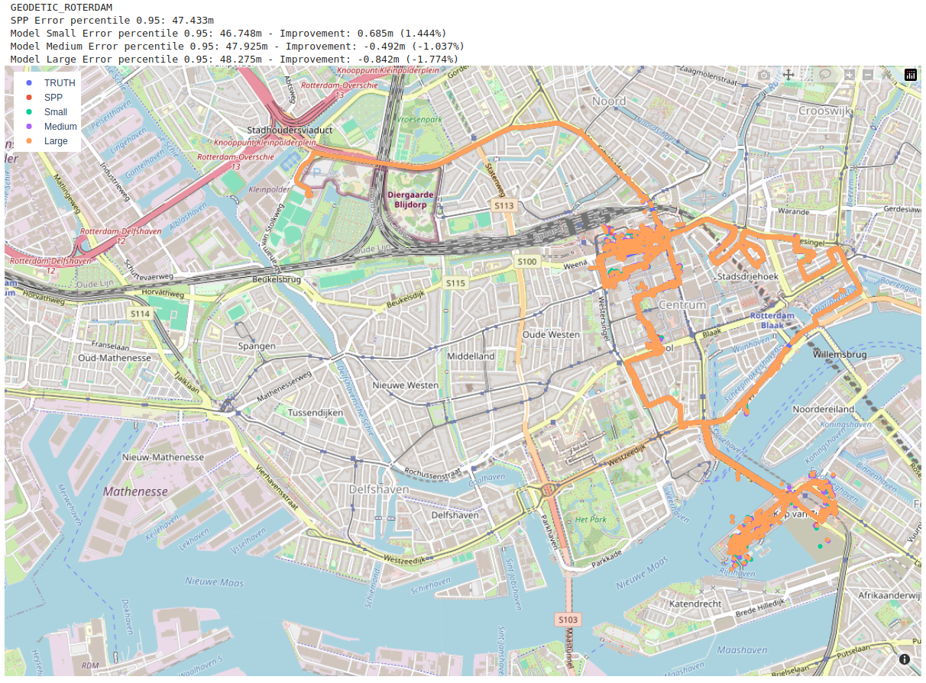
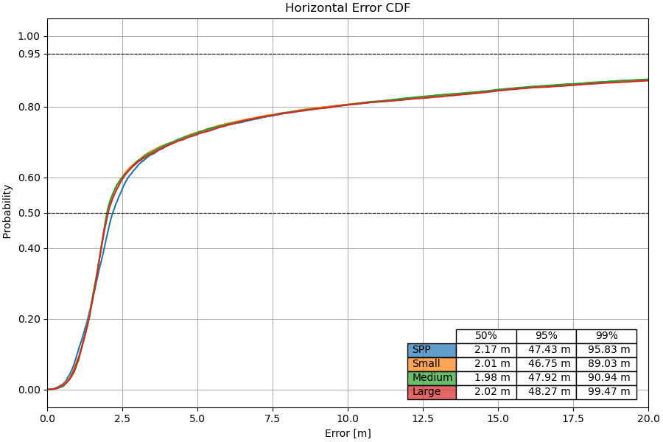
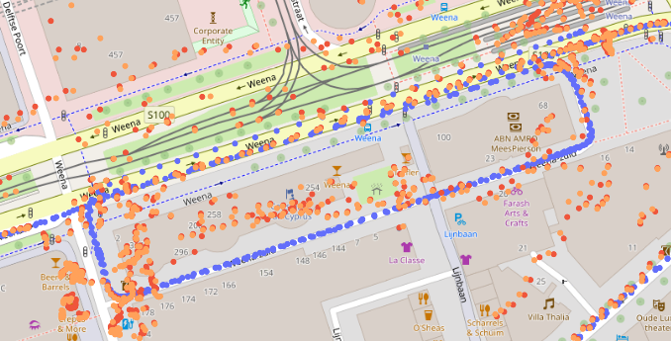
TEST.002 - Batch inference for multiple receivers
Performance of the model with Geodetic receiver in Rotterdam

Slide 23
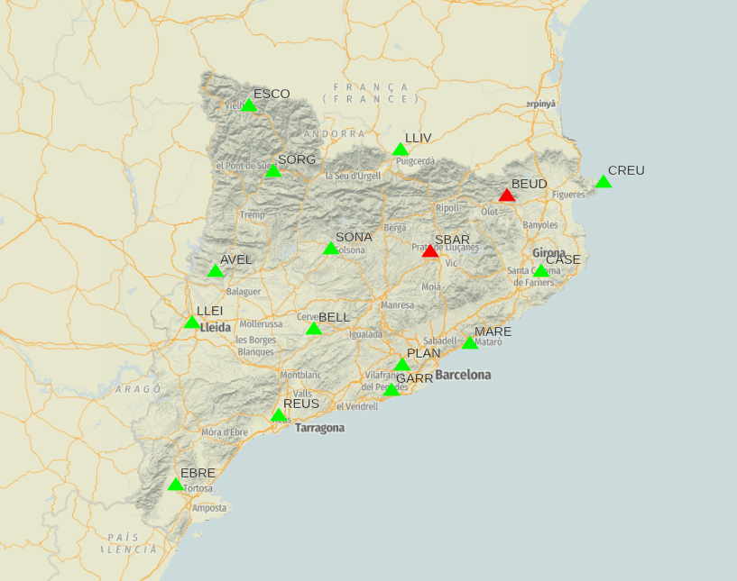
TEST.002 - Batch inference for multiple receivers
Trained 3 models with CORS stations from ICGC.
16 ground stations
1 month data (September 2023)
~1.3M epochs
Validation against three different stations
PLAN from CATNET in Barcelona (LEICA GR50)
SETE from SHOM in France close to Montpellier (TRIMBLE NETR9)
P575 from UNAVCO in Los Angeles (SEPT POLARX5)

Slide 24
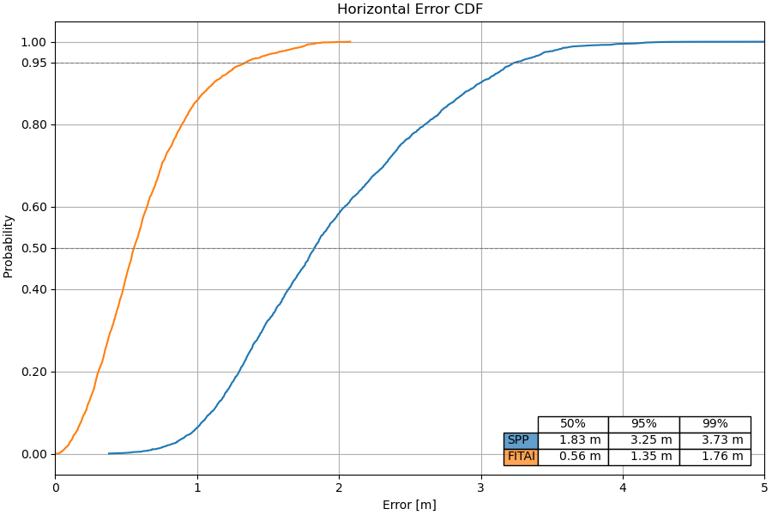
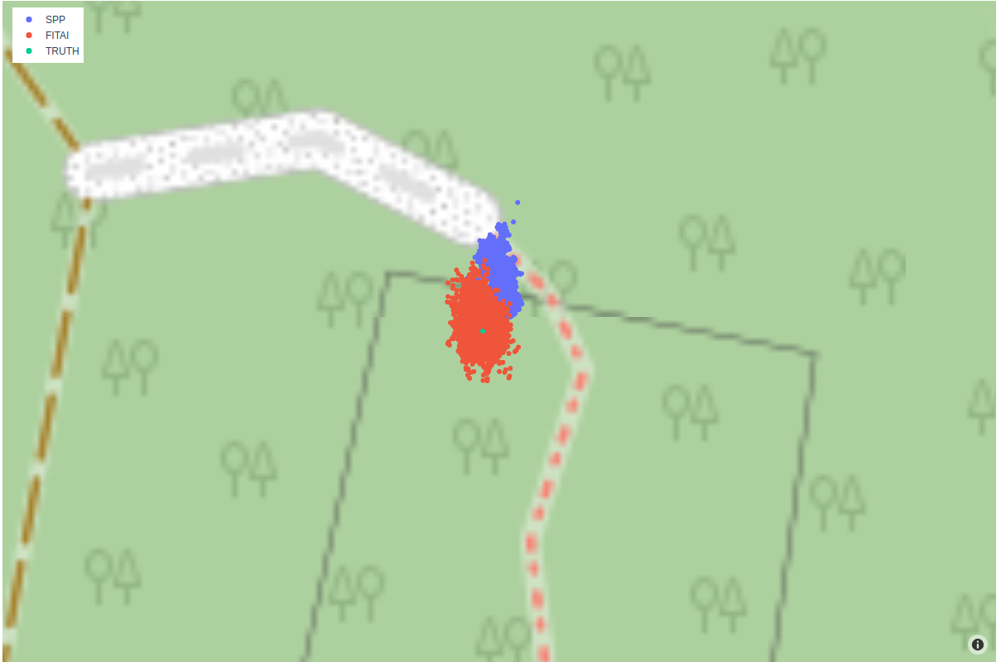
TEST.002 - Batch inference for multiple receivers
PLAN - Prediction works as expected

Slide 25
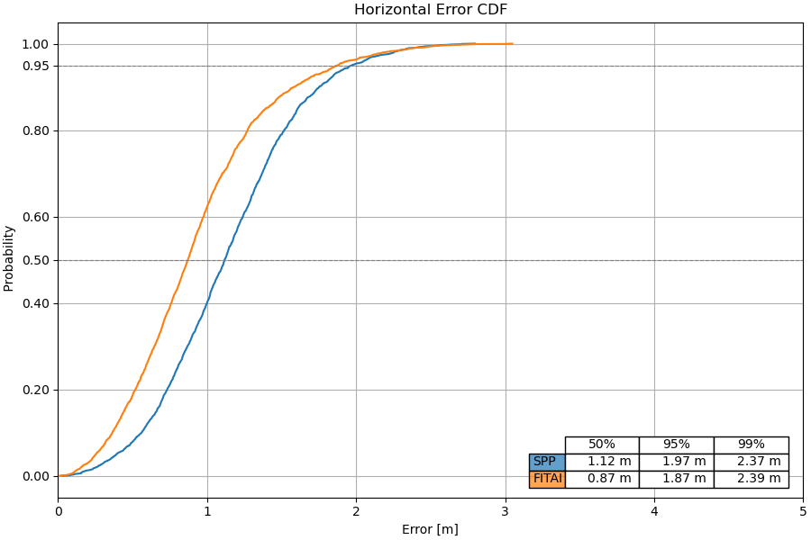
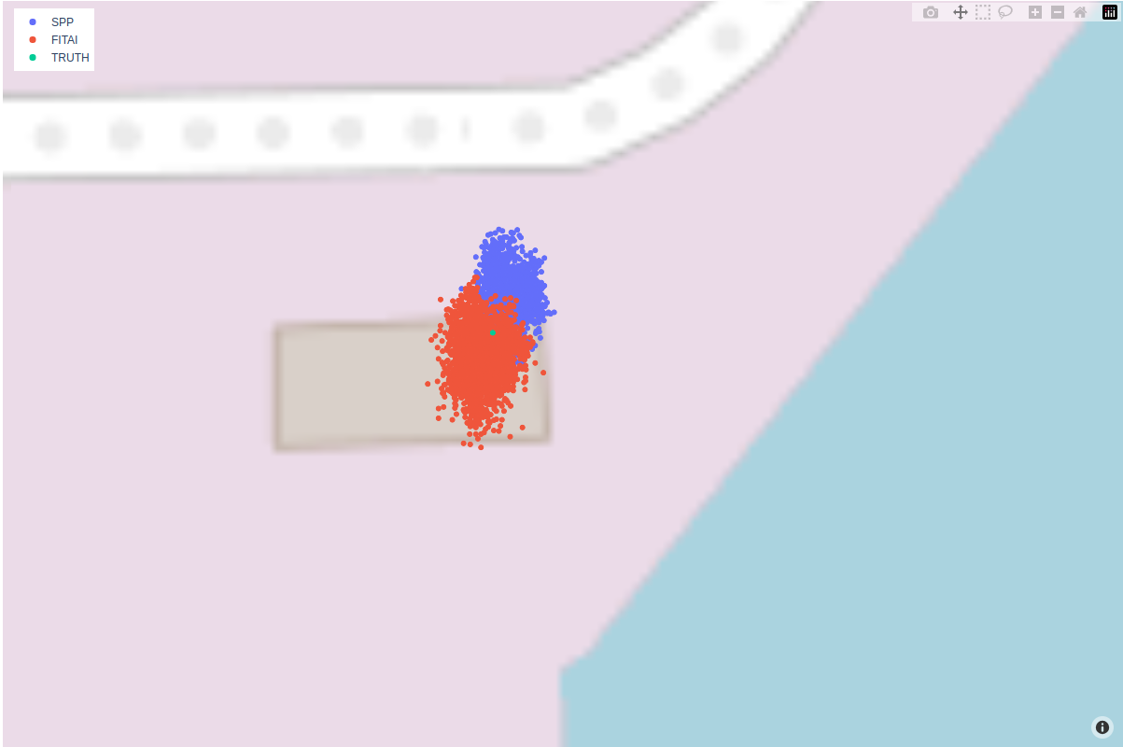
TEST.002 - Batch inference for multiple receivers
SETE - Prediction improvement smaller but still works

Slide 26
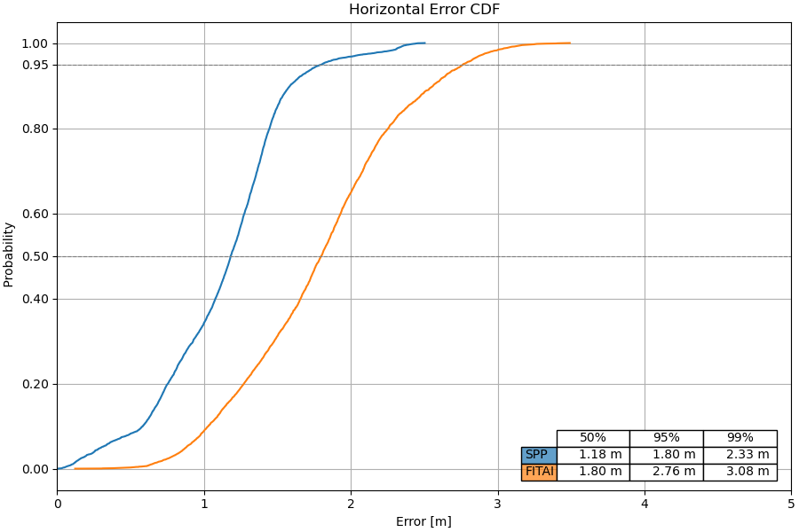
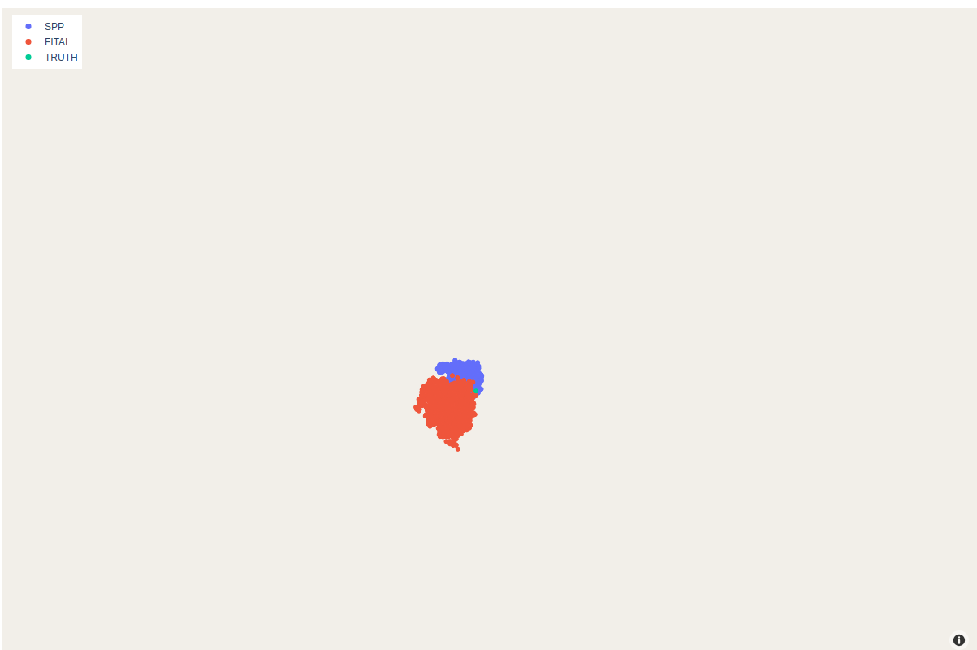
TEST.002 - Batch inference for multiple receivers
P575 - Prediction does not work, result worst than SPP

Slide 27
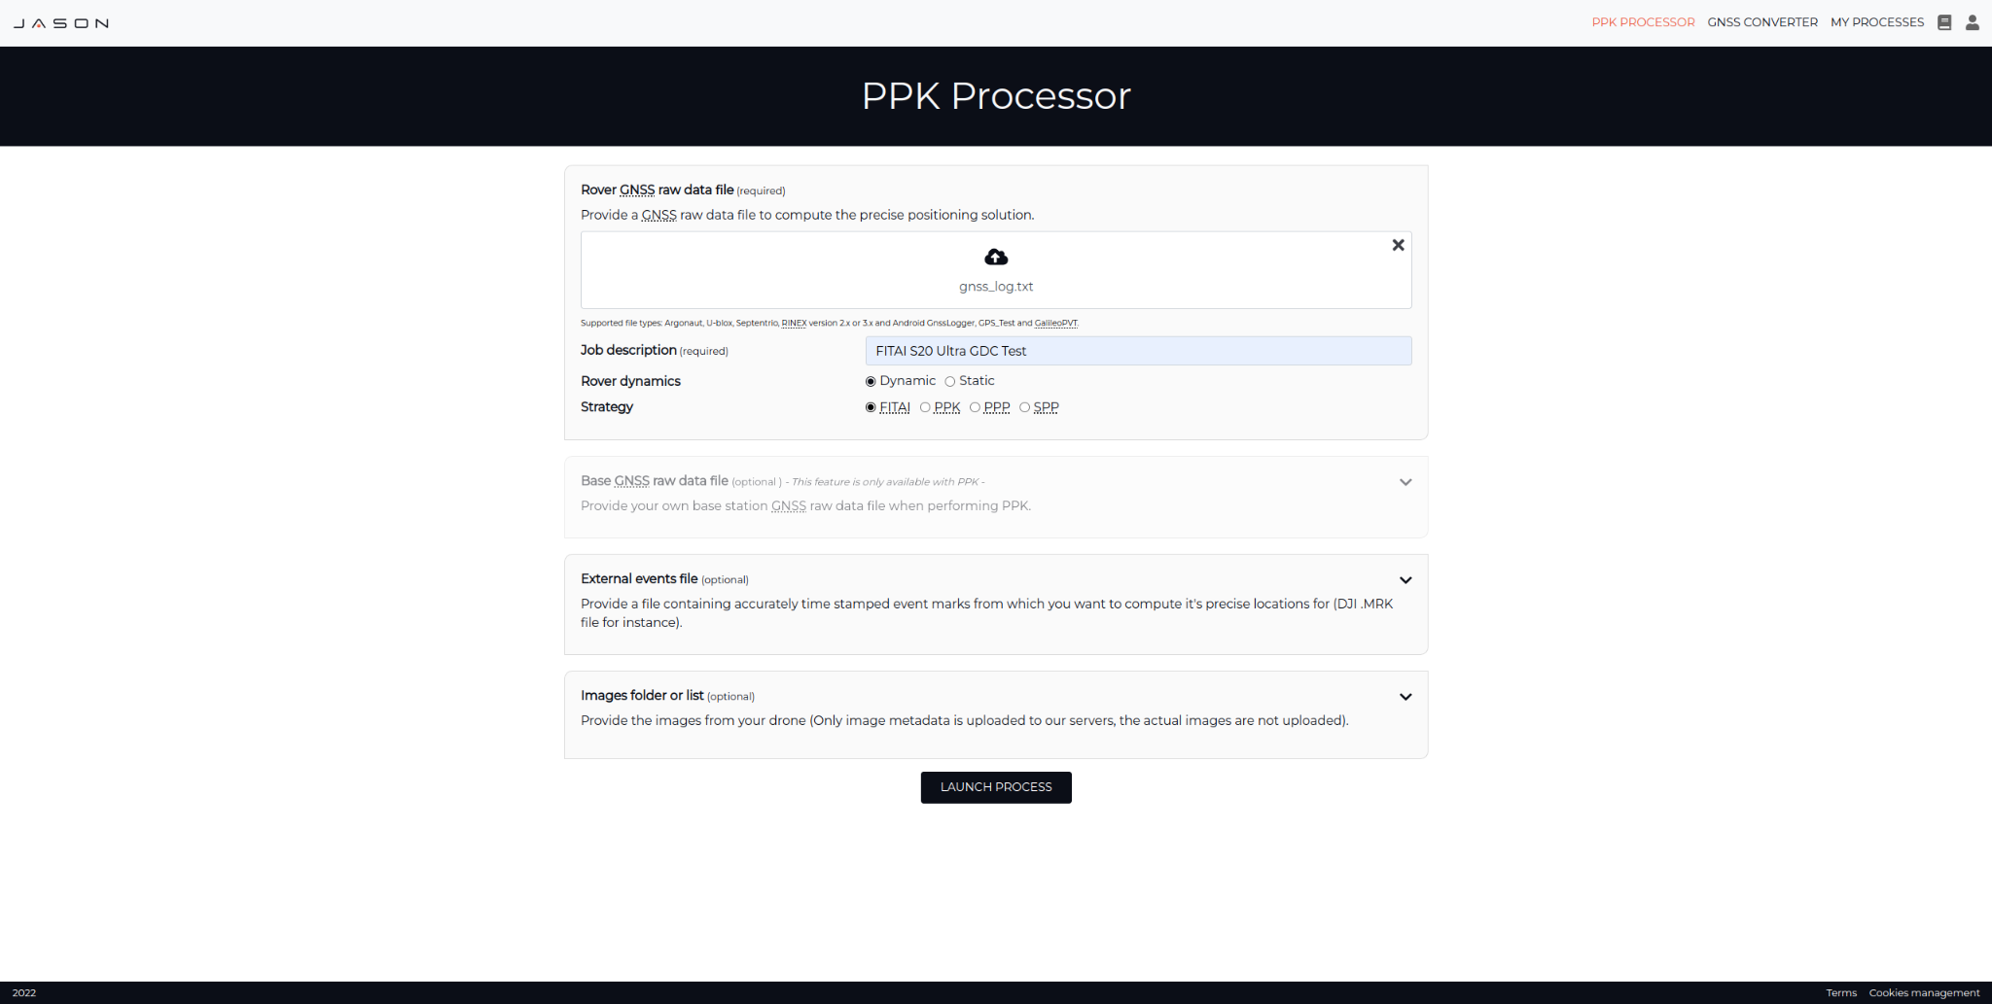
TEST.003 - JASON Integration
Demo time

Slide 28
TEST.003 - JASON Integration
Upload page

Slide 29
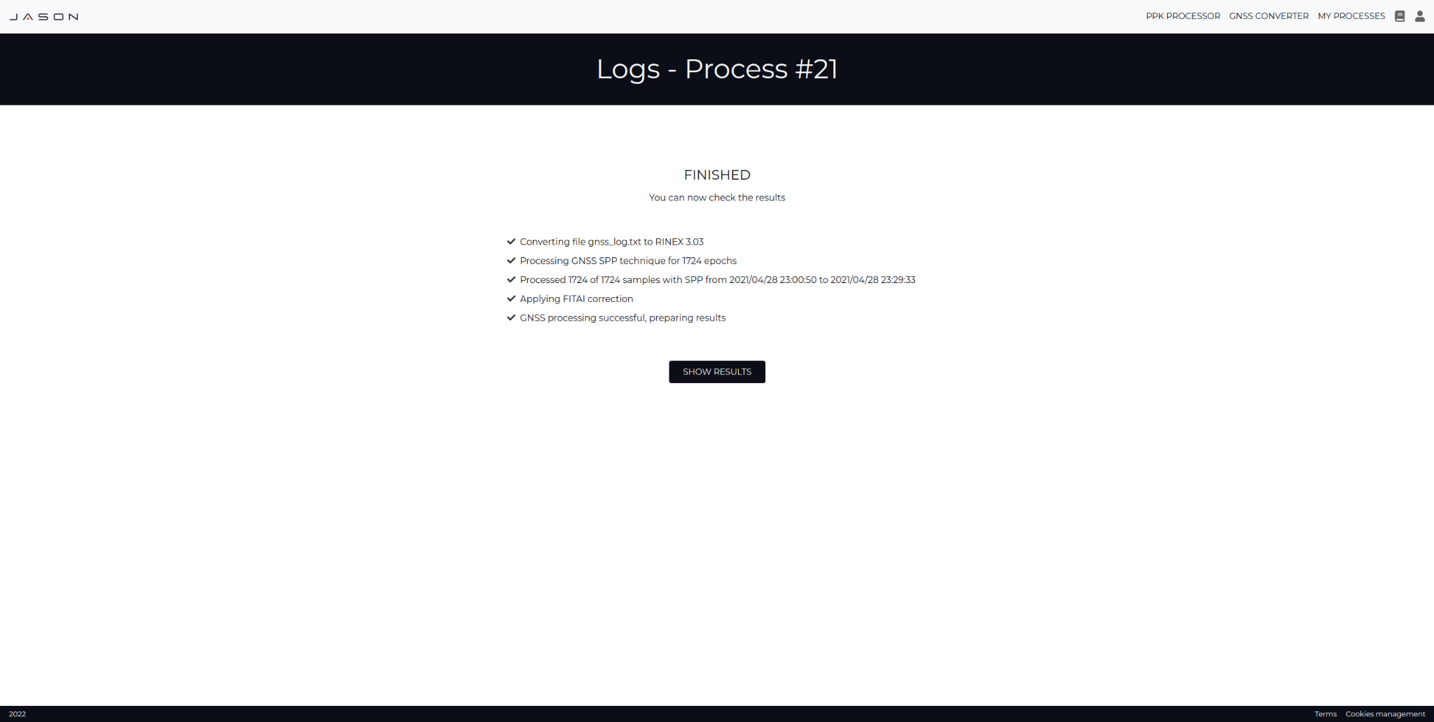
TEST.003 - JASON Integration
Logs page

Slide 30
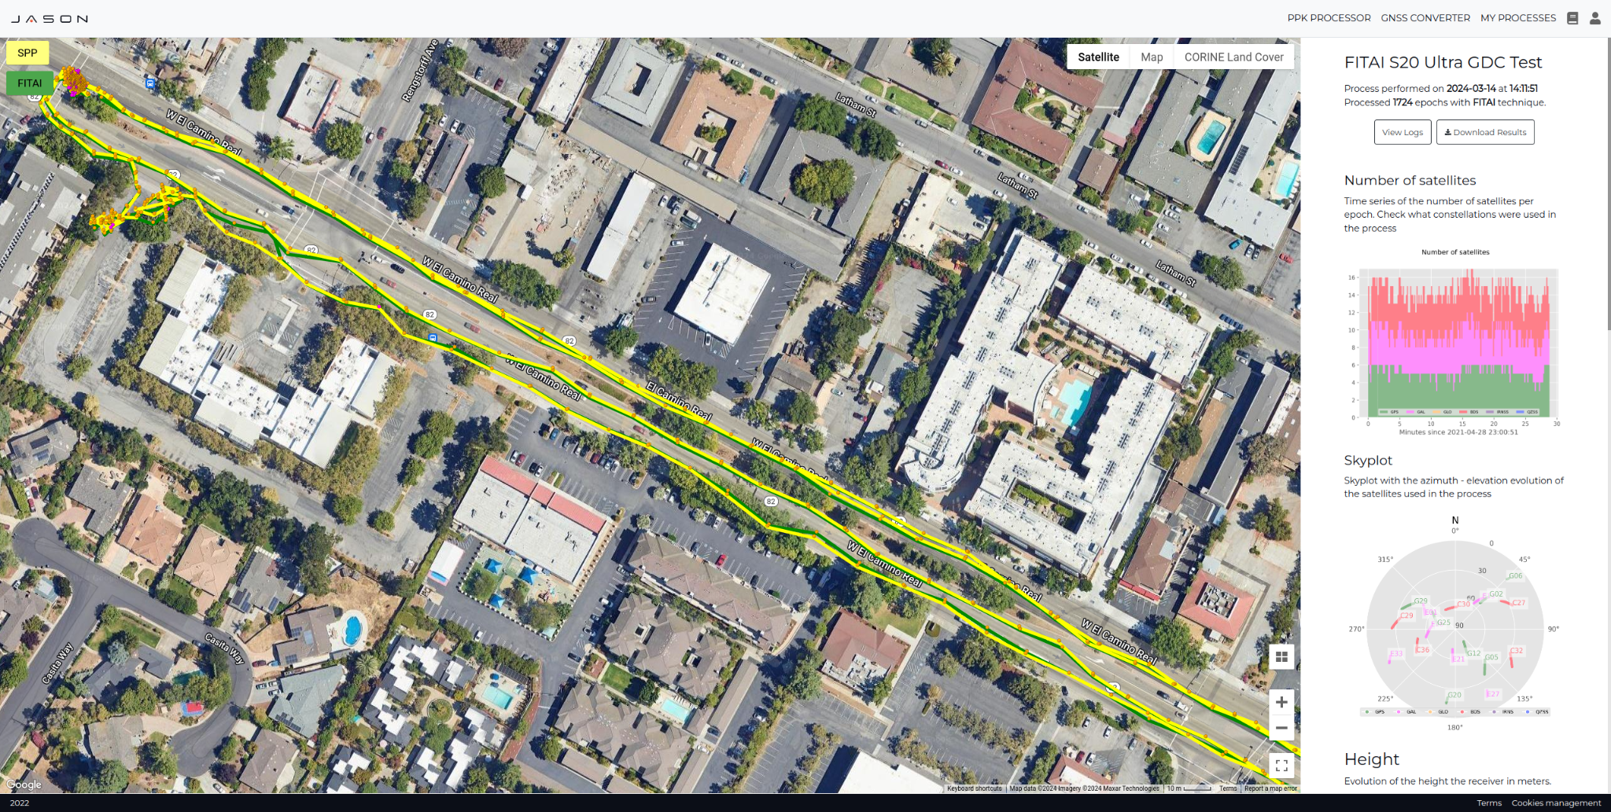
TEST.003 - JASON Integration
Results page

Slide 31
Agenda
11:00 Project status
11:05 ML Architecture overview
11:20 Validation results
11:50 Conclusions
12:15 Next steps

Slide 32
Conclusions
Choose data wisely
Elevation features
Network architectures and time correlation (LSTM, Transformers
Land Cover vs Building footprint
Data augmentation to increase observability
MLOps and continuous training/deployment
2D degradation due to 3D prediction
Tools to simplify the process

Slide 33
Agenda
11:00 Project status
11:05 ML Architecture overview
11:20 Validation results
11:50 Conclusions
12:15 Next steps

Slide 34
Next steps
Delivery of final documentation:
Photographic Documentation
TAS
Final Presentation
Final Presentation Recording
Executive Summary Report
Final Report
Final presentation at ESA?
ION Presentation: Abstract acceptance pending

