Slide 1

PODIUM – Final Presentation
12-01-2023

Slide 2
Agenda
Introduction
High Level Concept
Final Design Presentation
Performance Assessment
Development Plan

Slide 3
INTRODUCTION

Slide 4
Introduction
PODIUM: compact spacecraft navigation unit, designed to provide interplanetary missions with autonomous position and velocity estimations.
Pulsar X-ray observations are used to measure the distance and distance rate from the S/C to the Solar System Barycenter.
Designed to minimize the impact on the mission operational and accommodation constraints.
The onboard orbit determination function to estimate the complete orbital elements of the spacecraft.
L2 space observatories and planetary flybys are the current reference use cases.
Benefit: reduce the ground support for navigation and orbit correction/maintenance computation,
Reduce ground turnaround time: enable more accurate maneuvers, reduce the orbit maintenance mass budget

Slide 5
Main Unit Requirements
Volume: 60x15x24 cm³
Mass: 6 kg
Power: 20 W
Accuracy: 10 km position knowledge error with 99% probability at 90% confidence level at any time during L2 mission nominal science phase or 6 hours before a planetary flyby pericenter

Slide 6
HIGH
LEVEL
CONCEPT

Slide 7
High Level Concept
Grazing incidence x-ray mirrors with focal distance of 50 cm.
Effective area: 25 to 50 cm2 for photon energies in the range 0.2-10 kev
Several mirrors in the wolter-1 geometry is required for this purpose. Grazing incidence angles will be very small, below 2 deg.
FOV is 0.25 deg aperture
Photon arrivals are detected with a SDD sensor with accuracy below 1µsec
No gimbaling in order to meet the SWaP Requirements: the host S/C shall slew and point
Avionics for measurement processing and orbit determination based on a LEON4 processor
  Synchronous orbit propagation task
  Measurement generation and orbit determination kalman filter step in an asynchronous task
The unit operation proposed revolves around the continuous output of a navigation solution (position, velocity, time), which is improved via pulsar measurements through pulsar observation campaigns.
The pulsar measurement is a phase delay equivalent to a measure of the distance between the S/C and Earth or the Solar System Barycentre.

Slide 8
PODIUM
FINAL
DESIGN

Slide 9
Functional Design
Estimate Navigation Parameters
Receive Photon Signal
Reconstruct Pulse
Calculate Distance
Calculate Velocity
Withstand Loads
Concentrate Photons
Read Photons
Preprocessing
Time-Fold Photons
Create Pulse
Calculate Phase
Calculate Phase Shift
Calculate Distance
Calculate Frequency
Calculate Doppler Shift
Calculate Velocity
Compute Pulsar Measurements
Orbit Determination
Time Management
Withstand Radiation Loads
Withstand Thermal Loads
Withstand Mechanical Loads
Store Data
Communicate Data
Distribute Power
Filter Photons
Clock
Time Keeping
Convert Analogue to Digital signal
Process SIgnal
Propagate Orbit
Measurement update
Functional Architecture

Slide 10
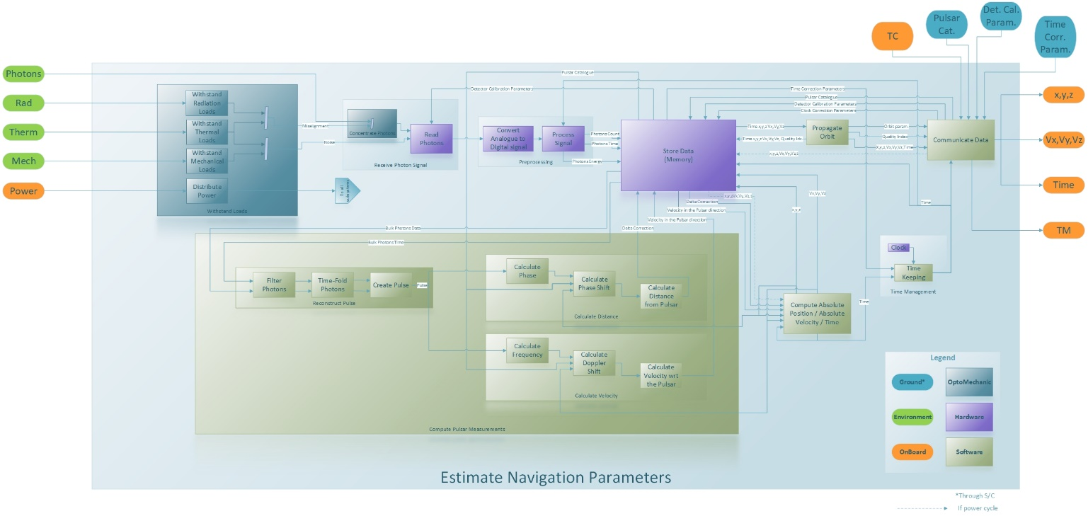
Functional Design
Functional Architecture

Slide 11
Functional Design
Modes

Slide 12
Functional Design
Modes
IDLE/SAFE_MODE: once switched on the unit enters directly into this mode.
  unit is ready to receive command, recording basic telemetry (for instance, detector temperature), and able to provide telemetry.
  No measurements provided in this mode.
  GROUND_UPDATE of onboard parameters carried out in this mode.
  The clock alignment with the provided parameters performed in this mode.
  Status update from ground or from spacecraft also performed in this mode.
CALIBRATION: allow calibration of detector (electronic noise, detector inhomogeneity, performance…), or any other element requiring calibration.
  This mode is entered/exited only from/to IDLE via telecommand.
OBSERVATION: observe pulsars, process signal, provide measurements, propagate orbit.
  entered upon reception of a specific command from the on-board computer triggering the start of the pulsar observation.
  exited autonomously once that the timing measurement and navigation solution are available to the PROPAGATION mode, via telecommand by the onboard compute in case of abort required, for instance, for loss of pointing attitude, or in the case of a failure.
  accessible through IDLE or through PROPAGATION mode.
  both performing observation, processing signal, providing measurements and propagating orbit simultaneously.

Slide 13
Functional Design
Modes
PROPAGATION: orbit propagation.
  entered either from IDLE/SAFE_MODE via telecommand or autonomously/via telecommand from OBSERVATION mode.
  can access OBSERVATION mode if new measurements are needed to keep a certain accuracy.
  exit to IDLE/SAFE_MODE if aborted via telecommand or in the case of a failure.
  solution is continuously provided.
GROUND_TEST: this mode is aimed at performing ground testing of the unit.
  specific ground connector and telecommand are required to access it.
  can only be reached from and go back to IDLE/SAFE_MODE.

Slide 14
Functional Design
Operation and Autonomy
As compared with star trackers:
  Pulsars are uniformly distributed in the plane of the sky, but much less dense than stars in a star tracker catalogue.
  The field of view must be narrow, so dedicated pointing is necessary.
  Long observation campaigns with good stability are required.
Therefore, the PODIUM measurement acquisition will not be in parallel with the normal operation of the S/C.
Dedicated slews and pointing modes for the host S/C are needed.
Two approaches:
  Commanded from PODIUM to S/C (high autonomy):
    To the pulsar that requires less rotation.
    To the pulsar that benefits the most the navigation solution.
  Commanded from S/C to PODIUM (less autonomy):
    Pulsar ID provided to PODIUM as an input
    Start and duration of observation triggered by S/C
      Longer observation -> higher accuracy
X PODIUM pointing has priority
V S/C pointing has priority

Slide 15
Functional Design
Operation and Autonomy
Distance measurement referred to the start of the observation:
  Longer observations increase accuracy of the position at the start of the observation, but decreases accuracy of the position at the current time.
Two operation modes proposed:
  Pull mode: the user S/C will request generation of measurement based on the photon phase data acquired from the start of observation.
  Push mode: PODIUM will generate a measurement at a given frequency (for example a measurement every second).

Slide 16
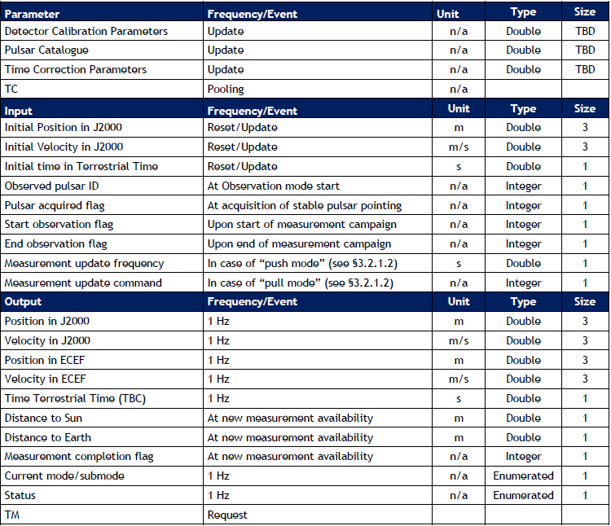
Functional Design
Interfaces
Parameters, Inputs and Outputs

Slide 17
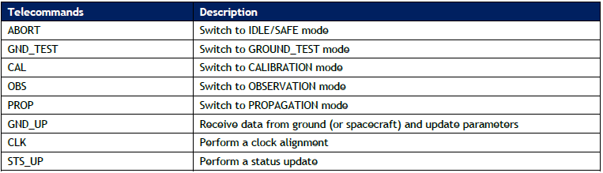
Functional Design
Interfaces
Telecommands

Slide 18


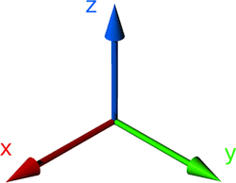

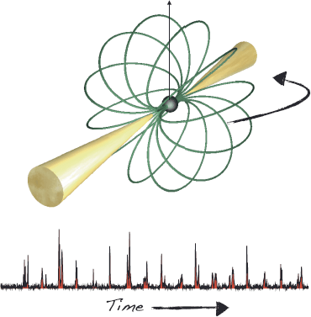
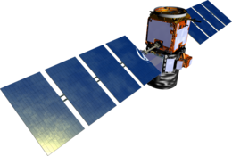





Measurement Generation
Mathematical concept
Transformation PSR→S/C
$$t_{a}^{S/C}=t_{e}^{PSR}+{Δt}^{PSR→S/C}$$
1
2
3
Binary
${Δt}^{PSR→S/C}=$ ${Δt}^{PSR→BB}+{Δt}^{BB→SSB}+{Δt}^{SSB→S/C}$
BB
1
2
SSB
Pulsar
$$\vec{r}$$
Spacecraft
3
$$\vec{V}$$
Earth

Slide 19

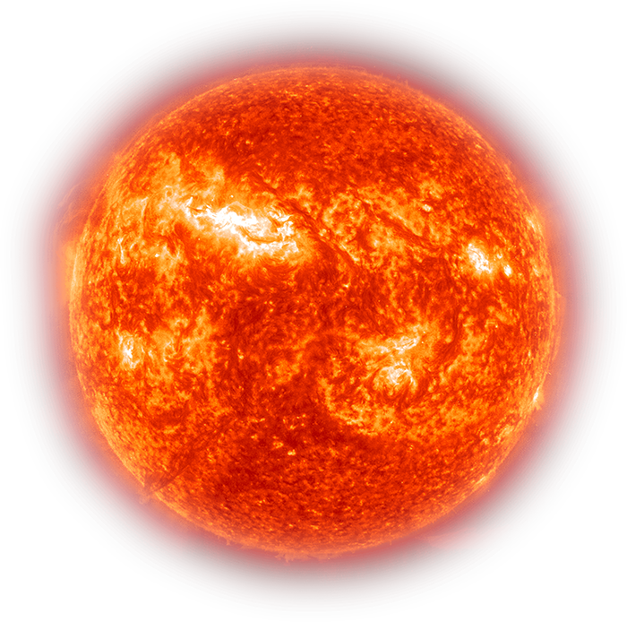






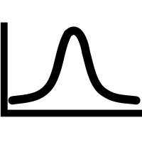














Binary
BB
SSB
Pulsar
$$\vec{r}$$
Spacecraft
$$\vec{V}$$
Earth
S/C OBSERVATION
$$φ$$
S/C - SSB
$$φ$$
$$t$$
Transformations
$$t$$
Observation: S/C
(Assumption of
$\vec{r}$ and $\vec{V}$)
Observation: S/C
Reference: S/C
Reference: SSB
EARTH OBSERVATIONS
TIMING MODEL AT SSB
$$Δt\left(\vec{r},\vec{V}\right)$$
$$φ$$
EARTH - SSB
$$φ$$
S/C PULSAR CATALOGUE
$$t$$
Transformations
$$t$$
$$φ$$
$$\vec{r},\vec{V}$$
Observation: Earth
Observation: Earth
$$t$$
Reference: Earth
Reference: SSB
PULSAR CATALOGUE
UPDATE
Observation: Earth
Reference: SSB

Slide 20
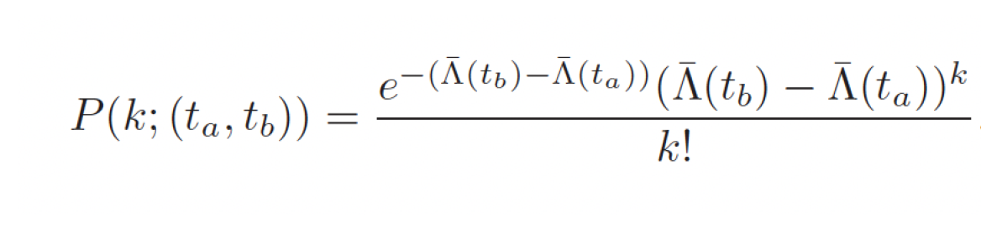
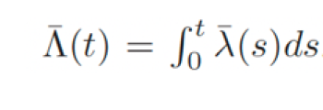
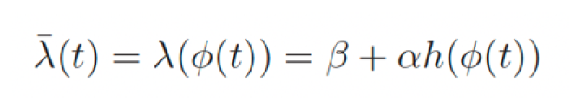
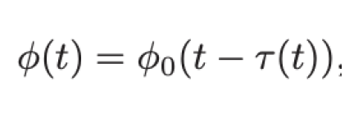
Measurement Generation
Mathematical concept
The fundamental data provided to the PODIUM algorithms are the observed photon event timestamps, accurate to 100ns RMS.
The observed photon event timestamps received are modelled as the arrival times of a Non-Homogeneous Poisson process (NHPP) with time varying cumulative count function Λ(t). For such process, the probability of k events arriving in the interval (ta, tb) is given by:
With a rate function of:
and
A pulsar timing model is a phase function:
where φ0 is the phase evolution at a hypothetical reference observatory and τ (t) is the light propagation time of the pulse wavefront moving from the detector to the reference observatory.

Slide 21
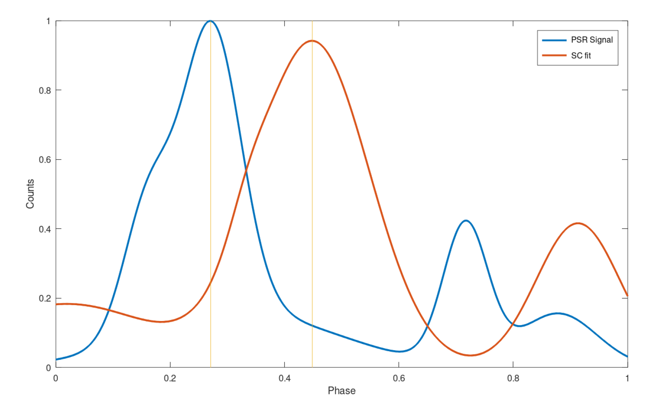
Measurement Generation
1. Collect arrival times of each photons (that will necessarily result being Poisson distributed) with an accuracy driven by the on-board clock tag capabilities.
2. Assign to each photon a phase tag using the phase equation
3. Where the frequency and its derivative are by the timing solution previously derived on ground (φ0(t)).
4. Fold the detected light-curve (phase versus number of counts) of the received photons and the φ0(t) provided on ground.
5. Fit a Gaussian using the minimum chi^2 procedure to both peaks of the folded light-curves.
6. Derive the modular difference between the two means of the two Gaussians, and its relative error.
7. Repeat this comparison if the observation is long enough to allow the data to be divided in chunks and the pulse profile being measurable in each chunk.
8. From this phase shift between the two folded profile derive the time shift (and its error using propagation techniques).
Mathematical concept
The typical XNAV algorithms work by observing several pulsars from a pre-defined catalog cyclically and when sufficient time is accumulated on a particular pulsar, the collected photon events are batch processed to extract pulse phase and Doppler delay estimates, which are finally passed to a navigation filter.

Slide 22
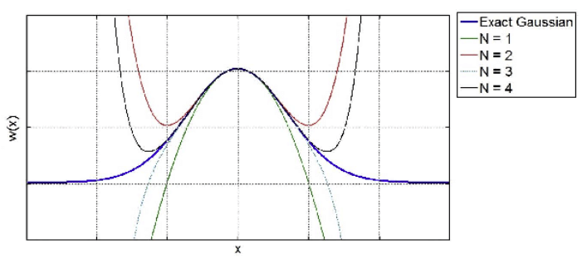
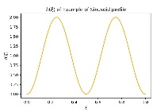
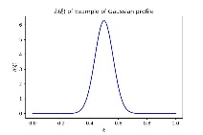
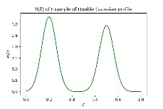
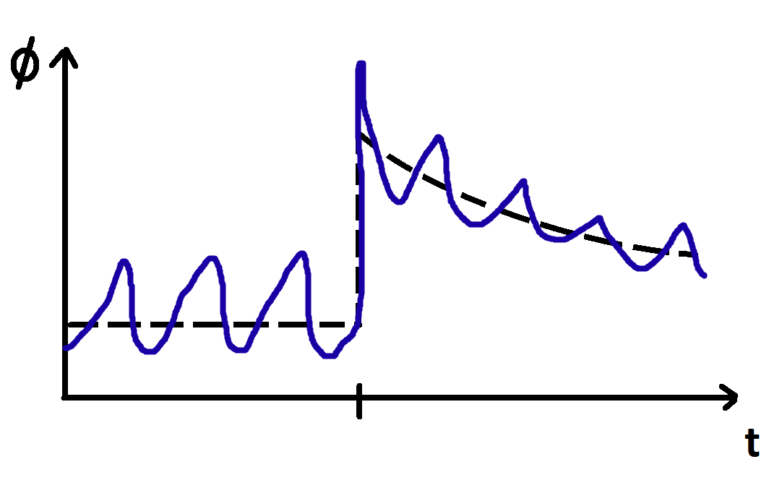


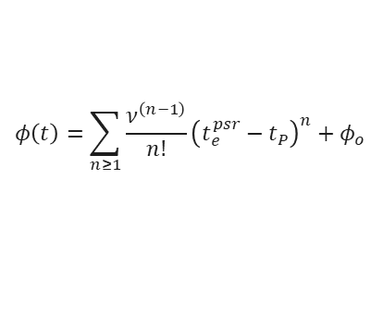
Measurement Generation
Pulse signal model (at PSR)
Taylor series
$$φ\left(t\right)=\sum_{n≥1}{\frac{ν^{\left(n−1\right)}}{n!}{\left(t_{e}^{psr}−t_{P}\right)}^{n}}+φ_{o}$$
Sinusoid
$$h\left(ξ\right)=1−\cos\left(4πξ\right)$$
$$h\left(ξ\right)=\frac{1}{σ\sqrt{2π}}e^{−\frac{{\left(ξ−ξ_{0}\right)}^{2}}{2σ^{2}}}$$
Gaussian
$$h\left(ξ\right)=weight·\left[\frac{1}{σ_{1}\sqrt{2π}}e^{−\frac{{\left(ξ−ξ_{0_{1}}\right)}^{2}}{2σ_{1}^{2}}}\right]+\left(1−weight\right)·\left[\frac{1}{σ_{2}\sqrt{2π}}e^{−\frac{{\left(ξ−{ξ_{0}}_{2}\right)}^{2}}{2σ_{2}^{2}}}\right]$$
Double Gaussian
Glitches
$φ_{g}\left(t\right)=Δφ+Δν\left(t_{e}^{psr}−t_{g}\right)+\frac{1}{2}Δ\dot{ν}{\left(t_{e}^{psr}−t_{g}\right)}^{2}+\left[1−e^{−\frac{t_{e}^{psr}−t_{g}}{τ}}\right]Δν_{t}\left(t_{e}^{psr}−t_{g}\right)$ $t_{e}^{psr}≥t_{g}$

Slide 23
Measurement Generation
Measurement simulation
Photon sequence generation steps
Retrieve pulsar data from pulsar catalogue
  Phases of Arrivals (POAs) retrieved from the pulsar catalogue. Data for J0030+0451 pulsar represented with blue dots in the plot.
Move POAs from reference to observation time
  POAs in the catalogue are referenced to a specific time. They must be phase-shifted to the observation time.
Perform a multiple Gaussian fitting to the data
  Multiple normal distributions (customized for each pulsar) are fitted to the data using the least squares method.

Slide 24
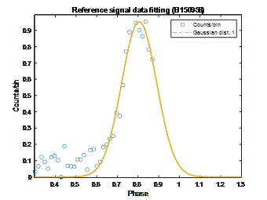
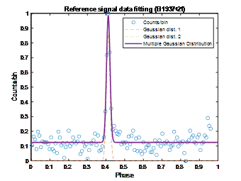
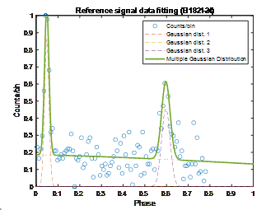
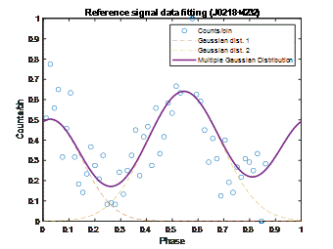
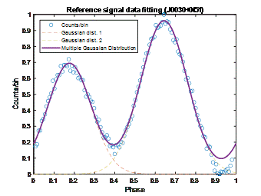
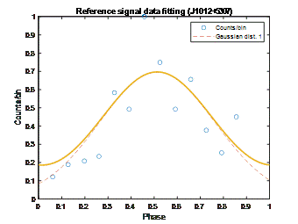
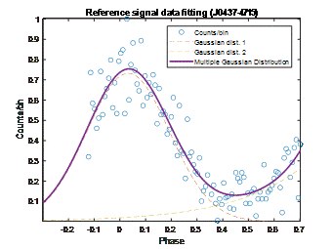
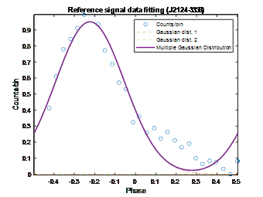
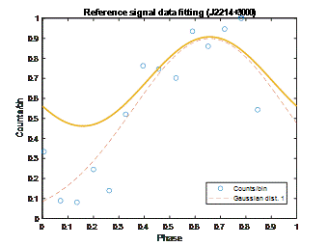
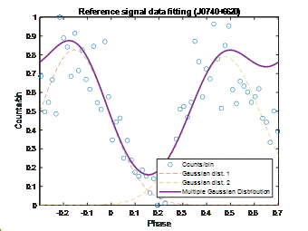
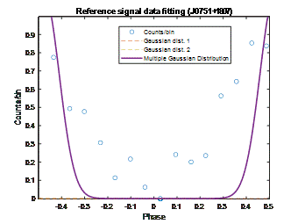
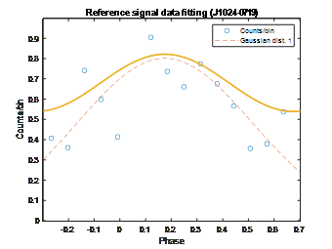
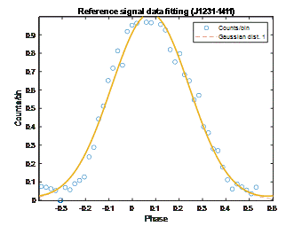
Measurement Generation
Measurement simulation
Pulsar profiles

Slide 25
Measurement Generation
Measurement simulation
Photon sequence generation steps
4. Generate photons hits
  Timestamps are generated from the Gaussian distributions using a Non-Homogeneous Poisson Process (NHPP), at the rates specified for the signal from the pulsar catalogue for the input effective area. These photons are generated at the same reference frame as the original data (SSB), at the observation time.
5. Generate noise photons hits
  Timestamps are generated using a Homogeneous Poisson Process (HPP) at the rates specified for the noise from the pulsar catalogue for the input effective area. The sum of the signal and noise photons are received by the telescope.
6. Transfer photons to the spacecraft
  The timestamps are transferred from the SSB to the position of the spacecraft using the light-time between the two points.

Slide 26
Measurement Generation
Measurement simulation
Photon sequence generation steps
7. Add clock and detector errors
  Clock errors: a model of the clock is simulated and added to the timestamps.
  Detector errors: Errors considered are the dead-time and the delay.
    The delay is added to the timestamps.
    Dead-time: time that the detector needs to recover from a photon read and to be able to read another photon.
Timestamps of photons at the telescope for 0.5 hours of observation. Aeff = 60 cm2. Pulsar: J0030+0451

Slide 27
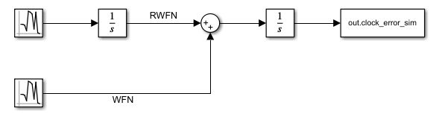
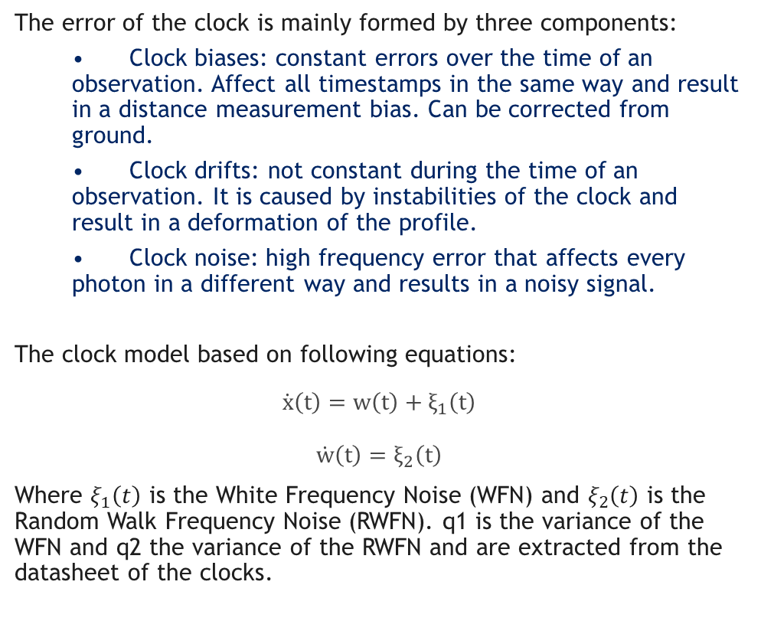
Measurement Generation
Measurement simulation
Clock Model
The error of the clock is mainly formed by three components:
  • Clock biases: constant errors over the time of an observation. Affect all timestamps in the same way and result in a distance measurement bias. Can be corrected from ground.
  • Clock drifts: not constant during the time of an observation. It is caused by instabilities of the clock and result in a deformation of the profile.
  • Clock noise: high frequency error that affects every photon in a different way and results in a noisy signal.
The clock model based on following equations:
$$\dot{x}\left(t\right)=w\left(t\right)+ξ_{1}\left(t\right)$$
$$\dot{w}\left(t\right)=ξ_{2}\left(t\right)$$
Where $ξ_{1}\left(t\right)$ is the White Frequency Noise (WFN) and $ξ_{2}\left(t\right)$ is the Random Walk Frequency Noise (RWFN). q1 is the variance of the WFN and q2 the variance of the RWFN and are extracted from the datasheet of the clocks.
Red and orange curves – 3-sigma of the error in seconds
Purple – Output of an actual simulation
The output is used by the simulator to add the error to the timestamps received by the detector.

Slide 28
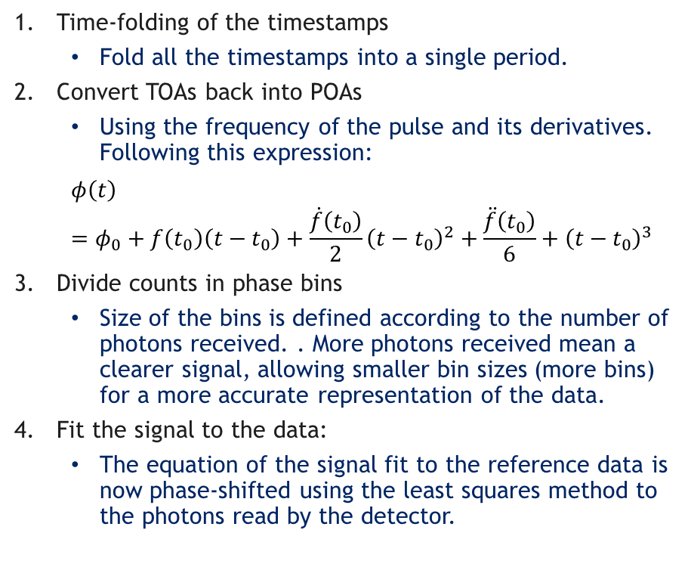
Measurement Generation
Measurement simulation
Pulse processing steps
Time-folding of the timestamps
  Fold all the timestamps into a single period.
Convert TOAs back into POAs
  Using the frequency of the pulse and its derivatives. Following this expression:
  $$φ\left(t\right)=φ_{0}+f\left(t_{0}\right)\left(t−t_{0}\right)+\frac{\dot{f}\left(t_{0}\right)}{2}{\left(t−t_{0}\right)}^{2}+\frac{\ddot{f}\left(t_{0}\right)}{6}+{\left(t−t_{0}\right)}^{3}$$
Divide counts in phase bins
  Size of the bins is defined according to the number of photons received. . More photons received mean a clearer signal, allowing smaller bin sizes (more bins) for a more accurate representation of the data.
Fit the signal to the data:
  The equation of the signal fit to the reference data is now phase-shifted using the least squares method to the photons read by the detector.

Slide 29
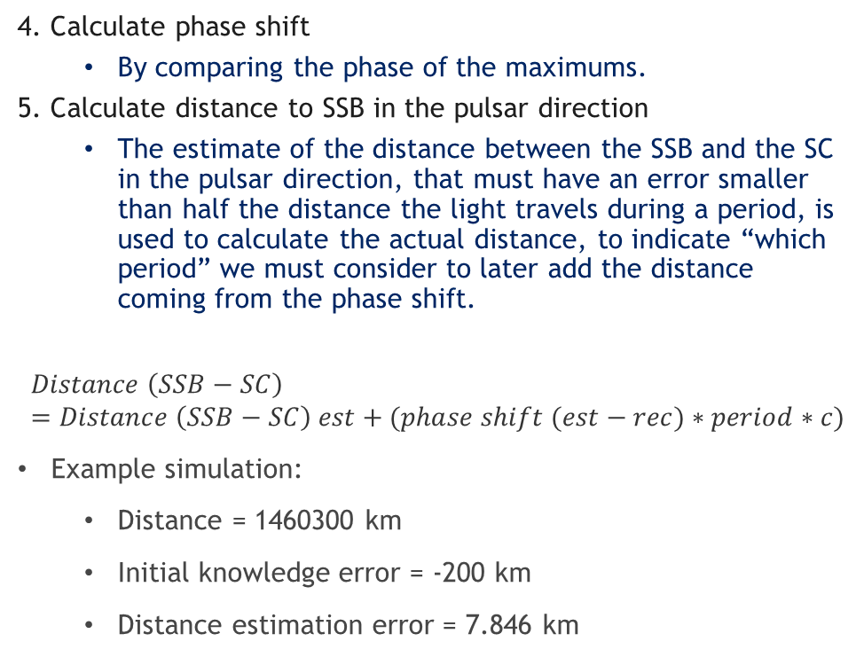
Measurement Generation
Measurement simulation
Pulse processing steps
4. Calculate phase shift
  By comparing the phase of the maximums.
5. Calculate distance to SSB in the pulsar direction
  The estimate of the distance between the SSB and the SC in the pulsar direction, that must have an error smaller than half the distance the light travels during a period, is used to calculate the actual distance, to indicate “which period” we must consider to later add the distance coming from the phase shift.
  $$Distance \left(SSB−SC\right)=Distance \left(SSB−SC\right) est+(phase shift (est−rec)∗period∗c)$$
Example simulation:
  Distance = 1460300 km
  Initial knowledge error = -200 km
  Distance estimation error = 7.846 km

Slide 30
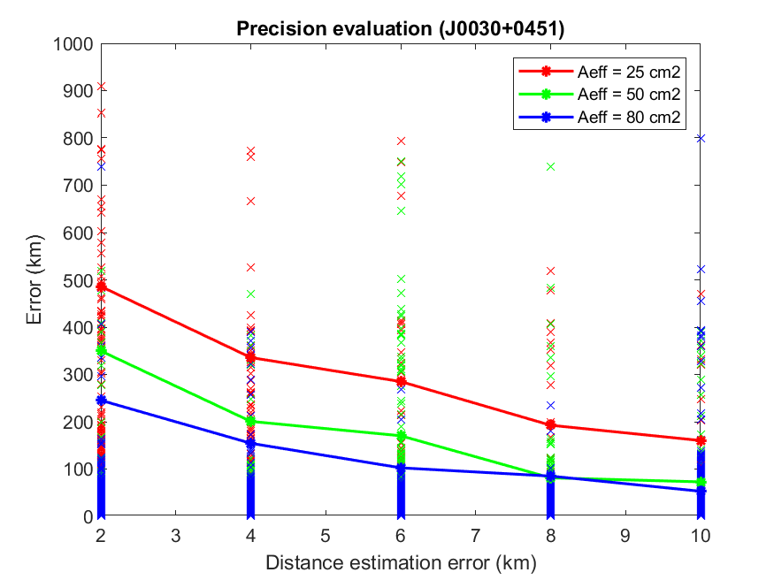
Measurement Generation
Pulsar campaign simulator
To assess the performance of the system with confidence, a campaign of several simulations must be launched for each of the pulsars.
The tool then uses the errors of each simulation to extract a measure of the 3-sigma confidence on the system, and creates the following plot (J0030+0451 for the example):

Slide 31
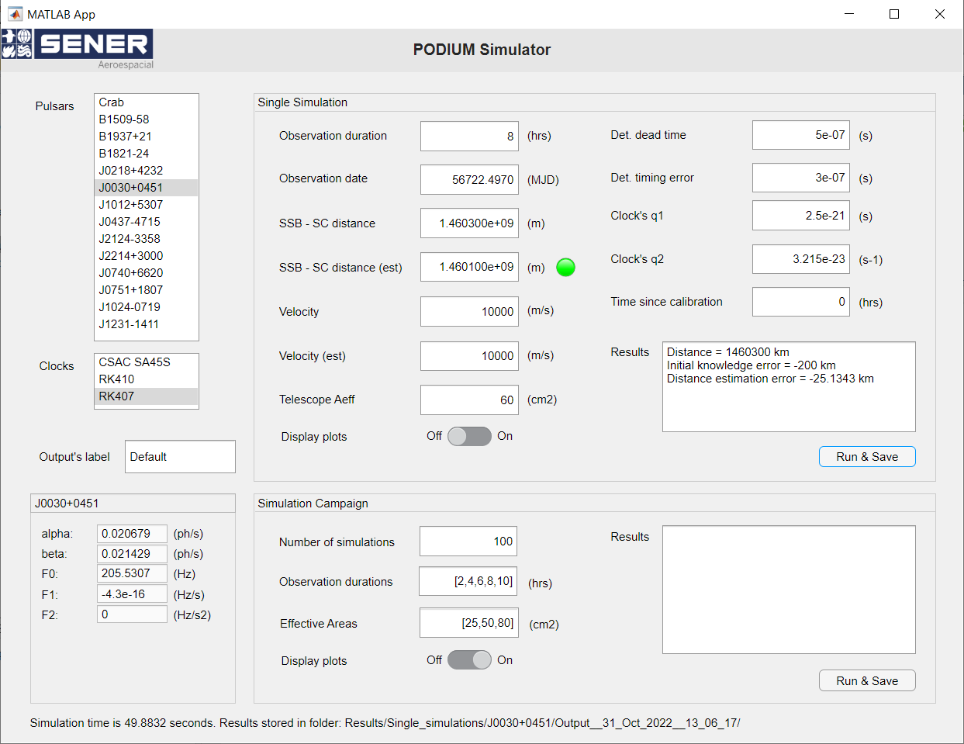
Measurement Generation
Simulator GUI

Slide 32
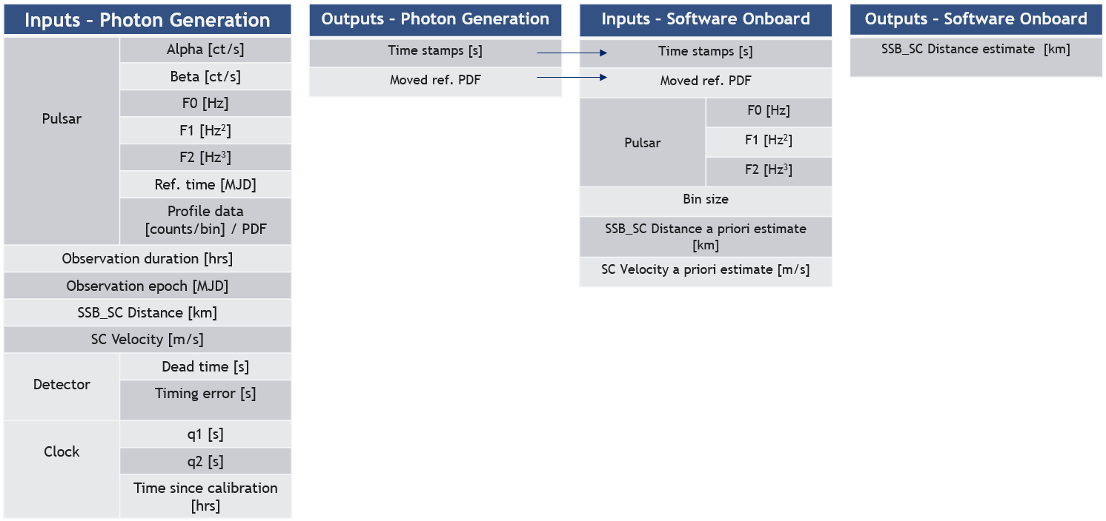
Measurement Generation
Data Flow between algorithms

Slide 33

Orbit determination
Algorithm design
The orbit determination functionality is implemented by an estimation algorithm based on LOTNAV’s Square Root Information Filter.
Trajectory propagation:
RK78 numerical integrator. Three modelling worlds are supported for navigation purposes:
  Nominal world: emulates a deterministic dynamical system with known parameters
  Estimated world: emulates a deterministic dynamical system with estimated deviations to the known parameters
  Real world: emulates a dynamical system with stochastic components added to the parameters defining the dynamic interactions. Includes errors and mismodelling, providing a dispersed trajectory around the nominal. The estimated world tries to determine the real world using observables in the navigation process.
Considered dynamics: gravitational forces, low-thrust propulsion, SRP, drag, residual accelerations.
SRIF Filter:
Uses the following derivatives to perform the orbit determination:
  Partial derivatives of the measurements with respect to the augmented state vector
  Partial derivatives of the augmented state vector at the end of the mapping time with respect to itself at the beginning of the mapping interval (transition matrix)
Estimates by considering a batch of measurements (Mapping Time Interval) which can be tuned. If a single measurement is included in each batch, the behaviour reduces to sequential estimation

Slide 34
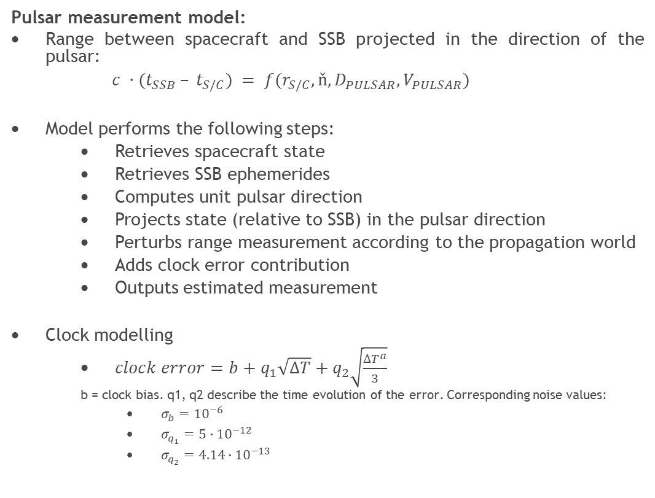
Orbit determination
Algorithm design
Pulsar measurement model:
Range between spacecraft and SSB projected in the direction of the pulsar:
  $$c ·(t_{SSB} – t_{S/C}) = f(r_{S/C},ň,D_{PULSAR},V_{PULSAR})$$
Model performs the following steps:
  Retrieves spacecraft state
  Retrieves SSB ephemerides
  Computes unit pulsar direction
  Projects state (relative to SSB) in the pulsar direction
  Perturbs range measurement according to the propagation world
  Adds clock error contribution
  Outputs estimated measurement
Clock modelling
  $clock error=b+q_{1}\sqrt{∆T}+q_{2}\sqrt{\frac{∆T^{a}}{3}}$
  b = clock bias. q1, q2 describe the time evolution of the error. Corresponding noise values:
    $σ_{b}={10}^{−6}$
    $σ_{q_{1}}=5∙{10}^{−12}$
    $σ_{q_{2}}=4.14∙{10}^{−13}$

Slide 35
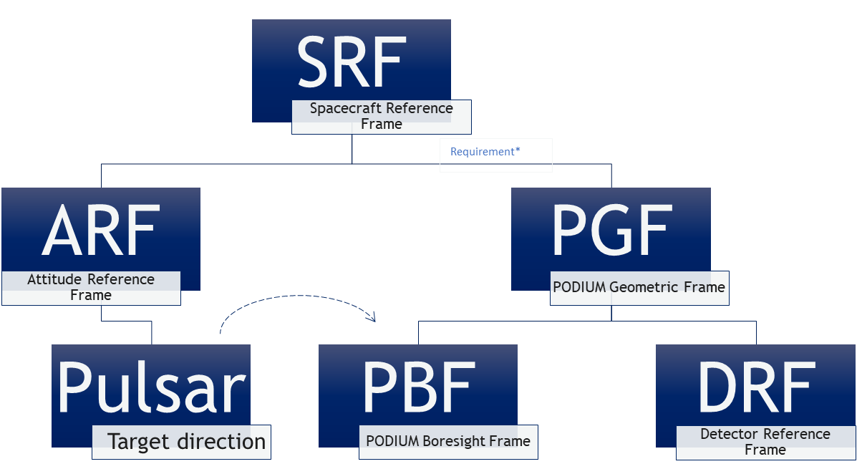
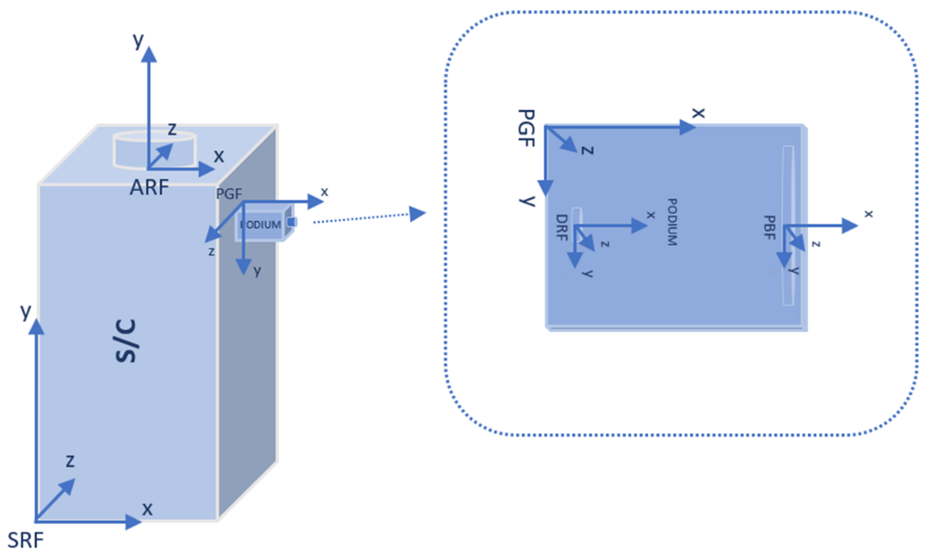
Alignment and Pointing
Reference Frames

Slide 36
Alignment and Pointing
Pointing Budget
Alignment and pointing requirements shall be defined and analysed taking into account two main needs:
The host S/C system shall be able to point the PBF to the Pulsar target direction with an accuracy such that the maximum (all) pulsar energy is collected taking into account the optical design capabilities.
  In other words, no Pulsar photons shall be lost due to pointing and alignments!
  This drives overall pointing budget
The DRF alignment shall ensure that no pulsar photons captured by the telescope are lost.
  This drives internal alignment stability, thus internal design
PES-1 includes all errors between the telescope boresight as known onboard in ARF and the pulsar direction as known onboard. As such, this error will include the attitude knowledge error and the attitude control error.
Pointing stability (RPE) is not prescribed: by choosing a SDD detector the focusing of the pulsar image is not relevant for measurements
  (the location of the photons impact on the detector is not relevant, as long as the photons hit the detector).
ID | Error Source | Contribuent value | Contribuent units | Statistic type | Comment
PES-1 | APE - ARF to Pulsar | 0.1 | deg | 99.7%ile | Assumed
PES-3 | ARF to SRF | 0.05 | deg | 99.7%ile | Reference value No calibration assumed WC as thermolastic unknown misalignment between Star Tracker and SRF.
PES-4 | SRF to PGF | 0.05 | deg | 99.7%ile | Assumed as misalignment between STR and SRF
PES-5 | PGF to PBF | 50 | arcsec | 99.7%ile | From Thermolastic analysis + 50% margin approx
PES-6 | PGF to DRF | 50 | arcsec | 99.7%ile | As for telescope boresight
PES-7 | Pulsar Direction Knowledge error | 60 | arcsec | 99.7%ile | Assumed, TBC
 | Total (RSS) | 0.125 | deg | 99.7%ile | Assuming uncorrelated errors
 | FOV semiaperture | 0.125 | deg |  | Reference value for 0.25 deg aperture

Slide 37
Calibration
Alignment Calibration
Alignment calibration: process used to estimate the direction of the PODIUM telescope boresight direction with respect to the S/C attitude reference frame to correct as much as possible for pointing knowledge errors
How? Compare the difference between the boresight direction known by the spacecraft system and the real pointing direction
  measure the location of the center of the observed pulsar image with respect to the center of the detector
  measure where each photon impacts the detector, to allow estimating the image center of brightness
  detector technology with image capability required
SDD detector is current baseline due to time tagging accuracy
  → No imaging capability (single pixel!) → alignment calibration not possible
  → since the photon acquisition will not be affected by defocusing or displacement of the photon impact due to misalignment, as long as this is small enough not to lose pulsar photons during observation

Slide 38
Calibration
Detector Calibration
There are two types of instrument (and detector, in particular) calibration:
Ground calibration - prior to launch
In-flight calibration - after launch
In-flight calibration should control the instrument performance and enable possible corrections to guarantee a correct data analysis
It is recommended to keep track of:
effective area as a function of energy. Keep in mind that optics plus detector determine the crucial total effective area
energy and timing resolution of the detector, especially the last one in PODIUM
Cross-calibration with data from other contemporaneous similar X-ray instruments is a technique used in scientific X-ray satellites, that can also be valid for modules of X-ray navigation
  The Crab pulsar is used by many missions as a calibration source for timing accuracy
  IACHEC collaboration: International Astronomical Consortium for High-Energy Calibration

Slide 39
Calibration
Detector Calibration
The detector energy calibration is not crucial for PODIUM. It would require an onboard calibration source, as for instance the radioactive source ⁵⁵Fe, with half-live 2.7 years. This solution is deemed non feasible given the limits in power, volume, mass of PODIUM, and to the inherent complexity of adding such type of mechanism.
Calibration shall be based on observation of some well-known sources ("standard candles"), like the Crab, to determine if there's some degradation in the instrument performance.
The absolute area calibration - which in fact calibrates the combined effective area of the detector and of the X-ray mirrors - can be done via cross-calibration with other satellites, because there's not an absolute flux calibrator in the sky. A good source to use is the Crab, comparing observations of PODIUM with observations from other satellites.

Slide 40
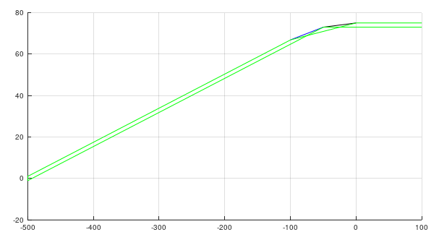
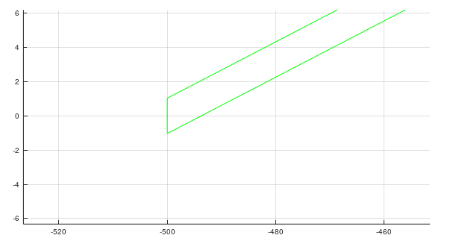
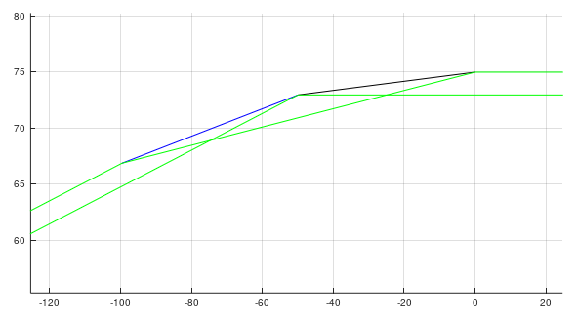
Optical Design
Telescope Architecture
Alternative to typical Wolter I Telescope
Focal length is 500 mm
  The Parabolic and Hyperbolic mirrors are substituted by Conical mirrors
  Pros
  Grazing angle is uniform at each shell and at both cones (optimum)
  Easier manufacturing
  Any number of mirrors could be installed in series
  Feasible to be used for small radios
  Cons
  The ray is not focused to a point but to a spot (not a problem)
  Defocus will produce a ring.
  Comments
  Grazing angle at the Par+Hyp is non-uniform and constrained by the geometry of the curves
  A spot in the detector is not a disadvantage because it has one unique pixel

Slide 41
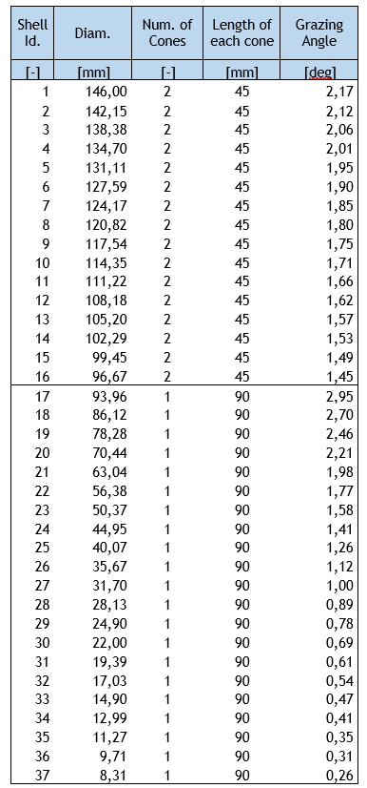
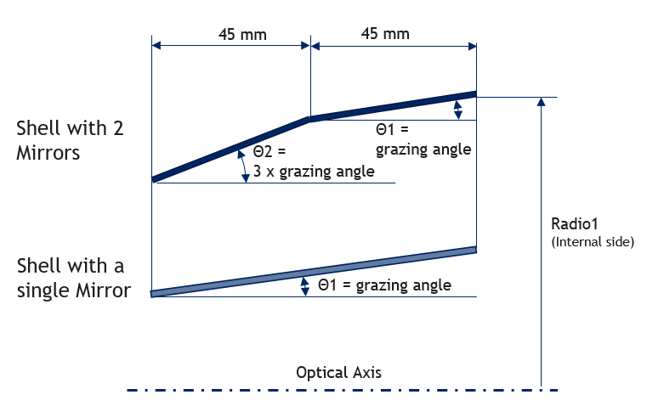
Optical Design
Telescope Architecture
Baseline design:
Conical mirrors are used
  External shells with large radio have 2 mirrors
  External shells with small radio have only 1 mirror
The angle of cone for the second mirror is 3 times the angle of the first one providing the same grazing angle for both
Number of shells: 37
  16 shells with 2 cones
  21 shells with 1 cone

Slide 42
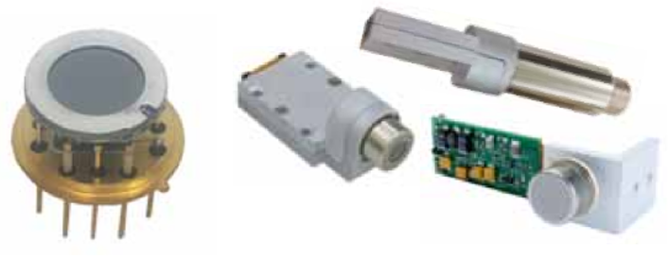
Optical Design
Focal Plane Design
Detector
  Based on the detector FastSDD-70 from Amptek.
  Detection surface of 70 mm² equivalent to 9.44 mm in a unique pixel
Alignment tolerances
  The photons coming in nominal configuration without thermal degradation, will get the detector in a circle of diameter 2.06 mm
  It allows a margin of ± 1.71 mm (in radio) for alignment, thermo-elastic deformation and LoS deviation

Slide 43
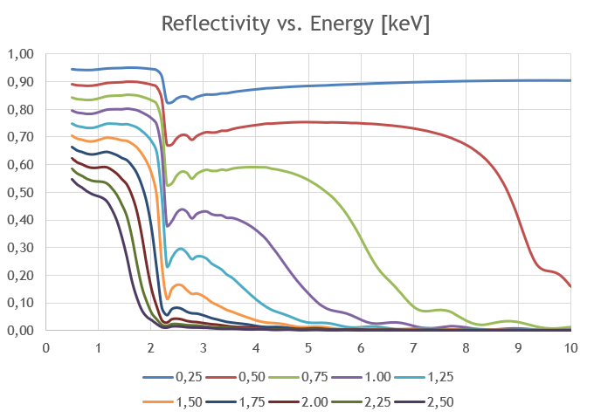
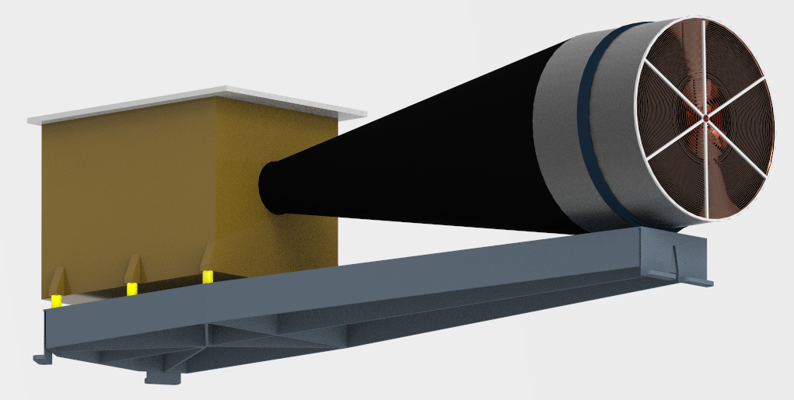
Optical Design
Selection of Materials
Materials for Mirrors:
The materials for mirrors have been selected to:
  Optimize the reflectivity at the useful photon energies
  Minimize the mass
Selection
  Layer 1 Au 25 nm
  Layer 2 NiCo 20 μm
  Substrate Al2O3 200 μm
Structural Materials:
Aluminum selected for:
  Most structural elements including OB, Electronic Boxes, supports and Radiator
  Provides good balance between mass, stiffness, thermal conductivity and CTE (that is not critical)
CFRP for the telescope Cone:
  For Telescope Cone
  Low density and low CTE to keep the Focal Distance
Reflection for the selected materials vs. grazing angle and photon energy
CFRP

Slide 44

Optical Design
Effective Area
Evaluation of the Effective Area:
Assumptions for the analysis
  The EA has been evaluated for photos rays parallel to the optical axis
  Mirror reflection was obtained from https://henke.lbl.gov
Evaluation method
  Each mirror shell was analyzed individually considering its annular area and grazing angle
  The estimated energy distribution for each star was also considered
Results conclusions
  The table shows the Effective Area for the stars considered
  It is considered an average EA of 60 cm²
Effective Area obtained for each selected star

Slide 45
Optical Design
Conclusions
Main conclusions on the optical design are:
The telescope does not require to focus the received photons on a single point. Due to that:
  Conical mirrors are used ⇨ Simpler design and manufacturing
  Low sensitivity to thermo-elastic and alignment degradations ⇨ Robust design
Nominal focal length is 500 mm
An Effective Area of 60 cm² is obtained
  The Focal Length could be reduced if smaller EA is acceptable ⇨ Possible optimization

Slide 46



Thermo-Mechanical Design
Mechanical Design
The Instrument design is based in the following main characteristics:
“U” shape electronics boxes distribution
  Provides volume optimization and minimum envelope
  Electronic box is used for shielding
  CoG closer to the I/F with the Platform
Instrument supports are integrated in the same piece than the OB
  Mass reduction
  Simpler integration
  Robust design
Iso-static supports with large flexibility
  Large flexibility in radial direction
  Adequate stiffness in vertical and tangential directions

Slide 47
Thermo-Mechanical Design
Thermal Design
Objective of the thermal design:
  To dissipate the heat of the Electronics and Focal Plane
Relevant elements involved in the thermal behaviour are:
  Electronics
    Power dissipating element
    The Detector is included
    Maximum power dissipated: 12 W
  Radiator
    Directly attached to the electronics box and to the Detector Cover
    Material: Silver Teflon 10 MIL
    Emissivity 0.85
    Absorptivity 0.10
  Focal Plane Case
    It is used to create a homogeneous thermal environment at the Detector and Amplifier
    Made in aluminium with high thermal conductivity

Slide 48
Thermo-Mechanical Design
Thermal Design
Relevant elements involved in the thermal behaviour are (Cont.):
  Optical Bench
    Made in aluminium with high thermal conductivity
  Heaters
    They are used to regulate the temperature of the Electronics when radiation is very high
    Located at the Focal Plane Case close to radiator
    Power installed: 5 W
  Mirrors
    Contains the mirrors
  External Thermal Isolation
    MLI (Multi-Layer Isolation) covers most external surface
    SLI (Single Layer Isolation) of VDA covers the aperture of the Telescope (TBC)
  S/C Baseplate (It is not part of the Instrument)
    The Instrument is attachment to S/C with FR4 washers for isolation

Slide 49

Thermo-Mechanical Design
Thermal Design
Thermal design baseline
Radiator directly attached to the electronic box
Radiator connected to the FP with a thermal link
Electronic and FP insolated from the OB
MLI covering the Instrument except for
  Radiator
  Telescope pupil (TBC)

Slide 50
Thermo-Mechanical Design
Preliminary Thermal Model
Objective: To size the Radiator and the power needed for Heaters.
Assumptions for this model:
  Only 1 DoF.
  The objective is to evaluate the temperature of the Radiator for a stationary heat flux given by the relation:
Pe + Ph = Pr + Pc
  Where:
    Pe: Power dissipated by the Electronics
    Rh: Power supplied by the Heaters
    Pr: Power radiated
    Pc: Power transmitted to the S/C by conductivity
  The Radiator has the same temperature than Electronics and Detector
  There is no external transmission of power but on the Radiator and I/F with the S/C Platform
  Reference working temperature of the S/C Platform: 20.0 ºC
  While Sun is hidden, there is not power absorption

Slide 51

Thermo-Mechanical Design
Preliminary Thermal Model
The analysis of the conductivity between Electronics and the S/C Platform gives the following values:
  Conductivity between elements in series
    Electronics / Optical Bench: 8 bolts M4 6.40 W/ºK
    Optical Bench / Bipod: 3 washers FR4 0.03 W/ºK
    Bipods: 3 titanium bipods 0.21 W/ºK
    Bipods / S/C Platform 12 bolts M4 0.21 W/ºK
  Global conductivity between Electronics & S/C
    Global conductivity Optical Bench / Platform 0.02 W/ºK
    Global conductivity Electronics / Platform 0.02 W/ºK (Driven by OB/Platform)

Slide 52


Thermo-Mechanical Design
Preliminary Thermal Model
Simulated Cases
  Simulations have the objective to maintain the Electronics at 20ºC and 28ºC.
  For both cases, the optimum radiator size is defined and check at 4 different environments & parameters

Slide 53
Thermo-Mechanical Design
Preliminary Thermal Model
Results
  Both cases have acceptable results:
    Electronics temperature is inside the operational range.
    The power transmitted to the S/C is not larger than 1.0 W except for the degraded scenario in which the Heaters do not work
    Power required by Heaters is 5.5 W and 5.0 W.
  The selected option as baseline is the first one for a stationary temperature of 20ºC.
    Resultant Radiator Size:
      Surface 0.034 m2
      Lateral side 150 mm
      Length 225 mm

Slide 54


Thermo-Mechanical Design
FEM Analysis
Characterization of the mass
Mass as per FEM model
  Radiator
  CFRP Cone
  Optical Bench
Mass uniformly distributed
  Electrical Box
  Mirrors
  Focal Plane

Slide 55



Thermo-Mechanical Design
FEM Analysis
Results:
Stiffness
  Natural frequencies ≥ 60 Hz
Thermal loads
  Temperature at I/F 20 ºC
  Temperature of Electronics 28 ºC
  Temperature of the radiator 25 ºC
  Conductivity of thermal washer 0.9 W/ºC
  Power dissipated by Electronics 12 W
Thermo-elastic deflection
  LoS deflection: 234 µrad
First 2 modes
Thermo-elastic load & deformation

Slide 56
Avionic Design
SW architecture and design
The PODIUM SW will provide the functionality needed by the PODIUM system for:
Load and start-up of the SW
Acquisition of data from the detector
Processing of signals and generation of navigation solution
Handle telecommands for configuration and send telemetries with its status
General management and monitorisation

Slide 57

Avionic Design
SW architecture and design: SW Components
Acquisition
Navigation Solution
TC Management
Management
Services
S/C Interface
Boot
RTOS

Slide 58
Avionic Design
SW architecture and design: Acquisition
The Acquisition component has the functionality aimed to process the data collected by the instrument detector and prepare it for providing it to the Navigation Solution.
The two functionalities provided by this package are the Photon Time-Folding and the Pulse Creation.
The Photon Time-Folding implements the process of folding the photons to allow the creation of pulse of signals. The algorithm is based in the epoch folding method.
The Pulse Creation will create a single pulse signal based on the feed from the photon time-folding algorithm, to be used as input for the Navigation Solution. This input will be made available in shared memory with the components in the Navigation Solution package.
The tasks associated to this functionality in this component work in synchronous and asynchronous way. They will synchronously acquire data from the detector, and asynchronously process them with the photon time-folding and provide them as measures for the Navigation Solution.

Slide 59

Avionic Design
SW architecture and design: Navigation Solution
The Navigation Solution component implements the generation of the absolute position, velocity, and time based on data acquired from the detector.
The Navigation Filter implements the Kalman filter that generates the absolute position and absolute velocity to be provided with the PVT.
Subcomponents:
Dynamical Models
Numerical Propagator
Reference Frames
Measurement Models
PVT Calculation

Slide 60
Avionic Design
SW architecture and design: Other components
TC Management: The TC Management component handles the TCs received by the SW. It will be able to execute the TC received from ground.
TM Management: The TM Management package manages the telemetries sent by the SW to the S/C. Its two main functionalities are the Navigation Telemetry and the Housekeeping.
S/C Interface: The S/C Interface package provides the interface with the spacecraft or/and ground. This interface is spacecraft/mission dependent and will be compliant with the platform interface specifications. It is composed of the TM/TC handling and the drivers.
Services: The Services package groups components that provide different services to the rest of the SW components. These components are: memory management, FDIR, clock management and mode management.
RTOS: The services and drivers needed to run the SW on top of the RTOS.
Boot: This component provides the functionality for loading the SW and the correct initialization of the rest of the SW components.

Slide 61

Avionic Architecture
Threads
Process | Allocation | Execution
Photon timetagging | FPGA | Continuous, synchronous
Pulse folding | SW | Can be synchronous or asynchronous. TBC based on memory required to store photon timetags.
Measurement Generation | SW | At specific times, Asynchronous
State estimation (OD Measurement Update) | SW | After measurement generation is complete, Asynchronous
Orbit Propagation (OD) | SW | Continuous, synchronous ~1Hz

Slide 62
Avionic Design
Electronic design
Blocks Diagram

Slide 63
Avionic Design
Function | P/N | Manufacturer | Description | Package | Qty.
Microprocessor | GR740-MSV-CGA625 | CAES (formerly COBHAM) | quad-core fault-tolerant LEON4 SPARC V8 processor | CGA 625 ceramic package | 1
LVDS Transmiter | UT54LVDS031LV/E | Aeroflex | Low Voltage Quad Driver | Flat-16 | 1
LVDS Receiver | UT54LVDS032LV/E | Aeroflex | Low Voltage Quad Receiver | Flat-16 | 1
Clock Generator | RK0721FM40M000000 | RAKON | High Reliability 10-7 stability class OCXO (Oven Controlled Crystal Oscillator) | Flat-10 | 1
Clock driver | UT54ALVC2525 | CAES (formerly COBHAM) | Clock Driver 1 to 8 Minimum Skew | Flat-14 | 1
TTL Level Shifter | RHRAC164245K01V | ST | 16-bit bidirectional level shifter 3.3V to 5V | Flat-48 | 2
FPGA | RTPF500TL-1CG1509V | Microsemi SoC | Lowest Power, Cost-Optimized, Mid-Range, RT PolarFire FPGA. | CG 1509 ceramic package | 1
DC/DC Voltage Supply | TPS50601A-SP | Texas Instruments | Linear Switching regulator, 20 pins | Flat-20 | 2
Power On Reset | 5962R9673802VXA | Texas Instruments | Quad comparator, 14 pins | Flat-14 | 1
Housekeeping | ADC128S102WGRQV | Texas Instruments | 8 channel ADC 12 bit | Flat-16 | 1
Volatile Memory | 3DSD2G16VS4767-MS | 3Dplus | 2Gbit SDRAM organized as 128Mx16 | SOP 54 | 3
Non volatile Memory | 3DMR1M08VS1426-MS | 3Dplus | 1 Mbit MRAM with a 8-bit interface | SOP 44 | 2
Mass Memory | 3DF02G08VS4215-MS | 3Dplus | 2 Gbit, 8 bit bus width, NOR Flash based on 64Mx8 | SOP 60 | 1
Analog to Digital Converter | AD9254 | Analog Devices | 14 bits, 150MSPS, 1.8V Analog to Digital Converter | CQFP 52 | 1
Electronic design - Main Devices

Slide 64
Avionic Design
Function/Sub-function | Function Definition | Implementation
Receive Photon Signal / Concentrate Photons | All photons incident in the collecting surface are concentrated onto the detector. | Performed by structural and optics parts.
Receive Photon Signal / Read Photons | The detector absorbs the photon to create electrons that will be read by the electronics. | Performed by detector.
Preprocessing / Convert analogue to digital signal | The output pulse of the detector is read, and its amplitude is stored digitally. | Performed by Hardware. Controlled by Firmware.
Preprocessing / Process signal | The time in which the electrons are created will be recorded to have the most accurate possible register of the time the photon reached the system. | Performed by Firmware.
Store Data | Raw data from the detector and the time-tag function, measurements data, and final absolute measurements data, along with calibration parameters and pulsar catalogues are stored in this function. | Performed by Software.
Compute Pulsar Measurement / Reconstruct Pulse | This function reconstructs the pulse of photons emitted by the pulsar. To do so, the photons are stored to then time-fold them when enough counts are achieved, to finally create the pulse. | Performed by Software.
Compute Pulsar Measurement / Calculate Distance | From the pulse created in the Reconstruct Pulse function, the distance to the pulsar can be calculated by comparing the phase of the pulses and using the initial position estimate. | Performed by Software.
Compute Pulsar Measurement / Calculate Velocity | Similar to the Calculate Distance function, this function calculates the velocity in the direction of the pulsar performing Doppler measurements from the pulse. | Performed by Software.
Orbit Determination / Propagate Orbit | The evolution of the orbit is propagated in time making use of dynamical models. | Performed by Software.
Orbit Determination / Measurement update | Once that a pulsar measurement is received, an estimation process is executed (Kalman step) to fuse the propagated state and the measurement data. | Performed by Software.
Functionality Allocation

Slide 65
Avionic Design
Function/Sub-function | Function Definition | Implementation
Time Management / Clock | Provides time pulse to the unit. | Performed by Hardware.
Time Management / Time Keeping | With the internal clock, the time estimation obtained by the Kalman Filter, and the time correction parameters, the corrected time is kept by this function. | Performed by Firmware.
Withstand Radiation Loads | Function in charge of protecting the other functions against radiation. | Performed by Hardware. Performed by structural parts.
Withstand Thermal Loads | Function in charge of protecting the other functions against thermal loads. | Performed by thermal and structural parts.
Withstand Mechanical Loads | Function in charge of protecting the other functions against vibrations and shocks. | Performed by structural parts.
Distribute Power | Provides power to the rest of the functions. | Performed by Hardware.
Communicate Data | This function controls the communications between the sub-functions of the system and the host spacecraft. It is a two-way communications link. | Performed by Hardware. Low level protocols. Performed by Firmware. Medium level protocols. Performed by Software. High level protocols.
Initialization | Power up & Initial Self check: Initial configuration. Initial self tests (health tests). Memory patch & dump. | Performed by Software (Flexibility) Microprocessor will implement the following functions: Reading MRAM memory (Boot SW). Copy MRAM App SW) into RAM. Built-in-self-tests. HW will implement specific Power-up circuitry. FW will perform the TM/TC comm. and internal SRAM Initialization.
Sequencing (operations/modes/sub-modes) | Modes sequencing – context information management (HW&SW configuration, TM/TC availability configuration). General Interruptions management (timing, communication bus, EDAC, internal errors…). TM/TC execution and management (prioritization, acknowledgement). Background tasks: Memory scrubbing. Watchdog refreshing. Timing checks. | Software implementation, although some very specific tasks will need resources on FW (registers and configuration at FPGA, …).
Functionality Allocation

Slide 66
Avionic Design
Function/Sub-function | Function Definition | Implementation
Synchronization (LOBT) | Implementation of LOBT management. Implementation of additional interrupts as needed. | Implemented by Firmware.
Time Stamping | Time Stamp of the acquired data. | Firmware performs the time stamp of the samples.
Housekeeping and Diagnostic Logs | Synchronization and timing of multiplexed sensors acquisition. HK, SW status, FW status. Synchronization of the complete set of HK parameter acquisition. | Firmware performs the synchronization functions and the data acquisition according to the programmed acquisition schedule. The software will program the FPGA to acquire the data according to the defined plan.
Memory management | Memory banks data In/Out. Memory patch/dump (from ground/platform). Memory checking (CRC or checksum) function. | Software for MRAM (BSW) and RAM (partly). TM/TC memory will be managed by the FPGA (in fact, this memory is composed of internal FPGA blocks) in order to implement EDAC protections.
Health status specific checking | Built in test sequences: RAM Memory Bank checking. MRAM Memory Bank checking. EDAC Checking. Memory banks Access. Interrupts. FPGA register Access. Watchdog checking. Clock and timing. Communication bus. | Software – Microprocessor will be in charge of monitoring the health status. Firmware. The PB-FPGA will check its internal memories and report its status to the software.
FDIR | Implementation through configuration tables for FDIR (parameters, checking type, threshold, recovery actions, events report generation). | Software (monitorization function).
Functionality Allocation

Slide 67

System Budgets
Mass Budget
The mass of the complete instrument without maturity margin is 6.0 kg

Slide 68

System Budgets
Volume Budget
Element | Envelope
Instrument (total) | 152 x 190 x 610 mm³
Requirement UR-6 ([AD 01]) | 150 x 150 x 500 mm³

Slide 69
System Budget
Power Budget
Item | Power consumption (W) | With Margin 20% (W) | Note
Detector (FastSDD) | 0,01 | 0,012
Detector Thermal control | 1,5 | 1,5 | Worst case
Preamplifier | 0,3 | 0,36
FEE | 1,5 | 1,8
Processing | 4,4 | 5,28
Power conditioning (65% efficiency) | 4,25 | 5,1
Telescope thermal control | 4 | 4,8
TOTAL | 15,96 | 18,852
Requirement (UR-5, [AD 01]) | 15

Slide 70

Pulsar Sky Catalogue
Source selection
14 pulsars included in the PODIUM Pulsar Sky Catalogue
12 nearby millisecond pulsars (MSPs) part of pulsar timing arrays (PTAs): Most stable “cosmic clocks”
2 young pulsars (Crab + B1509-58): Bright and narrow pulses → most precise phase measurements
Galactic distribution of the 14 PODIUM pulsars
Main factors considered for selection:
Pulsed X-ray flux
(impacts the precision of phase measurements)
Rotational stability
(impacts the accuracy of phase predictions)

Slide 71
Pulsar Sky Catalogue
Parameter database
Pulsar Timing:
Technique that builds upon the rotational stability of pulsars
Consists of developing a descriptive model of the NS spin properties through long-term monitoring
Timing ephemeris:
Deterministic model used to predict the rotational phase of pulses in any reference frame (e.g. SSB)
Precision level of a few tens of nanoseconds
Requires timing measurement of several parameters:
Rotational (e.g. spin period, spindown rate, etc.)
Astrometric (e.g. position, proper motion, etc.)
Orbital (if applicable)
Other extrinsic/stochastic factors (e.g., excess delays
caused by interstellar medium)

Slide 72
Pulsar Sky Catalogue
Parameter database
Pulsar Timing:
Technique that builds upon the rotational stability of pulsars
Consists of developing a descriptive model of the NS spin properties through long-term monitoring
Timing ephemeris:
Deterministic model used to predict the rotational phase of pulses in any reference frame (e.g. SSB)
Precision level of a few tens of nanoseconds
Requires timing measurement of several parameters:
Rotational (e.g. spin period, spindown rate, etc.)
Astrometric (e.g. position, proper motion, etc.)
Orbital (if applicable)
Other extrinsic/stochastic factors (e.g., excess delays
caused by interstellar medium)
Parameter database
Built from 10+ years of timing monitoring with various radio telescopes (including PTAs latest data release)

Slide 73

Pulsar Sky Catalogue
Model accuracy and phase prediction
Pulsars phase prediction accuracy degradation vs time
Errors in phase prediction → error in the derived navigation solution
Degradation in prediction accuracy estimated by :
Generated several realisations of timing models by randomly selecting pulsar parameters within measured uncertainty
Extrapolated pulse phases predicted by each model at fixed reference epoch and frequency
Total error budget of the models is the standard deviation of predicted phases

Slide 74
PODIUM
PERFORMANCE
ASSESSMENT

Slide 75
Measurement performance
Simulated environment and effects
The main effects considered are:
Light time between the reference position and the position of the spacecraft
  Distance/light speed
Signal photons (from the pulsar)
  Through a NHPP using the count rate and the shape of the reference pulsar profile for the whole observation duration
Noise photons from the background
  Through a HPP using the count rate for the whole observation duration
Error introduced by the clock
  Using Simulink model and selected clock characteristics
Error introduced by the detector
  Delay and dead time using the selected detector characteristics
Effective area of the telescope
  60 cm2 for all pulsars

Slide 76
Measurement performance
Simulation campaign
A simulation campaign has been performed over all the pulsars in the pulsar catalogue. For each pulsar, 300 simulations have been run for different observation durations and different effective areas (100 for crab).
Selected clock: Rakon rk407
Selected detector: Amptek FAST SDD
 | Observation time [hrs]
Pulsar | 0.25 | 0.5 | 0.75 | 2 | 4 | 6 | 8 | 10
Crab | 100 | 100 | 100 | - | - | - | - | -
B1509-58, B1937+21, B1821-24, J0218+4232, J0030+0451, J1012+5307, J0437-4715, J2124-3358, J2214+3000, J0740+6620, J0751+1807, J1024-0719, J1231-1411 | - | - | - | 300 | 300 | 300 | 300 | 300

Slide 77
Measurement performance
Results
 | Observation time [hrs] [Effective area cm2]
Pulsar | 0.25 |  |  | 0.5 |  |  | 0.75
 | 25 | 50 | 80 | 25 | 50 | 80 | 25 | 50 | 80
Crab | 26.5 | 16.7 | 15.5 | 17.5 | 13.3 | 9.6 | 13.7 | 11.0 | 8.6
Initial knowledge error = 5000 km
 | Observation time [hrs] Effective area [cm2]
Pulsar | 2 |  |  | 4 |  |  | 6 |  |  | 8 |  |  | 10
 | 25 | 50 | 80 | 25 | 50 | 80 | 25 | 50 | 80 | 25 | 50 | 80 | 25 | 50 | 80
B1509-58 | 755.3 | 543.2 | 458.6 | 583.6 | 419.8 | 291.8 | 486.1 | 324.2 | 250.7 | 392.4 | 253.7 | 207.5 | 345.3 | 248.9 | 178.6
B1937+21 | 321.7 | 313.6 | 326.4 | 301.6 | 324.5 | 328.8 | 323.8 | 335.1 | 301.4 | 316.5 | 315.5 | 307.9 | 313.7 | 298.7 | 255.7
B1821-24 | 590.5 | 579.0 | 614.1 | 603.0 | 603.6 | 500.7 | 583.1 | 481.5 | 449.0 | 587.2 | 503.5 | 408.5 | 592.4 | 417.2 | 273.6
J0218+4232 | 541.8 | 561.8 | 576.8 | 564.7 | 535.2 | 537.7 | 560.6 | 533.0 | 534.2 | 543.7 | 527.8 | 527.2 | 517.2 | 536.9 | 528.3
J0030+0451 | 485.9 | 349.6 | 245.2 | 335.7 | 200.7 | 154.4 | 284.9 | 170.3 | 102.5 | 192.5 | 81.4 | 85.0 | 160.2 | 72.8 | 53.0
J1012+5307 | 604.2 | 667.4 | 623.7 | 609.5 | 532.7 | 434.2 | 628.7 | 516.5 | 384.0 | 550.7 | 523.9 | 349.9 | 539.3 | 450.6 | 267.3
J0437-4715 | 213.2 | 165.5 | 125.3 | 154.4 | 98.7 | 97.6 | 130.8 | 92.4 | 65.6 | 96.5 | 75.0 | 66.4 | 92.8 | 75.3 | 57.5
J2124-3358 | 838.7 | 638.2 | 611.6 | 721.7 | 489.6 | 395.3 | 588.1 | 469.9 | 254.3 | 567.5 | 315.2 | 154.3 | 491.9 | 325.4 | 137.2
J2214+3000 | 642.9 | 580.0 | 604.0 | 639.5 | 617.2 | 604.4 | 584.1 | 543.3 | 569.7 | 582.6 | 588.8 | 585.6 | 562.9 | 576.4 | 589.4
J0740+6620 | 631.1 | 654.1 | 649.7 | 645.8 | 653.6 | 645.8 | 652.8 | 670.8 | 642.4 | 644.7 | 635.4 | 631.7 | 658.0 | 653.4 | 632.9
J0751+1807 | 604.7 | 578.5 | 568.5 | 595.8 | 524.2 | 543.6 | 559.8 | 537.8 | 531.0 | 543.5 | 539.9 | 481.6 | 562.0 | 517.9 | 453.0
J1024-0719 | 795.8 | 789.4 | 779.4 | 743.1 | 752.3 | 724.4 | 744.5 | 680.7 | 735.6 | 731.4 | 679.8 | 691.7 | 781.1 | 689.6 | 698.3
J1231-1411 | 389.8 | 275.4 | 217.7 | 262.8 | 206.4 | 173.6 | 217.3 | 135.4 | 112.6 | 163.2 | 109.4 | 81.5 | 150.5 | 92.4 | 73.2
Initial knowledge error = 22720 km
Initial knowledge error = 725 km
Initial knowledge error = 860 km
Initial knowledge error = 735 km
Initial knowledge error = 550 km

Slide 78
Measurement performance
Conclusions
6 of the 14 pulsars evaluated are bright enough to provide a significant improvement wrt the initial knowledge error (Crab, B1509-58, J0030+0451, J0437-4715, J2124-3358, J1231-1411).
The rest provide a rate of photons too low to perform good measurements with the effective area of our instrument
  The photons received are too scattered for the system to perform a good fitting over them
An important aspect of the pulsars is the frequency. The lower it is, the higher the initial knowledge error can be.
  Frequency also affects the precision of the distance calculation. An error in the phase fitting represents a higher error in the distance in a pulsar with low frequency
The intensity of the pulsar determines along the SNR the observation time needed to accurately reconstruct the pulse. The more intensity, the less time needed.
The shape of the pulses also affects the precision of the system. Diffuse peaks (with high deviations) are difficult to reconstruct as the noise scatter the time-tags of the photons. Very sharp peaks (with low deviations) are difficult to detect as a small number of photons are received from the very moment of the peak.
The clock error increases with time, not allowing the system to reach errors close to 0 no matter how high the duration of the observation is.

Slide 79
Orbit determination performance
Scenarios description
Interplanetary flyby
Interplanetary leg 100 days long with a high-altitude flyby of Earth after 50 days
Before and after flybys, spacecrafts run through very long (months or even years) interplanetary arcs in which typically no science or operations activities are scheduled. There is enough time to perform pulsar observations and reduce the work load on the operations ground segment.
A long interplanetary leg comes after the flyby, so trajectory correction manoeuvres can be performed to correct the flyby dispersions derived from the navigation errors.
L2 observatory
Very slow dynamics, meaning that orbit updates are needed with low frequency
Pulsars observations can be scheduled according to the science needs

Slide 80
Orbit determination performance
Simulation campaign description
A default set of parameters constitutes the baseline analysis. On top of that, some relevant parameters are changed to assess the sensitivity.
Scheduling of the observations: Acquisition availability is defined as the fraction of day that can be allocated to measurements acquisition.
Acquisition duration: output of the simulation campaign is the accuracy for acquisition times of 2h, 4h, 6h, 8h, 10h (lower values for Crab pulsar).
  Very low acquisition times yield very high errors so the focus is set on large acquisition times such as 8h and 10h.
Sensor effective area: The updated instrument design focuses on an effective area of around 60 cm2 so two values have been considered for the analyses, 50 cm2 (worst case) and 80 cm2 (best case)
Pulsars considered: Compares the results for the full catalogue with respect with the results with reduced catalogue configurations.

Slide 81
Orbit determination performance
Interplanetary Flyby
Baseline analysis parameters:
  Availability = 100% (pulsars signal acquisition can be performed during the whole day)
  Acquisition duration = 8 hours
  Effective instrument area = 80 cm2
  Full pulsars catalogue
Provides a best estimate of the system performance
Flyby epoch: increase in uncertainty due to nonlinearities

Slide 82

Orbit determination performance
Interplanetary Flyby
Catalogue choice: only three pulsars in the catalogue provide measurement errors ~10km. If those are removed, the average position knowledge is around 100km and the velocity knowledge raises to 10cm/s
Effective area: the loss of performance obtained by moving from the 80 cm2 down to 50 cm2 is not relevant.
Availability: When the availability is reduced from 100% to 25%, the effect on the transient is consistent as the time needed to recover from the flyby uncertainty peak reaches around 10 days. Steady state effect is much smaller. More observations needed close to flyby
Acquisition duration: The effect of this parameter is strongly dependent on the pulsars catalogue. Some pulsars have a significant drop in accuracy reducing acquisition time from 8 hours to 4 hours while others maintain acceptable performances.

Slide 83
Orbit determination performance
L2 observatory
Baseline analysis parameters:
  Availability = 100% (pulsars signal acquisition can be performed during the whole day)
  Acquisition duration = 8 hours
  Effective instrument area = 80 cm2
  Full pulsars catalogue
Provides a best estimate of the system performance

Slide 84

Orbit determination performance
L2 observatory
Catalogue choice: only three pulsars in the catalogue provide measurement errors ~10km. If those are removed, the average position knowledge is close to 100km and the velocity knowledge raises to 10cm/s. Also, transient phase is much larger. The drop in performance in this case is smaller than for the flyby but remains a key factor.
Effective area: the loss of performance obtained by moving from the 80 cm2 down to 50 cm2 is negligible
Availability: When the availability is reduced from 100% to 25%, the effect on the transient is consistent as the time needed to recover from the flyby uncertainty peak reaches around 10 days. Steady state effect is much smaller. More observations needed at the mission start
Acquisition duration: The effect of this parameter is strongly dependent on the pulsars catalogue. Some pulsars have a significant drop in accuracy reducing acquisition time from 8 hours to 4 hours while others maintain acceptable performances. The effect of this parameter is not relevant in this scenario

Slide 85
PODIUM
DEVELOPMENT
PLAN

Slide 86
Development plan intro
Evolution of the PODIUM unit concept and the development, manufacturing and testing of the PODIUM Engineering Model.
PODIUM will be developed starting from the preliminary design proposed in this activity
The development will be focused on the L2 observatory and interplanetary Fly-by mission scenarios.

Slide 87
Algos evolution (1)
MIL: Navigation algorithms
validation and verification of the onboard navigation algorithm, composed of the pulsar measurement generation and the orbit determination chain.
Implemented on a Functional Engineering Simulator facility preferably in Matlab/Simulink
SIL:
testing the execution of the measurement generation and orbit determination chain SW within the complete PODIUM SW in a specific Software Verification Facility
  The reception of pulsar photons is simulated
  Clock performances are simulated
  A single pulsar is employed
  A simplified version of the Pulsar Sky Catalogue will be included
  The execution of multiple tasks (measurement acquisition and generation, and orbit determination) will be tested.

Slide 88
Algos evolution (2)
HIL
This version is aimed at testing the complete measurement generation + Orbit determination function on the PODIUM main board.
Test first separately Meas Generation and Orbit Determination
A simplified version of the Pulsar Sky Catalogue will be included in order to handle the data representing observations of multiple pulsars.
The model will ensure that the core navigation chain (measurement generation + OD) can be run in real time within the allocated limits on the PODIUM processing unit (computational time, memory)
No representative power source will be used

Slide 89
Algorithms development
Version | Name | Objectives
V1.0 | Separate MG and OD | Development and Testing of separated Measurement Generation and Orbit Determination in Functional Engineering Simulator Execution of Meas Gener on avionic breadboard.
V2.0 | MG+OD | Development and Testing of the full Measurement Generation and Orbit Determination chain in Functional Engineering Simulator
V3.0 | MG+OD+Calibration | Inclusion of Calibration algorithms. Testing on SIL environment. Execution in HIL.
V4.0 | Full+FDIR | Development and testing of FDIR algorithms in FES and HIL environments.

Slide 90
SW Development
Version | Name | Objectives
V0.0 | Acquisition and basic memory | Acquisition of detector photon reading data. Basic time management (timetagging and clock reading). Basic memory management. Pulse folding. Initialization and ground mode entry.
V1.0 | Measurement Generation | Generation of pulsar measurement for a single pulsar. Output data storage. Entry in Observation mode. Single thread execution.
V2.0 | Orbit Determination | Computation of orbit determination solution. Entry in Propagation mode. Orbit propagation. Multiple threads management. Full Pulsar Catalogue management including update of pulsar data via telemetry. Calibration mode.
V3.0 | FDIR | Inclusion of first version of FDIR capabilities.

Slide 91
FW Development
For the FW development, the schedule is based on the following tasks and milestones:
Definition phase: During this phase, the FPGA Requirements Specification is defined. A control plan and a Development Plan are generated, a feasibility study is assessed and a risk analysis is performed.
This phase is closed at FPGA SRR.
Architectural Design phase: During this phase, the FPGA logic design is implemented and the RTL simulations are performed.
This phase is closed at FPGA PDR
Detailed Design & Layout phase: During this phase, the synthesis and layout is performed and verified. The post layout simulations are performed as well.
This phase is closed at FPGA DDR/CDR
Prototype Implementation & Validation phase: During this phase, the FPGA EQM programming and validation activities will be performed.
This phase is closed in the FPGA QR
EM Production phase: During this phase, the FPGA FM programming and electrical testing activities will be performed.
This phase is closed in the FPGA AR

Slide 92
Project Phases and Planning

Slide 93
Model philosophy
Model | Qty | Deliverable | SW Version | Parts Quality | Function
Avionics Breadboard | 1 | No | Development | COTS | Development of measurement generation function. SW and FW development.
Avionics Functional Model | 1 | No | V1 | Low Grade except LEON4. | SW and FW Development. Measurement generation function and OD verification.
Optical Model | 1 | No | N/A | Low Grade. | Optical assembly verification. This model is reused for EM.
Thermo Structural model | 1 | No | Thermal Control Only | Dummy. Low Grade for thermal control. | Thermomechanical verification.
Engineering Model v1 | 1 | Yes | V3 | FFF Representative | Functional and environmental verification. FFF Representative of FM. Thermomechanical verification of optics and electronics. SW .

Slide 94
Tools and Facilities (1)
FES
Matlab/Simulink simulator aimed at the development and testing of the Measurement Generation and Orbit Determination algorithms.
Concerning the FES:
It will run faster than real time
It will include performance simulation models of the optical and detection chain of PODIUM
It will include a performance model of the PODIUM clock
It will evolve from the current activity Measurement and Orbit Determination simulator
It will be used to perform Montecarlo and Parametric simulations to verify the algorithm performances
It shall be validated using the avionics models correlation data
EGSE
It will support the development, test, and qualification activities of the EM. In addition to that, it will be used for the acceptance test of production units
The EGSE will be designed and manufactured following a staggered approach according to the relevant test configurations for PODIUM:
Development environment
Qualification test configuration
Only one model of EGSE, but it will pass through the required upgrades mainly through SW updating, to support the different environments according to the unit development stage.

Slide 95

Tools and Facilities (2)
Test Environment facility (TEF)
It is composed of the EGSE and the MGSEs, as well as the required chambers and equipment required for environmental testing of PODIUM. The following environmental testing is expected for the EM:
Thermal-Vacuum chamber
Vibration table
Radiation testing chamber
Thermal-Vacuum and Vibration facilities are available at SENER Aeroespacial premises.
      X-Ray stimulator facility
      For functional testing of the photon acusition and measurement generation chain an X-Ray stimulator facility is required.
      Laptop commanding an X-ray emitter to generate photons’ sequences according to a user-selected Pulsar catalogue data (reference emitted pulse).
      This facility is considered applicable to the avionics breadboard, “shooting” photons at the detector directly.

Slide 96
Tools and Facilities (3)
In order to test the telescope mirror assembly, and for functional testing of the complete EM, the need for a specific testing facility at larger scale than the stimulation setup.
Various options have been identified, final selection to be carried out after RFI in future projects phases.

Slide 97
Cost Assessment
Assumptions apply to the cost assessment:
The assessment is obtained through similarity with other projects and senior personnel expert assessment
The Optical Model is reused for EM
No redundancies are included
The STM HW is not reused for EM HW
STM doesn’t use real mirrors
Mirrors/Optics cost includes design
Mirrors/Optics cost based on preliminary subco quotation
MGSE includes transport container
Models Costs
Models | Cost (EUR)
Avionics BB | 55000
Avionics FuMo | 90000
STM | 110000
EM | 1215000
Conical Mirrors – Optical Model | 1020000
CFRP Structural cone | 25000
OB & Metalic Structures | 25000
Thermal Control HW | 35000
Avionics | 110000
Total Models Cost (EUR) | 1470000
Engineering hours
Engineering Hours | Total FTE Hrs
Thermo-Mechanical design | 5000
Optical design | 3600
Avionics | 5400
SW | 10800
FW | 3600
Navigation algorithms | 10800
GSE | 3600
AIT | 5400
System | 7200
Management | 5540
Total Engineering hours | 60940
Facilities Costs
Facilities development/use | Cost (EUR)
EGSE | 150000
MGSE | 100000
OGSE | 50000
ThermalVacuum & Vibration (use) | 50000
Xray large facility | 50000
Xray stimulator | 30000
Tooling | 100000
Total Facilities Cost (EUR) | 530000

