Slide 1

Powder Metallurgy Based Materials for High Wear Resistance, High Hardness and High Temperature
Raja Khan, Alessandro Sergi

Slide 2






Project Partners
Advenit Makaya
Martina Meisnar
TWI partners with
Airbus D&S UK
Nammo Westcott Ltd previously Moog ISP, UK
ESR Space/ESR Technology
University of Birmingham

Slide 3
Aim & Objectives
Develop novel materials for spacecraft systems with high hardness, high wear resistance and high temperature capability using powder metallurgy (PM) based consolidation techniques.
Consolidate, evaluate and test novel PM materials to check their suitability for space applications.
2x demonstrator components;
  Materials
  Consolidation method
  Near net shape
  Performance

Slide 4
Presentation Outline
Space application and PM materials selection
Experimental Plan
Results & Discussion
  Powder characterisation
  Microstructure & mechanical properties
  Near net shape manufacturing
  Demonstrators PM material performance
Conclusions
Proposed Future Work
Notes:
This slide explain the different steps involved in the project to capture the different WP of the project.
Space application selection and PM materials selection (WP1000)
Experimental Plan (WP2000)
Powder characterisation (WP3000)
Microstructure & mechanical properties (WP4000)
Near net shape manufacturing (WP5000)
Demonstrators performance (WP6000)

Slide 5
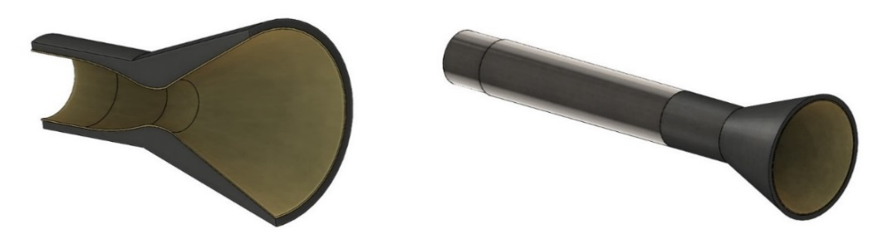
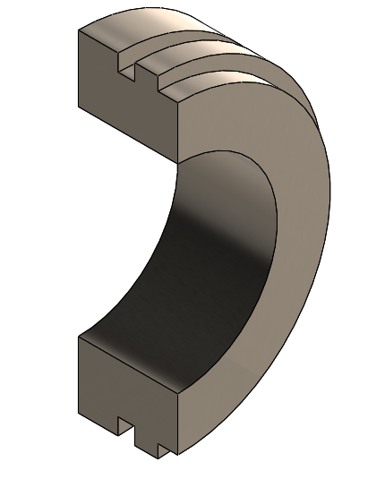
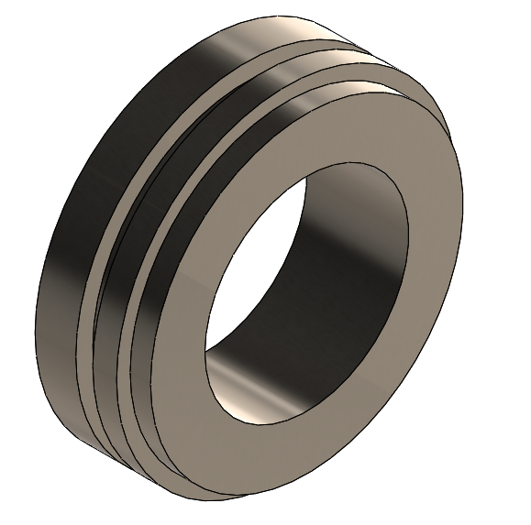
Space Applications Selection
Thruster Combustion Chambers
Mechanical Gas Seals

Slide 6
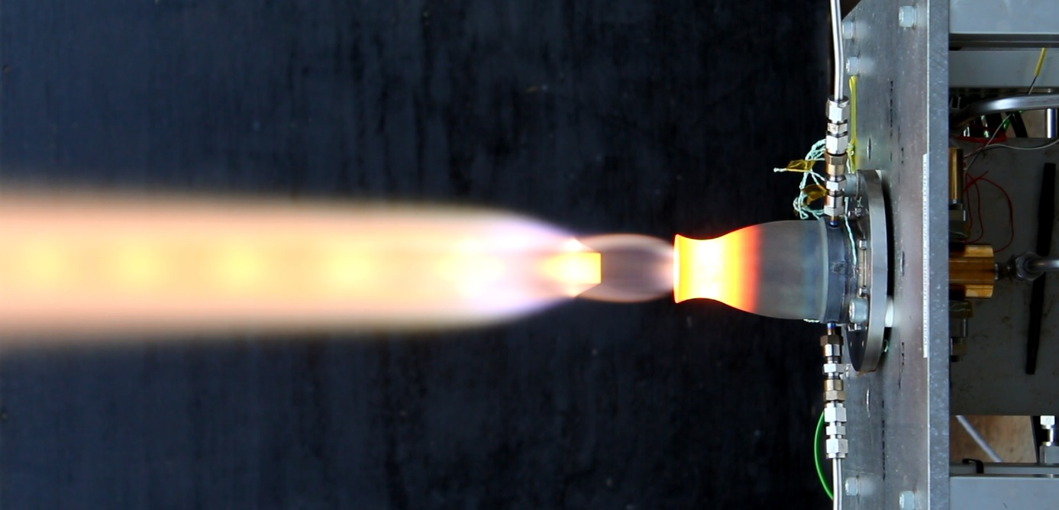
Thruster Combustion Chamber

Slide 7
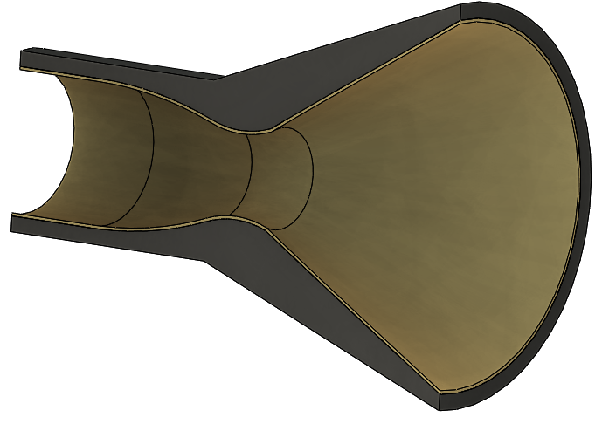
Thruster Combustion Chamber
Current state-of-the-art
  C103 niobium alloy is used with R512E di-silicide coating for chamber temperature up to ~1350°C
Target performance requirements:
Max service temperature ≥1400°C
High temperature creep & oxidation resistance
Yield stress at 20°C >260MPa
1000 thermal cycles in mission operation mode
CTE similar to Ti6Al4V
Weldability with Ti6Al4V
Notes:
The limit of C-103 alloy is represented by the R512E di-silicide coating, which limits the maximum operating temperature. The part manufactured C-103 needs to be sent to US to apply the coating and this can result in very long lead times. Furthermore C-103 is expensive and difficult to procure.

Slide 8
Thruster Combustion Chamber
Selected Materials: Nb and Nb-MMCs
Selected reinforcements for Nb-MMCs: SiC and Si₃N₄
Advantages:
Niobium (Nb) a refractory metal with low density, good ductility and excellent high temperature mechanical properties.
High oxygen (O) solid solubility, thus it is possible to tailor the mechanical properties by changing the O concentration.
Similar coefficient of thermal expansion (CTE) if compared to Ti6Al4V and better metallurgical compatibility with oxidation resistant coatings.
SiC and Si₃N₄ reinforcements can contribute to improve strength, creep- and high temperature oxidation- resistance.

Slide 9
Thruster Combustion Chamber
Down-select PM materials i.e. pure Nb and Nb-MMCs
Characterise powder materials
Consolidate pure Nb and Nb-MMCs via Hot Isostatic Pressing (HIP)
Determine as-HIPed material properties (microstructure, microhardness, tensile and creep) to compare against wrought C-103, currently used for the manufacture of thruster combustion chamber
Perform diffusion bonding (DB) trials to confirm the possibility of developing a high-temperature oxidation protective layer and explore the possibility of bonding Nb with Ti6Al4V via HIP DB
Manufacture thruster combustion chamber demonstrator using both Nb and Nb-MMCs

Slide 10
Nb Experimental Procedure
Nb base Powders
Nb fine (<44µm)
Nb mid range (15-100µm)
Nb coarse (<250µm)
Nb-5v.%SiC (<50µm Nb in <5µm SiC)
Nb-5v.%Si₃N₄ (<50µm Nb in <5µm SiC)
Powder Characterisation
Microstructure & Microhardness
Tensile Properties
HIP
Diffusion Bonding Trials
Demonstrator Manufacture

Slide 11
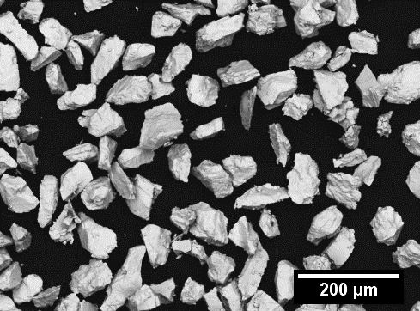
Nb Powder Characterisation
Nb fine
Nb mid range
Nb coarse
Nb-5%SiC
Nb-5%Si₃N₄

Slide 12
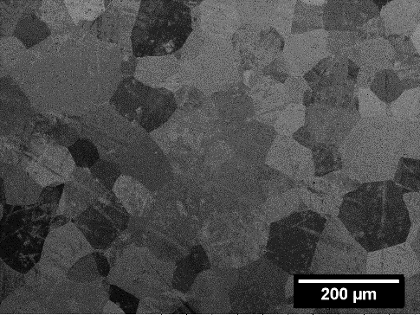
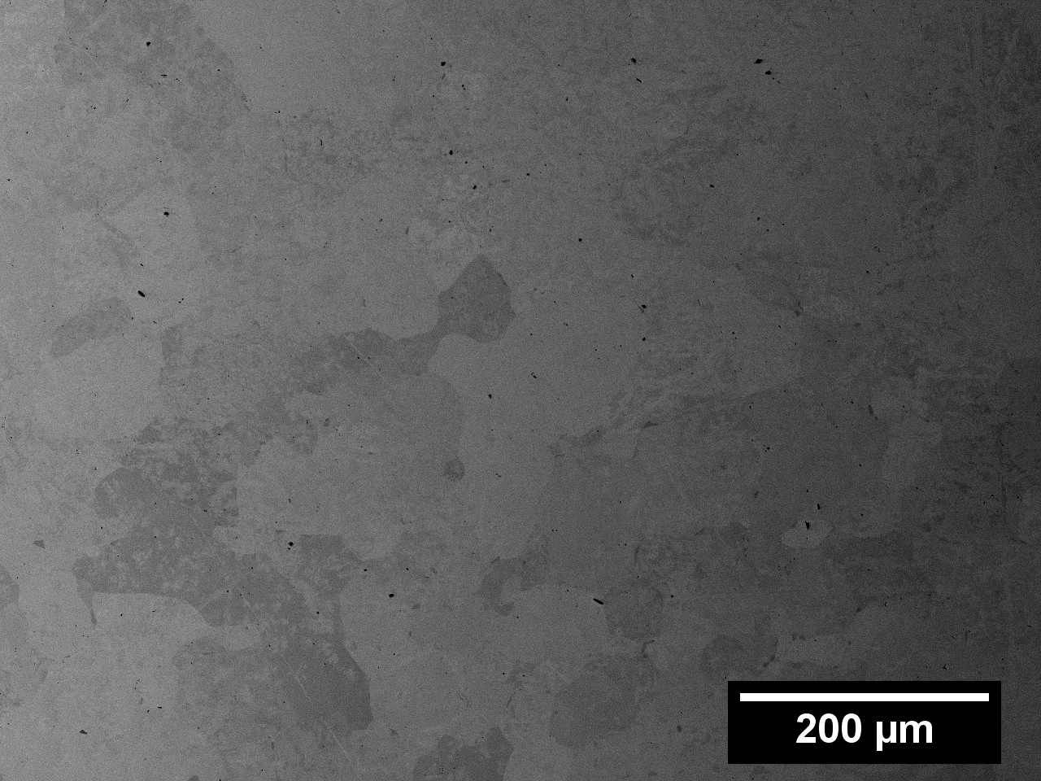
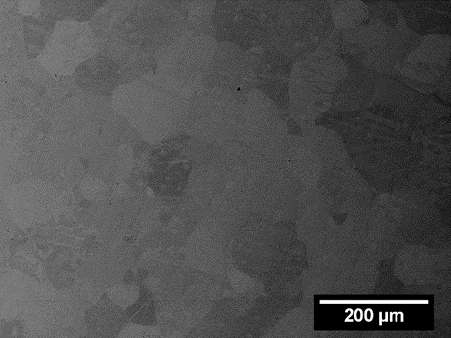
Nb as-HIPed Microstructure
Nb fine
Nb mid range
Nb coarse
Nb-5%SiC
Nb-5%Si₃N₄

Slide 13
Nb as-HIPed Microhardness
Nb fine, Nb coarse and Nb-MMCs have higher hardness if compared to wrought C-103
As-HIPed Powder Type | Oxygen Content [ppm] | Oxygen pick up [ppm]
Nb fine | 2361 | 512
Nb mid range | 390 | 88
Nb coarse | 1438 | 266

Slide 14
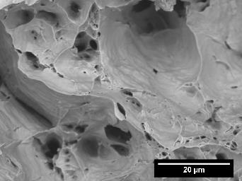
RT Tensile Properties as-HIPed Nb Mid range
YS target: 260MPa for Combustion Chamber
* ASTM International. B393-18 Standard Specification for Niobium and Niobium Alloy Strip, Sheet, and Plate. West Conshohocken, PA; ASTM International, 2018.
Notes:
Why we used Nb middle which had the lowest hardness. There are several reasons for that:
We wanted to know how oxygen level is impacting the tensile properties, this means that we should start from low oxygen levels and try to manipulate the powders to increase the tensile properties.
We did not have enough powders for Nb fine and Nb coarse
The fracture surfaces show a ductile fracture mode with the presence of dimples and confirming that the main fracture mode is micro-voids coalescence.

Slide 15
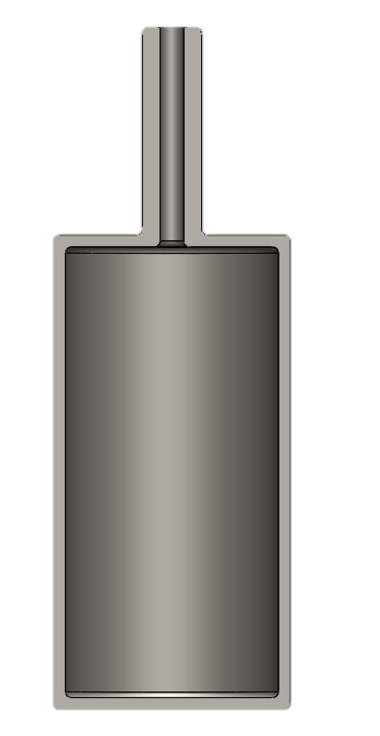




Why Sieving?
Mid range unsieved
Mid range sieved 50μm
Notes:
By sieving to a lower size, the surface to volume ratio of the powder is increased. This will generate a powder with a higher oxygen concentration.

Slide 16
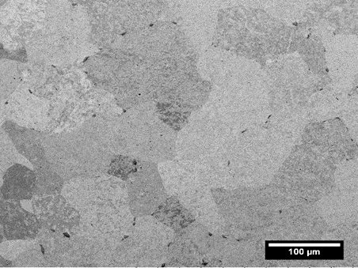
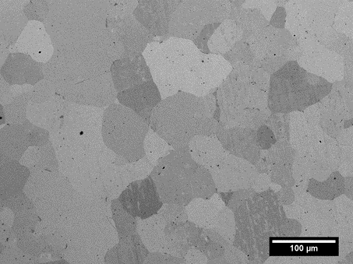
Microstructure of unsieved/sieved HIP Nb Powders
Mid range Nb powders were sieved using a 50μm sieve in order to increase the oxygen level.
SEM images and EBSD maps of HIPed Nb powders: Nb powder with O = 310 ppm HV0.3= 104 (left), Sieved Nb powders with O = 756 ppm
HV0.3= 135 (right)
Notes:
Sieved Nb results in a finer microstructure which also contributes to an increase in strength together with the higher O levels. EBSD Maps to highlight the difference in grain size among the two microstructures

Slide 17
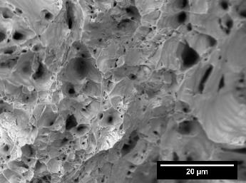
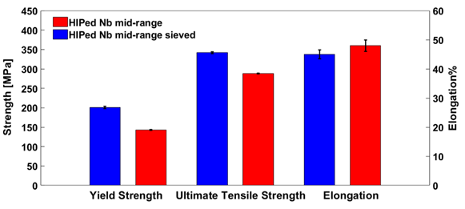
RT Tensile Properties of Sieved Nb
YS target: 260MPa for Combustion Chamber
Notes:
Sieved Nb shows much higher YS and UTS if compared to middle range Nb, while maintaining a good elongation. Even in this case the fracture surfaces show a ductile fracture mode with the presence of dimples and confirming that the main fracture mode is micro-voids coalescence.

Slide 18
Tensile properties Nb-MMCs
Room temperature tensile properties for Nb-5%SiC show a YS of 330MPa, higher if compared to wrought C-103. However, the levels of elongation are low, due to the presence of brittle ceramic particles and intermetallics.
Material | Temperature [°C] | 0.2% proof stress [MPa] | UTS [MPa] | %EL
Nb-5v.%SiC | RT | 330 | 373 | 1.5
Nb-5v.%SiC | 650 | 229 | 305 | 2
Wrought C-103 | RT | 260 | 370 | 20

Slide 19
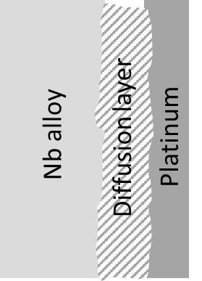
Pt-Nb HIP Diffusion Bonding Strategy
Mild Steel Canister
Nb Powder
Pt foil
80µm
Nb Foil

Slide 20
HIP Diffusion Bonded Nb-Pt-Nb Microstructure
The Pt diffusion layer shows a dense microstructure with no apparent defects and with a reaction layer thickness of around 15μm
A= Nb₃Pt
B= NbPt
C=NbPt₂
D= NbPt₃
Nb
Pt
This work
R.E. SEEDOLD “ELEVATED TEMPERATURE DIFFUSION IN THE SYSTEMS Nb-Pt, Nb-Se, Nb-Zn, Nb-Co, Ni-Ta, AND Fe-Mo

Slide 21
Nb-Ti6Al4V HIP Diffusion Bonding
Nb-Ti64 HIP DB microstructure shows ~15μm diffusion layer
15µm diffusion layer
HIPed Nb
Ti64
Ti64 powder (15-45µm)
α-phase
HIPed Nb
Nb-rich phase

Slide 22
Down-selected material:
Performances and netshape manufacturing
Notes:
Selection of Nb and Nb-5%SiC materials

Slide 23
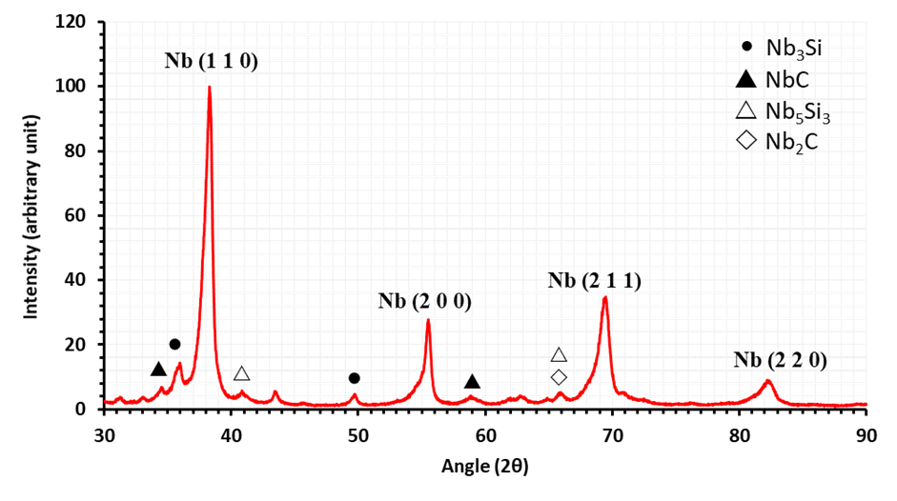
Nb-5%SiC microstructure
Presence of different hardening phases including carbides and silicides, responsible for the increase in tensile strength and high temperature oxidation properties.
Notes:
Also no presence of detectable defects.

Slide 24
Nb and Nb-5%SiC Tensile Properties
Nb-5%SiC shows higher levels of YS if compared to the minimum specifications for wrought C-103. However, the presence of hard brittle phases limits the %EL.
Nb (756ppm) shows enhanced levels of strength retaining a good elongation.
Sample | Temperature | 0.2% proof stress [MPa] | UTS [MPa] | %EL
Nb (301 ppm) | RT | 143 | 288 | 47.7
Nb (756 ppm) | RT | 201 | 342.5 | 45.0
Nb-5%SiC | RT | 330 | 373 | 1.5
Nb-5%SiC | 650°C | 229 | 305 | 2.0
Wrought C-103* | RT | 260 | 370 | 20
*ASTM International. B655/B655M-10(2018) Standard Specification for Niobium-Hafnium Alloy Bar and Wire. West Conshohocken, PA; ASTM International, 2018
Notes:
Despite the good RT properties for pure Nb it still does not match C-103 minimum specifications.

Slide 25
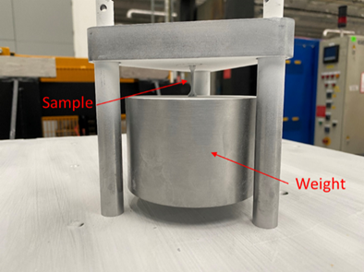
Nb-5%SiC Creep Properties
Creep test were performed as per Nammo test procedure using vacuum furnace.
Nb-5%SiC showed the lowest levels of plastic strain creep properties if compared to wrought C-103 and Nb-5%Si₃N_{4.}
Test conditions:
T=1200°C
Holding time=10h
Load= 11.9MPa
Sample | Initial gauge diameter, mm | Final gauge diameter, mm | Initial overall length, mm | Final overall length, mm | Plastic strain%
Nb-5%Si₃N₄ | 2.00 | 1.99 | 39.97 | 40.00 | 0.08
Nb-5%SiC | 2.00 | 2.00 | 40.05 | 40.08 | 0.07
Wrought C-103 | 2.04 | 2.04 | 40.07 | 40.11 | 0.10

Slide 26
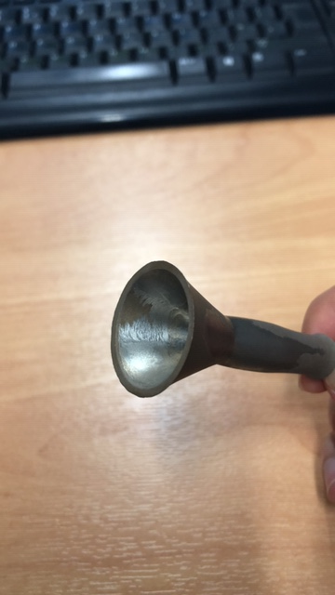
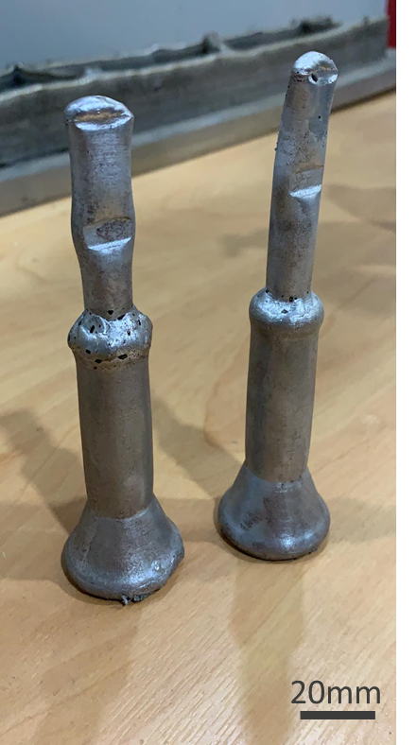
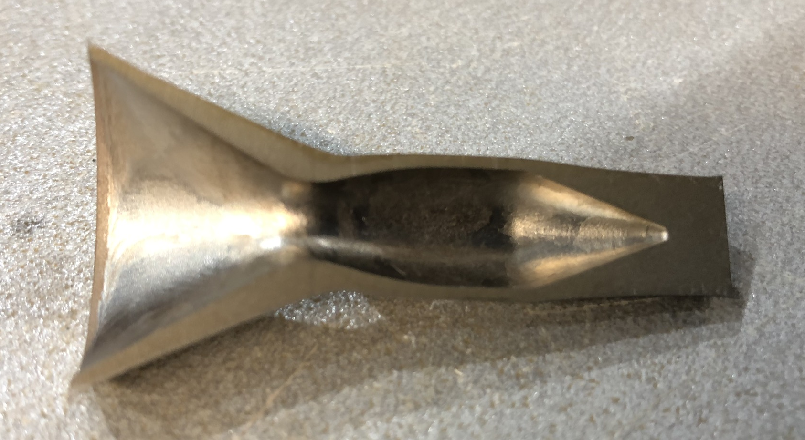
Thruster’s Combustion Chamber Demonstrators
Pure Nb combustion chamber
Nb-5v.%SiC combustion chamber
10mm

Slide 27
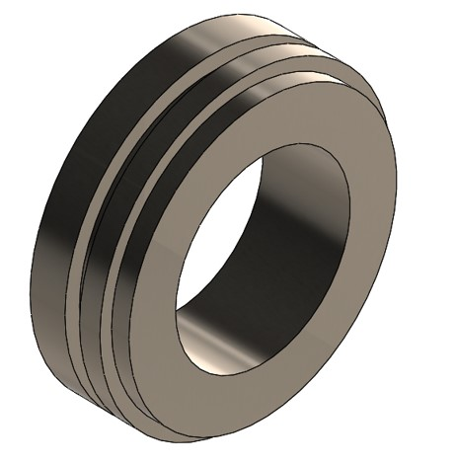
Mechanical Seals

Slide 28
Mechanical Gas Seals
Current state-of-the-art
  Ti alloy, SS, Ni alloy, Al₂O₃, SiC, Si₃N₄, WC depending on specific application
Target performance requirements:
Max service temperature 650°C
Hardness ≥700HV
1000 Cycles in engine operation mode
CTE similar to Inconel (IN) or Ti
Excellent edge retention properties

Slide 29
Mechanical Gas Seals
Selected Materials
IN625-MMCs
Selected reinforcements for Nb-MMCs
SiC and TiB₂
Advantages
IN625 has a good level of ductility, excellent corrosion properties and mechanical properties up to 650°C.
The addition of SiC and TiB₂ improves hardness and wear resistance of the alloy.

Slide 30
Mechanical Gas Seals
Material down-selection i.e., Inconel 625-base MMCs
HIP response of reinforcements ceramics with various volume fractions
Understand the HIP response and the microstructure of IN625-MMCs
Determine microhardness and wear properties of IN625-MMCs and compare results with the base material
Manufacture a mechanical seal demonstrator using the down-selected material

Slide 31
IN625-MMCs Experimental Procedure
IN625 powders:
IN625 (<45µm)
IN625-SiC
IN625-TiB₂
*5%, 10% and 25% volume reinforcement were used for IN625-SiC and IN625-TiB₂
Powder Characterisation
Microstructure & Microhardness
Wear Properties
HIP
Demonstrator Manufacture*
*using IN625-10v.%SiC

Slide 32
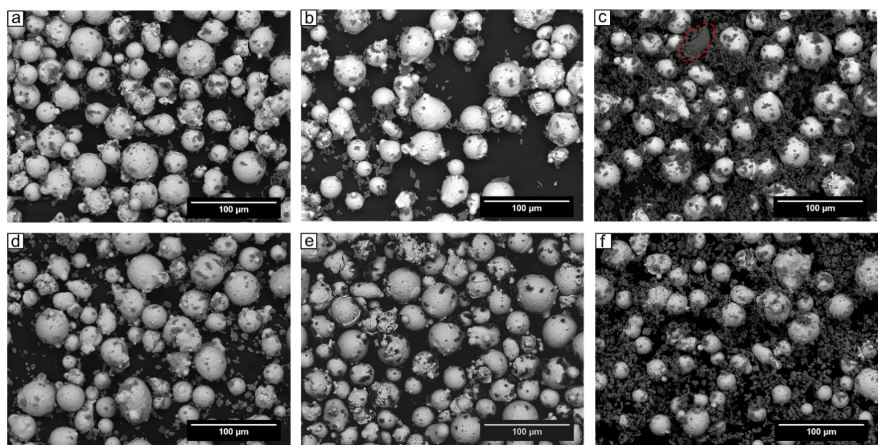
Powder Morphology
SEM powder morphology of: a) IN625-v.5%SiC; b) IN625-10v.%SiC; c) IN625-25v.%SiC; d) IN625-5v.%TiB₂; e) IN625-10v.%TiB₂; f) IN625-25v.%TiB₂

Slide 33
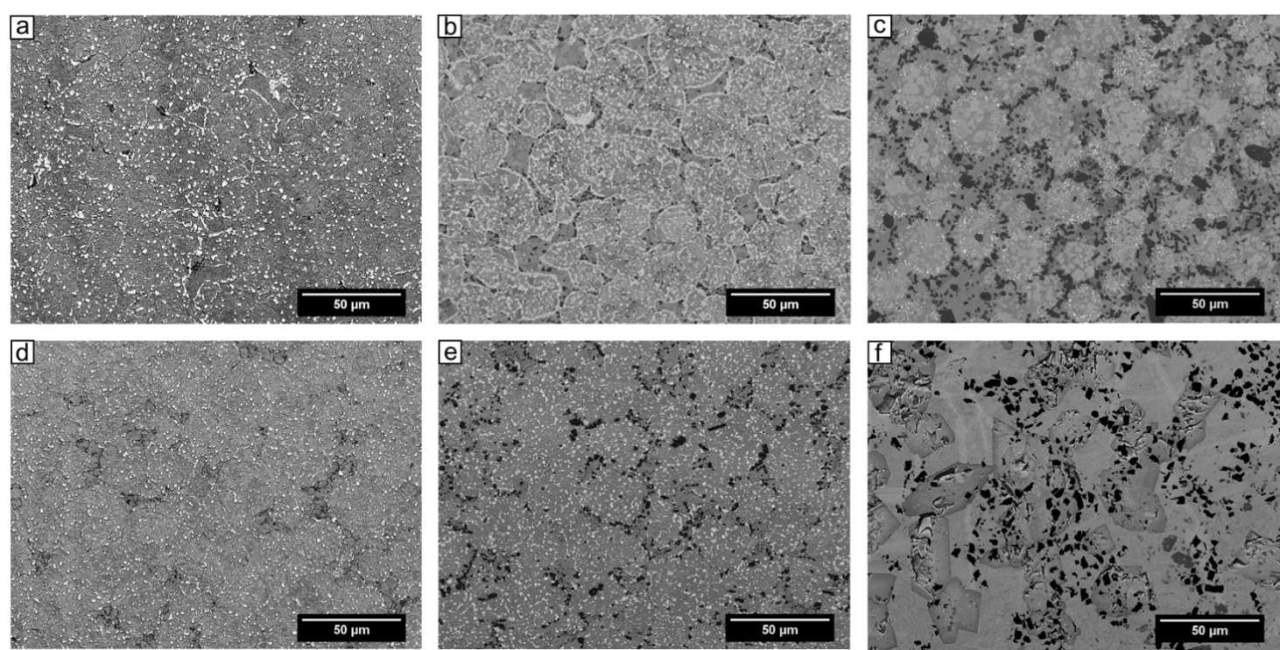
As-HIPed Microstructure
SEM as-HIPed microstructure of: a) IN625-v.5%SiC; b) IN625-10v.%SiC; c) IN625-25v.%SiC; d) IN625-5v.%TiB₂; e) IN625-10v.%TiB₂; f) IN625-25v.%TiB₂

Slide 34
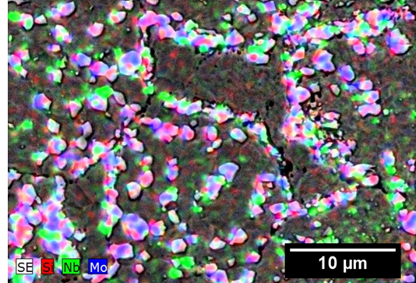
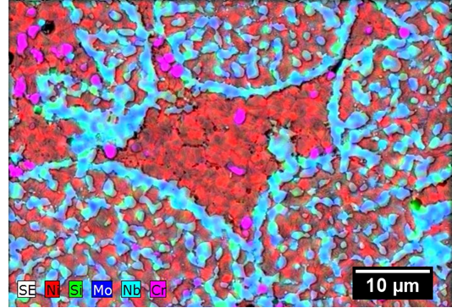
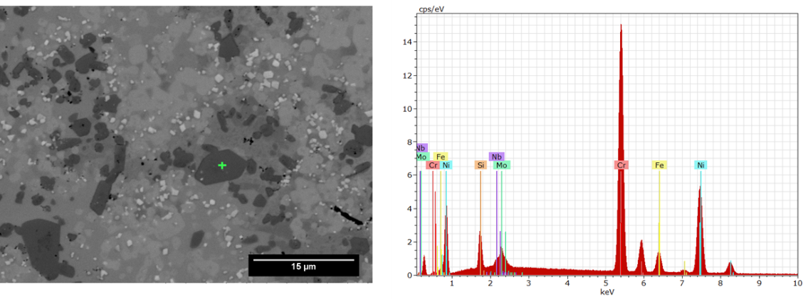
As-HIPed Microstructure EDS analysis
IN625-5v.%SiC
IN625-10v.%SiC
IN625-25v.%SiC
Notes:
IN625-25v.%SiC shows a different microstructure, in fact as described above it is characterised by the presence of Nb, Mo rich precipitates, discrete SiC particles are seen as coarse dark phase regions in below figure

Slide 35
As-HIPed Microhardness
Similar values of microhardness for IN625-SiC and IN625-TiB₂. IN625-25v.%SiC has higher level of hardness

Slide 36
Wear Test, COF IN625-SiC
Coefficient of Friction (CoF) reduces as the reinforcement fraction increases

Slide 37
Wear Test, COF IN625-TiB₂
CoF reduces as the reinforcement fraction increases.

Slide 38
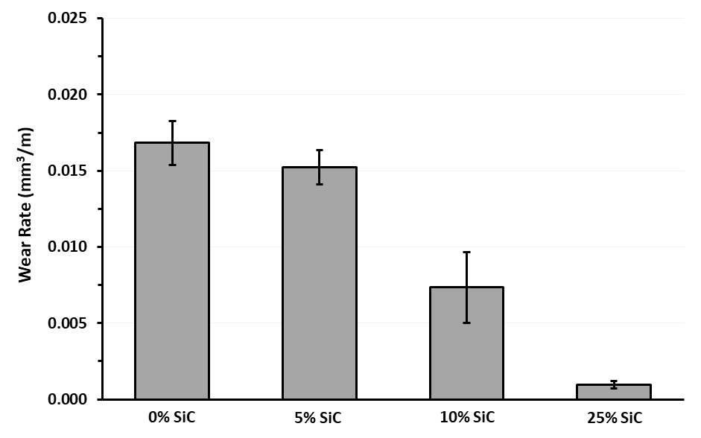
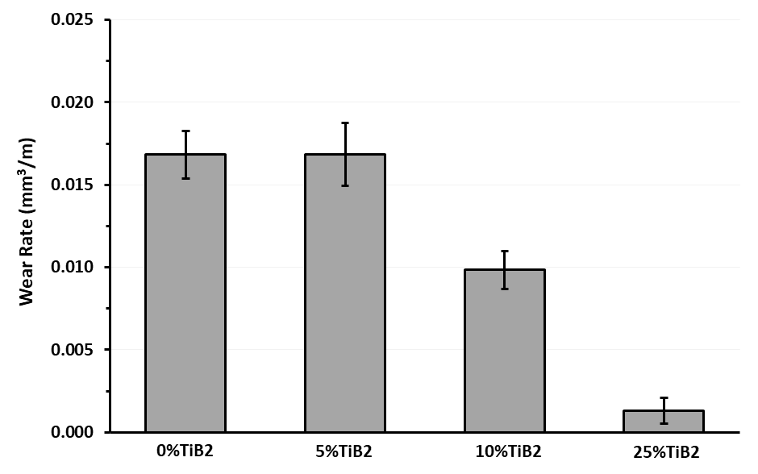
Wear Test, wear loss IN625-MMCs
Wear rate drastically reduces as the reinforcement fraction increases.
IN625-SiC
IN625-TiB₂

Slide 39
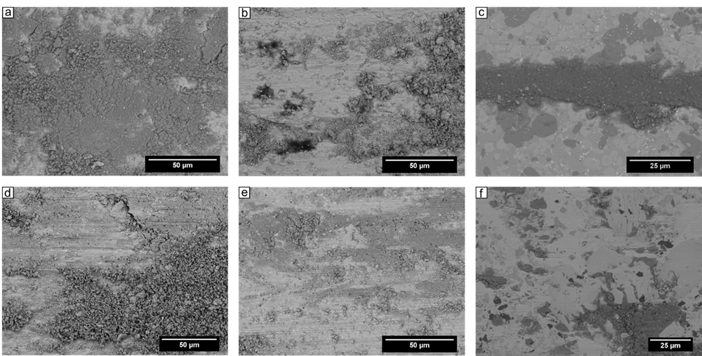
Wear Test, wear tracks
SEM micrographs of wear tracks for: a) IN625-v.5%SiC; b) IN625-10v.%SiC; c) IN625-25v.%SiC; d) IN625-5v.%TiB₂; e) IN625-10v.%TiB₂; f) IN625-25v.%TiB₂
Notes:
The wear tracks of 5v.%SiC and 5v.%TiB₂ are characterised by the presence of cracks, presence of debris and in 5v.%TiB₂ the presence of ploughing due to the reinforcement is more evident. As the reinforcement level is increased, the level of abrasive wear is reduced for both SiC and TiB₂ reinforcements.

Slide 40
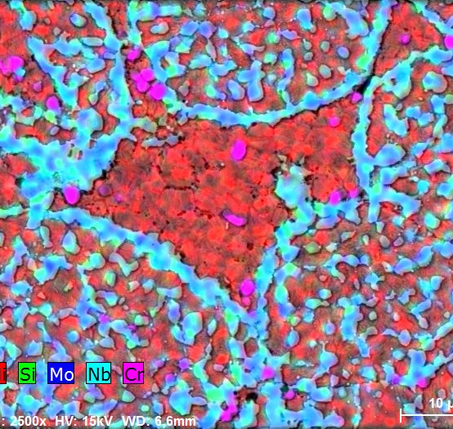
Down-selected material:
Performances and netshape manufacturing
Notes:
Down-selection of IN625-10%SiC, showing the microstructure and XRD, tensile tests and netshape manufacturing.

Slide 41
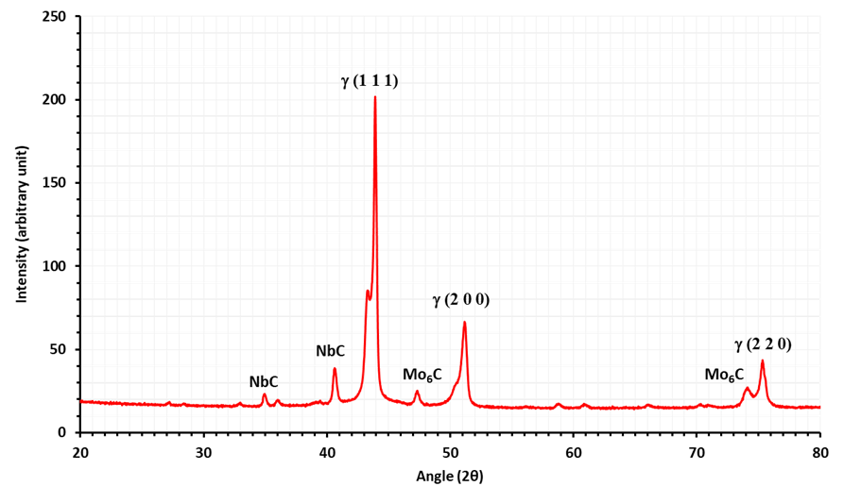
Microstructure IN625-10%SiC
IN625-10%SiC was selected thanks to its high level of hardness, uniform and fully dense microstructure and to the enhanced tribological properties.

Slide 42
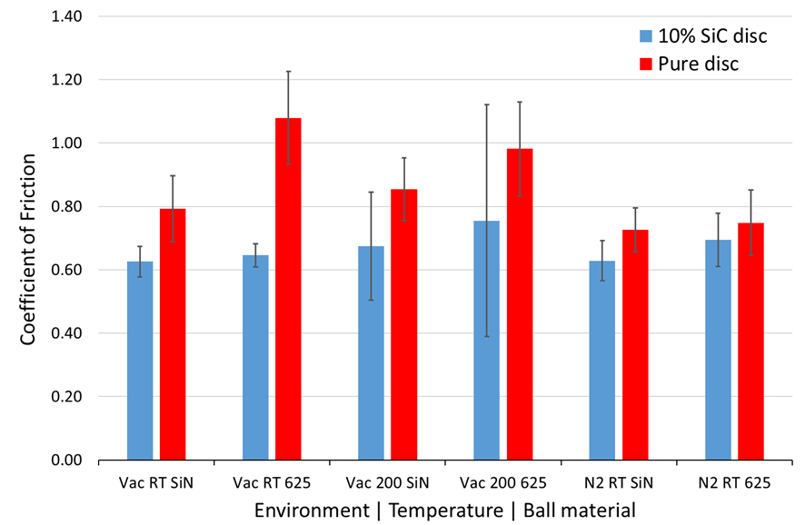
Wear Properties IN625-10%SiC
IN625-10%SiC shows better wear properties if compared to the base material in all the tested conditions at both RT and 200°C.

Slide 43
Tensile Properties
IN625-10%SiC exhibits low levels of %EL, and low Charpy V-notch absorbed energy (2J). This is caused by the presence of brittle phases around the particle boundaries.
Sample | Temperature | 0.2% proof stress [MPa] | UTS [MPa] | %EL
IN625 (wrought) | RT | 575 | 872 | 47
IN625 (wrought) | 650°C | 418 | 748 | 78.4
IN625 (HIPed) | RT | 523 | 918 | 30
IN625 (HIPed) | 650°C | 426 | 749 | 72
IN625-10%SiC | RT | - | 747 | 2.5
IN625-10%SiC | 650°C | 568 | 574 | 1.0
Notes:
The low levels of elongation are related to the presence of brittle hardening phases.

Slide 44
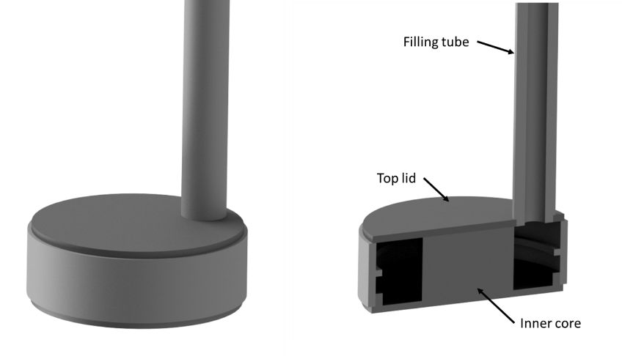
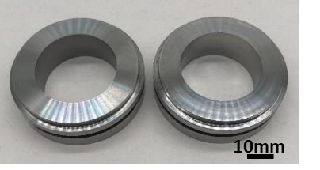
Mechanical Seal Demonstrator
Mechanical seal demonstrators were successfully manufactured. The results show a good geometrical accuracy and demonstrate the machining operations can be successfully performed on IN625-10%SiC
3D CAD drawing of canister design
Netshape Mechanical Seals

Slide 45
Conclusions
Nb- & IN625-MMCs were successfully HIPed showing a fully dense microstructure.
Microstructure, hardness and tribological properties are greatly affected by the reinforcement type and their fraction.
As the reinforcement fraction increase, hardness increases and above all a drastic improvement in the wear properties is noticed but at the expense of elongation and fracture toughness.
HIP diffusion bonding was successfully demonstrated between: Nb & Pt and Nb & Ti6Al4V materials combination which can revolutionised the manufacturing of combustion chamber using this approach for any future ESA products.
Combustion chamber and Mechanical seals demonstrators were successfully HIP in near netshaped form via PM HIP technique.

Slide 46
Future Works
High temperature oxidation resistance test and thermal shock tests on Nb-Pt system.
Perform in-situ HIP of Nb with graphite powders to develop NbC and improve both the strength and high temperature properties.
Assess the effect of phase dissolution on the mechanical properties of PM base MMCs materials for high temperature applications.
Perform a diffusion bonding study to assess the possibility of Pt HIP cladding on C-103 powder.
Assess the bonding strength of Nb-Ti6Al4V system.
Assess the use of nanoparticles reinforcement for both Nb- and IN625- matrix materials to maintain good wear resistance while improving the tensile, Charpy impact and creep resistance properties.
Production of Nb + ceramic powders by incorporating ceramic nanoparticles during billet casting, wire drawing, plasma atomisation (PA) or electrode induction gas atomisation (EIGA).

Slide 47

Dr Raja Khan CEng FWeldI FIMMM
Technology Consultant
Thermal Processing Technologies
Advanced Manufacturing Technologies
TWI Cambridge
DD: +44 (0)1223 899 557
Mob: +44 (0)7525 910549
Email: raja.khan@twi.co.uk

