Slide 1

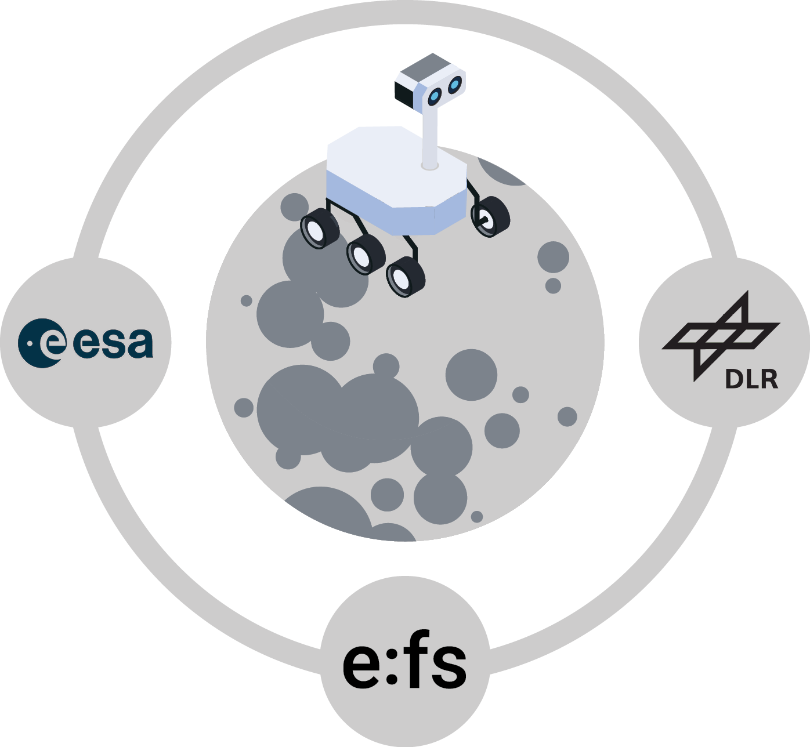
DeLeMIS – Final Presentation

Slide 2
Table of consents
01
Introduction
02
Status Quo and Architecture
03
Instrumentum
04
Demonstration
05
Final Review and Closure

Slide 3
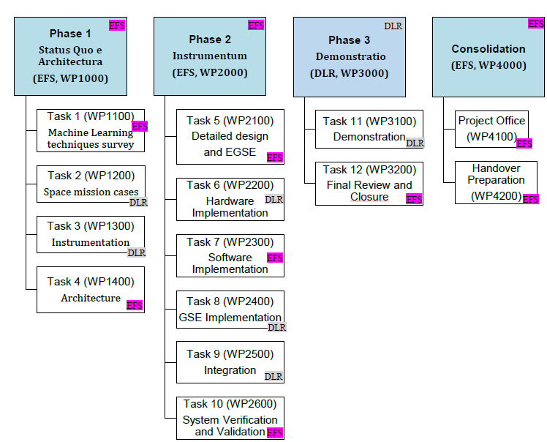
Introduction
Activity and Objectives
ESA/ESTEC founded project DeLeMIS (ESA 4000136972/21/NL/AS)
AI-methods are demonstrated that enable a planetary rover to move over uncertain terrain autonomously
Objectives:
Investigation of AI/ML-enabled algorithms for rover control and perception
Demonstration of improvements by AI/ML in the runtime

Slide 4
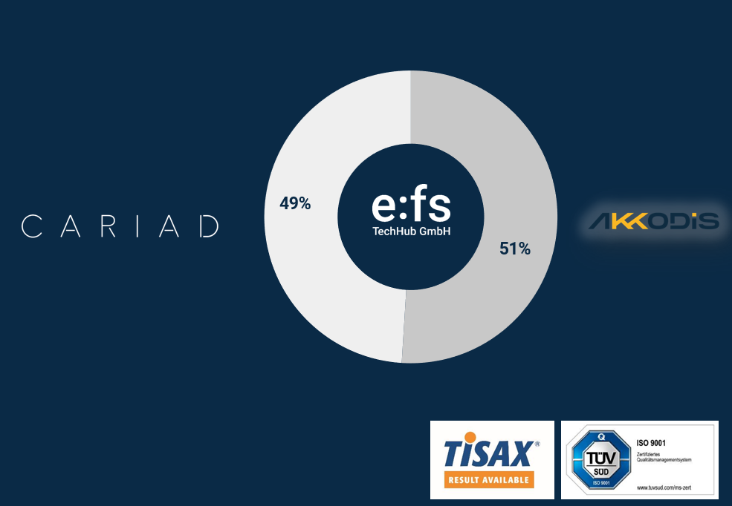
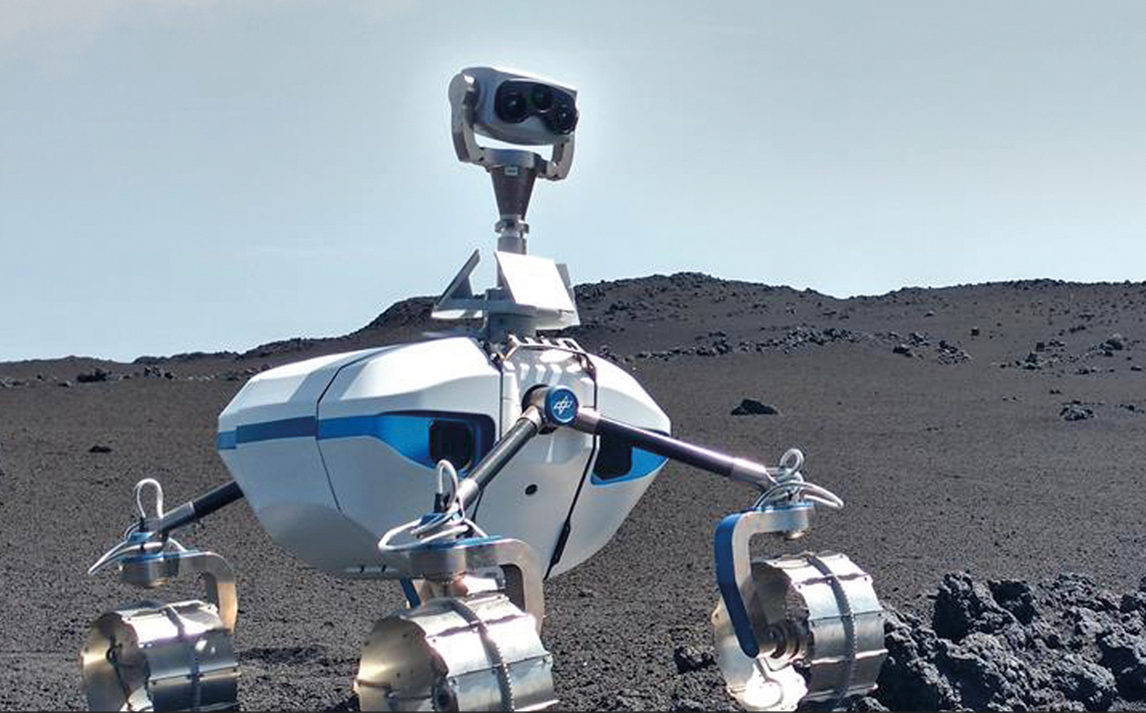
Introduction
Involved entities
e:fs TechHub GmbH (DE)
Prime Contractor
Main contributions:
ML/AI for motion control
Simulation environment
SW implementation and testing
German Aerospace Centre (DE)
Sub-Contractor
Main contributions:
ML/AI for perception
Rover system, GSE, and infrastructure
SW implementation and testing

Slide 5
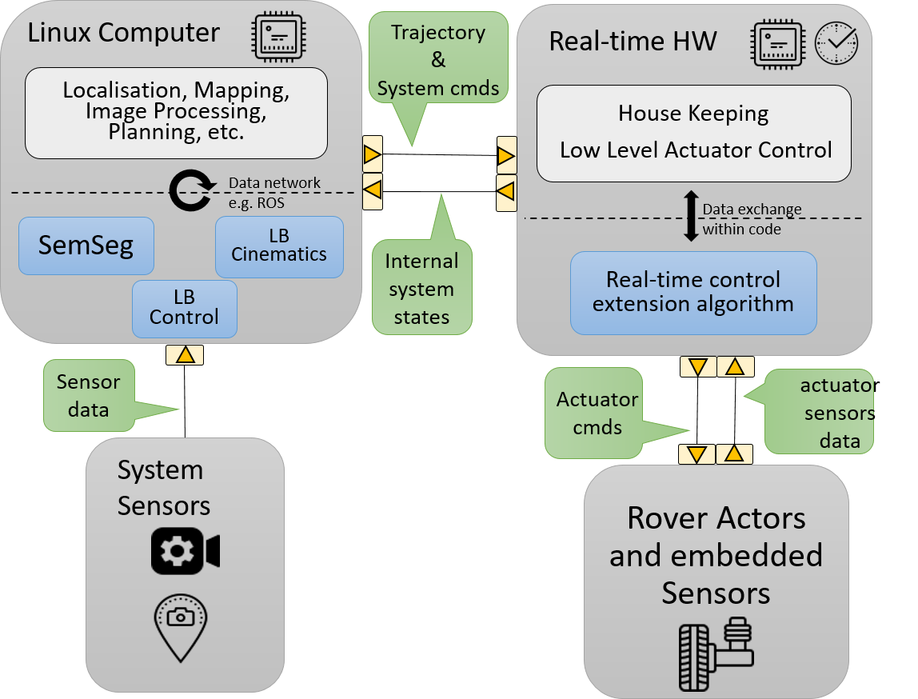
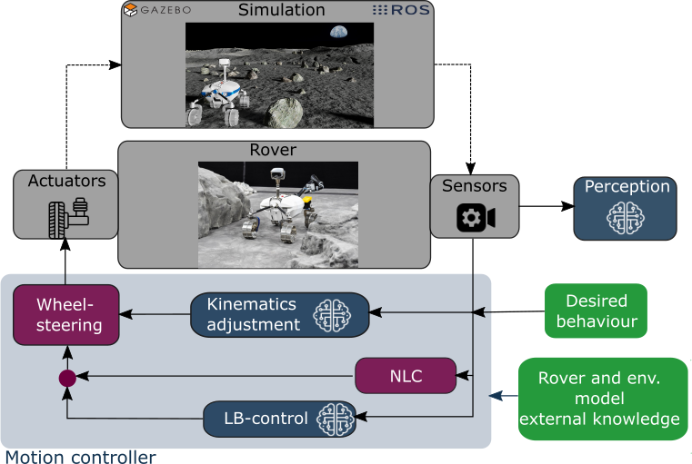
Status Quo and Architecture
Architecture
SW architecture: System and interfaces
High-level architecture of the project modules

Slide 6
Instrumentum
Detailed design and GSE - Learning-based algorithms
ML-based perception
ML-based kinematics adjustment
ML-based motion control

Slide 7
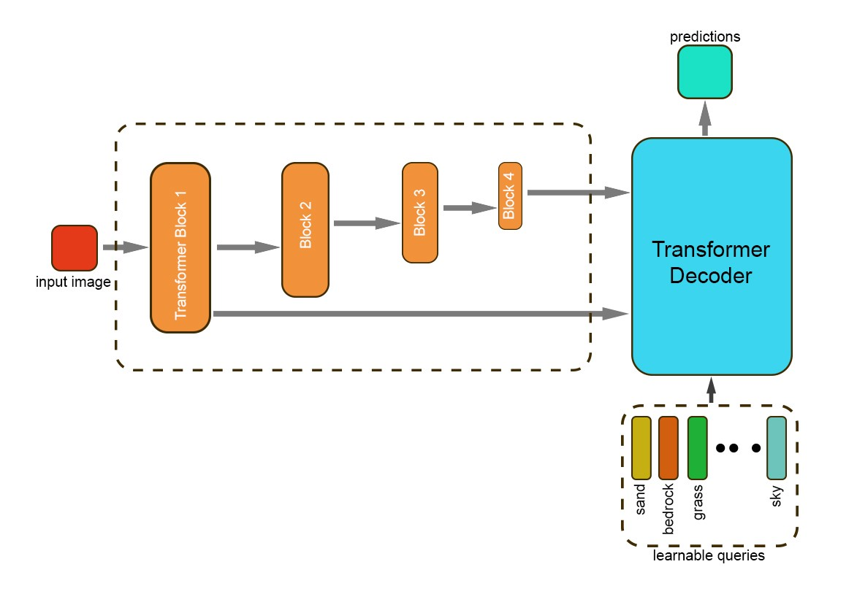
Instrumentum
Detailed design and GSE - ML-based perception
segment an image input based on predefined terrain classes
Rendering and generating data sets in OAISYS
encoder and decoder structure
Notes:
For this module, we aim to develop a perception method which can segment an image input based on predefined terrain classes.
The used neural network to perform that task is based on a transformer architecture as in Figure.
The developed network can be spitted into an encoder and decoder part. The encoder part extract semantic features from the provided image.
The decoder uses so-called queries, which are attended to these features. The outcome is an image prediction of semantic classes.
In the following we give more detail explanation about the structure of the encoder and decoder. In order to get the most information from the provided image the developed network uses a pyramid level transformer encoder. Instead of splitting the image into multiple patches, which are fed into the network, the entire pixel map is provided. After each encoder block the resulting image features are down-scaled and fed to the next encoder block. Transformer are using usually so-called Multi-Head Attention Layers in order to extract image features. However, such layers cannot directly be applied on the entire image, since the needed memory is too large for most hardware. Therefore, spatial reduction attentions (SRA) are used, which can handle such input tensors. The decoder of the network consists of a transformer architecture, which taking the image features from the encoder and learnable queries as input. The learnable queries are vectors, which can be used to store the information of a particular class. In the end of the training procedure each query represents one of the semantic classes. These queries are attended to the input features. If the input features are matching with a particular query, the query will be activated and therefore shows if a semantic class is present in the image. The output of the decoder
and with that the network is the semantic segmentation prediction.

Slide 8
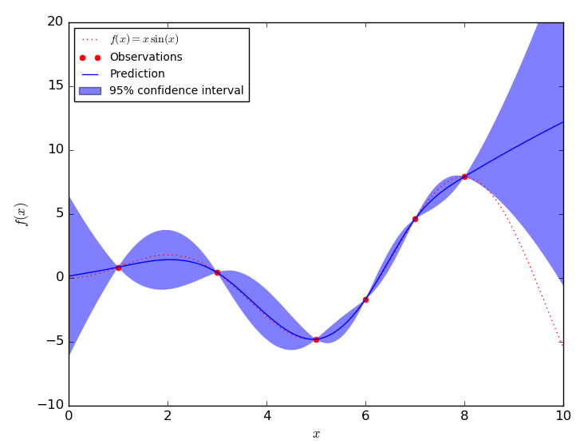
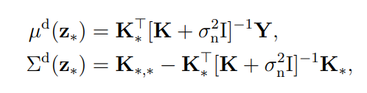
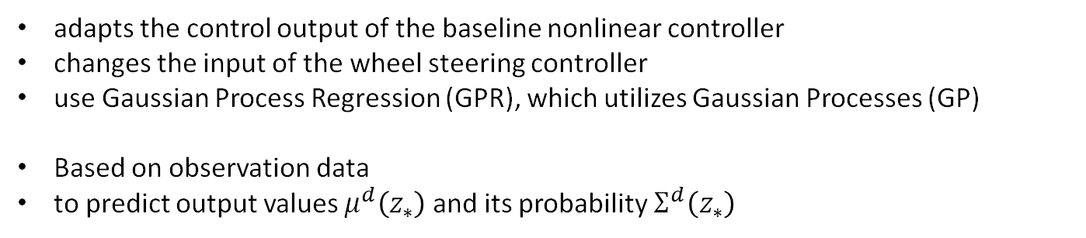
Instrumentum
Detailed design and GSE - ML-based kinematics adjustment
adapts the control output of the baseline nonlinear controller
changes the input of the wheel steering controller
use Gaussian Process Regression (GPR), which utilizes Gaussian Processes (GP)
Based on observation data
to predict output values $μ^{d}\left(z_{∗}\right)$ and its probability $Σ^{d}\left(z_{∗}\right)$
Interpreting Posterior of Gaussian Process for Regression [Kosasih2020]
Notes:
, that adapts the control output of the baseline nonlinear controller with an additive term.
This changes the input of the wheel steering controller and consequently impacts the rover movement.
For this purpose, an approximation function is designed, that is trained online on tracking data to improve the tracking behaviour.
Due to implementation reasons, we chose to use Gaussian Process Regression (GPR), which utilizes Gaussian Processes (GP) [56], [57] $g\left(z\right)\sim GP \left(m\left(z\right), k\left(z, z^{′}\right)\right)$.
Such a GP model can then be utilized to build a regression model by treating the model as a prior, defined only by a covariance function, also known as kernel function $k$. In our case, we use the common squared exponential kernel function.
By adding observation data, where $n_{z}$ denotes the number of features in the observation vector $Z$ and $N$ the number of data points $\left(z_{k}, y_{k}\right)$, the GP model can be used as a posterior distribution. This posterior distribution can then be used to predict output values $μ^{d}\left(z_{∗}\right)$ and its probability $Σ^{d}\left(z_{∗}\right)$ for a desired data points $z_{∗}$ (test points),
The features of the observation vector $z$ in the proposed approach consists of the current trajectory dynamics, described by the curvature and the velocity, and the roll angle of the bogie axles of the rover. The corresponding output (additive yaw rate for the nonlinear controller) of the observation is determined by the current tracking performance, the lateral deviation and heading error, according to the trajectory dynamics. The number of data points $N$ of the observation data is limited, due to increasing computational costs with every data point.
The selection of observation data is currently handled with a First In – First Out (FIFO) method. Other methods, such as covariance-based ones, must be further investigated and might be applied during the demonstration as well.
At the current state of the approach, the hyperparameter of the GPR are continuously optimized via the log marginal likelihood method [56] after a new data point is added to the observation data. Unfortunately, this method comes with a high computational cost, which might lead to a fixed set of hyperparameter from the simulation for the demonstration.

Slide 9
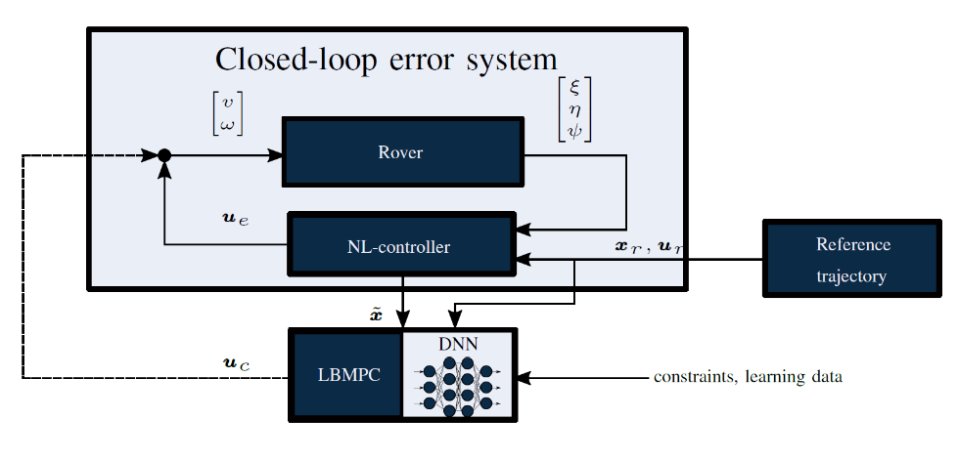
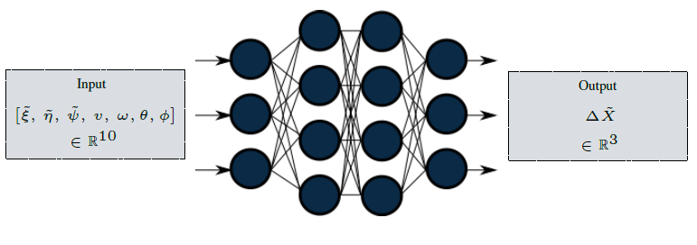
Instrumentum
Detailed design and GSE - ML-based motion control
Learning-based model predictive control (MPC)
combination with a non-linear controller (“no dependency on trajectory”)
Learning of the model error with DNNs

Slide 10
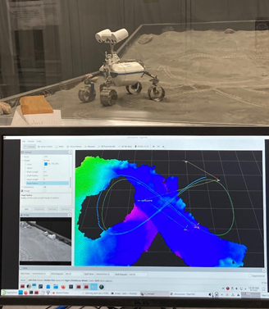
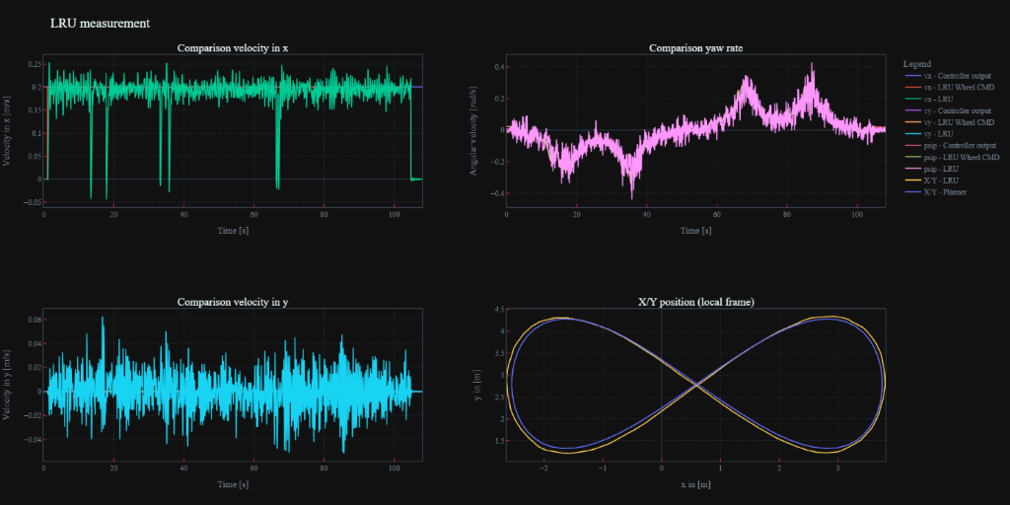
Instrumentum
Integration
System integration - Hardware and GSE
Interface: rover <-> tracking system
position data -> in software framework
System integration - Software Modules
build pipeline of e:fs ROS packages in DLR package management
interface DLR tracking system position and LRU odometry to e:fs planning layer
interface e:fs controller to DLR wheel steering module
logging of all necessary topics
save measurement data
Notes:
DLR – Kapitel 4.5

Slide 11
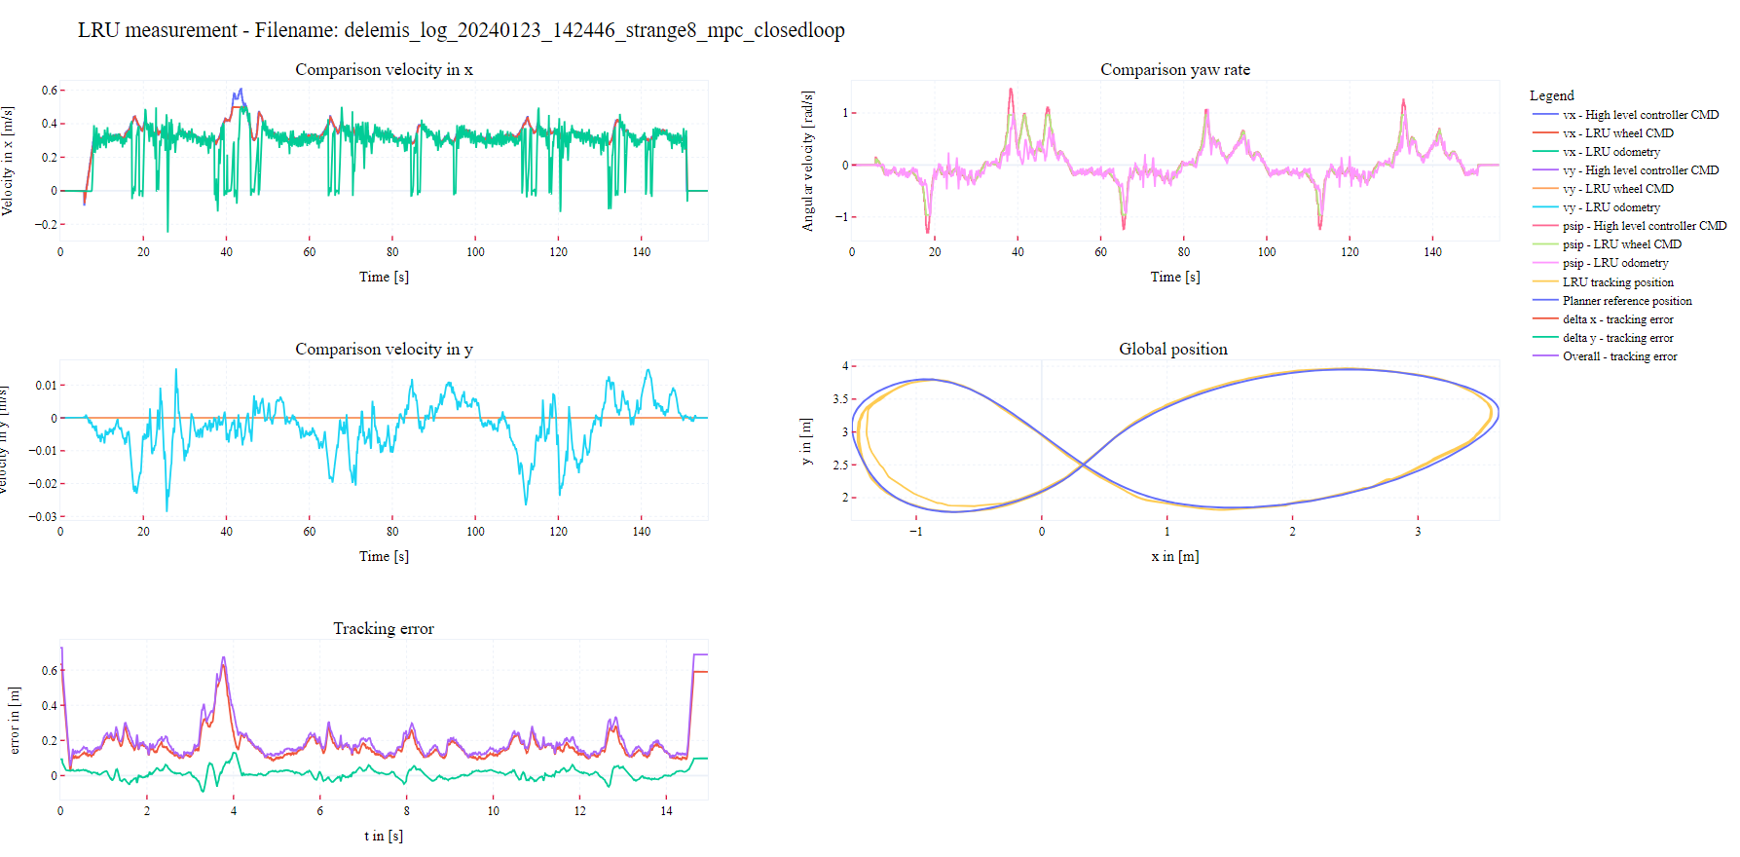
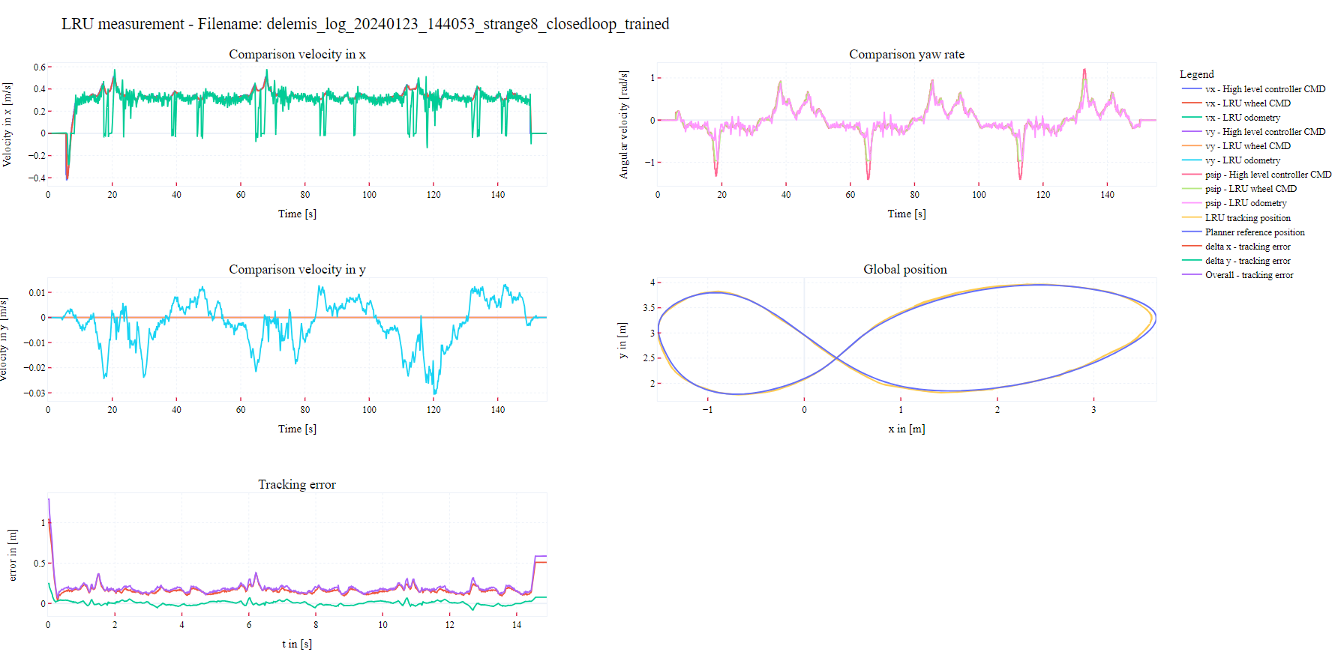
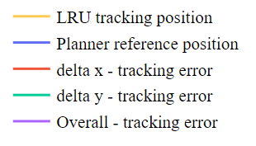
Demonstration
Demonstration: Learning-based MPC
    Drive 3: Closed loop drive with LB-MPC and the new trajectory.
    Drive 4: Closed loop drive with the Newly trained RNN in the LB-MPC
 | Ground truth (drive 2) | Closed loop (drive 3) | Closed loop trained (drive 4)
RMSE x | 0.3062 | 0.2075 | 0.1802
RMSE y | 0.0920 | 0.0335 | 0.0305
RMSE Overall | 0.3197 | 0.2102 | 0.2031

Slide 12
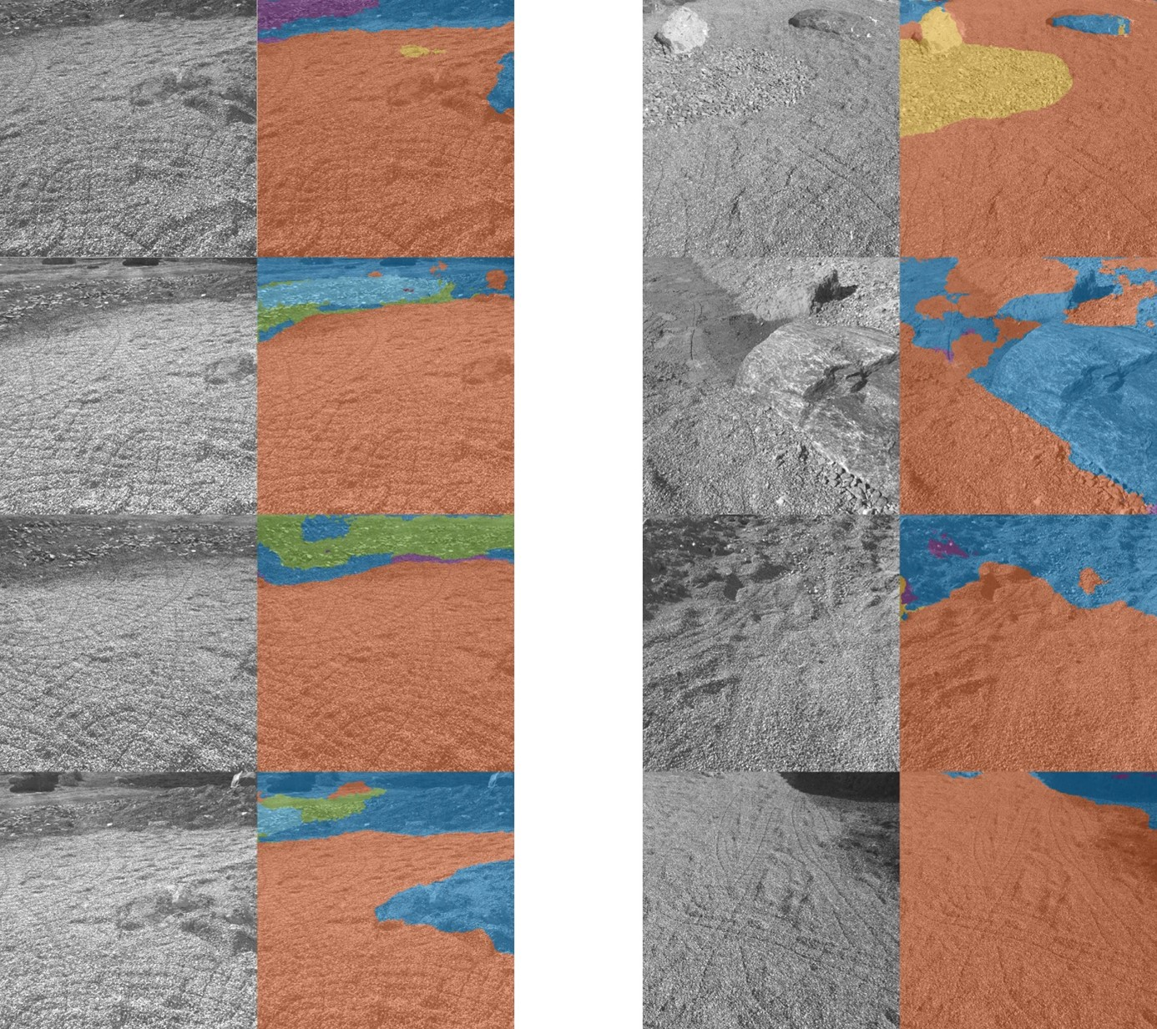
Demonstration
Demonstration: Perception – Semantic Segmentation
terrain segmentation network on real data collected by the rover LRU in the DLR outdoor lab.
different subclasses are correctly distinguished
was deployed on the ML device of the LRU system (Jetson TX2)
segmentation takes about 2.19 seconds for one inference pass

Slide 13
Final Review
Conclusion
Objectives:
  Investigation of AI/ML-enabled algorithms for rover control and perception ☑
  Demonstration of improvements by AI in the runtime ☑
Conclusion and path forward:
  Successful project achieving the objectives and great collaboration between ESA, e:fs, and DLR
  Further future projects already in discussion within the project team and exchange with ESA

Slide 14
Final Review
Next steps
Objectives to follow up:
  Further development and improvement of the algorithms for specific scenarios
  Extensive improvement, test, verification, and validation of existing algorithms and corresponding software
  Analysis of the robustness as well as the V&V for such algorithms requires dedicated methods. Investigate existing methods in the literature.
  Evolutionary progress introducing causal-AI in order to achieve a fault-tolerant and robust autonomous robotic system
Suggested approach: Follow-up project Robustness and Resilience for AI-Enabled Robotic Systems
  Robustness and Resilience Analysis of a complex autonomous robotic (sub-)system that utilizes classical and AI-based algorithms in the software, e.g. for the motion control, and navigation autonomy.
  FDIR and Analysis of the robotic (sub-)system using classical and modern AI-based methods such as causal inference and comparison.
2.

Slide 15
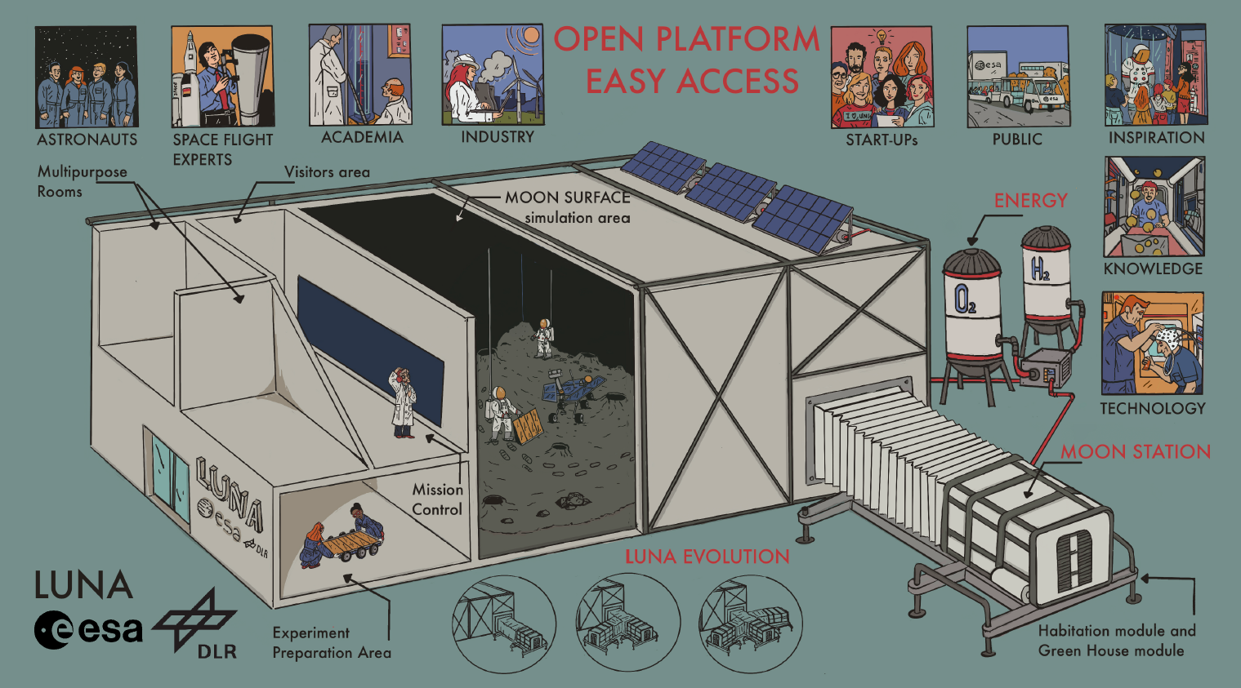
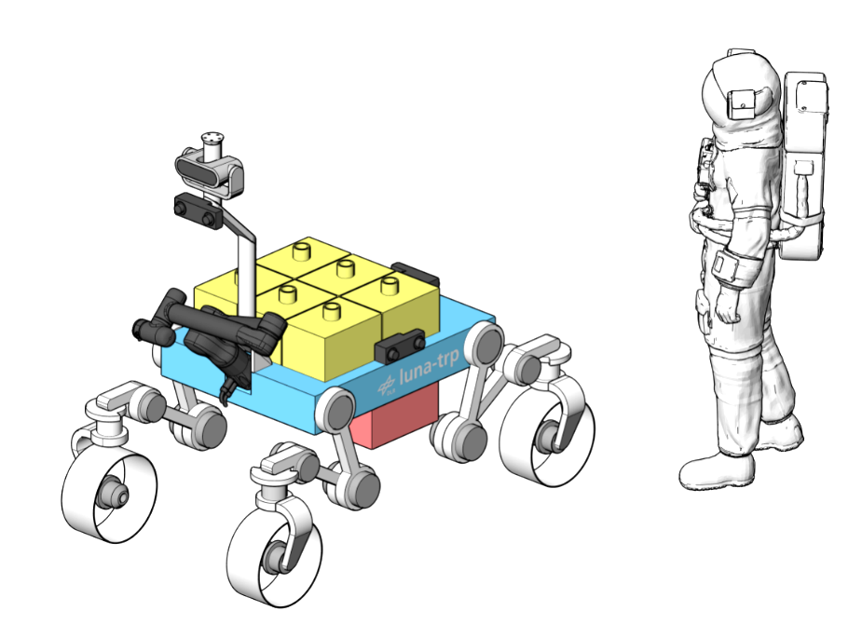
DeLeMIS 2.0
Autonomous Robotic System
Use case: Locomotion system of the rover TRP
  Highly maneuverable, all terrain, all weather
  Flexible, reconfigurable suspension system
  Broad number of interfaces for static payload
  Manipulator & docking interface for dynamic payload
Classical and AI-based motion control
Robustness and fault-tolerance for autonomous navigation
2.

Slide 16
DeLeMIS 2.0
Causal AI and causal inference for FDIR
  Causal root cause analysis – what were the reasons for a specific fault?
  What-if scenarios – what would have prevented the fault?
  Corner-Case search - rare parameter combination
  Quantification of causes and effects
  Causal data fusion
    Combines heterogenous data sources
    Calculate residual risk
  Backed up by well established and mature mathematical theory
  Explainability for AI algorithms (xAI)
complemented or
represented by
quantifies
quantifies
2.

Slide 17
Thank You!
Dr. Alen Turnwald
alen.Turnwald@efs-techhub.com

