Slide 1


DESI CC
4th June 2024

Slide 2
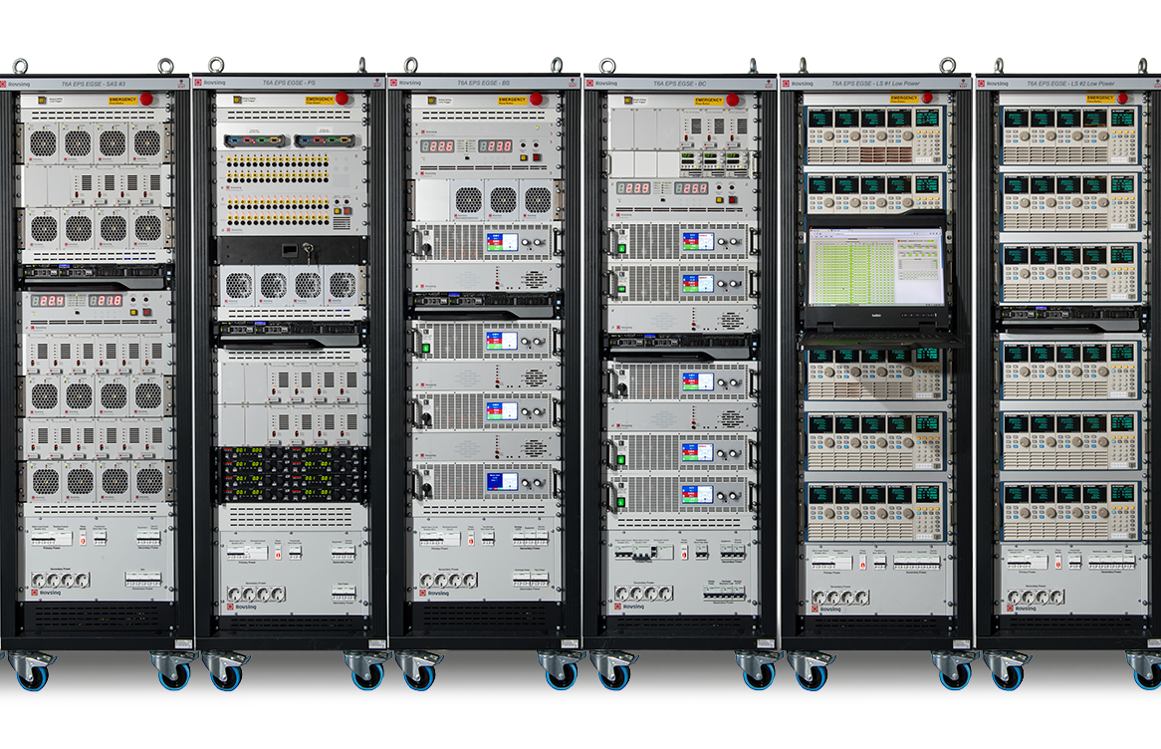
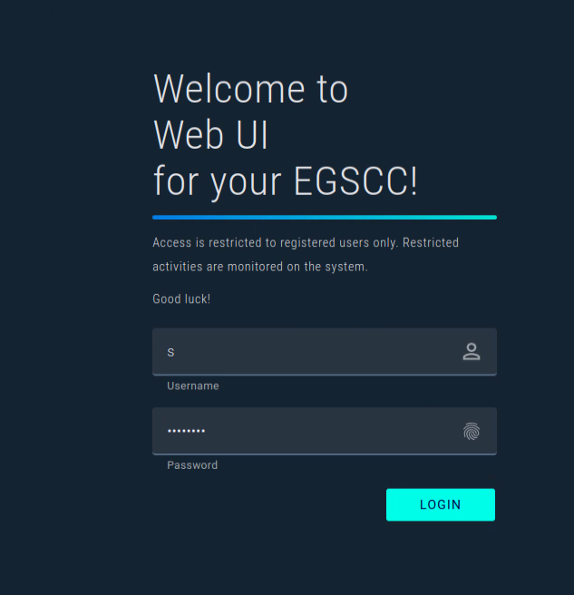
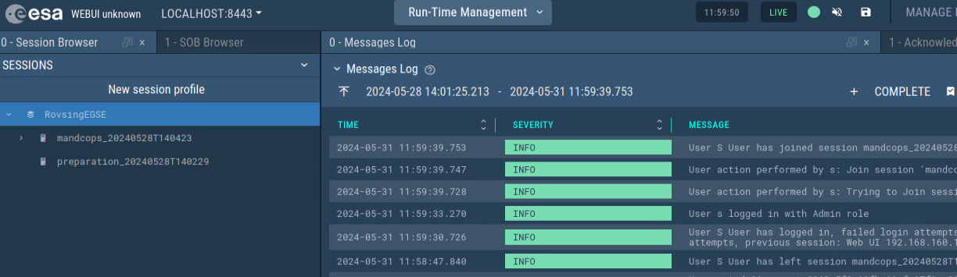

AGENDA
Introduction of project
Study Phase
EGS CC Integration
Conclusion

Slide 3
Introduction Project. EGSE Common Core (EGS-CC)
What is EGS-CC?
A new software framework developed for Spacecraft, AIT and Operations.
Development Status:
Development completed, entering maintenance phase
Collaborative effort led by ESA
Primary Aim:
To create a standardized platform for Central Checkout Systems for AIT and Operational Mission Control Systems.

Slide 4
Introduction Project. Rovsing EGSE Controller Features
EGSE Management:
Manages Hardware Units: Efficient management of various subsystems.
Subsystem Examples: Umbilical Power, Battery Simulators, Solar Array Simulators,
Integrated Software Components:
Man-Machine Interface (MMI)
CCS Interface
Logger and Archive Modules
Business Logic
Hardware Adaptors
Script Engine
Reporting Module

Slide 5
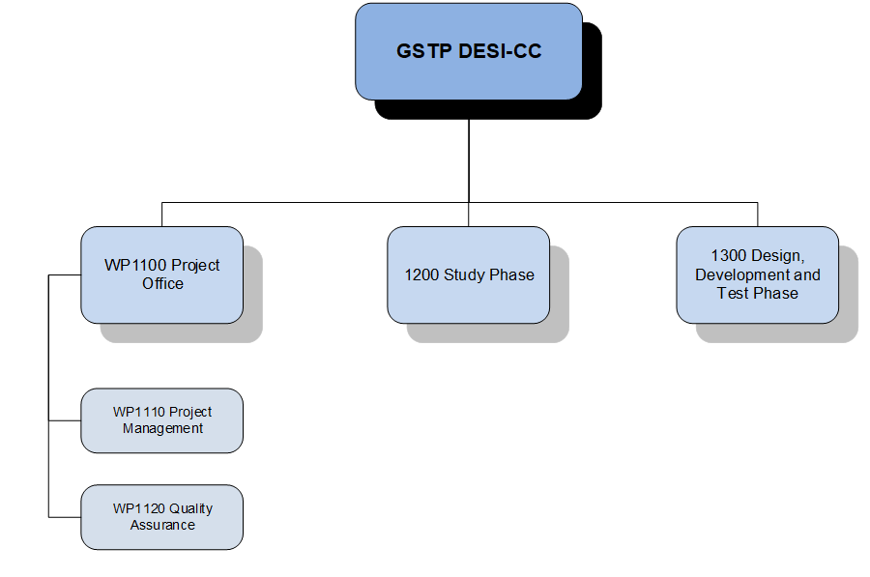
Introduction Project. Project Plan Overview

Slide 6
Introduction Project. Timeline Overview
03/2017
10/2017
01/2020
06/2023
06/2024
KO
Close out
Study Phase
Design Phase
Design, Develop and Test Phase

Slide 7
Study Phase. Initial High-Level DESI-CC Goals
The initial high-level goals of DESI-CC were to integrate the Rovsing EGSE Controller software core to the EGS-CC software framework. Examples of potential application:
• Adaptation to EGS-CC native software interfaces
• Compatibility to EGS-CC Common Data model
• Harmonization of MMI look and feel
• Overall technology harmonization

Slide 8
Study Phase Results
Setup seen from Common core
First initial idea following with EGSE-CC:
Define “EGS-CC Conceptual Data Model” in XTCE
  Define TM/TC packets. Rovsing FEE Controller should be able to import these definitions for internal usage.
  Create Displays.
  Create Procedures/Scripts for Testing.
Connect to Rovsing FEE Controller via the M&C Adaption component using EDEN/PUS protocol.
Use EGS-CC for logging/archiving.
Use EGS-CC for User Interface

Slide 9
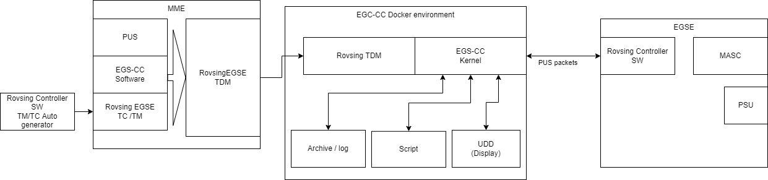
EGS CC Integration Diagram Overview

Slide 10
EGS CC Integration Key Features Achieved
1. Import TM/TC in EGS-CC: EGS-CC knows generic telecommands from the Rovsing Controller SW.
2. Connect to Rovsing FEE Controller via the M&C Adapters: The EGS-CC test environment is sending telecommands and receiving telemetry from the Rovsing Controller SW.
3. Create Procedures/Scripts for Testing: The EGS-CC can run test scripts reading telemetry from the Rovsing Controller SW and sending telecommands to it
4. Use EGS-CC for logging/archiving The EGS-CC takes care of logging and archiving of all TM/TCs.
5. Utilize EGS-CC UDD for displays: Use EGS-CC as a CCS to control the Rovsing Controller SW as a SCOE system. UDD displays represent SCOE Controller. Output is a set of UDD that is linked to the SCOE Controller TDM

Slide 11
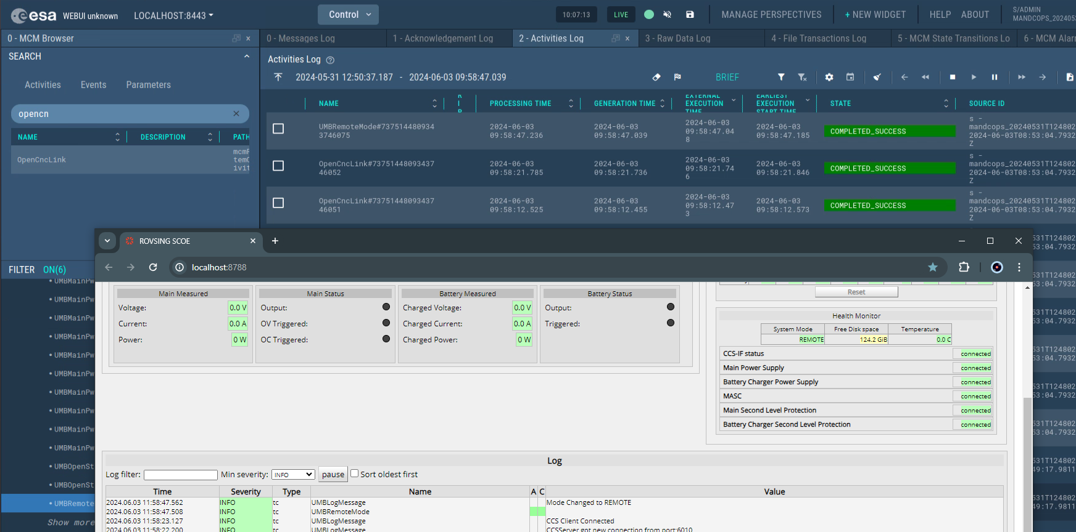
EGS CC Integration overall EGSCC UI
“Live” TM/TC in communication with the SCOE controller.

Slide 12
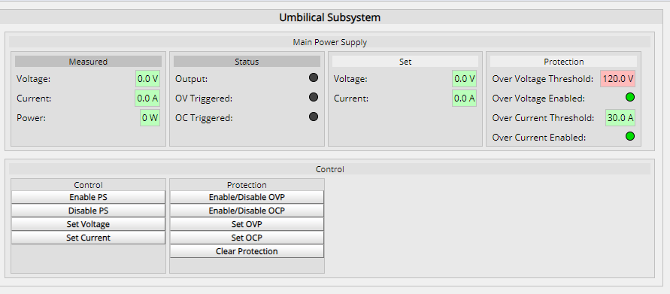
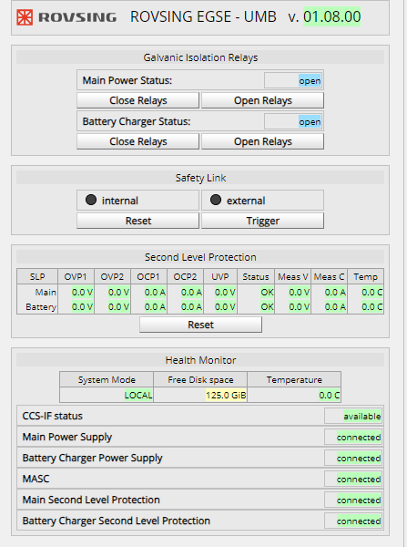
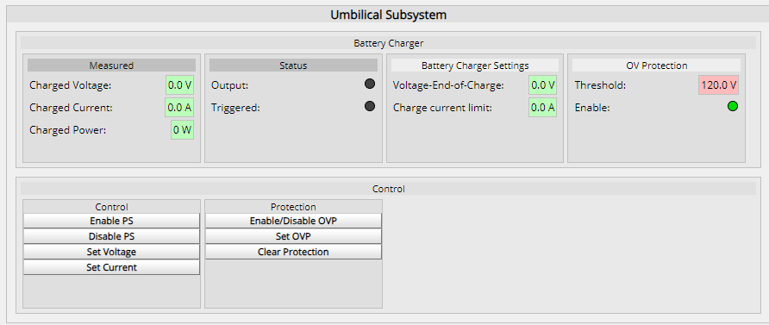
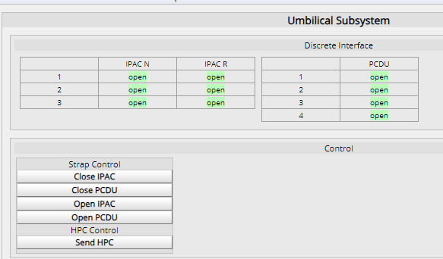
EGS CC Integration MMI Features
Rovsing Native MMI
EGSCC UDD
UMB SCOE SYSTEM

Slide 13
EGS CC Integration MMI Features Main Power Supply
Status
Control
Status
Control

Slide 14
EGS CC Integration MMI Battery Charger
Status
Control
Status
Control

Slide 15
EGS CC Integration MMI Umbilical Subsystem
Status
Status
Control
Control

Slide 16
EGS CC Integration MMI System Status
Status
Status
Status
Status

Slide 17
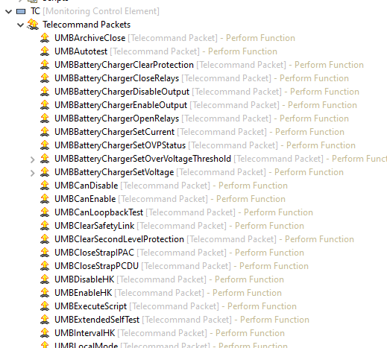
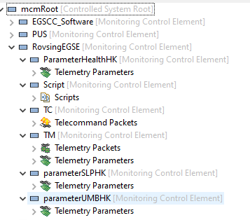
EGS CC Integration Key Features Achieved
  MME Model
  Telecommands
  Telemetries
  Mission Model

Slide 18
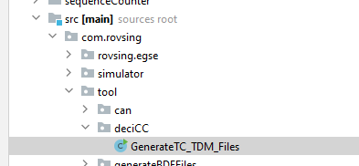
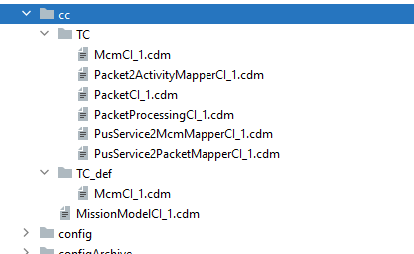
EGS CC Integration MiB import
Key Points:
Adding arguments to the telecomands manually
Structure the housekeeping package correctly with parameters
Generate specific arguments and parameters
Unique IDs must be take into consideration when you generate new items

Slide 19
EGS CC Integration Acceptance Test setup/configuration
Rovsing Controller Software
  Setup C&C protocol or EDEN protocol.
DESI CC Software
  EGSCC-Rovsing on Linux (Ubuntu)
Docker Setup
  Linux PC (Ubuntu)
Mission Model Editor (MME)
  Install Temurin 11

Slide 20
Conclusion and Future Work
Project Goal:
  To create an initial framework for the EGS-CC and Rovsing EGSE Controller.
Potential Benefits:
  Standardization of AIT and operations.
  Enhanced efficiency and reliability.
  Improved interoperability across the industry.
Industry Impact:
  Streamlined processes.
  Greater consistency in spacecraft testing and operations.
Lessons learned:
UDD editor is very time consuming
MME need to be improve
Complex system -> Clear and detail Documentation
Easier to upload TDM in the EGS-CC and clone items
Custom tools
Simplify/streamline MIB -> TDM conversion, benefit magnified as this will be a recurring task

Slide 21


ANY QUESTIONS OR COMMENTS?

