Slide 1

Plasma Bound De-Risk Project Final Presentation
13th of May 2024

Slide 2
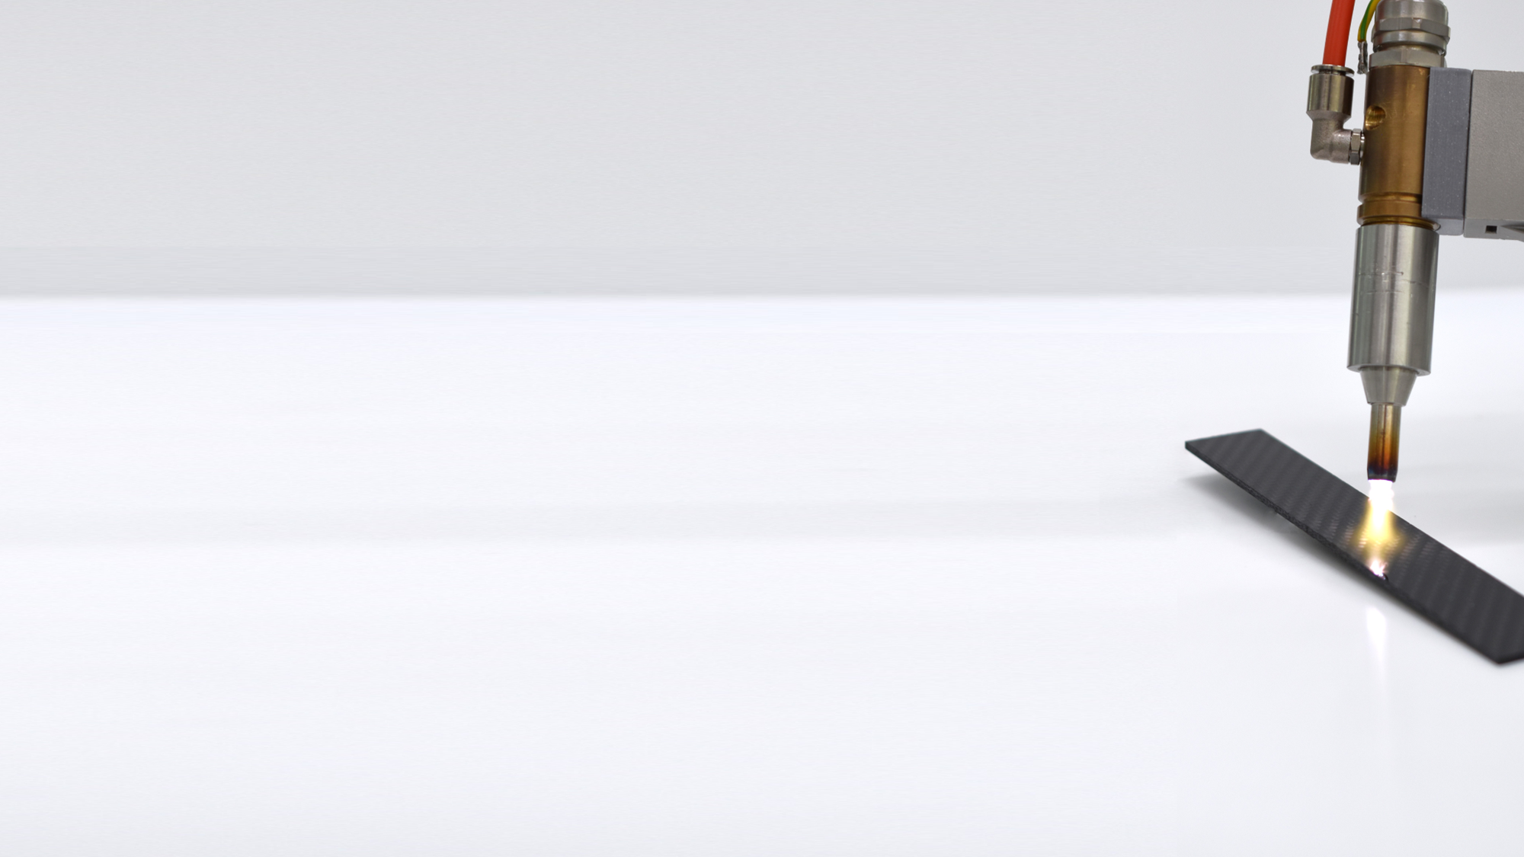

Presentation Outline
01
Project Proposal
02
Controlled Polymer Ablation Overview
03
WP2000 – Space Market Analysis
04
WP3000 – Qualification Approach
05
WP4000 – Test Campaign
06
WP5000 – Follow-On Activity Planning
07
Conclusion
2

Slide 3
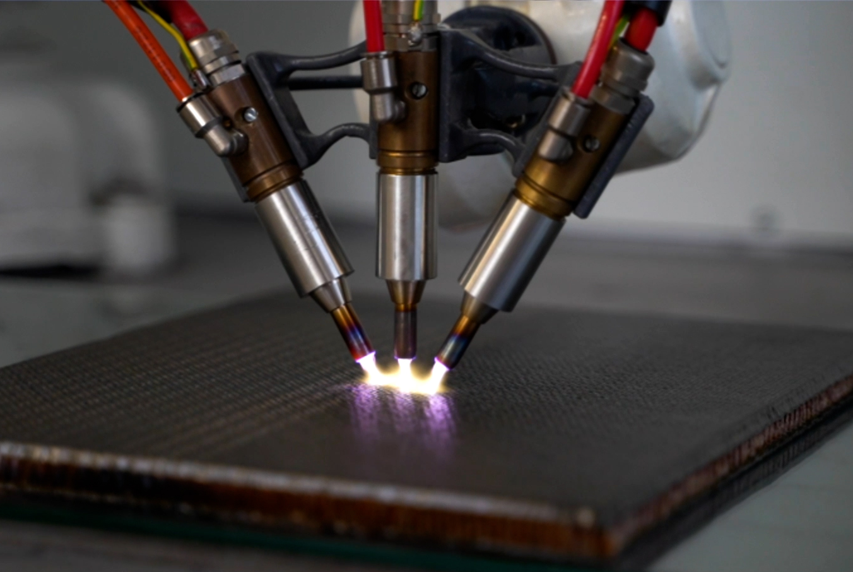
Proposal – January 2021
Project: Assessments to Prepare and De-Risk Technology Developments Framework (G617-241TA) –
Controlled Polymer Ablation (CPA).
Background: PlasmaBound is the sole provider of CPA - technology for enhanced adhesive bonding.
Scope: Development of CPA to TRL 4 for composite-to-composite bonding activities for space applications.
Timeline: 9 Months
Contractor: PlasmaBound Ltd.
Contractee: ESA
Supports: ÉireComposites Teo.
Composites Testing Laboratory Teo.
Mecano-ID
PLASMA BOUND
Notes:
General Support Technology Programme (GSTP) ESA

Slide 4
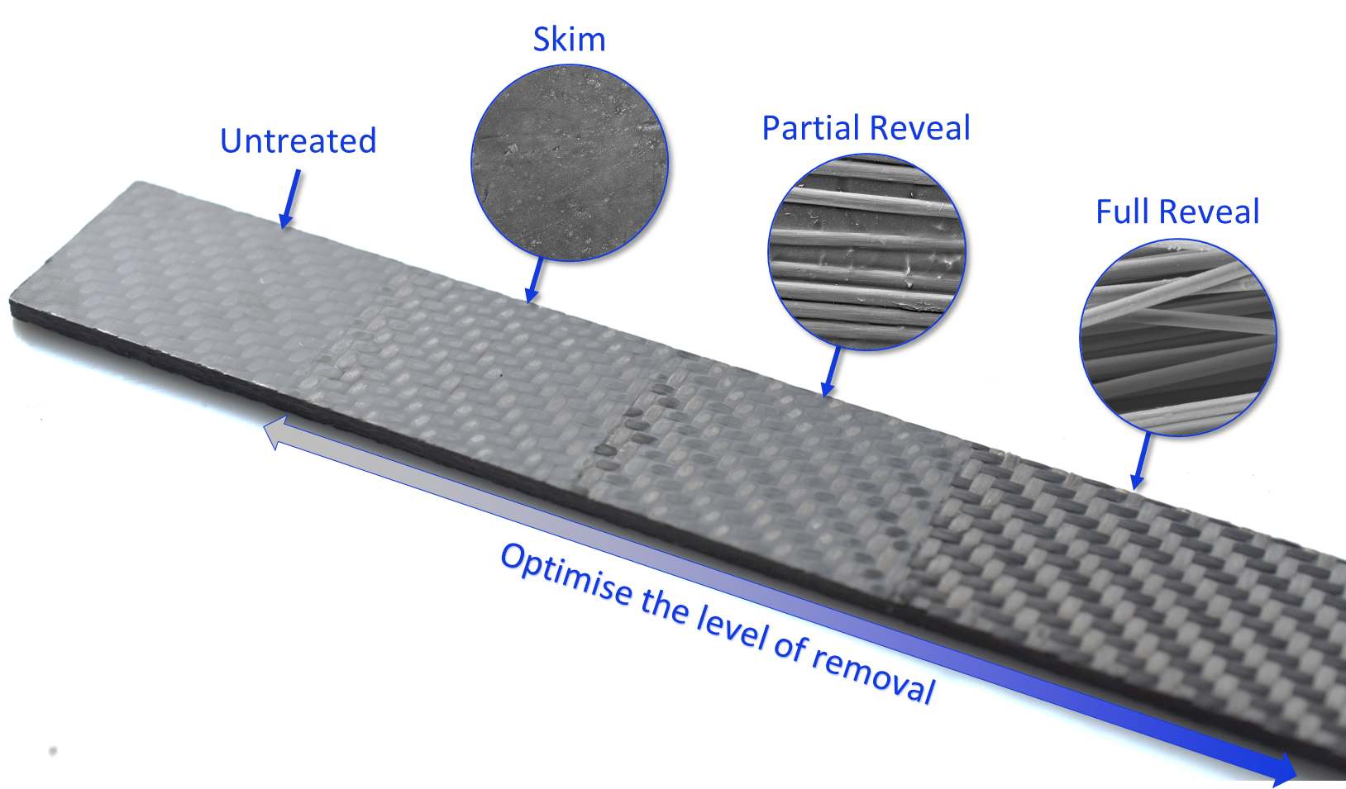
Controlled Polymer Ablation Overview
Highly reactive species like ions, electrons and radicals.
Breaks the chemical bonds within the polymer, leading to the dissociation of polymer molecules.
CPA Plasma Plume
Contaminant
Polymer
Fibre Weave
Revealed Fibres

Slide 5
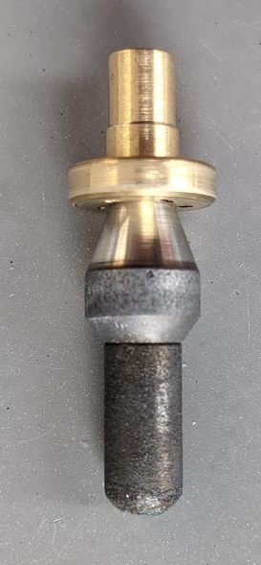
WP2000 – Space Market Analysis
D1 – Supply Induced Obsolescence Report
Supply & Demand:
Plasma device agnostic
Atmospheric plasma widely used
Rare Earth Materials:
  Hafnium in electrode
  EU is net exporter of Hafnium
PLASMA BOUND
5

Slide 6
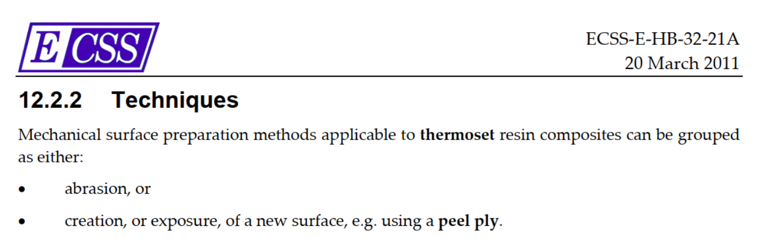
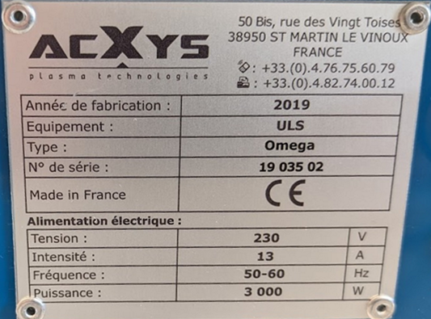
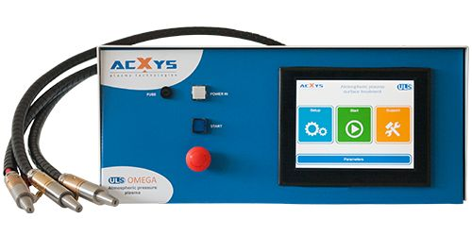
WP2000 – Space Market Analysis
D2 – Regulation Induced Obsolescence Report
  ECSS Compliance:
  “creation, or exposure, of a new surface”
  REACh Compliance:
  CPA add-on
  Air & Electricity consumed
  Waste exempt
RoHs Compliance:
CE marked device
Pg 221
PLASMA BOUND
6
Notes:
Registration, Evaluation, Authorisation and Restriction of Chemicals
Restriction of Hazardous Substances Directive

Slide 7
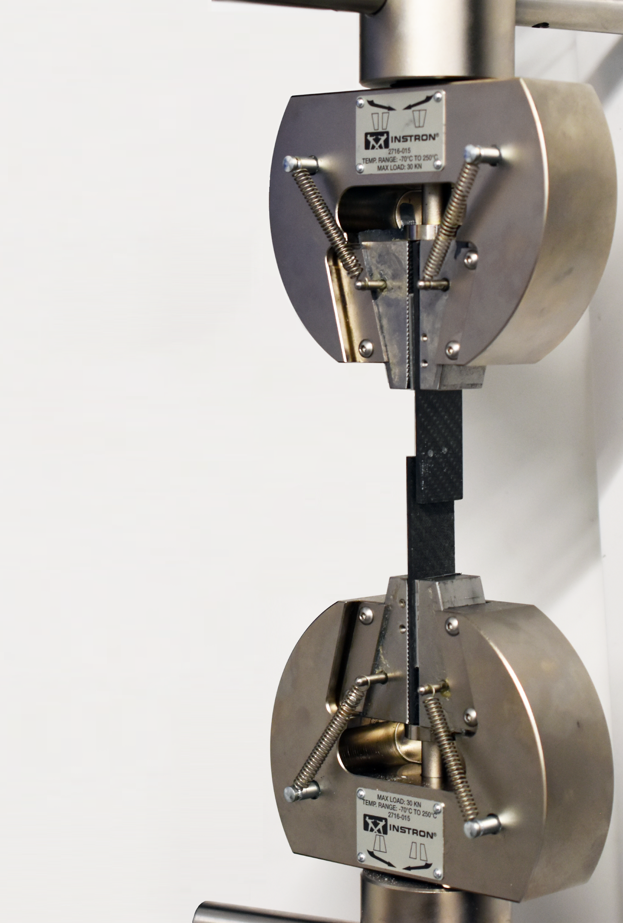
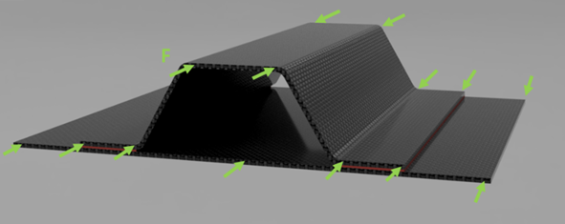
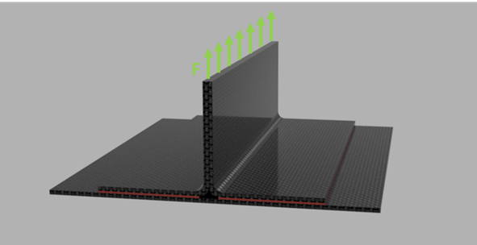
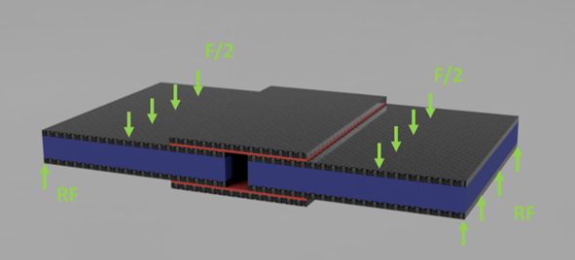
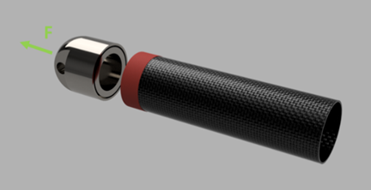
WP2000 – Space Market Analysis
D3&4 – Preliminary Technical Requirements Specifications & Breadboard Design Concepts
Technical Requirements:
Materials Selection
SotA preparation methods
Joint performance testing
Breadboard Design Concepts
PLASMA BOUND
7

Slide 8
WP3000 – Qualification Approach
D5 – Verification Plan
Storage Time Assessment
ISO 8 Clean Room Suitability Assessment
Verification Programme Matrix
Mechanical Abrasion
ECSS-E-HB-32-21A
Monolithic CFRP
NDT
Adhesive Bonding with EA9394 Paste
Specimen Machining
NDT
Standardised Testing
CPA
Peel Ply
Skin CFRP
NDT
Adhesive Bonding with EA9695 Film & ALU5052 Honeycomb
Specimen Machining
NDT
Standardised Testing
CPA
PLASMA BOUND
8
Notes:
Add full TS matrix in additional slides at the end. Ready for questions
Ver Table

Slide 9
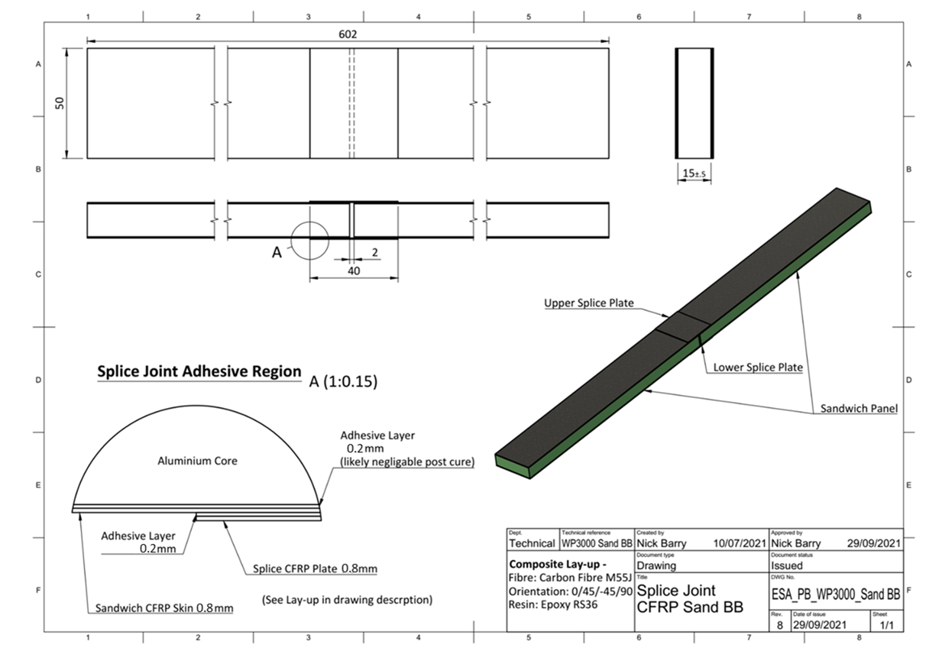
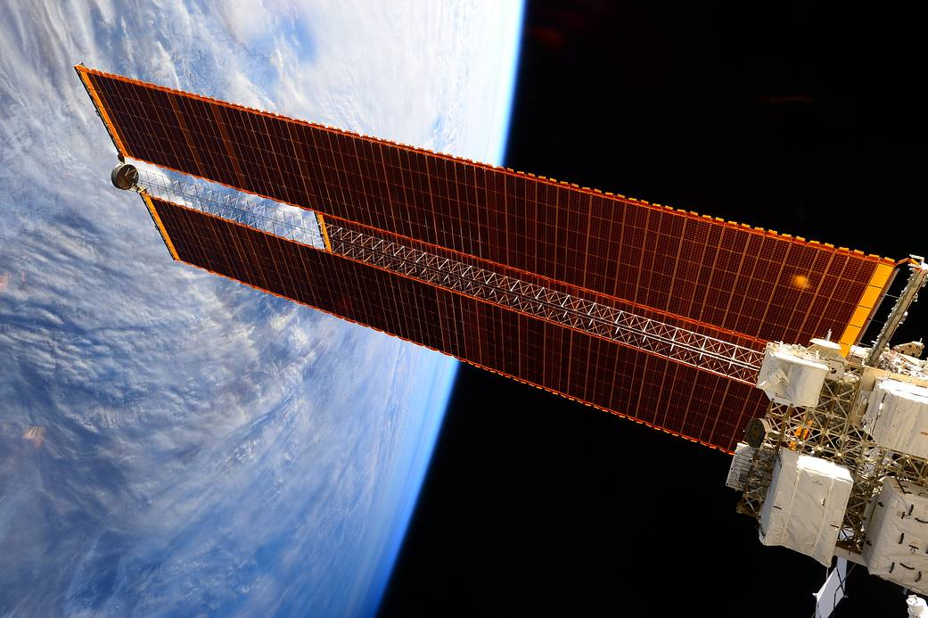
WP3000 – Qualification Approach
D6 – Breadboard Design Definition for Function Performance Verification
PLASMA BOUND
9
Notes:
The chosen space applications for monolithic CFRP are principally solar arrays and large satellite/platform primary structures with opportunities to expand to satellite primary structures with integrated mirror.
Figure 2‑4: CFRP Splice-Joint with adhesive bonding between both the skin to honeycomb core (green) and skin to splice plate, with Loctite EA9695 (skin to honeycomb) and Loctite EA9394 (skin to splice plate) adhesive applied (both represented in red). Note: the splice span is shortened for illustration purposes only.

Slide 10
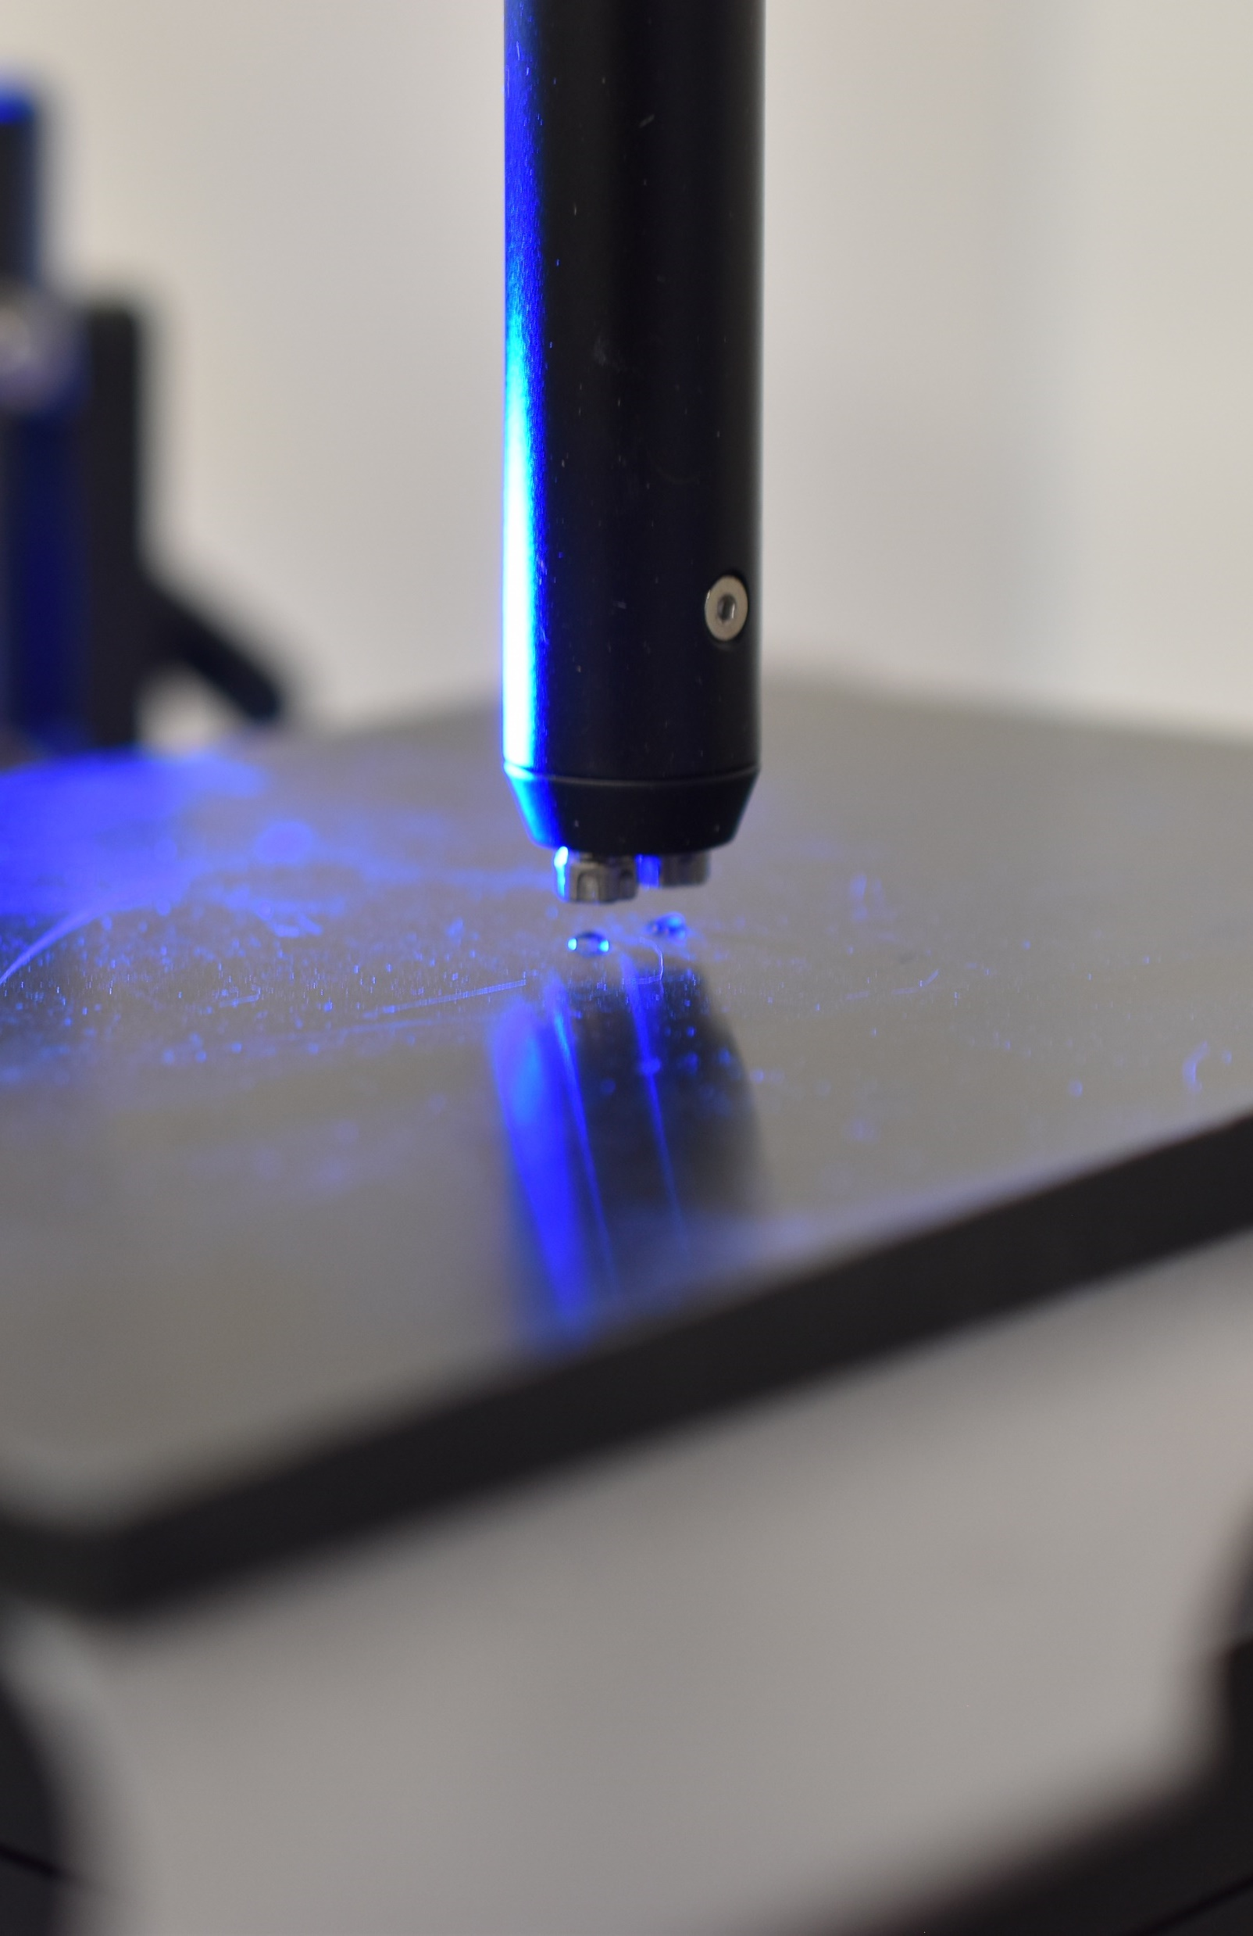
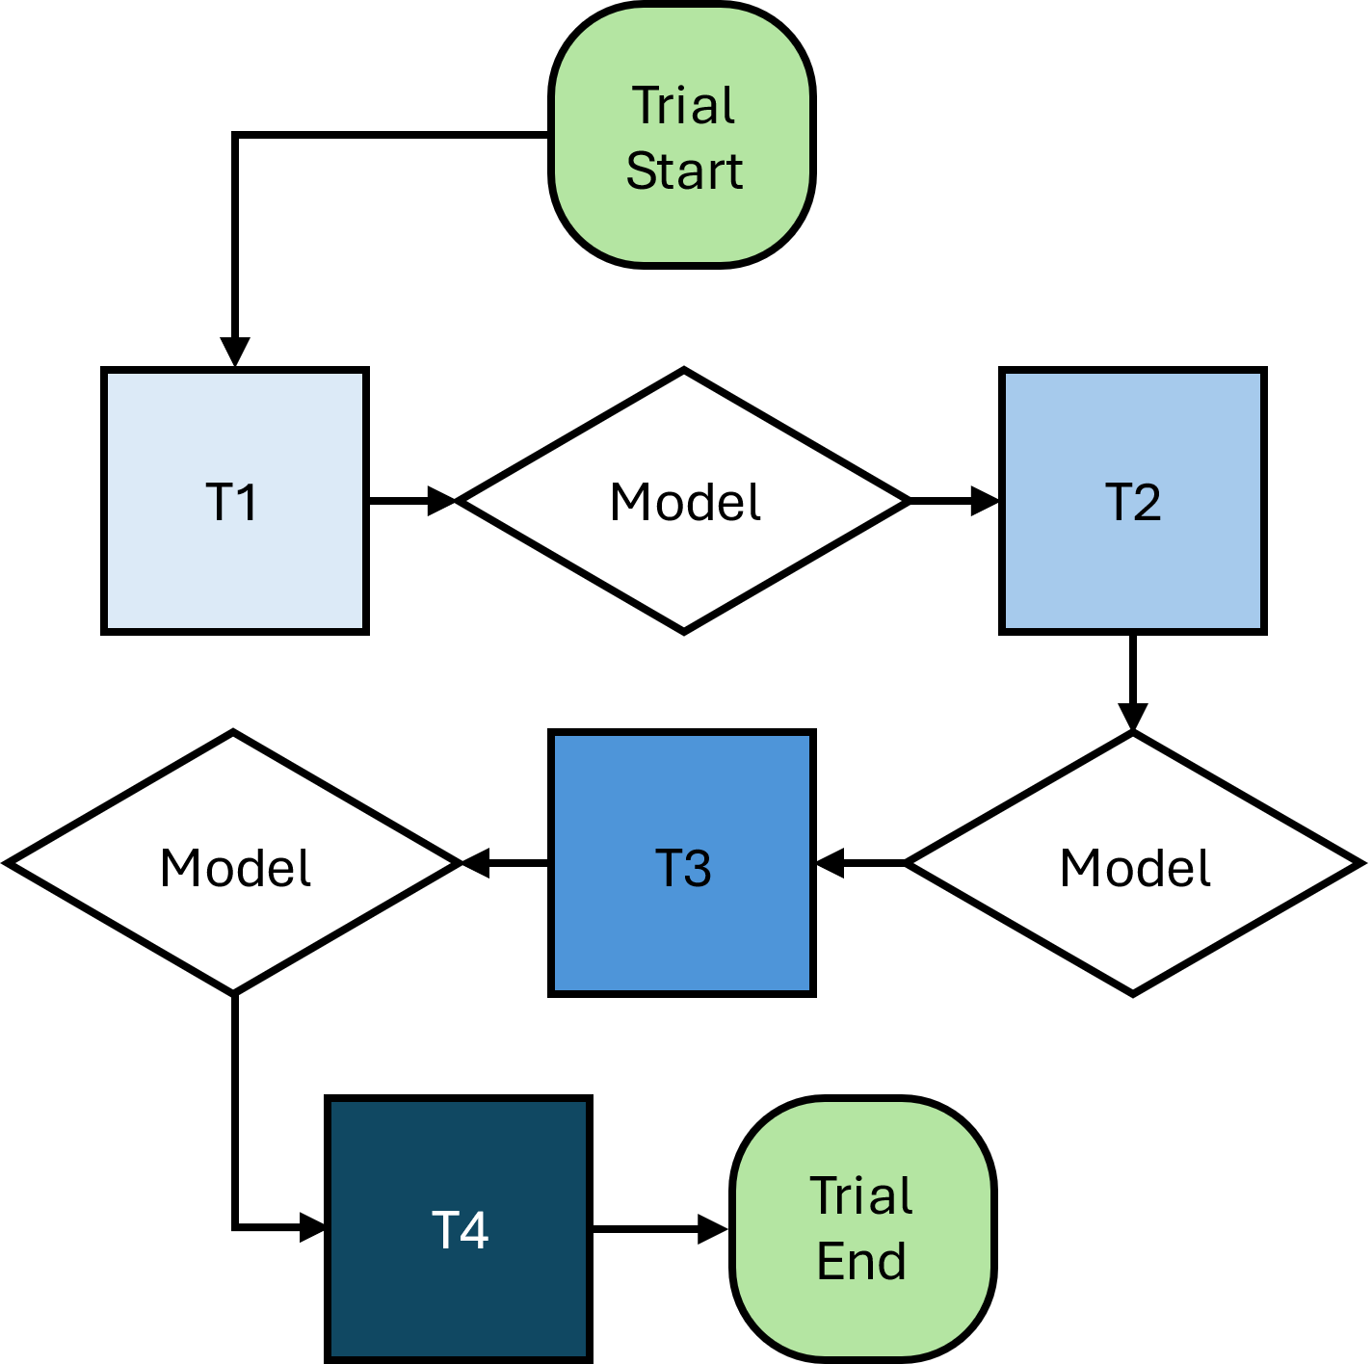
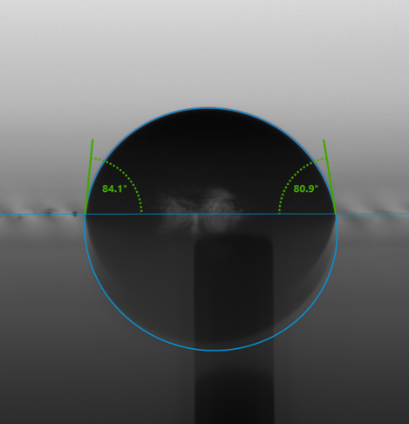
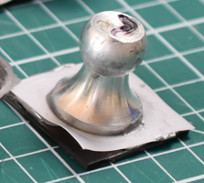
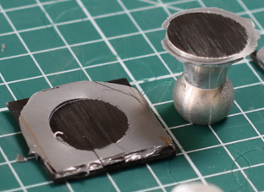
WP4000 – Test Campaign
D7 – Optimisation Process Parameters
6 Treatment Variables
DoE, SFE, Pull-off tests, Adhesive ST, Microscopy
PLASMA BOUND
10
Notes:
New: Gas Flow, [Plasma Frequency], Power, Modulation/PCT, Nozzle Height, Treatment Speed, Raster Gap.

Slide 11
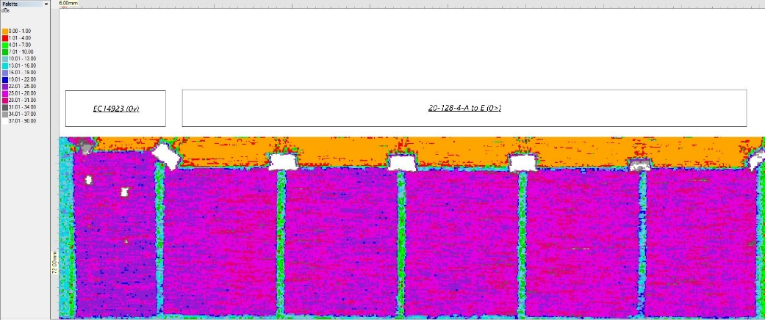
WP4000 – Test Campaign
D8.1 – Manufacturing Phase Report
Monolithic Bond Joints
Toray RS36 AFC 49 M55JB 6K 200g 36% 0.3m
8-ply lay-up, 1.6mm thick
[0/+45/-45/90° | 90/-45/+45/0°]
16-ply lay-up, 3.2mm thick
[0/+45/-45/90° | 90/-45/+45/0° |
0/+45/-45/90° | 90/-45/+45/0°]
Loctite EA9394 Aero Epoxy Paste Adhesive
Sandwich Bond Joints
Toray RS36 AFC 49 M55JB 6K 200g 36% 0.3m
4-ply lay-up, 0.8mm thick
[0/+45/-45/0°]
Loctite EA9695 Aero Epoxy Film Adhesive
Easy Composites ALU5052 (3.2mm cells, 15mm thickness)
PLASMA BOUND
11
Notes:
Figure 4‑32: Assembled FWT Panels – Date Scanned 05/01/2023 (Main dB Range: 21-31dB).

Slide 12
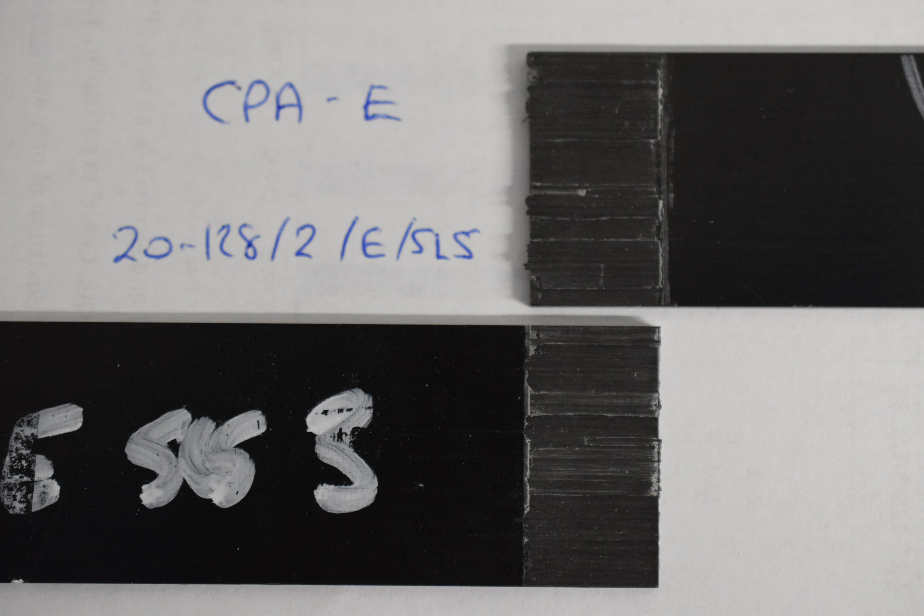
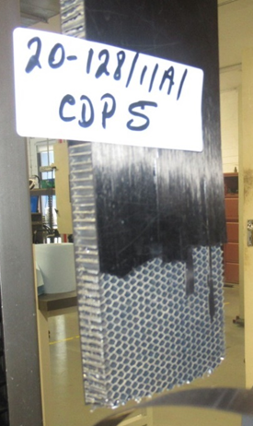
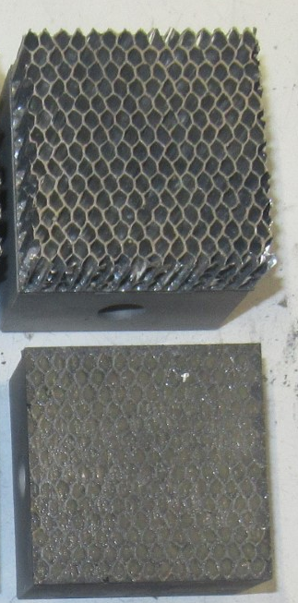
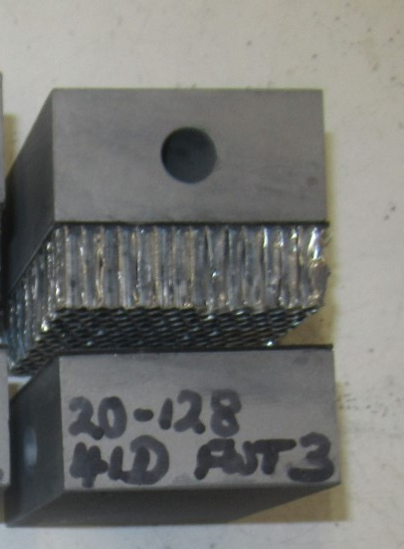
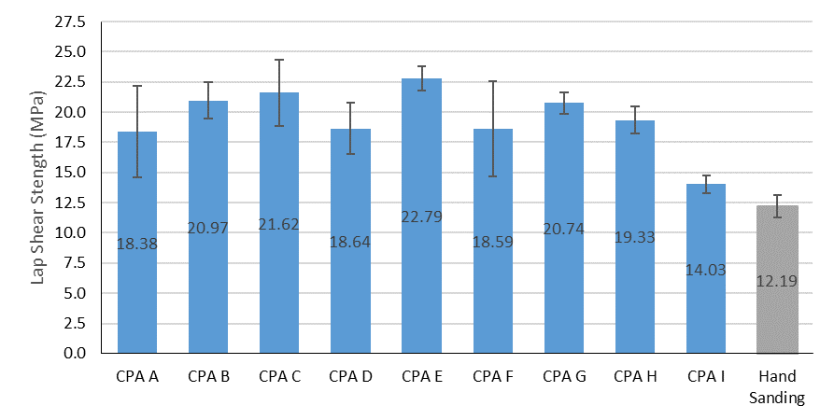
WP4000 – Test Campaign
CDP
FWT:
CPA Depth 4
D8.2 – Optimisation Test Report
Monolithic: SLS
Skin: FWT, CDP
SLS: CPA E
PLASMA BOUND
12
Notes:
Non-Standard Failure Mode for CDP Testing. The composite skin snapped.

Slide 13
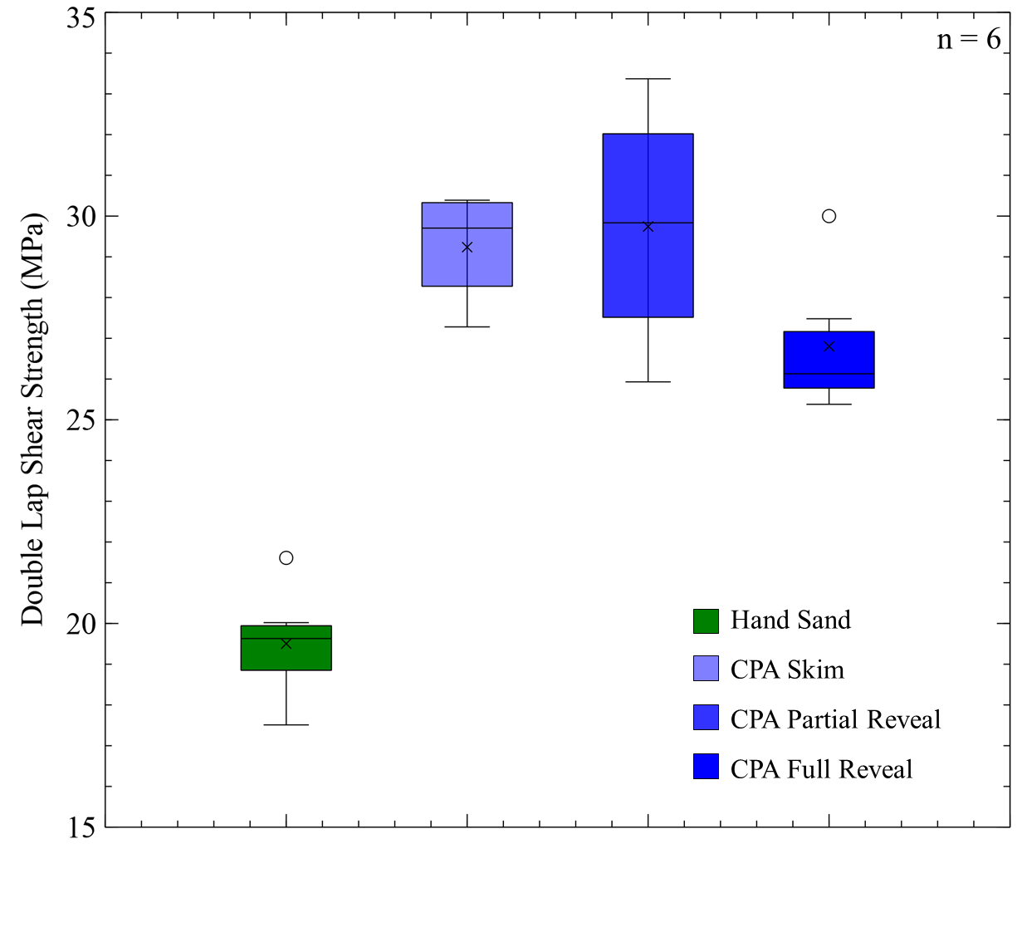
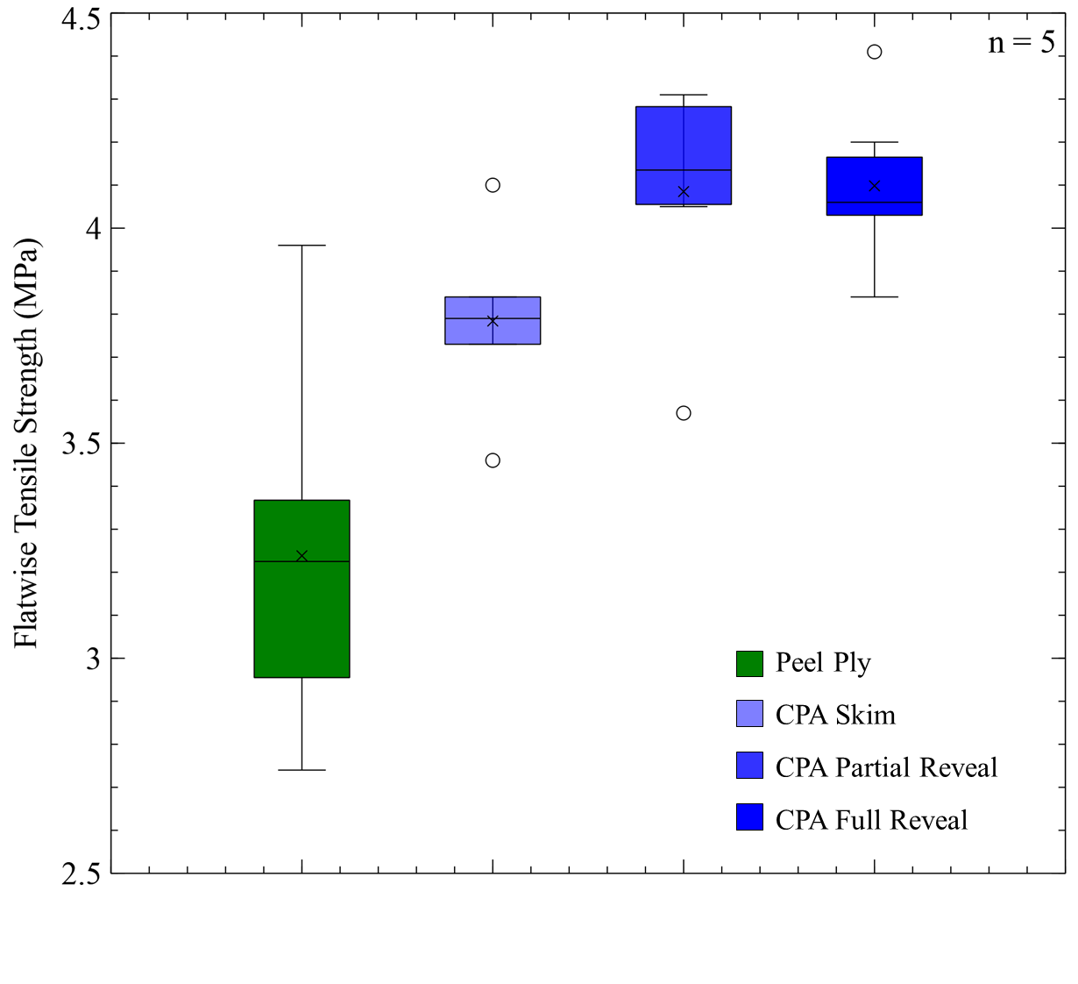
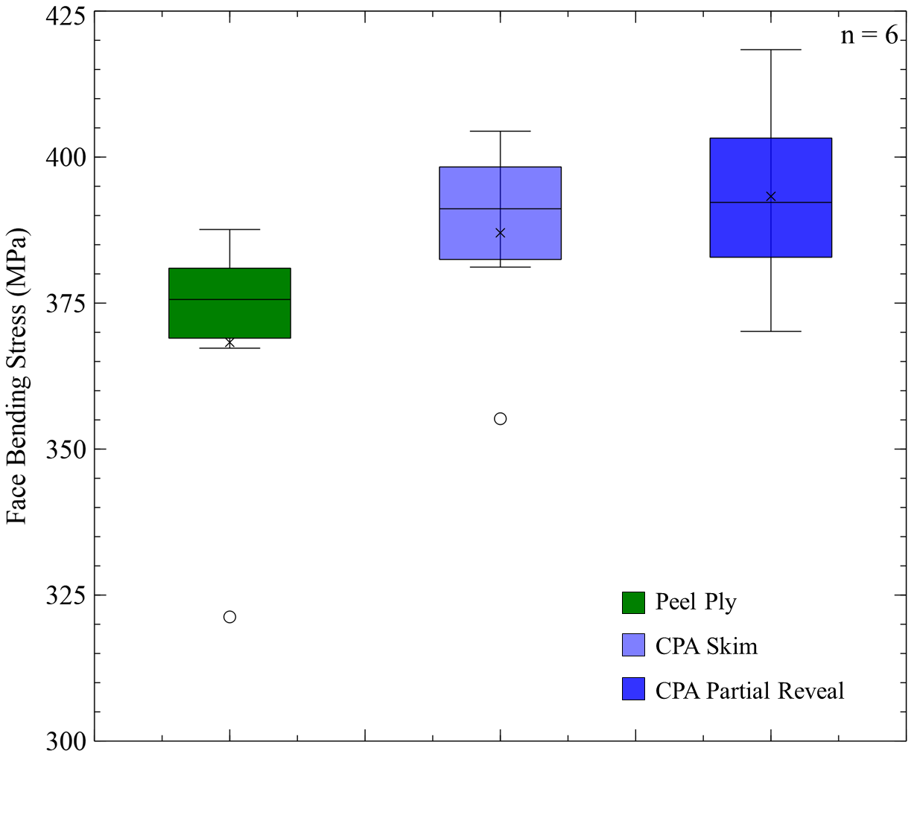
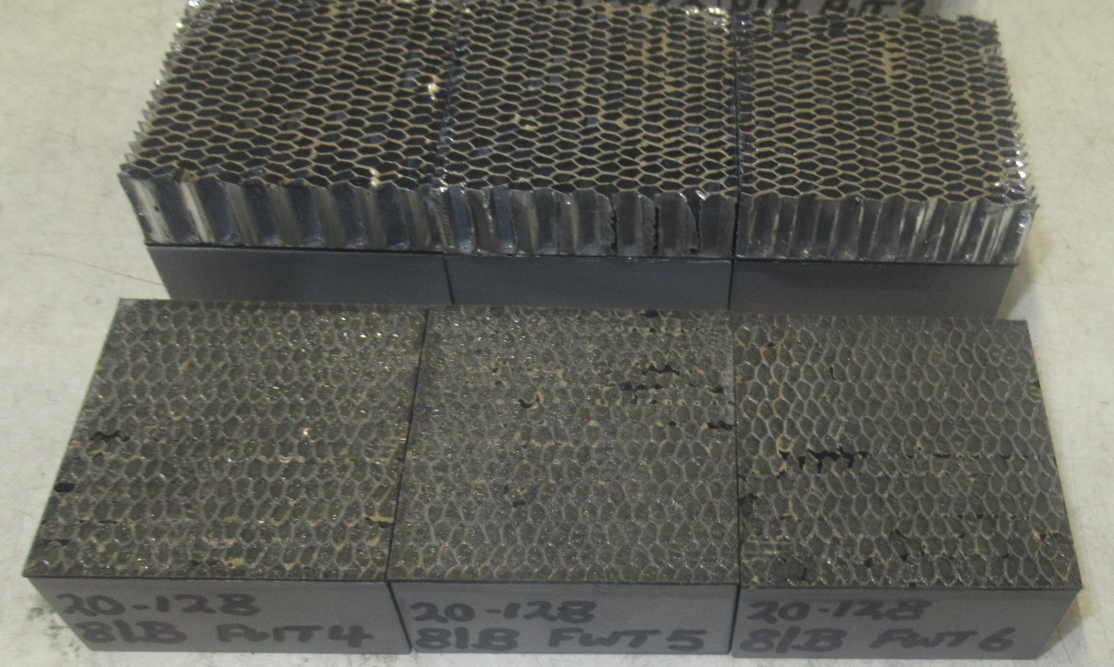
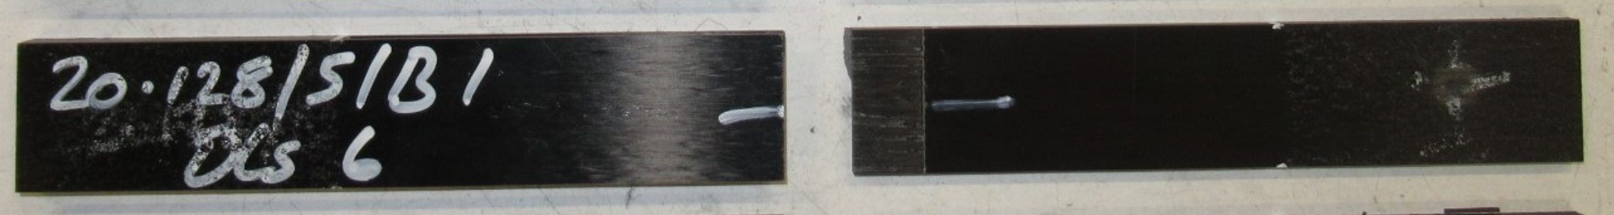
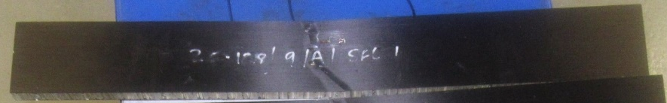
WP4000 – Test Campaign
D8.3 – Experimental Test Report
Monolithic: DLS Skin: FWT Skin: SFL
PLASMA BOUND
13

Slide 14
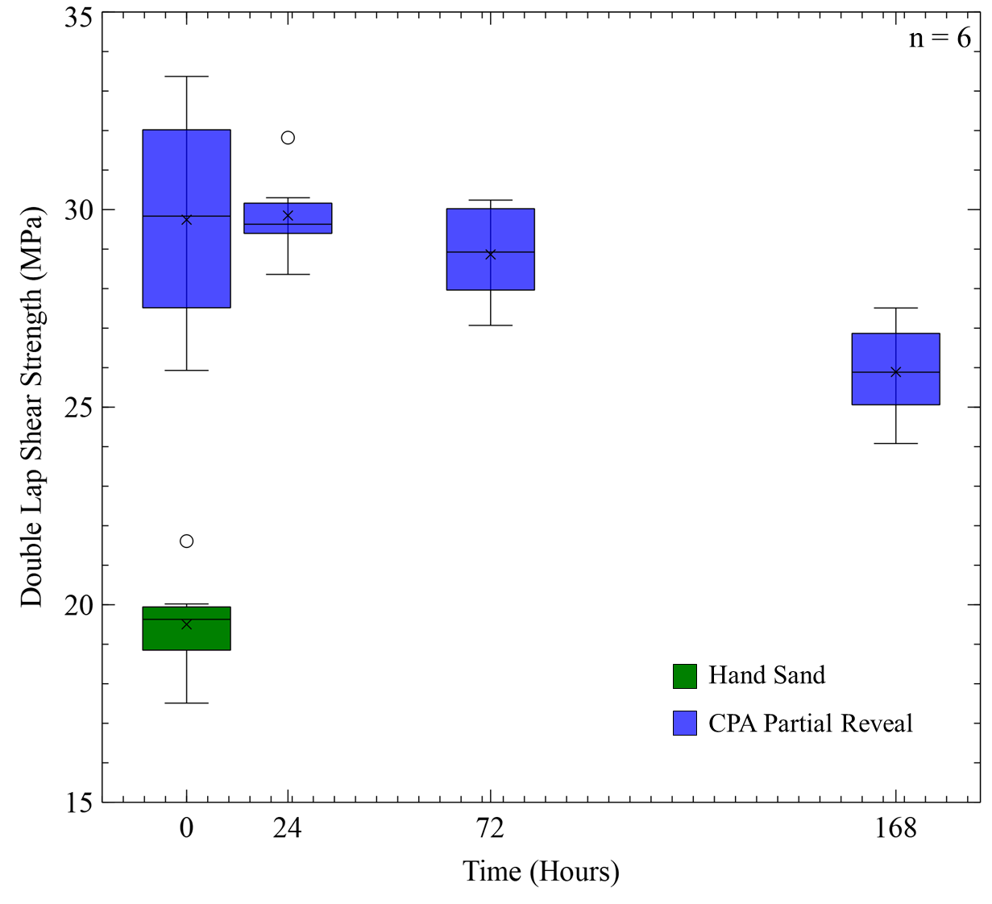
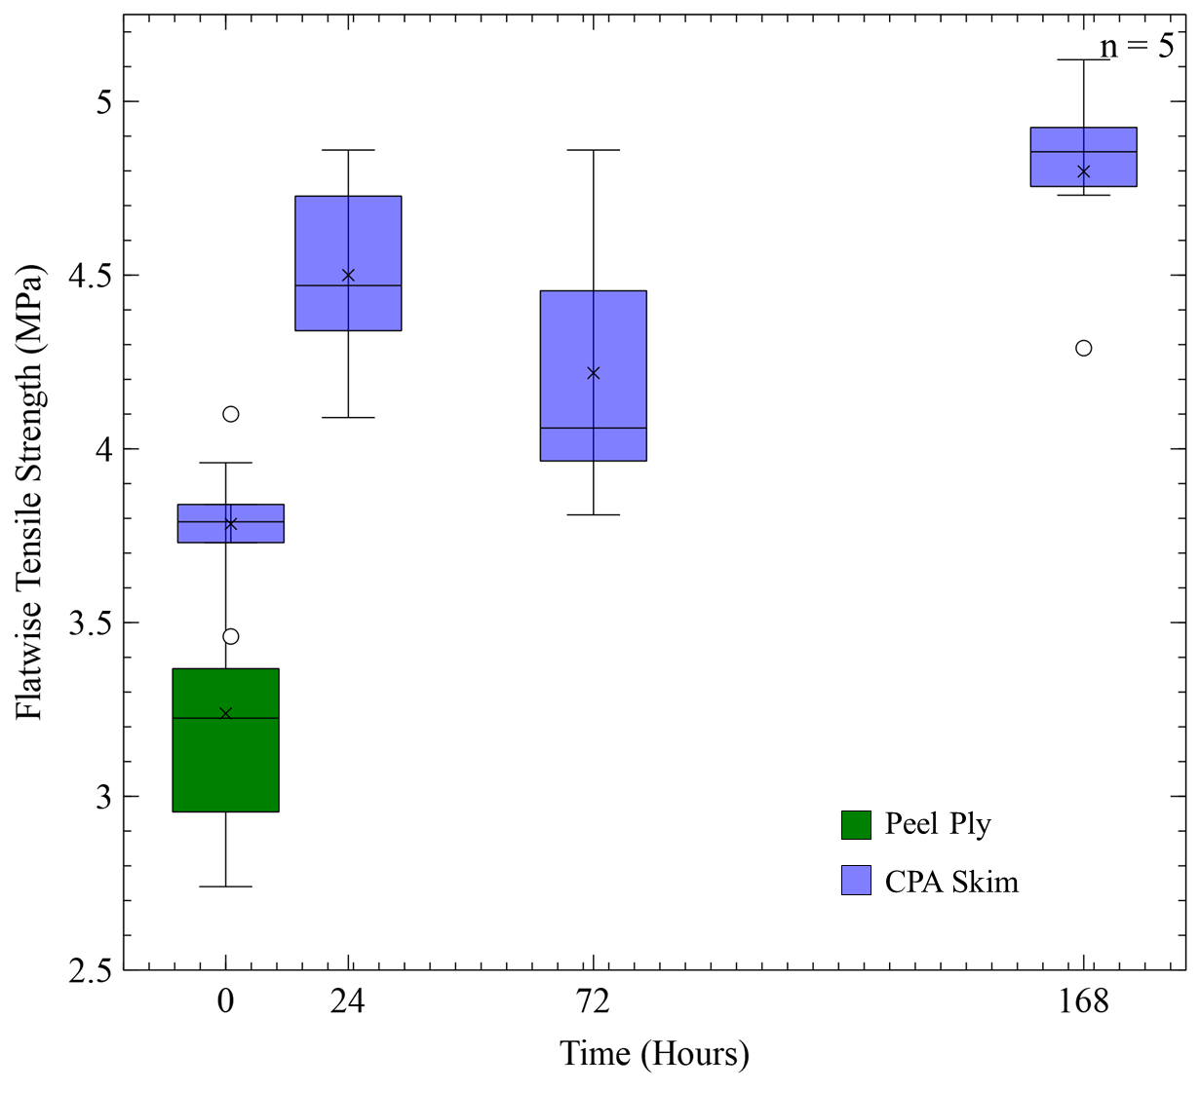
WP4000 – Test Campaign
D8.3 – Experimental Test Report
Monolithic: DLS after Storage Skin: FWT after Storage
PLASMA BOUND
14

Slide 15
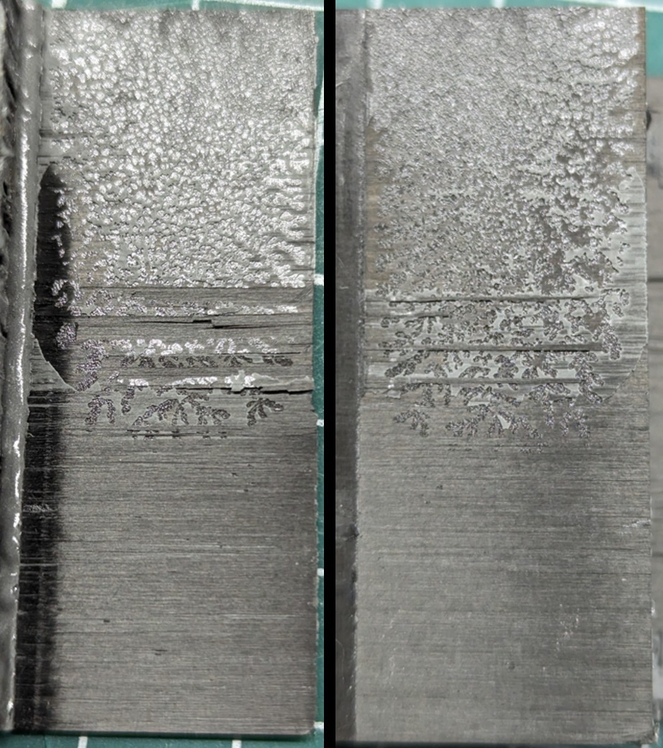
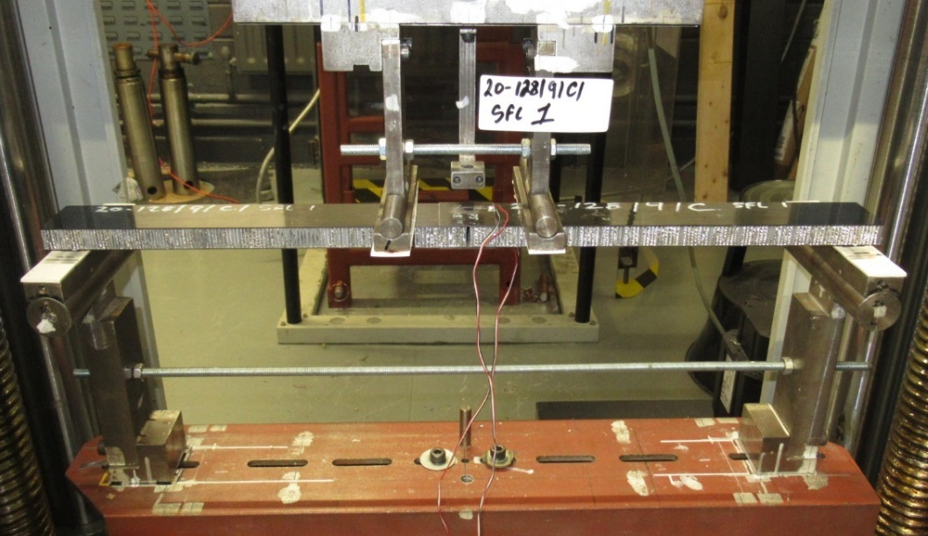
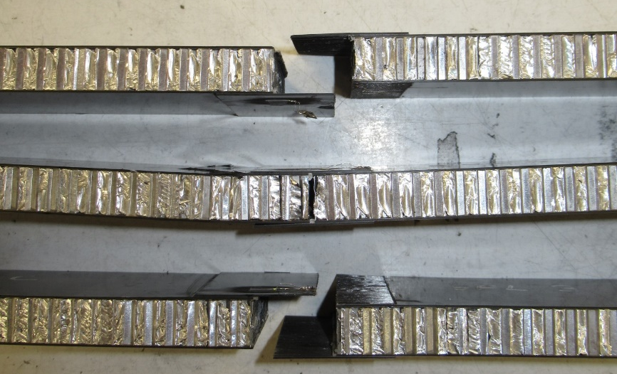
WP4000 – Test Campaign
n = 2
D9 – Breadboard Test Report
Sandwich Panels joined by
Monolithic Splice Plates
PLASMA BOUND
15
Notes:
The chosen space applications for monolithic CFRP are principally solar arrays and large satellite/platform primary structures with opportunities to expand to satellite primary structures with integrated mirror.
Figure 2‑4: CFRP Splice-Joint with adhesive bonding between both the skin to honeycomb core (green) and skin to splice plate, with Loctite EA9695 (skin to honeycomb) and Loctite EA9394 (skin to splice plate) adhesive applied (both represented in red). Note: the splice span is shortened for illustration purposes only.

Slide 16
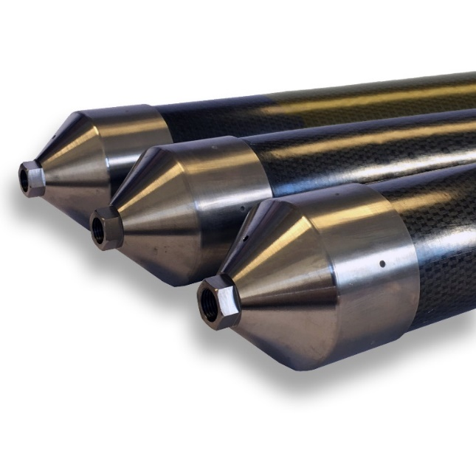

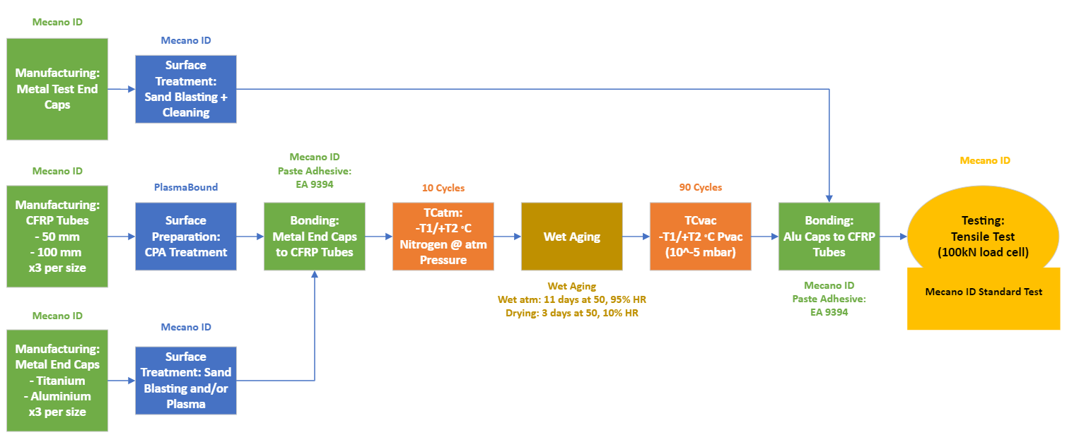
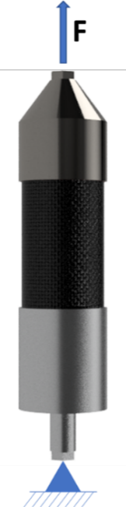
WP5000 – Follow-On Activity Planning
D10 – Developmental Plan – CPA to TRL 6
PLASMA BOUND
16

Slide 17
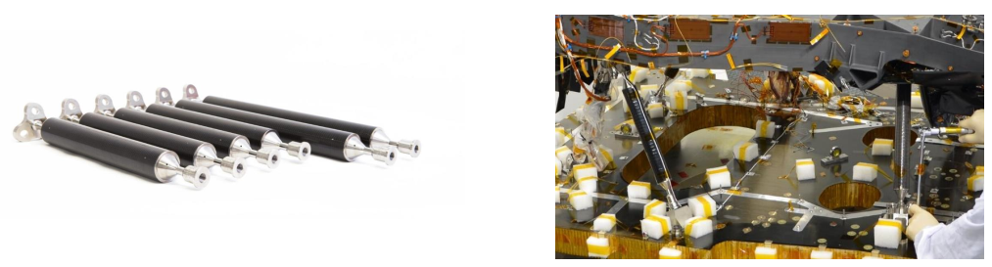
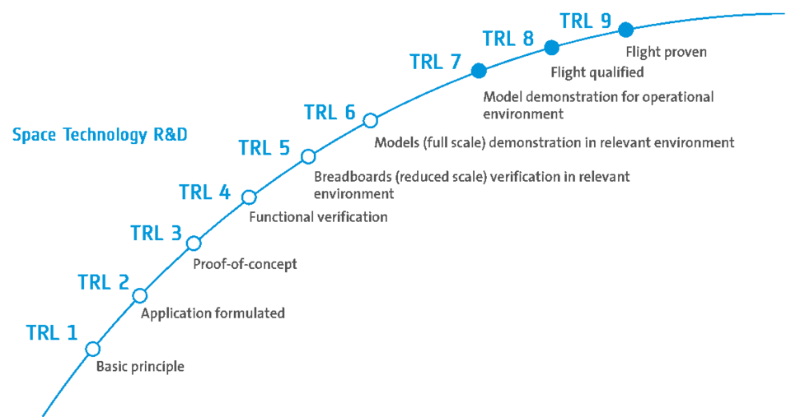
WP5000 – Follow-On Activity Planning
TRL 4 & 5 for Satellite Struts with Mecano ID
TRL 5 for Sandwich Structure Breadboard
TRL 6 Engineering Models (Partner and application needed for sandwich structure)
PLASMA BOUND
17
Notes:
Discuss Realtra with Nick, set up a comment on it

Slide 18
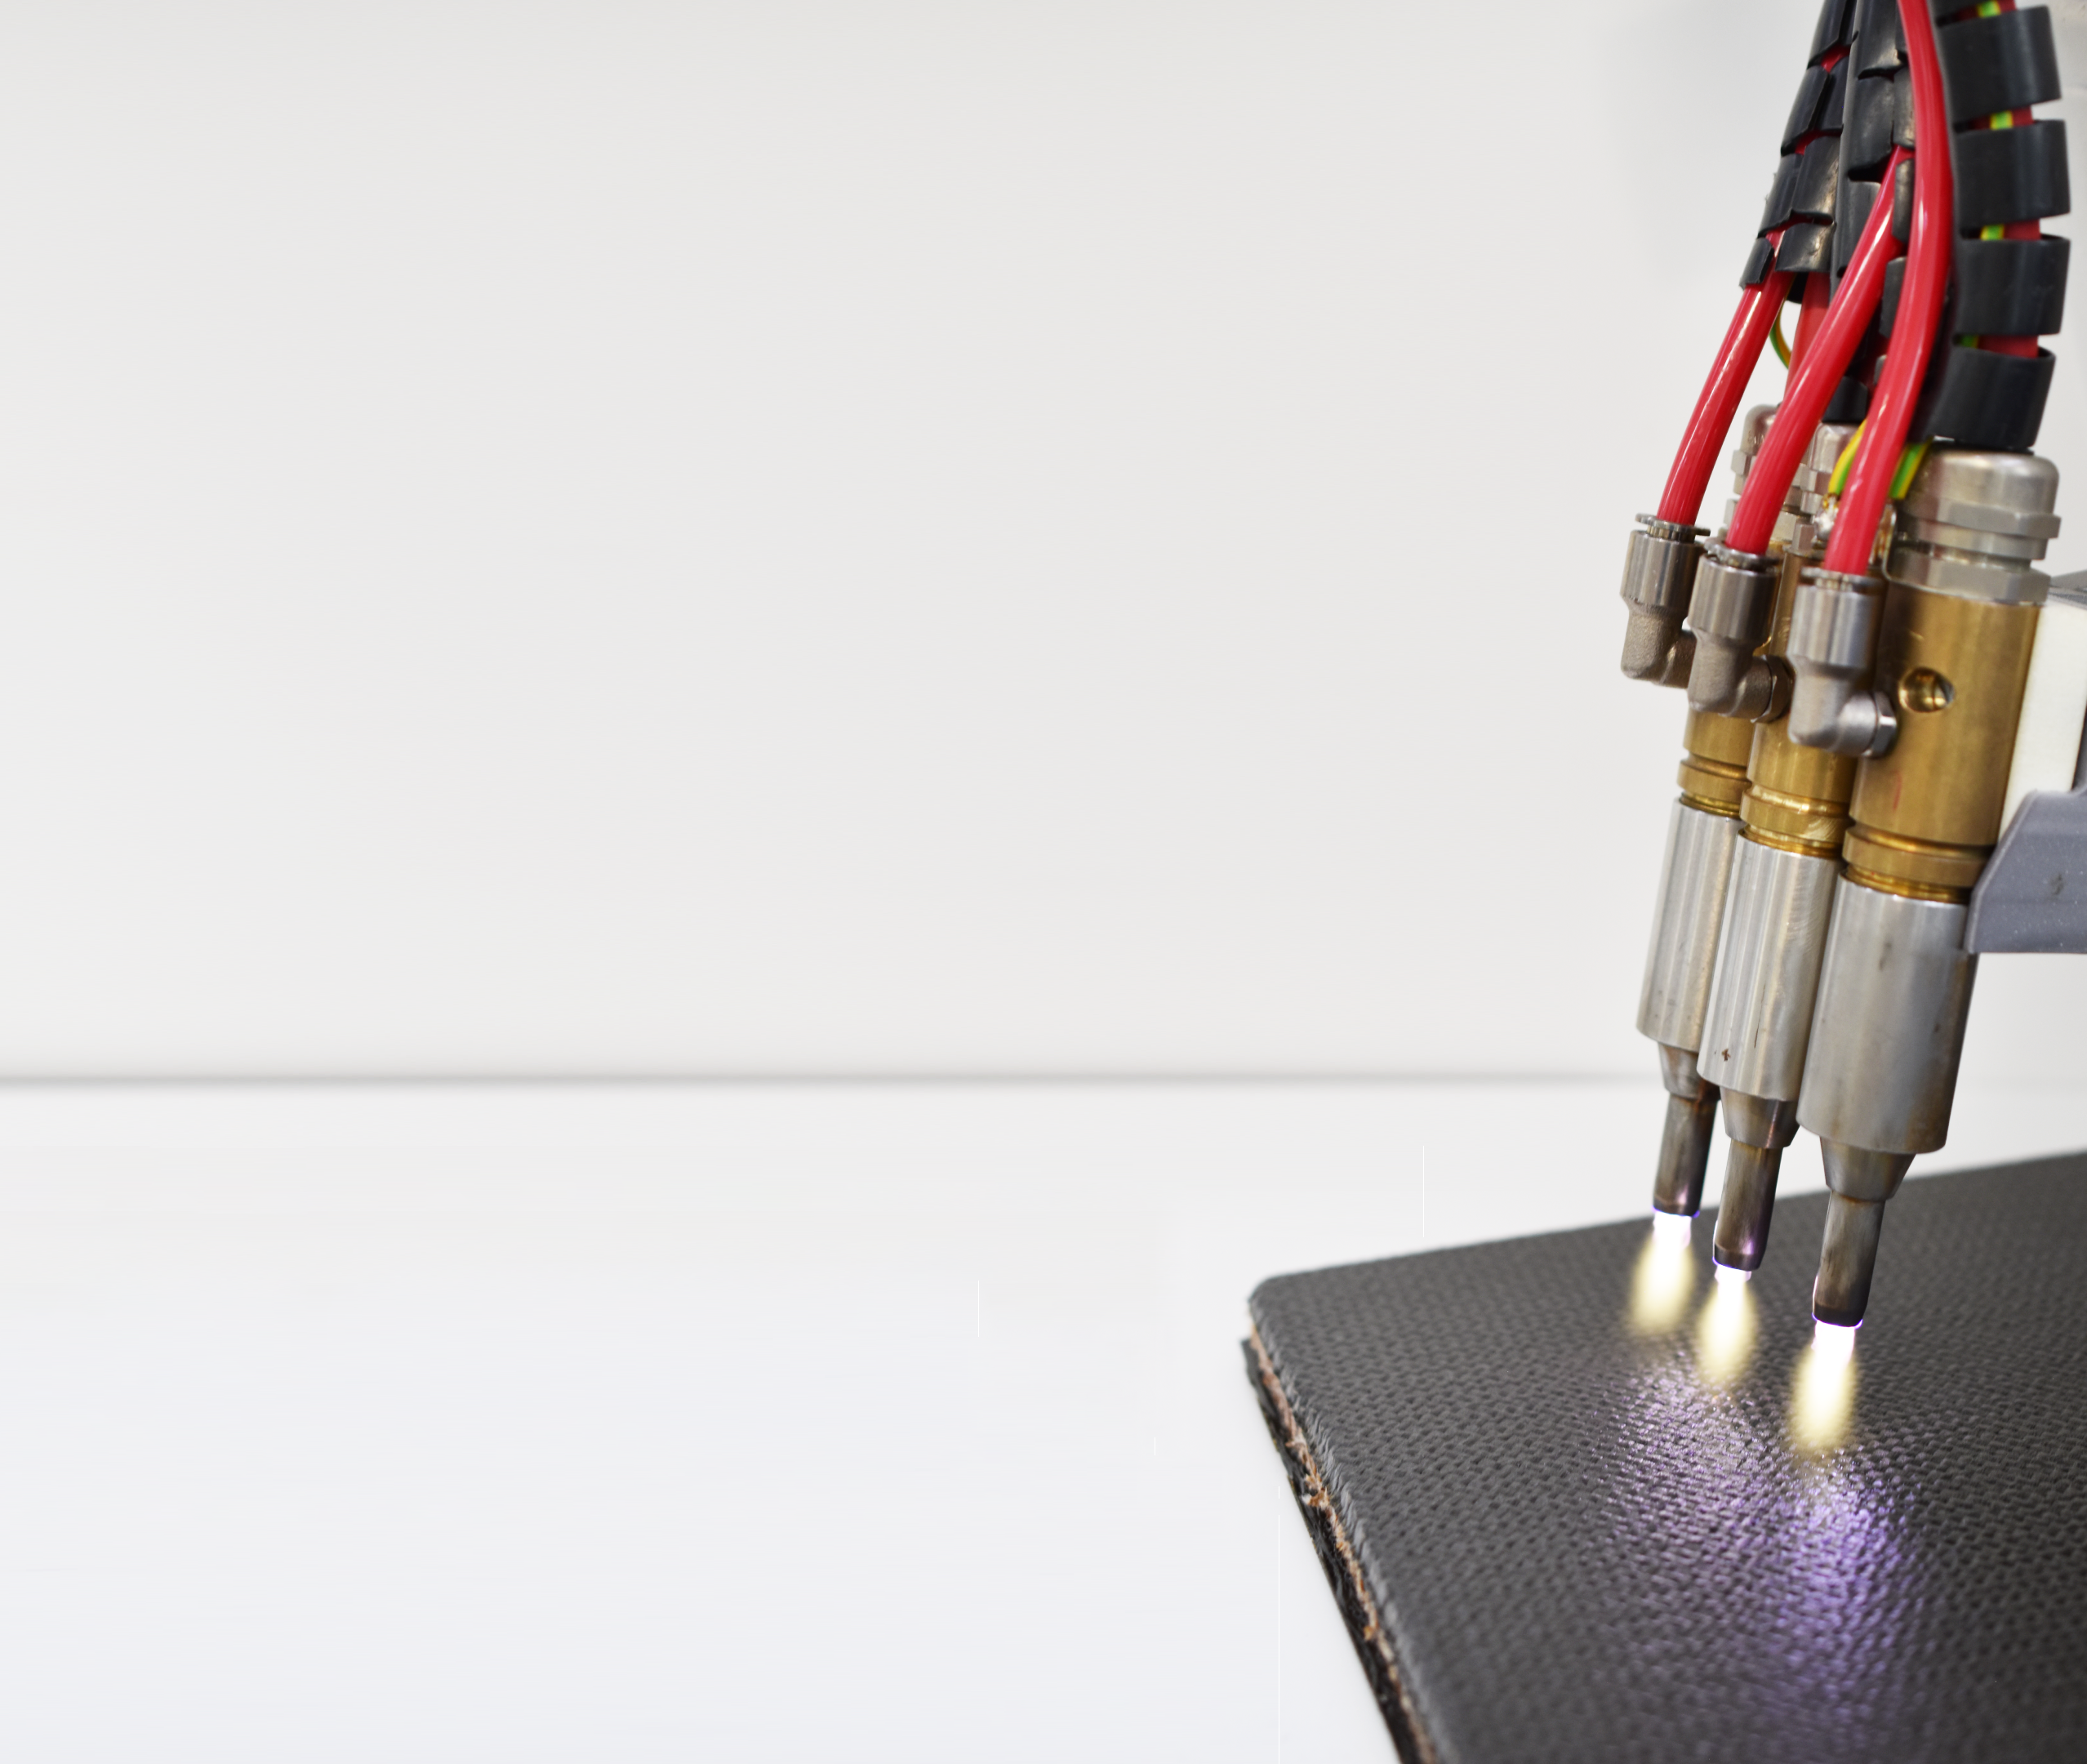
Conclusion
Objectives Achieved
TRL 3: Achieve Proof-of-Concept, address regulatory & obsolescence factors
TRL 4: Elemental Testing & Breadboard Testing
PLASMA BOUND
18

Slide 19
Deliverables
Doc ID | Deliverable Title | Milestone | Description of documents
D1 | Supply Induced Obsolescence Report | WP2000 | Investigate potential future supply chain adjustments.
D2 | Regulation Induced Obsolescence Report | WP2000 | Investigate potential future regulatory adjustments.
D3 | Preliminary/ Technical Requirement Report | WP2000 | Investigate functional performance requirements
D4 | Conceptual design of the Element (Breadboard Design) | WP2000 | Includes in-depth context for CPAs opportunities within space.
D5 | Validation and Verification Plan | WP3000 | Describing the purpose, goal and scope of testing for elevation to TRL 4.
D6 | Breadboard design definition for the functional performance verification | WP3000 | A description of the Monolithic and Sandwich Breadboards Justification for both breadboards against the application chosen.
D7 | Optimisation Process Parameters | WP4000 | Details of internal CPA optimisation activities(BIPR Concerned)
D8.1 | Manufacturing Phase Report | WP4000 | Manufacturing details.
D8.2 | Optimisation Test Report | WP4000 | Testing details. Wide range of CPA treatments (x10).
D8.3 | Experimental Test Report | WP4000 | Testing details. Narrowed range of CPA treatments (x3).
D9 | Breadboard Test Reports | WP4000 | Testing details. Breadboard testing on single CPA treatment type (x1).
D10 | Developmental Plan – CPA to TRL 6 | WP5000 | Details of activities for bringing PlasmaBound’s CPA solution to TRL 6.
PLASMA BOUND

Slide 20


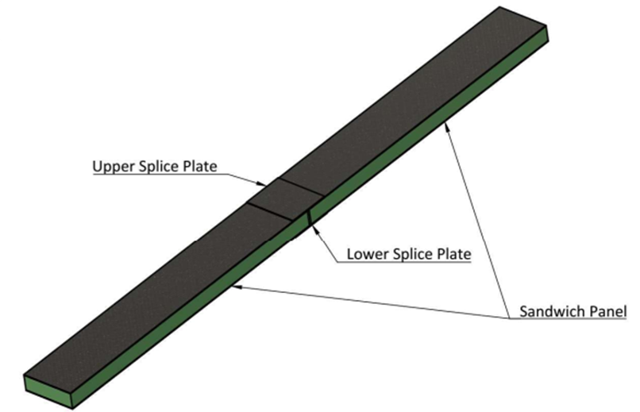
Project Schedule
Verification & Validation Plan
August ‘21
ÉireComposites Manufacturing Begins
January ‘22
CTL Testing Begins
October ‘22
Developmental Plan to TRL 6
January ‘24
Project KO
May ‘21
Supply & Regulation Induced Obsolescence Reports
June ‘21
Breadboard Design
September ‘21
PB Optimisation Lab Work September ‘22
ÉireComposites Manufacturing Ends
May ‘23
Breadboard Testing
January ‘24
Project Acceptance
May ‘24
Sources of Schedule Delay:
Global supply chain issue 2021
Difficulty obtaining project materials
Curing Cycle Issues – ÉireComposites
Concern over curing cycles in 2023 led to investigation of all production
Bonding issues – CTL
NDT detected large voids in SLS paste bond joints, after testing and investigation these were found to be false NDT readings
Manpower – Plasma Bound
Balancing long term projects with short term opportunities
PLASMA BOUND

