Slide 1

cRustacea in Space
Close-Out Meeting 2024-09-05

Slide 2
Project goals
Evaluate Rust for spacecraft onboard software development regarding
Execution on embedded targets
Execution on RTEMS operating system
Developer friendliness
Integration with legacy C-code
ECSS standard conformity
Qualification effort

Slide 3
Project structure
Evaluate Rust for spacecraft onboard software development regarding
Execution on embedded targets
Execution on RTEMS operating system
Developer friendliness
Integration with legacy C-code
ECSS standard conformity
Qualification effort
WP01
WP02
WP03

Slide 4


WP01: RTEMS Prototype Support for Rust
a small orange crab wearing a lab coat working on a prototype machine, laboratory background, cartoon, colorful

Slide 5


WP01: Questions investigated
Is Rust viable for our targets?
Can we create cross-compilers for our hardware targets, i.e. Zynq (and later probably Leon/Noel)?
Can we create cross-compilers for our used operating systems i.e. RTEMS?
And both at the same time?
Which Rust features are then available for us?
  Multithreading?
  std library?
  Unit test execution?
A small orange crab holding a white sign clipart

Slide 6
WP01: Explored options for Rust application on RTEMS
Build Rust toolchain for Zynq (bare metal)
Build #[no_std] application for RTEMS
Port stdlib to RTEMS
Build Rust application for RTEMS
Determine correct target flags
Possible alternative
Check out Rust frontend of GCC
Try to build gcc cross-compiler for RTEMS

Slide 7
WP01: Explored options for Rust application on RTEMS
Build Rust toolchain for Zynq (bare metal)
Build [no_std] application for RTEMS
Port stdlib to RTEMS
Build Rust application for RTEMS
Determine correct target flags
Possible alternative
Check out Rust frontend of GCC
Try to build gcc cross-compiler for RTEMS
Currently the project is in a too early stage to be useful for our work. Still worth to follow future developments.
https://rust-gcc.github.io/2023/01/01/2022-year-report.html

Slide 8
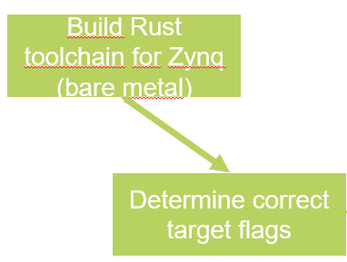
WP01: Finding compatible settings between Rust compiler and RTEMS compiler
Rust compiler already has support for armv7a-none-eabihf target and can be used as a baseline
To link with RTEMS libraries compatible compiler flags needed to be found
  The notation and naming conventions between the RTEMS GCC flags and the Rust target specification differ
  If flags are not compatible linker will reject linking compiled Rust objects with the RTEMS kernel

Slide 9

WP01: Build #[no_std] application for RTEMS
Use the standard rustc compiler for compiling user application
  Use #[no_std], #[no_main]
  Export Rust functions to extern C
Compile init C-code for RTEMS with cross-compiler
  Call exported Rust functions from C
Only very limited Rust features available as they depend on the Rust stdlib
arm-rtems6-gcc
rustc
cross-compiler
cross-linker
llvm
builds
compiles
compiles
RTEMS
Kernel
BSP
User application
RTEMS configuration
C application code
Rust application code

Slide 10

WP01: Porting stdlib to RTEMS
Added new target for RTEMS
  Includes porting the stdlib and libc to RTEMS
  Provides support for many Arm-based RTEMS BSPs
  So far only tested on Xilinx Zynq
Rust builds RTEMS application
  Cargo used for build system
  Compiles RTEMS init C-Code
  Compiles Rust application including the „main“ entry point
  Links Rust objects and RTEMS libraries into final executable
armv7-rtems6-gcc
cargo
cross-compiler
cross-linker
llvm
links
builds
RTEMS executable
RTEMS
Kernel
BSP
User application
RTEMS configuration
Rust std library
C application code
Rust application code

Slide 11
WP01: Questions & Answers
Is Rust viable for our targets?
Can we create cross-compilers for our hardware targets, i.e. Zynq (and later probably Leon/Noel)?
  Yes, we can configure the standard Rust compiler.
Can we create cross-compilers for our used operating systems i.e. RTEMS?
  Yes, it is. Porting of std crates done.
And both at the same time?
  Yes, we can link the standard arm-rtems-gcc toolchain for RTEMS and the Rust compiled code in one binary.
Which Rust features are then available for us?
  Multithreading? Yes, possible.
  std library? Yes, done.
  Unit test execution? Yes, possible.
A small orange crab holding a white sign clipart

Slide 12
WP01: Deliverables
Software packages
  Integrated RTEMS port for Rust integrated in open source project (see previous slide)
  Rust crate for the RTEMS related C-code (preview: https://github.com/thesummer/rtems-sys)
  Test example project using the rtems-sys crate to build an example application for RTEMS
Final report summarizing the results
Final presentation at ADCSS 2024

Slide 13
WP01: Outlook and Future Work
The current port can compile Rust applications for RTEMS including the standard libary. However the port needs stabilizing
  Not all features of the standard library tested
  With inclusion in the official Rust compiler it should be possible to use the Rust unit tests for identifying unsupported features and implementing them.
  This would open the possibility to upgrade the target port to Tier 2
Currently only the RTEMS-Arm targets are supported by the prototype port
  Further ports can for example for SPARC/Leon family or RISC-V targets would be of interest for the space community. The initial port should simplify this as shared code can be reused.
Work toward Rust compiler qualification for space processors
  Ferrocene is a qualified version of the official Rust compiler for certain targets. With RTEMS targets available in the official Rust project, working toward a qualified Rust compiler for space-related processors should be possible

Slide 14

WP02: on-board application example
DLR CC BY-NC-ND 3.0

Slide 15

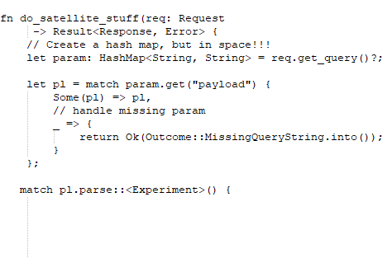

WP02: Questions investigated
Is a move to Rust worth it?
Are the Rust language features really that beneficial?
How does Rust code integrate with our development infrastructure (gitlab, JUnit tests, Doxygen, static analysis)
How does Rust integrate with existing code (C/C++)
How much effort is it to learn Rust as a C/C++ developer?
A small orange crab sitting on a keyboard of a desktop pc clipart

Slide 16
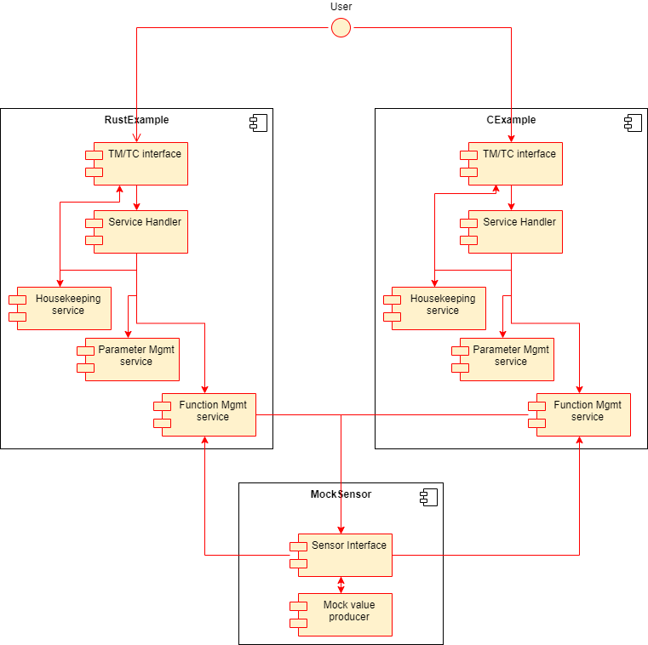
WP02: Technical Content
Comparison RUST vs. C
  Collecting differences in development
  Compare the reliability (e.g. by Valgrind)
Minimal example for common satellite application
  Command & Data Handling → PUS services:
    Service 3 Housekeeping
    Service 8 Function Management
    Service 20 Parameter Management
  Mock Sensor in C

Slide 17

Comparison - Research
We compared the implementation of three ECSS Packet Utilization Services in Rust and C.
Our comparison focused on the following key points:
Memory safeness and consumption
    Memcheck
    Heap consumption
Developer friendliness
  Readability
    Syntax and Expressiveness
    Ownership and Borrowing
    Lifetimes
    Error Handling
  Writability
    Learning Curve
    Tooling and Ecosystem
    Debugging and Testing
    Code Safety
RUST vs. C clipart

Slide 18
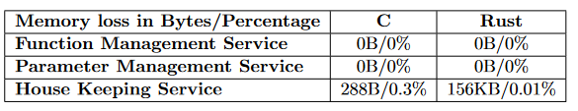
Memory Safeness
Memory Safeness: Memcheck Results
  Both C and Rust implementations showed low memory loss rates across three services.
  Minimal memory loss detected, indicating high memory safeness.
Conclusion:
  Both C and Rust demonstrate good memory safety for the small example.
  Rust provides more granular control and varied memory usage, while C maintains consistent allocation patterns.

Slide 19
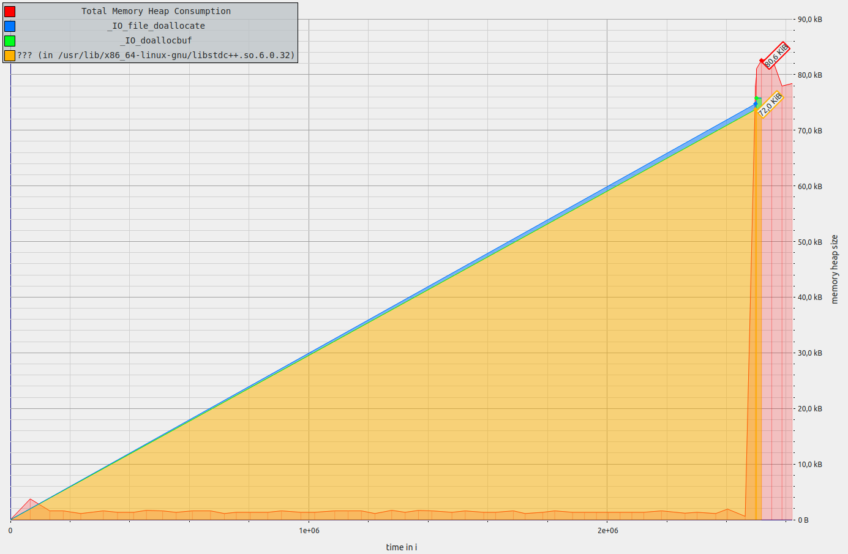
Heap Consumption Analysis – Massif Results
C – Implementation
  Consistent heap consumption (~80 KiB) across services
  peak allocation at service execution end.
Massif results from the C Housekeeping service

Slide 20
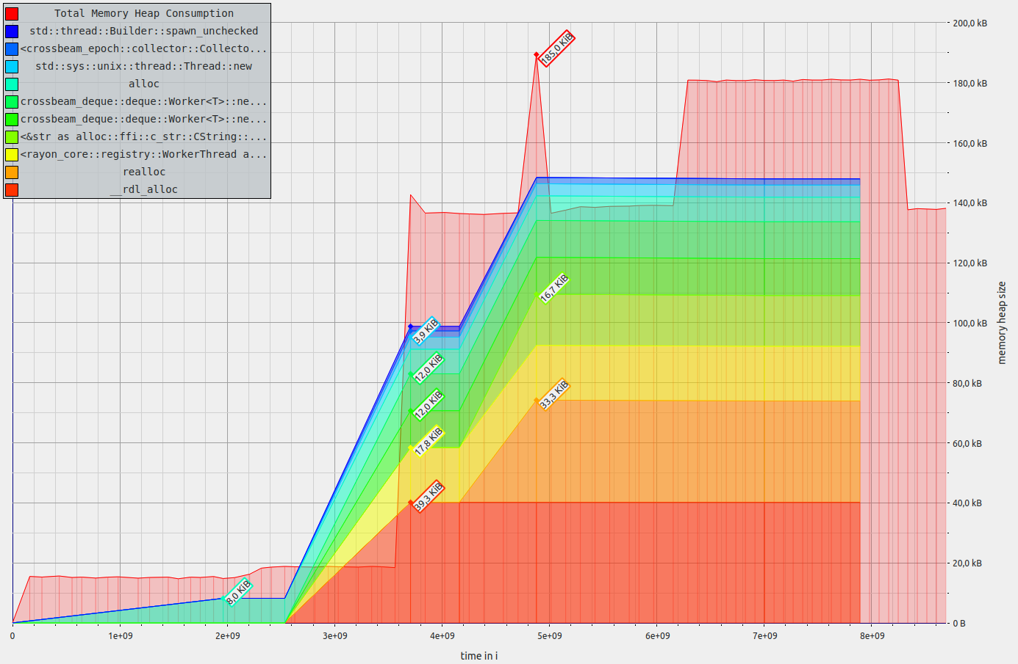
Heap Consumption Analysis – Massif Results
Rust Implementation
  Varies significantly
  Function & Parameter Management: ~30-40 KiB (lower than C).
  House Keeping Service: Up to 185 KiB with diverse contributors to heap allocation.
  → Rust shows more dynamic heap usage with varying consumption patterns.
Massif results from the Rust Housekeeping service

Slide 21

Developer Friendliness / Readabiltiy
Syntax and Expressiveness:
  C: Traditional syntax with explicit control structures like if statements and for loops.
  Rust: Modern syntax with pattern matching (match) and iterators for concise, readable, and maintainable code.
Ownership and Borrowing:
  C: Manual memory management, prone to dangling pointers and undefined behavior.
  Rust: Ownership and borrowing rules ensure safe memory management, preventing data races and enhancing reliability but can be complex at first.
Lifetimes:
  C: No explicit lifetime management, risking unsafe memory access in concurrency.
  Rust: Explicit lifetime annotations ensure memory safety, especially for concurrent programming, adding complexity but guaranteeing data validity.
Error Handling:
  C: Relies on return codes and structs, leading to unstructured error handling.
  Rust: Uses the Result type for structured error handling, making code more predictable and interfaces clearer.
A small orange crab reading a book clipart

Slide 22

Developer Friendliness / Writability
Learning Curve:
  C: Easier for basics but requires deep understanding for concurrency and memory management.
  Rust: Steeper learning curve due to ownership rules, but compiler aids learning. Takes more time initially.
Tooling & Ecosystem:
  C: Mature ecosystem; manual integration for libraries and tools.
  Rust: Modern tooling (cargo) for simplified package management and rapid ecosystem growth.
Debugging:
  C: Uses GDB; requires deep memory and hardware knowledge due to manual memory management.
  Rust: Also uses GDB but benefits from compile-time checks and safer memory management, reducing runtime errors.
A small orange crab writing a book clipart

Slide 23
Developer Friendliness / Writability(2)
Testing:
  C: Lacks built-in testing; requires external frameworks.
  Rust: Built-in testing framework integrated with cargo, simplifying testing processes.
Code Safety:
  C: Programmer-managed safety; prone to undefined behavior and vulnerabilities.
  Rust: Enforces compile-time safety, preventing many common issues for more secure code.
A small orange crab writing a book clipart

Slide 24
WP02: Conclusion & Future work
C remains a powerful and efficient language for systems programming
  Will stay → Legacy
Rust’s emphasis on safety and modern programming practices positions it as a strong contender for future development in performance and safety critical applications
  New Applications might utilize it
Future work:
  Including more services in the Rust implementation
    → Complete implementation of PUS standards in Rust

Slide 25

WP03: PA Aspects of critical software implemented in rust

Slide 26

WP03: Questions investigated
How difficult is it to qualify Rust Code?
How easy is it to extract code metrics from Rust?
Are all metrics from C needed?
Is it possible to qualify Rust code according to ECSS standards?
Does using Rust simplify the qualification process?
ECSS
A small orange crab wearing glasses sits on a big book cartoon

Slide 27
WP03: Activities and deliverables – M01
29 and 14 requirements from the ECSS-Q-ST-80C and ECSS-EST-40C were respectively selected as key parts of the software technology aspect
Deliverable:
  High-level analysis report of each of these requirements in regards to the Rust language and its features

Slide 28
WP03: Activities and deliverables – M02
Unit testing, static analysis and coverage tools were analyzed and surveyed
  Deliverable: Report containing highlights of the tools and initial study on them
Tasks | Surveyed tools
Build | cargo
Static analysis | rustc rust-clippy
Unit tests | cargo-test cargo-nextest
Code coverage | llvm-cov (instrumentation-based) clang (source-based) cargo-tarpaulin* grcov* kcov*

Slide 29
WP03: Activities and deliverables – M03
Evaluation of unit testing tools, static analysis and code coverage tools:
  cargo test and nextest
  rustc and rust-clippy
  LLVM instrumentation-based and tarpaulin
  Deliverables:
    DEMO
    Final activity report with evaluation of these tools within Rust application from WP02 and discussion about impact on ECSS-Q-ST-80C

Slide 30
WP03: Questions & Answers
How difficult is it to qualify Rust Code?
How easy is it to extract code metrics from Rust?
  Rust’s strong focus on compilation allows to:
    Use rustc as static code analysis tool
    Get instrumentation-based code coverage
  The Rust’s package manager, cargo, contains different libraries to obtain such metrics (e.g. cargo test, nextest, tarpaulin, rust-clippy)
ECSS
A small orange crab wearing glasses sits on a big book cartoon

Slide 31
WP03: Questions & Answers
How difficult is it to qualify?
Are all metrics from C needed?
  In the context of the evaluation of unit testing, code coverage and static analysis metrics:
    Unit testing and code coverage is always required
    Further evaluation on static analysis is required:
      The Rust compiler and rust-clippy offer a number of lints. This can be in the future compared against the metrics provided by static analysis tools dedicated to C applications
ECSS
A small orange crab wearing glasses sits on a big book cartoon

Slide 32
WP03: Questions & Answers
How difficult is it to qualify?
Is it possible to qualify Rust code according to ECSS standards?
  29 requirements from ECSS-Q-ST-80C and 14 requirements from ECSS-E-ST-40C are potentially impacted by Rust features
  1 requirement and 13 requirements on ECSS-Q-ST-80C show direct and partial impact respectively from the use of unit testing, code coverage or static analysis metrics tools (see next slide)
ECSS
A small orange crab wearing glasses sits on a big book cartoon

Slide 33
WP03: Qustions & Answers
How difficult is it to qualify?
Is it possible to qualify Rust code according to ECSS standards?
ECSS-Q-ST-80C Requirement | Impact from tools usage | Future actions for complete evaluation
5.2.1.1 | Indirect | N/A
5.2.1.3 | Indirect | N/A
5.2.1.4 | Partial | Evaluation on Rust compiler and static analysis metrics
5.2.5.1 | Partial | Evaluation on Rust compiler and static analysis metrics
5.3.1 | Partial | Evaluation on technology maturity aspects from the tools usage
5.3.2.1 | Partial | Evaluation on technology maturity aspects from the tools usage
5.3.2.2 | Partial | Evaluation on Rust compiler and static analysis metrics
5.6.1.2 | Partial | Further analysis on other code coverage tools and unit testing tools’ performance
5.6.2.1 | Partial | Further analysis on performance
6.2.2.2 | Partial | Evaluation on Rust compiler and static analysis metrics
6.2.2.3 | Partial | Evaluation on Rust compiler and static analysis metrics
6.2.3.2 | Partial | Further analysis on other code coverage tools and unit testing tools’ performance.
6.2.3.4 | Indirect | N/A
6.2.5.1 | Indirect | N/A
6.2.6.1 | Indirect | N/A

Slide 34
WP03: Questions & Answers
How difficult is it to qualify?
Is it possible to qualify Rust code according to ECSS standards?
ECSS-Q-ST-80C Requirement | Impact from tools usage | Future actions for complete evaluation
6.2.6.2 | Indirect | N/A
6.2.7.2 | Indirect | N/A
6.2.7.3 | Partial | Evaluation on Rust compiler and static analysis metrics
6.2.7.4 | Indirect | N/A
6.2.7.7 | Indirect | N/A
6.3.4.1 | Indirect | N/A
6.3.4.2 | Indirect | N/A
6.3.4.4 | Indirect | N/A
6.3.4.5 | Partial | Evaluation on Rust compiler and static analysis metrics
6.3.5.32 | Indirect | N/A
6.3.7.2 | Indirect | N/A
7.1.4 | Direct | Evaluation on Rust compiler and static analysis metrics. Further analysis on other code coverage tools and unit testing tools’ performance
7.1.5 | Partial | Further analysis on other code coverage tools
7.2.2.1 | Indirect | N/A

Slide 35
WP03: Questions & Answers
How difficult is it to qualify?
Does using Rust simplify the qualification process?
  Memory safety and Rust‘s focus on concurrency are features that may positively impact on some activites.
  cargo-test provides robust support, availability and documentation for different platforms, and ensures maintainability
  rust-clippy offers more metrics to measure code quality
  tarpaulin‘s scope is currently limited to line coverage and LLVM instrumentation-based coverage provides branch coverage at an unstable level (impact on req. 6.2.3.2)
ECSS
A small orange crab wearing glasses sits on a big book cartoon

Slide 36
WP03: Future work
Further evaluation of Rust compiler
Further evaluation on static analysis metrics provided by the Rust compiler and rust-clippy
More thorough examination of other available tools for code coverage metrics (including branch coverage)
Performance evaluation of tools

