Slide 1
Digitalization of the Thermal Engineering Process
Final Presentation
Public

Slide 2
Content

Slide 3
Content
Introduction
Project Objectives & Scope
Partners
Analysis & Requirements
Conceptual Data Model
Logical Data Model
Physical Data Model
Application Use Cases
Results, Challenges and Way Ahead
AOB

Slide 4
Introduction

Slide 5
Project Objectives and Scope
Identify the driving space thermal engineering processes that will benefit from digitalisation with the aim to build a data model of the thermal subsystem.
Prototype a data model of a space thermal subsystem from the identified processes using a three-tiered hierarchy of conceptual, logical, and physical data models.
Demonstrate the use of the data model in two distinct application cases to enable the digitalisation of specific processes.

Slide 6



Partners
Modeling and Software Engineering
Thermal Domain Experts
Thermal Domain and SysML Experts

Slide 7
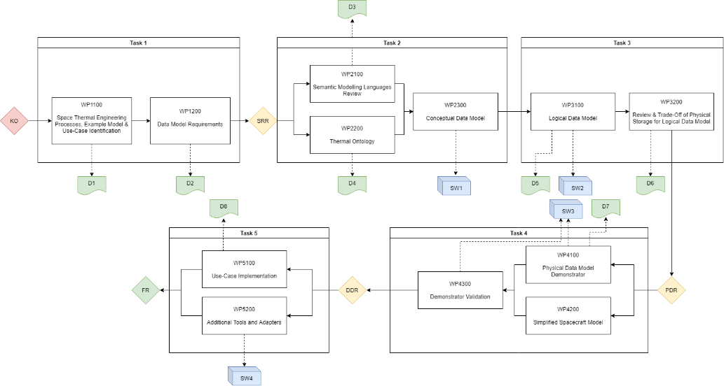
Work Logic

Slide 8
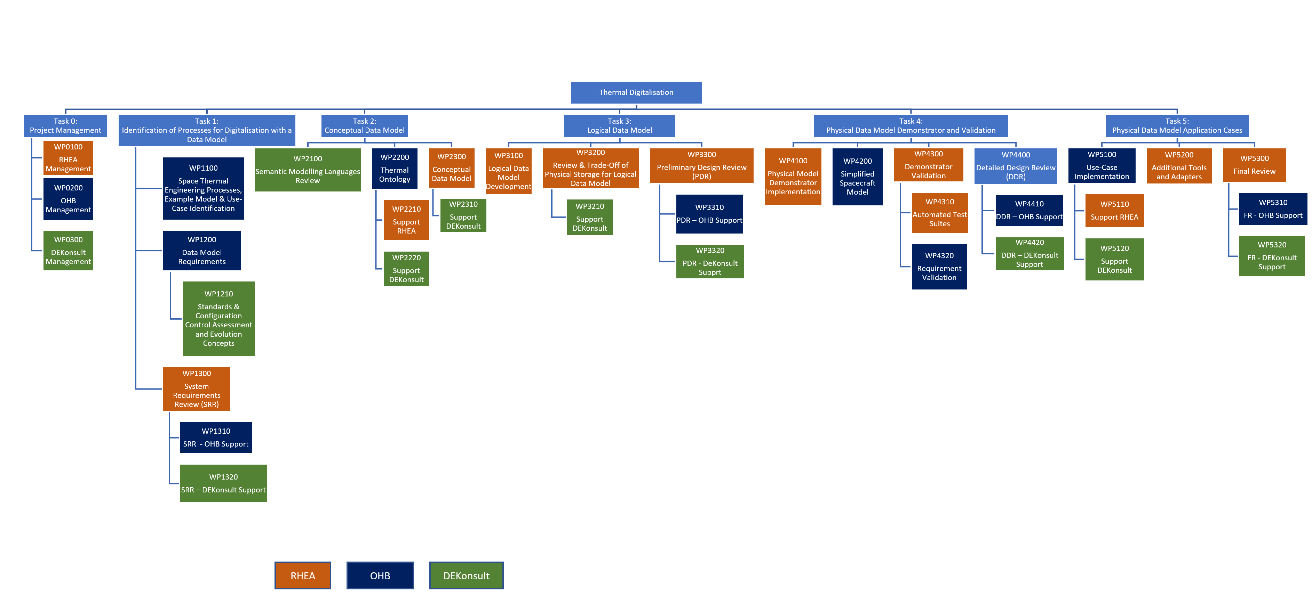
WPD

Slide 9
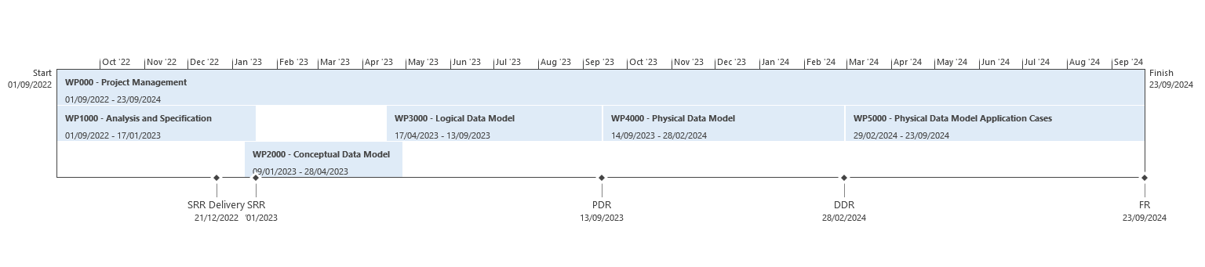
Schedule

Slide 10
Deliverables

Slide 11
Deliverables

Slide 12
Analysis and Requirements

Slide 13
Identification of the Thermal Processes for Digitalization
Identification, analysis and documentation of processes
Review and analysis of current thermal engineering processes and workflows at different project phase performed
Processes collected in a timeline mind map per project phase
Identification of tasks from this processes to identify where efficiency and accuracy can be improved by digitalization
Task most suitable for the digitalization are highlighted in the mind map.
These tasks are described in terms of workflow, actors and information exchanged to identify interfaces and dependencies between different user types

Slide 14
Identification of the Thermal Processes for Digitalization
Identification, analysis and documentation of processes
These tasks are described in terms of workflow, actors and information exchanged to identify interfaces and dependencies between different user types
2 Use Cases were presented and proposed for implementation in frame of DOTEP
  Use Case 1: Heater sizing and data exchange:
      focus on thermal ICD / data exchange that is performed at different project stages
  Use Case 2: Thermal Test Data Mapping
Implementation spacecraft system is chosen to be based on Hera

Slide 15
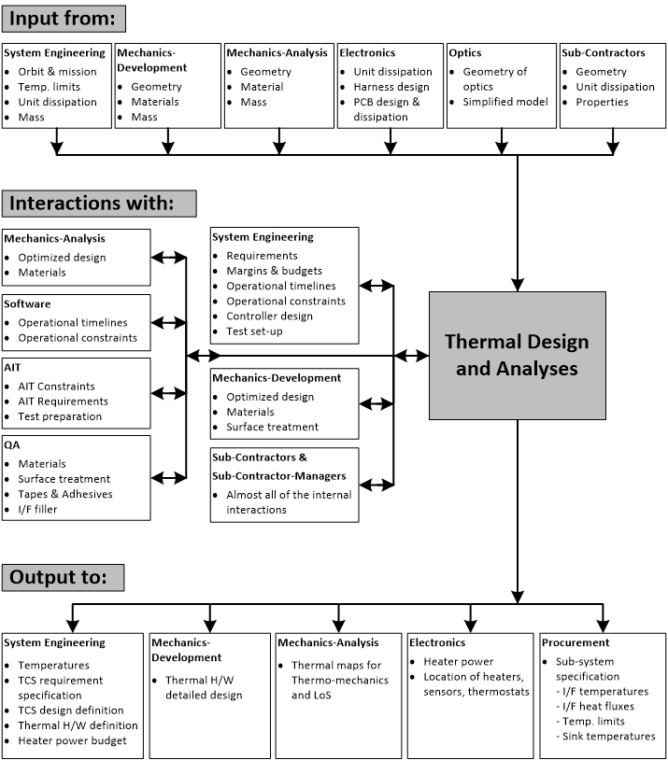
TCS interactions with other subsystems / disciplines

Slide 16
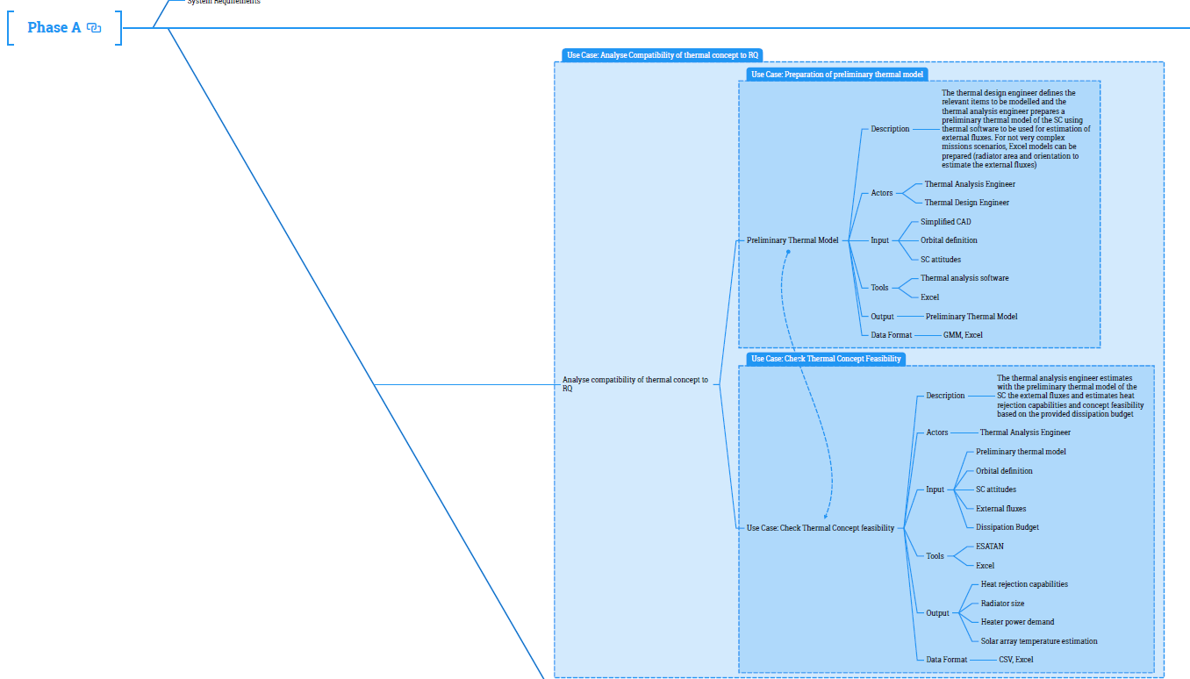
Process Mind Map (extract)

Slide 17
Requirements for a Space Thermal Data Model and Critical Assessments
Created a summary and critical assessment for E-ST-31-04 (STEP-TAS)
Extracted and sanitized flattened list of identified inputs/outputs from process analysis
Used both for STEP-TAS gap analysis
  Differentiates between concept coverage in STEP-TAS, and,
  actual implementation in at least one STEP-TAS reader or writer
Performed assessment of data modelling requirements from E-TM-10-23A
Consolidated a set of Data Modelling Requirements for DOTEP
Provided details on how to create flattened Excel workbook from D1 mindmap

Slide 18
Modelling Language Selection And Approach
Project requirement is to integrate with ESA Space System Ontology (SSO)
  Conceptual Data Model (CDM) in ORM, with NORMA Pro tool (but other possibilities were also explored)
Use a ‘middle-out’ approach to information modelling, i.e. a combination of:
top-down reuse of existing SSO UoDs (e.g. MBSE UoD), and,
bottom-up detailed modelling of required thermal engineering detail
SysML v2 selected as modelling language for Logical Data Model (LDM)
  Ran proof-of-concept to verify capability to capture semantic model in single language
  Can model process/behaviour and information / data structures
  Semantic rigour and precision equivalent to ORM (both founded on first order logic)
  Provides standardized API, suitable for code generation
  Can create example populations in compact textual notation that is easy-to-read by domain experts and software engineers → important for early validation

Slide 19
Physical Data Model Persistence Selection
6 Database types examined:
Relational – typical SQL, tables and rows
  Data is atomic but through operations can be combined quite easily
  Strict data definition and enforcement of relationships means that it is accurate, and data integrity can be insured.
NoSQL – document, wide-column and graph databases
  Highly scalable.
  Easier management and handling of larger data sets.
  Easier evolution of information meta data as it does not inherently rely on a rigidly structured meta-model/schema.
NewSQL – combining the scalability of NoSQL and atomicity of relational databases
Object-oriented Databases - object-oriented approach to storing data
  Good for large and complex data.
Time Series Databases - optimized for storing and serving time series through associated pairs of time(s) and value
Hierarchical Databases - parent-child model to store data, presenting a tree-like structure
  Good for high performance and high availability.

Slide 20
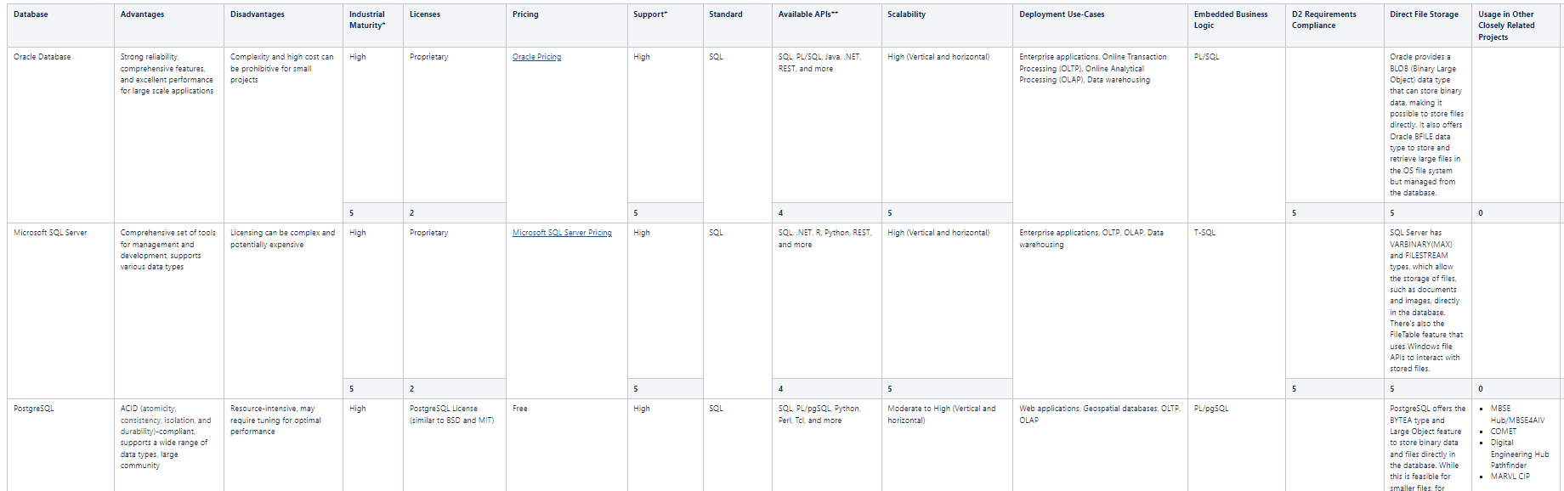
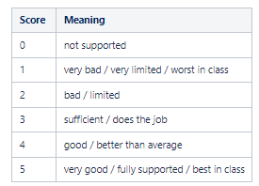
Physical Data Model Persistence
For each:
Advantages
Disadvantages
Industrial Maturity - rated
Licenses - rated
Pricing (where available)
Support level - rated
Which standard used
Available APIs - rated
Scalability - rated
Use cases
Embedded business logic
Compliance to requirements - rated
File storage - rated
Usage in closely related projects - rated

Slide 21
Physical Data Model Persistence
Database | Totals
Oracle Database | 31
Microsoft SQL Server | 31
PostgreSQL | 38
MySQL | 31
IBM DB2 | 31
SQLite | 31
MongoDB | 30
Apache Cassandra | 30
Redis | 28
Amazon DynamoDB | 26
Google Cloud Datastore | 24
CouchDB | 27
Neo4j | 26
Amazon Neptune | 25
Dgraph | 32
Google Spanner | 24
CockroachDB | 26
VoltDB | 27
db4o (database for objects) | 19
Objectivity/DB | 24
Versant Object Database | 24
PostgreSQL and Dgraph selected based on the tradeoff – same technology stack as MBSE Hub

Slide 22
Physical Data Model – Class Library and Tools
5 Languages Considered:
Python
Java
C#
JavaScript and Typescript
Go
Propose to use C# and .NET for PDM and demonstration developments based on familiarity and lack of drawbacks. Later in the project Python was also adapted.

Slide 23
Conceptual Data Model

Slide 24
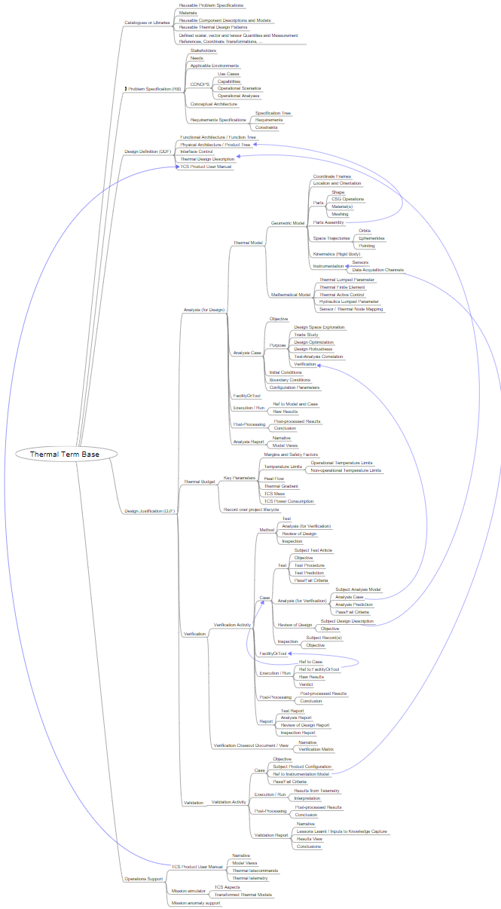
Conceptual Data Model – Inputs
Thermal Term Base Mind map
D1 - Identification of the Thermal Processes for Digitalisation
D2 - Requirements for a Space Thermal Data Model and Critical Assessments
D4 - Conceptual Data Model Description and Term Base
Inputs for the ORM Model:
MBSE SSO ORM Model (version 3)
MBSE Hub Project Model (contains OPS & RAMS UoDs)
MBSE4AIV Model
Previous existing models developed under ESA contracts which are not yet officially integrated into SSO/OSMoSE (Semicoma, E-RMS, ECSS-E-ST-70)

Slide 25
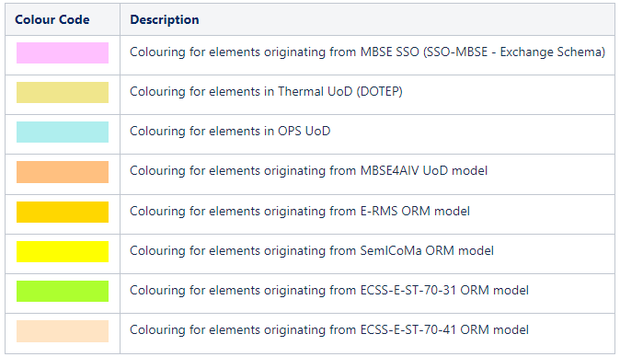
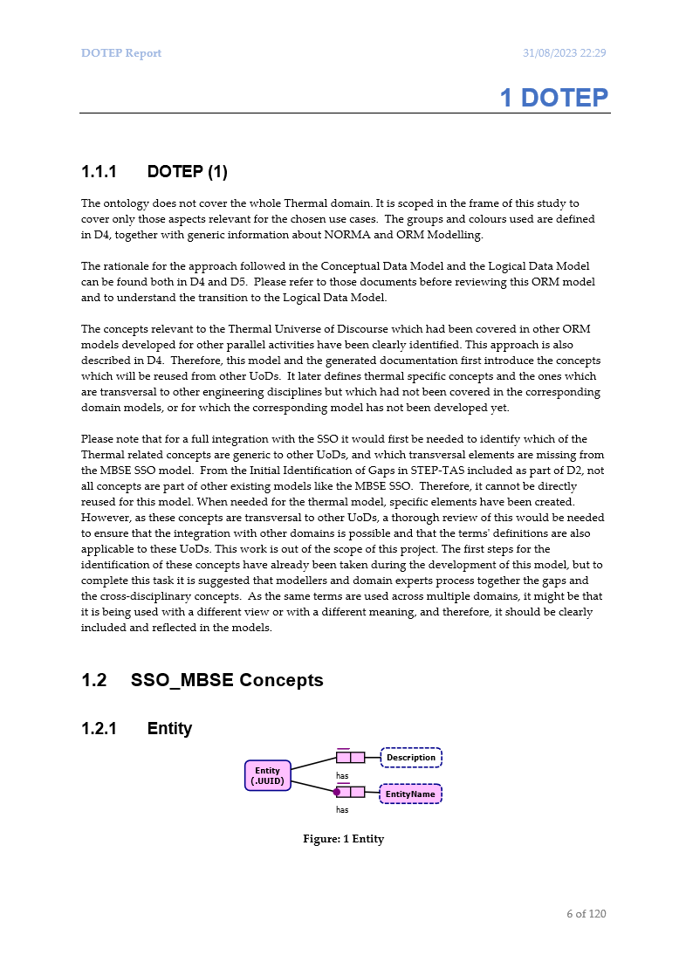
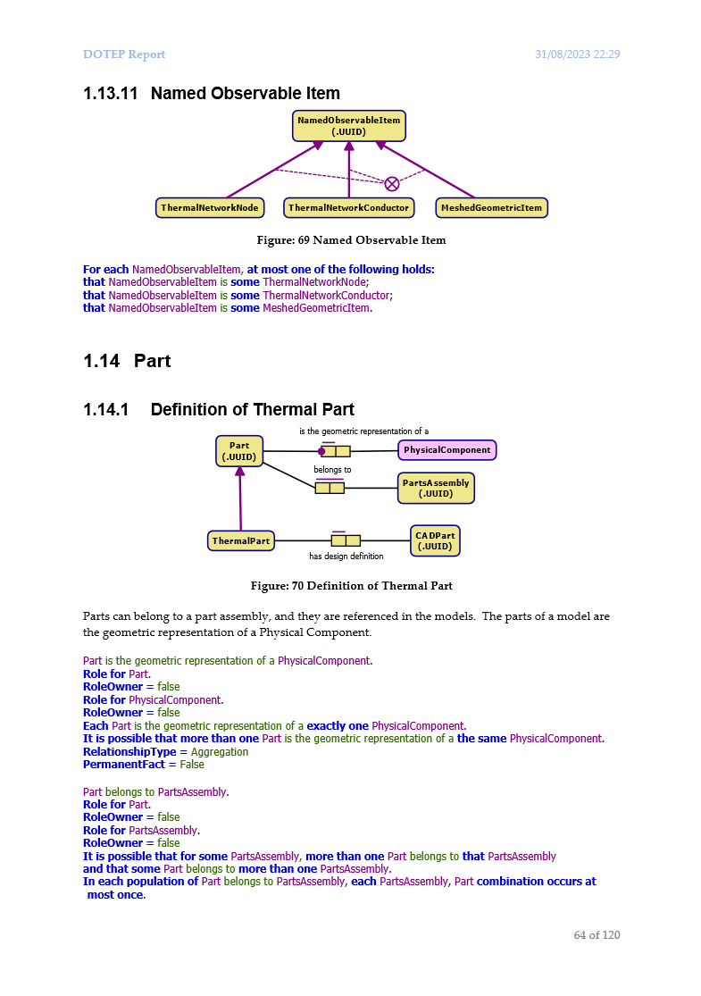
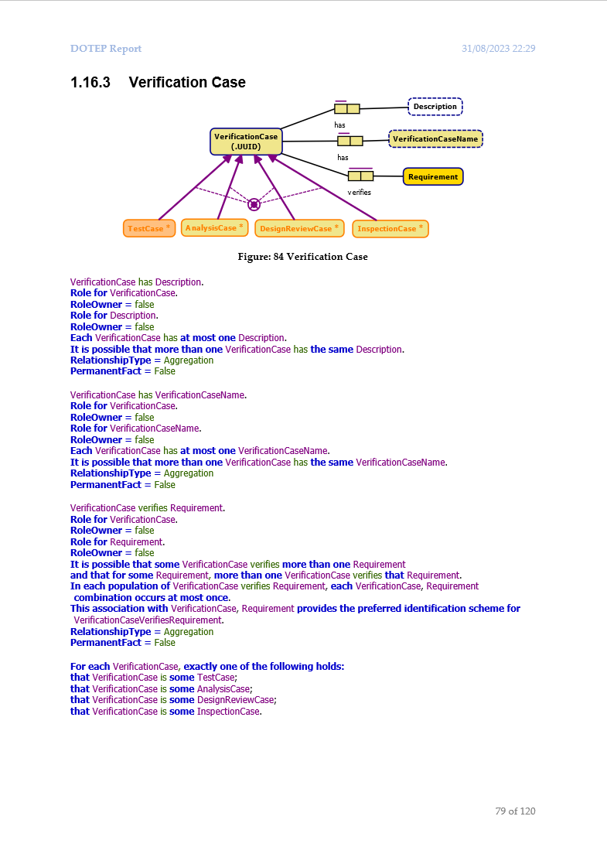
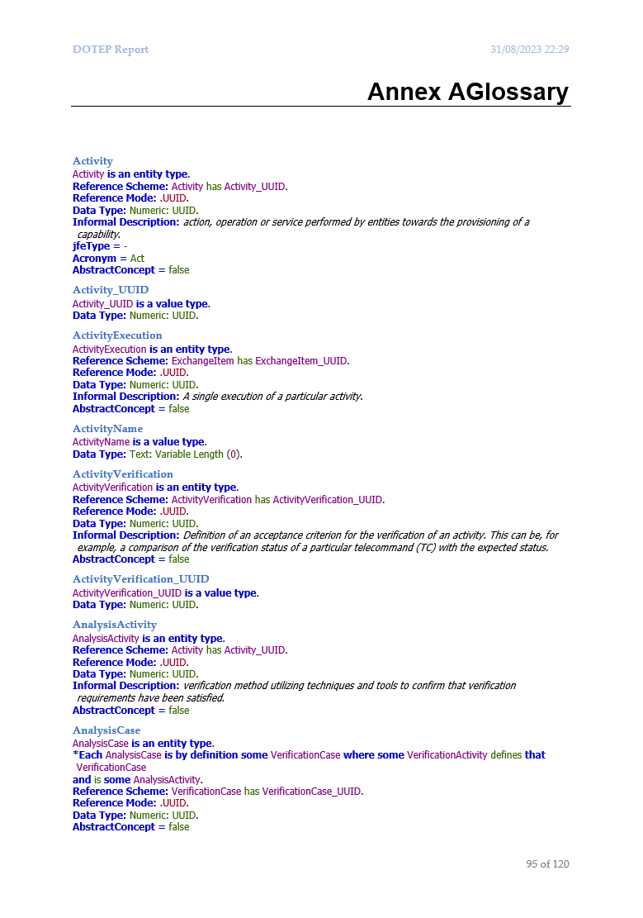
Conceptual Data Model – Documentation
Concepts & Conventions
Groups and Colours
Add Cover Page,
Use Cases Description,
and Complete Definitions
Autogenerated Word Report
    Diagrams & Verbalization
    Glossary (with Descriptions and Notes)
    Context and diagram explanation (Notes - Word Report Diagram Descriptions Group)

Slide 26
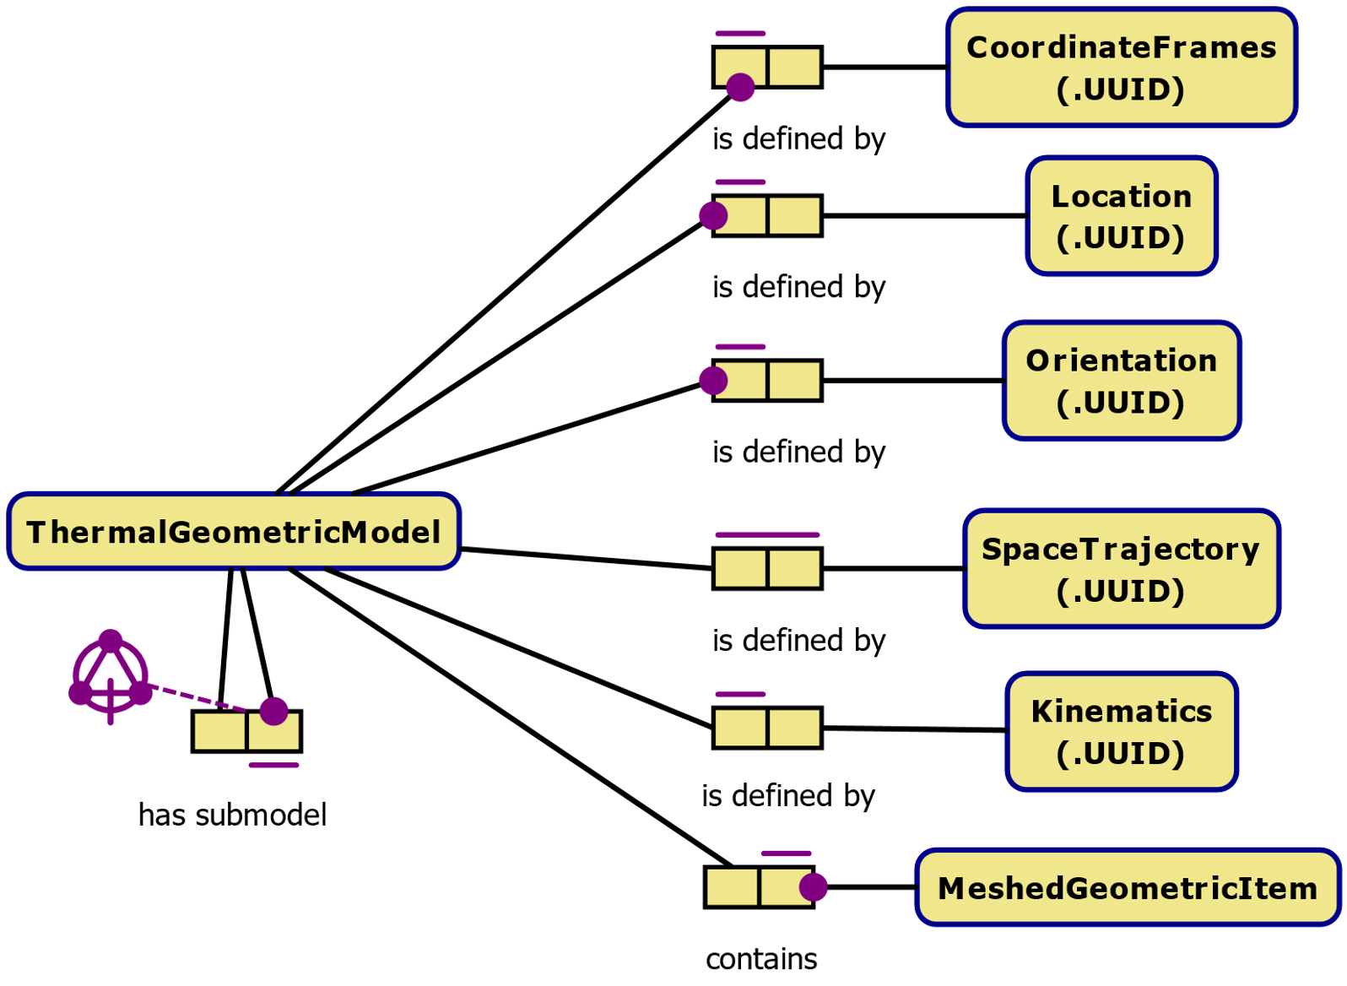
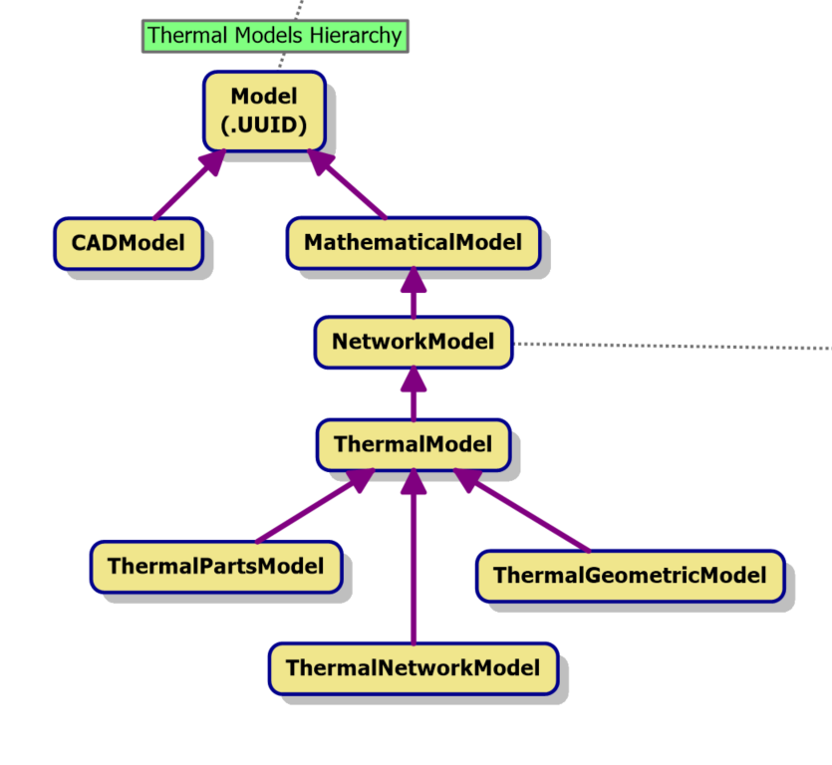
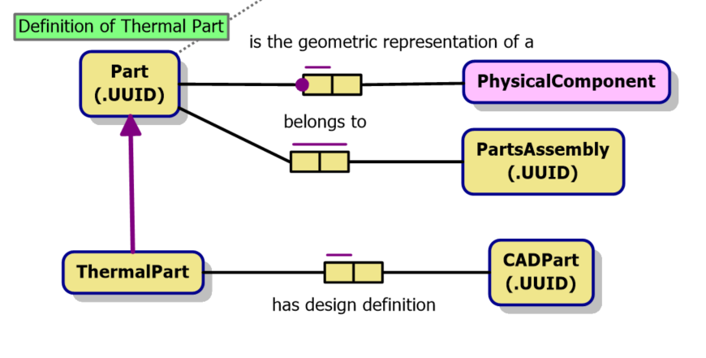
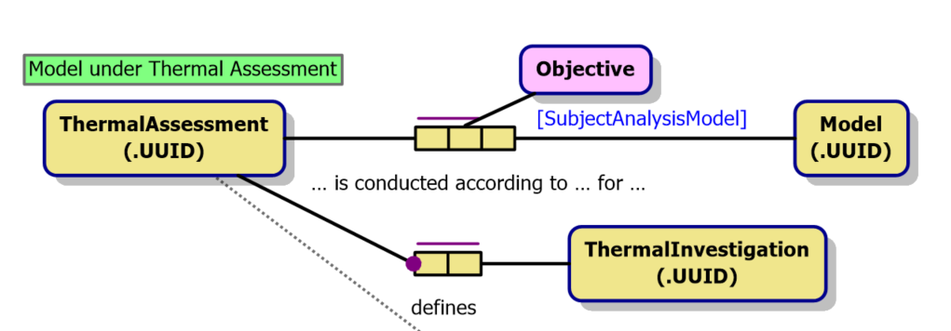
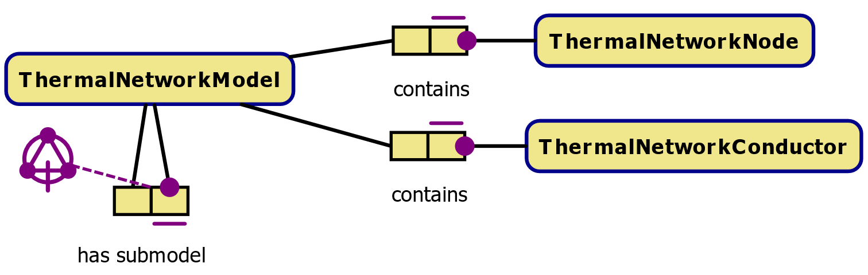
Conceptual Data Model – Main Contents

Slide 27
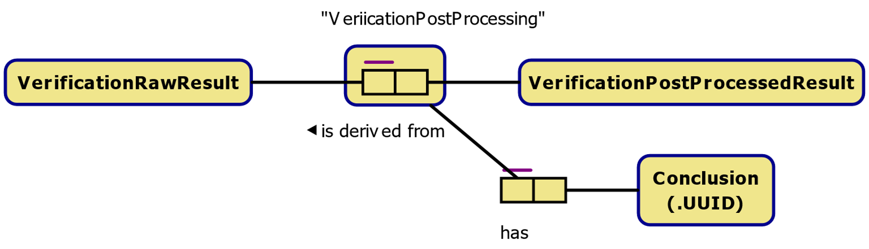
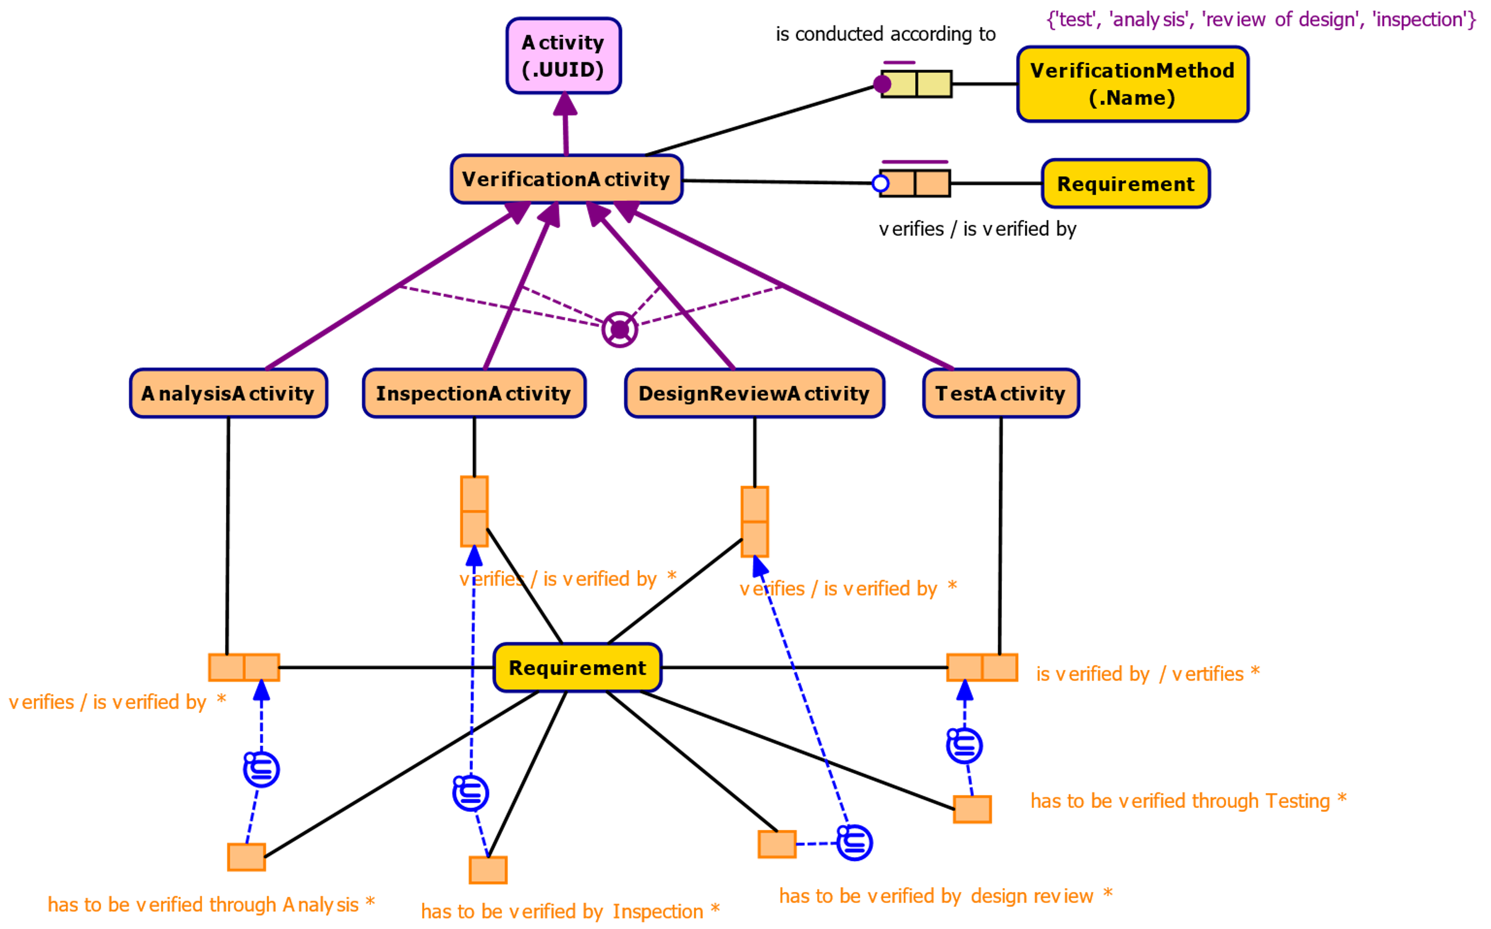
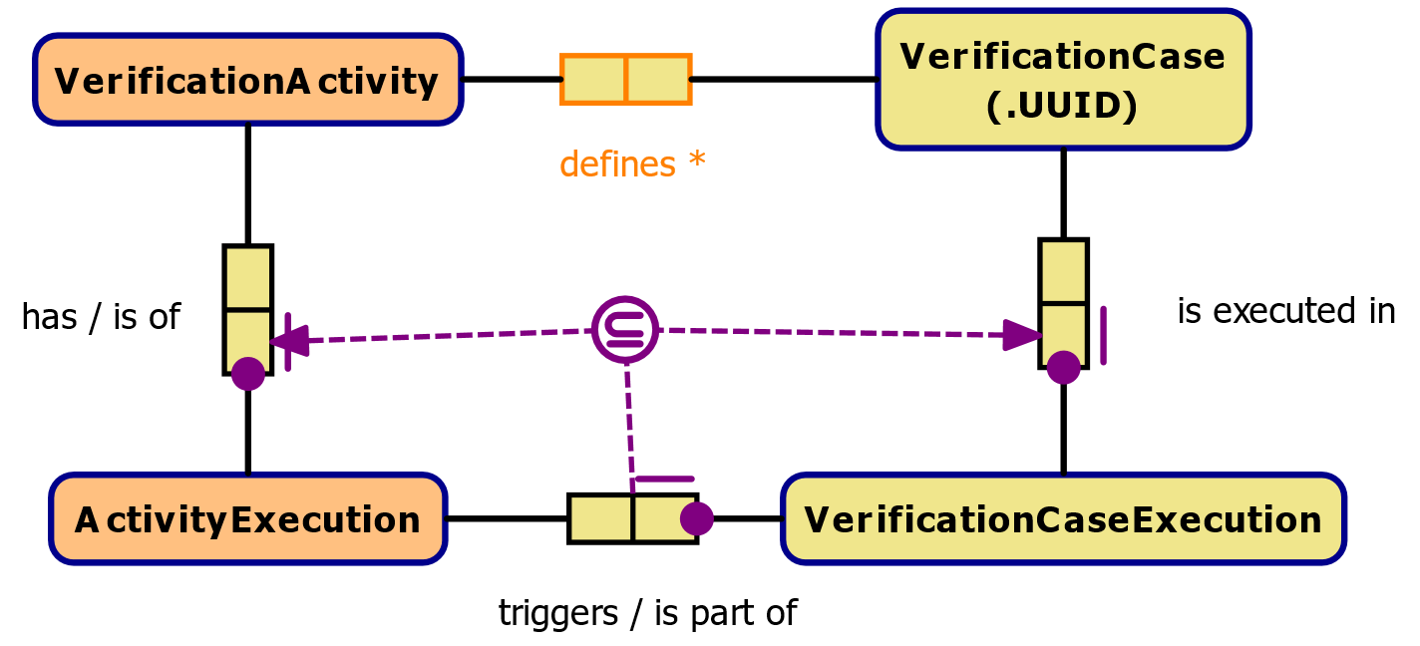
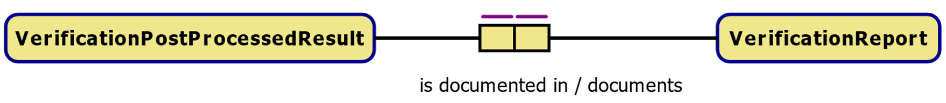
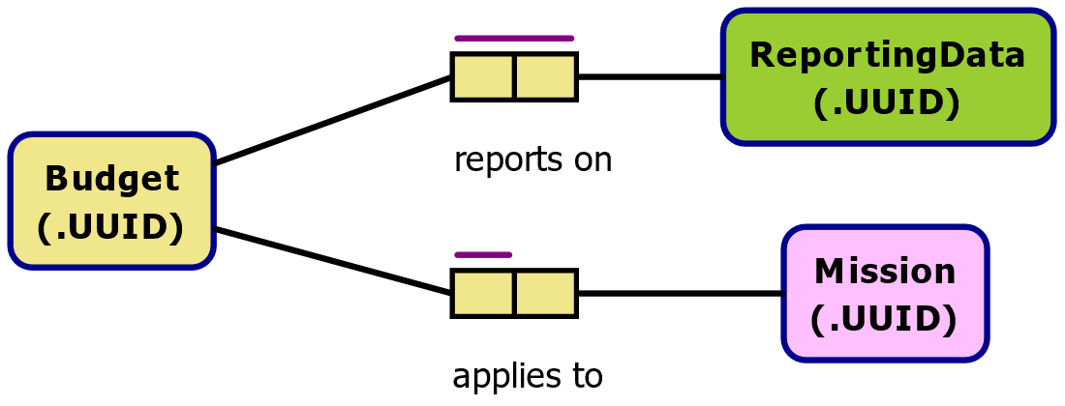
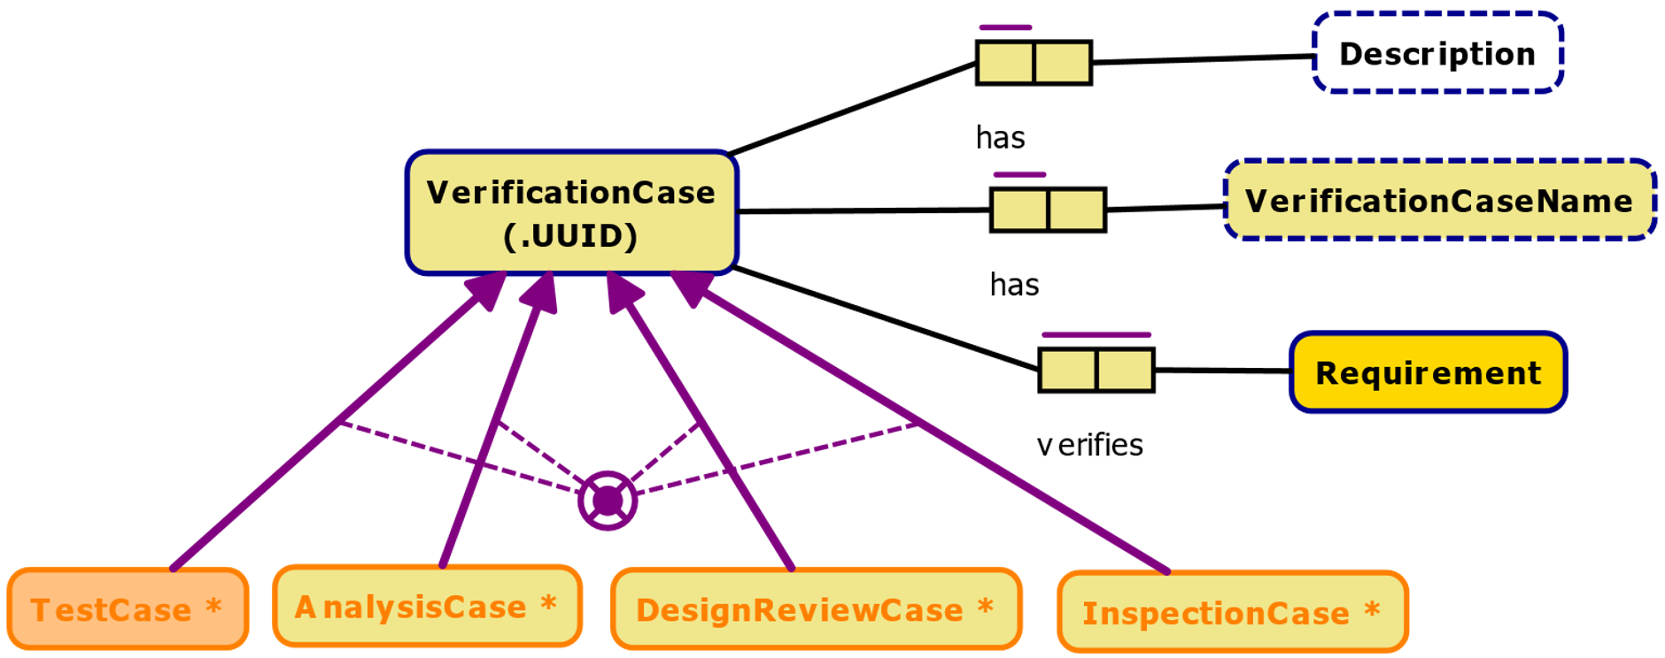
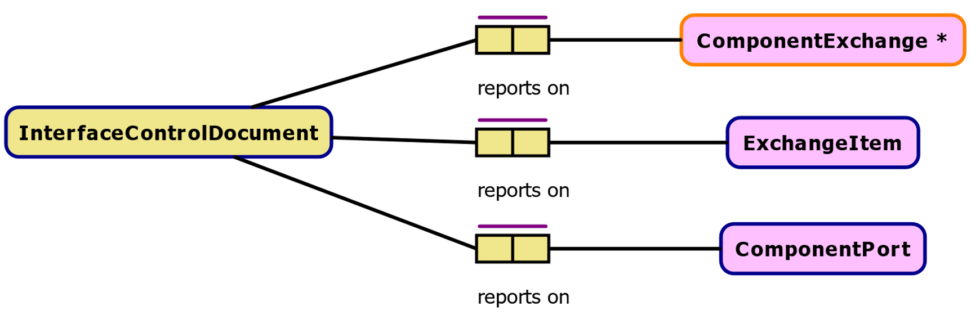
Conceptual Data Model – Main Contents

Slide 28
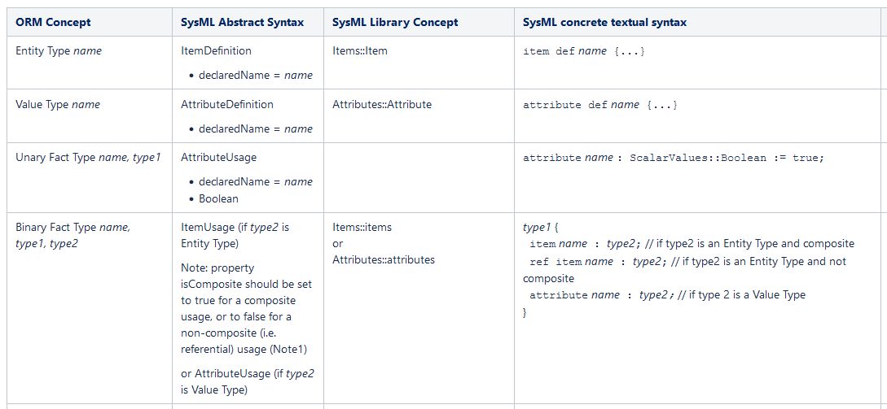
Conceptual Data Model – Mapping to LDM
To support transition and (future) automation of CDM to LDM transformation, a basic mapping from ORM to SysML2 concepts was made

Slide 29
Logical Data Model

Slide 30
Logical Data Model – Rationale and Approach
In an initial feasibility effort SysML2 was identified and confirmed as a highly suitable option for the LDM language / formalism
Main benefits
  Rigorous semantics combined with object-orientation and standardized API, i.e. can capture all SSO semantics and provides good basis for software code generation
  Powerful and compact textual notation as well as graphical notation
  Seamless integration with System Engineering UoD
  Reuse of common concepts from SysML2 standard libraries (ISO/IEC 80000 Quantities and Measurements, etc.)
  Can easily represent STEP-TAS data model and dictionary without loss of semantics
Potential downside: Not yet an official standard, no industrial tools yet (but expected 2024 Q3)
Selected (open source) SysML2 pilot implementation in Jupyter Lab Notebooks as modelling tool

Slide 31
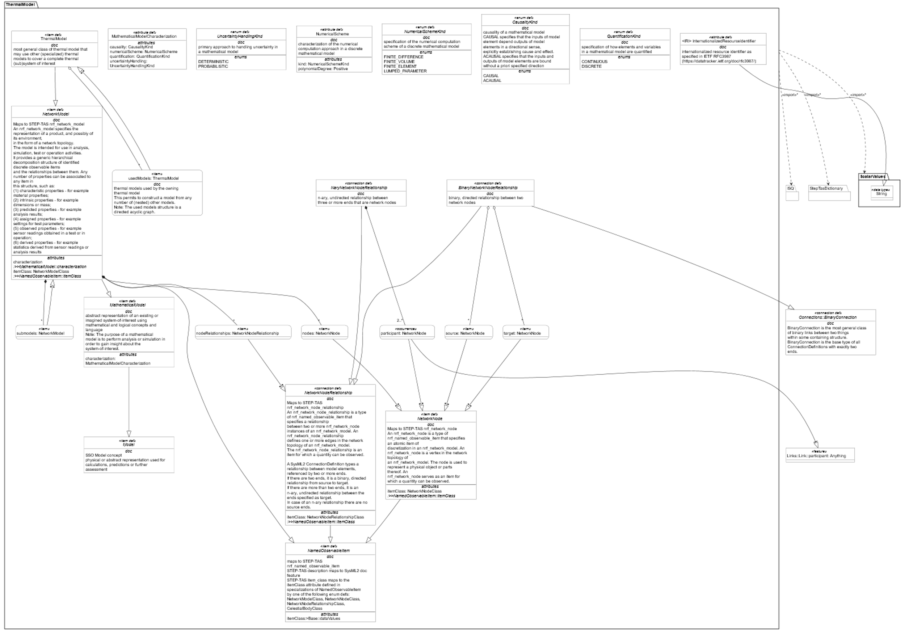
LDM Example: ThermalModel

Slide 32
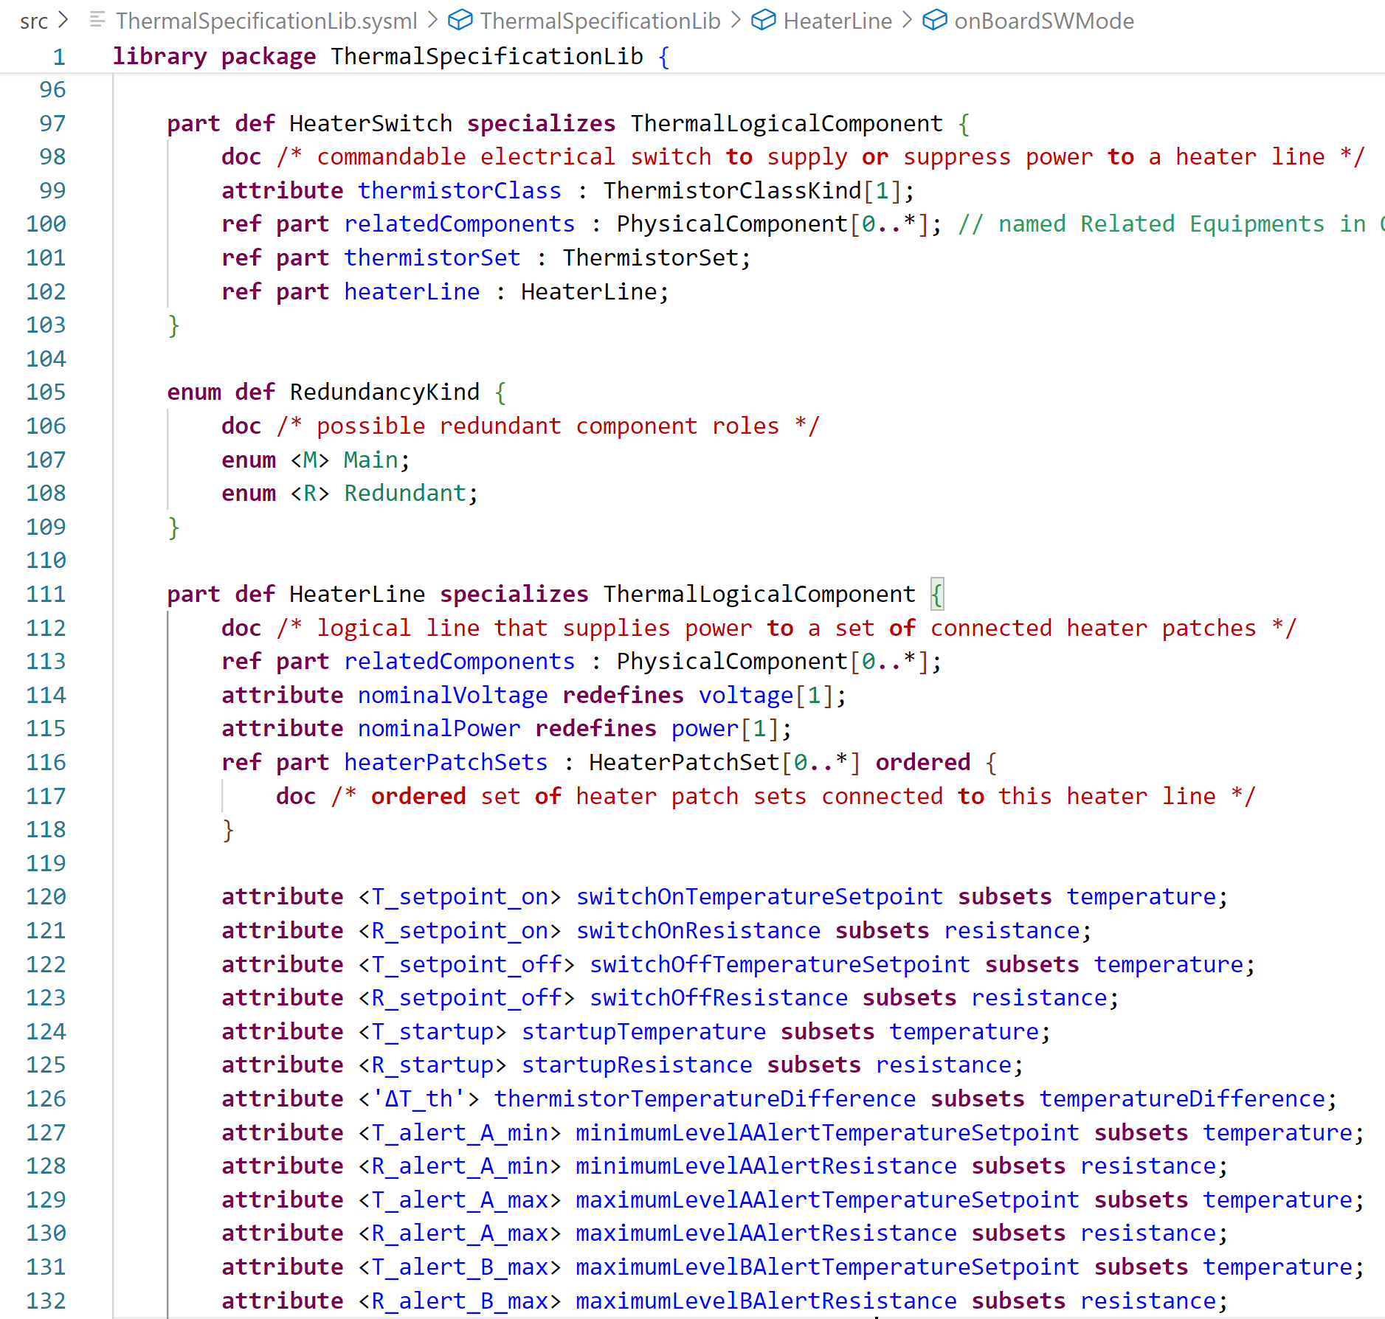
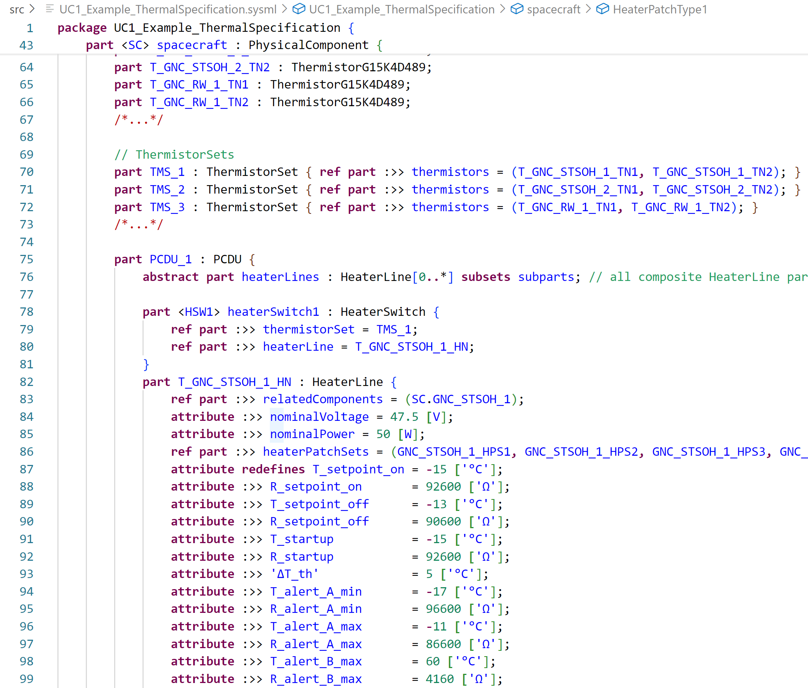
SysML2 Textual Notation Snippets
LDM specification snippet
LDM population snippet

Slide 33
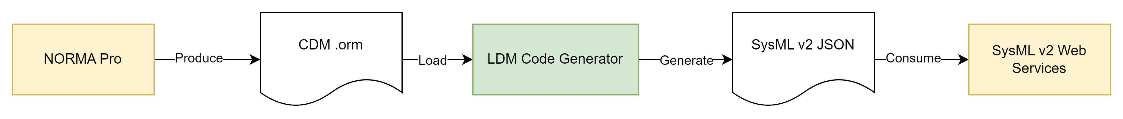
LDM Code Generator
Automatically transforms ORM models into SysML v2 json.

Slide 34
LDM Code Generator
Kalliope - a set of C# libraries used to read and write ORM2 files. Kalliope is used in RHEA products and projects to perform code generation.
    Licensed under Apache License 2.0
    Version 0.16
    Specifically, Kalliope.OO (object oriented) Dependencies: Kalliope.Xml, Kalliope, Kalliope.Dal and Kalliope.DTO
SysML2.NET - SysML2.NET is a .NET implementation of the OMG SysML2 specification. SysML2.NET provides a number of libraries in the form on an SDK as well as reference implementation such as a web-application and REST API.
    Licensed under Apache License 2.0
    Version 0.11.1
    Specifically, SysML2.NET and SysML2.NET.Serializer.Json

Slide 35
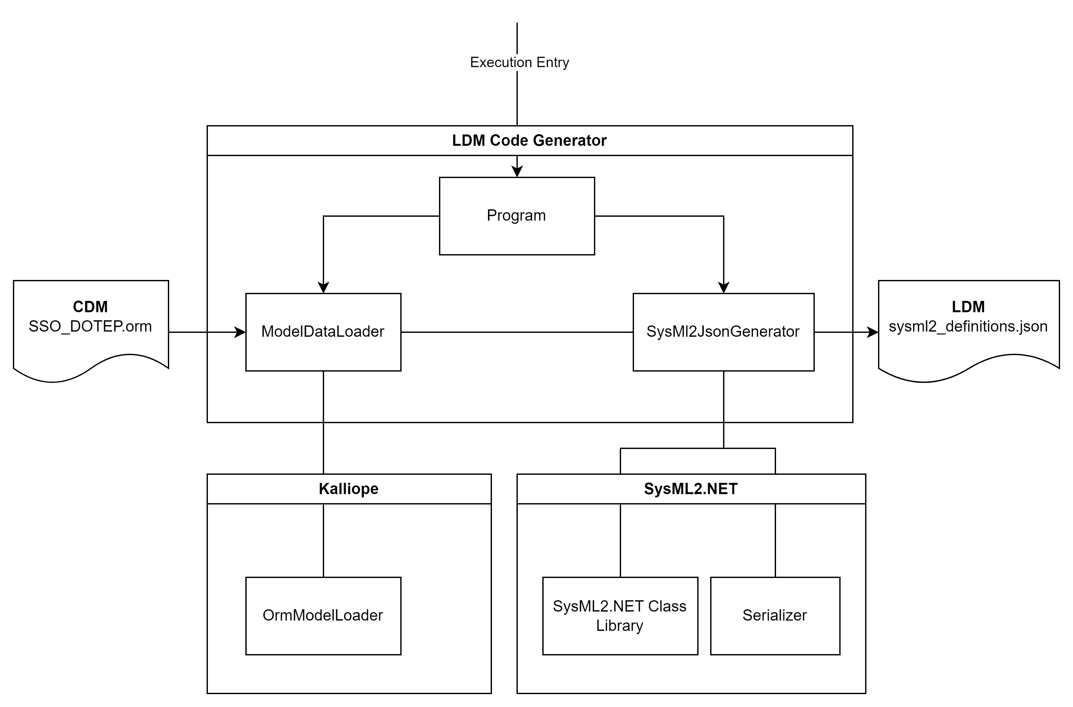
LDM Code Generator

Slide 36
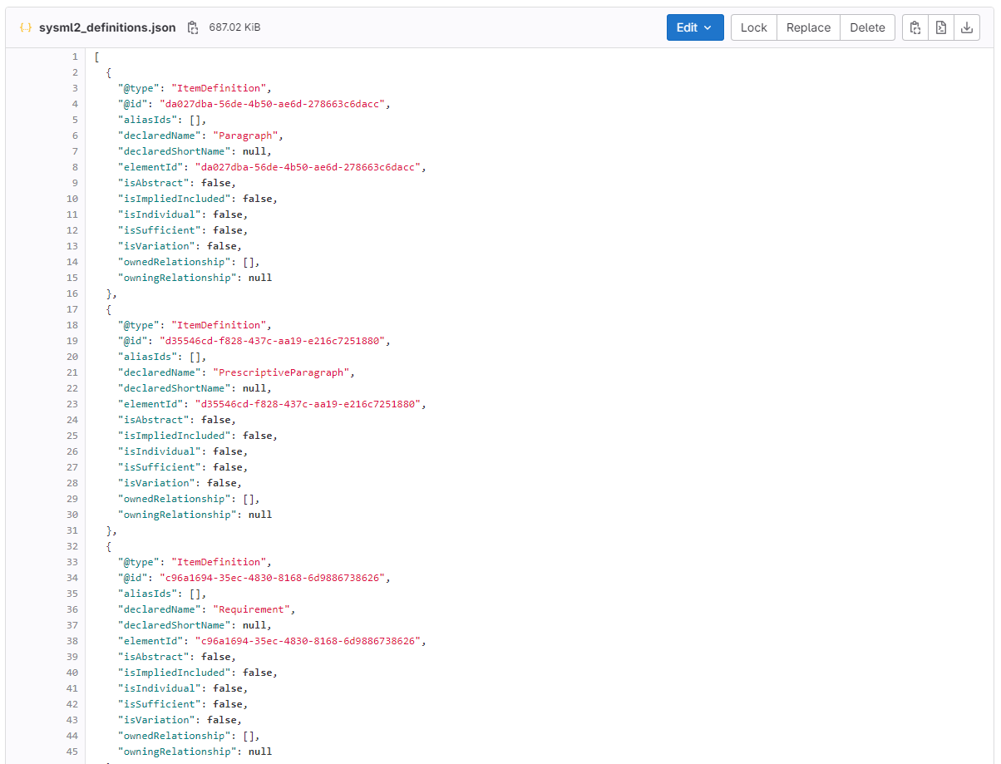
LDM Code Generator - Output

Slide 37
Model and Tool Interactions
Data Model Layer
Tools
CDM (in ORM)
NORMA Pro
& Starion report generator
semi-automated
LDM (in SysML v2)
SysML2 Jupyter Lab & SysIDE
Starion tool suite
(Kalliope, Hub, Dgraph, PostgreSQL, SysML2.NET, Web-App, ...)
OHB
Thermal tool suite
(ESATAN-TMS,
in-house, ...)
PDM (in C#, Python, JSON, HTTP/REST, ...)
PDM = Physical Data Model

Slide 38
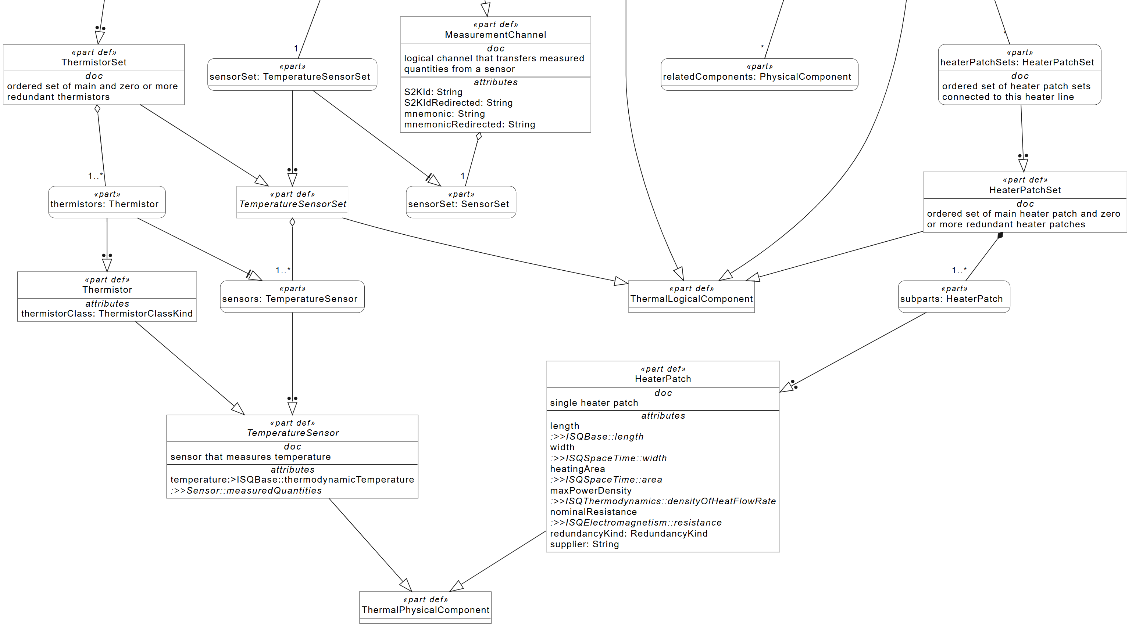
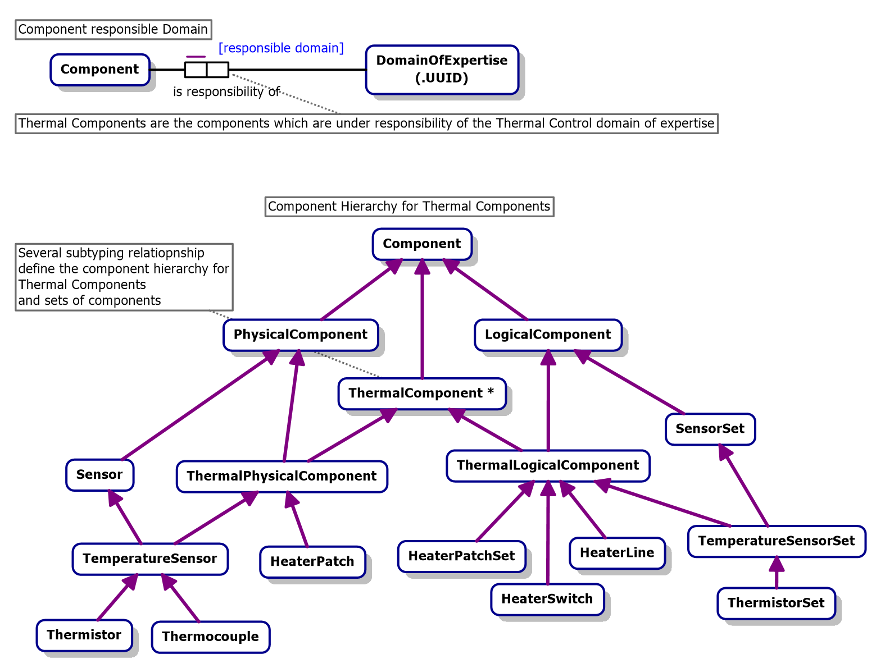
Conceptual and Logical Data Models
CDM example in ORM
LDM example in SysML2 graphical notation
Mapping between ORM and SysML v2 defined – already retains almost all semantics

Slide 39
Thermal Specification
New thermal specification model is introduced
  In addition to classic thermal analysis models
Thermal Specification is a digitalization of all thermal control info that is classically stored in natural language documents
  Full traceability from thermal problem specification (requirements, operational scenarios) to design solution elements
  Requirements relevant to TCS
  Thermal ICD, and any interfaces between the TCS and other subsystems
  Mappings of test or flight system sensors to thermal analysis nodes
  Mappings of active thermal control elements and electrical power circuitry and software, as well as telemetry and telecommands;
  Mappings of thermal sensors, heaters, etc., from thermal analysis models to 3D CAD
  Digitalized V&V specification: test cases, procedures, executions, and results

Slide 40
LDM - Conclusions
SysML2 works well as precise, efficient and human-readable language
Excellent basis for code generation and other model transformations
  Also, as a generic pattern for integration of any other discipline than thermal
Can capture all details using automated transformation from STEP-TAS
  Mapping is simple but rigorous – Dictionary is done – EXPRESS SCHEMA is feasible
Basic transformation of ORM CDM to SysML2 LDM is working
Currently analysis / simulation / operation results not yet covered
  But can be done using SysML2 standard library concepts that were heavily inspired by STEP-TAS/NRF
"ThermalSpecificationModel" seems attractive, potentially very powerful but simple

Slide 41
Physical Data Model

Slide 42
Physical Data Model
Technology specific implementation of the CDM.
Using the latest output from NORMA Pro.
Using RHEA’s Kalliope framework for transformation: https://github.com/RHEAGROUP/Kalliope
Open-source Handlebars templating engine used to write custom templates to produce all outputs.
Generates a full microservice that can be plugged into the RHEA MBSE Hub implementation as a separate UoD.
Code generator part of the solution.
Allows the use of the CDM model as a single source of truth.

Slide 43
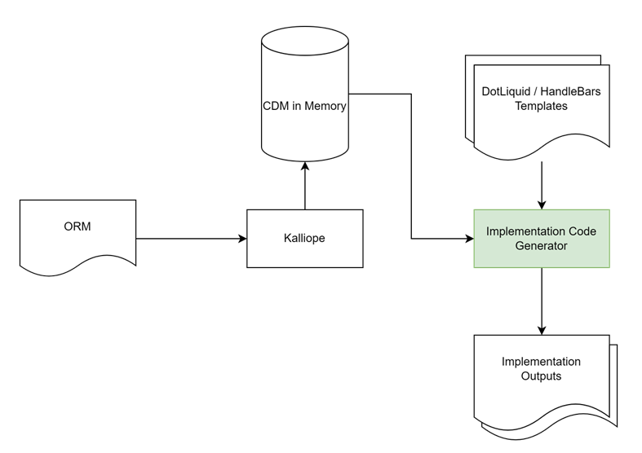
Code Generator

Slide 44
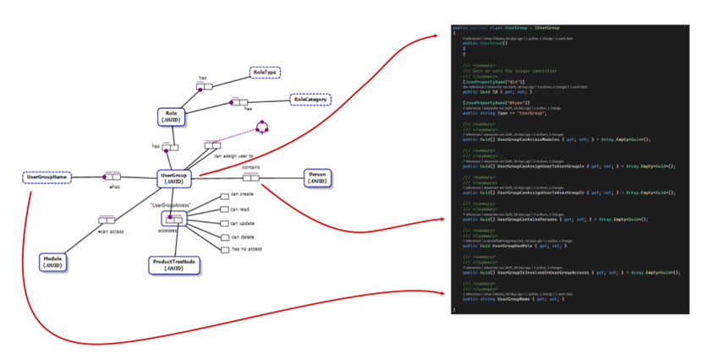
Kalliope

Slide 45
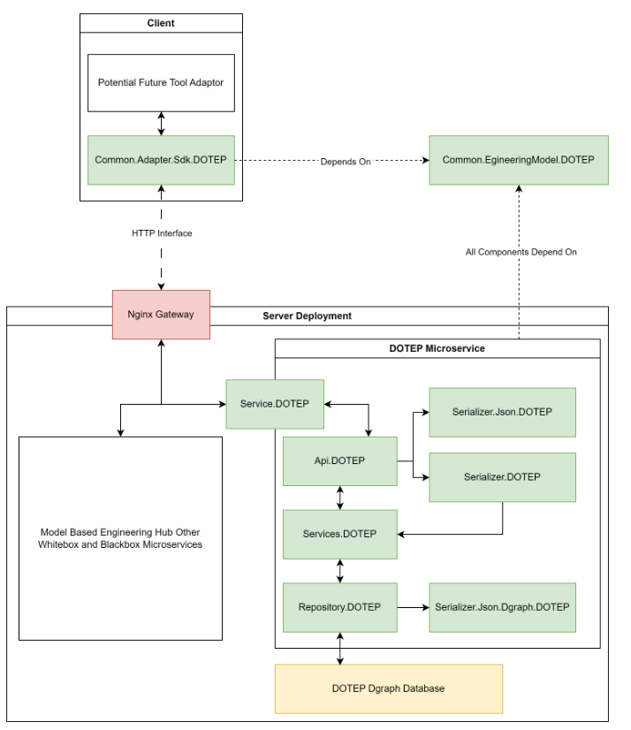
Interaction with MBSE Hub
Common class library reusable by all implementations.
SDK for further adapter development.
Microservice to handle the engineering model data for DOTEP.

Slide 46
C# PDM Components
Component Name | Description | Component Type
MBEH.Common.EgineeringModel.DOTEP | A .NET C# class library of all DOTEP PDM entities. Should be used as a basis for all developments necessary to manipulate DOTEP information. Should be utilized by both the server data storage implementations as well as any eventual clients. | Dynamically Linked Library
MBEH.Common.Adapter.Sdk.DOTEP | A .NET C# Software Development Kit that can be used to develop client adapters to communicate to the MBEH instance that supports the DOTEP PDM. Has all the required functionality that an adapter would need to use to interface with the APIs. | Dynamically Linked Library
MBEH.EgineeringModel.Api.DOTEP | All of the API modules that expose the HTTP routes for the PDM. When the microservice boots up in the context of MBEH all these routes become available for RESTful interface according to the specification in the MBEH ICD [AD3]. By calling these routes with various HTTP methods and using JSON payloads, information can be sent and retrieved by clients. | Dynamically Linked Library
MBEH.EgineeringModel.Repository.DOTEP | A .NET C# class library that provides interaction with DGraph database. | Dynamically Linked Library
MBEH.EgineeringModel.Serializer.Json.DOTEP | A .NET C# class library that provides JSON Serialization and Deserialization for all DOTEP PDM entities. Should be utilized by both the server data storage implementations as well as any eventual clients. | Dynamically Linked Library
MBEH.EgineeringModel.Serializer.Json.Dgraph.DOTEP | A .NET C# class library that provides JSON Serialization and Deserialization for all DOTEP PDM entities dedicated for DGraph database. Should be only used by the server data storage. | Dynamically Linked Library
MBEH.EgineeringModel.Service.DOTEP | The microservice application that exposes the functionality of the PDM through the utilization of all the other components. Serves as the entry to the application. | Application (microservice)
MBEH.EgineeringModel.Services.DOTEP | The service layer that sits between the API and the repository. Resolves the necessary repository implementations based on the called API routes. Contains the validation against the implemented ORM constraints and returns errors if they are violated. | Dynamically Linked Library

Slide 47
Test Data Population
The following approach is followed to generate the population to verify that the PDM can support the use cases:
The prepared SysML v2 use case implementations (transformed from the test data supplied above) are taken as a basis.
A unit test with assertions is created to cover as many included concept types as possible.
The unit test ensure the correct number and type of concepts is created and that the PDM can support these types from the test data. Validation of some of the ORM constraints is built into the process.
Once the unit test executes correctly it automatically generates a seed.json file that is included directly with the deployment
When a new instance of the hub with DOTEP functionality is deployed, the database is automatically populated from the seed file, and the concepts should be inspectable in Ratel.

Slide 48
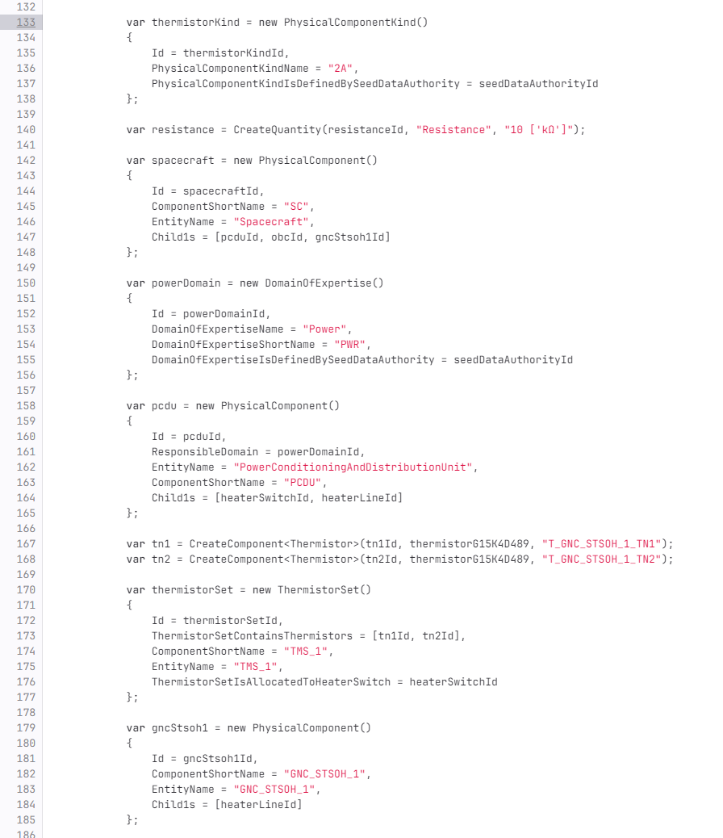
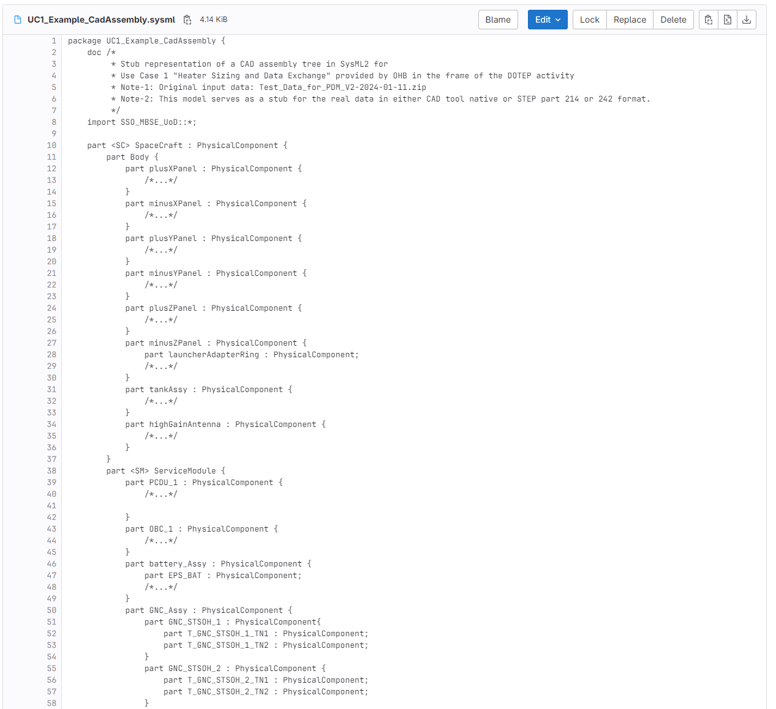
Test Data Population
Assertion that all validations pass:

Slide 49
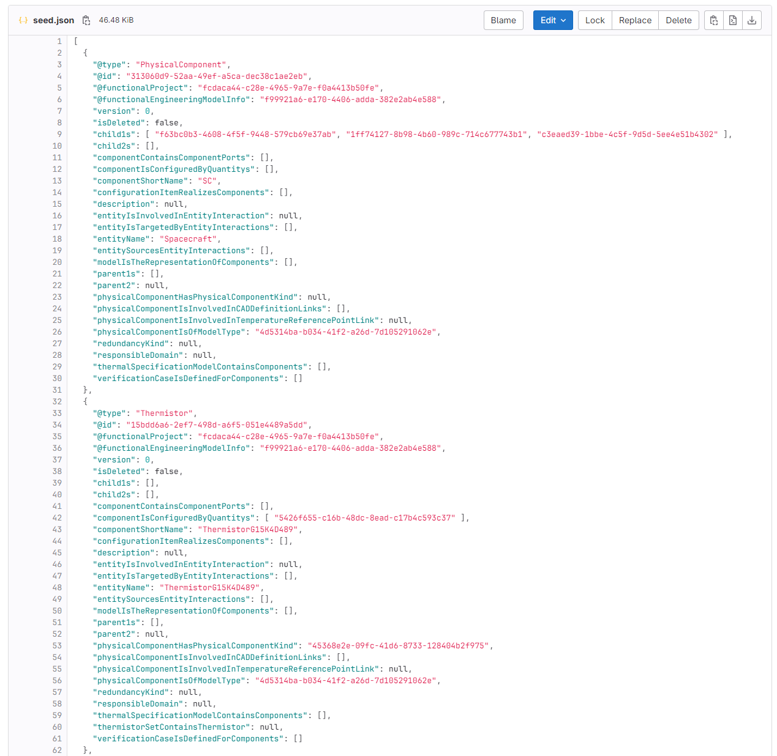
Test Data Population
JSON file is then used to seed database at deployment time.

Slide 50
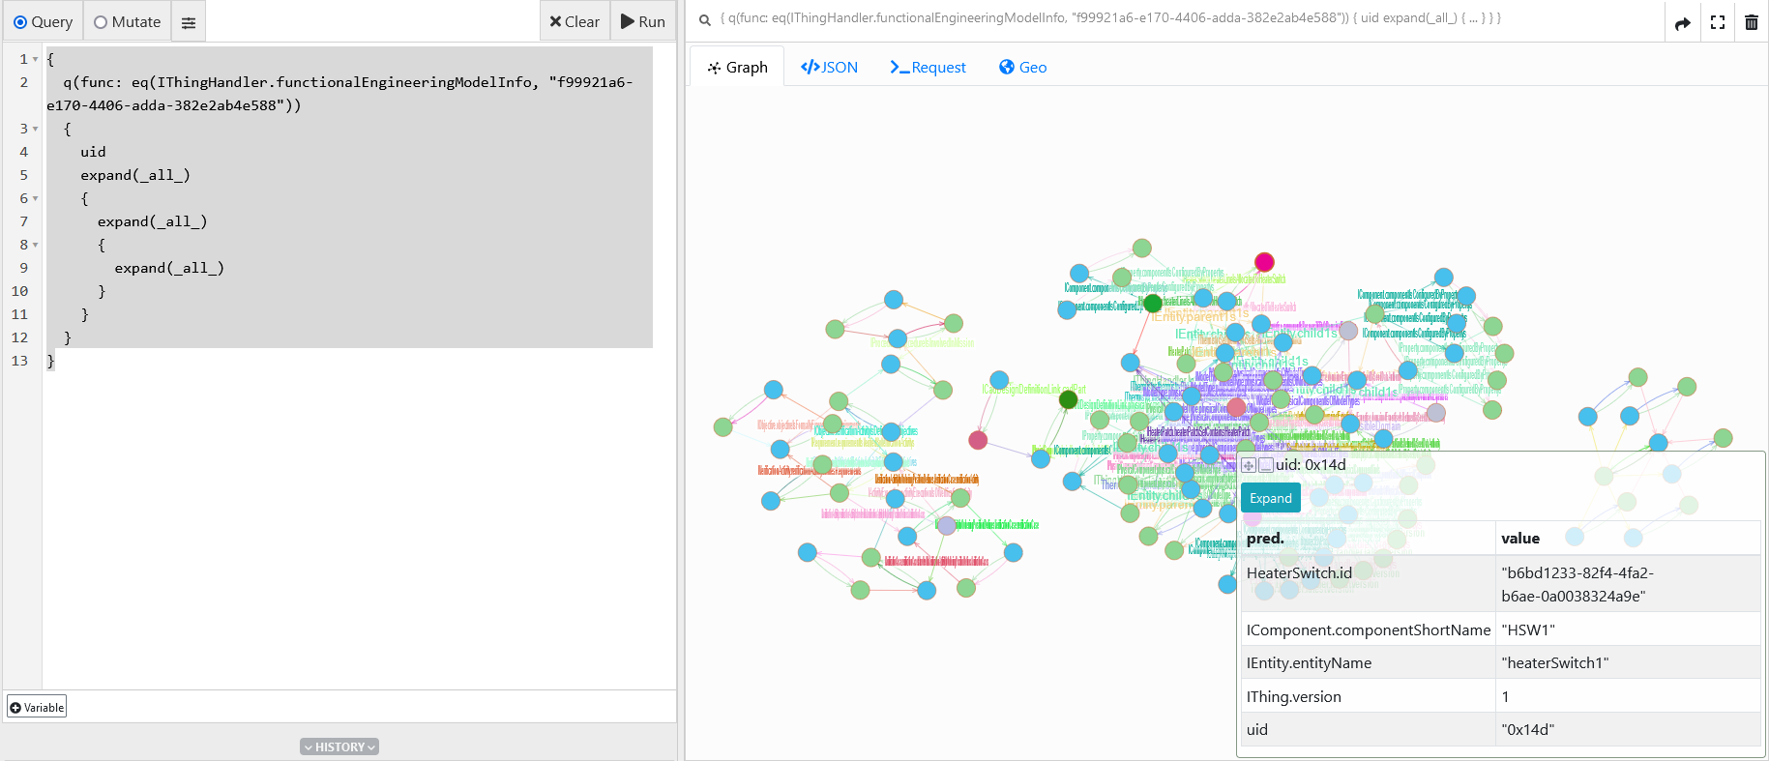
Check of Data (Ratel)

Slide 51
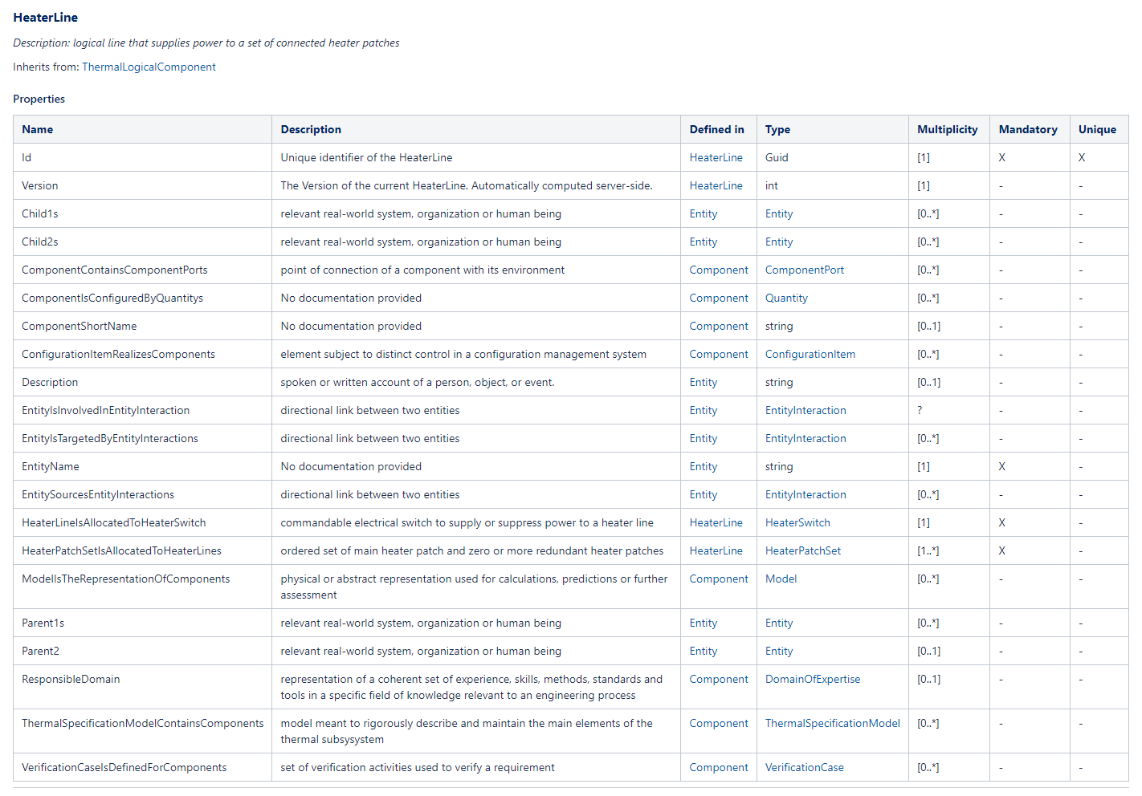
Class Structure Documentation
Fully code-generated class library document with inheritance, description of all properties, types, multiplicities and constraints.

Slide 52
Application Use Cases

Slide 53
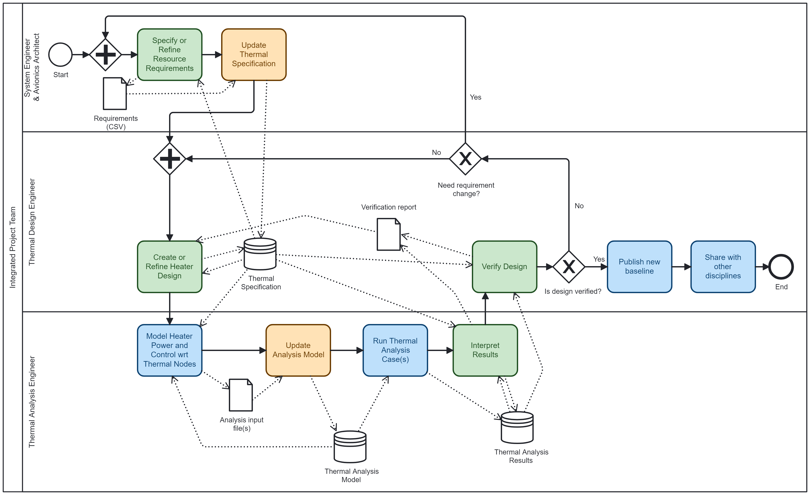
Demo Use Case Implementation
UC formalized workflow in BPMN notation
Same can be modelled in SysML2 action diagram, but pilot tool graphical auto-layout is not yet sufficiently mature

Slide 54
Demo Tool
Capabilities:
  Transformation of existing OHB input files to Thermal Specification
  Web-app to view and edit specification in a workflow step-by-step fashion
Uses (reduced) HERA TCS model as example
Implements use cases (1) heater design and (2) analysis-test correlation
Shows integration with ESATAN-TMS thermal analysis
Supports generic query and graph visualization of Thermal Specification
Supports ICD and VCD report generation from model
Implements Starion dockerized micro-service architecture & user-friendly web-apps

Slide 55
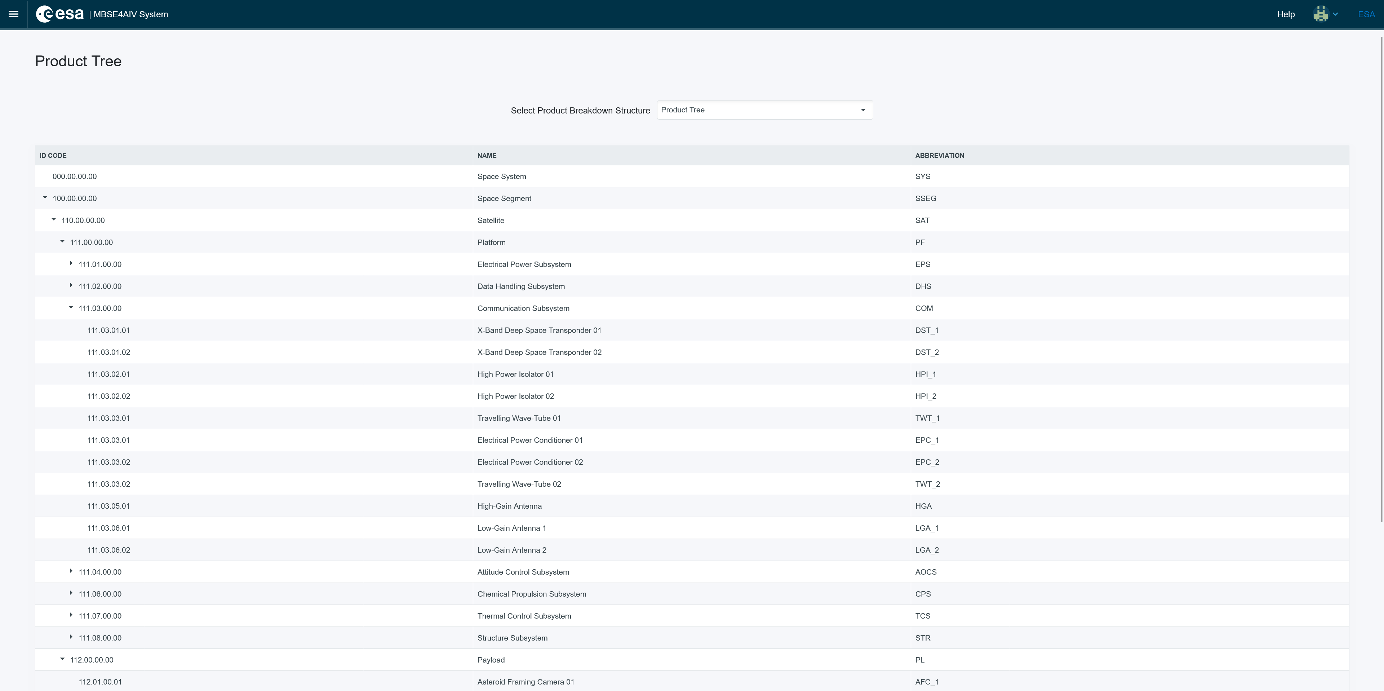
Heater Sizing Use Case – Product Tree

Slide 56
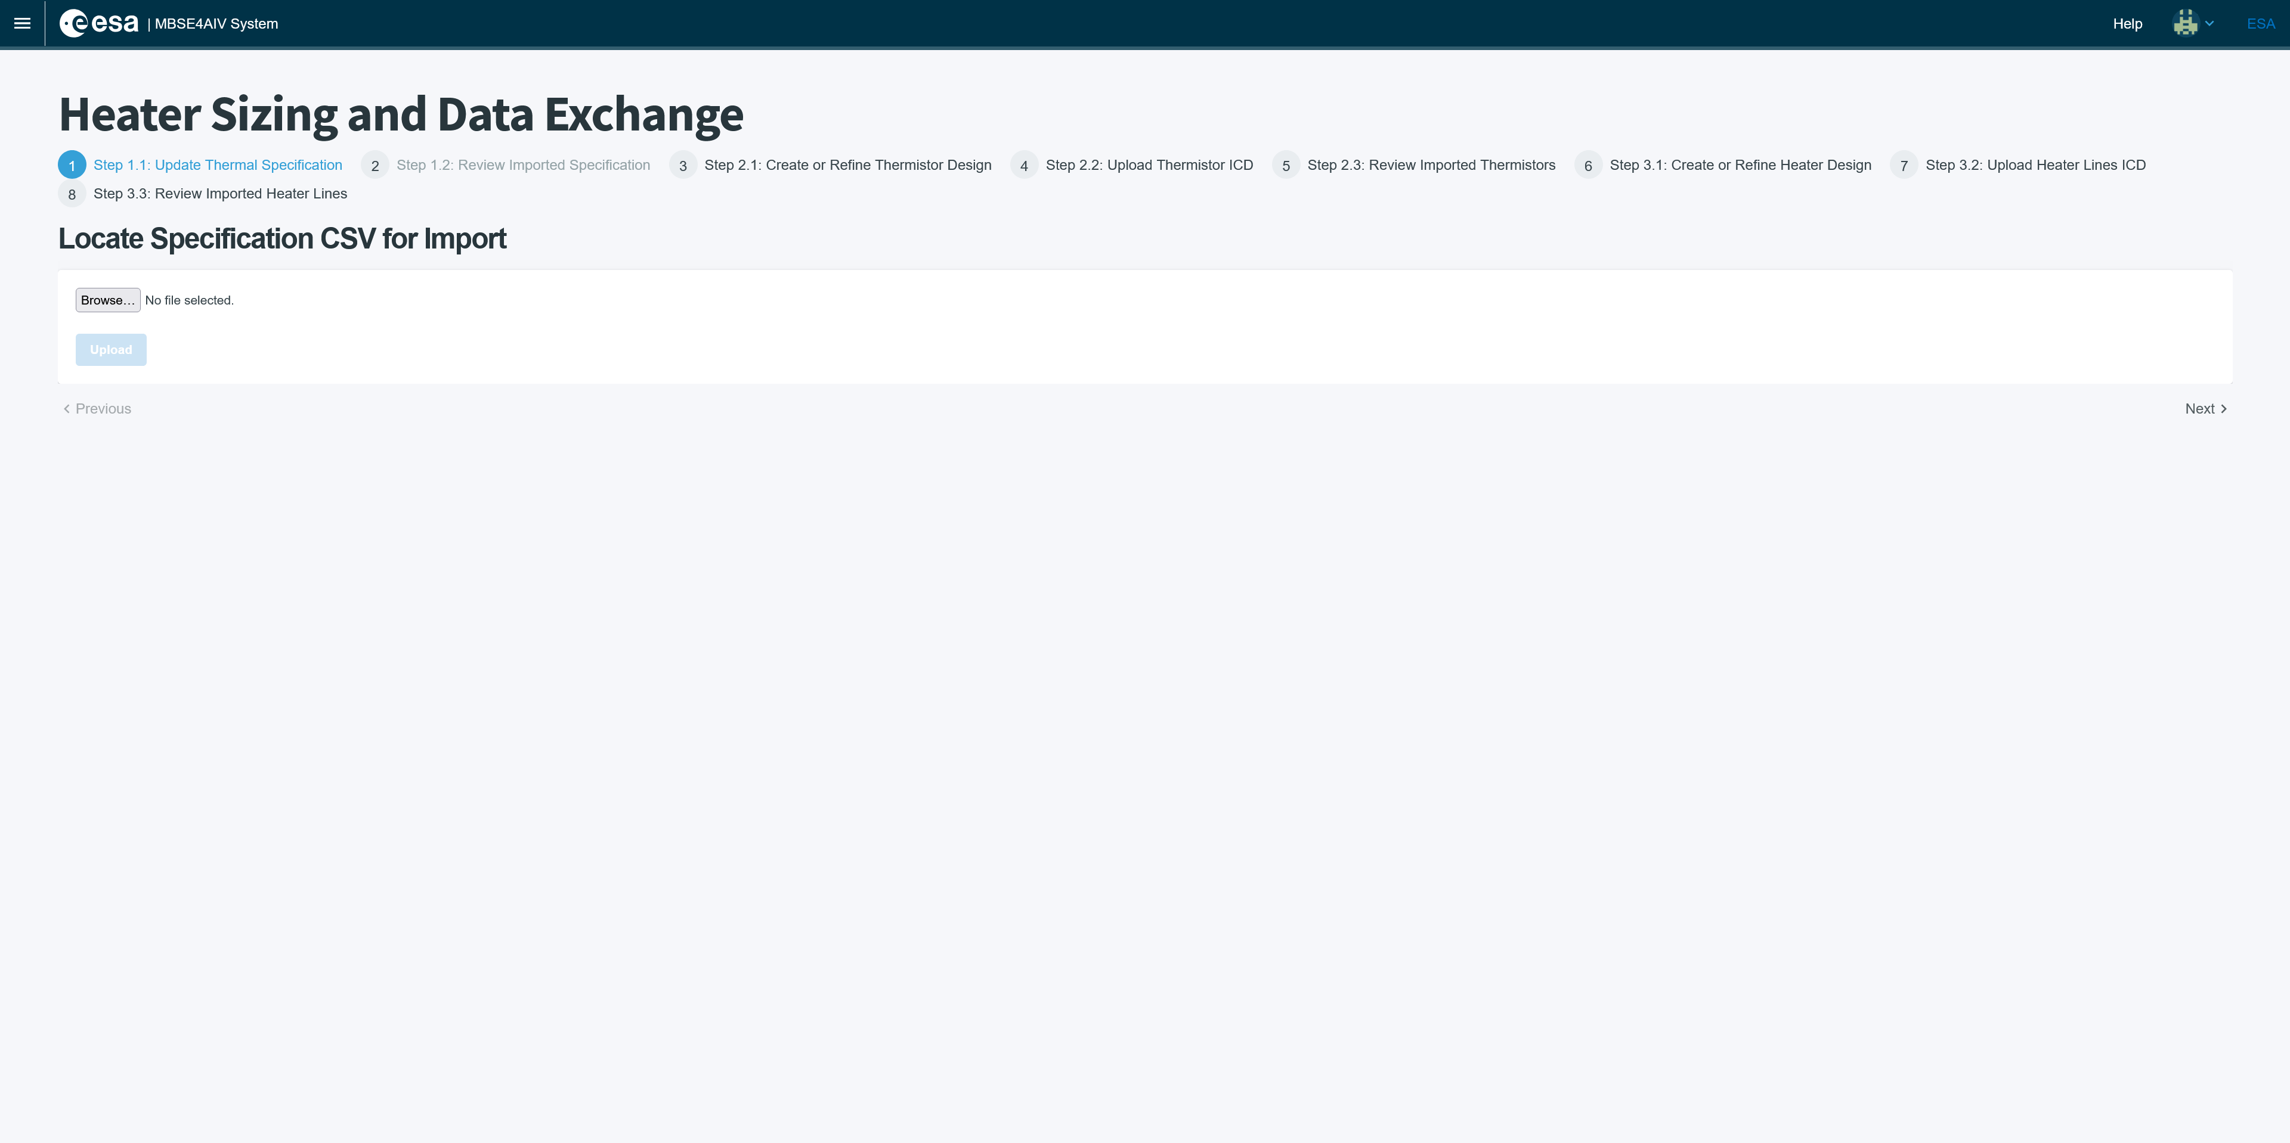
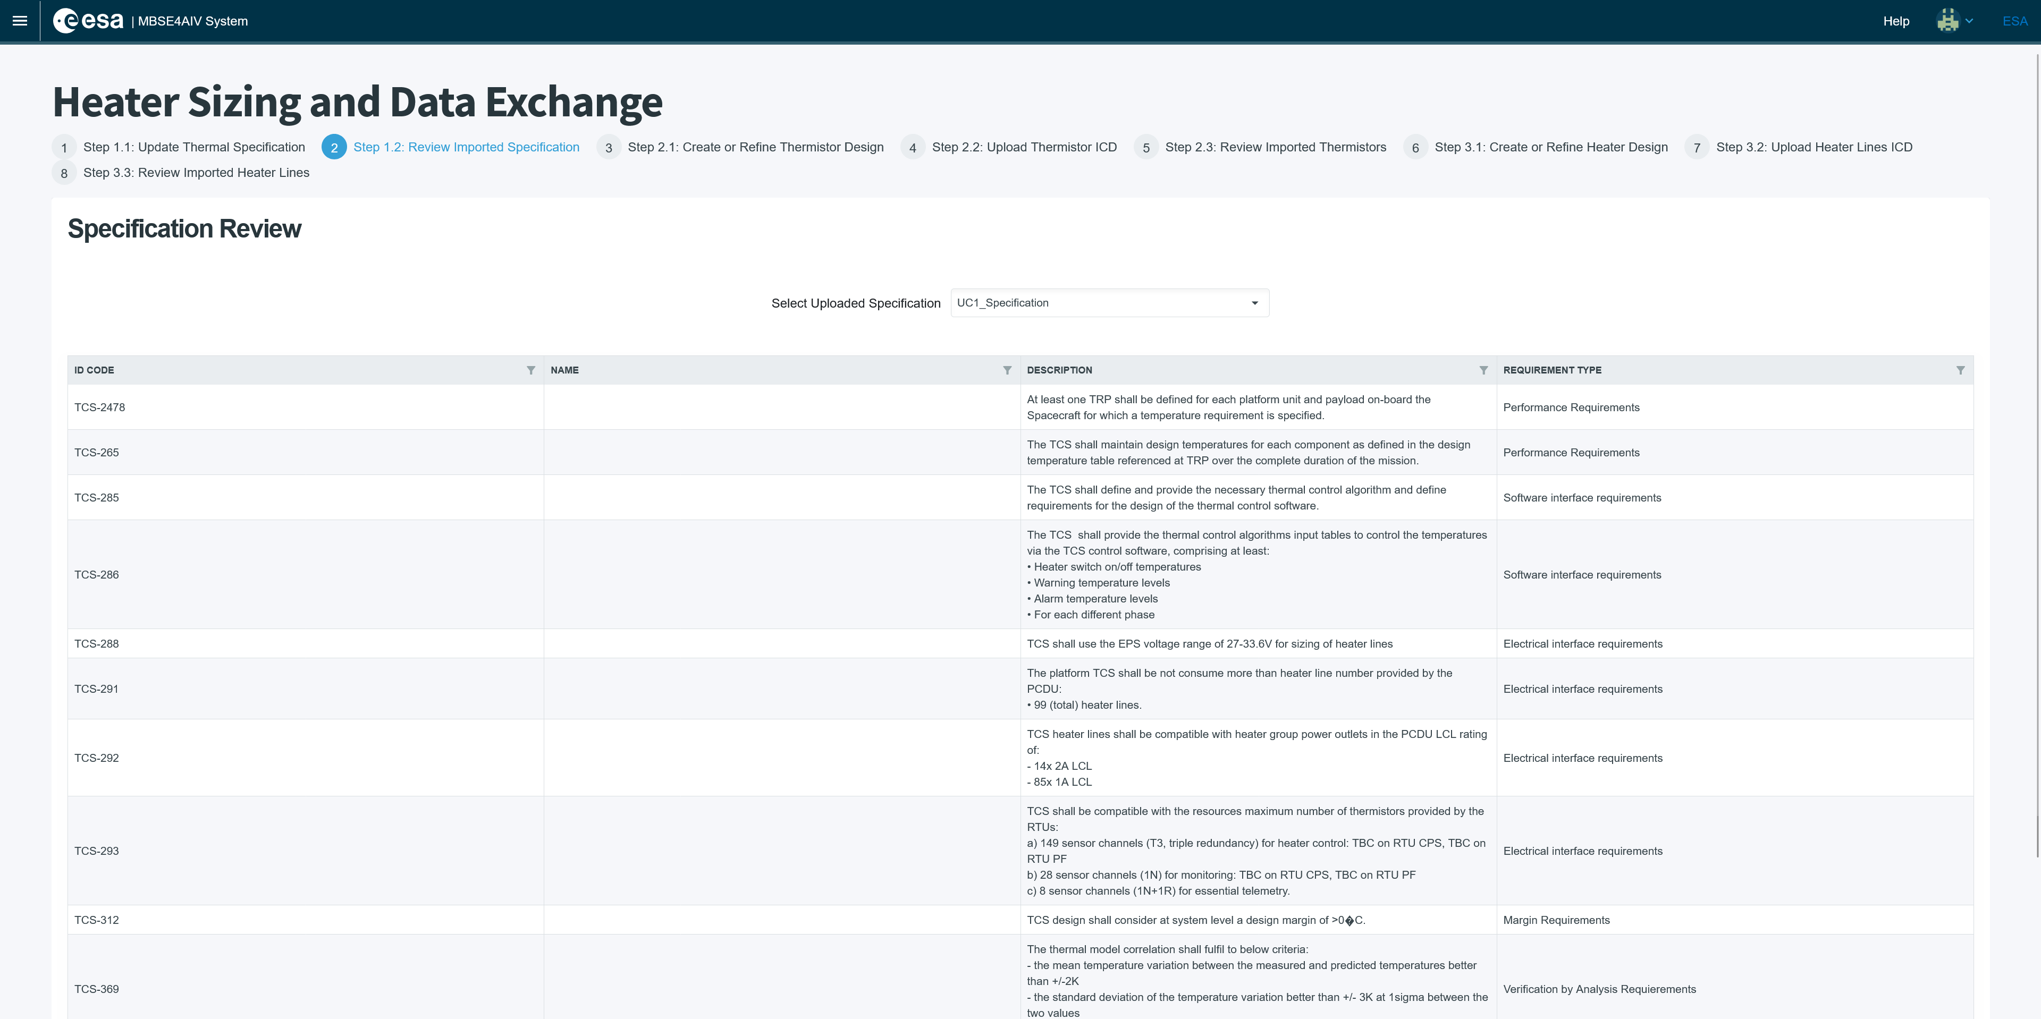
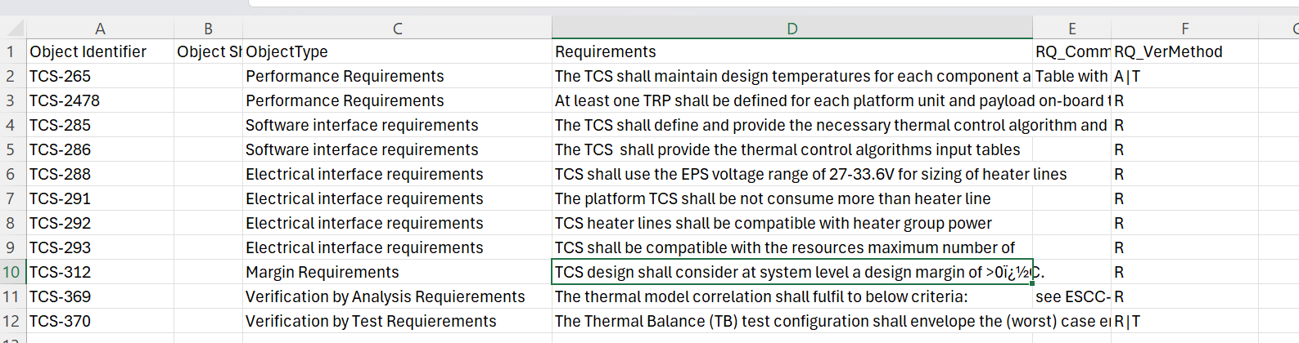
Heater Sizing Use Case – Requirements

Slide 57
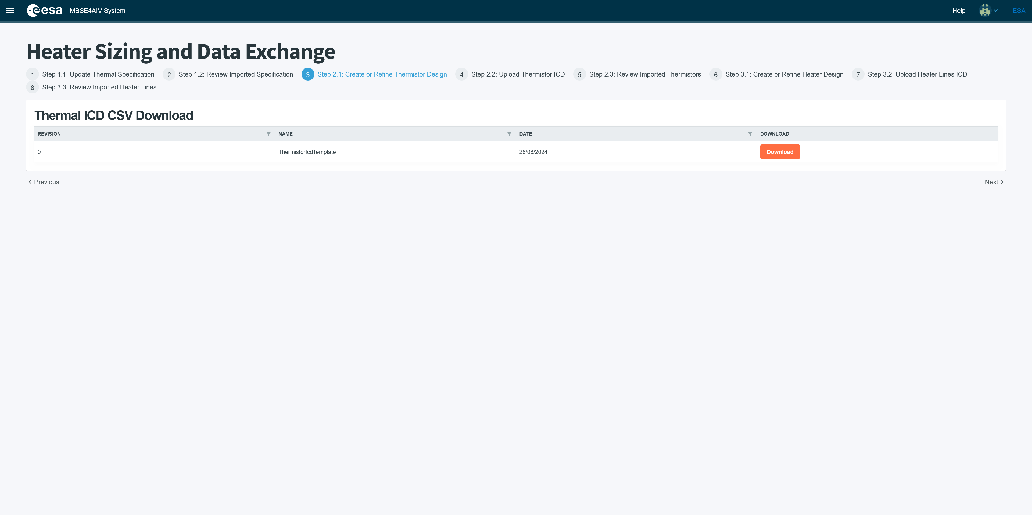
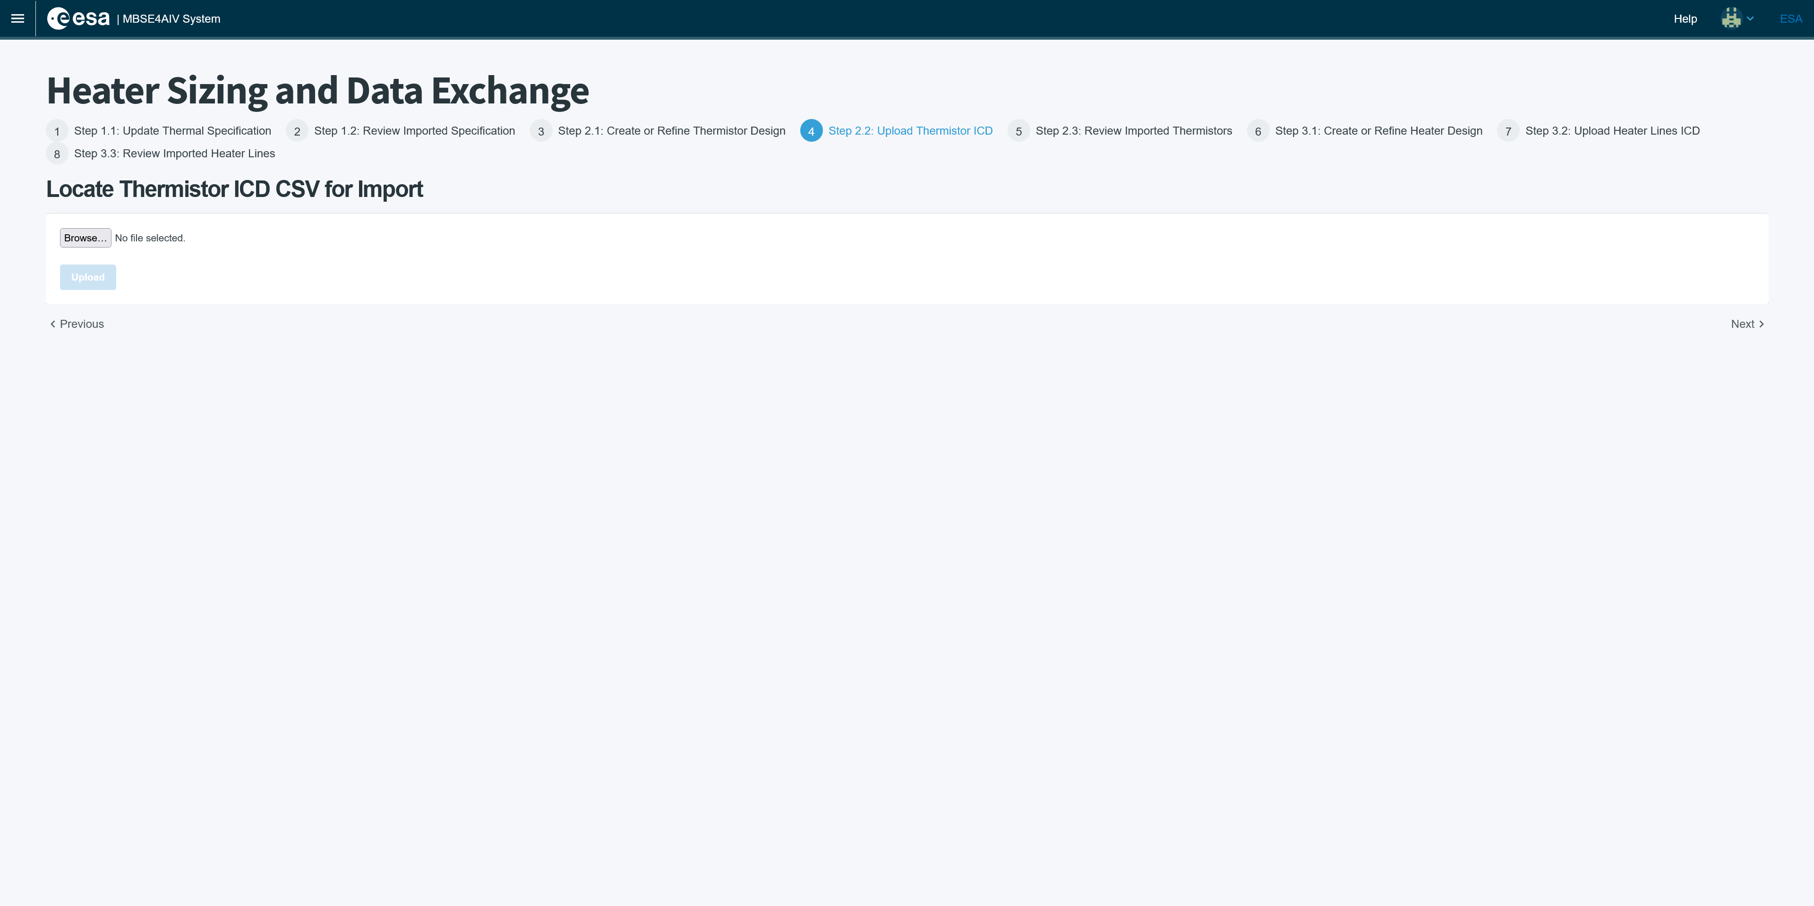
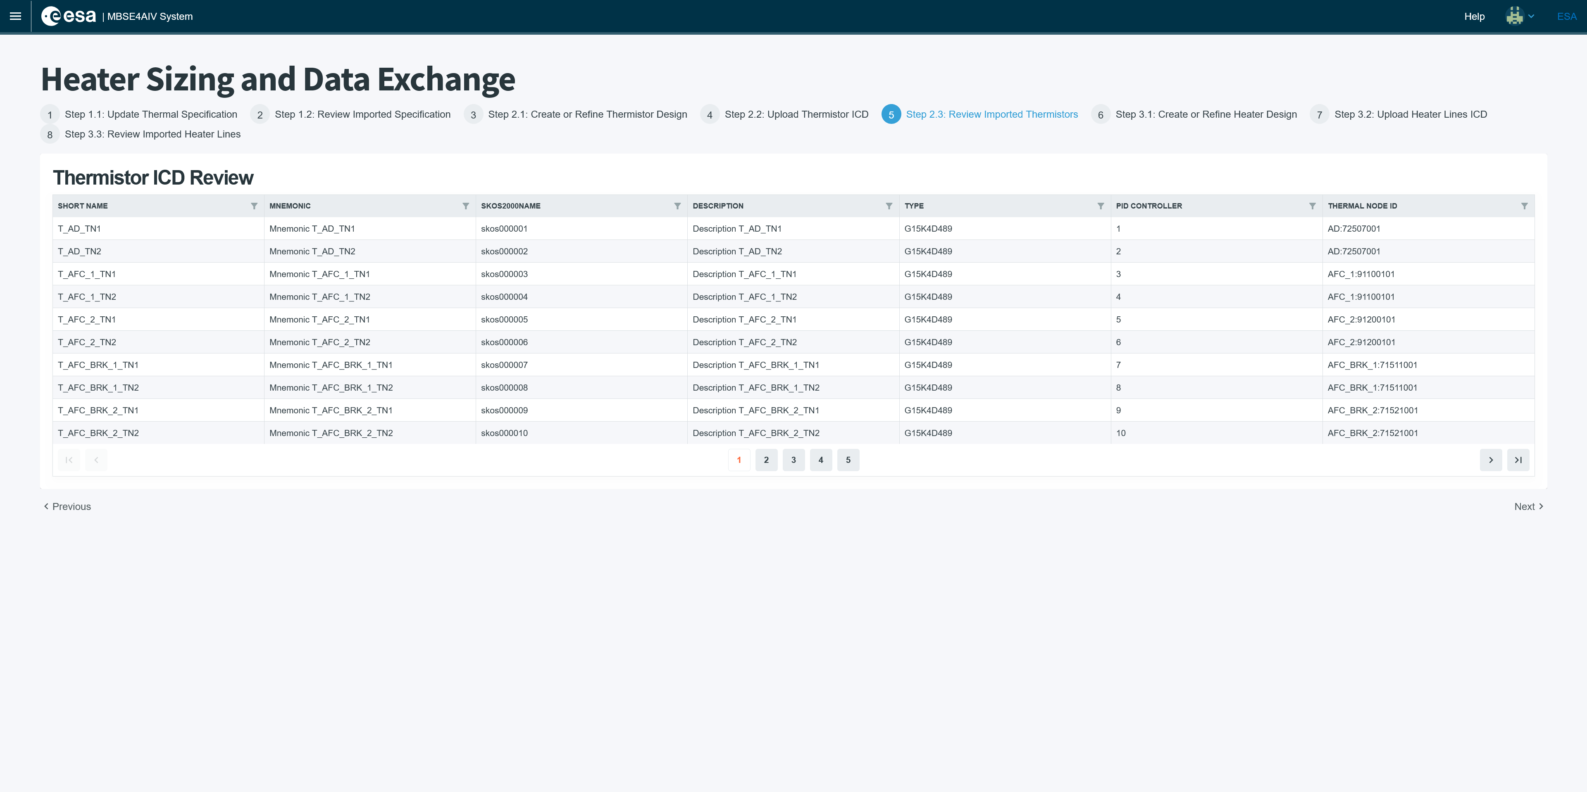



Heater Sizing Use Case – Thermistors

Slide 58






Heater Sizing Use Case – Heater Lines

Slide 59




Heater Sizing Use Case – ESATAN-TMS

Slide 60


MBSE Hub UI

Slide 61



Test Data Use Case – Requirements

Slide 62



Test Data Use Case – Thermal Analysis Cases

Slide 63



Test Data Use Case – Dissipation

Slide 64



Test Data Use Case – Test HeaterLines

Slide 65




Python API

Slide 66
Results, Challenges and Way Ahead

Slide 67
Results
Performed a deep analysis of the thermal engineering processes and produced recommendations on ones that would best benefit from digitization.
Developed and iterated a Thermal CDM complement to the SSO in ORM.
Developed an LDM and a pilot implementation Thermal Specification Model in SysML v2, showcasing possible further implementations using this language.
Built tools to automatically generate both C# and Python class libraries as well graph database schemas to support SSO compliant data persistence (PDM).
Built UIs on top of MBSE Hub implementation to support the demonstration cases.
Built ESATAN-TMS plugin to support bidirectional information exchange between the PDM and ESATAN.

Slide 68
Challenges and Recommendations
SSO still lacks many generic / transversal engineering concepts needed by Thermal
Important deficiencies in ORM / NORMA Pro
  No support for modules / namespace import → cannot integrate UoDs properly
    Current work-around is manual copy / paste and color-coding
  No integrated support for example populations – which is essential for validation
  No built-in support for enumeration types
New Thermal Specification is feasible, affordable and extensible
  Similar digitalization approach possible for other subsystem domains of expertise
  SysML2 basis allows for easy and rich interchange between subsystem and system layer
SysML2 tooling sufficiently mature for initial development
  Provides solid basis for code generation (similar to UML or Ecore data models)
  New substantially improved SysML2 tools expected shortly – low risk of obsolescence

Slide 69
Way Ahead
Increase TRL level of developed prototypes to be more generic in support of use cases, more fault tolerant and better looking.
Improve performance and scalability to manage effectively larger models.
Further interactions with other UoDs already implemented in the MBSE Hub prototype (OPRS/RAMS/AIV)
Prototype more advanced use of SysML v2:
  Conceptual data modeling of the ontology – use the LDM to drive creation of standardized exchange.
  Evolution of the reusable Thermal library for SysML v2.
  Integration with the highly capable test procedure capabilities of the language
  Use of SysML v2 capabilities as a PDM.

Slide 70
Contact: a.vorobiev@stariongroup.eu

