Slide 1
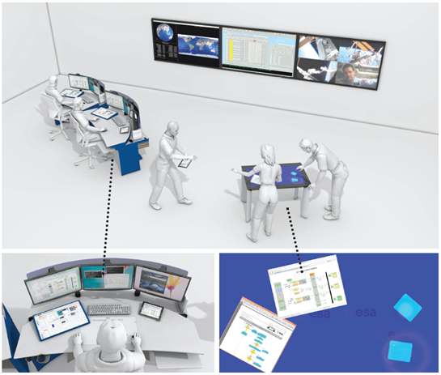
Advanced Ergonomics TRP Study (AERG)
Final Presentation
ESOC - 5/11/2013
Denis Javaux (SYMBIO)
Jan Charles Lenk (OFFIS)
Alexandr Puchkovskiy (OFFIS)
Giovanni Scotti (TERMA)
Sonja Sievi (ASTRIUM)
Georges Vroonen (SYMBIO)
Notes:
- Goals
- Methodology
- Results
Full title of the study:
Advanced Ergonomics on HCI for Satellite M&C, Problem
Analysis, Design & Planning Activities and Support for
Critical Operation Phases

Slide 2
The AERG Study
How Human Computer Interaction (HCI) interaction may evolve to support spacecraft operations in the next five to ten years ?
Improving the Human Computer Interaction for tasks typically performed by the Flight Control Team in Spacecraft control and ESTRACK Operators for M&C of the Ground Stations.
It focuses in particular on two areas:
Collaboration Support, improving the way operators at ESOC collaborate to accomplish mission operations;
Human Computer Interaction, introducing and evaluating new hardware technology to improve the user experience when interacting with M&C applications at ESOC

Slide 3
Project Phases
Task Analysis, Use Cases, Technology Review [Mar-Aug 2012]
Analyse Tasks at ESOC operations, define general Use Cases and particular scenarios to capture User Needs, review new technology
HCI Design [Aug-Dec 2012]
Develop guidelines and principles for future HCI and specific interaction design for the particular scenarios
Demonstrator Development [Jan 2013 – June 2013]
Develop a demonstrator for evaluating proposed interaction design
Evaluation and Final Report [June –Oct 2013]
Evaluate the proposed HCI overall design and the demonstrator implementation; Define recommendations for future Ground Segment System HCI in order to drive the evolution of HCI in the following years.
Notes:
Concerning the EVALUATION PHASE:
The Design that we will present later is the result of a consolidation process done during the Evaluation phase

Slide 4
Methodology
User centred approach
Early phases: Observation visits and User Workshops to gather user requirements and to validate the design
Demonstrator development phase: users experienced the prototype in progress, providing valuable comments.
Evaluation phase : workshop with the final Demonstrator; users exercise a simulated operational scenario and provide feedback
The SCRUM methodology was applied throughout the project (i.e. Sprint planning meetings, Sprint reviews)
Notes:
User centred approach: high involvement of end-users and other stakeholders (managers, SW designers, developers, etc.)

Slide 5
Concepts

Slide 6
Concepts
1. Collaboration
Enable a distributed group of operators to work more effectively in cooperation
  Normal operations (e.g. ESTRACK – SPACON interaction)
  Specific scenarios: discussing critical operations, contingencies, etc.
2. New approaches to HCI and touch technology
Touch technology for the operator at the console
Portable devices for nomadic/remote operations or monitoring
Touch tables for co-located teamwork
3. Touch technology applied to existing ESOC M&C applications
Operating the EGOS User Desktop M&C display using touch
Notes:
2. Touch interfaces: input and output directness
i.e. input is performed directly on the system’s output.
This makes (potentially) a SW system :
easier to understand
More intuitive to operate

Slide 7
Concepts: 1. Collaboration
The Collaborative Workspace concept (CWS)
Extension of the voice loop, in use at ESOC today
Adds capabilities to share visual resources (Views), besides audio communication
View : GUI to a generic application of the local operating system (SCOS-2000, STC2, PDF document, Database editor, etc.)
Views can be shared by an operator
on a Collaborative Workspace and
made visible, and possibly
controllable, by others.
Notes:
Collaboration: the design outlines the hardware and software infrastructure to enable a distributed group of operators to work cooperatively in specific scenarios (e.g. discussing critical operations, contingencies, etc.). The proposed solution includes hardware elements: a physical console equipped with computer hardware touch screen and regular TFT screens, portable Tablet devices, Touch Table, and a software infrastructure called the User Desktop for Collaboration (UDC).
The UDC proposes the concept of Collaborative Workspace (CWS) as an extension of the voice loop, in use at ESOC today, with capabilities to share visual resources, i.e. Views. View is the GUI to a generic application of the local operating system (e.g. SCOS-2000 M&C application, ESTRACK Mimic, a PDF reader, Word processing application), which can be shared by an operator on a Collaborative Workspace and made visible, and possibly controllable, by others.

Slide 8
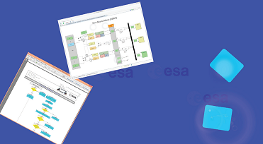
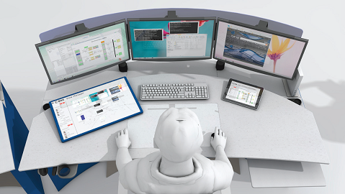
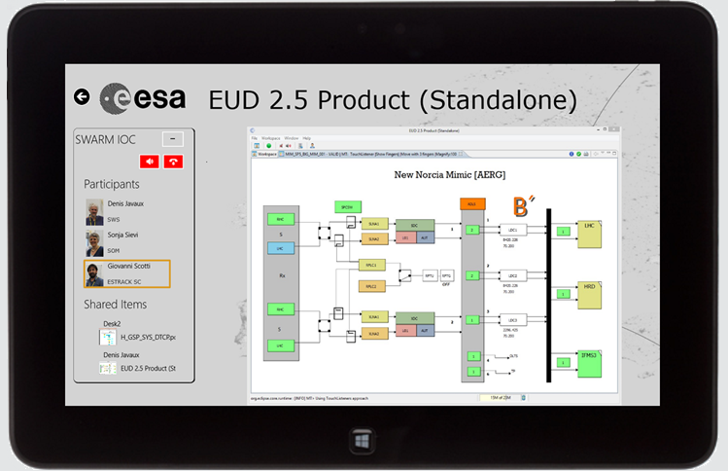
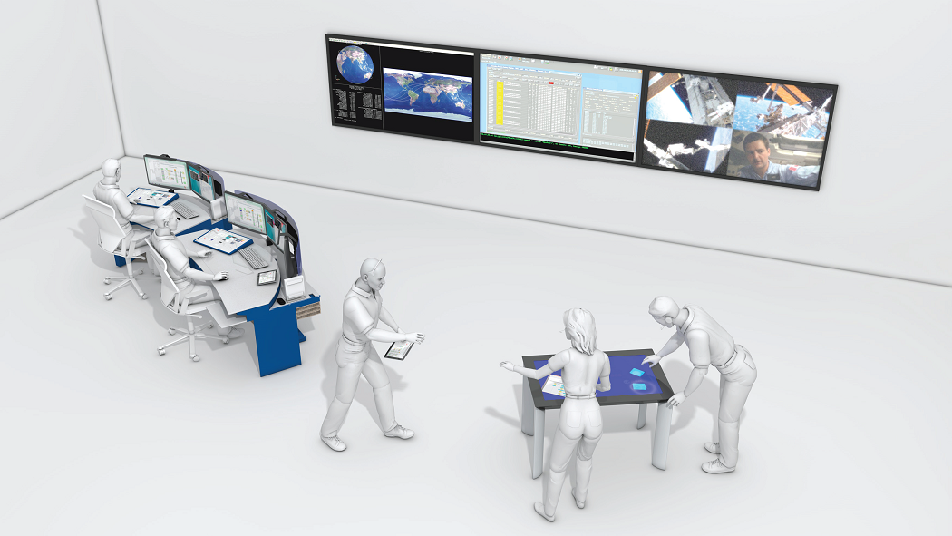
Concepts : 2. New approaches to HCI and touch technology
New Operator Console with Touch control
Tablet devices for nomadic or remote operations
Touch tables for co-located teamwork
Notes:
We have investigated the use of Touch Technology as alternative approach to human-computer interaction and as support for collaborative work:
- Defined a NEW CONSOLE for the operator in the Control Room and a set of touch-based devices:
- Touch screens on the Console
Portable Tablet devices : provide operators/manager not sitting at the console or located remotely with monitoring information and collaboration tools
Touch Table: WS where people gather to address specific tasks that require close contact. Monitoring data / Mission information available.
Later we will show advantages and limitations of such technology.
We have to highlight that the concepts and solutions proposed for improving collaborative work do not depend on the use of such technology.

Slide 9
Concepts: 3. Touch technology for M&C applications
How could new interaction technologies be applied to existing ESA M&C products?
Evaluate the impact of using Touch Technology for operating such products
Touch control for the EGOS User Desktop (EUD)
EUD is going to be the baseline software for all HCIs for Spacecraft M&C and ESTRACK operations at ESOC.
We investigated:
Mouse-like functions (point-and-click, drag & drop, ..) accessible on touch without adaptation but often cumbersome to use
Touch-oriented functions added to take really advantage of the specific interaction technology
Notes:
As anticipated,
one of the goals of AERG was to analyse the suitability of new technical options for existing ESA HCI, in particular multi touch control applied to the EGOS User Desktop product (EUD). Touch-oriented functions have been defined for the EUD and eventually implemented in the Demonstrator.
As we will show later:
Basic touch capabilities already available: Like for any mouse-oriented GUI operated via touch interface, also the plain EUD offers a set of basic touch functions out-of-the-box, but with severe limitations
Touch-oriented functions: Our implementation adds touch-oriented functions to the plain EUD. Our goal is not to reengineer the EUD to fully support touch devices, but rather to evaluate the impact of some improvements, functions which truly benefit from the specific touch interaction technology.

Slide 10
Design
(consolidated)
Notes:
What we are going to show is the
Final solutions, result of a Consolidation activity done on the original design made in the early phases of the study, after the prototyping and Evaluation phases.

Slide 11
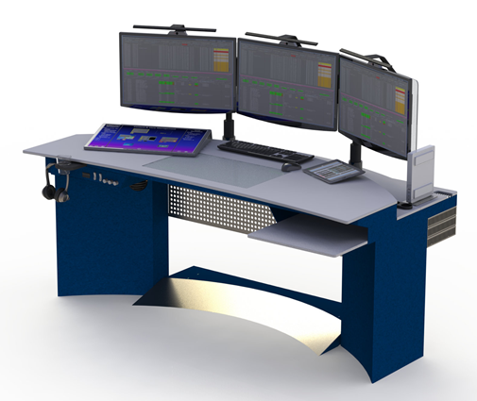
Design: Hardware
The physical console
The main workstation for a single operator for MCR, DCR, ECC
The console has been designed to accommodate the interactive devices, paying attention to :
Anthropometrics & Physical ergonomics
Cognitive needs (e.g. information
from the room to be seen)
Cooperative needs (e.g.,
interaction with adjacent
operators).
Notes:
Console designed considering various points of view

Slide 12
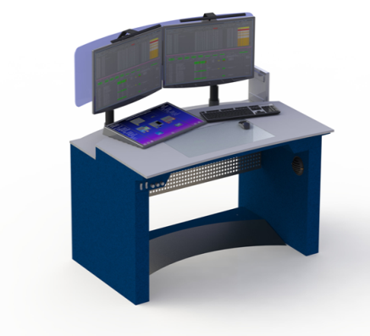
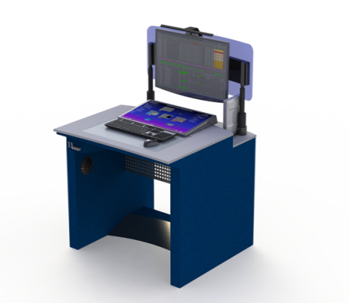
Design: Hardware
The physical console
Working surface (Width 180cm, Depth 65cm)
Vertical TFT displays in front of the operator (3x/2x/1x)
Multi Touch screen on the surface (interactive device, can replace the standard mouse/keyboard for some activities at the console)
Keyboard & Mouse, Virtual keyboard(s) also accessible on the touch display
Lamps (three rows of adjustable LEDs)
Dual air conditioning system (equipment and user)
Electric control for footrest position, height of the displays, light intensity (also via software to persist and restore user preferences)
Notes:
Various flavours of the console: 3, 2, 1 vertical display.
Physical Mock-up of the Console (3 displays) has been produced during the project and is available today.
Details will be provided later by SYMBIO during the Demonstration session.

Slide 13
Design: Software
The User Desktop For Collaboration (UDC)
SW infrastructure that provides:
Collaboration Functions
Window Management Functions
General principles:
Runs on desktop Computers, Tablets, Touch Tables
Operable with standard control devices (mouse, keyboard) as well as with touch technology
Compatible with legacy systems: the UDC is not an operational control system as such, like SCOS-2000 or STC2, but an infrastructure that can support any of these existing systems

Slide 14
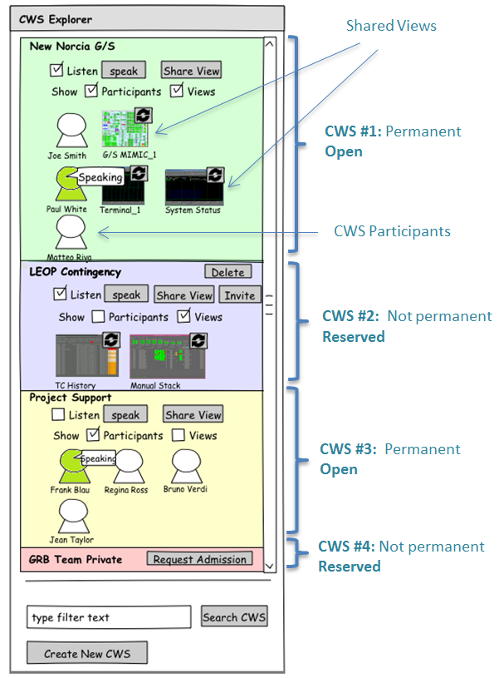
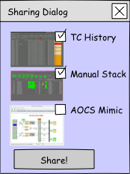
UDC: Collaboration functions
The CWS Explorer
CWS Overview
(resources, participants)
Create new CWS
(open or reserved)
Join existing CWS
Share local Views on a CWS ➢
Voice communication
Notes:
The CWS explorer as a kind of extension to the current Voice Loop control panel.

Slide 15
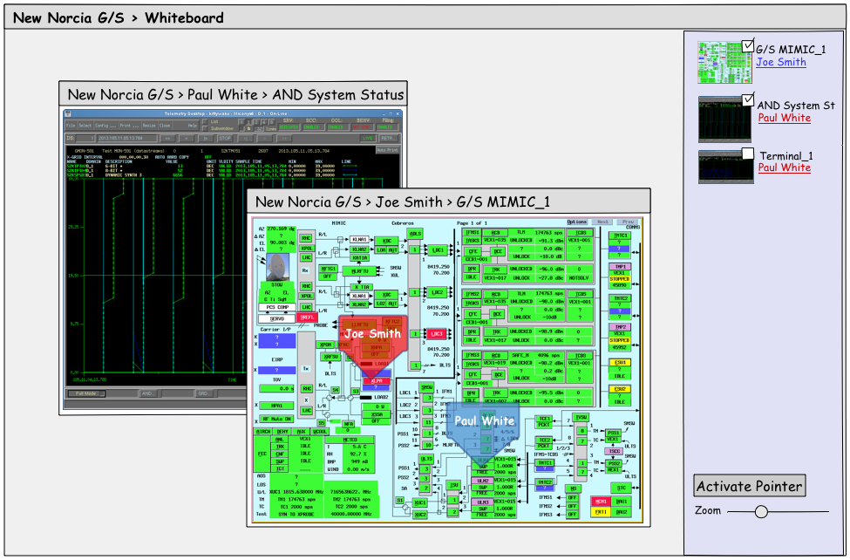
UDC: Collaboration functions
The CWS Whiteboard (one per CWS)
Show all views shared on a CWS
(possibly also with
Control capability)
Jointly seen by all CWS
participants
Allows them to work
together on a common
set of shared views
Point and highlight
elements of the shared
views
Notes:
- The CWS EXPLORER allows viewing (and controlling) all resources shared on a CWS
- It is the fundamental tool for making sure all CWS participants are “on the same page” during the discussion (look at the same information)

Slide 16
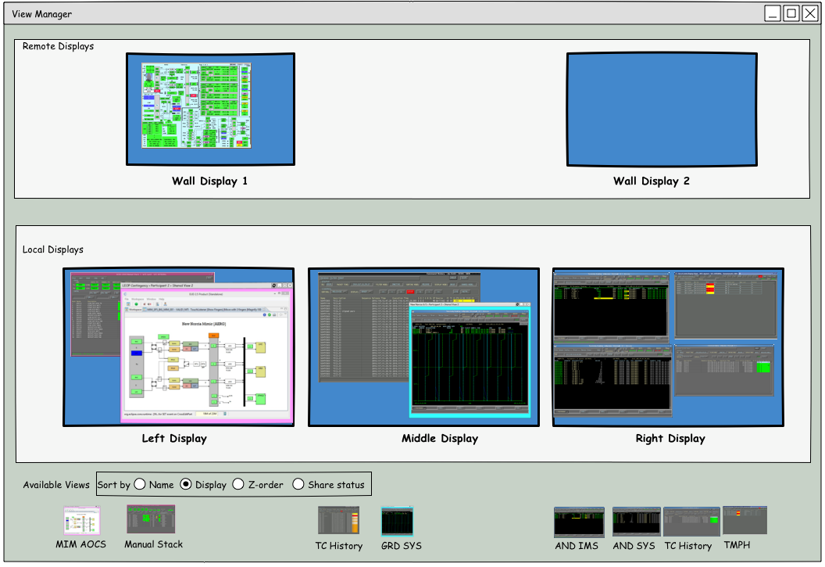

UDC: Window Management functions
The View Manager
Overview of the content of the local displays
(and possibly external screens, like wall displays)
Allows dispatching single views to one of the local monitors or to wall displays ➢

Slide 17

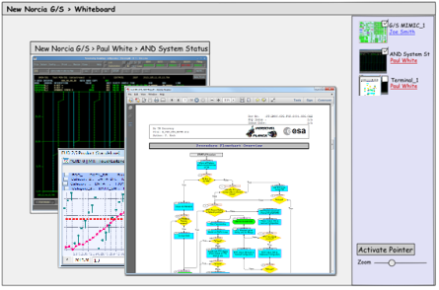
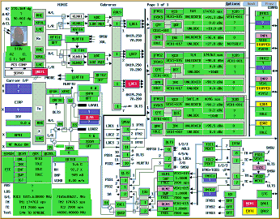
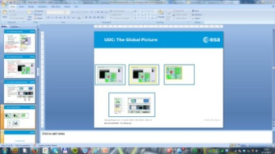


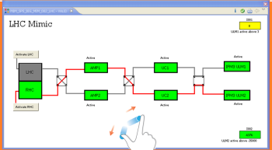
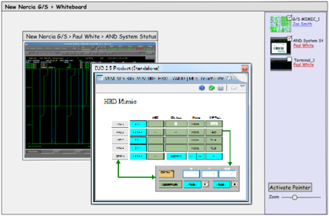
UDC: The Global Picture
CWS1 Whiteboard
CWS2 Whiteboard
CWS1 – A Shared View
Local User
View
User Display 1
User Display 2
User Display 3
User Console
CWS3 Whiteboard
User Touch Display
User Tablet
CWS Explorer
View Manager
Local User View
Wall Display

Slide 18
Prototyping

Slide 19
Prototyping
Prototyping, a strategy for :
trying things out and learning
dealing with things that are hard to predict
get feedback from stakeholders and users
getting new ideas
The Demonstrator
hardware and software artefact for evaluating the proposed design and technology

Slide 20

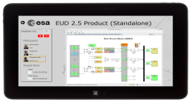
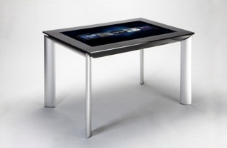
Demonstrator
Hardware
Console, workstation for a single operator, touch screen, mouse and keyboard on the top surface, three vertical TFT screens.
Tablet, a portable wireless device, providing support for nomadic activities.
Touch Table, allows co-located collaborative work
Software
User Desktop for Collaboration (UDC),
which implements the principal concepts of the design
(Collaboration and Window Management functions)
EGOS User Desktop for touch devices (EUD-Touch)
Developed on Windows 8 (mature touch support and fast prototyping)
Notes:
Windows 8 selected because its:
- mature Touch support for a broad range of devices
- Fast prototyping tools available

Slide 21
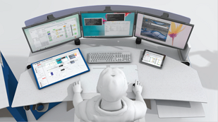
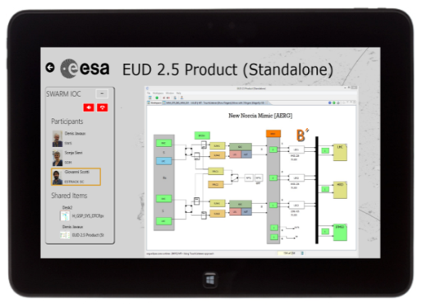

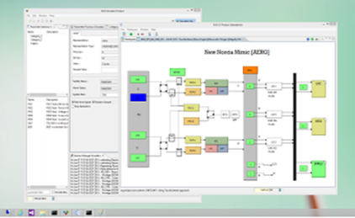
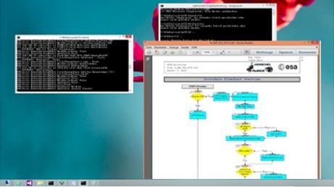
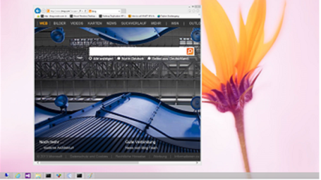
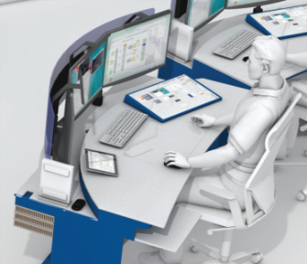
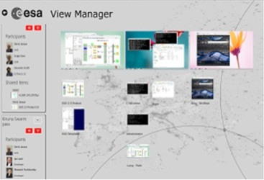
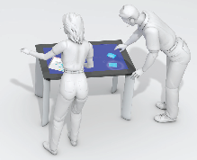

Demonstrator:
User Desktop for Collaboration
WS#1 Operator Console
WS#2
tablet
Shared
by WS#1
Shared
by WS#3
WS#3
Another workstation
- View Manager
- CWS Explorer
[next slide]
WS#4
Table
Notes:
All these devices are integrated within the UDC.
In this example, operators communicate via a CWS.
- Actions done by any participant to a shared View (e.g. browsing a procedure, zooming a plot) are reflected in all replicas of the view on the other workstations.
ANIMATION:
The UDC running on the Operator Console (WS#1): Three vertical displays, one touch display on the desk. The content of each of this displays is shown in the slide. The touch display includes the UDC Control Panel (more details in next slide)
WS#2 (tablet) WS#3 and WS#4 are other workstations connected to the system. They all share resources via CWS.
This slides shows, for instance, WS#2 showing a replica of the mimic shared by operator at WS#1;
WS#1 shows a FOP procedure (PDF document) shared by WS#3 (another console);
WS#4 (touch table) include all resources being shared by all CWS participants.

Slide 22


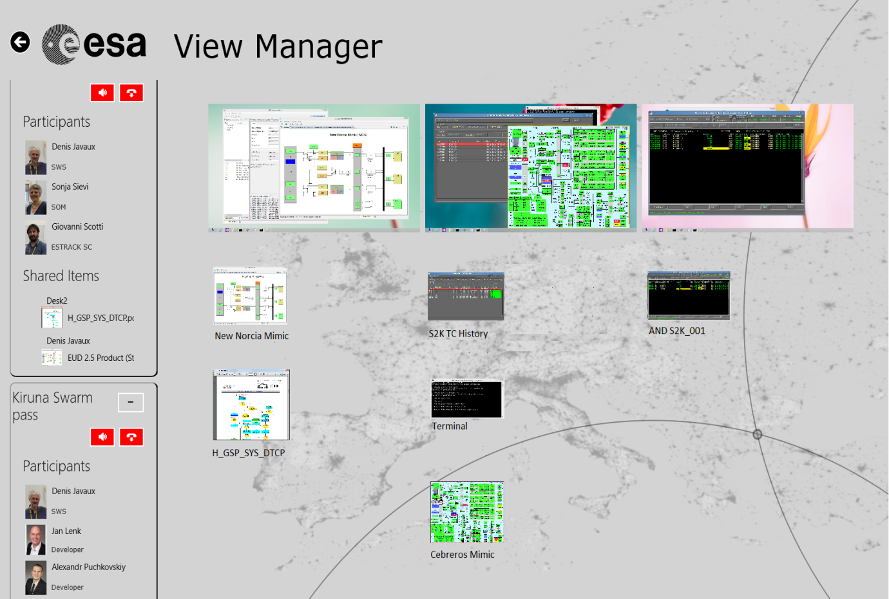
Demonstrator:
View Manager & CWS Explorer
View Manager
Displays Overview
Window Management
CWS Explorer
Available CWS’s
Available Shared Views
List of Participants
Share local views ➢
Inspect and control shared views
Audio controls
Operable via both Touch and Mouse
Notes:
Functions:
- overview of the content of the three monitors (View Manager). Views included in the monitor are represented as thumbnails.
Including views that in the monitor are obstructed . Additional external screens can be added to this group, like for instance wall displays;
- overview of the active Collaboration Workspaces, with their participants and the shared resources (CWS Explorer);
- dispatch, by drag & drop, single views to one of the local monitors or to wall displays;
- create new Collaboration Workspaces and invite people to join the collaborative session;
- share visual resources with the other participants of the Collaboration Workspace, like: Views of M&C applications, document, operational procedures, etc. This is done by dragging a View from the View Manager into the desired CWS on the left;
- access a Collaboration Workspace to inspect and control the Views being shared;
- communicate via audio feed with other participants of a CWS.

Slide 23
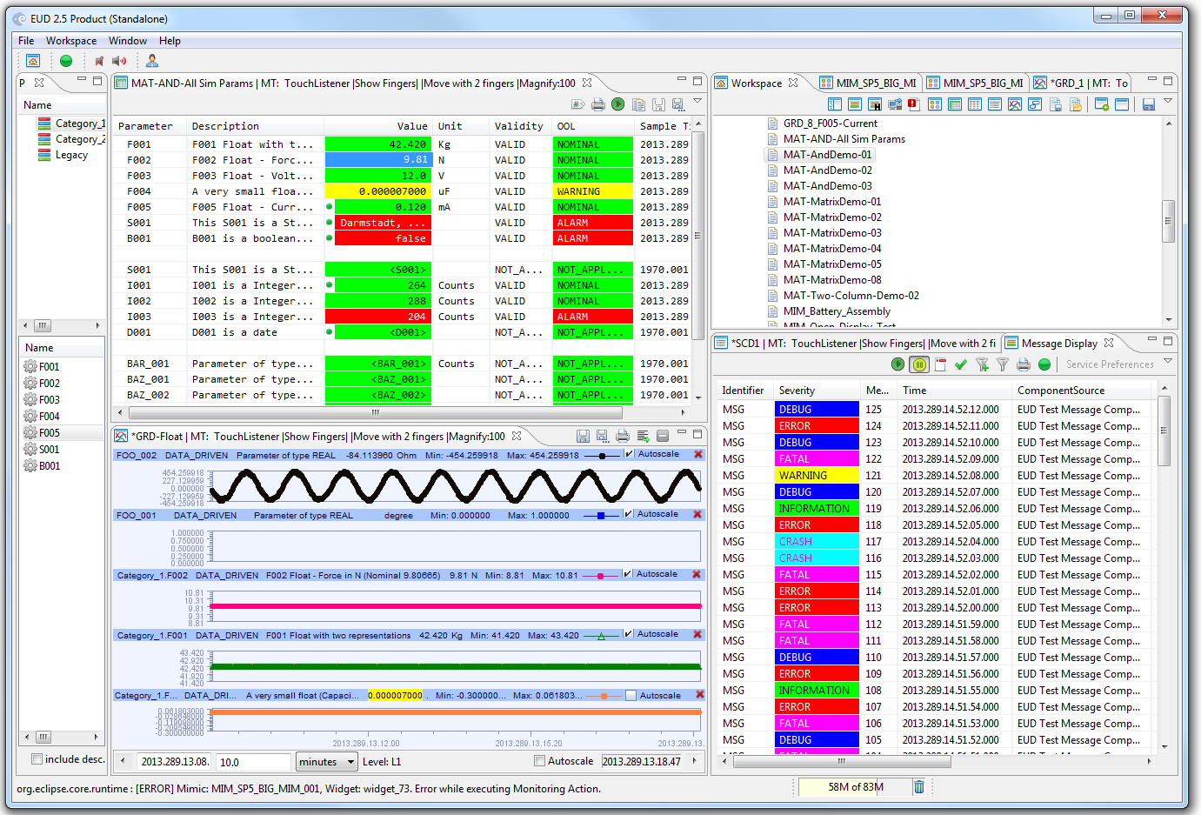

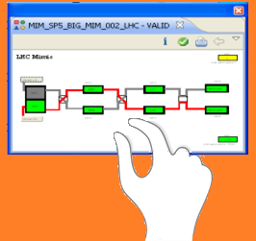
Demonstrator: EGOS User Desktop
Touch-oriented functions on EUD: Pinch to resize a View
Notes:
Investigation on the EUD for Touch as part of the prototyping.
Touch-oriented functions have been implemented in the Demonstrator.

Slide 24
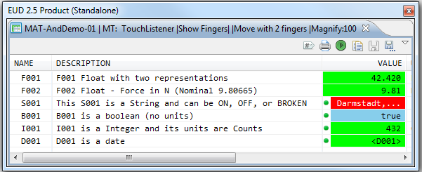
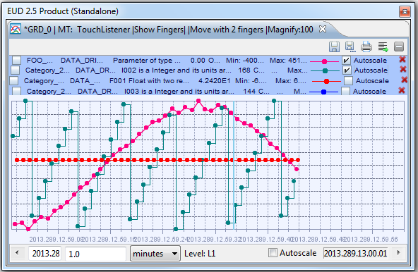
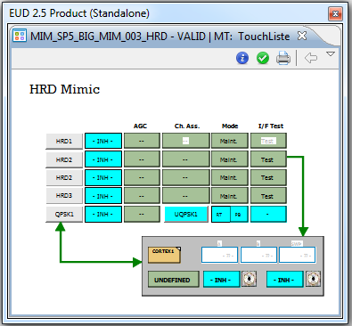

Demonstrator: EGOS User Desktop
Touch-oriented functions on EUD: Pan to move a View

Slide 25
Evaluation

Slide 26
Evaluation
Purpose:
Evaluation of the design concepts and technology proposed
Methodology:
Users exercise the Demonstrator. Feedback collected.
Workshops:
Preliminary Demonstrator (April 2013)
Final Demonstrator (July 2013). Users experienced:
  The User Desktop for Collaboration (collaborative session in a simulated operational scenario).
  The EUD-touch prototype
The lessons learned during the evaluation of the demonstrator have been considered for improving and refining the design.

Slide 27
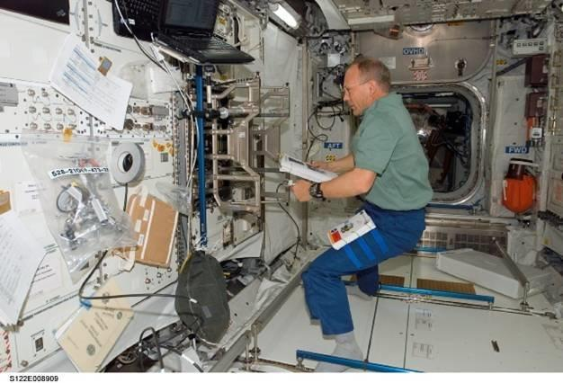

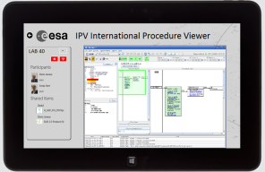

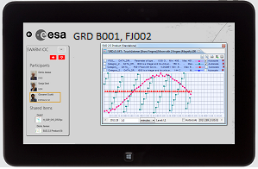
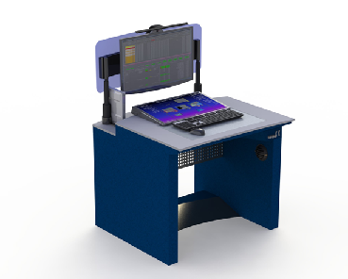


AERG concepts in Columbus Operations
Columbus Science Lab at ISS
System Operations
Synchronized Procedure
Execution (ODF)
Payload Operations
Asynchronous Information on Science experiments
COL-CC
USOC
Notes:
As part of the Evaluation phase, ASTRIUM has investigated on how far the concepts and methodologies elaborated during the Study
Could be integrated into a manned mission such as COLUMBUS (ISS).
Two interesting applications of the CWS concept in operations performed COOPERATIVELY by personnel on Ground and the Crew On-Board.
1. Columbus System Operations (Crew – ColCC)
CWS may provide a Collaboration Tool for Procedure Execution, with
Direct Monitoring from Ground of the on-board activities.
2. PAYLOAD Operations (Crew – Scientists @ USOCs)
For each Experiment CWS is used to share monitoring data and for exchanging information using the CWS as DROP-BOX.
Contact between USOC – Columbus Science LAB is not always possible, in fact.
→ The UDC should be able to handle ASYNCHRONOUS communication (buffering mechanisms).
Issues:
- Low bandwidth --> high data compression required
- contact not always possible --> buffering
USOC : User Support Operation Centre (Science operations)
ODF: On-board Data File, a dedicated procedure format using the International Procedure Viewer (IPV)

Slide 28
Evaluation Results
Collaboration support
The concept of Collaborative Workspace as extension to voice loops has potential to improve collaborative work during operations, among people in the same group or across different departments and locations;
Sharing views (M&C displays, Procedures, Documents, etc.) adds value to the discussion.
Mobility and collaboration
The portable Tablet could allow users (operator, managers) not sitting at the workstation, or remotely located (e.g. office) to contribute to a group discussion, having direct access to live monitoring information.

Slide 29
Evaluation Results
Touch Technology
Controlling the UI via Touch interface has shown, in general, severe limitations: Inaccuracy, Fatigue. Due to:
limited precision of the technology (touch HW and O.S.)
Ergonomic issues potentially causing long-term health problems
interaction design of the applications (EUD is mouse-oriented)
However,
the specific touch oriented functions added to the EUD appear more usable and efficient, with respect to equivalent mouse functions.
To be really effective on touch, UIs have to be explicitly engineered for this kind of technology.
Migration of existing mouse based UI products not feasible without heavy re-engineering.
Notes:
Ergonomics issues: position and movement of arms and hands can be unhealthy on long terms

Slide 30
Evaluation Results
Touch Table and co-located teamwork facilities
Touch tables for operations not practical (issues with touch control, requires dimmed light, tiring to work with)
However,
the concept of co-located teamwork facility can be a benefit:
a location where people gather to address specific tasks that require close contact (e.g. discussing critical issues, problems, recovery actions, etc.)
where live monitoring information, electronic documents, procedures, are available
➔

Slide 31
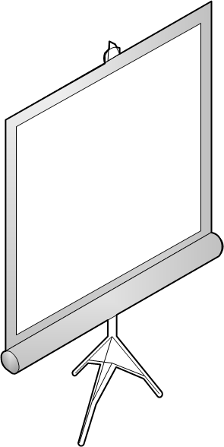
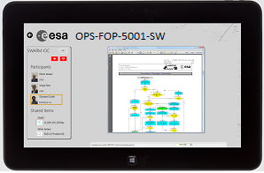

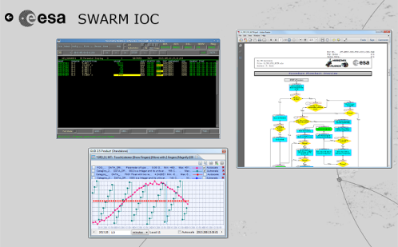
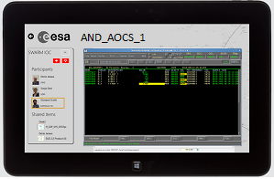



Evaluation Results
Co-located Teamwork Facility
A solution supported by the UDC design:
A wall display shows a CWS with a set of shared resources (replaces the touch table)
participants use own tablets for adding resources to the CWS and controlling them

Slide 32
Feasibility

Slide 33
Feasibility
What could be made available at ESOC operations in the near future?
Touch technology applied to existing ESOC UI applications (specific, limited uses)
Collaboration infrastructure supporting existing ESOC systems
Constraints:
Linux O.S.
Compatibility with legacy systems (SCOS-2000, STC-2, …)

Slide 34
Feasibility
Touch technology
Touch technology API still behind on LINUX
(SWT 3.7+ with touch support on Win32 and Mac OS only)
Existing applications are mouse oriented
✗ Not recommended (considerable time and effort to re-engineer S2K or STC2 GUIs that take really advantage of touch control)
➔ However, ad hoc implementations based on Windows are already possible with the EUD (multiplatform)
Collaboration
SW technology for video and audio distribution is already available on LINUX for desktop computers (RDP, RFB)
➔ A collaboration infrastructure supporting existing ESOC systems is today feasible on LINUX
Notes:
Touch is not recommended,
However, adapting existing EUD displays more suitable for Touch (e.g. Mimics) or creating new ones touch oriented can be done on Windows.
Collaboration:
The view sharing may be realised with existing out-of-the-box solutions like RDP (Remote Desktop Protocol) or RFB (Remote FrameBuffer protocol), however these TCP-based protocols are not well adaptable for multicast scenarios, causing significant overhead in network traffic.
We therefore recommend a Linux-specific custom implementation of video distribution for actively participating clients. This implementation would include screen capture and video compressing (for instance, based on the FFmpeg library for Linux systems), and a networking layer which uses the PGM (Pragmatic General Multicast) protocol, which reduces overhead in multicast connections, while ensuring that packets arrive without loss and in-order, unlike UDP.

Slide 35
Conclusions

Slide 36
Conclusions
There is a possibility at ESOC to further improve support to collaboration through CWSs as an extension of voice loops with content
Touch Technology should be introduced with care and UIs specifically designed for that kind of interaction
Tablet devices can provide mobile or remote access to monitoring information and a valuable collaboration tool

Slide 37




Advanced Ergonomics Study
Thank you
and to all the ESOC people that have contributed to this project:
operators, engineers, managers, …

