Slide 1
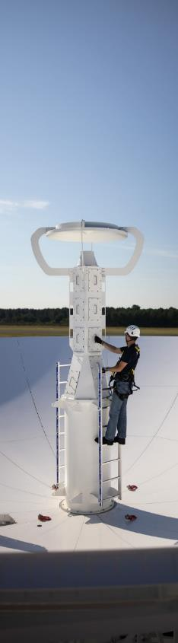
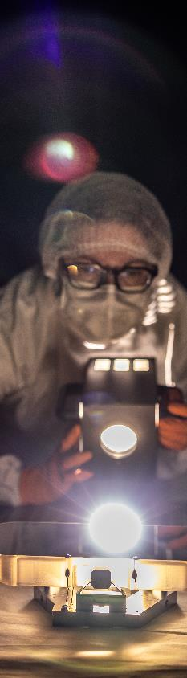
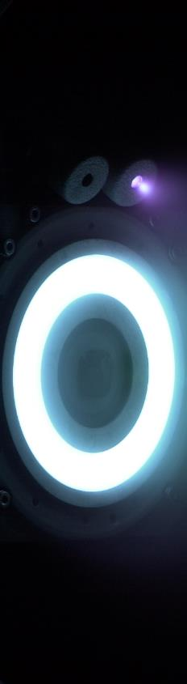
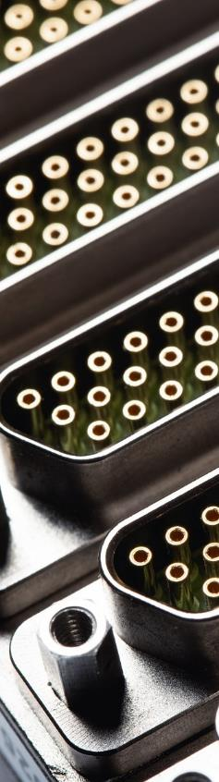
OCMO
Final Presentation

Slide 2
Agenda
01
04
|
|
Introduction / Context
Phase 2
02
05
|
|
Project Timeline
Project Review
03
|
Phase 1

Slide 3
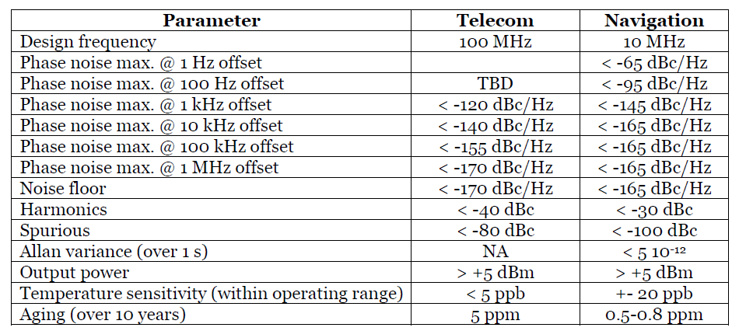
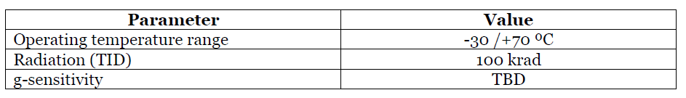
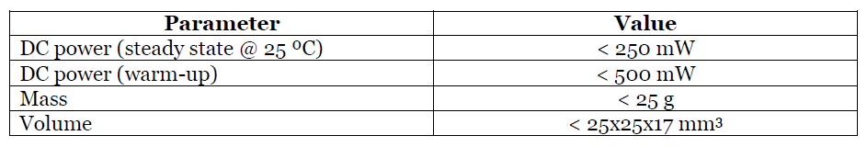
Introduction
Objective of the project
    Realize a 10 MHz and a 100 MHz MEMS high performance oscillator based on MEMS Resonator.
    Combine the advantage of Piezo technology (high Q factor), with the advantage of MEMS microstructures;
    Reduce overall power consumption of a standard low consumption OCXO.

Slide 4
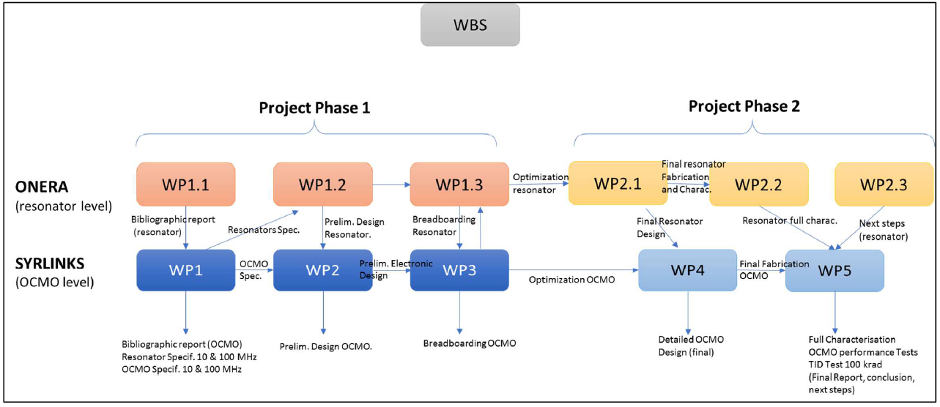
Introduction
CCN FemtoENG

Slide 5
Project Timeline (deliverables)
2020
Kick-Off
TN 1.1 Literature Review and Patent Survey
2022
TN 1.3 Critical Building Blocks Detailed Design
2023
TN 2.1 OCMO Detailed Design
Test Plan and Procedures
2024
TN 2.2 OCMO Performance Evaluation V1.1
TN 1.2 OCMO Preliminary Design
TN 2.3 OCMO Future Developments

Slide 6
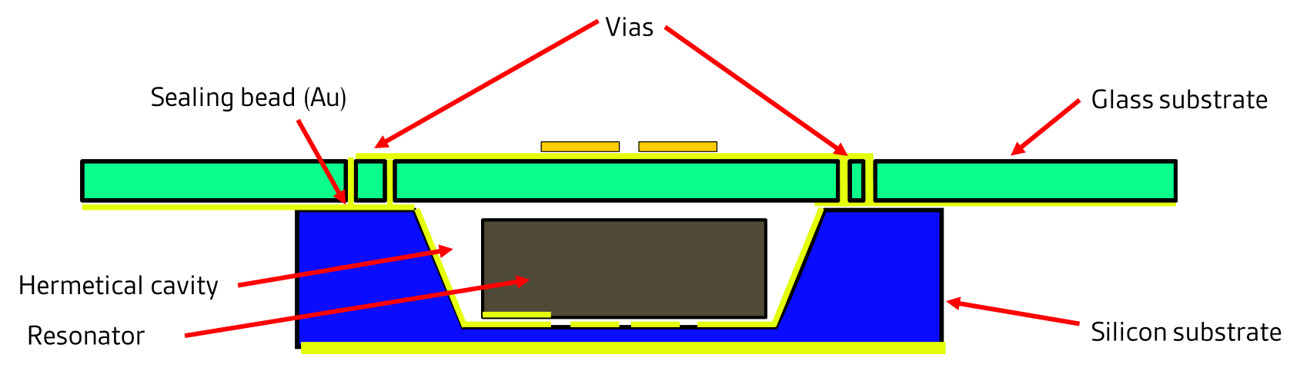
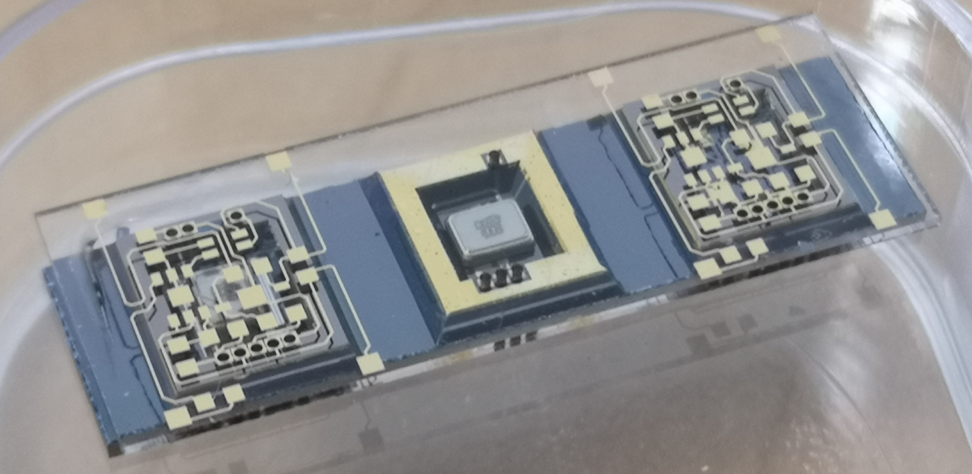
Phase 1
Literature Review (Oscillator and packaging)
  Solutions of vacuum packaging : Cold Welding, Gold wafer level thermocompression, Silex wafer stacking and MEMS.
  Presentation of IHR (Internally Heated Resonator) designs.
  Solutions of oscillator external packaging
  Electronics topology
  Presentation of first version of silicon oven.

Slide 7
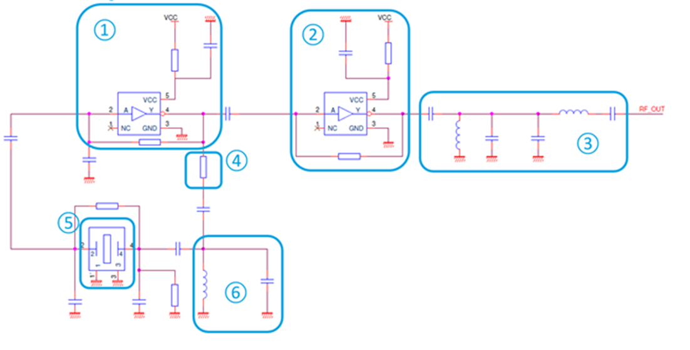
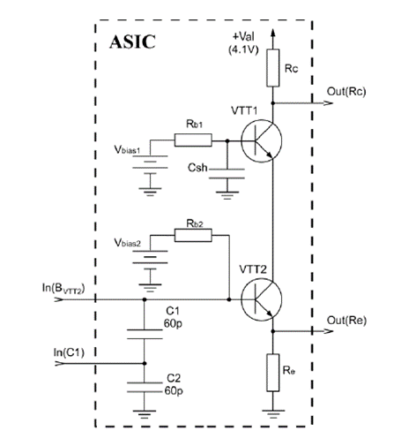
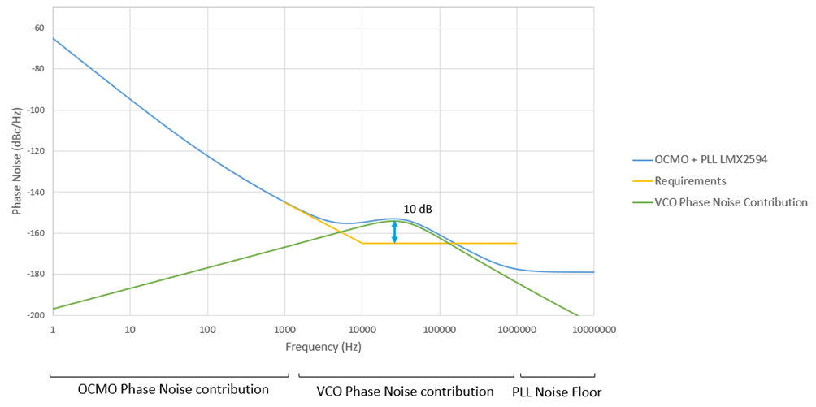
Phase 1
PDR (Oscillator, Accuracy & SiTime)
  Circuit design simulation analysis (Syrlinks ASIC & Pierce Gate) → Pierce Gate oscillator more suited for quartz MEMS (given expected motional resistance).
  Frequency accuracy and multiplication. Simulations and study of DDS and PLL synthesis → PLL more suited for performance less for power consumption.
  SiT5711A characterization
Phase Noise simulation of 10MHz MEMS oscillator (with expected motional parameters) + LMX2594 PLL). Output 10MHz for accuracy tuning

Slide 8
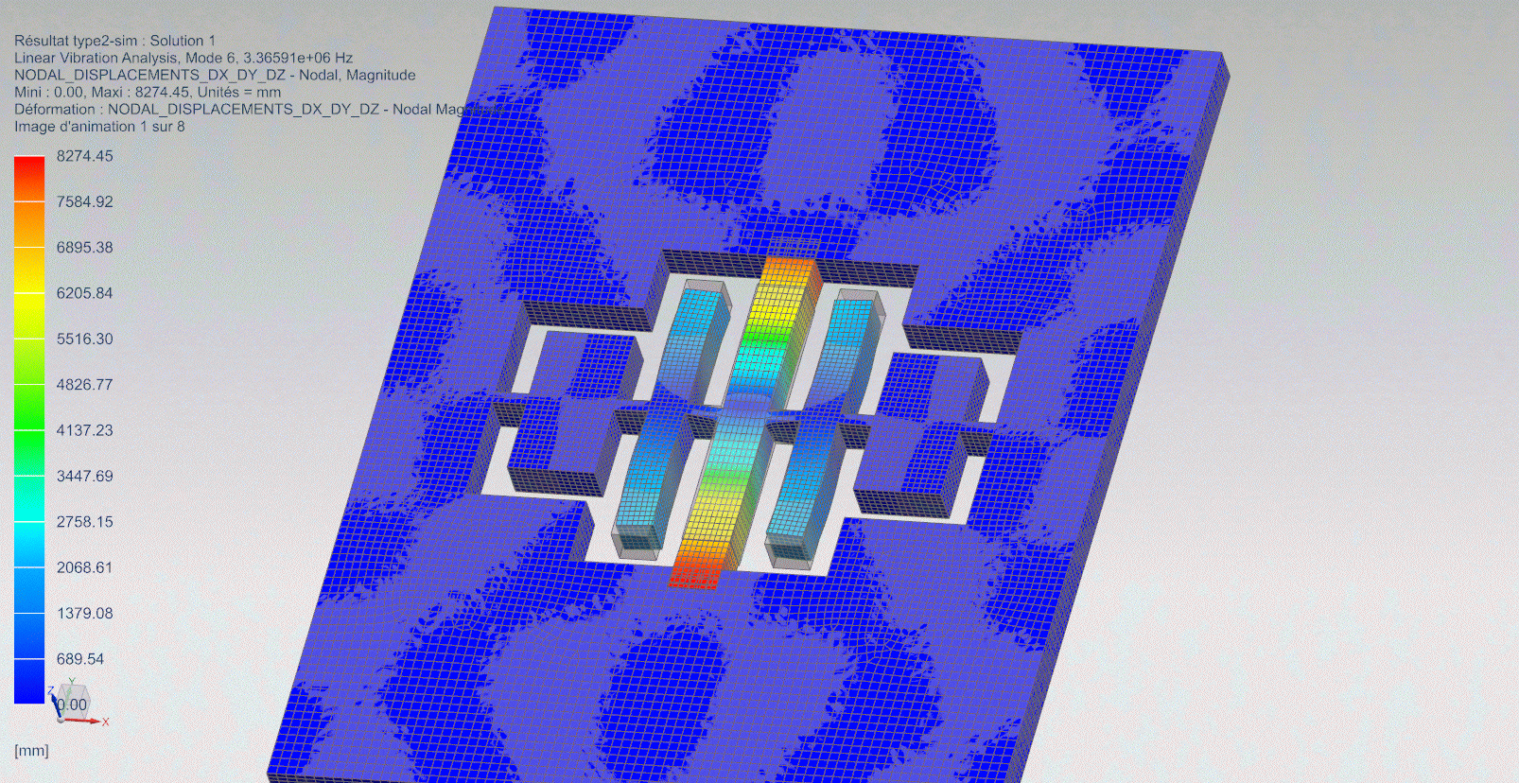
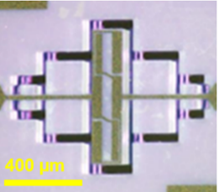
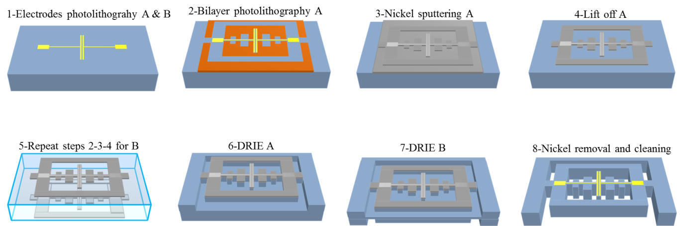

Phase 1
10MHz length extension mode resonator
 | Starting point | Phase 1
Fr | 4 MHz | 10 MHz
Tp | -10 °C | 125°C
Q | 100k – 300k | 100k
Rm | 10 kΩ | 3kΩ
100 µm thick wafer
Z-cut
2,5 x 2 mm²
  DRIE Process
- 8 resonators packaged under vacuum and measured

Slide 9
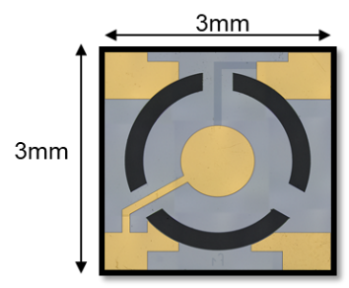
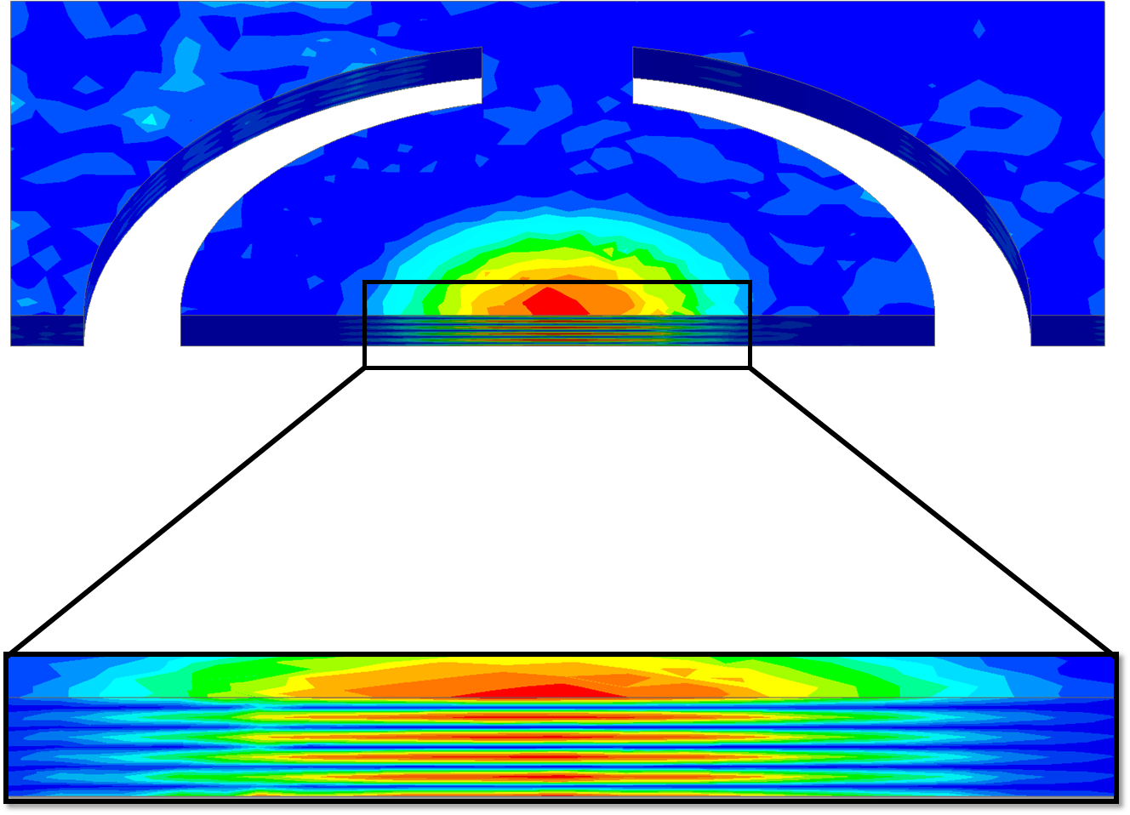
Phase 1
100MHz thickness shear mode resonator
  100MHz thickness shear mode resonator
Fr | 100 MHz
Rm | 2 kΩ
Co | 300 fF
Q | 100 000
  SC cut 5fth overtone Thickness Shear Mode Resonator
  H=100µm
  3 x 3 mm²
  Same DRIE process as the 10MHz LEM resonator

Slide 10
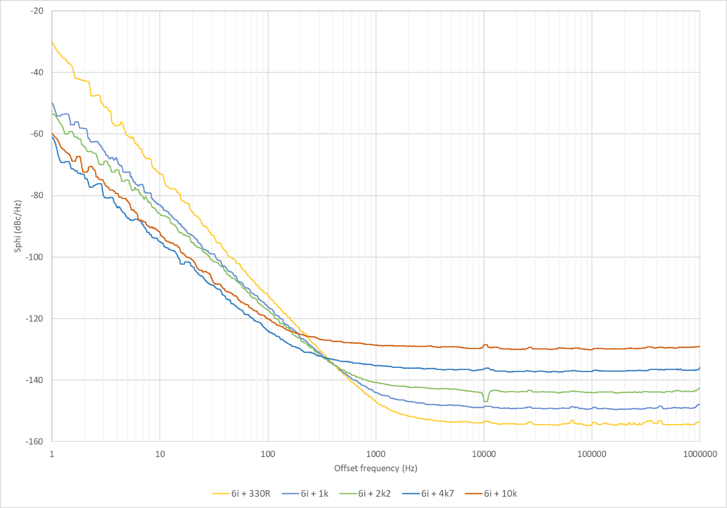
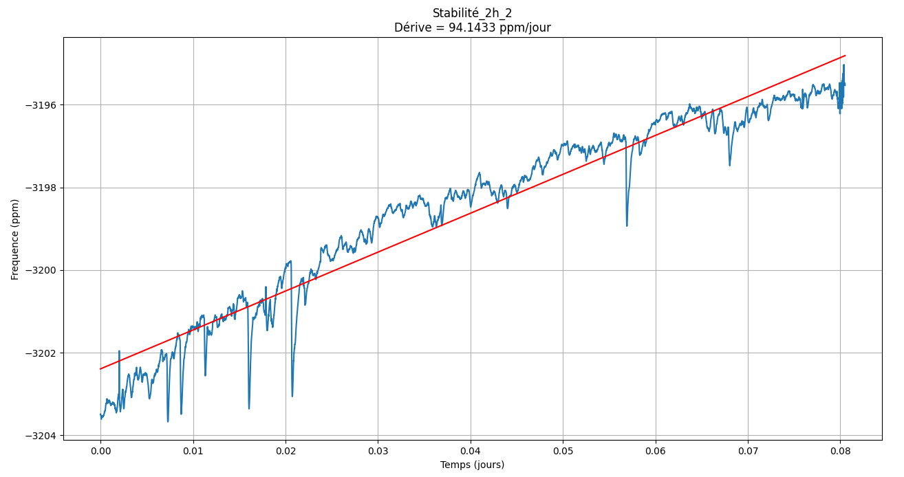
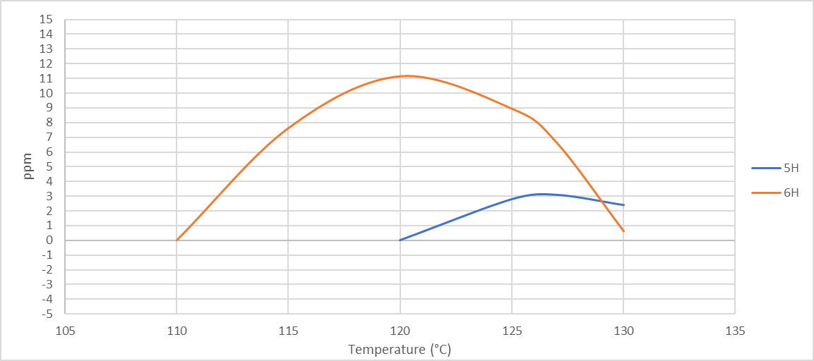
Phase 1
Phase noise of MEMS oscillator using « 6H » resonator for different drive levels.
CDR (Breadboard)
  Pierce gate with 10MHz MEMS breadboard and measurments.
  Heating of the resonators and FreqvsTemp measurements.
Upper turnover point of resonators 5H & 6H
Ageing of 6H MEMS oscillator (6ppm/day)

Slide 11
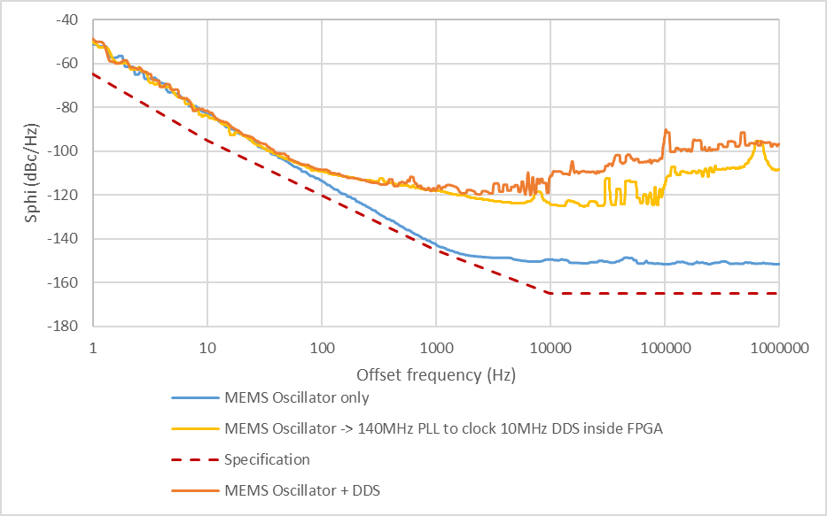
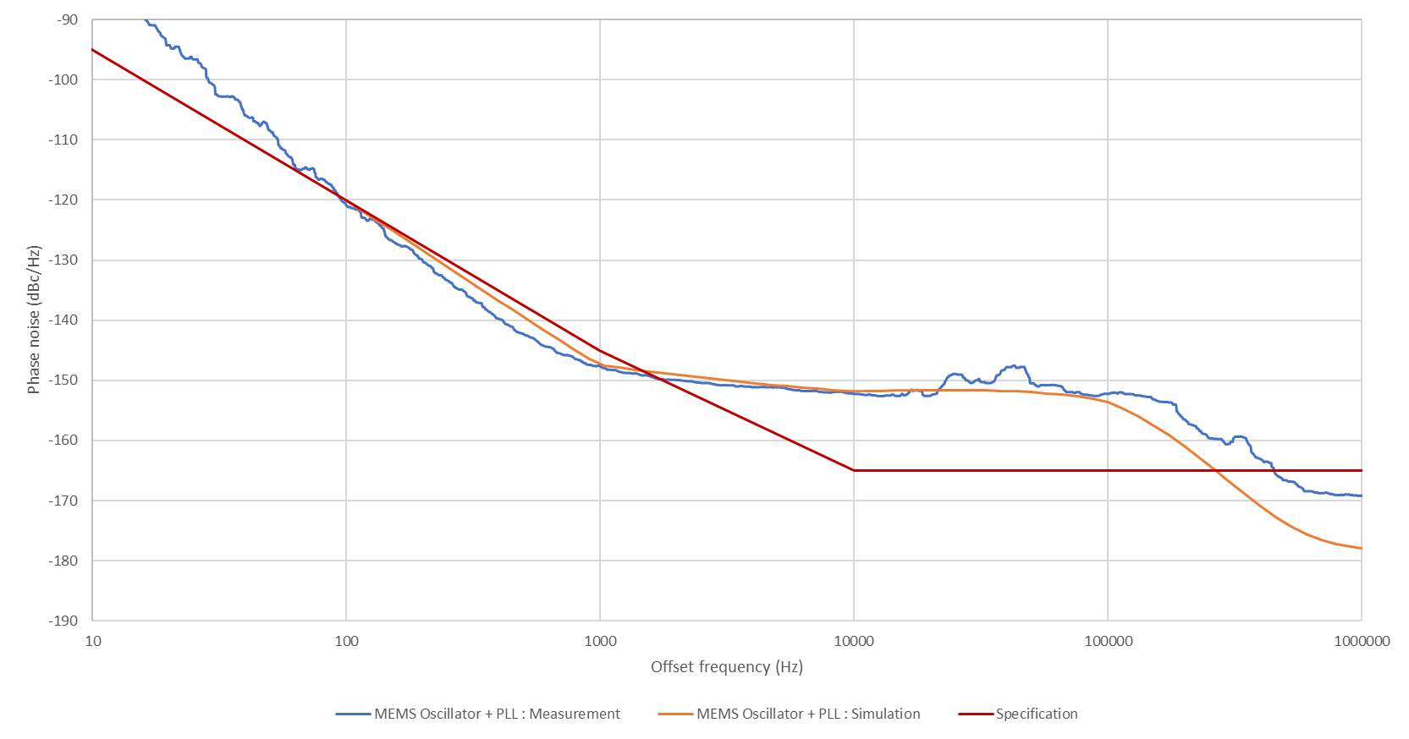
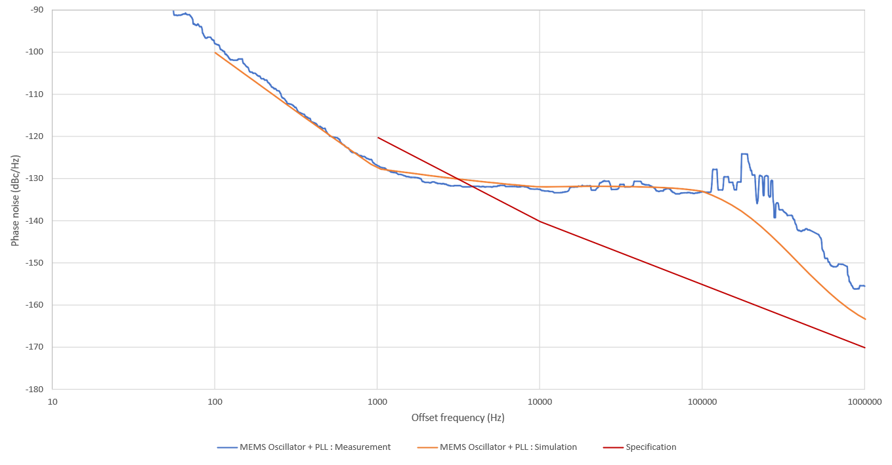
Phase 1
Phase Noise of 10MHz MEMS oscillator + DDS
Output=10MHz
CDR (Breadboard)
  LMX2594 simulations and measurments of 10MHz (accuracy) and 100MHz synthesis.
  DDS development and measurment using ICE40LP8K FPGA.
Phase Noise of 10MHz MEMS oscillator + PLL LMX2594
Output=10MHz
Phase Noise of 10MHz MEMS oscillator + PLL LMX2594
Output=100MHz

Slide 12
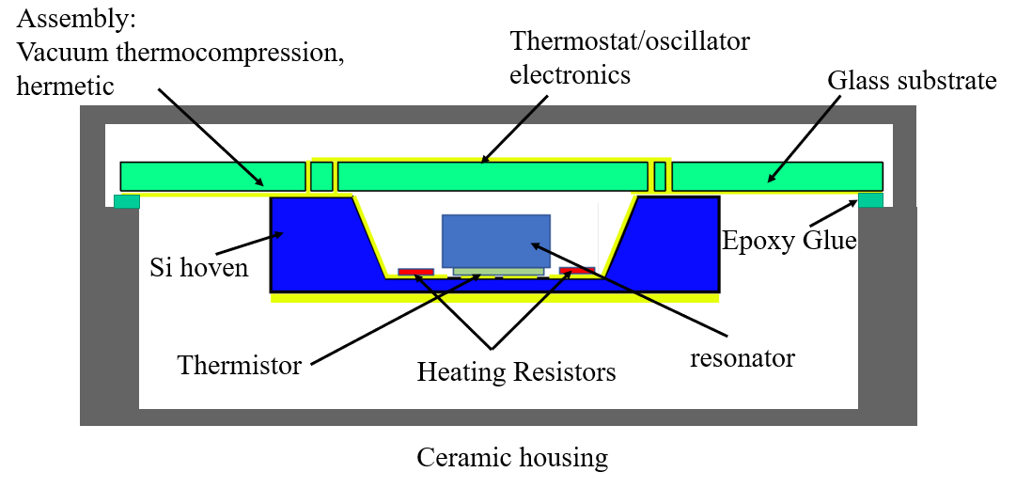
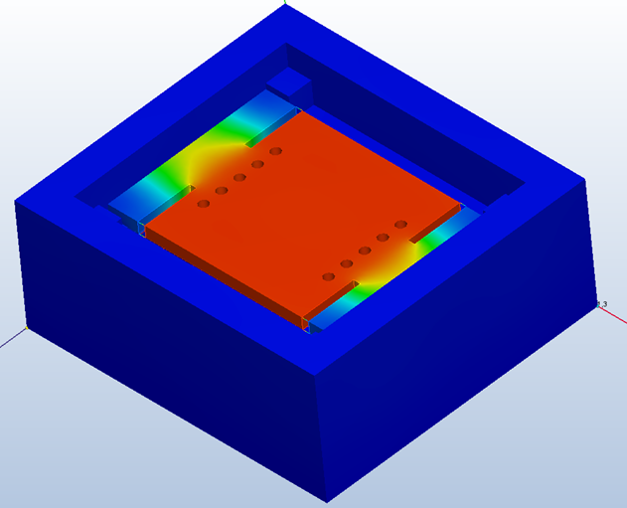
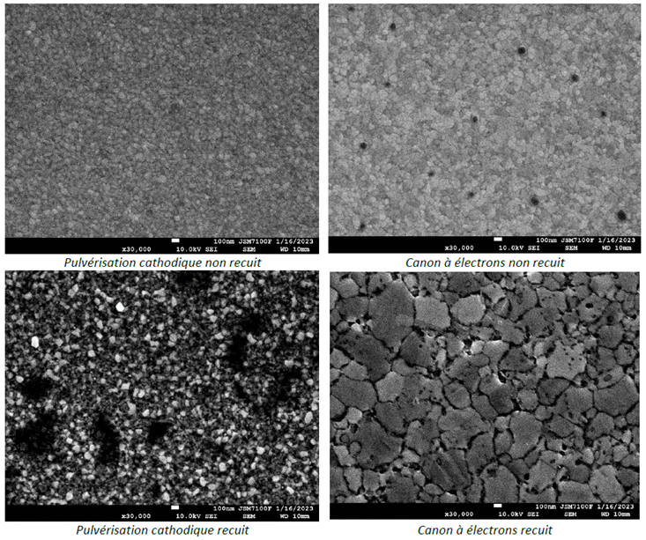

Phase 2
Cross-section view
DDR
  Presentation of the architecture
  Thermal simulation and optimization of the silicon oven
  Oven control circuit
  Study of electrical resistivity of thin layers Ti/Au (INSA)
  100MHz transimpedance amplifier oscillator simulation (Syrlinks)
  Silicon oven manufacturing flowchart definition

Slide 13
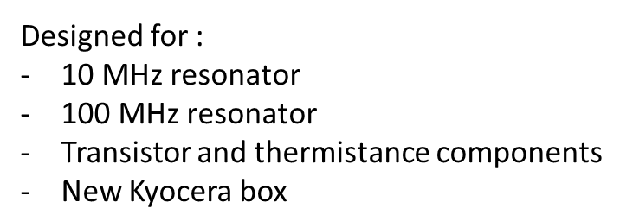
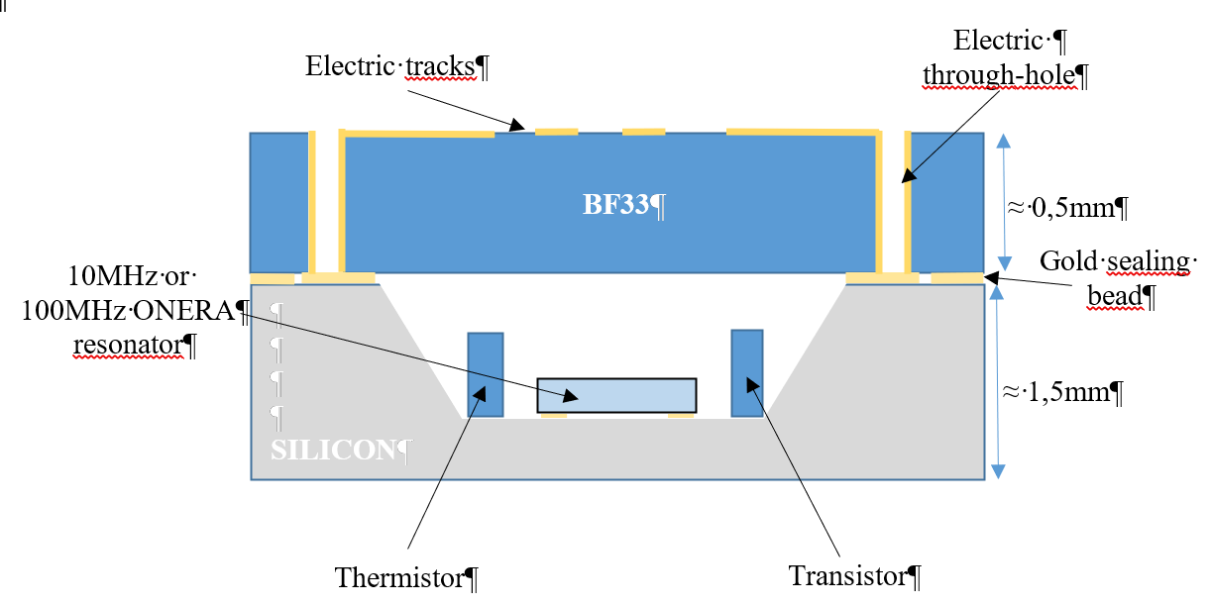
Phase 2 - TASK 1 : OCMO conception
OCMO section view

Slide 14
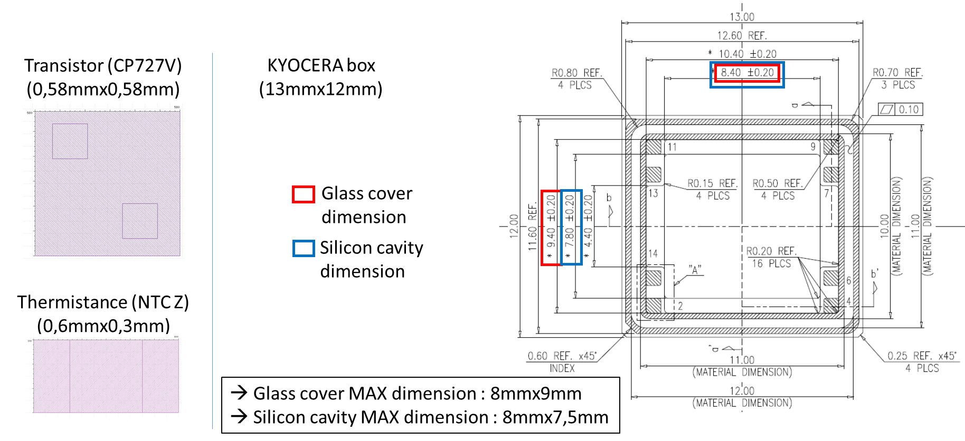
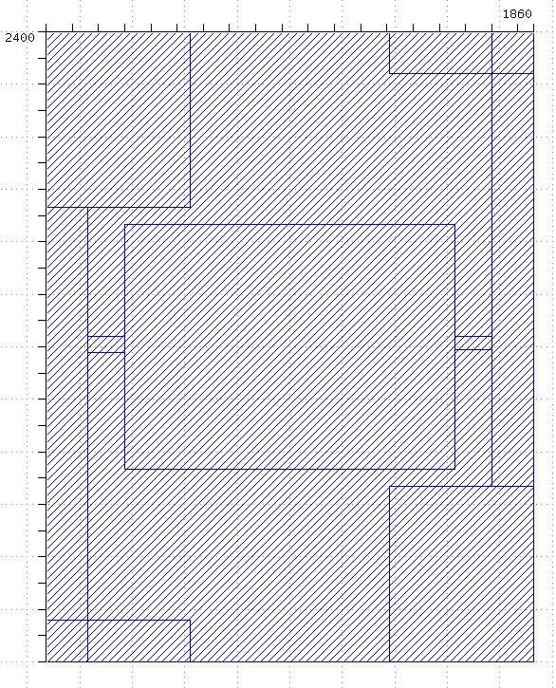
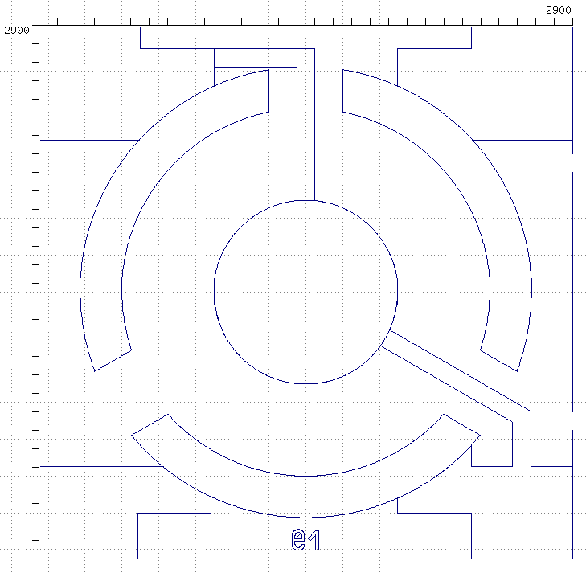
Phase 2 - TASK 1 : OCMO conception
OCMO Components Layout
10 MHz resonator (2,4mmx1,86mm)
100 MHz resonator (2,9mmx2,9mm)

Slide 15
Phase 2 - TASK 1 : OCMO conception
OCMO packaging

Slide 16
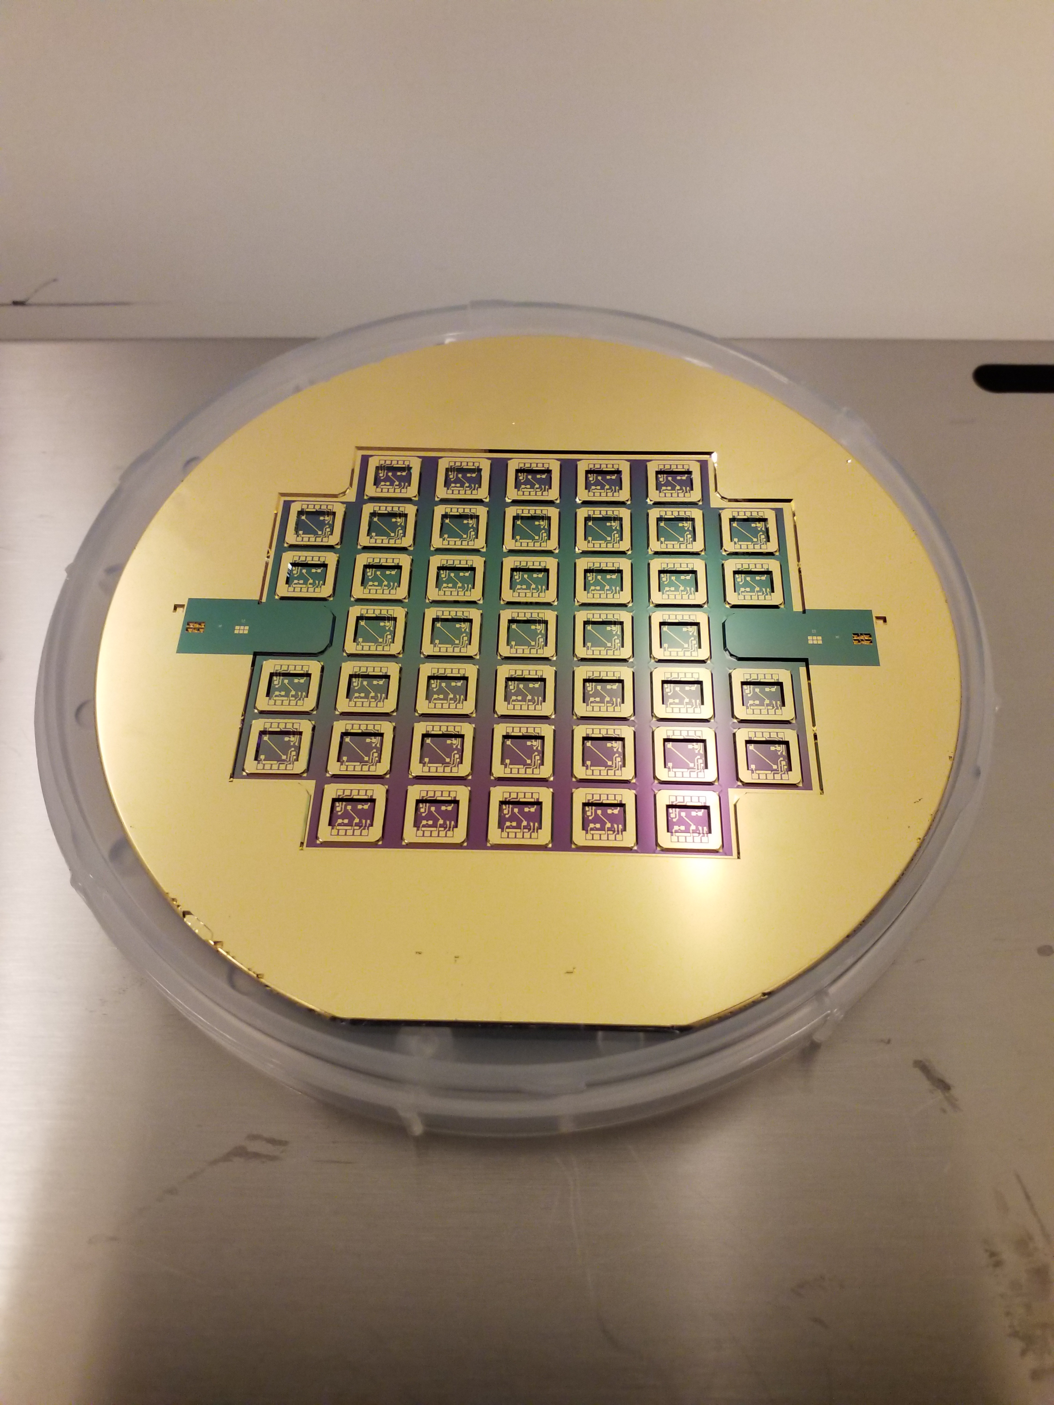
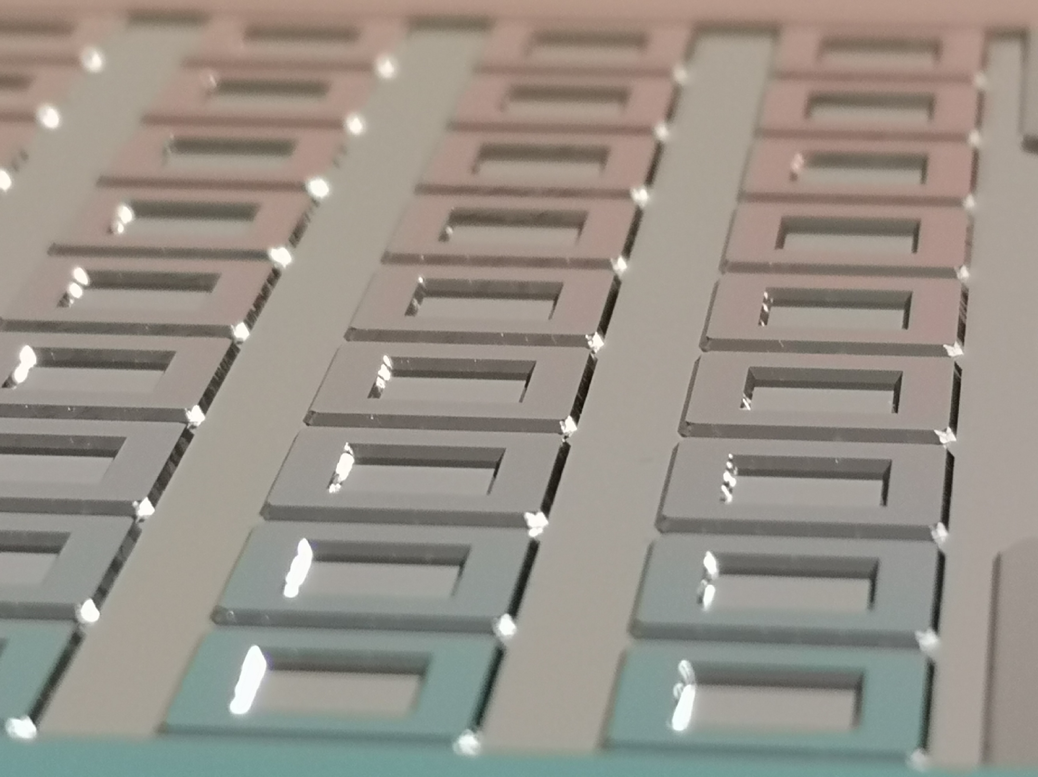
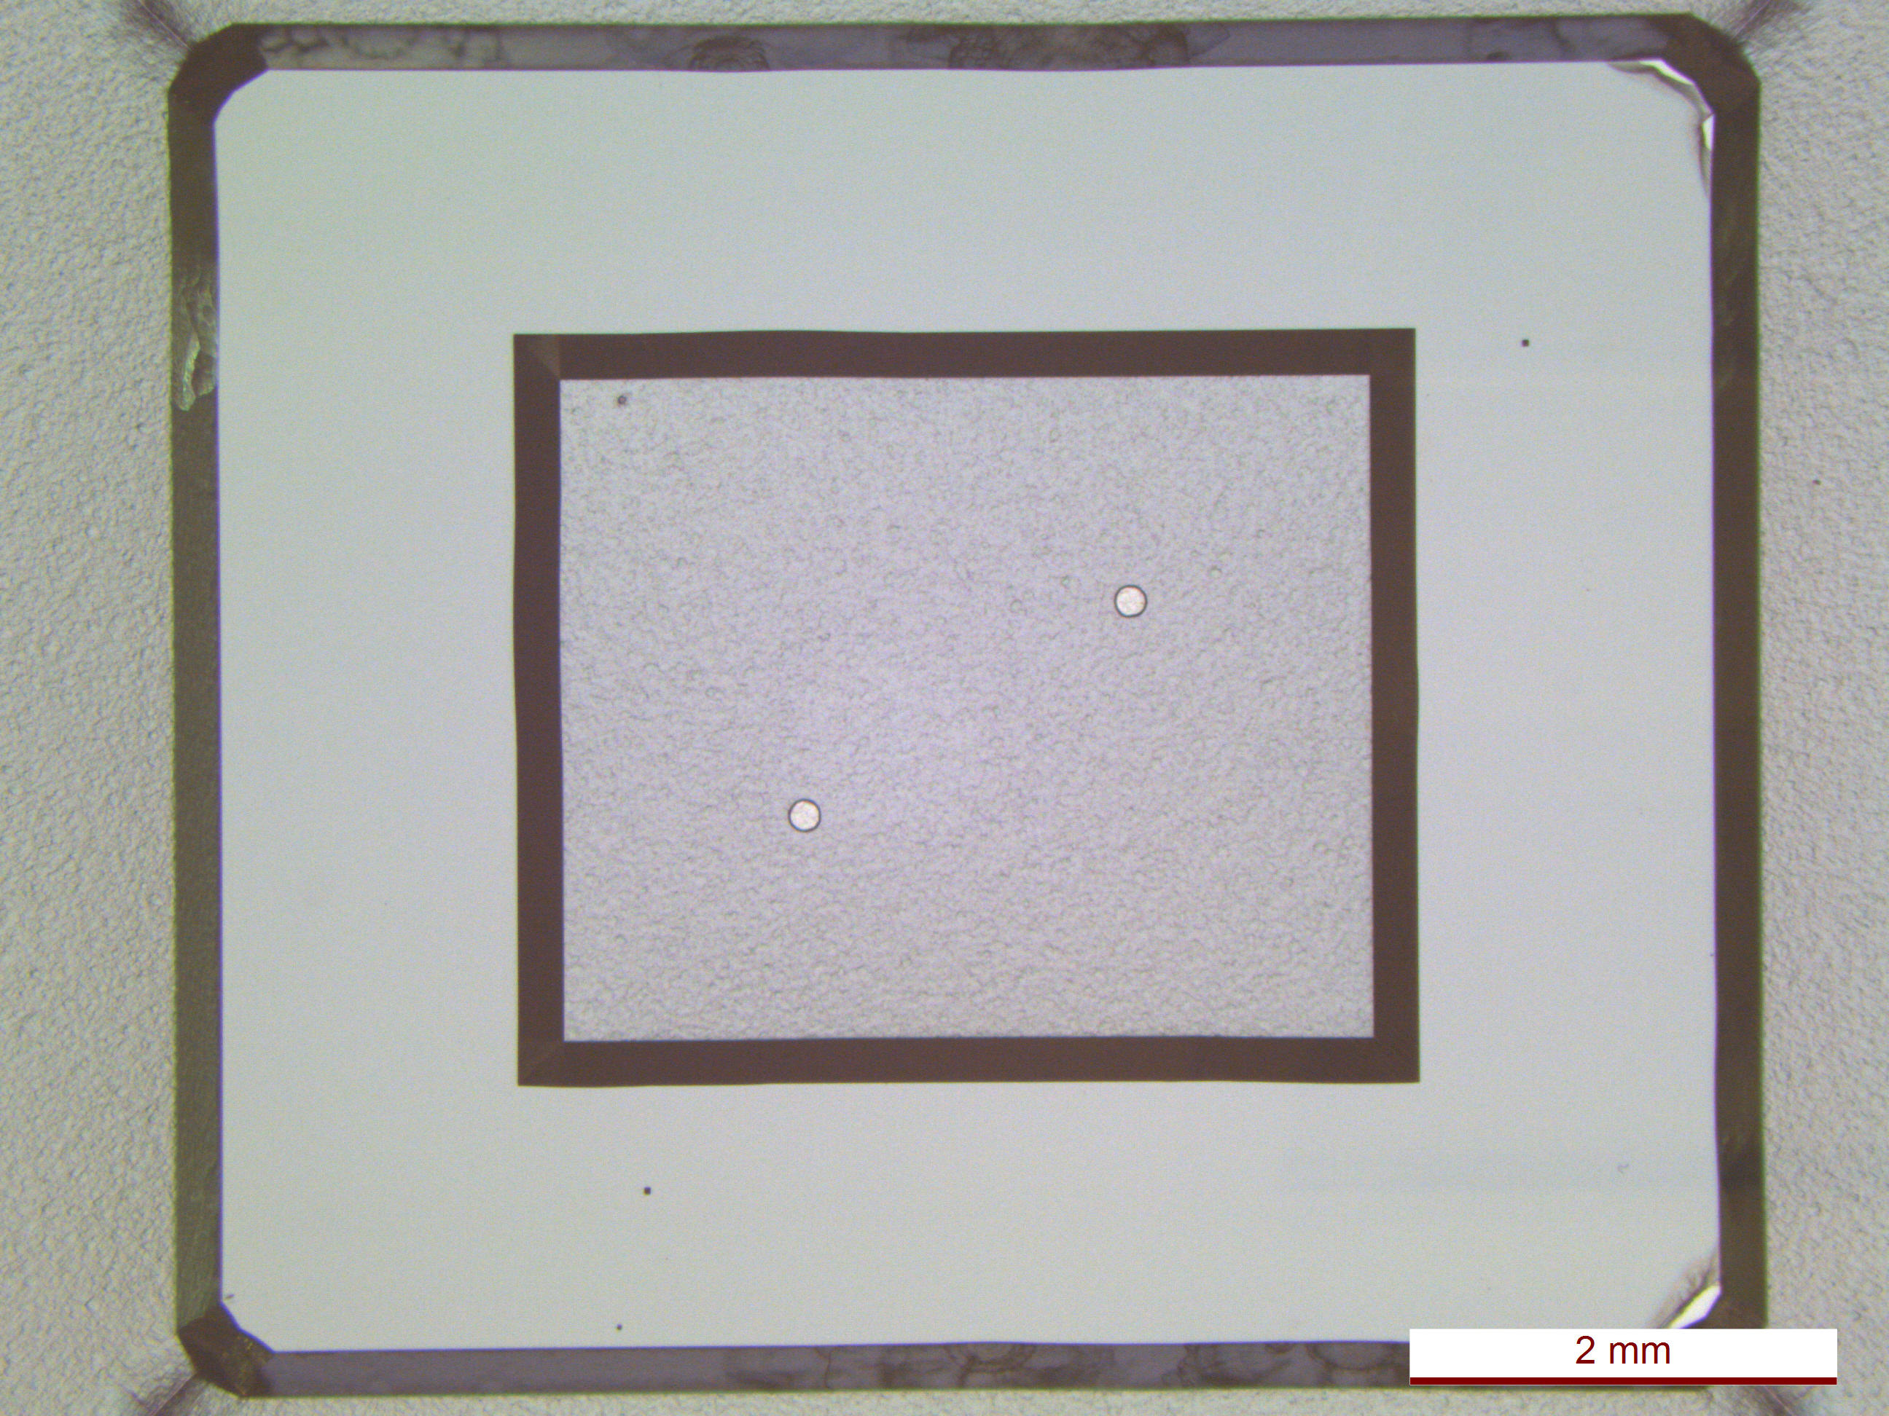
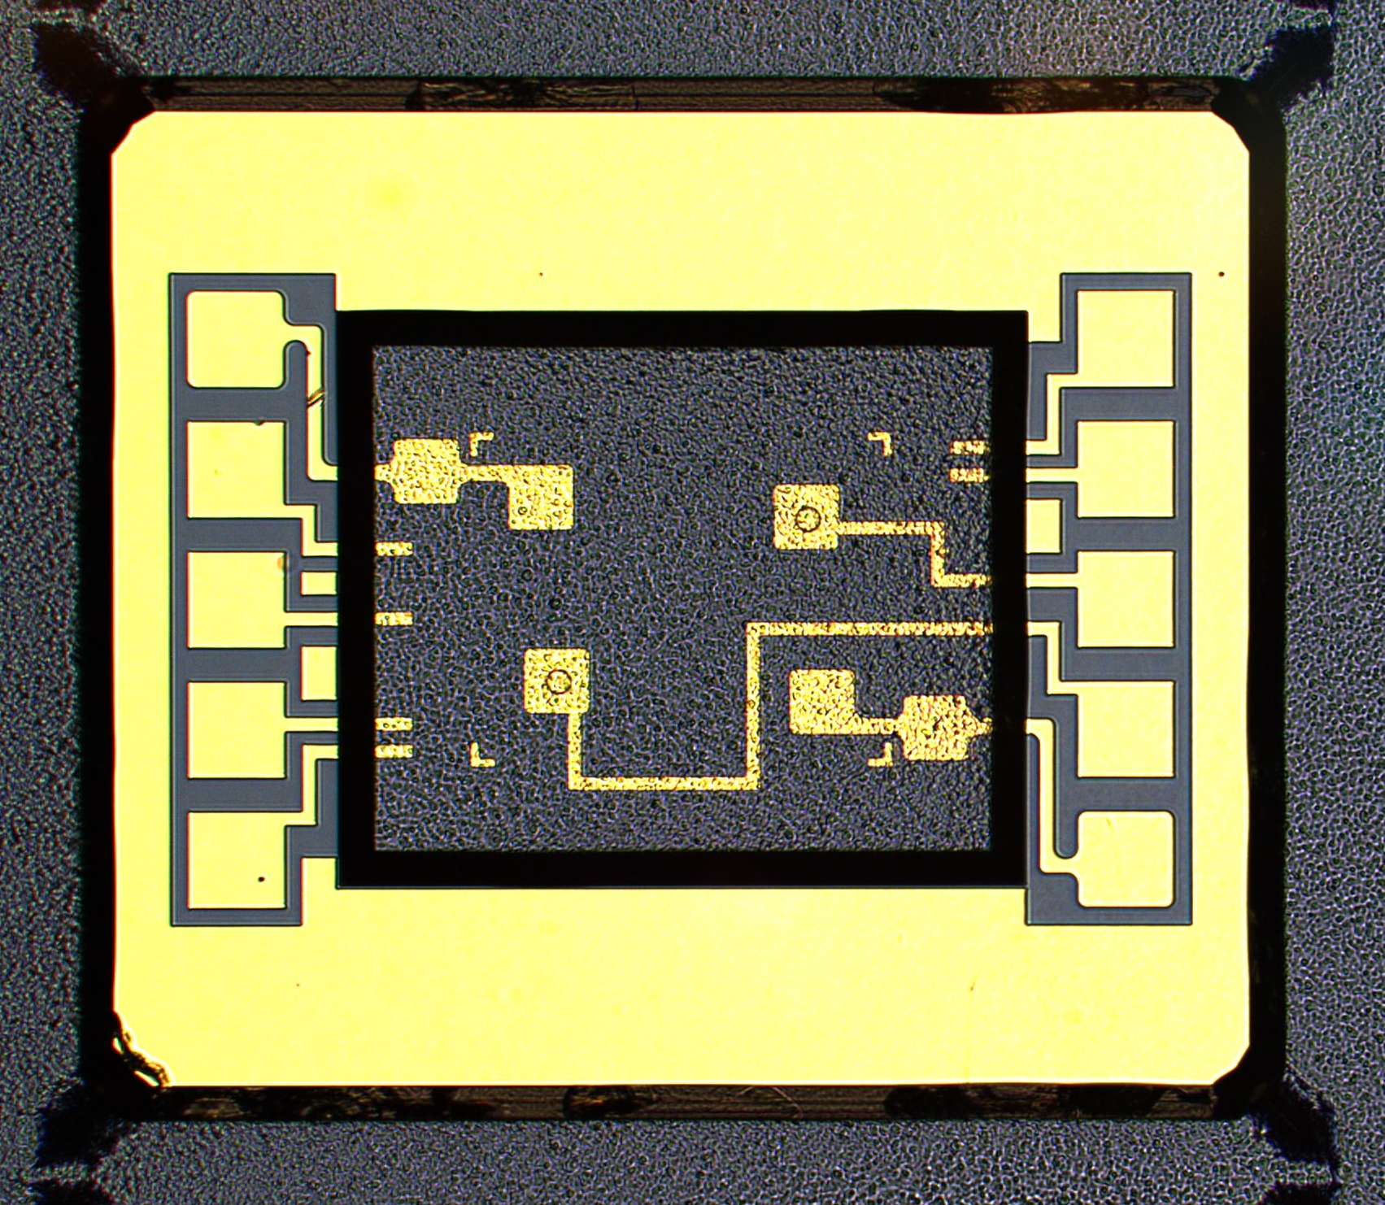
Phase 2 -TASK 1 : OCMO conception
Silicon cavity
N° | Step | Description
1 | Silicon wet etching | BHF 48 % Etching depth = 400 µm Etching velocity = 1µm/min
2 | Thermal oxidation | Thermal oxide = 2µm
3 | Silica opening | Ground electric contact with silicon wafer (parasitic capacitance suppression)
4 | Electric tracks and Gold sealing bead | Ti(10nm)/Au(300nm) electrode
Material | Silicon (100) 4 inch 1,5mm-thick Resistivity > 10 kW.cm
x2 on Q factor

Slide 17
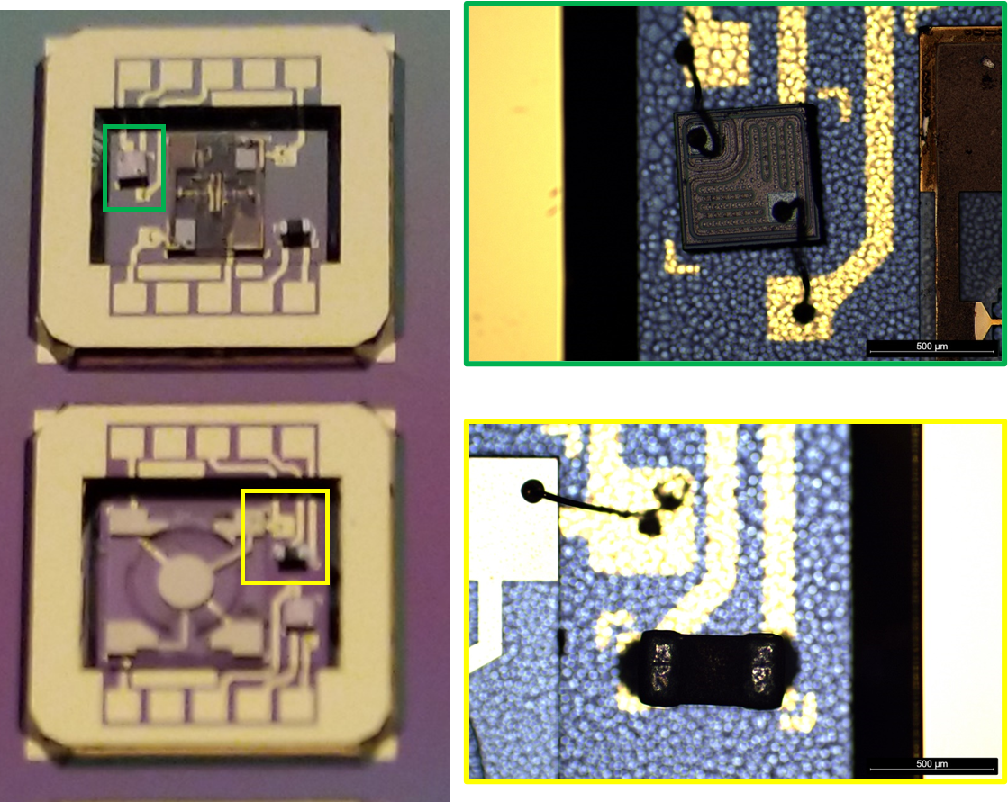
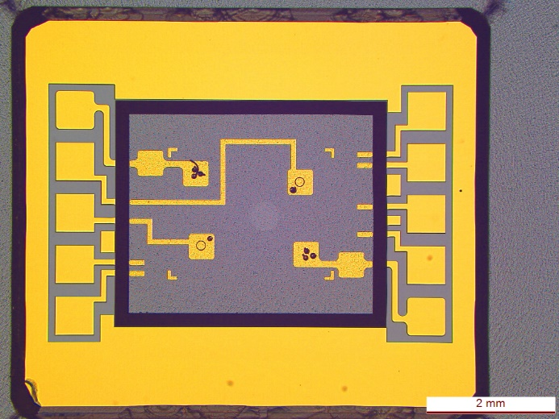
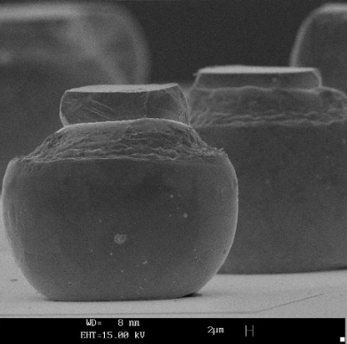
Phase 2 - TASK 2 : OCMO Fabrication Process flow
Silicon cavity
N° | Step | Description
1 | Components integration (MEMS resonator, Transistor, Thermistor) | H20E bonding glue and wire bonding
Gold bump spacer

Slide 18
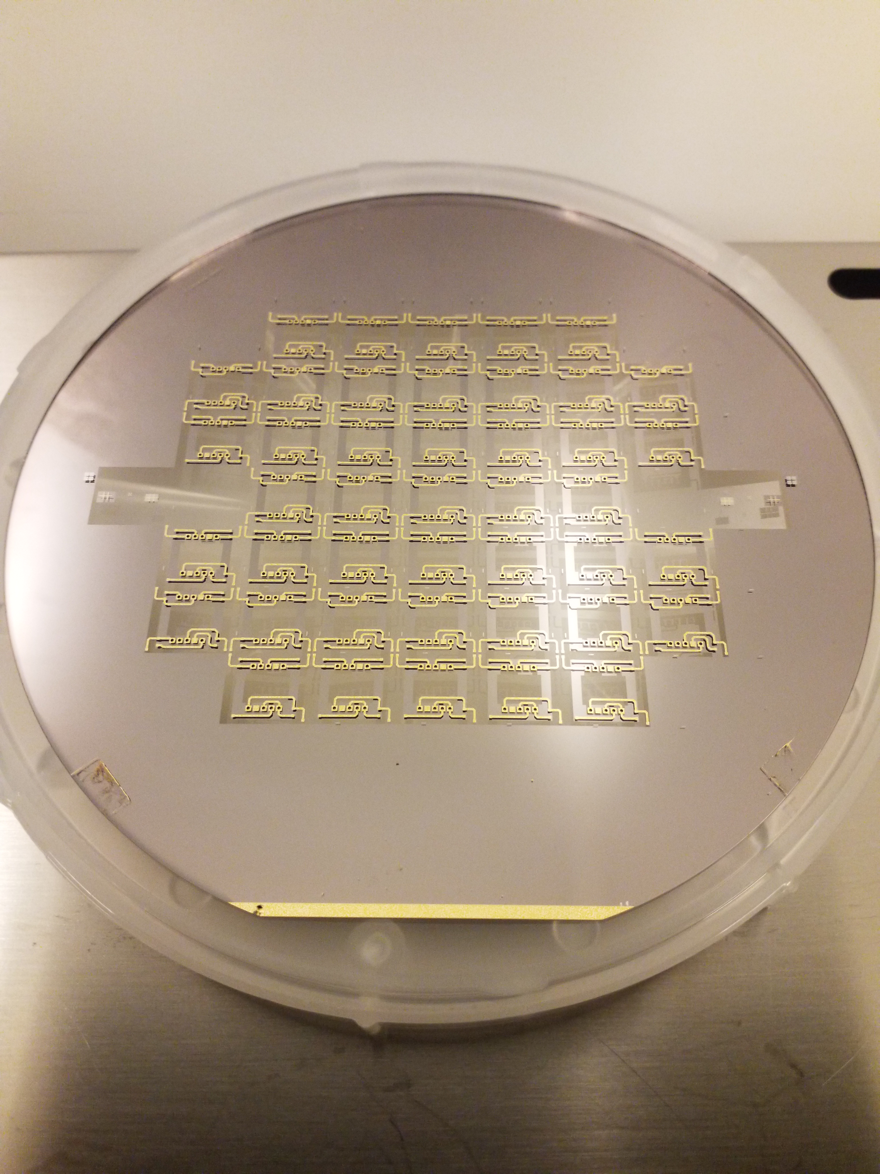
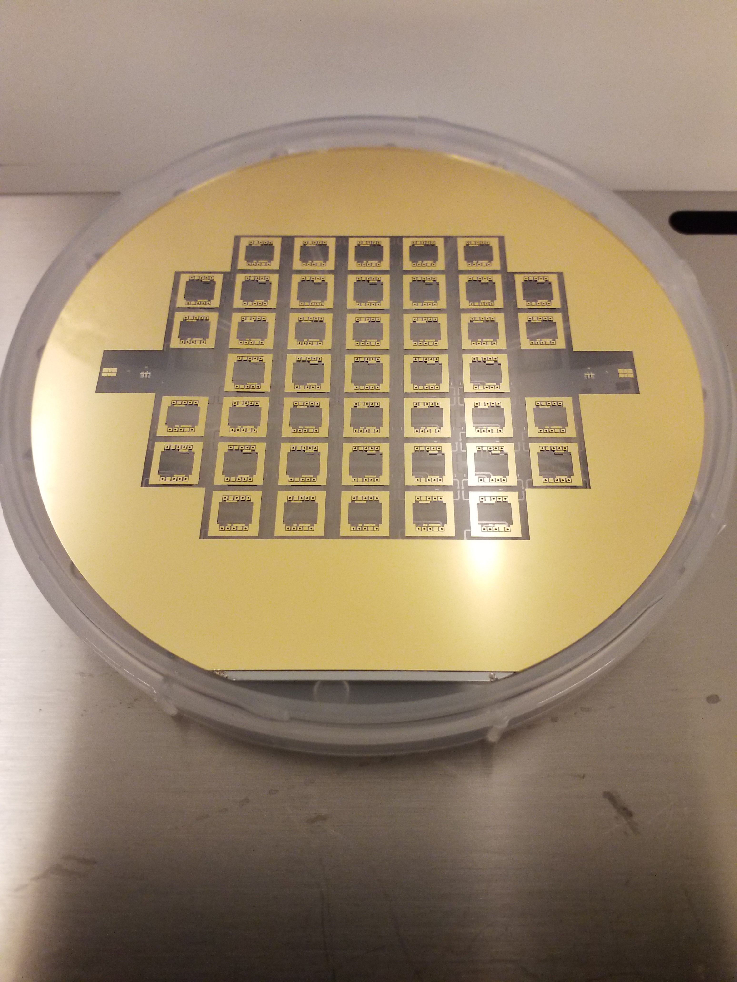
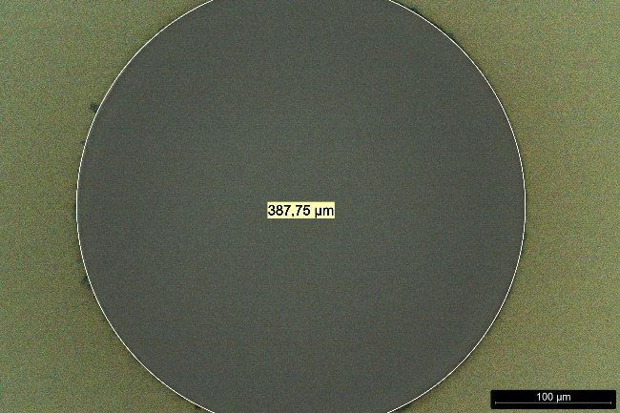
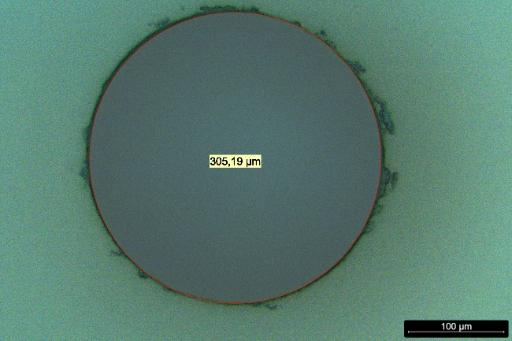
Phase 2 - TASK 2 : OCMO Fabrication Process flow
Glass cover
N° | Step | Description
1 | Through-holes by Femto-second laser micromachining | 400µm-diameter on TOP
2 | Electric tracks + holes metallisation + Gold sealing bead | Ti(10nm)/Au(300nm) electrode structuration on TOP and BOTTOM faces
Material | BF33 4 inch 0,5mm-thick
TOP FACE
BOTTOM FACE

Slide 19
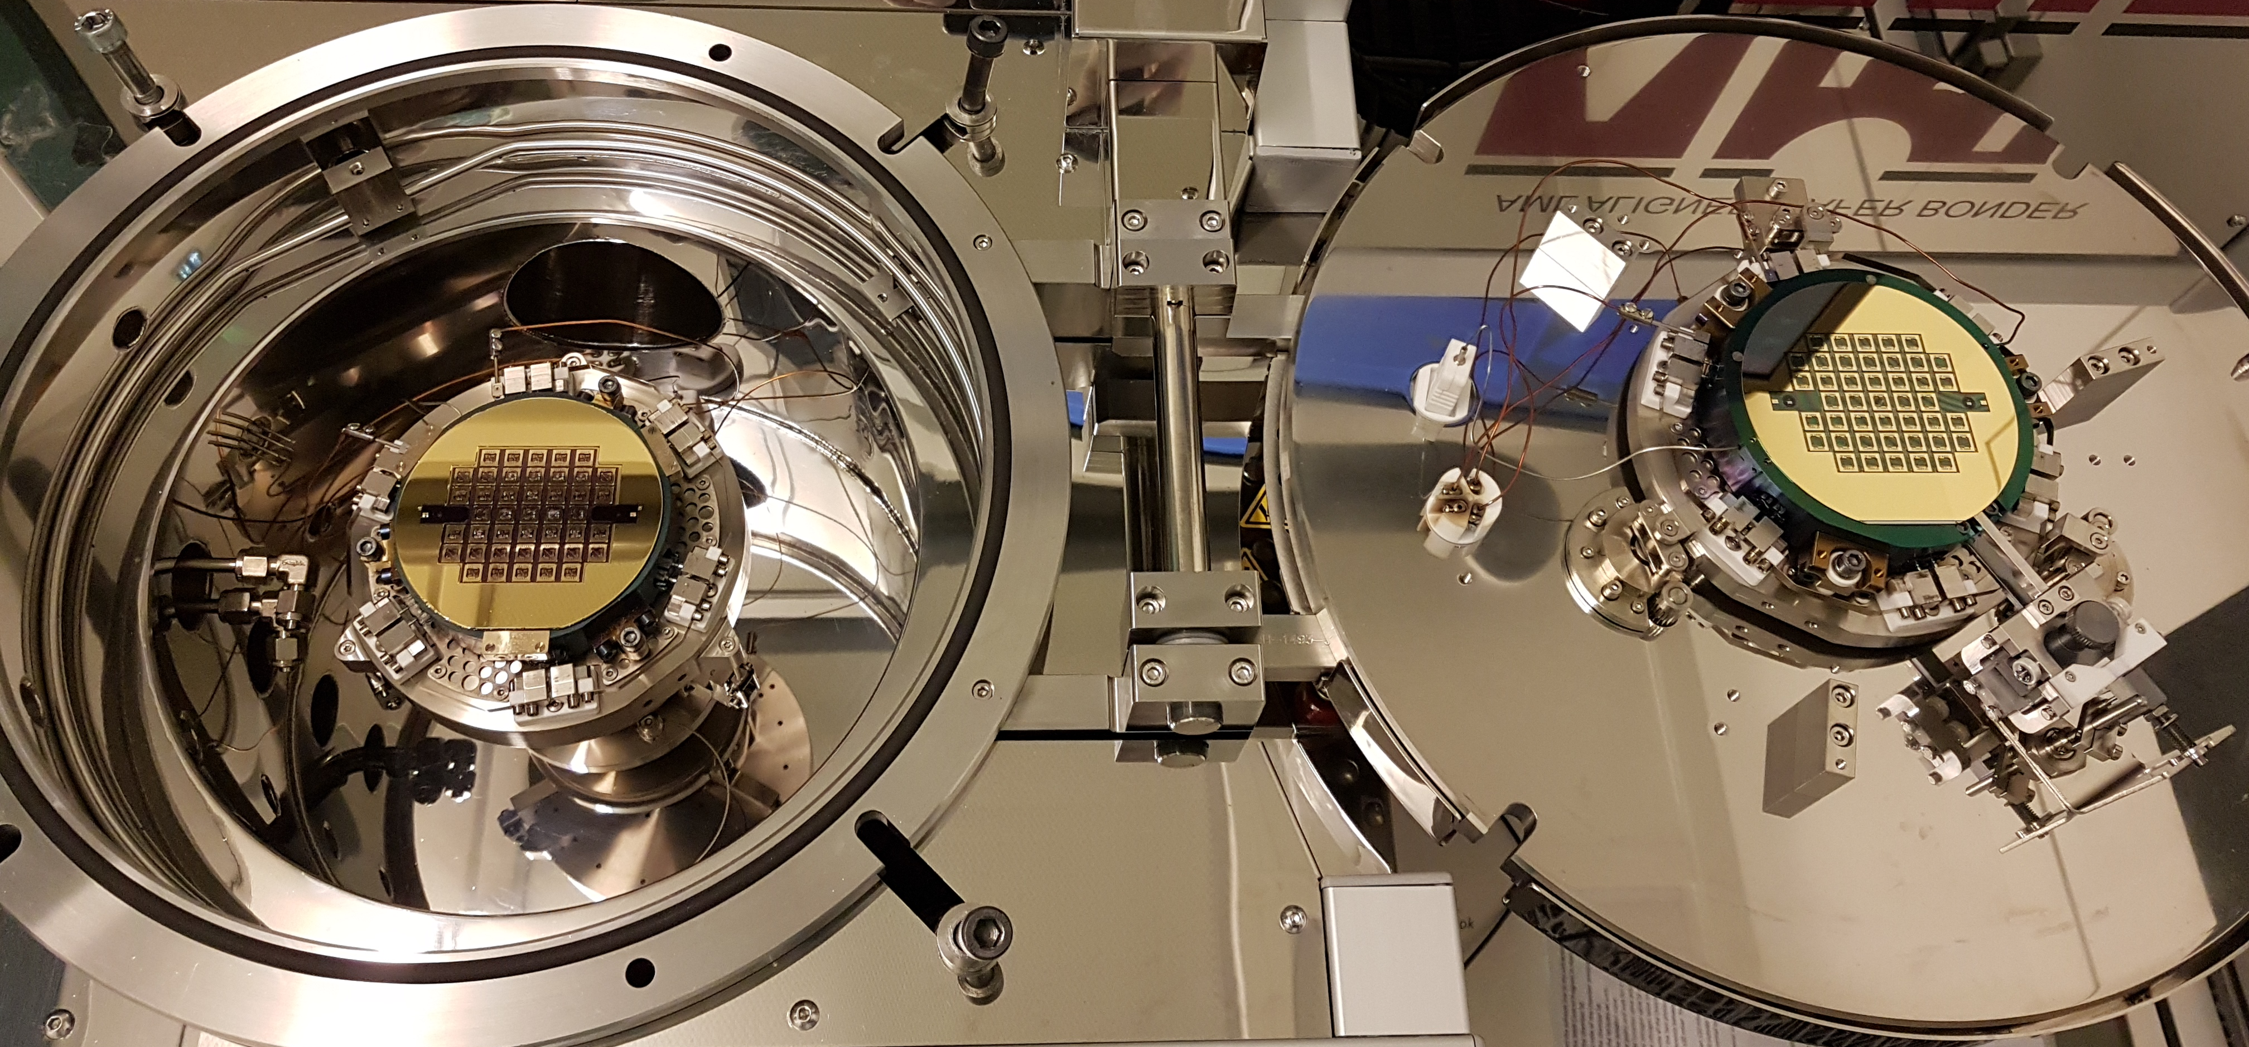
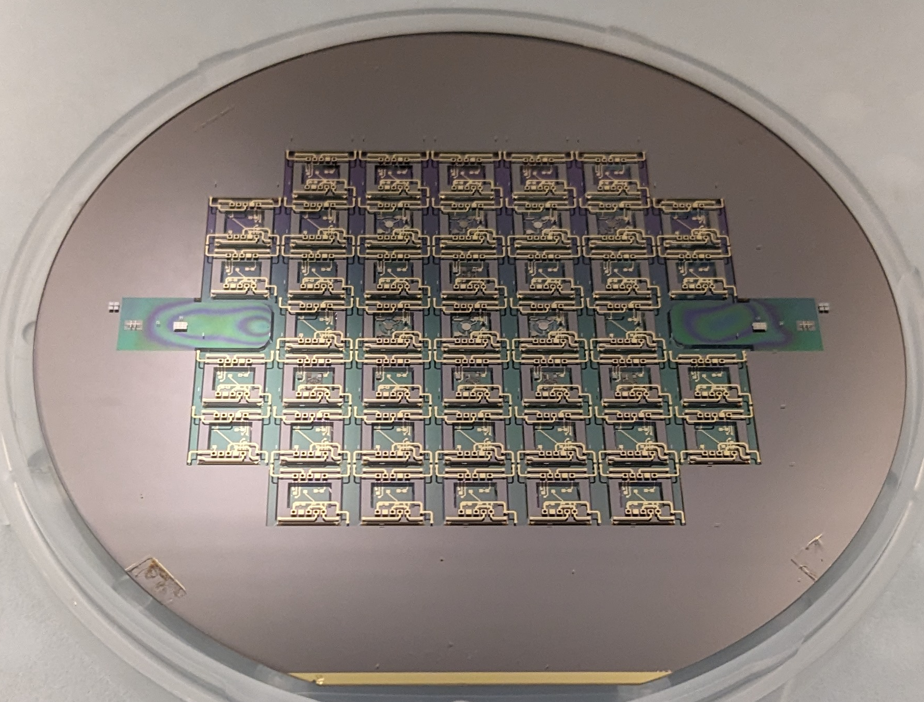
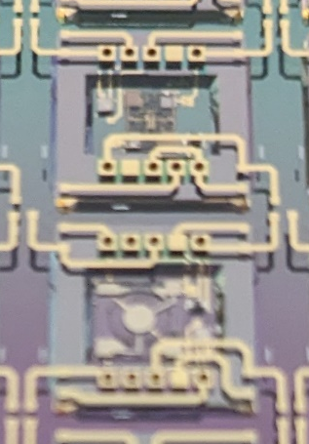
Phase 2 - TASK 2 : OCMO Fabrication Process flow
Assembling
N° | Step | Description
1 | Wafer alignment (Silicon cavity with BF33 cover) | Alignment defect < 5 µm
2 | Wafer bonding | Thermo-compression bonding T° = 100 °C (Limited by thermistor and transistor) Vaccum sealing = 10⁻⁵ mbar

Slide 20
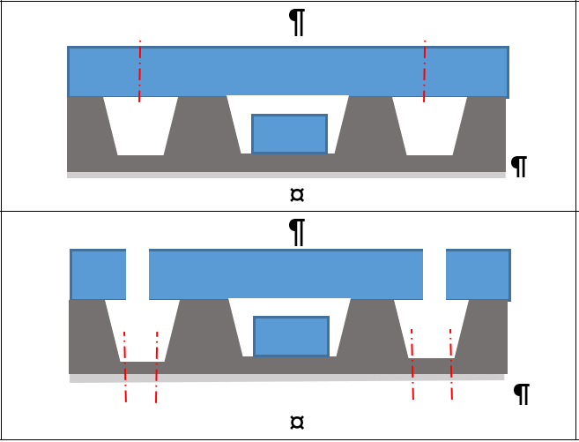
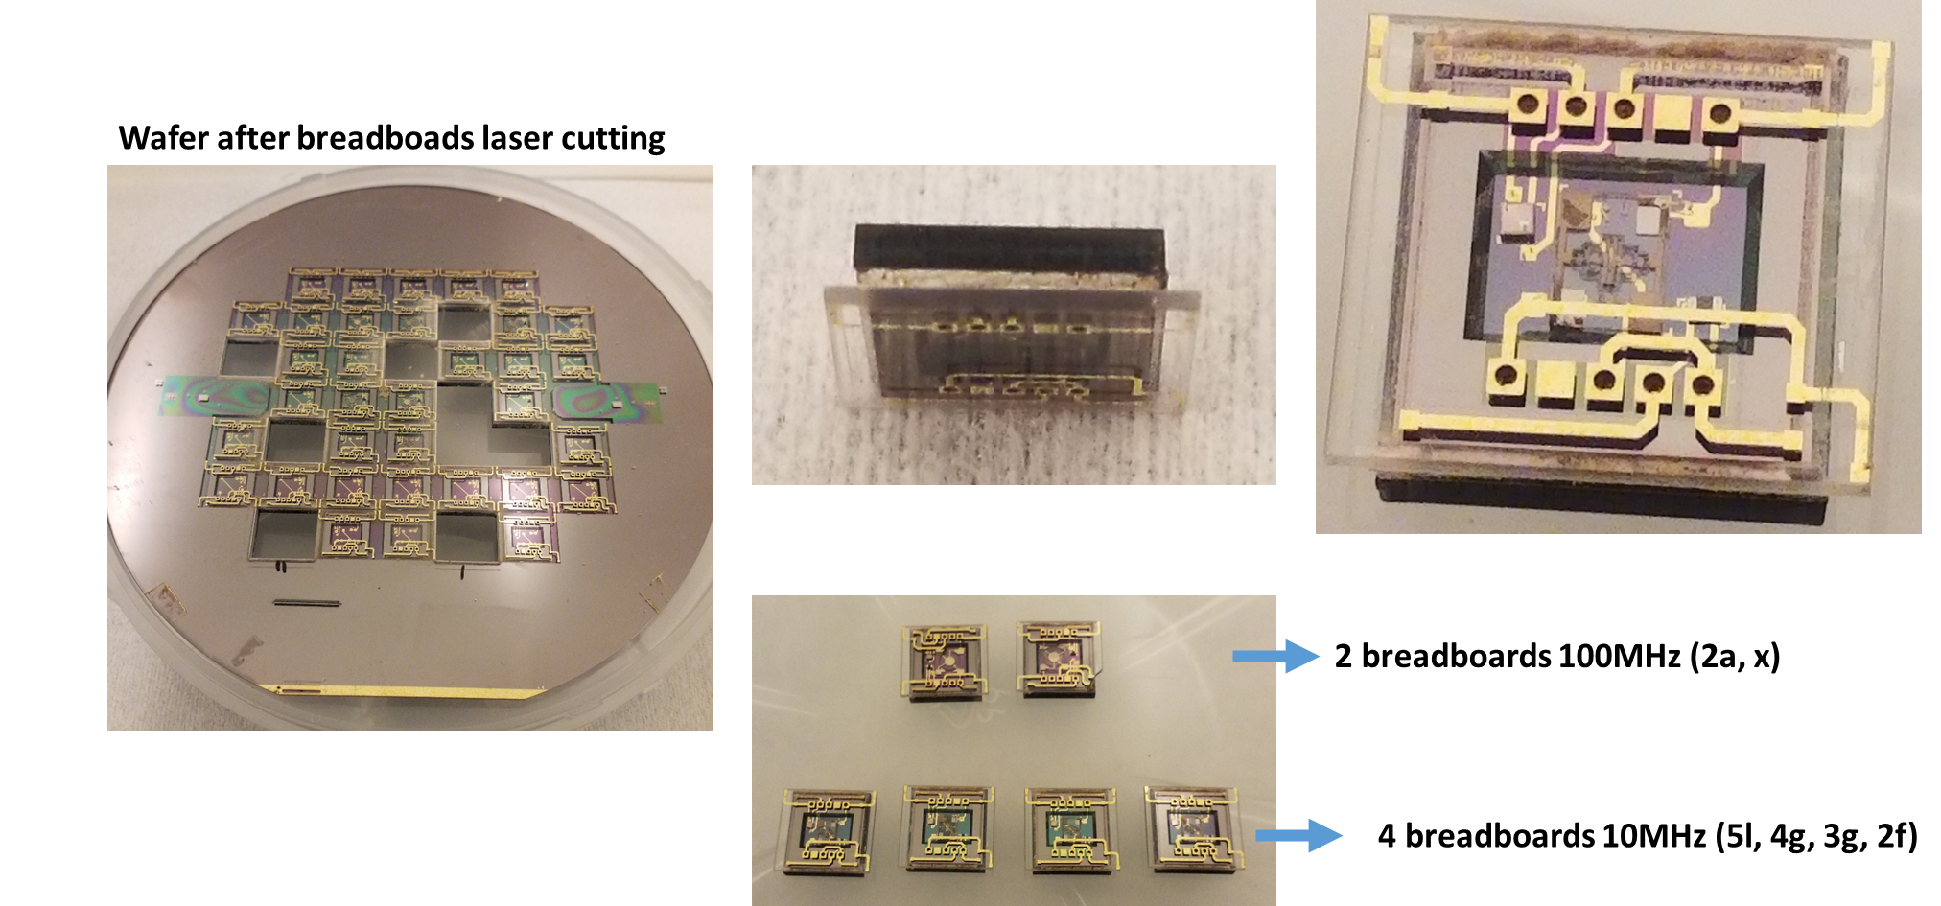
Phase 2 - TASK 2 : OCMO Fabrication Process flow
Breadboard separation
N° | Step | Description
1 | Cutting by femto-second laser

Slide 21
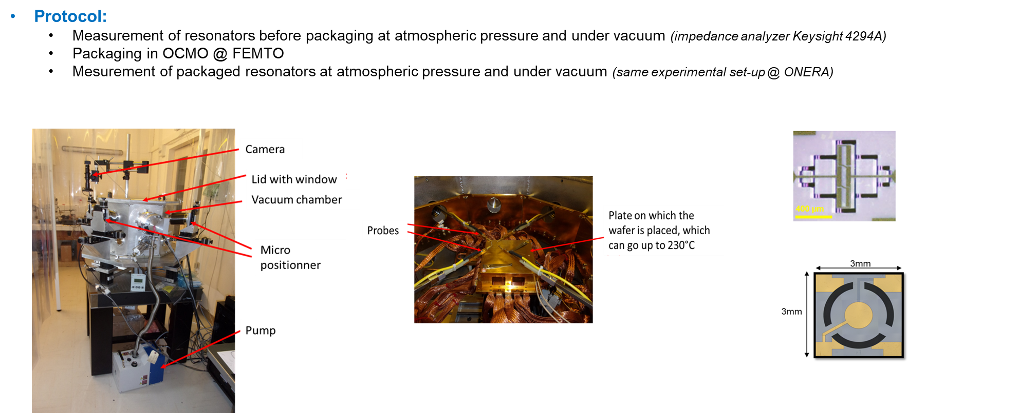
Phase 2 - TASK 3 : OCMO Characterization
Breadboard RF characterization

Slide 22
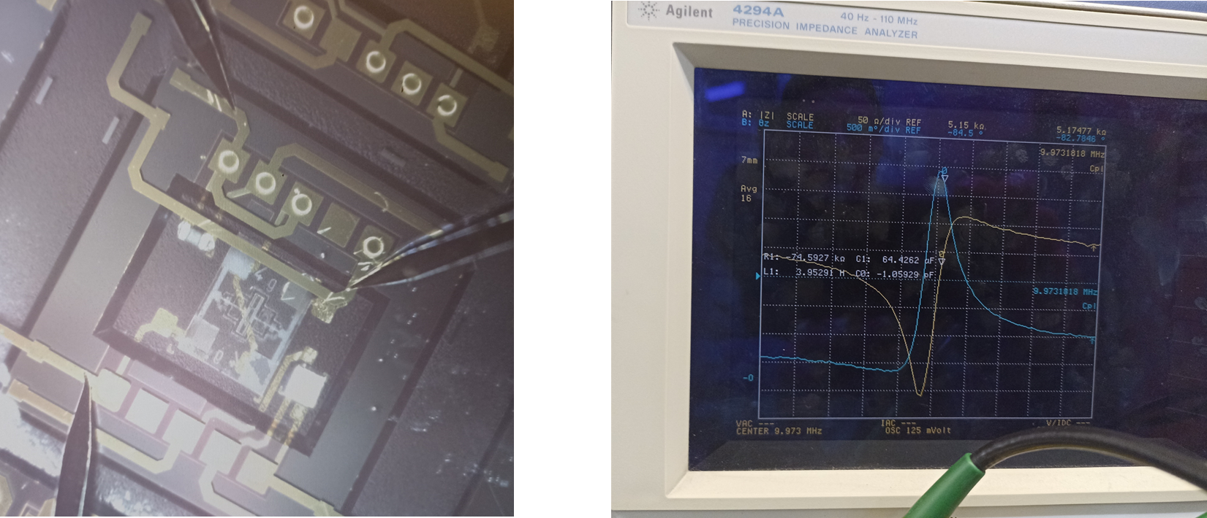
Phase 2 - TASK 3 : OCMO Characterization
Breadboard RF characterization
Characterization
It works

Slide 23
Phase 2 - TASK 3 : OCMO Characterization
Breadboard RF characterization
Perfomances
Observation 1 : The quality factor for OCMO breadboard evolves when it is placed in a vacuum chamber.
Interpretation 1 : The Gold/Gold bonding between silicon and glass cover is not hermetic.
Observation 2 : The resonance frequency is stable.
Interpretation 2 : The resonance frequency is not influenced by the resonator integration.

Slide 24

Phase 2 - TASK 4 : OCMO packaging
Re-sealing test to improve the hermiticity
After re-sealing test, the performances of the breadboard is close to before re-sealing,

Slide 25


Phase 2 - TASK 4 : OCMO packaging
Breadboard packaging
N° | Step | Description
1 | Breadboads integration in Ceramic box (DOWSIL 93-500 Space Grade glue & wire bonding)

Slide 26
Phase 2 - TASK 3 : OCMO Characterization
Breadboard in ceramic box characterization
Perfomances
Observation 1 : The OCMO packaged in the ceramic box works like without packaging.
Interpretation 1 : The integration of the OCMO inside a ceramic box is validated.
Observation 2 : There is not effect on the OCMO performance with or without the silicon to the ground.
Interpretation 2 : Maybe an native oxyde layer has been generated during the wafer standby.

Slide 27



Phase 2
TRB
  No vacuum inside silicon cavity (Outgassing or leaks) → Very high motional resistance, low quality factor → Impossible to drive the resonator in oscillator.
  No electrical continuity of electrical components inside the cavity. → No working oven or oscillator possible.
  → Switch to vacuum sealed 10MHz resonators from TN1.3 + Onera TIA oscillator for characterization.

Slide 28



Phase 2
TRB
  Aging (10MHz)
  Phase Noise (10MHz)
  ADEV (10 MHz)

Slide 29
Project Review (Conformity matrix 10MHz)
 |  | TN2.2 |  |  | TN1.3
Parameter | Specs - Navigation | OCMO 10MHz (4i Resonator) - Measured | Link | Conformity | OCMO 10MHz (6H Resonator) - Measured | Link | Conformity | Comments
Design Frequency | 10 MHz | 9.943 MHz | TN2.2 Table 7 | NC | 9.967 MHz | TN1.3 Figure 26 | NC | Related to resonator manufacturing process.
Phase Noise max. @1Hz | <-65 dBc/Hz | -40 dBc/Hz | TN2.2 Figure 19 | NC | -55 dBc/Hz | TN1.3 Figure 31 | NC | Related to high motional resistance of the resonator & Loaded Q
Phase Noise max. @100Hz | <-95 dBc/Hz | -70 dBc/Hz | TN2.2 Figure 19 | NC | -115 dBc/Hz | TN1.3 Figure 31 | C | Related to high motional resistance of the resonator & Loaded Q
Phase Noise max. @1kHz | <-145 dBc/Hz | -120 dBc/Hz | TN2.2 Figure 19 | NC | -130 dBc/Hz | TN1.3 Figure 31 | NC | Related to high motional resistance of the resonator & Loaded Q
Phase Noise max. @10kHz | <-165 dBc/Hz | -120 dBc/Hz | TN2.2 Figure 19 | NC | -135 dBc/Hz | TN1.3 Figure 31 | NC | Related to high motional resistance of the resonator, Drive Level & Noise Factor of sustaining amplifiers
Phase Noise max. @100kHz | <-165 dBc/Hz | -120 dBc/Hz | TN2.2 Figure 19 | NC | -135 dBc/Hz | TN1.3 Figure 31 | NC | Related to high motional resistance of the resonator, Drive Level & Noise Factor of sustaining amplifiers
Phase Noise max. @1MHz | <-165 dBc/Hz | -120 dBc/Hz | TN2.2 Figure 19 | NC | -135 dBc/Hz | TN1.3 Figure 31 | NC | Related to high motional resistance of the resonator, Drive Level & Noise Factor of sustaining amplifiers
Noise Floor | <-165 dBc/Hz | -120 dBc/Hz | TN2.2 Figure 19 | NC | -135 dBc/Hz | TN1.3 Figure 31 | NC | Related to high motional resistance of the resonator, Drive Level & Noise Factor of sustaining amplifiers
Harmonics | <-30 dBc | -9dB | TN2.2 Figure 26 | NC | // | // | NC | Filter to design
Spurious | <-100 dBc | -55dB | TN2.2 Figure 26 | NC | // | // | NC | Sustaining amplifier noise factor to improve
Allan Variance @1s | <5E-12 | 1E-9 | TN2.2 Figure 22 | NC | // | // | NC | Related to high motional resistance of the resonator & Loaded Q
Output Power | >5 dBm | 6,8 dBm | TN2.2 Figure 26 | C | // | // | C
Temperature sensitivity | <20 ppb | // | // | NC | // | // | NC | Not Tested
Aging @10Years | 0,5/0,8 ppm | 580 ppb/h | TN2.2 Figure 25 | NC | 250ppb/h | TN1.3 Figure 38 | NC | Not Tested
DC Power (steady state @25°C) | <250 mW | // | // | NC | // | // | NC | Not Tested
DC Power Warm-up | <500 mW | // | // | NC | // | // | NC | Not Tested
Mass | <25 g | // | // | NC | // | // | NC | Not Tested
Volume | <25x25x17mm² | // | // | NC | // | // | NC | Not Tested
Operating temperature range | [-30 ; 70°C] | // | // | NC | // | // | NC | Not Tested
Radiation (TID) | 100krad | // | // | NC | // | // | NC | Not Tested
g-sensitivity | TBD | // | // | NC | // | // | NC | Not Tested

Slide 30
Project Review (Conformity matrix 100MHz)
 |  | TN2.2 |  |  | TN1.3
Parameter | Specs - Telecom | OCMO 100MHz | Link | Conformity | OCMO 10MHz + PLL | Link | Conformity | Comments
Design Frequency | 100 MHz | // | // | NC | 100MHz | TN1.3 Table 4 | C | Accuracy of OCMO 10MHz + PLL thanks to fractional PLL
Phase Noise max. @1Hz | // | // | // | NC | // | //
Phase Noise max. @100Hz | TBD | // | // | NC | // | //
Phase Noise max. @1kHz | <-120 dBc/Hz | // | // | NC | -128 dBc/Hz | TN1.3 Table 4 | C
Phase Noise max. @10kHz | <-140 dBc/Hz | // | // | NC | -132 dBc/Hz | TN1.3 Table 4 | NC | Limited by PLL VCO
Phase Noise max. @100kHz | <-155 dBc/Hz | // | // | NC | -133 dBc/Hz | TN1.3 Table 4 | NC | Limited by PLL VCO
Phase Noise max. @1MHz | <-170 dBc/Hz | // | // | NC | -155 dBc/Hz | TN1.3 Table 4 | NC | Limited by PLL
Noise Floor | <-170 dBc/Hz | // | // | NC | -155 dBc/Hz | TN1.3 Table 4 | NC | Limited by PLL
Harmonics | <-40 dBc | // | // | NC | -9 dBc | TN1.3 Table 4 | NC
Spurious | <-80 dBc | // | // | NC | -55 dBc | TN1.3 Table 4 | NC
Allan Variance @1s | // | // | // | NC | // | // | NC | Not Tested
Output Power | >5 dBm | // | // | NC | 9dBm | TN1.3 Table 4 | C
Temperature sensitivity | <5 ppb | // | // | NC | // | // | NC | Not Tested
Aging @10Years | 5 ppm | // | // | NC | 250ppb/h | TN1.3 Figure 38 | NC
DC Power (steady state @25°C) | <250 mW | // | // | NC | 1.4W | TN1.3 Table 4 | NC | 1W PLL + 400mW pierce oscillator
DC Power Warm-up | <500 mW | // | // | NC | // | // | NC | Not Tested
Mass | <25 g | // | // | NC | // | // | NC | Not Tested
Volume | <25x25x17mm² | // | // | NC | // | // | NC | Not Tested
Operating temperature range | [-30 ; 70°C] | // | // | NC | // | // | NC | Not Tested
Radiation (TID) | 100krad | // | // | NC | // | // | NC | Not Tested
g-sensitivity | TBD | // | // | NC | // | // | NC | Not Tested

Slide 31
Project Review
++ :
  Prototypes vacuum sealed of 10MHz.
  Integration of resonator inside the silicon cavity (work on parasite capacitance).
  Resistivity of Ti/Au thin layers deposits.
  Wafer assembly cutting.
  Design, prototype and test of MEMS TIA oscillator.
  Design, manufacture and test of 100MHz thickness shear mode resonator.
  Working 10MHz oscillator.
  Working 100MHz oscillator (10MHz + PLL & 10MHz + DDS)
- - :
Conformity matrix showed a lot of measurements that could not have been performed by the end of the project. This is mainly because the final prototype was consisting of four non mature technical challenges:
  Design & manufacturing of the quartz MEMS resonators
  Design & manufacturing of the silicon oven cavity
  Integration of the resonators inside the silicon cavities
  Design of the electronics

