Slide 1
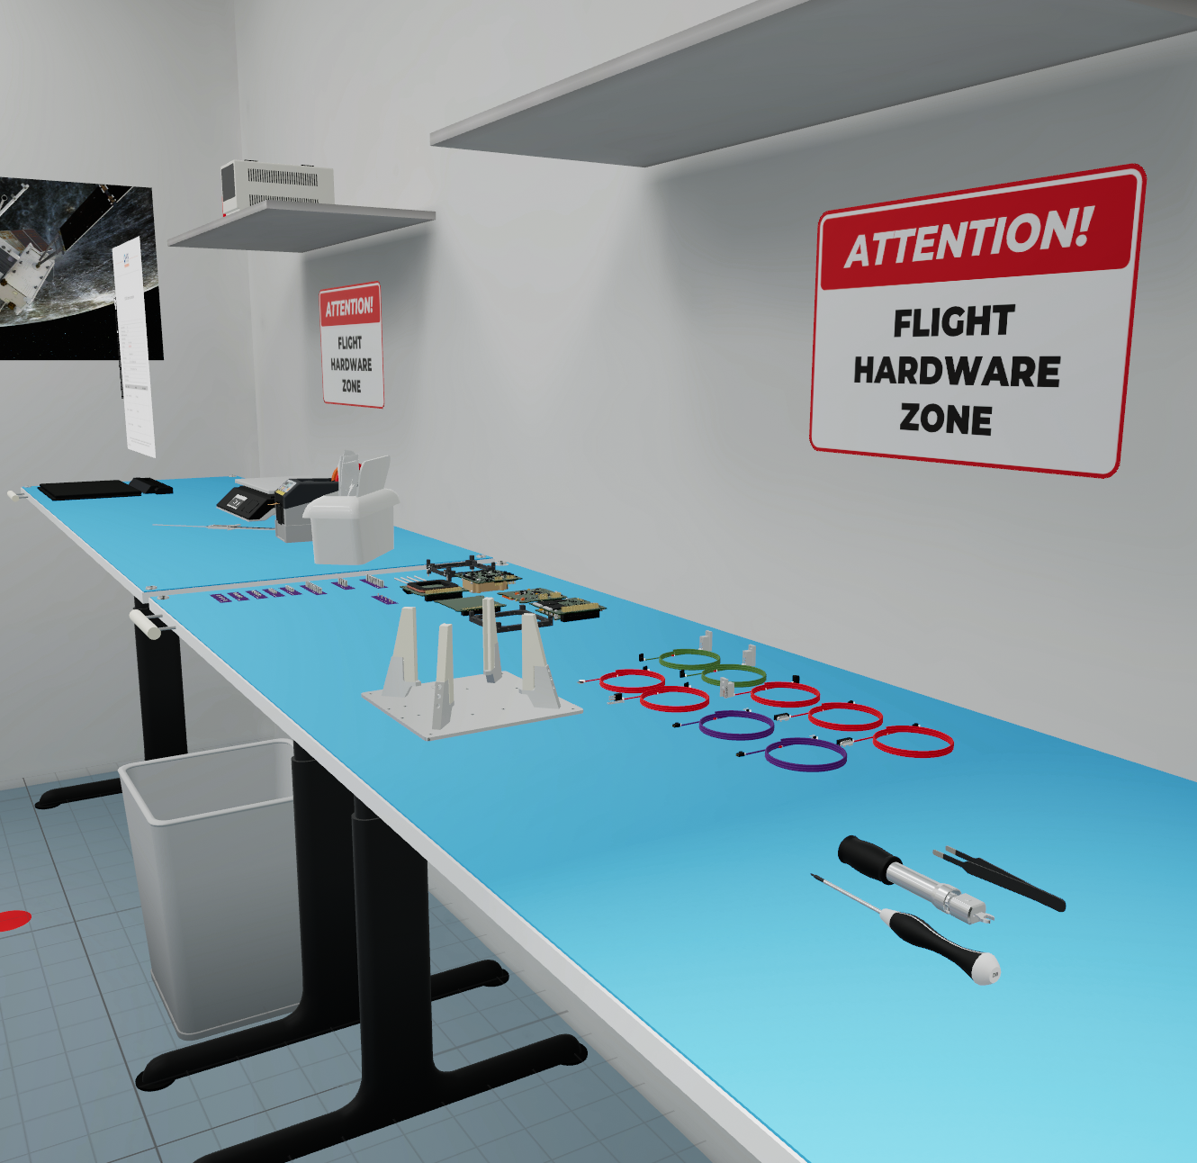
ICARUS
Taking training and evaluation of cleanroom operations and AIT to the next level

Slide 2
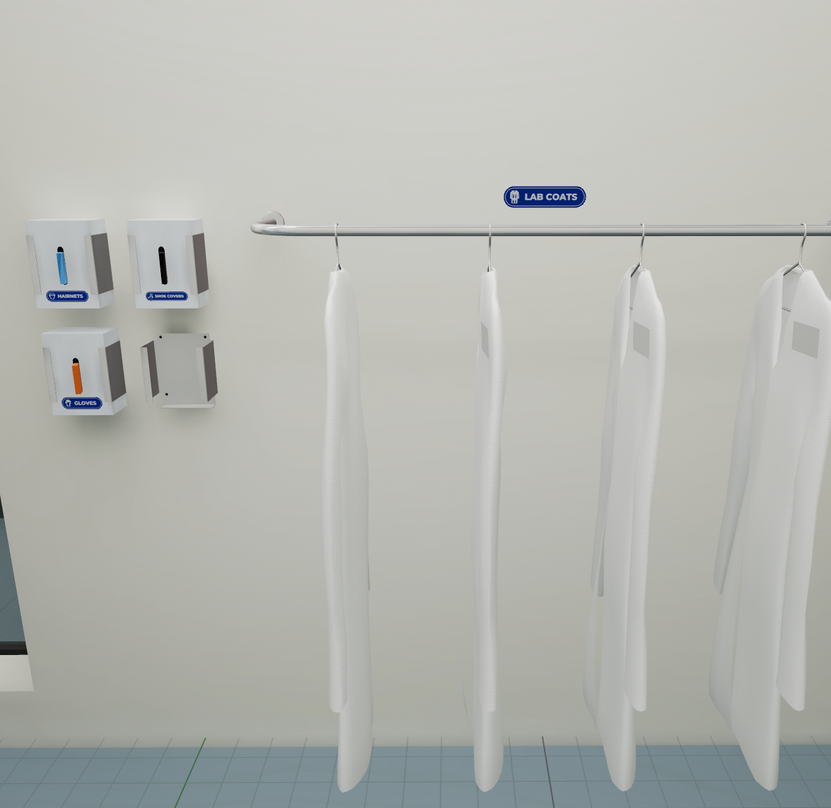
ICARUS
A VR environment which enables customers to train and evaluate cleanroom operations and assembly, integration and testing (AIT) of hardware.
To improve and assess knowledge, skills and attitude related to cleanroom operations and AIT.

Slide 3
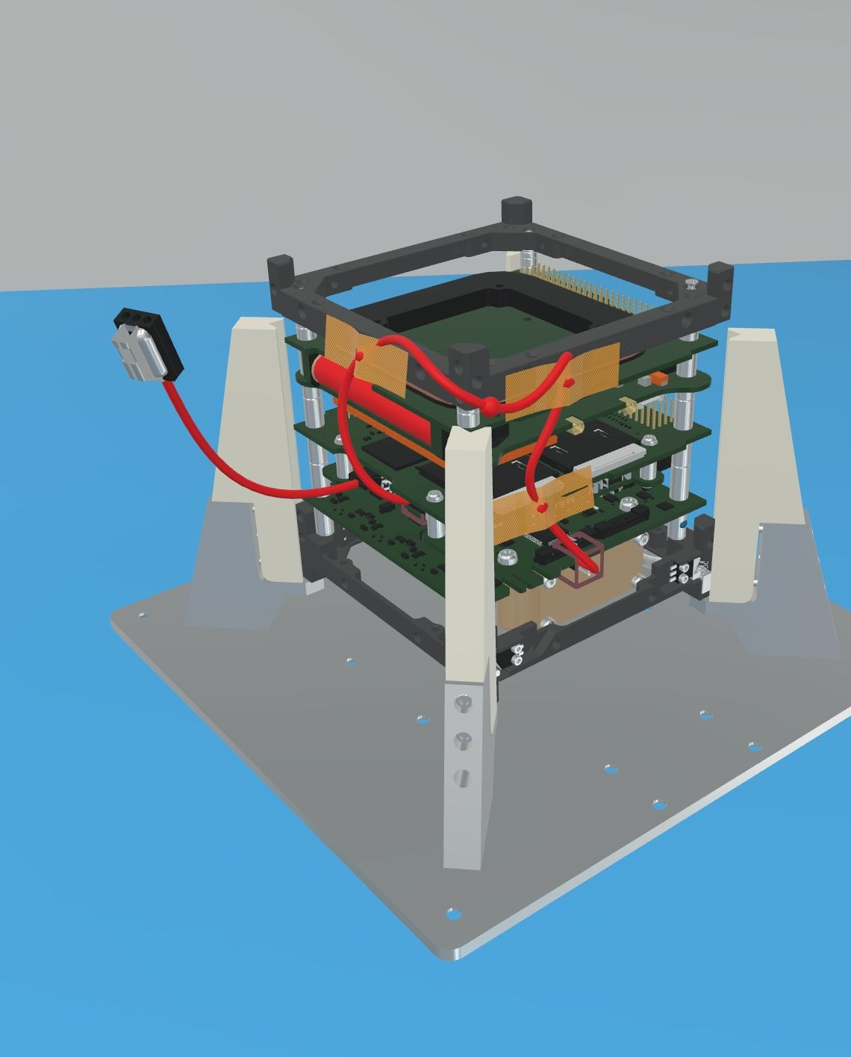
Demo
Click here to access an ICARUS demonstration video

Slide 4
Benefits
Support you in evaluating new staff and to ramp-up new hires faster and more efficiently.
Job to be Done | ICARUS Benefits
Training cleanroom operations and assembly procedures | Virtual training provides more flexibility in the timing of the training and lower cost by not using actual physical hardware for training purposes.
Knowledge retention of procedures | Increased knowledge retention of the recurring operations and procedures through virtual training of guidelines and best practices.
Evaluation of prospective hires | Assessment of prospective hires in virtual environment during hiring process, to assess their attitude towards cleanroom and AIT work (responsibility, safety awareness, precision, proactive communication).

Slide 5
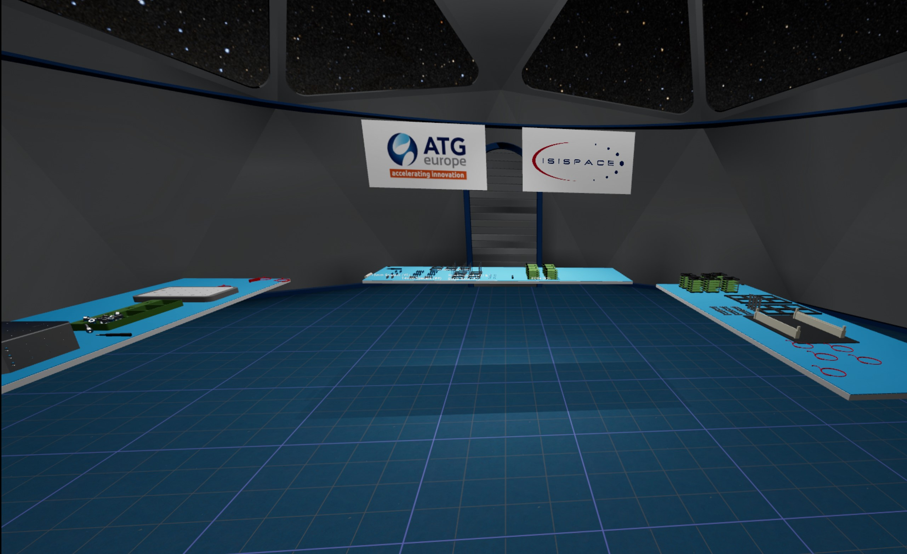
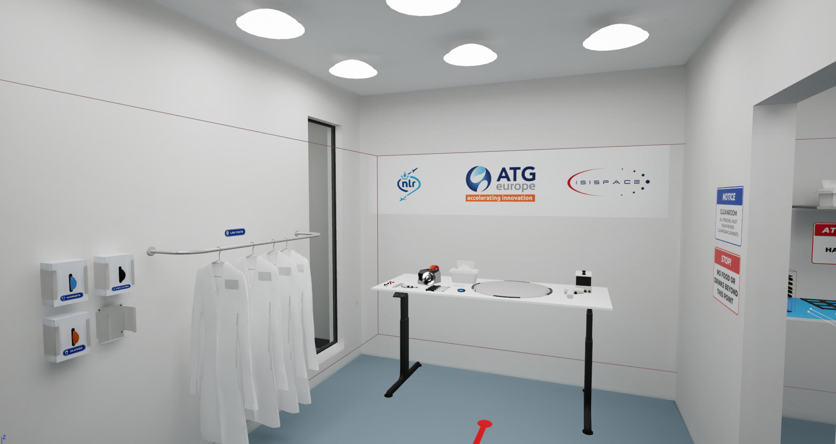
Schedule
2022: Derisk
July 2023: GSTP start
Sep 2024: MVP release

Slide 6
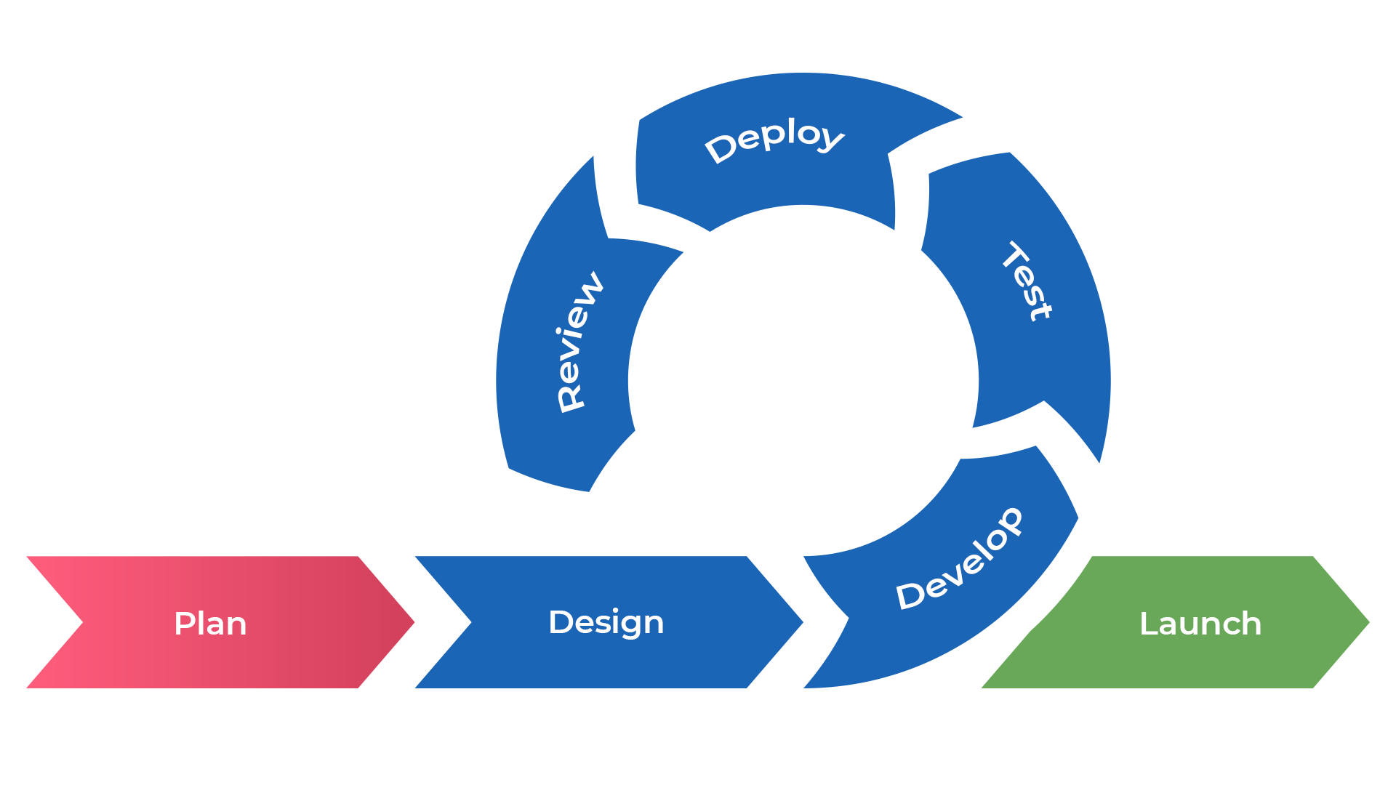
Focus on users and UX/UI
Key steps required to develop a VR tool which will be used in practise:
Central focus on the users and their needs
Good UX/UI at the core of the project
Iterative development, adaptive based on user input and feedback

Slide 7
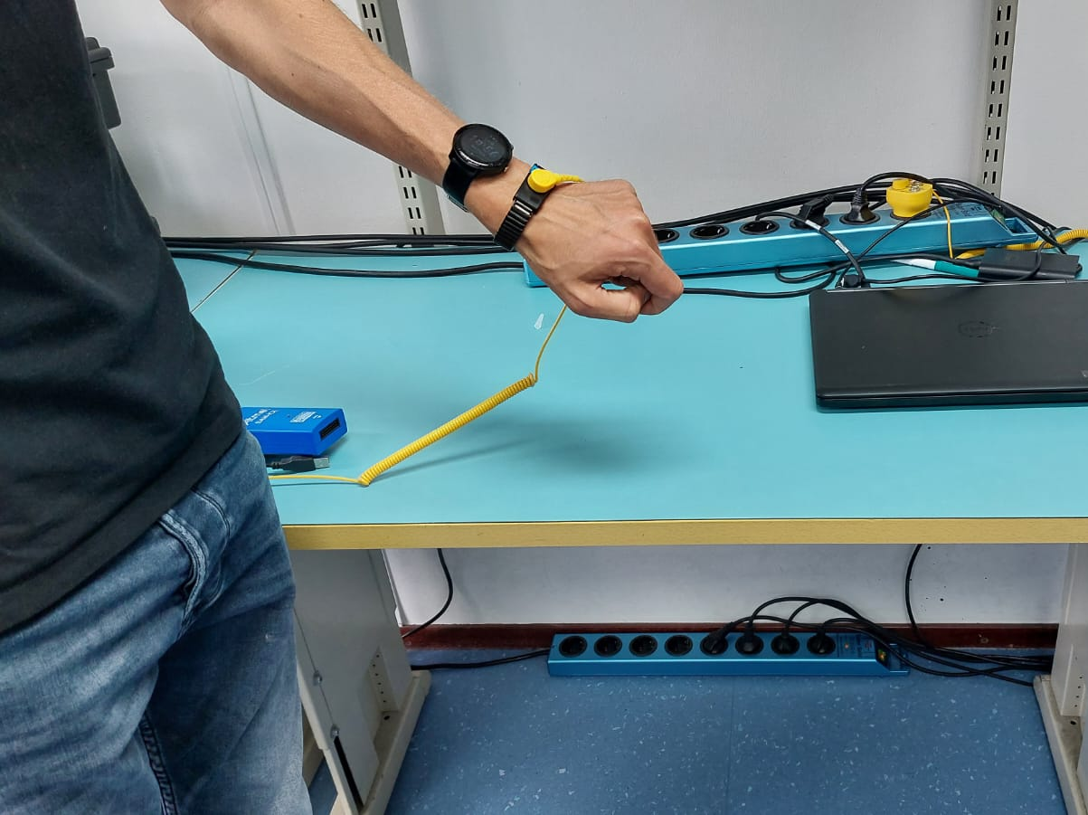
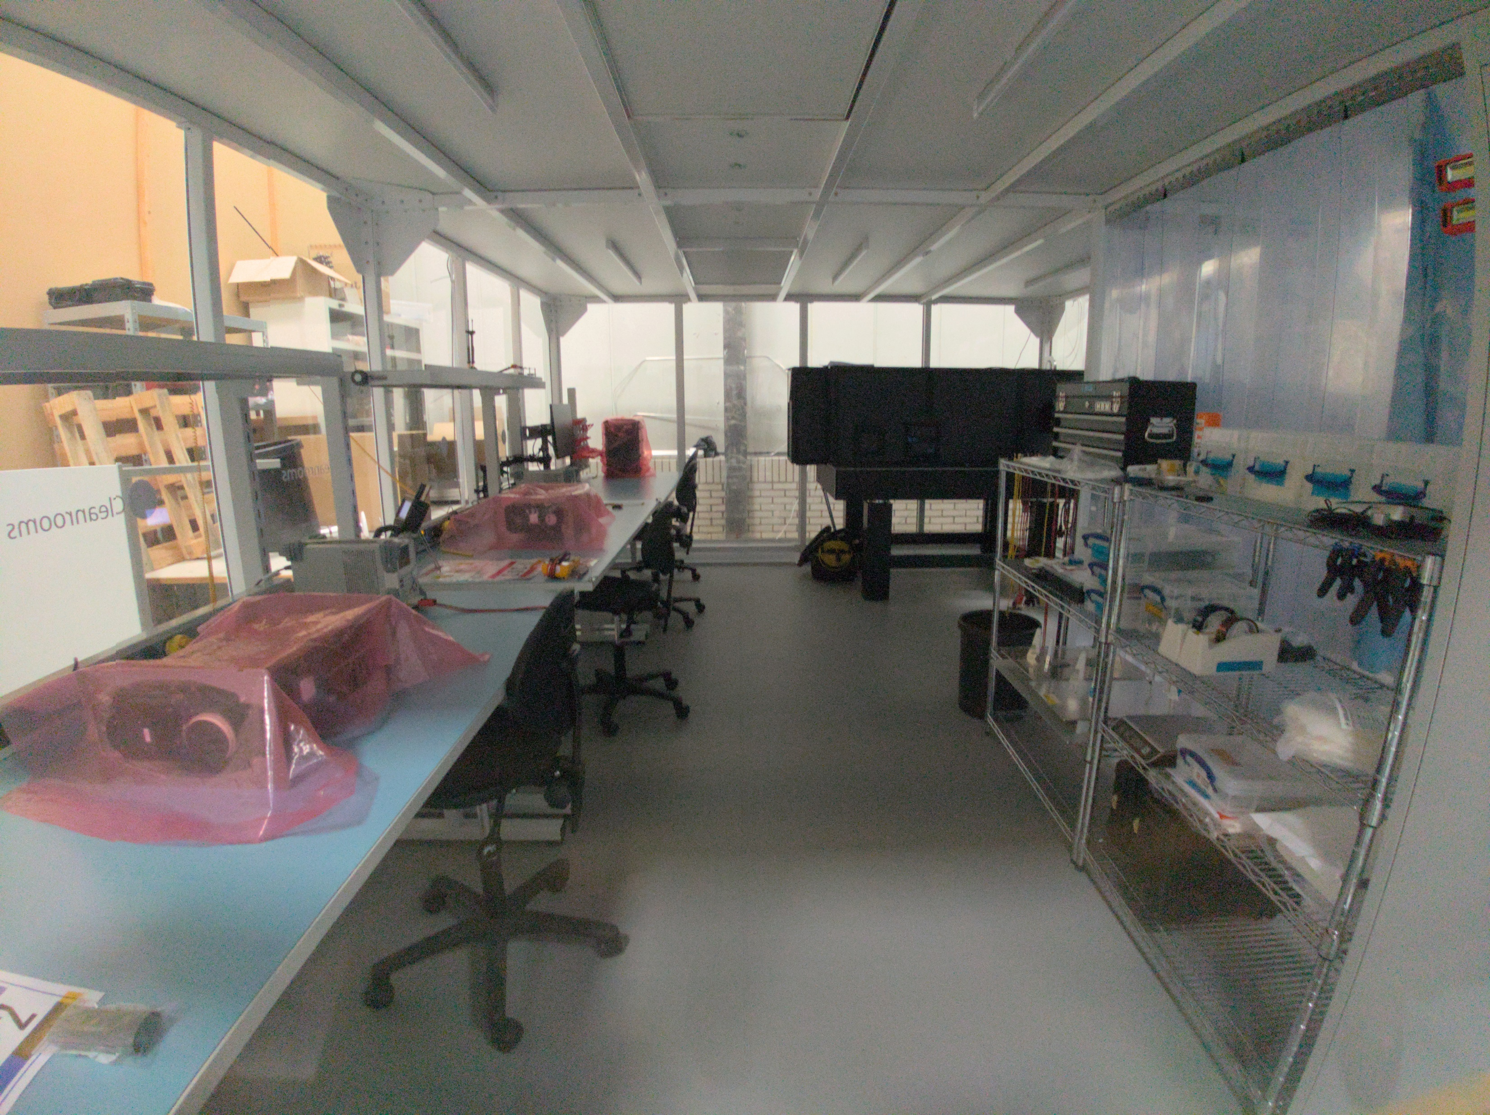
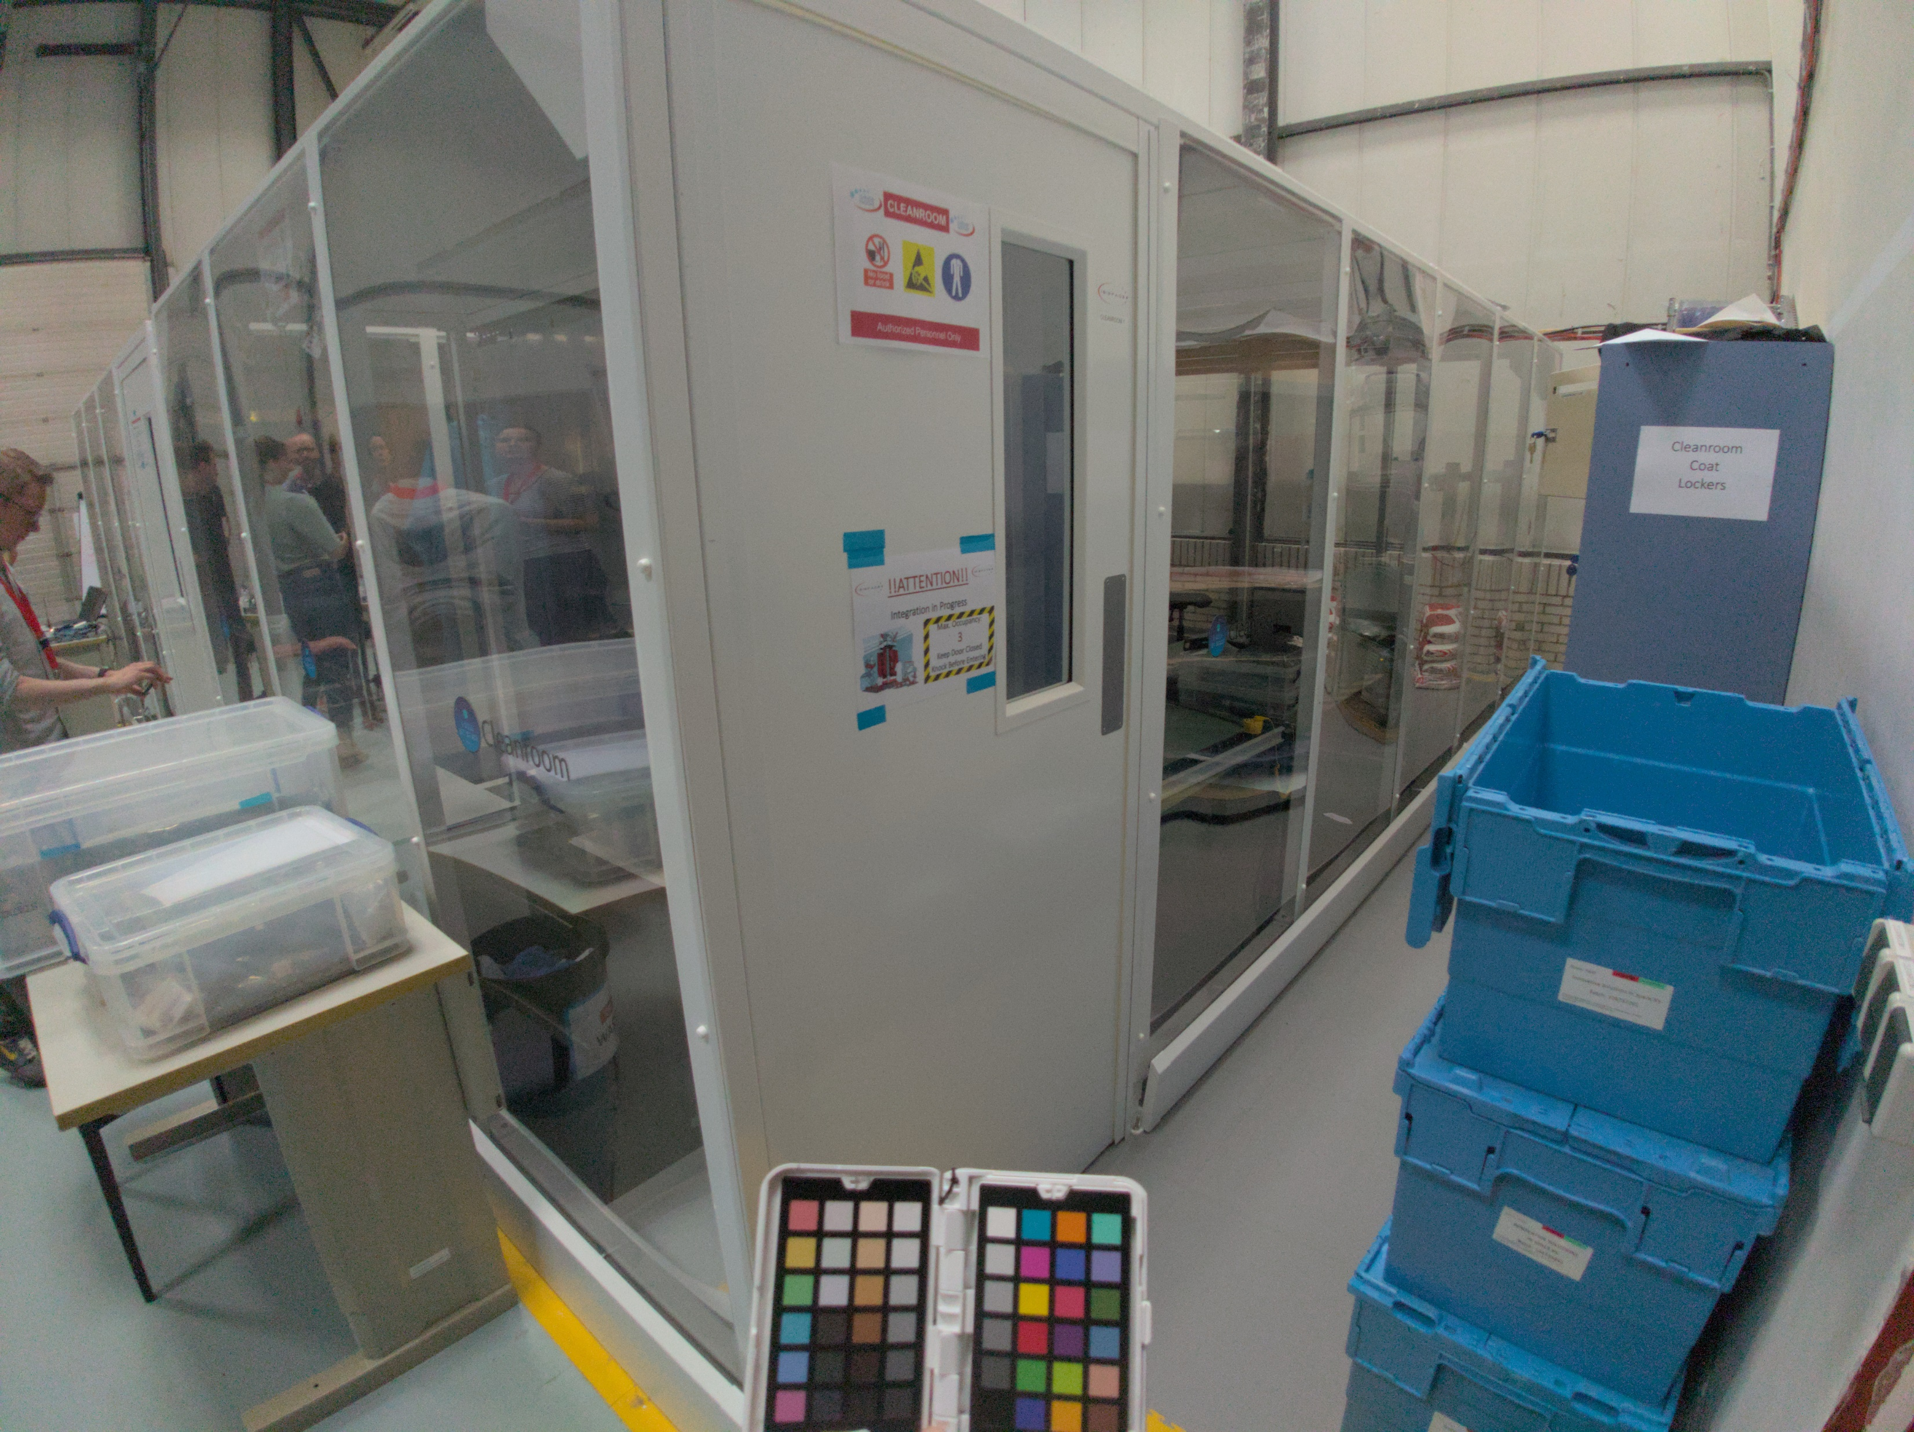
Training design
ICARUS requirements strongly based on input from ISISpace

Slide 8
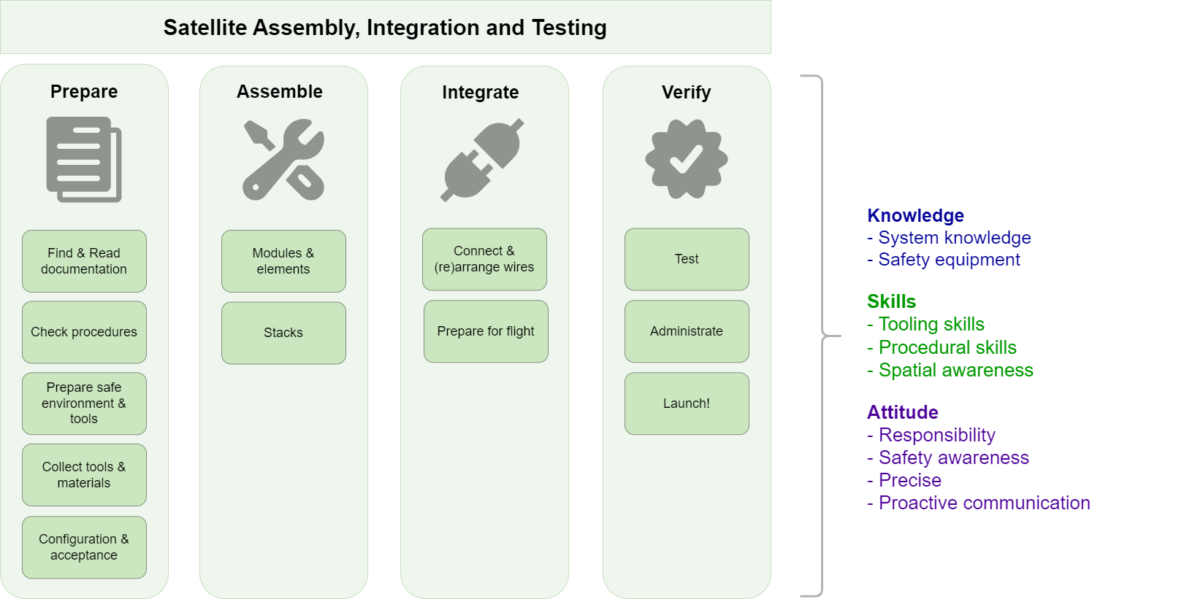
Training design
Operational competence profile for ISISpace AIT engineering based on Training Needs Analysis (TNA)

Slide 9
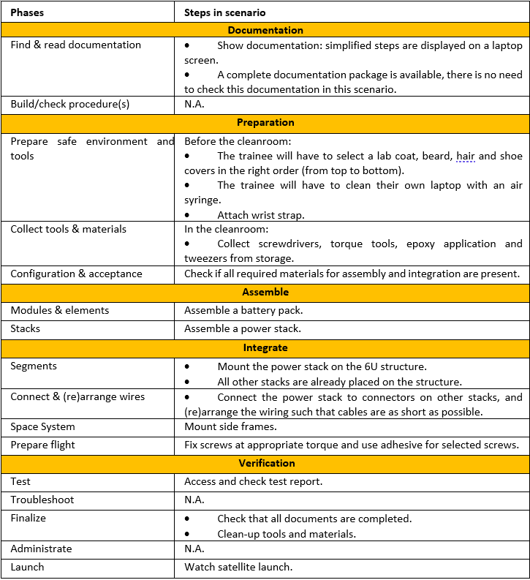
Training design
Training scenario excerpt

Slide 10
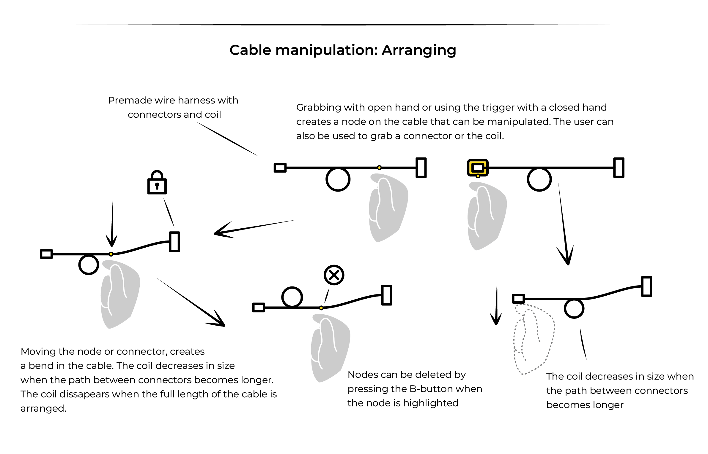
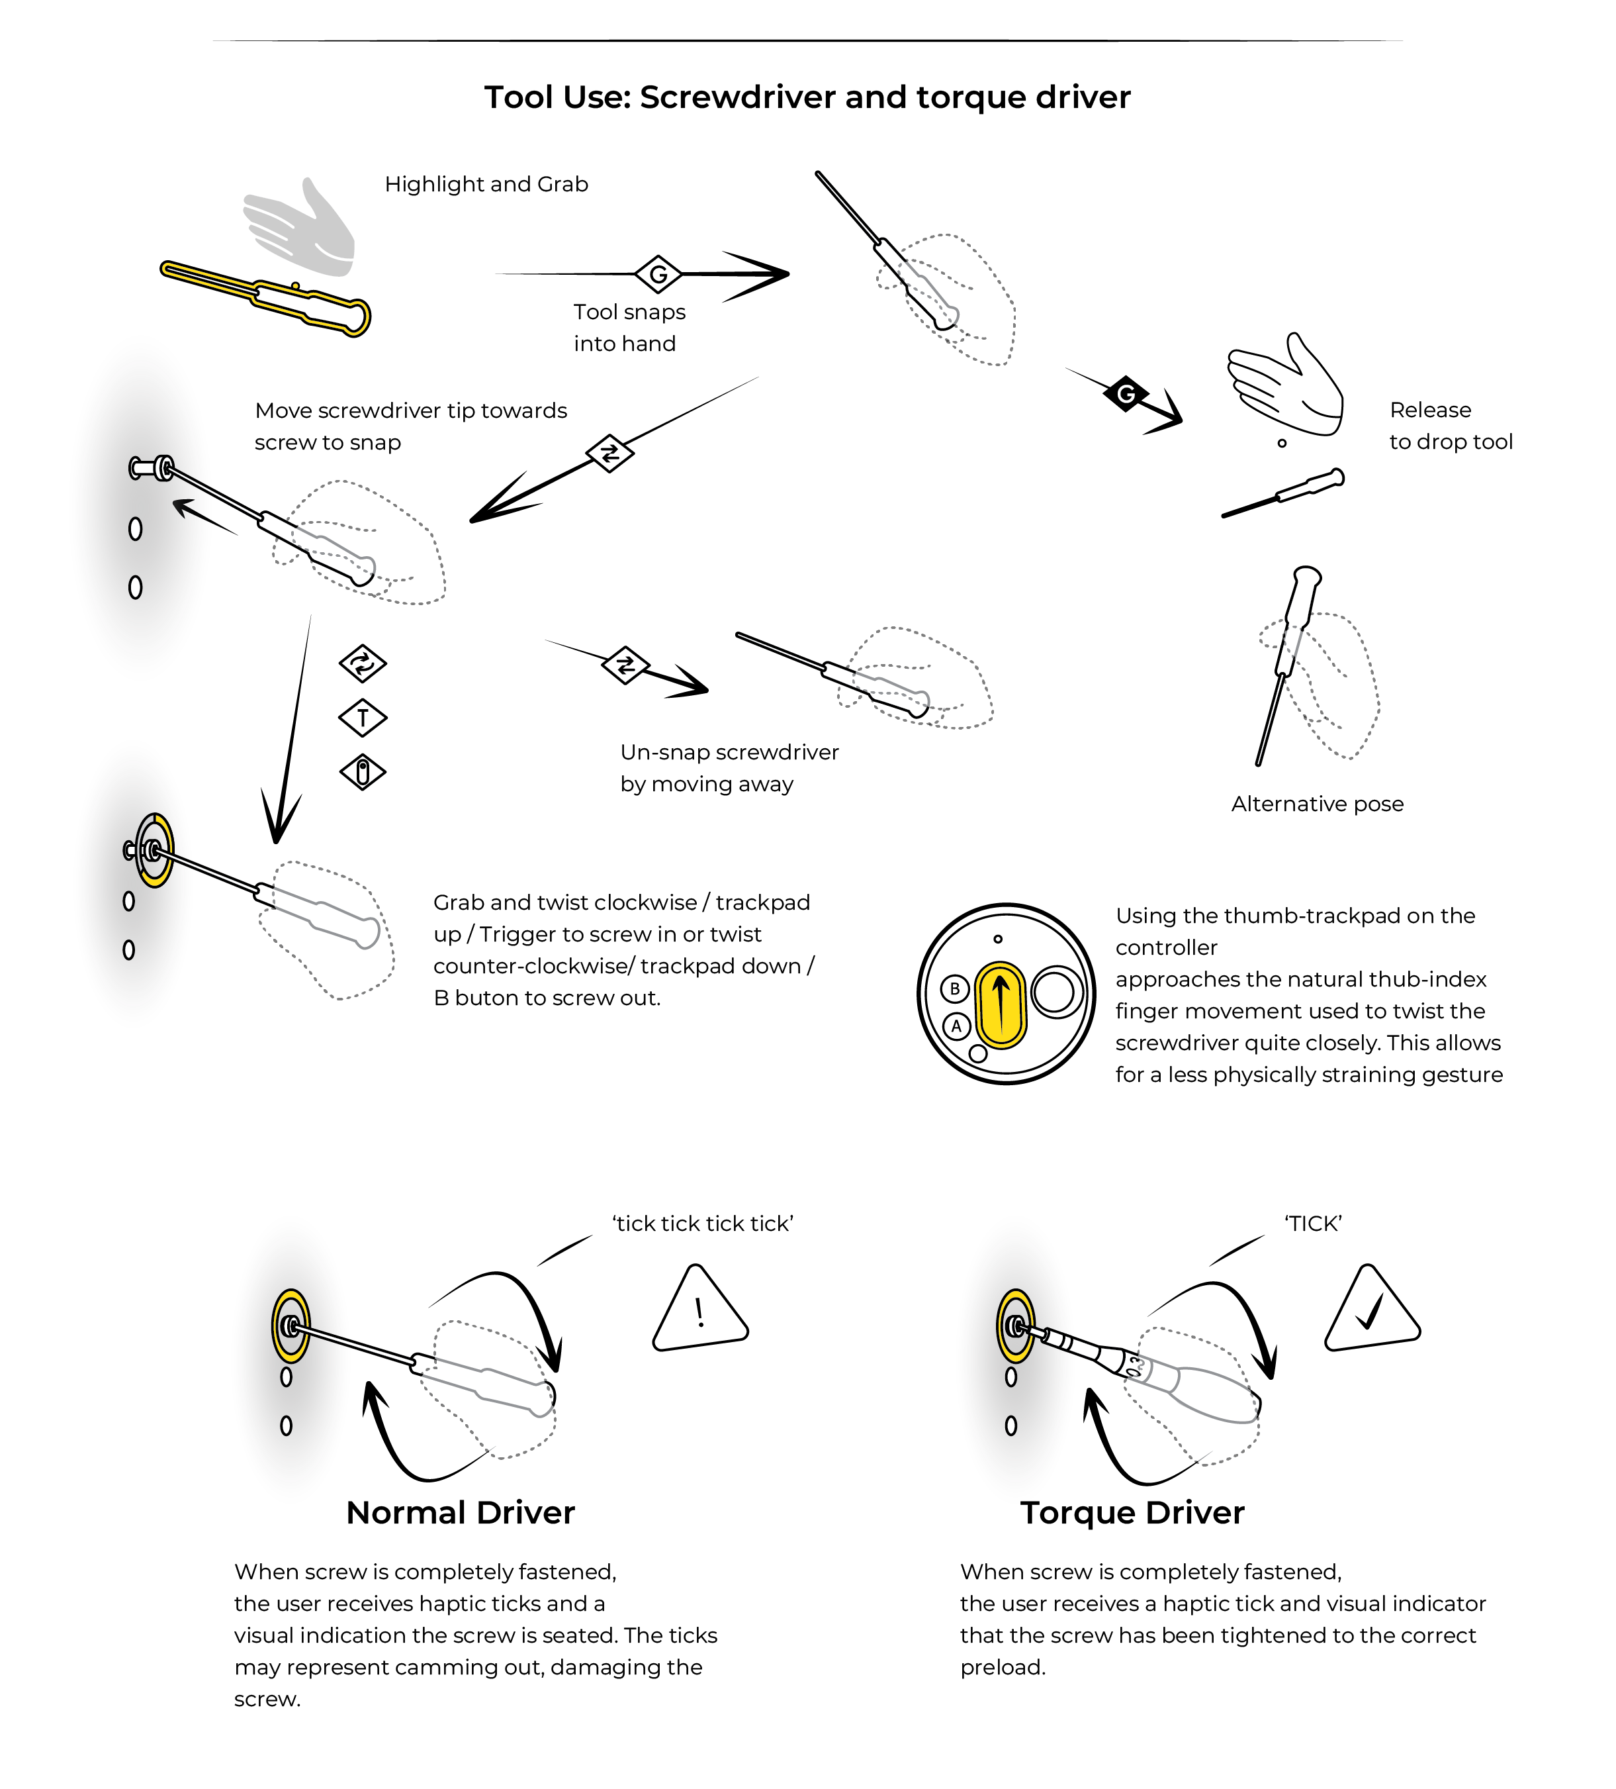
Implementation (UX/UI)
Our approach to UX/UI design for VR applications:
Based on requirements training scenario
Holistic approach, while keeping things as simple
Design runs slightly ahead but often parallel to development
Separate UX/UI from software implementation, but not too much
Lots of trial and error

Slide 11
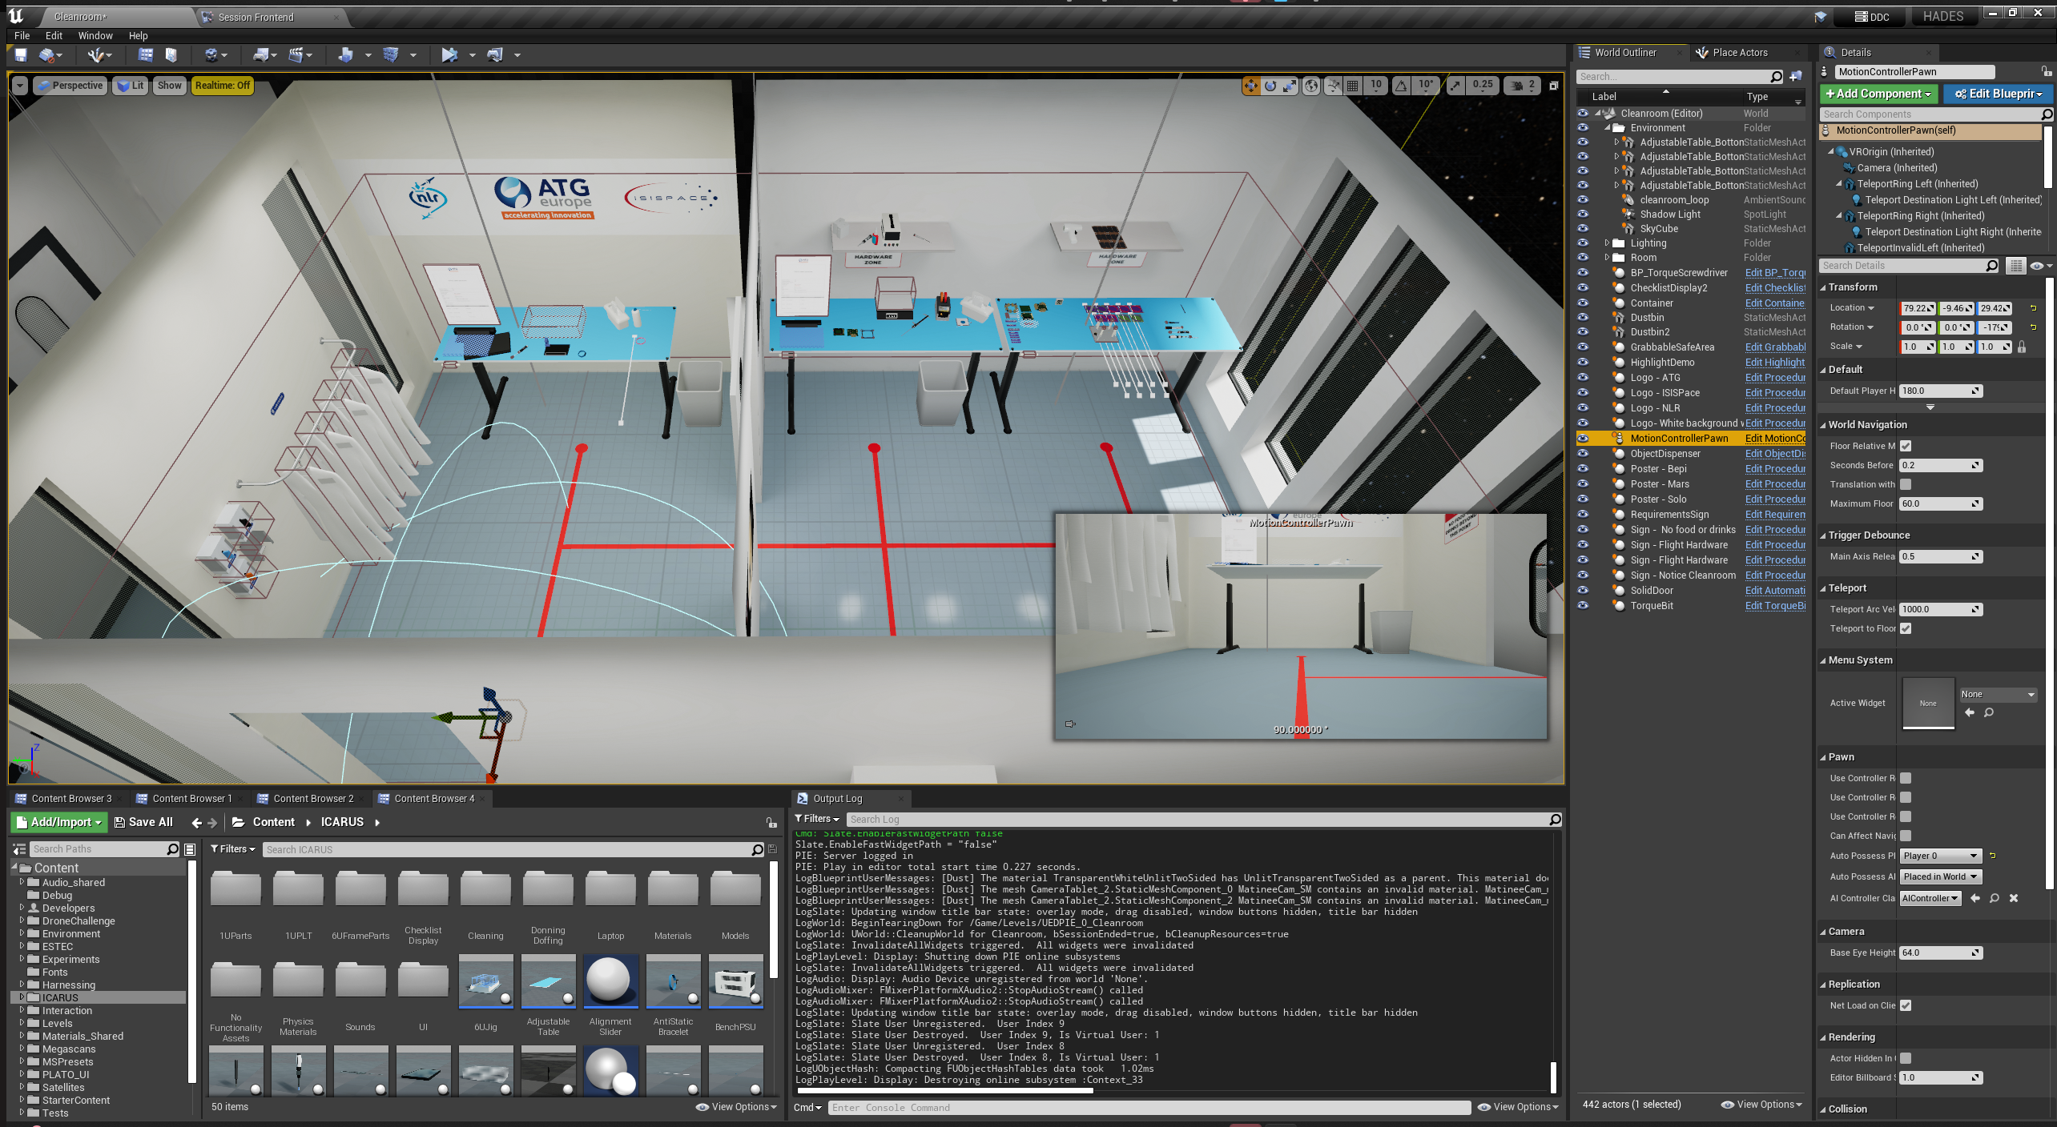
Implementation (code)
Developed in Unreal Engine (4)

Slide 12
Default features
Training scenario based on 1U cubesat model and ICARUS cleanroom
Based on real-world procedures and hardware
Realistic tools, cables and verification equipment
Supervised training
Running on Valve Index

Slide 13
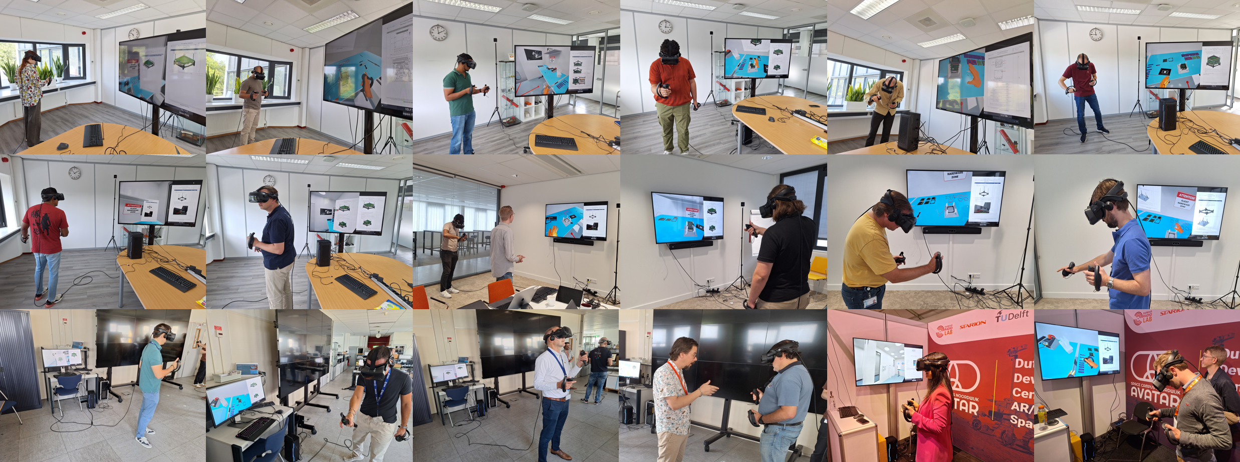
Validation
Date | Location | Number of Trainees | Trainer | Description
19-07-2024 | ISISpace | 2 | ATG | Functional tests, and initial trial with Integration tests, focusing on useability of tests and testing evaluation forms
20-08-2024 | NLR | 3* | ATG | Test sessions with NLR
29-08-2024 | ISISpace | 4 | ISISpace | Test sessions with ISISpace
30-08-2024 | ISISpace | 4 | ISISpace | Test sessions with ISISpace
06-09-2024 | ESTEC | 3* | ATG/ISISpace | Test sessions with ESA
19-09-2024 | ISD | 2* | ATG | Open testing during Industry Space Days at ESTEC

Slide 14
Test results

Slide 15
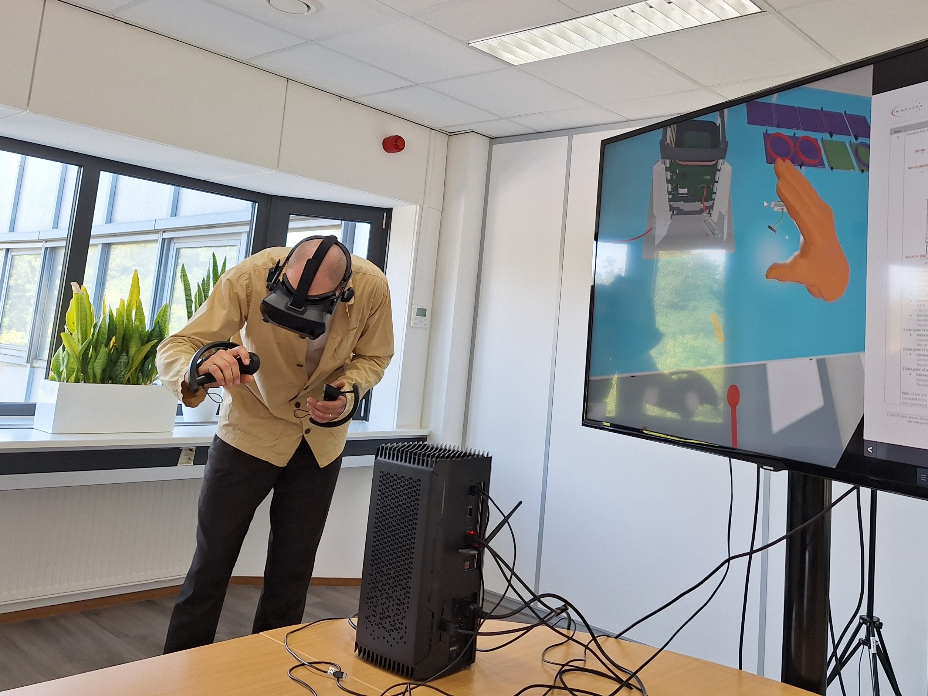
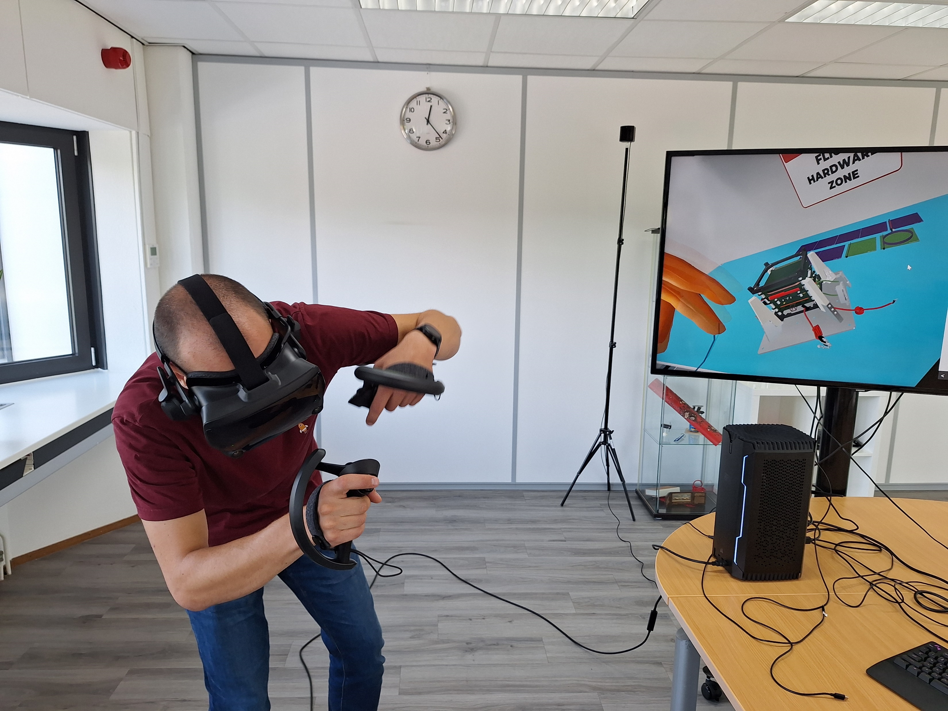
Conclusions (1)
Usability and Value: ICARUS provides a practical solution for training in complex environments, such as satellite assembly and cleanroom operations. Key advantages mentioned relate to:
Efficient Onboarding and Familiarization
Reducing Anxiety and Building Confidence
Cost and Resource Efficiency
Functionality: The functionality of ICARUS is generally considered effective, but there are areas for improvement. The main strengths mentioned relate to:
Realistic and Immersive Environment
Interactive Learning
Versatility
Further areas for Improvement mentioned relate to:
Precision and Fine Motor Skills
Technical Stability
Adaptation to User Experience Levels

Slide 16
Conclusions (2)
User Friendliness: User feedback suggests that the VR training tool is generally easy to use, with a few areas that could be optimized, related to:
Ease of Use
Instructional clarity
Comfort and ergonomics
In general, it is concluded that ICARUS MPV can adequately showcase the main value propositions / benefits considered.

Slide 17
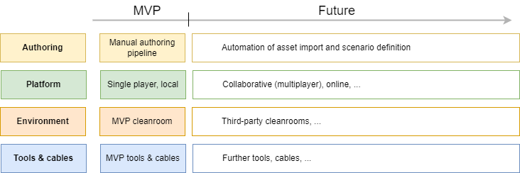
Future outlook (1)
Further development along commercial and R&D tracks:
Commercial track: commercialisation of MVP (see Options on next slide), also to further test viability, gather feedback and validate assumptions related to key value propositions of ICARUS
R&D track: further functional development, where for large features and use-cases additional R&D funding will be sought (GSTP, H2020, …).

Slide 18
Future outlook (2)
Short-term roadmap:
ID | Item
1 | Bugfixes
2 | Tutorial (in VR)
3 | Quest 2/3
Medium-term roadmap:
ID | Item
1 | Recording training session
2 | UX improvements
3 | Feedback or automatic pass/fail
4 | UE5 upgrade
5 | Save/reload
6 | Other satellite model
7 | Exploring alternatives for authoring and CAD import
8 | Branding

Slide 19
Options
Offering consists of:
VR training and evaluation based on ICARUS cleanroom scenario & 1U cubesat AIT scenario
VR training and evaluation based on custom cleanroom and procedures
VR training and evaluation based on custom hardware and procedures
Fully custom VR simulators
Pricing on request

Slide 20
Contact
Interested? Contact us at:
icarus@atg-Europe.com

