Slide 1
Idea I-2023-01289
Real-time in-situ monitoring of particle deposition with on-chip electronic dust counter (DUST : DUst System Tracker)
Final presentation slides

Slide 2
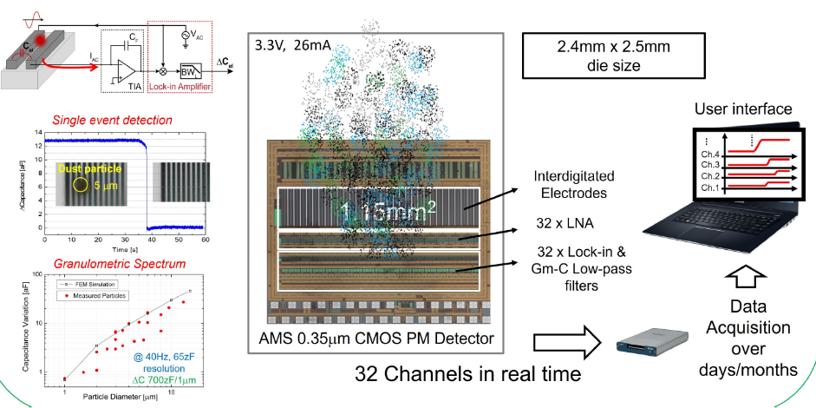
Synoptics of DUst System Tracker project

Slide 3
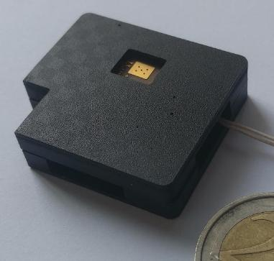
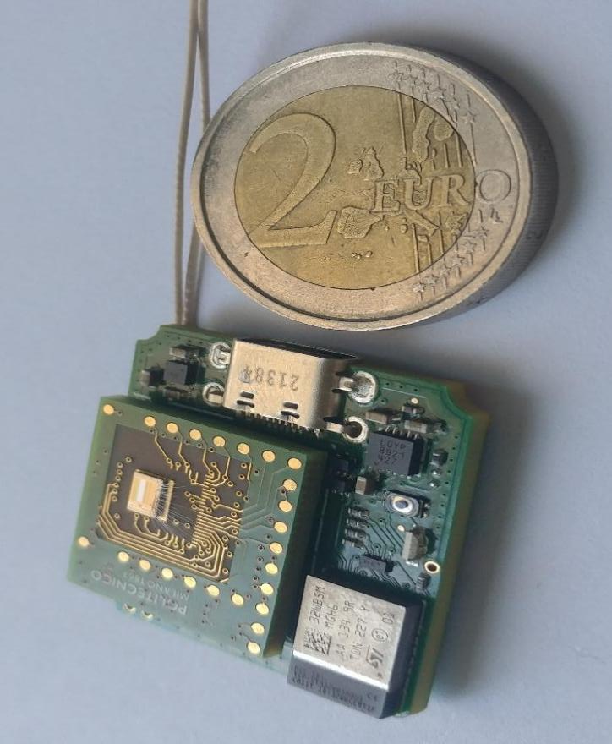
DUST sensor system realization
Power supply : +5V (USB) or 3.6<V_{ext}<6V, I_{max}=100mA (External) or Power bank (trickle charge) supporting I_{min}=37mA
Total Power consumption : 55 mW
A two boards system

Slide 4
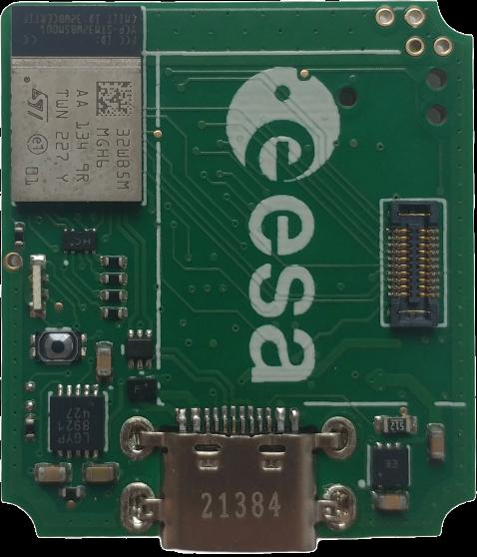
Micro-computer board
27mm
Bluetooth
30.5mm
STm micro controller
Sensor chip connector
External power supply
MicroSD
USB
Data transfer & firmware upload : USB, Bluetooth, UART, STm link

Slide 5
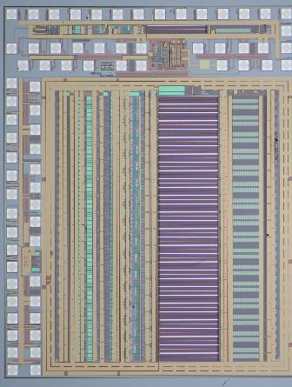
Sensor-chip board
18 mm
2 mm
20 mm
μC board connector
Sensor chip
Test pads
AMS technology, 0.35um

Slide 6
Principle of operation
Particle Matter (PM) changes the impedance between metal electrodes
Interdigitated electrodes are designed in a differential scheme to isolate PM signal variation from sensor overall impedance value
Electrodes are stimulated at fixed frequency (Ex. 100kHz) and the signal is extracted with a lock-in amplifier operating at the same frequency
M.Carminati, G.Ferrari, F.Guagliardo, M.Sampietro “ZeptoFarad capacitance detection with a miniaturized CMOS current front-end for nanoscale sensors”, Sensors and Actuators A, 172, pp.117-123 (2011)

Slide 7
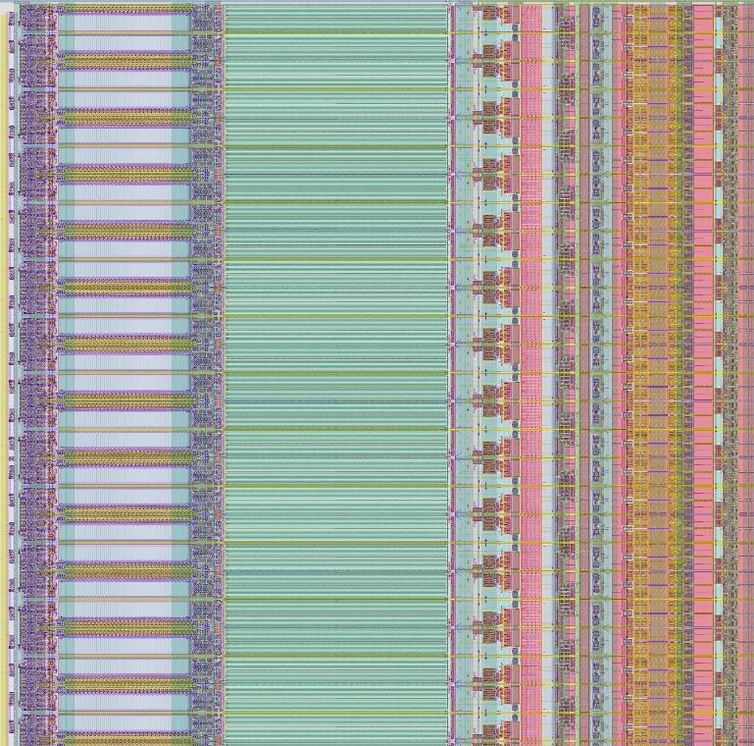
Chip layout & functionalities
Digital to Capacitance Converter (DCC)
Interdigitated Electrodes
Low-noise
amplifiers
Lock-in & Gm-C Low-pass filter
Sensing area (green area): 0.5 mm x 2 mm, subdivided in 32 channels
Interdigitated electrodes gap =1 μm
V_{AC} = 3.3V
Low pass filter of the Lock-in amplifier, BW = 100 Hz
32 Channels
Recordings : number of particles/ch pulse amplitude time of arrival
2 mm

Slide 8
Architecture internal to the chip
Chip output is a differential DC voltage proportional to the measured PM event
Circuit to reset the sensor when many particles have been depositing on the electrodes
P. Ciccarella, M. Carminati, M. Sampietro, G. Ferrari, “Multichannel 65 zF rms Resolution CMOS Monolithic Capacitive Sensor for Counting Single Micrometer-Sized Airborne Particles on Chip,” IEEE J. Solid-State Circuits, Vol. 51, No. 11, pp. 2545–2553, (2016)

Slide 9
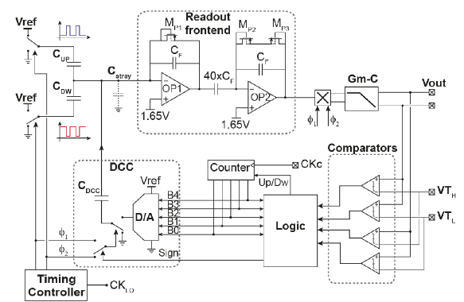
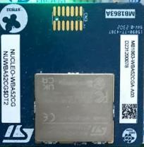
Monitoring & Acquisition of Sensor outputs
Sensor CHIP
Differential reading
TI ADS8867
16-bit
for particle counts & tracking
Δ
Ch1
DC monitoring
for channels monitoring
Ch2
Two 12-bit ADCs internal to the STm32

Slide 10
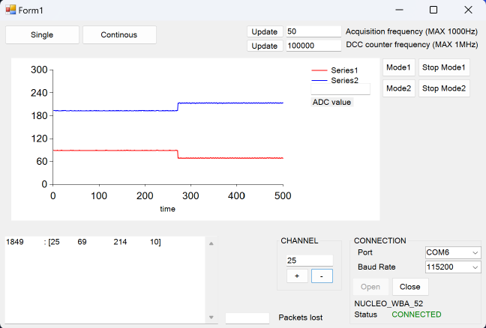
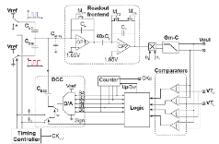
Monitoring & Acquisition of Sensor outputs
Sensor CHIP
Full scale 3.3V (255)
Mid value 1.65V (128)

Slide 11
Detection of plastic beads 8μm (1)
∼100
Thermo Scientific Fluoro-Max (red fluorescent polymer microspheres)
Particles powder 8um in diameter
∼550
F.Zanetto, F.Ciobanu, M.Carminati, G.Ferrari, M.Sampietro, J.Eck “Portable fallout monitoring instrument for particle tracking in space applications”, ISMSE-ICPMSE, Saint Raphael (France) 7-11 Oct. 2024

Slide 12
Detection of plastic beads 8μm (2)

Slide 13
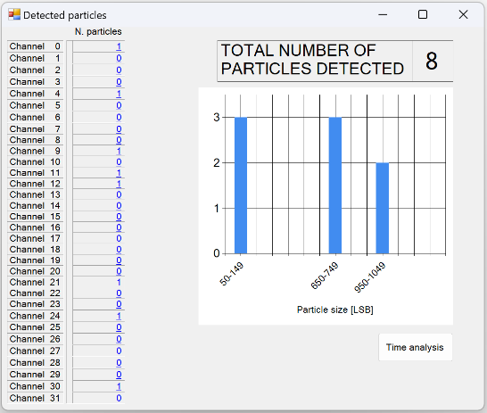
Dust particles counting
Example of outcome when a blow of microbeads of 8um in diameter are depositing on the surface of the detector
If the platform is not connected to the computer, PM is still counted (internal memory of STm or uSD) and once it is reconnected, all the data (number of particles, time instant and signal amplitude) are transmitted to the computer.

Slide 14
Noise performance on 32 channels
All channels are very low noise, ensuring very high resolution in the PM detection (signal of 8um bead is about 600 bins, channel noise is <10 bins)

Slide 15
Granulometric Spectrum
Detectable particle size: between 1 μm and about 20 μm
A different range can be targeted with a different geometry of electrodes. Example: with electrodes gap of 5μm, the range would be 5μm<PM<100 μm.

Slide 16
Data handling & communication method
Data can be acquired, collected and transmitted in many ways :
a) USB to computer in run time
+ raw sampling data on 32 ch.
+ time of arrival of particles + circuit and sensor operational parameters
+ access to μC
b) Data memorized in the internal memory of STm μC
. number of particles detected in each channel . transmission via Bluetooth
c) Data memorized in the μSD during experiment and transmitted off-line with USB/UART/Bluetooth
+ sampled values around the event
+ time of arrival of particles

Slide 17
Thermal behaviour of the system
The total Power consumption of 55 mW localizes in the sensor chip and in the 5V-to-3.3V DC-DC converter

Slide 18
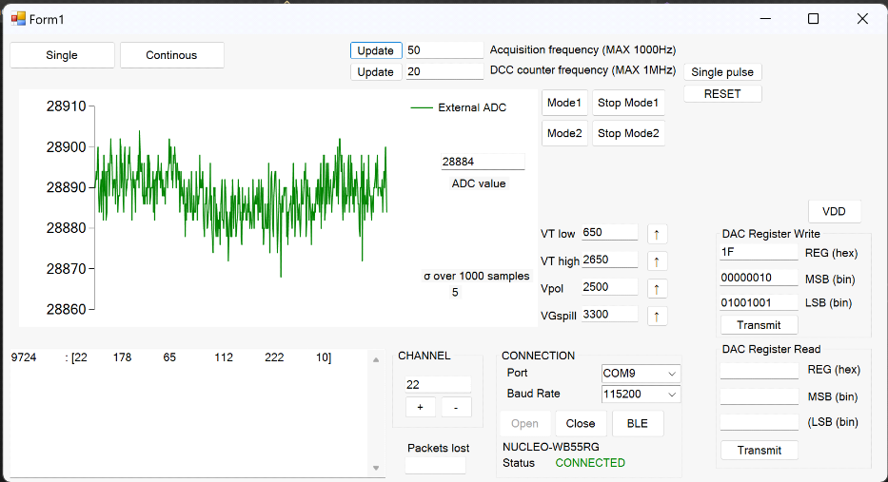
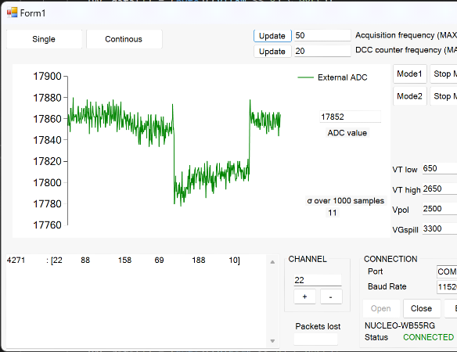
Insensitivity to ambient light
ROOM light
OFF
OFF
Light ON
SPOT light
OFF
OFF
Light ON
Light impinging onto the sensor produces an output signal of max 60 bins, to be compared with the 8um PM signal of 600 bins.

Slide 19
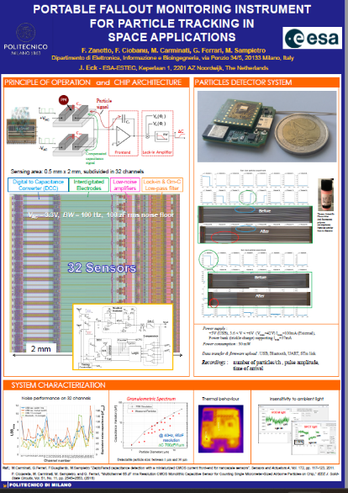

Dissemination
Conference partecipation

Slide 20
Gantt chart
20

Slide 21






The POLIMI staff of DUST project
Marco Sampietro
Full Professor
Giorgio Ferrari
Associate Professor
Marco Carminati
Associate Professor
Francesco Zanetto
Research Associate
I³N
Innovative Integrated
Instrumentation for Nanoscience
Florin Ciobanu
Adjoint researcher

