Slide 1

FAQAS2: Fault-based Automated Quality Assurance Assessment for Space 2
IMPROVE MUTATION TESTING IN SPACE SOFTWARE SYSTEMS
Fabrizio Pastore
University of Luxembourg
fabrizio.pastore@uni.lu
ADCSS
October 23rd, 2024

Slide 2





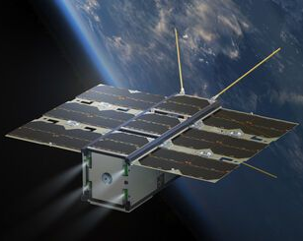
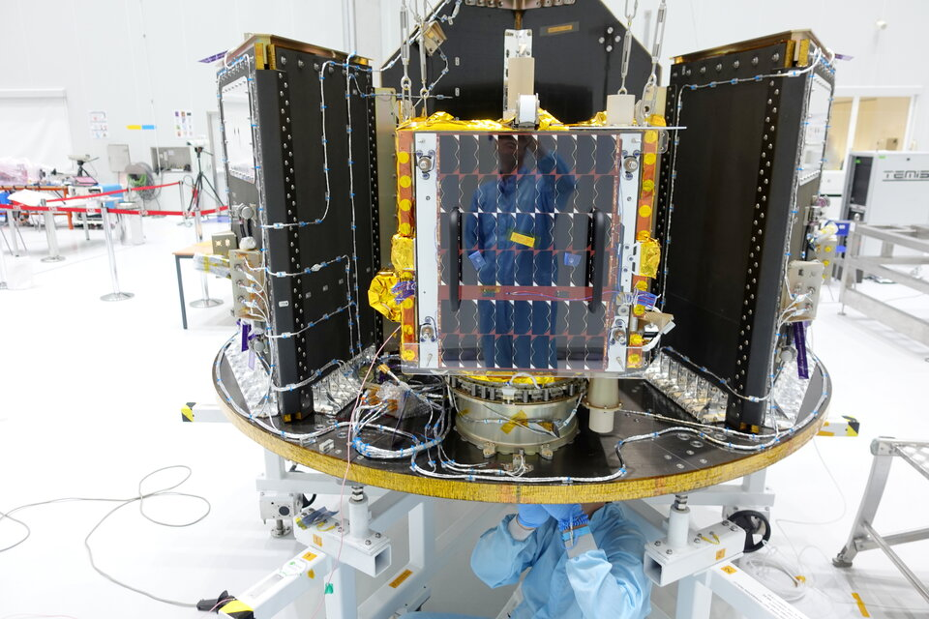



Fault-based, Automated Quality Assurance Assessment and Augmentation for Space Software 2
SnT/University of Luxembourg
Gomspace Luxembourg (GSL)
LuxSpace
Huld - Finland
Technology provider
Develop Nanosatellites
Case study provider
Technology validator
Develop Microsatelites
Case study provider
Technology validator
Develop SW solutions
ISVV supplier
Case study provider
Technology validator
https://faqas.uni.lu/
Notes:
what I present is the result of a projct funded by the european space agency that aims at assessing quality assurance practices and imrpoving them
At SnT, I am the PI, and worked with..
it nvolves gomspace luxebourg which is a developer of nanosatellites
and gomspace, who develop microsatellites

Slide 3

Software testing is prevalent in V&V
Word cloud for
ECSS-Q-ST-80C standard
Notes:
Well software testing is the prevalent V&V method.
To demonstrate it, this is a word cloud for the ST-80-C of the standards about quality assurance for space software,
and testing is the larger technical word

Slide 4
How to ensure
thorough testing?
Notes:
Our objctive is to ensure thorough testing then.

Slide 5
Mutation Analysis and Testing
SUT
SUT
SUT
SUT
SUT
SUT
SUT
SUT
Test
Suite
Test
Suite
Test
Suite
Test
Suite
Test
Suite
Test
Suite
Test
Suite
Test
Suite
FAIL
FAIL
PASS
FAIL
FAIL
PASS
PASS
FAIL
NewTest3
NewTest1
NewTest2
FAIL
FAIL
FAIL
Improve with Automatically Generated Test Cases
Notes:
Mutation analysis and testing are a solution.
Mutation analysis consists of assessing the quality of a test suite by generating several faulty version of the software and testing all of them, the proportion of faults detected by the test suite is called mutation score and provides an indication of the quality of the test suite, ideally all the faults should be detected.
Mutation testing instead is the practice of improving the quality of a test suite by automatically generating test cases that discover the fault not discovered by the original test suite.

Slide 6
FAQAS-2 toolset
Mutate C/C++ source code
Mutate the data exchanged
by C/C++ components
Generate
test cases in C/C++
that detect the injected faults
Generate
test cases in C
to exercise more
“data partitions”
Notes:
We developed a toolset for mutation analysis and testing.
It has a dual purpose, to support developers in improving their softwarer, and to imrpove agencies like ESA and ISVV suppliers to furher verify the software of third parties.
MASS mutates the source code of the software under test, it proviodes information like the list of live mutants and the mutation score that can be used to derive a verificatin report, according to our methodology.
The live mutants can then be used to identify new test inputs. For that we have a tool, MOTIF, that generates unit test cases that kill the live mutants.
The new test cases can be integrated into the test suite.
DAMAT mutates the data exchanged by components, to verify if the test suite can detect integration faults.
It works according to a fault model that is specified to replace nominal data with non-nominal data.
It provides informaton about the mutants being live, that is the test suite does not detect that some data was not as expected, which means that your test oracles are not effective.
And mutant not being applied, for example we were supposed to replace non-nominal values with nominal values, but the test suite does not exercise non-nominal values.
This information can be inspected to derive a verification report, further, live mutants mean that the test suite is missing test assertions, while mutants not applied mean that the test suite is not exercising all the data partitions. For this case, we developed a prototype that can automatically generate test cases exercising those partitions.

Slide 7
DEMO
FAQAS-2 toolset
Mutate C/C++ source code
Mutate the data
Generate
test cases in C/C++
that detect the injected fault
Generate
test cases in C
to exercise more
“data partitions”
Notes:
We developed a toolset for mutation analysis and testing.
It has a dual purpose, to support developers in improving their softwarer, and to imrpove agencies like ESA and ISVV suppliers to furher verify the software of third parties.
MASS mutates the source code of the software under test, it proviodes information like the list of live mutants and the mutation score that can be used to derive a verificatin report, according to our methodology.
The live mutants can then be used to identify new test inputs. For that we have a tool, MOTIF, that generates unit test cases that kill the live mutants.
The new test cases can be integrated into the test suite.
Since software systems are often affected by integration probvlems, we developed DAMAT, which mutates the data exchanged by components.
It provides informaton about the mutants being killed and the data partitions being exercised by the software under test.
This information can be inspected to derive a verification report, further, live mutants mean that the test suite is missing test assertions, while mutants not applied mean that the test suite is not exercising all the data partitions. For this case, we developed a prototype that can automatically generate test cases exercising those partitions.
To give a bit of concreteness, I show you a quick demo of our tools.

Slide 8
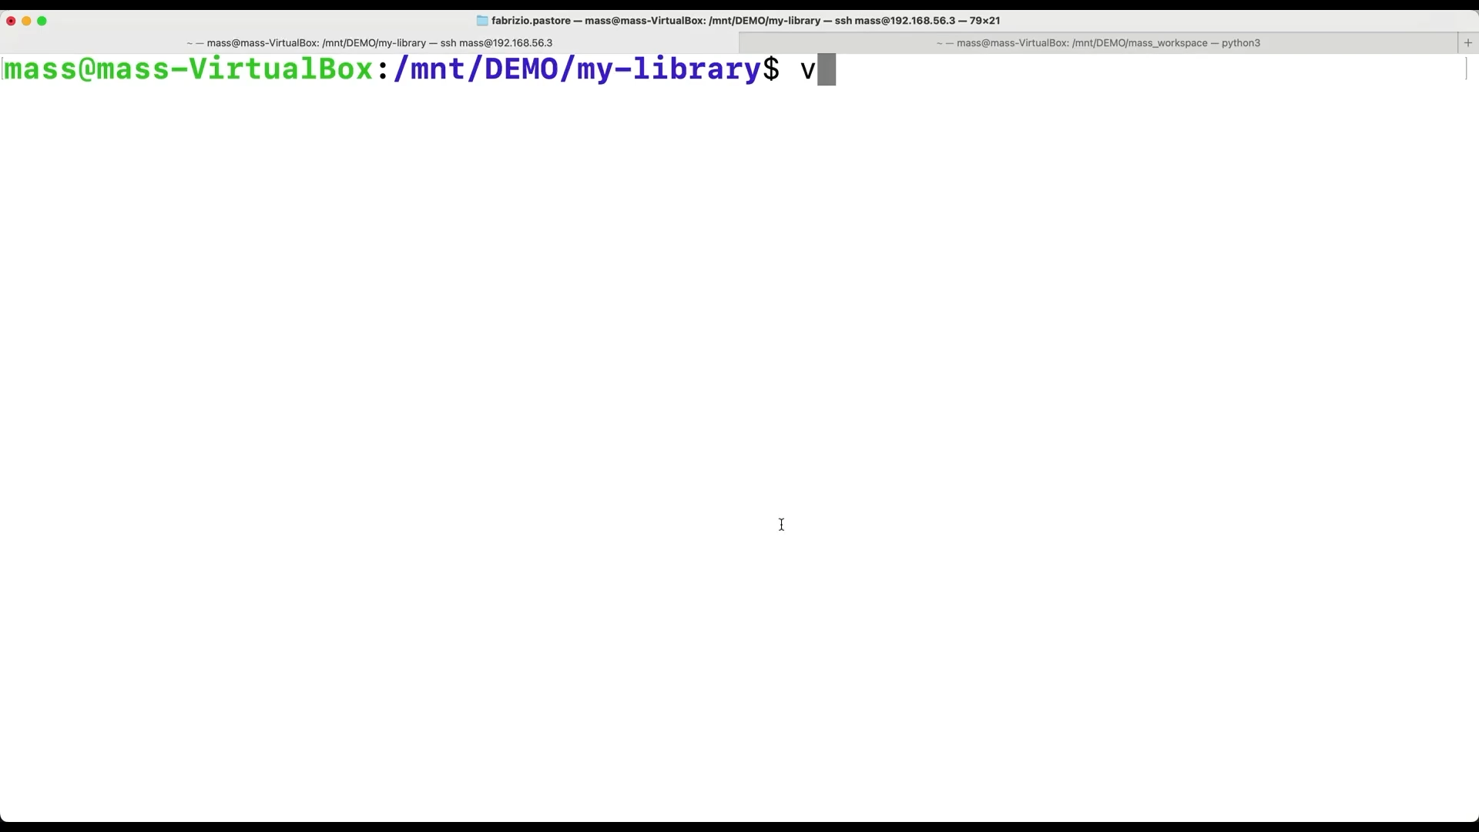
Faulty implementation

Slide 9
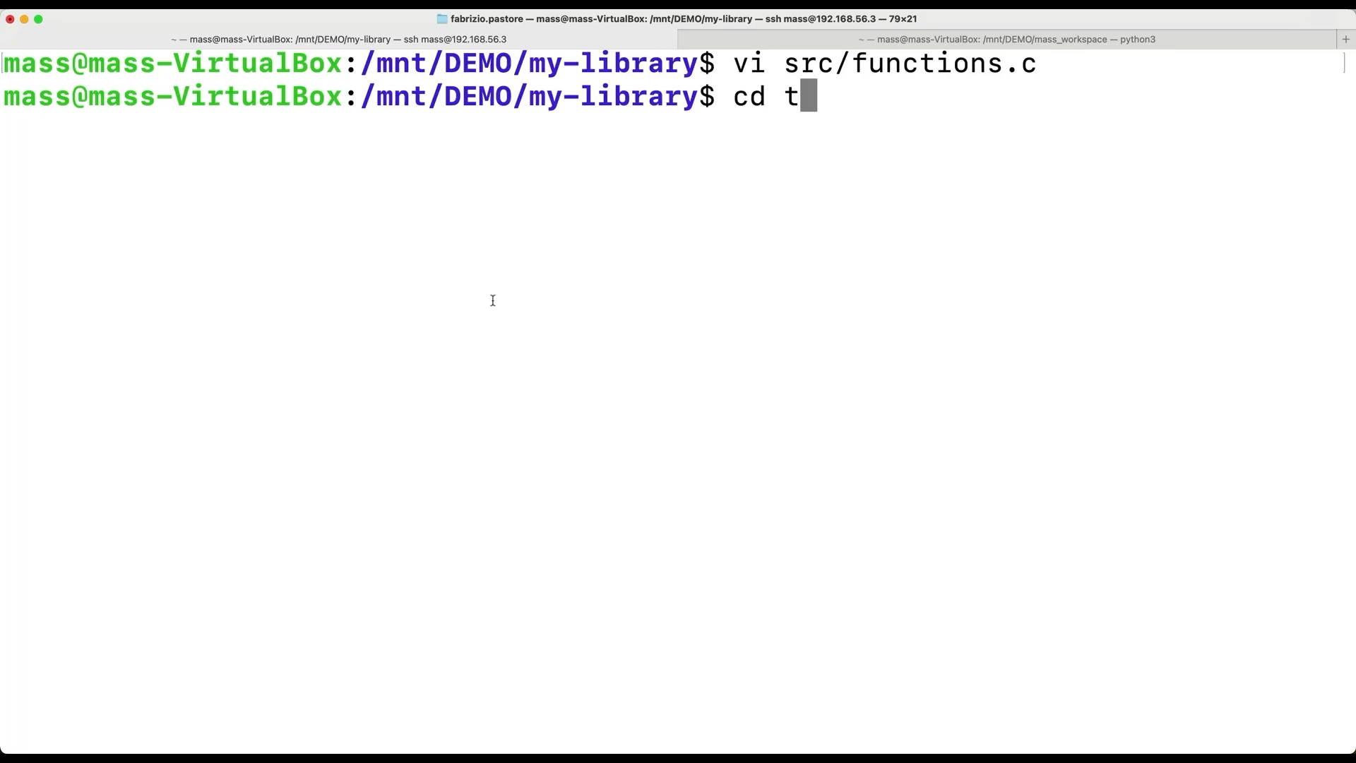

Slide 10
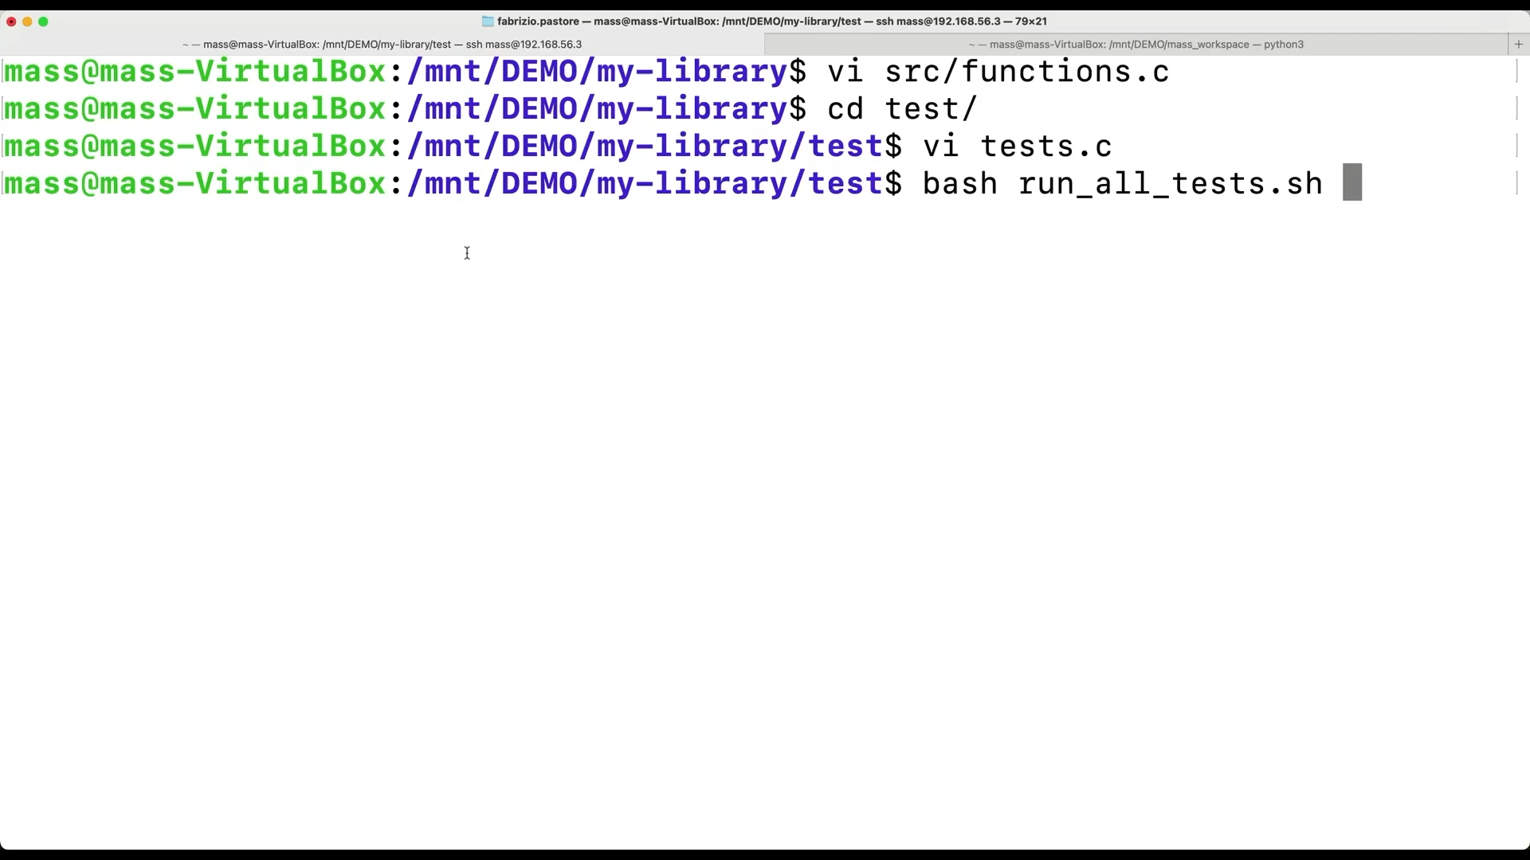
Function is fully covered by test cases but they don’t detect the fault.
Branch coverage and MC/DC cannot help to discover a limitation in the test suite.

Slide 11
Function is fully covered by test cases but they don’t detect the fault.
Branch coverage and MC/DC cannot help to discover a limitation in the test suite.
This function is not tested instead.

Slide 12
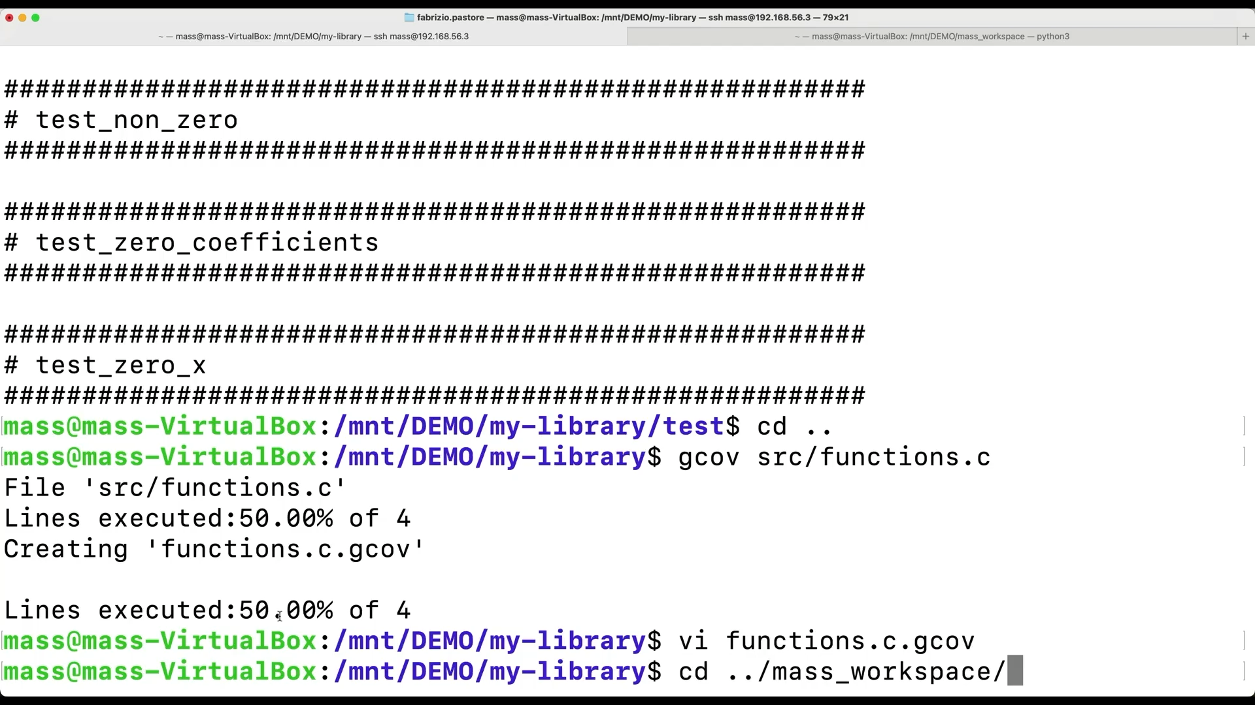
Test all the mutants

Slide 13
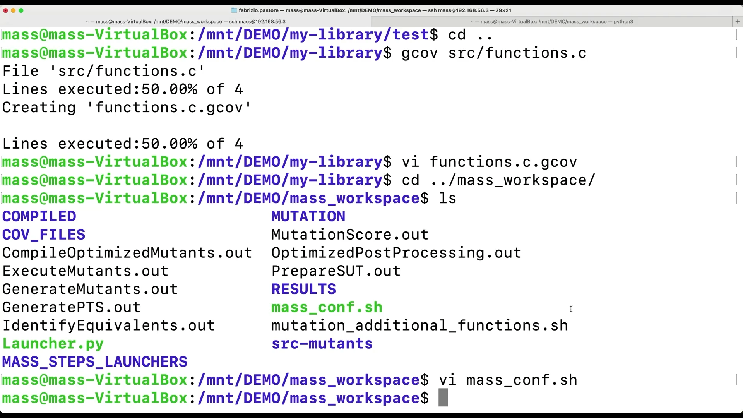

Slide 14
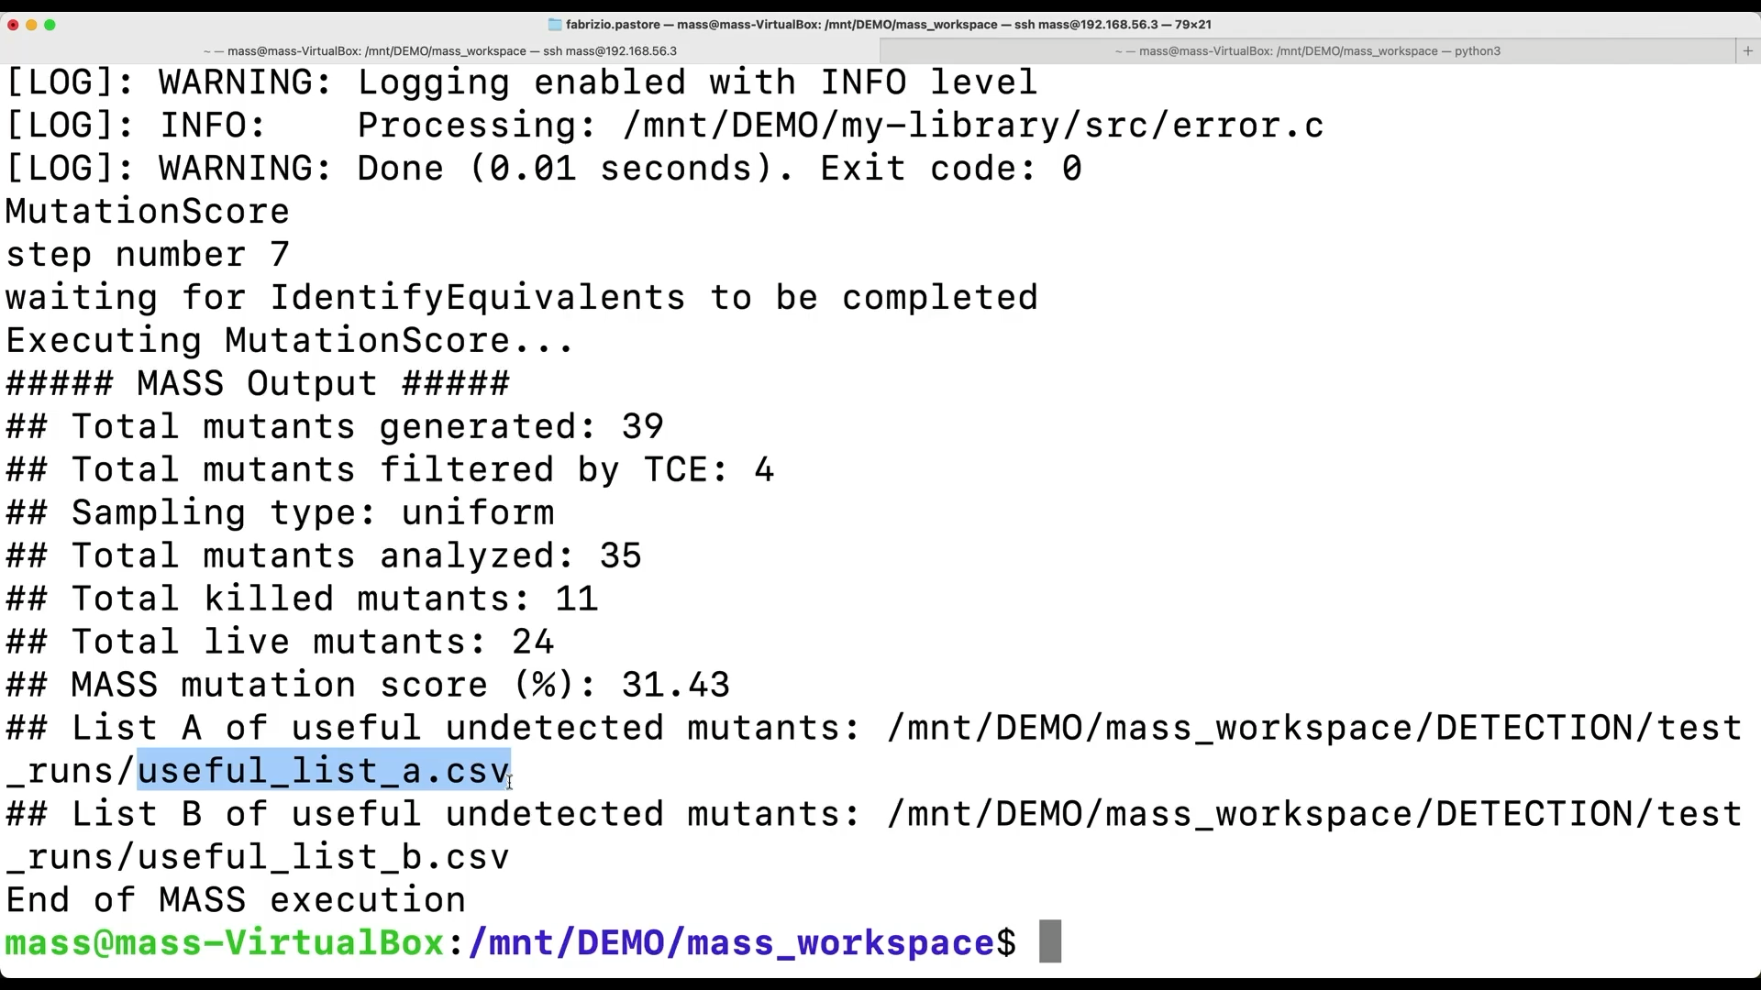

Slide 15
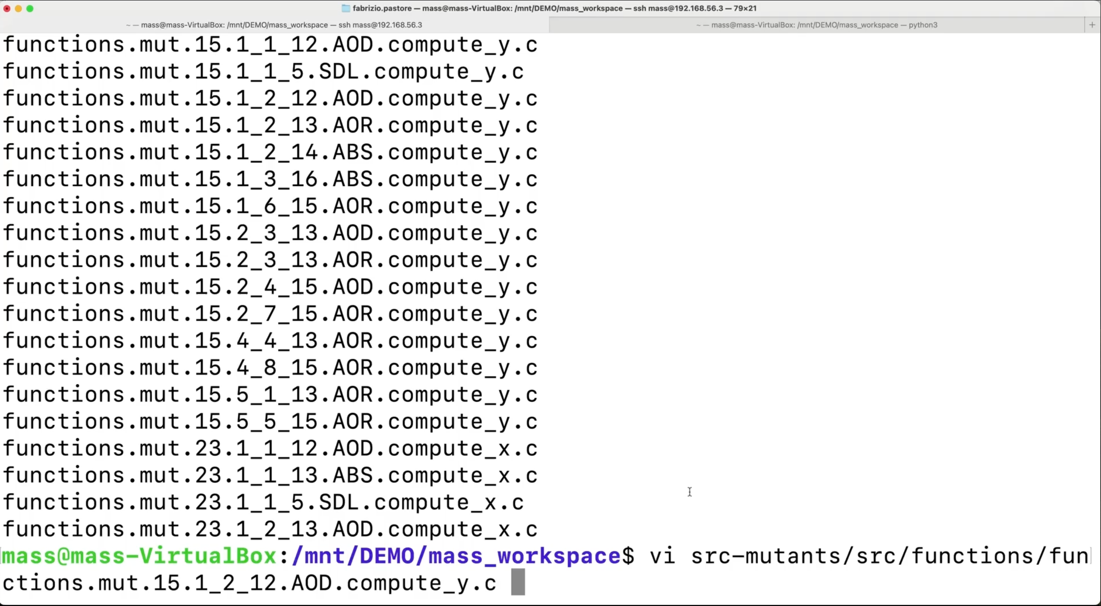
Notes:
We can open the mutant source

Slide 16
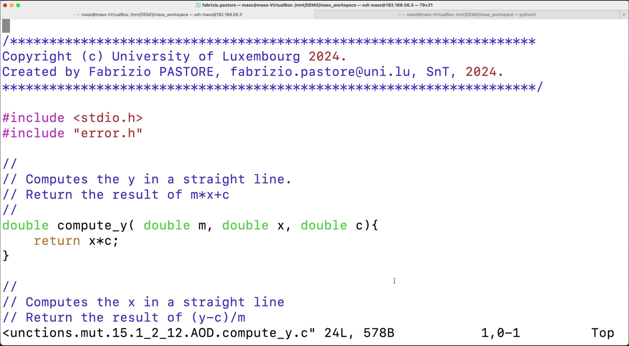
The test suite does not exercise the effect of ‘m’ on the result.
No need to understand the test suite limitation:
An appropriate test case will be generated!
Notes:
Here is the mutant, “m” was deleted. Since it was not detected it means that

Slide 17
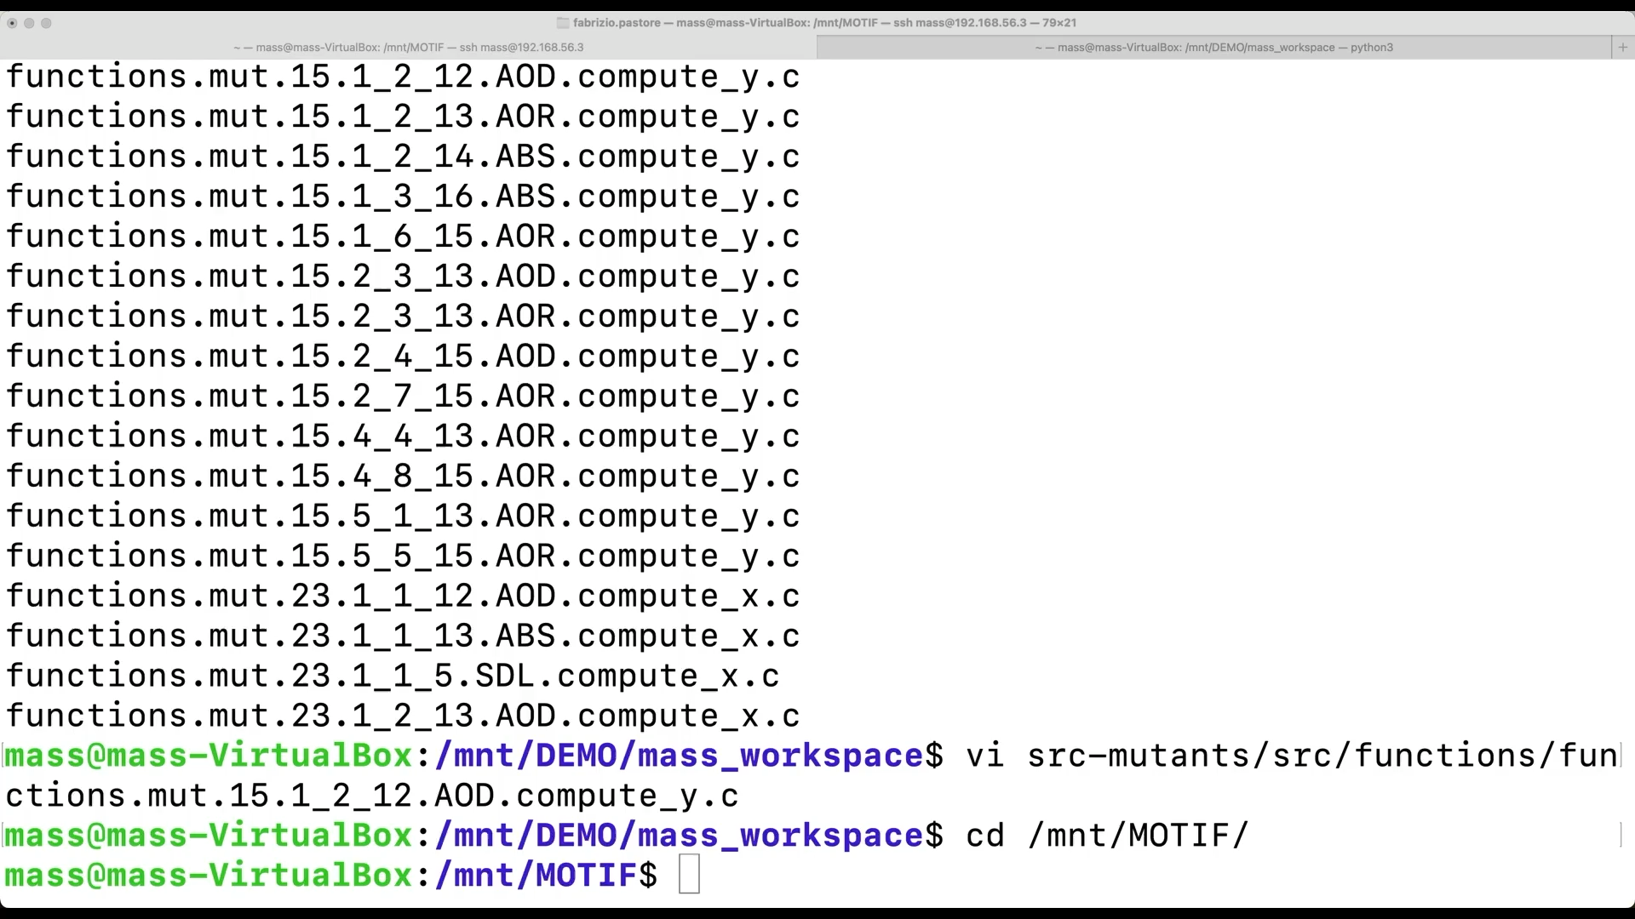

Slide 18
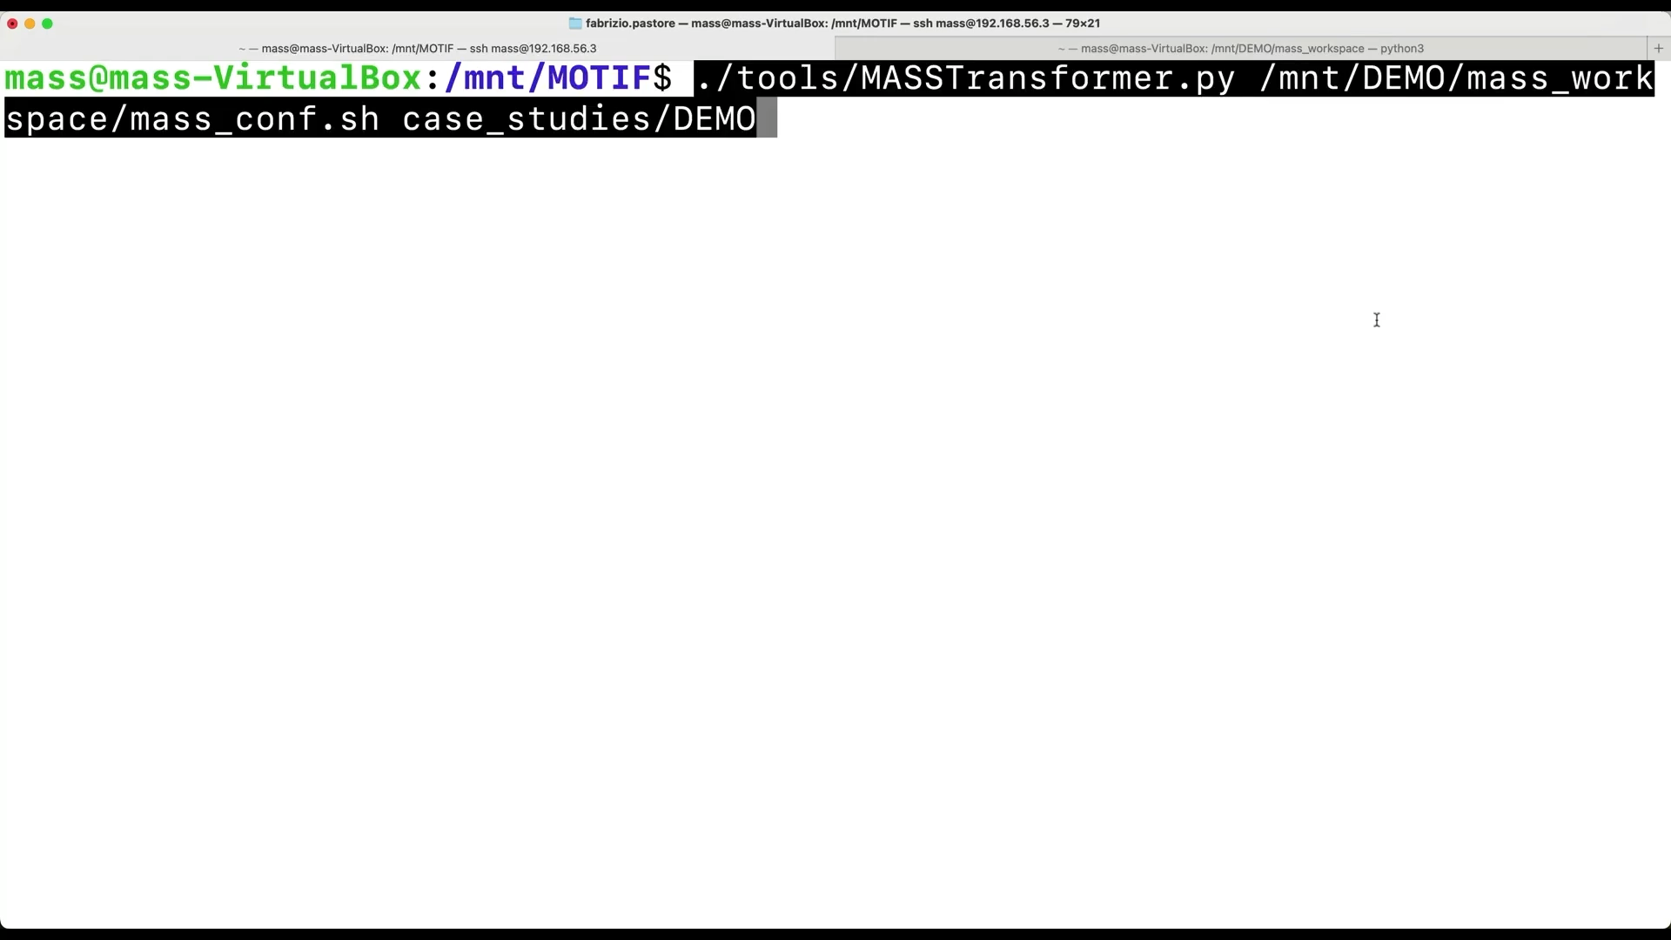

Slide 19
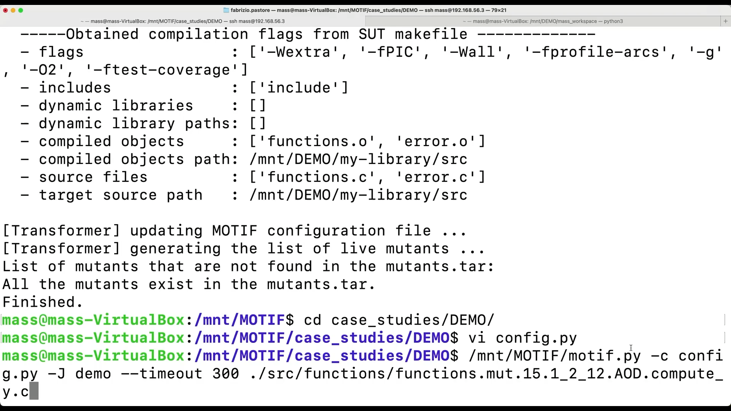

Slide 20
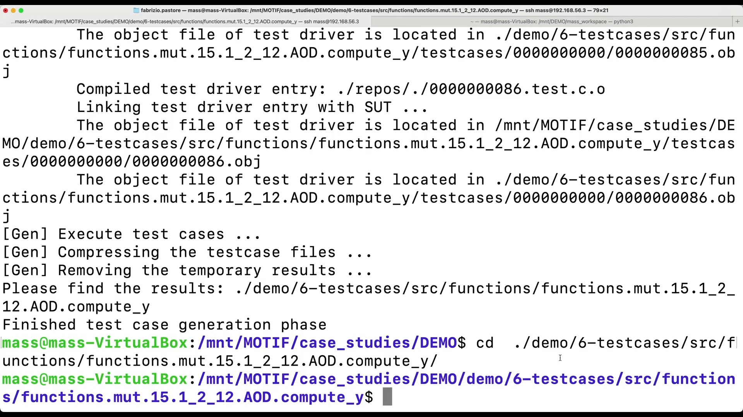
The new test case exercises the software with “corner case” inputs never tested before.
We shall manually verify the correctness of results.
Expected result based on specification docs: m*x+c = (-1)*(-1)+(-1) = 0
We discovered a fault!

Slide 21
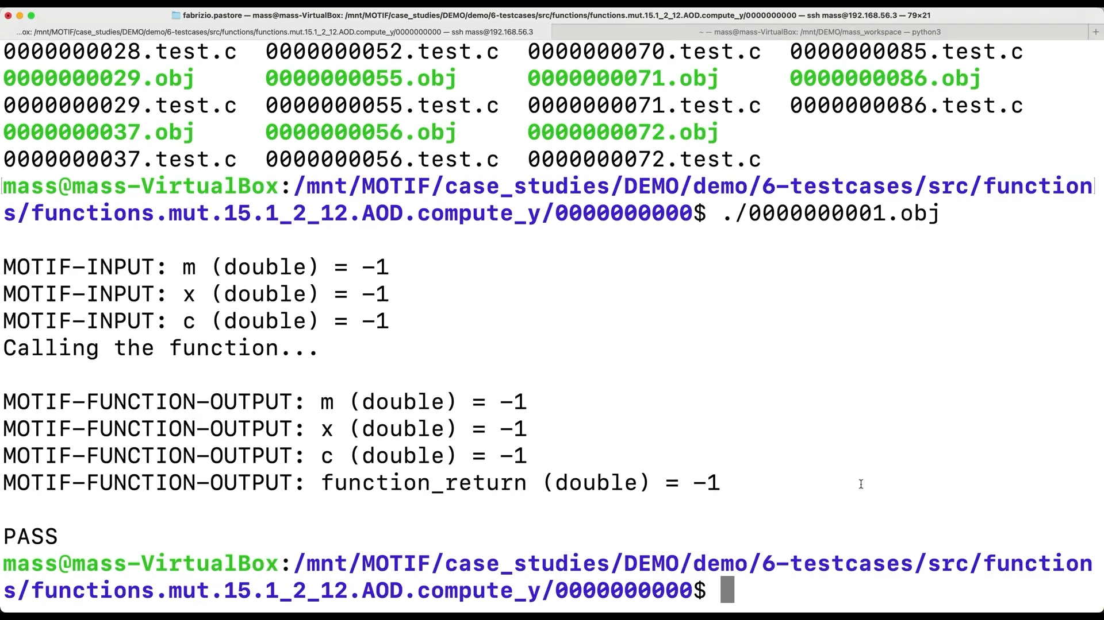
Input values
Expected outputs

Slide 22
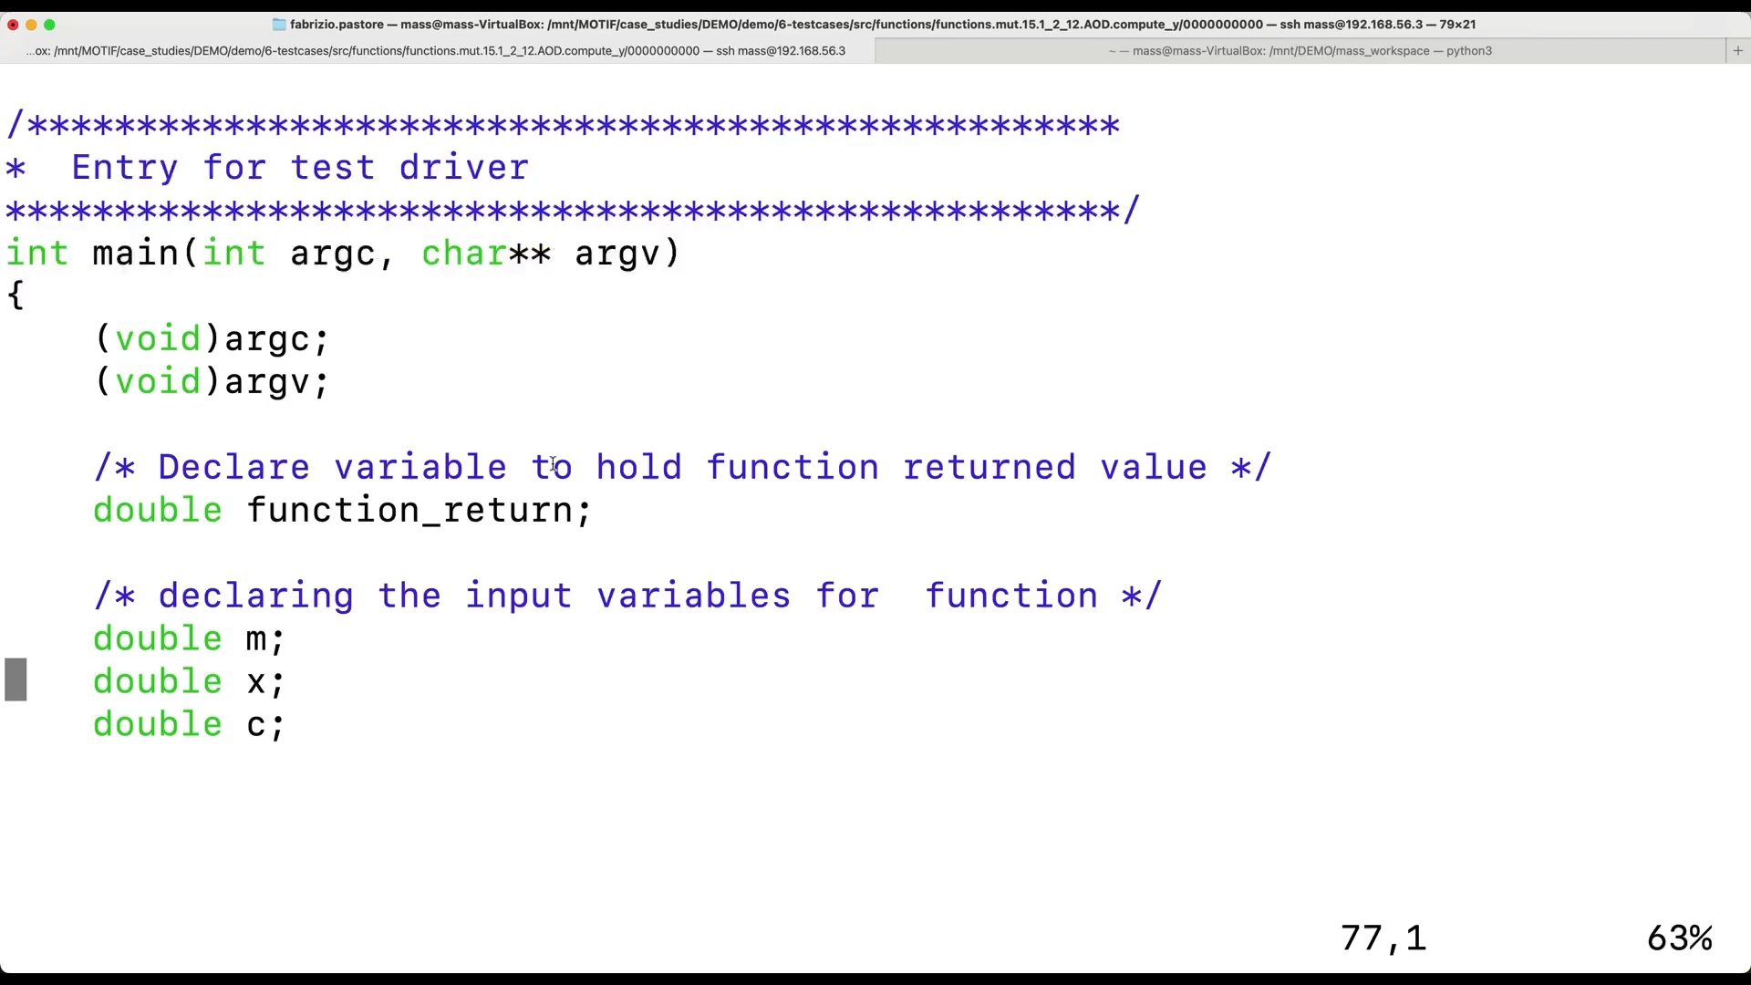
Replace value observed at runtime during fuzzing
with correct expected value

Slide 23
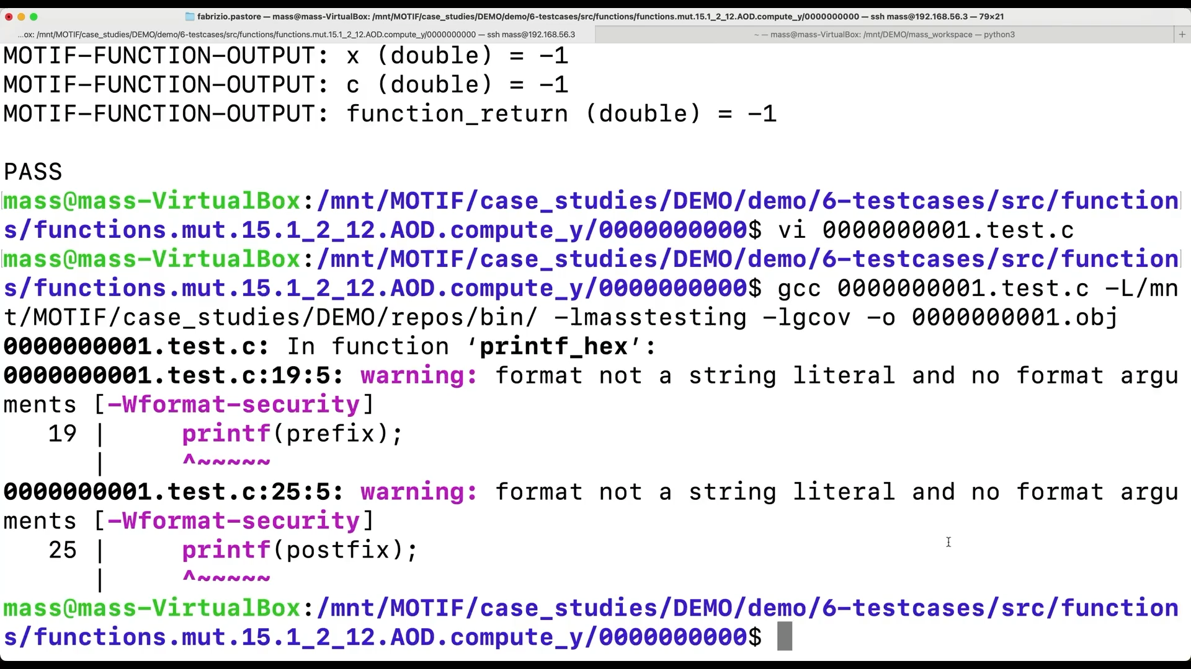

Slide 24
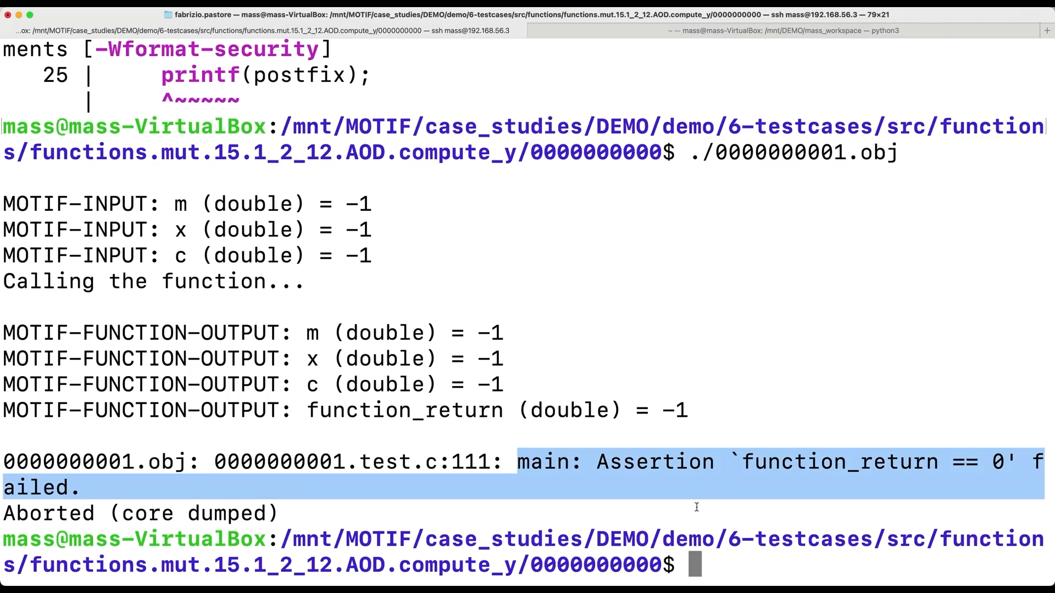

Slide 25
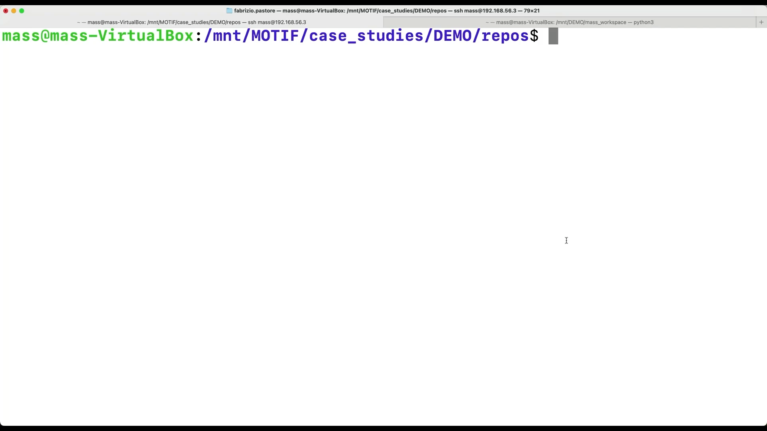

Slide 26
The MOTIF process
Live Mutant
SUT source
int main(...){
double m = load(..);
double x = load(..);
double c = load(..); double m_m = load(..);
double m_x = load(..);
double m_c = load(..); ret = compute_y(m,x,c); mut_ret = mut_ compute_y (m_m,m_x,m_c);
if( ! match ( ret, mut_ret ) ){ abort(); }
Generate fuzzing driver
Fuzzing driver
0100100001110110000
1100101101110110000
0101101101110110000
Binary input file
if( ! match (m, m_m ){ abort() };
if( ! match (x, m_x) { abort() };
if( ! match (c, m_c) { abort() };
Notes:
We therefore developed a pipeline that we called MOTIF
It reads a mutant and the source code of the SUT
First it generates a fuzzing driver based on the signture of the mutated function
The fuzzing driver reads a binary file received as input
And assigns chunks of its bytes to some variables
Those variables are used as arguments in the invocation of the function under test and its mutated version
Finally it checks if the output of the two functions match, otherwise we killed the mutant, which is wat we want and thus we cause a crash that will make the fuzzer store the input file
Since outputs can also be stored in input variables, we checks all the variables.

Slide 27
The MOTIF process
Mutation Testing
Live Mutant
SUT source
Execute fuzzer (AFL++)
Binary input file
Generate fuzzing driver
Executable fuzzing driver
Fuzzing driver
Coverage
Software Under Test
Post-processing
Crashing file
Crashing file
Crashing file
File killing mutant
File killing mutant
Generate executable test case
Test case
Notes:
Then it automatically generates a set of seed files. They have a number of bytes that correspond to what required to test the function under test with the fuzzing driver.
They are populated according to the parameter types but I have no time for details.
It compiles the fuzzing driver
And perform mutation testing by executing the fuzzer
The crashing files generated by the fuzzer are post processed to identify the ones killing the mutants, which are the one that crash the function under test or lead to different outputs
The file killing the mutants are used in the last phase were MOTIF generates a test case that invokes only the function under test
The engineer can compare the outputs with what expected by specifications and then either detects a bug or can integrate the test case in their test suite

Slide 28
Methodology
Notes:
our solution for code-drven mutation analysis aims to address scalability problems and minimizang equivalent and duplicate mutants

Slide 29
Test adequacy determination guidelines
Derived from the empirical assessment of the capability of detecting real faults of multiple test suites for ESAIL, S5 L1PP, and BepiColombo
Test suites shall have a code-driven mutation score above 70% (65% for data-driven)
Only above those thresholds, test suites have significantly higher fault detection rate than test suites not derived with mutation analysis (i.e., lower mutation score)
Poor test suites have a code-driven mutation score below 40% (20% data driven)
Below such threshold, they do not detect any real-world fault

Slide 30
ECSS/ISVV integration
In nominal ECSS, FAQAS-2 tools can be applied as follows:
Within ISVV:
ISVV suppliers select mutants
software developers run the analysis
 | Code-driven |  | Data-driven
 | analysis | testing | analysis | testing
Unit | Yes | Yes
Integration | Yes | Yes | Yes | Yes
System | Yes |  | Yes

Slide 31
Assessment
Notes:
our solution for code-drven mutation analysis aims to address scalability problems and minimizang equivalent and duplicate mutants

Slide 32
Empirical assessment
 |  |  |  | Assessed Tools
 | Subject | LOC | Test suite | MASS | MOTIF | DAMAT | DAMTEF
LuxSpace | ESAIL-CSW | 74,155 | System + Unit | Yes | Yes | Yes
 | Z80 emulator | 1999 | Unit | Yes | Yes | Yes
 | Zynq 7000 SW | 20 | Unit | Yes
GomSpace | LibGCSP | 9,836 | Integration | Yes | Yes
 | LibParam | 3,179 | Integration | Yes |  | Yes | Yes
 | LibUtil | 10,576 | Unit | Yes | Yes
ESA | MLFS | 5,402 | Unit | Yes | Yes
 | ASN1.CC | 4,338 | Unit | Yes | Yes
Huld | BepiColombo SIXS/MISX | 30,000 | System + Unit | Yes | Yes | Yes
 | S5 L1bPP | 23,000 | Integration + Unit | Yes | Yes | Yes
 | ExoMars RSI | 11,500 | System + Unit | Yes

Slide 33
Verification reports

Slide 34
Independent feedback
Code-driven and data-driven mutation are complimentary
Test suite pitfalls reported by code-driven and data-driven mutation are correct
FAQAS2 tools enabled the detection of real faults
Personnel training costs are non-negligible
Require parallel execution for large software
A small subset of mutants belonging to complex functions enables a quick application of the methodology (e.g., for ISVV)

Slide 35
FAQAS2: Fault-based Automated Quality Assurance Assessment for Space 2
IMPROVE MUTATION TESTING IN SPACE SOFTWARE SYSTEMS
http://faqas.uni.lu

Slide 36
Backup

Slide 37
How test cases are generated?

Slide 38
Test generation
int main(...){
double m = load(..);
double x = load(..);
double c = load(..); double m_m = load(..);
double m_x = load(..);
double m_c = load(..); ret = compute_y(m,x,c); mut_ret = mut_ compute_y (m_m,m_x,m_c);
if( ! match ( ret, mut_ret ) ){ abort(); }
AFL ++ fuzzer
0100100001110110000
1100101101110110000
0101101101110110000
Binary input file
if( ! match (m, m_m ){ abort() };
if( ! match (x, m_x) { abort() };
if( ! match (c, m_c) { abort() };
Coverage
Notes:
We therefore developed a pipeline that we called MOTIF
It reads a mutant and the source code of the SUT
First it generates a fuzzing driver based on the signture of the mutated function
The fuzzing driver reads a binary file received as input
And assigns chunks of its bytes to some variables
Those variables are used as arguments in the invocation of the function under test and its mutated version
Finally it checks if the output of the two functions match, otherwise we killed the mutant, which is wat we want and thus we cause a crash that will make the fuzzer store the input file
Since outputs can also be stored in input variables, we checks all the variables.

Slide 39
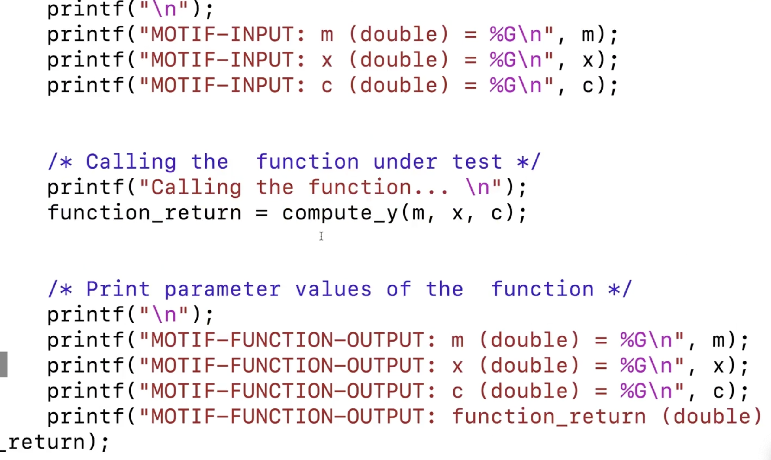
Test generation
int main(...){
double m = load(..);
double x = load(..);
double c = load(..); double m_m = load(..);
double m_x = load(..);
double m_c = load(..); ret = compute_y(m,x,c); mut_ret = mut_ compute_y (m_m,m_x,m_c);
if( ! match ( ret, mut_ret ) ){ abort(); }
AFL ++ fuzzer
0100100001110110000
1100101101110110000
0101101101110110000
Binary input file
Test case
Post-processing
if( ! match (m, m_m ){ abort() };
if( ! match (x, m_x) { abort() };
if( ! match (c, m_c) { abort() };
Notes:
We therefore developed a pipeline that we called MOTIF
It reads a mutant and the source code of the SUT
First it generates a fuzzing driver based on the signture of the mutated function
The fuzzing driver reads a binary file received as input
And assigns chunks of its bytes to some variables
Those variables are used as arguments in the invocation of the function under test and its mutated version
Finally it checks if the output of the two functions match, otherwise we killed the mutant, which is wat we want and thus we cause a crash that will make the fuzzer store the input file
Since outputs can also be stored in input variables, we checks all the variables.

