Slide 1



Feasibility study of the deployment of levitated quantum optomechanical sensors for atmospheric observation
Project Closure Meeting
Ravindra Desai, Animesh Datta, James Bateman, Daniel Oi, Rafal Gajewski
European Space Agency, Fixed Call for Proposals for Quantum Sensors for Earth Observation
Project Closure: 27th August 2025

Slide 2
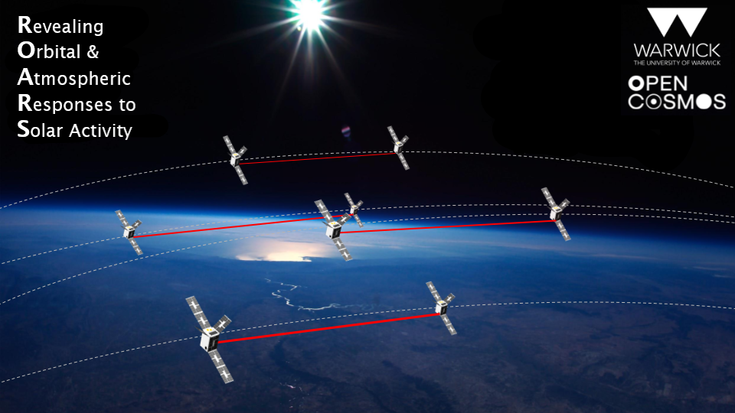









Solar Activity
M-I-T Coupling
Atmospheric Drag
Satellite Tracking
Data Assimilation
Collision Risk
2015 ESA “min-Fast” mission proposal – currently under consideration
bit.ly/ROARS_mission
ravindra.desai@warwick.ac.uk
ROARS Consortium features 28 institutions from 9 countries

Slide 3
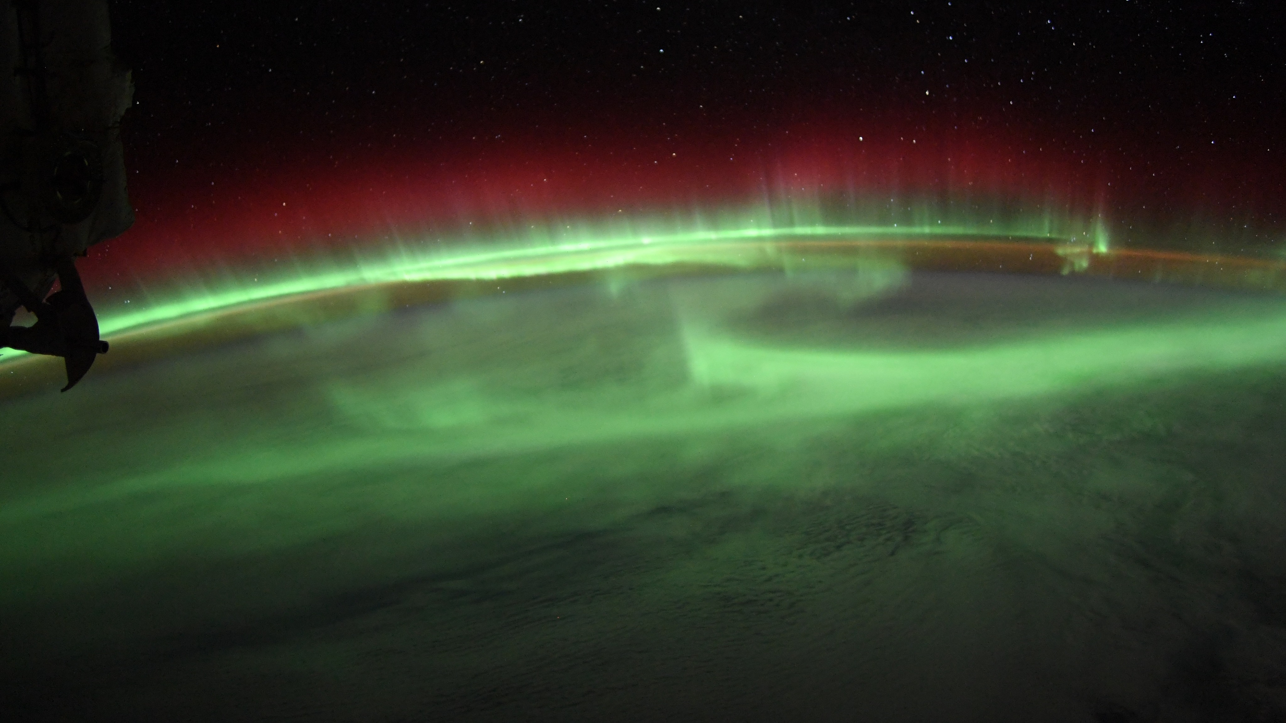
How much energy and momentum is transported from the magnetosphere into the upper atmosphere?
How is this energy and momentum redistributed within the ionosphere-thermosphere system, what are the key spatial scales, and what are their relative importance?

Slide 4
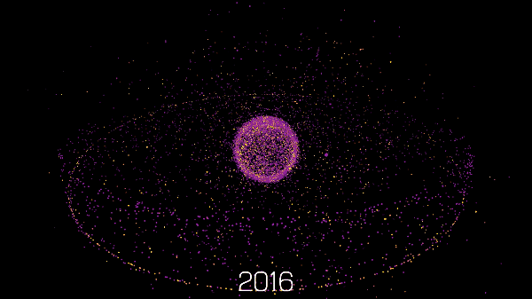
A short, yet messy history
Stuart Grey

Slide 5
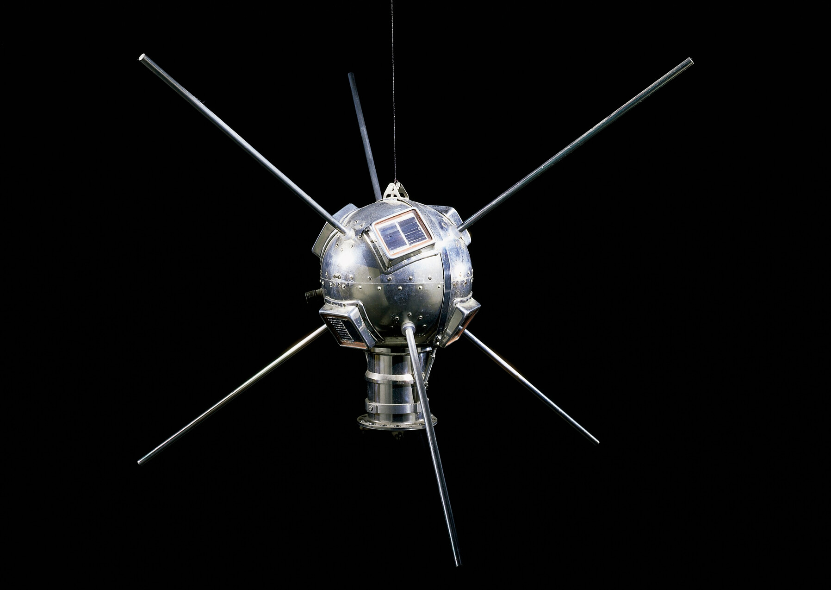
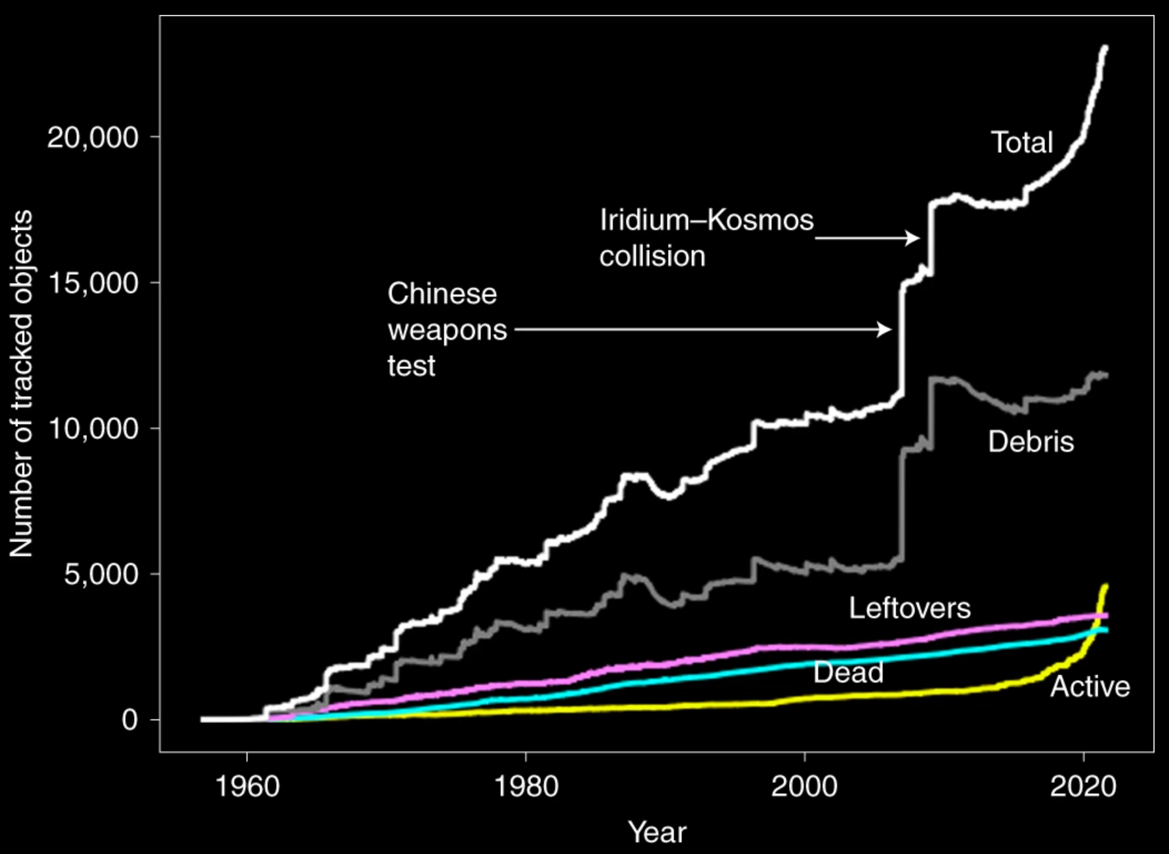
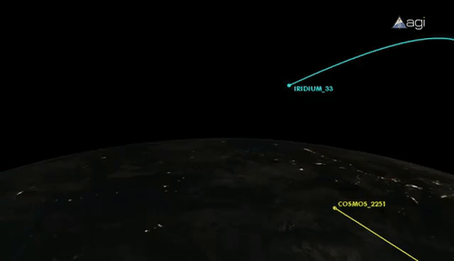
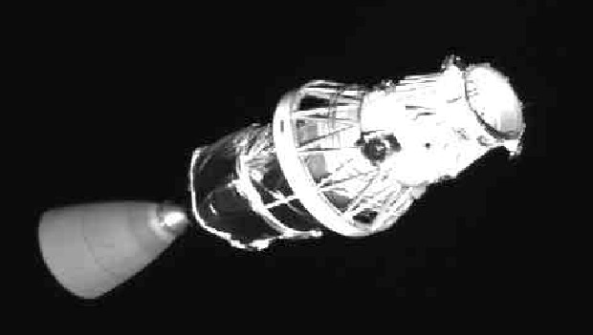
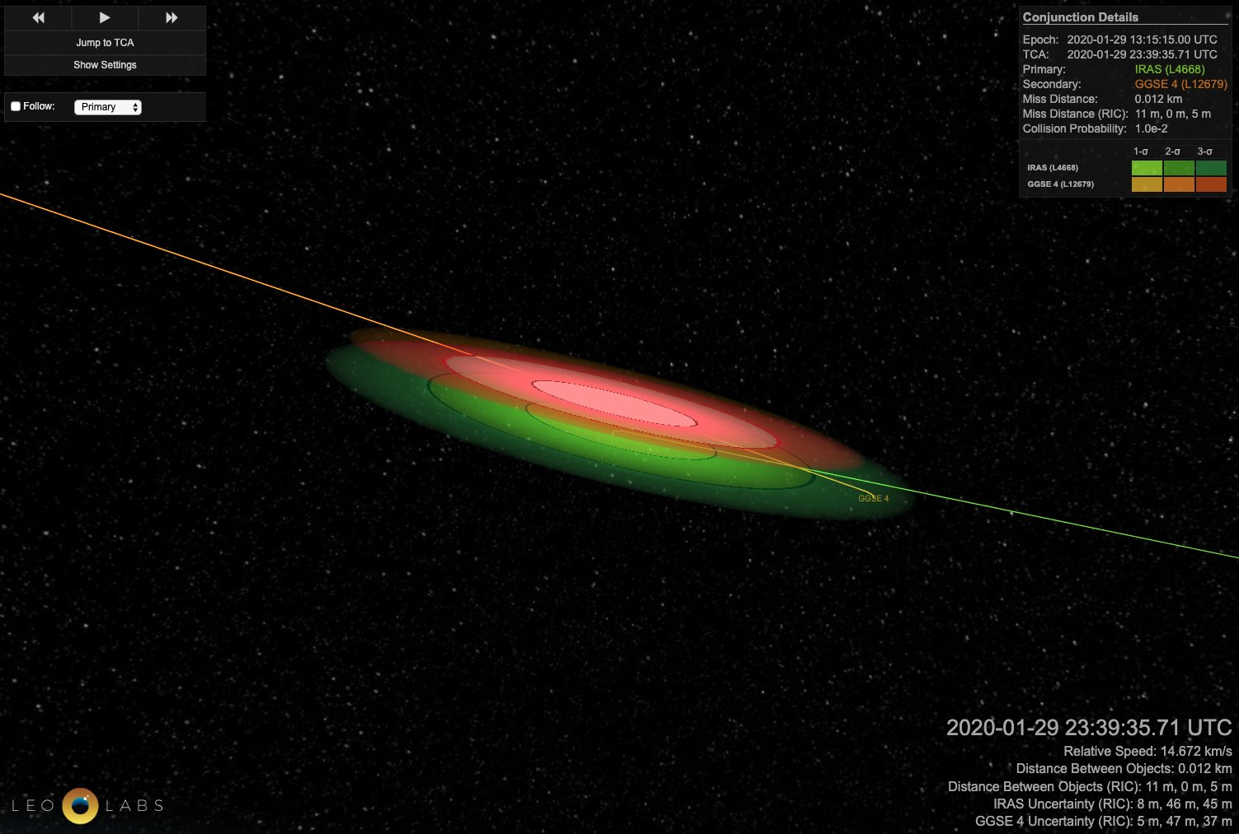
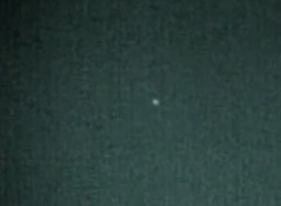
Space Debris
LeoLabs

Slide 6
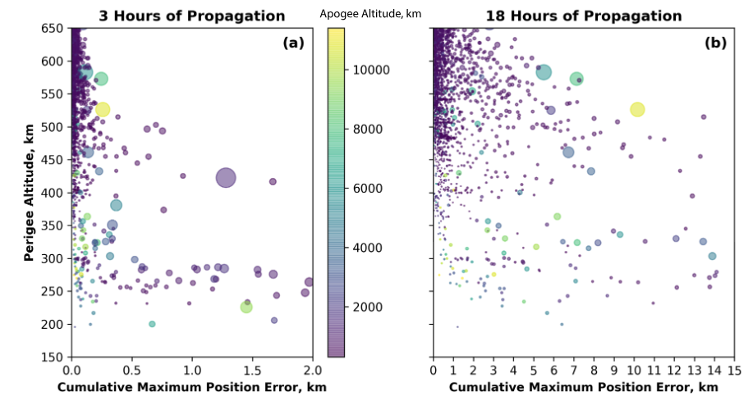
Flying Through Uncertainty
Berger et al., 2019

Slide 7
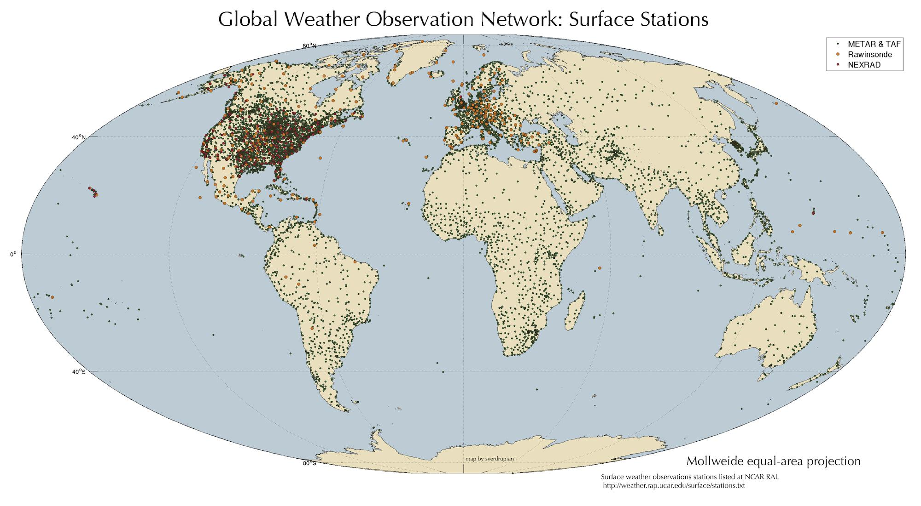
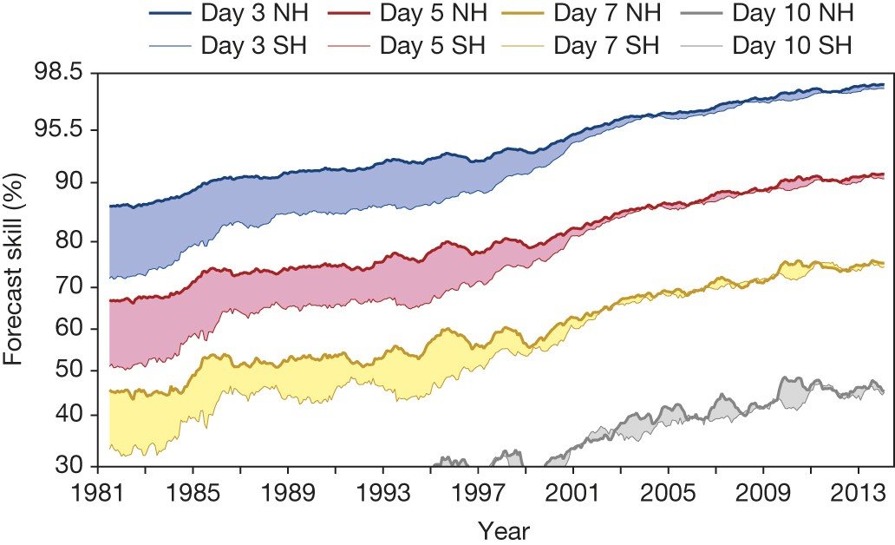
Lack of data severely constrains space weather forecasting capabilities
Bauer, P., Thorpe, A. & Brunet, G. The quiet revolution of numerical weather prediction. Nature 525, 47–55 (2015). https://doi.org/10.1038/nature14956

Slide 8
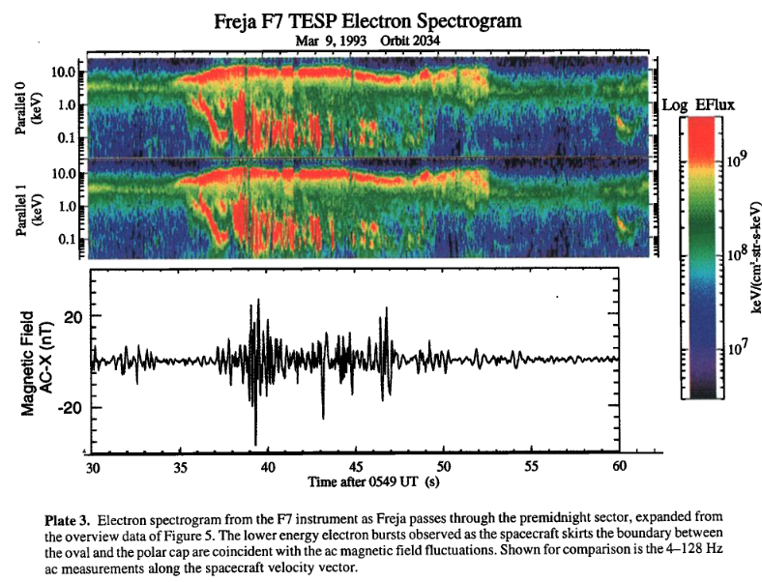
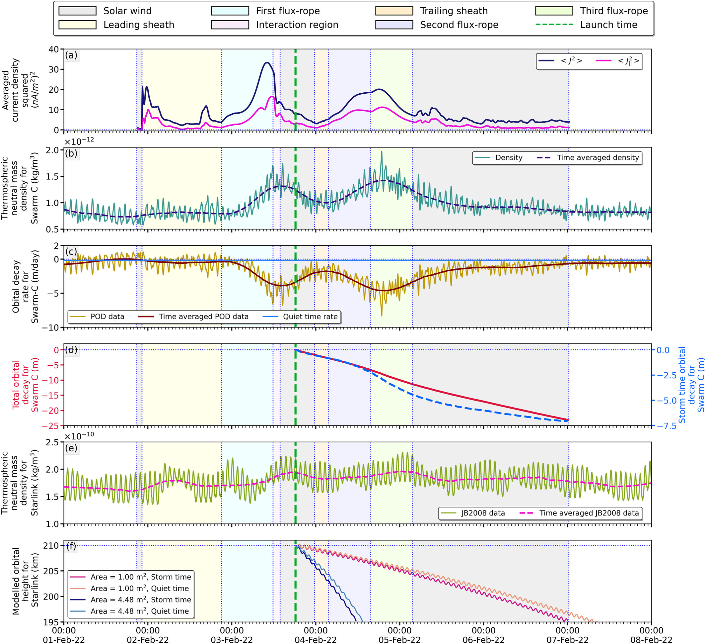
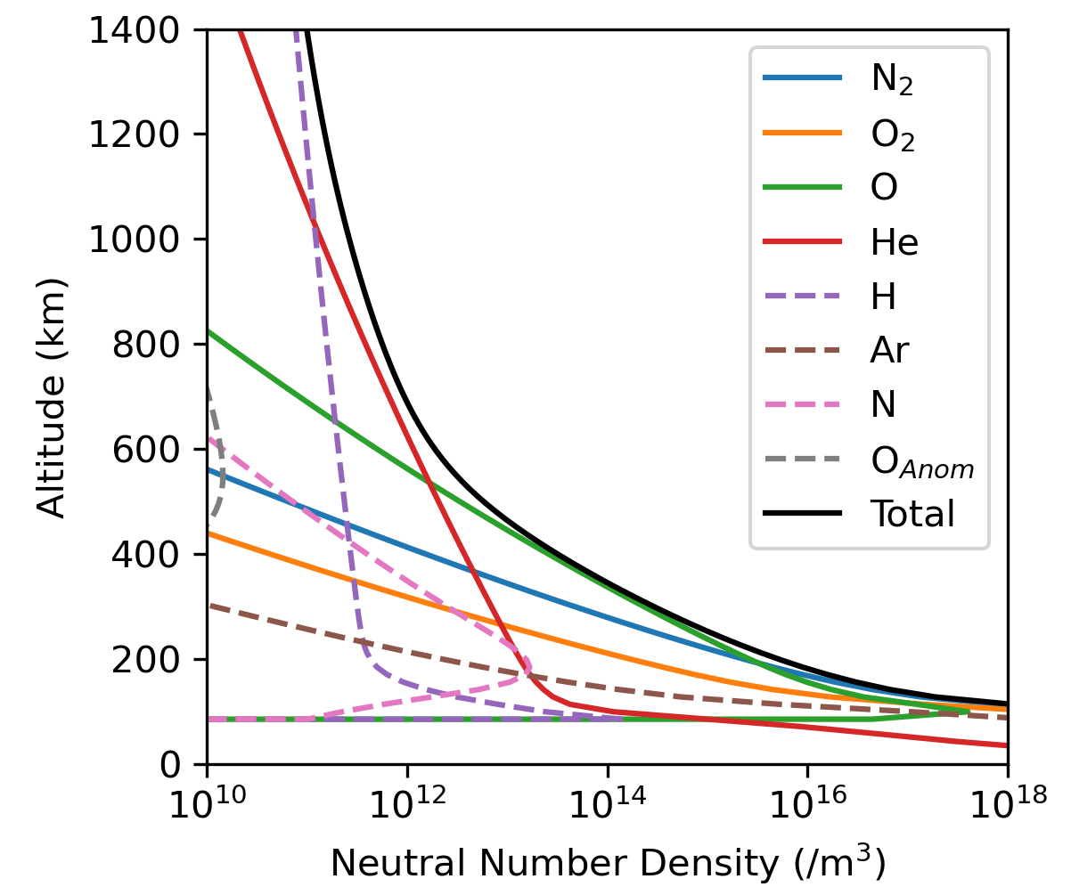
Magnetosphere-Ionosphere-Thermosphere coupling
Baruah et al., 2024
“Space-X storm” of February 2022
Accelerometers
We currently don’t have any direct measurements of thermospheric neutral particles!

Slide 9
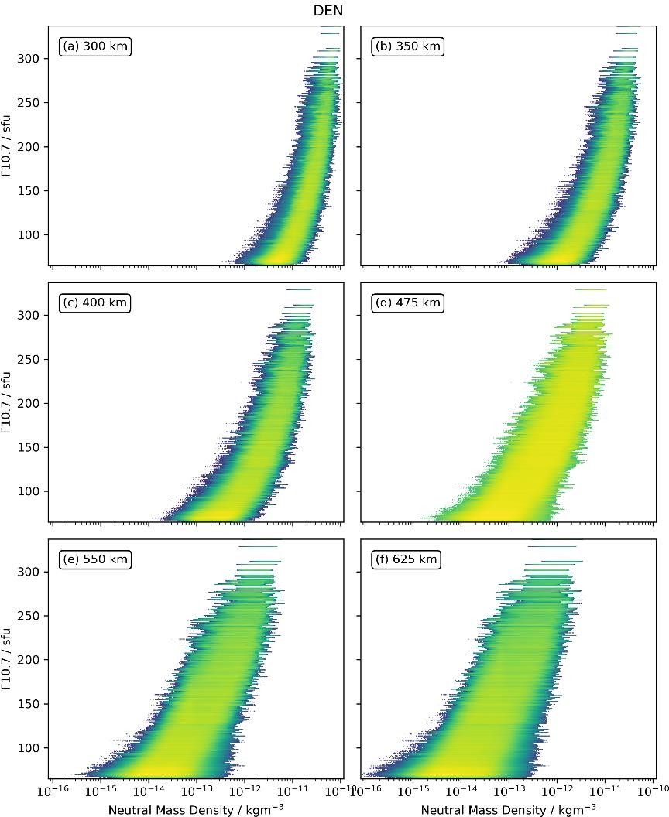
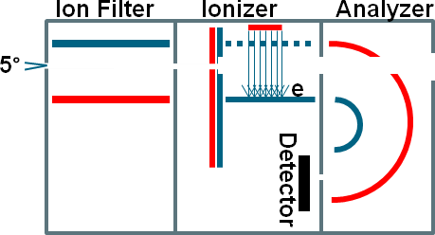
Study requirements
Conventional neutral mass spectrometers are limited in measuring absolute densities
Conventional technologies also struggle with low densities (sensitivity) Accelerometer and mass spectrometer densities often cross-calibrated against orbital changes and models
ROARS mass spectrometer design includes a GNSS chip to caiibrate densities

Slide 10
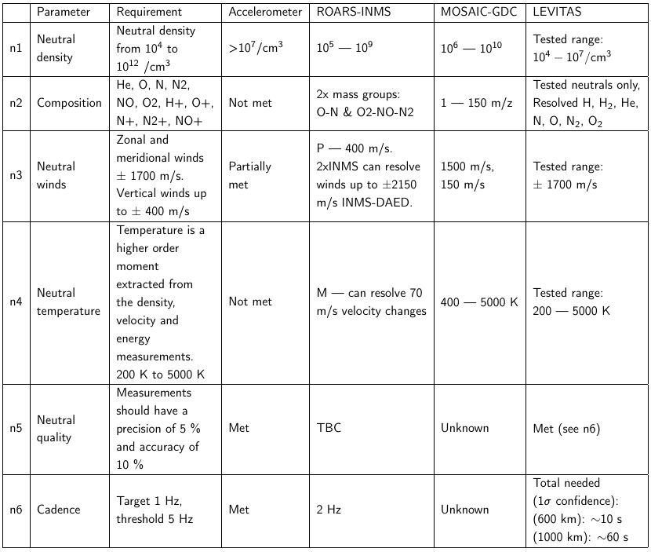
Study requirements

Slide 11
Study requirements
~1u ... >10⁴ u

Slide 12

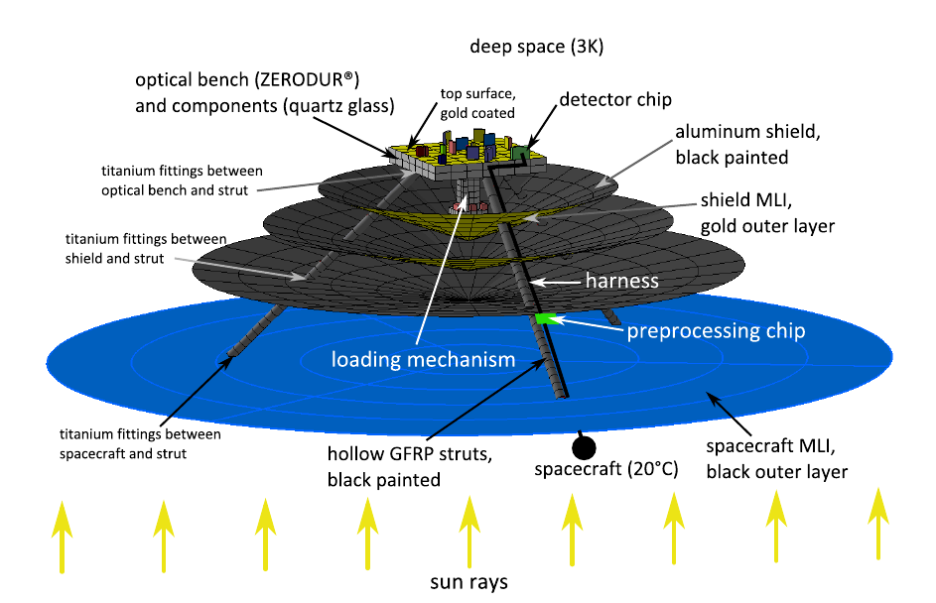
Pre-History of LEVITAS: MAQRO
ESA CDF-183 2018
Fundamental Physics Big Question: Probe wavefunction collapse of macroscopic quantum systems
Spacecraft at L2, utilise ambient vacuum conditions and passive cooling of bench to ~50K
Nanoparticle optically cooled to ground state
Wavefunction placed into superposition and observe interference
CDF: Technical maturity insufficient

Slide 13
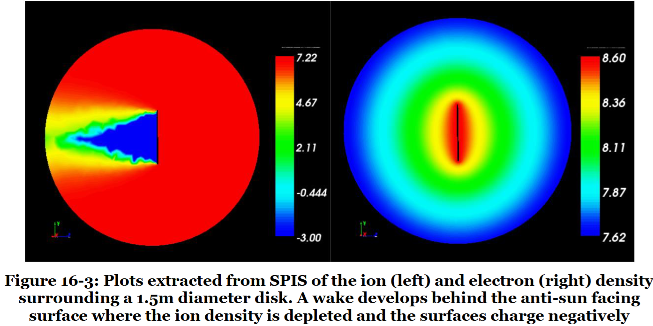
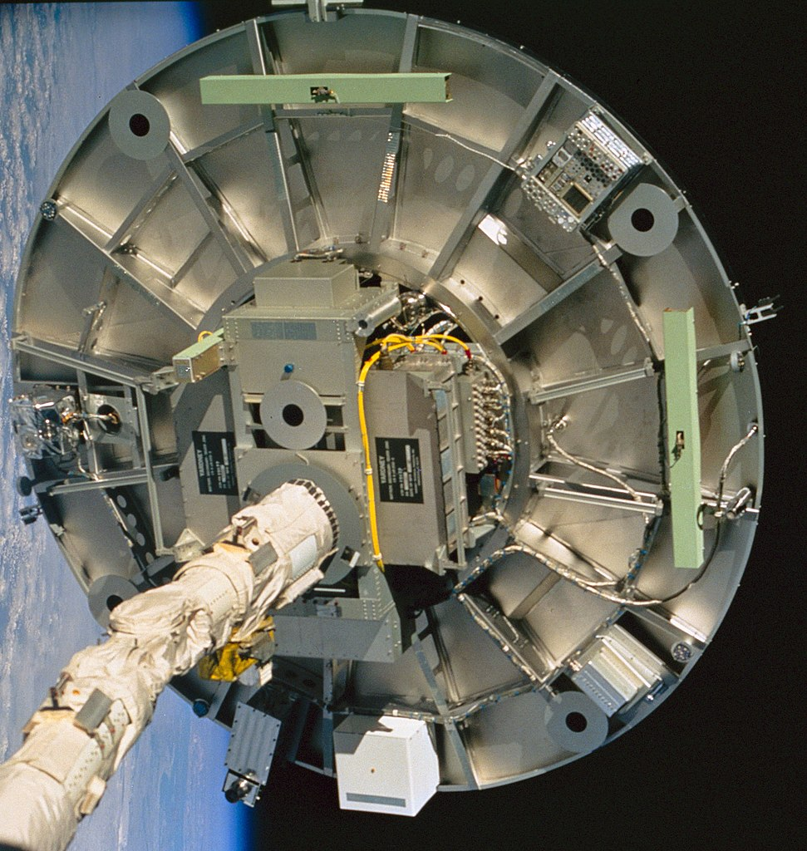
Space Quantum Sensors
ESA CDF-183 2018
Quantum system extremely sensitive to environment
Space-borne sensors of electric, magnetic, gravitational fields, inertial effects, clocks, provide stable references
Bug: MAQRO Experiment to probe Quantum Wavefunction Collapse extremely challenging, outgassing, thermal, radiation,...
Feature: Exploit quantum limited detection of nanoparticle motion, monitor interaction with space environment
(Initial discussions, ESA QT Workshop 2017)
cf. Proposals using cold atoms/BECs externally trapped, to confirm Wake Shield Effect and probe spacecraft flow conditions
Wake Shield Facility 1994-02-06 https://eol.jsc.nasa.gov/SearchPhotos/photo.pl?mission=STS060&roll=76&frame=095

Slide 14
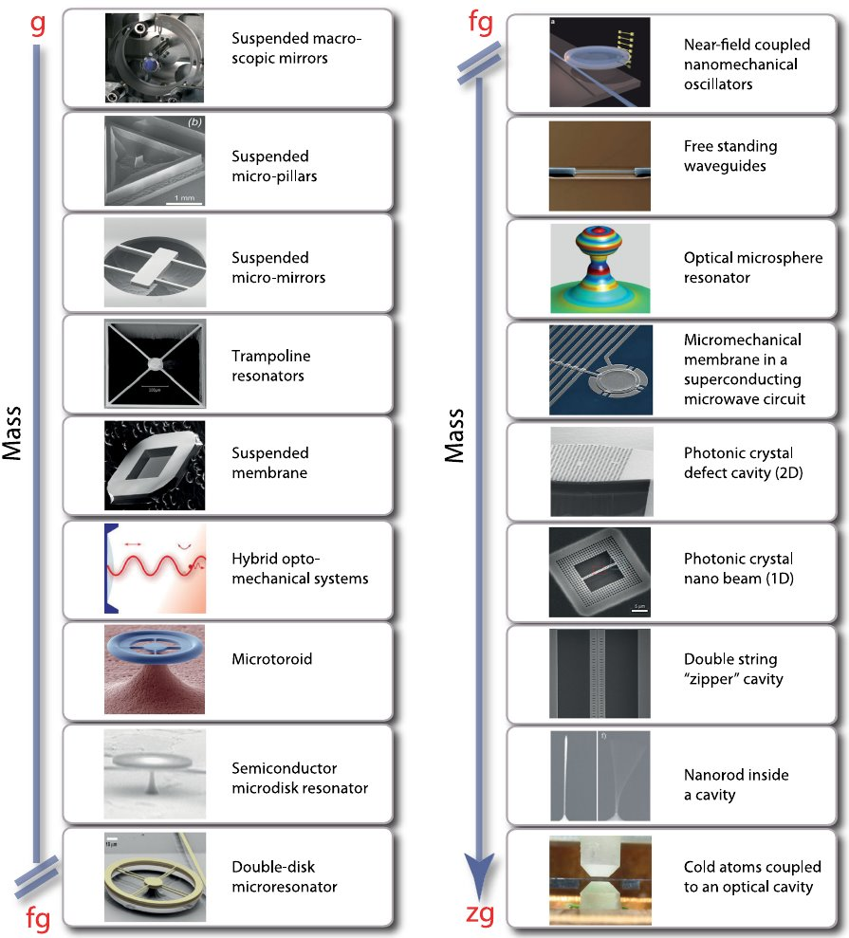
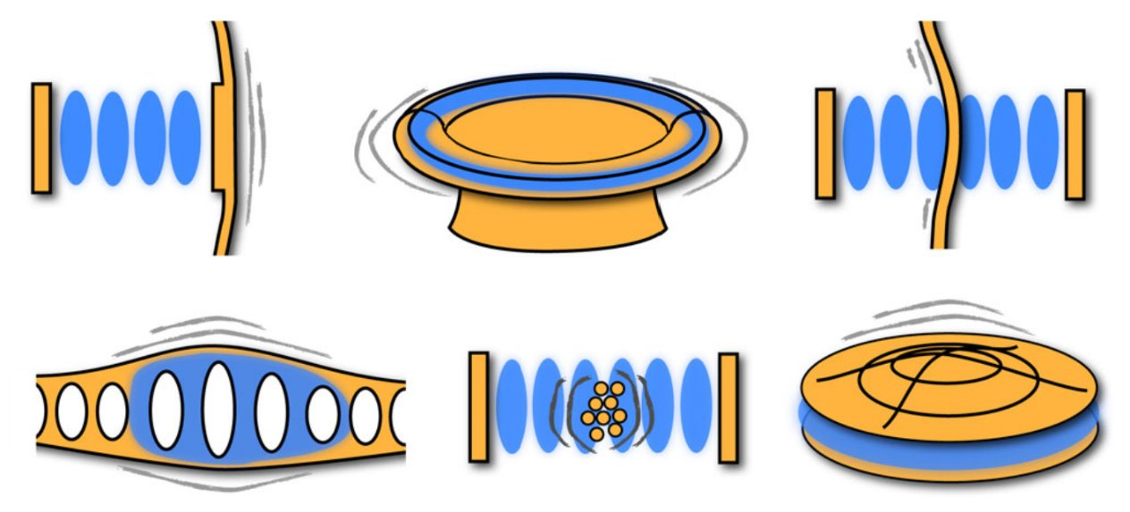
Optomechanics
Couple optical & mechanical degrees of freedom
e.g. optical cavity with movable mirror
Size & mass ranges from ~kg (LIGO) to nano & atomic
Frequencies from Hz to GHz
Quantum-limited laser control applied to mechanics
⇒ ground-state cooling, strong coupling, entanglement
Levitated Optomechanics ⇒ replace springs with fields
Aspelmeyer, Kippenberg, Marquardt; Cavity Optomechanics, Rev.Mod.Phys 86 1391 (2014)

Slide 15
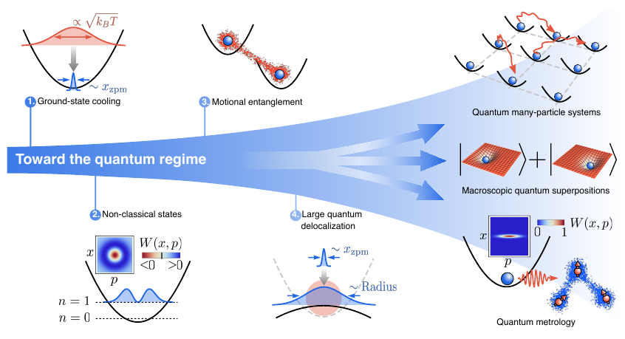
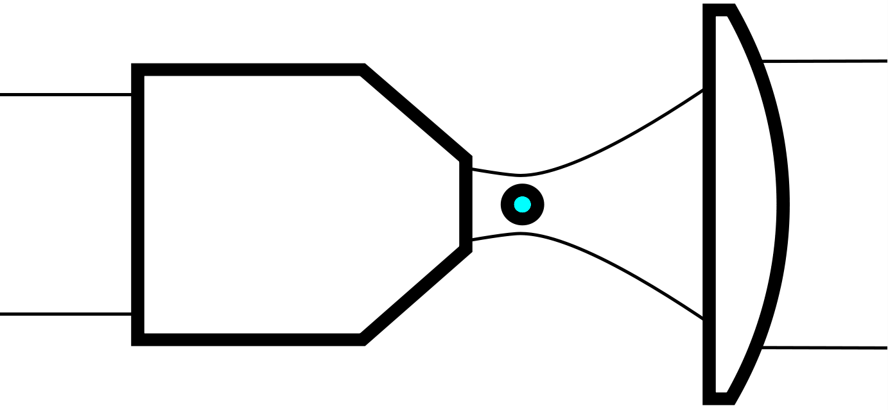
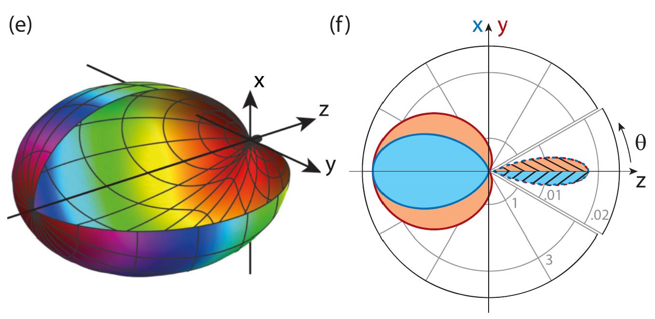
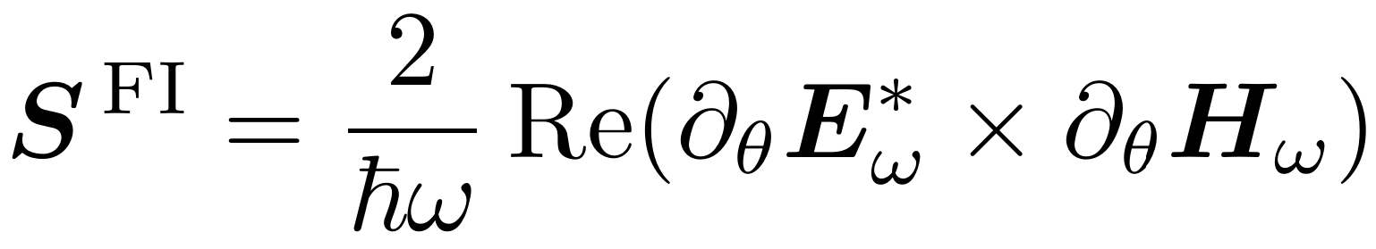
Levitated Optomechanics/Levitodynamics
Silica nanoparticle, dipole trapped
at high-aperture laser focus
Optical dipole potential:
p = ε₀χ E ; U = ½<p · E> = χ I / 2 c
Optimal homodyne readout
⇒ Maximum Fisher Information
⇒ Quantum-limited position readout
Gonzalez-Ballestero, Aspelmeyer, Novotny, Quidant, Romero-Isart; Science 374 eabg3027 (2021)
Hüpfl et al, Nature Physics, 20,1294 (2024)
Tebbenjohanns, Fimmer, Novotny; PRA 100 043821 (2019)

Slide 16
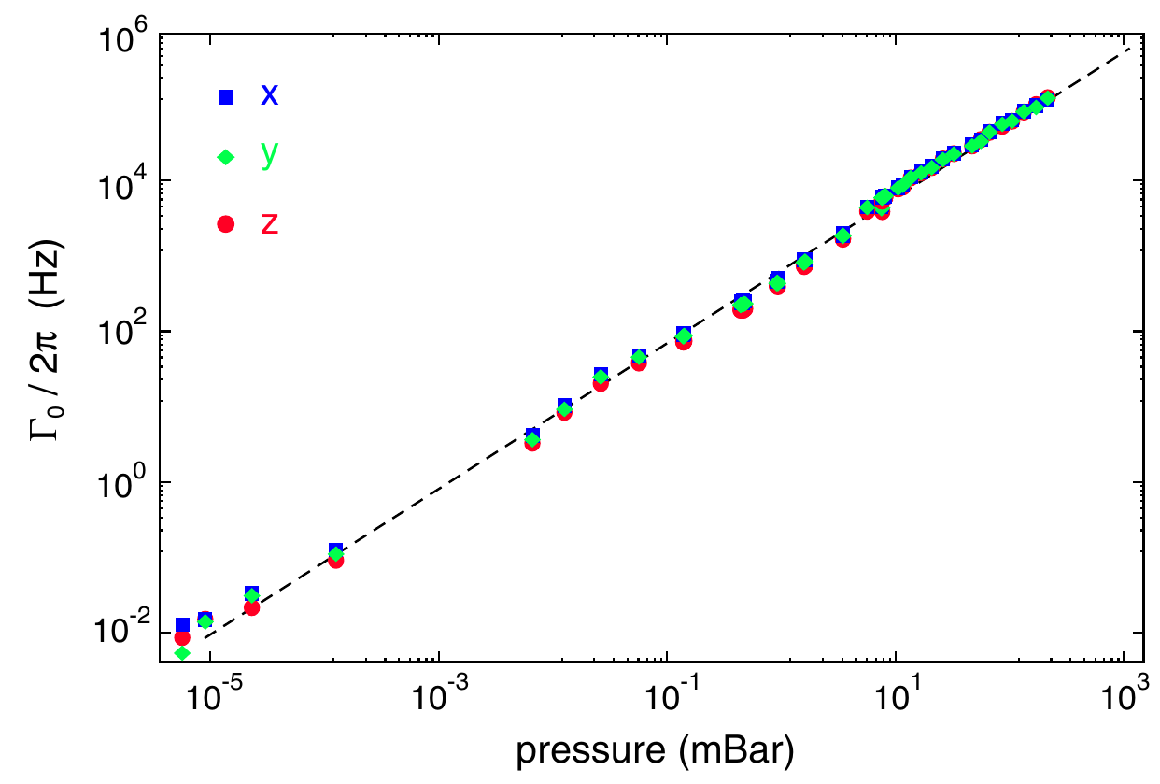
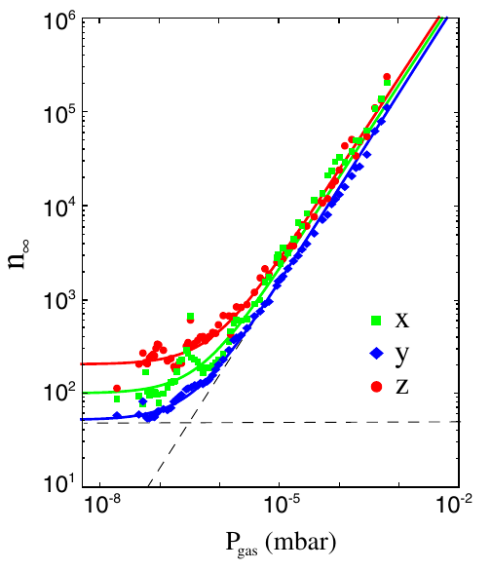
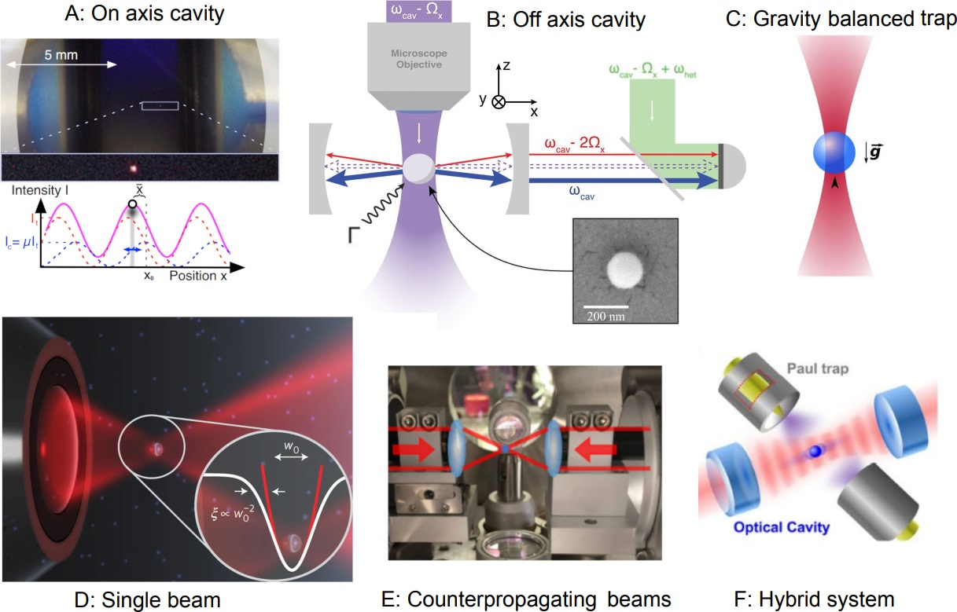
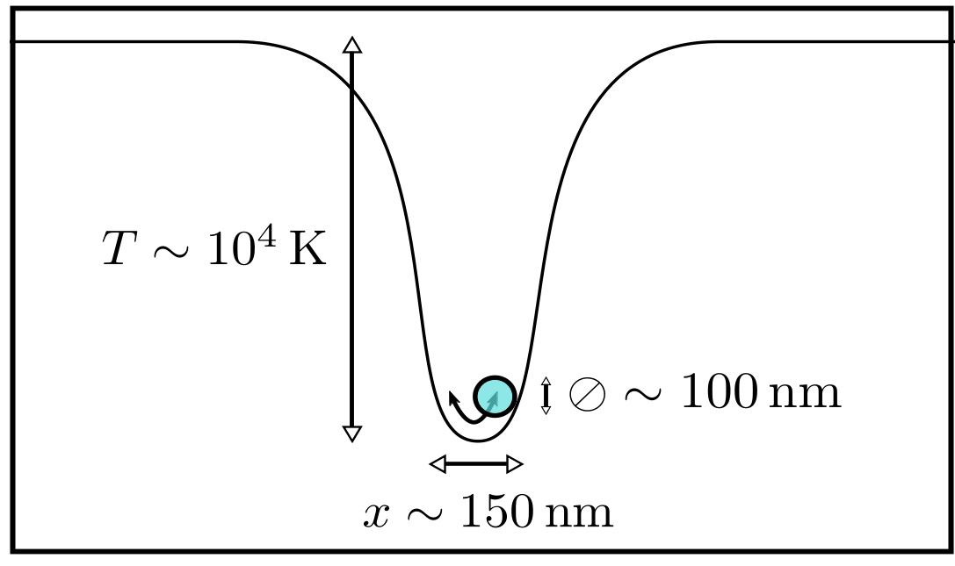
Levitated Optomechanics advantages
Gieseler, Deutsch, Quidant, Novotny; PRL 109 103603 (2012)
Jain, Gieseler, et al; PRL 116243601(2016)
Zoo of levitated optomechanical systems
Winstone et al, arXiv:2307.11858
Damping reduces with pressure; lower-limit set by photon recoil
Levitated nanoparticles
⇒ extremely low mass
⇒ extremely low damping
⇒ ultimately limited by photon recoil
Damping inextricably associated with fluctuations
Access ultimate (quantum) limits by removing all excess dissipation (mechanical clamping; background gas)
Scattered photons give recoil and position information
⇒ Standard Quantum Limit
SQL momentum resolution : √(ħ Ω M) ~ 1.9 u km/s

Slide 17
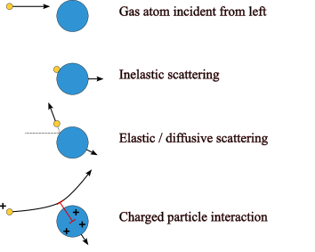
LEVITAS idea
Low-noise high-vacuum environment for quantum-limited sensitivity
LEO is sufficiently high vacuum to access this regime
⇒ No need for (heavy) chambers and pumps
Deliberately expose sensitive system to ram flux
⇒ gas collisions move from "bug" to "feature"
Individual collisions with gas particles ⇒ measurable recoil
Example : Atomic Oxygen in LEO ~ 7.8km/s
‣ Kick from Oxygen atom 16u x 7.8km/s = 125 u km/s
‣ Thermal spread at 1000K ~ 12 u km/s
‣ SQL sensitivity √(ħ Ω M) ~ 2 u km/s
⇒ Can resolve species because large mass ⇒ larger kick
‣ Rate = (number density) x (cross-section) x (speed) ~ 100/s
⇒ Collect statistics and infer temperature, density, wind
"Quantum-limited position detection and amplification: A linear response perspective" Clerk Phys.Rev.B 70 245306 (2004)
"Mechanical Detection of Nuclear Decays" Wang, Penny, Recoaro, Siegel, Tseng, Moore Phys.Rev.Lett. 133 023602 (2024)
"Collision-resolved pressure sensing" Barker, Carney, LeBrun, Moore, Taylor Phys.Rev.A 109 042616 (2024)

Slide 18
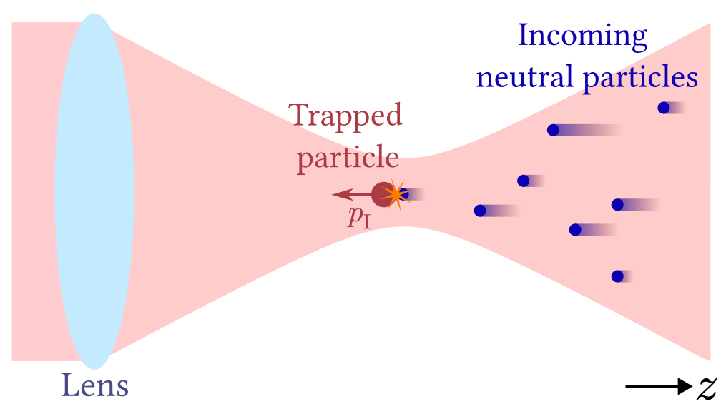

Performance modelling: problem setup
Nanoparticle trapped in laser focus (aligned along ram direction)
Shot-noise limited position readout
Incoming neutral particles along beam axis
Collisions impart momentum

Slide 19
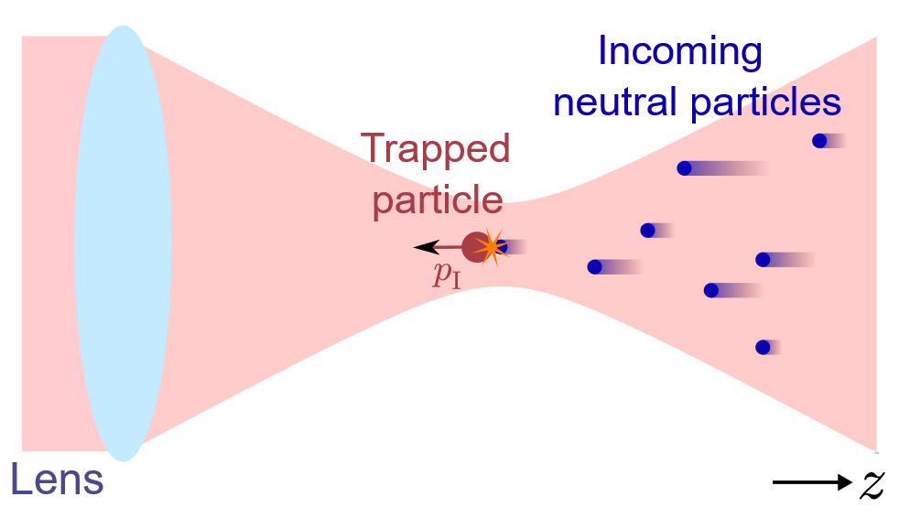


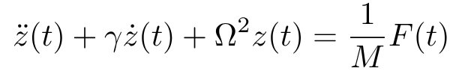
Performance modelling
Nanoparticle acted on by external force:
Force due to collisions
White noise force due to the laser (photon recoil), spectral density
Analysis performed in segments:
Objective: assess how well can we estimate using the nanoparticle position readout.
Objective: use performance metrics determined in step (1) to simulate realistic recoil data from atmospheric gas in the low-Earth orbit, and estimate gas properties:
Nanoparticle mass
Trap frequency
Damping rate
Composition
Temperature
Bulk wind velocity
Simulated nanoparticle centre-of-mass trajectories using (1d):

Slide 20
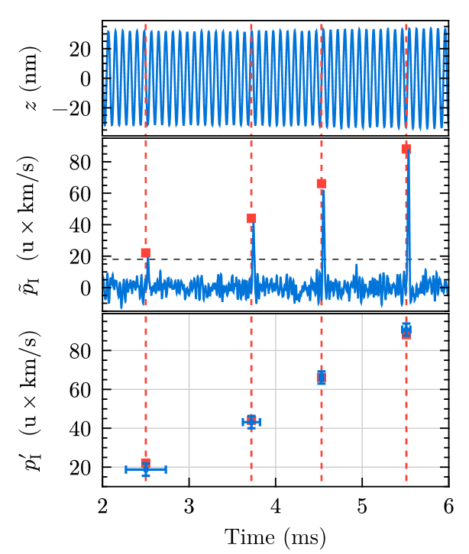
Step 1: Recoil momentum extraction
Simulated realistic experimental signal as: real trajectory + Gaussian white noise
Tracked nanoparticle state (position, velocity) and force impulses using a Kalman filter
Constant acceleration model for the force impulses
Peaks above noise floor in the moving average of the force impulse indicate occurrence of recoil events
Bayesian inference:
Use impulse peaks flagged by the Kalman filter initial guesses for Bayesian estimation
Analyse data in a window around the flagged times
Gives the best estimates and a measure of confidence (error bars) for the recoil momentum
Throughout we use the momentum unit u km/s: impact from atomic mass 1u at 1 km/s

Slide 21
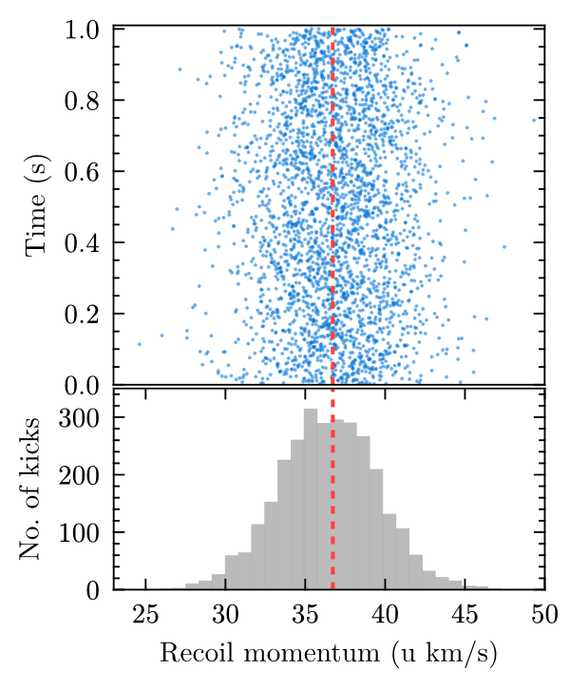
Recoil momentum extraction results
(Error bars not shown for clarity)
Simulation method:
Simulated a long-time trajectory (1 s @ 1 MS/s)
Applied momentum impacts at a uniform rate of 3000/s and constant amplitude 37 u km/s (~ impact on collision with He at ISS speed)
Used our detection algorithm to estimate recoil momentum
Results:
Each event recorded with ±3.2 u km/s error
Error from Bayesian analysis for each event consistent with sample statistics
2996 out of 2997 events detected and no false detections, with the detection threshold chosen at 18 u km/s.
Recoil extraction can be summarised by
Gaussian broadening with sigma = 3.2 u km/s
Detection threshold: only impacts > 18 u km/s detected

Slide 22





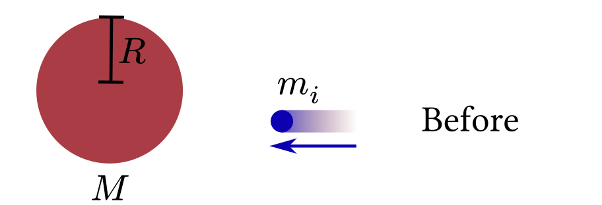
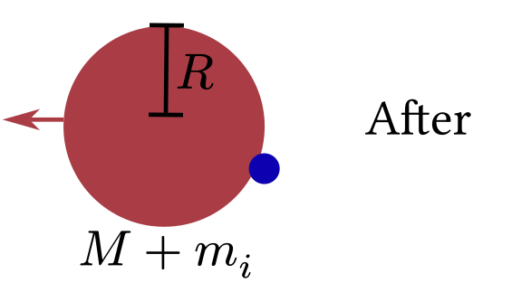
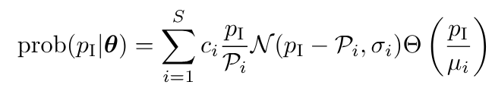





Estimating properties of atmospheric gas
Objective: estimate thermodynamic properties and composition of atmospheric gas based on the recoil data
Gas model:
Composed of species, with masses and number densities , such that
Velocity: 1d Maxwell-Boltzmann distribution, moving at relative velocity and temperature
Assuming fully inelastic collisions
Collision rate given by the nanoparticle cross-section:
wind velocity
Using these assumptions, we derive the recoil distribution,
Gaussian
Step function

Slide 23
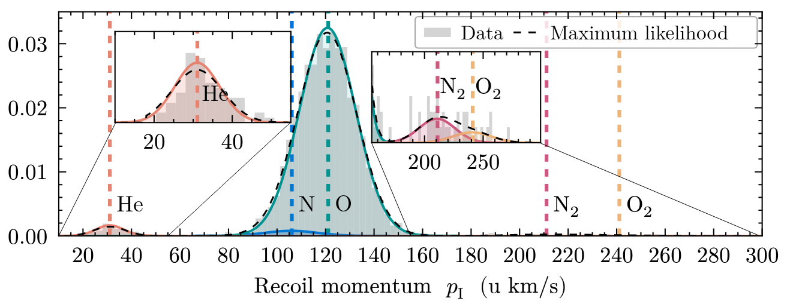
Recoil distribution: key features
Example (LEO @ 600 km altitude)
Spacecraft velocity: 7.5 km/s
Density: 5×10⁶ /cm³
Collision rate: ~ 100/s
Composition:
0.5 % H
3 % He
5% N
90 % O
1% N₂
0.5 % O₂
_{(NRLMSIS-00, 2011)}
Temperature: 1000 K
Wind velocity: 0km/s
Due to high relative velocity, species are separated in momentum domain
Peak centre position: wind velocity
Peak width: temperature
Relative area of the peaks: composition
No. of collected data points: collision rate => density

Slide 24
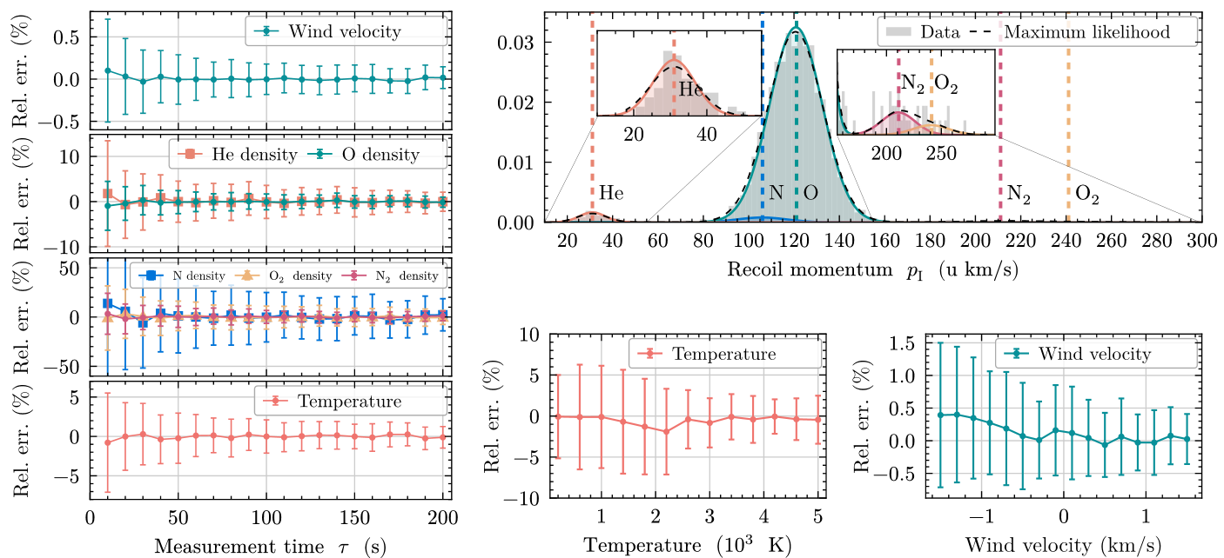
Case study 1: LEO @ 600 km altitude
Laser wavelength: 1550 nm
Laser power: 500 mW
Objective NA: 0.4
Nanoparticle radius: 50 nm
Sampling rate: 1 MS/s
(@ w=0 m/s, T= 1000 K)
Spacecraft velocity: 7.5 km/s
Density: 5×10⁶ /cm³
Collision rate: ~ 100/s
Composition:
0.5 % H
3 % He
5% N
90 % O
1% N₂
0.5 % O₂
_{(NRLMSIS-00, 2011)}
Temperatures: 200 – 5000 K
Wind velocities: ± 1.5 km/s
(@ tau = 10 sec.)
Hydrogen not included in the analysis, all other species resolved
~ 10 seconds needed to estimate the parameters with ±10 % precision

Slide 25
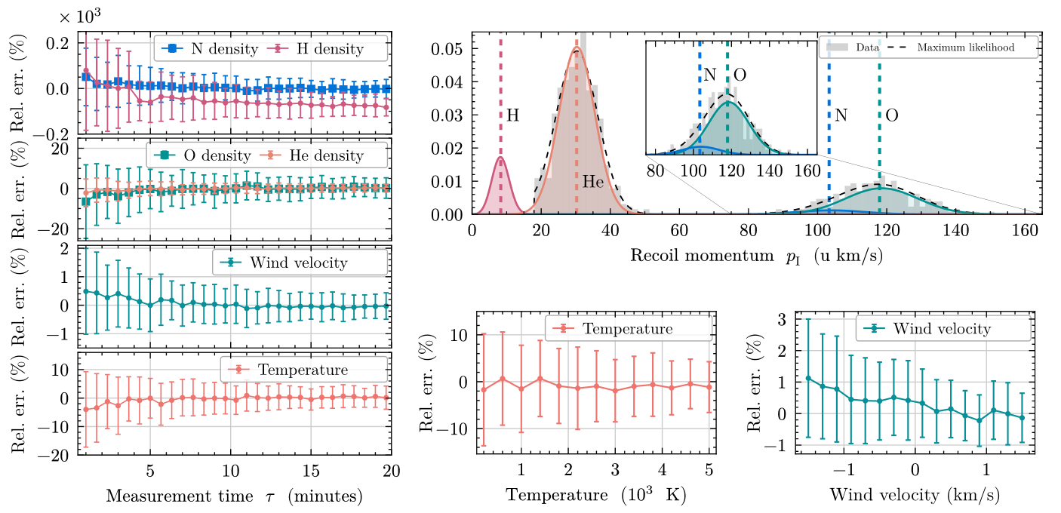
Case study 2: LEO @ 1000 km altitude
Laser wavelength: 1550 nm
Laser power: 500 mW
Objective NA: 0.4
Nanoparticle radius: 50 nm
Sampling rate: 1 MS/s
(@ w=0 m/s, T= 1000 K)
Spacecraft velocity: 7.3 km/s
Density: 10⁵ /cm³
Collision rate: ~ 5/s
Composition:
20 % H
58 % He
2 % N
20 % O
_{(NRLMSIS-00, 2011)}
Temperatures: 200 – 5000 K
Wind velocities: ± 1.5 km/s
All present species included in the analysis
(@ tau = 60 sec.)
Hydrogen significantly truncated by the detection threshold (>18 u km/s); max. likelihood distribution used to estimate the missing fraction (~ 20%) and compensate the density estimate
~ 60 seconds needed to estimate the parameters with ±10 % precision

Slide 26




Limitations and trade-offs
Minimum resolvable momentum: SQL tells us that detecting = 1.9 u km/s should be possible in principle (@ 50 nm nanoparticle radius)
Trade-off between minimum resolvable momentum and collision rate prop. to (mass)^{3/2}
Impacts well resolved when time between collisions > ¼ of the trap cycle (~ 20 µs)
max. resolvable density of ~10⁷/cm³ (@ 500 km LEO alt.)
At higher densities, the sensor may need to be operated in pressure mode (not individual impacts)
False detections: for long integration times mechanical noise can mimic collision events at a rate where and is the detection threshold
18 u km/s threshold gives false detection rate of 1/s which corresponds to minimum resolvable density ~ 10⁴/cm³
Lower densities can always be resolved by raising the threshold

Slide 27
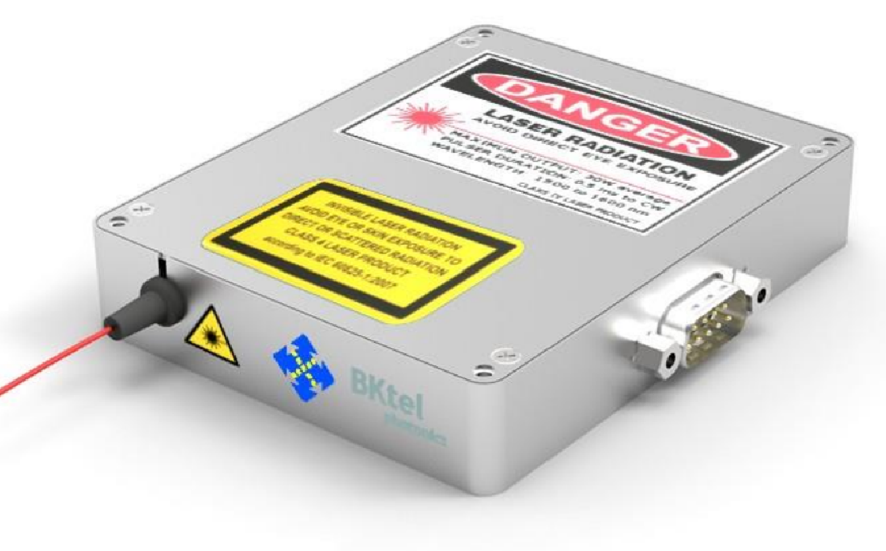
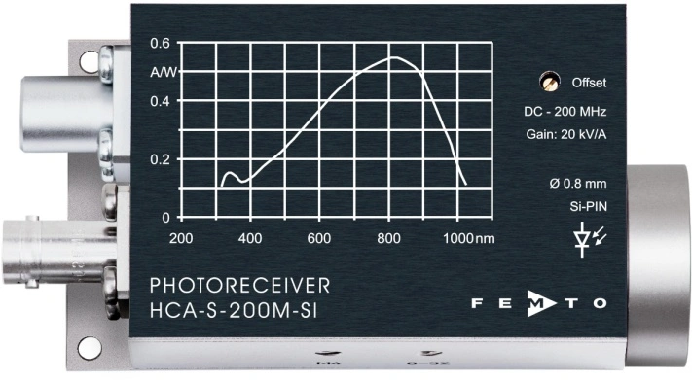
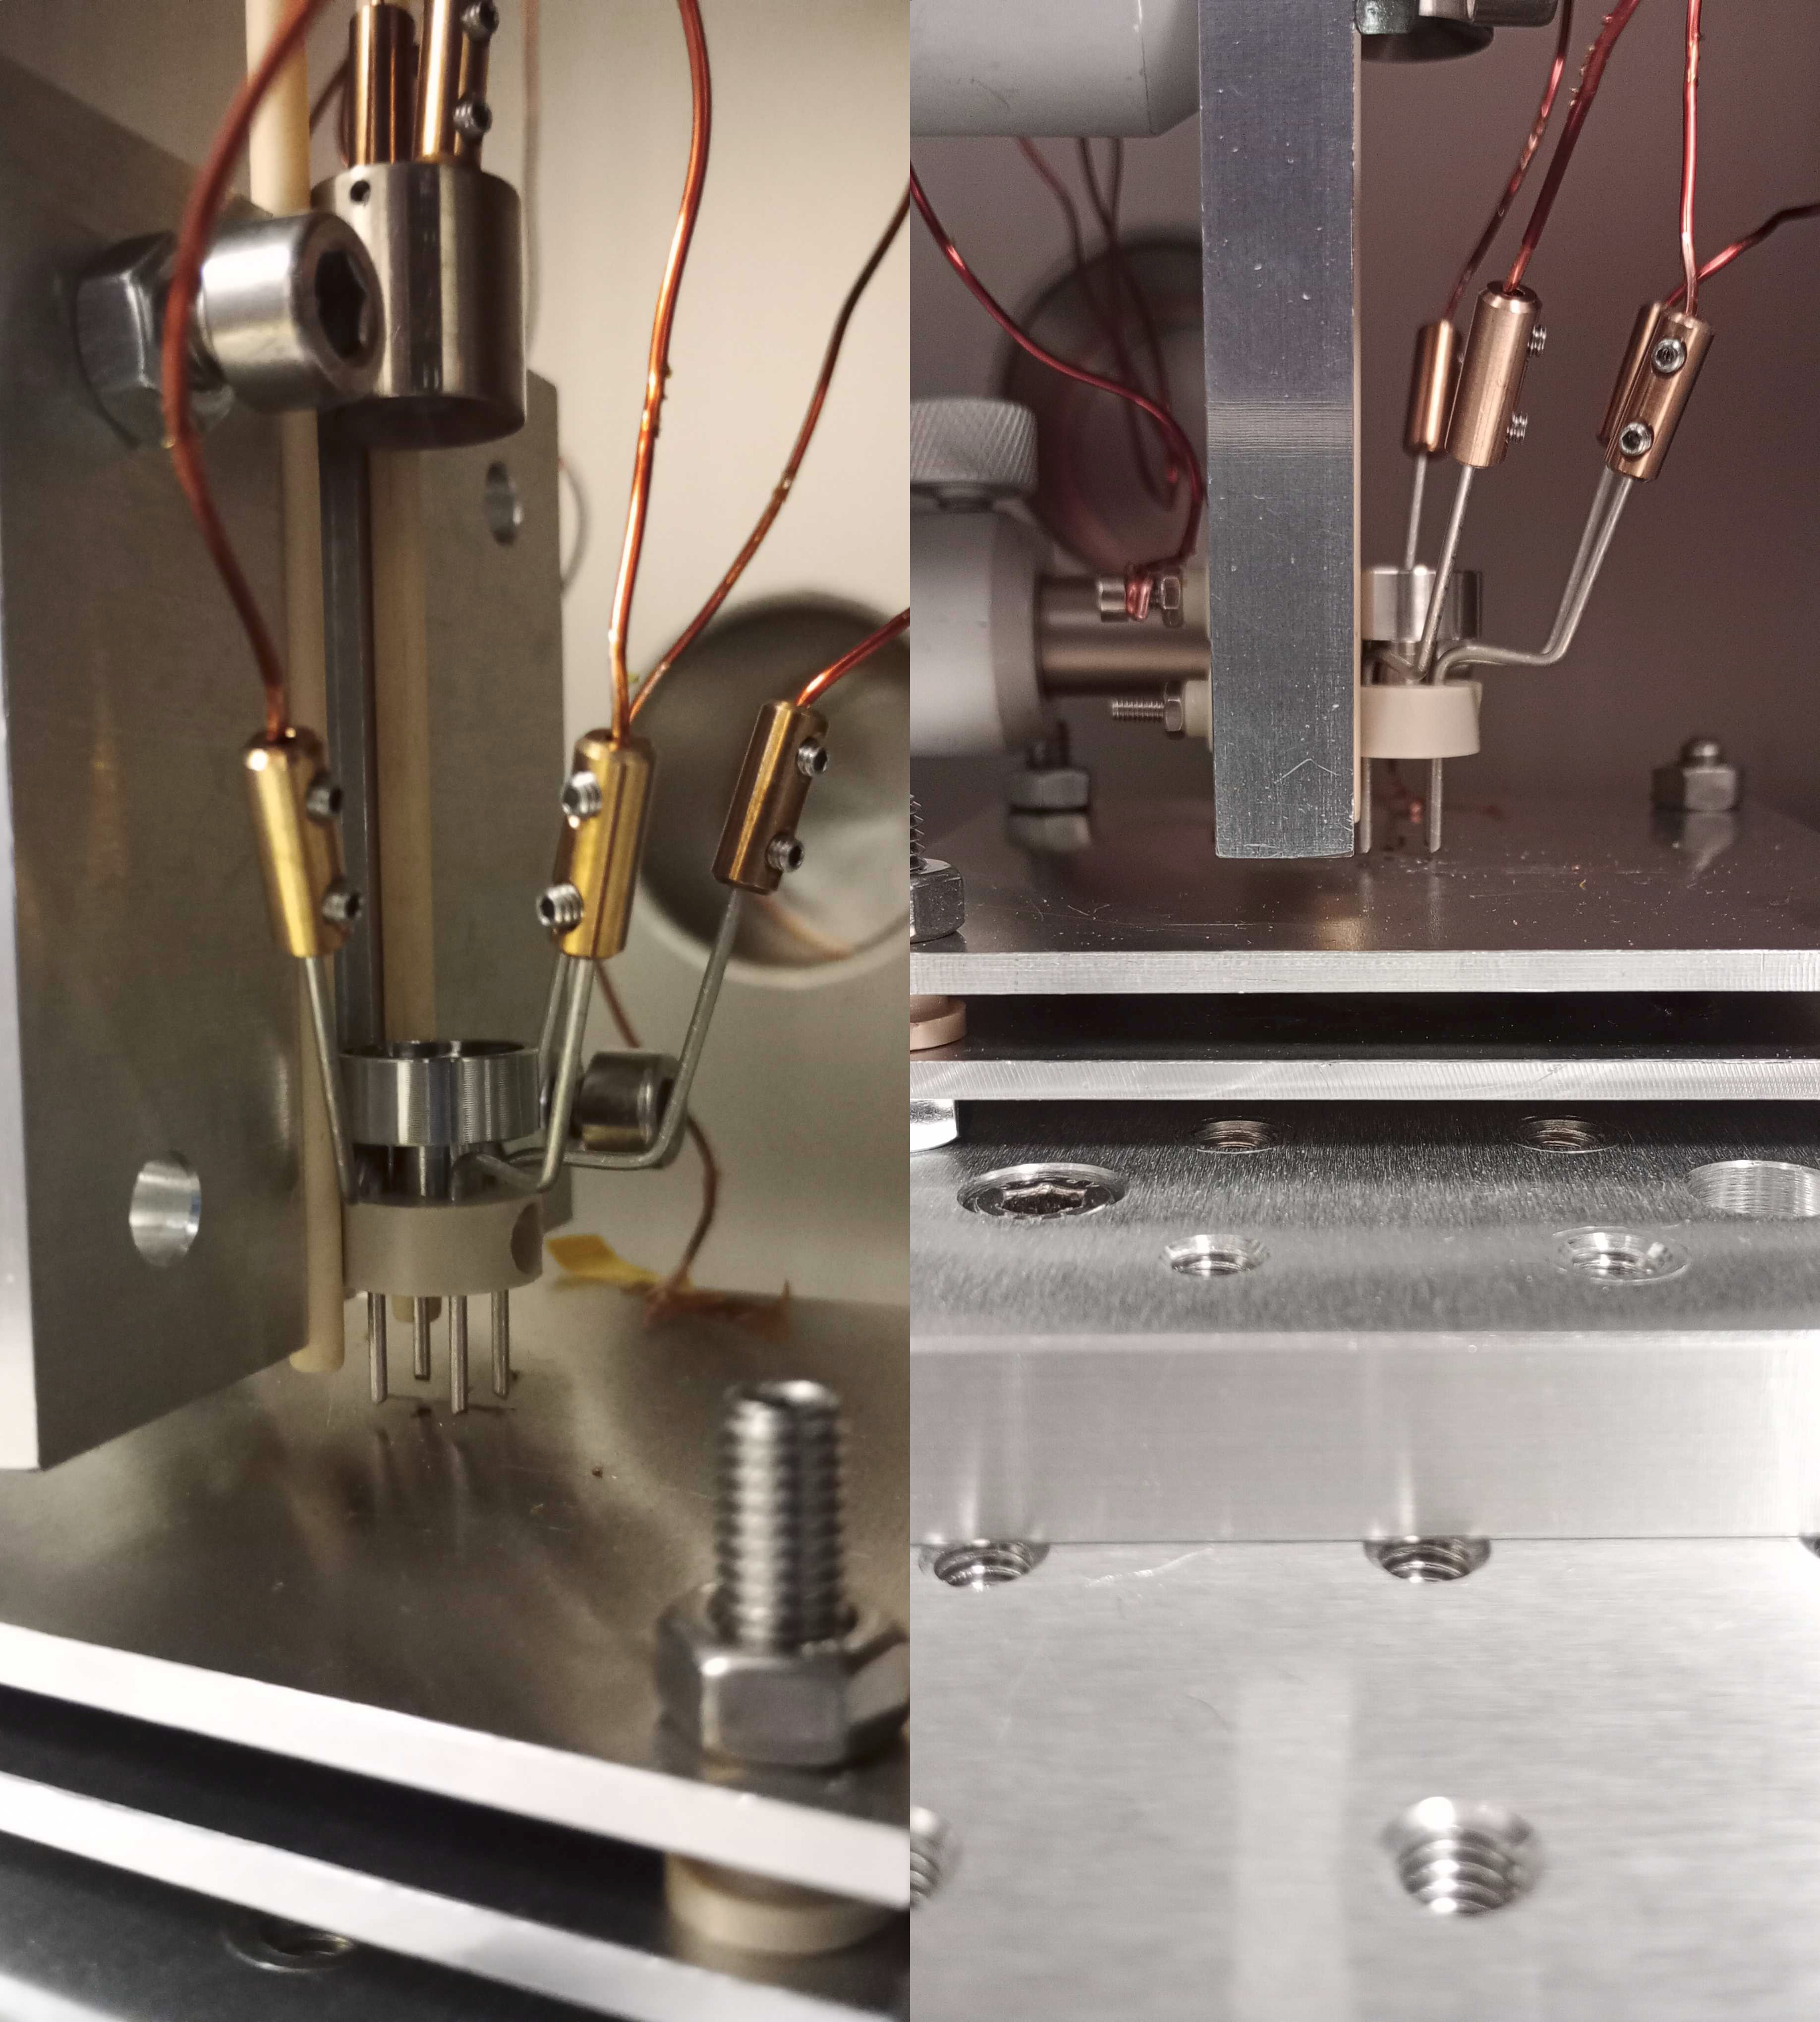

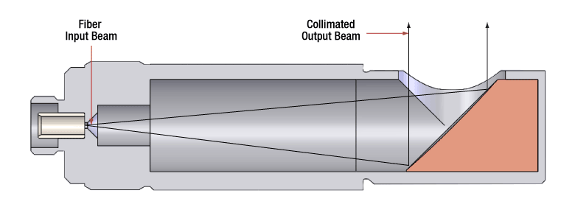
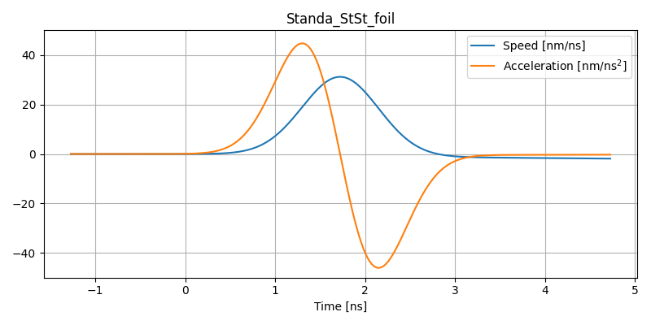
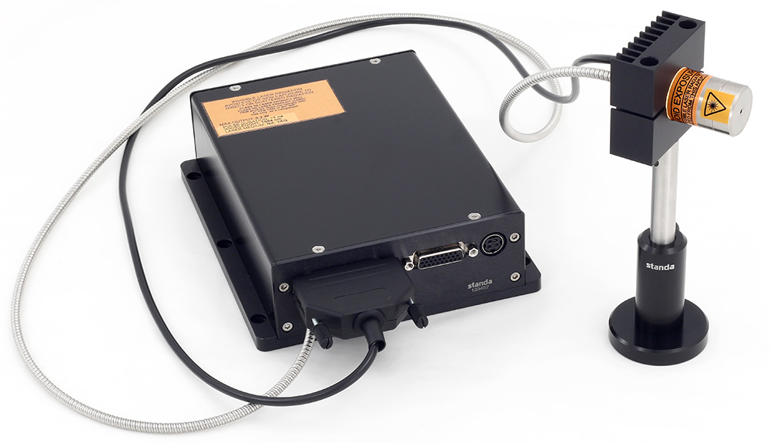
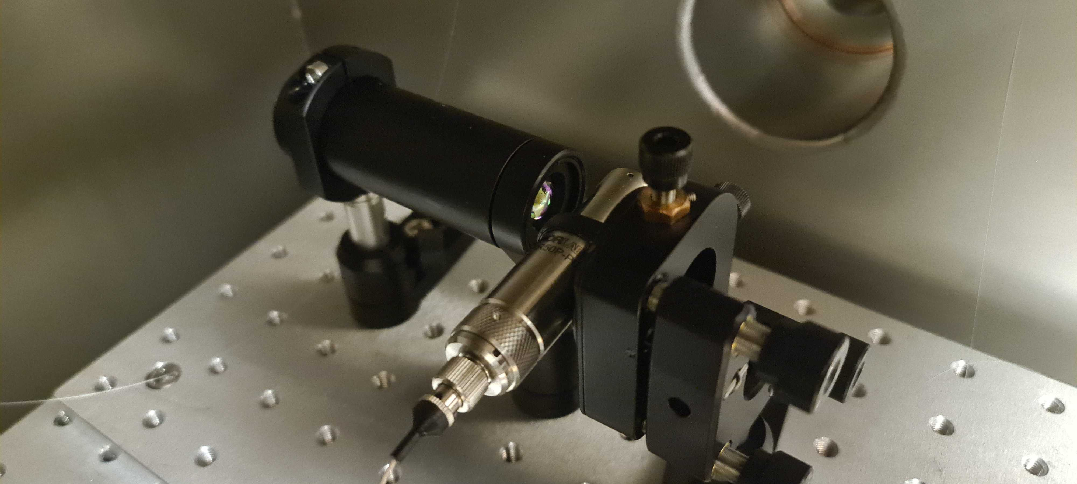







Hardware status
UK Space Agency ETP1-025 LOTIS
Development of levitated optomechanics subsystems
‣ Storage and dispensing
‣ Capture and conditioning
‣ Optomechanical trapping

Slide 28


Design Concept & SWaP estimates
Mass and Power ROM Estimate.
We assume a modest degree of development, design and optimisation for space.
Conservative estimate for payload computer power.
Scope for further optimisation with respect to algorithms and data reduction.
Illustration of the sensor head including planar RF Paul trap and LIAD.
Nanoparticles ejected by LIAD from StSt substrate are captured into the RF Paul trap
Then shuttled between regions and stored for transfer into an optical trap.
For illustration we show a 2D vector resolving configuration.

Slide 29

Development roadmap
(LOTIS) ⇒ TDE ⇒ BB ⇒ EBB
TDE (2025-26) Integrate LOTIS subsystems
‣ Critical milestone: Detect single collisions
‣ Thermal Xe source (3000K) mimics orbital momentum
BB (2026-27) Portable vacuum system
‣ Critical milestone: 2 km/s He beam validation
‣ Monoenergetic source proves momentum resolution
EBB (2027-28) Demonstrate Robustness
‣ Custom PCBs, autonomous operation
‣ Critical milestone: Week-long unattended operation
‣ Environmental pre-screening
Hardware exists and works separately
Systematic validation of proven subsystems
Each phase retires specific technical risks
Hypersonic beamline provides monoenergetic flux
Hypersonic beamline
Alexandrowicz lab, Chemistry Department, Swansea Uni.

Slide 30




Quantum Enhancements
Minimum resolvable momentum: SQL = 1.88u km/s for our parameters
For lower thresholds – e.g., on Mars
Ground state cooling: For T ~ 0.5 microK, $n$ ~ 0.5
Quantum mechanical squeezing: Squeeze optimal quadrature.
Back-action: Measuring position when really need momentum
arXiv:2504.17944 (2025)
Danilishin et al. Light: Science & Applications 7, 11 (2018)
Ghosh et al. PRA 102, 023525 (2020)

Slide 31
Study requirements
~1u ... >10⁴ u

Slide 32

Detecting interstellar neutrals @ L2
Spacecraft velocity: 26 km/s
Density: 0.03 /cm³
Collision rate: ~ 0.5/day (per nanoparticle)
Composition:​
50 % H​
50 % He​
Temperatures: 4000 – 8000 K​​
Wind velocities: ± 10 km/s​

Slide 33
Summary
LEVITAS has been investigated for future space applications:
Conclusions:
Represents a brand new sensing concept, with key advantages over mass spectrometers and accelerometer drag-based techniques:
High sensitivity reaches lower densities (altitudes greater than 600 km)
Provides a ”calibration-free” measurement capability, that could also be used to cross-calibrate conventional sensors
Well-suited for applications beyond LEO:
Interstellar Neutrals (ISNs), Energetic Neutral Atoms (ENAs), Martian exosphere, plasmas, heavy particles (e.g. hydrocarbons at Titan)
Laboratory tests required to raise TRL for in-orbit demonstration (IOD)
AGU presentations (2024, 2025) & paper in preparation

Slide 34









Bayesian inference of recoil momentum
For a single impulse at time and amplitude and a position data-set , derive the posterior probability distribution:
Likelihood func.
(Gaussian)
Prior prob. dist.
(Uniform)
using the dynamics model for the trajectory:
Harmonic motion
Impulse response
Gaussian white noise

Slide 35



Bayesian inference of recoil momentum
Best estimate: Given a position data-set , maximise the log of the posterior probability distribution for the time and amplitude of the momentum impulse
Confidence intervals: obtained using the diagonal elements of the Hessian matrix, evaluated at the best estimate:
(corresponds to 1 standard deviation of a Gaussian distribution)

Slide 36






Estimating properties of atmospheric gas
Objective: estimate thermodynamic properties and composition of atmospheric gas based on the recoil data
Generating recoil data set
Number of points in a data-set selected by sampling the Poisson distribution with average rate
Sample + Gaussian white noise (sigma = 3.15 u km/s)
Truncate data-set below 18 u km/s
Estimation method
Maximise likelihood function w.r.t. , likelihood function = recoil distribution + Gaussian broadening + truncation below threshold
Density estimates: where

Slide 37



Multiplexing
Some regimes, limited by integration time
⇒ track multiple particles
e.g. 10 particles at 100km : from 10mins to 1min
Macroscopic : Hardware-efficient multiplexing
‣ Cable connections : electrical and fibre
‣ Shared subsystems e.g LIAD, Paul trap electronics
‣ Architecture described in TN3
Microscopic : multiple nanoparticles within mm
‣ Collisions sparse : do not need to track continuously
‣ Time-division multiplexing e.g. AOM or DMD
SWIFT : Standing-Wave Interference Fibre Trap
‣ In development at Swansea (see right)
‣ Optical lattice with fast position control
‣ Shuttle to active (measurement) region
‣ Strong 2D confinement; in weak axial trap
‣ >100 particles feasible
Optical Levitation of Arrays of Microspheres
Phys. Rev. A 111 033514 (2025)
(David Moore group @ Yale)

Slide 38



Elastic and inelastic collisions
Geometric fix : replace sphere with plates
‣ orientates with polarisation
e.g. Geraci et al (Northwestern)
Hydrothermally grown β-NaYF
‣ extremely flat Ra~4.5nm
‣ smaller feasible
Alternatives
‣ hexagonal BN
‣ SiC
Main treatment (explicitly) assumes inelastic
⇒ gas particle momentum absorbed by nanoparticle
However, several processes : elastic, diffusive, inelastic
Atomic collisions ~ few eV is active area of physical chemistry
Depends on gas species and nanoparticle material
‣ coupling to surface phonons depends on gas atom mass
‣ metals provide electron-hole energy loss mechanism
Simple model
‣ coefficient of restitution 0 ≤ α ≤ 1
‣ spherical nanoparticle & specular scattering
⇒ broadening of momentum resolution

